Slide 1



Starting Soon: Groundwater Statistics for Environmental Project Managers
Technical and Regulatory Web-based Guidance on Groundwater Statistics and Monitoring Compliance (GSMC-1, 2013) at http://www.itrcweb.org/gsmc-1/
Download PowerPoint file
  Clu-in training page at
  http://www.clu-in.org/conf/itrc/gsmc/
  Under “Download Training Materials”
Using Adobe Connect
  Related Links (on right)
    Select name of link
    Click “Browse To”
  Full Screen button near top of page
Follow ITRC
Notes:
No associated notes.

Slide 2
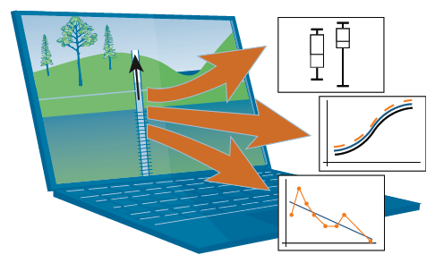
Groundwater Statistics for Environmental Project Managers
Welcome – Thanks for joining
this ITRC Training Class
Groundwater Statistics and Monitoring Compliance (GSMC) Technical and Regulatory Guidance Web-Based Document (GSMC-1)
Sponsored by: Interstate Technology and Regulatory Council (www.itrcweb.org) Hosted by: US EPA Clean Up Information Network (www.cluin.org)
Notes:
Statistical techniques may be used throughout the process of cleaning up contaminated groundwater. It is challenging for practitioners, who are not experts in statistics to interpret and use statistical techniques. ITRC developed the Technical and Regulatory Web-based Guidance Document on Groundwater Statistics and Monitoring Compliance (GMSC-1, 2013) and this associated training specifically for environmental project managers who review or use statistical calculations for reports, who make recommendations or decisions based on statistics, or who need to demonstrate compliance for groundwater projects. The training class will encourage and support project managers and others who are not statisticians to:
-- Use the ITRC Technical and Regulatory Web-based Guidance Document on Groundwater Statistics and Monitoring Compliance (GMSC-1, 2013) to make better decisions for projects
-- Apply key aspects of the statistical approach to groundwater data
-- Answer common questions on background, compliance, trend analysis, and monitoring optimization
ITRC's Technical and Regulatory Web-based Guidance Document on Groundwater Statistics and Monitoring Compliance (GMSC-1, 2013) and this associated training bring clarity to the planning, implementation, and communication of groundwater statistical methods and should lead to greater confidence and transparency in the use of groundwater statistics for site management.
ITRC (Interstate Technology and Regulatory Council) www.itrcweb.org
Training Co-Sponsored by: US EPA Technology Innovation and Field Services Division (TIFSD) (www.clu-in.org)
ITRC Training Program: training@itrcweb.org; Phone: 402-201-2419

Slide 3
Housekeeping
Course time is 2¼ hours
This event is being recorded
Trainers control slides
  Want to control your own slides? You can download presentation file on Clu-in training page
Questions and feedback
  Throughout training:
  type in the “Q & A” box
  At Q&A breaks: unmute your phone with #6 to ask out loud
  At end of class: Feedback form available from last slide
    Need confirmation of your participation today? Fill out the feedback form and check box for confirmation email and certificate
Copyright 2019 Interstate Technology & Regulatory Council,
50 F Street, NW, Suite 350, Washington, DC 20001
Notes:
3
Although I’m sure that some of you are familiar with these rules from previous CLU-IN events, let’s run through them quickly for our new participants.
We have started the seminar with all phone lines muted to prevent background noise. Please keep your phone lines muted during the seminar to minimize disruption and background noise. During the question and answer break, press #6 to unmute your lines to ask a question (note: *6 to mute again). Also, please do NOT put this call on hold as this may bring unwanted background music over the lines and interrupt the seminar.
Use the “Q&A” box to ask questions, make comments, or report technical problems any time. For questions and comments provided out loud, please hold until the designated Q&A breaks.
Everyone – please complete the feedback form before you leave the training website. Link to feedback form is available on last slide.

Slide 4





ITRC (www.itrcweb.org) – Shaping the Future of Regulatory Acceptance
Host organization
Network
  State regulators
    All 50 states, PR, DC
  Federal partners
  ITRC Industry Affiliates Program
  Academia
  Community stakeholders
Follow ITRC
Disclaimer
  Full version in “Notes” section
  Partially funded by the U.S. government
    ITRC nor US government warranty material
    ITRC nor US government endorse specific products
ITRC materials available for your use – see usage policy
Available from www.itrcweb.org
  Technical and regulatory guidance documents
  Online and classroom training schedule
  More…
DOE
DOD
EPA
Notes:
The Interstate Technology and Regulatory Council (ITRC) is a state-led coalition of regulators, industry experts, citizen stakeholders, academia and federal partners that work to achieve regulatory acceptance of environmental technologies and innovative approaches. ITRC consists of all 50 states (and Puerto Rico and the District of Columbia) that work to break down barriers and reduce compliance costs, making it easier to use new technologies and helping states maximize resources. ITRC brings together a diverse mix of environmental experts and stakeholders from both the public and private sectors to broaden and deepen technical knowledge and advance the regulatory acceptance of environmental technologies. Together, we’re building the environmental community’s ability to expedite quality decision making while protecting human health and the environment. With our network of organizations and individuals throughout the environmental community, ITRC is a unique catalyst for dialogue between regulators and the regulated community.
For a state to be a member of ITRC their environmental agency must designate a State Point of Contact. To find out who your State POC is check out the “contacts” section at www.itrcweb.org. Also, click on “membership” to learn how you can become a member of an ITRC Technical Team.
Disclaimer: This material was prepared as an account of work sponsored by an agency of the United States Government. Neither the United States Government nor any agency thereof, nor any of their employees, makes any warranty, express or implied, or assumes any legal liability or responsibility for the accuracy, completeness, or usefulness of any information, apparatus, product, or process disclosed, or represents that its use would not infringe privately owned rights. Reference herein to any specific commercial product, process, or service by trade name, trademark, manufacturer, or otherwise does not necessarily constitute or imply its endorsement, recommendation, or favoring by the United States Government or any agency thereof. The views and opinions of authors expressed herein do not necessarily state or reflect those of the United States Government or any agency thereof and no official endorsement should be inferred.
The information provided in documents, training curricula, and other print or electronic materials created by the Interstate Technology and Regulatory Council (“ITRC” and such materials are referred to as “ITRC Materials”) is intended as a general reference to help regulators and others develop a consistent approach to their evaluation, regulatory approval, and deployment of environmental technologies. The information in ITRC Materials was formulated to be reliable and accurate. However, the information is provided "as is" and use of this information is at the users’ own risk.
ITRC Materials do not necessarily address all applicable health and safety risks and precautions with respect to particular materials, conditions, or procedures in specific applications of any technology. Consequently, ITRC recommends consulting applicable standards, laws, regulations, suppliers of materials, and material safety data sheets for information concerning safety and health risks and precautions and compliance with then-applicable laws and regulations. ITRC, ERIS and ECOS shall not be liable in the event of any conflict between information in ITRC Materials and such laws, regulations, and/or other ordinances. The content in ITRC Materials may be revised or withdrawn at any time without prior notice.
ITRC, ERIS, and ECOS make no representations or warranties, express or implied, with respect to information in ITRC Materials and specifically disclaim all warranties to the fullest extent permitted by law (including, but not limited to, merchantability or fitness for a particular purpose). ITRC, ERIS, and ECOS will not accept liability for damages of any kind that result from acting upon or using this information.
ITRC, ERIS, and ECOS do not endorse or recommend the use of specific technology or technology provider through ITRC Materials. Reference to technologies, products, or services offered by other parties does not constitute a guarantee by ITRC, ERIS, and ECOS of the quality or value of those technologies, products, or services. Information in ITRC Materials is for general reference only; it should not be construed as definitive guidance for any specific site and is not a substitute for consultation with qualified professional advisors.

Slide 5




Meet the ITRC Trainers
Harold Templin
Indiana Department of Environmental Management
Indianapolis, IN
317-232-8711
htemplin@idem.IN.gov
Lizanne Simmons
Kleinfelder, Inc.
San Diego, CA
619-831-4600
Lsimmons
@kleinfelder.com
Chris Stubbs
Ramboll
Emeryville, CA
510-420-2552
cstubbs
@ramboll.com
Randall Ryti
Neptune and Company
Los Alamos, NM
505-662-0500
rryti@neptuneinc.org
Read trainer bios at https://clu-in.org/conf/itrc/GSMC/
Notes:
Harold Templin is a Senior Geologist at the Office of Land Quality of the Indiana Department of Environmental Management (IDEM). Since 1985, Harold has worked as a geologist with compliance and permitting of hazardous waste facilities and solid waste landfills. In that role, Harold has designed or approved ground water monitoring systems, sampling and analysis plans, and statistical evaluation plans. While working at IDEM Harold has set on numerous panels setting policy and guidance for closure of land disposal facilities, and risk assessment of corrective action sites. Since 1977, Harold has worked with land use regulations and with efforts to encourage the best use of our natural resources. This is Harold’s first effort of working on an ITRC team. Harold earned a BS degree in geology from Indiana State University in 1972. Additionally, Harold has taken additional graduate level courses in hydrogeology and groundwater modeling at Indiana University. Harold is a licensed professional geologist in the State of Indiana.
Chris Stubbs is a principal consultant with Ramboll in Emeryville, California. Since 2000, he has worked in environmental science and engineering, with special emphasis on groundwater hydrology and chemical fate and transport in the environment. Specific areas of expertise include groundwater modeling, statistical analysis, risk-based site assessment and remediation, exposure analysis and human health risk assessment. He has prepared evaluations of the risk from vapor intrusion into indoor air at numerous sites, including preparing expert reports and giving deposition testimony as an expert witness. He has developed regional groundwater flow and transport models to evaluate remedial alternatives and to estimate cleanup times. Chris is a member of the ITRC Groundwater Statistics and Monitoring Compliance project team. Chris earned a bachelor’s degree in 1988 in physics from the University of California at Berkeley, CA. He earned a master’s degree in 1996 in technology and policy, a master’s degree in 1996 in environmental engineering, and a PhD in 2000 in hydrology and water resource engineering all from the Massachusetts Institute of Technology in Cambridge, MA. He is a professional civil engineer in California.
Liz Simmons is a Senior Principal Geologist and Senior Fellow over the Environmental Site Characterization Practice for Kleinfelder in the San Diego, California office. Liz has worked for Kleinfelder since 1998, and in the environmental field since 1984. Her extensive technical background includes numerous groundwater assessments, risk assessments, modeling, groundwater optimization, and litigation support for sites encompassing industrial facilities, landfills and surface impoundments, oil refinery and underground fuel storage sites, and superfund sites, both in the United States and abroad. As Technical Practice Leader, she is also responsible for providing on-going technical training to Kleinfelder personnel. Liz has been active in the ITRC since 2008, and has been involved with the Contaminated Sediments, Groundwater Statistics and Monitoring Compliance, and Geophysical Classification for Munitions Response workgroups. She earned a bachelor’s degree in geology from Brigham Young University in Provo, Utah in 1979, and underwent graduate studies in petroleum geology and geophysics at California State University in Long Beach from 1981-1984. Liz is a registered PG with the California Board for Professional Engineers, Land Surveyors and Geologists.
Randall Ryti is a Senior Scientist with Neptune and Company, Inc. in Los Alamos, New Mexico. Randall was one of the founding partners of Neptune in 1992 and has worked on basic and applied environmental problems, including ecological and human health risk assessment support to the Los Alamos National Laboratory, the Hanford Site, and other clients. These risk assessment projects have addressed environmental contamination including groundwater over large spatial scales with multiple stressors, large and complex databases, and significant involvement of regulators, natural resource trustees, and the public. Randall has also assisted in the planning, decision logic, and statistical design of environmental data collection activities for Environmental Restoration sites at Department of Energy facilities (Hanford, Los Alamos, and Savannah River), Department of Navy Base Realignment and Closure facilities in California, and EPA-lead Superfund sites. Randall has been a member of ITRC teams since 2009 and has been active in the Groundwater Statistics and Monitoring Compliance team starting in 2011. Randall received the Industry Recognition Award from the ITRC in October 2012. Randall earned a bachelor's degree in biology from University of California Los Angeles in 1979 and a PhD in biology from University of California San Diego in 1986. Randall is certified as a Senior Ecologist by the Ecological Society of America.

Slide 6

Are You Drowning in Groundwater Data From Your Sites?
What data should you use?
Where do you start?
What are the data telling you?
How do you make the best use of your data?
Notes:
No associated notes.

Slide 7

Can a Statistical Approach Help to Manage My Groundwater Data?
If you are not a statistician
  More informed consumer of statistics
  Confidence to spot misapplications and mistakes
  Review selection of tests
  Understand language of statistics
If you are a statistician
  Help make your work and conclusions understandable to a general audience
ITRC GSMC, Section 1
Notes:
No associated notes.

Slide 8
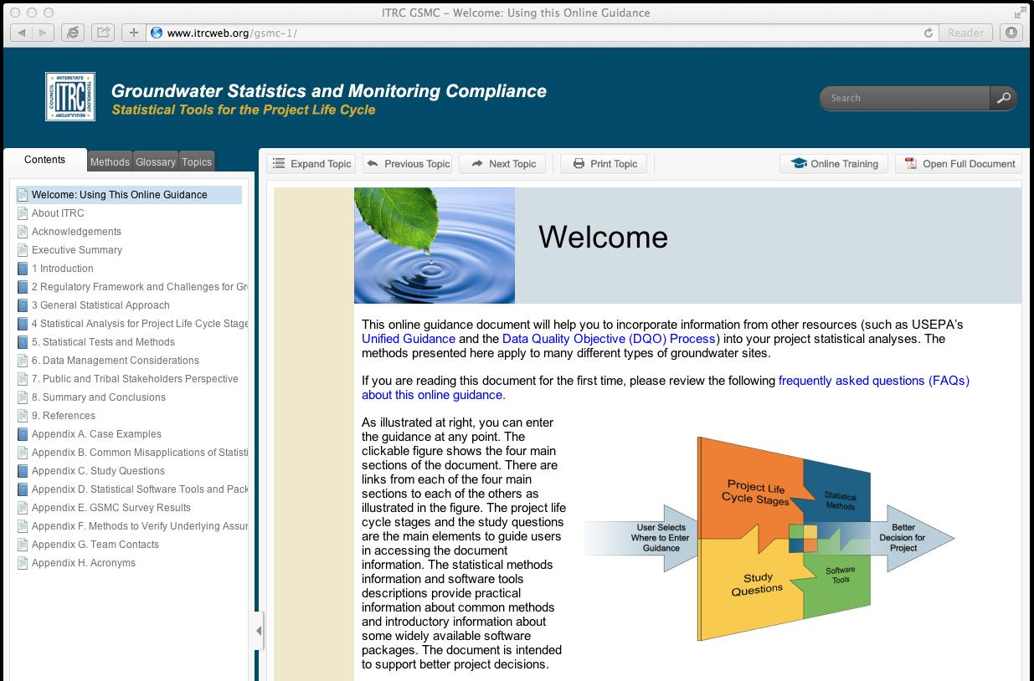
ITRC Solution
Groundwater Statistics and Monitoring Compliance, Statistical Tools for the Project Life Cycle
Ask the right questions to apply statistics
Direct you to an appropriate statistical method
Maximize the value of the data
http://www.itrcweb.org/gsmc-1/
Notes:
No associated notes.

Slide 9
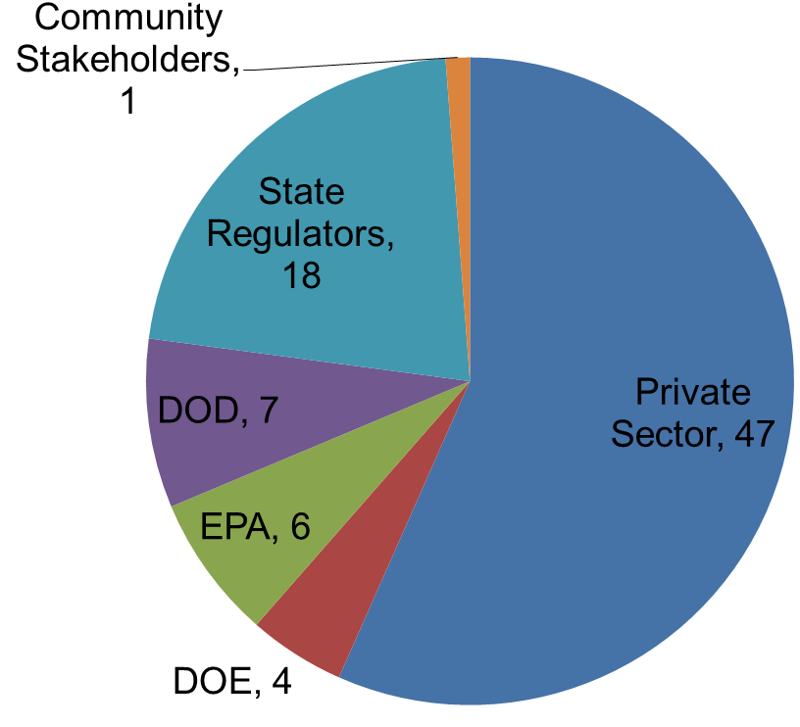
Groundwater Statistics and Monitoring Compliance Team
Team formed in 2011
Experts from DOD, EPA, DOE, industry, states, consulting
ITRC GSMC-1, Acknowledgements, Appendix G
Notes:
ITRC formed this team in 2011 to develop the ITRC Groundwater Statistics and Monitoring Compliance document and training.
The team of experts includes
State regulators
Federal partner experts from DOD, DOE and EPA
Consulting community and from industry

Slide 10
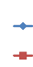
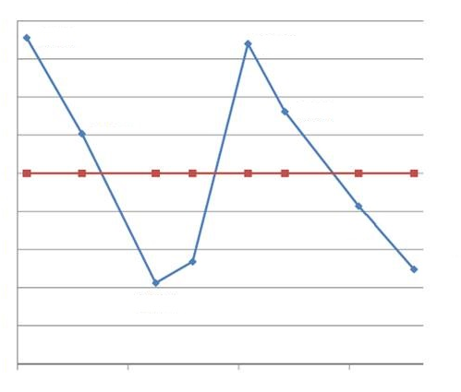
Regulatory Challenge Example: Meeting a Criterion
Specific standard
  Established Criterion (0.5 mg/L)
  Two consecutive values
  Certainty of decision
Statistical approach
  Upper confidence limit (UCL) of the mean (0.689 mg/L) above criterion
Post Remediation Data
MW-1
Criterion
UCL
0.80
0.60
0.40
0.20
0.00
Concentration mg/L
12/2010
6/2011
12/2011
6/2012
ITRC GSMC, Section 2
Notes:
Statistically, the upper confidence limit (UCL) is 0.689 mg/L more remediation is needed to be confident the groundwater concentration is below the criterion.
Additional reference for information about groundwater variability: McHugh, T., L. M. Beckley, et al. (2011). "Factors influencing variability in groundwater monitoring data sets." Ground Water Monitoring & Remediation 31(2): 92-101.
Definition of upper confidence limit (UCL): The upper value on a range of values around the statistic (for example, mean) where the population statistic (for example, mean) is expected to be located with a given level of certainty, such as 95% (science-dictionary.org 2013).
See the GSMC-1 document for more glossary items: www.itrcweb.org/gsmc-1

Slide 11
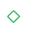
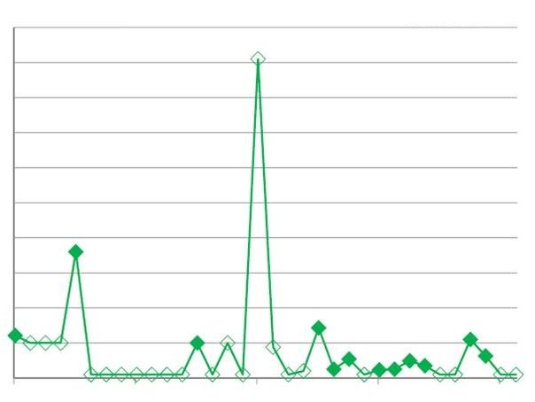
Regulatory Challenge Example: Managing Nondetects/Censored Data
Multiple values
Simple substitution
  Mean = 0.0078 mg/L
  UCL = 0.0125 mg/L
Kaplan-Meier
  Mean = 0.0022 mg/L
  UCL = 0.0055 mg/L
Dissolved Chromium
Nondetect
Criterion
0.1
0.08
0.06
0.04
0.02
0
Concentration mg/L
Upper confidence limit (UCL)
1996 2000 2004 2008 2012
ITRC GSMC, Section 2, Section 5.7
Notes:
Definition of nondetects: Laboratory analytical result known only to be below the method detection limit (MDL), or reporting limit (RL); see "censored data" (Unified Guidance).
Definition of censored data: Values that are reported as nondetect. Values known only to be below a threshold value such as the method detection limit or analytical reporting limit (Helsel, D.R. 2012)
Helsel, D.R. 2005. Nondetects and Data Analysis. Hoboken, NJ: John Wiley & Sons.
Helsel D.R. 2012. Statistics for Censored Environmental Data Using Minitab and R. 2nd ed. Hoboken, New Jersey: John Wiley & Sons.
USEPA. 2009. "Statistical Analysis of Groundwater Monitoring Data at RCRA Facilities." Unified Guidance EPA 530/R-09-007. Washington DC: United States Environmental Protection Agency. http://www.epa.gov/osw/hazard/correctiveaction/resources/guidance/sitechar/gwstats/unified-guid.pdf.

Slide 12
ITRC Document is for Environmental Project Managers
You can use the document for a number of project management activities
  Reviewing or using statistical
  calculations for reports
  Making recommendations or decisions
  based on statistics
  Demonstrating compliance for
  groundwater projects
Notes:
No associated notes.

Slide 13
Training Roadmap
What You Will Learn
How to use the GSMC Document
Getting Ready to Apply Statistics
Question & Answer Break
How to Apply Study Questions for
  Background
  Compliance
  Trend Analysis
  Monitoring Optimization
Summary
Question & Answer Break
Notes:
No associated notes.

Slide 14
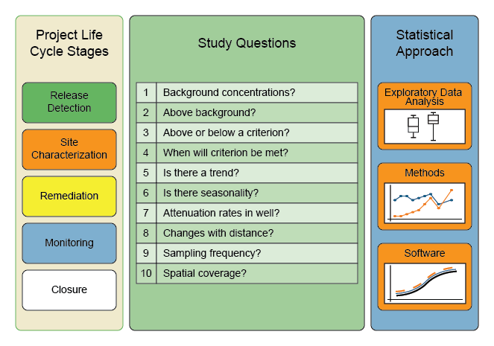
Groundwater Statistics and Monitoring Compliance (GSMC) Document Framework
Groundwater statistical methods have applications throughout the life cycle of environmental projects
Groundwater statistical tests can support decision making, regardless of how the project is defined
ITRC GSMC, Section 4
Notes:
The terminology and framework for the project life cycle stages may vary under different regulatory programs. To simplify the organization of the document the team chose these 5 project life cycle stages.
Groundwater Statistics and Monitoring Compliance (GSMC) Document (GSMC-1)

Slide 15
Site Problem Statements Take the Form of Study Questions
This document explores some of the common problem statements (Study Questions) that guide decision making throughout environmental projects
ITRC GSMC, Section 4, Appendix C
Notes:
No associated notes.

Slide 16
Connect Your Site Questions with Statistical Tests and Methods
ITRC GSMC, Section 4, Appendix C
Notes:
The study questions serve as a bridge to connect life cycle-based activities on your sites with relevant statistical approach (exploratory data analysis, tests, and software) that may assist you with site decisions using groundwater data.
Definition of exploratory data analysis (EDA): An approach for initial data evaluation using graphical methods to open-mindedly explore the underlying structure and model of a dataset to aid in selection of the best statistical methods. Typical techniques are box plots, time series plots, histograms, and scatter plots (Tukey 1977; NIST/SEMATECH 2012; Unified Guidance).
NIST/SEMATECH. 2012. "e-Handbook of Statistical Methods." In. http://www.itl.nist.gov/div898/handbook/ (accessed August 2013).
Tukey, J.W. 1977. Exploratory Data Analysis. Reading, MA: Addison-Wesley.
USEPA. 2009. "Statistical Analysis of Groundwater Monitoring Data at RCRA Facilities." Unified Guidance EPA 530/R-09-007. Washington DC: United States Environmental Protection Agency. http://www.epa.gov/osw/hazard/correctiveaction/resources/guidance/sitechar/gwstats/unified-guid.pdf.

Slide 17
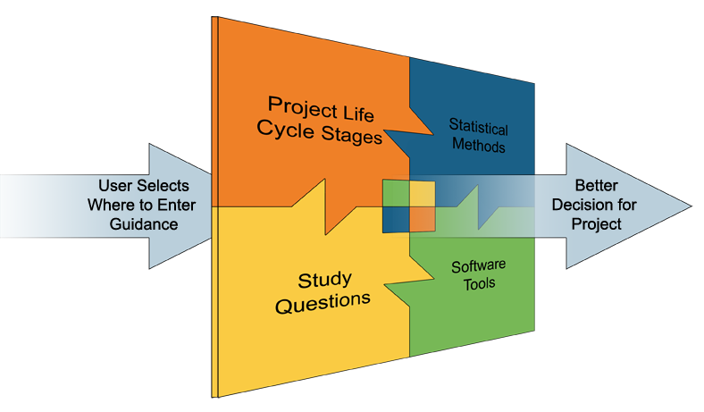
Use the Document To Support Your Site Decisions at any Project Life Cycle Stage
  Project Life Cycle Stages (Section 4) Study Questions (Appendix C)
  Statistical Methods (Section 5) Software Tools (Appendix D)
Notes:
The web-based document was designed to be accessed from many different perspectives or sections
All of the sections of the document are interconnected and can be accessed from any other section.
This figure is located on the Welcome screen of the web-based tech-reg document and by clicking on the named parts of the document, you will go to that section of the document.

Slide 18
Connects to Other Statistical Resources For Groundwater Data
Support use of EPA’s March 2009 Statistical Analysis of Groundwater Monitoring Data at RCRA Facilities (EPA’s Unified Guidance)
Data Quality Objective (DQO) Process
  Systematic planning tool based on the scientific method that identifies and defines the type, quality and quantity of data needed to satisfy a specified use
Other statistics references
ITRC GSMC, Section 9
Notes:
The team has tried to make this document user friendly for the Project Manager with its cross references and links to the study questions methods, and tools.
This web-based guidance document will help you to incorporate information from other resources
Unified Guidance (USEPA. 2009. "Statistical Analysis of Groundwater Monitoring Data at RCRA Facilities." In Unified Guidance EPA 530/R-09-007. Washington DC: Unites States Environmental Protection Agency. www.epa.gov)
Guidance on Systematic Planning Using the Data Quality Objective Process (USEPA. 2006a. "Guidance on Systematic Planning Using the Data Quality Objectives Process." In EPA QA/G-4. Washington D.C.: United States Environmental Protection Agency. http://www.epa.gov/QUALITY/qs-docs/g4-final.pdf)
ASTM documents (for example, ASTM. 2012. Standard Guide for Developing Appropriate Statistical Approaches for Groundwater Detection Monitoring Programs. West Conshohocken, PA: ASTM International)
Textbooks on groundwater statistics (for example, Gibbons, R.D. 1994. Statistical Methods for Groundwater Monitoring. New York: John Wiley & Sons)
Other guidance documents on the DQO process (for example, United States Army Corp of Engineers (USACE). 1998. "Environmental Quality, Technical Project Planning (TPP) Process." EM 200-1-2. Washington, D.C.: Department of the Army. www.usace.army.mil/missions/environmental/technicalprojectplanning.aspx.)

Slide 19
Training Roadmap
How to use the GSMC Document
Getting Ready to Apply Statistics
Question & Answer Break
How to Apply Study Questions for
  Background
  Compliance
  Trend Analysis
  Monitoring Optimization
Summary
Question & Answer Break
Notes:
This next section reviews the major elements of the statistical approach applied to groundwater data.

Slide 20
What Use Is Statistics?
Statistics is the science of drawing conclusions from data
  Visualize and understand data
  Separate signal from noise
  Summarize large-scale behavior
  Quantify uncertainty
  Make better and more defensible decisions
This section reviews the major elements of the statistical approach applied to groundwater data
Notes:
No associated notes.

Slide 21

Hypothesis Testing: Guilty or Not Guilty?
Crime: Burglary (laptop)
Defendant: Mr. Ivan M. Shifty
Assume defendant is not guilty (null hypothesis)
Present evidence (fingerprints, stolen goods)
Prove guilt beyond a reasonable doubt?
We want to avoid errors
  1. Shifty is innocent but goes to jail (false positive)
  2. Shifty is guilty but goes free (false negative)
Notes:
No associated notes.

Slide 22
Decision Errors
Site characterization phase of life cycle
Null hypothesis H₀: Site groundwater is NOT contaminated
True State of Site
Decision based on statistical sample
H₀: Site Not Contaminated
H_{A}: Site Is Contaminated
Not
Contaminated
Correct Conclusion
(Probability = 1-α)
False Positive
(Probability = α)
Significance Level
Contaminated
False Negative
(Probability = β)
Correct Conclusion
(Probability = 1-β)
Power
ITRC GSMC-1, Section 3.6.1
Notes:
See also USEPA. 2006a. "Guidance on Systematic Planning Using the Data Quality Objectives Process." In EPA QA/G-4. Washington D.C.: United States Environmental Protection Agency. http://www.epa.gov/QUALITY/qs-docs/g4-final.pdf. for more information (Table 7)

Slide 23
Statistical Decision-Making
When making statistical decisions, we should consider both types of errors
  One error type may be more important to avoid
“Statistical significance”
  Small chance that result is a false positive
Selecting significance level (α)
  Medicine: 1 in 20 (5%) Physics: 1 in 3.5 million
False negative error (β) / Power (1-β)
  Depends on variability, sample size, effect size
  Remember to check power if null is not rejected
Notes:
No associated notes.

Slide 24
Key Aspects
What are the key aspects of a statistical approach?
  Develop a conceptual site model
  Conduct exploratory data analysis
  Design statistical sampling plan
  Evaluate statistical evidence and uncertainty
  Check statistical assumptions
ITRC GSMC-1, Section 3
Notes:
All of these concepts are discussed in Section 3 of the web-based guidance document www.itrcweb.org/gsmc-1
Purpose of using a statistical approach is to make better, more defensible decisions (for example, has the site impacted groundwater?).

Slide 25
Develop Conceptual Site Model
CSM = Written and graphical expression of site knowledge
Specific conductance
(in µS/cm)
150
900
Groundwater flow
Landfill
800
10,000
River
Tidal Influence
16,000
Figure Source: Adapted from USEPA 2009
Notes:
Figure Source: USEPA. 2009. "Statistical Analysis of Groundwater Monitoring Data at RCRA Facilities." In Unified Guidance EPA 530/R-09-007. Washington DC: United States Environmental Protection Agency. www.epa.gov
A CSM summarizes the potential contaminant sources and transport pathways through the subsurface. For example, here is a landfill situated near a stream. Groundwater flows under the landfill toward the stream. We want to look at specific conductance to see whether the landfill is leaking. But in this case, there is another potential source of chloride to groundwater—the stream is tidally influenced. Importance of getting the CSM right is crucial to doing good statistics.

Slide 26
CSM: Example
Was there a release from the landfill?
To answer, we statistically evaluate specific conductance (along with other parameters)
Two possible approaches:
  Interwell testing (compare multiple site wells, potentially affected vs. background wells)
  Intrawell testing (compare results in one well over time)
Based on CSM, one approach might be better
ITRC GSMC-1, Section 3
Notes:
No associated notes.

Slide 27
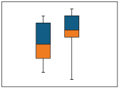
Conduct Exploratory Data Analysis
All data should be plotted!
The top 5 plots to use:
  Time series plot – trends, inconsistencies
  Box plot – comparing groups, distributions, outliers
  Scatter plot – association between variables
  Histogram – distribution
  Probability plot –distribution, outliers
ITRC GSMC-1, Section 5.1
Notes:
No associated notes.

Slide 28
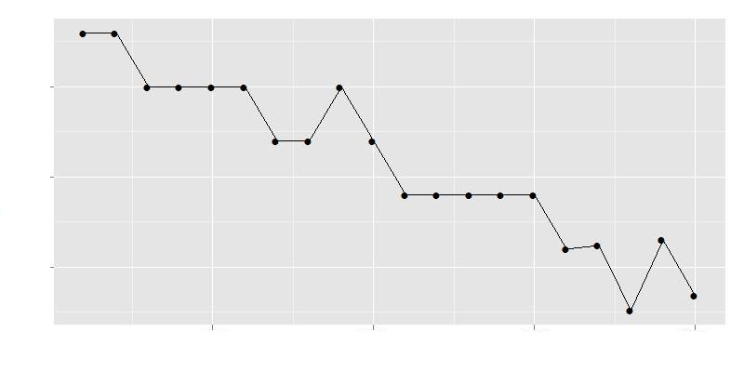
Time Series Plots
Plot time series to look for possible trends and outliers
15
10
5
Benzene (ppb)
1995 2000 2005 2010
ITRC GSMC-1, Section 3
Notes:
Another important aspect of conducting a good statistical evaluation is exploratory data analysis (EDA). This is nothing more than taking a good hard look at the data, particularly using graphs that show clearly what’s going on.
For example, we often want to look at trends. According to this plot, benzene concentrations at a well appear to be going down over time.

Slide 29
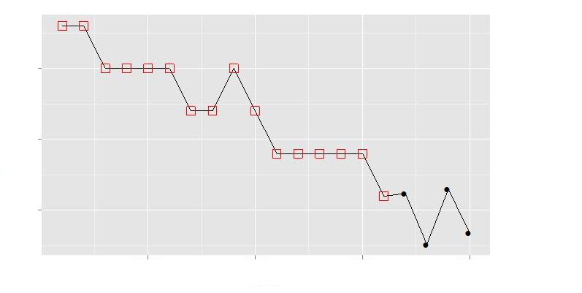
Time Series Plots
Remember to distinguish nondetects
15
10
5
Detect
Nondetect
Benzene (ppb)
Detection limits are
decreasing over time
1995 2000 2005 2010
ITRC GSMC-1, Section 3, Section 5.7
Notes:
Figure 5-14 Example time series plot of benzene data with nondetects.

Slide 30
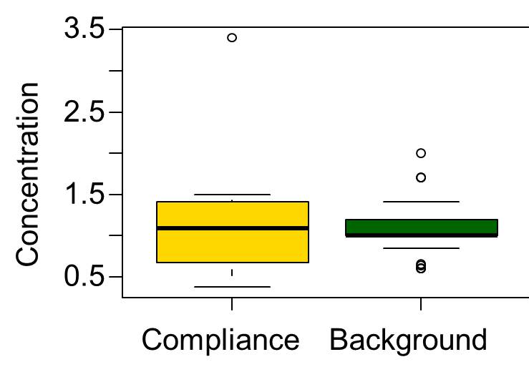
Box Plots Compare Groups
Box plot components:
  Line - median
  Box - (75%-25%)
  Whiskers
  Circles - extreme values
Shows central tendency, spread, and outliers
ITRC GSMC, Section 5.1
Notes:
Understand your data; see what your data set is telling you. The side-by-side box plots show that the data sets have similar buy not equal variances. It is fairly common that data from a compliance well will have a larger variance than data from a background well.

Slide 31
Scatter Plot
Scatter plots show the relationship between two variables,
such as concentrations measured in a single well.
ITRC GSMC, Section 5.1
Figure Source: Adapted from USEPA 2009
Notes:
Figure Source: USEPA. 2009. "Statistical Analysis of Groundwater Monitoring Data at RCRA Facilities." In Unified Guidance EPA 530/R-09-007. Washington DC: United States Environmental Protection Agency. www.epa.gov

Slide 32
Design Statistical Sampling Plan
Planning for statistical decisions
  Select sampling plan to control decision errors (prior to sampling)
  Understand statistical power achieved (after sampling)
Understand design tradeoffs
  Sample size
  Power
  Significance level
  Effect size
ITRC GSMC-1, Section 3
Notes:
Every decision using real data involves uncertainty. Did we conclude the site was impacting groundwater when it really wasn’t (false positive)? Or perhaps the site was a source of groundwater contamination and we didn’t see it because there wasn’t enough data (false negative). The best way to control these potential errors is through up front planning through a quality assurance project plan or something similar.
Sometimes we can’t plan ahead. We can still use the same statistical tools to help us understand the level of uncertainty.

Slide 33

Evaluate Statistical Evidence
Hypothesis testing
  Null hypothesis (e.g., not guilty) versus alternative hypothesis (e.g., guilty)
  Is there sufficient evidence to reject the null hypothesis (burden of proof)?
Choice of null hypothesis depends on purpose
  Do site concentrations exceed background?
  Have cleanup goals been achieved?
  Is there a trend in concentrations?
ITRC GSMC-1, Section 3, 5
Notes:
No associated notes.

Slide 34
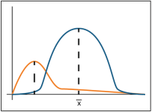
Hypothesis Testing
The Steps:
1. Define your hypotheses (null, alternative)
2. Compute the test statistic from the data under the assumption that the null is true
3. Calculate the probability (p-value) of what was observed if null were true
4. Make a decision
  Reject null hypothesis if p-value is less than significance level of test (α)
  Fail to reject the null and verify power of test
Notes:
No associated notes.

Slide 35
Value of p-values
All test statistics (and p-values) measure the discrepancy between what you actually observe and what you’d expect to see if the null is true
Could these data have arisen solely due to natural variability?
  P-value measures the strength of the evidence against the null hypothesis
  Lower p-values represent stronger evidence (it’s less likely null is true)
ITRC GSMC-1, Section 3
Notes:
No associated notes.

Slide 36
Describing Uncertainty
“The mean concentration is 5.1 mg/L.”
How reliable is this estimate?
Statistical Intervals
  Use an interval (“error bars”) to show reliability
  Types: confidence, prediction, tolerance
Confidence level (1-α) of the interval (e.g., 95%)
  Probability that interval will include the value of interest
  Hypothesis tests can be formulated using intervals
Notes:
No associated notes.

Slide 37
Confidence and Prediction Intervals
Confidence intervals show uncertainty in statistics calculated from existing data (means, medians, slopes)
Prediction intervals are used to evaluate how consistent future samples are to existing data
True
Mean
Future
Samples
ITRC GSMC-1, Section 5
Notes:
Confidence intervals are often used when comparing mean groundwater concentrations to fixed standards such as maximum contaminant levels (MCLs). Prediction intervals are often used for detection monitoring at RCRA facilities to determine whether future samples are consistent with background concentrations.

Slide 38
How to Select and Test the Null Hypothesis
Release Detection/
Site Characterization
Corrective Action/ Remediation
Site is assumed to be clean unless proven otherwise
Hypothesis:
  Null: Mean ≤ MCL
  Alt: Mean > MCL
Confidence interval test:
  Reject if lower confidence limit on mean > MCL
Site is assumed to be contaminated unless proven otherwise
Hypothesis:
  Null: Mean ≥ MCL
  Alt: Mean < MCL
Confidence interval test
  Reject if upper confidence limit on mean < MCL
Notes:
No associated notes.

Slide 39
Test Assumptions
COC = Benzene
Well = GWC-5
Detects
Nondetects
Testing for outliers
  Outliers can dramatically skew statistical limits
50
40
30
20
10
Concentration (ppb)
1995 2000 2005
ITRC GSMC-1, Section 3, Section 5
Figure Source: Kirk Cameron, Ph.D.
Notes:
All statistical tests are based on some sort of simple model of reality. The statistical model never matches reality exactly, but we need to check that the assumptions of the model are more or less satisfied. For example, the presence of outliers can wreck havoc with statistical tests. These extreme values should be identified and investigated – just a typo, lab error, or maybe real.

Slide 40
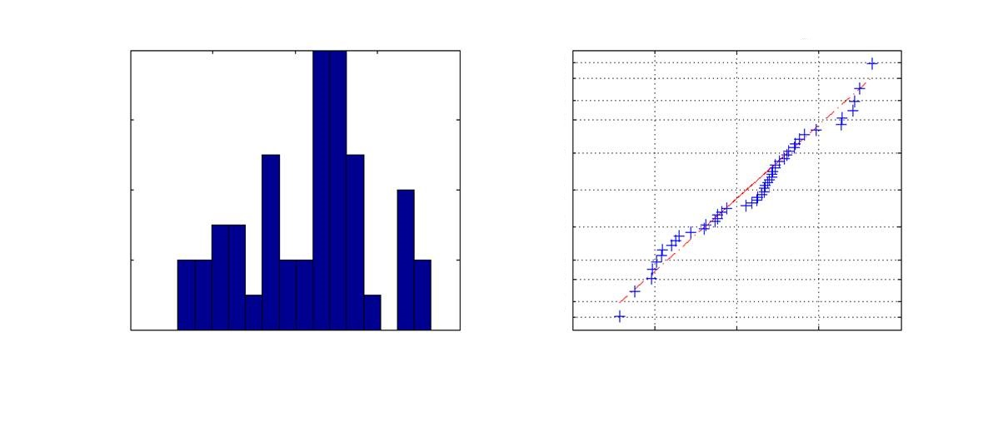
Testing Distributions
Does the data follow a standard statistical distribution (normal, lognormal, gamma)?
  If yes, can use parametric methods
  If no, can use nonparametric methods
8
6
4
2
0
Histogram
Normal Probability Plot
0.99
0.95
0.75
Probability
Frequency
0.50
0.25
0.05
0.01
0 1 2 3 4
0 1 2 3 4
Concentration (µg/L)
Concentration In(µg/L)
ITRC GSMC-1, Section 3, Section 5
Notes:
Another common assumption is that of normality. Do the data follow a bell curve? If not, then non-parametric approaches should be favored.
Figure A.5 from the web-based document.

Slide 41
Other Assumptions
Spatial/temporal independence
  Don’t sample too often!
  Replicates/duplicates not independent
Background stability
  Trends in background rule out standard tests
80
70
60
50
Toluene Concentration (ppb)
5 10 15 20
Sampling Event
ITRC GSMC-1, Section 3
Figure Source: Kirk Cameron, Ph.D.
Notes:
Temporal independence– standard tests assume independence; positively correlated data tend to underestimate true variance; can lead to wrong decisions
Advice– don’t sample too often; quarterly sampling just a rule of thumb; run a pilot study to get site-specific sampling frequency
Background stability/stationarity– standard tests assume a stationary mean in background; variance will be overestimated and significant changes missed if trends are not accounted for
Advice– switch to trend test or remove effect of trend first

Slide 42
Closing Thoughts on Getting Ready to Apply Statistics
Plot the data
Are there sufficient data to make a good decision with appropriate error rates?
Confirm regulatory requirements
Use results of statistical analyses with other lines of evidence
“If you torture the data long enough, it will confess to anything.”
Notes:
No associated notes.

Slide 43
Question & Answer Break
Follow ITRC
Notes:
No associated notes.

Slide 44
Training Roadmap
How to use the GSMC Document
Getting Ready to Apply Statistics
Question & Answer Break
How to Apply Study Questions for
  Background
  Compliance
  Trend Analysis
  Monitoring Optimization
Summary
Question & Answer Break
Notes:
No associated notes.

Slide 45
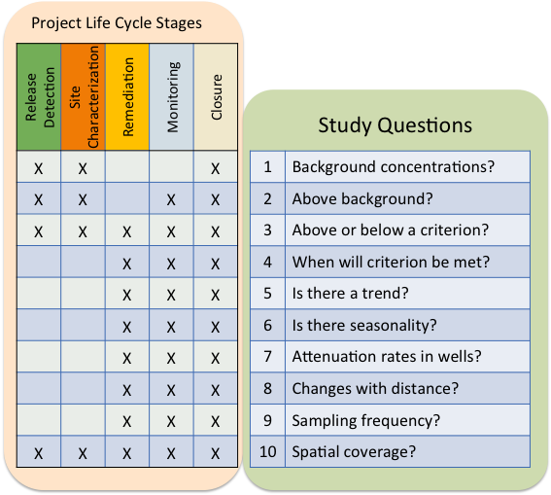
Connecting Life Cycle Stages and Study Questions
ITRC GSMC-1, Section 4, Appendix C
Notes:
We use the project life cycle stages and the study questions to illustrate the connections to the example information for the hypothetical sites.
Project life cycle stages are shown as columns. The study questions are listed on the right. The study questions that generally apply to each of the life cycle stages are noted with the X’s in the table on the left. In the web-based document this connection between life cycle stages and study questions is used to help the reader find information that is relevant for their particular site.

Slide 46
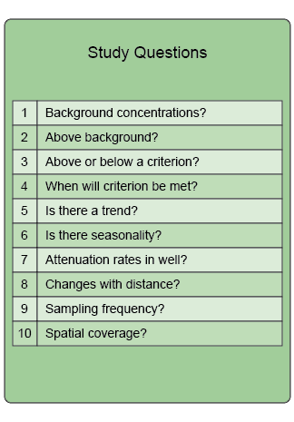
Background
ITRC GSMC-1, Section 4, Appendix C
Notes:
Two of the 10 questions are directly related to background.

Slide 47
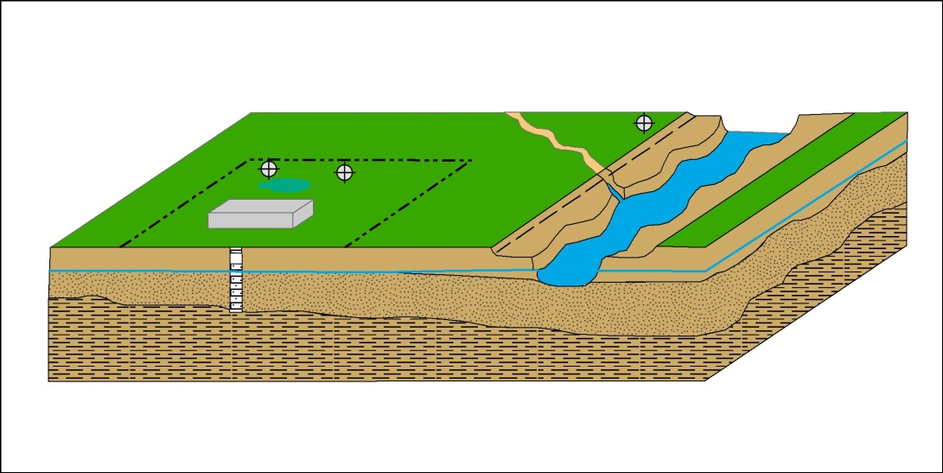
Background
What is background?
  Groundwater not influenced by site
Basis of background
  Site related vs. not site related
  Regulatory threshold
  Published literature
Wells
  One well many times
  - Intrawell
  Many wells - Interwell
ITRC GSMC-1, Study Question 1, 2
Notes:
Site related vs. not site related: In general, both native and man-made sources need to be taken into account; however, a baseline must be established, because groundwater may already be tainted with concentrations of a contaminant from either native or man-made sources that would make it difficult, if not impossible, to clean up to a “pristine” standard. The web-based guidance document addresses this in more detail.
Intrawell vs. Interwell (see Slide 31)
Intrawell – Sample one well many times and compare
Interwell – Sample many wells many times and compare

Slide 48
Considerations for Statistical Analysis of Background
Avoid known sources of site-related contamination
Distance and direction of selected wells from source
Review of geologic/hydrogeologic information
Multiple aquifer characteristics
Project data quality objectives (DQOs)
  Sufficient number of samples
  Quality of the dataset
Notes:
DQOs – should be developed up front
Sufficient samples to provide reliable results
Quality of dataset (multiple detection limits)
A good CSM model should be developed to maximize the validity of your assumptions.

Slide 49
EDA for Background
Use of EDA (Exploratory Data Analysis) in selection of background wells (section 3.3.3, section 3.5)
  Inspecting sample data – assess dataset quality
    Multiple detection limits
    Analytical methods (e.g., EPA methods 8020, 8021, 8260)
  Graphical plots of sample data – assess shape of the dataset (section 5.1)
  Determine the distribution of the sample data
    Parametric or non-parametric (section 5.6)
    Outliers (section 5.10)
ITRC GSMC-1, Section 3, 5
Notes:
Use Exploratory Data Analysis methods to help evaluate a potential background dataset.
To get a quick visual, use graphical methods such as histograms, quartile plots, box plots or scatter plots to plot the dataset and evaluate the shape of the dataset to provide insight into the overall spread and potential distribution of the data.
Distribution of the dataset will help you determine whether parametric or non-parametric (doesn’t fit normal distribution) statistical methods will be needed in your evaluation of background. For example, t-test (parametric) is sensitive to outliers.

Slide 50
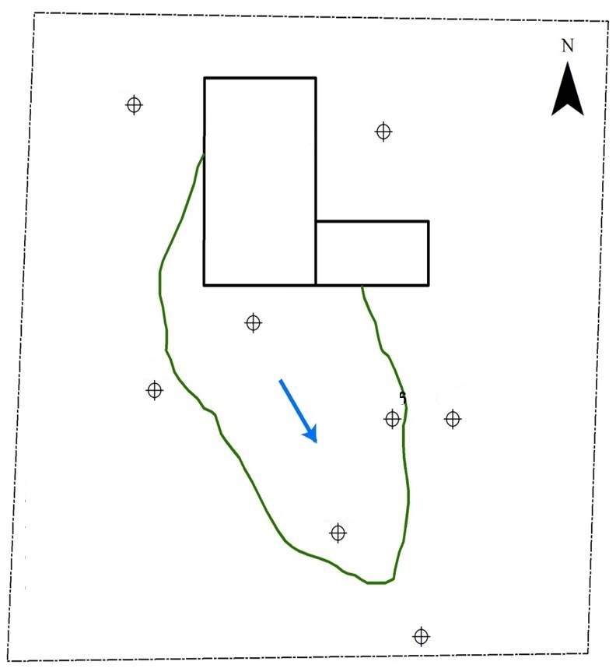
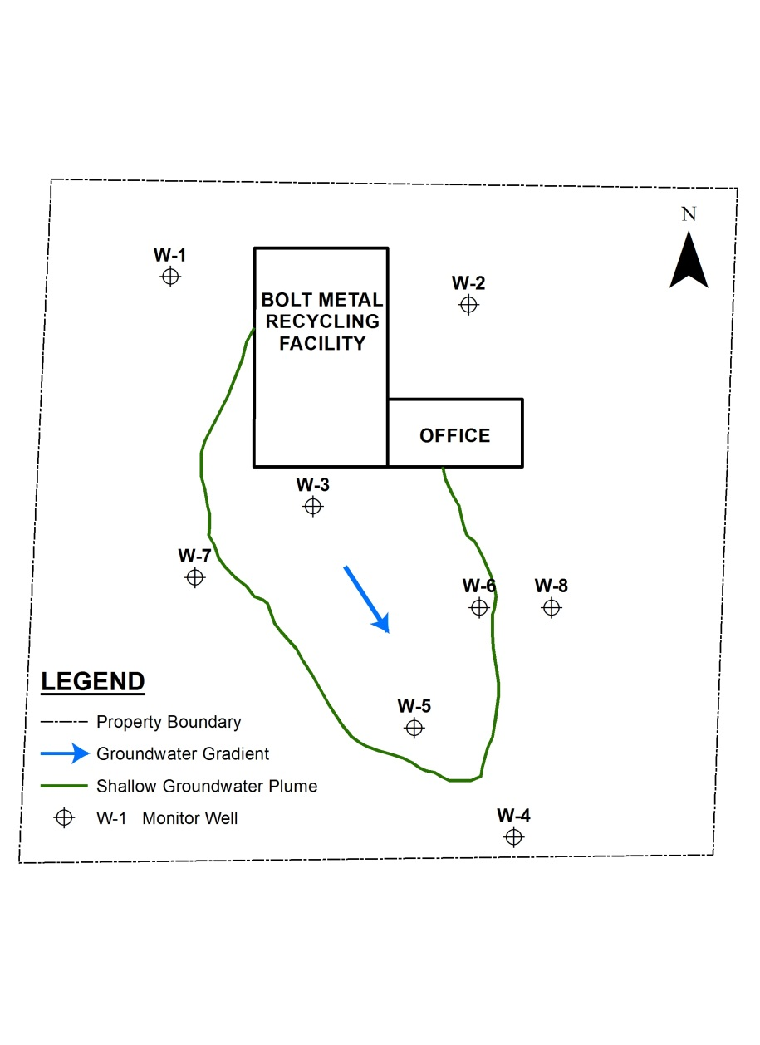
Background Example
Study Question 1: What are background concentrations?
Study Question 2: Are concentrations greater than background concentrations?
Metal recycling facility
  Arsenic
  Determine preliminary background wells for evaluation based on CSM
W-1
W-2
Bolt
metal recycling facility
Office
W-3
W-7
Groundwater gradient
W-6
W-8
W-5
Property boundary
Shallow groundwater plume
Monitoring well
W-4
Notes:
This example site shows a site with a groundwater plume and wells located upgradient (W-1 and W-2), side-gradient (W-7 and W-8) and down-gradient (W-3, W-4, W-5 and W-6) from the plume. It will be used to show how potential background well data can be evaluated to determine whether the dataset can be used to characterize background.

Slide 51
Background Example Dataset
Arsenic (μg/l)
Date | W-1 | W-2
1/2009 | 2.9 | 3.1
4/2009 | 3.1 | 4.9
7/2009 | 2.6 | 2.6
10/2009 | 2.4 | 2.5
1/2010 | 2.7 | 3.2
4/2010 | 3.0 | 7.5
7/2010 | 2.6 | 2.8
10/2010 | 2.5 | 2.8
1/2011 | 2.7 | 3.5
EPA Drinking Water MCL = 10 μg/l
Identify a dataset
Number of samples
Address nondetects
Notes:
To identify whether a dataset that would be consistent with background:
Select a potential dataset - evaluate quality, shape and distribution. Outliers?
What are the DQOs - how do they apply to number of samples?
Are there non-detects (in this case, no)?
Both upgradient wells are below the MCL.

Slide 52
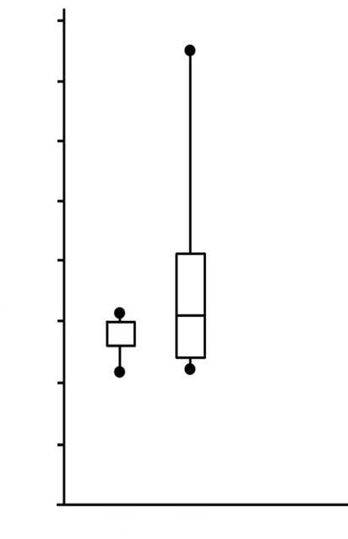
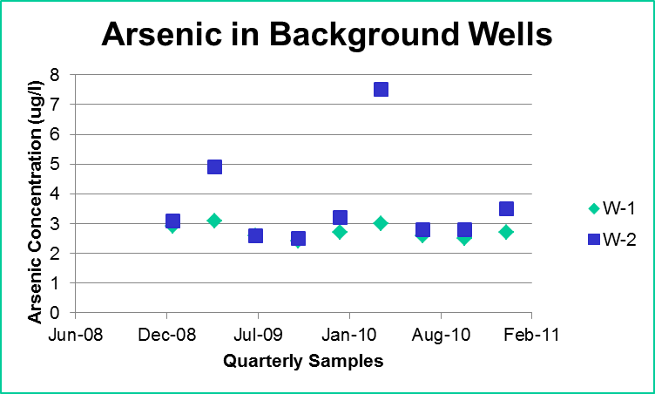
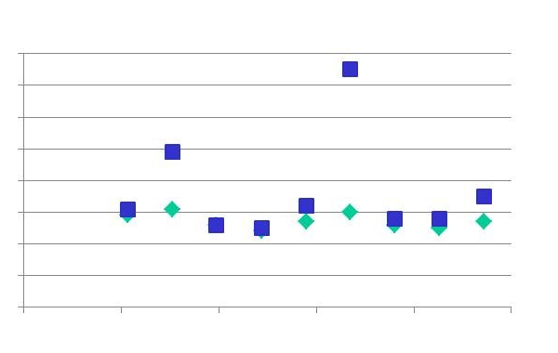
Background Example Tools
8
6
4
2
0
Statistical analysis of data set
  Methods and tools
Interpretation of results
Arsenic in Background Wells
8
6
4
2
0
W-1
W-2
Arsenic concentration (µg/l)
Arsenic concentration (µg/l)
W-1 W-2
Jun-08
Dec-08
Jul-09
Jan-10
Aug-10
Feb-11
Quarterly Samples
Notes:
Methods and tools to do preliminary statistical analysis:
Probability Plots (Section 5.1.5), Time Series Plots (Section 5.1.1), Outlier Identification (Section 5.10)
Interpretation of Results:
Understanding the source of variation (natural or man made, site related or not site related)
Temporal changes
Presence of outliers
Does your CSM need to be revised?

Slide 53
Training Roadmap
How to use the GSMC Document
Getting Ready to Apply Statistics
Question & Answer Break
How to Apply Study Questions for
  Background
  Compliance
  Trend Analysis
  Monitoring Optimization
Summary
Question & Answer Break
Notes:
No associated notes.

Slide 54
Monitoring Compliance
ITRC GSMC-1, Section 4, Appendix C
Notes:
Two of the 10 questions are directly related to compliance.
Question 4 deals with when a particular criterion will be met, which is not considered in the IBT. Please refer to the web-based document for more information on Question 4.

Slide 55
Why Monitoring Compliance?
Why monitoring?
  Evaluate site characteristics
  Evaluate chemical concentrations for compliance with groundwater protection criteria
Monitoring design
  Evaluate chemicals present over time
  Identifying a release
  Develop conceptual site model
  Compliance with regulatory requirements
ITRC GSMC-1, Study Question 3
Notes:
No associated notes.

Slide 56
Basis of Monitoring Compliance
Groundwater criteria compliance
  MCL
  Background
  Risk-based value
  Ecological protection value
Basis of compliance
  Number of samples
  Distribution
  Regulatory threshold
  What is the compliance point?
Notes:
No associated notes.

Slide 57
Monitoring Compliance Example
Study Question 3: Are concentrations above or below a criterion?
W-1
W-2
Bolt
metal recycling facility
Office
W-3
W-7
Groundwater gradient
W-6
W-8
W-5
Property boundary
Shallow groundwater plume
Monitoring well
W-4
Notes:
Determined that wells W-1 and W-2 are background wells. Based on our CSM, wells W-7 and W-8 are side gradient.
For this question, focusing on wells W-3, W-4, W-5 and W-6, within the plume and/or downgradient of the suspected source.

Slide 58
Monitoring Compliance Dataset
Is the site in compliance? Are chemical concentrations less than or greater than a criterion?
  Selection of data set
  Statistical analysis of data set
    Methods and tools
  Interpretation of results
  Uncertainty
Arsenic (μg/l)
Date | W-3 | W-6 | W-5 | W-4
1/2009 | 78 | 23 | 11.9 | 2.9
4/2009 | 79 | 28 | 10.9 | 3.0
7/2009 | 66 | 22 | 9.1 | 2.7
10/2009 | 67 | 21 | 8.5 | 2.6
1/2010 | 90 | 26 | 11.1 | 2.7
4/2010 | 89 | 27 | 11.4 | 2.8
7/2010 | 73 | 25 | 9.4 | 2.4
10/2010 | 70 | 24 | 9.2 | 2.3
1/2011 | 72 | 26 | 10.8 | 2.6
EPA Drinking Water MCL = 10 μg/l
Notes:
Although W-3 and W-6 are several times the MCL and W-4 is below the MCL, you may think you might not need statistics. Misconception. There is always uncertainty in the results.

Slide 59
Monitoring Compliance Dataset
Is the site in compliance? Are chemical concentrations less than or greater than a criterion?
  Selection of data set
  Statistical analysis of data set
    Methods and tools
  Interpretation of results
  Uncertainty
Arsenic (μg/l)
Date | W-3 | W-6 | W-5 | W-4
1/2009 | 78 | 23 | 11.9 | 2.9
4/2009 | 79 | 28 | 10.9 | 3.0
7/2009 | 66 | 22 | 9.1 | 2.7
10/2009 | 67 | 21 | 8.5 | 2.6
1/2010 | 90 | 26 | 11.1 | 2.7
4/2010 | 89 | 27 | 11.4 | 2.8
7/2010 | 73 | 25 | 9.4 | 2.4
10/2010 | 70 | 24 | 9.2 | 2.3
1/2011 | 72 | 26 | 10.8 | 2.6
EPA Drinking Water MCL = 10 μg/l Data are measured values
Notes:
No associated notes.

Slide 60
Monitoring Compliance Dataset
Is the site in compliance? Are chemical concentrations less than or greater than a criterion?
  Selection of data set
  Statistical analysis of data set
    Methods and tools
  Interpretation of results
  Uncertainty
Arsenic (μg/l)
Date | W-3 | W-6 | W-5 | W-4
1/2009 | 78 | 23 | 11.9 | 2.9
4/2009 | 79 | 28 | 10.9 | 3.0
7/2009 | 66 | 22 | 9.1 | 2.7
10/2009 | 67 | 21 | 8.5 | 2.6
1/2010 | 90 | 26 | 11.1 | 2.7
4/2010 | 89 | 27 | 11.4 | 2.8
7/2010 | 73 | 25 | 9.4 | 2.4
10/2010 | 70 | 24 | 9.2 | 2.3
1/2011 | 72 | 26 | 10.8 | 2.6
EPA Drinking Water MCL = 10 μg/l
Notes:
No associated notes.

Slide 61
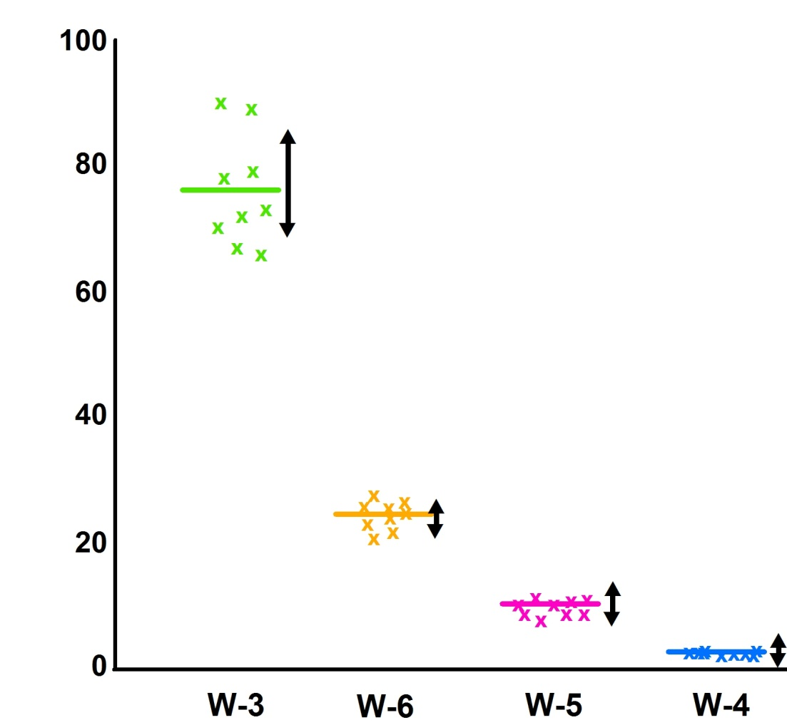
Confidence Intervals in Compliance
100
80
60
40
20
0
Important concept – confidence intervals
  Mean
  Percentile
  Variability
  Parametric vs. Nonparametric
Concentration, µg/l
Confidence Interval
Mean
W-3 W-6 W-5 W-4
Notes:
Many kinds of confidence intervals
Mean (average) is a typical confidence measure.

Slide 62
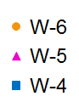
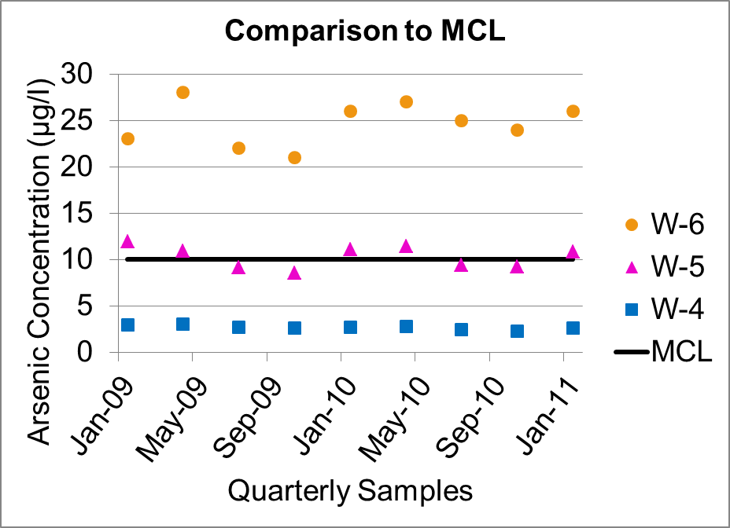
Monitoring Compliance State Guidance Example
What is clean?
  95UCL W-6 = 25.4
  95UCL W-5 = 12.7
  95UCL W-4 = 3.1
The consequence of the limit
The consequence of the distribution
Comparison to MCL
30
20
10
0
Arsenic Concentration (µg/l)
MCL
Jan-09
May-09
Sep-09
Jan-10
May-10
Sep-10
Jan-11
Quarterly Samples
Notes:
This site is in the State of Washington, and we must use guidance that has been designed by the state. This is one method, and it doesn’t match up with what is in the Unified Guidance. In the web-based document we identify the topic areas where programs are likely to have guidance (see Section 2.2.1)
What is considered clean is most-often determined by the regulatory program (under law, regulation or guidance). Those requirements may not have a statistical basis.

Slide 63
Monitoring Compliance State Guidance Example
State of WA Guidance
Arsenic (μg/l) | W-3 | W-6 | W-5 | W-4
SD | 8.8 | 2.4 | 1.2 | 0.2
Mean | 76.0 | 24.7 | 10.3 | 2.7
Confidence (0.05) | 5.8 | 1.5 | 0.8 | 0.2
UCL | 83.8 | 25.4 | 12.7 | 3.1
Max Data Value | 90 | 28 | 11.9 | 3.0
10% Data >MCL | Yes | Yes | Yes | No
 | OUT | OUT | OUT | IN
95UCL of mean
< MCL?
Max data value
< 2X MCL
Are 10% of the data > MCL?
MCL 10 μg/l
In = In Compliance
Out = Out of Compliance
Notes:
Data from wells W-3, W-6, W-5 and W-4 were evaluated using the State of Washington compliance test:
Is the upper 95% CI on mean less than the cleanup standard?
Is the maximum data point value less than 2x the cleanup standard?
Are 10 Percent of the data above the cleanup standard?
For W-3, that would be no, no and yes, so not clean
For W-6, that would be no, no and yes, so not clean
For W-5, that would be no, yes, and yes, so not clean
For W-4, that would be yes, yes, and no, so clean

Slide 64
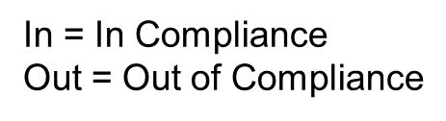
Monitoring Compliance RCRA Example
40 CFR 264.99 evaluation using USEPA’s Statistical Analysis of Groundwater Monitoring Data at RCRA Facilities, Unified Guidance (2009)
Arsenic (μg/l) | W-3 | W-6 | W-5 | W-4
SD | 8.8 | 2.4 | 1.2 | 0.2
Mean | 76.0 | 24.7 | 10.3 | 2.7
Confidence (0.05) | 5.8 | 1.5 | 0.8 | 0.2
UCL | 83.8 | 25.4 | 12.7 | 3.1
LCL | 70.2 | 23.1 | 9.5 | 2.5
 | OUT | OUT | IN | IN
MCL 10 μg/l
Notes:
As referenced in the web-based document, when looking at a RCRA situation (based on 40 CFR 264.99), the US EPA’s Unified Guidance document is typically used.

Slide 65
Training Roadmap
How to use the GSMC Document
Getting Ready to Apply Statistics
Question & Answer Break
How to Apply Study Questions for
  Background
  Compliance
  Trend Analysis
  Monitoring Optimization
Summary
Question & Answer Break
Notes:
No associated notes.

Slide 66
Trends
ITRC GSMC-1, Section 4
Notes:
Four of the 10 questions are directly related to trends. Trend analyses are indirectly related to all questions. For example, trend analyses are a component of exploratory data analysis. In addition, one also just consider when trends when establishing or comparing to background or how to optimize monitoring networks. Although trend analyses can be relevant to any of the project life cycle phases, they are most important to remediation, monitoring, and closure.
Question 8 deals with spatial trends, which are not considered in the IBT. Please refer to section 5.15 of the web-based guidance document for more information on spatial statistical methods.

Slide 67
Trend Basics: A Picture Is Worth a Thousand Words…
Detected
Measurements
2.35
2.25
Analyte Concentration (mg/L)
2.15
2.05
1.95
Jan-03
Sep-03
May-04
Jan-05
Sep-05
ITRC GSMC-1, Study Question 5
Figure Source: Adapted from USEPA 2009
Notes:
Figure Source: USEPA. 2009. "Statistical Analysis of Groundwater Monitoring Data at RCRA Facilities." In Unified Guidance EPA 530/R-09-007. Washington DC: United States Environmental Protection Agency. www.epa.gov
Start with a scatter plot of your data … three years of data from a single well
scatter plots
Graphical representation of multiple observations from a single point used to illustrate the relationship between two or more variables. An example would be concentrations of one chemical on the x-axis and a second chemical on the y-axis. They are a typical exploratory data analysis tool to identify linear versus nonlinear relationships between variables (Unified Guidance).

Slide 68
...But Formal Statistical Analyses Are Essential
Detected
Measurements
Linear Regression
2.35
2.25
Analyte Concentration (mg/L)
2.15
2.05
1.95
Jan-03
Sep-03
May-04
Jan-05
Sep-05
Figure Source: Adapted from USEPA 2009
Notes:
Figure Source: USEPA. 2009. "Statistical Analysis of Groundwater Monitoring Data at RCRA Facilities." In Unified Guidance EPA 530/R-09-007. Washington DC: United States Environmental Protection Agency. www.epa.gov
Formal statistical tests answer:
1) is there a trend (cyclical, increasing, decreasing)? and/or 2) what is the slope (or rate of change)?
linear regression analysis
A parametric statistical method to measure the linear trend of a data set using data point regression residuals that are based on assumptions of normality, homoscedasticity, and independence (Unified Guidance).
parametric
A statistical test that depends upon or assumes observations from a particular probability distribution or distributions (Unified Guidance).

Slide 69
Trend Applications
All project life cycle phases
  Exploratory Data Analysis (EDA Section 3.3.3) — are background levels stable?
Specific project life cycle phases
  Release detection (Section 4.2) — are concentrations steadily increasing?
  Assessing compliance (Section 4.6) — is monitored natural attenuation feasible/realistic?
  Optimization (Section 4.5) — is the sampling effort appropriate?
Notes:
Exploratory data analysis applies to all project life cycle phases. Several statistical tests assume that concentrations are stable. For example, the background statistics assume there is no trend in the background well.
Seasonal or cyclical changes in concentrations can appear consistent with transient changes in concentrations. For documenting a release it is important to show changes are steadily increasing by using trend analyses and documenting statistical significance. Trend analyses can support assessment of monitored natural attenuation by estimating a rate of change or a date that a target concentration might be attained.

Slide 70
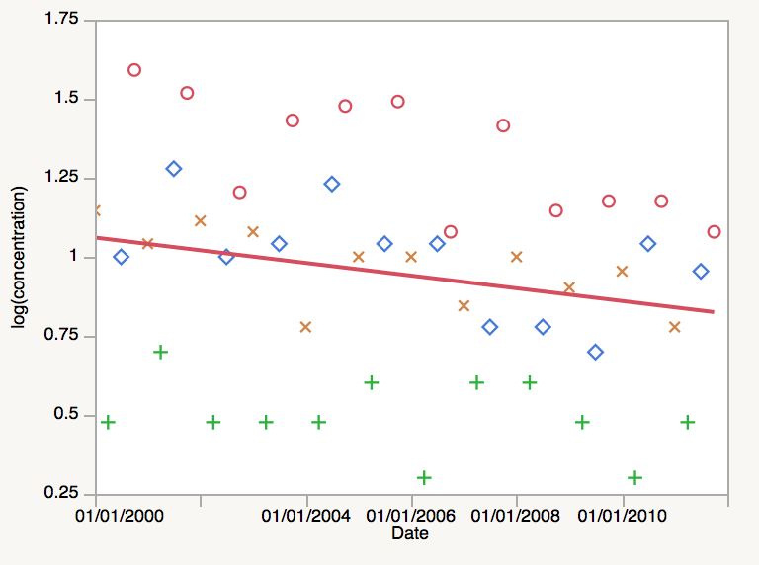
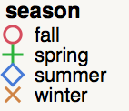
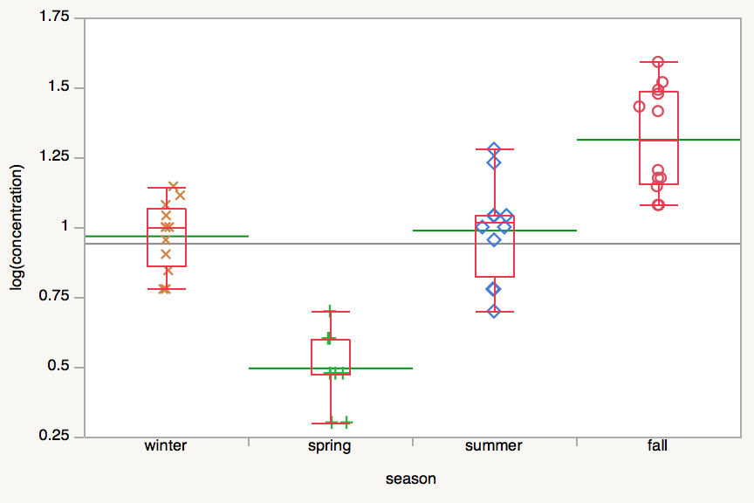
Trend Example Seasonality
Study Q6 (Appendix C) – Is there seasonality?
To adjust for seasonality, take the value minus the season mean plus the overall mean.
+0.3
Data from Appendix A, Table A-2
log(concentration) = 2.99 - 6.37e-10*Date,
r²=0.045
Grand mean 0.94
Winter mean 0.97
Spring mean 0.50
Summer mean 0.99
Fall mean 1.32
0.94
0.94
-0.2

Slide 71
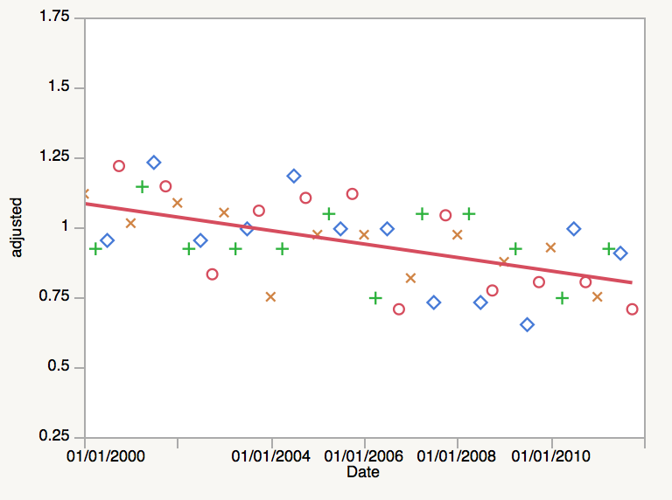
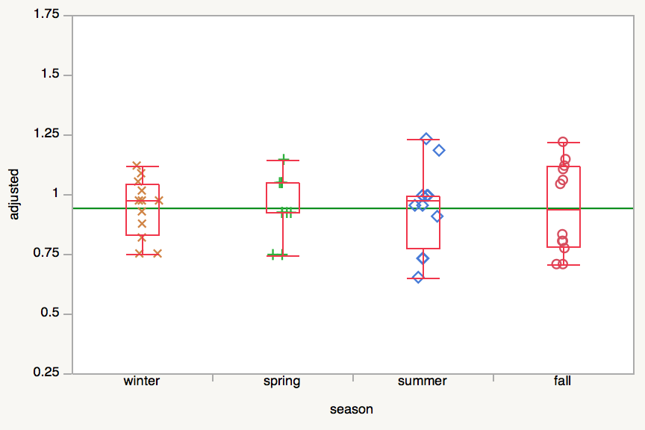
Trend Example Seasonality - Adjusted Data
Study Q6 (Appendix C) – Is there seasonality?
Adjusted data have similar slope but substantially more significant trend (compare r² values)
Data from Appendix A, Table A-2
log(concentration) = 3.40 – 7.63e-10*Date,
r²=0.323
Recall that the unadjusted r²=0.045

Slide 72
Trend Example
Attenuation
Study Q7 (Appendix C) – What is the attenuation rate?
  Combine trend with confidence band to test against criterion
60
40
20
0
TCE
90% Conf. Band
Theil-Sen Line
Clean-Up Goal
TCE (ppb)
5 10 15 20 25 30
Month
ITRC GSMC-1, Study Question 7
Figure Source: Kirk Cameron, Ph.D.
Notes:
Data used to generate the figure are from the EPA’s Unified Guidance, Example 21-7. USEPA. 2009. "Statistical Analysis of Groundwater Monitoring Data at RCRA Facilities." In Unified Guidance EPA 530/R-09-007. Washington DC: United States Environmental Protection Agency. www.epa.gov
Statistical confidence bands on observed trends can help to establish compliance. The scatterplot graph displays TCE concentrations over time at a monitoring well. Note that first sample result less than the criterion has an upper confidence band on the individual concentrations greater than the criterion. The upper confidence bound for the next result is less than the criterion. The confidence bands are calculated for the predicted values (y-axis, dependent variable, TCE concentration in the well).
The Theil-Sen test is a nonparametric (no statistical distribution assumed) test that can be used with or without seasonality.
confidence interval
Statistical interval designed to bound the true value of a population parameter such as the mean or an upper percentile (Unified Guidance).
nonparametric
Statistical test that does not depend on knowledge of the distribution of the sampled population (Unified Guidance).

Slide 73
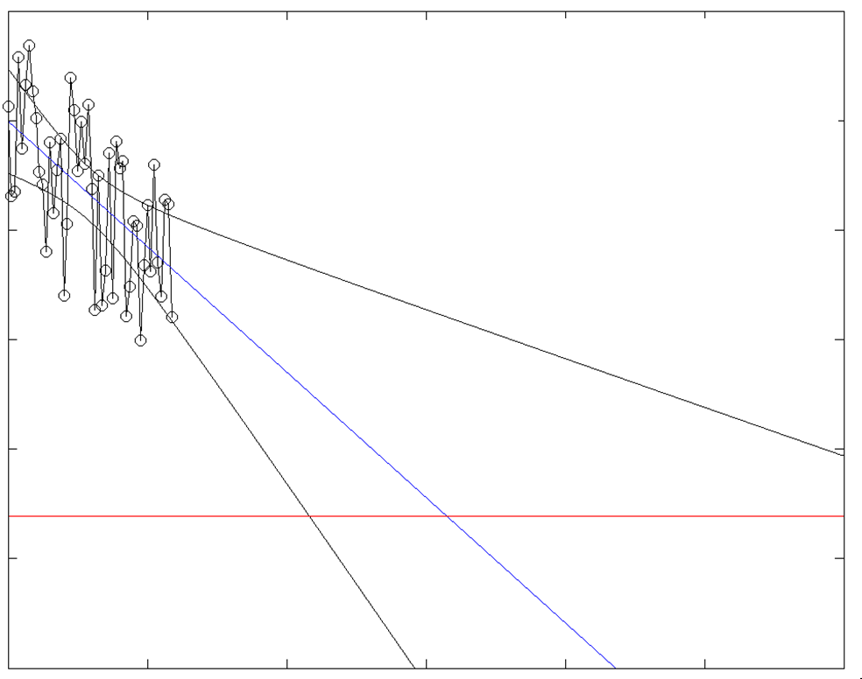
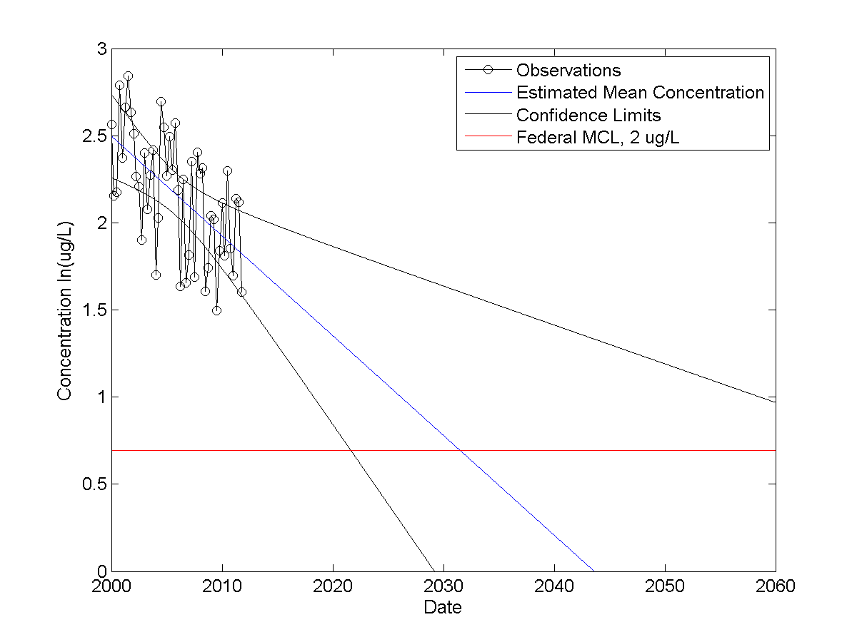
Trend Example
Projecting Concentrations
20
7.4
2.7
When will the extrapolated mean concentration reach a criterion?
  Example A.2 from Appendix A
  Project future concentrations using past trends
  Observations
  Estimated Mean Concentration
  Confidence Limits
  Criterion, 2 µg/l
Concentration (µg/L) [logarithmic scale]
ITRC GSMC-1, Study Question 4
2000 2020 2040 2060
Notes:
Statistical confidence bands on observed trend models can help to establish compliance. Note that the confidence bands on the model are quite different from those calculated for individual points shown on the previous slide. For this example the projected dates of compliance run from about 2020 to 2075 (off the x-axis scale).
Extrapolating from current conditions to future mean concentrations leads to wider and wider confidence limits. This is due to extrapolating from the mean x or mean of dates sampled to future conditions. The mean data of the measured data (mean x) is marked by the dashed line. Confidence is greatest at the mean x-value (date) and expands with greater lags. Consider that when one extrapolates to possible future outcomes that there is a mean slope but also a range of possible slopes. We are also familiar with increasing bounds on model predictions based on predicted future storm tracks.
Figure A-11. How long until the compliance goal is met?

Slide 74
Training Roadmap
How to use the GSMC Document
Getting Ready to Apply Statistics
Question & Answer Break
How to Apply Study Questions for
  Background
  Compliance
  Trend Analysis
  Monitoring Optimization
Summary
Question & Answer Break
Notes:
No associated notes.

Slide 75
Optimization
ITRC GSMC-1, Section 4
Notes:
There are two study questions that deal specifically with optimization or determining the appropriate sampling frequency or well selection.

Slide 76
Optimization
Optimization entails efficient data collection – collecting the right amount of data for the decisions (Section 4.5.3)
Sampling design optimized for any site when
  Little statistical correlation or redundancy in sample results, AND
  Adequate data collected for accurate decisions
ITRC GSMC-1, Study Questions 9, 10
Notes:
Similar results collected from nearby locations or closely-spaced times may indicate correlation or redundancy
Optimization can lead to either a larger or smaller number of wells, number of samples, or analytical suites
Sites at later stages in the project life cycle are more likely to have redundant data and the information necessary to conduct optimization
Optimization, like any statistical sampling procedure, should be completed with adequate site knowledge based on the conceptual site model.
Also, note there is a related ITRC team and guidance document http://gro-1.itrcweb.org
Geostatistics for Remediation Optimization
Leads: Ning-Wu Chang (nchang@dtsc.ca.gov) and Harold Templin (htemplin@idem.in.gov)
Project: Remediation optimization can improve performance, increase monitoring efficiency, and justify contaminated site decisions. For complex groundwater cleanup projects, however, optimizing the remediation performance monitoring system is challenging. A simple, deterministic decision flow chart may not adequately account for complex site conditions. Geostatistical approaches can be used as tools to evaluate optimization opportunities to improve groundwater remediation performance and monitoring. Geostatistical approaches for remediation optimization typically use spatial and temporal statistics to estimate correlations and redundancy between sampling locations and events. These approaches also identify areas and periods of high statistical uncertainty in a groundwater monitoring network over time. This project will develop a web-based guidance document and Internet-based training course to help state regulators and project managers understand how to use geostatistical approaches for remediation optimization and make better decisions regarding site cleanup.

Slide 77
Temporal Optimization
Goal: optimize sampling frequencies
  Are consecutive sampling events redundant?
  Or using statistical terminology --
  Is autocorrelation present?
Strategy: adjust frequency to minimize correlation while still capturing trends
ITRC GSMC-1, Study Question 9
Notes:
Phased sampling approach typical of many sites—
Generally sample more frequently in initial project phases
Reduce frequency once temporal relationships can be established
Common tests to identify temporal correlation (autocorrelation) include sample autocorrelation function (ACF) and rank von Neumann. The web-based document has information on methods to assess autocorrelation, including the example in Appendix A-2 that was discussed in the last section of this training.
autocorrelation
Correlation of values of a single variable data set over successive time intervals (Unified Guidance).

Slide 78
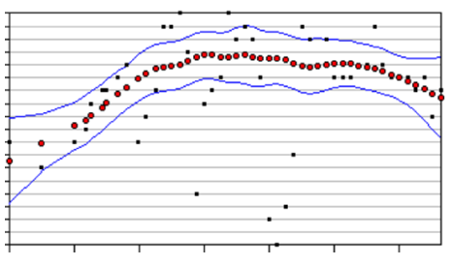
Temporal Approaches:
Iterative Thinning
Example A.4 from Appendix A
34
32
30
28
26
24
22
20
18
16
MW-2
Chromium (total)
1999 2001 2003 2005 2007 2009 2011
Original data
Smoothed data
90% Confidence Interval
Example worked using Visual Sampling Plan (VSP)
ITRC GSMC-1, Section 5.8.7
Notes:
Figure A-15. Visual Sampling Plan (VSP) results for concentration (mg/l) from MW-2.
Iterative thinning method. Iterative thinning examines whether sampling frequencies can be reduced due to temporal redundancy in the sampling events. This approach identifies redundancy by first estimating a baseline trend using the full data set, after which the trend is repeatedly re-estimated using subsets of the full data to identify the average number of data points needed to accurately reconstruct the baseline. The computations in iterative thinning create a series of ‘what if’ scenarios estimating the nature of the trend that would have been identified if only some of the existing data had been sampled. The overriding principle in iterative thinning is that if a trend can be accurately reconstructed using fewer sampling events, the optimal sampling frequency should be based on this smaller number.
This example is from Appendix A, A-4 and used the VSP software (see Appendix D.23). The black symbols represent the original quarterly well sample data and the red symbols are the smoothed trend using all data. The blue band is the 90% confidence interval on the trend. According to the VSP output, the optimal sampling frequency for MW-2 would be 227 days. If a semi-annual frequency (180 days) were proposed for future sampling in this well, there would be a 50% reduction in sampling costs with no significant difference in the ability to monitor trends in this well.
The user selects the following Simulation Parameters in VSP:
Smoothing bandwidth: for example 0.3
Number of simulations: for example 500
Confidence interval (CI) confidence level: 90% [for the smoothed line]
Percent of simulated trend required to be within the CI: for example 75%

Slide 79
Temporal Approaches:
Cost Effective Sampling (CES)
Rate of Change (Linear Regression)
Sampling Frequency
High
MH
Medium
LM
Low
I
Q: Quarterly
S: Semiannual
A: Annual
Q
PI
S
NT
Mann-Kendall Trend
S
A
I = Increasing
PI = Probably Increasing
NT = No Trend
S = Stable
PD = Probably Decreasing
D = Decreasing
MH = Medium High
LM = Medium Low
PD
D
Rate of change relative to cleanup goal vs. trend.
ITRC GSMC-1, Section 5.8.7, Appendix C.9
Figure Source: AFCEC 2012
Notes:
Figure Source: Air Force Civil Engineer Center (AFCEC). 2012. "Monitoring and Remediation Optimization System (MAROS) Software, User's Guide and Technical Manual." In: Air Force Center for Environmental Excellence. http://www.gsi-net.com/en/software/free-software/maros-30.html.
See Also Ridley, M.N., V.M. Johnson, and R.C. Tuckfield. 1995. Cost-Effective Sampling of Groundwater Monitoring Wells. Vol. UCRL-JC-118909. Livermore, CA: Lawrence Livermore National Laboratory
Cost-effective sampling method (CES). In CES, a linear trend is estimated for each chemical-well pair and then classified according to the slope of the apparent trend as well as how much variation exists around the trend. Trends with relatively ‘flat’ slopes (small rates of change) and low variation are recommended for less frequent sampling, while trends with higher slopes or higher degrees of variation are targeted for more frequent sampling. The overriding principle is to (1) sample more frequently at locations where the apparent changes are more dynamic and associated with the greatest statistical uncertainty, and (2) sample less frequently when the trend is changing little and is statistically more certain (that is, less variable). A high rate is change is 2 times the cleanup goal, medium is equal to the cleanup goal, and low is 50% of the cleanup goal.

Slide 80
Spatial Optimization
Goal: optimize number and/or placement of well locations
  Are any wells redundant?
  Should new wells be added and where?
Strategy: assess spatial uncertainty either by
  Removing specific wells or groups of wells
  Locating areas with highly uncertain concentrations and few or no wells
ITRC GSMC-1, Study Question 10
Notes:
Spatial optimization is a challenging objective and an active area for research
Requires lots of data; broad spatial coverage
Optimization software results should be checked against what is known or hypothesized about contamination via the CSM (see section 3.2 of the web-based document), and other lines of evidence.

Slide 81
Spatial Approaches
Identify spatial redundancy (well removal)
  Tools
    Genetic algorithms
    GTSmart
    Slope factors/ relative errors
    Kriging uncertainty
    Qualitative evaluation
N₂
Delaunay triangle
N₃
d₀₂
d₀₃
N₀
N₁
d₀₄
d₀₁
N₄
d₀₅
Voronoi diagram
N₅
ITRC GSMC-1, Study Question 9
Wells
Figure Source: AFCEC 2012
Notes:
Figure Source: Air Force Civil Engineer Center (AFCEC). 2012. "Monitoring and Remediation Optimization System (MAROS) Software, User's Guide and Technical Manual." In: Air Force Center for Environmental Excellence. http://www.gsi-net.com/en/software/free-software/maros-30.html.
Spatial redundancies in a monitoring network can be identified, leading to fewer sampling points and more cost-effective monitoring. In this case, multiple tools and approaches exist to answer the question. For instance, nearest neighbor estimation can be combined with leave-one-out cross-validation to generate the slope factors in MAROS. Some approaches remove one well at a time or groups of wells, then try to either reproduce plume maps using the reduced network or minimize the statistical uncertainty of the resulting network
3TMO uses qualitative evaluation (see Appendix D.1);
GTS uses quasi-genetic algorithm called GTSmart (see Appendix D.6);
Summit Tools uses genetic algorithm (see Appendix D.21);
MAROS uses slope factors (see Appendix D.11);
VSP uses kriging uncertainty (see Appendix D.23)

Slide 82
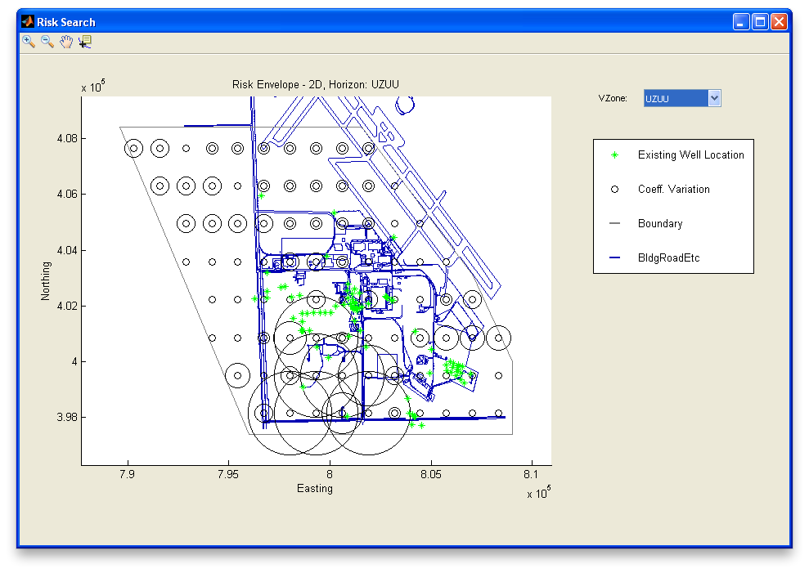
Spatial Approaches: Network Adequacy/Sufficiency (Add New Wells)
Locate areas with high uncertainty and low spatial coverage
5km
Existing well location
Coeff. variation
Geostatistical Temporal-Spatial Software (GTS, Appendix D.6)
Example Data Courtesy AFCEC 2013
Notes:
Figure Source: Map of network adequacy evaluation results developed in GTS using example data from the software. Example data courtesy AFCEC 2013.
The plus symbols locate existing wells. The circles represent current estimates of uncertainty in concentrations. Add wells where uncertainty is high and coverage of existing wells is low. Remove wells is coverage is high and uncertainty is low. The CSM should be considered when making decisions to either add or remove wells from the monitoring network.

Slide 83
Optimization Software
Temporal and spatial optimization tools
  3-Tiered Monitoring and Optimization Tool (3TMO, Appendix D.1)
  Monitoring and Remediation Optimization Software (MAROS, Appendix D.11)
  Summit Tools (Appendix D.21)
  Visual Sample Plan (VSP, Appendix D.23)
  Geostatistical Temporal-Spatial Software (GTS, Appendix D.6)
ITRC GSMC-1, Appendix D
Notes:
Spatial optimization generally relies on geostatistical methods to understand the distance over which sample results are correlated and the strength of such relationships. Temporal optimization relies on estimating trends and the uncertainty associated with those trends.
3TMO
The 3-Tiered approach to LTMO is unique when compared to existing LTMO statistical applications because it focuses on qualitative factors that are supported by quantitative statistical analysis. The spatial analysis included in 3TMO is a qualitative evaluation facilitated by the Map Tool; the spatial importance of each well is not quantitatively determined using geostatistics.
MAROS
Uses simple statistics and decision frameworks to prioritize data collection efforts and link data to defensible site management decisions. Can use results from this software to develop lines of evidence, which combined with professional judgment, can be used to inform site management decisions for safe and economical long-term monitoring of groundwater plumes. Can use MAROS to help design and calculate remediation performance metrics and as a tool to evaluate progress toward site remedial goals.
GTS
GTS has five modular components linked together in a user-friendly interface: Prepare, Explore, Baseline, Optimize, and Predict. The Optimize component runs two distinct types of temporal optimization—iterative thinning and temporal variograms—as well as spatial optimization involving both a search for statistical redundancy and an assessment as to whether and where new wells should be added. Finally, the Predict module focuses on flagging newly imported data that are inconsistent with projected trends and maps.
Summit Tools
SampleOptimizer and SampleTracker are tools for both spatial and spatio-temporal analysis for monitoring network optimization. SampleOptimizer applies mathematical optimization to monitoring networks in an easy-to-use desktop software tool. SampleTracker reviews new monitoring data against historical data.
VSP
VSP has a module to evaluate redundancy of wells. The well redundancy modules in VSP can identify redundant wells and identify a technically defensible temporal spacing of observations for wells. The redundant well module uses a geospatial analysis based on kriging. VSP also has a module to help with new well placement to reduce estimation uncertainty. The sampling frequency well evaluation is applied on a well-by-well basis and is based on iterative thinning methods.

Slide 84
Training Roadmap
How to use the GSMC Document
Getting Ready to Apply Statistics
Question & Answer Break
How to Apply Study Questions for
  Background
  Compliance
  Trend Analysis
  Monitoring Optimization
Summary
Question & Answer Break
Notes:
No associated notes.

Slide 85
Statistical Methods/Tests
14 groups of methods
  Grouped based type and application
  Examples
    5.1 Graphical methods
    5.2 Confidence limits
    5.5 Trends
    5.7 Nondetects
References provided, including references to EPA’s Unified Guidance
Details for each
  Applications and relevant study questions are linked
  Assumptions
  Requirements and tips
  Strengths and weaknesses
  Further information
  Not intended as a “how to,” but a resource
ITRC GSMC, Section 5
Notes:
In Section 5 of the web-based document the statistical methods are grouped by their application.
There are references provided for the methods.
A lot of practical information about the methods is provided in Section 5.

Slide 86
Appendix D: Software Tools and Packages
Brief summaries included for widely available software packages – 23 included
Based on survey results and team input
Information included
  Approximate cost
  Operating system requirements
  Ease of use
  Data Import
  Capabilities
  Benefits and Limitations
  References
Software Packages
D.1 3TMO | D.13 PAM
D.2 CARStat | D.14 Pro-UCL
D.3 ChemStat | D.15 R for Statistics
D.4 DUMPStat | D.16 Sanitas
D.5 Excel | D.17 SAS
D.6 GTS | D.18 Scout
D.7 GWSDAT | D.19 SPSS
D.8 JMP | D.20 Statistica
D.9 MATLAB | D.21 Summit Tools
D.10 MINITAB | D.22 SYSTAT
D.11 MAROS | D.23 VSP
D.12 NCSS
ITRC GSMC Appendix D
Notes:
Appendix D includes summaries of 23 statistical software packages. Table D-1.
Each summary includes some practical information such as the approximate cost and capabilities.
You should be sure to carefully review any software to be sure that it is applicable to your needs.

Slide 87
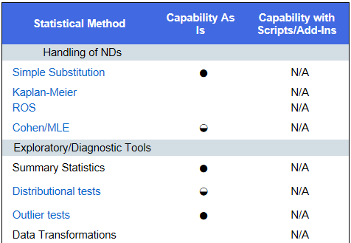
Appendix D: Software Packages Capabilities Table
ITRC GSMC Appendix D
Notes:
Ratings are none, some capability and full capability. These can be used to determine which software can implement the functions that you are looking for.

Slide 88
The Big Challenge
Groundwater Data Management
Based on data quality objective (DQO) procedures
Large site databases
  Environmental Restoration Information System (ERIS)
  Navy Installation Restoration Information Solution (NIRIS)
  Staged Electronic Data Deliverable (SEDD)
Good practices
  Streamline data analysis
  Provide a basic structure
ITRC GSMC, Section 6
Notes:
No associated notes.

Slide 89
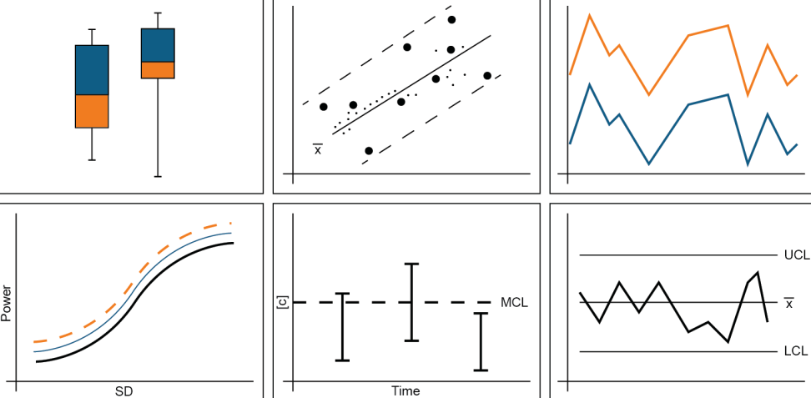
Overall Course Summary
Statistical Information
What You Have Learned
Statistics…
More confident with statistical concepts
Better able to select appropriate statistical methods for your project
Appropriate software tools for your project
ITRC GSMC, Section 3
Notes:
Statistical concepts
Select appropriate methods and software tools
Avoid misapplications of statistics at your groundwater sites.

Slide 90
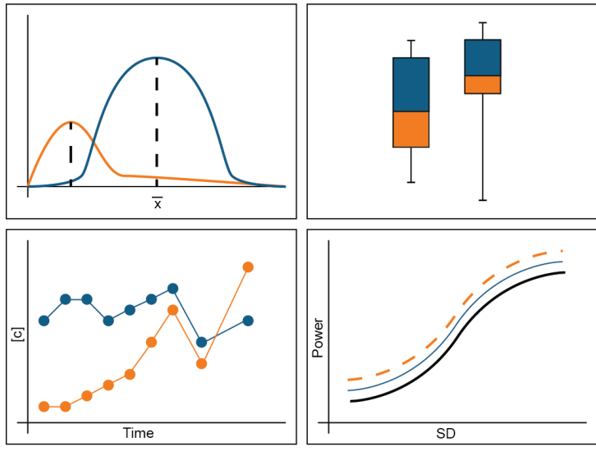
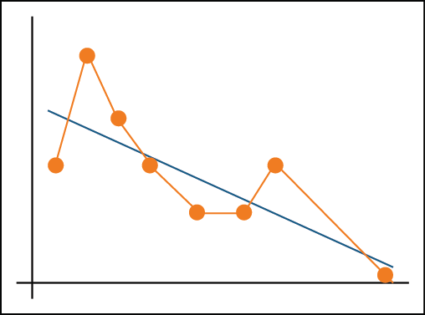
Overall Course Summary
Practical Applications
Ready for practical application of statistics in four key areas:
  Background
  Compliance
  Trend analysis
  Monitoring optimization
ITRC GSMC, Appendix C
Notes:
No associated notes.

Slide 91
Overall Course Summary
Navigating the ITRC GSMC Guidance Document
ITRC GSMC Guidance Document
http://www.itrcweb.org/gsmc-1/
Access to meet your needs
ITRC GSMC, Section 1
Notes:
You learned how the Web-based guidance document fits together to give you a resource in evaluating or designing a statistical approach.
This document guides the project manager in using appropriate statistical methods to address common project tasks (such as evaluating whether a groundwater remedy is functioning effectively or whether there is a downward trend which supports a natural attenuation remedy selection) and make better decisions for their projects.
You may also find the GSMC Team as a resource for more information (Appendix G).

Slide 92
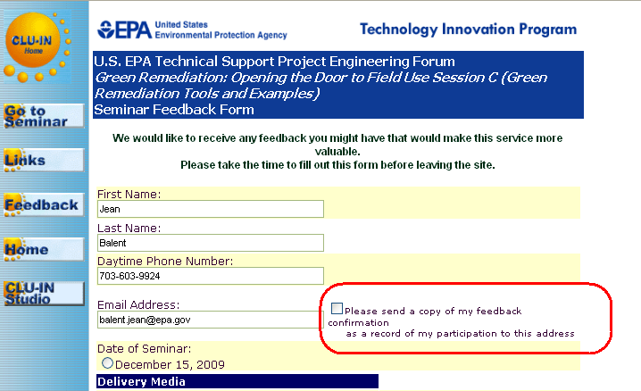

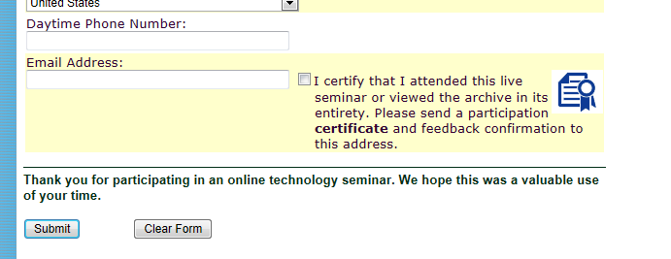
Thank You
Follow ITRC
2nd question and answer break
Links to additional resources
  http://www.clu-in.org/conf/itrc/gsmc/resource.cfm
Feedback form – please complete
  http://www.clu-in.org/conf/itrc/gsmc/feedback.cfm
Register for “Geospatial Analysis for Optimization at Environmental Sites” training at https://clu-in.org/conf/itrc/GRO/
Need confirmation of
your participation today?
Fill out the feedback form and check box for confirmation email and certificate.
Notes:
Links to additional resources:
http://www.clu-in.org/conf/itrc/gsmc/resource.cfm
Your feedback is important – please fill out the form at:
http://www.clu-in.org/conf/itrc/gsmc/feedback.cfm
The benefits that ITRC offers to state regulators and technology developers, vendors, and consultants include:
Helping regulators build their knowledge base and raise their confidence about new environmental technologies
Helping regulators save time and money when evaluating environmental technologies
Guiding technology developers in the collection of performance data to satisfy the requirements of multiple states
Helping technology vendors avoid the time and expense of conducting duplicative and costly demonstrations
Providing a reliable network among members of the environmental community to focus on innovative environmental technologies
How you can get involved with ITRC:
Join an ITRC Team – with just 10% of your time you can have a positive impact on the regulatory process and acceptance of innovative technologies and approaches
Sponsor ITRC’s technical team and other activities
Use ITRC products and attend training courses
Submit proposals for new technical teams and projects

