Slide 1



Starting Soon:
LNAPLs Training – Part 2 of 3
Light Non-Aqueous Phase Liquid (LNAPL) Site Management: LCSM Evolution, Decision Process, and Remedial Technologies (LNAPL-3, 2018) - https://lnapl-3.itrcweb.org/
Download PowerPoint file
  Clu-in training page at https://clu-in.org/conf/itrc/LNAPL-3/
  Under “Download Training Materials”
Download information for reference during class
  Figure 1.1 (from the LNAPL-3 guidance document)
Using Adobe Connect
  Related Links (on right)
    Select name of link
    Click “Browse To”
  Full Screen button near top of page
Poll Question
Follow ITRC
Notes:
The projects I work on are limited by: (choose the best answer)
Budget constraints, there is sufficient time and technical understanding how goals could be achieved
Technical constraints, site characteristics (fine grained soil, depth to impacts, bedrock) limit effectiveness of technologies and ability to reduce impacts
Time constraints, there is a time driver which limits the available approaches to addressing concerns achieving goals

Slide 2
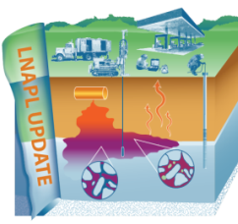
Part 1: Understanding LNAPL Behavior in the Subsurface
Welcome – Thanks for Joining
this ITRC Training Class
Based on ITRC Guidance Document:
Light Non-Aqueous Phase Liquid (LNAPL) Site Management: LCSM Evolution, Decision Process, and Remedial Technologies (LNAPL-3, 2018)
3-Part Training Series: Connecting the Science to Managing Sites
Part 2: LNAPL Conceptual Site Models and the LNAPL Decision Process
Part 3: Using LNAPL Science, the LCSM, and LNAPL Goals to Select an LNAPL Remedial Technology
Sponsored by: Interstate Technology and Regulatory Council (www.itrcweb.org) Hosted by: USEPA Clean Up Information Network (www.cluin.org)
Notes:
The newly updated LNAPLs (Light Non-Aqueous Phase Liquids) training courses help users set appropriate LNAPL remedial goals in the context of a site-specific LNAPL conceptual site model, provide tools to screen LNAPL remedial technologies to identify an optimal LNAPL remedial technology to achieve the goals, and provide example performance metrics that would be set to gauge remedial effectiveness and demonstrate achievement of the goals.
A sound LNAPL understanding is necessary to effectively characterize and assess LNAPL conditions and potential risks, as well as to evaluate potential remedial technologies or alternatives. The ITRC LNAPLs Team’s updated training courses provide:
a technical understanding of LNAPL key concepts and behavior in the subsurface
LNAPL conceptual site model (LCSM) development
framework for making LNAPL remediation and management decisions
informed remedial technology selection and appropriate technology application
LNAPL Training Part 1: An Improved Understanding of LNAPL Behavior in the Subsurface - Connecting the Science to Managing Sites
Part 1 explains how LNAPLs behave in the subsurface and examines what controls their behavior. Part 1 also explains what LNAPL data can tell you about the LNAPL and site conditions. Relevant and practical examples are used to illustrate key concepts.
LNAPL Training Part 2: LNAPL Conceptual Site Models and Remedial Decision Framework - Do you know where the LNAPL is and how to address LNAPL concerns? Part 2 addresses LNAPL conceptual site model (LCSM) development as well as the overall framework for making LNAPL remediation and management decisions. Part 2:
discusses key LNAPL and site data
when and why those data may be important, and
how to effectively organize the data into an LCSM.
Part 2 also discusses how to resolve LNAPL concerns by selecting appropriate goals and objectives, choosing applicable technologies, and assigning remedial performance metrics and endpoints. Part 2 concludes with a special focus on LNAPL Transmissivity and how it may be used to improve LNAPL decision making.
LNAPL Training Part 3: Using LNAPL Science, the LCSM, and LNAPL Goals to Select an LNAPL Remedial Technology - Part 3 of the training fosters informed remedial technology selection and appropriate technology application. Part 3:
discusses remedial technology groups,
introduces specific remedial technologies,
provides a framework for technology selection, and
introduces a series of tools to screen the several remedial technologies addressed in the updated ITRC document.
A case study demonstrates the use of these tools for remedial technology selection, implementation, and demonstration of successful remediation.
ITRC (Interstate Technology and Regulatory Council) www.itrcweb.org
Training Co-Sponsored by: US EPA Technology Innovation and Field Services Division (TIFSD) (www.clu-in.org)
ITRC Training Program: training@itrcweb.org; Phone: 402-201-2419

Slide 3
Housekeeping
Course time is 2¼ hours
This event is being recorded
Trainers control slides
  Want to control your own slides? You can download presentation file on Clu-in training page
Questions and feedback
  Throughout training:
  type in the “Q & A” box
  At Q&A breaks: unmute your phone with #6 to ask out loud
  At end of class: Feedback form available from last slide
    Need confirmation of your participation today? Fill out the feedback form and check box for confirmation email and certificate
Copyright 2018 Interstate Technology & Regulatory Council,
50 F Street, NW, Suite 350, Washington, DC 20001
Notes:
3
We have started the seminar with all phone lines muted to prevent background noise. Please keep your phone lines muted during the seminar to minimize disruption and background noise. During the question and answer break, press #6 to unmute your lines to ask a question (note: *6 to mute again). Also, please do NOT put this call on hold as this may bring unwanted background music over the lines and interrupt the seminar.
Use the “Q&A” box to ask questions, make comments, or report technical problems any time. For questions and comments provided out loud, please hold until the designated Q&A breaks.
Everyone – please complete the feedback form before you leave the training website. Link to feedback form is available on last slide.

Slide 4





ITRC (www.itrcweb.org) – Shaping the Future of Regulatory Acceptance
Host organization
Network
  State regulators
    All 50 states, PR, DC
  Federal partners
  ITRC Industry Affiliates Program
  Academia
  Community stakeholders
Follow ITRC
Disclaimer
  Full version in “Notes” section
  Partially funded by the U.S. government
    ITRC nor US government warranty material
    ITRC nor US government endorse specific products
ITRC materials available for your use – see usage policy
Available from www.itrcweb.org
  Technical and regulatory guidance documents
  Online and classroom training schedule
  More…
DOE
DOD
EPA
Notes:
The Interstate Technology and Regulatory Council (ITRC) is a state-led coalition of regulators, industry experts, citizen stakeholders, academia and federal partners that work to achieve regulatory acceptance of environmental technologies and innovative approaches. ITRC consists of all 50 states (and Puerto Rico and the District of Columbia) that work to break down barriers and reduce compliance costs, making it easier to use new technologies and helping states maximize resources. ITRC brings together a diverse mix of environmental experts and stakeholders from both the public and private sectors to broaden and deepen technical knowledge and advance the regulatory acceptance of environmental technologies. Together, we’re building the environmental community’s ability to expedite quality decision making while protecting human health and the environment. With our network of organizations and individuals throughout the environmental community, ITRC is a unique catalyst for dialogue between regulators and the regulated community.
For a state to be a member of ITRC their environmental agency must designate a State Point of Contact. To find out who your State POC is check out the “contacts” section at www.itrcweb.org. Also, click on “membership” to learn how you can become a member of an ITRC Technical Team.
Disclaimer: This material was prepared as an account of work sponsored by an agency of the United States Government. Neither the United States Government nor any agency thereof, nor any of their employees, makes any warranty, express or implied, or assumes any legal liability or responsibility for the accuracy, completeness, or usefulness of any information, apparatus, product, or process disclosed, or represents that its use would not infringe privately owned rights. Reference herein to any specific commercial product, process, or service by trade name, trademark, manufacturer, or otherwise does not necessarily constitute or imply its endorsement, recommendation, or favoring by the United States Government or any agency thereof. The views and opinions of authors expressed herein do not necessarily state or reflect those of the United States Government or any agency thereof and no official endorsement should be inferred.
The information provided in documents, training curricula, and other print or electronic materials created by the Interstate Technology and Regulatory Council (“ITRC” and such materials are referred to as “ITRC Materials”) is intended as a general reference to help regulators and others develop a consistent approach to their evaluation, regulatory approval, and deployment of environmental technologies. The information in ITRC Materials was formulated to be reliable and accurate. However, the information is provided "as is" and use of this information is at the users’ own risk.
ITRC Materials do not necessarily address all applicable health and safety risks and precautions with respect to particular materials, conditions, or procedures in specific applications of any technology. Consequently, ITRC recommends consulting applicable standards, laws, regulations, suppliers of materials, and material safety data sheets for information concerning safety and health risks and precautions and compliance with then-applicable laws and regulations. ITRC, ERIS and ECOS shall not be liable in the event of any conflict between information in ITRC Materials and such laws, regulations, and/or other ordinances. The content in ITRC Materials may be revised or withdrawn at any time without prior notice.
ITRC, ERIS, and ECOS make no representations or warranties, express or implied, with respect to information in ITRC Materials and specifically disclaim all warranties to the fullest extent permitted by law (including, but not limited to, merchantability or fitness for a particular purpose). ITRC, ERIS, and ECOS will not accept liability for damages of any kind that result from acting upon or using this information.
ITRC, ERIS, and ECOS do not endorse or recommend the use of specific technology or technology provider through ITRC Materials. Reference to technologies, products, or services offered by other parties does not constitute a guarantee by ITRC, ERIS, and ECOS of the quality or value of those technologies, products, or services. Information in ITRC Materials is for general reference only; it should not be construed as definitive guidance for any specific site and is not a substitute for consultation with qualified professional advisors.

Slide 5


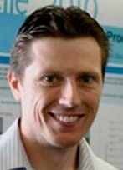

Meet the ITRC LNAPL Trainers – Part 2
Tom Fox
Colorado Division of Oil
and Public Safety
Denver, Colorado
303-318-8535
tom.fox@state.co.us
Eric Nichols
Substrata LLC
Newfields, New Hampshire
603-770-6577
eric@substrata.us.com
Andrew Kirkman
BP America
Naperville, Illinois
832-619-4759
andrew.kirkman@bp.com
Jon Smith
AECOM
Southfield, Michigan
248-931-5675
Jonathon.Smith@aecom.com
Read trainer bios at
https://clu-in.org/conf/itrc/LNAPL-3/
Notes:
Tom Fox is an Environmental Protection Specialist in the Division of Oil and Public Safety (OPS) within the Colorado Department of Labor and Employment in Denver, Colorado. Tom has worked with the OPS since 2007. General duties include reviewing site characterization reports and corrective action plans; and providing guidance to optimize technical and economic feasibility of corrective actions, implementation/operation of systems, and reimbursement via the state fund. In addition, Tom has been involved in special projects such as developing electronic reporting formats, assessing the success of carbon injection for petroleum cleanups, and modifying Colorado's policy on LNAPL recovery. Prior to joining OPS, Tom was a petroleum geologist with ARCO from 1982-1986 doing exploration in the western US, and an environmental consultant on petroleum projects for several companies during 1986-2007. Tom has authored several articles, papers and presentations on assessment and corrective action techniques. Tom earned a bachelor's degree in earth science (geology) from Millersville State College (Pennsylvania) in 1980 and a master's degree in geology from Michigan State University in 1982. He maintains a license as a Professional Geologist in Wyoming.
Andrew Kirkman is the lead LNAPL Technical Specialist for BP America located in Naperville, IL. Andrew joined BP in 2012 and currently supports LNAPL related site remediation, educational advocacy and research efforts. Previously, was the Global LNAPL Technical lead for AECOM Environment. Andrew worked as a consultant at AECOM for 14 years. Andrew focused on characterization and remediation of railroad, manufactured gas plant tie treatment facilities petroleum terminals and refineries in North America as well as Thailand, Indonesia, Australia, New Zealand, Brazil, Europe and United Arab Emirates. Andrew has led and participated in multiple industry advocacy efforts related to LNAPL, these include: 1) chairing the ASTM task group that created the standard for estimation of LNAPL transmissivity and the task group that is revising the ASTM Standard guidance document related to LNAPL Conceptual Site Models and Remediation Strategies; 2) generating publications for Applied NAPL Science Review, American Petroleum Institute, and Groundwater Monitoring and Remediation and; 3) presenting training sessions and technical discussions at regulatory agencies, conferences and for industry on topics such as use of NAPL transmissivity, LNAPL baildown tests, core analyses and laser induced fluorescence technology and improved LNAPL conceptual site models.
Eric M. Nichols , PE, is a principal at Substrata LLC in Newfields, New Hampshire. He has characterized and remediated contaminated sites since 1985. Eric founded Substrata LLC in 2014. Previously, he worked for ARCADIS and LFR from 1996-2014, and for Weiss Associates from 1985-1995. Eric serves as a technical resource for LNAPL and petroleum characterization, remediation, natural source zone depletion, vapor intrusion, and litigation support. Eric has taught short courses for several organizations, including the U.S. Environmental Protection Agency, the National Ground Water Association, the American Society for Testing and Materials, the New England Interstate Water Pollution Control Commission, the American Petroleum Institute, and the University of California Extension. Eric has contributed to ITRC documents and training since 1998 as a member and trainer for the Fuel Oxygenates Team, the LNAPL Team, and the Petroleum Vapor Intrusion Team. Eric has received Industry Appreciation Awards for his service on ITRC teams. Eric earned a bachelor's degree in Civil Engineering from the University of California, Berkeley, in 1982 and a master’s degree in Civil Engineering from the Massachusetts Institute of Technology in 1985. He is a licensed professional engineer in California.
Jon Smith is a Technical Leader with AECOM, located in Southfield, Michigan. Jon has worked in environmental site investigation and remediation since 2003, specializing in characterization and remediation of sites with nonaqueous phase liquids (NAPLs). His experience includes the planning and execution of site investigations using a diverse set of characterization and data evaluation techniques, development of conceptual site models, assessment of NAPL mobility and recoverability, evaluation of natural source zone depletion (NSZD), and remediation technology screening and implementation. Jon has helped lead applied field research projects on LNAPL tracer testing, LNAPL transmissivity measurement, NSZD, and in situ bioremediation. He has provided technical training on NAPLs to several regulatory agencies within the U.S. and Canada and has served as a technical leader on NAPL projects in the U.S., Canada, Europe, Australia, and Western Asia. Jon earned a bachelor's degree in geology from Michigan State University in East Lansing, Michigan in 2002.

Slide 6
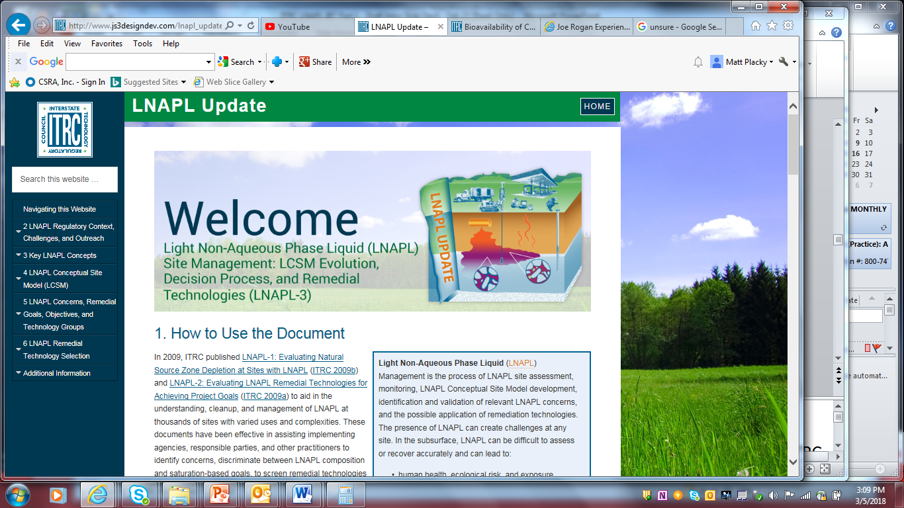
Your Online LNAPL Resource https://lnapl-3.itrcweb.org/
Expansion of LNAPL Key Concepts
Development of a LNAPL Conceptual Site Model (LCSM) Section
Emphasis on identifying SMART objectives
Expansion of Transmissivity (Tn) and Natural Source Zone Depletion (NSZD) via Appendices
Notes:
Welcome to Part 2 of our ITRC LNAPL training series. We assume everyone attended Part 1 and we will quickly move into our Part 2 content.
We want to remind you to visit the ITRC web site to view and use the updated, web-based document. Here is what’s new about LNAPL-3 (4 items listed at bottom of slide).
This guidance can be used for any LNAPL site regardless of size and site use.

Slide 7
Learning Objectives
3-Part Training Series
Part 1
Use LNAPL science to your advantage and apply at your sites
Develop LNAPL Conceptual Site Model (LCSM) for LNAPL concern identification
Inform stakeholders about the decision-making process
Select remedial technologies to achieve objectives
Prepare for transition between LNAPL strategies or technologies as the site moves through investigation, cleanup, and beyond
“SMART”-ly measure progress toward an identified technology-specific endpoint
Part 2
Part 3
Notes:
Learning objectives for this 3-part series.
Part 1 – listed on slide
Part 2
Develop a comprehensive LCSM for the purpose of identifying specific LNAPL concerns.
From that, establish appropriate LNAPL remedial goals and specific, measurable, attainable, relevant, and time-bound (or SMART) objectives for these concerns.
Inform stakeholders of the capability and limitations of various LNAPL remedial technologies.
Part 3 (next week)
Select remedial technologies that will best achieve the overall remedial goals for a site.
Describe the process to transition between LNAPL strategies or technologies as the site moves through investigation, cleanup, and beyond.
Evaluate the implemented remedial technologies to measure progress toward an identified technology specific endpoint.

Slide 8
LNAPL Science: Key to Improving Decision-making
LNAPL Part 1 Summary
Use LNAPL science to your advantage and apply at your sites
It is important to use LNAPL science and apply it to make good decisions
Notes:
The main take away from Part 1 of our 3-part series is that our knowledge and understanding of LNAPL behavior has evolved. We should all use that knowledge to improve our decision-making at release sites. Key points last week were:
LNAPL in wells does not mean 100% saturation (dispel pancake)
LNAPL may be present in the subsurface even if not in MWs
LNAPL creates Saturation vs. Composition concerns
Apparent LNAPL Thickness challenges:
LNAPL in well does not mean it is migrating
Transmissivity is a better indicator of recoverability than thickness
Stable LNAPL bodies can still result in sheens or long-term compositional concerns
Biological processes play a large role in LNAPL depletion. These have not been appreciated until recently.
CLICK! And reiterate.

Slide 9
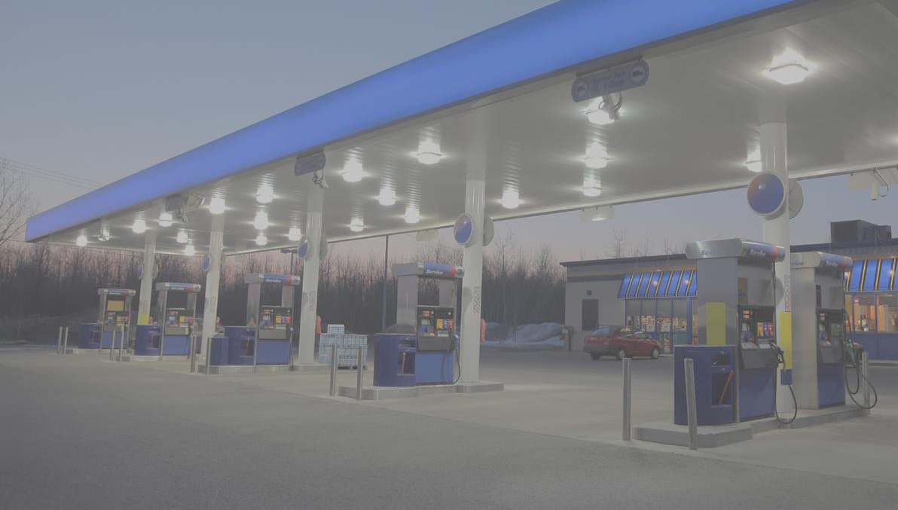
ITRC 3-Part Online Training Leads to YOUR Action
TODAY
Part 1:
Connect Science to LNAPL Site Management
(Section 3)
Part 2:
Build Your LNAPL Conceptual Site Model
(Sections 4 and 5)
Part 3:
Select / Implement LNAPL Remedies
(Section 6)
YOU
Apply knowledge at your LNAPL sites
Based on the ITRC LNAPL-3 Document: LNAPL Site Management: LCSM Evolution, Decision Process, and Remedial Technologies
Notes:
Our 3-part training series focuses on helping you:
Connect Science to LNAPL Site Management
Build your LNAPL Conceptual Site Model
Select/Implement LNAPL Remedies
This training will be incomplete unless YOU (CLICK) apply this information. After this training our expectation is that you will use ITRC science-based resources to improve decision making at your LNAPL sites (and for you regulators and other government agency staff, look at ways you can incorporate ITRC states guidance into your own guidance).
Today (CLICK) in Part 2, we ask: Do you know where the LNAPL is and how to address LNAPL concerns?

Slide 10
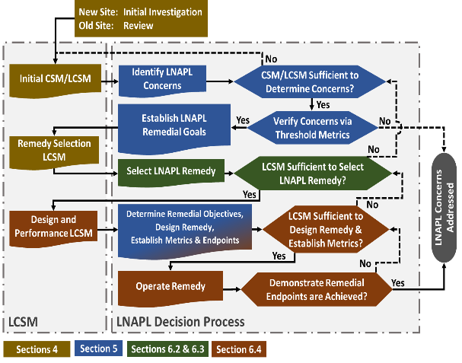
LNAPL Part 2 Agenda
Discuss the evolution of the LCSM
  Concerns
  Remedy Selection
  Remedy Performance (Covered in Part 3)
LNAPL Online Training Part 2
Relate the LCSM to Site Strategy
  Identification and Classification of Concerns
  Establishing Remedial Goals to Address Concerns
  Development of Remediation Objectives
Figure 4-1, LNAPL-3
Notes:
In relation to the process flow diagram in the LNAPL document, this is the section we will covering today.
Today we will
Show how to develop an LNAPL conceptual site model and how that empowers you to make LNAPL remediation and management decisions
Discuss key LNAPL and site data for the model
When and why those data may be important
How to effectively organize the data into an LCSM
Discuss how to relate LNAPL concerns by selecting appropriate goals and objectives, choosing applicable remedies, and assigning remedial performance metrics and endpoints to those objectives

Slide 11
Poll the Group
The projects I work on are limited by: (choose the best answer)
  Budget constraints, there is sufficient time and technical understanding how goals could be achieved
  Technical constraints, site characteristics (fine grained soil, depth to impacts, bedrock) limit effectiveness of technologies and ability to reduce impacts
  Time constraints, there is a time driver which limits the available approaches to addressing concerns achieving goals
Poll Question
Notes:
No associated notes.

Slide 12

Welcome to Progression
Beyond Infinity
The LCSM is continually updated, but each update represents a focus specific to that project phase
LCSM Evolution
Figure 4-1, LNAPL-3
Notes:
No associated notes.

Slide 13



Data Collection & Evaluation is Parallel with Decision Making
Data Collection &
Interpretation
Decision Making
Initial CSM/LCSM
Identify LNAPL Concerns
Verify Concerns via
Threshold Metrics
Establish Remedial Goals
Remedy Selection LCSM
Determine Remediation Objectives
LCSM Evolution
Select LNAPL Remedy(ies)
Select Remedial Metrics
Implement Remedy
Performance Metrics
Technology Transition Points
Remediation Endpoints
Design &
Performance LCSM
Concerns Addressed
Notes:
Further highlight the parallel between the decision making and the data collection
Although we have broken these out they are really in Parallel. The decision making process and the LCSM will both be discussed today, but it is worthwhile to keep this figure in mind.

Slide 14
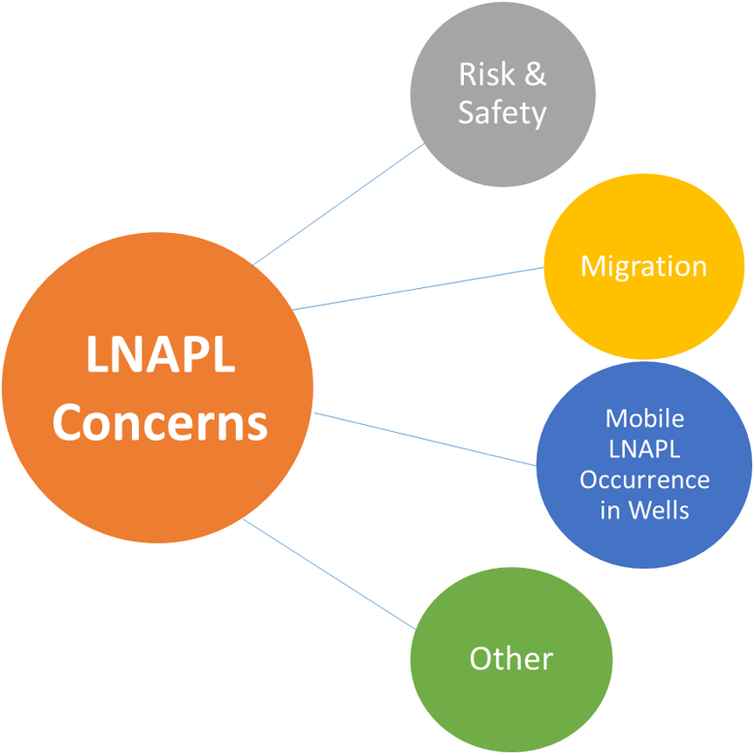
LNAPL Concerns
The Initial LCSM identifies specific LNAPL concerns
LCSM
LNAPL
Concerns
Initial LCSM
Notes:
LCSM informs and identifies LNAPL concerns
Stakeholder engagement – chapter 2

Slide 15
Initial LCSM
Overall, the Concerns portion of the LCSM are typically well developed and mature
Recent improvements in this area include
  ITRC’s Petroleum Vapor Intrusion guidance and online training
    Screening distances (ITRC, 2015)
  Natural Source Zone Depletion
  Plume stability & NSZD (Part 1)
  LNAPL transmissivity to improve understanding of recoverability as related to maximum extent practicable
  Sheens – Related Appendix in LNAPL Update document
Ongoing Development
  TPH guidance is being updated
Recommended completeness test for Initial LCSM
  LCSM should be able to inform a series of typical questions
  Amount of detail for a given question is decided by asking “is there sufficient understanding to enable Decision Making?”
Initial LCSM
Notes:
Define what the concerns LCSM is, what is the intent, the final decision made based on it, what is characterized as part of it.
NSZD – Natural Source Zone Depletion

Slide 16
What is Needed for the Initial LCSM
Consistently Needed or Possibly Needed?
Receptors – NEED to understand where they are relative to plume
Extent of impacts – NEED to understand if receptors are affected
Migration – NEED to understand if existing impact extent will change
LNAPL Occurrence in wells – Regulatory driven NEED
Hydraulic Conductivity – Typically not needed to evaluate Concerns. Site Specific – for Concerns and Often Needed in Remediation
Distribution of LNAPL and dissolved/vapor within the extent of Impacts – Typically not needed to evaluate concerns, Site Specific – for Concerns and Often Needed in Remediation
Initial LCSM
Notes:
Point out that if sufficient information is in hand to know that excavation is decided upon or no remediation is needed, then continued testing is not worthwhile.

Slide 17
The Concerns LCSM Litmus Test
  The questions provided:
    Are typical of multiple guidance (ASTM, CRCcare, IPECA, EPA)
    Encourage a systematic framework to develop an LCSM
    Encourage a systematic thought process to help confirm the completeness of the LCSM
    Only apply to the Initial LCSM & may not be sufficient to select a remedy
Is current and future land use known?
Does the potential for preferential pathways exist?
How does stratigraphy relate to affecting impacts and potential migration?
Is the source and extent of the LNAPL known?
Are dissolved or vapor issues expected based on LNAPL composition?
Are dissolved or vapor plumes characterized?
Do soil or groundwater concentrations exceed criteria?
Are exposure pathways complete or incomplete?
Is the LNAPL body stable?
Is the mobile LNAPL hydrogeologic condition known?
Initial LCSM
Notes:
No associated notes.

Slide 18
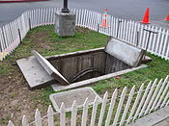
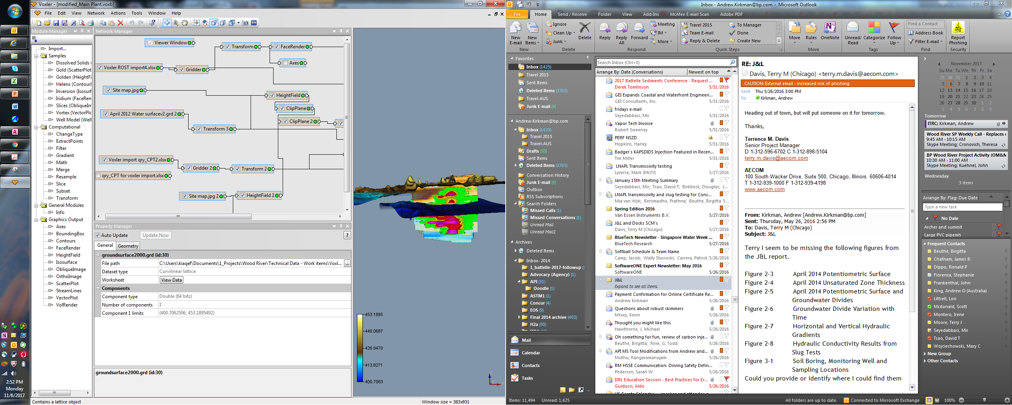
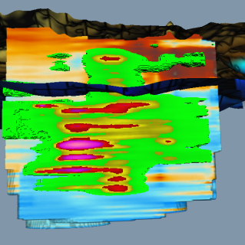


The Amount of Knowledge
INCREASING COMPLEXITY
Site Setting and Physical Factors
Offsite Plume/Sensitive Receptors
Occupied Above-Ground Structure
Preferential Pathway/GW Use
Business and Community Factors
Aboveground Receptors
Utilities, Groundwater Use
On-going Development
Tier 3
Migration / Transport / Toxicity / Persistence
Geologic Heterogeneity Fractured Rock/Karst
Transient /Seasonal Conditions Affect Distribution
Increasing:
LCSM Complexity
Data Density
Lines of Data
LCSM Evolution
Hydrogeologic & LNAPL Composition Factors
INCREASING COMPLEXITY
Tier 2
Heterogeneous,
Fractured Bedrock,
High Solubility/Toxic
Persistent, Seasonal
Undeveloped
Limited Access
No Surface Water
No Groundwater Use
Tier 1
Homogenous
Low Solubility
Degradable
Unconsolidated
Consistent GW Flow Trends
Figure 4-2, LNAPL-3 (adapted from ASTM 2014)
Notes:
No associated notes.

Slide 19
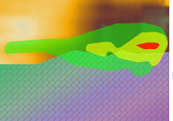
Tier 1 vs. Tier 3
Tier 1 Retail – Diesel in Sand
  10 – 15 feet to Water-table
  Dissolved plume contained onsite (MNA)
  Mobile LNAPL in wells – T_{n} 1.0 ft²/day
  LNAPL is not under any buildings
  Release occurred 10+ years ago
  Well Defined Remedial Concerns
  No risk, Tn above but close to 0.8 ft²/day
Tier 3 Retail – Gasoline Interbedded
Soil Over Bedrock
Water- Table 15-20 ft. depth
Fractured bedrock at ~25 ft depth,
Down gradient receptors - 30 year old bedrock screened wells exhibit impacts
LNAPL is off-site in unconsolidated soil
What are remaining questions for the LCSM?
    Likely requires nest well pairs (unconsolidated bedrock) for dissolved delineation
Receptor Well
Flow
Notes:
Note the light brown on the right of the Tier 3 is a sand, yes its not in the description because soil type changes off-site but on-site borings don’t tell us that.
Example Remaining Questions : Where is LNAPL?, Is all LNAPL sourcing the impacts to wells or only the portion in bedrock or portion in shallow sand? Is dissolved phase through poor surface completion or bedrock aquifer

Slide 20
Knowledge Check
Choose the Best Answer
The concept of continually updating the LCSM throughout the remedial process means:
  The LCSM should become increasingly complex throughout the remedial process
  Even if performance monitoring indicates progress toward endpoints, better check between borings to ensure uniform treatment
  Reinvestigate with the latest tools as new characterization technologies evolve
  The LCSM is updated to inform decisions throughout the project. Each decision point may require different data.
Poll Question
Notes:
We asked you a question at the start of our presentation

Slide 21
Summary
Initial LCSM and The Decision
Is there sufficient information for a given question to support identification of Concerns?
Is additional site characterization required for evaluating the Concerns LCSM?
  Initial characterization activities may go beyond collecting data for concerns
  Combining mobilizations for concerns and remedial selection characterization may improve efficiency at sites where remediation is already known to be needed
  Collecting remedial-technology-focused characterization data at more complex sites may result in incomplete data collection, or less efficient data collection
Initial LCSM
Notes:
No associated notes.

Slide 22
Learning Objectives
Become familiar with LNAPL decision process and key terms:
  LNAPL Concerns
  Remedial Goals
  Remediation Objectives
LNAPL Decision Process
Notes:
Now that we have been oriented to the LCSM, let’s take a closer look at the overall LNAPL decision process and some key concepts and terms. The information we’re about to cover comes from Chapter 5 in our guidance document.
Here is the first learning objective for this portion of today’s training.

Slide 23
More Learning Objectives
Understand three classes of LNAPL remediation objectives:
  Mass Recovery
  Phase Change
  Mass Control
  To apply ITRC framework for LNAPL remedial technology selection
LNAPL Decision Process
Notes:
The second learning objective is to...

Slide 24
And More Learning Objectives
Understand how metrics are applied:
  Threshold Metrics for verifying or eliminating LNAPL concerns
  Performance Metrics for assessing remedy effectiveness, and determining when remediation endpoints have been met
LNAPL Decision Process
Notes:
A third outcome

Slide 25
ITRC LNAPL Management
Initial LCSM
What do you have?
Identify LNAPL Concerns
and Establish LNAPL Remedial Goals
What needs to be done?
LNAPL Decision Process
Select Remediation Technology to Achieve Remedial Objectives
Now
How do you do it?
Install Remedial Technology and Monitor Performance
Notes:
25
What we will be covering in this module.
25

Slide 26

LNAPL Concerns
The LCSM identifies specific LNAPL concerns
LCSM
LNAPL Decision Process
Notes:
LCSM informs and identifies LNAPL concerns

Slide 27
Example LNAPL Concerns
Risk & Safety
  Petroleum vapor intrusion
  Groundwater ingestion
  Acute safety hazards
Migration
  Spread of LNAPL body, resulting in future risk
LNAPL Concerns
LNAPL Decision Process
Mobile LNAPL Occurrence in Wells
  Addresses “Maximum Extent Practicable” regulatory requirement
Other
  Sheens
  Geotechnical
  Aesthetics (stains and odors)
Notes:
Some specific examples of each type of LNAPL concern
Stakeholder engagement – refer to Chapter 2

Slide 28
LNAPL Decision Process
Figure 5-1, LNAPL-3
Decision Process Element
Risk & Safety Concerns
Migration Concerns
Mobile LNAPL Occurrence Concerns
Exposure to vapors
Exposure to affected groundwater
Fire & explosion hazards
Potential to spread and/or create new risk
Appearance of mobile LNAPL in wells
Identify LNAPL Concerns
Threshold Metrics
Threshold Metrics
Threshold Metrics
Verify Concerns
LNAPL Composition
LNAPL
Saturation
LNAPL
Saturation
Establish Remedial Goals
LNAPL Decision Process
Abate unacceptable vapor concentrations
Reduce groundwater concentrations
Remove mobile LNAPL to abate mobility
Contain LNAPL at defined boundary
Remove mobile LNAPL to recoverable limit
Some concerns addressed or eliminated
Determine Remediation Objectives
Remedy Selection/
Implementation
Remedy Selection/
Implementation
Remedy Selection/
Implementation
Select Remedy
Performance
Metrics
Performance
Metrics
Performance
Metrics
Establish Metrics
End Point
End Point
End Point
Remedial Endpoints
Notes:
No associated notes.

Slide 29
Verifying Concerns with Threshold Metrics
LNAPL Concern
Verified Concern?
Risk & Safety
Threshold Metric
Verified concerns need remedial goals
Yes
LNAPL Decision Process
No
Migration
Threshold Metric
Yes
No
Notes:
This “off-ramp” allows some concerns to be addressed without the need for remedial action. Example: if ingestion of GW at a supply well is a risk concern, then a comparison of in-hand data to drinking water standards, and an evaluation of dissolved plume stability, may show that the concern can be addressed without the need for further remedial action.

Slide 30
Knowledge Check
Which statement is true?
An LNAPL concern…
Does not need to be identified before remedial action occurs
May sometimes be addressed by testing against a threshold metric
Is nothing to worry about
Can only be addressed through remedial action
Poll Question
Notes:
No associated notes.

Slide 31
LNAPL Remedial Goals
LNAPL Concern
Type of LNAPL Goal
Risk
Composition
Migration
Saturation
LNAPL Decision Process
Occurrence (MEP)
Saturation
Other
Aesthetic or
Combination
Notes:
Goals translate an LNAPL concern into a measurable LNAPL condition.
Each concern may have its own goal. Sometimes multiple concerns may share a common goal.
(For brevity, only Composition and Saturation examples are carried forward in the next slides)
More on goals in the next slide…

Slide 32


Remedial Goal vs.
Remediation Objectives
LNAPL Remedial Goal:
the desired change in LNAPL conditions
Aspirational… envisioning a future state
Established before choosing remedy
LNAPL Remediation Objectives:
the actions and desired outcomes that need to occur using the chosen technology
Tactical… how to get to the goal
Determined in parallel with
remedy selection
LNAPL Decision Process
These definitions are the opposite of what they were in the previous ITRC LNAPL Guide
Notes:
A goal states, in general terms, the measurable change that you seek in the LNAPL condition.
Both graphics tagged with creative commons license

Slide 33
LNAPL Remedial Goals
Each LNAPL Remedial Goal expresses a desired change in LNAPL conditions
Composition-Based Goals
Reduce vapor concentrations
Reduce groundwater concentrations
Saturation-Based Goals
Reduce LNAPL saturation
Contain migrating LNAPL
Etc.
Etc.
Remedial Goals must be identified before choosing remedial technology(ies)
LNAPL Decision Process
Notes:
A goal states, in general terms, the measurable change that you seek in the LNAPL condition.
At this stage, you have enough information to start the process of selecting a remedial strategy.
You can’t pick a remedy until you know what it needs to achieve!

Slide 34
LNAPL Remediation Objectives
LNAPL remediation objectives describe how the goal will be accomplished by the selected technology(ies)
Remediation objectives state the actions and desired outcomes that need to occur using the chosen technology
Combined with the agreed-upon endpoint and performance metrics, the remediation objectives becomes SMART
  SMART = Specific, Measurable, Attainable (or agreed-upon), Realistic (or relevant), Time-based
LNAPL Decision Process
Notes:
SMART = Specific, Measurable, Attainable (or agreed-upon), Realistic (or relevant), Time-based

Slide 35
LNAPL Remediation Objectives
Mass Recovery
Abate LNAPL body migration by removal of LNAPL Mass
Remove mobile LNAPL to the MEP
Etc.
Abate unacceptable vapor accumulations by sufficient depletion of volatile constituents from LNAPL
Reduce dissolved concentrations at point of compliance by sufficient depletion of soluble constituents from LNAPL
Etc.
Phase
Change
LNAPL Decision Process
Mass
Control
Contain LNAPL at a defined boundary
Prevent migration beyond a point of compliance
Etc.
Notes:
We categorize remedial technologies by the primary remedial mechanism that each employs.
The choice of technology – and remedial mechanism -- can influence how the objectives are expressed.
An objectives statement typically includes an active word such as : “stop,” “abate”, “control,” “change,” “remove” or “recover.”
NSZD can work across all three categories of objectives.

Slide 36
Technology Groups and Objectives
Mass Control
Phase Change
Mass Recovery
Phase Change
LNAPL Decision Process
Mass Recovery
Mass Control
Dual Phase Extraction
Key Point: Some technologies have more than one effect and may serve more than one objective
Notes:
This slide shows the first cut of how to think about technologies. What do they do? In the tech reg, this is also referred to as the “primary mechanism” by which LNAPL remediation takes place.
In addition to the primary mechanism, most technologies also act in other ways. These “multiple actions” of a technology can be simply represented by the ternary (triangular) diagram.
Example: Dual-phase extraction volatilizes, extracts, and biodegrades LNAPL, so it has both mass recovery and phase change mechanisms

Slide 37
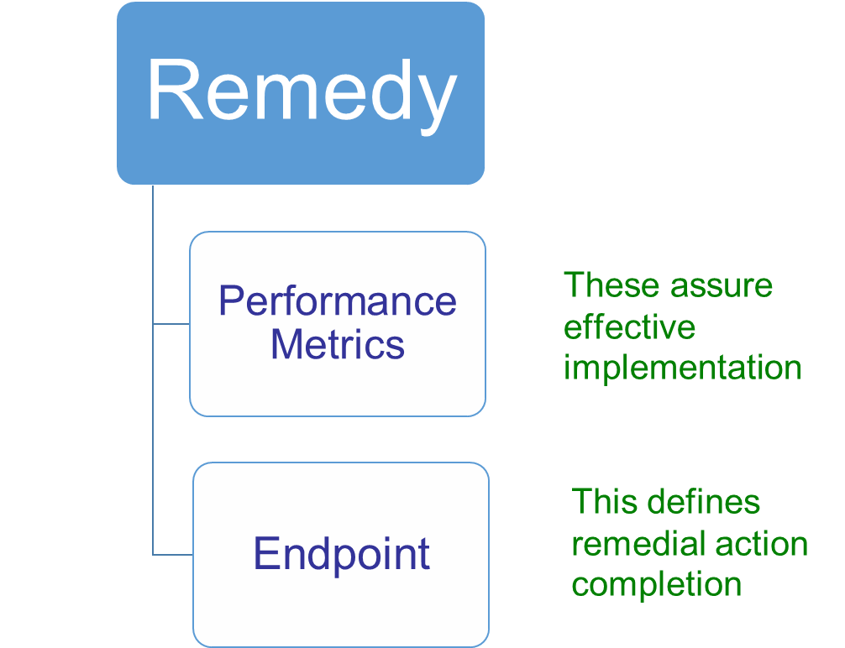
Choose Remedial Technology(ies), then Identify Performance Metrics & Endpoints
Performance Metrics and Endpoints are SMART and technology-specific
LNAPL Decision Process
Notes:
The remedy needs to be capable of meeting the identified LNAPL remedial objectives. Then it needs performance metrics to assure that it is implemented effectively. It also needs an endpoint to know when it has done its job.
Rather than “trying something to see what happens” this process identifies what is expected to happen, and what to expect when you are done.
SMART = Specific, Measurable, Attainable (or agreed-upon), Realistic (or relevant), Time-based

Slide 38

Q&A Break
Follow ITRC
1st Question and Answer Break
Notes:
No associated notes.

Slide 39
  Why Are We Focused on the Remedy LCSM
Current practices and resulting CSMs are effective at identifying risks and concerns.
CSMs are also sufficient to identify completion of remediation (i.e., there are no more concerns, risk, etc.)
Refinement of CSMs for technology Selection, Optimization & Confirmation represent the highest potential for improvement
  Historically, remedies have been selected based on an incomplete understanding of LNAPL occurrence, nature and remedy performance
  Remediation has often been driven by LNAPL thickness in wells without considering the relationship between LNAPL thickness and recoverability or the effects of LNAPL recovery on subsurface conditions
The Remedy Selection LCSM aims to inspire continuation of improvements to CSMs for LNAPL remedy selection
Remedy Selection LCSM
Notes:
Discuss how in past years, the concerns at a given site have not readily changed whether its dissolved phase concentrations, PVI, MEP. However understanding the efficacy of remedial technologies to achieve various goals has changed. Pump and treat and LNAPL recovery are not going to restore aquifer conditions. LNAPL in wells is generally not the largest source of LNAPL. Correctly directing your focus means weighing additional lines of evidence to establish an effective remedial approach.

Slide 40
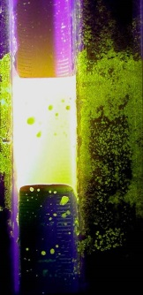
Remedy Selection Needs Improvement
This Starts with the LCSM
Our concerns are known,
We know the Remedial Technology Types
Ok, move ahead with remediation?!? Give it a shot?
Insufficient data often exists at end of concerns LCSM to choose a remedy that will achieve remedial goals
LNAPL in Well
No Migration
Remedy Selection LCSM
Vacuum- Truck It Out
Notes:
No associated notes.

Slide 41

Transmissivity Has Improved Remedy Selection
Well with LNAPL
Thickness = 2 feet
T_{n} = 2 ft²/day
Volume in well = 1.4 gal
Monthly Vacuum Truck
Drawdown - 2 feet
Time – 1 hour
Monthly Volume Produced
Stored + Induced Flow
1.4 gallons +1.7 =3.1 gal/month
36.2 gal/year
Above Ground
(ASTM E2856-13)
25 feet
LNAPL Zone
Vacuum Truck Effort results in 0.4% saturation reduction across 25 foot Radius each year
25 years required to reach 0.8 ft²/day
Active Skimming reaches it in 0.8 years
2 feet of Mobile LNAPL interval
Saturation varies between 8% and 45%
8 % Residual Saturation
27% Average Mobile Saturation
5 feet of Residual Smear Zone
API LDRM Model with Published Values for soil and LNAPL parameters
Calibrated to LNAPL Tn field value
1 hour of time outside of Field Tn Testing
Below Ground
See Table 4-4 in ITRC LNAPL-3 for Estimation Tools
Notes:
Message is Why are we not doing this for other mechanisms. Tn has allowed for improved Estimates for Recovery performance. We need to move in that direction for remaining mechanisms of remediation.
We have tools to do this for multiple mechanisms

Slide 42
Remedy Selection Should be Informed by the LCSM not just the Concern
The concern associated with a gauged LNAPL thickness or a dissolved phase concentration does not indicate how to eliminate it
This Section will identify approaches to answer
  Where remediation needs to target
  Which remedial mechanisms may be effective
  Improved quantification of these mechanisms prior to implementing a technology
Remedy Selection LCSM
Notes:
The concerns alone do not inform the remedial selection, gauged thickness does not mean recovery will be effective. We are going to discuss approaches to better inform remedy decisions. This essentially becomes a remedy selection LCSM

Slide 43
Improved Remedy Selection is Achieved through Understanding
1. Where is the Source Mass?
A. Homogenous Permeable Soil
B. Interbedded within coarser zones that are surrounded by finer grained layers
C. Within low permeability media, secondary porosity, fractures, karst
D. Is the LNAPL source distributed above or below the water-table
2. What Is Nature of the Source?
A. Volatile and/or Soluble
B. Biodegradable
Remedy Selection LCSM
C. Mobile vs Residual Fractions
3. What is Achievable for a Given Technology?
A. Mobility-Based Limit
B. Volatility-Based Limit
C. Solubility-Based Limit
D. Biodegradability-Based Limit
E. Other – Safety, Depth, Sustainability (e.g., community impact, energy/resource use).
F. Design Data – Radius of Treatment, Waste Production/Treatment
Notes:
Each Layer build upon the previous question, this is less true for the concerns question but not absent from those either.
Discuss that this is the goal of the LCSM or the thinking behind it. Including these aspects into an LCSM improves decision making relative to the remedy selection. As we go through this section we will discuss some of the methods to evaluate these topics. This slide and the next provide the big picture and the details are forth coming.
Improved remedy selection is achieved through Understanding
LNAPL Distribution relative to
Soil layers
Water-table
Nature of the Source
Recoverability, volatility, biodegradability
Residual vs mobile LNAPL fractions
Understanding technical limitations of a technology
These are technology and Site Specific

Slide 44
Remedy Selection LCSM Questions
1. Where is the Source Mass?
Identifies where to target remediation
Identifies Physical factors/limitations to consider for impacted soil
  Soil Permeability
  Depth - absolute and relative to water table
References (See Tables 4.2 in the ITRC LNAPL-3 Document for additional Tools)
Brief Discussion of Tools is Next
Remedy Selection LCSM
Notes:
Characterization can be qualitative e.g., Tier 1 or more quantitative, higher resolution Tier 2-3

Slide 45
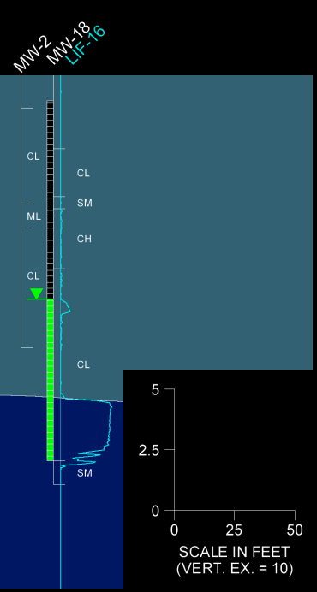
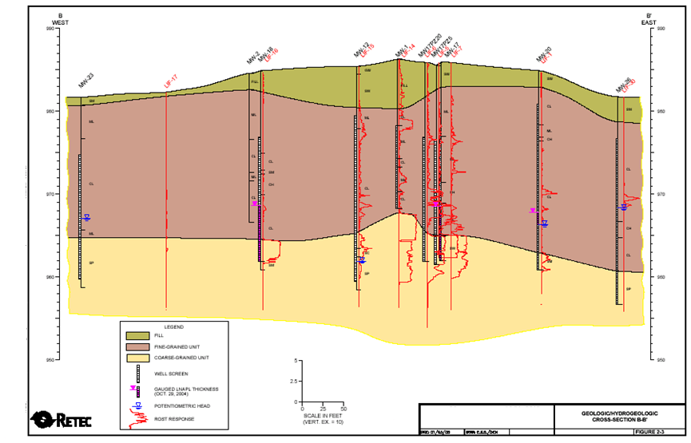
Hydrogeologic Condition Affects
Remedial Efficacy & Selection
Dry Well
Remedy Selection LCSM: Where is Source Mass
7.1 ft
2.4 ft
Notes:
Go To 3D model and Discuss Bullets, We know can focus the recovery to the areas with the highest potential fro mobile recovery (courtesy of Andrew Kirkman)

Slide 46
Diagnostic Gauge Plots
Utilize Equilibrium Fluid Levels to Inform
Non-Equilibrium Data
Not Applicable to
Diagnostic Gauge Plots
Fluid Interface Elevation (ft MSL)
Remedy Selection LCSM: Where is Source Mass
Bottom of Screen
LNAPL Thickness (ft)
Provided by Andrew Kirkman
Notes:
No associated notes.

Slide 47
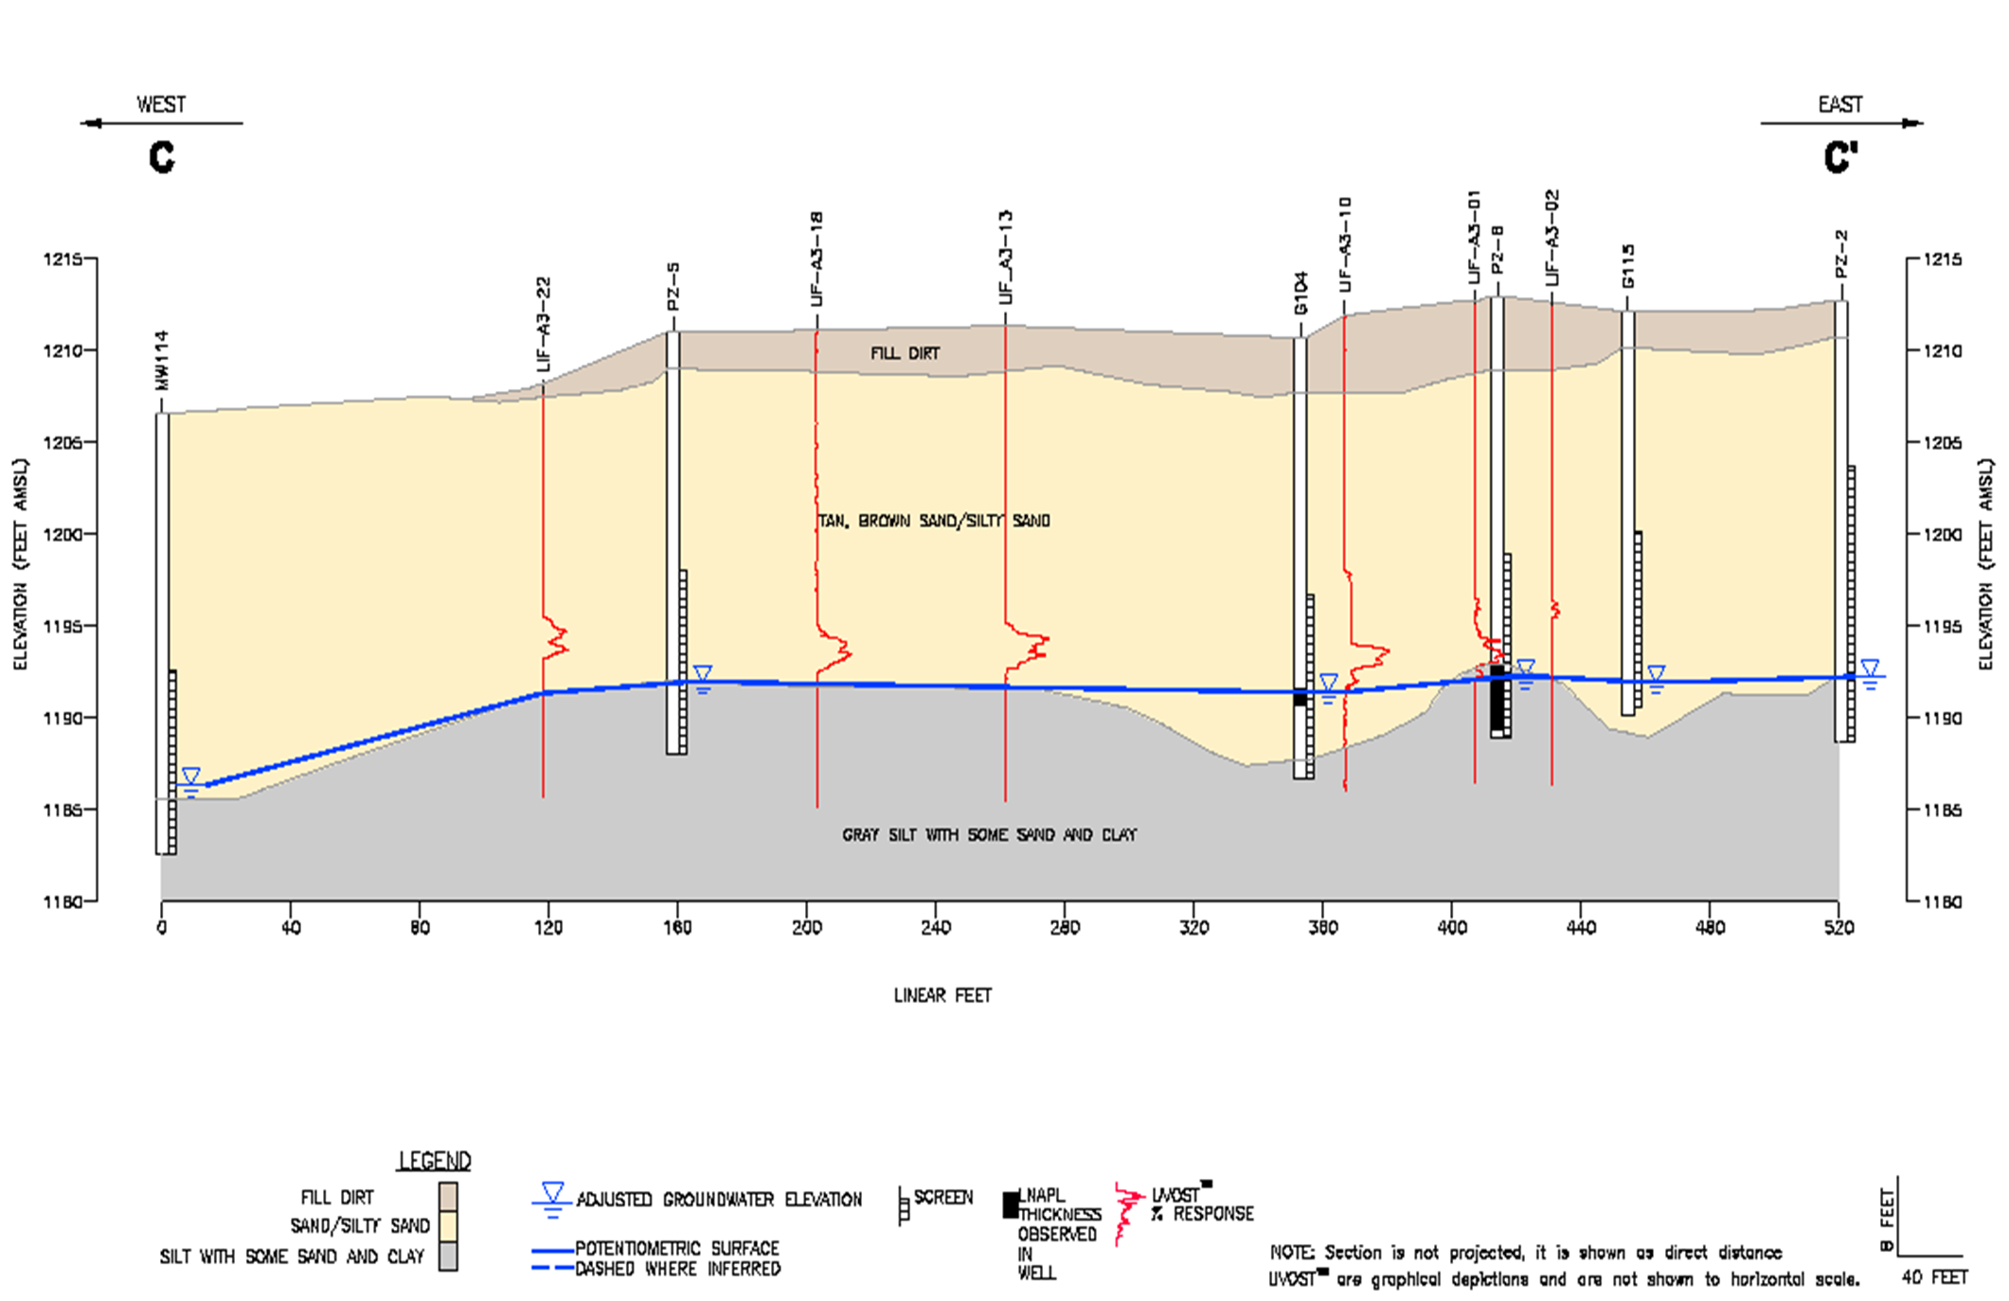
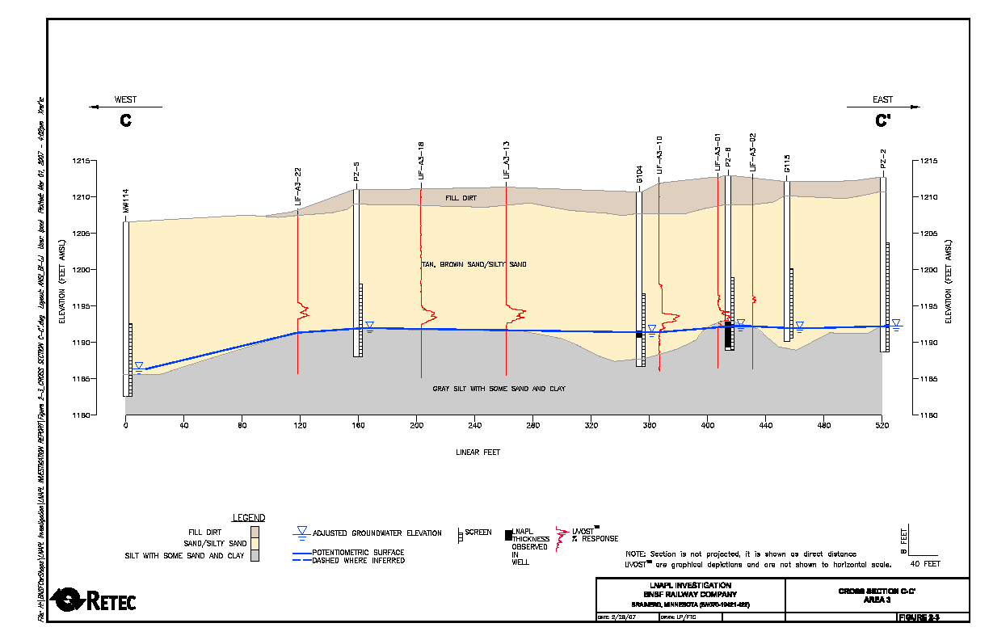
Where is the LNAPL?
Above or Below the Water-table
Remedy Selection LCSM: Where is Source Mass
Provided by Andrew Kirkman
Notes:
No associated notes.

Slide 48
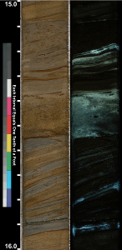
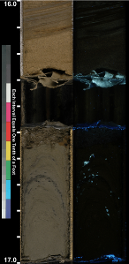
Core Photography Supports the Diagnostic Gauge Plot Results
Core
Core
Remedy Selection LCSM: Where is Source Mass
Core Depth Scale Does Not Directly Correlate to Plot Elevation Scale
Provided by Andrew Kirkman
Notes:
If the remedial driver is MEP, perhaps this helps identify why 2-4 foot thickness might be in a well but low recovery, transmissivity is observed. If the remedial driver is dissolved phase risk, then this might help target remedial activities.

Slide 49
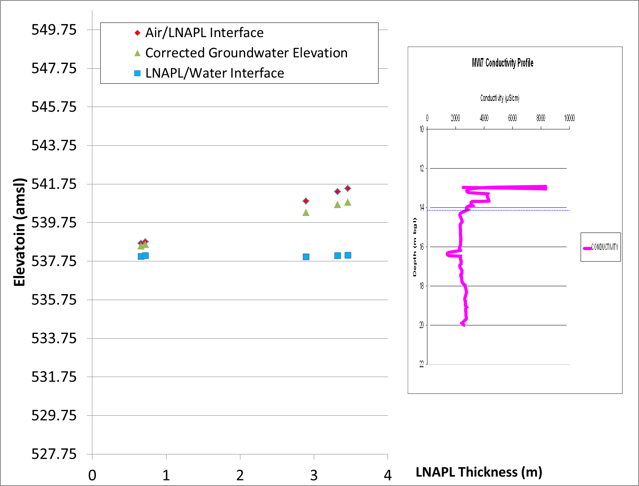
Diagnostic Gauge Plots
Bedrock Application
Provided By D. De Courcy Bower, 2017
Remedy Selection LCSM: Where is Source Mass
Note: Elevation and Depth Scales are aligned
Notes:
Gauging data is useful, Gauging data not over time but plotted as a diagnostic gauge plot combined with subsurface geologic characterization is even more useful.

Slide 50
Summary For Where is The Source
Soil Characterization
    Soil Boring Logs
    Cone penetrometer tool
    Hydraulic profiling tool
    Core photographs
Fluid Elevation Vs Soil Data
    Diagnostic Gauge Plots
    Cross-sections
    Hydrographs with geology
    Baildown tests
Identifies where injection/ gradient driven technologies will target
Identifies hydrogeologic condition of mobile LNAPL and the elevation
  Vacuum has limited effect on confined LNAPL
  Water Drawdown has limited effect on perched LNAPL
Characterization Data
Remedial Application
Remedy Selection LCSM: Where is Source Mass
See Geology/Hydrogeology & LNAPL Delineation in Table 4-2 of LNAPL-3
Notes:
Note that Injection could be ISCO, Air Sparging, perhaps Injected media. Gradient driven technologies include, LNAPL recovery, Soil Vapor extraction, surfactant flushing

Slide 51
Summary For Where is The Source
Characterization Data
Remedial Application
LNAPL Source Distribution
    Head space (GRO Range)
    Shake Tests
    TPH analysis for soil
    Laser Induced Fluorescence
    Membrane Interface Tool
    Core photographs
    LNAPL transmissivity map
    (Combine with Soil Profile Data)
Geophysical Data
  See Bedrock Appendix &
  ITRC Fractured Rock Guide
Identifies where injection/ gradient driven technologies will target
Identifies vertical intervals of fractures
(Combine with LNAPL Source Distribution Data)
Remedy Selection LCSM: Where is Source Mass
Notes:
Note that Injection could be ISCO, Air Sparging, perhaps Injected media. Gradient driven technologies include, LNAPL recovery, Soil Vapor extraction, surfactant flushing

Slide 52
Remedy Selection LCSM Questions
1. Where is the Source Mass?
Identifies where to target remediation
Identifies Physical factors/limitation to consider for impacted soil
  Soil Permeability
  Depth - absolute and relative to water table
Identifies factors/limitation related to the LNAPL
  Volatile, residual, mobile, biodegradable
Table 4.2 in ITRC LNAPL update Document includes methods under
  LNAPL Chemical /Physical Properties
  LNAPL Recoverability
  Natural Degradation Processes
  Intense Discussion of Tools is Next
2. What Is Nature of the Source?
Remedy Selection LCSM: Nature of the Source
Notes:
Characterization can be qualitative e.g., Tier 1 or more quantitative, higher resolution Tier 2-3
Is it Volatile
LNAPL composition tools
Headspace results
PVI Concern
Is It Biodegradable?
Fuel type knowledge
GC analysis
NSZD data
What is the Residual vs Mobile Fraction
Transmissivity 0.1 to 0.8 ft2/day – empirical
Residual smear zone vs mobile interval - can be qualitative or quantitative

Slide 53
Key Points
What is the Nature of the Source
The LCSM needs metrics to indicate relative efficacy of different remedial mechanisms
  LNAPL transmissivity indicates recovery efficacy
  Composition can help evaluate the biodegradability and vapor removal mechanisms
  Soil gas and headspace readings are also indicative of relative volatility
Poll Question
Notes:
Poll - Class Understanding of Transmissivity
What is your understanding of Transmissivity?
Understand its use and have applied on sites
Understand its use but not much experience
Know little about it

Slide 54
Characterize the Site for Metrics Related to Remedial Mechanisms
Remedial Mechanism
  LNAPL Recoverability
  Vapor Extraction
  Air Sparging
  Biodegradation
    Biovent
    BioSparge
    NSZD
Characterization Data
  LNAPL Transmissivity
  Mobile vs Residual
  Vapor Pressure
  LNAPL Composition
  Compound Specific Biodegradation Rate
  CO₂ Efflux / NSZD data
  Respiration Rate
Remedy Selection LCSM: Nature of the Source
The Remedy Selection LCSM uses characterization data to indicate relative remedial effectiveness
Notes:
Train Module #3 will take these remedial mechanisms and describe each technology in more detail & how these mechanisms may overlap
Note that, unless remediation is needed why would we characterize these as part of the concerns, Tn perhaps but biodegradation or NSZD rate probably not. This is why there is a remedy LCSM and a Concerns LCSM. While many of these aspect overlap with Concerns, not all do and the degree to which they might be characterized doesn’t as well.

Slide 55
Why is 3D Delineation Worthwhile
Knowledge Check
LNAPL is a source to dissolved plume
LNAPL Tn is above 0.1 to 0.8 ft²/day but is stable and not migrating
Should we implement LNAPL Recovery?
  Yes
  No
  Insufficient information
Remedy Selection LCSM: Where is Source Mass
Poll Question
Transmissivity ft²/day
>0
0.8
2
- Monitoring well
Notes:
Should we implement LNAPL Recovery?
Yes
No
Insufficient information

Slide 56
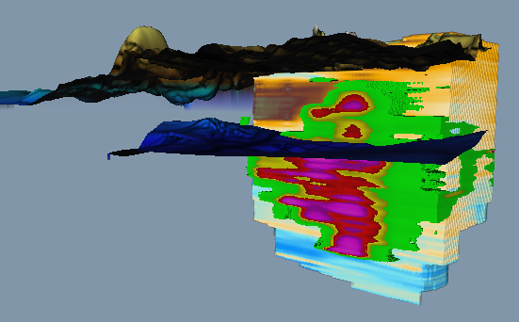
Fraction of Mobile vs Residual Hydrocarbon
Ground Surface
30 feet to Groundwater
Fine Grained
Water-Table
1 – 2 foot Mobile
LNAPL Interval
LIF Response
60 Additional feet of
Residual Zone
Sands
The 1-2 feet of mobile LNAPL Mass
What about
  0.2 foot of mobile LNAPL?
<<
90 feet of residual vadose and saturated impacts
4 feet of residual LNAPL?
Remedy Selection LCSM: Nature of the Source
  Data such as TPH or saturation in mobile interval and above and below the water-table can indicate relative fractions
  Models such as the LDRM model by API can also help evaluate
  Consider seasonality of water-table fluctuations on LNAPL
Notes:
While the is an example of a large LNAPL release the principles are the same for smaller LNAPL releases. E.g. a smaller release may result in 0.2 feet of thickness and a 10 foot smear zone. Where the relative difference in mobile interval and smear zone are not as dramatic other tools may be important and knowing the difference is still important for remedial strategy.

Slide 57
Empirical Method
Mobile vs Residual Fractions
2009 ITRC LNAPL guidance on LNAPL Transmissivity
  Several sites were closed or given no further action based on
    Asymptotic recovery or demonstrations that recovery would not benefit source reduction
    Stable LNAPL bodies
    No risk to receptors
  These sites exhibited LNAPL transmissivity values between 0.1 and 0.8 ft²/day
  This range is a good indicator where further recovery may not be practicable and residual LNAPL dominates the source
  LNAPL Transmissivity Information
    ITRC Updated LNAPL-3 Appendix for Overview
    Test Methods and Analysis – See ASTM E2856-13
    Data Analysis – See API LNAPL Transmissivity Workbook (API.org)
Remedy Selection LCSM: Nature of the Source
Notes:
No associated notes.

Slide 58
Composition and Volatility
Table 3-2 provides indicators with gasoline in mind (e.g., PID readings >500 ppmv)
Composition can be known based on facility operations
  e.g., Retail with Gasoline only
Composition can also be analyzed for with LNAPL samples
  LNAPL analyzed by GC/FID method – provides a good understanding and is similar in layout to the bar chart below
Remedy Selection LCSM: Nature of the Source
KEROSENE
FUEL OIL
GASOLINE
DIESEL
MOST VOLATILE & SOLUBLE
LEAST VOLATILE & SOLUBLE
Notes:
No associated notes.

Slide 59
LNAPL composition data also helps characterize volatility
  Lighter hydrocarbons on left
  Heavier hydrocarbons on right
  Peak height and width indicates relative concentration
  Lighter End of Gasoline range LNAPL is ideal for vapor extraction, a phase-change technology
Isopentane (iC5)
Propane (nC4)
Pentane (nC5)
Remedy Selection LCSM: Nature of the Source
Provided by BP
Toluene (Tol)
m,p Xylene (m,p-xyl)
o Xylene (o-xyl)
Naphthalene (Naph)
Benzene (Bnz)
Ethyl benzene (EB)
Octane (nC8)
Dodecane (nC12)
GASOLINE
DIESEL
Notes:
Explain that a chromatogram presents the relative mole fraction of individual hydrocarbon constituents. The smaller hydrocarbons are to the left and as we move right the hydrocarbon compounds increase in size/molecular weight.
Discuss that Chromatograms may hold a large amount of detail. We are primarily looking at ranges of what is present to help select the best remedy. This chromatogram presents the gasoline range fraction of LNAPL. When a Chromatograms has a higher proportion of peaks in the light end of gasoline range the volatilization mechanism can be effective given the correct geologic conditions. We cut of the Diesel range of this hydrocarbon.

Slide 60
Low Volatility LNAPL
Fresh Diesel LNAPL Example
  VOC constituents represent a tiny fraction of total Diesel composition
    As a result, diesel rarely generates vapor concerns or dissolved phase BTEX concerns
    Vapor extraction is not effective
  Alkanes are ideal for biodegradation
    Microbes overcome low solubility of alkanes
    PAHs are degradable but at lower rates
    Isoprenoids are also more resistant to biodegradation but still biodegrade
nC11
nC13
40
40
nC12
35
35
nC14
30
30
nC15
M
nC10
M
i
25
25
i
l
nC16
l
l
l
i
i
v
nC17
v
o
o
Remedy Selection LCSM: Nature of the Source
l
20
20
l
t
t
s
s
15
nC18
15
nC19
10
nC9
1,2,4 TMB
Pristane
nC20
10
Phytane
nC21
5
Naph
5
m/p-xyl
nC22
MCHX
nC8
EB
o-xyl
nC23
nC24
nC25
nC26
nC4
iC5
nC5
nC6
nC7
Tol
0
0
0
5
10
15
20
25
30
35
40
GASOLINE
DIESEL
LUBE OIL
Minutes
Provided by BP
Notes:
No associated notes.

Slide 61
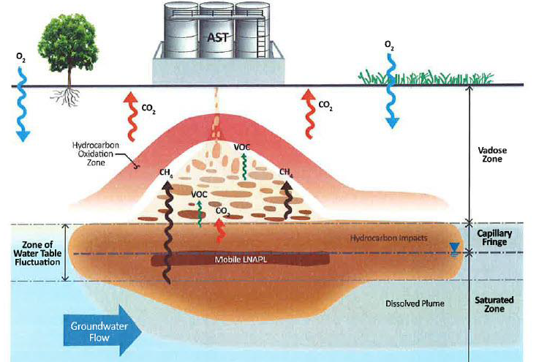
Natural Source Zone Depletion
A Baseline for Biodegradation
Represents a Conceptualization and Quantification of biodegradation processes in the subsurface
  Includes aerobic and anaerobic
Highlights that Microbes Are Ubiquitous and remain active in the same pores as LNAPL
Can address a large range in hydrocarbon composition
Rate varies based on composition
Current methods quantify the majority of degradation using thermal, CO₂ efflux, or soil gas methods
Remedy Selection LCSM: Nature of the Source
API, 2017
Notes:
Note that this is discussed more as a leading and lagging metric in Part 3
Also why are we focused on biodegradation, Other remedial metrics, indicators, e.g., volatility, Tn are more mature. There is less awareness of the biodegradation performance than other mechanisms.

Slide 62
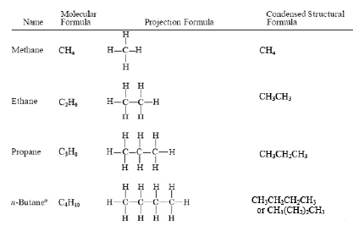
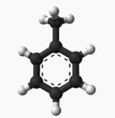

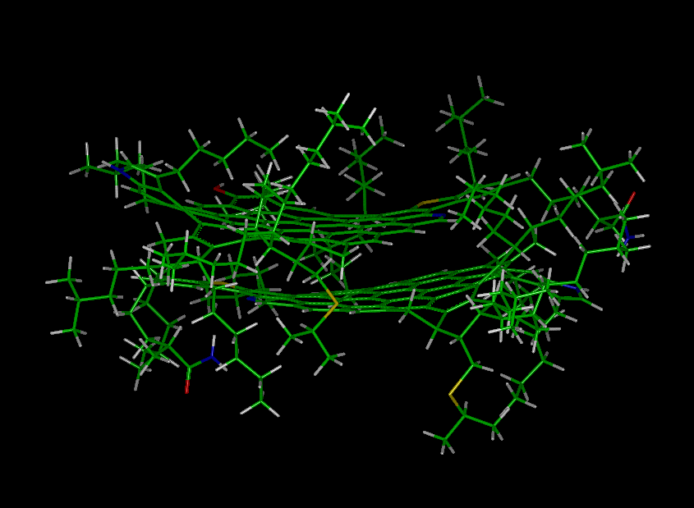
Biodegradation is Dependent on Molecular Structure
Normal Alkanes
The more branching in a hydrocarbon structure, the more difficult to biodegrade
Microbes are not limited by toxic threshold concentrations of hydrocarbon as they eat it
Remedy Selection LCSM: Nature of the Source
Whoa, yummies!
How does that diffuse and break up?
(i.e., How Do I Eat That?)
Octane & Toluene
A Typical Asphaltene
Microbe
Jill
Microbe
Bob
Notes:
We’ve discussed one aspect to understand the nature of the source mobile vs residual fraction, Now we are going more towards the chemical side or compositional nature of the source.
We will discuss biodegradation and vapor aspects as related to remedial mechanisms
Glucose, can be a straight chain carbon molecule with hydrogen and OH groups. It’s the most basic substrate for us. I look at alkane hydrocarbons similar for microbes when considering hydrocarbon degradation. More complicated structures have less net energy due to more difficult bonds to break, lower hydrogen molecules resulting in lower energy yield.

Slide 63
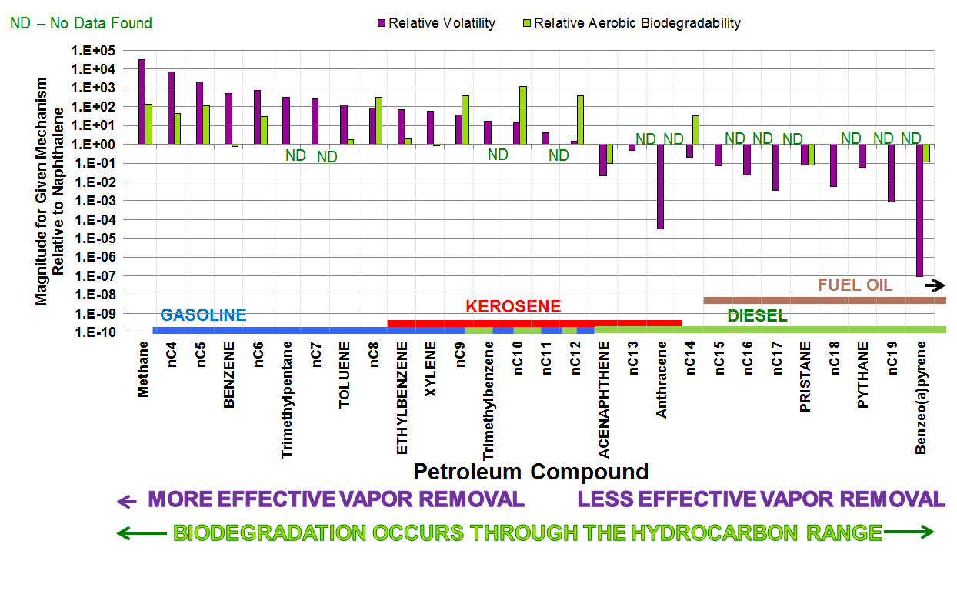
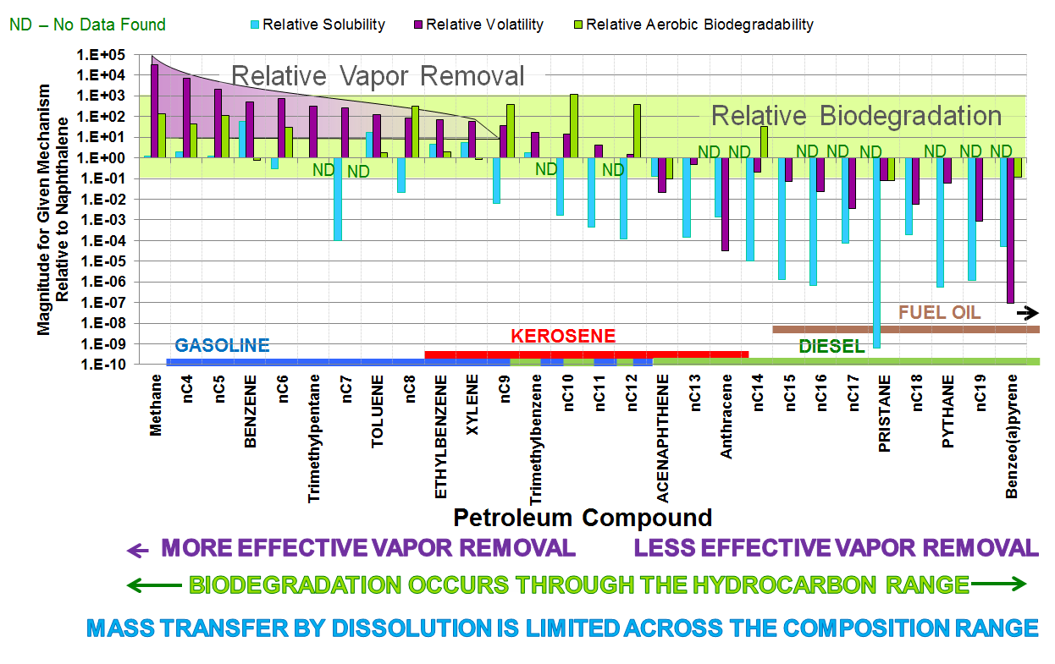
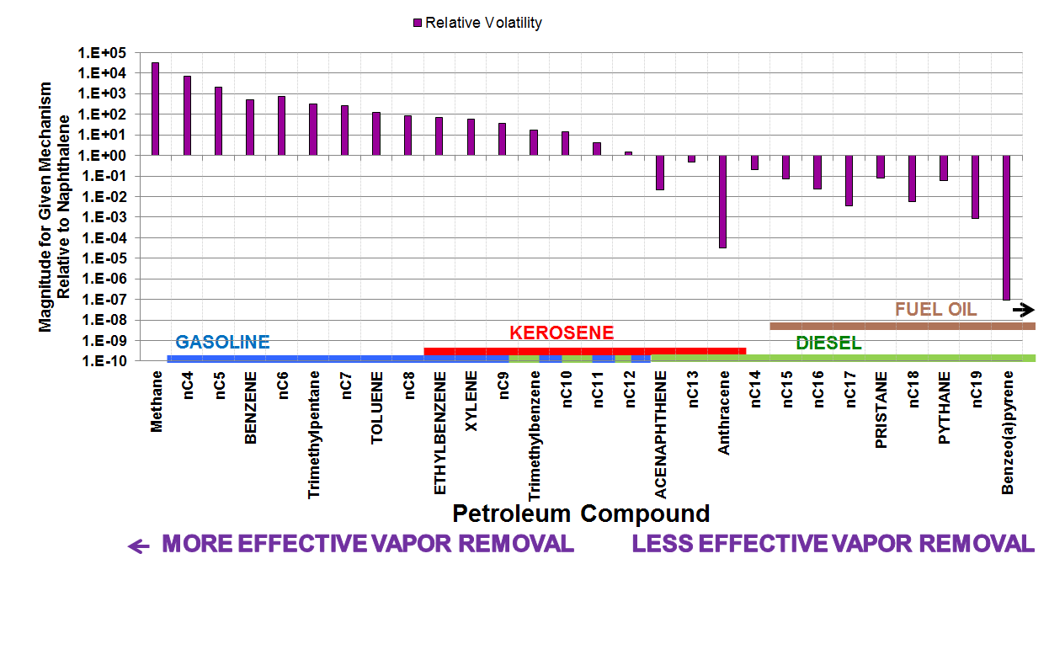
How Do Removal Mechanisms Change with Composition
Remedy Selection LCSM: Nature of the Source
Developed by ITRC Team
Notes:
Doesn’t have to be soluble to be biodegradable
Vapor limit is in gasoline to kerosene transition
This is a graph of vapor pressure – black line and biodegradation rates – purple line
The biodegradation rate constant values are not in the same units as vapor pressure and the absolute values are not comparable. What is comparable is how these values change with hydrocarbon constituent.
The x-axis represents LNAPL types, gasoline, Kerosene, diesel as well as individual components of these mixtures

Slide 64
Example Technology Parameters
Improving the LCSM for Remedy Selection
LNAPL Transmissivity is a good example of a predictive metric that can be characterized without Pilot testing
Parameters that can be quantified to allow initial technology performance estimates/comparisons
  General Remediation
  LNAPL Recovery
  Bioremediation
      Passive
      Bioventing
      Biosparge
      Phytoremediation
  Soil Vapor Extraction / Air Sparging
  Soil Type/Permeability/Hydraulic Conductivity
  LNAPL Transmissivity, Decline curve data from existing recovery data
  Mobile vs Residual
  NSZD Rate or Respiration Test
  LNAPL Composition
  Macro & Micro Soil Nutrients
  LNAPL Characterization for volatile fraction and constituent fractions
  Pilot Test
Remedy Selection LCSM: Nature of the Source
Notes:
No associated notes.

Slide 65
Example Technology Parameters
Improving the LCSM for Remedy Selection
  ISCO, Carbon Injection, other injection technologies
  Surfactant
  Thermal
  3D Delineation of source zone to be treated
  Soil Permeability/Hydraulic Conductivity
  LNAPL Composition
  Bench/Pilot Scale Testing
  3D Delineation of Source Zone
  LNAPL Physical Properties
  Soil Permeability/Hydraulic Conductivity
  Bench/Pilot Scale Testing
  3D Delineation of Source Zone
  LNAPL Physical Properties
  Bench/Pilot Scale Testing
Remedy Selection LCSM: Nature of the Source
Notes:
No associated notes.

Slide 66
Estimating the Performance of Potential Remedies
While mobile LNAPL may exist, alternate mechanisms may still be more effective at Source Remediation
Remedial Mechanisms can evaluate individual constituent removal vs bulk LNAPL removal
Biodegradation may outperform other mechanisms
  Confirm the composition and weathering during LCSM development
Sufficient science exists today to compare expected performance rates
Go review USEPA, ASTM, API, Army Corps of Engineers, scientific literature, and unit conversion references to quantify performance expectations
Remedy Selection LCSM: Nature of the Source
Notes:
No associated notes.

Slide 67
Remedy Selection LCSM Questions
1. Where is the Source Mass?
Identifies where to target remediation
Identifies Physical factors/limitation to consider for impacted soil
  Soil Permeability
  Depth - absolute and relative to water table
Identifies factors/limitation related to the LNAPL
  Volatile, residual, mobile, biodegradable
More advanced characterization can occur (See Table 4.2)
Utilizes the past 2 questions (Site Specific) and the characteristics of a given technology to define
  Site Specific Remedial effectiveness, cost, waste, impact to current land usage, safety and other feasibility study like considerations
Utilize ITRC Appendix Tables and External Technology Specific References (See Tables 4.3 & 4.4, ITRC Update Document)
2. What Is Nature of the Source?
Remedy Selection LCSM
3. What is Achievable for a Given Technology?
Notes:
Characterization can be qualitative e.g., Tier 1 or more quantitative, higher resolution Tier 2-3

Slide 68
Empirical Method
Mobile vs Residual Fractions
These data represent
  4 sites Ranging from 400 ft./day to 0.3 ft./day hydraulic conductivity
    Site 1 - 400 ft/day sand and gravel
    Site 2 – 30 ft/day sand overlain by fine grained silts and clays
    Site three – 0.3 ft/day sandy silt
    Site 4 – 0.03 ft/day silty sand
  Fraction of LNAPL recovered above 0.3 to 0.8 ft²/day is provided, along with remaining residual and mobile
Remedy Selection LCSM: Technically Achievable
Notes:
No associated notes.

Slide 69
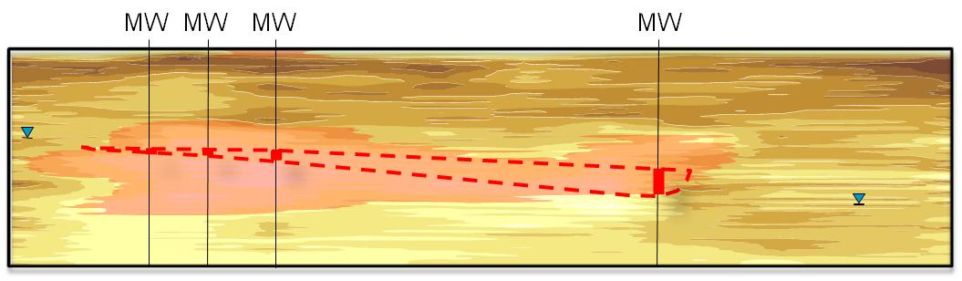

Fraction of Reduced LNAPL Impact Case Study A (Typical Sites)
Residual LNAPL Fraction (unrecoverable)
Fraction of LNAPL Beyond Proposed Endpoint Range/was not Recovered
Fraction of LNAPL Beyond Proposed Recovery Endpoint/Continued to be Recovered with Significant Effort
Fraction of LNAPL Within Proposed Endpoint Range
Source: Kirkman, AECOM
10 years – Elapsed Time
10 years – Estimated Time
Mobile LNAPL
Fraction of Initial LNAPL Volume (%)
Residual LNAPL
Wells 23-24
Site 1
Site 2
Site 3
Site 4
Notes:
Mobile interval is for sites 1 and 2. Sites 3 and 4 utilized entire smear zone to estimate residual and mobile fractions
Sites 1 and 2 utilized Decline curve analysis and core analyses. Sites 3 and 4 utilized multiple TPH soil samples and recovery data.

Slide 70
Fraction of Reduced LNAPL Impact Case Study A (Typical Sites)
Residual LNAPL Fraction (unrecoverable)
Fraction of LNAPL Beyond Proposed Endpoint Range/was not Recovered
Fraction of LNAPL Beyond Proposed Recovery Endpoint/Continued to be Recovered with Significant Effort
Fraction of LNAPL Within Proposed Endpoint Range
Source: Kirkman, AECOM
10 years – Elapsed Time
10 years – Estimated Time
Residual LNAPL Fraction (T_{n} =0 ft²/day)
Fraction of LNAPL Beyond Proposed Endpoint Range/was not Recovered
Fraction of LNAPL Beyond Proposed Recovery Endpoint/
LNAPL Transmissivity (T_{n}) Was Lower Than 0.8 ft²/day
Fraction of Initial LNAPL Volume (%)
Fraction of LNAPL Within Proposed Endpoint Range
T_{n} Greater Than 0.3-0.8 ft²/day
Wells 23-24
Site 1
Site 2
Site 3
Site 4
Notes:
No associated notes.

Slide 71
Fraction of Reduced LNAPL Impact Case Study A (Typical Sites)
Residual LNAPL Fraction (unrecoverable)
Fraction of LNAPL Beyond Proposed Endpoint Range/was not Recovered
Fraction of LNAPL Beyond Proposed Recovery Endpoint/Continued to be Recovered with Significant Effort
Fraction of LNAPL Within Proposed Endpoint Range
Source: Kirkman, AECOM
10 years – Elapsed Time
10 years – Estimated Time
Fraction of Initial LNAPL Volume (%)
Wells 23-24
Site 1
Site 2
Site 3
Site 4
Notes:
No associated notes.

Slide 72
Why Do LCSMs quantify recoverability (Tn) and not Enhanced Biodegradation Potential?
After Hawthorne et al.
Provided by
AECOM
Remedy Selection LCSM: Technically Achievable
Average Removal Rates
Average INITIAL LNAPL recovery rate ~ Average Bioventing rate FOR 1 FOOT OF SOIL TREATMENT
Microbes are not limited by concentration of LNAPL (i.e., too toxic)
Limited by nutrients, water content, composition of LNAPL
Data Sources Represent API Tn Database & AFCEE Bioventing Database
Notes:
No associated notes.

Slide 73
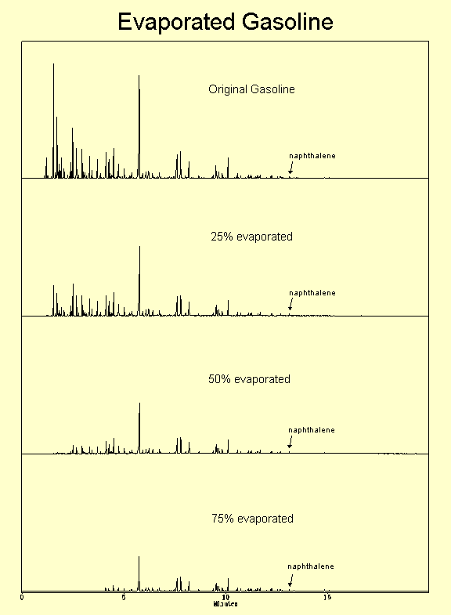
Soil Vapor Extraction Analogy
Vapor Pressure ~ 9 PSI
Toluene
Vapor Extraction addresses the majority of the LNAPL
Typical SVE systems are not left with Toluene though?
  Toluene is highly biodegradable
  SVE enhances oxygen delivery which results in biodegradation beyond the volatilization
  Measure CO₂ to compare vapor removal to biodegradation
Toluene
Remedy Selection LCSM: Technically Achievable
Toluene
Vapor Pressure 0.4 – 0.002 PSI
(Note: Chromatograms Have Been Normalized To Make The Heights of Naphthalene Peaks Equal)
Wigger, J.W., Torkelson, B. 1997. Petroleum Hydrocarbon Fingerprinting - Numerical Interpretation Developments, in proceedings, 4th Annual International Petroleum Environmental Conference
http://www.bioremediationgroup.org/BioReferences/Tier1Papers/petroleum.htm
Toluene
Notes:
Describe volatilization and phase change process. Discuss how benzene dissolved concentrations would decrease and over all GRO would decrease because less soluble compounds remain. Ask is the toluene mass increasing or concentration? Ask with SVE is volatilization the only mechanism
Challenge thinking about left over mass, no benzene, no risk, so now what?

Slide 74
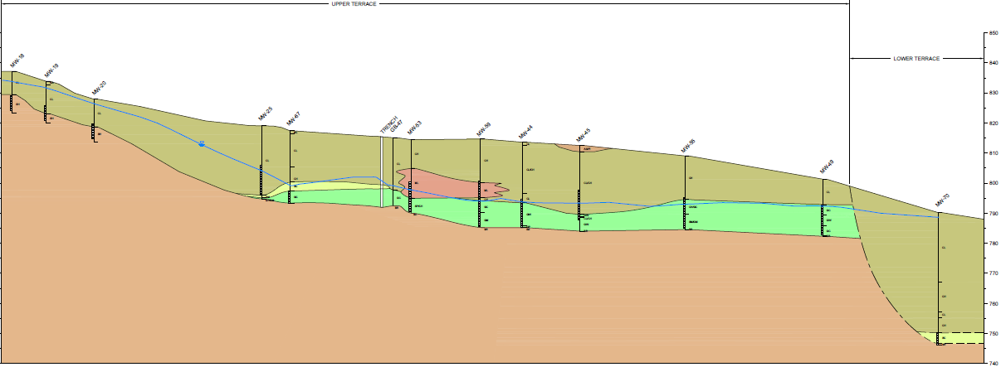
Why Performance Estimates Are Important
Site – MPE within Terraced and Channelized Deposits
Multi-phase extraction system to address historical gasoline release
Water-table fluctuations affect all remedial mechanisms
Remedy Selection LCSM: Technically Achievable
Provided by BP
Notes:
No associated notes.

Slide 75
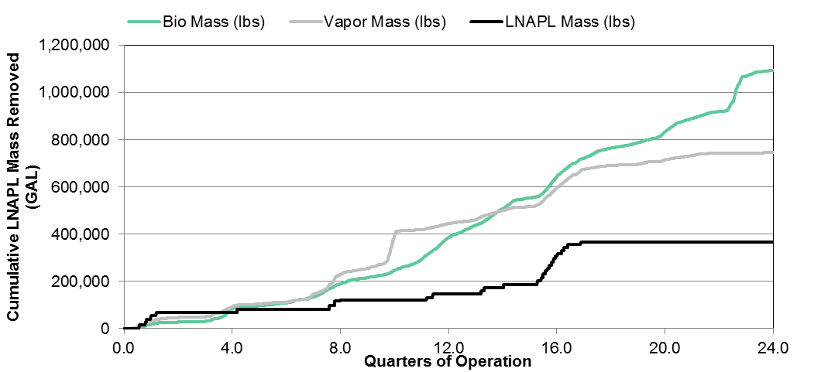
Good Conceptual Models are Needed to Forecast Performance
LNAPL in wells occurred initially and represented potentially recoverable LNAPL
Was the waste of produced water worthwhile for the LNAPL Recovery?
  23 gpm for 14 years ~ 170 Million Gallons of Water (Oil:Water Ratio 0.0003)
  Could bio and vapor have made up of the smaller LNAPL fraction?
What technology should be used now to complete remediation?
  LNAPL in wells still remains
  Benzene concentration in groundwater remains above remedial goal
Poll Question
Remedy Selection LCSM: Technically Achievable
Drought Conditions
Provided by BP
Notes:
LNAPL Transmissivity was not quantified to decide if LNAPL Recovery should be implemented, thickness was
Poll – Knowledge Check
What technology should be used now to complete remediation?
LNAPL Recovery
Bioremediation
Vapor
Surfactant
ISCO

Slide 76
Site Specific Limits of Technology
Site Limits of Technology Combine the inherent Technical Limits with Site Considerations
  Sites with existing systems can utilize remedial performance data when selecting alternate remedies
    Decline curve analysis
    Sustainability analysis including waste generation, economic, Community
  The waste stream treatment of a given technology represents a higher level of cost/effort/risk than alternate remedial mechanisms that achieve a similar or higher level of effectiveness
    An operating industrial facility may be able to treat water more easily than a retail station
    Why utilize propane to oxidize 100 ppm vapor when biodegradation dominates?
  Source zone is inaccessible due to source relative to infrastructure or other physical obstacles
Remedy Selection LCSM: Technically Achievable
Notes:
No associated notes.

Slide 77
Technically Achievable
Tiered Approach is Applicable
Higher Tier Sites may benefit from quantified metrics for comparing technology performance estimates
Analytical or other Modelling Tools May Benefit Technology Performance
  Use of these tools encourages higher resolution data collection
  Quantification of Parameters
    Often several of the Parameters can be looked-up or calibrated based on a few site specific parameters
  Table 4-4 In the guidance provides references to existing analytical calculation methods, tools and/or models for various remedial mechanisms
  Moving in this direction will encourage development of additional tools to further inform performance expectations
Remedy Selection LCSM: Technically Achievable
Notes:
No associated notes.

Slide 78
Unit Conversion Challenges
Few technologies utilize similar performance metrics / units
  LNAPL Recovery – GPD, $/Gal, LNAPL-Water Recovery Ratio
  Vapor – lbs./hr., $/lb.
  ISCO – ?? $/lb., change in dissolved phase / source mass, it’s a contact sport
  NSZD – gal/acre/year
Need to find a similar unit for comparison
  Gal/Acre/year useful for Mass Removal
  $/lb. removed is frequently used
  Pounds of CO2 produced per Pound of Contaminant Removed
  Constituent specific mass removal rates for vapor or dissolved plumes may be required
  Risk to Workers (Remediation or active facility)
  Risk Reduction to Community
Remedy Selection LCSM: Technically Achievable
Notes:
Discuss why Change in GW concentrations isn’t enough
A lack of change in GW concentration doesn’t indicate why a given technology didn’t work, was it contact issues, is the rate too low. It is one metric but perhaps needs to be supplemented.

Slide 79
Technically Achievable
What is it?... Examples Include
Remedial Mechanism
Technically Achievable / Limit
LNAPL Recoverability
Volatilization
  Air Sparging
  Soil Vapor Extraction
Biodegradation
  Biovent
  BioSparge
  NSZD
  Phytoremediation
Injection
  ISCO
  Carbon
LNAPL Recoverability
  LNAPL Transmissivity - 0.1 to 0.8 ft²/day
Volatilization
  Vapor Pressure 10-100X less than Gasoline (i.e., 0.9 – 0.09 psi)
  Biodegradation dominates
Biodegradation
  Rate of degradation too low to achieve remedial goal in timeframe
  Soil texture limits oxygen delivery
Injection
  Soil texture limits delivery of oxidant/other media
Remedy Selection LCSM: Technically Achievable
Notes:
No associated notes.

Slide 80
Knowledge Check
Enter Yes or No for each question
Sheen on Creek, LNAPL in well nearby, LNAPL transmissivity is < 0.05 ft²/day
  Should recovery be considered? (Y/N)
  Is recovery likely to be the final remedy? (Y/N)
  What else could be done to improve remedy selection?
    We are good to install a final remedy
    Improve vertical and horizontal resolution of impacts and soil type
    Quantify Biodegradation Rate
    Estimate Volatile Fraction of LNAPL in place
    Confirm Sheen LNAPL originates from impacts in well
Poll Question
Notes:
Should recovery be considered? (Y/N)
Is the recovery Final or Interim measure? (Y/N)
What else could be done to improve remedy selection?
We are good to install a final remedy
Improve vertical and horizontal resolution of impacts and soil type
Quantify Biodegradation Rate
Estimate Volatile Fraction of LNAPL in place
Confirm Sheen LNAPL originates from impacts in well

Slide 81
Choose Remedial Technology(ies), then Identify Performance Metrics & Endpoints
Performance Metrics and Endpoints are SMART and technology-specific
LNAPL Decision Process
Notes:
Now that we’ve covered the remedy selection phase of the LSCM, let’s return to the LNAPL decision process. You seen this slide already. Recall that the selected remedy needs to be capable of meeting the established LNAPL remedial goals and remediation objectives. The remedy also needs performance metrics to assure that it is being implemented effectively. It also needs an endpoint to know when it has done its job.
SMART = Specific, Measurable, Attainable (or agreed-upon), Realistic (or relevant), Time-based

Slide 82

Performance Metrics
Technology-specific!
Verifies that remedy is being
effectively implemented
Allows for mid-course corrections
Tracks progress toward endpoint
Example performance metric for bioventing:
  Maintain a specified minimum oxygen content in a targeted region of LNAPL-affected soil (to deplete LNAPL mass by aerobic biodegradation)
LNAPL Decision Process
Notes:
The remedy needs to be capable of meeting the identified LNAPL remedial objectives. Then it needs performance metrics to assure that it is implemented effectively. It also needs an endpoint to know when it has done its job.
[example with numeric metric(s)]
Clip art source: http://clipart-library.com/metrics-cliparts.html

Slide 83

Endpoints
Also technology-specific!
Defined as:
  LNAPL concern has been
  addressed, OR
  Practicable limit of the technology
If technology reaches its practicable limit before LNAPL concern is abated, then the endpoint marks the transition to the next technology in the treatment train
LNAPL Decision Process
Notes:
The remedy needs an endpoint to know when it has done its job.
Example of a endpoint: Dissolved risk concern about benzene -> LNAPL composition goal –> phase change mechanism -> SVE remedy. Endpoint is when dissolved concentrations are reduced to risk-based or regulatory limits at points of compliance.
Transitions should be expected and planned, based on expected performance of technology… not a disappointment or a surprise.
Clip art source: http://www.clker.com/clipart-treasure-map-1.html

Slide 84
Knowledge Check
Which statement is true?
Remedial Performance Metrics and Endpoints…
Poll Question
Are optional
Are the same for every technology
Are technology-specific and site-specific
Notes:
No associated notes.

Slide 85
Examples of Concerns Leading to
SMART Remedial Outcomes
LNAPL is the source of a dissolved phase plume that may affect a supply well
LNAPL may
be migrating
LNAPL present
in a well
Identify
LNAPL Concerns
Verify Concerns
Establish Remedial Goals
Determine
Remediation
Objectives
Select
Remedy
Establish
Metrics
Remediation Endpoints
Figure 5-2, ITRC LNAPL-3
Groundwater
Standards
LNAPL
Plume Stability
ITRC recommended endpoint range for recoverability
Reduce
dissolved-phase concentrations to generic or site-specific standards
Contain LNAPL and reduce the potential for migration
Reduce LNAPL saturation
Reduce dissolved-phase impacts
Reduce mobile LNAPL mass
Recover LNAPL mass to recoverable limit
Air sparging and soil vapor extraction
Dual-pump liquid
extraction
Dual-pump liquid
extraction
Specific
LNAPL Decision Process
Measurable
Stable
dissolved
plume
Stable
LNAPL
plume
LNAPL transmissivity
Attainable
Stabilized dissolved concentrations; standards met at compliance point
Demonstration of functional LNAPL stability
Transmissivity decreased to practical limit of recovery
Relevant
Timely
Notes:
Putting it all together, we get this.
SMART = Specific, Measurable, Attainable (or agreed-upon), Realistic (or relevant), Time-based
Reiterate that metrics and endpoints should rely on multiple converging lines of evidence

Slide 86
ITRC LNAPL Management
LNAPL Assessment LCSM
What do you have?
Identify LNAPL Concerns
and Set LNAPL Remedial Goals
What needs to be done?
LNAPL Decision Process
Select Remediation Technology to Achieve Remediation Objectives
How do you do it?
Now
Install Remedial Technology and Monitor Performance
Notes:
86
What will be covered in upcoming third training module.
86

Slide 87
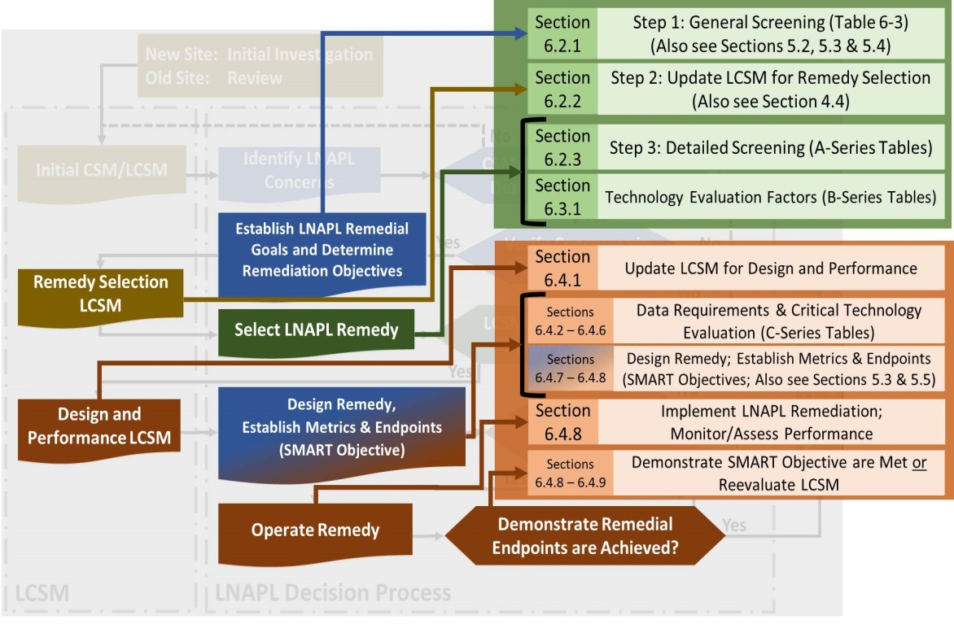
LNAPL Remedial Technology Screening Process for Verified Concerns
Step 1 – Screen technologies
on the remedial goals
Step 2 – Screen technologies
on site geological factors and
LNAPL characteristics
Step 3 – Comparative analysis
Step 4 – Identify critical data
needs
Step 5 – Select technology(ies)
address concern(s)
LNAPL Decision Process
Figure 6-1, ITRC LNAPL-3
The Remedy Selection and Design LCSM is
further developed & updated during these steps
Notes:
These are the major topics and concepts covered the next module
Good opportunity to reiterate LCSM update theme. You are getting data to: a. complete a step in the decision process and b. to update/confirm your LCSM.

Slide 88
Decision Making and Technology Selection Summary
Use the systematic decision-making process
A robust LCSM identifies LNAPL Concerns
Establish Remedial Goals to address Verified Concerns
Identify the right technology(ies) to abate the Verified Concerns
LCSM is referred to and refined as-needed to design and implement the remedy
SMART objectives lead to project success
LNAPL Decision Process
Notes:
What have we covered?
SMART = Specific, Measurable, Attainable (or agreed-upon), Realistic (or relevant), Time-based
Tie whole presentation together more… identify points made in all presentation

Slide 89
ITRC 3-Part Online Training Leads to YOUR Action
NEXT
Part 1:
Connect Science to LNAPL Site Management
(Section 3)
Part 2:
Build Your LNAPL Conceptual Site Model
(Sections 4 and 5)
Part 3:
Select / Implement LNAPL Remedies
(Section 6)
YOU
Apply knowledge at your LNAPL sites
Based on the ITRC LNAPL-3 Document: LNAPL Site Management: LCSM Evolution, Decision Process, and Remedial Technologies
Notes:
We are near the end of Part 2 of training to use ITRC’s new LNAPL document.
(CLICK) Next week in Part 3, we will
Discuss remedial technology groups
Introduce specific remedial technologies
Provide a framework for technology selection
Introduce tools to screen the technologies for use
Introduce performance metrics to optimize your efforts and decide when to stop and/or use another technology
Use a case study to demonstrate the use of these tools

Slide 90
Apply Part 2 on the Job
Think about one of your sites and what data is available to go through a short Remedy Selection LCSM exercise to select potential remedial technology mechanisms or confirm the current remedial technology.
Additional insight on remedial technologies will be provided in Part 3, which will help further the evaluation.
Apply What You Have Learned
Notes:
No associated notes.

Slide 91

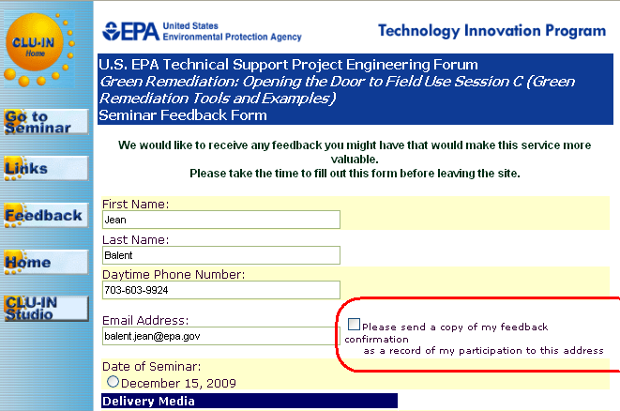
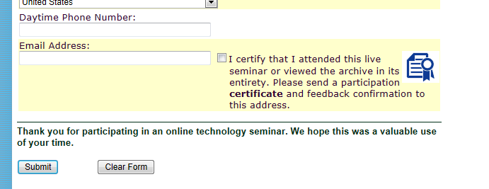
Thank You
Follow ITRC
2nd question and answer break
Links to additional resources
  http://www.clu-in.org/conf/itrc/LNAPL-3/resource.cfm
Feedback form – please complete
  http://www.clu-in.org/conf/itrc/LNAPL-3/feedback.cfm
Poll Question
Need confirmation of your participation today?
Fill out the feedback form and check box for confirmation email and certificate.
Notes:
Links to additional resources:
http://www.clu-in.org/conf/itrc/LNAPL-3/resource.cfm
Your feedback is important – please fill out the form at:
http://www.clu-in.org/conf/itrc/LNAPL-3/feedback.cfm
The benefits that ITRC offers to state regulators and technology developers, vendors, and consultants include:
Helping regulators build their knowledge base and raise their confidence about new environmental technologies
Helping regulators save time and money when evaluating environmental technologies
Guiding technology developers in the collection of performance data to satisfy the requirements of multiple states
Helping technology vendors avoid the time and expense of conducting duplicative and costly demonstrations
Providing a reliable network among members of the environmental community to focus on innovative environmental technologies
How you can get involved with ITRC:
Join an ITRC Team – with just 10% of your time you can have a positive impact on the regulatory process and acceptance of innovative technologies and approaches
Sponsor ITRC’s technical team and other activities
Use ITRC products and attend training courses
Submit proposals for new technical teams and projects

