Slide 1
Starting Soon: Petroleum Vapor Intrusion
Petroleum Vapor Intrusion (PVI) Technical and Regulatory Guidance Web-Based Document (PVI-1) www.itrcweb.org/PetroleumVI-Guidance
Download PowerPoint file
  Clu-in training page at http://www.clu-in.org/conf/itrc/PVI/
  Under “Download Training Materials”
Download flowcharts for reference during the training class
  http://www.cluin.org/conf/itrc/PVI/ITRC-PVI-FlowCharts.pdf
Using Adobe Connect
  Related Links (on right)
    Select name of link
    Click “Browse To”
  Full Screen button near top of page
Poll Question
Notes:
No associated notes.

Slide 2
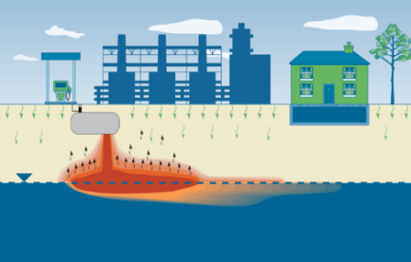
Petroleum Vapor Intrusion: Fundamentals of Screening, Investigation, and Management
Welcome – Thanks for joining
this ITRC Training Class
Petroleum Vapor Intrusion (PVI) Technical and Regulatory Guidance Web-Based Document (PVI-1) www.itrcweb.org/PetroleumVI-Guidance
Sponsored by: Interstate Technology and Regulatory Council (www.itrcweb.org) Hosted by: US EPA Clean Up Information Network (www.cluin.org)
Notes:
Chemical contaminants in soil and groundwater can volatilize into soil gas and migrate through unsaturated soils of the vadose zone. Vapor intrusion (VI) occurs when these vapors migrate upward into overlying buildings through cracks and gaps in the building floors, foundations, and utility conduits, and contaminate indoor air. If present at sufficiently high concentrations, these vapors may present a threat to the health and safety of building occupants. Petroleum vapor intrusion (PVI) is a subset of VI and is the process by which volatile petroleum hydrocarbons (PHCs) released as vapors from light nonaqueous phase liquids (LNAPL), petroleum-contaminated soils, or petroleum-contaminated groundwater migrate through the vadose zone and into overlying buildings. Fortunately, in the case of PHC vapors, this migration is often limited by microorganisms that are normally present in soil. The organisms consume these chemicals, reducing them to nontoxic end products through the process of biodegradation. The extent and rate to which this natural biodegradation process occurs is strongly influenced by the concentration of the vapor source, the distance the vapors must travel through soil from the source to potential receptors, and the presence of oxygen (O₂) in the subsurface environment between the source and potential receptors.
The ITRC Technical and Regulatory Guidance Web-Based Document, Petroleum Vapor Intrusion: Fundamentals of Screening, Investigation, and Management (PVI-1, 2014) and this associated Internet-based training provides regulators and practitioners with consensus information based on empirical data and recent research to support PVI decision making under different regulatory frameworks. The PVI assessment strategy described in this guidance document enables confident decision making that protects human health for various types of petroleum sites and multiple PHC compounds. This guidance provides a comprehensive methodology for screening, investigating, and managing potential PVI sites and is intended to promote the efficient use of resources and increase confidence in decision making when evaluating the potential for vapor intrusion at petroleum-contaminated sites. By using the ITRC guidance document, the vapor intrusion pathway can be eliminated from further investigation at many sites where soil or groundwater is contaminated with petroleum hydrocarbons or where LNAPL is present.
After attending this ITRC Internet-based training, participants should be able to:
Determine when and how to use the ITRC PVI document at their sites
Describe the important role of biodegradation impacts on the PVI pathway (in contrast to chlorinated solvent contaminated sites)
Value a PVI conceptual site model (CSM) and list its key components
Apply the ITRC PVI 8 step decision process to screen sites for the PVI pathway and determine actions to take if a site does not initially screen out (e.g., site investigation, modeling, and vapor control and site management)
Access fact sheets to support community engagement activities at each step in the process
For reference during the training class, participants should have a copy of the flowcharts, Figures 1-2, 3-2, and 4-1 from the ITRC Technical and Regulatory Guidance Web-Based Document , Petroleum Vapor Intrusion: Fundamentals of Screening, Investigation, and Management (PVI-1, 2014) and are available as a 3-page PDF at http://www.cluin.org/conf/itrc/PVI/ITRC-PVI-FlowCharts.pdf
Starting in late 2015, ITRC will offer a 2-day PVI focused classroom training at locations across the US. The classroom training will provide participants the opportunity to learn more in-depth information about the PVI pathway and practice applying the ITRC PVI guidance document with a diverse group of environmental professionals. Email training@itrcweb.org if you would like us to email you when additional information is available.
ITRC (Interstate Technology and Regulatory Council) www.itrcweb.org
Training Co-Sponsored by: US EPA Technology Innovation and Field Services Division (TIFSD) (www.clu-in.org)
ITRC Training Program: training@itrcweb.org; Phone: 402-201-2419

Slide 3
Housekeeping
Course time is 2¼ hours
This event is being recorded
Trainers control slides
  Want to control your own slides? You can download presentation file on Clu-in training page
Questions and feedback
  Throughout training:
  type in the “Q & A” box
  At Q&A breaks: unmute your phone with #6 to ask out loud
  At end of class: Feedback form available from last slide
    Need confirmation of your participation today? Fill out the feedback form and check box for confirmation email.
Copyright 2015 Interstate Technology & Regulatory Council,
50 F Street, NW, Suite 350, Washington, DC 20001
Notes:
3
Although I’m sure that some of you are familiar with these rules from previous CLU-IN events, let’s run through them quickly for our new participants.
We have started the seminar with all phone lines muted to prevent background noise. Please keep your phone lines muted during the seminar to minimize disruption and background noise. During the question and answer break, press #6 to unmute your lines to ask a question (note: *6 to mute again). Also, please do NOT put this call on hold as this may bring unwanted background music over the lines and interrupt the seminar.
Use the “Q&A” box to ask questions, make comments, or report technical problems any time. For questions and comments provided out loud, please hold until the designated Q&A breaks.
Everyone – please complete the feedback form before you leave the training website. Link to feedback form is available on last slide.

Slide 4





ITRC (www.itrcweb.org) – Shaping the Future of Regulatory Acceptance
Host organization
Network
  State regulators
    All 50 states, PR, DC
  Federal partners
  ITRC Industry Affiliates Program
  Academia
  Community stakeholders
Disclaimer
  Full version in “Notes” section
  Partially funded by the U.S. government
    ITRC nor US government warranty material
    ITRC nor US government endorse specific products
  ITRC materials copyrighted
Available from www.itrcweb.org
  Technical and regulatory guidance documents
  Internet-based and classroom training schedule
  More…
DOE
DOD
EPA
Notes:
The Interstate Technology and Regulatory Council (ITRC) is a state-led coalition of regulators, industry experts, citizen stakeholders, academia and federal partners that work to achieve regulatory acceptance of environmental technologies and innovative approaches. ITRC consists of all 50 states (and Puerto Rico and the District of Columbia) that work to break down barriers and reduce compliance costs, making it easier to use new technologies and helping states maximize resources. ITRC brings together a diverse mix of environmental experts and stakeholders from both the public and private sectors to broaden and deepen technical knowledge and advance the regulatory acceptance of environmental technologies. Together, we’re building the environmental community’s ability to expedite quality decision making while protecting human health and the environment. With our network of organizations and individuals throughout the environmental community, ITRC is a unique catalyst for dialogue between regulators and the regulated community.
For a state to be a member of ITRC their environmental agency must designate a State Point of Contact. To find out who your State POC is check out the “contacts” section at www.itrcweb.org. Also, click on “membership” to learn how you can become a member of an ITRC Technical Team.
Disclaimer: This material was prepared as an account of work sponsored by an agency of the United States Government. Neither the United States Government nor any agency thereof, nor any of their employees, makes any warranty, express or implied, or assumes any legal liability or responsibility for the accuracy, completeness, or usefulness of any information, apparatus, product, or process disclosed, or represents that its use would not infringe privately owned rights. Reference herein to any specific commercial product, process, or service by trade name, trademark, manufacturer, or otherwise does not necessarily constitute or imply its endorsement, recommendation, or favoring by the United States Government or any agency thereof. The views and opinions of authors expressed herein do not necessarily state or reflect those of the United States Government or any agency thereof and no official endorsement should be inferred.
The information provided in documents, training curricula, and other print or electronic materials created by the Interstate Technology and Regulatory Council (“ITRC” and such materials are referred to as “ITRC Materials”) is intended as a general reference to help regulators and others develop a consistent approach to their evaluation, regulatory approval, and deployment of environmental technologies. The information in ITRC Materials was formulated to be reliable and accurate. However, the information is provided "as is" and use of this information is at the users’ own risk.
ITRC Materials do not necessarily address all applicable health and safety risks and precautions with respect to particular materials, conditions, or procedures in specific applications of any technology. Consequently, ITRC recommends consulting applicable standards, laws, regulations, suppliers of materials, and material safety data sheets for information concerning safety and health risks and precautions and compliance with then-applicable laws and regulations. ITRC, ERIS and ECOS shall not be liable in the event of any conflict between information in ITRC Materials and such laws, regulations, and/or other ordinances. The content in ITRC Materials may be revised or withdrawn at any time without prior notice.
ITRC, ERIS, and ECOS make no representations or warranties, express or implied, with respect to information in ITRC Materials and specifically disclaim all warranties to the fullest extent permitted by law (including, but not limited to, merchantability or fitness for a particular purpose). ITRC, ERIS, and ECOS will not accept liability for damages of any kind that result from acting upon or using this information.
ITRC, ERIS, and ECOS do not endorse or recommend the use of specific technology or technology provider through ITRC Materials. Reference to technologies, products, or services offered by other parties does not constitute a guarantee by ITRC, ERIS, and ECOS of the quality or value of those technologies, products, or services. Information in ITRC Materials is for general reference only; it should not be construed as definitive guidance for any specific site and is not a substitute for consultation with qualified professional advisors.

Slide 5




Meet the ITRC Trainers
Ian Hers
Golder Associates Ltd
Burnaby, British Columbia, Canada
604-298-6623
ihers@golder.com
Matt Williams
Michigan Department of Environmental Quality
Lansing, Michigan
517-284-5171
WilliamsM13
@Michigan.gov
Loren Lund
CH2M HILL
Shelley, Idaho
208-357-5351
Loren.Lund@ch2m.com
George DeVaull
Shell
Houston, Texas
281-544-7430
george.devaull
@shell.com
David Folkes
Geosyntec Consultants
Centennial, Colorado
303-790-1340
dfolkes@geosyntec.com
Notes:
Matthew Williams is the Vapor Intrusion Specialist for the development and implementation of methods used to investigate and assess vapor intrusion issues for the Remediation and Redevelopment Division of the Michigan Department of Environmental Quality. He is a Geologist that has 18 years of experience in both the public and private sectors working on a wide variety of projects across the United States.
He has drafted several guidance documents and standard operating procedures for the MDEQ and has conducted numerous training and talks on soil gas methods and vapor intrusion for stakeholder groups and consultants. He co-leads ITRC 2-day classroom training on Petroleum Vapor Intrusion and is a trainer in both the 2-day classroom and Internet-based training. Matt earned a Bachelor of Science degree in Geology from Central Michigan University in Mt Pleasant, Michigan in 1993.
George DeVaull is a Principal Technical Expert in Environmental, Soil and Groundwater with Shell Global Solutions US Inc. in Houston, Texas. He has worked at Shell since 1990 on many hundreds of soil and groundwater projects across the oil and gas industry including downstream (refineries to retail), exploration and production, chemicals, and multi-party sites across many countries and six continents. His current work includes research & development on chemical fate and transport (biodegradation in the environment, soil vapor migration and intrusion into enclosures, environmental evaluation of novel and new chemical products); risk assessment frameworks and applications (human and ecological evaluations), and guidance and standards development and technical consultation (US, States, other countries, joint industry/government consortia, ASTM, API). George is a principal author of the BioVapor vapor intrusion model. For ITRC, George has contributed as a member of the petroleum vapor intrusion team since 2012. George earned a Bachelor of Science,1984, and Master of Science, 1985, in mechanical engineering, and a PhD, 1990, all from University of Illinois Champaign-Urbana.
Ian Hers is a Senior Associate Engineer with Golder Associates located in Vancouver, British Columbia and has worked for Golder since 1988. He has 20 years professional experience in environmental site assessment, human health risk assessment and remediation of contaminated lands. Ian is a technical specialist in the area of LNAPL and DNAPL source characterization, monitored natural attenuation and source zone depletion, vapour intrusion, and vapour-phase in situ remediation technologies, and directs or advices on projects for Golder at petroleum-impacted sites throughout North America. He has developed guidance on LNAPL assessment and mobility for the BC Science Advisory Board for Contaminated Sites (SABCS) and the BC Ministry of Environment. Ian joined the ITRC LNAPL team in March 2008. Ian earned a bachelor's degree in 1986 and master’s degree in 1988 in Civil Engineering from the University of British Columbia in Vancouver, BC. He then completed a doctoral degree in Civil Engineering from University of British Columbia in 2004. He is on the Board of Directors of the SABCS, is a Contaminated Sites Approved Professional in BC, and is a sessional lecturer at the University of British Columbia.
Loren Lund is a Principal Technologist for CH2M Hill in Shelley, Idaho. He has worked at CH2M HILL since 2008 and in environmental risk analysis and vapor intrusion since 1990. Loren is CH2M HILL’s Vapor Intrusion Practice Leader, responsible for overseeing/training staff and insuring vapor intrusion best practices are applied. He is responsible for the company’s compendium of best practices, standard operating procedures, quality assurance procedures, and VI website. Loren is an organizing committee member, classroom instructor, session chair, and presenter for the Air and Waste Management Association (AWMA) VI specialty conferences. He is a member of the Interstate Technology Regulatory Council (ITRC) Petroleum VI team, where he was the co-team leader responsible for authoring one of the chapters. Loren co-chairs the Navy VI Focus Group, was a co-author of the Navy 2011 Background Indoor Air Guidance for VI, and the senior technical leader for the Web-based Navy VI Tool and the current Navy Environmental Sustainability Development to Integration (NESDI) VI Decision Framework database project. He has reviewed multiple national VI guidance documents, authored over a dozen papers, and has been a session chair or featured speaker at more than a dozen VI conferences or sessions since 2004. Loren has presented over a dozen webinar training sessions on VI assessment and mitigation in the last five years. He earned a bachelor’s degree in chemistry, a Ph.D. in biochemistry, and was a post-doctorate and adjunct professor in toxicology at the University of Texas in Austin.
David Folkes is a Principal with Geosyntec Consultants, Inc. in Denver, Colorado. Dave has worked on over 100 vapor intrusion (VI) projects across North America and overseas since 1998, including sites in Europe, South America, Australia, and Southeast Asia. He is Project Director of the Redfield Site, one of the largest VI sites in the US, and has served as an expert witness on several major VI cases, including class action lawsuits. Dave has been extensively involved with development of VI practice and guidance in the US, including training of regulators and consultants on use of the 2002 draft EPA VI guidance; and assistance with VI guidance development and training in many states over the past decade. As a member of the Interstate Technology and Regulatory Council (ITRC) VI Team, Dave helped develop its 2007 guidance and served as an instructor for VI training classes over the next four years. Dave earned his bachelor's degree in Geological Engineering in 1977 and his master's degree in Civil Engineering in 1980, both from the University of Toronto, Canada. He is a registered professional engineer in Colorado.

Slide 6
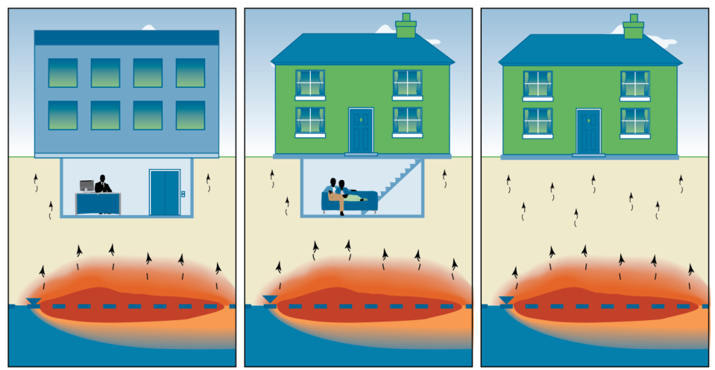
What is Vapor Intrusion (VI)? What is Petroleum Vapor Intrusion (PVI)?
Vapor Intrusion (VI) is the process by which volatile vapors partition from contaminated groundwater or other subsurface sources and migrate upward through vadose zone soils and into overlying buildings
Petroleum vapor intrusion (PVI) is a subset of VI that deals exclusively with petroleum hydrocarbon (PHC) contaminants
Notes:
No associated notes.

Slide 7
Aerobic Biodegradation -
Key to Limiting PVI
Defining feature of PVI that distinguishes it from VI of other volatile chemicals, principally chlorinated hydrocarbons (PCE, TCE)
Breakdown of chemicals by microorganisms in vadose zone soils
PHC-degrading bacteria found in all environments and can consume hydrocarbons rapidly in the presence of O₂
Can limit transport and VI effects of PHC vapors
Notes:
No associated notes.

Slide 8
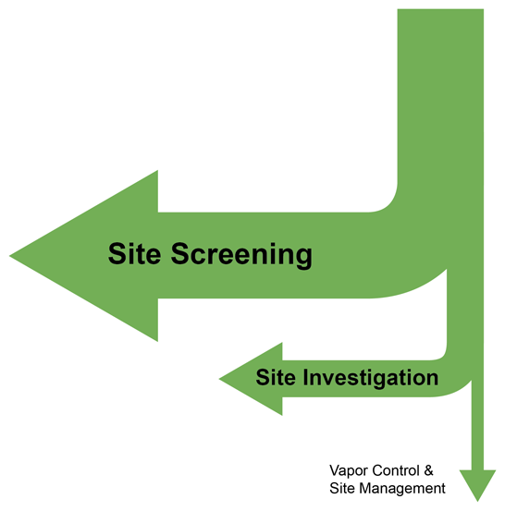
The Effect of Aerobic Biodegradation
Unlike Chlorinated Vapor Intrusion (CVI),
the vast majority of PVI sites can be screened out . . .
. . . and do not require vapor control (mitigation)!
Notes:
No associated notes.

Slide 9
PVI – What is the Big Deal?
Lack of guidance and training to support confident decision making
Experience with chlorinated compound vapor intrusion (CVI) heightens concern for PVI
Limited resources without effective prioritization process to focus on sites with greatest potential for PVI
Financial impacts (e.g., delays in construction or property transactions)
Potential adverse health effects of building occupants if vapors at sufficiently high concentrations
Notes:
No associated notes.

Slide 10
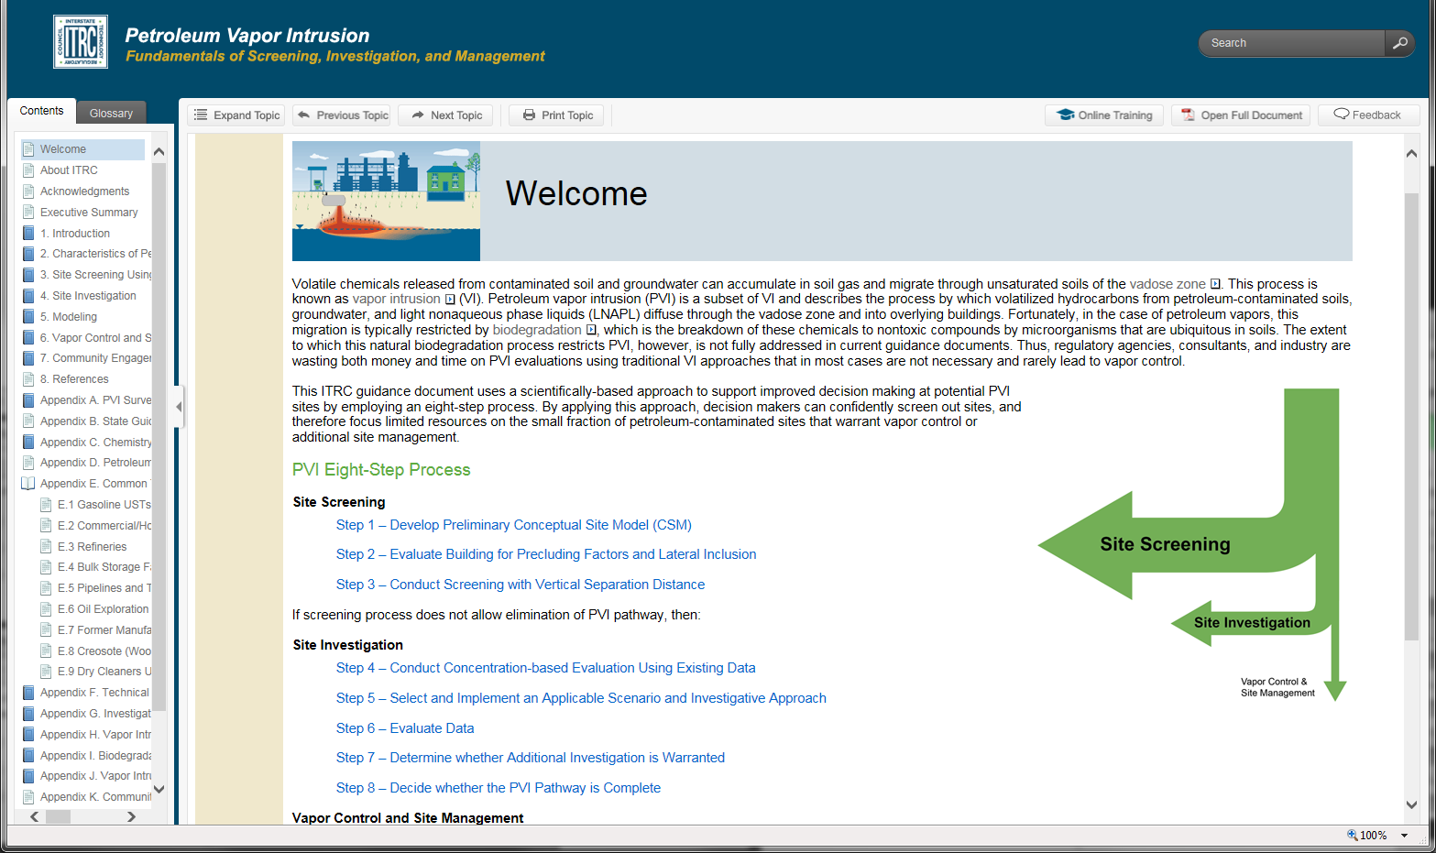
The ITRC Solution - Guidance
Petroleum Vapor Intrusion (PVI): Fundamentals of Screening, Investigation, and Management
KEY
POINT:
Only applies to PVI Pathway, not for chlorinated or other non-petroleum compounds [See ITRC VI-1, 2007]
Notes:
No associated notes.

Slide 11
ITRC’s PVI Guidance – What It Can Do for YOU!
Comprehensive strategy for screening, investigating and managing potential PVI sites
Consistent approach for regulators and practitioners
Brings credibility - nationally developed, consensus-based decision making strategy
Scientifically based on latest research
Applicable for a variety of petroleum site types from underground storage tanks (USTs) to larger petroleum sites (e.g., refineries and pipelines)
KEY
POINT:
Developed by over 100 team members across environmental sectors (including 28 state agencies)
Notes:
No associated notes.

Slide 12
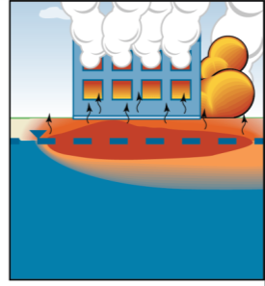
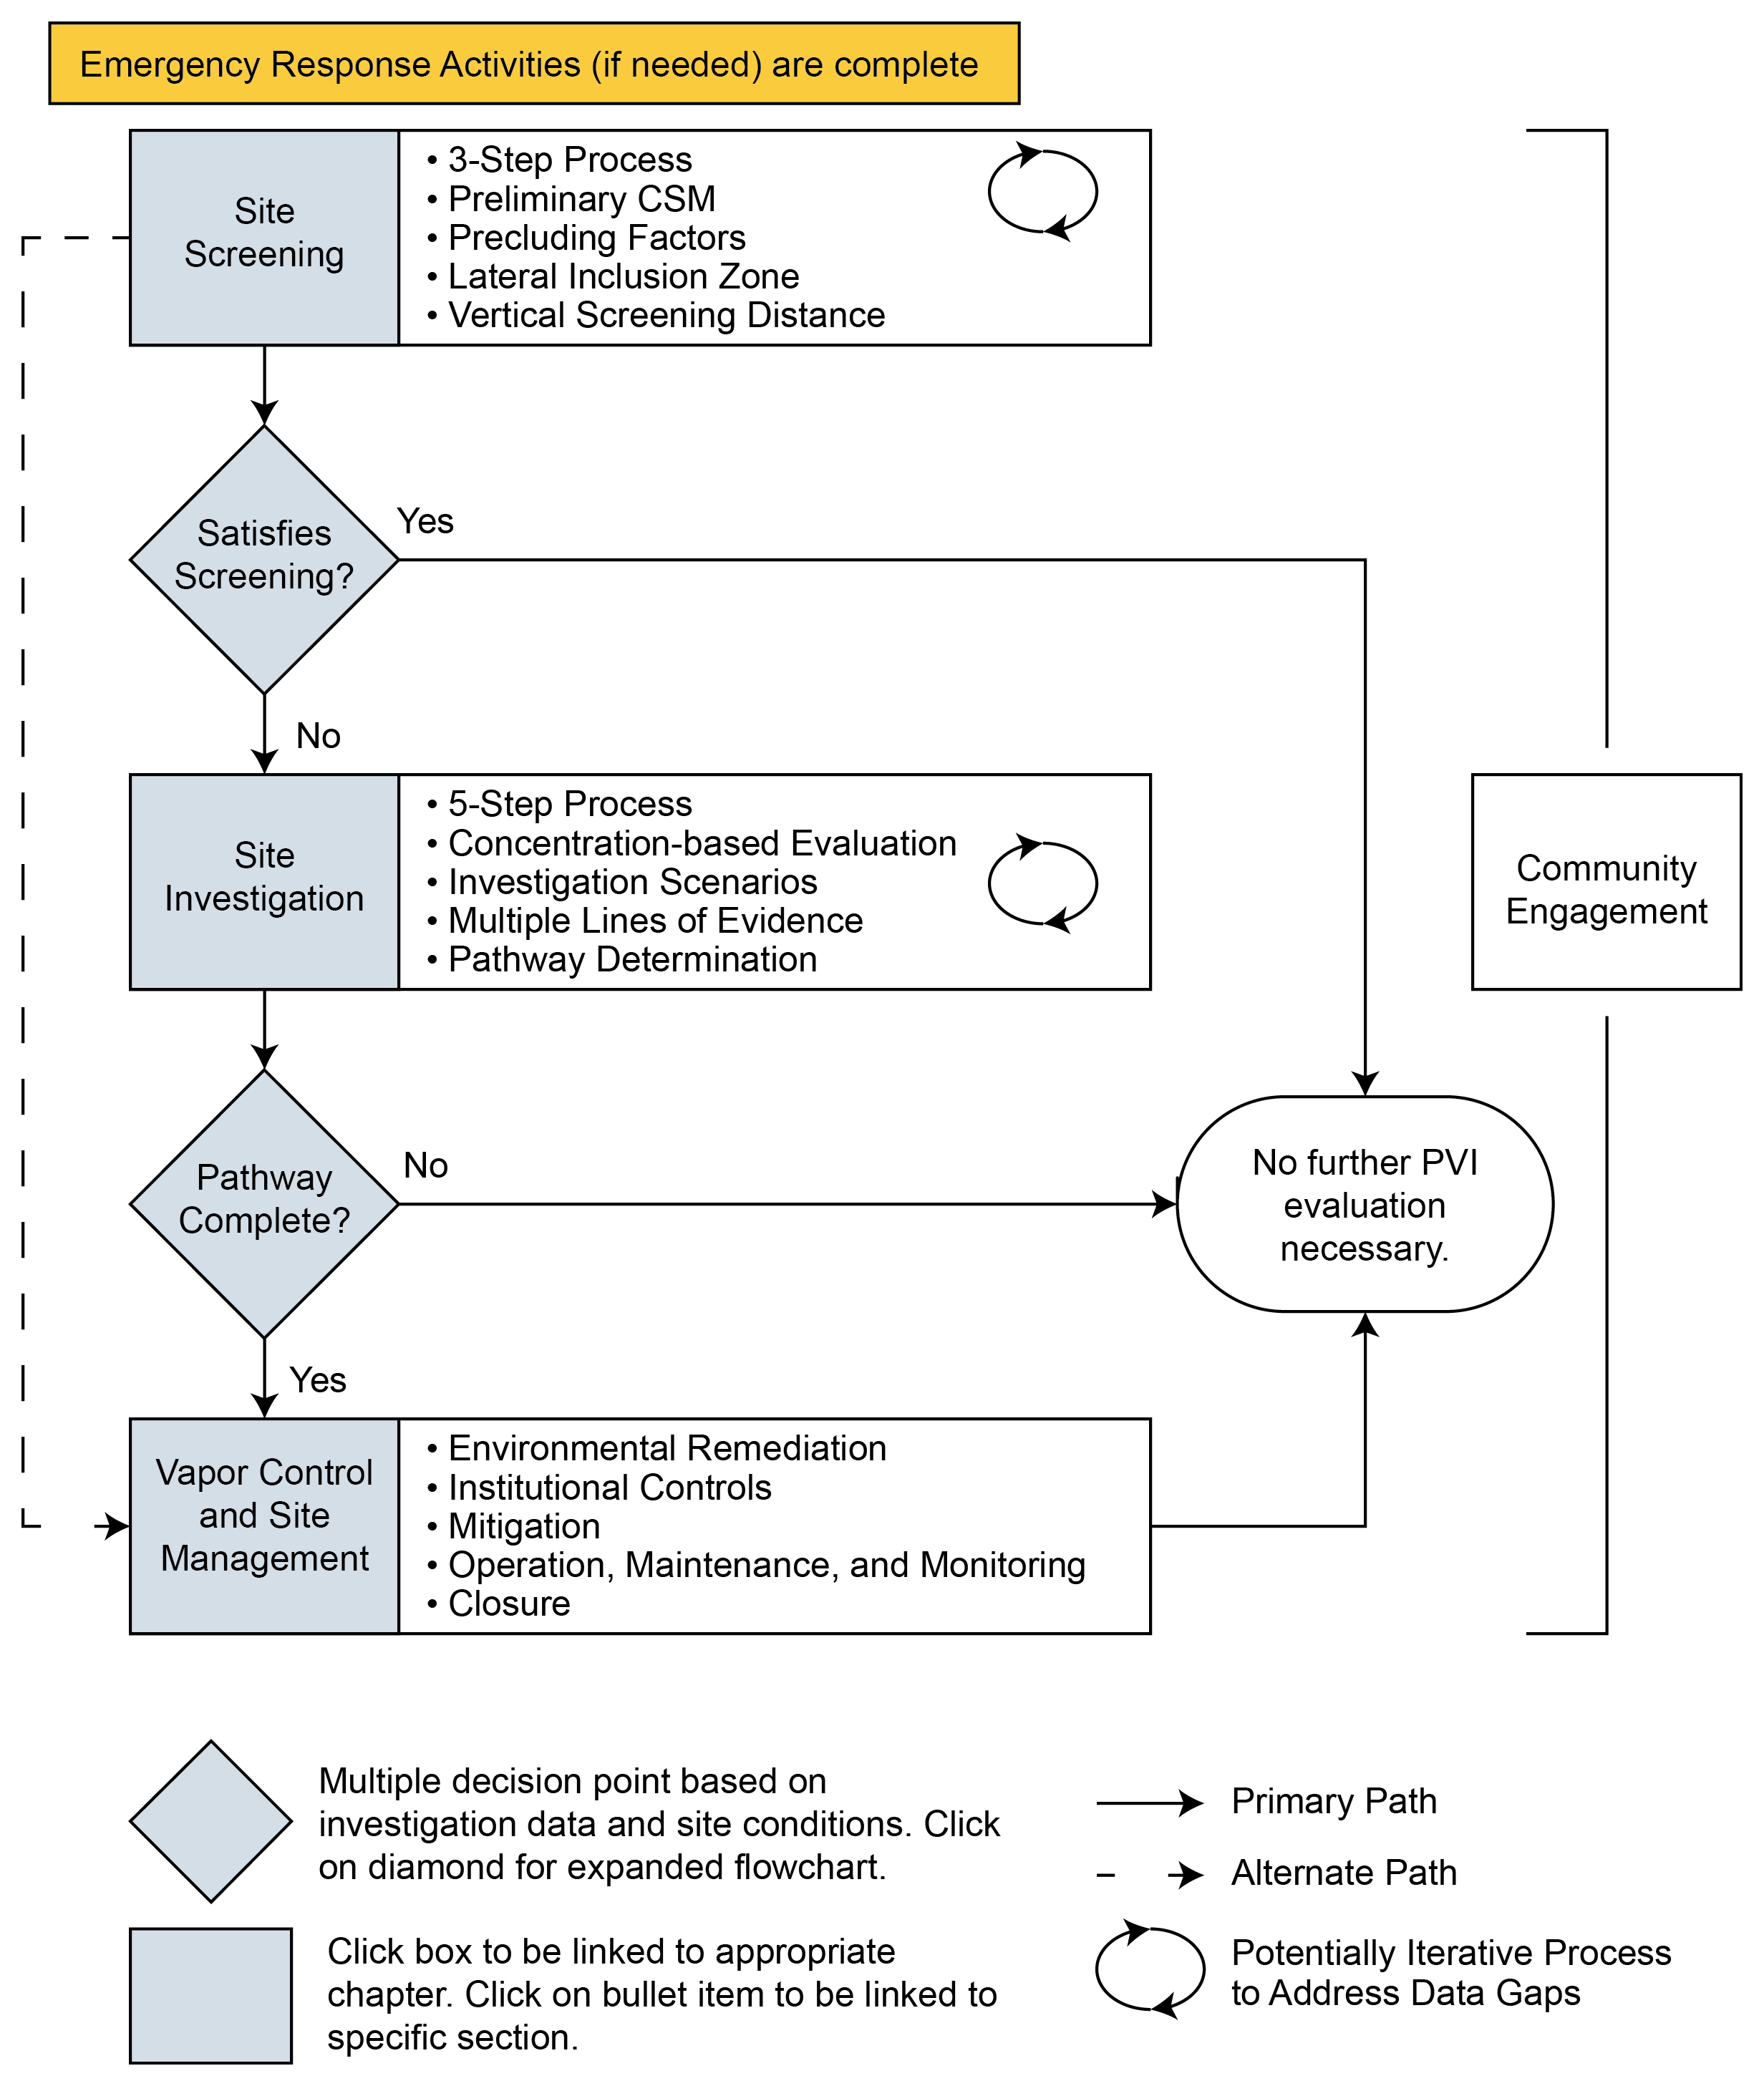
ITRC’s PVI Assessment Strategy
Handout provided
Assumes any emergency response activities are complete
Figure 1-2. PVI strategy flowchart
Emergency Situation
Strategy includes:
  Site screening using
  Vertical screening distance
  Site investigation
  Vapor Control and Site Management
ITRC PVI-1, 2014: Figure 1-2
Notes:
No associated notes.

Slide 13
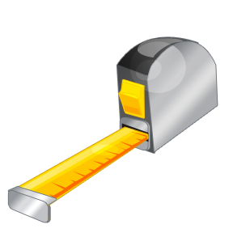
Intent of Using PVI Screening Method Based on Vertical Screening Distance
Produce consistent and confident decisions that are protective of human health
Minimize investigative efforts at sites where there is little risk of a complete PVI pathway
Prioritize resources for sites with the highest risk for a complete PVI pathway
Notes:
No associated notes.

Slide 14
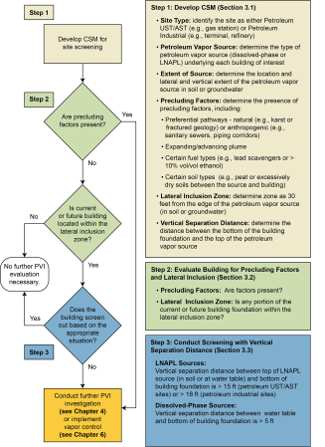
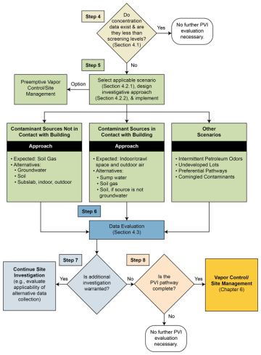
Users Follows Step-Wise Approach
Handout provided
Step 1: Develop preliminary conceptual site model (CSM)
Step 2: Evaluate site for precluding factors and lateral inclusion
Step 3: Screen building using vertical separation distance
If screening process does not allow elimination of PVI pathway:
Step 4: Conduct concentration-based evaluation using existing data
Step 5: Select and implement applicable scenario and investigative approach
Step 6: Evaluate data
Step 7: Decide if additional investigation warranted?
Step 8: Decide if the PVI pathway complete?
Notes:
Handout available at http://www.cluin.org/conf/itrc/PVI/ITRC-PVI-FlowCharts.pdf
Also available http://www.itrcweb.org/PetroleumVI-Guidance, Figures 1-2, 3-2, and 4-1

Slide 15
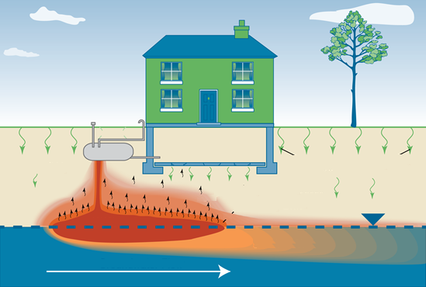
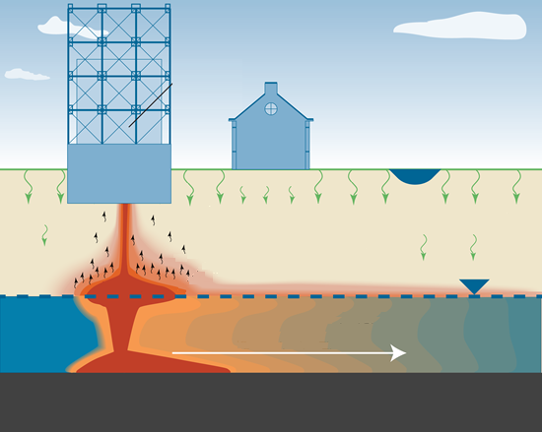
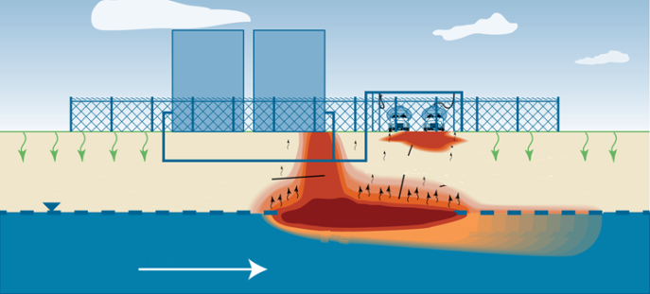
ITRC PVI Guidance Applicability
Beyond Gas Stations…….
Gasoline and diesel USTs
Commercial/home heating oil UST
Refineries
Bulk storage facilities
Pipeline/transportation
Oil exploration/production sites
Former Manufactured Gas Plants
Creosote facilities
Dry cleaners using petroleum solvents
Poll Results
ITRC PVI-1, 2014: Appendix E
Notes:
No associated notes.

Slide 16
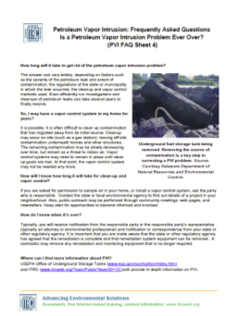
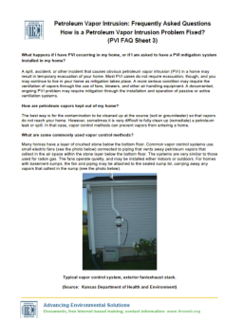
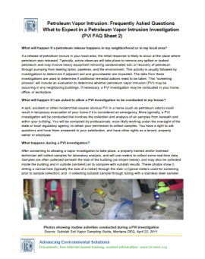
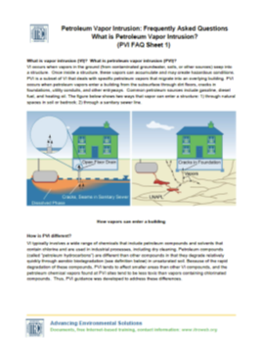
Community Engagement
Be Prepared!
PVI
PVI investigation can be disconcerting and intrusive to the public
Be prepared to address PVI-specific concerns and questions that are likely to arise during any phase of investigation, mitigation, or remediation
Community Engagement FAQs
(Appendix K)
  What is PVI?
  What to Expect in a PVI
  Investigation
  How is a PVI Problem Fixed?
  Is a PVI Problem Ever Over?
Community Engagement
ITRC PVI-1, 2014: Appendix K – Frequently Asked Questions Fact Sheets
Notes:
No associated notes.

Slide 17
How ITRC’s PVI Guidance Relates to Other Documents
Builds on the existing ITRC Vapor Intrusion (VI) guidance (VI-1, 2007) which focused primarily on chlorinated compounds vapor intrusion (CVI)
  Can be a companion to the ITRC VI 2007 guidance or stand alone
Complements the currently drafted USEPA Office of Underground Storage Tank (OUST) PVI guidance document
  Limited to USTs in comparison to ITRC PVI document applicability to various types of petroleum sites
Notes:
No associated notes.

Slide 18
After Today’s Training You Should Know:
When and how to use ITRC’s PVI document
Important role of biodegradation in the PVI pathway (in contrast to chlorinated solvent contaminated sites)
Value of a PVI conceptual site model (CSM) and list its key components
How to apply the ITRC PVI 8 step decision process to:
  Screen sites for the PVI pathway
  Take action if your site does not initially screen out
    Investigation and Modeling
    Vapor Control and Site Management
When and how to engage with stakeholders
Notes:
No associated notes.

Slide 19
Today’s Road Map
Introduction
PVI Pathway
Site Screening
Community
Engagement
Participant Questions
PVI Pathway
Investigation & Modeling
Vapor Control &
Site Management
Participants Taking Action
Participant Questions
Notes:
No associated notes.

Slide 20
PVI Pathway
Learning Objectives
Value of a PVI conceptual site model (CSM) and list its key components
Important role of biodegradation in the PVI pathway (in contrast to chlorinated solvent contaminated sites)
  Factors that influence aerobic biodegradation of petroleum vapors
PVI Pathway
Notes:
Biodegradation
3 factors: distance, concentration, oxygen (O2)

Slide 21
PVI Pathway
Characteristics of PVI
Vapor intrusion and vapor flow basics
Differences between PVI vs. CVI (chlorinated vapor intrusion)
Biodegradation – and why we can rely on it
  Evidence for biodegradation
  The importance of O₂
Case studies/interactions demonstrating biodegradation
PVI conceptual site model (CSM)
PVI Pathway
ITRC PVI-1, 2014: Chapter 1 and Chapter 2
Notes:
No associated notes.

Slide 22
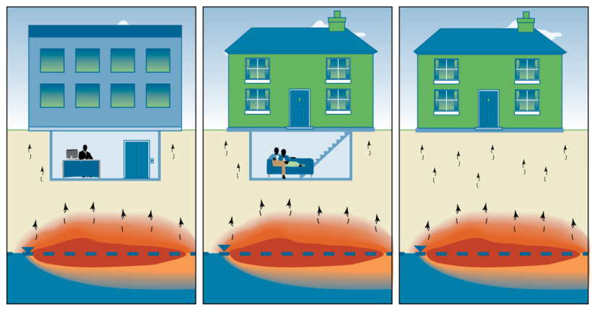
Vapor Intrusion – Vapor Flow
Limited By:
Buildings (air exchange, positive pressure, background)
Building foundations (intact, no cracks or unsealed penetrations)
Vadose zone
  High soil moisture or clay (no vapor migration)
  Aerobic biodegradation
  Lateral offset
Source and groundwater
  Clean water lens over source, clay layers
  Finite source mass, saturated vapor limits
PVI Pathway
KEY
POINT:
Presence of subsurface source does not always result in observed vapor intrusion.
Notes:
CSM
4 compartments or components:
Building, foundation, soil layer (separating), vapor source
Vapors need to get from ‘source’ to enclosure to be a risk.
In many instances petroleum vapors can’t (don’t) make it from the source to the enclosure.
For any one or more of the listed reasons
We focus on aerobic biodegradation, because it is significant and nearly ubiquitous.

Slide 23
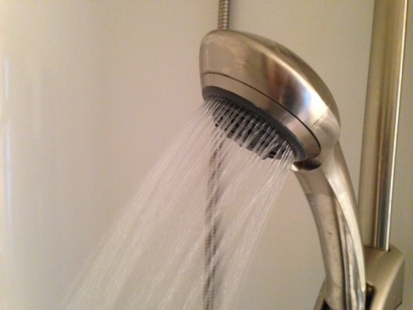
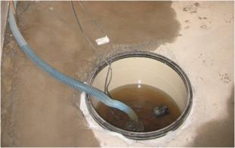
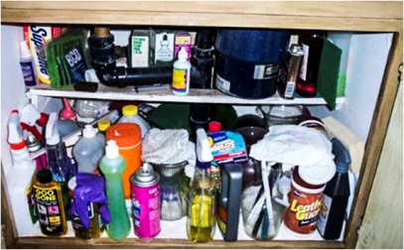
Vapor Impacts to Indoor Air, NOT Related to VI Pathway
Other potential issues:
Ambient outdoor air quality
Vapors off-gassing from tap water
Impacted water or product inside a building
Household or commercial products stored or used in a building
Building materials containing volatile compounds
Household activities
PVI Pathway
Notes:
There are other conceptual models for vapor intrusion.
Not covered here.
There’s also other potential risk ‘impacts’ at sites (groundwater ingestion, soil contact, etc.), again, not covered here.

Slide 24
Poll Question
What is your level of experience with addressing chlorinated compound vapor intrusion (CVI) sites?
  No experience
  Very limited experience (just a couple of sites)
  Some experience (somewhere in between)
  Extensive experience (more than 15 sites)
Poll Question
Notes:
No associated notes.

Slide 25
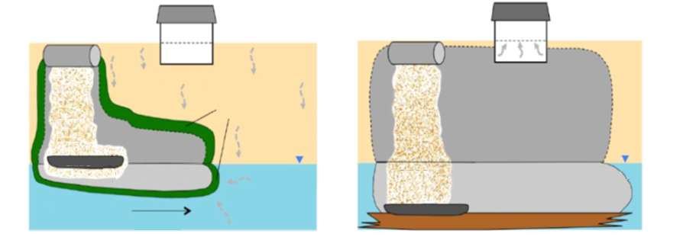
Differences Between PVI and CVI
Figure:
Petroleum Hydrocarbons And Chlorinated Solvents Differ In Their Potential For Vapor Intrusion (PDF). EPA. March 2012.
O₂ Transport
Potential Vapor Plume
Aerobic Bio-degradation Zones
Residual LNAPL
Vapor Plume
LNAPL
LNAPL
Residual DNAPL
Dissolved Plume
Dissolved Plume
Smear Zone
DNAPL
Variable | PVI | CVI
Type of chemical | non-chlorinated hydrocarbon | chlorinated hydrocarbon
Example | Benzene | perchloroethylene (PCE)
Source Type | LNAPL | DNAPL
Aerobic biodegradation | Consistently very rapid | Consistently very limited
Vapor intrusion potential | low | High
Degradation products | CO₂, H₂O | intermediates
PVI Pathway
KEY
POINT:
Soil vapor clouds for CVI are bigger than for PVI. Why? Answer: Aerobic Biodegradation
Notes:
Graphic is from an EPA publication (as noted)
Petroleum Hydrocarbons And Chlorinated Solvents Differ In Their Potential For Vapor Intrusion (PDF). EPA. March 2012.
http://www.epa.gov/oust/cat/pvi/index.htm
Key: different chemicals behave differently

Slide 26
Petroleum Vapors Biodegrade Rapidly
Petroleum biodegradation
  Occurs reliably
    Microorganisms are ubiquitous
  Starts rapidly
    Short acclimation time
  Occurs rapidly
    Where oxygen is present
PVI Pathway
KEY
POINT:
Microbial communities can start consuming PHCs within hours or days of the introduction of PHCs into the subsurface.
Notes:
No associated notes.

Slide 27
Biodegradation is Widely Recognized as a Significant Process
US EPA. 2002. Draft Guidance . EPA/530/D-02/004
US EPA. 2005. EPA/600/R-05/106
ITRC, 2007. Vapor intrusion: A practical guideline
US EPA, 2012. Hydrocarbons and Chlorinated Solvents Differ in their potential for vapor intrusion
USEPA, 2013. Draft - OSWER – Assessing Mitigating VI
USEPA, 2013, Draft – OUST - Guide for PVI at USTs
Others …
many hundreds of peer-reviewed publications.
PVI Pathway
KEY
POINT:
Aerobic petroleum biodegradation is significant. We can use this in practical evaluation of PVI.
Notes:
Biodegradation gets mentioned in regulatory guides (as listed).
Also there are many hundreds (if not near thousands) of publications referring to petroleum chemical biodegradation.
Refs [for information]:
US EPA. 2002. Draft Guidance for Evaluating the Vapor Intrusion to Indoor Air Pathway from Groundwater and Soils (Subsurface Vapor Intrusion Guidance). EPA/530/D-02/004, U.S. Environmental Protection Agency Office of Research and Development, Washington, DC, Washington, D.C., November, 2002: pp. 52.
Tillman, F.D., and J.W. Weaver. 2005. Review of recent research on vapor intrusion. EPA/600/R-05/106, U. S. Environmental Protection Agency Office of Research and Development, Washington, DC, September, 2005: pp. 41.
ITRC. 2007. Vapor intrusion: A practical guideline. Interstate Technology & Regulatory Council, Washington, D.C., January, 2007: pp. 74.
US EPA. 2011. Petroleum Hydrocarbons And Chlorinated Hydrocarbons Differ In Their Potential For Vapor Intrusion. United States Environmental Protection Agency, Washington, D.C., September, 2011: pp. 13.
USEPA: OSWER FINAL GUIDANCE FOR ASSESSING AND MITIGATING THE VAPOR INTRUSION PATHWAY FROM SUBSURFACE SOURCES TO INDOOR AIR (EXTERNAL REVIEW DRAFT), April 2013. U.S. Environmental Protection Agency Office of Solid Waste and Emergency Response.
USEPA: Guidance For Addressing Petroleum Vapor Intrusion At Leaking Underground Storage Tank Sites, U.S. Environmental Protection Agency, Office of Solid Waste and Emergency Response, Office of Underground Storage Tanks
Washington, D.C. April 2013.

Slide 28
Aerobic Biodegradation Basics
PVI Pathway
Many bacteria
PHC degrading bacteria are found in all environments and can consume hydrocarbons rapidly in presence of O2, limiting transport of petroleum vapors.
KEY
POINT:
Notes:
No associated notes.

Slide 29
Influences on Extent and Rate of Biodegradation
Key factors:
Concentration of vapor source
Distance vapors need to travel to potential receptors
Presence of O₂ between source and potential receptors
PVI Pathway
Notes:
No associated notes.

Slide 30
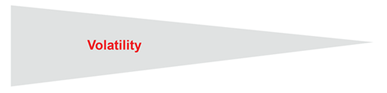
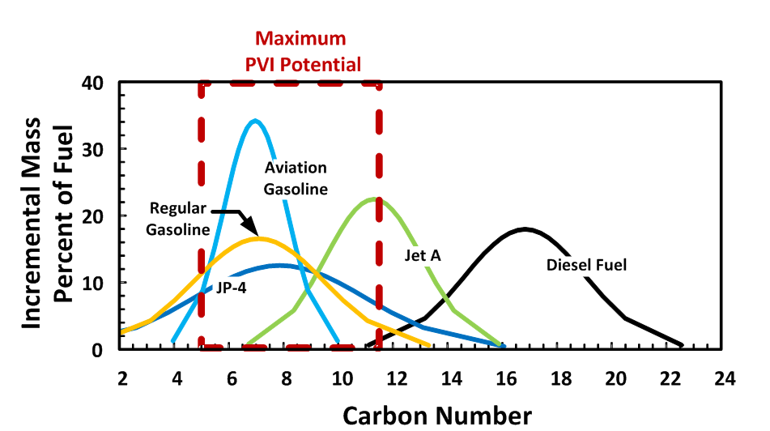
Vapor Source
PVI Pathway
See Figure 2-3 ITRC PVI Guide
Notes:
No associated notes.

Slide 31
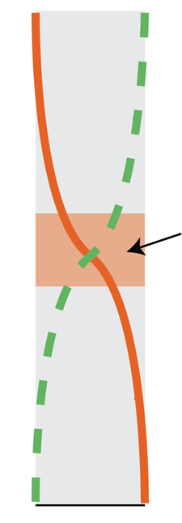
Observed Petroleum Vapor Soil Gas Profiles
0₂
Lower Concentration Source | Higher Concentration Source
Dissolved Groundwater Source | LNAPL Source
Clean Soil Model | Dirty Soil Model
Deeper ‘reaction zone’ | Shallower ‘reaction zone’
Lower VOC surface flux | Higher VOC surface flux
Lower Oxygen Demand | Higher Oxygen Demand
Aerobic Biodegradation Front
PVI Pathway
Hydrocarbon
0
1
Relative soil-gas concentrations
Notes:
This shows a ‘slice’ of the conceptual model: The soil compartment

Slide 32
Evidence for Aerobic Biodegradation
Case Study
Inverse relationship of oxygen and petroleum vapors
Inverse relationship of oxygen and carbon dioxide
Oxygen
Carbon Dioxide
Benzene
LNAPL
Beaufort, SC NJ-VW2 (Lahvis,et al., 1999)
Coachella, CA COA-2
(Ririe, et al 2002)
Salina Cash Saver VMW-1 (UDEQ 7/27/07)
Notes:
soil gas profiles for a number of sites.
Vapor source (here benzene) at depth
Oxygen at surface (21%v/v)
Profiles are complementary.
Carbon dioxide supports concept of biodegradation and transformation.
Note source and surface separation distance

Slide 33
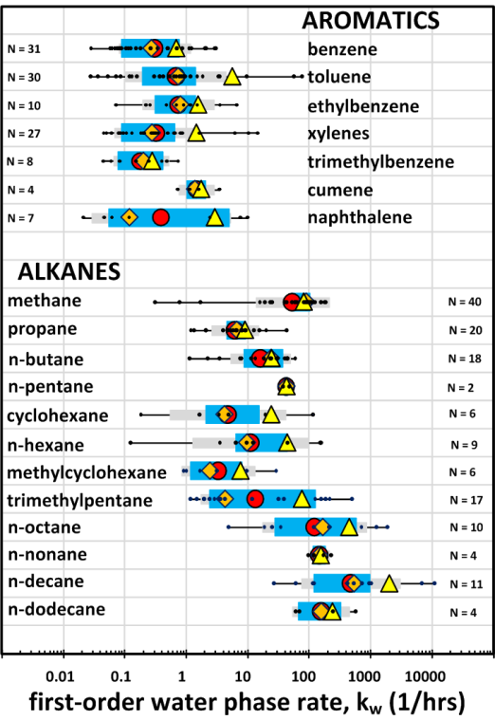
Aerobic Petroleum Biodegradation Rates in Soil: Compiled Data
Empirical data
  From field measurements, columns, microcosms.
  First-order. Normalized by ‘water-phase’ concentration
Applicability
  Scenario-specific
  For aerobic, air connected vadose-zone soils
  Don’t mix rates (not interchangeable with ground- water or source-zone attenuation rates)
PVI Pathway
ITRC PVI-1, 2014: Figure I-1
Notes:
From the soil gas profiles data on the prior slide, as well as a lot of other field and laboratory data, we can estimate degradation rates.
Aerobic data.
For air-connected vadose zone soils.
This is from the ITRC PVI guide if you want more detail.
Overall, these rates are fast (compared to soil diffusion); but not infinite.
Final note that these rates are specific to the scenario (vadose zone soils).
They are normalized to ‘water phase’ concentrations; since the biodegradation occurs in the water phase and at rates proportional to water-phase concentration.
Other rates (groundwater, LNAPL source depletion) are different; don’t mix them up.

Slide 34
Aerobic Petroleum Biodegradation Rates in Soil
With these rates
  In aerobic soils, petroleum chemicals attenuate over relatively short distances
  50% decrease in 5 to 50 cm
    Approximate range
    Depending on soil conditions
PVI Pathway
KEY POINTS: Rates are fast – compared with diffusion;
geometric decrease in concentration over distance
Notes:
No associated notes.

Slide 35
Environmental Effects on Biodegradation
Despite general reliability of aerobic biodegradation in reducing PVI, it can be limited by availability of O₂
  Oxygen into subsurface
    Under building foundations
  Limited soil diffusion
    Soils with high moisture
    Soils with low permeability
  Oxygen demand
    Presence of high PHC concentrations (e.g., near LNAPL source)
    Soils with high organic content
PVI Pathway
Notes:
While occurs reliably, can be limited
Depends on O2 into soil
Factors such as foundations, soils, distance (in soil) can limit oxygen in the subsurface.
Also oxygen demand from other petroleum chemicals, or from organic matter in soil (such as very peaty soils) will have high oxygen demand.

Slide 36
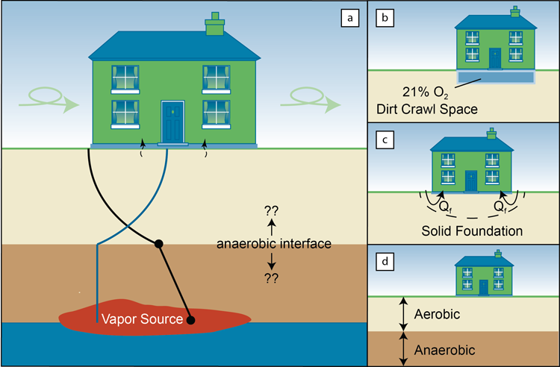
Common Question: Is there enough O2 under buildings to support biodegradation?
Answer: Generally, Yes, even modest O2 transport yields sufficient aerobic biodegradation in most cases
PVI Pathway
KEY
POINT:
Two key factors – both needed – to run out of oxygen:
Limited oxygen transport below the foundation
High oxygen demand
Notes:
Question:
Does O₂ get into soils?
Answer:
Generally yes.
It is hard to keep 21% O₂ in ambient air out of unsaturated soils.

Slide 37
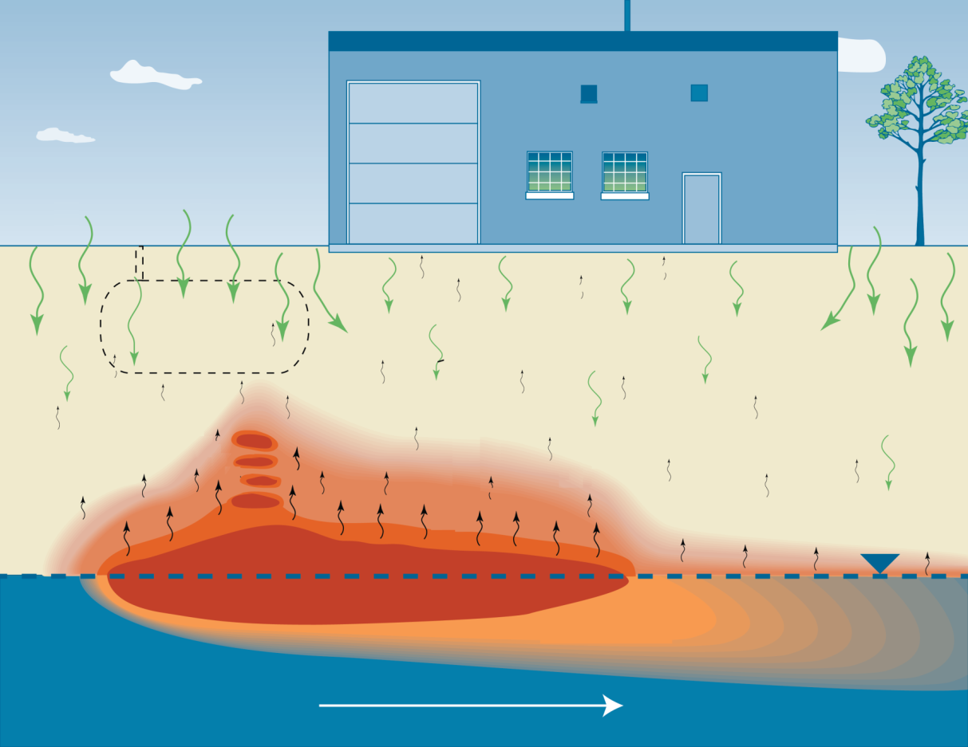
PVI – General Conceptual Site Model (CSM)
O₂
O₂
Former UST Location
Oxygen Diffusion
PVI Pathway
Vadose Zone
Petroleum Vapor
Anaerobic Zone
Aerobic Biodegradation Zone
biodegradation
Dissolved Plume
Notes:
Showing a figure for a – revisited – conceptual model.
Shows both petroleum vapors and O2
Degradation zone within the soil layer
Separation between the vapor ‘source’ and the building foundation.

Slide 38

Community Engagement
What is PVI?
PVI
What is VI? What is PVI?
What is aerobic biodegradation
What is the most common cause of PVI?
Where is PVI most likely to occur
What are the health effects caused by PVI?
What do I do if I suspect that PVI is occurring?
Where can I find more information about PVI?
Community Engagement
ITRC PVI-1, 2014: Appendix K – Frequently Asked Questions Fact Sheets
Notes:
No associated notes.

Slide 39
PVI Pathway
Summary
Petroleum biodegradation
  Evidence
  Rates
Oxygen in the subsurface
  Lots of oxygen in air
  It does not take much in the subsurface for significant biodegradation
Be prepared for community engagement
PVI Pathway
Notes:
No associated notes.

Slide 40
Today’s Road Map
Introduction
PVI Pathway
Site Screening
Community
Engagement
Participant Questions
Site Screening
Investigation & Modeling
Vapor Control &
Site Management
Participants Taking Action
Participant Questions
Notes:
No associated notes.

Slide 41
Site Screening
Outline and Learning Objectives
Outline
  Describe the conceptual site model
  Summarize the empirical basis for screening
  Describe the step-wise approach
  Provide case study example
Learning Objectives
  Understand basis for site screening and how to implement the step-wise approach
  Apply the screening approach at potential PVI site using a case study
Site Screening
Notes:
No associated notes.

Slide 42
Site Screening
Definition and Rationale
New method for PVI screening
Based on the vertical screening distance
  Minimum soil thickness between a petroleum vapor source and building foundation necessary to effectively biodegrade hydrocarbons below a level of concern for PVI
Based on empirical data analysis and modeling studies
Approach expected to improve PVI screening and reduce unnecessary data collection
Site Screening
Notes:
No associated notes.

Slide 43
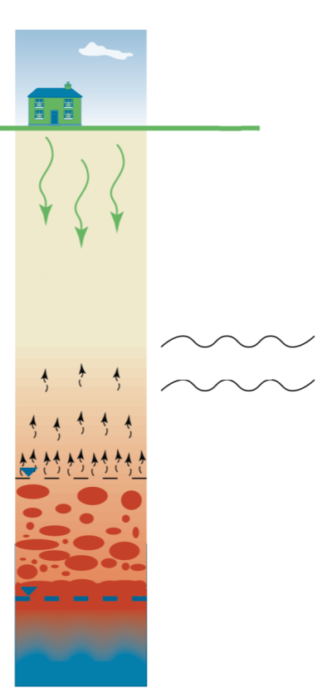
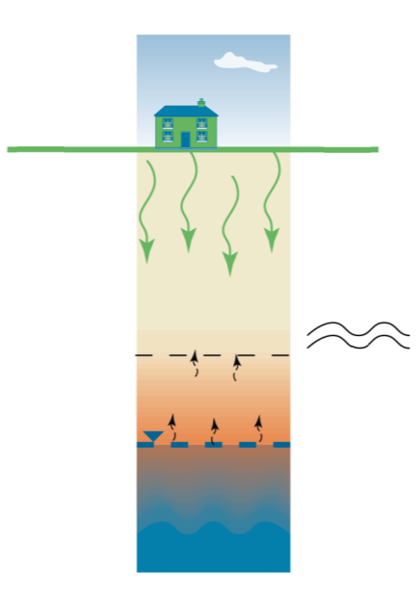
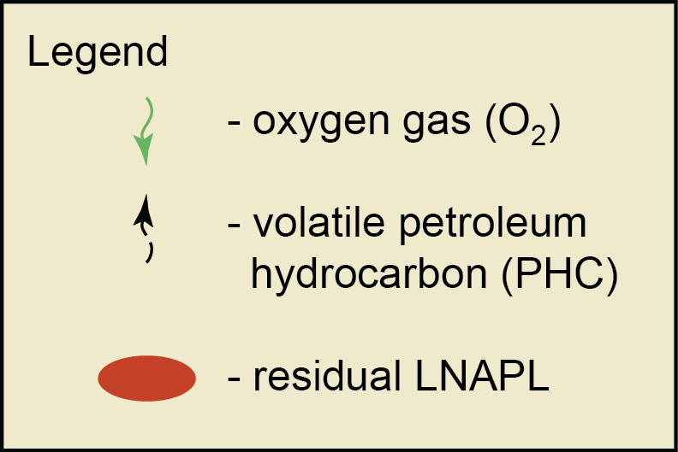
Conceptual Model of
Vertical Screening Distances
Vertical screening distances
LNAPL Source
Dissolved Phase Source
5 feet – dissolved-phase sources
15 feet - LNAPL sources (petroleum UST/AST sites)
18 feet – LNAPL sources (petroleum industrial sites)
Vertical Separation Distance
Unsaturated Zone
Aerobic Zone
Aerobic Zone
Vertical Separation Distance
Unsaturated Zone
Water Table
Site Screening
Aerobic Bio-degradation Interface
Aerobic Bio-degradation Interface
Saturated Zone
Water
Table
Anaerobic Zone
Includes Residual LNAPL in soil and smear zone
Saturated Zone
ITRC PVI-1, 2014: Figure 3-1
Notes:
UST – underground storage tanks
AST – above ground storage tanks

Slide 44
Basis for Site Screening
Large body of research on analysis of empirical data and modeling document the significance of vadose zone biodegradation and support vertical screening distances:
  Davis (2009, 2010)
  Peargin and Kolhatkar, (2011)
  Wright (2011)
  USEPA (2013)
  Lahvis et al. (2013)
  Wright (2013)
Groundwater, soil and soil gas data from hundreds of petroleum release sites spanning a range of environmental and site conditions and geographical regions
Site Screening
ITRC PVI-1, 2014: see Appendix F for details
Notes:
No associated notes.

Slide 45
USEPA Database
Starting point was database by Robin Davis (State of Utah)
Expanded database by adding new sites and fields
Focus of analysis (main EPA report) was 74 sites; additionally, data for 124 Australian sites analyzed separately (Appendix C to EPA report)
Checked data, screened data based on quality indicators, added filters
Mostly gasoline sites (data obtained 1995-2011)
38 sites with soil vapor data below buildings
Analysis conducted for three site and source types: 1) dissolved phase sites, 2) LNAPL – UST/AST sites and 3) LNAPL – petroleum industrial sites
Site Screening
74 sites in main database!
Notes:
No associated notes.

Slide 46
USEPA Database – Number of Sites
4
Canada
1
13
22
3
4
15
1
7
Site Screening
1
1
Additionally 124 Australian sites separately analyzed
1
1
US Unknown
1
Australia
Notes:
No associated notes.

Slide 47
USEPA Database Number of Soil Vapor Analyses
CH₄
B
CO₂
T
O₂
E
Site Screening
X
TPH
N
829 paired measurements of contaminants in groundwater and associated soil vapor concentrations
Analysis conducted for 10 compounds plus TPH fractions!
Notes:
No associated notes.

Slide 48
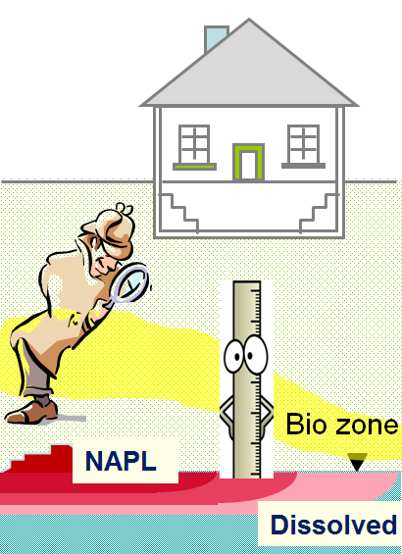
Empirical Data Analysis
Probability-based method: soil vapor concentrations compared to risk-based threshold vapor concentrations for varying vertical distances
Vertical distance of vapor attenuation based on distance between vapor probes required to attenuate benzene to 50-100 µg/m³; consideration of 100-fold (0.01) attenuation from subsurface to indoor air.
Non-detects addressed through robust substitution, Kaplan-Meier method
Distance
Threshold
Site Screening
Concentration
Notes:
No associated notes.

Slide 49
USEPA Vertical Distance Method – Dissolved Source
Dissolved Phase Source
Vertical Separation Distance
Unsaturated Zone
Aerobic Zone
Water Table
Site Screening
Aerobic Bio-degradation Interface
Saturated Zone
Benzene requires greatest distance to attenuate
Vertical screening distance = 5 feet
Notes:
No associated notes.

Slide 50
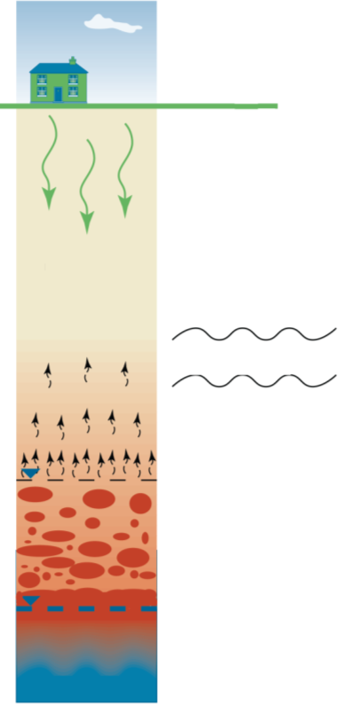
USEPA Vertical Distance Method – LNAPL Source UST/AST Sites
LNAPL Source
Aerobic Zone
Vertical Separation Distance
Unsaturated Zone
Site Screening
Aerobic Bio-degradation Interface
Water
Table
Anaerobic Zone
Saturated Zone
Vertical screening distance = 15 feet
Notes:
No associated notes.

Slide 51
USEPA Vertical Distance Method – LNAPL Source Industrial Sites
LNAPL Source
Benzene vs. Distance
-
NAPL (Industrial)
1.E+07
> DL N=196
18 ft
< DL N=55
1.E+05
Benzene Vapor Conc. (μg/m³)
1.E+03
100
μ
Aerobic Zone
g/m
3
50
μ
1.E+01
g/m
3
Vertical Separation Distance
Unsaturated Zone
1.E-01
-10
10
30
50
Source
-
probe separation Distance (ft)
Site Screening
Benzene Conditional Probability
-
NAPL
Aerobic Bio-degradation Interface
100
80
Water
Table
60
Anaerobic Zone
Probability Conc < Threshold
<100 & < 50 data are the same
40
20
Probability < 100 (1/2DL)
Probability < 50 (1/2DL)
Saturated Zone
Vertical screening distance = 18 feet (limited data)
0
0
10
20
30
Source probe separation distance (ft)
Notes:
No associated notes.

Slide 52
The Effect of Soil Gas Screening Level on Screening Distance
What if my agency recommends lower soil gas screening levels than those used in the empirical studies?
Distances
are relatively
insensitive to
the soil gas
screening
level
Benzene soil gas screening level (µg/m³) | LNAPL screening distance (feet) | Dissolved-phase screening distance (feet)
100 < | 13.2 | 0.3
50 < | 13.6 | 0.91
30 < | 14.0 | 1.5
20 < | 14.3 | 2.0
10 < | 14.8 | 3.0
5 < | 15.4 | 4.1
KEY
POINT:
The vertical screening distances are protective to very low soil gas screening levels.
Notes:
Add to presentation after slide No. 54 in ITRC_PVI_110514ibt.ppt
Table from Appendix F
Discuss.
There’s also a number of other questions answered concisely in this appendix -

Slide 53
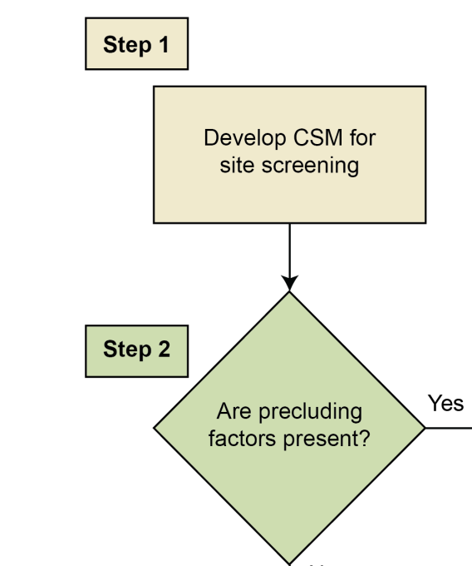
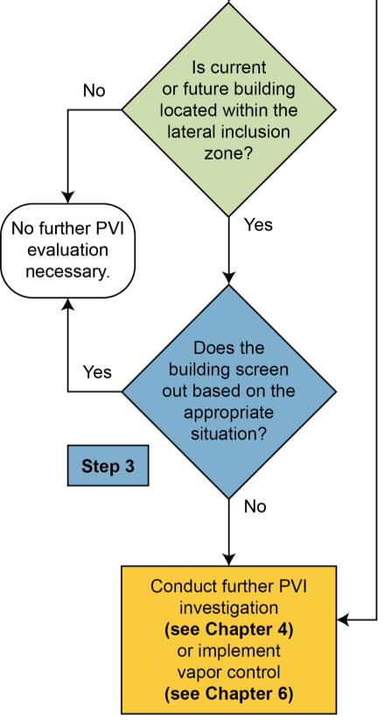
Using the Site Screening Process
Handout provided
Site Screening
No
ITRC PVI-1, 2014: Figure 3-2
Notes:
No associated notes.

Slide 54

Step 1: Develop Conceptual Site Model (CSM)
Preliminary CSM using soil and groundwater data collected as part of routine initial site investigation
Visualization of site conditions, allows for evaluation of contaminant sources and impacted media, migration pathways, and potential receptors
For PVI CSM
  Site type
  Petroleum vapor
  source
  Extent of source
  Precluding factors
  Lateral inclusion zone
  Vertical separation
  distance
O₂
O₂
Site Screening
Former UST Location
Oxygen Diffusion
Anaerobic Zone
Aerobic Biodegradation Zone
Vadose Zone
Dissolved Plume
Notes:
No associated notes.

Slide 55
Step 1: Develop CSM
Site Type
Site type
  Petroleum UST/AST sites
    e.g., service stations or similar
  Petroleum industrial sites
    e.g., terminals, refineries, pipelines
Differences in the vertical screening distances according to site type may relate to the volume of the LNAPL release or extent of the LNAPL plume.
Site Screening
KEY
POINT:
Notes:
No associated notes.

Slide 56
Step 1: Develop CSM
Petroleum Vapor Source
Petroleum vapor source (Table 3-1)
  LNAPL vs dissolved-phase source
  Multiple lines of evidence approach
    Direct indicators (LNAPL, sheen)
    Indirect indicators (concentrations, PID readings, etc.)
  LNAPL source includes sites with free-phase or residual LNAPL (which may be difficult to detect)
Site Screening
Notes:
No associated notes.

Slide 57
Step 1: Develop CSM
Petroleum Vapor Source
Table 3-1. General LNAPL indicators for PVI screening
Indicator | Comments
Groundwater
Benzene: > 1 - 5 mg/L TPH_{(gasoline)}: > 30 mg/L BTEX: > 20 mg/L Current or historical presence of LNAPL (including sheens) | There is not a specific PHC concentration in groundwater that defines LNAPL because of varying product types and degrees of weathering.
Soil
Current or historical presence of LNAPL (including sheens, staining) Benzene > 10 mg/kg TPH _{(gasoline)} > 250 - 500 mg/kg Ultraviolet fluorescence (UV) or laser induced fluorescence (LIF) fluorescence response in LNAPL range PID or FID readings > 500 ppm | The use of TPH soil concentration data as LNAPL indicators should be exercised with caution. TPH soil concentrations can be affected by the presence of soil organic matter. TPH soil concentrations are not well correlated with TPH or O₂ soil gas concentrations (Lahvis and Hers 2013b).
Location relative to UST/AST
Adjacent (e.g., within 20 feet of) a known or suspected LNAPL release area or petroleum equipment | The probability of encountering LNAPL increases closer
Site Screening
Notes:
Notes:
1 One or more of these indicators may be used to define LNAPL.
2 Value used in the derivation of screening distances by USEPA (2013a) and Lahvis and Hers (2013b).
3 Value used in the derivation of screening distances by Peargin and Kolhatkar (2011).
4 Value used in the derivation of screening distances by USEPA (2013a).
5 Value recommended by Lahvis and Hers (2013b).
6 Value is from ASTM E2531-06.
7 Value recommended by USEPA (2013a) and Lahvis and Hers (2013b).

Slide 58
Step 1: Develop CSM
Extent of Source
Extent of source – delineation is essential
  Top of LNAPL in groundwater, soil, and smear zone – soil sampling at sufficient frequency with field screening and lab analysis
  Dissolved plume – edge of plume using MCLs, detection limits or other criteria
Site Screening
Notes:
No associated notes.

Slide 59
Step 1: Develop CSM
Precluding Factors
Precluding factors
  Preferential pathways (natural, karst or fractured geology, or anthropogenic, sewers)
  Expanding/advancing plume
    See also ITRC’s Evaluating LNAPL Remedial Technologies for Achieving Project Goals (LNAPL-2, 2009)
  Certain fuel type (e.g., lead scavengers or > 10% vol/vol ethanol)
    See also ITRC's Biofuels: Release Prevention, Environmental Behavior, and Remediation (Biofuels-1, 2011)
  Certain soil types (e.g., peat [foc>4%] or very dry soils [<2% by vol.])
Site Screening
Notes:
No associated notes.

Slide 60
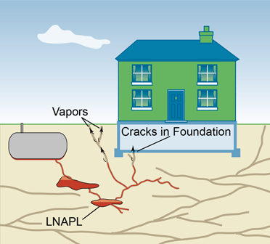
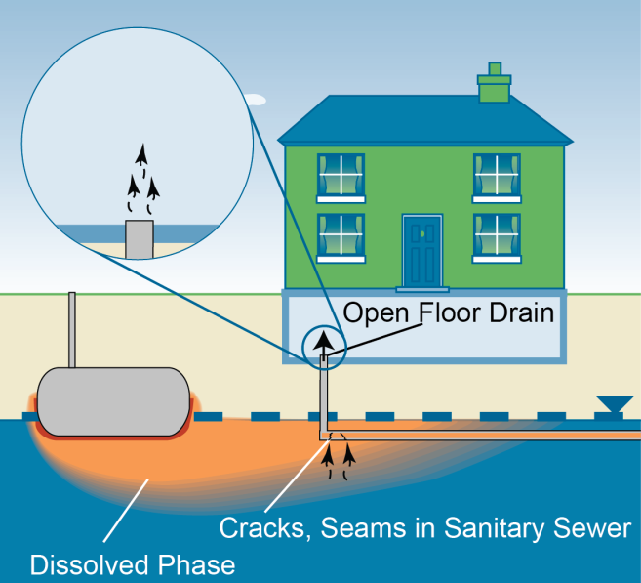
Precluding Factors – Preferential Pathways
Site Screening
Precluding factor: fractured or karst geology
Precluding factor: conduit intersecting source and entering building
ITRC PVI-1, 2014: Figure 3-3, 3-4
Notes:
No associated notes.

Slide 61
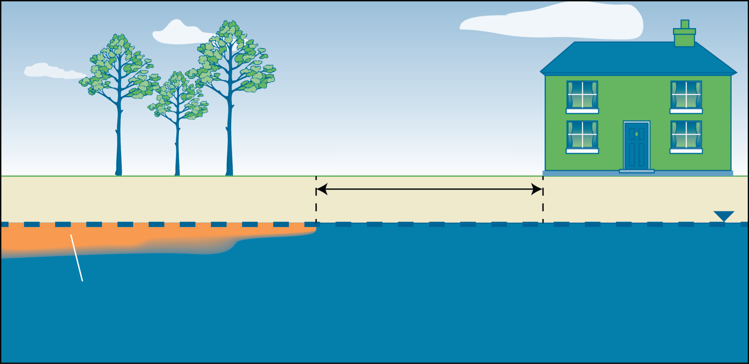
Step 1: Develop CSM
Lateral Inclusion Zone
Lateral inclusion zone
  30’ from leading edge of contamination to building
Lateral Inclusion Zone
Site Screening
x > 30 ft
Dissolved Phase
Notes:
No associated notes.

Slide 62
Step 1: Develop CSM
Vertical Separation Distance
Dissolved Phase Source
Vertical separation distance
  Measured from top of the petroleum vapor source to the bottom of the building foundation
    Consider water table fluctuations
Vertical Separation Distance
Unsaturated Zone
Aerobic Zone
Site Screening
Water Table
Aerobic Bio-degradation Interface
Saturated Zone
Notes:
No associated notes.

Slide 63
Step 2: Evaluate Building for
Precluding Factors and Lateral Inclusion
Are precluding factors present? (from previous slides)
If no precluding factors, determine if edge of building foundation is within lateral inclusion zone (30 feet from the edge of the petroleum vapor source).
Site Screening
Notes:
No associated notes.

Slide 64
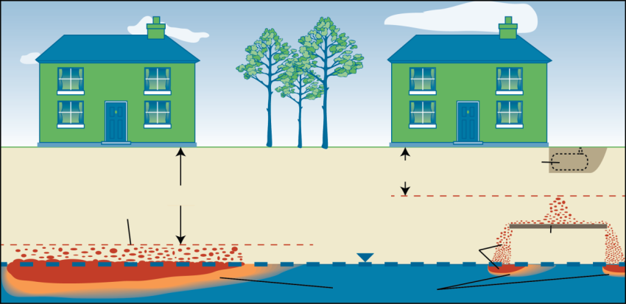
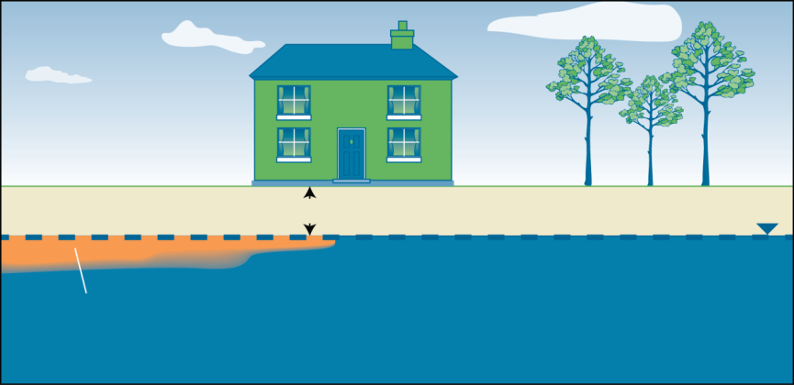
Step 3: Conduct Screening with Vertical Separation Distance
LNAPL:
Petroleum UST/AST
= 15 ft
Industrial = 18 ft
Former
UST Location
Z
Top of LNAPL Smear Zone
Z
LNAPL
Perching Unit
LNAPL
Dissolved Phase
Site Screening
Dissolved Phase Source:
All petroleum site types
= 5 ft
Z z>5 ft
Dissolved Phase
ITRC PVI-1, 2014: Figure 3-5, 3-6
Notes:
No associated notes.

Slide 65
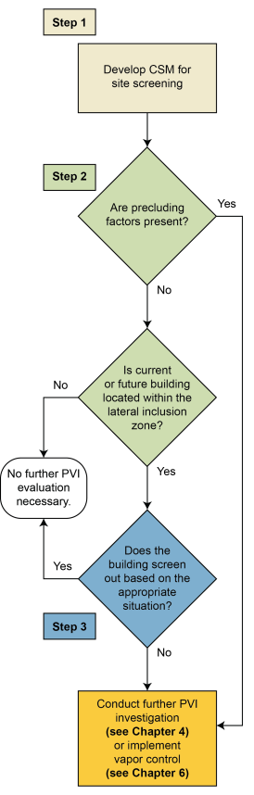
Case Study Using Vertical Screening:
Santa Clara, Utah
Step 1: Develop CSM
Step 2:
  Precluding Factors?
    No preferential pathways
    Plume stable/shrinking
    No lead scavengers and
    <10% ethanol
  Within Lateral Inclusion
  Distance?
    Yes (building <30 ft from
    dissolved source)
Step 3: Sufficient Vertical Separation?
  Yes (Dissolved source 6.83 ft below basement slab)
Further PVI Investigation?
  UDEQ determined PVI pathway not complete
6.83 ft
Benzene 2,680 ug/L
TPH-g 29,200 ug/L
Case Study
Courtesy Robin Davis UTDEQ
Notes:
No associated notes.

Slide 66
Today’s Road Map
Introduction
PVI Pathway
Site Screening
Community
Engagement
Participant Questions
Investigation & Modeling
Vapor Control &
Site Management
Participants Taking Action
Participant Questions
Notes:
No associated notes.

Slide 67
Today’s Road Map
Introduction
PVI Pathway
Site Screening
Community
Engagement
Participant Questions
Site Investigation
Investigation & Modeling
Vapor Control &
Site Management
Participants Taking Action
Participant Questions
Notes:
No associated notes.

Slide 68
Site Investigation
Overview
Site Screening (Chapter 3) did not eliminate PVI from further consideration due to:
  Insufficient vertical separation distance
  Precluding factors
  Regulatory requirements
What now?
Site Investigation (Chapter 4) and Investigation Methods and Analysis Toolbox (Appendix G)
Site Investigation
Notes:
No associated notes.

Slide 69
Site Investigation
Learning Objectives
To apply the 5-step process outlined in the Chapter 4 decision flow chart using a multiple lines of evidence approach
About additional information available in Appendix G “Toolbox” to help you select the investigative strategy that is right for your site.
  Includes list of approaches with pro/cons, methods, videos, considerations and more….
You will learn:
Site Investigation
Key
Point:
Focus the investigation only on data and lines of evidence needed to assess PVI
Notes:
No associated notes.

Slide 70

Site Investigation Process and Flow Chart
Figure 4-1
(Steps 1-3 in Chapter 3, Site Screening)
Step 4: Concentration-Based Evaluation
Step 5: Select Scenario and Design Investigation Approach
Step 6: Evaluate Data
Step 7: Determine Need for Additional Investigation
Step 8: Determine if PVI Pathway Complete
Site Investigation
Notes:
No associated notes.

Slide 71
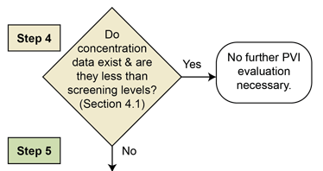
Step 4: Concentration-Based Evaluation
Site Investigation
Compare existing concentrations with screening criteria
  Criteria often vary by state/region
NOTE: Concentration-Based Evaluation is separate from vertical distance screen in Chapter 3
Notes:
No associated notes.

Slide 72
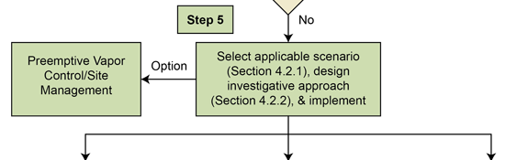



Step 5: Select Scenario and Design Investigation Approach
Other
Site Investigation
Scenario 1
Scenario 2
Consider scenarios when selecting investigation strategy and methods
Key
Point:
Understanding applicable regulatory requirements is part of designing a successful investigation.
Notes:
No associated notes.

Slide 73
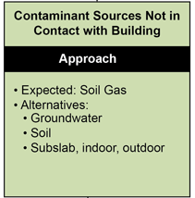
Step 5: Scenario 1 - Contamination NOT in Contact with Building
Soil gas (exterior, near-slab, or sub-slab) sampling is expected approach since:
  Reflects partitioning, sorption, and biodegradation in vadose zone between source and building
Alternative approaches may be considered
  Examples - groundwater, soil, subslab soil gas, or indoor air and outdoor air data
  Phased or concurrent sampling
Site Investigation
Notes:
No associated notes.

Slide 74
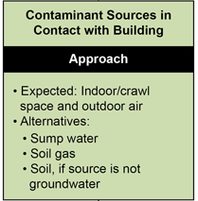
Step 5: Scenario 2 - Contamination in Contact with Building
Indoor or crawlspace and outdoor air sampling is expected approach since:
  Sub-slab soil gas sampling may not be possible
CAUTION: Interpretation of indoor results often confounded by indoor or outdoor sources of PHCs
Site Investigation
Notes:
No associated notes.

Slide 75
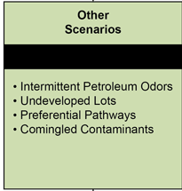
Step 5: Other Scenarios - Special Cases or Exceptions
Intermittent petroleum odors
  Walk-through
  Verification sampling
  Further investigation
Undeveloped lots
  Soil gas
  Groundwater sampling
Preferential pathways
  Indoor air sampling
Comingled contaminants
  Refer to ITRC Vapor Intrusion Pathway: A Practical Guideline V-1 (2007)
Site Investigation
Notes:
No associated notes.

Slide 76
Investigation Methods and Analysis Toolbox – Appendix G
What samples can be collected?
  Table G-6. Pros and Cons of Various Investigative Strategies
How do I ensure sample integrity during soil gas collection?
  G.5 Active Soil Gas Methods
Why should I do a pre-building survey?
  G 11.1 Pre-Sampling Building Surveys
The Tool Box is a tremendous resource and answers many questions about the What, Hows, and Whys
Site Investigation
Key
Point:
Includes videos, step-by-step instructions, list of analysis methods and more………
Notes:
No associated notes.

Slide 77
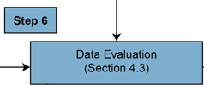
Step 6: Evaluate Data
To assess completeness and significance of the PVI pathway
KEY
POINT:
Data evaluation methods vary; check with regulatory agency
Data quality considerations
  Detection limits; false positives/negatives, and sampling errors
Multiple-lines-of-evidence evaluation (ITRC VI-1 (2007))
  Compare with screening levels
    Default, empirical, or modeled attenuation
  Compare ratios within or between sample types
  Account for potential bias from background sources
  Consider individual/cumulative strength of evidence
Site Investigation
Notes:
No associated notes.

Slide 78
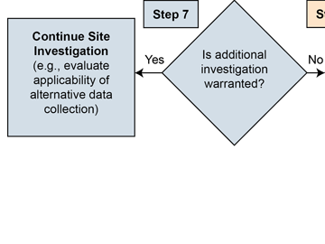
Step 7: Determine Need for Additional Investigation
Site Investigation
This step reflects iterative nature of PVI investigations
Considerations
  Delineation of pVOCs adequate?
  All potentially affected buildings considered?
  Evidence sufficiently strong to support decision?
  Vapor controls can be considered at any step
Notes:
No associated notes.

Slide 79
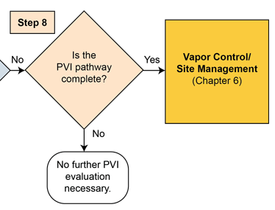
Step 8: Determine if PVI Pathway is Complete
Site Investigation
Notes:
No associated notes.

Slide 80
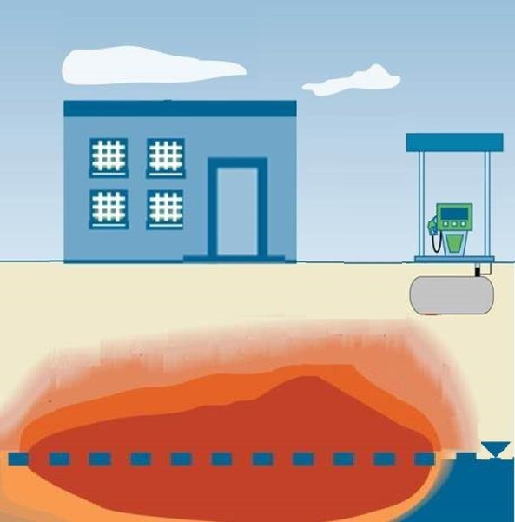
Case Study – Background
Case Study
Gasoline/Diesel Station
in Salina, UT
Operated since 1971
Black top /concrete surface
Silty/sand interbedded with fine-grained sand
Groundwater at 20 ft bgs
Petroleum releases from dispensers, product lines, and USTs
20 ft
Case Study
PVI Source
Courtesy Robin Davis UTDEQ
Notes:
No associated notes.

Slide 81

Case Study – PVI Screening
Case Study
Step 1: Develop CSM
Step 2:
  Precluding Factors?
    No preferential pathways
    Plume stable/shrinking
    No lead scavengers and
    <10% ethanol
  Within Lateral Inclusion Distance?
    Yes (building <30 ft from dissolved/LNAPL sources)
Step 3: Sufficient Vertical Separation?
  No (top of LNAPL 5 ft below slab)
Further PVI Investigation?
  Yes
5 ft
Case Study
Notes:
No associated notes.

Slide 82
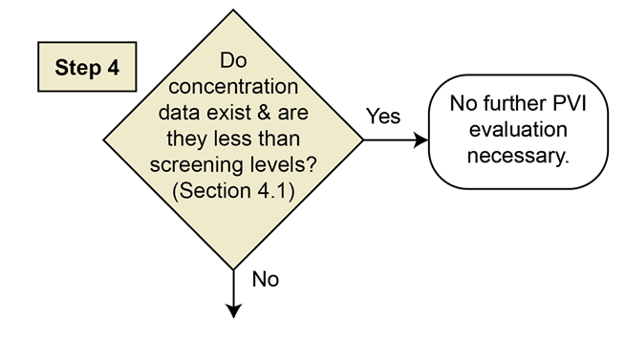

Case Study – Site Investigation
Concentration Based Evaluation
Case Study
Benzene 7,800 – 270,000 µg/m³
Case Study
Step 4: Concentrations
< Screening Levels?
Benzene near-slab (1.5 ft bgs)
soil gas: 7,800 – 270,000 µg/m³
Vapor intrusion screening level (VISL) = 50-100 µg/m³ (example only)
No, concentrations are not below screening levels, go to step 5
Notes:
No associated notes.

Slide 83


Case Study – Site Investigation
Investigation Scenario
5 ft
Case Study
Notes:
No associated notes.

Slide 84


Case Study – Site Investigation
Investigation Scenario and Strategy
Case Study
Indoor
air
Subslab
soil gas
  Outdoor
  air
5 ft
Case Study
Step 5: Select Scenario and Investigation Strategy
Contamination NOT in Contact with Building
Concurrent subslab soil gas, indoor, and outdoor air sampling (2 events)
  See Appendix G for investigative methods
Notes:
No associated notes.

Slide 85


Case Study – Site Investigation
Data Evaluation
Case Study
Benzene <4.2 –
43 µg/m³
Benzene <3.5
– 3.7 µg/m³
Benzene
<3.1 – 3.6 µg/m³
5 ft
Case Study
Step 6: Evaluate Data
Indoor/outdoor air reporting
limits >1E-06, but similar to 1E-05 risk-based VISLs
Subslab concentrations < VISLs (50-100 µg/m³ – example only)
Indoor levels similar to 1E-05 risk-based VISL, non-detect, or similar to outdoor air concentrations
VISL = Vapor Intrusion Screening Level
Notes:
No associated notes.

Slide 86


Case Study – Site Investigation
Additional Investigation/Pathway Complete?
Case Study
Step 7: Additional Investigation Warranted?
Step 8: PVI Pathway Complete?
Case Study
Benzene <3.5
– 3.7 µg/m³
Benzene <3.5 –
43 µg/m³
No (sufficient data were available)
No, since indoor levels similar to 1E-05 risk-based VISL, non-detect, or similar to outdoor air concentrations
Benzene
<3.1 – 3 .6 µg/m³
5 ft
Notes:
No associated notes.

Slide 87

Community Engagement
What to expect in a Petroleum Vapor Intrusion Investigation
PVI
What will happen if a petroleum release happens in my neighborhood or in my local area?
What will happen if I am asked to allow a PVI investigation to be conducted in my house?
What happens during a PVI investigation?
Where can I find more information about PVI investigations?
Community Engagement
ITRC PVI-1, 2014: Appendix K – Frequently Asked Questions Fact Sheets
Notes:
No associated notes.

Slide 88
Site Investigation
Summary
Know the applicable regulatory requirements for PVI investigations
Take multiple lines of evidence approach
Apply 5-step process outlined in decision flow chart
  Concentration-based evaluations can be performed at various points in process
  Consider CSM scenario when selecting investigation strategy and methods
    Contamination in contact, not in contact, or other
  Consider feasibility of soil gas sampling as it reflects partitioning, sorption, and biodegradation
Use Appendix G “Toolbox” as guide to expected and alternative investigation methods
Communicate with stakeholders
Site Investigation
Notes:
No associated notes.

Slide 89
Today’s Road Map
Introduction
PVI Pathway
Site Screening
Community
Engagement
Participant Questions
Modeling
Investigation & Modeling
Vapor Control &
Site Management
Participants Taking Action
Participant Questions
Notes:
No associated notes.

Slide 90
Modeling
Overview and Learning Objectives
Overview
  Why use models and the process to follow when conducting a PVI modeling study
  Describe the BioVapor model
  Provide case studies where BioVapor model was used
Learning Objectives
  Determine if modeling is applicable for evaluating the PVI pathway at your sites
  Understand why the BioVapor model is often an appropriate choice for evaluating the PVI pathway
  Ask appropriate questions about model inputs and results
Modeling
ITRC PVI-1, 2014: Chapter 5 and Appendix H and Appendix I
Notes:
No associated notes.

Slide 91
Why Use Models to Evaluate PVI?
Predict health risk when fail screening process
Derive clean-up goals (based on acceptable risk)
Better understand biodegradation processes and key factors – conduct “what-if” analyses
Support remedial design – how much oxygen do I need?
Support vertical screening distances
Modeling
KEY
POINT:
Vapor-transport modeling can be used to evaluate the fate and transport of contaminant vapors from a subsurface source, through the vadose zone, and potentially into indoor air.
Notes:
No associated notes.

Slide 92
Acceptability of Models for Evaluating PVI Pathway
Use of models in regulatory program vary
  Continues to evolve as rules and regulations are revised
From MA DEP (2010), in states where VI modeling may be applied
  May be used as the sole basis for eliminating consideration of the VI pathway (11 states)
  It may be applied as a line of evidence in the investigation (7 states)
  If applied, it may require confirmatory sampling (8 states)
Modeling
Notes:
No associated notes.

Slide 93

Framework for Using Models for PVI Pathway Assessment
Modeling
ITRC PVI-1, 2014: Figure 5-2
Notes:
No associated notes.

Slide 94
3 Model Types Used to Evaluate PVI
Empirical - use predictions based on observations from other sites (such as bioattenuation factors)
  Example: vertical screening distance
Analytical - mathematical equations based on a simplification of site conditions
  Example: Johnson & Ettinger (J&E), BioVapor
Numerical - allow for simulation of multi-dimensional transport and provide for more realistic representation of site conditions
  Due to level of data and effort (increased costs), rarely used
Modeling
ITRC PVI-1, 2014: Appendix H
Notes:
No associated notes.

Slide 95

Overview of BioVapor Model
API: Download at: http://www.api.org
Why use
  Quantify the contribution of aerobic biodegradation
  Relatively easy to use, available, built-in parameter database
  Reviewed and accepted by EPA, basis for EPA PVIScreen
Model characteristics
  Same conceptual framework as J&E but includes ‘O₂-limited aerobic bio’
  Similar caveats on model applicability and use
  Key biodegradation inputs:
    Oxygen boundary conditions
    First-order decay constant
    Baseline respiration rate
  Source concentrations also important
Modeling
ITRC PVI-1, 2014: Table 5-1
Notes:
No associated notes.

Slide 96

Oxygen in the BioVapor Model
1
Three Options:
Specify O₂ concentration below foundation
  Measure oxygen
Let the model balance hydrocarbon flux & oxygen consumption
  Specify airflow under foundation (“Qf “) – determines O₂ mass transfer
Specify aerobic depth
  Measure vapor profile
2
Modeling
3
Key
Point:
Pick one method; the others are related (and predicted)
Methodology relatively unique to BioVapor (particularly #2)
Notes:
No associated notes.

Slide 97
Source Concentrations in the BioVapor Model
Vapors at fuel-impacted sites are primarily aliphatic hydrocarbons; aromatics represent small percentage (typically <10%)
BioVapor allows you to input full petroleum vapor composition
Chemical analysis and inputs should reflect oxygen demand, e.g., through “TPH” vapor analysis or aliphatic and aromatic hydrocarbon fractions
Modeling
Key
Point:
Source hydrocarbon concentrations input should address total oxygen demand including methane
Notes:
No associated notes.

Slide 98
BioVapor Case Study –
Salt Lake City, UT – Dissolved Source
Shallow dissolved hydrocarbon source below townhouses (source – building separation 4ft (1.2 m))
Source GW concentrations
  TPH = 12 mg/L
  Benzene 4 mg/L
Measured subslab < predicted concentrations (model conservative)
Modeling added line of evidence for no concern with respect to indoor air
Measured benzene
Oxygen
Benzene
Case Study
GW Conc (mg/L) |  | Vapor Conc (mg/m³)
 | Measured Source | Predicted Source | Measured Subslab | Predicted Subslab
TPH | 12 | 22,600 | 0.14 | 10.9
Benzene | 4 | 46.3 | <0.005 | 0.006
For details see Hers & Jourabchi 2014 “Comprehensive Evaluation of the BioVapor …”, AWMA VI Conf., Sept 10-11,’14
Notes:
No associated notes.

Slide 99
BioVapor Case Study –
Stafford, NJ – LNAPL Site
Case Study
Shallow LNAPL source below houses (source – building separation = 5ft (1.52 m))
Source SV concentrations
  Benzene = 660 mg/m3
  TPH = 200,000 mg/m3
Measured indoor air & subslab < predicted concentrations (model conservative)
Modeling added line of evidence for evaluating background, predicts aromatics & aliphatics behavior well
Oxygen
Iso-octane
Benzene
Case Study
J&E
J&E
Source Vapor Conc. (mg/m³) |  | Indoor Air Conc. (mg/m³)
 |  | Predicted | Measured
Benzene | 660 | 0.017 | <0.0025
Hexane | 6,150 | 0.39 | <0.0025
Iso-octane | 1,930 | 0.91 | 0.70
MTBE | 5,940 | 4.8 | 0.24
Notes:
No associated notes.

Slide 100
Modeling
Summary
Determine if modeling is applicable for evaluating the PVI pathway at your sites
Identify appropriate model(s) for evaluating the PVI pathway
BioVapor model is often an appropriate choice for evaluating the PVI pathway
Ask appropriate questions about model results
Modeling
Notes:
No associated notes.

Slide 101
Today’s Road Map
Introduction
PVI Pathway
Site Screening
Community
Engagement
Participant Questions
Vapor Control and Site Management
Investigation & Modeling
Vapor Control &
Site Management
Participants Taking Action
Participant Questions
Notes:
No associated notes.

Slide 102
Vapor Control & Site Management
Learning Objectives and Overview
How factors unique to PVI mitigation may affect your remedy decisions
Types of vapor control strategies to manage PVI when indoor air exceed mitigation action levels, or are likely to exceed screening levels in future buildings
Where to find more detailed information on
  Design, operations and maintenance (O&M) and closure of mitigation systems
  Community engagement
Handout provided
Vapor Control and Site Management
Figure 1-2. PVI strategy flowchart
ITRC PVI-1, 2014: Chapter 6
Notes:
No associated notes.

Slide 103
Factors Unique to PVI Mitigation
Petroleum soil/groundwater impacts typically less extensive and easier to remediate than chlorinated solvent impacts
Vertical migration of petroleum vapors limited by bioattenuation
Introduction of oxygen below building may reduce or eliminate impacts
High concentrations potentially explosive
Vapor Control and Site Management
KEY
POINT:
The unique properties of petroleum VOCs may affect the appropriate response action
Notes:
No associated notes.

Slide 104


Vapor Control Strategies for Petroleum Hydrocarbons
Environmental remediation
Mitigation
Institutional controls
or any combination
of these approaches
Vapor Control and Site Management
Figure 6-1. Small-scale soil vapor extraction (SVE) system designed to address the source of vapors. Photo Source: Vapor Mitigation Sciences, LLC.
Figure J‑4. Passive sump mitigation system. Photo Source: Kansas Dept. of Health and Environment
KEY
POINT:
Both short-term and long-term risks should be considered to determine the appropriate response action
Notes:
No associated notes.

Slide 105

Example 1 – Vapor Control Strategies
Residual TPH in soils above groundwater, adjacent to building
Evacuate
Remediation
  Excavate & remove source
  Soil vapor extraction
  Utility trench dam
Mitigation
  Sub-slab depressurization
  Building positive pressure
  Sealing cracks (only)
Institutional Controls
  Restrict residential use
  Require testing/mitigation if occupied
  Require continued O&M of mitigation
Indoor air above residential, below commercial screening levels
Soil vapor above screening levels
Poll Question
Example 1: Residual TPH in soils above groundwater, adjacent to building.
Notes:
Which vapor control strategy is likely to be most suitable for Example 1? Select up to 3 options.
Evacuate
Remediation: Excavate & remove source
Remediation: Soil vapor extraction
Remediation: Utility trench dam
Mitigation: Sub-slab depressurization
Mitigation: Building positive pressure
Mitigation: Sealing cracks (only)
Institutional Controls: Restrict residential use
Institutional Controls: Require testing/mitigation if occupied
Institutional Controls: Require continued O&M of mitigation
Discuss what doesn’t make sense in this situation, pro’s and con’s of the remaining options, what might be unique to PVI etc.
In this case, building mitigation would typically not make sense. Even though indoor air is above the residential SL (presumably background has been addressed or acknowledged), the concentrations are below commercial SLs, so they’re not too high (also meaning that evacuation would not be warranted). Since excavation and/or SVE could likely be accomplished fairly quickly, even residential risk might be acceptable (considering the short duration of exposure). Although the source is fairly close to the building, vapor migration along the utility line is likely the main pathway, suggesting that a trench dam should be considered. ICs should not be needed in this case, assuming that active remediation is the selected approach. SVE in the source zone would likely prevent lateral movement of vapors toward the building.

Slide 106
Example 1 – Suggested Approaches
Residual TPH in soils above groundwater, adjacent to building
Evacuate
  Not an emergency!
Remediation
  Excavate & remove source
  Soil vapor extraction
  Utility trench dam
Mitigation
  Likely not warranted
  Indoor air screening levels > Residential, < Commercial
Institutional Controls
  Restricting residential use an option if applicable
Indoor air above residential, below commercial screening levels
Soil vapor above screening levels
Example 1: Residual TPH in soils above groundwater, adjacent to building.
Notes:
Which vapor control strategy is likely to be most suitable for Example 1? Select up to 3 options.
Evacuate
Remediation: Excavate & remove source
Remediation: Soil vapor extraction
Remediation: Utility trench dam
Mitigation: Sub-slab depressurization
Mitigation: Building positive pressure
Mitigation: Sealing cracks (only)
Institutional Controls: Restrict residential use
Institutional Controls: Require testing/mitigation if occupied
Institutional Controls: Require continued O&M of mitigation
Discuss what doesn’t make sense in this situation, pro’s and con’s of the remaining options, what might be unique to PVI etc.
In this case, building mitigation would typically not make sense. Even though indoor air is above the residential SL (presumably background has been addressed or acknowledged), the concentrations are below commercial SLs, so they’re not too high (also meaning that evacuation would not be warranted). Since excavation and/or SVE could likely be accomplished fairly quickly, even residential risk might be acceptable (considering the short duration of exposure). Although the source is fairly close to the building, vapor migration along the utility line is likely the main pathway, suggesting that a trench dam should be considered. ICs should not be needed in this case, assuming that active remediation is the selected approach. SVE in the source zone would likely prevent lateral movement of vapors toward the building.

Slide 107
Example 2 – Vapor Control Strategies
LNAPL plume extends under building, less than 2 feet below slab
Evacuate
Remediation
  Excavate & remove source
  Source remediation (MPE, bio, etc.)
  Utility trench dam
Mitigation
  Sub-slab depressurization
  Building positive pressure
  Sealing cracks (only)
Institutional Controls
  Restrict residential use
  Require testing/mitigation if occupied
  Require continued O&M of mitigation
Indoor air above residential, below commercial screening levels
Poll Question
Example 2: LNAPL plume extends under building, less than 2 feet below slab.
Notes:
Which control strategy is likely to be most suitable for Example 2? Select up to 3 options.
Evacuate
Remediation: Excavate & remove source
Remediation: Source remediation (MPE, bio, etc.)
Remediation: Utility trench dam
Mitigation: Sub-slab depressurization
Mitigation: Building positive pressure
Mitigation: Sealing cracks (only)
Institutional Controls: Restrict residential use
Institutional Controls: Require testing/mitigation if occupied
Institutional Controls: Require continued O&M of mitigation
Discuss what doesn’t make sense in this situation, then pro’s and con’s of the remaining options.
In this case, the contamination is extensive and below the building, so excavation and/or remediation, while likely required in any case, might not control vapors quickly enough. Not an emergency situation given the concentrations, but mitigation with a requirement to continue mitigation O&M until source cleanup is achieved would be reasonable. Building positive pressure is not typically a good approach for residential buildings (a commercial building would not require mitigation). Sealing cracks is seldom sufficient. Source remediation should also consider the potential for generating more vapors (e.g., sparging).

Slide 108
Example 2 – Suggested Approaches
LNAPL plume extends under building, less than 2 feet below slab
Evacuate
  Not an emergency situation!
Remediation
  Source under structure
  Unlikely to address VI in reasonable time frame
Mitigation
  Likely best option, or….
Institutional Controls
  May be an option in commercial settings
Indoor air above residential, below commercial screening levels
Example 2: LNAPL plume extends under building, less than 2 feet below slab.
Notes:
Which control strategy is likely to be most suitable for Example 2? Select up to 3 options.
Evacuate
Remediation: Excavate & remove source
Remediation: Source remediation (MPE, bio, etc.)
Remediation: Utility trench dam
Mitigation: Sub-slab depressurization
Mitigation: Building positive pressure
Mitigation: Sealing cracks (only)
Institutional Controls: Restrict residential use
Institutional Controls: Require testing/mitigation if occupied
Institutional Controls: Require continued O&M of mitigation
Discuss what doesn’t make sense in this situation, then pro’s and con’s of the remaining options.
In this case, the contamination is extensive and below the building, so excavation and/or remediation, while likely required in any case, might not control vapors quickly enough. Not an emergency situation given the concentrations, but mitigation with a requirement to continue mitigation O&M until source cleanup is achieved would be reasonable. Building positive pressure is not typically a good approach for residential buildings (a commercial building would not require mitigation). Sealing cracks is seldom sufficient. Source remediation should also consider the potential for generating more vapors (e.g., sparging).

Slide 109
Example 3 – Suggested Approaches
Top of smear zone less than 5 feet below future building foundations
Evacuate
Remediation
  Excavate & remove source
  Source remediation (MPE, bio, etc.)
  Replace/clean top 5 feet of soil
Mitigation
  Sub-slab depressurization
  Building positive pressure
  Sealing cracks (only)
Institutional Controls
  Restrict residential use
  Require testing/mitigation if occupied
  Require intrinsically safe building design
Soil vapor above residential, below commercial SLs
Poll Question
Example 3: Top of smear zone less than 5 feet below future building foundations.
Notes:
Note, choices slightly different for this scenario.
Which control strategy is likely to be most suitable for Example 3? Select up to 3 options.
Evacuate
Remediation: Excavate & remove source
Remediation: Source remediation (MPE, bio, etc.)
Remediation: Replace/clean top 5 feet of soil
Mitigation: Sub-slab depressurization
Mitigation: Building positive pressure
Mitigation: Sealing cracks (only)
Institutional Controls: Restrict residential use
Institutional Controls: Require testing/mitigation if occupied
Institutional Controls: Require intrinsically safe building design
In this case, remediation might be feasible before development. Alternatively, cleaning up the upper 5 feet might be sufficient to allow development without VI concerns (while long term remediation including MNA continues). Ics requiring evaluation and/or mitigation at the time of development might be required.

Slide 110
Example 3 – Vapor Control Strategies
Top of smear zone less than 5 feet below future building foundations
Evacuate
  No one is there!
Remediation
  Can it occur before development?
  Create bioattenuation zone with 5+ feet clean soil?
Mitigation
  If remediation not complete
  More options with new construction
Institutional Controls
  If remediation not complete
Soil vapor above residential, below commercial SLs
Example 3: Top of smear zone less than 5 feet below future building foundations.
Notes:
Note, choices slightly different for this scenario.
Which control strategy is likely to be most suitable for Example 3? Select up to 3 options.
Evacuate
Remediation: Excavate & remove source
Remediation: Source remediation (MPE, bio, etc.)
Remediation: Replace/clean top 5 feet of soil
Mitigation: Sub-slab depressurization
Mitigation: Building positive pressure
Mitigation: Sealing cracks (only)
Institutional Controls: Restrict residential use
Institutional Controls: Require testing/mitigation if occupied
Institutional Controls: Require intrinsically safe building design
In this case, remediation might be feasible before development. Alternatively, cleaning up the upper 5 feet might be sufficient to allow development without VI concerns (while long term remediation including MNA continues). Ics requiring evaluation and/or mitigation at the time of development might be required.

Slide 111

PVI Mitigation Resources
Chapter 6 (Vapor Control and Site Management)
  Overview of strategies
  Factors unique to PVI mitigation
Appendix J (Vapor Intrusion Control)
  Detailed information on methods, selection factors, design, O&M, closure strategies
  Table J-1 – Summary of Mitigation Methods
    Technology
    Typical applications
    Challenges
    Range of installation costs
Vapor Control and Site Management
ITRC PVI-1, 2014: Chapter 6 and Appendix J
Notes:
No associated notes.

Slide 112

Community Engagement
How is a Petroleum Vapor Intrusion Problem Fixed?
PVI
What happens if I have PVI occurring in my home, or if I am asked to have a PVI remediation system installed in my home?
How are petroleum vapors kept out of my home?
What are some commonly used vapor control methods?
How do I operate a vapor control system?
Where can I find more information about PVI investigations?
Community Engagement
ITRC PVI-1, 2014: Appendix K – Frequently Asked Questions Fact Sheets
Notes:
No associated notes.

Slide 113

Community Engagement
Is a Petroleum Vapor Intrusion Problem Ever Over?
PVI
How long will it take to get rid of the petroleum vapor intrusion problem?
So, I may have a vapor control system in my home for years?
How will I know how long it will take for clean-up and vapor control?
How do I know when it’s over?
Where can I find more information about PVI?
Community Engagement
ITRC PVI-1, 2014: Appendix K – Frequently Asked Questions Fact Sheets
Notes:
No associated notes.

Slide 114
Vapor Control and Site Management
Summary
Unique PVI factors may affect mitigation approach
  Remediation may be more appropriate than building mitigation
  Consider remediation/mitigation technologies that increase oxygen levels below building
  Combine remediation and mitigation technologies
  Consider explosion potential
  Think outside the box
The ITRC PVI guidance provides useful information and references for mitigation
Vapor Control and Site Management
Notes:
No associated notes.

Slide 115
After Today’s Training You Should Know:
When and how to use ITRC’s PVI document
Important role of biodegradation in the PVI pathway (in contrast to chlorinated solvent contaminated sites)
Value of a PVI conceptual site model (CSM) and list its key components
How to apply the ITRC PVI 8 step decision process to:
  Screen sites for the PVI pathway
  Take action if your site does not initially screen out
    Investigation and Modeling
    Vapor Control and Site Management
When and how to engage with stakeholders
Notes:
No associated notes.

Slide 116
ITRC PVI 2-Day Classroom Training
Content
  More in-depth information about the PVI pathway
  Practice applying the ITRC PVI guidance document
  Participate with a diverse group of environmental professionals
Locations (starting in Fall 2015)
  Email training@itrcweb.org if you would like us to email you when additional information is available
Notes:
No associated notes.

Slide 117

Thank You for Participating
2nd question and answer break
Links to additional resources
  http://www.clu-in.org/conf/itrc/PVI/resource.cfm
Feedback form – please complete
  http://www.clu-in.org/conf/itrc/PVI/feedback.cfm
Need confirmation of your participation today?
Fill out the feedback form and check box for confirmation email.
Notes:
Links to additional resources:
http://www.clu-in.org/conf/itrc/PVI/resource.cfm
Your feedback is important – please fill out the form at:
http://www.clu-in.org/conf/itrc/PVI
The benefits that ITRC offers to state regulators and technology developers, vendors, and consultants include:
Helping regulators build their knowledge base and raise their confidence about new environmental technologies
Helping regulators save time and money when evaluating environmental technologies
Guiding technology developers in the collection of performance data to satisfy the requirements of multiple states
Helping technology vendors avoid the time and expense of conducting duplicative and costly demonstrations
Providing a reliable network among members of the environmental community to focus on innovative environmental technologies
How you can get involved with ITRC:
Join an ITRC Team – with just 10% of your time you can have a positive impact on the regulatory process and acceptance of innovative technologies and approaches
Sponsor ITRC’s technical team and other activities
Use ITRC products and attend training courses
Submit proposals for new technical teams and projects

