Slide 1



Starting Soon: Remediation Management of Complex Sites
Remediation Management of Complex Sites, RMCS-1 http://rmcs-1.itrcweb.org
Download PowerPoint file
CLU-IN training page at http://www.clu-in.org/conf/itrc/rmcs/
Under “Download Training Materials”
Download flowchart and checklist for reference during the training class
http://www.clu-in.org/conf/itrc/RMCS/Excerpts_from_ITRC_RMCS-1_2017.docx
Using Adobe Connect
Related Links (on right)
Select name of link
Click “Browse To”
Full Screen button near top of page
Poll Question
Follow ITRC
Notes:
Poll: Have you worked on a complex site?
Yes
No
Not sure
Poll: What makes a site complex?
Geologic conditions
Hydrogeologic conditions
Geochemical conditions
Contaminant-related conditions
Large-scale
Surface access
Long remedial time frames
Overlapping regulatory responsibilities and changing regulations
Setting achievable site objectives
Maintaining effective institutional controls
Changes in land use
Funding considerations
Other

Slide 2

Remediation Management of Complex Sites
Welcome – Thanks for Joining
this ITRC Training Class
Remediation Management of Complex Sites (RMCS-1)
ITRC Technical and Regulatory Guidance document
Sponsored by: Interstate Technology and Regulatory Council (www.itrcweb.org) Hosted by: USEPA Clean Up Information Network (www.cluin.org)
Notes:
Training Overview - Remediation Management of Complex Sites (RMCS-1)
http://rmcs-1.itrcweb.org
At some sites, complex site-specific conditions make it difficult to fully remediate environmental contamination. Both technical and nontechnical challenges can impede remediation and may prevent a site from achieving federal- and state-mandated regulatory cleanup goals within a reasonable time frame. For example, technical challenges may include geologic, hydrogeologic, geochemical, and contaminant-related conditions as well as large-scale or surface conditions. In addition, nontechnical challenges may also play a role such as managing changes that occur over long time frames, overlapping regulatory and financial responsibilities between agencies, setting achievable site objectives, maintaining effective institutional controls, redevelopment and changes in land use, and funding considerations.
This training course and associated ITRC guidance: Remediation Management of Complex Sites (RMCS-1, 2017), provide a recommended holistic process for management of challenging sites, termed “adaptive site management.” This process is a comprehensive, flexible, and iterative process that is well-suited for sites where there is significant uncertainty in remedy performance predictions. Adaptive site management includes the establishment of interim objectives and long-term site objectives that consider both technical and nontechnical challenges. Periodic adjustment of the remedial approach may involve multiple technologies at any one time and changes in technologies over time. Comprehensive planning and scheduled evaluations of remedy performance help decision makers track remedy progress and improve the timeliness of remedy optimization, reevaluations, or transition to other technologies/contingency actions.
By participating in this training course we expect you will learn to apply the ITRC guidance document to:
Identify and integrate technical and nontechnical challenges into a holistic approach to remediation
Use the Remediation Potential Assessment to identify whether adaptive site management is warranted due to site complexity
Understand and apply adaptive site management principles
Develop a long-term performance-based action plan
Apply well-demonstrated techniques for effective stakeholder engagement
Access additional resources, tools, and case studies most relevant for complex sites
Communicate the value of the guidance to regulators, practitioners, community members, and others
Ultimately, using the guidance that can lead to better decision making and remediation management at complex sites. The guidance is intended to benefit a variety of site decision makers, including regulators, responsible parties and their consultants, and public and tribal stakeholders.
Case studies are used to describe real-world applications of remediation and remediation management at complex sites. Training participants are encouraged to view the associated ITRC guidance Remediation Management of Complex Sites (RMCS-1, 2017) prior to attending the class.
ITRC (Interstate Technology and Regulatory Council) www.itrcweb.org
Training Co-Sponsored by: US EPA Technology Innovation and Field Services Division (TIFSD) (www.clu-in.org)
ITRC Training Program: training@itrcweb.org; Phone: 402-201-2419

Slide 3
Housekeeping
Course time is 2¼ hours
This event is being recorded
Trainers control slides
Want to control your own slides? You can download presentation file on Clu-in training page
Questions and feedback
Throughout training: type in the “Q & A” box
At Q&A breaks: unmute your phone with #6 to ask out loud
At end of class: Feedback form available from last slide
Need confirmation of your participation today? Fill out the feedback form and check box for confirmation email and certificate
Copyright 2019 Interstate Technology & Regulatory Council, 50 F Street, NW, Suite 350, Washington, DC 20001
Notes:
3
Notes:
We have started the seminar with all phone lines muted to prevent background noise. Please keep your phone lines muted during the seminar to minimize disruption and background noise. During the question and answer break, press #6 to unmute your lines to ask a question (note: *6 to mute again). Also, please do NOT put this call on hold as this may bring unwanted background music over the lines and interrupt the seminar.
Use the “Q&A” box to ask questions, make comments, or report technical problems any time. For questions and comments provided out loud, please hold until the designated Q&A breaks.
Everyone – please complete the feedback form before you leave the training website. Link to feedback form is available on last slide.

Slide 4





ITRC (www.itrcweb.org) – Shaping the Future of Regulatory Acceptance
Host organization
Network
State regulators
All 50 states, PR, DC
Federal partners
ITRC Industry Affiliates Program
Academia
Community stakeholders
Follow ITRC
Disclaimer
Full version in “Notes” section
Partially funded by the U.S. government
ITRC nor US government warranty material
ITRC nor US government endorse specific products
ITRC materials available for your use – see usage policy
Available from www.itrcweb.org
Technical and regulatory guidance documents
Online and classroom training schedule
More…
DOE
DOD
EPA
Notes:
Notes:
The Interstate Technology and Regulatory Council (ITRC) is a state-led coalition of regulators, industry experts, citizen stakeholders, academia and federal partners that work to achieve regulatory acceptance of environmental technologies and innovative approaches. ITRC consists of all 50 states (and Puerto Rico and the District of Columbia) that work to break down barriers and reduce compliance costs, making it easier to use new technologies and helping states maximize resources. ITRC brings together a diverse mix of environmental experts and stakeholders from both the public and private sectors to broaden and deepen technical knowledge and advance the regulatory acceptance of environmental technologies. Together, we’re building the environmental community’s ability to expedite quality decision making while protecting human health and the environment. With our network of organizations and individuals throughout the environmental community, ITRC is a unique catalyst for dialogue between regulators and the regulated community.
For a state to be a member of ITRC their environmental agency must designate a State Point of Contact. To find out who your State POC is check out the “contacts” section at www.itrcweb.org. Also, click on “membership” to learn how you can become a member of an ITRC Technical Team.
Disclaimer: This material was prepared as an account of work sponsored by an agency of the United States Government. Neither the United States Government nor any agency thereof, nor any of their employees, makes any warranty, express or implied, or assumes any legal liability or responsibility for the accuracy, completeness, or usefulness of any information, apparatus, product, or process disclosed, or represents that its use would not infringe privately owned rights. Reference herein to any specific commercial product, process, or service by trade name, trademark, manufacturer, or otherwise does not necessarily constitute or imply its endorsement, recommendation, or favoring by the United States Government or any agency thereof. The views and opinions of authors expressed herein do not necessarily state or reflect those of the United States Government or any agency thereof and no official endorsement should be inferred.
The information provided in documents, training curricula, and other print or electronic materials created by the Interstate Technology and Regulatory Council (“ITRC” and such materials are referred to as “ITRC Materials”) is intended as a general reference to help regulators and others develop a consistent approach to their evaluation, regulatory approval, and deployment of environmental technologies. The information in ITRC Materials was formulated to be reliable and accurate. However, the information is provided "as is" and use of this information is at the users’ own risk.
ITRC Materials do not necessarily address all applicable health and safety risks and precautions with respect to particular materials, conditions, or procedures in specific applications of any technology. Consequently, ITRC recommends consulting applicable standards, laws, regulations, suppliers of materials, and material safety data sheets for information concerning safety and health risks and precautions and compliance with then-applicable laws and regulations. ITRC, ERIS and ECOS shall not be liable in the event of any conflict between information in ITRC Materials and such laws, regulations, and/or other ordinances. The content in ITRC Materials may be revised or withdrawn at any time without prior notice.
ITRC, ERIS, and ECOS make no representations or warranties, express or implied, with respect to information in ITRC Materials and specifically disclaim all warranties to the fullest extent permitted by law (including, but not limited to, merchantability or fitness for a particular purpose). ITRC, ERIS, and ECOS will not accept liability for damages of any kind that result from acting upon or using this information.
ITRC, ERIS, and ECOS do not endorse or recommend the use of specific technology or technology provider through ITRC Materials. Reference to technologies, products, or services offered by other parties does not constitute a guarantee by ITRC, ERIS, and ECOS of the quality or value of those technologies, products, or services. Information in ITRC Materials is for general reference only; it should not be construed as definitive guidance for any specific site and is not a substitute for consultation with qualified professional advisors.

Slide 5

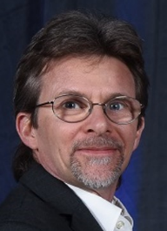

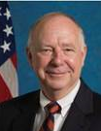

Meet the ITRC Trainers
John Price III
WA Dept. of Ecology
Richland, WA
509-372-7971
John.Price@ecy.wa.gov
Michael Truex
PNNL
Richland, WA
509-371-7072
mj.truex@pnnl.gov
Roy Thun
GHD
Santa Clarita, CA
661-287-3855
roy.thun@ghd.com
Sam Brock
Retired - AFCEC
San Antonio, TX
210-602-4650
Sam.brock7@icloud.com
Chuck Newell
GSI Environmental Inc.
Houston, TX
713-522-6300
cjnewell@gsi-net.com
Read trainer bios at https://clu-in.org/conf/itrc/rmcs/
Notes:
John Price III is the Tri-Party Agreement Section Manager for the Washington Department of Ecology in Richland, Washington. John has worked with the Nuclear Waste Program since 2000. John administers the Federal Facility Agreement and Consent Order for the US Dept of Energy Hanford site in WA state, and is his program’s tribal liaison to three tribal nations with ceded rights at the Hanford site. He supervises a ten-person team including five hazardous waste compliance inspectors and two Natural Resource Damage Assessment specialists. He has over 35 years experience cleaning up radioactively contaminated sites in 17 states. John was an ITRC team member for Determining Cleanup Goals at Radioactively Contaminated Sites: Case Studies (2002), and since 2014 has been a team leader for Remediation Management of Complex Sites. John earned a bachelor’s degree in Hydrology from the University of Arizona in Tucson, Arizona in 1979 and holds Washington licenses in Geology and Hydrogeology.
Roy Thun is a Senior Environmental Specialist with GHD, Santa Clarita, California. Since 1987, Roy has built his expertise as an accomplished environmental portfolio manager and complex site strategy expert working in both environmental consulting and a Fortune 100 energy company. His expertise includes developing integrated site strategies and closure options for complex sites, CERCLA, stakeholder engagement, multi-party site coordination, consent decree negotiations, application of institutional controls, NRD negotiations, and independent review. Roy co-leads GHD’s complex site strategy reviews, helping clients find cost-effective, reasonable & attainable remedial objectives and timelines for their sites. Roy is the Program Advisor for ITRC’s TPH Risk Evaluation at Petroleum Contaminated Sites and current member of the ITRC PFAS team. He previously participated on ITRC’s Long-Term Contaminant Management Using Institutional Controls team. Roy is also a contributor to several ASTM environmental liability standards. Roy earned a bachelor’s of science degree in geology from California State University Northridge in 1988 and a master’s in business administration (MBA) from Pepperdine University in Los Angeles, California in 1995. Roy is a Professional Geologist, ISI Envision Sustainability Professional (ENV. SP), and Los Angeles County Metro Sustainability Council Member.
Charles (Chuck) J. Newell, Ph.D., P.E. is a Vice President of GSI Environmental Inc. in Houston, Texas and has worked for GSI since 1989. His professional expertise includes site characterization, groundwater modeling, non-aqueous phase liquids, risk assessment, natural attenuation, bioremediation, non-point source studies, software development, and long-term monitoring projects. He is a member of the American Academy of Environmental Engineers, a NGWA Certified Ground Water Professional, and an Adjunct Professor at Rice University. He has co-authored five U.S. EPA publications, eight environmental decision support software systems, numerous technical articles, and two books: Natural Attenuation of Fuels and Chlorinated Solvents and Ground Water Contamination: Transport and Remediation. He has taught graduate level groundwater courses at both the University of Houston and Rice University. He has been awarded the Hanson Excellence of Presentation Award by the American Association of Petroleum Geologists, the Outstanding Presentation Award by the American Institute of Chemical Engineers, and the 2001 Wesley W. Horner Award by the American Society of Civil Engineers (for the paper, “Modeling Natural Attenuation of Fuels with BIOPLUME III”). Chuck was cited as the Outstanding Engineering Alumni from Rice University in 2008 and for the ITRC Environmental Excellence Award in 2016. He earned a bachelor's degree in Chemical Engineering in 1978, a master’s degree in Environmental Engineering in 1981, and a Ph.D. in Environmental Engineering in 1989, all from Rice University in Houston Texas. Chuck is a professional engineer registered in Texas.
Michael Truex is a Senior Project Manager at Pacific Northwest National Laboratory (PNNL), Richland, Washington. Since 1992 he has worked in remediation research and field applications. Mike’s experience includes work at Department of Energy (DOE), Department of Defense (DoD), and private remediation sites. Major programs include support to the DOE Hanford Site providing technical and programmatic support for assessing and implementing improved remediation and characterization technologies. Mike has also been a principle investigator for multiple treatability tests at the Hanford site. He has managed and participated in large programs providing technical support to the DoD installations and has been a co-principle investigator for multiple remediation technology demonstration projects funded through the DoD. In addition to authoring numerous journal articles and technical reports, Mike has also authored multiple technical guidance documents. He led publication of technical guidance documents for performance assessment of soil vapor extraction systems and for pump-and-treat remediation. He has also authored and contributed to documents that provide guidance for Monitored Natural Attenuation, evaluation of contaminant transport in the vadose zone, and development of conceptual models. Mike has contributed to the Remediation Management of Complex Sites ITRC team. He earned a bachelor’s degree in mechanical engineering from the University of Illinois in Champaign-Urbana, IL in 1986 and a master’s degree in environmental engineering from Washington State University in Pullman, WA in 1991.
Dr. Samuel L Brock retired January 2019 as the Subject Matter Expert for Toxicology for the Environmental Management Directorate, Technical Support Division of the United States Air Force Civil Engineer Center, San Antonio, Texas. As the Subject Matter Expert, his responsibilities included resolving problems or issues impacting toxicology and risk assessment concerning the conditions and vulnerabilities of systems extending across the Air Force and DoD. Responsibilities also included developing and advocating for required technical courses in conjunction with the Air Force Institute of Technology (AFIT) and/or other schools. He served as an invited Instructor at the Air Force Institute of Technology, Wright Patterson AFB, OH, from 2003 through 2015 and he was an internet-based training Instructor on the ITRC Project Risk Management for Site Remediation technical guidance from 2011 through 2014 as well as Remediation Management of Complex Sites technical guidance from 2018 and continues as an “Emeritus” trainer. He represented the Air Force on working groups developing National and DoD guidance on remediation risk management, explosive risk assessment, vapor intrusion, and bioavailability of contaminants in soil and sediments. Sam has been a member of the ITRC Remediation Risk Management Team, the ITRC Green and Sustainable Remediation Team; the Remediation Management of Complex Sites Team and currently, the Implementing Advanced Site Characterization Tools Team. Sam regularly presented at professional meetings and technical forums on remediation topics. His recent work included supporting DoD Materials of Emerging Regulatory Interest working groups and Military Family Housing Privatization Initiative activities addressing persistent legacy pesticides in soil. Sam developed and deployed an initiative software-enabled process to implement principles and practices for Remediation Management of Complex Sites across the Air Force Enterprise portfolio of difficult, high cost sites. Sam received a Doctorate in Veterinary Medicine from Purdue University in West Lafayette, Indiana in 1970 and a Master of Public Health, Epidemiology from University of North Carolina in Chapel Hill in 1976. He is a Licensed Veterinarian in Texas and is certified by the American College of Veterinary Preventive Medicine.

Slide 6
The Challenge – Meeting Site Objectives at Complex Sites
Complete remediation (no use restrictions) is a significant challenge at complex sites
ITRC team definition of a complex site:
Remediation progress is uncertain and remediation may not achieve closure or even long-term management within a reasonable time frame
“Reasonable time frame” for restoring resources to beneficial use is subject to interpretation and depends on site circumstances
ITRC RMCS-1 Executive Summary
Notes:
No associated notes

Slide 7
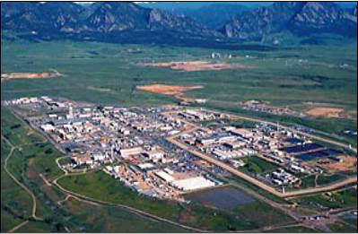
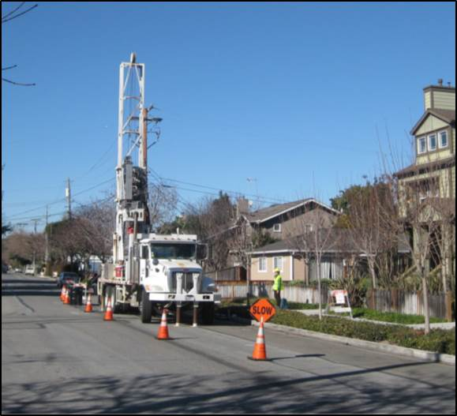
The Challenge – Meeting Site Objectives at Complex Sites
Aerial view of the Rocky Flats Site, Colorado
ITRC RMCS-1 Figure 15 (DOE 2017)
Delineating TCE plume in a residential area near Middlefield-Ellis-Whisman (MEW) Site, California
ITRC RMCS-1 Figure 12 (CPEO 2016b)
Notes:
No associated notes

Slide 8
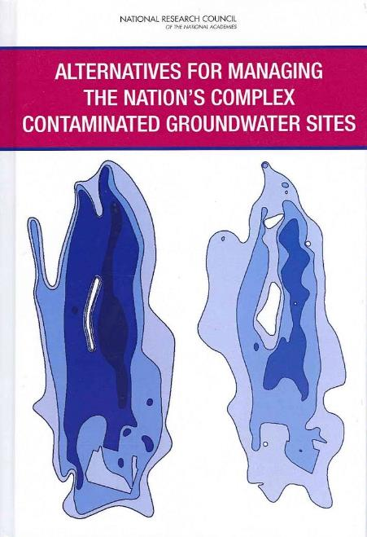
Complex Sites Nationwide
National Research Council reported contaminant levels at 126,000 sites inhibit site closure
Roughly 10% are “complex”
Cost to complete = $127 billion
Clear need for additional guidance
National Research Council, 2013
Notes:
No associated notes

Slide 9
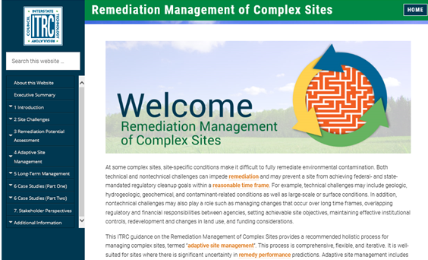
ITRC Guidance for Complex Sites
Recommended process for complex sites
Adaptive site management
Consolidates existing guidance, best practices, tools, and technologies
16 case studies - real-world applications
ITRC Technical and Regulatory Guidance
Remediation Management of Complex Sites RMCS-1
http://rmcs-1.itrcweb.org
Notes:
No associated notes

Slide 10
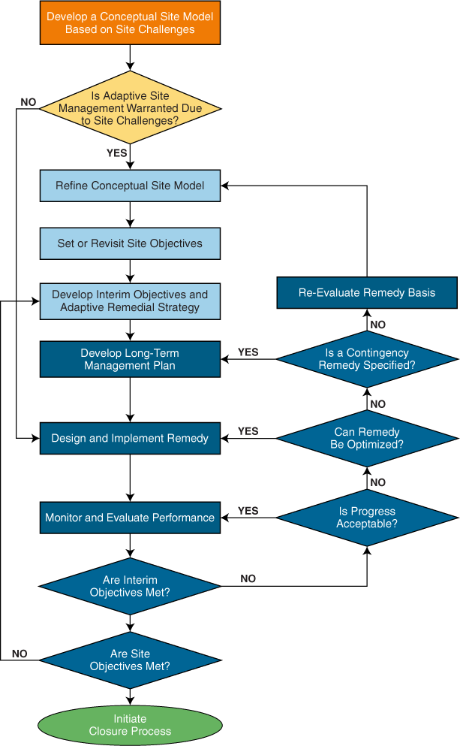
Adaptive Site Management Comprehensive, Flexible, and Iterative
Chapter 2. Site Challenges
See Training Handout
Chapter 3. Remediation Potential Assessment
Chapter 4. Adaptive Remedy Selection
Chapter 5. Long-Term Management
ITRC RMCS-1 Chapter 1, Figure 1
Notes:
A full-page version of this flowchart is included in the ITRC RMCS-1 Excerpts document that was provided with registration information

Slide 11
Benefits of Adaptive Site Management
Maintain protection of human health and the environment and fulfill regulatory obligations
Base decisions on robust conceptual site models
Streamline decision making and save costs
Demonstrate interim progress that leads to long-term results
Reduce barriers to using available remedial approaches
Return sites to beneficial reuse
Notes:
No associated notes

Slide 12
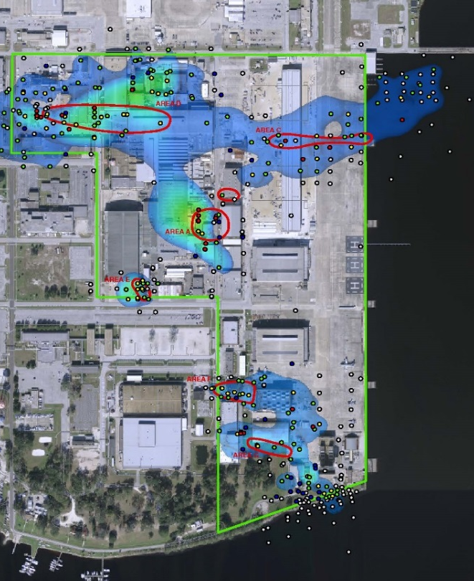
Case Study: Naval Air Station Jacksonville, Florida, Operable Unit 3
Used adaptive site management
Discontinued interim remedial actions
Refined conceptual site model
Determined key exposure pathways
Adopted a risk-based remedial approach
Several pilot studies, innovative tools and technologies
ITRC RMCS-1, Figure 28
Notes:
No associated notes

Slide 13
Key to Your Success Engage Stakeholders
Stakeholders include citizen and Tribal communities, environmental advocacy members, and members of the affected public
Methods for stakeholder involvement
Existing cleanup program processes
Restoration Advisory Board/stakeholder meetings
Public outreach and community meetings
Planning process
Adaptive site management
ITRC RMCS-1, Chapter 7
Notes:
No associated notes

Slide 14
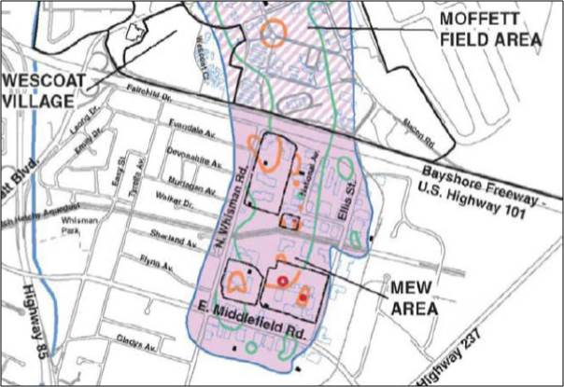
Case Study: Stakeholder Involvement at Middlefield-Ellis-Whisman Site
Community members are constructive partners in decision-making
Model permit process for cooperation between regulators and local land use planning jurisdictions
Vapor intrusion study area at Middlefield-Ellis-Whisman (MEW) site, California
ITRC RMCS-1, Figure 10, CPEO 2016a
Notes:
No associated notes

Slide 15
After Today’s Training We Expect You Will Be Able To:
Identify and integrate technical and nontechnical site challenges presented by complex sites
Use the Remediation Potential Assessment
Apply adaptive site management principles
Develop a long-term performance-based action plan
Effectively engage stakeholders
Access additional resources
Communicate the value of this guidance
Notes:
No associated notes

Slide 16
Today’s Road Map
Site challenges
Remediation Potential Assessment
Questions and answers
Adaptive remedy selection
Long-term management
Preparing you to take action
Questions and answers
Notes:
No associated notes

Slide 17
Site Challenges Learning Objective
See Training Handout
Chapter 2. Site Challenges
Identify and integrate technical and nontechnical site challenges into a holistic approach to remediation
Chapter 3. Remediation Potential Assessment
Chapter 4. Adaptive Remedy Selection
Chapter 5. Long-Term Management
ITRC RMCS-1, Figure 1
Notes:
No associated notes

Slide 18
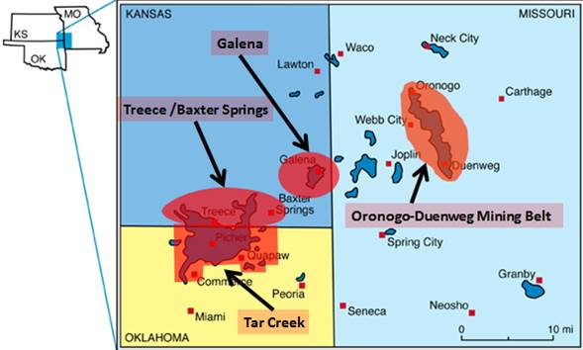
Complex Site?
ITRC RMCS-1, Figure 37, modified from Kansas Geological Survey, 2001
Notes:
No associated notes

Slide 19
Description of a Complex Site
At “complex sites”, remediation progress is uncertain and remediation is not anticipated to achieve closure or even long-term management within a reasonable time frame
Both technical and non-technical challenges can impede remediation
Identifying challenges can improve the conceptual site model (CSM) and maximize remedial effectiveness
Poll Question
ITRC RMCS-1 Executive Summary, Chapter 2
Notes:
Poll: Which remediation time frame usually makes for a complex site?
>10 years
>30 years
>60 years
>100 years
Time frame does not determine site complexity

Slide 20
ITRC Survey Results: Diversity of Responses – Remedial Time Frame
ITRC RMCS-1, Table 1
Notes:
No associated notes

Slide 21
Identify Site Challenges
Technical Examples
Non-Technical Examples
Geologic
Hydrogeologic
Geochemical
Contaminant-related
Large-scale
Site objectives
Changes over long time frames
Regulatory
Institutional controls
Land use
Funding
Notes:
No associated notes

Slide 22
Identify Technical Challenges Geologic Conditions
Geologic heterogeneity/ preferential flow paths
Fractured bedrock
Karst bedrock
Low-permeability media
10 m
250 m
Clay units (dark colored) dip from upper left to lower right, an example of stratigraphic heterogeneity
Photo courtesy of Hubbard 2015
ITRC RMCS-1 Table 2
Notes:
No associated notes

Slide 23
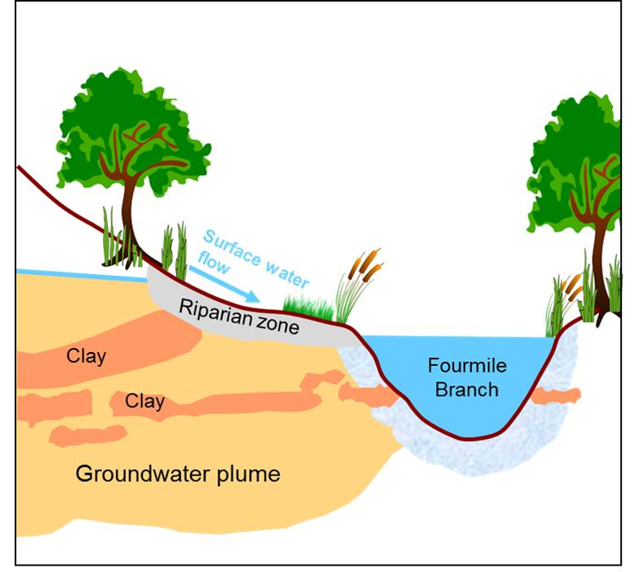
Identify Technical Challenges Hydrogeologic Conditions
Extreme or variable groundwater velocities
Fluctuating water table
Deep contamination
Surface water and groundwater interactions and impacted sediment
Surface water/groundwater interactions downgradient of F-Area, Savannah River Site, South Carolina
Notes:
No associated notes

Slide 24
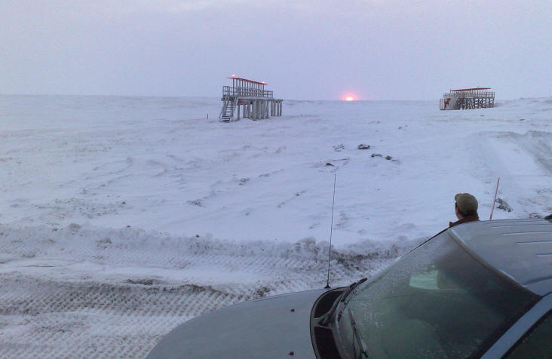
Identify Technical Challenges Geochemical Conditions
Extreme geochemistry
Alkalinity, pH, redox conditions, salinity, ionic strength, hardness
Extreme groundwater temperatures
Geothermal sources
Low temperatures, permafrost
Low temperatures decrease biological activity at North Pole Refinery, Alaska, Redbullet16 / Wikimedia Commons
ITRC RMCS-1, Table 2
Notes:
No associated notes

Slide 25
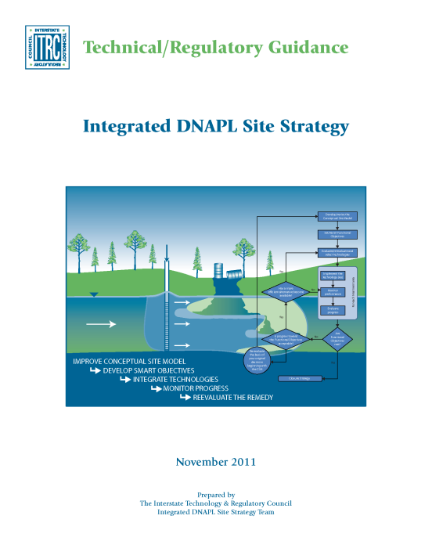
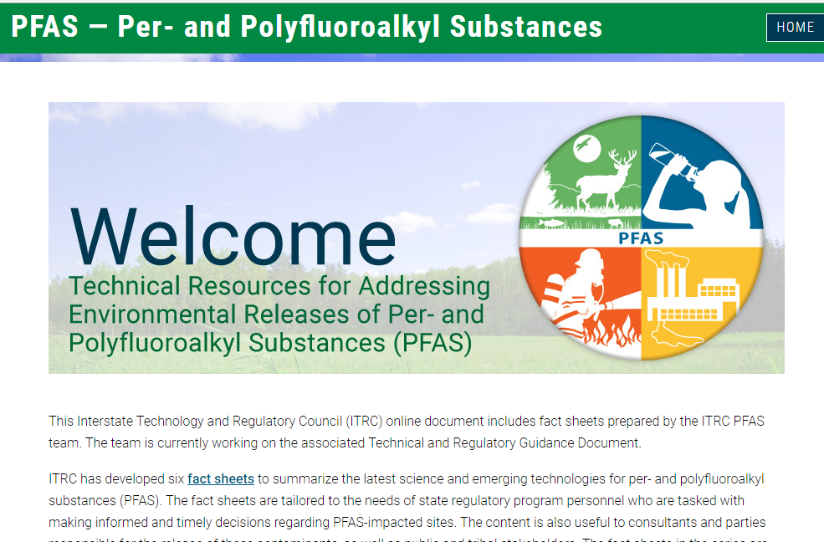
Identify Technical Challenges Contaminant-Related Conditions
Light or dense nonaqueous phase liquids (LNAPL or DNAPL)
Recalcitrant contaminants
High concentrations or multiple contaminants
Emerging contaminants
ITRC RMCS-1, Table 2; ITRC ISC-1 2015;
ITRC IDSS-1 2015; ITRC Fractured Rock and PFAS Team Fact Sheets, 2017
Notes:
No associated notes

Slide 26

Identify Technical Challenges Large-Scale Sites
Location and extent of contamination
Depth of contamination
Number, type and proximity of receptors
Extensive or comingled plumes
ITRC RMCS-1, Table 2 and Figure 37, modified from Kansas Geological Survey, 2001
Notes:
No associated notes

Slide 27
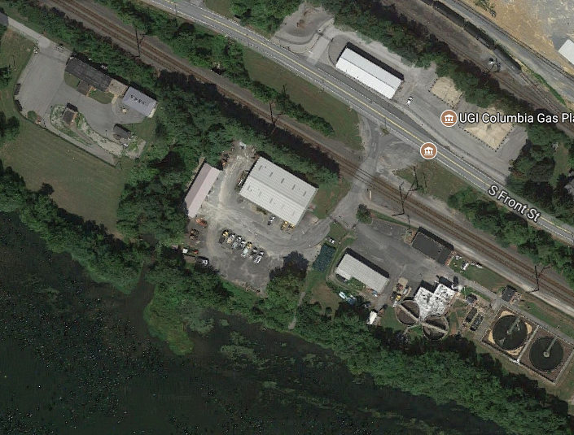
Technical Challenges Case Study: UGI Columbia Gas Site, Pennsylvania
UGI Columbia
Gas Plant
Residual tar in river sediments, groundwater and deep in fractured bedrock
Tar will slowly dissolve over centuries
Susquehanna River
Google Maps 2017
Notes:
No associated notes

Slide 28
Identify Non-Technical Challenges
Site objectives
Changing site objectives
Societal expectations
Green and sustainable remediation
Managing changes over long time frames
Phased remediation
Future use
Site management
Regulatory
Federal and state cooperation
Changing laws and regulation
Orphan sites
Contaminants without regulatory guidance/criteria
ITRC RMCS-1, Table 3; ITRC GSR-2
Notes:
No associated notes

Slide 29

Identify Non-Technical Challenges
Institutional controls
Tracking and managing
Enforcing
Long-term management
Land use
Changing land, water use
Multiple owners
Site access
Funding
Lack of funds, political influence on program funding
Deer graze on Rocky Flats National Wildlife Refuge in Colorado
Footwarrior, Wikimedia Commons
ITRC RMCS-1, Table 3; ITRC IC-1, 2016
Notes:
No associated notes

Slide 30
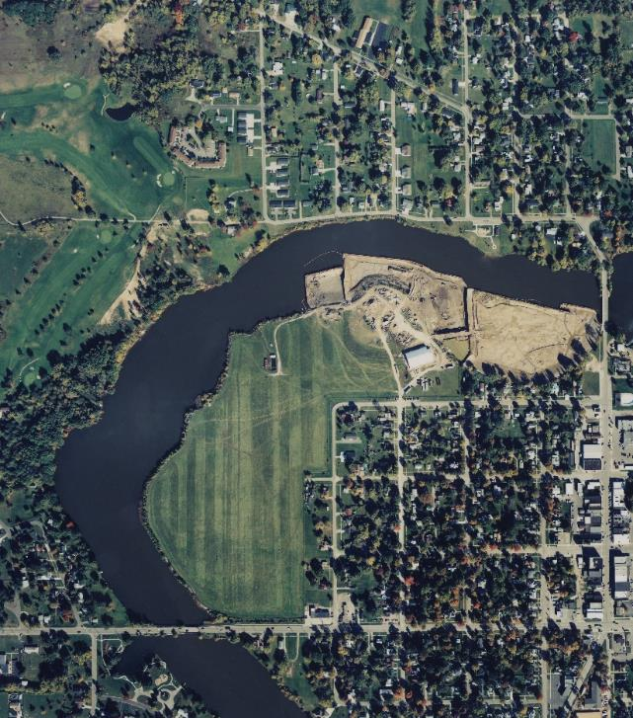
Non-Technical Challenges Case Study: Velsicol Site, Michigan
Contaminated city wells and Pine River
DNAPL pools 100 feet deep
Livestock impacts and community economic hardship
Limited funding prompted stakeholder involvement
Pine River
OU 2
Site
OU1
ITRC RMCS-1 Figure 46, Heidlauf 2017
Notes:
No associated notes

Slide 31
Conceptual Site Model Maturity
General Environmental Cleanup Steps | CSM Life Cycle
Site Assessment | Preliminary CSM Baseline CSM
Site Investigation and Alternatives Evaluation | Characterization CSM Stage
Remedy Selection | Design CSM Stage
Remedy Implementation | Remediation / Mitigation CSM Stage
Post-Construction Activities | Post-Remedy CSM Stage
Site Completion
Conceptual Quantitative
USEPA, 2011a. Environmental cleanup best practices: Effective use of the project life cycle conceptual site model. EPA 542-F-11-011.
Notes:
No associated notes

Slide 32
Site Challenges Summary
Complex sites typically have multiple challenges
Both technical and non-technical challenges can impede remediation
Identifying them can improve the conceptual site model and maximize remedial effectiveness
Notes:
No associated notes

Slide 33
Today’s Road Map
Introduction
Site challenges
Remediation Potential Assessment
Questions and answers
Adaptive remedy selection
Long-term management
Preparing you to take action
Questions and answers
Notes:
No associated notes

Slide 34
Remediation Potential Assessment Learning Objective
See Training Handout
Chapter 2. Site Challenges
Chapter 3. Remediation Potential Assessment
Use the Remediation Potential Assessment to identify whether Adaptive Site Management is warranted due to site challenges
Chapter 4. Adaptive Remedy Selection
Chapter 5. Long-Term Management
ITRC RMCS-1, Figure 1
Notes:
No associated notes

Slide 35
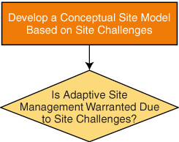
Remediation Potential Assessment Process and Outcome
Process
Outcome
Screening tool uses weight-of-evidence approach to assess if site is likely to achieve remedial objectives in a reasonable time frame
Basis for aligning expectations with actual remediation potential
Promotes effective and transparent interaction
Site objectives are attainable OR
Remediation potential is low – consider adaptive site management
ITRC RMCS-1, Figure 1
Notes:
No associated notes

Slide 36
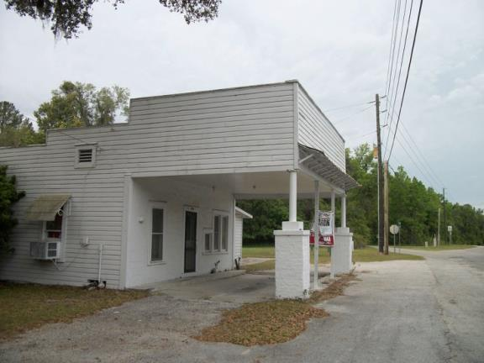
“Can You Get There?”
Small, shallow site
Sandy water bearing unit
Low concentrations
Benzene (attenuates fast)
Very little non-aqueous phase liquid
Source: DanTD / Wikimedia Commons
Notes:
No associated notes

Slide 37
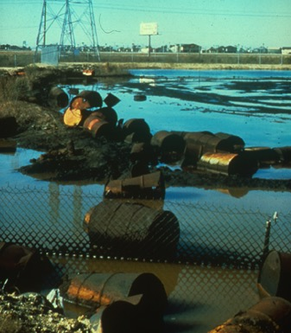
“Can You Get There?”
Small, shallow site
Sandy water bearing unit
Low concentrations
BTEX (attenuates fast)
Very little NAPL
Large site, deep contamination
Much of source under buildings
Sand, silt, fractured clays
Not much biodegradation
Need > 99.9% reduction
Sources: DanTD / Wikimedia Commons,
GSI Environmental
Notes:
No associated notes

Slide 38
Remediation Potential Assessment Purpose
Intended to inform the remedial decision process and determine if adaptive management process is beneficial
Can allow for greater transparency and facilitate future reviews of the process
Flexible process that can be modified as appropriate for the site
Notes:
No associated notes

Slide 39
Remediation Potential Assessment (RPA)
DOES:
DOES NOT:
Allow flexibility and site-specific input in an iterative process
Require detailed supporting data on the nature and extent of contamination
Consider remediation potential of individual factors in context of other pertinent factors
Provide a means to avoid requirements
Evaluate whether a site is complex
Directly consider cost
Produce a default decision
Notes:
No associated notes

Slide 40

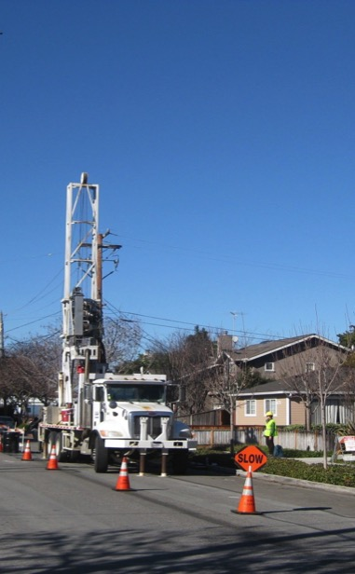
Remediation Potential Assessment Key Criteria (Pre-Remedy)
8 Questions…
How difficult is it to work at the surface of the site?
Martin Abegglen / Wikimedia Commons
See Figure 12, CPEO, 2016b
ITRC RMCS-1 Figure 12, CPEO, 2016b
Notes:
No associated notes

Slide 41
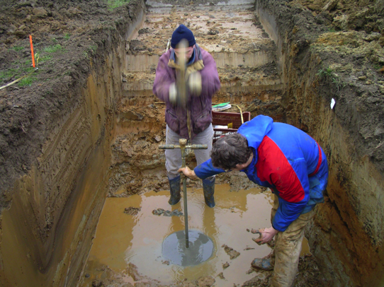
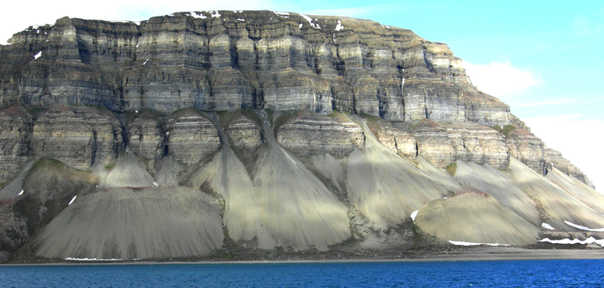
Remediation Potential Assessment Key Criteria (Pre-Remedy)
8 Questions…
How difficult is it to work at the surface of the site?
How difficult is it to drill at the site?
x
Laurent Deschodt / Wikimedia Commons
x
Wilson44691 / Wikimedia Commons
Notes:
No associated notes

Slide 42
Remediation Potential Assessment Key Criteria (Pre-Remedy)
What is the scale of the source zone or plume?
Notes:
No associated notes

Slide 43
Remediation Potential Assessment Key Criteria (Pre-Remedy)
What is the scale of the source zone or plume?
What contaminant concentration reduction is needed?
90% ?
99% ?
99.9% ?
99.99% ?
Notes:
No associated notes

Slide 44

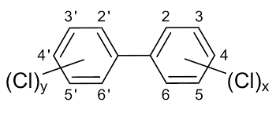
Remediation Potential Assessment Key Criteria (Pre-Remedy)
What is the scale of the source zone or plume?
What contaminant concentration reduction is needed?
Do the key site constituents readily attenuate relative to the travel time to receptors?
Sources: Dschanz / Wikimedia Commons; Public Domain
Notes:
No associated notes

Slide 45
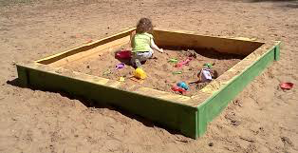
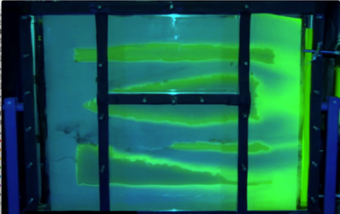
Remediation Potential Assessment Key Criteria (Pre-Remedy)
What is the scale of the source zone or plume?
What contaminant concentration reduction is needed?
Do the key site constituents readily attenuate relative to the travel time to receptors?
Does difficult-to-remove mass exist at the site?
Al Silonov / Wikimedia Commons
L. Donor., T. Sale, CSU
Notes:
No associated notes

Slide 46
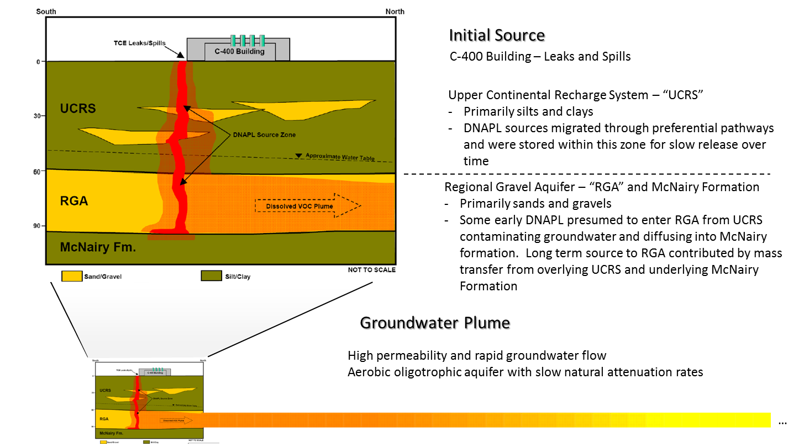
Case Study: Paducah Gaseous Diffusion Plant, Kentucky
Surface Access
Difficult to Remove Mass
Clay/Silt
Sand
Drilling Difficulty
DNAPL Source Zone
Sand
Concentration Reduction
Dissolved Plume
Gravel
Attenuation
Scale of Source and/or Plume
ITRC RMCS-1, Figure 43 (DOE 2010a)
Notes:
No associated notes

Slide 47
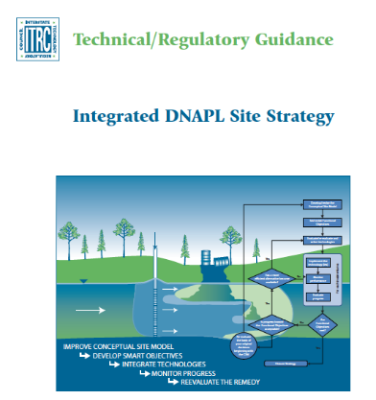
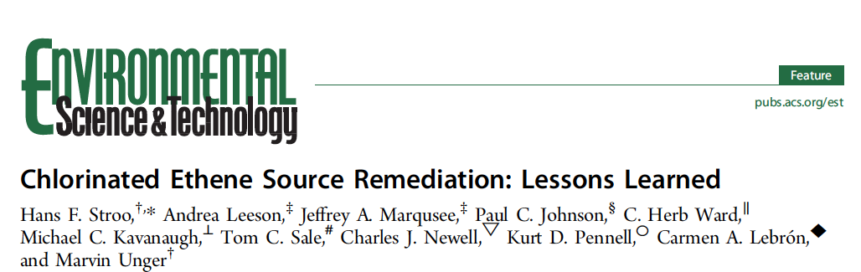
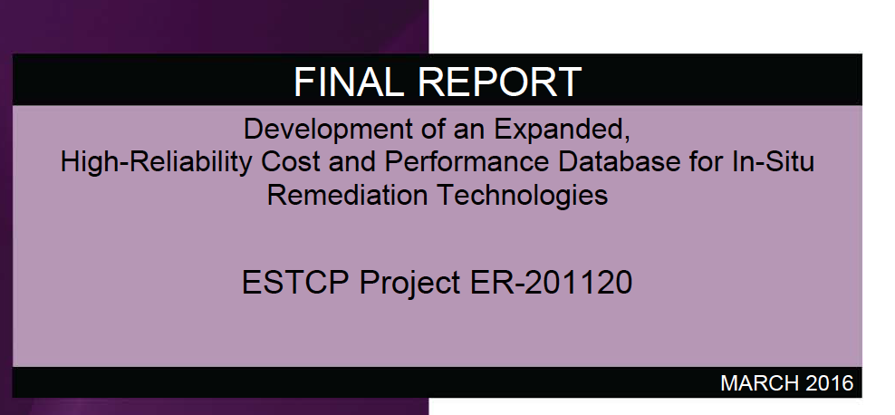
Remediation Potential Assessment Key Criteria (Pre-Remedy)
What is the predicted performance for available remedial technologies?
2011
2012
2015
Notes:
Full references:
Stroo, H.F., A. Leeson, J.A. Marqusee, P.C. Johnson, C.H. Ward, M.C. Kavanaugh, T.C. Sale, C.J. Newell, K.D. Pennell, C.A. Lebron, and M. Unger. 2012. “Chlorinated Ethene Source Remediation: Lessons Learned.” Environmental Science and Technology 46:6438-6447.
McGuire,Travis ; Adamson,David ; Newell,Charles ; Kulkarni,Poonam, 2016. Development of an Expanded, High Reliability Cost and Performance Database for In Situ Remediation Technologies. ESTCP Project Report ER-201120. http://www.dtic.mil/get-tr-doc/pdf?AD=AD1024199
ITRC. 2011. Integrated DNAPL Site Strategy. IDSS-1.

Slide 48
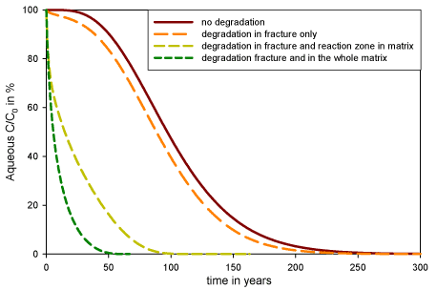
Remediation Potential Assessment Key Criteria (Pre-Remedy)
100
Degradation
None
Fracture only
Fracture & reaction zone in matrix
Fracture & in whole matrix
8. What is the predicted time frame for achieving interim and site objectives?
Aqueous C/C0 in %
NRC, 2013
0
300
Model/Analysis
USEPA REMChlor or REMFuel Model
Natural Attenuation Software
Matrix diffusion
Concentration vs. time First order rate calculations
Years
Notes:
No associated notes

Slide 49
Remediation Potential Assessment Matrix of Evaluation Criteria
Evaluation Criteria | Likelihood of Achieving Remediation Objectives
 | High | Moderate | Low
Access
Drilling feasibility
Scale
Concentration reduction
Attenuation
Difficult-to-remove mass
Technology performance
Time frame
Total checked:
Evaluate each criteria as high, moderate or low
Weight criteria to reflect relative importance
Assess conclusion
✔
✔
✔
✔
✔
✔
✔
✔
4
2
2
ITRC RMCS-1, Table 7
Notes:
No associated notes

Slide 50
Remediation Potential Assessment Matrix of Evaluation Criteria
Evaluation Criteria | Likelihood of Achieving Remediation Objectives
 | High | Moderate | Low
Access
Drilling feasibility
Scale
Concentration reduction
Attenuation
Difficult-to-remove mass
Technology performance
Time frame
Total checked:
Evaluate each criteria as high, moderate or low
Weight criteria to reflect relative importance
Assess conclusion
✔
✔
✔
✔
✔
✔
✔
✔
1
3
4
ITRC RMCS-1, Table 7
Notes:
No associated notes

Slide 51
Remediation Potential Assessment Key Criteria (Post-Remedy)
Has the existing remedy been effectively operated and maintained?
Are aquifer conditions or contaminant sources adequately characterized? Have they changed?
Are concentrations reductions occurring at the rate anticipated?
Does the selected remedy adequately address contaminants and/or hydrogeologic conditions?
Can interim and/or site objectives (and contaminant-specific cleanup levels) be met with other technologies within a reasonable time frame?
Notes:
No associated notes

Slide 52
Remediation Potential Assessment Summary
Screening tool - provides a valuable process; does not produce a default decision
You answer eight technical questions and use Weight-of-evidence to assess if site is likely to achieve remediation objectives
Allows flexibility and site-specific input in an iterative process
Goal: Determine if…
Site objectives are likely attainable OR
Remediation potential is low – Adaptive Site Management will be important
Notes:
No associated notes

Slide 53
Q&A Break
Follow ITRC
See Training Handout
Chapter 2. Site Challenges
Chapter 3. Remediation Potential Assessment
Chapter 4. Adaptive Remedy Selection
Chapter 5. Long-Term Management
Notes:
No associated notes

Slide 54
Today’s Road Map
Site challenges
Remediation Potential Assessment
Questions and answers
Adaptive remedy selection
Long-term management
Preparing you to take action
Questions and answers
Notes:
No associated notes

Slide 55
Learning Objective
See Training Handout
Chapter 2. Site Challenges
Chapter 3. Remediation Potential Assessment
Chapter 4. Adaptive Remedy Selection
Understand and apply adaptive site management principles
Chapter 5. Long-Term Management
ITRC RMCS-1, Figure 1
Notes:
No associated notes

Slide 56
Adaptive Remedy Selection
See Training Handout
Use Adaptive
Site Management?
(Remediation Potential
Assessment)
Yes
Refine Conceptual Site Model
Poll Question
Set or Revisit Site Objectives
Develop Interim Objectives and Adaptive Remedial Strategy
ITRC RMCS-1, Figure 1
Notes:
Poll: Did a remedy at your complex site fail to meet expectations?
Yes
No
Too soon to tell
Other
Poll: If yes, what actions were taken? (select all that apply)
Remedy optimization
Contingency remedy implemented
Site characterization
Technology testing
Modified site objectives
Other

Slide 57
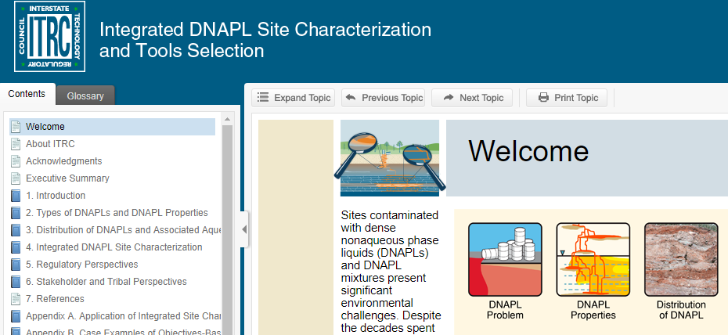
Refine Conceptual Site Model
Prior to revisiting remedy
Are site challenges described?
What inhibited remediation progress?
What are data gaps?
Tools for remedy evaluation
ITRC ISC-1 2015
http://www.itrcweb.org/DNAPL-ISC_tools-selection/
ITRC RMCS-1, Appendix B
Notes:
No associated notes

Slide 58
Conceptual Site Model Australia Case Study
Phase | Source |  | Proximal Plume |  | Distal Plume
Permeability/ Transmissivity | Low | High | Low | High | Low | High
Soil vapor
DNAPL |  |  | NA | NA | NA | NA
Groundwater
Sorbed
LEGEND Equivalent aqueous concentration (mg/L)
 | HIGH (>1,000)
 | MODERATE/HIGH (100-1,000)
 | MODERATE (10-100)
 | LOW (1-10)
 | NOT APPLICABLE
(NA)
20-Compartment model summarizing the conceptual site model of contaminant mass at the site. ITRC RMCS-1, Figure 69 and Appendix B
Notes:
No associated notes

Slide 59
Set or Revisit Site Objectives
Site objectives are overall remedial expectations, including protecting public health and the environment
Set site objectives
Consider complexities
Consider different geologic or operable units, source area and plume -- “site segments”
Revisit site objectives
If progress is insufficient despite optimization
Refine Conceptual Site Model
Set or Revisit Site Objectives
Develop Interim Objectives and Adaptive Remedial Strategy
ITRC RMCS-1, Figure 1
Notes:
No associated notes

Slide 60
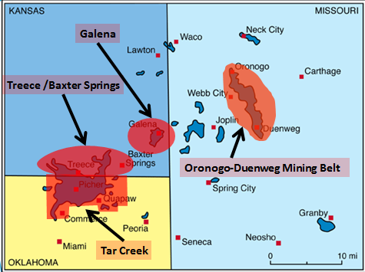
Site Objectives at Complex CERCLA Sites
Protect human health and environment
Meet Applicable or Relevant and Appropriate Requirements (ARARs) or criteria for ARAR waiver
Inconsistent application of state standards
Fund balancing
Equivalent performance
Interim measures
Greater risk
Technical impracticability (TI)
Poll Question
TI waiver at Tri-State Mining District (Oklahoma, Kansas, Missouri)
CERCLA - Comprehensive Environmental Response, Compensation and Liability Act
ITRC RMCS-1 Chapter 4, 40 CFR 300.430(f)(1)(ii)(C), USEPA 1993, 2012
Notes:
Poll: Have you evaluated the applicability of an ARAR waiver?
Yes
No
Considered but did not formally evaluate
Poll: What approach was selected following the evaluation?
ARAR waiver
Another approach
Unknown
Not applicable

Slide 61
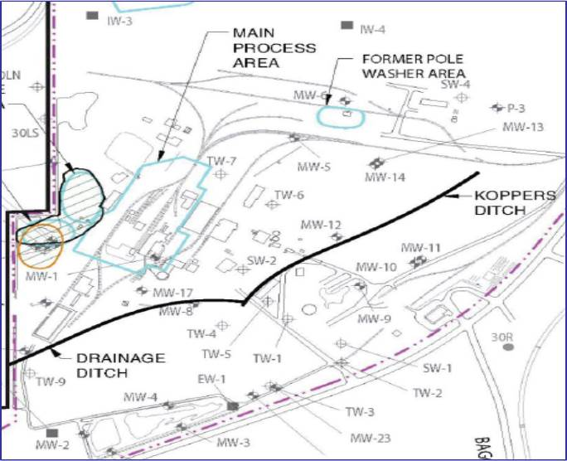
Case Study: ARAR Waiver at a Wood Treatment Facility, Oroville, California
Complexities
Recalcitrant creosote and pentachlorophenol DNAPL
Drinking water aquifer
Record of Decision amendment included TI waiver
Groundwater goal within 4-acre area is containment, not restoration
TI zone
TI zone at the Koppers Oroville, California wood treatment facility
ITRC RMCS-1 Figure 7, USEPA 2013a
Notes:
No associated notes

Slide 62
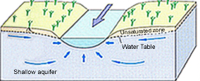
CERCLA Sites Alternate Concentration Limits
Alternate concentration limits can be used in groundwater only if
Groundwater discharges to surface water
No statistically significant increase in concentrations downstream
No exposure to off-site contaminated groundwater prior to discharge
No recent case studies identified
Image from U.S. Geological Survey
CERCLA Section 121(d)(2)(B)(ii), USEPA, 2005b
Notes:
No associated notes

Slide 63
RCRA and Other State Programs ITRC Survey
Team surveyed states about their approaches
RCRA, Brownfields, Underground Storage Tank programs
Responses from 40 states
Does your state allow the following to meet site objectives…
…as a primary means?
…after the original selected remedy fails to reach site objectives within the planned remedial time frame?
RCRA – Resource Conservation and Recovery Act (for hazardous waste management)
ITRC RMCS-1 Figures 3-4, Appendix A
Notes:
No associated notes

Slide 64
RCRA and Other State Programs
40
38
36
34
30
23
20
Number of states responding yes to survey
19
20
Institutional controls to manage exposure
Risk-based (site-specific) criteria
Designated points of compliance
Alternate concentration limits
10
State TI provisions
Low-threat closure criteria
0
ITRC RMCS-1 Figures 3-4, Appendix A
Notes:
No associated notes

Slide 65



Develop Interim Objectives and Adaptive Remedial Strategy
Interim objectives are intermediary goals that guide progress towards achieving site objectives
Adaptive remedial strategy is a combination of technologies and approaches to meet interim objectives
Refine Conceptual Site Model
Set or Revisit Site Objectives
Poll Question
Develop Interim Objectives and Adaptive Remedial Strategy
ITRC RMCS-1, Figure 1
Notes:
Poll: Restore groundwater to beneficial uses - Site Objective or Interim Objective?
Site objective
Interim objective
Not sure
Poll: Reduce mass flux off site by 50% within five years so that hydraulic control is no longer needed - Site Objective or Interim Objective?
Site objective
Interim objective
Not sure

Slide 66
Interim Objectives
Should be Specific Measurable Attainable Relevant and Timebound (SMART)
Contaminant mass flux or discharge decrease by [x]% within [#] years
Target degradation rates met within [#] years
Capping to prevent direct exposure
Guide short-term decisions and actions
Optimization
Technology transitions
Meeting interim objectives → progress
ITRC IDSS-1, 2011; ITRC MASSFLUX-1, 2010
Notes:
No associated notes

Slide 67
Select Adaptive Remedial Strategy Step 1. Identify Options
Biological treatment
Chemical treatment
Thermal treatment
Removal
Enhanced extraction
Source flux reduction
Contaminant mass flux reduction
Pump and treat
Permeable reactive barriers
Enhanced attenuation
Monitored natural attenuation
Hydraulic containment
Passive hydraulic barrier
Discharge zone treatment
Vapor intrusion mitigation
Institutional controls
Alternative water supply
Options | Description and References
In situ biological treatment | Applying an amendment into the aquifer to bioremediate a targeted volume (ITRC 2002, 2008, Parsons 2004, USEPA 2000, DOE 2002)
Source flux reduction | Applying remediation or containment to reduce the flux of contaminants moving from the source zone to the plume (ITRC 2008b, 2010b, Looney et al., 2006)
Institutional controls | Applying administrative restrictions to prevent contaminant exposure or other actions that would negatively impact contamination (USEPA 1997a, 2009b, 2010a, ITRC 2016b)
ITRC RMCS-1 Table 10 for complete listing
Notes:
No associated notes

Slide 68
Select Adaptive Remedial Strategy Step 2. Compare Remedial Approaches
CERCLA Nine Criteria
Threshold Criteria
Overall protection of human health and the environment
Compliance with ARARs
Balancing Criteria
Long-term effectiveness and permanence
Reduction of toxicity, mobility or volume
Short-term effectiveness
Implementability
Cost
Modifying Criteria
State acceptance
Community acceptance
Follow regulatory process
Assess using threshold and balancing criteria for CERCLA, RCRA sites
Additional considerations due to complexities
How does each remedial approach address complexities?
40 CFR 300.430(e)(9)(iii)
Notes:
No associated notes

Slide 69

Select Adaptive Remedial Strategy Step 2. Compare Remedial Approaches
Additional considerations
Level of confidence in ability to implement remedy
Synergy with other technologies/approaches
Adaptability over time
Information gained to improve future decisions
Robustness of design including interim objectives, metrics, and performance monitoring data
Other
ITRC RMCS-1 Appendix B
www.clipartpanda.com
Notes:
No associated notes

Slide 70
Select Adaptive Remedial Strategy Step 3. Remedy Selection
Prepare a matrix of site objectives and remedies for each area of the site
Site Objectives | Selected Remedy
 | Source | Plume
Objective #1 | Technology 1 Technology 2 | Technology 1 Technology 3
Objective #2
Objective #3
ITRC RMCS-1, Table 11
Notes:
No associated notes

Slide 71
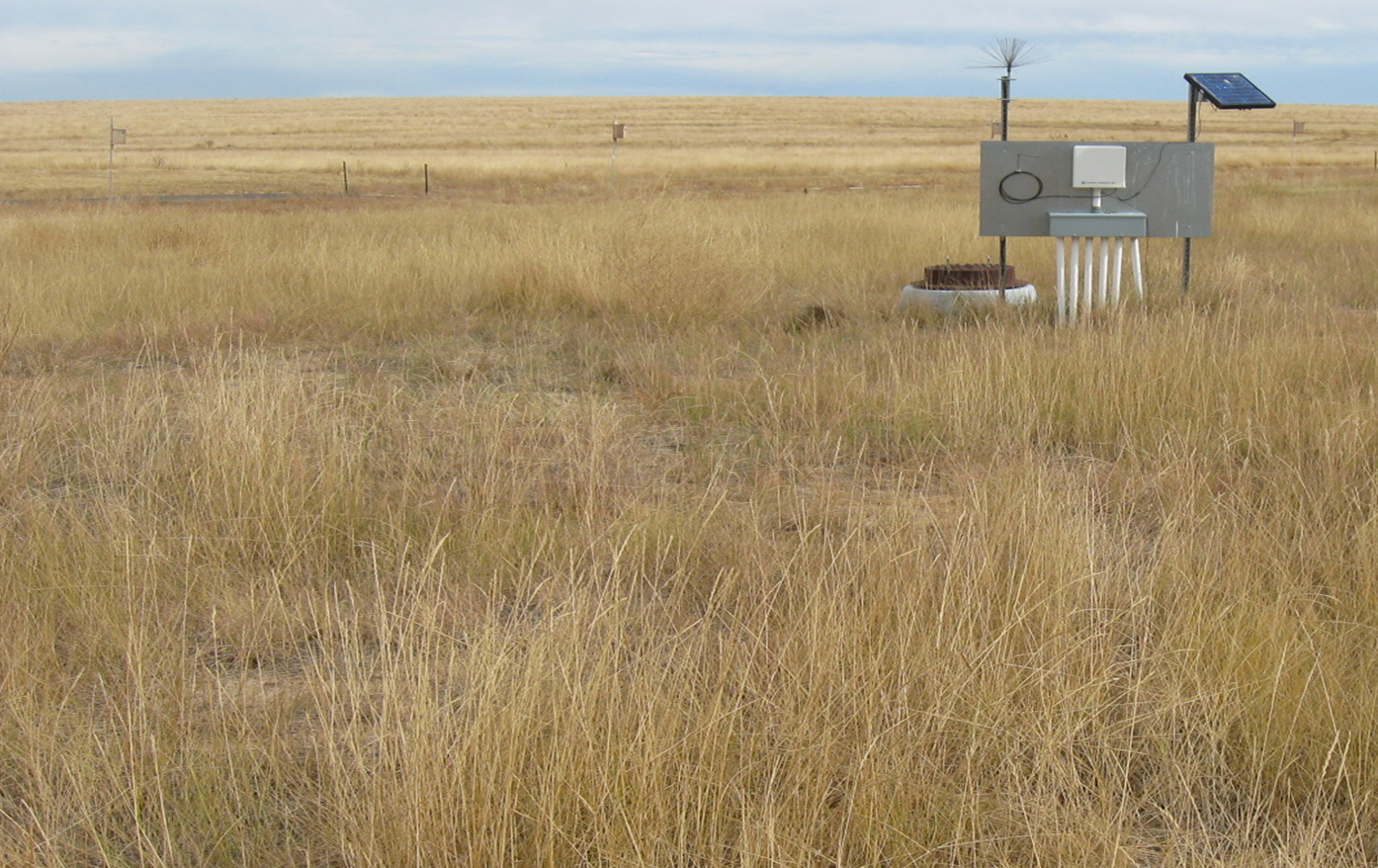
Case Study: Rocky Mountain Arsenal, Colorado
Native vegetation
Soil (4 feet)
Biota barrier (1.5 feet)
Subgrade
ITRC RMCS-1 Figures 26 and 27, CDPHE 2000
Notes:
No associated notes

Slide 72
Rocky Mountain Arsenal, Colorado Remedy Components
Site Objectives | Selected Remedy
 | On-Site | Off-Site
Source removal and treatment | Waste and soil treatment, stabilization Excavation Groundwater extraction and treatment | Off-post groundwater intercept and treatment system
Containment | Boundary treatment systems Slurry walls Stabilization/capping | Boundary treatment systems
Protection of human health and ecology | Capping Land use restrictions Unexploded ordnance disposal Alternate water supply | National wildlife refuge Deed restrictions Long-term monitoring Five-year reviews Trust for potable water supply and distribution Medical monitoring Biomonitoring Trust for long-term O&M
Notes:
No associated notes

Slide 73

Document Remedial Approach
Articulate how components work together
For each component of the remedial approach
Describe technology
State interim objectives
State how the performance will be evaluated (performance metrics)
Follow regulatory program requirements for documentation
Can facilitate remedy transitions
H'arnet / Wikimedia Commons
Notes:
No associated notes

Slide 74
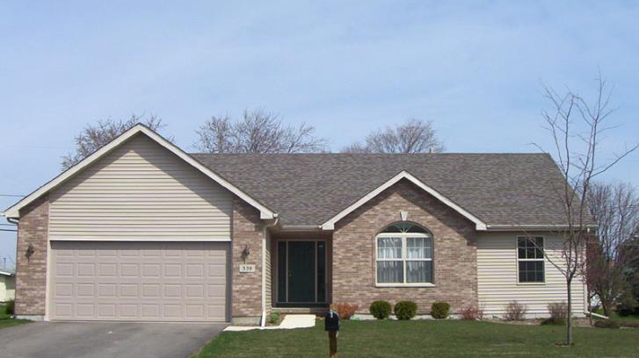
Engaging Stakeholders and Tribes Stakeholder and Tribal Perspectives
Stakeholder and Tribal concerns and values
Gathering and organizing information
Creating a forum
Influencing decisions
Advisory boards
Technical assistance
SanjibLemar / Wikimedia Commons
ITRC RMCS-1 Chapter 7
Notes:
No associated notes

Slide 75
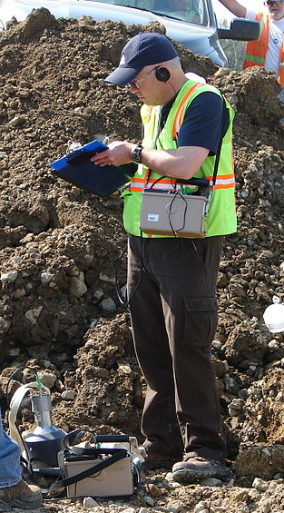
Engaging Stakeholders and Tribes Responsible Party Perspectives
Seek out community members
Provide them with tools to participate constructively
Build trust for effective outreach
Organize public meetings
Share technical documents, information
Work with media
ITRC RMCS-1 Chapter 7
Energy.gov / Wikimedia Commons
Notes:
No associated notes

Slide 76

Summary Adaptive Site Management Principles
Refine conceptual site model
Set or revisit site objectives
Survey highlights flexibility of some state programs in setting or revisiting site objectives
Build adaptive remedial strategy
May need multiple technologies, phases for each site area
Set interim objectives to guide remedial progress
Repeat process if remedy is not on track
Notes:
No associated notes

Slide 77
Today’s Road Map
Site challenges
Remediation Potential Assessment
Questions and answers
Adaptive remedy selection
Long-term management
Preparing you to take action
Questions and answers
Notes:
No associated notes

Slide 78
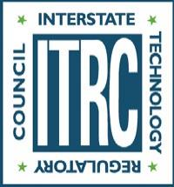
Learning Objective
See Training Handout
Chapter 2. Site Challenges
Chapter 3. Remediation Potential Assessment
Chapter 4. Adaptive Remedy Selection
Chapter 5. Long-Term Management
Develop a long-term performance-based action plan
ITRC RMCS-1, Figure 1
Notes:
No associated notes

Slide 79
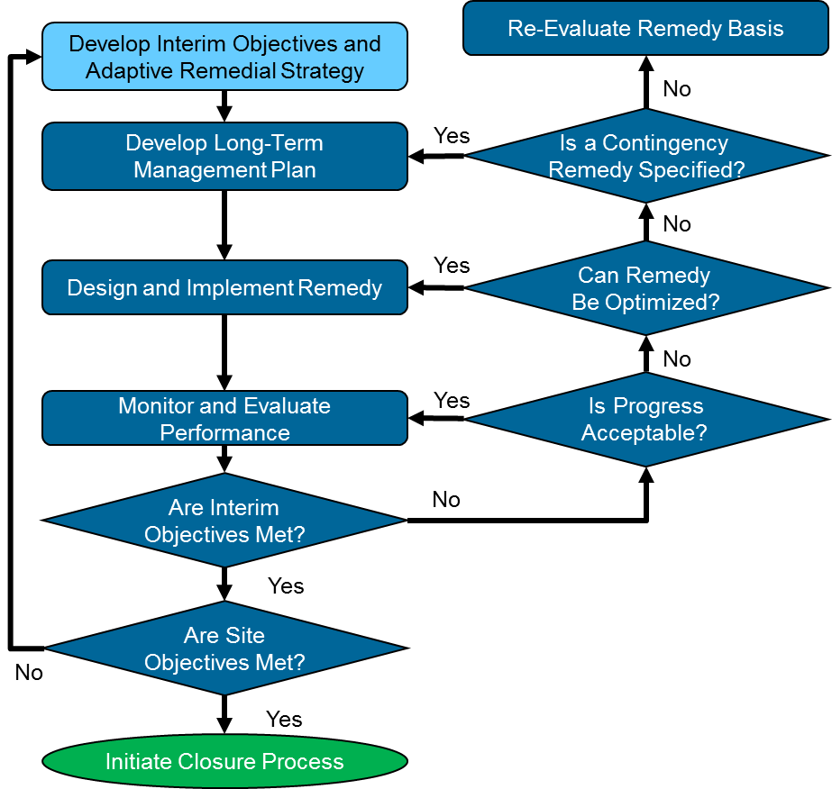
Adaptive Site Management
Decision Logic
ITRC RMCS-1,
Figure 1
Notes:
No associated notes

Slide 80

Develop Long-Term Management Plan Purpose and Value
Learn via process (living site-specific document)
Identify weak links
Inform decision makers
Engage stakeholders
Provide a completion strategy (many decades)
Document remedy expectations and progress
Expedite remedy re-evaluations and transitions
Make timely remediation management decisions
Notes:
No associated notes

Slide 81
Develop Long-Term Management Plan Plan Components
Completion strategy
Description of the selected remedy
Expected performance over time
Performance model predictions
Timeline and criteria for monitoring and periodic evaluations
Decision logic for remedy transitions
Project risks and uncertainty
Notes:
No associated notes

Slide 82
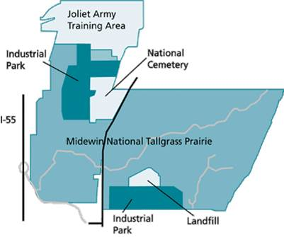
Develop Long-Term Management Plan Completion Strategy
Path to achieve site objectives
Likely iterative for complex sites
Collaborative process
Consider options to maximize future land use
Consult relevant guidance
Map of proposed future uses for Joliet Army Ammunition Plant, Illinois (ITRC RMCS-1 Figure 36)
Examples: ITRC RPO-3, USEPA 2014. Groundwater remedy completion strategy
Notes:
A compendium of tools, approaches and models is provided as Appendix B

Slide 83
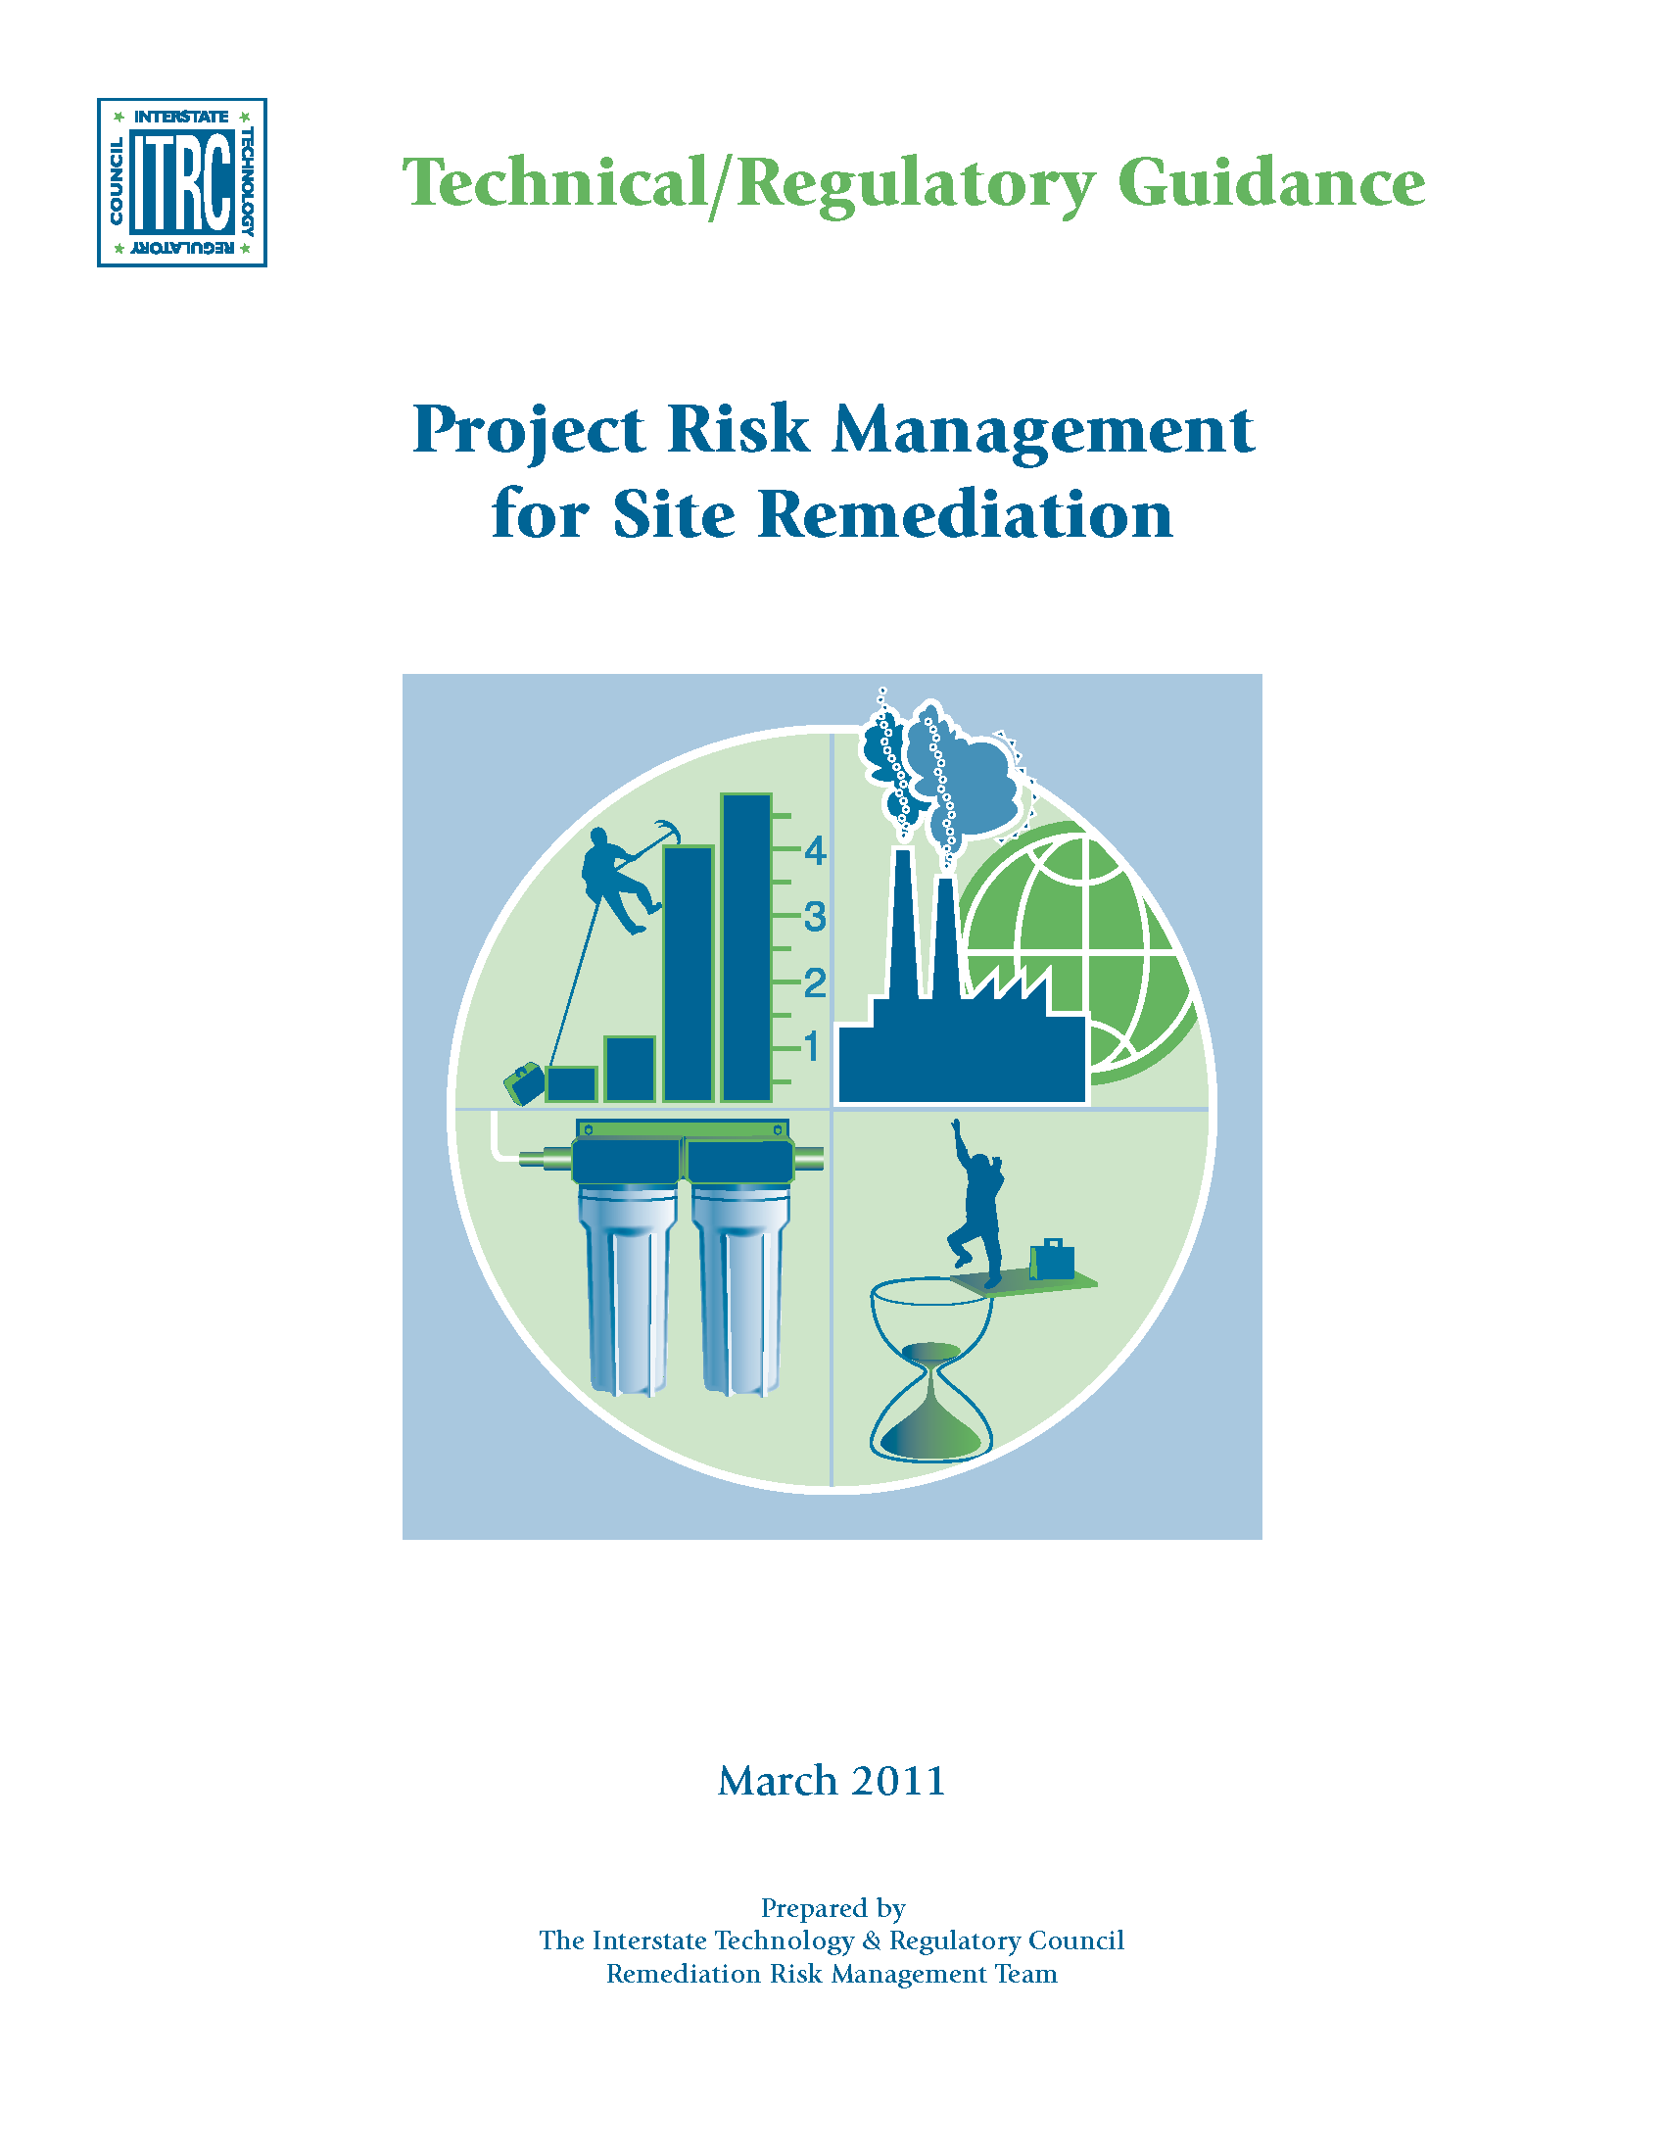
Develop Long-Term Management Plan Project Risks and Uncertainty
Process to identify and respond to key project risk events
Identify and assess potential project risks
Actions to reduce risk (e.g., filling a data gap)
Use contingency planning tools
Download risk register template: https://clu-in.org/conf/itrc/rrm/ ExampleRRMForms.docx
ITRC RRM-1, 2011
http://www.itrcweb.org/GuidanceDocuments/RRM-1.pdf
Notes:
No associated notes

Slide 84
Develop Long-Term Management Plan Describe the Selected Remedy
Remedy for each site segment (e.g., plume, source area, off-site plume)
Interim objectives, performance metrics
May need to set these during long-term management phase
Time frame predicted to meet interim objectives
Maintenance and monitoring considerations
Notes:
No associated notes

Slide 85
Develop Long-Term Management Plan Example Description - Selected Remedy
Site Objective | Remedy Component | Interim Objective/ Performance Metric
Remediate contamination | In situ treatment | Reduce contaminant concentrations by 1 order of magnitude
Control migration | In situ treatment | Reduce mass flux from the source area by 80%
 | Pump and treat | Demonstrate capture using multiple lines of evidence
Prevent exposure | Engineering controls | Maintain engineering controls and fencing per operation and maintenance plan
 | Institutional controls | Deed restriction for land and groundwater use
ITRC RMCS-1 Table 12; ITRC IC-1 2016
Notes:
No associated notes

Slide 86
Develop Long-Term Management Plan Example - Performance Model Prediction
Contaminant Concentration
Interim objective
1
2
Years
3
ITRC RMCS-1, Figure 6; ITRC GRO-1, 2016; ITRC GSMC-1, 2013
Notes:
No associated notes

Slide 87
Monitor and Evaluate Performance
Schedule for monitoring and periodic evaluations stated in long-term management plan
Monitoring program aligned with performance objectives
Monitor and Evaluate
Performance
See Training Handout
Notes:
No associated notes

Slide 88
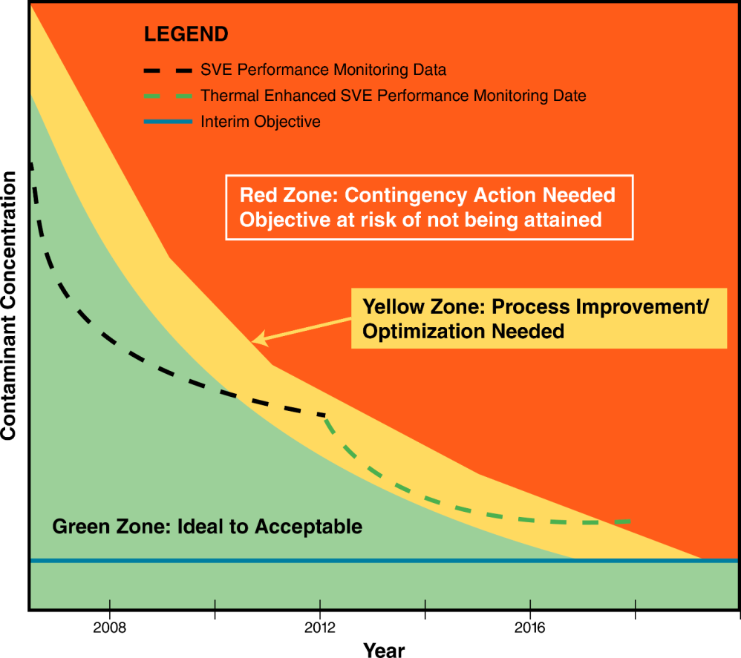
Monitor and Evaluate Performance Compare Actual and Predicted Performance
SVE Performance Monitoring Data
Thermal Enhanced SVE Performance Monitoring Data
Interim Objective
Contaminant Concentration
1
Years
2
3
SVE – Soil vapor extraction
ITRC RMCS-1, Figure 6
Notes:
No associated notes

Slide 89
Monitor and Evaluate Performance Periodic Evaluation Checklist Example
See Training Handout
Site
Contaminant properties known and considered?
Has source mass been evaluated?
Are plume dynamics well understood, increasing, shrinking or stable?
Are contaminant concentrations decreasing and on target to achieve objectives?
Technology
Performance evaluation
Technology alternatives cost/benefit analysis
Poll Question
ITRC RMCS-1 Table 13
Notes:
Full checklist is in the guidance/can be downloaded under Links to Additional Materials
Poll: When is the best time to review technology performance in detail?
- After every monitoring event
- During every periodic evaluation
- Only if technology fails to make progress towards interim objective
- After an interim objective has been met

Slide 90
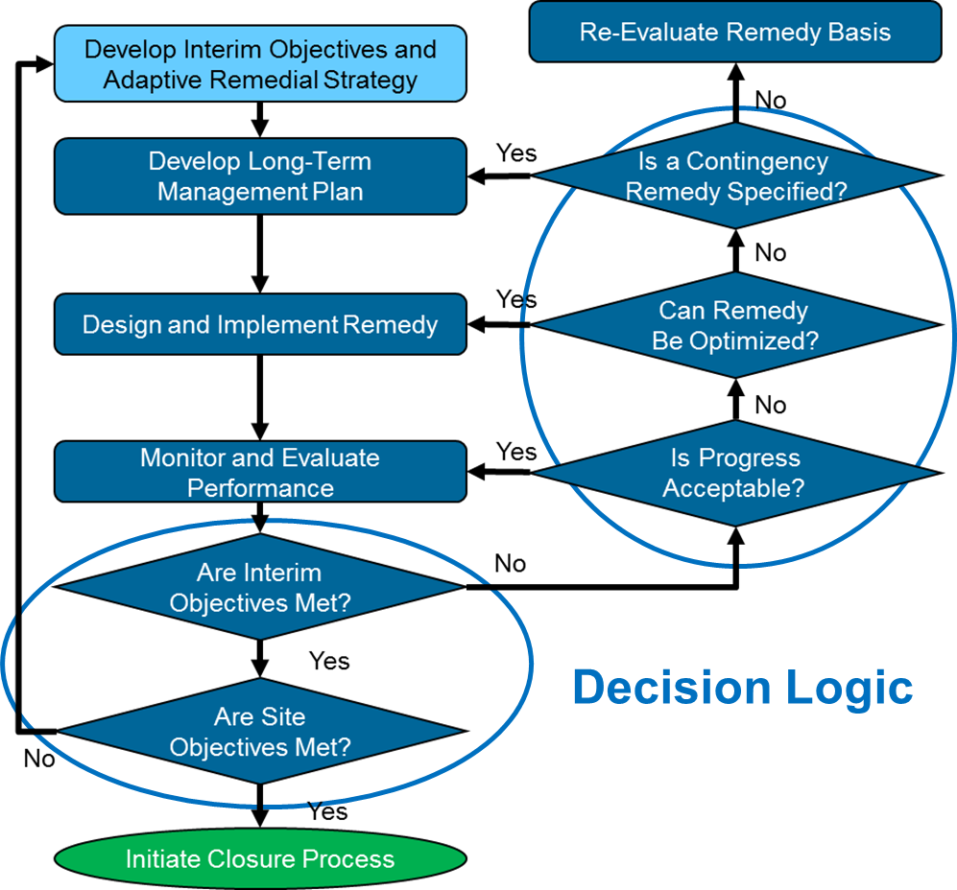
Decision Logic Potential Outcomes of Periodic Evaluations
Remedy/remedy phase is complete OR
Remedy is on track OR
Optimization is needed OR
Revised remedial approach is warranted
See Training Handout
ITRC RMCS-1, Figure 1
Notes:
No associated notes

Slide 91
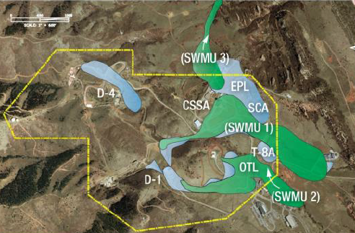
Example: Reaching Technology Limits at a Colorado Site
TCE and NDMA in fractured rock 125 feet deep
Enhanced in situ bioremediation for TCE
Reached asymptotic concentrations above action levels
Pilot studies of other technologies ineffective
Transitioned to MNA and institutional controls
Trichloroethylene (TCE) in bedrock (blue) and alluvial (green) aquifers after in situ bioremediation (Image from Brock 2012)
NDMA – N-nitrosodimethylamine
Notes:
No associated notes

Slide 92
Long Term Management Summary
Value of a plan
Plan components
Monitor and evaluate performance
Follow decision logic
ITRC RMCS-1, Chapter 5
Notes:
No associated notes

Slide 93
Today’s Road Map
Site challenges
Remediation Potential Assessment
Questions and answers
Adaptive remedy selection
Long-term management
Preparing you to take action
Questions and answers
Notes:
No associated notes

Slide 94
Our Opportunity to Improve
See Training Handout
Science and technology give us options for challenging sites
A robust and iterative conceptual site model is key to success
Consensus-driven interim objectives help us make progress
Adaptive site management facilitates finding an achievable path to common goal
Poll Question
Notes:
Poll: Would you recommend using Adaptive Site Management at your sites?
- Yes
- No
- Unsure – Need to learn more

Slide 95
What Actions Can You Take To Make Progress at Complex Sites?
Use and encourage use of the ITRC Guidance
Know your site – technical and non-technical challenges
Assess the remediation potential at your site(s)
Apply adaptive site management principles
Get your stakeholders involved early and develop consensus-based interim objectives
Schedule periodic evaluations of remedy performance to track remedy progress and make improvements
Notes:
No associated notes

Slide 96

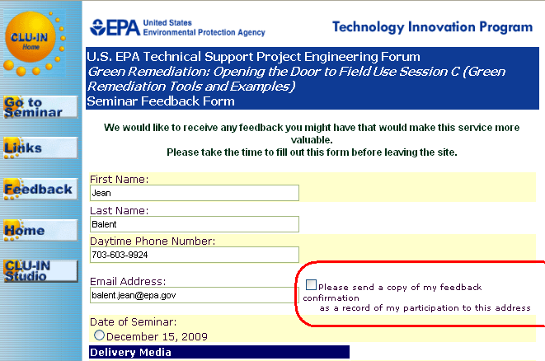

Thank You
Follow ITRC
2nd question and answer break
Links to additional resources
http://www.clu-in.org/conf/itrc/RMCS/resource.cfm
Feedback form – please complete
http://www.clu-in.org/conf/itrc/RMCS/feedback.cfm
Poll Question
Need confirmation of your participation today?
Fill out the feedback form and check box for confirmation email and certificate.
Notes:
Poll:
Would you recommend using Adaptive Site Management at your sites?
Yes
No
Unsure – Need to learn more
Links to additional resources:
http://www.clu-in.org/conf/itrc/RMCS/resource.cfm
Your feedback is important – please fill out the form at:
http://www.clu-in.org/conf/itrc/RMCS/feedback.cfm
The benefits that ITRC offers to state regulators and technology developers, vendors, and consultants include:
Helping regulators build their knowledge base and raise their confidence about new environmental technologies
Helping regulators save time and money when evaluating environmental technologies
Guiding technology developers in the collection of performance data to satisfy the requirements of multiple states
Helping technology vendors avoid the time and expense of conducting duplicative and costly demonstrations
Providing a reliable network among members of the environmental community to focus on innovative environmental technologies
How you can get involved with ITRC:
Join an ITRC Team – with just 10% of your time you can have a positive impact on the regulatory process and acceptance of innovative technologies and approaches
Sponsor ITRC’s technical team and other activities
Use ITRC products and attend training courses
Submit proposals for new technical teams and projects

