Slide 1
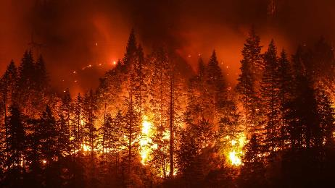
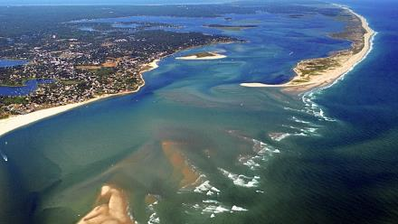
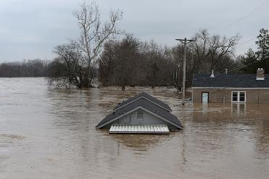
Sustainable Resilient Remediation Training
(SRR-1)
This Photo by Unknown Author is licensed under CC BY-SA-NC
Sponsored by: Interstate Technology and Regulatory Council (www.itrcweb.org)
Hosted by: US EPA Clean Up Information Network (www.clu-in.org)
Notes:
Training Course Overview:
The Sustainable Resilient Remediation (SRR) training will provide an overview of SRR and present five sections from the ITRC web based guidance document (GSRM-3, 2021):
Importance & Value of SRR(Sect 2)
Advancing the Practice: Social and Economic Dimensions of Sustainability and Resilience (Sect 5)
Integrating Resilience & Sustainability into the Remedial Project Life Cycle (Sect 6)
Key Sustainable & Resilient Best Management Practices (Sect 7)
Resources including an Interactive Map, Case Study database, and a BMP checklist (Sect 4, Appendix ?, )
After this webinar you should understand:
How to use the interactive web document
The importance of implementing sustainable and resilient practices during remediation at contaminated sites.
The importance of integrating social and economic dimensions of sustainable and resilience into the remediation process.
How to integrate sustainable and resilient practices into the remediation project life cycle
How to use the interactive resources provided in the web based document
For regulators and other government agency staff, sustainable and resilient remediation practices can hopefully be incorporated into your own programs. With Climate Change and Environmental Justice becoming paramount issues at local, state and federal levels, SRR should be incorporated more and more during the remediation process at contaminated sites. Proponents have found that the incorporation of SRR has provided for more trust between stakeholders and made the remediation process smoother and saved money in many cases.
Prior to attending the training class, participants are encouraged to view the associated ITRC guidance, Sustainable Resilient Remediation (GSR-3). Additionally, for participants interested in a more detailed information about Green & Sustainable Remediation (GSR), please view the ITRC Green and Sustainable Remediation: State of the Science, (GSR-1) and Green and Sustainable Remediation: A Practical Framework (GSR-2).

Slide 2




Housekeeping
Recording for On Demand Viewing
Course Information and Materials: https://clu-in.org/conf/itrc/srr
Technical difficulties? Use Q&A Pod
Certificate of Course Completion
Copyright 2020 Interstate Technology & Regulatory Council,
1250 H Street, NW Suite 850 | Washington, DC 20005

Slide 3






ITRC – Shaping the Future of Regulatory Acceptance
Host Organization
Network - All 50 states, PR, DC
Federal Partners
ITRC Industry Affiliates Program
Academia
Community Stakeholders
Disclaimer
  https://srr-1.itrcweb.org/about-itrc/#disclaimer
Partially funded by the US government
    ITRC nor US government warranty material
    ITRC nor US government endorse specific products
ITRC materials available for your use – see usage policy
DOE
DOD
EPA
www.itrcweb.org
Notes:
The Interstate Technology and Regulatory Council (ITRC) is a state-led coalition of regulators, industry experts, citizen stakeholders, academia and federal partners that work to achieve regulatory acceptance of environmental technologies and innovative approaches. ITRC consists of all 50 states (and Puerto Rico and the District of Columbia) that work to break down barriers and reduce compliance costs, making it easier to use new technologies and helping states maximize resources. ITRC brings together a diverse mix of environmental experts and stakeholders from both the public and private sectors to broaden and deepen technical knowledge and advance the regulatory acceptance of environmental technologies. Together, we’re building the environmental community’s ability to expedite quality decision making while protecting human health and the environment. With our network of organizations and individuals throughout the environmental community, ITRC is a unique catalyst for dialogue between regulators and the regulated community.
For a state to be a member of ITRC their environmental agency must designate a State Point of Contact. To find out who your State POC is check out the “contacts” section at www.itrcweb.org. Also, click on “membership” to learn how you can become a member of an ITRC Technical Team.
Disclaimer: This material was prepared as an account of work sponsored by an agency of the United States Government. Neither the United States Government nor any agency thereof, nor any of their employees, makes any warranty, express or implied, or assumes any legal liability or responsibility for the accuracy, completeness, or usefulness of any information, apparatus, product, or process disclosed, or represents that its use would not infringe privately owned rights. Reference herein to any specific commercial product, process, or service by trade name, trademark, manufacturer, or otherwise does not necessarily constitute or imply its endorsement, recommendation, or favoring by the United States Government or any agency thereof. The views and opinions of authors expressed herein do not necessarily state or reflect those of the United States Government or any agency thereof and no official endorsement should be inferred.
The information provided in documents, training curricula, and other print or electronic materials created by the Interstate Technology and Regulatory Council (“ITRC” and such materials are referred to as “ITRC Materials”) is intended as a general reference to help regulators and others develop a consistent approach to their evaluation, regulatory approval, and deployment of environmental technologies. The information in ITRC Materials was formulated to be reliable and accurate. However, the information is provided "as is" and use of this information is at the users’ own risk.
ITRC Materials do not necessarily address all applicable health and safety risks and precautions with respect to particular materials, conditions, or procedures in specific applications of any technology. Consequently, ITRC recommends consulting applicable standards, laws, regulations, suppliers of materials, and material safety data sheets for information concerning safety and health risks and precautions and compliance with then-applicable laws and regulations. ITRC, ERIS and ECOS shall not be liable in the event of any conflict between information in ITRC Materials and such laws, regulations, and/or other ordinances. The content in ITRC Materials may be revised or withdrawn at any time without prior notice.
ITRC, ERIS, and ECOS make no representations or warranties, express or implied, with respect to information in ITRC Materials and specifically disclaim all warranties to the fullest extent permitted by law (including, but not limited to, merchantability or fitness for a particular purpose). ITRC, ERIS, and ECOS will not accept liability for damages of any kind that result from acting upon or using this information.
ITRC, ERIS, and ECOS do not endorse or recommend the use of specific technology or technology provider through ITRC Materials. Reference to technologies, products, or services offered by other parties does not constitute a guarantee by ITRC, ERIS, and ECOS of the quality or value of those technologies, products, or services. Information in ITRC Materials is for general reference only; it should not be construed as definitive guidance for any specific site and is not a substitute for consultation with qualified professional advisors.

Slide 4





Today’s SRR Trainers:
  John Doyon (Co-Team Leader)
  NJ Dept. of Environmental Protection john.doyon@dep.nj.gov
  Elisabeth Freed
  U.S. EPA
  freed.elisabeth@epa.gov
  Nathan Hagelin
  Wood PLC nathan.hagelin@woodplc.com
  Thomas O’Neill
  Retired (NJ Dept. of Environmental Protection)
  tkoneillnj@gmail.com
  Michelle Mullin
  U.S. EPA
  mullin.michelle@epa.gov
Read trainer bios: https://clu-in.org/conf/itrc/SRR

Slide 5
Introduction
Resources, Background & Value of SRR
Economic & Social Benefits
Integrating SRR
Sustainable Best Management Practices
Notes:
Hello everyone and thank you for joining the ITRC Webinar on Sustainable Resilient Remediation

Slide 6
Sustainable Resilient Remediation
Sustainable resilient remediation (SRR) is an optimized solution to cleaning up and reusing a hazardous waste site that limits negative environmental impacts, maximizes social and economic benefits, and creates resilience against increasing threats.

Slide 7
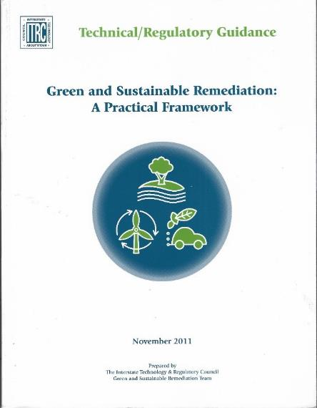
Introduction
Update of ITRC’s Green and Sustainable Remediation: A Practical Framework (ITRC 2011a)
Includes strong resilience component –increasing threat of extreme weather events, sea-level rise, & wildfires.
Recommends consideration of social and economic costs & benefits of a cleanup along with environmental costs & benefits.
Notes:
Sustainable Resilient Remediation evolved from the prior ITRC Guidance documents published in 2011 that discuss Green and Sustainable Remediation.
A strong resiliency component is incorporated.
This new web based SRR document recommends careful and continuous consideration of social and economic costs and benefits of a remediation along side of environmental costs and benefits

Slide 8
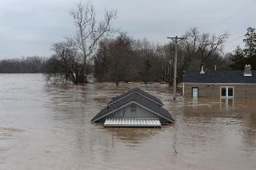

Why Sustainable Resilient Remediation
Extreme Weather Increasing in Frequency & Magnitude:
  Flooding
  Hurricanes
  Tornadoes
  Droughts
  Wildfires
  Sea Levels Rising
  Inundation
  Erosion
This Photo by Unknown Author is licensed under CC BY-SA-NC
Section 1 Introduction
8
Notes:
Why Sustainable Resilient Remediation?
We have seen an increase in the frequency and magnitude of extreme weather events. Increased flooding, the number and strength of hurricanes, we are seeing increased tornado clustering, climate patterns are shifting increasing flooding in north Atlantic and Midwest while increasing drought conditions in the southwest resulting in wildfires.
We also see increasing sea levels along coastal communities resulting in Inundation and Erosion.

Slide 9
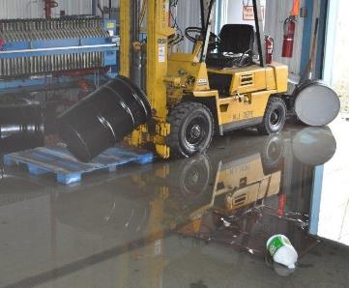
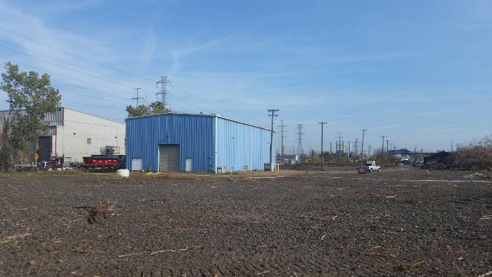
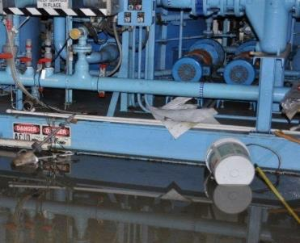
Contaminated Site Impacted by Climate Change
Impacting Sites
  Flooding
  Fires
  Power outages
  Wind damage
Photos courtesy of Thomas O’Neill
9
Notes:
These events have a direct impact on our lives, but also impact contaminated sites undermining the goal of what we are attempting to accomplish through the remediation of these sites –protect human health and the environment. Because of extreme weather events, contaminated sites become vulnerable to flooding, fires, wind damage, and power outages.

Slide 10







Solutions – Sustainable Resilient Remediation
Address Cause – Sustainability
Address Result - Resilience
10
Notes:
In this document we address this through two basic actions. Sustainable actions that address the root cause (climate change). And Resiliency Actions that address the results of climate change identified through vulnerability assessments.
Sustainable Actions:
Reduce the carbon footprint
Utilize natural (green) resources throughout project
Use clean renewable energy in place of carbon fuels
Optimize remedial activities.
Resiliency Actions
Assess vulnerabilities to climate impacts
Address vulnerabilities in the remedial design
Incorporate Resiliency into the remedy

Slide 11
What the Report Contains
Answers to frequently asked questions (FAQs) about SRR
Table 2‑1. The value of SRR and references to case studies reflective of answers.
FAQ | Answer | Case Study Match(es)*
Do sustainable and resilient remedies improve long-term risk management? | Yes. Practitioners identify project risks not normally considered. Sustainable risk management includes emissions mitigation and community revitalization. Resilient risk management maximizes adaptive capacity to changing climatic conditions. | Santa Susana Field Laboratory, Area IV—used cost/risk reduction tools. Senator Joseph Finnegan Park used risk management in determining remedy scope that limits long-term risk.
11
Notes:
The Importance and Value section includes - Answers to FAQs about SRR. Ties to case studies

Slide 12
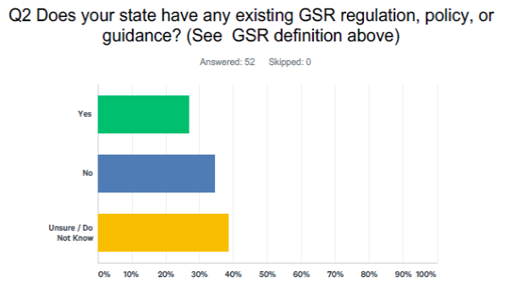
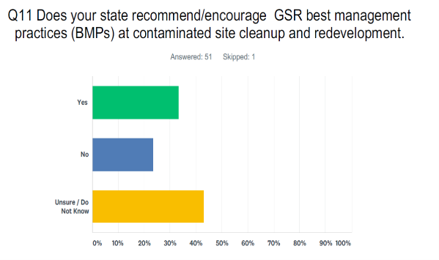
What the Report Contains
State Survey Summary: Conducted Fall 2019
12
Notes:
Some of the information found in the report include:
A summary of the State survey that was conducted in the Fall of 2019 which includes responses from all 50 states discussing the opportunities and barriers that they perceived with regard to SRR

Slide 13
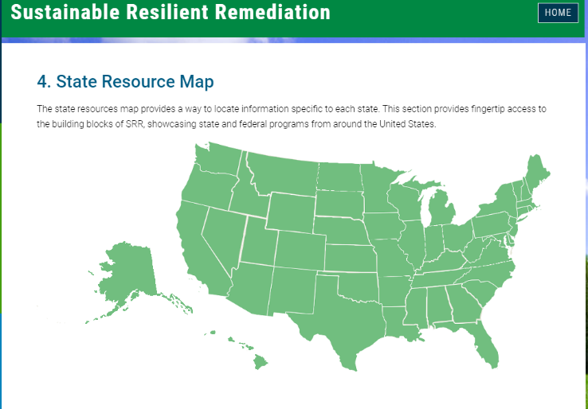
What the Report Contains
Online map with links to available state & federal resources to quickly find examples & best practices
13
Notes:
Some of the information found in the report include:
An online-interactive map that provides links to state & federal resources regarding SRR

Slide 14
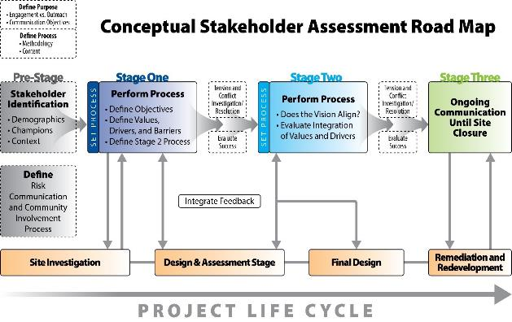
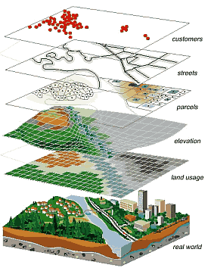
What the Report Contains
Expanded information on resources for social & economic dimensions of sustainability
Sites and Places
Boundaries
Tribal Land
Nonattainment Areas
Layer from the Web
Other Information
USEPA EJ Screen
14
Notes:
Some of the information found in the report include:
Information on resources regarding social and economic dimensions of sustainability such as:
USEPA EJ Screen
Stakeholder Assessments
Social & Economic Benefit Analysis Tools

Slide 15
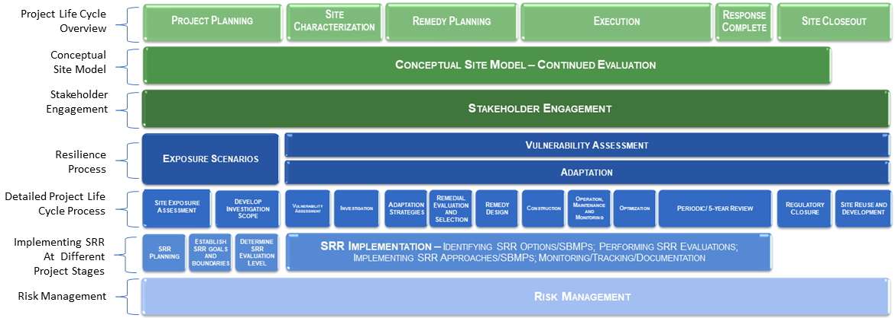
What the Report Contains
An updated framework that illustrates how and why sustainability and resilience should be integrated throughout the remedial project life cycle
15
Notes:
5. An updated framework illustrating the integration of sustainability & resiliency into the remediation project lifecycle.

Slide 16
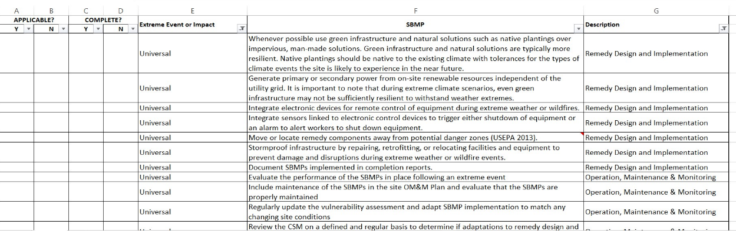
What the Report Contains
Appendix D. Sustainable Best Management Practice Checklists
Y
Y
N
N
N
Y
Y
Y
Y
Y
Y
16
Notes:
Easy to use checklists of key sustainable BMPs

Slide 17
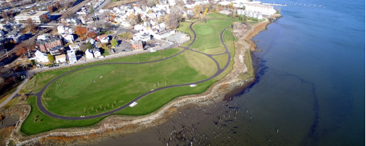
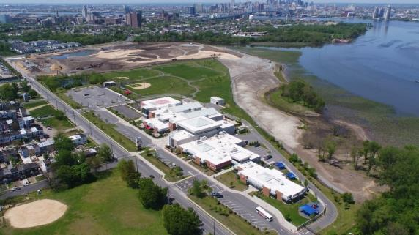
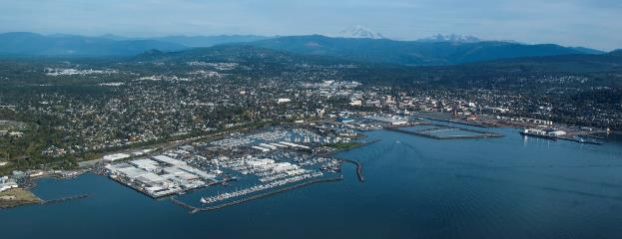
What the Report Contains
Case studies illustrating the application of SRR considerations
Harrison Avenue Landfill/Cramer Hill Waterfront Park Project
Camden, New Jersey
Senator Joseph Finnegan Park
Port Norfolk, Boston, Massachusetts
Bellingham Waterfront, Bellingham, Washington
17
Notes:
Case Studies that illustrate how SRR is applied at sites

Slide 18
What the Report Contains
Future Recommendations
Economic/social/environmental balance at local level
Risk management implementation (use more relevant local information)
Demonstrated value from SRR techniques
Metrics development to track progress SRR actions & goals
Guidance/standardized methods for conducting vulnerability assessments
Case studies of intentional resiliency implementation
Periodic site reviews that include an evaluation of resiliency
Greater focus on SRR in site design phase
Research & focus on adaptive capacity
Notes:
Recommendations for the future such as the development of metrics to track progress of Sustainable Resilient Remediation:
Better understanding of economic/social/environmental balance at local level.
Implement a more risk management approach - use more relevant local information when possible.
Demonstrate value that SRR techniques can bring - additional case studies showing value/success.
Additional research/examples and focus on adaptive capacity.
Develop metrics to track progress on goals of SRR actions.
Develop further guidance/standardized methods for conducting vulnerability assessments.
Better examples of intentional resiliency implementation in case studies.
Encourage periodic site reviews that include an evaluation of resiliency.
Encourage greater focus on SRR in design phase of site work.

Slide 19
Introduction
Resources, Background & Value of SRR
Economic & Social Benefits
Integrating SRR
Sustainable Best Management Practices
See Section 1 Introduction of the SRR Webpage Document
Notes:
Hello everyone and thank you for joining the ITRC Webinar on Sustainable Resilient Remediation

Slide 20

SRR Resources
Frequently Asked Questions (FAQs) – Section 2
Case Studies
    Case Study Matrix – Section 2 and Appendix A
    Advancing the Practice: Social and Economic Dimensions of Sustainability and Resilience – Section 5
Tech Sheets for Selected State Resources – Section 3 and Appendix C
State Resources Map – Section 4
Sustainable Resilience Remediation Framework – Section 6
Sustainable Best Management Practice Checklist – Section 7 and Appendix D
Use Resources to Learn and Navigate
Notes:
Notes:
There are 313 SBMPS that Michelle will reference or the 311 case studies plus the 4 detailed case studies in Section 5.
The resources help you find information, navigate the document.
You can use many of these resources as project management tools and to help manage project risk.
The resources help you document your work, allowing transparency and accountability to your internal and external stakeholders.
You will see that they can be used during any phase of the remediation process. Although we recommend bring them in as early in the process as you can, anytime is better than not at all. Even during OM&M Five-year Reviews or Remediation Process Optimizations.
There are plenty of other resources available in the document, figures, tables, pictures, these are the major ones that will help you learn our key messages and navigate the document.
References:
ITRC Improving Environmental Site Remediation Through Performance-Based Environmental Management (RPO-7), https://www.itrcweb.org/GuidanceDocuments/RPO-7.pdf
ITRC Remediation Process Optimization: Identifying Opportunities for Enhanced and More Efficient Site Remediation (RPO-1), https://www.itrcweb.org/GuidanceDocuments/RPO-1.pdf
ITRC Project Risk Management for Site Remediation (RRM-1), https://www.itrcweb.org/GuidanceDocuments/RRM-1.pdf

Slide 21
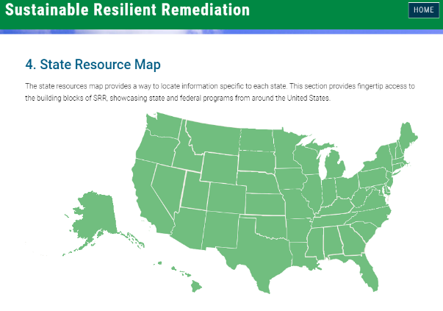
SRR Resources – State Resources Map (Section 4)
Climate Resilience
Green and Sustainable Remediation (GSR)
Wildfire Resilience
Examples of the information you will find:
  Laws and regulations
  Executive orders (EOs) state and federal
  Policy and guidance
  Other resources
  State case studies
  Federal resources
Figure 4-1. Interactive State Resource Map
Notes:
Notes:
Sustainability is more than an environmental concept that asks us to be efficient with resources. It is an integrated concept also involving economic progress and enhancing human equity
Project teams must also consider the impacts to communities a cleanup serves. Project teams must engage the community early in the process and ensure the engagement is continued throughout the process.
Requires:
Gathering community data – Need historical perspective of the site and community vision for the cleanup and redevelopment
Considering how a site or its cleanup might differently affect different communities – Similar types of sites may be viewed by communities in different ways. The community desires need to be met.
Balance between the three pillars of sustainability (environmental, social, & economic)
Eliminate the perception that economic and social concerns are external to cleanup

Slide 22
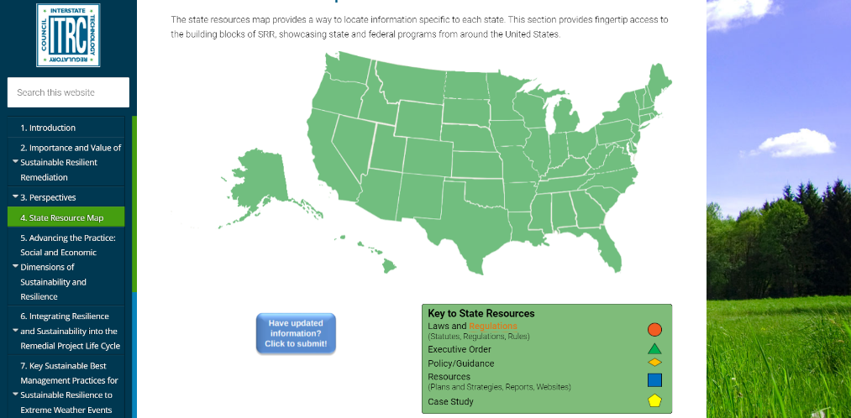
SRR Resources – State Resources Map

Slide 23
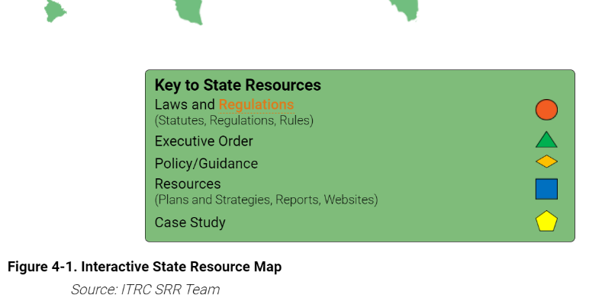
SRR Resources – State Resources Map

Slide 24
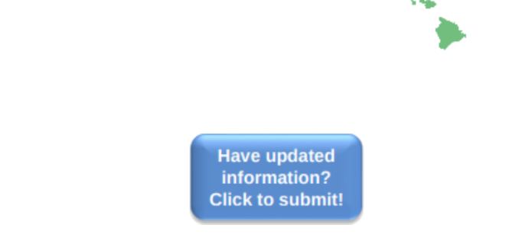
SRR Resources – State Resources Map
Figure 4-1. Interactive State Resource Map
Source: ITRC SRR Team

Slide 25
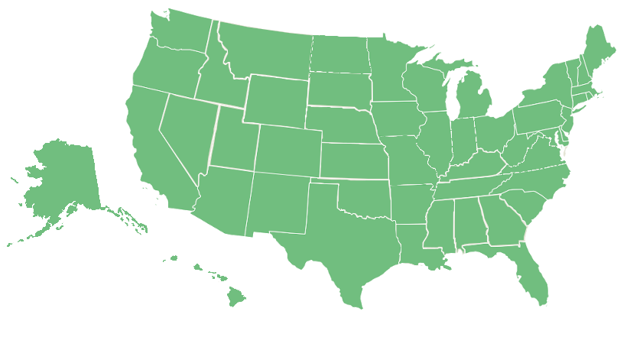
SRR Resources – State Resources Map
Figure 4-1. Interactive State Resource Map
Source: ITRC SRR Team
Notes:
Notes:
Key
Laws and Regulations (Statutes, Regulations, Rules) - Orange Circle
Executive Order – Green Triangle
Policy/Guidance – Gold Sideways Diamond (polygon)
Resources (Plans and Strategies, Reports, Websites) – Blue Square
Case Study – Yellow pentagon

Slide 26
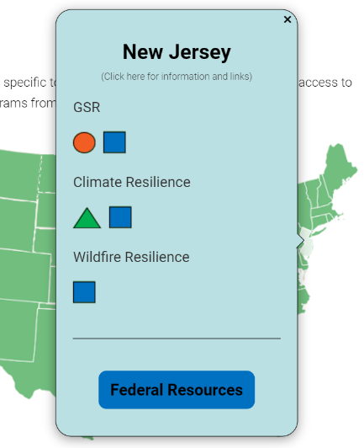
SRR Resources – State Resources Map
Figure 4-1. Interactive State Resource Map
Source: ITRC SRR Team
Notes:
Notes:
Key
Laws and Regulations (Statutes, Regulations, Rules) - Orange Circle
Executive Order – Green Triangle
Policy/Guidance – Gold Sideways Diamond (polygon)
Resources (Plans and Strategies, Reports, Websites) – Blue Square
Case Study – Yellow pentagon

Slide 27
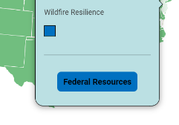
SRR Resources – State Resources Map
Figure 4-1. Interactive State Resource Map
Source: ITRC SRR Team

Slide 28
SRR Resources – State Resources Map
Figure 4-1. Interactive State Resource Map
Source: ITRC SRR Team
Notes:
Notes:
Key
Laws and Regulations (Statutes, Regulations, Rules) - Orange Circle
Executive Order – Green Triangle
Policy/Guidance – Gold Sideways Diamond (polygon)
Resources (Plans and Strategies, Reports, Websites) – Blue Square
Case Study – Yellow pentagon

Slide 29
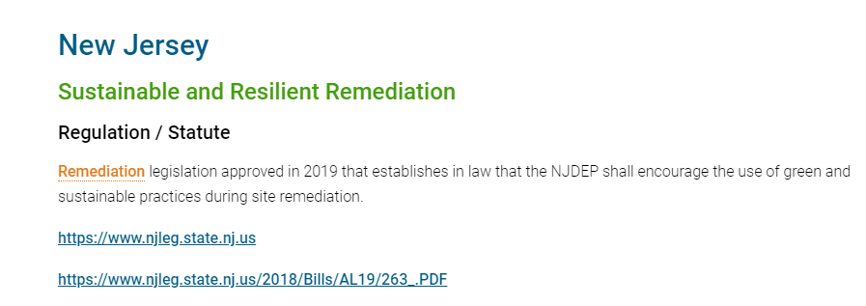
SRR Resources – State Resources Map
Notes:
Notes:
Navigation reference, where to find this – Section 4. Show how. (For all of the resources) Will tie into what the primary presenters do.
Button: Report errors and bad links, feel free to make suggestions on resources:
Let us know when new information becomes available, did you find the information useful, feedback is good, we will be available to answer questions

Slide 30
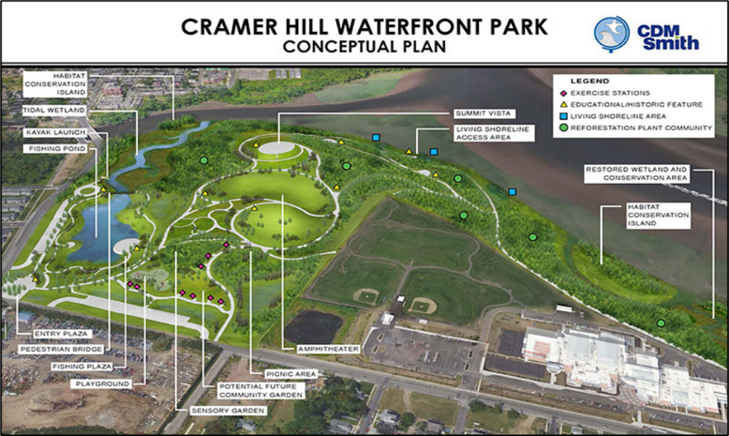
SRR Resources – Case Studies
Case Studies in Section 5: Advancing the Practice: Social and Economic Dimensions of Sustainability and Resilience
Harrison Avenue Landfill/Cramer Hill Waterfront Park Project Camden, New Jersey
Figure 5‑9. Conceptual graphic of the waterfront park
Source: www.nj.gov/dep/nrr/cramer-hill.htm
Notes:
Notes:
These four case studies are presented in the document, no need to leave the document to view this information. These case studies were developed or fleshed out by SRR Team members, they provide a great level of detail on how they illustrate resiliency and sustainability. They provide links for even further detail on the projects.
Four cases in Section 5.
311 in Case Study Matrix referenced in Section 2 found in Appendix A

Slide 31
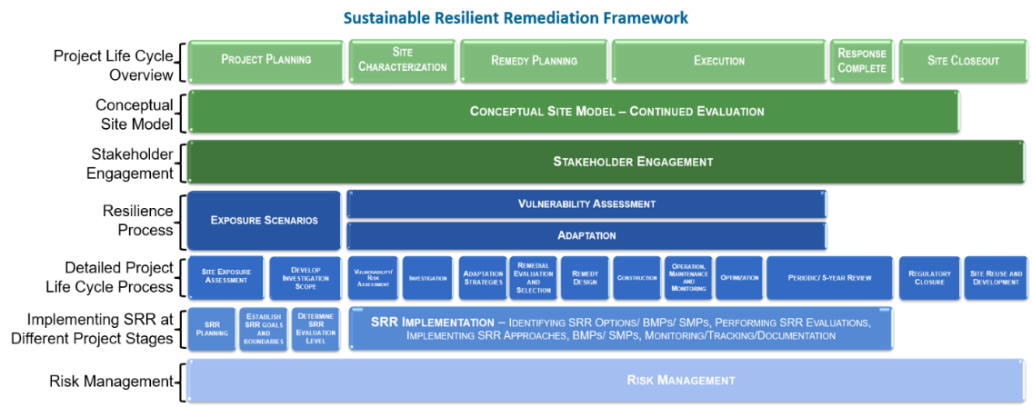
SRR Resources – Life Cycle & Framework Integration
Figure 6‑1. SRR framework. Source: ITRC SRR Team
Notes:
Notes:
Document Resource, Navigation, Project Management Tool.
No matter where you are in the project life cycle we have information for you.
Coming up Roy/Nathan will mention tool, The Sustainable Resilient Remediation Framework is a visual reference for how sustainability and resilience are part of the remediation process. In addition to a visual reference, it acts as a navigation tool to allow you jump to your area of interest quickly and efficiently.

Slide 32
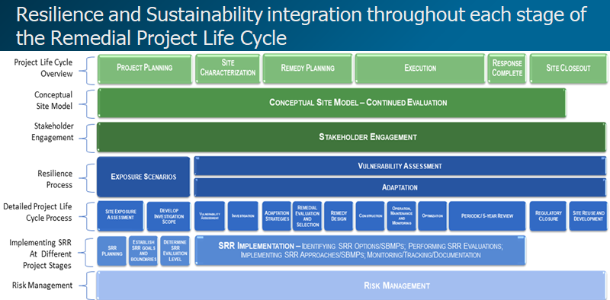
SRR Resources – Life Cycle & Framework Integration
Figure 6‑1. SRR framework. Source: ITRC SRR Team
Notes:
Notes:
Note references
As with all of our tools we made them with project managers and regulators in mind, so you can document and communicate how you came to your decisions, build these into you project documentation
Note return to framework button

Slide 33
SRR Resources – Life Cycle & Framework Integration
The social dimension of SRR includes consideration of critical stakeholder needs and concerns (often called stakeholder values). In this context, site-specific objectives, goals, and processes for an SRR assessment are informed by multiple stakeholder values (Cundy et al. 2013). Project stakeholders can include emergency personnel, utility providers, and hazardous waste management specialists (Kumar and Reddy 2020). Transforming sustainable, resilient benefits and mitigating unintended impacts to environmental justice (Section 5.2) and other underserved communities are core components of SRR risk management (Section 6.1.6).
Notes:
Notes:
More info in the section, this is just a clip so you can read it. Note the built-in references and citations.

Slide 34
SRR Resources – Life Cycle & Framework Integration
The social dimension of SRR includes consideration of critical stakeholder needs and concerns (often called stakeholder values). In this context, site-specific objectives, goals, and processes for an SRR assessment are informed by multiple stakeholder values (Cundy et al. 2013). Project stakeholders can include emergency personnel, utility providers, and hazardous waste management specialists (Kumar and Reddy 2020). Transforming sustainable, resilient benefits and mitigating unintended impacts to environmental justice (Section 5.2) and other underserved communities are core components of SRR risk management (Section 6.1.6).
Notes:
Notes:
More info in the section, this is just a clip so you can read it. Note the built-in references and citations.

Slide 35
SRR Resources
Case Study Matrix
Section 2; Appendix A
Frequently Asked Questions
Section 2.2
Tech Sheets
Appendix C
Sustainable BMP Checklists
Section 7; Appendix D
Notes:
Notes:
A Case Study Matrix in standard spreadsheet form is available in Appendix A, for simplicity in use.
FAQs: 2.2.1 Why is SRR Valuable? 2.2.2 What Are Common Misperceptions about SRR?
Michelle will give you details on the 313 SBMPs, excellent documentation tool, great for communicating how decisions were made, helps provide the transparency that stakeholders rightly demand.
Tech Sheets are found in Appendix C as a wealth of information.
Tech Sheets also include:
Guidance
Executive Orders
Funding
Additional Case Studies
State Resource Matrix
Sustainable BMP Checklists are found in Section 7 and Appendix D for you to pluck out and use in a buffet of options for particular site, as no two are the same.
ITRC has a range of other documents on related topics that we’ve mention, CSM, RPO, RRM, and of course GSR. All with related archived training at Clu-in.org
Remind users about feedback tool – on State Resources Map we want to know what is working, or not working, both as a document and how you find it useful, or not, for your implementation plan. Let us know how you are doing implementing SRR/GSR in your work, success stories we’d appreciate knowing if our document helped.

Slide 36

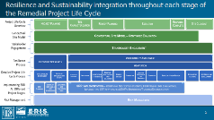
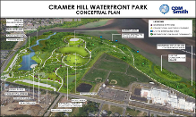
SRR Resources Summary
Frequently Asked Questions (Section 2)
Case Studies (Section 2; Appendix A, and Section 5.10)
Tech Sheets for Selected State Resources (Section 3 and Appendix C)
State Resources Map (Section 4)
Sustainable Resilience Remediation Framework (Section 6)
Sustainable Best Management Practice Checklists (Section 7 and Appendix D)
State Resource Map
SRR Framework
Case Studies
SRR Guidance Document
Notes:
Notes:
Take away: Use the State Resources Map to find out what is going on locally and nationally, Integration Framework to navigate and learn, and Case Studies to see success stories and find situations like yours.
An updated, from GSR-2, framework illustrating the integration of sustainability & resiliency into the remediation project lifecycle
Easy to use checklists of key sustainable BMPs
A range of Case Studies that illustrate how SRR is applied at site

Slide 37
SRR – History, Importance and Value
Background, Context, History
Extreme Weather Events, Sea-Level Rise, & Wildfires
  Impacts to integrity of environmental remediation solutions and, in turn, the public health and environment of the surrounding communities
Case Study Matrix
Frequently Asked Question (FAQs) Answers
Use SRR Value to Educate Others
Notes:
Notes:
All this can be found in Section 2 of the Document.
Background and context on evolution to and value of SRR Improves the remediation process
Brief overview of the history of hazardous waste cleanup and the importance of GSR
Climate change impacts from extreme weather events, sea-level rise, and wildfires to the integrity of environmental remediation solutions and, in turn, the public health and environment of the surrounding communities
Case study matrix that summarizes projects where SRR has been implemented
Frequently asked questions (FAQs) about misperceptions and the value of SRR that prove the case for using SRR, along with references to case studies
Among the most common questions, just what are resiliency and sustainability:
Remember: “…sustainability considers the remedy’s impact on the environment, resilience considers the environment’s impact on the remedy…”
References:
ITRC Improving Environmental Site Remediation Through Performance-Based Environmental Management (RPO-7), https://www.itrcweb.org/GuidanceDocuments/RPO-7.pdf
ITRC Remediation Process Optimization: Identifying Opportunities for Enhanced and More Efficient Site Remediation (RPO-1), https://www.itrcweb.org/GuidanceDocuments/RPO-1.pdf
ITRC Project Risk Management for Site Remediation (RRM-1), https://www.itrcweb.org/GuidanceDocuments/RRM-1.pdf

Slide 38
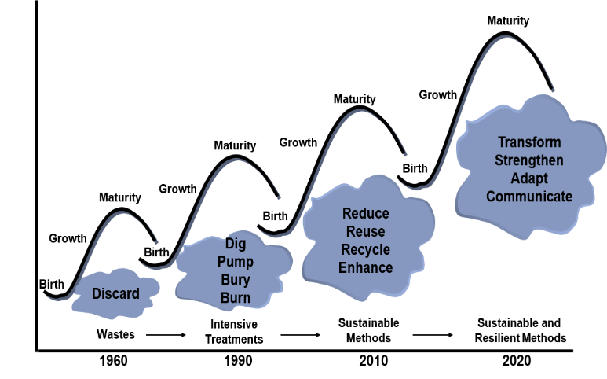
Evolution of Environmental Remediation to SRR
Document Figure 2‑1. Evolution of environmental remediation to SRR. Source: Adapted from Ellis and Hadley (2009).
Notes:
Notes:
Approaches to cleaning up contaminated sites became more standardized in the United States following the establishment of transformative federal regulations (and subsequent state regulations) governing their remediation. Since the early days of site cleanup activities, the remediation industry has progressed through several cycles representing different approaches for achieving cleanup objectives (Figure 2-1). Until recently, the development of remedial approaches relied mostly on a static site characterization (for example, current and historical groundwater elevations, flow directions, precipitation rates) that reflected conditions at a single point in time. Conceptual site models (CSMs) have generally placed more emphasis on how past site activities created current site conditions, a snap shot, and little attention on what could happen at a site in the future.
1960’s - Dump where you could, on site, off site – back 40, in lakes, rivers, ocean.
Regulations
1990 – Intensive site remediation, dig and dump/haul, in-situ/ex-situ, SVE, etc. Focused on attacking the source area’s and later on the dissolved plumes
Clean and Green Initiatives
2010 – Selecting products and chemicals needed for remediation with green in mind, e.g. biodiesel for yellow iron/machines, how to power the sites
Now we and others are advocating SRR – broad view of the site, yes, green but also what will the site look like when complete, or no further active action, be that 5, 10, 20, or 30 years from now can it be resilient over that period, can it be sustainable, an effective remediation with minimal or even positive social and economic impact on the community it is located in.
Since 2000, cleaning up contaminated sites has generally consisted of a risk-based approach while maintaining the primary objective of protecting human health and the environment. As a result, many contaminated sites are being addressed through long-term management (for example, institutional and engineering controls, land-use restrictions, hydraulic control, source containment, passive treatment, monitoring, and natural attenuation, or some combination) rather than resource-intensive, active source removal. In long-term management, protecting human health and the environment is not a static objective to be achieved, but a condition that must be maintained throughout the lifespan of the remedy. Requires continuous or periodic review of the remediation, see ITRC’s RPO, RRM documents.

Slide 39



SRR Sustainability Principles and Practices
Start of Sustainable and Resilient Remediation
US EPA
2008
SURF
2009
ITRC
2011
Overview Document: Green and Sustainable Remediation: State of the Science and Practice
Technical & Regulatory Guidance: Green and Sustainable Remediation: A Practical Framework
Sustainable Remediation White Paper—Integrating Sustainable Principles, Practices, and Metrics into Remediation Projects
Green Remediation: Incorporating Sustainable Practices into Remediation of Contaminated Sites
Notes:
Notes:
If you are not familiar with documents, we recommend that your read them…
The above documents not only provided guideposts on what was considered practical for implementation based on general industry stakeholder acceptance, they provided industry with tools and practices that could be applied. These tools and practices place as much emphasis on ensuring sustainability in the process of cleanup as they do in the long-term impacts of the remedy. GSR is not a means of justifying a less effective remedial action, but instead a case for weighing the additional measures of environmental, social, and economic effectiveness alongside remediation potential at all stages. The intentionality of considering these GSR elements is its key distinguishing feature.
Many lessons have been learned about GSR (for example, the importance of stakeholder engagement), the science has advanced (social and economic impact evaluations), and new tools have emerged since the ITRC published its guidance documents in 2011. Many of these attributes are summarized in a review (Favara et al. 2019). This new ITRC guidance, Sustainable Resilient Remediation (GSR-3), presents these lessons learned as resources for state agencies and other decision makers, remediation and resilience practitioners, and affected communities. These documents are still valid can by used by remediation practitioners, government officials, stakeholders, and site owners; but they should now be read in light of a clear understanding of SRR. Failure to do so may result in lost opportunities to improve the remediation’s ultimate outcome be it the physical remediation or it’s impact to the community around the site. SRR helps broaden the thought process needed for sound remediation. So, please take time to go read these documents.
The evolution described above has provided a mechanism with which to address resilience in remediation. There is growing evidence that shifting short- and long-term climatic conditions will critically influence the performance of many types of infrastructure, including contaminant management and remediation measures intended to protect human health and the environment (Maco et al. 2018, O'Connell and Hou 2015, Reddy, Kumar, and Du 2019). In 2019, the Government Accountability Office (GAO) published a report entitled Superfund, U.S. EPA Should Take Additional Actions to Manage Risks from Climate Change, which highlights several National Priorities List (NPL) sites’ vulnerability to extreme weather.

Slide 40
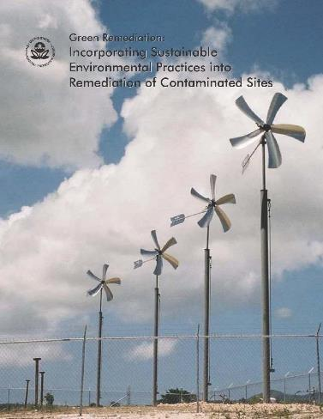
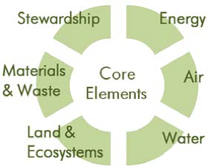
SRR Sustainability Principles and Practices
Start of Sustainable and Resilient Remediation
USEPA (2008): Green Remediation: Incorporating Sustainable Practices into Remediation of Contaminated Sites
Notes:
Notes:
This document identified tools and practices place as much emphasis on ensuring sustainability in the process of cleanup as they do in the long-term impacts of the remedy. GSR is not a means of justifying a less effective remedial action, but instead a case for weighing the additional measures of environmental, social, and economic effectiveness alongside remediation potential at all stages. The EPA got the ball rolling on building in intentionality of considering these GSR elements is its key distinguishing feature.
Net environmental benefit “Green Remediation: The practice of considering all environmental effects of remedy implementation and incorporating options to maximize net environmental benefit of cleanup actions.”
“This primer outlines the principles of green remediation and describes opportunities to reduce the footprint of cleanup activities throughout the life of a project. Best management practices (BMPs) outlined in this document help decision-makers, communities, and other stakeholders (such as project managers, field staff, and engineering contractors) identify new strategies in terms of sustainability. These strategies complement rather than replace the process used to select primary remedies that best meet site-specific cleanup goals.”

Slide 41
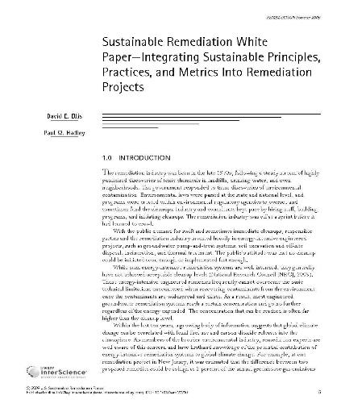
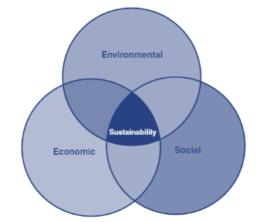

SRR Sustainability Principles and Practices
Sustainable Remediation Forum (SURF) (2009) Integrating Sustainable Principles, Practices, and Metrics into Remediation Projects
Notes:
Notes:
Many lessons have been learned about GSR (for example, the importance of stakeholder engagement), the science has advanced (social and economic impact evaluations), and new tools have emerged since the ITRC published its guidance documents in 2011. Many of these attributes are summarized in a review (Favara et al. 2019). This new ITRC guidance, Sustainable Resilient Remediation (GSR-3), presents these lessons learned as resources for state agencies and other decision makers, remediation and resilience practitioners, and affected communities.
Introduced the now famous Triple Bottom Line Venn diagram to a broader audience, with Environmental, Social and Economic circles with sustainability in the middle.

Slide 42
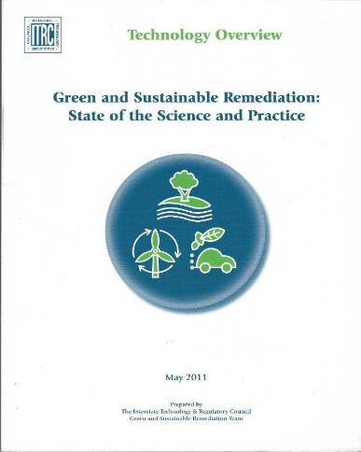
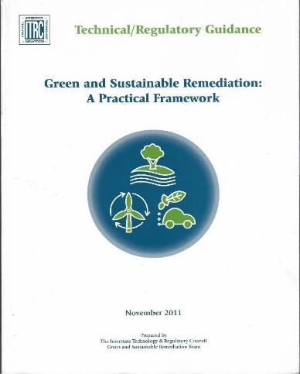
SRR Sustainability Principles and Practices
Technology Overview Document: Green and Sustainable Remediation: State of the Science and Practice (May 2011)
Technical and Regulatory Guidance: Green and Sustainable Remediation: A Practical Framework
(November 2011)
Notes:
Notes:
Authors and contributors to prior doc were either team members, contributors, or reviewers to the ITRC work.
The evolution described above has provided a mechanism with which to address resilience in remediation. There is growing evidence that shifting short- and long-term climatic conditions will critically influence the performance of many types of infrastructure, including contaminant management and remediation measures intended to protect human health and the environment (Maco et al. 2018, O'Connell and Hou 2015, Reddy, Kumar, and Du 2019). In 2019, the Government Accountability Office (GAO) published a report entitled Superfund, U.S. EPA Should Take Additional Actions to Manage Risks from Climate Change, which highlights several National Priorities List (NPL) sites’ vulnerability to extreme weather.
These documents are still valid can by used by remediation practitioners, government officials, stakeholders, and site owners; but they should now be read in light of a clear understanding of SRR. Failure to do so may result in lost opportunities to improve the remediation’s ultimate outcome be it the physical remediation or it’s impact to the community around the site. SRR helps broaden the thought process needed for sound remediation. So, please take time to go read these documents.
This evolution has brought us here: Many lessons have been learned about GSR (for example, the importance of stakeholder engagement), the science has advanced (social and economic impact evaluations), and new tools have emerged since the ITRC published its guidance documents in 2011. Many of these attributes are summarized in a review (Favara et al. 2019). This new ITRC guidance, Sustainable Resilient Remediation (SRRR-1), presents these lessons learned as resources for state agencies and other decision makers, remediation and resilience practitioners, and affected communities. These documents are still valid can by used by remediation practitioners, government officials, stakeholders, and site owners; but they should now be read in light of a clear understanding of SRR. Failure to do so may result in lost opportunities to improve the remediation’s ultimate outcome be it the physical remediation or it’s impact to the community around the site. SRR helps broaden the thought process needed for sound remediation. So, please take time to go read these documents.
The evolution described above has provided a mechanism with which to address resilience in remediation.
References:
There is growing evidence that shifting short- and long-term climatic conditions will critically influence the performance of many types of infrastructure, including contaminant management and remediation measures intended to protect human health and the environment (Maco et al. 2018, O'Connell and Hou 2015, Reddy, Kumar, and Du 2019). In 2019, the Government Accountability Office (GAO) published a report entitled Superfund, U.S. EPA Should Take Additional Actions to Manage Risks from Climate Change, which highlights several National Priorities List (NPL) sites’ vulnerability to extreme weather.

Slide 43
Why is SRR valuable?
Resilience measures have favorable economic returns on investment (NIBS 2018)
Environmental impacts can add costs to the clean up
Social impacts include the need to spend more after environmental impacts to restore communities to whole
“…60% of all nonfederal NPL sites are in areas that may be impacted by flooding, storm surge, wildfires, and/or sea-level rise.” GAO, 2019
Notes:
Notes:
What you put into resiliency and sustainability will be returned, maybe many times over
Just look to my example, that is not so bad, my dedicated PM and her contractors mitigated the cost and time damage
Why waste precious resources, time and money, on an existing project when there are other projects to deal with
While sustainability considers the remedy’s impact on the environment, resilience considers the environment’s impact on the remedy. However, this distinction is not so simple. For example, a remedy that is vulnerable to extreme weather—that is, not resilient when exposed to an extreme weather event—may fail to reach its design life, thereby causing significant adverse impacts to the surrounding environment. These environmental impacts, in turn, may have associated economic (for example, the cost to clean up a release caused by extreme weather and reestablish the remedy) and social impacts (for example, the impacts to the community from the release caused by the extreme weather or the additional costs to reestablish the remedy at the expense of using those funds for another cleanup action). To be truly sustainable, a remedy must maintain functionality for the duration of its design life and do so by being resilient to extreme events and changing conditions. The interconnectedness of sustainability and resilience, particularly as they relate to the cleanup of contaminated sites, reemphasizes the importance of, what we are advocating, an integrated approach.
References:
National Institute of Building Sciences (NIBS 2018)
Superfund, U.S. EPA Should Take Additional Actions to Manage Risks from Climate Change (GAO, GAO-20-73, 2019)
Notes from the GAO report of the 1,336 sites evaluated, 421 were described as needing no further action, 90% non-federal, federal make up almost 10%.

Slide 44
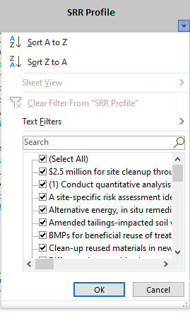
Importance and Value – Case Studies
What you will find in the case studies:
  Name, Location
  Overview of remediation activities
  Elements of SRR performed at that site
  Offset/avoidance achieved
  Tools used to support SRR work
  References and links
  Regulatory program(s)
Appendix A. Case Studies in Sustainable Resilient Remediation
Notes:
Notes:
Note that it is a downloadable Excel Spreadsheet.
311 Case Studies Summarized in the Matrix
I’ve shortened up the headers to squeeze them into the bullets on this slide; and, no, I don’t expect you to be able to read the example. I just wanted to show you format for the case studies, it’s spreadsheet. Because it’s a spreadsheet we’ve organized the columns and data for speedy and efficient searches – so you can find what you need.
Reserved for pop out demo to show detail tease of sample drop down menu(s)
Actual Headers from Appendix A as described in Section 2, note they can sort using the dropdown menus to speed them to the info they want
Case study name (which may be referenced in other parts of this document)
Location of case study
Overview of remediation activities conducted
Elements of SRR activities performed at site
Examples of environmental, economic, social, and resilience benefit(s) derived from the work
Offset/avoidance achieved
Tools used to support SRR work
Literature references or links to full case study
Regulatory program work was completed under

Slide 45
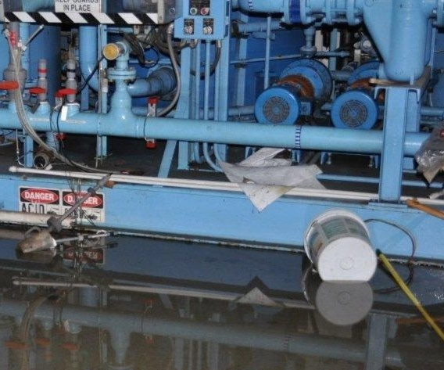

Importance and Value
  SRR IS Important & HAS Value
Making sure that remediation is successful
  Ensuring that valuable resources are not wasted by poor planning
  Promoting social and economic benefits
“…sustainability considers the remedy’s impact on the environment, resilience considers the environment’s impact on the remedy…” ITRC, SRR-1
Photos Courtesy of the NJDEP
Notes:
Notes:
Take away: SRR will help improve site remediation by providing tools to address sustainability and resiliency, “…sustainability considers the remedy’s impact on the environment, resilience considers the environment’s impact on the remedy…”
SRR is Important and Has Value:
Remember what SRR is: “…sustainability considers the remedy’s impact on the environment, resilience considers the environment’s impact on the remedy…”
Making sure that remediation is successful while human health, and the environment are continuously protected. Sustainable – achieve remediation with min impact to environment/social/economic
Use sustainable and resilience risk management so as not waste time and money redoing what has already been done – not spending these when they are desperately needed elsewhere
Promoting social and economic benefits Remediation sites while hazardous should not remain a continuing burden to the community – they can represent opportunities for the future
The document provides you with information, tools, and examples
Please listen to our main message today which is – bring resiliency and sustainability to your projects, you won’t regret it. You don’t have to use everything that we have presented feel free to customized what you use to the particular facts of your project. The earlier you do it in the process the bigger the impact on building in adaptation to promote both resiliency and sustainability. If you can’t do it now, please consider these thoughts and recommendations during periodic review, such as Five-year reviews. Site remediation project impacts are so much more than their physical footprint foot print they exist as part of a larger environment, community, and region!
We are providing you have the tools, resources, and references, ……just do it !
Click to next slide…hand off presentation to….provide name

Slide 46
Introduction
Resources, History & Value of SRR
Social & Economic Evaluations & Benefits
Integrating SRR
Sustainable Best Management Practices

Slide 47

Understand the Social & Economic Dimensions of SRR
  Importance of considering the social & economic impacts of remediation on communities
  Environmental justice
  Linking desired outcomes to metrics or progress indicators
  Incorporating sustainability & resilience into brownfield sites
  Three evaluation levels to be considered when assessing social & economic dimensions of SRR
  Discussion of ecosystem services
  Case studies
Use Metrics & Indicators to Document
Sustainable resilient remediation is an optimized solution to cleaning up and reusing contaminated sites that, among other things, maximizes social and economic benefits.
Section 5: Advancing the Practice

Slide 48
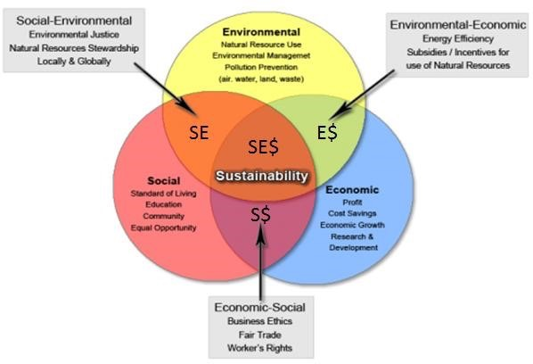
The Three Pillars of Sustainability
Courtesy of USEPA
Notes:
This figure came out of the USEPA Document EPA/600/R/12/687 | October 2012 | www.epa.ord titled A Framework of Sustainability Indicators at EPA
The Venn diagram represents the three pillars of Sustainability and illustrates the interconnectedness of the Environmental, Social and Economic aspects of sustainability. The Social issues such as the standard of living, education, community, and equal opportunity mesh with the Environmental issues such as the use of Natural Resources, Environmental Management, and Pollution Prevention which in turn mesh with the Economic aspects like profit, cost savings, economic growth, and research & development. Without considering all three together, sustainability may not be achieved.
Economic impact: Economic vitality, jobs, infrastructure, cost-effectiveness. The effect that an event or scenario has on the economy in the surrounding community, such as impacts on business revenue, employment, and salaries.
Social justice: Fair treatment of all people in a society, including respect for the rights of minorities and equitable distribution of resources among members of a society.
Socioeconomic: Refers to society-related economic factors. The socioeconomic factors that determine health include employment, education, and income.

Slide 49
Considering Social & Economic Impacts of
Remediation on Communities
SRR is more than an environmental concept that asks us to be efficient with resources
Project teams must also consider the impacts of the cleanup on communities
SRR requires the:
  Gathering of community data as well as environmental data
  Consideration how a site or its cleanup might differently affect different communities
  Balance among the three pillars of sustainability (environmental, social, & economic)
Delivers better projects at lower total costs by increasing overall community benefit & ownership
Notes:
Sustainability is more than an environmental concept that asks us to be efficient with resources. It is an integrated concept also involving economic progress and enhancing human equity
Project teams must also consider the impacts to communities a cleanup serves. Project teams must engage the community early in the process and ensure the engagement is continued throughout the process.
Requires:
Gathering community data – Need historical perspective of the site and community vision for the cleanup and redevelopment
Considering how a site or its cleanup might differently affect different communities – Similar types of sites may be viewed by communities in different ways. The community desires need to be met.
Balance between the three pillars of sustainability (environmental, social, & economic
perception that economic and social concerns are external to cleanup

Slide 50
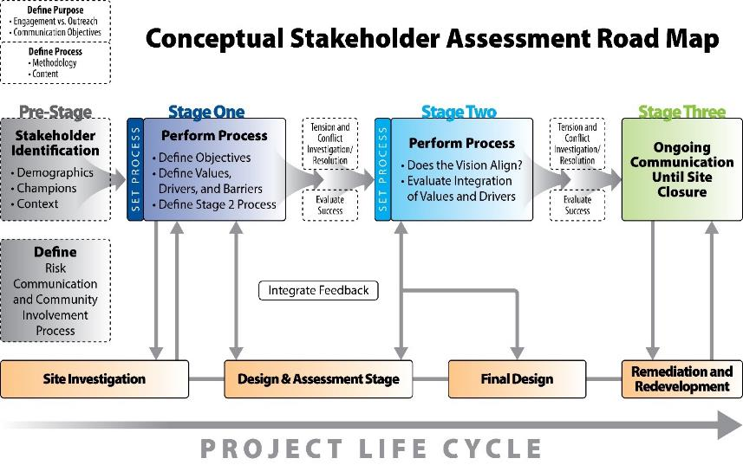
Stakeholder Engagement
Figure 5‑5. Conceptual stakeholder assessment road map.
Source: Ridsdale and Harclerode (2019). Used with permission.
Notes:
Define site-specific sustainability & resiliency objectives
Identify indicators & metrics, and obtain data
Evaluate Environmental, Social, and Economic Impacts
Stakeholder engagement evolves throughout projects lifecycle
Define purpose & process of engagement
Stakeholder engagement is a continuous process
A means of partnership and information exchange
Before undertaking any communication or planning with stakeholders, the core project team should have a discussion on what the known or anticipated SRR stakeholder values are for the project, in the context of the remediation site and the affected community. A desktop review of community demographic data and applicable news and social media can help a project team initially assess stakeholder needs and concerns. This is considered “Pre-Stage”. Not all projects require the same level of engagement. Determination on the level of engagement and who should be engaged should be made during project planning and revisited as new stakeholder concerns and needs arise. Furthermore, individual stakeholders’ interest in and influence on a project may change over time, prompting a revised or more comprehensive engagement strategy.
Stage 1 is identified as the first official stage of the engagement process and involves engaging stakeholders to define early SRR objectives and values.
Stage 2 involves evaluating if remedial actions are in line with the stakeholders’ needs and concerns, and if any conflicts arise, developing a plan to address them. This “conflict check in” is suggested to avoid a prolonged conflict, which may lead to project delays, uncertainties in public acceptance, or unwanted negative press.
Stage 3 of the road map takes place during the remediation activities and involves continued communication with the stakeholders on progress, updates, and early identification of conflicts that may arise.

Slide 51
Environmental Justice
The fair treatment and meaningful involvement of all people regardless of race, color, national origin, or income, with respect to the development, implementation, and enforcement of environmental laws, regulations, and policies.
Fair Treatment
Meaningful Involvement
Notes:
Fair treatment - No group should bear a disproportionate burden of environmental harms and risks, including those resulting from the negative environmental consequences of industrial, governmental and commercial operations or programs and policies.
Meaningful involvement - Potentially affected populations have an appropriate opportunity to participate in decisions about a proposed activity that will affect their environment and/or health; the public’s contribution can influence the regulatory agency’s decision; the concerns of all participants involved will be considered in the decision-making process; and the rule-writers and decision-makers seek out and facilitate the involvement of those potentially affected.
Even the most well-intentioned cleanup projects can perpetuate these systemic disparities if they fail to address them in project planning, execution, or operation.
Robust stakeholder engagement is crucial for achieving meaningful outcomes environmental justice communities.
Minority, low income, and indigenous communities are often the most vulnerable and overburdened by environmental and public health stressors, and therefore deserve special consideration.
Pursuit of environmental justice should be considered as an overarching goal for a cleanup project.
There should be multiple opportunities for two-way dialogue and collaboration with all stakeholders throughout the project lifecycle and beyond.
Different levels of engagement are needed for various stakeholder groups (e.g., those directly affected vs indirectly affected).

Slide 52
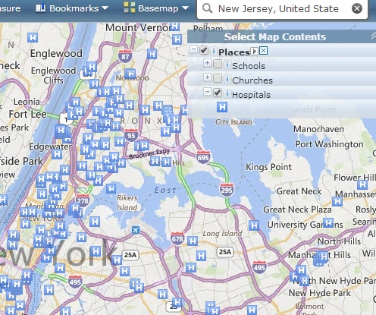
EJ Screen
USEPA EJ Screen: https://www.epa.gov/ejscreen
Sites and Places
Boundaries
Tribal Land
Nonattainment Areas
Layer from the Web
Other Information
Section 5.2: Special Considerations for Low-Income and Minority Communities
Notes:
Even the most well-intentioned cleanup projects can perpetuate these systemic disparities if they fail to address them in project planning, execution, or operation.
Robust stakeholder engagement is crucial for achieving meaningful outcomes environmental justice communities.
Don’t assume that the lead organization and other decision makers understand the concerns of the people in the surrounding community.
Recognize that people may be skeptical that the lead organization is telling the truth, cares about them, and is willing to work with them.
Research the full range of opinions and concerns including general attitude, knowledge and perceptions about the cleanup activities.
Regularly ask community leaders and the stakeholders if there are other groups or individuals who are missing from the outreach and who should be involved.

Slide 53
State Environmental Justice Resources Examples
California: CalEnviroScreen 3.0, California Office of Environmental Health Hazard Assessment
Maryland: MD EJScreen, Community Engagement, Environmental Justice, & Health
Washington: Washington Tracking Network, Washington State Department of Health
New Jersey: https://www.nj.gov/dep/ej/

Slide 54
Social and Economic Evaluations Levels
Level 1 (Sustainable Best Practices):
Adopt and incorporate those social and economic BMPs that promote quality-of-life improvements and mitigate unintended impacts that directly affect the community and indirectly affect broader society.
Level 2:
Combines the selection and implementation of SBMPs with some degree of qualitative or semi-quantitative evaluation.
Level 3:
Combines the selection and implementation of SBMPs with a rigorous quantitative evaluation.
Both Level 2 & 3 assess how site cleanup and restoration activities may result in beneficial or unintended social, economic, and environmental impacts.
Notes:
Level 1 Evaluation – Sustainable Best Practices – adopt and incorporate those social and economic BMPs that promote quality-of-life improvements and mitigate unintended impacts that directly affect the community and indirectly affect broader society. Examples include: Standard Guide for Integrating Sustainable Objectives into Cleanup that offers a comprehensive sustainable remediation BMPs list or Institute for Sustainable Infrastructure EnvisionTM PreAssessment Checklist that provides a simple preplanning checklist for assessing project sustainability in increasing awareness of issues, including quality of life, leadership, resource allocation, natural world, and climate and risk.
Level 2 evaluation: combines the selection and implementation of SBMPs with some degree of qualitative or semi-quantitative evaluation. This level of evaluation assesses how site cleanup and restoration activities may result in beneficial or unintended social, economic, and environmental impacts. For example, stakeholders present their level of preference on criteria used to select a proposed project, remediation alternative, or preferred land use scenario.
Level 3 evaluation: combines the selection and implementation of SBMPs with a rigorous quantitative evaluation. This level of evaluation assesses how site cleanup and restoration activities may result in beneficial or unintended social, economic, and environmental impacts.
Example: There is a difference between conducting stakeholder engagement sessions with a community and only considering & assessing the impacts on social, economic, and environmental factors of a project. -- Not sure what you are trying to say here. What else should the stakeholder engagement should consider?

Slide 55
Social and Economic Evaluations for SRR
Level 1 Evaluation
Identify and Adopt Sustainable Best Practices
Notes:
Level 1 Evaluation – Sustainable Best Practices – adopt and incorporate those social and economic BMPs that promote quality-of-life improvements and mitigate unintended impacts that directly affect the community and indirectly affect broader society. Examples include: Standard Guide for Integrating Sustainable Objectives into Cleanup that offers a comprehensive sustainable remediation BMPs list or Institute for Sustainable Infrastructure EnvisionTM PreAssessment Checklist that provides a simple preplanning checklist for assessing project sustainability in increasing awareness of issues, including quality of life, leadership, resource allocation, natural world, and climate and risk.

Slide 56
Social and Economic Evaluations for SRR
Level 2 Evaluation
Combines selection & implementation of SBMPs with some qualitative or semi-quantitative evaluation
Notes:
Level 2 evaluation: combines the selection and implementation of SBMPs with some degree of qualitative or semi-quantitative evaluation. This level of evaluation assesses how site cleanup and restoration activities may result in beneficial or unintended social, economic, and environmental impacts. For example, stakeholders present their level of preference on criteria used to select a proposed project, remediation alternative, or preferred land use scenario.
Example: There is a difference between conducting stakeholder engagement sessions with a community and only considering & assessing the impacts on social, economic, and environmental factors of a project. -- Not sure what you are trying to say here. What else should the stakeholder engagement should consider?

Slide 57
Social and Economic Evaluations for SRR
Level 3 Evaluation
Combines selection & implementation of SBMPs with rigorous quantitative evaluation
Notes:
Level 3 evaluation: combines the selection and implementation of SBMPs with a rigorous quantitative evaluation. This level of evaluation assesses how site cleanup and restoration activities may result in beneficial or unintended social, economic, and environmental impacts.
Example: There is a difference between conducting stakeholder engagement sessions with a community and only considering & assessing the impacts on social, economic, and environmental factors of a project. -- Not sure what you are trying to say here. What else should the stakeholder engagement should consider?

Slide 58

Linking Desired Outcomes to Metrics
Develop cleanup/remedial options that fit the needs of:
  Site conditions
  Site reuse
  Community concerns
Examples include:
  Addressing contamination that poses a risk to human health or the environment
  Incorporating resilient technologies that addresses and even mitigates future impacts of climate change
  Addressing contamination that migrates off site
  Developing remedy options that allow for sustainable reuse

Slide 59
Brownfields: Incorporating Sustainability & Resilience
Redevelopment can lead to healthier more economically secure communities.
Can play important role in addressing climate change threats and strengthening the community by incorporating sustainability and resiliency into the remediation and redevelopment processes.
The Climate Smart Brownfield Manual is one resource that provides a comprehensive approach for communities to think about climate mitigation, adaptation, and resilience for the redevelopment of Brownfields.
Section 5.5: Integrating Sustainability and Resiliency into Brownfields Redevelopment

Slide 60







Ecosystem Services
All the processes and outputs provided by nature:
  Provisioning services (food, fuel, water)
  Regulating services (air quality, fresh water)
  Supporting services (soil formation, photosynthesis)
  Cultural services (recreation and tourism)
Section 5.6: Ecosystem Services

Slide 61
Ecosystem Services
Benefits, in the broadest sense, derived from natural resources
Reciprocity between humans and environment
Two main ways to assign value to ecosystem services:
  Avoided costs
  Replacement costs
Look to end use remedial site as well as technical aspects of cleanup
  Engage stakeholders
  Seek expert help
Notes:
Supporting services are those ecosystem services not used directly by people, but which are necessary for all other ecosystem services. They include soil formation, photosynthesis, and nutrient and water cycling.
Provisioning services refer to products produced by ecosystems that are used by or directly impact human populations, including food, fuel, and fresh water.
Regulating services relate to ecosystem process regulation and include air quality, climate, water, and pollination.
Cultural services are the human benefits obtained through ecosystem services, such as cultural diversity, recreational opportunities, or aesthetic amenities.
Ecosystem management and conservation activities are common methods to protect ecosystems and maintain the services they provide, avoiding the need for costly alternative providers of service.
Avoided costs refer to costs that are not incurred because ecosystem services are protected or preserved (see Hu 2018)
Replacement costs refer to the costs of engineered systems to replace ecosystem services (for example, engineered storm water systems to replace natural functions; see ITRC’s Stormwater Best Management Practices Performance Evaluation guidance (ITRC 2018b).
Two main ways to assign value to ecosystem services: Is this accurate? What about cultural benefits/costs? What about provisioning benefits (harvesting corn?)
Avoided costs
Replacement costs

Slide 62
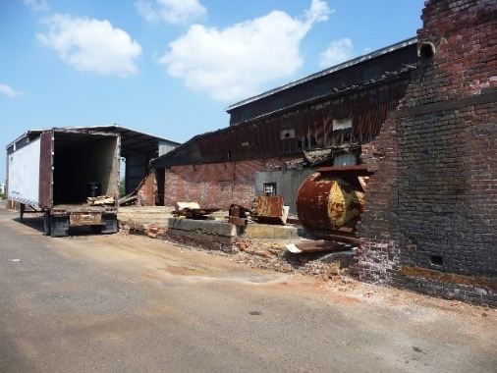
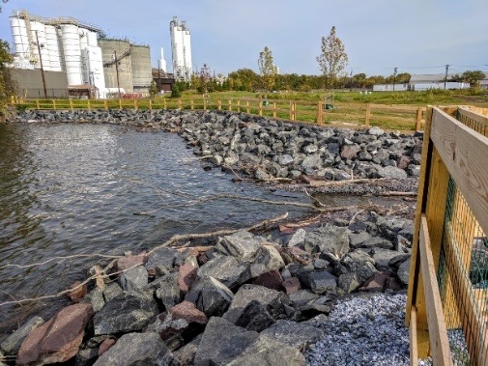
Case Study: Phoenix Park (Camden, New Jersey)
After
Before
Photos Courtesy of the NJDEP
Section 5.10: Case Studies
Notes:
Officials opened Phoenix Park in Camden, On Tuesday, June 2, 2015.
Phoenix Park represents an example of how cleanup can support redevelopment, provide important local services, and build bridges with communities
The park, a former brownfield property, was created on what was once a factory along the Delaware River.
The park was once home to a factory that processed natural materials to make chalk and other products for about 100 years.
Camden County’s Municipal Utility Authority (MUA), New Jersey Department of Environmental Protection (NJDEP), and the Camden Redevelopment Authority worked together with local community groups to turn a vacant riverside plot into much needed open space that also improved functioning of the city’s water treatment system
This collaboration helped rebuild trust between the community and government agencies, something that cannot be taken for granted when working with historically disadvantaged communities.

Slide 63
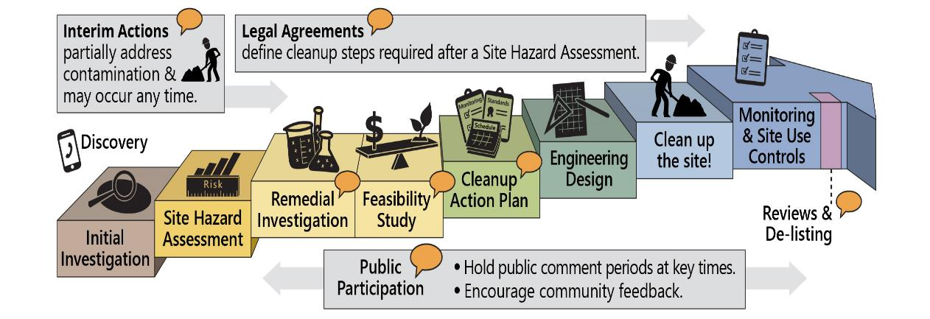
Case Study: Bellingham Bay, Washington
Courtesy of Washington State Department of Ecology

Slide 64
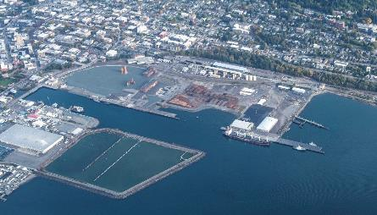
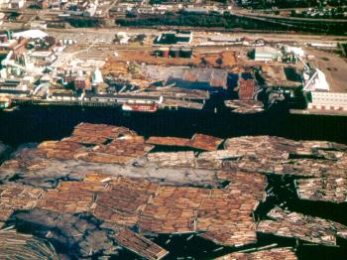
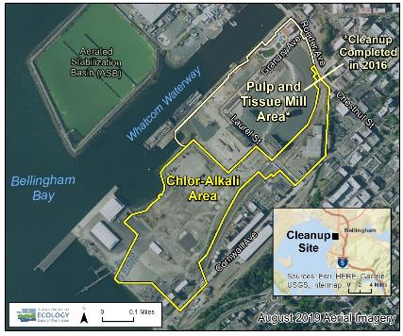
Case Study: Bellingham Bay, Washington
Cleanup Areas
After
Before
Courtesy of Washington State Department of Ecology
Georgia Pacific West
Section 5.10: Case Studies
Notes:
This initiative brings together 14 government and industry organizations along with residents and businesses with an interest in improving the health of the Bay.
An example of what can be accomplished when multiple agencies and organizations work together to plan cleanups that meet the needs of local communities using principles of integrated project planning and public participation in decision making
Bellingham Bay has an industrial history as a key port for lumber processing, creation of paper goods, and other maritime trades.
As with many industries, advances in technology and a changing local economy has led to some of those businesses closing doors or leaving town for other locations.
When businesses leave, however, they do not always take all their hazardous waste with them.
The Bellingham Bay Demonstration Project has resulted in the development of a comprehensive strategic environmental planning document; helped revitalize the community’s waterfront through construction of a dock, construction of a beach and general waterfront rehabilitation; served as a national model for comprehensive environmental management; identified 19 high priority habitat restoration projects; and controlled pollution sources.

Slide 65
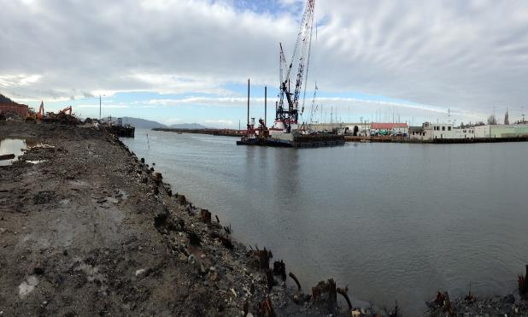

Case Study: Bellingham Bay, Washington
Before
After
Waypoint Park
Courtesy of Washington State Department of Ecology

Slide 66
Summary
Collect Data
Engage Community
Think About Future & Resilience
Don’t Forget Ecological Services
Make World Better Place

Slide 67

Questions?
Please use the Q&A Pod to submit questions.

Slide 68
Introduction
Resources, History & Value of SRR
Social & Economic Evaluations & Benefits
Integrating SRR
Sustainable Best Management Practices

Slide 69

Integrating SRR Key Concepts
Integrate “Social” considerations through stakeholder engagement
Consider natural resource utilization throughout project
Address vulnerability to changing climate, weather and fire hazards
Seek ways to continuously improve carbon footprint
Notes:
I’m going to walk you through the process of integrating SRR throughout the project lifecycle.
You will learn:
(toggle after each bullet)
- How to integrate social considerations through stakeholder engagement
- Consider natural resource use, or conservation throughout the project lifecycle
- Seek ways to minimize a projects carbon footprint, and
- Address vulnerability to changing climate, weather and fire hazards

Slide 70
SRR Integration throughout each stage of the Remedial Project Life Cycle
Project Stage
SRR Integration
Notes:
- As a project progresses through the various phases of the project life cycle, shown along the top this SRR integration tool
(toggle toggle)
- the SRR Integration components below them are considered and integrated
(toggle toggle)
- The interactive SRR integration tool shown here was designed to help users visualize relationships between the typical remediation project life cycle and SRR components.
- Please note, in this section of the training, we have provided a marker in the upper right-hand corner of the training slides indicating where we are in the SRR integration process.

Slide 71

Project Planning – starts with the SRR Conceptual Site Model
Considers variability of climate & wildfire threats
Seeks stakeholder engagement
Integrates threats and stakeholder concerns into remedy
Updated throughout remedy implementation
Figure 6-5. Expansion of
CSM Influences
CSM is the heart of the project
Notes:
- Every successful remediation project has a fully-vetted CSM at its core.
- The diagram on this slide puts the SRR CSM at the heart of the project.
- Surrounding all aspects of the project is the threat of climate and wildfires.
- Threat mitigation is integral to the process and relies on:
- stakeholder engagement including the incorporation of social and economic BMPs;
- the consideration of green and sustainable elements in remedy selection and design; and
- the incorporation of sustainable best management practices in the implementation, operation, maintenance and optimization of the remedy.
- A SRR CSM incorporates additional elements that consider the short- and long-term effects of climate change and wildfires on the resiliency of the remedial solution, including:
- The future variability of climate & wildfire threats
- Stakeholder engagement in remedy selection and site reuse
- Integration of climate/wildfire threats and stakeholder concerns into remedy
- The CSM is updated throughout the project life cycle to account for changed conditions and threat changes

Slide 72

SRR Conceptual Site Model
Project Planning
Site Closeout
The SRR CSM is:
  Built with end use in mind
  Incorporates climate and wildfire data
  Adapts as site-specific challenges are discovered
  Incorporates environmental, economic and social benefits
  Results in a solution that is resilient and sustainable
RESOURCES:
SRR State Resource Map
U.S. Climate Resilience Toolkit
Environmental Footprint Analysis Spreadsheet
SiteWise
Figure 6-4. SRR CSM.
Notes:
- For the SRR guidance document, we updated the ITRC Guidance Document, Remediation Management of Complex Sites published in 2017 with sustainability and remedy resiliency.
- Ultimately the SRR CSM seeks to provide the information necessary to consider remedies that are protective to human health and the environment, in anticipation of more frequent and severe weather events, wildfires and other climate change hazards, while also accounting for important social and economic influences to the site and community.
- The SRR CSM uses forecasted changes in the frequency and severity of extreme weather events and wildfires and longer-term changes as a means to consider future direct and indirect impacts to the remedy.
- These impacts might result in reduced remedy effectiveness, decline in natural resources, acceleration of geomorphic processes, and prolonged environmental stressors such as sea-level rise and drought.
- As noted earlier, an SRR CSM also incorporates periodic updates to consider condition changes, like new climate change information and forecasting.

Slide 73

Climate Change Factors for the SRR CSM
Table 7‑1. Relevant SBMPs
based on climate change factors.
Notes:
SRR CSMs
- This table, from Section 7 of the guidance document, provides an example of climate change factors for the SRR CSM
- Traditional CSMs typically do not incorporate sustainability considerations or resilience to local climate change impacts.
- The lack of sustainability considerations can result in a remedy that creates an unnecessary depletion of natural resources and unanticipated increases in GHG emissions.
- In the absence of local climate change data in the CSM, remedial designs often incorporate default or regional climate information.
- This remedial design approach may not necessarily generate the appropriate level of engineered resilience for the anticipated life of the remedy (Thun 2019).
- Emerging CSM frameworks have begun to recognize inadequacies in the traditional CSM approach (Kumar and Reddy 2020).

Slide 74

SRR Stakeholder Engagement
Project Planning
Site Closeout
Stakeholder values consideration
Planning Stage:
  Stakeholder roadmap
  Purpose and process for engagement
  SMART SR objectives
  How SR will be measured and achieved
  Remedy impact on social and economic factors
Trust
Source: ITRC Risk Communication Toolkit
Notes:
Stakeholder Engagement – IMPORTANT throughout all project components
- The social dimension of SRR include consideration of stakeholders needs and concerns (often called stakeholder values).
- In this context, site-specific objectives, goals, and processes for an SRR assessment are informed by multiple stakeholder values.
- Transforming sustainable, resilient benefits and mitigating unintended impacts to environmental justice (Section 5.2) and other underserved communities are core components of SRR (Section 6.1.6).
- Like the CSM, stakeholder engagement evolves throughout the project life cycle, demonstrating the importance of developing and implementing a continuous, phased engagement process.

Slide 75

SRR Levels of Evaluation:
Determine what is the appropriate level for your project
Project Planning
Increasing level of evaluation:
  Qualitative
  Semi-quantitative
  Quantitative
Figure 6‑7.
SRR evaluations.
Notes:
- In this SRR guidance, as mentioned earlier in this training, we have established three levels of SRR evaluation based on the complexity and profile of the site.
- This allows SRR integration to be flexible and adaptable to scope, scale and budget.
- Identifying extreme weather and wildfire potential are important as they may influence the selection of the most appropriate level of evaluation.
- Sites that are particularly vulnerable to extreme events may require a higher level of evaluation.
(toggle)
- Level 1 – Evaluate exposure scenarios, determine which extreme weather events and wildfire scenarios could occur, then adopt SBMPs. SBMPs are discussed in detail in the next section of this training and in Section 7 of the guidance document.
- Level 2 – In addition to the Level 1 SBMPs, Level 2 evaluations incorporate some degree of qualitative or semi-quantitative evaluation. For example, simple mathematical calculations and tools, weight and rack approaches, stakeholder input. Example tools: Spreadsheets for Environmental Footprint Analysis (SEFA), SiteWise, and Social Sustainability Evaluation Matrix (SSEM)
- Level 3 – incorporates a full vulnerability assessment with rigorous quantitative evaluation, such as climate models downscaled to the site, and lifecycle assessment for environmental sustainability
- Next we look at site characterization

Slide 76

Site Characterization: Additional SRR Considerations
Site Characterization
Collect data on extreme weather and wildfires
Collect data for resilient remedy design
Incorporate site vulnerability and risk assessments
Notes:
There are three major categories of SRR integration to be considered during the site characterization stage that are different or perhaps supplemental to traditional approaches
(toggle after each bullet)
- In addition to defining nature and extent of contamination, collect data on extreme weather, wildfires, and other site-specific risks such as sea level rise
- Collect data for resilient remedy design – wind, temperature extremes, erosion, etc
- Incorporate site vulnerability and climate and fire-related risk assessments
Getting SRR integrated into your data early will arm you with the information required for informed stakeholder engagement and for set you up for successful and sustainable site reuse outcomes

Slide 77




Site Characterization: Vulnerability Assessment
Site Characterization
Incorporate local and regional climate data into CSM
Collect data to evaluate vulnerability to climate change and extreme weather during the remedial action and long-term site management
Assess vulnerability and identify data gaps to achieve robust vulnerability assessment
Reevaluate vulnerabilities/data gaps as remedy becomes more clear
Notes:
What is required for an accurate and meaningful vulnerability assessment?
- Build regional and local climate data into CSM, site-specific data may be required
- Collect data to evaluate vulnerability to climate change and extreme weather during the remedial action and long-term site management
- Assess vulnerability and identify data gaps to achieve robust vulnerability assessment
- Reevaluate vulnerabilities/data gaps as the remedy becomes more clear

Slide 78
Remedy Planning Phase
Remedy Planning
Remedial Evaluation and Selection
Overall goal = meet Remedial Action Objectives (RAOs)
  For SRR: select remedies with low impact that attain RAOs and align with stakeholder, community and economic developments needs
All remedies should be effective and resilient short- and long-term
Best opportunity to create lasting SRR influence
Notes:
As you transition from site characterization to the remedy planning phase, you need to be thinking not just about the most technically and cost-effective approaches, but also about the the most sustainable and resilient approaches to meet your ROAs
- Always - identify, screen, select, and design the best remedy to meet Remedial Action Objectives (RAOs)
- Also - select remedies with low impact that attain RAOs and align with stakeholder, community and economic developments needs
- Ongoing - remedies should be effective and resilient , both short- and long-term
This is the best opportunity to create lasting SRR influence on the project overall.

Slide 79

Implementing SRR: Remedy Planning
Remedy Planning
Figure 6-10 SRR Implementation
Define resilience metrics
Vulnerability assessment of technologies using established project metrics
Can vulnerabilities be mitigated through adaptation or SBMPs?
For each alternative, identify adaptation strategy, SBMPs
Calculate the level of effort and cost of adaptation
Document and include in the remedy evaluation
Notes:
There are specific actions you can take during the remedy planning stage that will influence remedy selection and project outcomes:
- establish resilience metrics – how will you measure resilience and what will be your design constraints. For example, how much sea level rise, how intense and frequent the wildfires, how intense the storms
- Conduct a vulnerability assessment of technologies against these metrics
- Can the vulnerabilities be mitigated through adaptation or SBMPs?
- For each alternative, identify adaptation strategy, SBMPs
- Calculate the level of effort and cost of adaptation – there is a cost-benefit for every adaption
- Document and include in the remedy evaluation, include S&R in the evaluation criteria, dedicate a section of the remedial action plan to S&R, write up your vulnerability assessment

Slide 80

Incorporating SRR into Remedy Design
Remedy Planning
Remedy Design
Update vulnerability assessment,
Evaluate potential risks, are they risk acceptable?
Considerations with sustainable and resilient approach
Document the remaining risk that was accepted
Incorporate optimal SBMPs in design
Notes:
Next we look at how to integrate SRR in the remedy design phase, which is primarily about Preventing remedy failure and optimizing sustainability. Follow a deliberate and stepwise process.
(toggle after each bullet)
- Update vulnerability assessment, determine whether the risk acceptable, to the engineer, the regulator, and stakeholders in the community
- Select the most sustainable and resilient approach to manage risk, in consideration of the cost-benefit of that approach
- Incorporate SBMPs in design
- Document the remaining risk that was accepted – you may need to refer to the agreements made with stakeholders in the event of a remedy failure that was within the accepted risk tolerance.

Slide 81

Risk Management
Project Planning
Site Closeout
Remediation Risk Management: Is the remedy vulnerable; will a climate event disrupt remedy during project lifecycle?
Resilient Risk Management: Is the selected remedy resilient to the identified vulnerabilities?
Sustainable Risk Management: Are there unintended impacts of the remedy: environmental, economic, social - that require mitigation?
Figure 6-12 Probability of Extreme Weather Event or Wildfire occurring vs Length of Time
Notes:
- For every remediation project, there is a balance between risk and reward.
- We cannot plan or design for every inevitability or eventuality, SRR is not a perfect science, but an informed process to assure a better outcome, no matter the scale or complexity,
- This is extremely important in the context of SRR.
- Although climate models and our overall understanding of climate change is improving with time, there remains uncertainty, and uncertainty is magnified when it is projected at the scale of an individual remediation site.
- While it is safe to assume sea level will continue to rise for the foreseeable future, we cannot predict acutely the rate and magnitude of sea level rise at an individual point in space; therefore, the principal tenants of SRR suggest we plan conservatively so that our remedies will endure throughout the project lifecycle.
- However, when conservative approaches greatly increase cost, it may not be practical or even possible to implement them; therefore, we introduce and accept risk in remedy planning, and we negotiate that risk with stakeholders to achieve reasonable expectations for project outcomes.
- We categorize that risk management into remediation (is the remedy vulnerable), resilience (is the remedy resilient to the identified vulnerabilities) and sustainability (are there unintended impacts that require mitigation).
- You may refer to ITRC’s guidance document, Project Risk Management for Site Remediation (2011) for more on this topic

Slide 82


OM&M – SRR Considerations
Execution
May account for high percentage of overall footprint – how can you reduce?
Timeframe is longer and more susceptible to climate change and extreme weather impacts – how do account for these potential impacts?
May include opportunities to replace equipment, reduce energy usage, reduce waste reduce noise and other impacts
Notes:
- The OM&M stage for active remedial solutions is often the longest stage in the project lifecycle, and therefore it can have a large footprint.
- Given OM&M can continue for decades, the vulnerability risk is high, and it increases with time due to climate change, extreme weather events and wildfires.
- Therefore, resiliency is a key factor during O&M.
- For example, a capping system designed to reduce infiltration must be resilient to extreme weather and climate-related degradation permanently, or at least until the waste beneath it is environmentally degraded.
- The cost-benefit of resilience during O&M is a key business factor affecting responsible parties.
- An inexpensive pre-fabricated treatment shed may represent low capital cost during construction, but the cost of replacement must be considered in the context of the treatments shed’s resiliency to extreme weather and wildfires – it may not be the lowest lifecycle cost, and it may not receive stakeholder acceptance/endorsement, i.e., reputational risk.

Slide 83

Optimization – SRR Considerations
Execution
Improve performance, efficiency and footprint
Revisit design assumptions against changed or anticipated conditions
Opportunity to transition to Adaptive Strategy
Operation
OM&M
Optimization
5-yr Review
Notes:
- Optimization by its very nature is an SRR activity.
- Optimization often presents a unique opportunity to reduce the environmental footprint of the remedy.
- There are many types of optimization activities, including reducing redundancy and incorporating more efficient procedures in the performance monitoring program; switching to or incorporating more local labor, laboratories, suppliers; transitioning from an active to a passive remedy, such as monitored natural attenuation; and adapting to remediation progress by adjusting stakeholder expectation and the site reuse plan in circumstances where the remedial action objectives are determined to ne unrealistic or unattainable.
- Unfortunately, it is the poor overall track record of site closure that presents this opportunity for optimization to add benefit.

Slide 84

Site Reuse and Redevelopment – SRR Considerations
Provides an opportunity to positively impact the community
Engage stakeholders in the community
Future climate change addressed?
Perform vulnerability assessment
Cost-benefit analysis
Image from www.epa.gov/land-revitalization
Notes:
The reuse and redevelopment phase provides an opportunity to positively impact the community. Ideally, the reuse plan has been baked into the project from the onset, but there are still opportunities to influence the sustainability of the site going forward
- Continue your engagement with the stakeholders in the community:
- Develop reuse plan around the real and tangible needs of the community
- Address environmental justice concerns – can you make an improvement to an area that has been historically oppressed by inequitable environmental degradation?
- Do environmental land use restrictions impinge on reuse value to the community? – for example, does a no-build restriction due to vapor intrusion unfairly impinge in reuse and can it be released through appropriate engineering controls?
- Future climate change needs to be addressed to ensure long-term protectiveness – is the reuse plan resilient to extreme weather events and wildfire?
- Perform or revisit the vulnerability assessment – can the remedy accommodate identified climate change risk factors considering long-term reuse plan? Have those risk factors changed since the remedy was planned?
- Cost-benefit analysis – is it an efficient use of resources to design and construct for resilience, as opposed to reserving for the potential, uncertain cost of repairs?

Slide 85

SRR Case Study – Pharmacia Upjohn, CT
SRR during characterization:
  Treat investigation derived waste on site
  Utilize existing structures
  Use passive / no purge sampling
  Use ultra low-sulphur diesel fuel
  Use electric, hybrid, CNG vehicles
Photo Source: U.S. EPA, August 2015
Notes:
- For illustrative purposes during this section of the training, we refer to the Pharmacia-Upjohn case study presented in the SRR guidance.
- The Pharmacia site, located in North Haven, CT along the Quinnipiac River, was formerly mined for clay in brick production and then used for chemical and electronics manufacturing.
- This case study pre-dates this new SRR guidance document, but is an excellent example of the incorporation of SBMPs and a sustainable, community-driven outcome
- During the site characterization stage, Pharmacia implemented and documented many practical SRR components listed on the slide.
- What is noteworthy about these priorities is that many serve the dual purpose of carbon footprint and cost reduction.
- Also noteworthy – the process from project planning through site reuse requires perseverance and dedication – it can take a long time and is often not linear

Slide 86

SRR Case Study – Pharmacia Upjohn, CT
SRR during remedy:
  Incorporate vegetation for carbon sequestration
  Recycled slag in barrier wall
  Onsite materials for capping and backfill
  Excavation areas as retention basins
  Local S&G for permeable barriers
  Cut and fill to avoid offsite disposal
  Use in-situ vs ex-situ soil mixing
  Support biodiversity with habitat enrichment
Photo Source: U.S. EPA, August 2015
Notes:
- Let’s look again at the Pharmacia Upjohn case study.
- This time as an example of how SRR best management practices were incorporated into the remedy design and execution stages of the project.
- Here were the highest priority SRR considerations for each remedial component of the projects.
- The capping systems and hydraulic barrier at Pharmacia were used to control groundwater migration, prevent impacts to sensitive ecosystems, reduce infiltration and accommodate the on-site consolidation of contaminated soils.
- The SRR considerations include excellent examples of the use of on-site, local, and recycled materials, the incorporation of vegetation, and the enhancement of habitat to support biodiversity.

Slide 87



SRR Case Study – Pharmacia Upjohn, CT
Ecological enhancements
New freshwater wetland
Wetland will serve to manage site-wide stormwater management
Two-thirds of 78-acre site will be an ecological preserve. Seventeen acres will be redeveloped for commercial/industrial
Photos Source: U.S. EPA, August 2015
Notes:
- Incorporating SRR throughout the remedial project lifecycle, beginning at the project planning phase and including a robust stakeholder engagement process, has driven the Pharmacia Upjohn project forward with a vision for the site re-use in mind.
- At Pharmacia, a sustainable outcome to remediation is being realized, one that takes into account the environmental, social and economic aspects of sustainability, built around a resilient remediation and enduring reuse plan.
- By creating habitat, opening the site to the community as an ecological preserve, and retaining a portion of the property for commercial development, the end-state of this project addresses the social, environmental and economic needs of the community

Slide 88
Integrating SRR Summary
Accounting for variability of climate and wildfire threats throughout every phase the Project Life Cycle can substantially reduce long-term site management risks
Early stakeholder engagement can greatly help inform the social and economic aspects for a sustainable remedy
The SRR CSM integration of climate and wildfire data along with stakeholder perspectives provides for sustainable and resilient decision making throughout the project life cycle
Notes:
There are three main takeaways from this Integrating SRR section of the training that I would like to review:
- Accounting for variability of climate and wildfire threats throughout the Project Life Cycle can substantially reduce long-term site management risks
- Early stakeholder engagement can greatly help inform the social and economic aspects for a sustainable remedy
- The SRR CSM integration of climate and wildfire data along with stakeholder perspectives provides for sustainable and resilient decision making throughout the project life cycle.

Slide 89
Introduction
Resources, History & Value of SRR
Social & Economic Evaluations & Benefits
Integrating SRR
Sustainable Best Management Practices
Notes:
Thank you, Nathan. NEXT SLIDE

Slide 90
Sustainable Best Management Practices (SBMPs)
Effective and practical methods or techniques to build or adapt a cleanup site to climate change
Minimize impact or damage to the environment and community
Use SBMPs as Project Minimums
Notes:
Before we get too deep on this topic you may be wondering, “Why do we call these Sustainable BMPs, or SBMPs? Usually they are just called “BMPs”
The BMPs we included in the guidance are not JUST effective and practical methods to build or adapt a cleanup site to climate change-
They ALSO minimize impact or damage to the environment and community
Remember, the resilient cleanups guidance builds on its GSR predecessors.

Slide 91

Sustainable Best Management Practices for SRR
Notes:
Where can you get all the gems I’m about to share with you?
From the main guidance webpage, use the navigation pane on the left CLICK and go to section 7

Slide 92
Sustainable Best Management Practices for SRR
+
Key Resources
=
Resilient Cleanup
SBMPs
Notes:
You’ve heard the importance, the “why” and the “how” of SRR, but you are probably still asking “WHAT do I actually do to make the cleanup resilient?”
That’s where the SBMP section comes in!
In this section we give you the SBMPs, yes, but we pair those with key resources, background information, and additional things to consider. These things added together equal a resilient cleanup approach.

Slide 93


Sustainable Best Management Practices for SRR
Some SBMPs are universally relevant regardless of extreme event
Each extreme event includes:
  An overview
  Recommended secondary or cascading extreme events to review
  SBMPs by phase of remediation
Notes:
Looking back at the navigation pane on the left side of the webpage – you can see the SBMPs are organized by weather or climate events that may become extreme in duration, intensity, frequency, or location. Throughout this module I will simply refer to them as extreme events. There is also a category for SBMPs that are universally relevant regardless of which extreme event may impact the cleanup.
The extreme events included in the guidance are [USE POINTER TO POINT GENERALLY TO THE EVENTS IN THE LIST] wind, snow and hail, fluctuating groundwater elevation levels, flooding, bank and shoreline erosion, wildfire, sea-level rise, evapotranspiration, storm surge and permafrost thaw. You can see that the guidance is very comprehensive.
Due to depth of information on wildfires, we included two sections on wildfires – one for adapting ahead of a wildfire, and one for adapting after a wildfire has occurred at the remediation.
Each section includes an overview of how the extreme events generally impact remediations. This allows you to gain a better understanding of the importance of the SBMPs included in the guidance.
We also point out which extreme events are related to the one you are reading about. We call these secondary or cascading extreme events, because they may happen at the site for the same reason the primary event happens (for example- evapotranspiration and fluctuating groundwater levels happen under similar environmental conditions), or they may happen as a result of the primary event (such as flash flooding after a wildfire).

Slide 94
Sustainable Best Management Practices for SRR
Figure 6‑5. Expansion of CSM influences.
Notes:
As Nathan described, [USE POINTER TO CIRCLE THE OUTER RING] climate and wildfire threats surround all aspects of the remediation project.
NEXT SLIDE

Slide 95





Sustainable Best Management Practices for SRR
Assessing Vulnerability
Planning
Design and Implementation
OM&M
Crisis Management
Notes:
So we organized the SBMPs within each extreme event by remediation project phase to make it very easy for you to find the SBMPs you need.
We also included vulnerability assessment and crisis management SBMPs relevant to the specific extreme event you are exploring.

Slide 96

Sustainable Best Management Practices for SRR
Figure 7‑1. SBMP process.
Notes:
I’m now going to show you how flexible and practical the SBMP guidance is.
I’ll show you how to step through the SBMP process using Figure 7-1 in the guidance
Then I will discuss a few of the universally relevant SBMPs,
And use a case study from the guidance to demonstrate specifics.
So- how do you get started? Well, you enter the SBMP cycle based on a trigger.
CLICK
There are three possible triggers- #1 You may know that the site is in a region with a general vulnerability such as having less precipitation. #2 an extreme event may have occurred, such as flooding, or #3 you’ve done a comprehensive vulnerability assessment.
If trigger #2 or #3 is how you entered, then you can go right to the extreme event sections of the guidance to find the appropriate SBMPs.
NEXT SLIDE

Slide 97

Sustainable Best Management Practices for SRR
Table 7‑1. Relevant SBMPs based on climate change factors.
Notes:
However, If trigger #1 brought you here (a general knowledge of climate conditions in the region), you may need help identifying applicable extreme events. For example, you know your region generally is experiencing decreasing precipitation.
You can use Table 7-1 to navigate to the relevant extreme events by USE POINTER simply following the row for precipitation decrease, and wherever an “x” is in the column, navigate to that extreme event. The table is hyperlinked to the sections, to make navigation really easy.

Slide 98
Sustainable Best Management Practices for SRR
Figure 7‑1. SBMP process.
Notes:
Once you know the primary vulnerabilities, read the overview sections for each extreme event to identify associated secondary or cascading extreme events to also review.
After identifying all applicable primary and secondary extreme events, you can either read the SBMPs in the text of the guidance, or you can use the fully customizable tool we provide you as Appendix D.
NEXT SLIDE

Slide 99

SBMPs by Extreme Event – Appendix D
Appendix D. Sustainable Best Management Practice Checklists
Notes:
When we developed this guidance, one of the most important priorities for us was to make sure it was thorough and comprehensive. Something you could really use to get beyond “concept” and into implementation. We researched every source we could find to consolidate 313 SBMPs into this one-stop-shop guidance.
Another top priority was making the guidance EASY to use. This tool was included to allow you to completely customize it to the cleanup site specifications.
The tool is filterable by extreme event and phase of the project
The tool is fillable, for documenting which SBMPs are applicable and which were implemented.
So now I will give you a taste of some of the SBMPS that are universally applicable regardless of the extreme events the cleanup is vulnerable to.

Slide 100




Universally Applicable SBMPs for SRR
Assessing Vulnerability
Assume extreme events will continue
Identify secondary extreme events
Review local vulnerability information
Figure 4-1. Interactive State Resource Map
Notes:
SBMPs for assessing vulnerability can include:
1. Assuming the site is vulnerable to known vulnerabilities. I know this might sound obvious, but it’s really easy for us to overlook the obvious sometimes. If the site is in a 500-year floodplain, assume it is vulnerable to flooding. Don’t assume that a 500-year event isn’t applicable to your 30-year remedy. Instead, consider that the flooding is likely to increase in frequency, intensity, and duration.
2. Second, Review the secondary or cascading events we identify for you in the Overview Section for each extreme event.
3. Review local vulnerability information – CLICK These are identified in each extreme event section and in the resources map – which is a major hub of tools

Slide 101


Universally Applicable SBMPs for SRR
Planning and Prioritizing
Seek and Review Traditional Ecological Knowledge (TEK)
Integrate into contracts
Predict Financial Risks
Notes:
During planning and prioritizing, some SBMPs you can always implement are:
1. Seek and Review Traditional Ecological Knowledge or TEK. TEK is uniquely defined by each tribe. The US Fish and Wildlife Service has generalized it as the evolving knowledge acquired by indigenous and local peoples over hundreds or thousands of years through direct contact with the environment. It is specific to a location and includes the relationships between the environment and people. It is not a static understanding of how the environment was; it continues to evolve and identify changes in the environment. It is an important part of the tribal consultation process and may be relevant even where formal consultation is not required, and for sites not located on tribal reservations. We explain this more in the guidance.
2. Putting SRR into your Request for Proposals and Scopes of Work ensures that contracts will be set up with SRR in mind
3. Extreme events can create financial risk, use the case studies in Appendix A of the guidance to gain insight on predicting financial risks from extreme events.

Slide 102



Universally Applicable SBMPs for SRR
Remedy Design and Implementation
Use Green Infrastructure
Stormproof Infrastructure
Document
Notes:
During remedy design and implementation
Use green infrastructure and natural solutions such as plants native to the existing climate with tolerances for the likely future climate
Stormproof infrastructure onsite and consider partnering with the community to stormproof critical access or operational infrastructure not on-site
Documenting your SBMP selection and prioritization process, and whether they were implemented is key for reviewing effectiveness during periodic reviews or after crisis management

Slide 103



Universally Applicable SBMPs for SRR
Operation, Maintenance, and Monitoring (OM&M)
Update Vulnerability Assessment
Review CSM
(on defined and regular basis)
Evaluate Performance
Notes:
Speaking of periodic review- one of the top SBMPs you can implement is:
1. Update the vulnerability assessment on a defined and periodic basis and adapt SBMP implementation to match any changing site conditions
2. Also Review the CSM on a defined and periodic basis to determine if adaptations to remedy design and construction need to be made. This review can be on the same timeline as the vulnerability assessment review. You can streamline both by coupling them with any other OM&M inspection, monitoring, maintenance, or reporting requirements.
3. After any extreme event you will want to evaluate the performance of the SBMPs. Did they work as expected? Do you need to make any engineering tweaks?

Slide 104



Universally Applicable SBMPs for SRR
Crisis Management
Reevaluate site boundaries and pathways
Reassess monitoring and sampling
Revise safety procedures
Notes:
One phase of the project you may not yet be very familiar with, but which is predicted to increase as extreme events increase at cleanup sites is Crisis Management.
When responding to an extreme event it is important to:
1. Reevaluate site boundaries and potential pathways for contaminant migration
2. And second, to reassess monitoring and sampling protocols
These are both important because the extreme event may have opened new pathways for migration and may even have changed the chemicals of concern. 3. You should also revise safety procedures to reflect the increased likelihood, duration, or intensity of the extreme event.

Slide 105

SBMP Integration: Case Study
Iron Mountain Mine, Shasta County, CA
Site Description: 4,400-acre site with historic acid mine drainage discharges to multiple waterways, including a source of drinking water.
Remedial action objective: eliminate the mine discharges that are harmful to the environment.
Interim Remedies:
  Source Control
    AMD collection and treatment
    Water management
US EPA, Cleanups in My Community
Notes:
Now that we’ve gone over the process of implementing SBMPs in general, and we’ve reviewed some of the key SBMPs you can implement at any site during any phase of remediation, let’s step through a real-life example.
I pulled this case study from Appendix A of the guidance because it was a site that was already well into OM&M when resilience was considered.
I know many of us believe that adaptation can only really be integrated during the planning and design phases. You’ve heard us say it can happen at any stage, and you’ve seen some general ideas, but you may still not really believe it.
I hope this case study shows you how possible it is to implement SBMPs for resilience even at one of your sites, which may already be beyond planning and design.
The case study is for the Iron Mountain Mine superfund site, which is in it’s 6th 5-year review. READ SLIDE
DON’T READ
USEPA. Sixth Five-Year Review Report for Iron Mountain Mine Superfund Site, September 2018 https://semspub.epa.gov/work/09/100010569.pdf
Site Homepage: https://cumulis.epa.gov/supercpad/cursites/csitinfo.cfm?id=0901755

Slide 106

SBMP Integration: Iron Mountain Mine Case Study
Step 1: What trigger brought the cleanup into the climate resilient SBMP process
Extreme events have occurred
  Wildfires
  Severe Storms
Figure 7‑1. SBMP process.
Notes:
So what brought this cleanup into the SBMP process?
CLICK
The trigger was that wildfires and severe storms created significant challenges for site operators.
Although the remedies are operating as intended, climate change was not given the level of consideration this guidance recommends early on.
The treatment was not built with resilience to wildfire or severe storms in mind.
The ongoing extreme events necessitate resiliency improvements

Slide 107
SBMP Integration: Iron Mountain Mine Case Study
Step 2: Identify and prioritize the SBMPs
Review Wind, Pre-Wildfire, Post-Wildfire and Universally Applicable SBMPs
Review the secondary and cascading extreme event SBMPs identified in the primary extreme event SBMPs
Figure 7‑1. SBMP process.
Notes:
The next step is to identify and prioritize the SBMPs
CLICK Start by reviewing the wind, pre and post wildfire, and universally applicable SBMP overview sections. This will help you identify the
CLICK possible secondary or cascading extreme events- Sites vulnerable to high winds may also be vulnerable to storm surge, bank and shoreline erosion, or evapotranspiration
Sites vulnerable to wildfire risk may also be vulnerable to flooding, fluctuating groundwater elevation levels, or permafrost thaw
Now, I think you can tell, not all secondary vulnerabilities will be relevant to a site. Knowledge about where the cleanup is located can narrow down the additional extreme events to review.
For example, Iron Mountain Mine is not located on an ocean shoreline or in the arctic circle, so storm surge and permafrost thaw are not relevant.

Slide 108

SBMPs by Extreme Event – Appendix D
Appendix D. Sustainable Best Management Practice Checklists
Notes:
To identify only the SBMPs relevant to the extreme events of concern at your site, use Appendix D. For Iron Mountain Mine, start by filtering the Extreme Event column to only view SBMPs for Wind, Pre-Wildfire, Post-Wildfire, Flooding, fluctuating groundwater elevation levels, bank and shoreline erosion, and evapotranspiration.
You also always want to review the Universally Applicable SBMPs
This shortens the list from 313 to 198 SBMPs

Slide 109

SBMPs by Extreme Event – Appendix D
Appendix D. Sustainable Best Management Practice Checklists
Notes:
You can further shorten the list by filtering based on the phase of remediation.
The Iron Mountain mine remedy is already in implementation and OM&M, so filter the “Description” column to view only the SBMPs for Remedy Design and Implementation, OM&M, and General.
Because extreme events have already occurred, you also want to include Crisis Management SBMPs
Now you have cut the list of SBMPs by more than half. (128 SBMPs)

Slide 110

SBMPs by Extreme Event
Appendix D. Sustainable Best Management Practice Checklists
Y
Y
N
N
N
Y
Y
Y
Y
Y
Y
Notes:
This is where the tool gets really awesome.
As you read through the SBMPs you can use the tool to fill in which ones are applicable, and which ones are not applicable.
You can then filter to only view the applicable SBMPs!
Applicable SBMPs can then be sorted based on priority- you can move them around, break them out into new worksheets, add columns to denote priority – do whatever works for you!
Since it is fully customizable it can facilitate discussions with a client, contractor, regulator, or community; You can work on it together, or provide it as a deliverable.
Another feature – it can be your documentation tool, where you note which SBMPs were implemented, any tweaks you had to make in the field, etc.
PLUS- You can come back to your completed tool later to assist with SBMP evaluation during periodic site reviews

Slide 111
SBMP Integration: Iron Mountain Mine Case Study
Step 3: Implement the applicable and prioritized SBMPs
Replace portions of the treatment system with nonflammable stainless steel
Add redundancies in the treatment system
Develop vegetation management especially with plants that effectively spread fires
Continue and increase coordination with local emergency responders
Update the Emergency Preparedness Plan
Update the Asset Management Plan
Figure 7‑1. SBMP process.
Notes:
To make Iron Mountain Mine more resilient to wildfire and storms the following SBMPs were implemented READ LIST ON SLIDE

Slide 112
SBMP Integration: Iron Mountain Mine Case Study
Step 4: Evaluate the effectiveness of the SBMPs
  Cal Fire on-site visits to advise on fire prevention measures
  5-year review assessments
Figure 7‑1. SBMP process.
Notes:
Effectiveness of SBMPs is reviewed on a periodic and defined basis.
This site is subject to 5-year reviews, and as part of that process, CLICK Cal Fire conducts on-site visits to advise on fire prevention measures.
If your cleanup site is not subject to 5-year reviews, or any mandatory review of OM&M, Long-Term Stewardship or Land Use Controls- implement a review anyway!
Climate change is evolving quickly. Nathan showed us how errors increase with longer modeling timeframes. One way to overcome this uncertainty is through regular review of site conditions and updated climate projections.
-Regulators can consider requiring periodic review to ensure the long-term effectiveness of the remedy and protection of human health and the environment as site conditions change
-responsible parties should volunteer periodic review to reduce liabilities as site conditions change
Should the review always be a 5-year review? If you’re not required to do 5-year reviews, consider defining the periodic review time period as one that makes sense for the location, vulnerabilities, and community
We discuss how to do this more fully in the guidance

Slide 113
SBMP Integration: Iron Mountain Mine Case Study
Step 5: Re-evaluate vulnerabilities
  Consideration of climate change in the final sitewide RI/FS is being assisted by running climate change scenarios in the Water Quality Model.
  5-year review
Figure 7‑1. SBMP process.
Notes:
Re-evaluating site vulnerabilities at Iron Mountain Mine occurs at the same time as evaluating SBMP effectiveness, it’s all part of the 5-year review. It can also be part of the periodic review for your site!
The best way to re-evaluate vulnerabilities is to perform a vulnerability assessment for the site
At Iron Mountain mine one way they assess vulnerability is to run climate change scenarios in their water quality model

Slide 114

SBMP Conclusion
Flexible
Comprehensive
Easy
Notes:
To conclude- The SBMP portion of the guidance is flexible - in three ways:
First – logistically you can read it or you can use the customizable tool
Second- it is adaptable to any cleanup site, under any cleanup program, at any phase – not just for Superfund, and not just during planning and design. ALL PROGRAMS AND ALL PHASES.
There are no required or mandatory SBMPs, instead you can find whatever relates to the extreme events your cleanup is vulnerable to. And you can easily find them based on the phase of the remediation
CLICK
The guidance is also COMPREHENSIVE
- with 313 SBMPs and TONS of information to help you understand the importance of each one and why it was included. We scoured hundreds of sources, and they are all linked throughout the guidance and in the resources map, making this a one-stop-shop for information on resilience.
-We also include SBMPs for responding to an extreme event because crisis management is becoming increasingly important as climate changes.
CLICK
The guidance is easy – we make it easy for you to identify secondary or cascading extreme events. We link to other parts of the guidance that go more in depth, such as the demographic analysis. We tell you which resources are likely to be most useful for that extreme event. We made you a tool that you can custom tailor to your individual cleanup and use for documentation, evaluation and information sharing.

Slide 115
SBMP Summary
Know the site vulnerabilities
Adapt the remediation to climate change!
Identify SBMPS
Implement SBMP
Notes:
Now I’ve told you the “What” of SRR implementation. You are ready.
Ready to find the relevant SBMPs, based on the likely extreme events, for every phase of the remediation. You now know how to:
1. CLICK Understand your site vulnerabilities based on known information about the site location, or extreme events having occurred, or from conducting a full vulnerability assessment using the tools provided
2. CLICK You know how to identify the relevant SBMPs by reading section 7 of the guidance, navigating to the extreme events that the site is vulnerable to. And using the fully-customizable tool in Appendix D.
3. CLICK You also know how to Work with the project team and stakeholders to implement the SBMPs, this includes periodic review of the site vulnerabilities and evaluation of SBMP effectiveness.
CLICK You came to this portion of the training understanding the importance of an adaptive remedy, but not knowing exactly what to implement. Now you have all the tools you need to easily find the right adaptive measures for your cleanup site and CLICK ensure a resilient remedy that is protective of human health and the environment for the long-term.
I will now hand it back to the moderator for Q&A NEXT SLIDE

Slide 116

Thank you for attending!
Questions
Email further questions on today’s session to: training@itrcweb.org
Sustainable Resilient Remediation Training & Feedback Form & Certificate of Completion:
https://clu-in.org/conf/itrc/srr
Notes:
We would like to hear back from you today so please be sure to fill out the online feedback form that’s linked on this last slide. You can also access the feedback form by clicking Feedback in the related links section and then clicking browse to. Filling out the feedback form and certifying that you participated will allow you to receive a certificate of completion.
If you need further clarification on the answers or would like to ask more questions, feel free to email us at training@itrcweb.org and we will follow up with our trainers to get your questions answered.
As a reminder, ITRC archives all its training classes, so if you find that you have additional time or looking for additional training opportunities, please visit Clu-In and the archived trainings to see if there are other courses that might interest you.

