Slide 1



Starting Soon: TPH Risk Evaluation at Petroleum-Contaminated Sites
TPH Risk Evaluation at Petroleum-Contaminated Sites (TPHRisk-1, 2018)
Download PowerPoint file
CLU-IN training page at https://clu-in.org/conf/itrc/TPHrisk/ Under “Download Training Materials”
Using Adobe Connect
Related Links (on right)
Select name of link
Click “Browse To”
Full Screen button near top of page
Poll Question
Follow ITRC
Notes:
Poll Question:
How have you typically evaluated TPH risk? (multiple responses)
Have not evaluated TPH – have based risk assessments on indicator chemicals (BTEX/PAHs) only
Compared bulk TPH data to published screening levels
Compared fractionated TPH data to published screening levels
Conducted risk assessment on TPH fraction data
Use as a semi-quantitative delineation tool
Used to identify fuel type

Slide 2

TPH Risk Evaluation at Petroleum-Contaminated Sites
Welcome – Thanks for joining
this ITRC Training Class
Prepared by
The Interstate Technology & Regulatory Council
TPH Risk Evaluation Team
Sponsored by: Interstate Technology and Regulatory Council (www.itrcweb.org) Hosted by: US EPA Clean Up Information Network (www.cluin.org)
Notes:
Training Course Overview:
Remediation at petroleum release sites is often infeasible for technical or cost reasons. Many of these sites could be depleted in typical indicator compounds, such as BTEXN, but still heavily contaminated in terms of Total Petroleum Hydrocarbons (TPH). The traditional indicator compound approach for managing petroleum contaminants may not fully identify short- and long-term potential environmental concerns, can create delays in project schedules and cost overages for sub-surface utility work or redevelopment. It is important to consider a comprehensive cumulative risk-based approach to more effectively incorporate TPH data in addition to traditional BTEXN data for cleanup and long-term management decisions.
The basis for this training course is the ITRC guidance: TPH Risk Evaluation at Petroleum-Contaminated Sites (TPHRisk-1, 2018). The guidance builds on long-standing and current research and experience, and presents the current science for evaluating TPH risk at petroleum-contaminated sites. The methods and procedures to evaluate human and ecological risk and establish cleanup requirements in the various media at petroleum release sites will assist decision makers in developing and implementing a technically defensible approach. In addition, the guidance provides information and supplemental references to assist practitioners and project managers in the assessment of fate, transport, exposure, and toxicity of TPH. The guidance users will also gain information that may be used in conjunction with classic tiered approaches for risk-based decision making (ASTM 2015b, ITRC Risk 3 2015), including modifications in the assessment and remedial-decision and regulatory framework for TPH impacts through direct comparison to screening levels, site-specific modification of screening levels, and complete site-specific risk assessment for sources, receptors, and pathways, where appropriate.
The target audience for this guidance and training course include:
-Regulators and Program Managers interested in knowing how site management decisions can influence the TPH risk evaluation process.
-Risk assessors new to TPH data or those who want additional knowledge and training in the current methods and common practices for collecting and using TPH data in assessments to more accurately determine human health and/or ecological risks at petroleum-contaminated sites.
-Stakeholders who are either engaged in redevelopment at former petroleum release sites or folks who are involved in community engagement and revitalization activities.
As a participant in this training you will learn to:
-Recognize the ITRC document as a go-to resource for evaluating TPH risk at petroleum-contaminated sites
-Recognize how TPH -impacted media interacts with the environment and changes over time
-Select appropriate analytic method(s) to match site objectives
-Apply the decision framework to determine when a site-specific target level may be more appropriate than a generic screening level for TPH
Training participants are encouraged to view the associated ITRC guidance, TPH Risk Evaluation at Petroleum-Contaminated Sites (TPHRisk-1, 2018) prior to attending the class.
ITRC (Interstate Technology and Regulatory Council) www.itrcweb.org
Training Co-Sponsored by: US EPA Technology Innovation and Field Services Division (TIFSD) (www.clu-in.org)
ITRC Training Program: training@itrcweb.org; Phone: 402-201-2419

Slide 3
Housekeeping
Course time is 2¼ hours
This event is being recorded
Trainers control slides
Want to control your own slides? You can download presentation file on CLU-IN training page
Questions and feedback
Throughout training: type in the “Q & A” box
At Q&A breaks: unmute your phone with #6 to ask out loud
At end of class: Feedback form available from last slide
Need confirmation of your participation today? Fill out the feedback form and check box for confirmation email and certificate
Copyright 2019 Interstate Technology & Regulatory Council, 50 F Street, NW, Suite 350, Washington, DC 20001
Notes:
3
Notes:
We have started the seminar with all phone lines muted to prevent background noise. Please keep your phone lines muted during the seminar to minimize disruption and background noise. During the question and answer break, press #6 to unmute your lines to ask a question (note: *6 to mute again). Also, please do NOT put this call on hold as this may bring unwanted background music over the lines and interrupt the seminar.
Use the “Q&A” box to ask questions, make comments, or report technical problems any time. For questions and comments provided out loud, please hold until the designated Q&A breaks.
Everyone – please complete the feedback form before you leave the training website. Link to feedback form is available on last slide.

Slide 4





ITRC (www.itrcweb.org) – Shaping the Future of Regulatory Acceptance
Host organization
Network
State regulators
All 50 states, PR, DC
Federal partners
ITRC Industry Affiliates Program
Academia
Community stakeholders
Follow ITRC
Disclaimer
Full version in “Notes” section
Partially funded by the U.S. government
ITRC nor US government warranty material
ITRC nor US government endorse specific products
ITRC materials available for your use – see usage policy
Available from www.itrcweb.org
Technical and regulatory guidance documents
Online and classroom training schedule
More…
DOE
DOD
EPA
Notes:
The Interstate Technology and Regulatory Council (ITRC) is a state-led coalition of regulators, industry experts, citizen stakeholders, academia and federal partners that work to achieve regulatory acceptance of environmental technologies and innovative approaches. ITRC consists of all 50 states (and Puerto Rico and the District of Columbia) that work to break down barriers and reduce compliance costs, making it easier to use new technologies and helping states maximize resources. ITRC brings together a diverse mix of environmental experts and stakeholders from both the public and private sectors to broaden and deepen technical knowledge and advance the regulatory acceptance of environmental technologies. Together, we’re building the environmental community’s ability to expedite quality decision making while protecting human health and the environment. With our network of organizations and individuals throughout the environmental community, ITRC is a unique catalyst for dialogue between regulators and the regulated community.
For a state to be a member of ITRC their environmental agency must designate a State Point of Contact. To find out who your State POC is check out the “contacts” section at www.itrcweb.org. Also, click on “membership” to learn how you can become a member of an ITRC Technical Team.
Disclaimer: This material was prepared as an account of work sponsored by an agency of the United States Government. Neither the United States Government nor any agency thereof, nor any of their employees, makes any warranty, express or implied, or assumes any legal liability or responsibility for the accuracy, completeness, or usefulness of any information, apparatus, product, or process disclosed, or represents that its use would not infringe privately owned rights. Reference herein to any specific commercial product, process, or service by trade name, trademark, manufacturer, or otherwise does not necessarily constitute or imply its endorsement, recommendation, or favoring by the United States Government or any agency thereof. The views and opinions of authors expressed herein do not necessarily state or reflect those of the United States Government or any agency thereof and no official endorsement should be inferred.
The information provided in documents, training curricula, and other print or electronic materials created by the Interstate Technology and Regulatory Council (“ITRC” and such materials are referred to as “ITRC Materials”) is intended as a general reference to help regulators and others develop a consistent approach to their evaluation, regulatory approval, and deployment of environmental technologies. The information in ITRC Materials was formulated to be reliable and accurate. However, the information is provided "as is" and use of this information is at the users’ own risk.
ITRC Materials do not necessarily address all applicable health and safety risks and precautions with respect to particular materials, conditions, or procedures in specific applications of any technology. Consequently, ITRC recommends consulting applicable standards, laws, regulations, suppliers of materials, and material safety data sheets for information concerning safety and health risks and precautions and compliance with then-applicable laws and regulations. ITRC, ERIS and ECOS shall not be liable in the event of any conflict between information in ITRC Materials and such laws, regulations, and/or other ordinances. The content in ITRC Materials may be revised or withdrawn at any time without prior notice.
ITRC, ERIS, and ECOS make no representations or warranties, express or implied, with respect to information in ITRC Materials and specifically disclaim all warranties to the fullest extent permitted by law (including, but not limited to, merchantability or fitness for a particular purpose). ITRC, ERIS, and ECOS will not accept liability for damages of any kind that result from acting upon or using this information.
ITRC, ERIS, and ECOS do not endorse or recommend the use of specific technology or technology provider through ITRC Materials. Reference to technologies, products, or services offered by other parties does not constitute a guarantee by ITRC, ERIS, and ECOS of the quality or value of those technologies, products, or services. Information in ITRC Materials is for general reference only; it should not be construed as definitive guidance for any specific site and is not a substitute for consultation with qualified professional advisors.

Slide 5





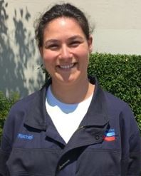


Meet the ITRC Trainers
Jennifer Strauss
Colorado DLE
Denver, CO
303-318-8548
jennifer.strauss@state.co.us
Diana Marquez
Burns & McDonnell
Kansas City, MO
816-822-3453
dmarque@burnsmcd.com
Mani Nagaiah
Langan
Phoenix, AZ
954-320-2121
mnagaiah@Langan.com
Usha Vegagiri
AECOM
Oakland, CA
510-874-3123
usha.vedagiri@aecom.com
Rachel Mohler
Chevron ETC
Richmond, CA
510-242-4939
RMohler@chevron.com
Jeff Kuhn
Former Montana DEQ
Helena, MT
406-498-7122
jkuhnmt@bresnan.net
Read trainer bios at https://clu-in.org/conf/itrc/TPHrisk/
Ross Steenson
San Francisco RWQCB
Oakland, CA
510-622-2445
ross.steenson@waterboards.ca.gov
Notes:
Jennifer Strauss is an Environmental Protection Specialist for the Colorado Division of Oil & Public Safety (OPS) in Denver, Colorado. Jennifer has worked with the Remediation Section since 2012. She reviews and analyzes Site Characterization Reports, Corrective Action Plans, State Lead and Petroleum Brownfields Work plans, and Monitoring & Remediation Reports to support the cleanup of contamination from petroleum storage tanks. Jennifer was involved in the creation of the web-based OPS Petroleum Program Guidance Document and is a member of the Application Review Group for the Recognized Environmental Professional Program. Prior to working with OPS, Jennifer spent eight years at the Pennsylvania Department of Environmental Protection working on stormwater planning and permitting, the Act 2 Voluntary Cleanup Program, and the Corrective Action Program. Jennifer has contributed to ITRC as a team member since 2016 for the Total Petroleum Hydrocarbon Risk Evaluation team. She earned a bachelor’s degree in geology from Temple University, Philadelphia, Pennsylvania in 2002.
Manivannan (Mani) Nagaiah is a Project Engineer with Langan Engineering and Environmental Services in Phoenix, Arizona. Mani’s career has been focused on the management of small to large-scale, complex NAPL sites as well as petroleum release sites with TPH impacts. Since joining Langan in 2006, he has spearheaded several petroleum release investigations, designed and optimized LNAPL recovery systems and corrective actions, and established technically feasible and practical road maps for site closure. Mani has worked on NAPL/petroleum release investigative and remediation projects in the north-east corridor, Georgia and Florida. More recently, he has moved to Phoenix and the Southwest market. He has authored peer reviewed publications and presented on a wide-range of LNAPL topics in several national conferences. Since 2016, Mani has been an active participant with the ITRC TPH team and is new to the ITRC training team. He is also the co-author of the accompanying HDOH case studies document for the TPH guidance. Mani holds a bachelor’s degree in Civil Engineering from ACCET, Madurai Kamaraj University in Tamil Nadu, India (2000) and a master’s degree in environmental engineering from Oklahoma State University in Stillwater, Oklahoma (2003). Mani is a registered professional engineer and maintains active licensure in several states.
Rachel Mohler is the Gas Chromatography Technical Team Leader for the Chevron Energy Technology Company in Richmond, California. Since joining Chevron in 2007, her interests have lied in advanced analytical characterization of organic compounds in a variety of matrices. Over the past eight years, she has collaborated with researchers from various disciplines (e.g., biochemistry, toxicology, environmental science, and hydrogeology) to better understand the composition of and the risk posed by organics in the groundwater at historic petroleum release sites. In addition to frequently presenting her research results to audiences at technical conferences, she is also passionate about describing her work to elementary, middle and high school students to promote STEM (science, technology, engineering, and math). Rachel has over twenty publications in peer-reviewed journals, two patents, and serves as a reviewer for multiple technical publications including Environmental Science and Technology (an ACS journal), and Journal of Chromatography A. She has been a contributor and active member of the ITRC TPH Risk Evaluation at Petroleum Contaminated Sites team. Rachel earned a Bachelor’s degree in Chemistry from the University of California, Riverside in 2002 and a Doctor of Philosophy in Chemistry from the University of Washington in 2007.
Ross Steenson is a senior specialist geologist with the San Francisco Bay Regional Water Quality Control Board and has worked for the agency since 2008. He has over 29 years of regulatory and professional experience in the investigation and cleanup of a wide variety of contaminated sites. In his current role, he provides technical support to staff, oversees cases, and develops and maintains agency guidance. His technical expertise includes vapor intrusion, contaminated groundwater discharges to surface water, contaminated sediment, and risk assessment. Since 2012, in a team of two, he maintains and updates the agency’s Environmental Screening Levels, and is the lead for Total Petroleum Hydrocarbon screening levels. He was the lead author for preparing the agency’s 2016 Petroleum Metabolites technical document. He earned a bachelor’s of science degree in geology from The College of William and Mary in 1986 and a master’s of science degree in geology from Miami University in 1991. He has been a certified California hydrogeologist since 1997.
Diana Marquez is an Associate Toxicologist with Burns & McDonnell in Kansas City, MO and has worked for the company since June 1995. She serves as the company’s National Practice Leader for Risk Assessment Services. She has over twenty years of risk assessment experience and has worked with a wide variety of sites under CERCLA, RCRA, and state-led programs. She has successfully completed work nationwide for both human health risk assessments and the determination of site-specific cleanup levels. She has direct experience working with large PRP groups on complex sites that require careful negotiations with regulators. Through this experience, she has gained in-depth knowledge of state and federal regulations. She authored 15+ publications on risk assessment, risk-based corrective actions, and vapor intrusion. Diana earned a bachelor’s degree in biology from Villanova University in Villanova, PA in 1991 and a master’s degree in toxicology from University of New Mexico in Albuquerque, NM in 1992.
Usha Vedagiri is a Principal Risk Assessor and Manager of the Northern California Risk Practice with AECOM located in Oakland, California. Since 1998, Usha has worked at AECOM (formerly URS) specializing in human health risk assessment, ecological risk assessment, risk-based remediation goals, chemical-specific exposure and toxicity assessments and risk management plans. In support of remediation, permitting and exploration/extraction projects, she is responsible for management, scoping and execution of risk assessments, strategy development for risk-based remediation and redevelopment at contaminated sites, and risk identification and mitigation planning for resource development, in the United States and abroad. She has designed sampling and analysis plans and toxicity testing programs for environmental and biological media and evaluated risks related to a variety of chemicals including petroleum hydrocarbons, PAHs, PFAS, PCBs, dioxins, metals, and pesticides in terrestrial, freshwater and estuarine environments. For petroleum hydrocarbons, she has evaluated human health risks using a variety of USEPA and individual state-level guidance and ecological risks using technical methods ranging from screening-level assessments to complex modeling and testing-based approaches. Prior to AECOM, she worked for 8 years in the environmental consulting field with EA Engineering and IT Corporation. Since 2013, Usha has contributed to ITRC as a team member for ITRC's Risk Assessment, Bioavailability in Contaminated Soils, TPH Risk Evaluation at Petroleum-Contaminated Sites and PFAS teams. Usha earned a bachelor's degree in biology from Ethiraj College in India and a master's and Ph.D., in Environmental Science from Rutgers University in New Brunswick, New Jersey.
Jeffrey A. Kuhn is a hydrogeologist and was a program manager for the Montana Department of Environmental Quality (DEQ). Throughout his career Jeff has overseen remediation programs including the Montana Leaking Underground Storage Tank (LUST) Program, Federal LUST Trust Program, Brownfields Program, and DSMOA/FUDS Programs. He also directed research efforts at several complex petroleum projects throughout the state. He had led numerous technical task forces, forums, and work groups, worked as an expert witness on petroleum cases, and served as the LUST Task Force Chair for the Association of State and Territorial Solid Waste Management Officials (ASTSWMO). Jeff also served on ITRC’s Board as the State-Member-at-Large. He has participated on many ITRC Teams, such as the Management of Complex Sites Team, LNAPL Team, Petroleum Vapor Intrusion Team, and MtBE Team. Jeff currently writes a column for “LUSTline” on site assessment approaches, the use of innovative petroleum remediation technologies, and fuel additives. Jeff teaches geology and natural history in Glacier National Park and leads interpretive hikes for the Glacier Institute and Granite Park Chalet. Jeff has a B.S. degree in Geology and German Language from Juniata College, and an M.S. degree in Geology from the University of Montana, Missoula, MT.

Slide 6
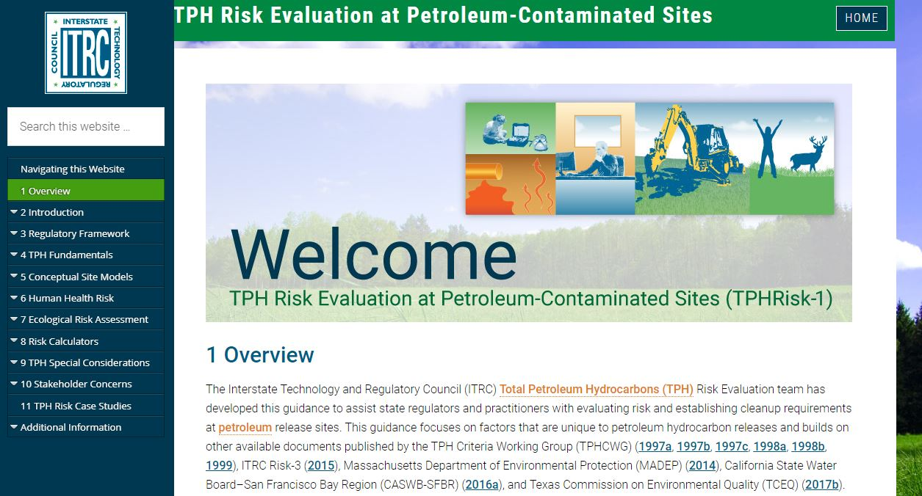
TPH Risk Evaluation at Petroleum-Contaminated Sites (TPHRisk-1, 2018)
Notes:
TPH Risk Evaluation at Petroleum-Contaminated Sites (TPHRisk-1, 2018)
https://tphrisk-1.itrcweb.org/

Slide 7
Road Map
Why the Guidance?
Learn What TPH is
Learn TPH Analytical Methods
Questions and Answers
Environmental Fate of TPH
Assessing Human and Ecological Risk from TPH
Stakeholders Considerations
Closing
Questions and Answers

Slide 8
Why This Guidance?
Purpose
Facilitate better-informed decisions relating to the evaluation of TPH risk at petroleum-contaminated sites, help regulators and project managers, who may not be skilled in risk assessment, interpret results
Goal
Create better TPH guidance to help states develop consistent methodology for establishing risk-based cleanup levels and for establishing methods for risk-based corrective actions

Slide 9
Learning Objectives
After participating in this ITRC training course you will:
Recognize the ITRC document as a go-to resource for evaluating TPH risk at petroleum-contaminated sites
Recognize how TPH can change over time
Select appropriate analytical method(s) to match site objectives
Apply the decision process to determine when a site-specific target level may be more appropriate than a generic screening level for TPH

Slide 10

Regulatory Framework for TPH
Remedial Approaches & Risk Management
are not consistent;
may not address long- and short-term concerns with petroleum contaminant mass;
petroleum cleanups were based on laboratory concentrations to non-detect; and
the States Survey (Appendix C) shows a trend to a risk-based approach.
Federal & State TPH Regulations
challenges
State Underground Storage Tank Program Contacts:
https://www.epa.gov/ust/underground-storage-tank-ust-contacts#states
Clipart Of LLC©

Slide 11
Benefits to the Audience
Provides practical, applicable guidance on evaluating TPH for risk assessors
Regulators
Consultants
Industry
Stakeholders

Slide 12
How to Use This Document
TPH Fundamentals/Chemical Properties
Regulatory Framework and Stakeholder Engagement
Emergency Response / Initial Investigation
Figure 2-4
TPH Guidance
Decision Framework
Preliminary Conceptual Site Model (CSM)
Site Investigation/ Update CSM
Calculators
Human Health Risk Assessment
Ecological Risk Assessment
Special Considerations
(Short-term Risks, aesthetics etc.)
Additional Data Collection (Interim response actions, partial remediation etc.), as needed
Site Closure or Corrective Action and Institutional Controls Planning
(Refer to ITRC LNAPL and Institutional Control guidance)

Slide 13
Case Study: Tank Farm
Case Study
Site Status: Inactive, Commercial Redevelopment
Petroleum Release Type: Gasoline & Diesel
Impacted Media: Soil, Soil Vapor, & Groundwater
HIDOH Case Study #1 (HIDOH 2018)

Slide 14
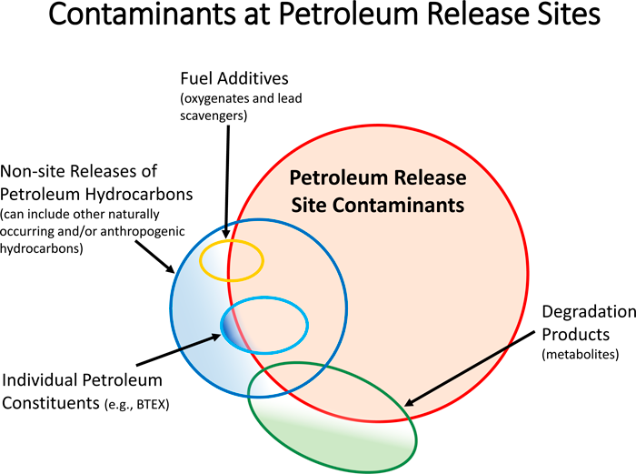
How will YOU treat TPH Differently?
ITRC TPHRisk-1 Figure 2-2

Slide 15
Road Map
Why the Guidance?
Learn What TPH is
Learn TPH Analytical Methods
Questions and Answers
Environmental Fate of TPH
Assessing Human and Ecological Risk from TPH
Stakeholders Considerations
Closing
Questions and Answers

Slide 16
Learn What TPH is
GRO
DRO
EPH
PRO
Gx
ETPH
PVOC
STARS
Dx
NWTPH
VPH
Ran out of Space!
Let’s untangle these terms!

Slide 17
Learning Objectives – Learn What TPH is
Know TPH sources and releases
Identify TPH constituents and properties
Understand bulk TPH and challenges
Provide considerations for TPH - specific CSM using the case study
Be familiar with common pitfalls with CSM development
Notes:
Speaker notes:
In this portion of the presentation, we will understand what TPH is – its sources, constituents, composition and key properties that make it unique. Also, we will use a case study to review the preliminary CSM for a typical TPH release site and work through the interactions with the environment – sources/pathways and receptors. We will also go through an overview of the state of the TPH practice, and pass on to investigative and risk assessment strategies in the subsequent sections.

Slide 18
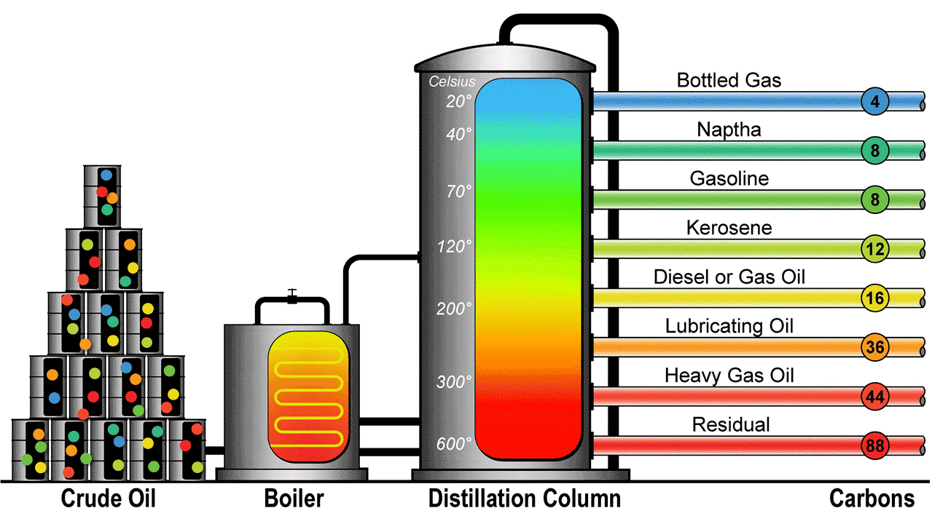

TPH – Where does it come from?
Process Units – Alkylation, Reforming, Hydrocracking, Fluid Cat Cracking, Cokers, etc.
TPH
Conversion ^
Courtesy of Haley & Aldrich
8
Carbon Number
Notes:
Speaker Notes:
Crude oil and individual refinery products are typically characterized as TPH in environmental media. We are looking at a simple schematic of crude oil processing at a refinery. Crude oil contains hydrocarbons primarily with carbon and hydrogen and includes heteroatoms such as sulfur, nitrogen, or oxygen and inorganic constituents, such as metals. Refining process is essentially distillation and conversion, whereby crude oil is boiled and distillation cuts are taken at different temperatures into various commercial products such as gasoline, kerosene, jet fuel, diesel and so on and do forth. Currently, there are specifications for over 2,000 petroleum products!. In general, TPH includes a carbon range up to C-44.

Slide 19


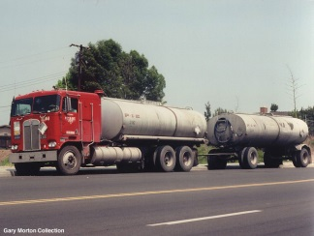
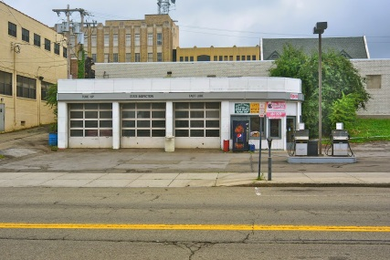

TPH – Where does it come from?
Crude Oil
Trucks, Railcar, Ship, Barge, Pipeline
Terminals
Refinery
Additives
Exploration and Production
Refineries
Air/Sea ports
Offshore sheens
Terminals
Service stations
Pipelines/Utilities/Sewers
Residential (think heating oil)
Distribution &
Retail
End User(s)
19
Notes:
Speaker Notes:
What is your typical TPH site?. As you can see, TPH in the environment and human or ecological exposures can occur at any of the stages along the way from the oil wells, through the terminals to the end users. Yes, some of these sites could be your classic LNAPL release site as well. Where petroleum TPH is detected in the environment, there is often petroleum LNAPL not too far way. Participants are encouraged to check out the ITRC documents and training on LNAPL. LNAPL and TPH are often “two sides of the same coin”.

Slide 20
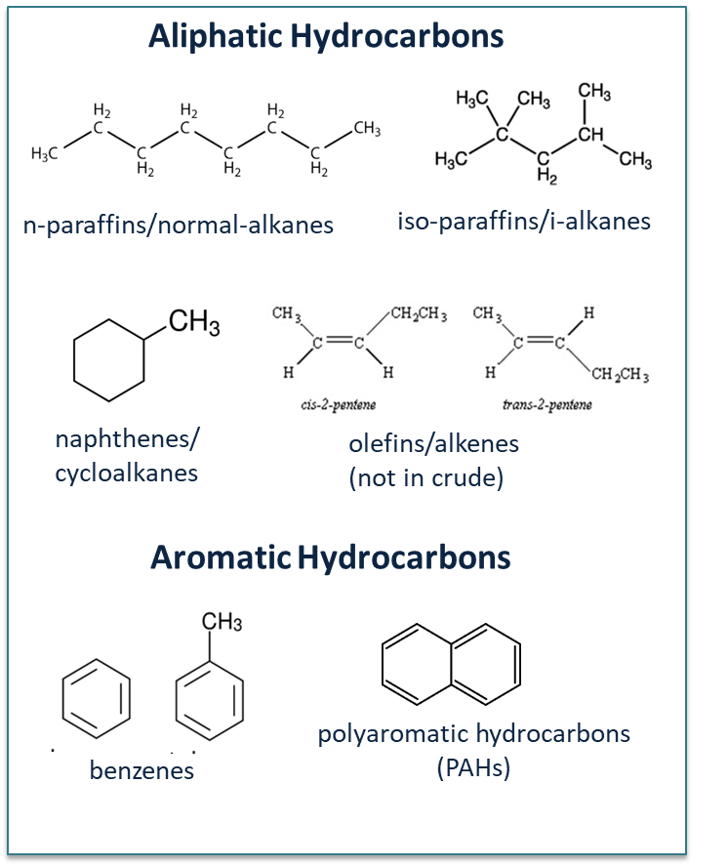
TPH Constituents – Key Properties
Aliphatic Hydrocarbons:
Straight, branched and cyclic
Non-polar
Low water solubility
Aromatic Hydrocarbons:
Ring structures
Some polarity
Increased solubility in water
ITRC TPHRisk-1 Figure 4-3
Notes:
Speaker Notes:
Hydrocarbons can be broadly classified as aliphatics and aromatic. The aliphatics of interest to us are alkanes and alkenes (straight chain, branched and cycloalkanes). Alkenes are less than 5% in fuels. Aromatics are ringed structure hydrocarbons with conjugated bonds – think benzene (the simplest aromatic) and PAHs (like napthalenene, anthrancene, phenanthrene etc.)
Key properties that are relevant for a TPH assessment. Aliphatics are non-polar and less water soluble. The aromatics have some polarity and increased solubility in water. Also, in relative terms, the aliphatics have lower boiling point and prone to evaporation than aromatics with the same number of carbons.

Slide 21
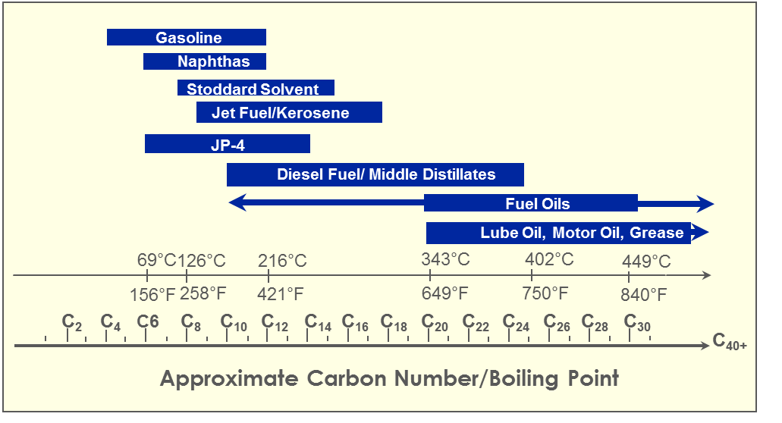
What is in that petroleum release?
Bulk TPH Analysis is not composition specific.
Products overlap in carbon ranges.
ITRC TPHRisk-1 Figure 4.2 (TPHCWG 1998)
JP – Jet Propellant
Notes:
Speaker notes:
Now we will understand the composition of TPH. Here is a chart showing petroleum constituents and carbon ranges. As noted, products are mixtures of hydrocarbons and the common fuel types overlap in carbon ranges. Those overlapping portions are the same and no method (bulk or speciated) would differentiate them because the components are the same. In terms or risk, if you have hydrocarbon constituents from a certain carbon number range, it does not matter if they are diesel, jet fuel or petroleum.
Bottom-line:
Bulk TPH analysis is not composition specific. Very good screening method – it is generally not suitable for a solid risk evaluation
Products overlap in carbon ranges

Slide 22
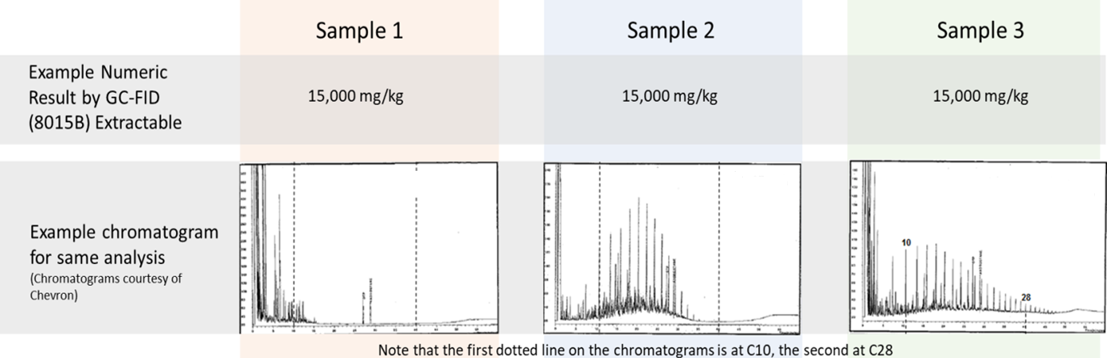
Bulk TPH – What’s in that number?
Gasoline
Diesel Fuel
South Louisiana Crude
X- AXIS: Elution Time/Carbon Number
Y AXIS: Relative Concentration
ITRC TPHRisk-1 Figure 2-3
Notes:
Speaker Notes:
This slide presents bulk TPH data using EPA method 8015 from the same site. Although the visual is poor (I am sorry), the x-axis represents elution time/carbon number and the y-axis represents relative concentration.
The same concentration of TPH in different areas of a site might be composed of dissimilar products; which in turn, may represent different risks to human or ecological health and the environment. The TPH concentration (estimated at 15,000 ppm) can represent different sources (in this case gasoline, diesel or crude) and composed of dissimilar fractions, which represents different risk to human and ecological health and the environment.
TPH is a complex mixture, not all hydrocarbons and analytical methods are limited.

Slide 23
So what is TPH?
TPH in environmental media is a measurement that is:
Defined by the analytical method used to measure it
Provides an approximate concentration of the total hydrocarbons in a complex mixture
Provides information about the size and distribution of the hydrocarbons
Not necessarily “total”, not necessarily all from petroleum and not necessarily all hydrocarbons
TPH data can only be properly interpreted with a good CSM!
Notes:
Speaker notes:
TPH is a quantitative value representing the amount of petroleum related material in a sample – soil/sediment, water or air. It is defined by the analytical method used to measure it, and the methods used can be variable from state to state and even from lab to lab. TPH is essentially the known or assumed aliphatic and aromatic hydrocarbon mixture that is either originally released into the environment or that remains after weathering. And where it can occur can occur as gross impacts in soil or sediment, dissolved hydrocarbons that have partitioned in groundwater or surface water. Or that partitioned from the mixture to the soil air for the air matrix. Not all TPH is from petroleum, and in some cases what is reported as TPH may be non-petroleum material that simply get detected by the analysis. This could include naturally occurring non-petroleum materials, other organic contaminants, or metabolic products of petroleum biodegradation. For interpreting and reporting TPH properly, make sure you have a good conceptual site model and check the regulatory framework at the state or local level.

Slide 24
TPH Evaluation - Challenges
Composition changes with time and space due to weathering, influenced by site-specific conditions
Impractical to analyze for hundreds of individual compounds
Limited toxicity data
Group hydrocarbons with similar characteristics (e.g., environmental fate, toxicity, etc.)
ITRC TPHRisk-1 Chapters 4 and 6
Notes:
Speaker notes:
Here is an evolution of the TPH fractionation approach. We have already gone through the challenges of using bulk analysis and the limitation in analyzing hundreds of individual compounds and the limitation of available toxicity data. So what is fractionation?. It is simply the process of differentiating aliphatic and aromatic portion of TPH either instrumentally and chemically. It is an grouping of aliphatic and aromatic compounds (generally about C-44) in which certain carbon ranges having similar properties can be defined and a representative toxicity for the mixture can be assigned for risk assessment purposes. Care must be taken to compare results obtained by methods with different definitions of the carbon ranges. Fraction approach is the key link to relating TPH composition in different media with risk.
Use fractionation analytical methods to quantify fraction concentrations
Assign toxicity values and physical/chemical properties

Slide 25
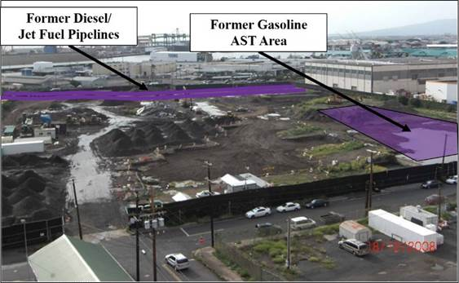
Case Study: Tank Farm
Ocean
Case Study
HIDOH Case Study #1 (HIDOH 2018)
Notes:
Speaker Notes:
Circling back to the case study that we’ve already mentioned, we’re going to talk more about the site features and potential for impacts in nearby areas. The area on the right was the location of the gasoline above ground tanks and the area near the top was the location of the diesel pipeline. All environmental media were impacted, from groundwater to soil gas. The redevelopment company and neighbors were concerned about direct exposure to the soils and groundwater, as well as impacts to the nearby harbor. Care was taken to inform the owners and tenants when sampling was scheduled and that the data generated was sent to the appropriate stakeholders.

Slide 26
Common Pitfalls to CSM Development
Reliance on BTEX and PAH data for CSM development
CSM development allied with human direct exposure only
Incorrect consideration for natural degradation data (e.g., consideration for TPH metabolites)
Failure to incorporate nature, location and concerns from residual contamination
Notes:
Speaker notes:
We polled the workgroup early on during the development of the TPH risk evaluation document. Here are some common themes that emerged from the discussion. There can be pitfalls when managing a TPH site. One of the most common is relying on individual constituents (e.g., BTEX) alone when making remedial decisions. Many of them will degrade before the toxic fractions do. Collecting samples for both fractions and individual constituents (e.g., BTEX) is recommended.
Focusing on direct human exposure and leaving out peripheral pathways can underestimate risk. A detailed CSM can help guide risk decisions in the right direction. Also, revising the CSM as the site ages will document changes in the plume and help understand the pockets of residual contamination.
Because petroleum will degrade naturally in the environment, unlike chlorinated compounds, collecting data that takes metabolites into consideration is also recommended.
Another common pitfall is not getting the stakeholders involved in the remedial process early enough. Property owners, neighbors and possible buyers need to be kept informed about progress, setbacks and re-development institutional controls.

Slide 27
Poll Question
What is TPH?
TPH is defined by the analytical method
TPH is an accurate measure of the total hydrocarbons
TPH concentration does not include biodegradation products and metabolites
None of the above
Poll Question
Notes:
Answer:
Number 1 – TPH is defined by the analytical method

Slide 28
Road Map
Why the Guidance?
Learn What TPH is
Learn TPH Analytical Methods
Questions and Answers
Environmental Fate of TPH
Assessing Human and Ecological Risk from TPH
Stakeholders Considerations
Closing
Questions and Answers

Slide 29
Learning Objectives – Learn TPH Analytical Methods
Select the appropriate TPH Analytical Method based on data quality objectives
Properly interpret analytical results
Recognize when to question analytical results
Recognize uses for field methods
Notes:
You’ve heard from Mani how complicated this TPH mixture can be, so it is very important to have a basic understanding of how the TPH number was calculated, so that these values are not misused to draw erroneous conclusions about a site. TPH is defined by the analytical measurement and after this training each of you should be able to select the best analytical method based on your data quality objectives. You should also be able to properly interpret the analytical results and recognize when the results are questionable. Let’s dive in.

Slide 30
TPH: Method Defined Parameter
Considerations in selecting the analytical method include:
Project Objectives
Regulatory Requirements
Application (detection, delineation, monitoring, risk assessment, etc.)
Petroleum type (if known)
Media
No method can do everything!
Notes:
TPH is a method defined parameter and since no method can do everything, you should consider the following items in order to select the most appropriate method. What are your data quality objectives and application? Are you looking to delineate the area of contamination or perform a risk assessment? These two objectives could require different analytical methods. Also, certain methods should not be applied to every media. Again, I want to emphasize that TPH is defined by the analytical method used to measure it and results should be reviewed in the context of the underlying characterization and risk evaluation. Methods should be fit for purpose and cost effective

Slide 31
Preferred Laboratory method
Laboratory method for TPH analysis: Gas Chromatography
For separating mixtures into components
Based on volatility of molecules
Several options for detectors
inlet
detector
column
carrier gas
oven
Notes:
In order to get some useful information around the what is in the TPH mixture the molecules need to be separated or parsed out. The preferred lab methods use a gas chromatograph also known as GCs. As the name of the technique suggests, this instrument separates molecules in the gas phase to better understand by volatility or carbon number what is present in the complex TPH mixture. There are a variety of TPH analytical methods that are based on analysis by GC.

Slide 32
Selecting appropriate TPH Lab Methods (Table 5-4)
Site Assessment, determination of extent of impacts, total extractable organics
EPA Methods 8015 and 8260
TX1005
Human Health Risk assessments, Fate and Transport, RSLs, Site Specific Ecological Risk assessment
TX1006, MADEP VPH/EPH, WA Dep Ecology
Site Assessment of hydrocarbons only, determination of extent of hydrocarbon impacts
EPA Method 3630C with 8015, 8260
EPA Method 3630C with TX1005
Talk to the Lab if there are questions!
For additional details see Table 5-4 of guidance document, Zemo, 2016 Whitepaper
Notes:
If you have a choice on what TPH method to use at site, here is a brief summary of TPH methods for water and soil matrices. Bulk TPH methods such as EPA methods 8015, EPA method 8260 or TX1005 are the designed for site assessment, determination of the extent of impacts or quantification of total extractable organics. These methods should be used for every sample collected at a site.
Because it is difficult to evaluate risk for as varied a mixture as TPH, many states have turned to methods that separate the sample into fractions. In order to better understand fate and transport or risk, fractionation methods fractionation methods are frequently applied to a small percentage of the samples to better understand areas hot areas or areas of high uncertainty. Typical methods such as TX1006, MADEP VPH/EPH, or WA Dep of Ecology methods should be used. I’ll describe more about what these methods are in subsequent slides.
If you are only interested in hydrocarbons and not total extractable organics or metabolites, EPA method 3630C followed by a bulk TPH method should be used. Additional details on the analytical methods can be found in Table 5-4 of the guidance document or the 2016 Zemo API whitepaper reference in the document. If you are still unsure of what TPH method to use, I encourage you to talk to the chemists at the lab and your risk assessor. If the optimal TPH method has not been used to collected TPH data at a site, Diana will discuss this in the risk section.

Slide 33
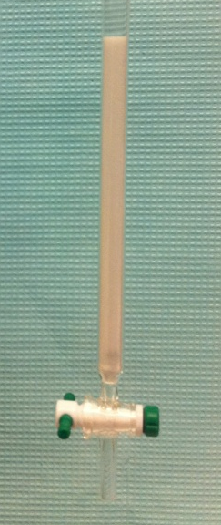
Silica Gel Cleanup (Fact Sheet A.2)
USEPA Method 3630C
Removes non-hydrocarbons
Column cleanup is most effective
Should request that lab surrogate be added to ensure efficient cleanup
Used with Bulk TPH method
Uses include:
Determination of extent of hydrocarbon impact
Delineation of true hydrocarbons or what could be natural occurring organics in background or metabolites
Not to be used for TPHg or Air samples
Shake?
1g column?
10g column?
For additional details see Appendix 2 of guidance document
Notes:
Let’s start with a commonly used technique to remove method interferences. EPA method 3630C describes the use of silica gel to remove polar, non-petroleum hydrocarbons and potentially naturally occurring compounds from the analysis. The silica gel cleanup results in a hydrocarbon only sample that can then be analyzed for bulk TPH. The results from this analysis is a TPH number without polar or non-hydrocarbon intereferents. This silica gel shown in the column on the right is a fine grain version of the material that is found in various new items such as shoes and suitcases and is used to separate the hydrocarbons from the non-hydrocarbons. There are a variety of cleanup options, but the column cleanup is the most effective at removal of non-hydrocarbons. A lab surrogate should be used to ensure the silica gel efficiently retains the non-hydrocarbons.
SGC is part of making sure your have your site conceptual model right. Silica gel cleanup is frequently used in the determination of extent of hydrocarbon impact, locations of biodegradation and to better understand where to perform active remediation.
Currently, there is no cleanup method for volatile or air phase samples.

Slide 34
Fractionation (Fact Sheet A.7)
Fractionation typically relies on the use of silica gel to separate the sample into aliphatic and aromatic classes*
The fractions are then injected into a GC for separation into carbon ranges
However, they
Cost more than bulk TPH
Raise the reporting limits
Non-hydrocarbons will be removed from analysis (results)
* Class separation in the volatile range does not rely on use of silica gel
Solubility?
Volatility?
Hydrocarbons?
Toxicity?
Notes:
Now lets take a look at how silica gel is used for risk assessment or fate and transport purposes. Here silica gel is not used to cleanup the sample but to separate the sample into saturates and aromatics to help answer the questions on the right. Fractionation can be applied to all matrices, NAPL, soil, water, gas, but it is not typically recommended for water because years ago there were a number of studies performed that allowed us to easily predict the hydrocarbons in the water phase. We know that C19 aliphatics or C30 aromatics are not soluble in water. Caution should also be used if fractionating soil gas samples and an alternative fractionation method that does not require the use of silica gel for volatiles should be considered. Please refer to the Fact Sheet in the guidance document for additional information.
The saturates and aromatics fractions are then injected into a GC to obtain information on equivalent carbon ranges. If you are reviewing fractionation data, be sure to check the carbon ranges, because these will vary depending on where the site is located and the governing agency. Ross and Diana will describe the use of this data in their sections.
Although the fractionation methods can provide detailed information, they do cost more than bulk TPH, they will remove non-hydrocarbons from the analysis and there will be raised reporting limits. The issue around raised reporting limits had a big impact at some sites in Maine where the impacted well was in close proximity to a kerosene tank that spilled. The bulk TPH concentrations were coming back around 200 ug/L however after running the MADEP method, the results were non-detect. This was a problem because there was clearly hydrocarbons present at the site based on odors of hydrocarbons. Be aware that the raised reporting limits can exceed the odor threshold.

Slide 35
Case Study: Tank Farm Application of Analytical Methods
Case Study
Soil: Bulk TPH collected across the site
Soil Vapor: Fractionation data collected at select locations in the diesel plume to determine site specific screening levels
Groundwater: Bulk TPH with silica gel cleanup collected in select areas along downgradient edges of diesel plume to assess the degradation state and determine locations requiring active remediation
HIDOH Case Study #1 (HIDOH 2018)
Notes:
Collected groundwater TPH data without and with SGC to determine areas where LNAPL was heavily degraded and likely dominated by TPH-related metabolites
Assess degradation state
Understand what could discharge into a nearby harbor
Collected fractionated data to determine carbon range of soil vapors collected around the diesel release
Study recommended considering collecting fractionation data in areas where composition is uncertain or believed to have high variability

Slide 36
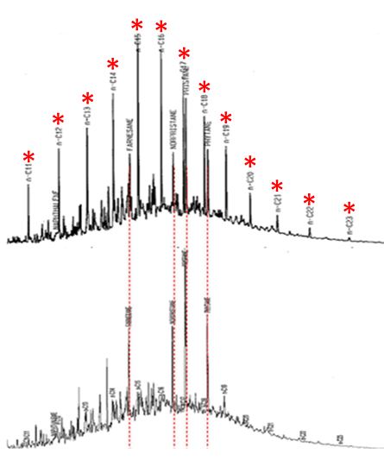
Chromatograms are not just pretty pictures (Fact Sheet A.6)
Provide information on
Type of material
Presence of non-hydrocarbons
Presence of solvents
Presence of non-dissolved hydrocarbons
Poor integration
Weathering
Degree of weathering
Type of weathering
For details ask your chemist
C# 11
17
23
ITRC TPHRisk-1 Figure A5-4
Notes:
Chromatograms can be provided for the methods mentioned in this section and are more than just pretty pictures. These “pictures” are integrated to yield the TPH values and can provide information on all the items listed here. On the right, I’ve shown two chromatograms collected from the same samples but at different times. As one moves from the left to the right carbon number increases. The samples analyzed here cover carbon numbers 11-23. If the sample is relatively unweathered, a picket fence pattern will stand out as shown by the red asterisks. This pattern is not present in the lower chromatogram and indicates that significant weathering has occurred at the site. One the next couple of slide I would like to demonstrate how chromatograms can be used to interpret what is being quantified as TPH.
PAL: put copy of slide 29 to refer back to Mani’s talk.

Slide 37
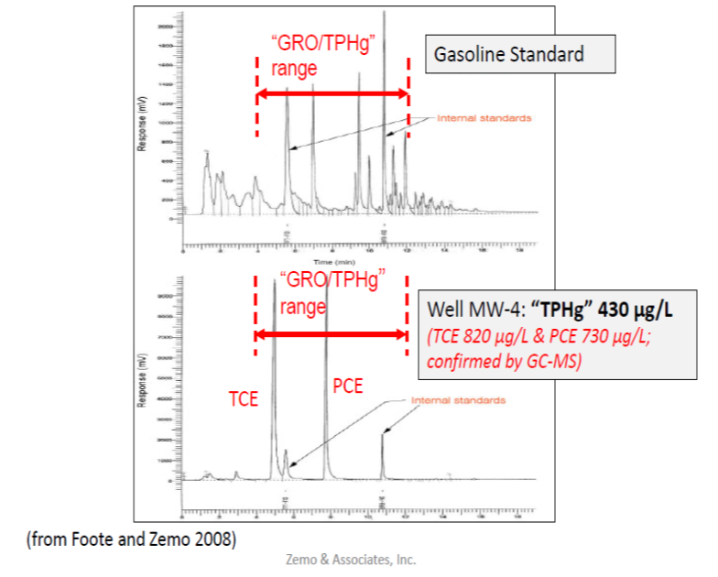
Practical Example #1 of Measurement Interferents (as determined by chromatograms)
Response (mV)
Internal Standards
Response (mV)
Internal Standards
ITRC TPHRisk-1 Figure A5-0
Notes:
Now I would like to spend a few minutes going through a couple of examples on how chromatograms can be used to quickly identify TPH measurement interferents. The example presented here was a common problem, because historically, at corner strip malls, responsible parties were required to run a TPH by 8015 to analyze for hydrocarbons and 8260 for solvents. Folks ended up chasing phantom gasoline at some sites because solvents will be quantified as TPH. Remember TPH is not always total, not only petroleum and not only hydrocarbons. A review of the chromatograms can be extremely important.
In this example the agency said there was a gasoline plume based on the 8015 TPH results. I would first like to draw your attention to the upper chromatogram showing an expected pattern for gasoline range material. Since gasoline is a complex mixture containing over 300 compounds, one would expect to see a complex chromatogram with lots of peaks. This is exactly what you see in this upper chromatogram showing a gasoline standard.
The chromatogram that was obtained from the well at the site contained essentially four peaks, two of which are internal standards. If there are only a few peaks present in the chromatogram I would be highly skeptical that the GC is actually detecting the presence of hydrocarbons. In this case a GC-MS confirmed that the peaks are chlorinated compounds and not hydrocarbons. Chlorinated compounds can be extracted and quantified as TPH.

Slide 38
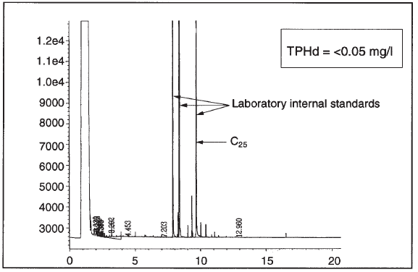
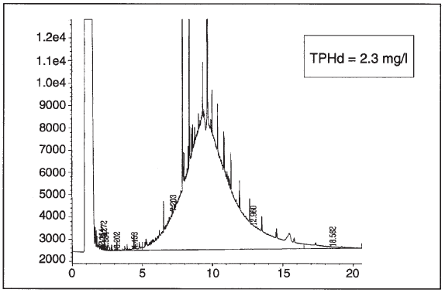
Practical Example #2 of Measurement Interferents (as determined by chromatograms)
After Silica Gel Cleanup
Before Silica Gel Cleanup
ITRC TPHRisk-1 Figure A5-5 (Zemo 2016)
Notes:
A site is held open because of TPHd in groundwater. The lab reported a TPHd value of 2.3 mg/L. A review of chromatograms reveals that there are multiple spikes in the chromatogram and a big hump. There are a couple of red flags present in this chromatogram indicating that this sample might not be measuring hydrocarbons. The dead giveaway is the hump and the more subtle indicator is the presence of discreet spikes (or peaks) that are not in a repeating pattern. The hump is centered around the internal standard which is typically a C19 aromatic compound. One would not expect compounds in that carbon range to be very soluble in water. SGC shown in the insert confirmed that these compounds were non-hydrocarbons and the 8015 TPHd concentration lowered to ND.

Slide 39
Poll Question
All USEPA Method 8015 results are directly comparable, regardless of lab
True
False
Not Sure
Poll Question
Poll Question
Notes:
Read the question. The correct answer is False and we are going to describe why on the next slide.

Slide 40
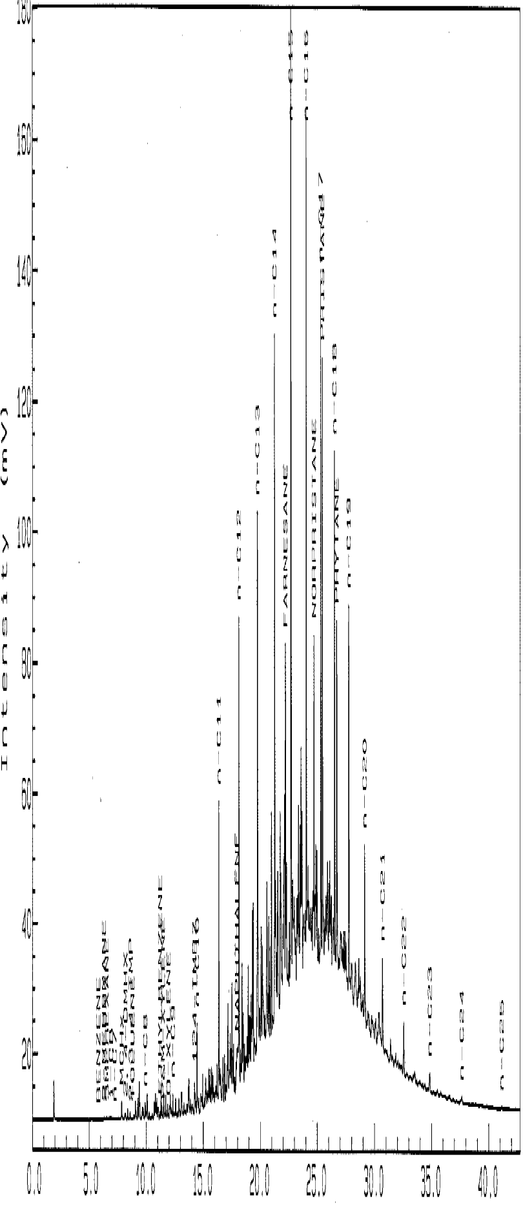
Not all TPHd by EPA method 8015 is Equal
Extraction Solvent
n-pentane
dichloromethane
Baseline Correction
Carbon Ranges
C6-C10 vs. C6-C12
C12-C26 vs. C12-C28
Calibration Standard
Proper baseline integration
Don’t assume a change has occurred at a site if the TPH value suddenly changes!
Modified from ITRC TPHRisk-1 Figure A5-4
Notes:
When comparing data from different labs and different methods, you need to remember a few things. The first is that you should not assume all data generated by 8015 is the same and comparable. The quantified value depends on the extraction solvent, baseline correction, carbon ranges used for the integration and the calibration standards. Just because the TPH value at a site suddenly increases or decreases, don’t assume a change has occurred at a site.

Slide 41
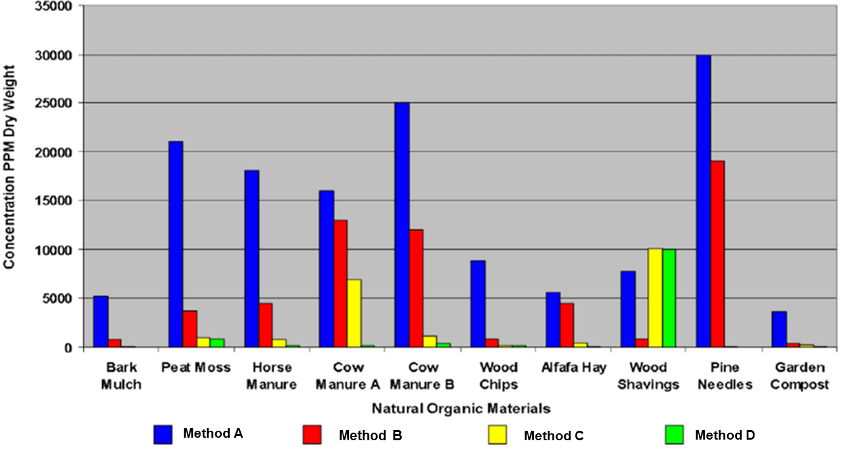
Four TPH Methods will Yield Four Different Results
And will measure “TPH” for non-petroleum hydrocarbons!
ITRC TPHRisk-1 Figure 5-3 (NewFields. 2002)
Notes:
The second message I want to leave you with is demonstrated by this bar graph. Four methods will yield four different results. Each color bar is a different TPH method and the vertical axis is the TPH concentration. It is readily apparent that there is poor agreement between the methods. Not only will the results be different for the various methods, but non-petroleum hydrocarbons can be quantified as TPH. If your results don’t make sense dig into the data a little and review the chromatograms as well as site conditions that could point to naturally occurring compounds

Slide 42

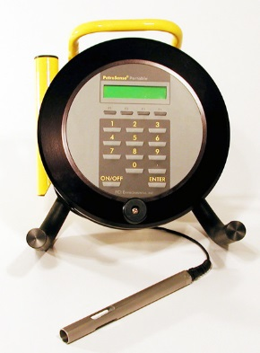
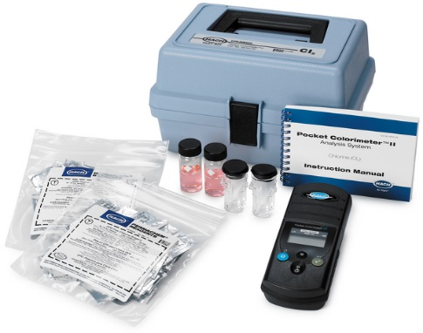
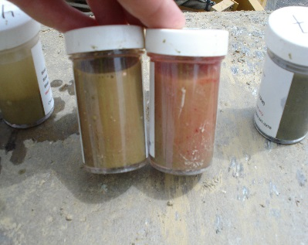
TPH Field Methods
When do field methods make sense
During initial field screening
During plume delineation
While excavation is open
Which field methods make sense
Is product known
Volatiles
Semi-volatiles
Wet chemistry vs meter
Appendix D
Pros and Cons
Follow up with laboratory methods to confirm your conclusions!
http://www.buygasmonitors.com/rae-systems-minirae-3000
Oil-in-soil collected by Maine DEP
http://www.petrosense.com/PHA-100.html
www.hach.com/test-kits/immunoassay-test-kits
Notes:
I would like to conclude by mentioning field methods. These methods can provide valuable information during initial field screening, plume delineation and while excavation is open and ongoing. Examples of field methods include bag headspace using a PID for volatiles and a wet chemistry test like Oil-in-Soil for semi-volatiles. A more in depth description of the pros and cons of these methods can be found in Appendix D of the guidance document. Because the poor precision of these methods, laboratory results should be used to confirm your conclusions.

Slide 43
Road Map
Why the Guidance?
Learn What TPH is
Learn TPH Analytical Methods
Questions and Answers
Environmental Fate of TPH
Assessing Human and Ecological Risk from TPH
Stakeholders Considerations
Closing
Questions and Answers

Slide 44
Road Map
Why the Guidance?
Learn What TPH is
Learn TPH Analytical Methods
Questions and Answers
Environmental Fate of TPH
Assessing Human and Ecological Risk from TPH
Stakeholders Considerations
Closing
Questions and Answers

Slide 45
Learning Objectives – Environmental Fate of TPH
Key Message: TPH composition changes after release to the environment and composition affects risk.
Understand how physical weathering changes TPH composition
Understand biological weathering also changes TPH composition and generates petroleum metabolites
Anticipate TPH composition changes throughout a site
Notes:
Speaker Notes:
Key Point: TPH composition is important because it impacts risk.
Environmental fate: 1) transport through a compartment (e.g., medium); transfer between compartments (partitioning); and transformation by biological, chemical, or physical processes (weathering).
- Why do we need to understand about TPH in different media?
How do we collect relevant TPH suitable for a robust CSM and Risk Assessment?
Effectively evaluate and develop CSMs

Slide 46
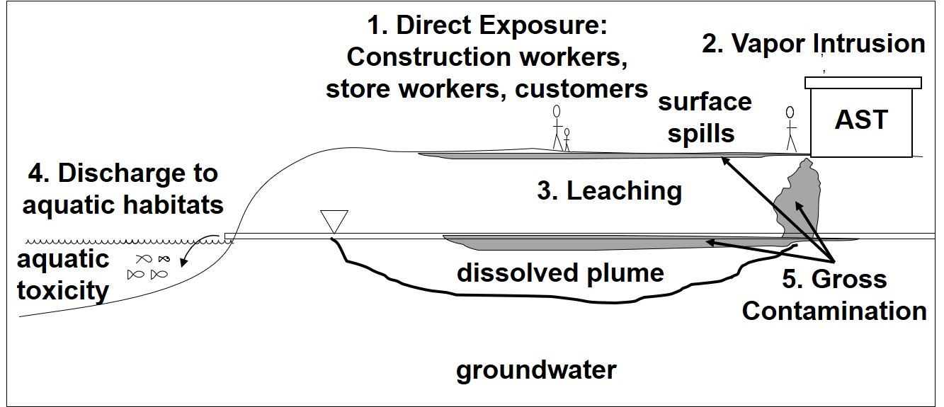
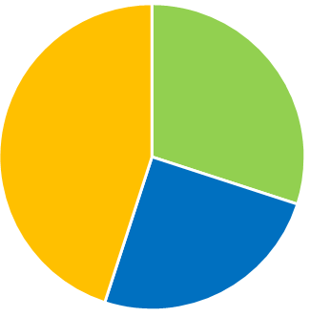
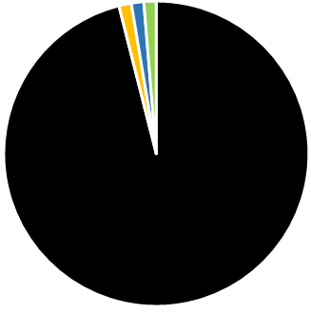
Conceptual Site Model: Source and Migration Pathways
Case Study
Hydrocarbons and metabolites
Phase
Releases:
Gasoline AST
Diesel pipeline
Contamination extent defined using bulk TPH
NAPL (non-aqueous phase liquid)
Air/Vapor
Water
Sorbed
HIDOH Case Study #1, Figure 1-3 (HIDOH 2018)
Notes:
Speaker notes: Key Idea: The composition of TPH in a sample from any medium affects risk. It’s critical to understand how the composition in the vapor and dissolved plumes differ from the source zone due to partitioning and transformation processes.
Former Fuel Tank Farm CSM from the Hawai’i-hosted case studies for the guidance.
Releases of gasoline and diesel from an aboveground storage tank (AST) and a diesel pipeline abandoned in place.
The extent of contamination has been defined using bulk TPH analyses (e.g., TPH-gasoline, TPH-diesel, etc.)
Areas of gross contamination or presence of NAPL (residual or mobile). NAPL has reached the shallow groundwater table (5-10 feet bgs)
Shallow soil - pipeline
Subsurface soil/groundwater beneath the AST
Pathways and concerns are listed on the figure: [ONLY POINT OUT ONE OR TWO]
Direct exposure risk
Vapor intrusion risk (note: impacts are shallow)
Leaching to groundwater
Contaminated groundwater migration to aquatic habitats
Gross contamination (NAPL)
Pie Charts (animation) – These pie charts are intended to convey relative hydrocarbon mass (size of pie) and phase (oil/NAPL, vapor, water, sorbed).
Over 99% of the hydrocarbon mass is in the NAPL.
Figure Source: HIDOH Case Study #1 Figure 1-3 with pie charts created by the Fate team. Relative proportions estimated.

Slide 47
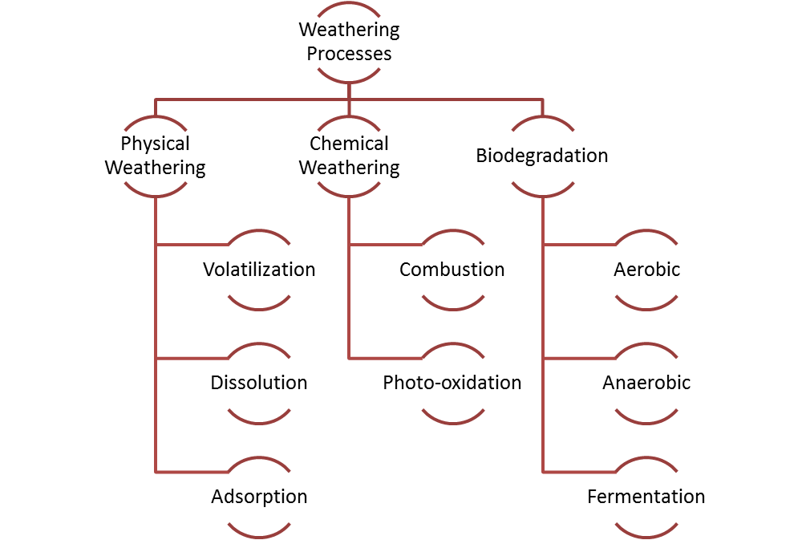
Weathering Processes Overview
ITRC TPHRisk-1 Figure 4-8
Notes:
Speaker notes: Key Idea: We emphasize the more dominant weathering processes in the coming slides: volatilization, dissolution, adsorption, and biodegradation (both aerobic and anaerobic).
Point to the guidance for further information.
Figure Source: ITRC TPH Risk Assessment Guidance

Slide 48
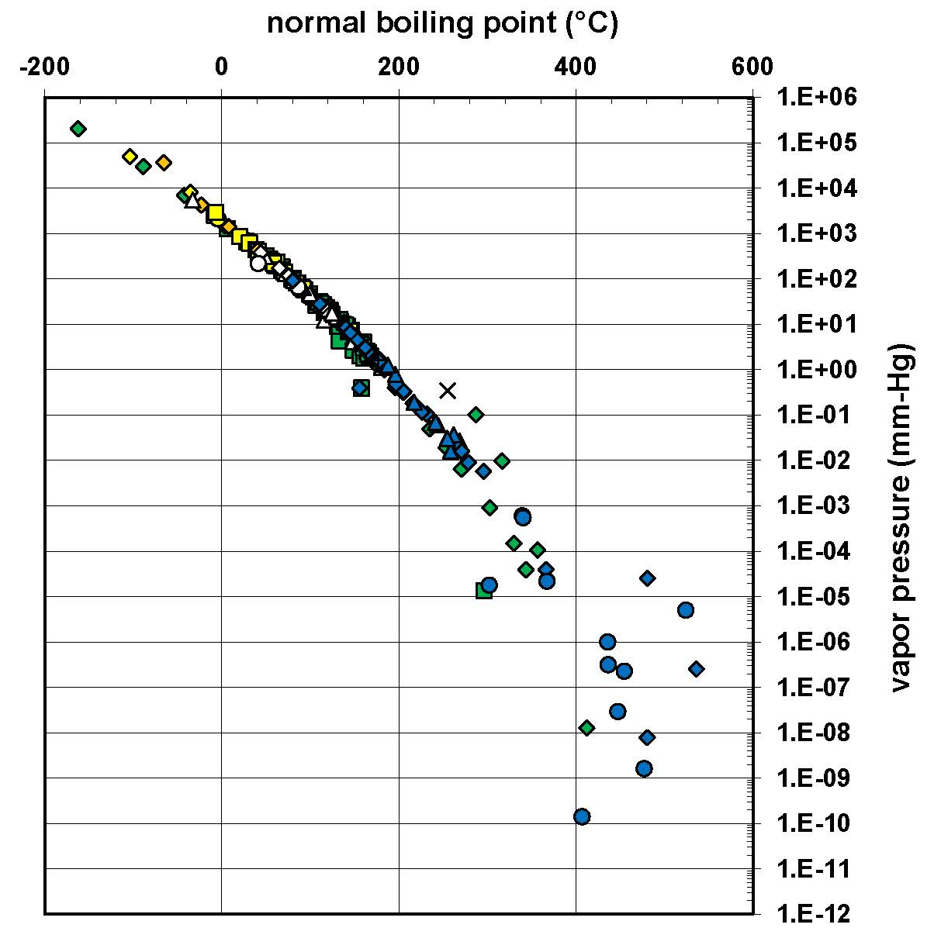
Partitioning: Oil to Vapor
Boiling Point vs. Vapor Pressure
All classes plot along single curve
Smaller hydrocarbons have greater volatilization potential and likely dominate TPH vapor composition
Note: Scatter at lower vapor pressure is related to measurement difficulty
x
Aliphatics
Aromatics
Biphenyls
Cycloalkenes and cyclodienes
Alkenes (straight and branched) and Dienes
Alkynes
Graph courtesy of Shell
Notes:
Speaker notes: Key Idea: Smaller hydrocarbons are more volatile than larger hydrocarbons. TPH vapor composition is dominated by these smaller aliphatic and aromatic hydrocarbons.
Explain Graph:
This figure introduces the simplest case, partitioning of hydrocarbons to vapor.
The x axis is boiling point so this corresponds to retention time in a gas chromatogram.
The y axis is vapor pressure.
The colors differentiate the many classes of hydrocarbons such as alkanes, alkenes, alkynes, aromatics and so on. Let’s focus on the green (aliphatics) and blue (aromatics). [DON’T ANNOUNCE ALL THE CLASSES]
Vapor pressure is inversely correlated with boiling point for all hydrocarbons, which is why we call this a simple case. Note the scatter at the bottom of the chart is related to the difficulty in measuring lower vapor pressures.
Additional notes:
Boiling point = temperature at which liquid pressure equals the vapor pressure. Example: propane (C3H8) is a gas at normal surface temperatures and pressures so keeping it in storable liquid form requires refrigeration.
USEPA considers a chemical volatile if VP greater than or equal to 1 mm Hg. This corresponds to the boiling point of n-decane (C10H20).
Figure Source: George DeVaull, Shell, 9/05/18, using TPH Criteria Working Group data (augmented)

Slide 49
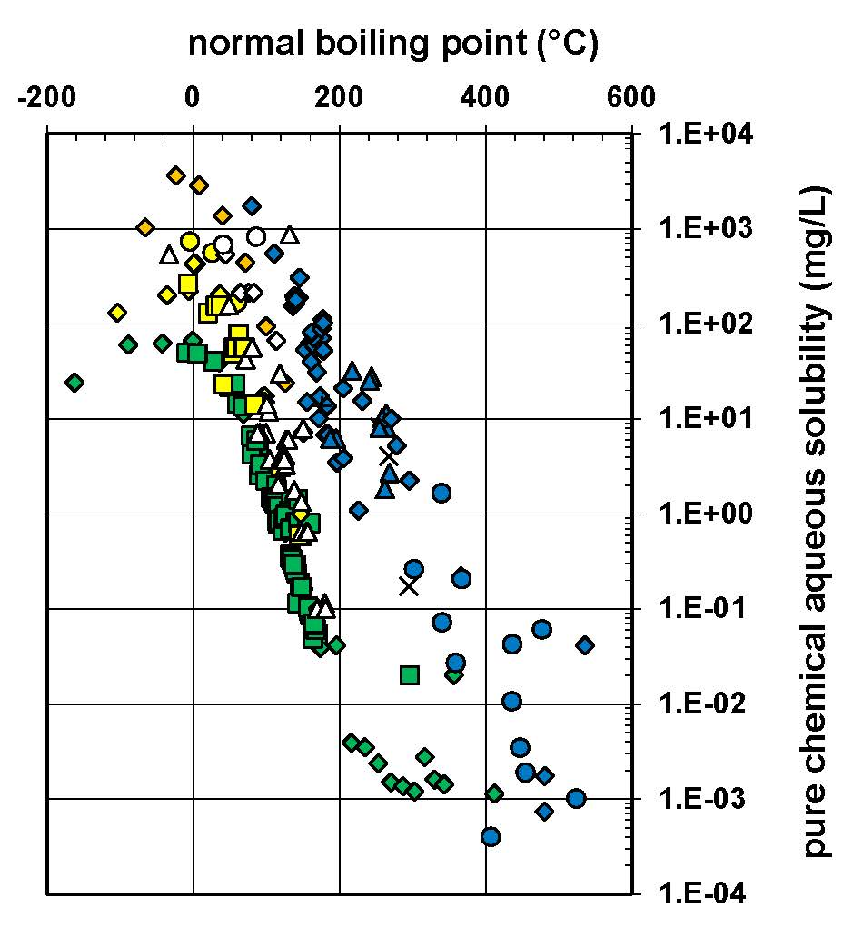
Partitioning: Oil to Water
Boiling Point vs. Aqueous Solubility
Smaller hydrocarbons are more soluble
Hydrocarbon structure differences:
Aromatics (solid line/right) most soluble
Aliphatics (dashed line/left) least soluble
TPH water composition likely dominated by aromatics
x
Aliphatics
Aromatics
Biphenyls
Cycloalkenes and cyclodienes
Alkenes (straight and branched) and Dienes
Alkynes
Graph courtesy of Shell
Notes:
Speaker notes: Key Idea: Smaller hydrocarbons more soluble than larger hydrocarbons, however there are differences based on chemical class/structure. The composition of the TPH water-soluble fraction likely is dominated by aromatics with some other hydrocarbons. The aliphatics generally speaking are not soluble. This is important for characterizing risk related to drinking water exposure and exposure to ecological receptors.
Explain graph:
This figure introduces partitioning of hydrocarbons to water, which is more complex than our previous slides on oil partitioning to vapor.
The x axis is boiling point.
The y axis is aqueous solubility.
Similar to volatility, smaller compounds have greater solubility than larger compounds, but molecule structure contributes to significant variation. The TPH analysis can capture all of these soluble constituents.
Figure Source: George DeVaull, Shell, 7/17/18, using TPH Criteria Working Group data (augmented)

Slide 50
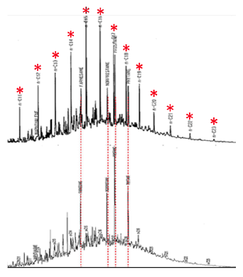
Biodegradation (Biological Weathering)
Biodegradation of hydrocarbons well documented for +100 years
Hydrocarbons readily undergo biodegradation under aerobic conditions
Some hydrocarbons degrade more readily than others (see figure)
Biodegradation is a stepwise process – each step leads to new metabolites
Highly Branched Alkanes Remain After Biodegradation
Anaerobic biodegradation typically is slower and more prone to buildup of petroleum metabolites
ITRC TPH RISK-1 Figure A5-3
Notes:
Speaker notes: Key Idea: Biodegradation is well documented as a major contributor to hydrocarbon mass reduction in the environment. The process of biodegradation generates petroleum metabolites that can be further degraded.
Hydrocarbons are susceptible to biodegradation particularly under aerobic conditions, but also under anaerobic conditions.
The necessary conditions occur in the majority of soils (e.g., microorganisms capable of utilizing HCs, moisture, oxygen, nutrients).
Most of us are familiar with hydrocarbons tendency to be degraded rapidly and/or over short distances in aerobic conditions. Unless you’re new to the industry, you’ve probably observed this at numerous sites.
Anaerobic biodegradation occurs, but it is much slower. Another way to say this is that it is inefficient, otherwise we wouldn’t have oil reservoirs. Notes on metabolites – are susceptible to further biodegradation there just can be a local buildup due to limited availability of electron acceptors (e.g., oxygen).
Diagram: MAY NOT BE NECESSARY TO DESCRIBE THE DIAGRAM IF PREVIOUSLY DESCRIBED IN THE LAB METHODS SECTION
Additional notes:
Occurrence of biodegradation typically assessed using historical trends in contaminant concentration data, water geochemistry data, and measurement of biogases
Rates – Something to keep in mind about rates of biodegradation is that it will depend on the phase. Biodegradation is a stepwise process involving many steps. NAPL tends to take longer to degrade than vapor or water plumes – there is more mass and therefore more electron acceptor demand (e.g., oxygen)

Slide 51
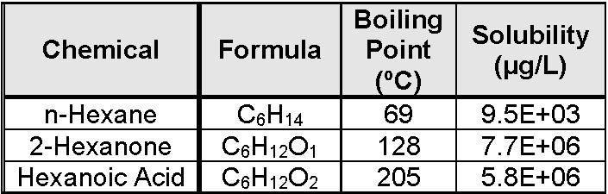
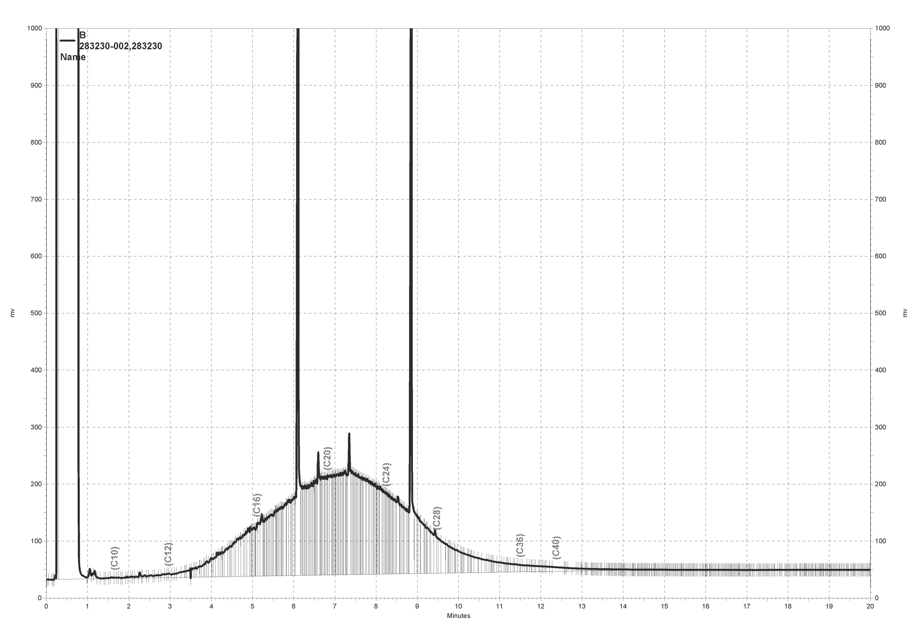
Petroleum Metabolites
Are intermediate biodegradation products
Molecules include oxygen and have properties different from hydrocarbons (e.g., polar)
Commonly detected as extractable TPH when silica gel cleanup (SGC) not used. Identify using:
Chromatogram pattern
Analysis with and without SGC
Understanding of solubility
Conceptual site model
Solubility of n-Hexane vs.
Two n-Hexane Metabolites
Characteristic Metabolite
Unresolved Complex Mixture (Hump)
TPH-diesel: 2,900 µg/L
After SGC: non-detect
TPH-diesel
C24
TPH-motor oil
C10
C36
Table values from USEPA Estimation Parameter Interface Suite
Chromatogram from CA site
Notes:
Speaker notes: Key Ideas listed below:
Petroleum metabolites are produced during weathering, primarily biodegradation but also photooxidation.
Metabolites have oxygen in the molecule, are polar (meaning the electrons are not shared equally), and preferentially partition into water.
Describe the solubility table: point out differences in solubilities and potentially boiling points
Metabolites are primarily measured via the extractable TPH analysis when silica gel cleanup is not used. Note that there may be gasoline range metabolites (see 2-hexanone BP in table – that’s about C8).
Identifying metabolites involves using multiple lines of evidence, several of which are on the slide
Chromatogram: Point out the overlap with both the TPH-diesel and TPH-motor oil range
It has been my observation that at many sites where TPH is tested both with and without SGC, the TPH concentration in groundwater is dominantly metabolites.
Lastly, the metabolites may pose toxicity different from the parent compounds and would require a different risk evaluation.
Additional notes:
The example chromatogram is one where metabolites were inferred based on multiple lines of evidence: chromatogram matching (e.g., Lang et al. 2009 and Zemo et al. 2003 and 2016), bulk TPH analysis with and without SGC (reminder: using SGC prevents metabolite detection), and CSM (solubility, source location).
We’re using one term “metabolites” to keep things simple. Use of metabolites for photo-oxidation products is not strictly correct. Other terms include polar compounds or polar metabolites. These compounds include alcohols, aldehydes, esters and carboxylic acids. Similar compounds are degradation products of natural organic matter. The source of the oxygen is water or aquifer sediment.
Sources:
Table based on phys/chem properties from USEPA Estimation Parameter Interface (EPI) Suite.
Chromatogram from petroleum site in CA.

Slide 52
Example TPH Fractions: TPH Criteria Working Group vs. EPA
TPH Criteria Working
Group
13 Transport Fractions
EC12-16
EC16-21
EC21-35
(same properties as EC16-21)
-- not considered a transport fraction--
Aliphatic
EC5-6
EC8-10
EC10-12
EC6-8
Molecular Structure
EC12-16
EC16-21
EC21-35
Aromatic
EC7-8 Toluene
EC5-7
Benzene
EC8-10
EC10-12
Increasing Equivalent Carbon (EC) Number
EC5-8
EC12-16
EC16-21
EC21-35
(same properties as EC16-21)
-- not considered a transport fraction--
EC8-16
EC16-35
EPA
6
Toxicity
Fractions
Aliphatic
Medium
Low
EC10-12
High
EC5-6
EC8-10
EC6-8
Molecular Structure
EC6-9
EC12-16
EC16-21
EC21-35
EC9-22
EC22-35
Aromatic
EC7-8 Toluene
Medium
EC5-7
Benzene
Low
EC10-12
High
EC8-10
Increasing Equivalent Carbon (EC) Number
Notes:
Speaker notes: Transition/Pivot from talking about classes of hydrocarbons to TPH fractions as vehicle/tool for conveying both composition and risk at the same time. Reminder: TPH composition affects risk and something that is unique to TPH risk assessment is the use of fractions.
The use of a TPH fraction approach with fractionation methods is the considered best for assessing TPH risk because the approach provides accurate hydrocarbon quantitation aligned with toxicity values and physical/chemical parameters. It can be helpful to think in terms of TPH fractions (similar groups of hydrocarbons) for both composition and risk. Here we provide examples of two fraction approaches and in the interest of time will use the simpler one in the coming slides to illustrate TPH composition changes due to weathering. Why? Because TPH composition is critical for understanding risk.
Explain Diagrams:
Each diagram divides the hydrocarbons into 2 major classes: aliphatics on top in green and aromatics on the bottom in blue
Each class is sliced into the smaller fractions based on equivalent carbon (EC), increasing from left to right on the x axis.
TPH Criteria Working Group – The top diagram shows the 13 TPHCWG “transport” fractions (the 14th Fraction, high-boiling aliphatics, is not considered mobile). Starting from the left, each successively larger carbon fraction has transport properties that are about an order of magnitude less. So, by mid-diagram, the fractions are about 4 orders of magnitude less volatile and soluble.
USEPA – These fractions are based on available toxicity information and are larger simply due to limited availability of toxicity criteria.
Since it is easier to think about TPH composition/risk in the 6 fractions rather than 13 (or 14) fractions, we will use 6 EPA fractions (low, medium, high, aliphatic vs. aromatic) to illustrate TPH composition in following slides.
Additional Notes:
This comparison is for discussion purposes and is not advocating for any particular fraction approach. Other agencies employ a fraction approach but the fractions differ. For example, in Europe, this is referred to as the hydrocarbon block method where the blocks are 3 carbons each (i.e., TPH carpaccio).
Figure Source: Created by the Fate section using the EC and molecular structure from the TPHCWG and USEPA

Slide 53
TPH Composition in Non-Aqueous Phase Liquid (NAPL)
Example TPH Fraction Proportions in Three Unweathered NAPLs
Gasoline TPH Fractions
Motor Oil TPH Fractions
Aliphatic
Aromatic
Diesel TPH Fractions
Y-Axis: Mass fraction (1.00 = 100%)
Using 6 EPA TPH Fractions
Fraction compositions estimated from ATSDR documents
Notes:
Speaker notes: Key Idea: TPH fraction composition depends first on the oil/fuel (NAPL) composition and then weathering processes. On this slide, we start with the basics: NAPL composition.
Explain how to read the graphs:
The 3 graphs present the TPH fraction composition for three different TPH mixtures: gasoline, diesel, and motor oil.
X axis shows the presence of the 6 conceptual fractions in increasing equivalent carbon number: Light, Medium, and High. Colors differentiate the two major hydrocarbon classes: aliphatics (green) and aromatic (blue).
Y axis is the proportion with a maximum value of 1. For each graph, the total fraction proportions are 1 (100% by weight). For the motor oil, about 76% is heavy aliphatic in this example
Compare two of the mixtures only: gasoline versus motor oil or gasoline versus diesel
Although we are deferring risk discussion to the next section, keep in mind that once you select the fractions and tox values, you can mentally switch back and forth between composition and risk. The fraction composition (e.g., light aliphatic, medium aliphatic, etc.) of different NAPLs are important for risk
Figure Source: Graphs created for training. Fraction composition developed using ATSDR documents and USEPA TPH fractions.

Slide 54
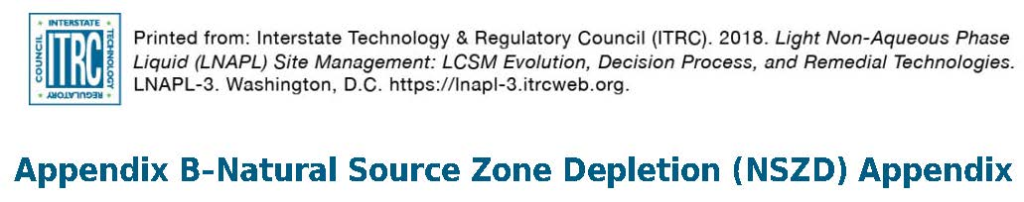
NAPL: TPH Composition Change Due to Weathering
Weathering of NAPL is also known as Natural Source Zone Depletion (NSZD) – see ITRC LNAPL-3 (2018)
Over time, weathering changes the remaining NAPL composition (and therefore risk)
Mobile hydrocarbons partition out, depleting the remaining NAPL
While biodegradation continues, metabolites will be generated

Slide 55
Weathered NAPL: TPH Composition Change Example
Gasoline TPH Fractions
(Unweathered)
Diesel TPH Fractions
(Unweathered)
trace
Case Study
Gasoline TPH Fractions
(Weathered)
Diesel TPH Fractions
(Weathered)
Aliphatic
Aromatic
Composition: weathered gasoline from IRhodes
weathered diesel based on TPHCWG data
Notes:
Speaker notes: Compare these examples of fresh and weathered fuels released at our case study site: gasoline and diesel.
Graphs: Already explained, repeat as needed.
Gasoline:
As you recall from our partitioning graphs, smaller hydrocarbons are the most volatile and soluble constituents
Compare (unweathered vs weathered gasoline): In this example the low carbon range fractions are completed depleted.
In the absence of fractionated data, you could infer the fractions by reviewing the sample chromatograms from your bulk TPH analyses.
Diesel:
Compare overall relative proportional shifts between gasoline and diesel: This weathered diesel example doesn’t show quite as much depletion as the preceding weathered gasoline example, but it does illustrate the overall shift to proportionally heavier fractions.
Compare Medium Aliphatic vs. Aromatic fractions for the unweathered and weathered diesel: There is still a moderate proportion of the medium range aliphatics (probably branched hydrocarbons) while the medium aromatics have been more strongly depleted.
Again, with knowledge of tox values, you can mentally estimate relative risk.
Figure Source: Graphs created by the Fate section. Unweathered NAPL graphs are the same as Slide 74. Weathered composition data from Ileana Rhodes of GSI for weathered gasoline and from TPHCWG for weathered diesel

Slide 56
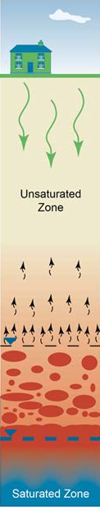
Vapor: TPH Fraction Composition Near NAPL and Fate/Exposure
TPH Vapor Attenuation to Surface in Presence of Oxygen
Gasoline Volatile Fractions
Aliphatic
Aromatic
Y-Axis: Mass fraction (1.00 = 100%)
Using 6 EPA TPH Fractions
Aerobic (oxygen-rich)
Unsaturated zone
Anaerobic biodegradation interface
Diesel Volatile Fractions
Anaerobic (oxygen-depleted)
LNAPL Smear Zone
Source: ITRC PVI Guidance 2014
Composition based on Uhler et al. 2010
Notes:
Speaker notes: Key Idea: TPH fraction composition in the vapor phase typically consists of small aliphatics and aromatics, which is important to understand because this relates to vapor intrusion risk. TPH vapors attenuate sharply in the vadose zone over short distances in the presence of oxygen.
Graphs: Already explained, repeat as needed.
Near NAPL TPH Vapor Composition Notes:
These graphs are constructed in the same fashion as the ones for NAPL, with the exception they present vapor compositions.
The volatile hydrocarbon fractions are light aliphatics and aromatics, and to a much lesser extent medium aliphatics and aromatics
The vapor phase fraction composition is enriched in these lighter fractions even for middle distillate fuels (e.g., Jet A, diesel)
Total concentrations of gasoline vapors estimated at 100,000s ug/m3 versus less than 1,000 ug/m3 for diesel
Fate and Transport Effects on TPH Vapor Composition notes:
Hydrocarbon vapor plumes typically are limited to thin zones around NAPL and heavily impacted media as a result of aerobic biodegradation in unsaturated zone.
See ITRC Petroleum Vapor Intrusion guidance for further information on hydrocarbon vapor fate and transport
Case Study Notes:
In our case study, the only area where there is a vapor intrusion concern is in the release area due to significant impacts (gross contamination/NAPL) in shallow soil.
Figure Source: Graphs created for training. Vapor fraction composition estimated based on Uhler et al. 2010. The vapor attenuation diagram is modified from ITRC PVI Guidance Figure 3-1.
Uhler, A.D., K.J. McCarthy, S.D. Emsbo-Mattingly, S.A. Stout, and G.S. Douglas. 2010. Predicting Chemical Fingerprints of Vadose Zone Soil Gas and Indoor Air from Non-Aqueous Phase Liquid Composition. Environmental Forensics, 11: 342-354. [cited in Workbook]

Slide 57
Groundwater: TPH Fraction Composition (Near NAPL)
Example TPH Fraction Proportions in Water from Two NAPLs (Unweathered)
Aliphatic
Aromatic
Gasoline Soluble Fractions
Y-Axis: Mass fraction (1.00 = 100%)
Using 6 EPA TPH Fractions
Fate of TPH Groundwater Plumes
Dissolved hydrocarbons attenuate with increasing distance from release
TPH-Gasoline Plume Length (Shih et al. 2004):
Median: about 220 feet
Max: about 600 feet
Diesel Soluble Fractions
Composition based on Zemo and Synowiec (1995)
Notes:
Speaker notes: Key Idea: TPH fraction composition in the water phase typically consists predominantly of small aromatics, with some small aliphatics and some medium aromatics. Such a composition has implications for drinking water exposure to humans and direct contact concerns for ecological receptors.
Graphs: Already explained, repeat as needed.
These graphs are constructed in the same fashion as the ones for NAPL, with the exception they present water-soluble TPH compositions.
The soluble hydrocarbon fractions are light aliphatics and aromatics, and to a much lesser extent medium aromatics
TPH groundwater plumes can be thin bands around NAPL/heavily impacted media or cigar-shaped plumes
Much of the dissolved mass can consist of metabolites at older, more weathered sites. These typically are mainly detected in the bulk TPH-diesel analysis and as well as the TPH-motor oil analysis.
Max concentrations of dissolved hydrocarbons for TPH-gasoline are 200 mg/L and about 1-5 mg/L for diesel.
Both TPH and metabolites attenuate with distance from the source
Figure Source: Graphs created for training. Water soluble fraction composition estimated based on Zemo and Synowiec 1995
Zemo, D.A. and K.A. Synowiec. 1995. TPH Detections in Groundwater: Identification and Elimination of Positive Interferences. In Proceedings of the 1995 Conference on Petroleum Hydrocarbons and Organic Chemicals in Ground Water, p. 257-271. Westerville, Ohio. National Ground Water Association.

Slide 58
Groundwater: Fate and Exposure
Redox Zonation
NO₃⁻ Fe³⁺(Mn⁴⁺) SO₄²⁻ methanogenesis
NAPL
aerobic
Groundwater Flow Direction
Increasing Distance to the Left
dissolved hydrocarbons
relative concentration
metabolites
Information on relative hydrocarbon/metabolite concentrations based on Zemo et al. 2016.
Natural Attenuation of Fuels and Chlorinated Solvents in the Subsurface (Wiedemeier et al. 1999)
Notes:
Speaker notes: Key idea: TPH composition changes along the flowpath. This differential in fate affects composition, which in turn affects exposure.
General: Both charts start with the source at the right with groundwater flow to the left [just like the Case Study CSM figure]. Otherwise, the charges are not related.
Top Diagram: TPH composition changes along the flowpath due to:
differential transport and sorption of individual hydrocarbons
different susceptibilities of hydrocarbons to biodegradation,
different redox zones along the flowpath. The chart shows the classic electrochemical sequence from right to left
Bottom Diagram: Looking at bulk TPH composition for the hydrocarbons and metabolites.
Hydrocarbons: highest concentrations near the source and diminishing downgradient
Metabolites: the metabolites are generated via biodegradation so concentrations increase downgradient of the source area and highest parts of the dissolved hydrocarbon plume. They also attenuate. Over time, metabolite concentrations may increase near source (the apex of the triangle may shift to the right)
The metabolite extends further than the hydrocarbon plume and has implications for exposure.
The x-axis can be either distance or time
Figure Source: The redox zonation concept is not new. This figure is. The relative concentration figure also is new, partly based on Zemo et al. 2016 and partly team members experience.

Slide 59
Poll Question
CSM: 30-year old, large diesel spill at bulk terminal site, where diesel is about EC8-EC26.
What soluble TPH fractions or petroleum-related compounds are more likely present in a groundwater sample downgradient of the source area?
All fractions/chemicals
Low aromatics (EC6-EC9)
High aliphatics (EC16-EC35)
Petroleum metabolites
None of the above
Poll Question
Notes:
Multiple answer
General: The potential hydrocarbons present are limited by the composition of the released fuel/oil, partitioning (which compounds dissolve in water or might have been depleted via volatilization) and susceptibility to biodegradation. Since biodegradation is all but certain to occur, petroleum metabolites will be generated.
1-We would not expect all fractions or chemicals considering oil/fuel type and weathering processes
2-Low aromatics are more soluble, however they constitute only a small fraction of diesel and are more likely to have been depleted to physical and biological weathering.
3-High aliphatics have low to trace solubility and are not likely to partition into water to any significant degree.
4-Petroleum metabolites are soluble and more likely to be present than not, given the large release volume and certainty that biodegradation is occurring.
5-It is less likely that no TPH fractions or petroleum-related compounds are present given the large release and age.
Keep in mind that composition can be determined at your site by (1) use of a fractionation analysis and (2) analyzing extractable TPH both with and without silica gel cleanup.

Slide 60
Summary: Environmental Fate of TPH
TPH is a complex mixture
The mass and composition of TPH change after release in a site-dependent manner depending on:
Individual hydrocarbon properties
Site conditions
Understanding how TPH mass and composition change at a site leads to understanding how TPH risk changes at a site
Notes:
Speaker notes: Key Idea: It’s important to understand how TPH composition changes because it affects toxicity and the nature of exposure (vapor inhalation, groundwater ingestion and dermal contact, etc.)
After release, hydrocarbons are redistributed from NAPL into the vapor and water phases based on their properties
Vapor – light aliphatics and aromatics
Water – primarily light aromatics with some light aliphatics and medium aromatics
The mass and composition of all phases (NAPL, vapor, water, sorbed) are altered over time due to biodegradation, generating metabolites. These mass and compositional changes in turn affects the risk evaluation.

Slide 61
Road Map
Why the Guidance?
Learn What TPH is
Learn TPH Analytical Methods
Questions and Answers
Environmental Fate of TPH
Assessing Human and Ecological Risk from TPH
Stakeholders Considerations
Closing
Questions and Answers

Slide 62
Learning Objectives – Assessing Human and Ecological Risk from TPH
Learn how tiered screening-level and site-specific approaches can be applied to human health and ecological TPH risk assessments
Recognize how the unique analytical and fate and transport characteristics of TPH as a mixture affect risk assessment
Determine whether your existing data is sufficient to estimate TPH risk
Gain an appreciation for the uncertainties specific to TPH risk assessment
Poll Question

Slide 63
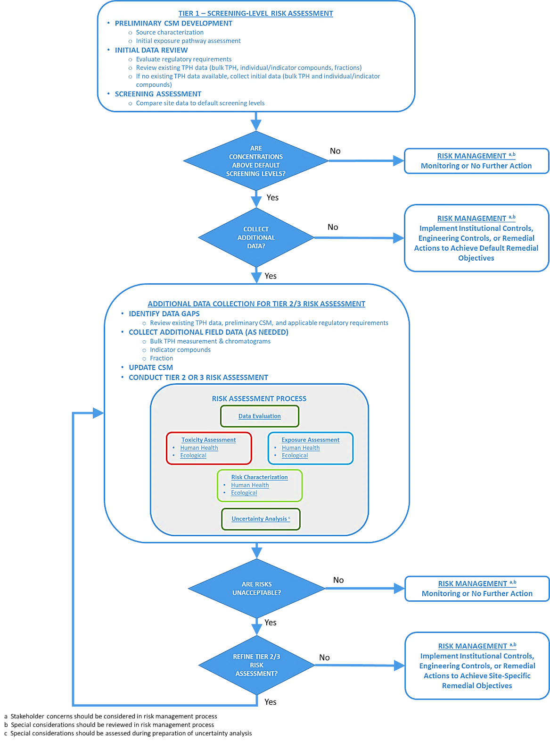
Tiered TPH Risk Assessment Framework
Screening level assessment
Site-specific assessment
Human health and ecological
ITRC TPHRisk-1 Figure 1-1

Slide 64
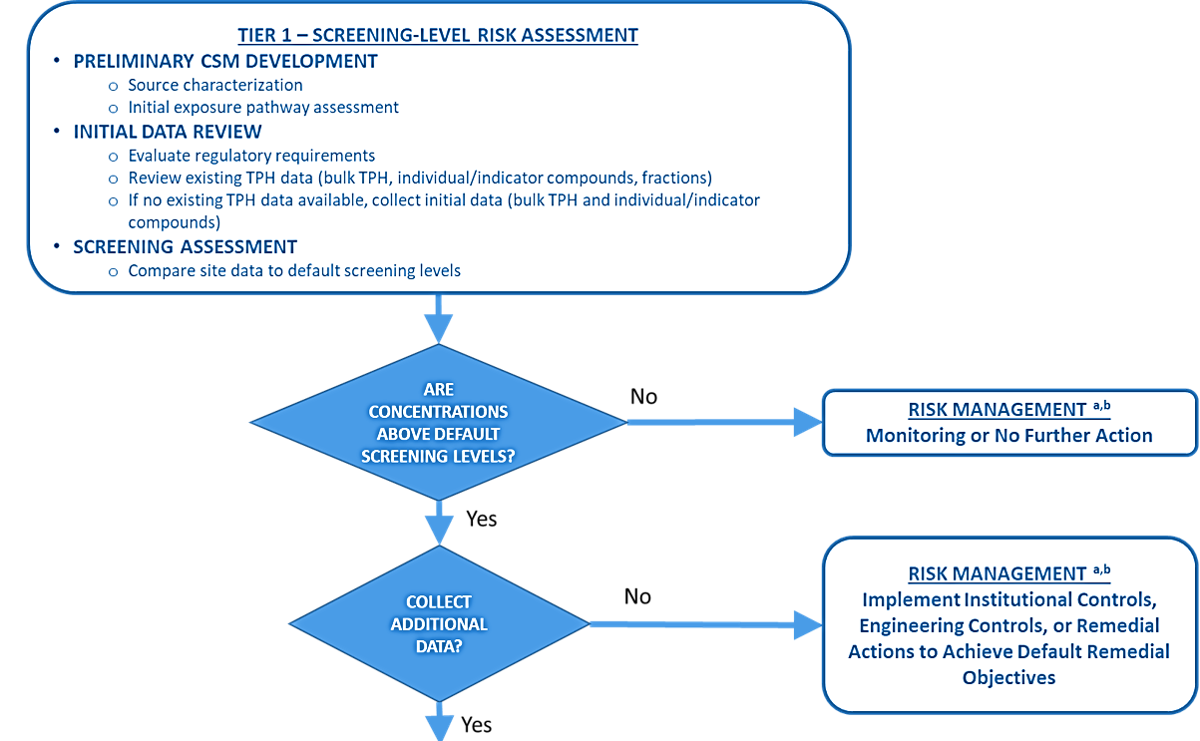
Screening-Level Assessment
ITRC TPHRisk-1 Figure 1-1

Slide 65
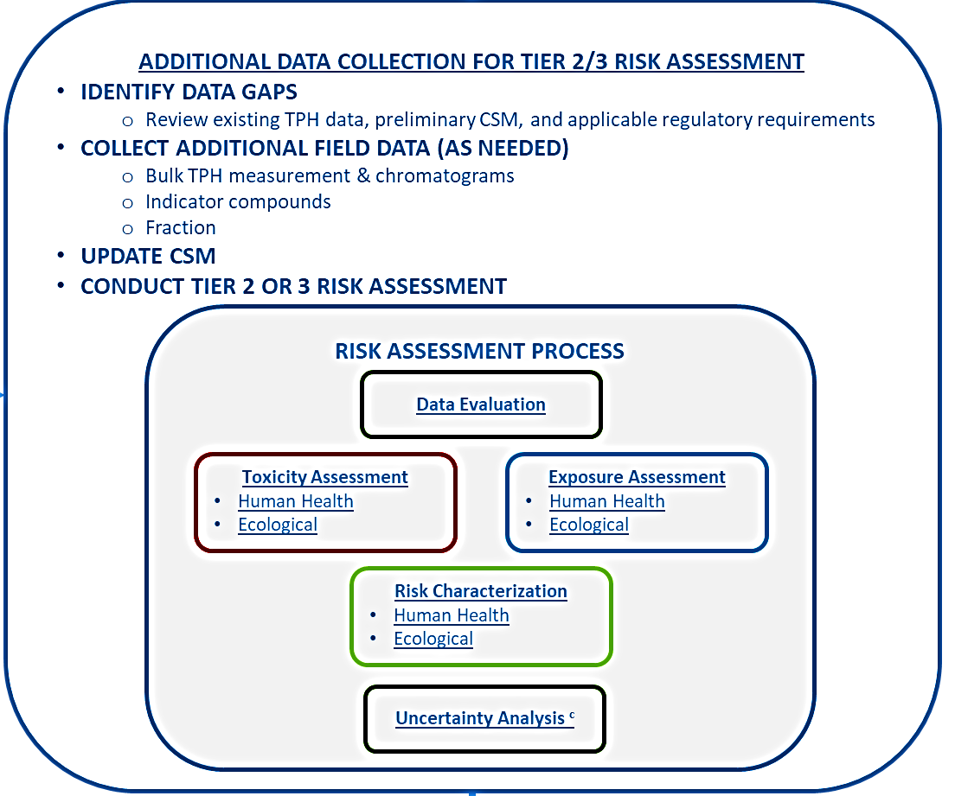
Site-Specific Assessment
ITRC TPHRisk-1 Figure 1-1

Slide 66
Conceptual Site Model: Exposure Assessment
Unique characteristics of TPH effect exposure assessment
Partitioning across media
Changes over time
Case Study
HIDOH Case Study #1 (October 2018)

Slide 67
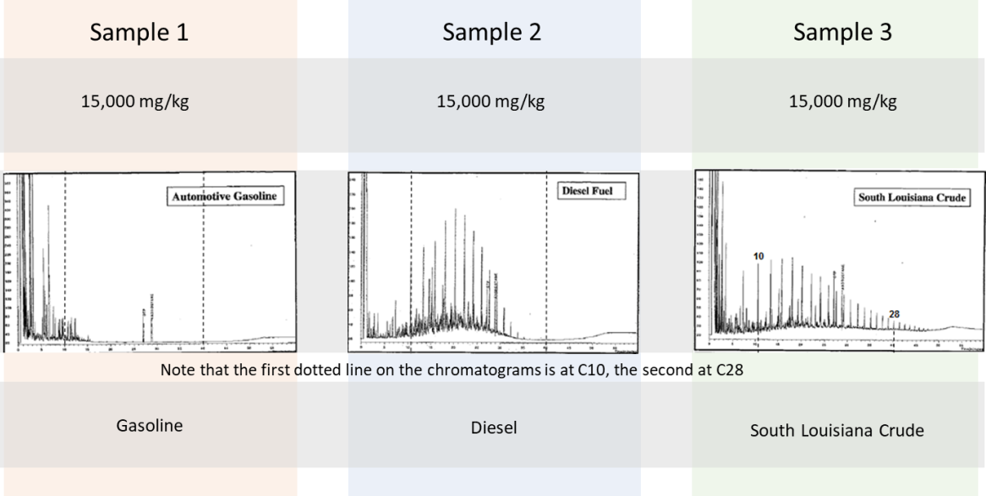
Human Health Exposure Pathways – Poll Question
Sample 1
Sample 2
Sample 3
15,000 mg/kg
15,000 mg/kg
15,000 mg/kg
Poll Question
Gasoline
Diesel
South Louisiana Crude
ITRC TPHRisk-1 Figure 2-3
Notes:
Looking at these three chromatographs and considering what we’ve learned about fate and transport…
Poll Questions:
1. Looking at Sample 1 – What is the dominant exposure pathway likely to be?
A - Inhalation
B - Dermal contact
C - Ingestion
Looking at Sample 3 – Are there any exposure pathways that can be readily excluded?
A – Inhalation
B – Migration to surface water
C – Ingestion
D – None of the above

Slide 68
Human Health Toxicity Assessment
Individual Compound Approach
C₅
C₃₅
Carcinogenic PAHs
C₆
C₁₈
C₂₂
Whole Product
C₅
C₃₅
RfD for mineral oil, JP-4, etc. . .
Fraction/Surrogate
C₅
C₃₅
RfD = 2 (weighted mixture)
C₈
RfD = 0.1 (petroleum streams)
RfD = 1 (mineral oil)
C₁₆
ITRC TPHRisk-1 Figure 6-2

Slide 69
Analytical Methods vs Toxicity Values
Group TPH Fractions intervals to be consistent with TPH toxicity values
 |  | Aliphatic |  |  |  |  |  |  |  |  |  |  |  |  |  |  |  |  |  |  |  |  |  |  |  |  |  |  |  |  |  |  |  |  |  |  |  | Aromatic
Carbon Chain Length |  | 5 | 6 | 7 | 8 | 9 | 10 | 11 | 12 | 13 | 14 | 15 | 16 | 17 |  | 18 |  | 19 | 20 | 21 | 22 | 23 | 24 | 25 | 26 | 27 | 28 | 29 | 30 | 31 | 32 |  | 33 | 34 | 35 | 36 |  | 5 |  | 6 | 7 | 8 | 9 | 10 | 11 | 12 | 13 | 14 | 15 | 16 | 17 | 18 | 19 | 20 | 21 | 22 | 23 | 24 | 25 | 26 | 27 | 28 | 29 | 30 | 31 | 32 | 33 |  | 34 | 35 | 36
USEPA 8015B | TPH-g | TPH-g |  |  |  |  |  |  |  |  |  |  |  |  |  |  |  |  |  |  |  |  |  |  |  |  |  |  |  |  |  |  |  |  |  |  |  | TPH-g
 | TPH-d |  |  |  |  |  | TPH-d |  |  |  |  |  |  |  |  |  |  |  |  |  |  |  |  |  |  |  |  |  |  |  |  |  |  |  |  |  |  |  |  |  |  |  |  | TPH-d
 | TPH-mo |  |  |  |  |  |  |  |  |  |  |  |  |  |  |  |  |  |  |  |  |  | TPH-mo |  |  |  |  |  |  |  |  |  |  |  |  |  |  |  |  |  |  |  |  |  |  |  |  |  |  |  |  |  |  |  |  |  |  | TPH-mo
Fractionation | VPH
 | EPH
Mapping WDOE TPH Fractionation Method Intervals to RBSLs
MA Toxicity Category |  | Aliphatic C5-C8 |  |  |  | Aliphatic C9-C18 |  |  |  |  |  |  |  |  |  |  |  | Aliphatic C19-C36 |  |  |  |  |  |  |  |  |  |  |  |  |  |  |  |  |  |  |  |  |  |  |  |  | Aromatic C9-C10 |  |  |  |  |  |  |  | Aromatic C11-C22
US EPA Toxicity Category |  | Aliphatic Low |  |  |  | Aliphatic Medium |  |  |  |  |  |  |  |  |  |  |  | Aliphatic High |  |  |  |  |  |  |  |  |  |  |  |  |  |  |  |  |  |  |  |  | Aromatic Low |  |  |  | Aromatic Medium |  |  |  |  |  |  |  | Aromatic High
from Goldberg Day, AEHS March 2015

Slide 70
Example Toxicity Values Under TPH Fraction Approach
Fractions | TPHCWG (1997) |  | MA DEP (2003) |  | USEPA PPRTV (2009) |  | TCEQ (2010)
 | RfD (mg/kg-d) | Surr (s) Comp (c) | RfD (mg/kg-d) | Surr (s) Comp (c) | RfD (mg/kg-d) | Surr (s) Comp (c) | RfD (mg/kg-d) | Surr (s) Comp (c)
Aliphatics Low Carbon Range (C5-C8) (EC5-EC8) | 5 | (s) Commer-cial hexane where n-hexane is ≤53% | 0.04 | (s) n-hexane | 0.3 | (s) n-hexane | 0.06 | (s) n-hexane
Aromatics Low Carbon Range(C6-C8) (EC6-EC<9) | 0.2 | (s) toluene | NA | (c) benzene | 0.004 | (c) benzene | 0.1 | (s) ethyl- benzene
 |  |  | 0.2 | (c) toluene
 |  |  |  |  | 0.08 | (c) toluene
 |  |  | 0.1 | (c) ethyl- benzene
 |  |  |  |  | 0.1 | (c) ethyl- benzene
 |  |  | 2 | (c) xylenes
 |  |  |  |  | 0.2 | (c) xylenes
 |  |  | 0.2 | (c) styrene
TPHCWG – Total Petroleum Hydrocarbon Criteria Working Group
MA DEP – Massachusetts Department of Environmental Protection
USEPA = United States Environmental Protection Agency
TCEQ – Texas Commission on Environmental Quality
PPRTV – Provisional Peer-Reviewed Toxicity Values
ITRC TPHRisk-1 Table 6-1

Slide 71
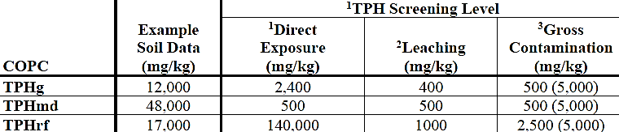
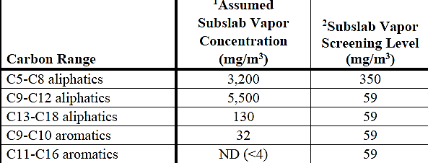
Case Study – Toxicity Assessment
Started with bulk TPH data
Uncertainty in nature of product in diesel range prompted fraction analysis for soil gas
Case Study
HIDOH Case Study #1 (October 2018)

Slide 72
Assessment of Metabolites
Challenge assessing risk
Limited toxicity information for individual metabolites and mixtures
Options for evaluating metabolite toxicity
Exclude from evaluation
Use the RfD from the Rogers et al. (2002) study
Adopt the toxicity ranking model from Zemo et al. (2013, 2016)
Treat the bulk metabolites and bulk hydrocarbons as having similar toxicity (HIDOH, 2017) and (CSWB-SFBR, 2016)

Slide 73
Case Study – Risk Management
Primary pathway of concern was vapor intrusion
Acute safety/explosive concern
Addressed stakeholder concerns
Vapor mitigation systems
Asphalt cover to address direct contact
Emergency hazard management plans for safety concerns
Case Study

Slide 74





Now let’s move on from humans…

Slide 75
ERA Poll Question
Three different sites:
Site A – gas station release from a UST, paved site, depth to groundwater at 100 feet below land surface
Site B – gas station release, paved with channeled groundwater discharge to a creek a half-mile away
Site C – continuing release from an oil refinery with terrestrial and aquatic habitats nearby
Poll Question
Notes:
Poll Questions: You have three different sites with different levels of complexity
Which site would be adequately addressed with a screening level ERA?
A – Site A
B – Site B
C – Site C
Which site would be best addressed with a site-specific ERA:
A – Site A
B – Site B
C – Site C

Slide 76
An ERA may not be Necessary When:
Absence of viable habitats (e.g., paved sites)
Contamination found below the root zone and burrowing zones of ecological receptors
No release to nearby, viable (or protected) aquatic and terrestrial habitats
Policies and regulations on exclusion criteria (see Table 5-3)

Slide 77
Do a Screening-Level ERA When:
State or local regulations require an ERA
Screening Level values are available
Screening levels are appropriate for site conditions and type of release
Data Requirements for Screening ERA
Consider data for bulk TPH (TPH-g, TPH-d) and indicators (BTEX, PAHs)
TPH fraction data usually not available or necessary
See Tables 7-12 and 7-13 for analytical data choices and uses
ITRC TPHRisk-1 Tables 7-12 and 7-13

Slide 78
Example TPH Screening Levels – TPH-g
CA Water Board Whole Product Screening Levels for Water (Table 7-1)
Canadian Soil Guidelines for Fraction F1
More details on available screening levels in Section 7.2 and Table 7-1
 | Fresh (ppb) | Marine (ppb) | Estuarine (ppb)
TPH-g | 500 | 3,700 | 500
 | Plants and Invertebrates (ppm) | Wildlife (ppm)
TPH F1 (C6-C10) | 210-320 | 11,000

Slide 79
Do a Site-Specific ERA When:
When screening levels are lacking or exceeded
At complex sites with multiple media, sensitive habitats and receptors
Data needs for Site-Specific ERA
Consider combination of useful data types
Whole product and indicators
Water soluble and water accommodated fractions for aquatic habitats
Aliphatic/Aromatic fractions primarily available for aquatic assessment
See Tables 7-2,7-3 and 7-4 for analytical data choices and uses
ITRC TPHRisk-1 Tables 7-12 and 7-13

Slide 80
Scoping a Site-Specific ERA
Exposure Assessment
Focus on direct exposure
Bioaccumulation
Primarily PAHs
Toxicity Assessment
Aquatic and terrestrial biota
Physical toxicity
(not included in this guidance)
Chemical toxicity
Multiple approaches
Metabolites
Emerging concern under study

Slide 81
Toxicity Assessment - Approaches
Source of TPH Toxicological Data
Research Literature
Structure Activity Models
Site Measurements
Ecotoxicity Databases
Upside – Based on real world testing.
Downside – Limited availability of data for whole product and TPH fractions. Variable data quality on underlying studies.
Hydrocarbon Toxicity Models
Upside – Can be defined for site-specific mixtures or components.
Downside – Untested or unverified assumptions.
Media Specific Toxicity Testing
Upside – Direct measure of toxicity under site-specific conditions.
Downside – Sensitive to confounding factors and inability to identify specific cause.
Numeric Criteria
Regulatory or Site-Specific
Toxicity Acceptability Criteria
ITRC TPHRisk-1 Figure 7-1

Slide 82
Characterizing HH and Eco Risk and Uncertainties
Key Uncertainties
Representativeness of fractions, components and/or surrogates of TPH
Screening levels (representative of TPH mix, risk based source, applicable endpoints
Non-additivity of TPH risk and TPH component double-counting
Toxicity value/test representativeness to underlying exposure mechanisms, especially when TPH + non-TPH mixtures
Additional direct or indirect impacts from TPH (oiling, direct contact, indirect changes to habitat)
Use of field data
Type of data used (bulk vs fractionated)
ITRC TPHRisk-1 Table 7-15

Slide 83
Road Map
Why the Guidance?
Learn What TPH is
Learn TPH Analytical Methods
Questions and Answers
Environmental Fate of TPH
Assessing Human and Ecological Risk from TPH
Stakeholders Considerations
Closing
Questions and Answers

Slide 84
Learning Objectives - Stakeholder Considerations
Recognize what groups can be potential stakeholders
Know what stakeholder engagement tools are available
Approach some common sources of confusion and concern about TPH risk assessment and decision-making for stakeholders – e.g., fires, explosions, health, appearance, odor, taste
Chapter 10 in the guidance document
WE ALL WANT TO BE HEARD!

Slide 85
Communication with Stakeholders
Who are Stakeholders?
Important Components of Risk Communication
Empathy and respect
Understandable facts and conclusions about TPH
Required Public Notifications
Notify owners and tenants before sampling
Provide TPH data with appropriate explanation
Appropriate Communication Tools
Conveying technical concepts (Table 10-2)
Factsheets, posters, outreach meetings
Websites and links to TPH information

Slide 86
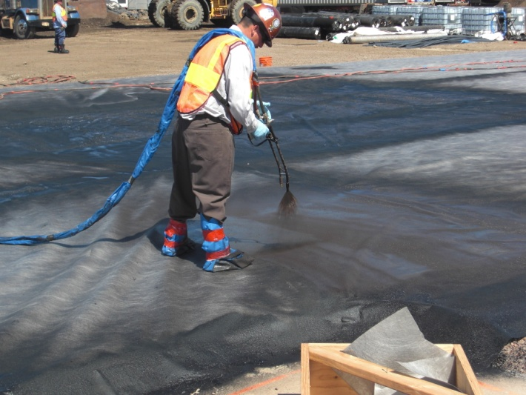
Tank Farm Redevelopment
Community Engagement Plan (CEP)
Town Hall meeting scheduled several years before remediation began
Built credibility and trust through targeted remedial actions, mitigation and monitoring
CEPs should be appropriate for the site
Case Study
HIDOH Case Study #1 (HIDOH 2018)

Slide 87
Stakeholder Concerns Associated with TPH – Property Values
Property Devaluation Concerns
Not unique to TPH
Devaluation may be real or perceived
Concern is often related to residual TPH and a Monitored Natural Attenuation (MNA) remedy
Addressing Property Devaluation Concerns
Explain why selected remedy is protective and effective, especially for MNA
Describe how all activities are done with agency oversight
Address individual property owners concerns too

Slide 88
Stakeholder Concerns Associated with TPH – Technical Issues
Household sources of TPH/ ”Background” TPH
There are many potential sources of TPH
Paint thinners, cosmetics, natural oils, urban air (Table 10-3)
We can only manage site-related TPH
TPH and methane – explosions?
Potential degradation product, see ITRC PVI guidance (2014) and ASTM methane standard
Understanding what TPH data means – a challenge
Nuisance concerns vs health risks?
Taste and odor are not health risks but covered in some states
Project Success
Technical approach + stakeholder engagement

Slide 89
Road Map
Why the Guidance?
Learn What TPH is
Learn TPH Analytical Methods
Questions and Answers
Environmental Fate of TPH
Assessing Human and Ecological Risk from TPH
Stakeholders Considerations
Closing
Questions and Answers

Slide 90
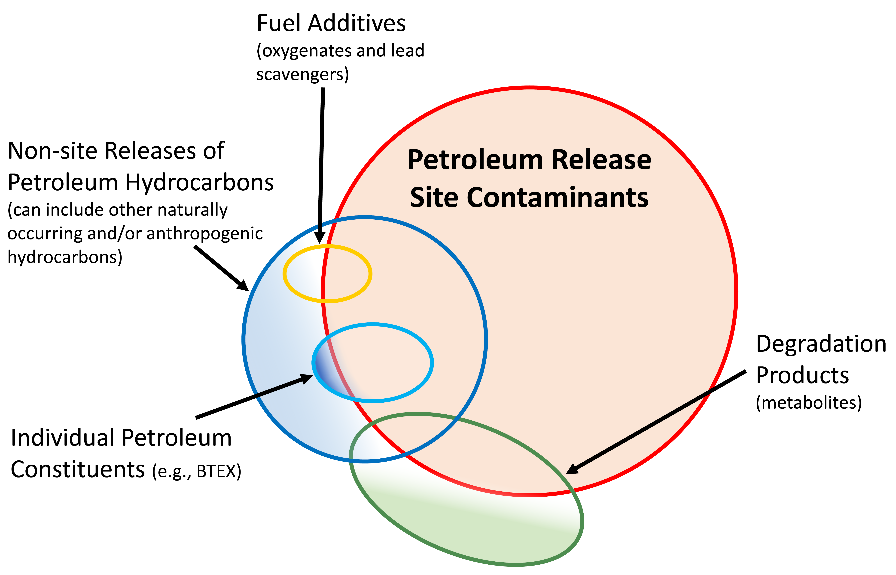
How will YOU evaluate TPH now?
What does your TPH site data really represent?
Have you considered the following:
Reviewing your chromatograms?
Fractionating your TPH results?
Using the silica gel cleanup method to understand the metabolite fraction? (USEPA Method 3630C)
ITRC TPHRisk-1 Figure 2-2
Notes:
Now that you have learned more about TPH, how will YOU evaluate and apply this into your projects in determining what your TPH data truly represents?
As we heard, TPH results depend on the analytical method used and include both aliphatics and aromatic compounds in an identified carbon range. So are you reviewing the chromatograms and determining fractionated compounds in your analyses currently?
In addition, did you select the appropriate TPH Analytical Methods based on your data quality objectives, including using:
total methods vs. fractionated methods
purgeable and extractable methods

Slide 91
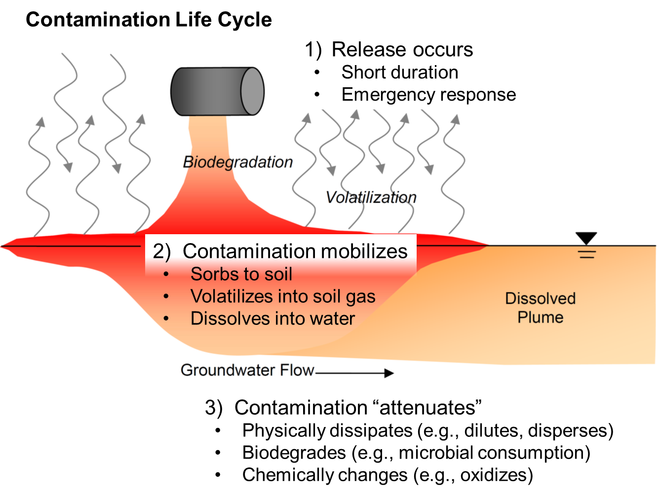
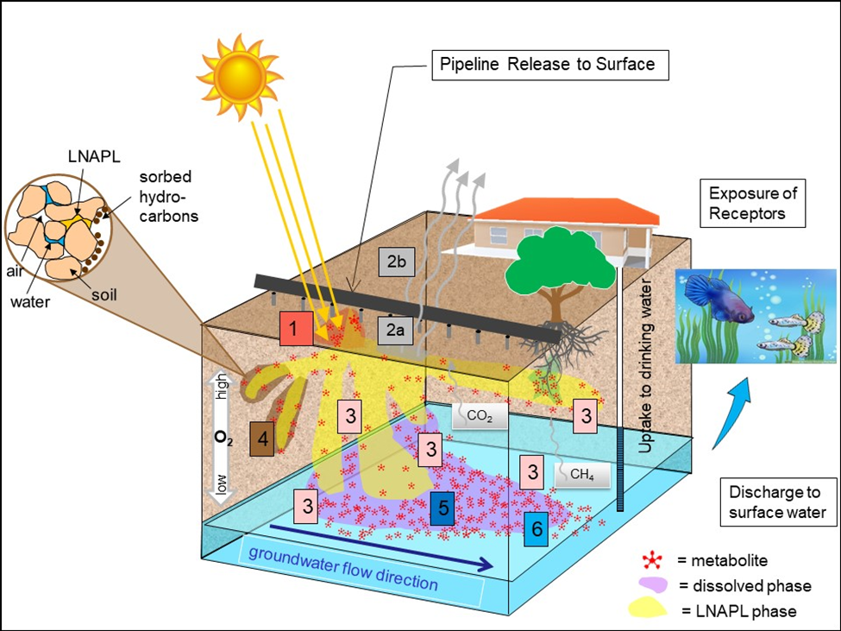
Is Your CSM Complete?
Are there data gaps or lifecycle considerations?
Did you modify the CSM to integrate TPH?
How do TPH metabolites affect your CSM?
Old bulk TPH data at re-opened sites?
Should you resample and update the CSM?
ITRC TPHRisk-1 Figures 6-1 & 4-9
Notes:
Now the next question you should be asking yourself is “Is my CSM complete?” Your CSM will be used to develop the site investigation strategy and should be updated throughout the risk evaluation, remediation, and closure life-cycle stages.
So there is value at looking through the data again at your sites and reevaluating whether the fate and transport considerations have been thoroughly addressed or have they changed (see picture below).
Is data over 25 yrs old keeping you up at night since they were using previous methods like EPA Method 418.1 or should you be giving the data another “real hard look”. Are these sites under institutional control or actually closed? Are they potentially going to reopen based on what we have discussed today?

Slide 92
Conceptual Site Model: Where is the Source Mass?
Case Study
Hydrocarbons and metabolites
Phase
Releases:
Gasoline AST
Diesel pipeline
Contamination extent defined using bulk TPH
NAPL (non-aqueous phase liquid)
Air/Vapor
Water
Sorbed
HIDOH Case Study #1, Figure 1-3 (HIDOH 2018)
Notes:
Speaker notes: Key Idea: The composition of TPH in a sample from any medium affects risk. It’s critical to understand how the composition in the vapor and dissolved plumes differ from the source zone due to partitioning and transformation processes.
Former Fuel Tank Farm CSM from the Hawai’i-hosted case studies for the guidance.
Releases of gasoline and diesel from an aboveground storage tank (AST) and a diesel pipeline abandoned in place.
The extent of contamination has been defined using bulk TPH analyses (e.g., TPH-gasoline, TPH-diesel, etc.)
Areas of gross contamination or presence of NAPL (residual or mobile). NAPL has reached the shallow groundwater table (5-10 feet bgs)
Shallow soil - pipeline
Subsurface soil/groundwater beneath the AST
Pathways and concerns are listed on the figure:
Direct exposure risk
Vapor intrusion risk (note: impacts are shallow)
Leaching to groundwater
Contaminated groundwater migration to aquatic habitats
Gross contamination (NAPL)
Pie Charts (animation) – These pie charts are intended to convey relative hydrocarbon mass (size of pie) and phase (oil/NAPL, vapor, water, sorbed)
Figure Source: HIDOH Case Study #1 Figure 1-3 with pie charts created by the Fate team. Relative proportions estimated.

Slide 93
Addressing Stakeholder Concerns
Seek to build trust and credibility with communities by addressing real and perceived TPH concerns:
Potential Health and Ecological Impacts
Assessment of indoor air and sub-slab vapors
See ITRC Vapor Intrusion Guidance
Aesthetic Criteria
State-specific nuisance ordinances
Especially odor, visual complaints
Potential property devaluation
Notes:
As Usha indicated earlier, stakeholder concerns should be considered and addressed appropriately, especially as they relate to the potential health and ecological impacts associated with these release sites. In order to address these concerns, an assessment of the site conditions such as indoor air and/or sub-slab vapor sampling should be determined to evaluate if there is a potential human health risk to the inhabitants of the associated on-site and/or off-site tenants, if there is a potential explosion hazard, etc.
In addition, are you considering the local State, County, and Cities’ nuisance ordinances, especially as it relates to odor and/or visual complaints?
There also may be an associated potential or perceived property devaluation with the subject property or adjacent properties – For example, an adjacent resident to a bulk terminal may be concerned with having the pollution migrate onto their property and is concerned that they cannot sell their property and as such they plan on either taking you or your client to court, etc.
And last but not least is building trust and credibility with the communities. We need to get over the death in the family syndrome, where we are hesitant to share any information with the public. So in order to build trust and credibility, we need to be transparent about the situation and not try to hide it (people can tell when not being truthful). Take time to explain the data in simple terms so that people can understand and state of the science and associated risk involved with it. Be willing to admit on what you don’t know if there is an absence of data.

Slide 94
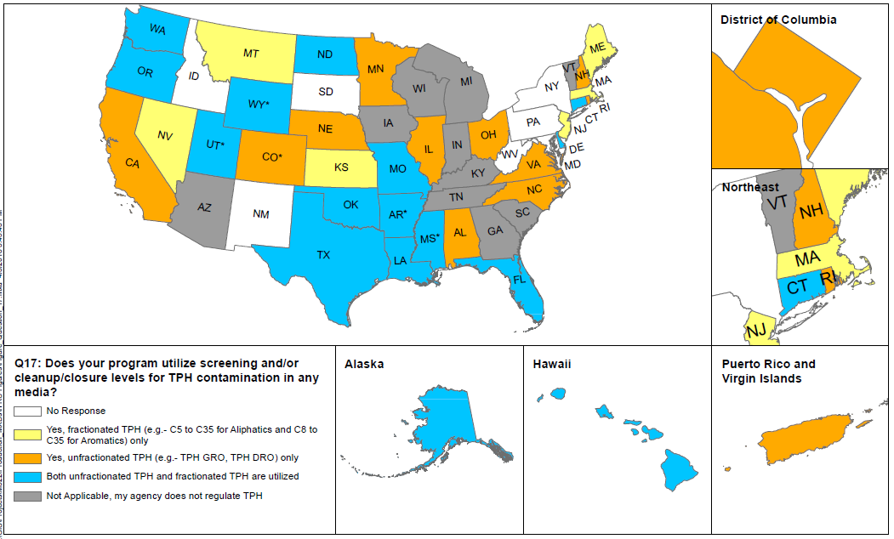
Use this Guidance!
Where can I find help?
On-line calculators (ITRC TPH Risk Chapter 8)
Examples of Case-Studies using TPH data (HI)
What are States currently doing with TPH data? (see “TPH State Survey – Screening and/or Cleanup Levels”)
ITRC TPHRisk-1 Figure Q17
Notes:
So the take home lesson for this presentation is that you should use this guidance!
There are an abundance of useful tools and resources associated within this document such as the on-line calculators, case study examples that may relate to your sites, and seeing what other states are doing currently to evaluate whether your state could benefit from this.
There are numerous benefits that ITRC offers to state regulators and technology developers, vendors, and consultants, which include:
Helping you build your knowledge base and raise your confidence about new environmental technologies
Helping you save time and money when evaluating environmental technologies
Guiding you in the collection of performance data to satisfy the requirements in multiple states
Helping you avoid the time and expense of conducting duplicative and costly demonstrations
Providing a reliable network among members of the environmental community to focus on innovative environmental technologies
How can you get involved with ITRC:
Join an ITRC Team – with just 10% of your time you can have a positive impact on the regulatory process and acceptance of innovative technologies and approaches
Sponsor ITRC’s technical team and other activities
Use ITRC products and attend training courses
Submit proposals for new technical teams and projects
Links to additional resources:
http://www.clu-in.org/conf/itrc/xxxx/resource.cfm
Your feedback is important – please fill out the form at:
http://www.clu-in.org/conf/itrc/xxxx/feedback.cfm

Slide 95

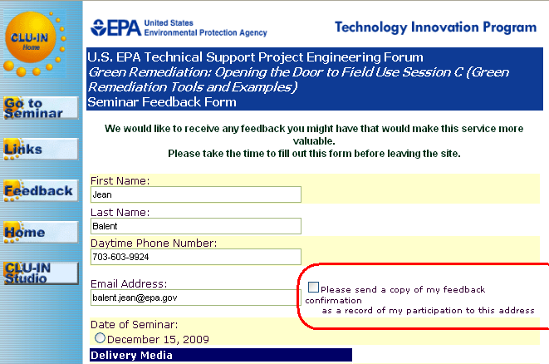

Thank You
Follow ITRC:
2nd question and answer break
Links to additional resources
http://www.clu-in.org/conf/itrc/TPHrisk/resource.cfm
Feedback form – please complete
http://www.clu-in.org/conf/itrc/TPHrisk/feedback.cfm
Poll Question
Need confirmation of your participation today?
Fill out the feedback form and check box for confirmation email and certificate.
Notes:
With that we would like to thank you for your time today in participating in the TPH Risk Evaluation at Petroleum-Contaminated Sites presentation and recommend that you look through the additional resources provided in the link below and also give us your feedback on the presentation. Now lets turn the time over to those that have any questions.

