Slide 1



Starting Soon: Issues and Options in Human Health Risk Assessment – A Resource When Alternatives to Default Parameters and Scenarios are Proposed
Decision Making at Contaminated Sites: Issues and Options in Human Health Risk Assessment (RISK-3, 2015) http://www.itrcweb.org/risk-3
Download PowerPoint file
  CLU-IN training page at
  http://www.clu-in.org/conf/itrc/risk3/
  Under “Download Training Materials”
Using Adobe Connect
  Related Links (on right)
    Select name of link
    Click “Browse To”
  Full Screen button near top of page
Poll Question
Follow ITRC
Notes:
Poll Questions as training class starts:
On projects with site-specific risk assessments, what topics have you encountered that were not covered in the guidance document that you usually use? (select all that apply)
Including institutional controls
Addressing data gaps
Choosing among toxicity values
Justifying site-specific exposure factors
Working with probabilistic risk assessment
None of the above
I have not worked on projects with site-specific risk assessments
What other topics have you encountered that were not covered in the guidance document that you usually use? (short answer)

Slide 2

Issues and Options in Human Health Risk Assessment – A Resource When Alternatives to Default Parameters and Scenarios are Proposed
Welcome – Thanks for joining
this ITRC Training Class
Sponsored by: Interstate Technology and Regulatory Council (www.itrcweb.org) Hosted by: US EPA Clean Up Information Network (www.cluin.org)
Notes:
Many state and local regulatory agencies responsible for the cleanup of chemicals released to the environment have adopted regulations, guidance and policies that define default approaches, scenarios, and parameters as a starting point for risk assessment and the development of risk-based screening values. Regulatory project managers and decision makers, however, may not have specific guidance when alternative approaches, scenarios, and parameters are proposed for site-specific risk assessments, and are faced with difficult technical issues when evaluating these site-specific risk assessments. This ITRC web-based document is a resource for project managers and decision makers to help evaluate alternatives to risk assessment default approaches, scenarios and parameters.
ITRC's Decision Making at Contaminated Sites: Issues and Options in Human Health Risk Assessment (RISK-3, 2015) guidance document is different from existing ITRC Risk Assessment guidance and other state and federal resources because it identifies commonly encountered issues and discusses options in risk assessment when applying site-specific alternatives to defaults. In addition, the document includes links to resources and tools that provide even more detailed information on the specific issues and potential options. The ITRC Risk Assessment Team believes that state regulatory agencies and other organizations can use the RISK-3 document as a resource or reference to supplement their existing guidance. Community members and other stakeholders also may find this document helpful in understanding and using risk assessment information.
After participating in this ITRC training course, the learner will be able to apply ITRC's Decision Making at Contaminated Sites: Issues and Options in Human Health Risk (RISK-3, 2015) document when developing or reviewing site-specific risk assessments by:
-- Identifying common issues encountered when alternatives to default parameters and scenarios are proposed during the planning, data evaluation, toxicity, exposure assessment, and risk characterization and providing possible options for addressing these issues
-- Recognizing the value of proper planning and the role of stakeholders in the development and review of risk assessments
-- Providing information (that includes links to additional resources and tools) to support decision making when alternatives to default approaches, scenarios and parameters are proposed
ITRC offers additional documents and training on risk management. ITRC's Use of Risk Assessment in Management of Contaminated Sites (RISK-2, 2008) and associated Internet-based training archive highlight variation of risk-based site management and describes how to improve the use of risk assessment for making better risk management decisions. ITRC's Examination of Risk-Based Screening Values and Approaches of Selected States (RISK-1, 2005) and associated Internet-based training archive focus on the process by which risk-based levels are derived in different states.
ITRC (Interstate Technology and Regulatory Council) www.itrcweb.org
Training Co-Sponsored by: US EPA Technology Innovation and Field Services Division (TIFSD) (www.clu-in.org)
ITRC Training Program: training@itrcweb.org; Phone: 402-201-2419

Slide 3
Housekeeping
Course time is 2¼ hours
This event is being recorded
Trainers control slides
  Want to control your own slides? You can download presentation file on Clu-in training page
Questions and feedback
  Throughout training:
  type in the “Q & A” box
  At Q&A breaks: unmute your phone with #6 to ask out loud
  At end of class: Feedback form available from last slide
    Need confirmation of your participation today? Fill out the feedback form and check box for confirmation email and certificate
Copyright 2019 Interstate Technology & Regulatory Council,
50 F Street, NW, Suite 350, Washington, DC 20001
Notes:
3
Although I’m sure that some of you are familiar with these rules from previous CLU-IN events, let’s run through them quickly for our new participants.
We have started the seminar with all phone lines muted to prevent background noise. Please keep your phone lines muted during the seminar to minimize disruption and background noise. During the question and answer break, press #6 to unmute your lines to ask a question (note: *6 to mute again). Also, please do NOT put this call on hold as this may bring unwanted background music over the lines and interrupt the seminar.
Use the “Q&A” box to ask questions, make comments, or report technical problems any time. For questions and comments provided out loud, please hold until the designated Q&A breaks.
Everyone – please complete the feedback form before you leave the training website. Link to feedback form is available on last slide.

Slide 4

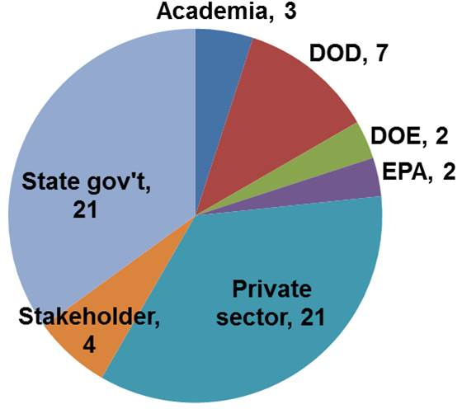
ITRC (www.itrcweb.org) – Shaping the Future of Regulatory Acceptance
Host organization
ITRC Risk Team
Disclaimer
  Full version in “Notes” section
  Partially funded by the U.S. government
    ITRC nor US government warranty material
    ITRC nor US government endorse specific products
ITRC materials available for your use – see usage policy
Available from www.itrcweb.org
  Technical and regulatory guidance documents
  Online and classroom training schedule
Notes:
The Interstate Technology and Regulatory Council (ITRC) is a state-led coalition of regulators, industry experts, citizen stakeholders, academia and federal partners that work to achieve regulatory acceptance of environmental technologies and innovative approaches. ITRC consists of all 50 states (and Puerto Rico and the District of Columbia) that work to break down barriers and reduce compliance costs, making it easier to use new technologies and helping states maximize resources. ITRC brings together a diverse mix of environmental experts and stakeholders from both the public and private sectors to broaden and deepen technical knowledge and advance the regulatory acceptance of environmental technologies. Together, we’re building the environmental community’s ability to expedite quality decision making while protecting human health and the environment. With our network of organizations and individuals throughout the environmental community, ITRC is a unique catalyst for dialogue between regulators and the regulated community.
For a state to be a member of ITRC their environmental agency must designate a State Point of Contact. To find out who your State POC is check out the “contacts” section at www.itrcweb.org. Also, click on “membership” to learn how you can become a member of an ITRC Technical Team.
Disclaimer: This material was prepared as an account of work sponsored by an agency of the United States Government. Neither the United States Government nor any agency thereof, nor any of their employees, makes any warranty, express or implied, or assumes any legal liability or responsibility for the accuracy, completeness, or usefulness of any information, apparatus, product, or process disclosed, or represents that its use would not infringe privately owned rights. Reference herein to any specific commercial product, process, or service by trade name, trademark, manufacturer, or otherwise does not necessarily constitute or imply its endorsement, recommendation, or favoring by the United States Government or any agency thereof. The views and opinions of authors expressed herein do not necessarily state or reflect those of the United States Government or any agency thereof and no official endorsement should be inferred.
The information provided in documents, training curricula, and other print or electronic materials created by the Interstate Technology and Regulatory Council (“ITRC” and such materials are referred to as “ITRC Materials”) is intended as a general reference to help regulators and others develop a consistent approach to their evaluation, regulatory approval, and deployment of environmental technologies. The information in ITRC Materials was formulated to be reliable and accurate. However, the information is provided "as is" and use of this information is at the users’ own risk.
ITRC Materials do not necessarily address all applicable health and safety risks and precautions with respect to particular materials, conditions, or procedures in specific applications of any technology. Consequently, ITRC recommends consulting applicable standards, laws, regulations, suppliers of materials, and material safety data sheets for information concerning safety and health risks and precautions and compliance with then-applicable laws and regulations. ITRC, ERIS and ECOS shall not be liable in the event of any conflict between information in ITRC Materials and such laws, regulations, and/or other ordinances. The content in ITRC Materials may be revised or withdrawn at any time without prior notice.
ITRC, ERIS, and ECOS make no representations or warranties, express or implied, with respect to information in ITRC Materials and specifically disclaim all warranties to the fullest extent permitted by law (including, but not limited to, merchantability or fitness for a particular purpose). ITRC, ERIS, and ECOS will not accept liability for damages of any kind that result from acting upon or using this information.
ITRC, ERIS, and ECOS do not endorse or recommend the use of specific technology or technology provider through ITRC Materials. Reference to technologies, products, or services offered by other parties does not constitute a guarantee by ITRC, ERIS, and ECOS of the quality or value of those technologies, products, or services. Information in ITRC Materials is for general reference only; it should not be construed as definitive guidance for any specific site and is not a substitute for consultation with qualified professional advisors.

Slide 5





Meet the ITRC Trainers
Diana Marquez
Burns & McDonnell
Kansas City, MO
816-822-3453
dmarque@burnsmcd.com
Kevin Long
Terraphase Engineering Inc.
Princeton, NJ
609-462-2855
kevin.long@terraphase.com
Barrie Selcoe
Jacobs
Houston, TX
281-246-4322
barrie.selcoe@jacobs.com
Emily Strake
Langan
Warrington, PA
215-491-6526
estrake@langan.com
Vivek Mathrani
California DTSC
Berkeley, CA
510-540-3737
Vivek.mathrani@dtsc.ca.gov
Read trainer bios at https://clu-in.org/conf/itrc/risk3/
Notes:
Diana Marquez is an Associate Toxicologist with Burns & McDonnell in Kansas City, MO and has worked for the company since June 1995. She serves as the company’s National Practice Leader for Risk Assessment Services. She has over twenty years of risk assessment experience and has worked with a wide variety of sites under CERCLA, RCRA, and state-led programs. She has successfully completed work nationwide for both human health risk assessments and the determination of site-specific cleanup levels. She has direct experience working with large PRP groups on complex sites that require careful negotiations with regulators. Through this experience, she has gained in-depth knowledge of state and federal regulations. She authored 15+ publications on risk assessment, risk-based corrective actions, and vapor intrusion. Diana earned a bachelor’s degree in biology from Villanova University in Villanova, PA in 1991 and a master’s degree in toxicology from University of New Mexico in Albuquerque, NM in 1992.
Barrie Selcoe is a Principal Technologist with Jacobs in Houston, Texas. Barrie has worked at Jacobs since 2018, specializing in human health risk assessment. She is responsible for planning and overseeing human health risk-based activities at hazardous waste sites across the U.S. and internationally. She utilizes numerous federal (USEPA and Department of Defense) and state guidance documents in risk assessment projects, and is involved in all stages of site planning, investigation and reporting, cleanup level identification, and remedial action planning. She has been involved in risk assessments in 40 states and about 20 countries. She has worked on risk assessments incorporating incremental sampling and site-specific bioaccessibility studies. She has provided risk assessment services for numerous Comprehensive Environmental Response, Compensation, and Liability Act (CERCLA)/Superfund sites, Resource Conservation and Recovery Act (RCRA) facilities, state-program sites, voluntary actions, and international projects. She has prepared risk assessments for various types of sites, including industrial and commercial facilities, industrial and municipal landfills, bulk fuel terminals, rivers, U.S. Department of Defense facilities, and residential areas. Prior to Jacobs (which purchased CH2M in 2018), she worked as a human health risk assessor for 19 years with CH2M, 7 years with Philip Environmental, and 3 years with O'Brien & Gere Engineers. Since 2012, Barrie has contributed as a team member on ITRC's Risk Assessment team, Bioavailability in Contaminated Soil team, TPH Risk Evaluation at Petroleum-Contaminated Sites team, and PFAS team. She earned a bachelor's degree in microbiology from San Diego State University in San Diego, California in 1986, and a Master's of Public Health from the University of Pittsburgh Graduate School of Public Health in Pittsburgh, Pennsylvania in 1999.
Vivek Mathrani has been a Staff Toxicologist in the Human and Ecological Risk Office at the California Department of Toxic Substances Control (DTSC) since January 2010. He works out of DTSC’s regional office in Berkeley, CA. He provides human health risk assessment and toxicology support to DTSC’s Brownfields and Environmental Restoration Program and Safer Consumer Products Program. Prior to DTSC, Vivek spent three years as an exposure assessor in the California Department of Pesticide Regulation’s Worker Health and Safety Branch. Vivek’s doctoral dissertation work dealt with inflammation signaling pathways and airway remodeling under inhalation of ozone and particulate matter. His past involvement with ITRC includes membership on the Environmental Molecular Diagnostics, Green and Sustainable Remediation, and Risk Assessment teams. Vivek earned his doctorate and master’s degrees in Pharmacology and Toxicology from the University of California, Davis in 2006. He earned a bachelor’s degree in Chemistry from the California Institute of Technology in Pasadena in 2000. Vivek also earned certification as a Diplomate of the American Board of Toxicology in 2010.
Kevin Long is a Principal Consultant in Terraphase’s Princeton, NJ office. Since 2000, he has applied risk assessment and risk management strategies to support site characterization, risk management, and redevelopment at hazardous waste and brownfield sites under Superfund, RCRA, and various state and provincial cleanup programs. Working on such projects, he has helped to control unacceptable human exposures at dozens of sites, including those that may pose an imminent and substantial danger to human health. Such projects have involved addressing contamination in all sorts of environmental media and, in many cases, have required complex exposure assessment, fate and transport modeling, statistical analysis, risk management design, and risk communication. He has been a member of the ITRC Risk Assessment team since 2012. Kevin earned a bachelor’s degree in 2000 and master’s degree in 2006, both in Civil and Environmental Engineering, from Princeton University in Princeton, NJ.
Emily Strake is a consultant with Langan Engineering and Environmental Services, Inc. in Warrington, Pennsylvania. She provides technical expertise in the areas of risk assessment and environmental chemistry. Since 2000, Emily has worked assessing chemical data and the potential adverse health effects to humans from exposure to hazardous contaminants in soil, sediment, groundwater, surface water, ambient and indoor air, and various types of animal, fish, and plant materials. She routinely applies environmental cleanup guidance and policies associated with multiple federal and state agencies, and has been the primary author or key contributor of risk assessment reports and screening evaluations for projects governed under USEPA RCRA and CERCLA, and state programs in California, Delaware, Pennsylvania, New Jersey, Connecticut, Oregon, New York and Maryland. Additionally, she has broad experience in the development of preliminary remediation goals and site-specific action levels, and has performed assessments to focus areas of investigation and identify risk-based alternatives for reducing remediation costs. She has been active in the ITRC Risk Assessment Team since 2012. Emily completed an undergraduate degree in chemistry in 2000 from Cedar Crest College in Allentown, PA and earned a Master’s of Business Administration in 2012 from The University of Scranton in Scranton, PA.

Slide 6
Poll Question – Knowledge and Experience
How much knowledge and experience do you have with risk assessments using site-specific values and parameters in place of default values and lookup tables?
  None – new to risk assessment
  Have used or reviewed site-specific parameters or exposure pathways in a limited way
  Have used or reviewed many site-specific parameters, approaches and processes in risk assessment
  Have used or reviewed site-specific risk assessment extensively
Poll Question
Notes:
No associated notes.

Slide 7
Why Develop Guidance
Use of risk assessment in decision making is widely accepted
Site-specific risk assessment can be complex
Decision makers are faced with technical issues when applying professional judgment
Models
Analysis
Data Quality
Exposure Parameters
Toxicity
Policy
Data Gaps
Decisions
Exposure Concentration
Framework
Exposure Area
Processes
Regulations
Default values
Professional Judgment
Exposure Media
Site Conceptual Exposure Model
Planning
Site-Specific
Engineering Controls
Institutional Controls
Notes:
No associated notes.

Slide 8
When working with risk assessments, do you have questions about…
Situations that don’t fit the default approach in guidance documents?
Equations and assumptions that you don’t recognize or aren’t in your guidance document?
Technical validity/defensibility of the calculations?
Notes:
No associated notes.

Slide 9
RISK-3
Not Your Typical Risk Guidance
Decision Making at Contaminated Sites: Issues and Options in Human Health Risk Assessment
Not a “how to” guide for risk assessments
Focuses on key technical issues
Provides “options” for resolving each issue
  Alternatives
  Recommendations
  Solutions
  Approaches
Notes:
No associated notes.

Slide 10
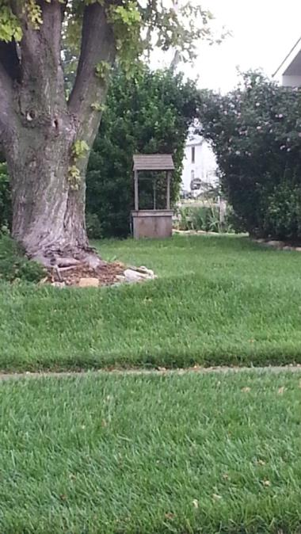
When Would I Use the RISK-3 Document?
Intended to address “non-standard” situations that might not be covered in guidance documents.
Example:
  Off-site groundwater receptors
Photo Source: D. Marquez, used with permission
Notes:
No associated notes.

Slide 11

How can the RISK-3 document help me?
If you are a project manager
  More informed consumer of risk assessment results
  Confidence to spot misapplications and mistakes
  Review selection of values
  Understand language of risk assessment
If you are a risk assessor
  Help make your work and conclusions understandable to a general audience
  Provide a one-stop reference for addressing technical issues
  Help make better decisions about alternatives or options for values and parameters in a risk assessment
Notes:
No associated notes.

Slide 12
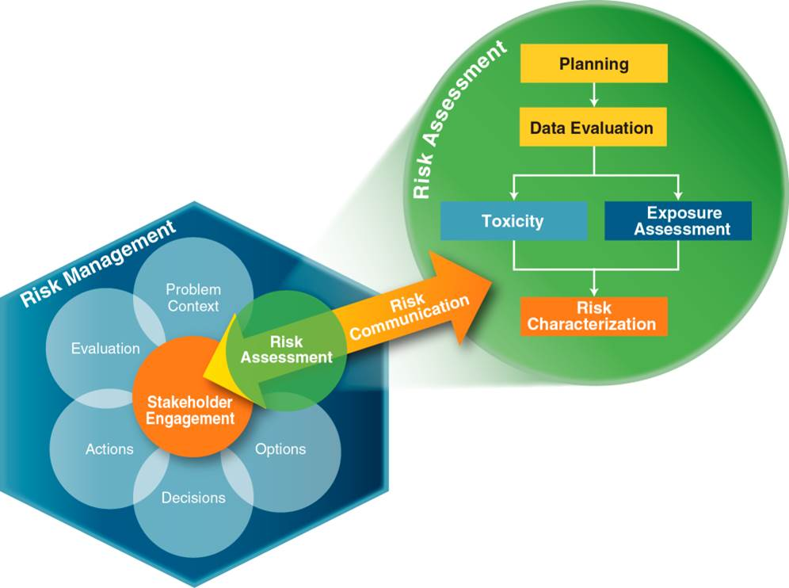
Presentation Overview
Overview of risk assessment in cleanup
Issues and options for the risk
assessment subject areas
How to use the web-based
document
Adapted from "Framework for Environmental Health Risk Management.” (Commission 1997)
Notes:
Figure Source: Adapted from Commission, Presidential/Congressional. 1997a. "Framework for Environmental Health Risk Management. Final Report, Volume 1." Washington, D.C.: The Presidential/Congressional Commission on Risk Assessment and Risk Management. http://www.riskworld.com/riskcommission/default.html.

Slide 13
What is Risk Assessment?
(Chapter 1)
Overview of risk assessment
Risk = Toxicity x Exposure
What is the risk to human health?
What chemicals and exposures are driving the risk?
What are the chemical’s health effects?
What is the relationship between exposure and health effects?
How will people contact the chemical?
What is the magnitude, frequency and duration of contact?
Notes:
No associated notes.

Slide 14
Use of Risk Assessment in
Site Cleanups (Chapter 2)
Tailor risk assessment to needs of project
  What is goal of the risk assessment?
  How complex is the site?
  Can goals be achieved using a screening level approach or is a site-specific risk assessment warranted?
What approach should be used?
  Baseline risk assessment
  Forward versus backward calculations
  Tiered approach
  Deterministic or probabilistic approaches
Notes:
No associated notes.

Slide 15
Baseline Risk Assessment
An analysis of the risks caused by a release in the absence of any actions to control or mitigate the exposure
Conducted to quantify potential risks posed by chemicals in environmental media and determine if these risks require action
ITRC RISK-3 Section 2.3
Notes:
No associated notes.

Slide 16

Forward vs Backward
Estimate Site Risks
Estimate Screening Levels
ITRC RISK-3 Section 2.1
Notes:
No associated notes.

Slide 17
Tiered Approach to Risk Assessment
Risk Assessment | Tier 1 | Tier 2 | Tier 3
Site-Specificity of Exposure Variables
Cost of the Risk Assessment | $$ | $$$ | $$$$
Uncertainty and Bias in Resulting Cleanup Levels
Cost of Remediation (often but not always) | $$$$ | $$$ | $$
ITRC RISK-3 Section 2.2
Notes:
No associated notes.

Slide 18
Deterministic or Probabilistic Risk Assessment
Deterministic
  Uses a single value for each input parameter
  Can use established default assumptions or site-specific information
  Single number result – simplifies decision making
Probabilistic
  Uses statistically derived distributions of input values to calculate a range of risk
  Supports a quantitative uncertainty analysis
  Range of results – better understand uncertainty
ITRC RISK-3 Section 2.4
Notes:
No associated notes.

Slide 19
Planning (Chapter 3)
Notes:
No associated notes.

Slide 20
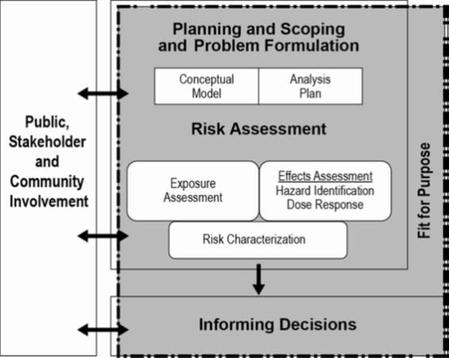
Overview of Chapter 3
Chapter organized around 3 general issues:
  Scoping and technical approach – “fit for purpose”
  Conceptual site model
  Data & information
Site-specific & thorough
Alternate approaches
  Not default
  Where allowed
Figure source: USEPA 2012. Draft Framework for Human Health Risk Assessment to inform Decision Making
Notes:
Figure source: USEPA. 2012c. Human Health Risk Assessment (Web Page), Science and Technology, EPA Risk Assessment. United States Environmental Protection Agency. http://www2.epa.gov/risk/human-health-risk-assessment

Slide 21

Poll Question – Identifying Appropriate Stakeholders
Have you worked on a project where stakeholders were engaged only AFTER the risk assessment was written, and addressing their concerns caused major risk assessment rewrites?
    Yes, almost every time
    Yes, a few times
    No
Poll Question
Notes:
No associated notes.

Slide 22
Identify Appropriate Resources
Issue: Identifying appropriate resources for the risk assessment
  Option – Engage all appropriate stakeholders during planning
Stakeholders
  People or agencies
  Indian Tribes and Native Americans
  Interested or affected
  Concerns, input, and insight
  More accepting of decisions when engaged
ITRC RISK-3 Section 3.1.1.3
Notes:
No associated notes.

Slide 23
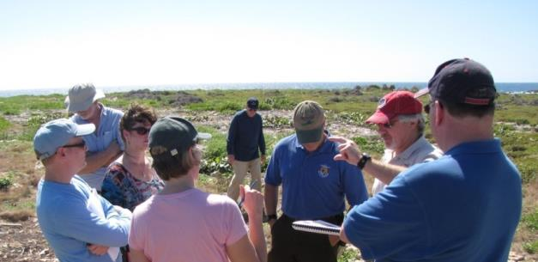
Communicate Throughout the Project
Issue: Communicating during the risk assessment planning & implementation process
  Option – Engage resources & other stakeholders early and throughout the process
Risk assessor input: investigation and risk assessment scope and approach, exposure scenarios, data needs, cleanup goals
ITRC RISK-3 Section 3.1.2.2
Photo Source: J. Martin, used with permission
Notes:
Example site in Puerto Rico.

Slide 24
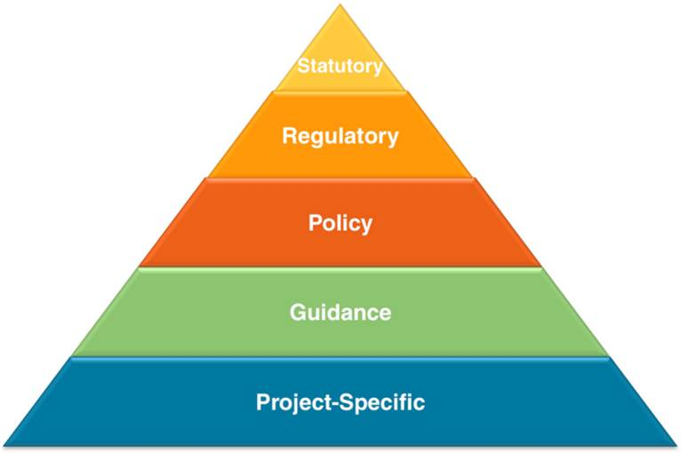
Identify the Regulatory Context
Issue: Identify the appropriate regulatory context
  Option – Establish the regulatory jurisdiction in which the site is located & lead agency
  Option – Understand the pertinent
  regulations, policies, and guidance
Regulatory program affects
  Scope
  Assumptions
  Interpretation
Figure 3-1. Regulatory context hierarchy
ITRC RISK-3 Section 3.1.3
Notes:
Figure 3-1. Regulatory context hierarchy

Slide 25
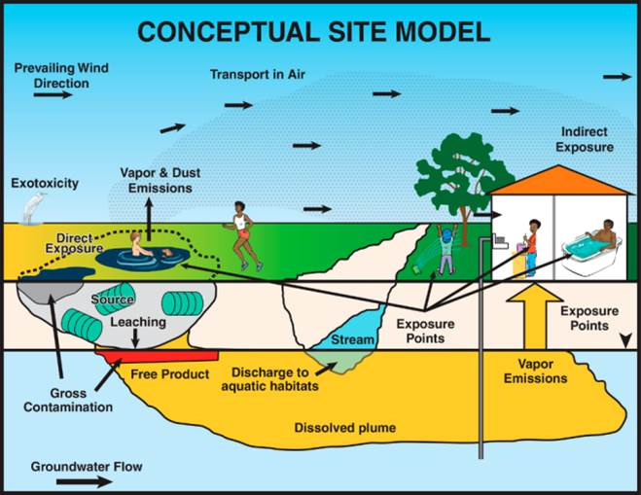
Use a Site-Specific CSM
Issue: What if you have a generic or inadequate conceptual site model (CSM)?
  Option – Prepare a site-specific CSM during planning & refine throughout the project
Planning tool for data needs
  Media
  Locations
  Depths
Update iteratively
  Exposure scenarios
  Exposure points
  Receptors
ITRC RISK-3 Section 3.2.1
Figure Source: ITRC 2012 ISM-1
Notes:
Figure Source: ITRC. 2012 Incremental Sampling Methodology. ISM-1. Washington, D.C.: Interstate Technology & Regulatory Council. http://www.itrcweb.org/Ism-1/Executive_Summary.html.

Slide 26

Poll Question – Institutional Controls and Engineering Controls
Have you reviewed a risk assessment where institutional controls (ICs) or engineering controls (ECs) were incorporated into the risk assessment?
    Yes – ICs only
    Yes – ECs only
    Yes – both ICs and ECs
    No
  Example ICs: legal restrictions preventing digging, groundwater use, or residential land use
  Example ECs: soil vapor barrier, concrete barrier, clean fill cover
Poll Question
Notes:
Many states and programs have guidance on this issue; be aware of applicable guidance.

Slide 27
Incorporating ICs, ECs, or Remedial Action May be Useful
Issue: Determining whether to include ICs, ECs, or planned remedial action in the CSM
  Option – Incorporate ICs or ECs
Typical baseline risk assessment – no further action
Discuss during planning; if allowed, incorporate to evaluate:
  Risk under land use control (for example, industrial)
  Residual risk outside excavation
Other ITRC documents:
  An Overview of Land Use Control Management Systems (ITRC BRNFLD-3, 2008) – see http://www.itrcweb.org/GuidanceDocuments/BRNFLD-3.pdf
  Long Term Contaminant Management Using ICs (ITRC IC-1, 2016) – see http://institutionalcontrols.itrcweb.org
ITRC RISK-3 Section 3.2.3.1
Notes:
Former ITRC teams prepared guidance documents titled “An Overview of Land Use Control Management Systems” in 2008 and “Long Term Contaminant Management Using Institutional Controls” – on ITRC website.

Slide 28
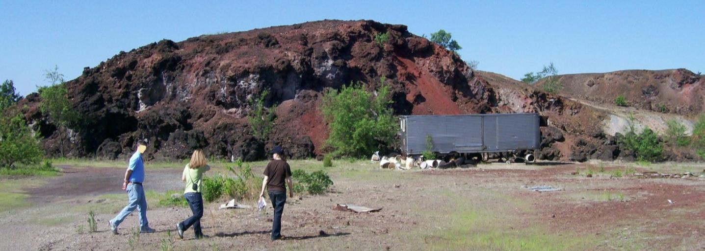
Example – IC Incorporated into CSM
Former industrial facility; metal waste residue piles
Planning stage - incorporate ICs
  Current site zoning & reasonably foreseeable site use
  Residential use unlikely
ITRC RISK-3 Section 3.2.3.1
Photo Source: B. Selcoe, used with permission
Notes:
Example site in Illinois.

Slide 29
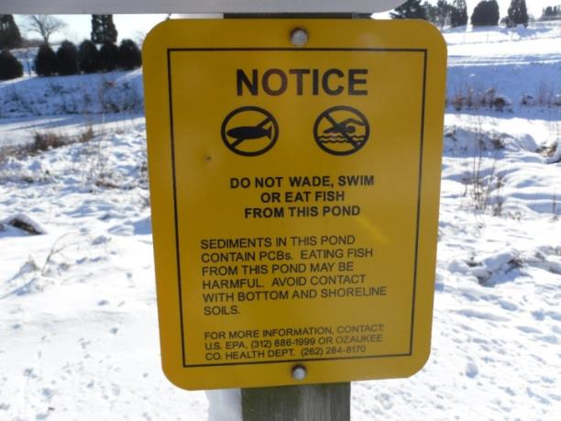
Example – IC Not Incorporated into CSM
Pond sediments impacted by PCBs
IC = agencies prohibit wading, swimming, fishing
Planning stage – do not consider ICs
Risk assessment will assess scenarios and need for ICs (might modify based on risk assessment results)
ITRC RISK-3 Section 3.2.3.2
Photo Source: B. Selcoe, used with permission
Notes:
Example site in Wisconsin.

Slide 30

The Amount of Data Needed for Risk Assessment Varies by Site
Issue: Determining the adequacy of data & information for the risk assessment
  Option – Incorporate risk assessment data needs during project planning
Consider:
  Media
  Concentration ranges
  Number of samples
  Proximity to sources
  Analytes & detection limits
  Age of data
ITRC RISK-3 Section 3.3.1.1
Notes:
No associated notes.

Slide 31
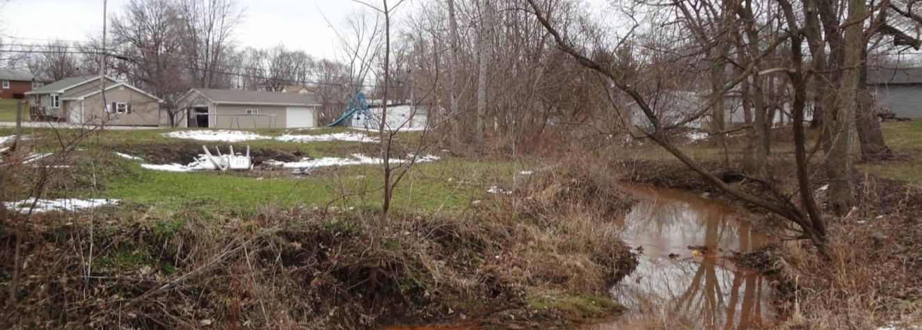
Example - Data Needs Evaluated During Project Planning
Impacted creek downstream from a former smelter
Planning stage – site visit with PMs & risk assessors; sediment deposition areas, proximity to receptors, accessibility, play areas, edible-size fish
Used to develop data needs
ITRC RISK-3 Section 3.3.1.1
Photo Source: B. Selcoe, used with permission
Notes:
Example site in Illinois.

Slide 32
Many More Issues Addressed in Chapter 3
Data and information (Section 3.3)
  Assessing hot spots
  Determining whether the data set is representative of the exposure areas
  Recognizing biases in the data set that will affect risk estimates
  Selecting analytical parameters
  Addressing background concentrations in the risk assessment
Notes:
No associated notes.

Slide 33
Data Evaluation (Chapter 4)
Notes:
No associated notes.

Slide 34


Overview of Chapter 4
Chapter organized around 5 general issues:
  Data gaps
  Data usability
  Data reduction concerns
  Data visualization and analysis
  Data screening and chemical selection process
Alternate approaches (not default, where allowed)
Notes:
No associated notes.

Slide 35
Identify Which Data Gaps Should be Filled
Issue: Identifying & filling data gaps
  Option – Determine if additional data changes the risk assessment results
  Option – Collect additional data to address the gap
Uncertainty inherent in all sampling & risk assessment efforts
  Not all data gaps are significant
  Significant when insufficient for evaluating exposure and risk
ITRC RISK-3 Section 4.1.1
Notes:
No associated notes.

Slide 36
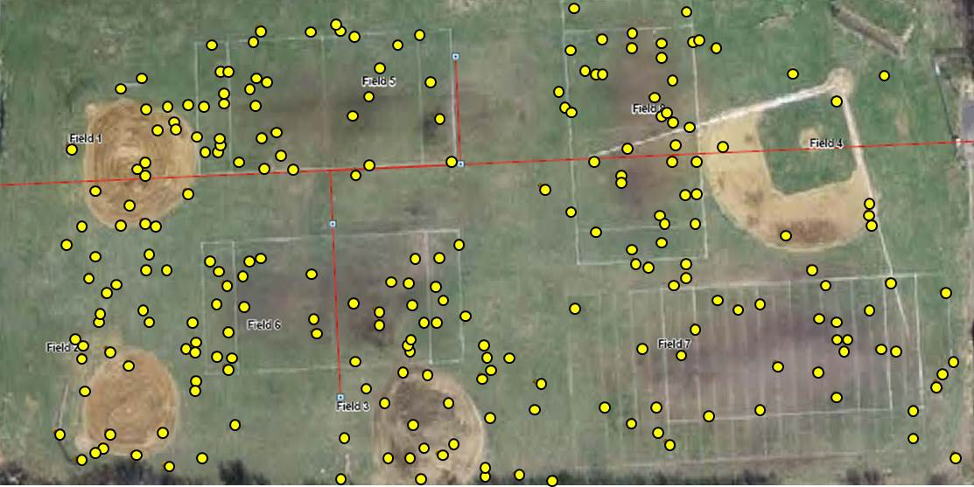
Example – Not all Data Gaps are Significant
Impacted soil from adjacent industrial site
Planning stage – site layout; incremental & discrete sampling
“Data gaps” near center but concentration gradient from source
Data near site center would not change conclusions
= sampling location
Photo Source: CH2M Hill, used with permission
Notes:
No associated notes.

Slide 37
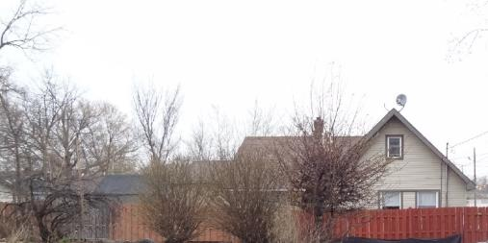
Sometimes Data Gaps Cannot be Filled
Issue: Addressing permanent data gaps
  Option – Assume the concentrations present
Potential approaches
  Estimate concentrations
  Surrogate exposure area
  Professional judgment from similar sites
  Conservative risk management decision
ITRC RISK-3 Section 4.1.2
Photo Source: B. Selcoe, used with permission
Notes:
No associated notes.

Slide 38

Visualize Site Data for Better Understanding
Issue: Accurately displaying & visualizing data
  Option – Use common data visualization tools, considering the limitations of the tool
Can reveal site-specific data patterns not portrayed by tables.
Project needs may warrant multiple tools
Various data visualization tools discussed; pros/cons – see guidance
2 examples:
  Probability Plots
  2-dimensional maps
ITRC RISK-3 Section 4.4.1
Notes:
No associated notes.

Slide 39
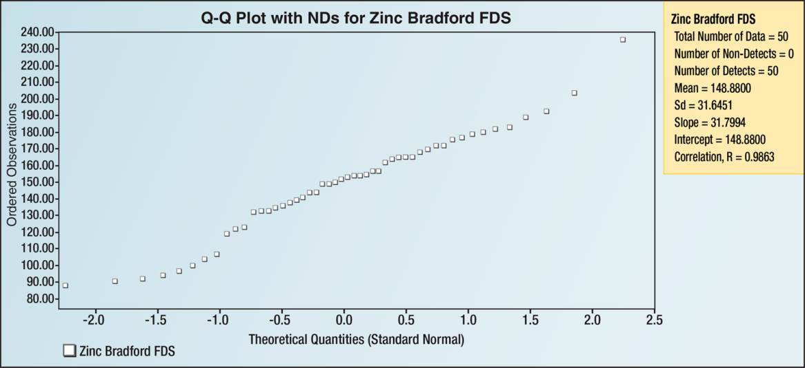
Probability Plots Reveal Distribution & Outliers
Probability plot (quantile plot)
USEPA’s ProUCL software
Pros: Provides data distribution type & statistical outliers
Cons: No concentration locations or temporal information
Figure 4-3.
Q-plot example developed using USEPA’s ProUCL statistical software package
ITRC RISK-3 Section 4.4.1
Data Source: Bradford et al 1996 and Solt 2010
Notes:
Figure 4-3 from the RISK-3 document Data Source: from
Bradford, G.R., A.C. Change, A.L. Page, D. Bakhtar, J.A. Frampton, and H. Wright. 1996. "Background Concentrations of Trace Metals and Major Elements in California Soils." Kearny Foundation of Soil Science, Division of Agriculture and Natural Resources, University of California.
Solt, M.J. 2010. Multivariate Analysis of Lead in Urban Soil in Sacramento, CA, California State University, Sacramento.
Q-plot example developed using USEPA’s ProUCL statistical software package.
See the ITRC GSMC-1 document for information about ProUCL www.itrcweb.org/gsmc-1, Appendix D.14

Slide 40
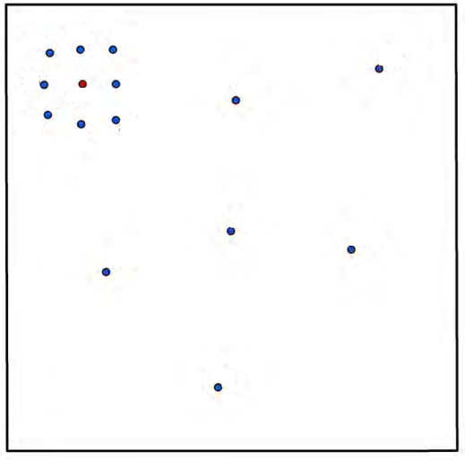
2-D Maps Reveal Spatial Distribution
2-D map
Pros: Provides spatial distribution of concentrations and location of highest detected concentration
Cons: No temporal information
5
10
50
0.5
25
100
75
5
10
5
80
4
0.3
Figure 6-10. Hypothetical exposure area with clustered data.
10
1
= sampling location
ITRC RISK-3 Section 4.4.1
Notes:
Figure 6-10. Hypothetical exposure area with clustered data.

Slide 41
Select Conservative Screening Levels for Site Exposures
Issue: Identifying appropriate screening levels
  Option – Select applicable screening values consistent with the CSM and regulatory framework
Screening levels
  Conservative for site scenarios
  Identify chemicals for further evaluation
  Vary based on assumptions, risk targets, background
  Are not cleanup levels
Plan for changes in screening levels
  Values may change
  Exposure scenarios may change
ITRC RISK-3 Section 4.5.1
Notes:
No associated notes.

Slide 42
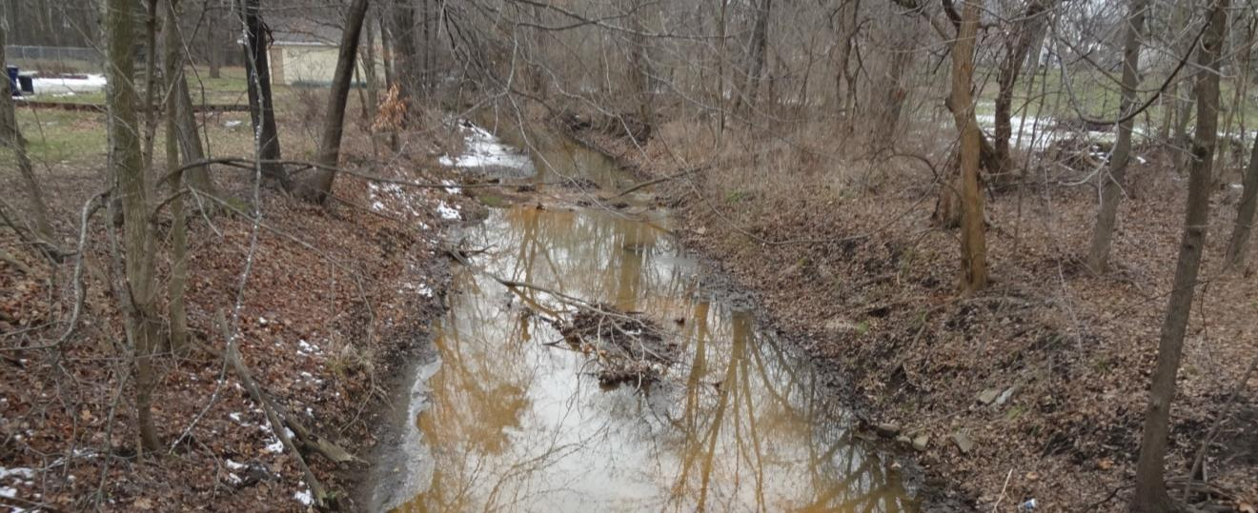
Example – Screening Levels (SLs) are Conservative for the CSM
Shallow creek in residential area; no edible-size fish
Exposure scenario – wading
Sediment - residential soil SLs
Surface water – drinking water SLs
ITRC RISK-3 Section 4.5.1.1
Photo Source: B. Selcoe, used with permission
Notes:
Example site in Illinois.

Slide 43
Many More Issues Addressed in Chapter 4
Data Usability (Section 4.2)
  Measurement units
  Data representativeness
Data Reduction Concerns (Section 4.3)
  Duplicate samples
  Pooling data
  Non-detects
Data Screening and Chemical Selection Processes (Section 4.5)
  Chemicals with missing screening values
  Consideration of background
Notes:
No associated notes.

Slide 44
Toxicity (Chapter 5)
Notes:
No associated notes.

Slide 45
Toxicity Assessment Overview
Risk = Toxicity x Exposure
What are the chemical’s health effects?
What is the relationship between exposure and health effects?
How will people contact the chemical?
What is the magnitude, frequency and duration of contact?
Notes:
No associated notes.

Slide 46
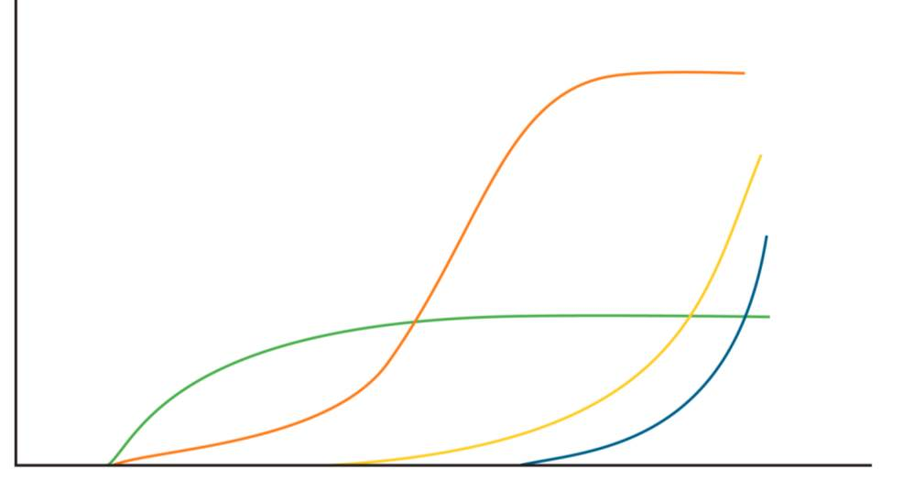
Dose Response
Relationship between the exposure and health effects
% Response
Dose or Concentration
ITRC RISK-3 Appendix B
Source: NCEA, USEPA 2010
Notes:
USEPA. 2010. "Overview of IRIS Human Health Effect Reference and Risk Values." Reading Packet HBA 202. Basics of Human Health Risk Assessment (HBA) Course Series. Washington, D.C.: United States Environmental Protection Agency.
NCEA - National Center for Environmental Assessment (www.epa.gov/ncea)

Slide 47
Toxicity Issues Encountered
Toxicity values may be selected from multiple sources
    e.g. tetrachloroethylene
Toxicity values are reassessed and updated
    e.g. trichloroethylene
A toxicity value may not be adopted nor established
    e.g. TPH
 | SF_{O} | IUR | RfD_{o} | RfC_{i}
Contaminant | (mg/kg-day)⁻¹ | (mg/m³)⁻¹ | mg/kg-day | mg/m³
Tetrachloroethylene | 2.1E-03 | 2.6E-07 | 6.0E-03 | 4.0E-02
Trichloroethylene | 4.6E-02 | 4.1E-06 | 5.0E-04 | 2.0E-03
Total Petroleum Hydrocarbons (Aromatic Low) |  |  | 4.0E-03 | 3.0E-02
USEPA Regional Screening Levels Table excerpt.
Notes:
USEPA. 2015. USEPA Regional Screening Levels (RSL) Table.
USEPA. 2014e. USEPA Regional Screening Levels (RSL) User's Guide (November 2014) and Generic Tables. http://www2.epa.gov/risk/regional-screening-table-users-guide-june-2015

Slide 48
Sources of Toxicity Values
Issue: Choosing among toxicity values from multiple sources
  Adequate protection of human health?
  Acceptance of assessment by regulatory agency?
ITRC RISK-3 Section 5.1.1
Notes:
No associated notes.

Slide 49
Sources of Toxicity Values
Options:
  2003 USEPA guidance
    Tier 1 – USEPA’s Integrated Risk Information System
    Tier 2 – USEPA’s Provisional Peer Reviewed Toxicity Values
    Tier 3 – Other Sources – additional USEPA and non-USEPA sources, including toxicity values prepared by states and other agencies
  Use USEPA guidance supplemented with 2007 Environmental Council of the States (ECOS) guidance
  Use state agency toxicity values or hierarchy
    For PCE, California did not adopt 2012 revised, less stringent IRIS values
  Consult experts in toxicology
ITRC RISK-3 Appendix A
Notes:
No associated notes.

Slide 50
Poll Question – Updated Toxicity Values
Do you use EPA’s hierarchy of toxicity values in your risk assessments?
  Yes, always
  No, we have another method
  It depends
  Don’t know
Poll Question
Notes:
No associated notes.

Slide 51
Updated Toxicity Values
Issue: Change in toxicity value (e.g. trichloroethylene)
  U.S. EPA TCE RfC = Accelerated Response Action Level (RAL)
  10⁻⁵ Lifetime Cancer Risk is >2x RAL
  New decision criterion for vapor intrusion risk management
Noncancer Toxicity Value | State of CA (2009) | U.S. EPA (2011) | Relative Protectiveness
Reference Concentration (RfC; μg/m³) | 600 | 2 | 300-fold
Notes:
No associated notes.

Slide 52
Toxicity Value Unavailable
Issue: Toxicity value is not readily available
    e.g. perfluoroalkylated substances
Options:
  Determine if the value is needed to guide risk management decision
    Is the contaminant co-located with another hazard?
    Is the exposure pathway significant?
ITRC RISK-3 Section 5.1.2
Notes:
No associated notes.

Slide 53
Toxicity Value Unavailable
Options: (continued)
  Use a surrogate value intended for
    Different time frame (e.g. subchronic for chronic) or
    Exposure route (e.g. oral for inhalation)
  Superfund Health Risk Technical Support Center
    Identify a value and develop a PPRTV
    Identify a surrogate chemical
      for example, Benzene for low-range aromatic TPH
    (513) 569-7300
    http://www.epa.gov/superfund/health/research.htm
Notes:
No associated notes.

Slide 54
Additional Toxicity Issues in
Chapter 5
Assessing toxicity of chemical groups and mixtures
Assessing toxicity of mutagenic carcinogens
Addressing toxicity of lead
Understanding uncertainty in toxicity values
Notes:
No associated notes.

Slide 55
Questions & Answers
Follow ITRC
Notes:
No associated notes.

Slide 56
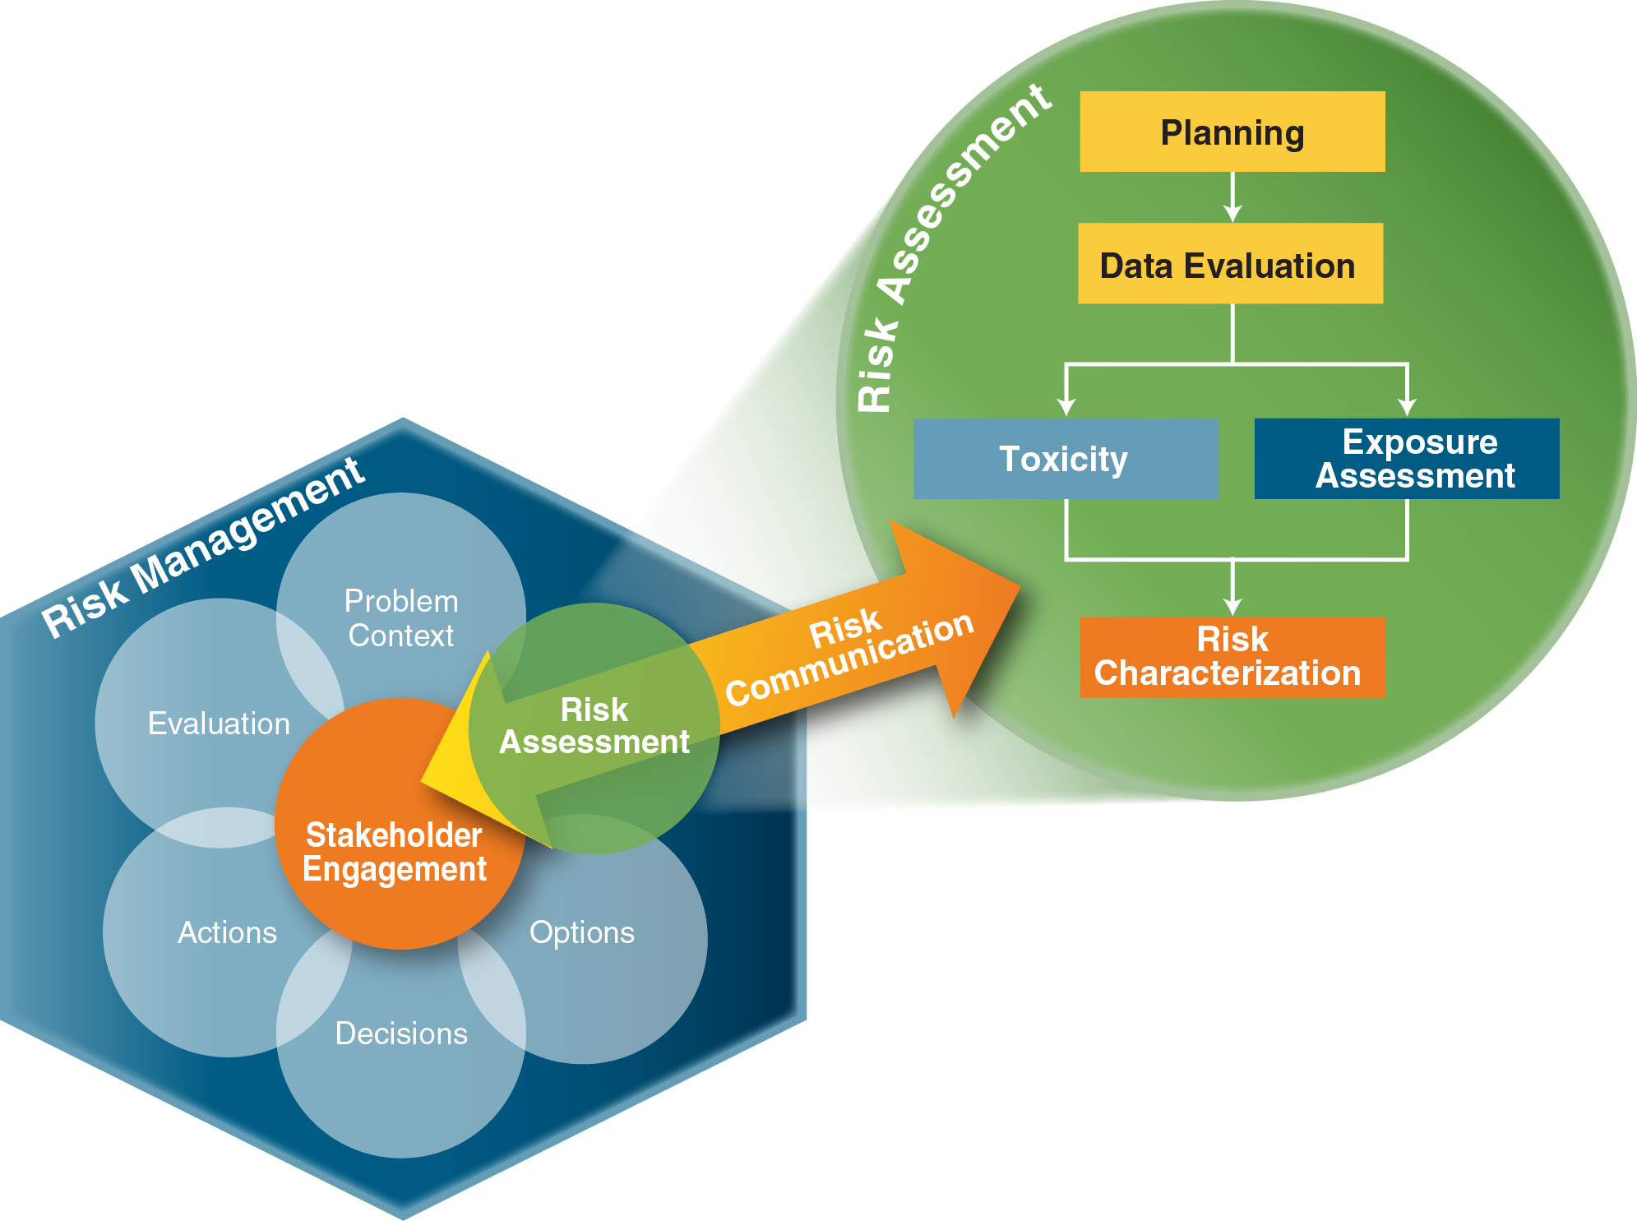
Exposure Assessment (Chapter 6)
Notes:
No associated notes.

Slide 57
Exposure Assessment Overview (Chapter 6)
What are the chemical’s health effects?
What is the relationship between exposure and health effects?
How will people contact the chemical?
What is the magnitude, frequency and duration of contact?
Notes:
No associated notes.

Slide 58
Exposure Assessment Overview (Chapter 6)
Issues
  Justifying site-specific exposure factors
  Prorating exposure factors
  Bioavailability
  Exposure areas vs. exposure patterns
  Exposure concentrations (modeling vs. measuring)
  Modeling (for example, accounting for limited mass)
  Uncertainty in estimating exposure concentrations
  Site-specific exposure vs. background exposure
Notes:
No associated notes.

Slide 59
Exposure Areas/Exposure Units
Issue: Exposure areas often not representative of actual exposure patterns
  Based on default exposure areas
  Based on operational units or areas of concern
ITRC RISK-3 Section 6.2.1
Notes:
No associated notes.

Slide 60
Poll Question – Exposure Area Basis
Have you ever prepared or reviewed a risk assessment in which the area or unit of exposure was arbitrary?
    Yes
    No
Poll Question
Notes:
No associated notes.

Slide 61
Exposure Areas/Exposure Units
Issue: Exposure areas often not representative of actual exposure patterns
  Based on default exposure areas
  Based on operational units or areas of concern
Receptor Activity
+
Exposure Media
Exposure Area/Unit
Notes:
No associated notes.

Slide 62

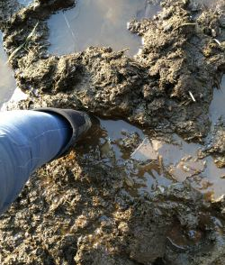
Exposure Areas/Exposure Units
Different receptors will have different activity patterns and thus different exposure areas
Notes:
No associated notes.

Slide 63
Exposure Areas/Exposure Units
Different receptors will have different activity patterns and thus different exposure areas
Consistency between estimates of the exposure concentrations and the exposure patterns of the receptor(s) being evaluated
Risk assessment may not adequately answer the site-specific risk management questions
Notes:
No associated notes.

Slide 64
Exposure Areas/Exposure Units
Issue: Exposure areas often not representative of actual exposure patterns
  Option – Establish exposure areas based on known or anticipated uses
ITRC RISK-3 Section 6.2.1.1
Notes:
No associated notes.

Slide 65
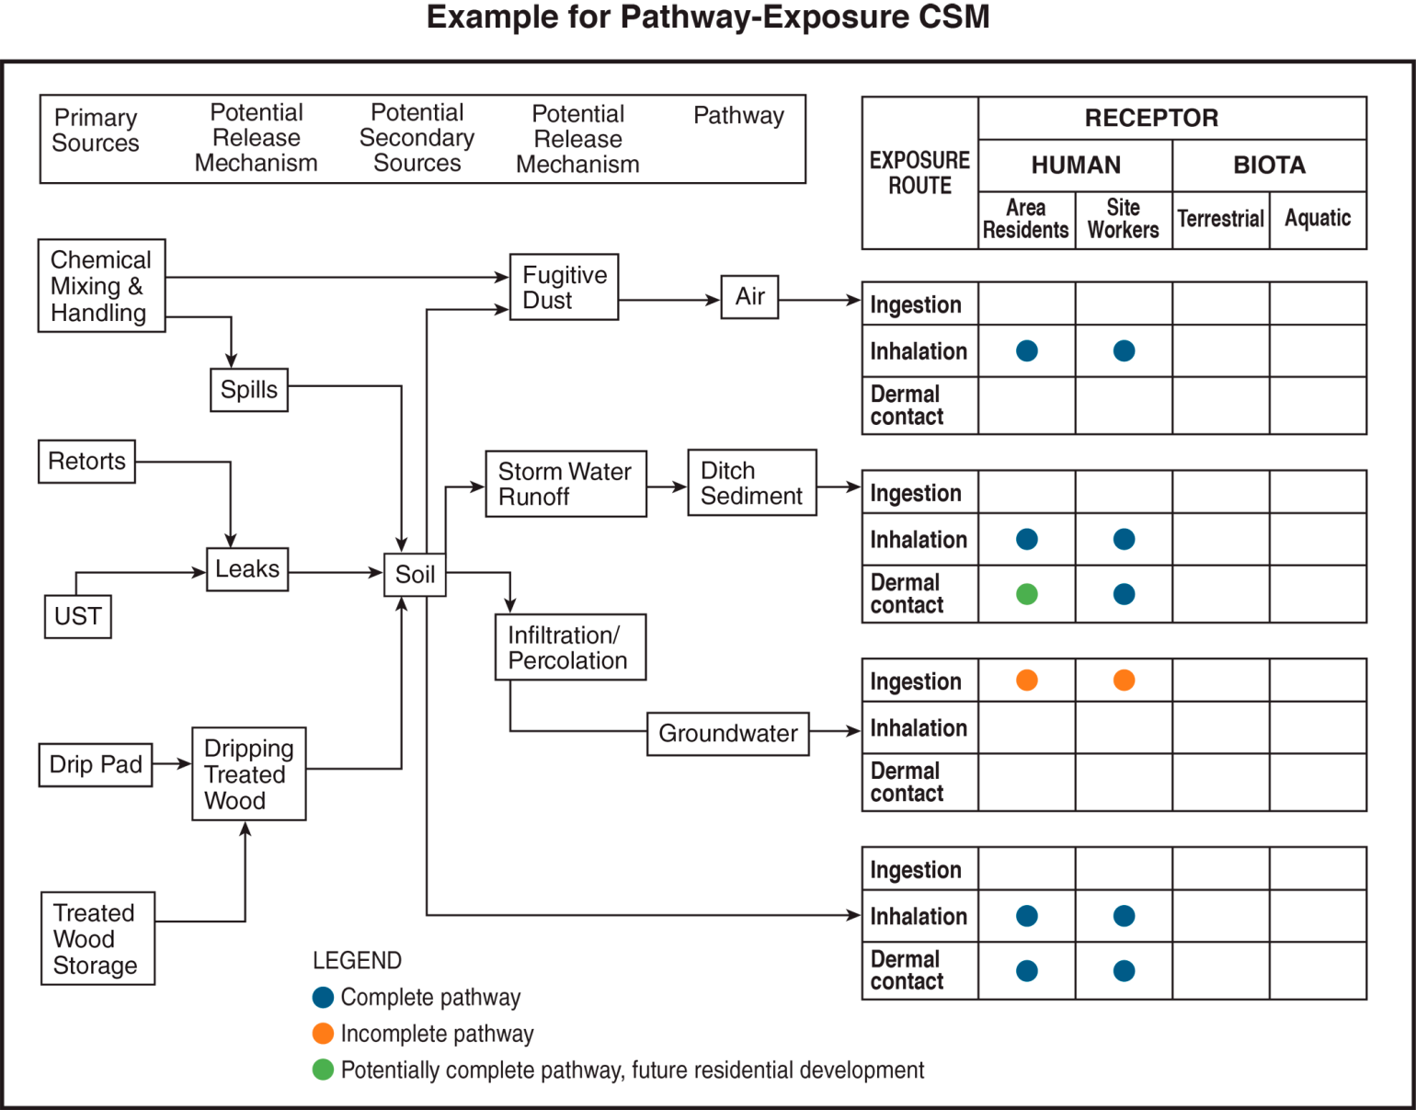
Exposure Areas/Exposure Units
Establish Exposure Areas Based on Known or Anticipated Uses
Conceptual Model for Potential Human Exposure
Figure Source
DTSC 2008
Notes:
Figure source: DTSC. 2008. Proven Technologies and Remedies Guidance – Remediation of Metals in Soil. Sacramento, CA: California Environmental Protection Agency, Department of Toxic Substances Control. http://www.dtsc.ca.gov/PublicationsForms/upload/Guidance_Remediation-Soils.pdf.

Slide 66
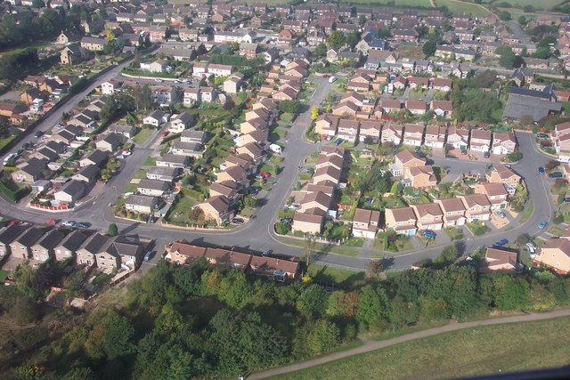
Exposure Areas/Exposure Units
Establish Exposure Areas Based on Known or Anticipated Uses
Notes:
No associated notes.

Slide 67
Exposure Areas/Exposure Units
Issue: Exposure areas often not representative of actual exposure patterns
  Option – Point-by-point risk calculations
ITRC RISK-3 Section 6.2.1.2
Notes:
No associated notes.

Slide 68
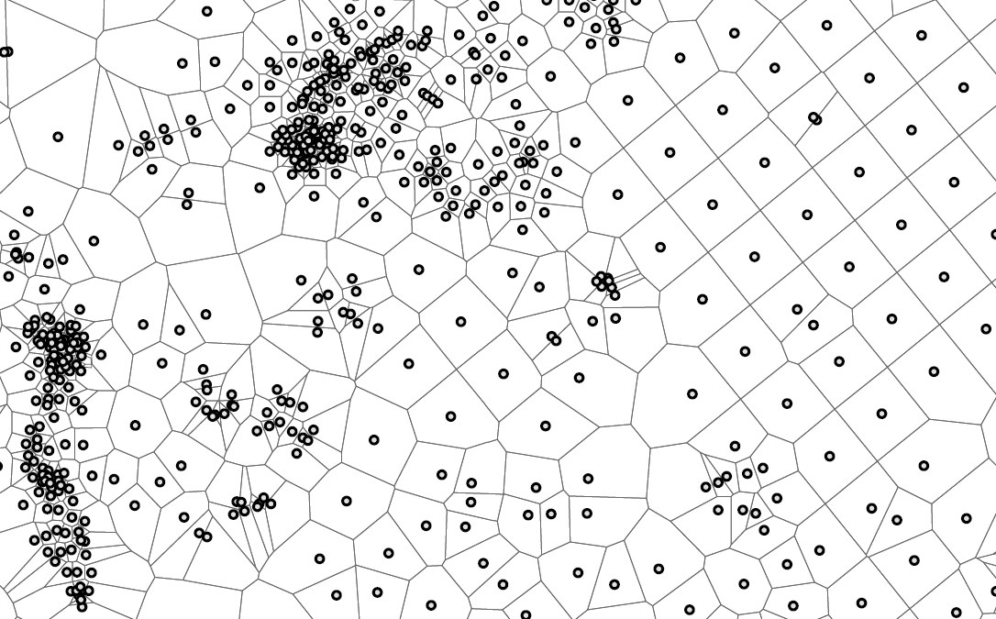

Exposure Areas/Exposure Units
Point-By-Point Risk Calculations
Soil Sample Location
Soil Sub-Area Polygons
Figure 6-7. Soil sampling locations as individual exposure areas (represented by Thiessen polygons).
Notes:
Figure 6-7. Soil sampling locations as individual exposure areas (represented by Thiessen polygons).

Slide 69
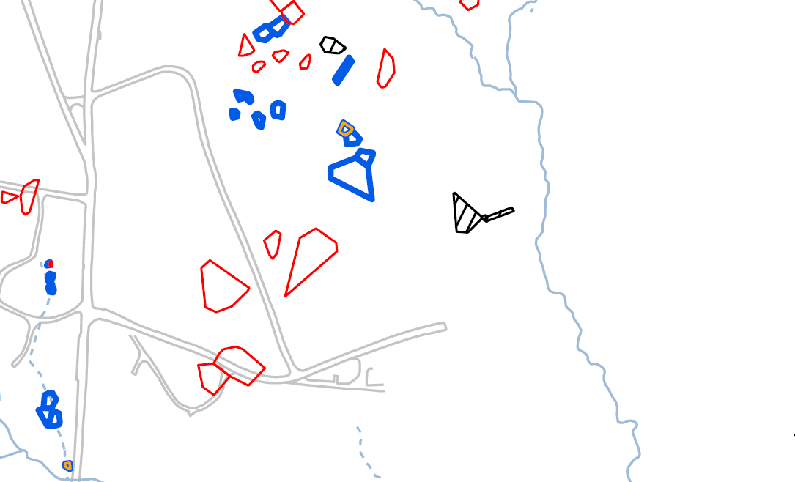
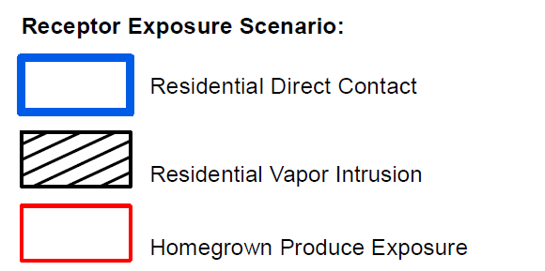
Exposure Areas/Exposure Units
Point-By-Point Risk Calculations
Potential Exposure Area
Example: 0.25 acres
Receptor Exposure Scenario:
Residential Direct Contact
Residential Vapor Intrusion
Homegrown Produce Exposure
Figure 6-8. Locations potentially warranting further assessment or risk management.
Notes:
Figure 6-8. Locations potentially warranting further assessment or risk management.

Slide 70
Exposure Factors
Issue: Justifying site-specific exposure factors
  Exposure not routinely encountered
  Default exposure factors not been established
ITRC RISK-3 Section 6.1.1
Notes:
No associated notes.

Slide 71
Poll Question – Default exposure factors not available
Have you ever prepared or reviewed a risk assessment which involved the evaluation of exposures for which default exposure factors were not available?
    Yes
    No
Poll Question
Notes:
No associated notes.

Slide 72
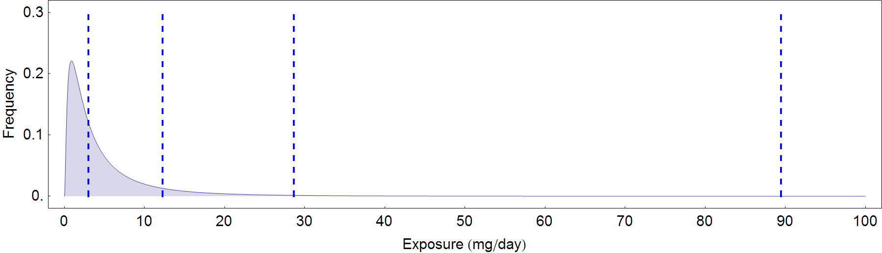
Exposure Factors
Issue: Justifying site-specific exposure factors
  Option – Probabilistic exposure assessment
50th
90th
98th
99.9th
ITRC RISK-3 Section 6.1.1.3
Notes:
No associated notes.

Slide 73

Exposure Factors
Issue: Justifying site-specific exposure factors
Dose = mg chemical per kg body weight per day
C = contaminant concentration (mg/L)
IR = intake rate (L/day)
EF = exposure frequency (days/year)
ED = exposure duration (years)
BW = body weight (kg)
AT = averaging time (days)
Notes:
No associated notes.

Slide 74
Exposure Factors
Justifying Using Probabilistic Exposure Assessment
Dose = mg chemical per kg body weight per day
C = contaminant concentration (mg/L)
IR = intake rate (L/day)
EF = exposure frequency (days/year)
ED = exposure duration (years)
BW = body weight (kg)
AT = averaging time (days)
Notes:
No associated notes.

Slide 75

Exposure Factors
Justifying Using Probabilistic Exposure Assessment
Notes:
No associated notes.

Slide 76

Exposure Factors
Justifying Using Probabilistic Exposure Assessment
USEPA Exposure Factors Handbook, 2011
available from: http://cfpub.epa.gov/ncea/risk/recordisplay.cfm?deid=236252
Notes:
USEPA. 2011c. Exposure Factors Handbook: 2011 Edition. EPA/600/R-09/052F. Washington, D.C.: United States Environmental Protection Agency, Office of Research and Development, National Center for Environmental Assessment. http://cfpub.epa.gov/ncea/risk/recordisplay.cfm?deid=236252

Slide 77
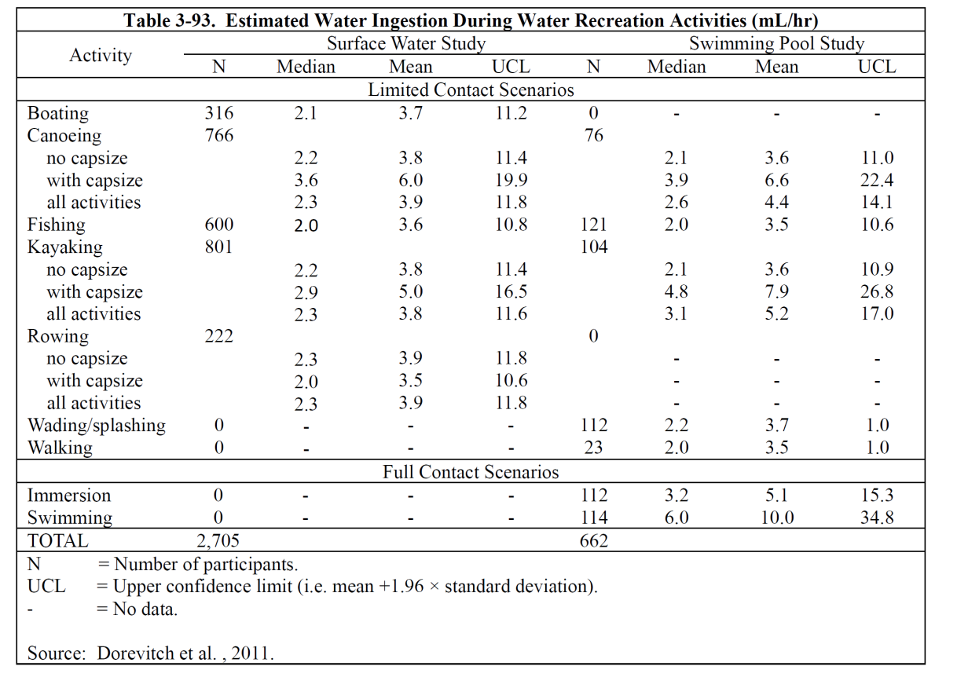
Exposure Factors
Justifying Using Probabilistic Exposure Assessment
Table from USEPA 2011
Notes:
USEPA. 2011c. Exposure Factors Handbook: 2011 Edition. EPA/600/R-09/052F. Washington, D.C.: United States Environmental Protection Agency, Office of Research and Development, National Center for Environmental Assessment. http://cfpub.epa.gov/ncea/risk/recordisplay.cfm?deid=236252

Slide 78
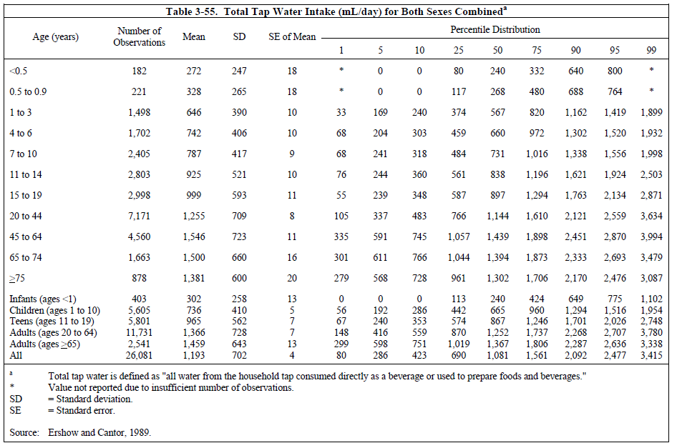
Exposure Factors
Justifying Using Probabilistic Exposure Assessment
Table from USEPA 2011
Notes:
USEPA. 2011c. Exposure Factors Handbook: 2011 Edition. EPA/600/R-09/052F. Washington, D.C.: United States Environmental Protection Agency, Office of Research and Development, National Center for Environmental Assessment. http://cfpub.epa.gov/ncea/risk/recordisplay.cfm?deid=236252

Slide 79
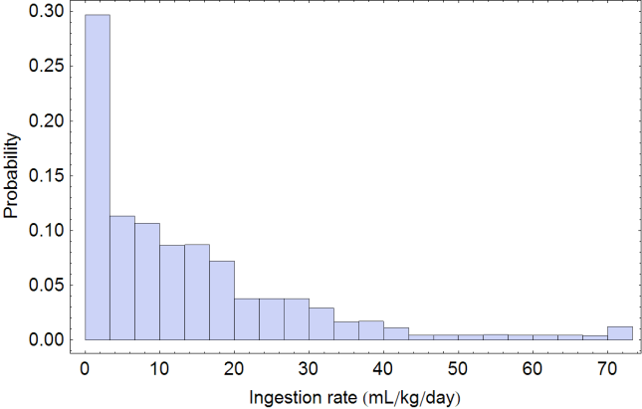
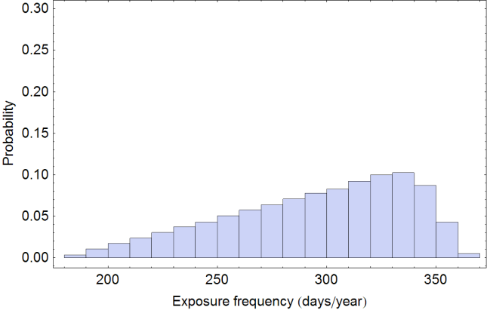
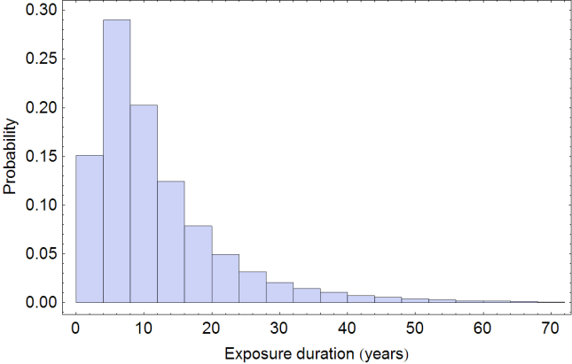


Exposure Factors
Justifying Using Probabilistic Exposure Assessment
IR/BW
EF
ED
50th
90th
95th
98th
99th
99.9th
LADD (mg/kg-day)
Notes:
No associated notes.

Slide 80
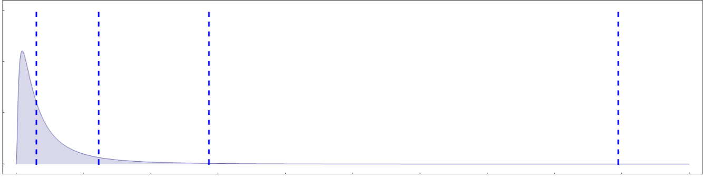
Exposure Factors
Justifying Using Probabilistic Exposure Assessment
“Reasonable Maximum Exposure” or RME, which is defined as “conservative but within a realistic range of exposure.” - National Contingency Plan (NCP)
0.3
0.2
0.1
0
50th
90th
98th
99.9th
High-End Exposures
Frequency
Reasonable Max Exp.
Maximum Exposures
0 20 40 60 80 100
Exposure (mg/day)
For more information see USEPA 2004. "An Examination of EPA Risk Assessment Principles and Practice“
Notes:
USEPA. 2004a. An Examination of EPA Risk Assessment Principles and Practices. EPA/100/B-04/001. Washington D.C.: United States Environmental Protection Agency, Office of Science Advisor Staff Paper. http://itrcweb.org/FileCabinet/GetFile?fileID=6879

Slide 81

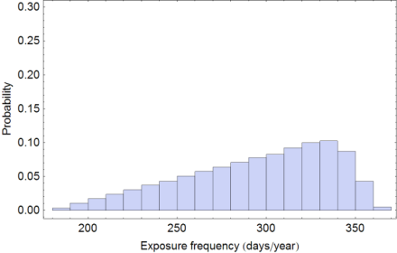

Exposure Factors
Justifying Using Probabilistic Exposure Assessment
IR/BW
EF
ED
2,000 mL/day
70 kg
350 days/yr
30 yrs
0.0117 mg/kg-day
0.5
0.4
0.3
0.2
0.1
0.0
50th
90th
95th
98th
99th
99.9th
Reasonable
Max Exposure
Probability
LADD (mg/kg-day)
Notes:
No associated notes.

Slide 82
Exposure Factors
Justifying Using Probabilistic Exposure Assessment
Issue: Justifying site-specific exposure factors
  Option – Probabilistic exposure assessment
  To determine reasonable “values” to use for each exposure factor
  Demonstrate that use of these values would result in exposure within 90-98% (reasonable maximum exposure)
Notes:
No associated notes.

Slide 83
Exposure Concentrations
Issue: Conservative fate and transport models
  Infinite source mass assumptions
  Uniform distribution of contamination
  No contaminant attenuation
  Instantaneous equilibrium partitioning
ITRC RISK-3 Section 6.2.3
Notes:
No associated notes.

Slide 84
Exposure Concentrations
Issue: Conservative fate and transport models
  Option – Use mass balance check
  Chemical concentration distribution should be well defined
  Likely will require additional field data
ITRC RISK-3 Section 6.2.3.2
Notes:
No associated notes.

Slide 85
Exposure Concentrations
Using Mass Limited Check
Mass Balance (Limit) Check
Estimates mass to which receptor exposed (over period of exposure)
Total mass in contaminated source area
Mass of exposure can’t exceed mass in source
Mass_{exposure} = C_{w} x IR x EF x ED
Receptor Well
Unsaturated Zone
Contaminated Soil Source
Mass_{soil} = C_{s} x ρ_{b} x V_{s}
Saturated Zone
Groundwater Plume
Groundwater Flow
Figure 6-9. Soil migration to groundwater – mass limited check.
Notes:
Figure 6-9. Soil migration to groundwater – mass limited check.

Slide 86
Exposure Concentrations
Issue: Accounting for uncertainty
  Exposure concentration intended to be average “site-related” concentrations routinely contacted by receptor
  Based upon actual monitoring data
  Arithmetic average (mean) concentration may not provide defensible estimate of true average concentration
ITRC RISK-3 Section 6.2.4
Notes:
No associated notes.

Slide 87
Exposure Concentrations
Issue: Accounting for uncertainty
  Option – Upper confidence limits on mean
  Provides conservative estimate of the average exposure concentration
  Accounts for uncertainty given limited data
ITRC RISK-3 Section 6.2.4.1
Notes:
No associated notes.

Slide 88

Exposure Concentrations
5
10
50
0.5
25
75
5
100
10
80
5
Dose = mg chem/kg body weight
per day
C = contaminant concentration
(mg/kg)
IR = intake rate (kg/day)
EF = exposure frequency (days/year)
ED = exposure duration (years)
BW = body weight (kg)
AT = averaging time (days)
4
0.3
10
1
What is the average concentration in this area?
Hypothetical Exposure Area
Notes:
Hypothetical exposure area example

Slide 89
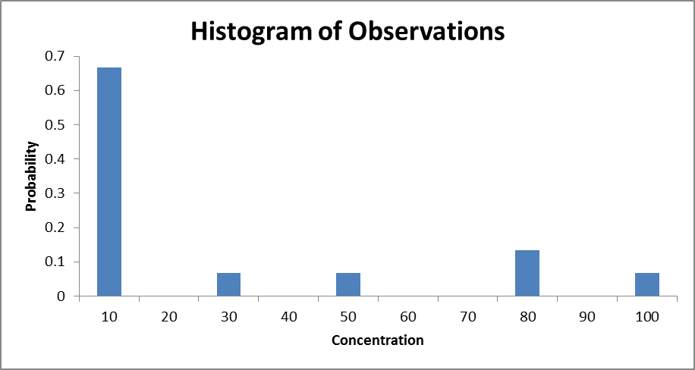
Exposure Concentrations
Upper Confidence Limits on the Mean
Arithmetic Mean
25 mg/kg
95% UCL
on the Mean
58 mg/kg
95%
86 mg/kg
Based on 15 Samples
Notes:
No associated notes.

Slide 90
Exposure Concentrations
4
10
9
12
5
50
0.5
17
25
25
75
5
9
100
10
80
Additional
Sampling
Location
5
38
8
46
14
16
4
0.3
0.8
10
1.9
1
Hypothetical Exposure Area
Notes:
No associated notes.

Slide 91
Exposure Concentrations
Upper Confidence Limits on the Mean
Arithmetic Mean
25 mg/kg
95% UCL
on the Mean
58 mg/kg
95%
86 mg/kg
Based on 15 Samples
Notes:
No associated notes.

Slide 92
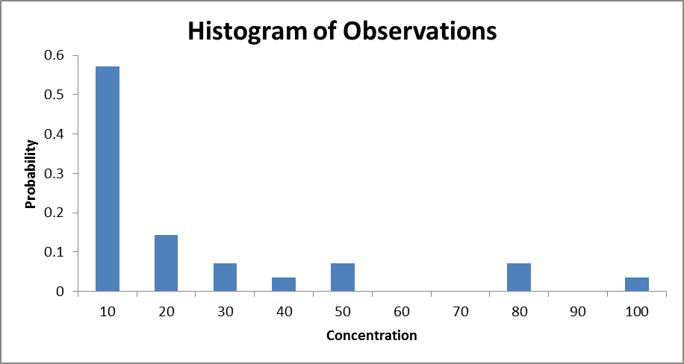
Exposure Concentrations
Upper Confidence Limits on the Mean
Arithmetic Mean
21 mg/kg
Arithmetic Mean
25 mg/kg
95% UCL
on the Mean
58 mg/kg
95%
78 mg/kg
95%
86 mg/kg
95% UCL
on the Mean
33 mg/kg
Based on 28 Samples
Notes:
No associated notes.

Slide 93
Exposure Concentrations
Issue: Accounting for uncertainty
  Option – Area-weighted averaging
  Used to estimate appropriate exposure concentrations
  Where data are unevenly distributed, UCLs on the mean may not provide reasonable estimates of exposure concentration
  Statistical methods can assess the uncertainty in area-weighted averages (e.g., nonparametric bootstrap method with weighted bootstrap resampling)
ITRC RISK-3 Section 6.2.4.2
Notes:
No associated notes.

Slide 94
Exposure Concentrations
Area-Weighted Average
5
10
50
0.5
25
75
100
5
10
80
5
4
0.3
10
1
Hypothetical Exposure Area
Notes:
No associated notes.

Slide 95
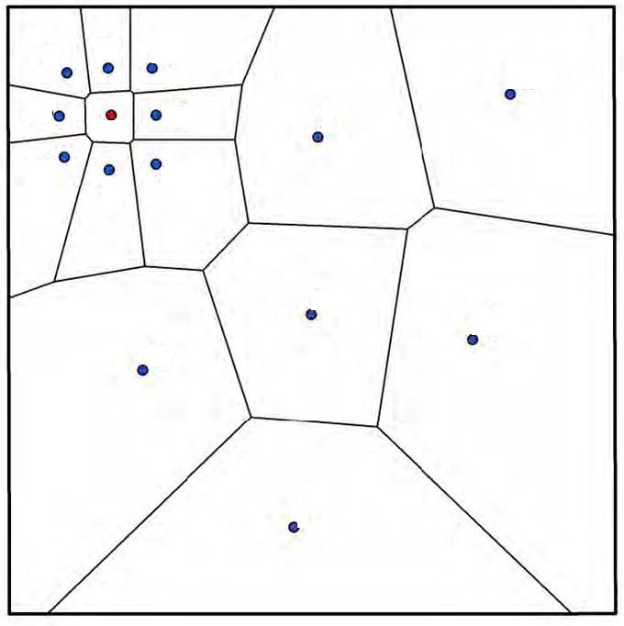
Exposure Concentrations
Area-Weighted Average
5
10
50
0.5
25
75
100
5
10
80
5
4
0.3
10
1
Figure 6-11. Hypothetical Exposure Area with Thiessen Polygons
Notes:
Figure 6-11. Hypothetical one-acre exposure area with Thiessen polygons.

Slide 96

Exposure Concentrations
Area-Weighted Average
5
10
50
0.5
25
75
5
100
10
80
5
4
0.3
10
1
Hypothetical Exposure Area
95% UCL on the mean = 58 mg/kg
Notes:
No associated notes.

Slide 97
Exposure Assessment Overview (Chapter 6)
Issues
  Justifying site-specific exposure factors
  Prorating exposure factors
  Bioavailability
  Exposure areas vs. exposure patterns
  Exposure concentrations (modeling vs. measuring)
  Modeling (for example, accounting for limited mass)
  Uncertainty in estimating exposure concentrations
  Site-specific exposure vs. background exposure
Notes:
No associated notes.

Slide 98
Risk Characterization (Chapter 7)
Notes:
No associated notes.

Slide 99
Risk Characterization Overview
(Chapter 7)
Integration of information from the toxicity assessment and exposure assessment to draw an overall conclusion about risk
Provides: Basis for the calculations
What are the chemical’s health effects?
What is the relationship between exposure and health effects?
How will people contact the chemical?
What is the magnitude, frequency and duration of contact?
Notes:
No associated notes.

Slide 100
Presentation of Risk Results
Issue: Unclear presentation of risk results
  Option – Organized and systematic presentation
  Identify chemicals and pathways contributing most significantly to the risks
  Provide an understanding of the uncertainties and bias inherent in the evaluation
  Presentation of results should include:
    Risk for each chemical
    Risk by route of exposure
    Risk by medium
    Total risk
ITRC RISK-3 Section 7.2.1.1
Notes:
No associated notes.

Slide 101
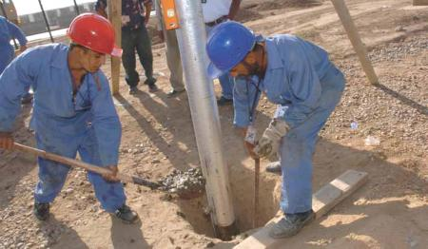
Example – Construction Worker Scenario
Exposure media include soil and groundwater
Chemicals include arsenic and benzo(a)pyrene “B(a)P”
Notes:
No associated notes.

Slide 102
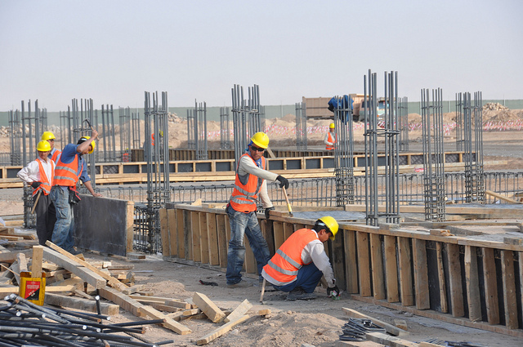
Example – Construction Worker Scenario
Potentially complete exposure pathways include:
  Incidental ingestion of soil
  Dermal exposure to soil
  Dermal contact with groundwater
Notes:
No associated notes.

Slide 103
Risk Results For Each Chemical
Presentation of results should include:
  Risk for each chemical from soil ingestion
Chemical | RME Soil Concentration mg/kg | ADD mg/kg-day | Oral RfD mg/kg-day | HQ | LADD mg/kg-day | CSF (mg/kg-day)⁻¹ | Cancer Risk
Arsenic | 9.14E+00 | 6.44E-06 | 3.00E-04 | 0.02 | 9.20E-08 | 1.50E+00 | 1E-07
  RME = Reasonable Maximum Exposure
  ADD = Average Daily Dose
  RfD = Reference Dose
  HQ = Hazard Quotient
  LADD = Lifetime Average Daily Dose
  CSF = Cancer Slope Factor
Notes:
No associated notes.

Slide 104
Risk Results By Route of Exposure
Presentation of results should include:
  Risk by route of exposure:
    Soil ingestion
    Dermal exposure to soil
Chemical | RME Concentration in Soil mg/kg | ADD mg/kg-day | Oral RfD mg/kg-day | HQ | LADD mg/kg-day | Oral CSF (mg/kg-day)⁻¹ | Cancer Risk
Arsenic | 9.14E+00 | 6.44E-06 | 3.00E-04 | 0.02 | 9.20E-08 | 1.50E+00 | 1E-07
B(a)P | 6.03E+00 | 4.25E-06 | NA | -- | 6.07E-08 | 7.30E+00 | 4E-07
Chemical | RME Concentration in Soil mg/kg | ADD mg/kg-day | Dermal RfD mg/kg-day | HQ | LADD mg/kg-day | Dermal CSF (mg/kg-day)⁻¹ | Cancer Risk
Arsenic | 9.14E+00 | 6.37E-07 | 3.00E-04 | 0.002 | 9.11E-09 | 1.50E+00 | 1E-08
B(a)P | 6.03E+00 | 1.82E-06 | NA | -- | 2.60E-08 | 7.30E+00 | 2E-07
Notes:
No associated notes.

Slide 105
Risk Results by Medium
Presentation of results should include:
  Risk by medium
  Soil
Chemical | Incidental Ingestion of Soil |  | Dermal Exposure to Soil |  | Total Hazard and Risk
 | HQ | Cancer Risk | HQ | Cancer Risk | HQ | Cancer Risk
Arsenic | 0.02 | 1E-07 | 0.002 | 1E-08 | 0.02 | 1E-07
B(a)P | -- | 4E-07 | -- | 2E-07 | -- | 6E-07
 |  |  |  | TOTAL | 0.02 | 7E-07
    Groundwater
Chemical | Dermal Exposure to Groundwater |  | Total Hazard and Risk
 | HQ | Cancer Risk | HQ | Cancer Risk
Arsenic | 0.1 | 5E-05 | 0.1 | 5E-05
B(a)P | -- | 2E-05 | -- | 2E-05
 |  | TOTAL | 0.1 | 7E-05
Notes:
No associated notes.

Slide 106


Presentation of Total Risk
Presentation of results should include:
  Total Risk
Chemical | Incidental Ingestion of Soil |  | Dermal Exposure to Soil |  | Dermal Exposure to Groundwater |  | Total Hazard and Risk
 | HQ | Cancer Risk | HQ | Cancer Risk | HQ | Cancer Risk | HI | Cancer Risk
Arsenic | 0.02 | 1E-07 | 0.002 | 1E-08 | 0.1 | 5E-05 | 0.1 | 5E-05
B(a)P | -- | 4E-07 | -- | 2E-07 | -- | 2E-05 | -- | 2E-05
 |  |  |  |  |  | TOTAL | 0.1 | 7E-05
Notes:
No associated notes.

Slide 107
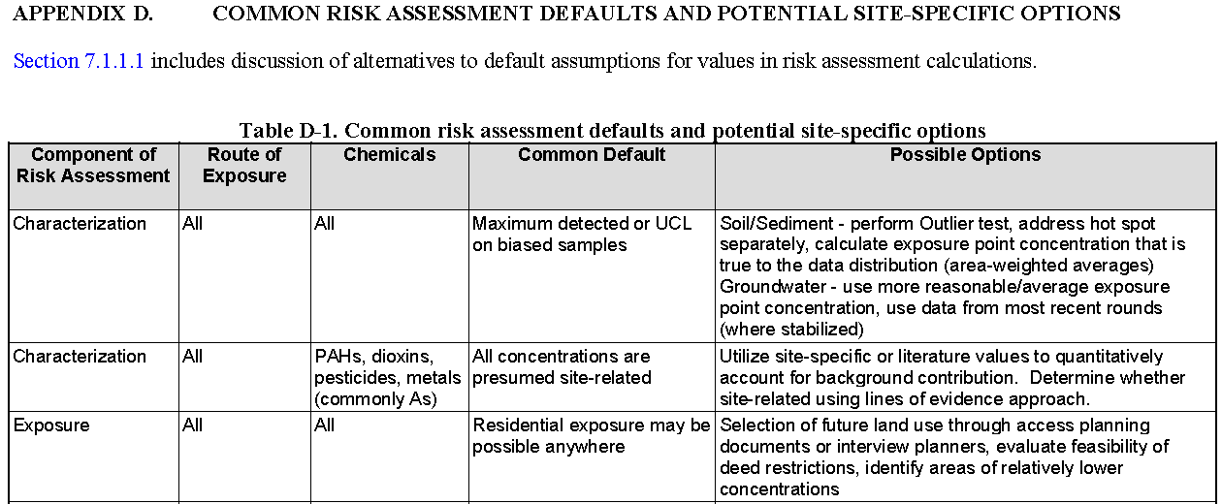
Alternatives To Default Assumptions
Issue: Default assumptions
  Option – Alternatives to default assumptions
  Excerpt of Table D-1
Table D-1: Common risk assessment defaults and potential site-specific options
ITRC RISK-3 Section 7.1.1.1 and Appendix D
Notes:
No associated notes.

Slide 108
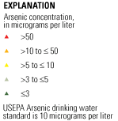
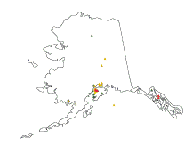
Account For Background
Issue: Default assumptions
  Option – Account for background
Background arsenic in groundwater
Figure Source: USGS.
Available from http://water.usgs.gov/nawqa/trace/arsenic/
Notes:
Figure Source: USGS.
Available from http://water.usgs.gov/nawqa/trace/arsenic/
See also
http://pubs.usgs.gov/fs/2000/fs063-00/fs063-00.html

Slide 109
Account For Background
Presentation of risk without background arsenic
Chemical | Incidental Ingestion of Soil |  | Dermal Exposure to Soil |  | Dermal Exposure to Groundwater |  | Total Hazard and Risk
 | HQ | Cancer Risk | HQ | Cancer Risk | HQ | Cancer Risk | HI | Cancer Risk
Arsenic | 0.02 | 1E-07 | 0.002 | 1E-08 | 0.1 | 5E-05 | 0.1 | 5E-05
B(a)P | -- | 4E-07 | -- | 2E-07 | -- | 2E-05 | -- | 2E-05
Total |  |  |  |  |  |  | 0.1 | 7E-05
Risk Attributable To Background Arsenic |  |  |  |  |  |  | 0.08 | 3E-05
Total Risk Without Background (Site Risk) |  |  |  |  |  |  | 0.04 | 4E-05
Qualitatively discuss background contribution to total risk
Notes:
No associated notes.

Slide 110
Poll Question – Uncertainty
Have you reviewed a risk assessment with a generic or incomplete uncertainty section?
    Yes, frequently
    Yes, a few times
    No
Poll Question
Notes:
No associated notes.

Slide 111
Uncertainty and Bias
Uncertainty refers to a lack of knowledge of how well the calculated results represent the actual risks
  Unknown amount of variability
  Can lead to over- or under-estimation of potential risk
Protective bias can be used to address uncertainty
  Shifts all results in a “conservative” direction
ITRC RISK-3 Section 7.3.1
Notes:
No associated notes.

Slide 112
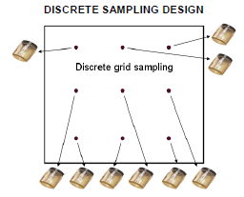
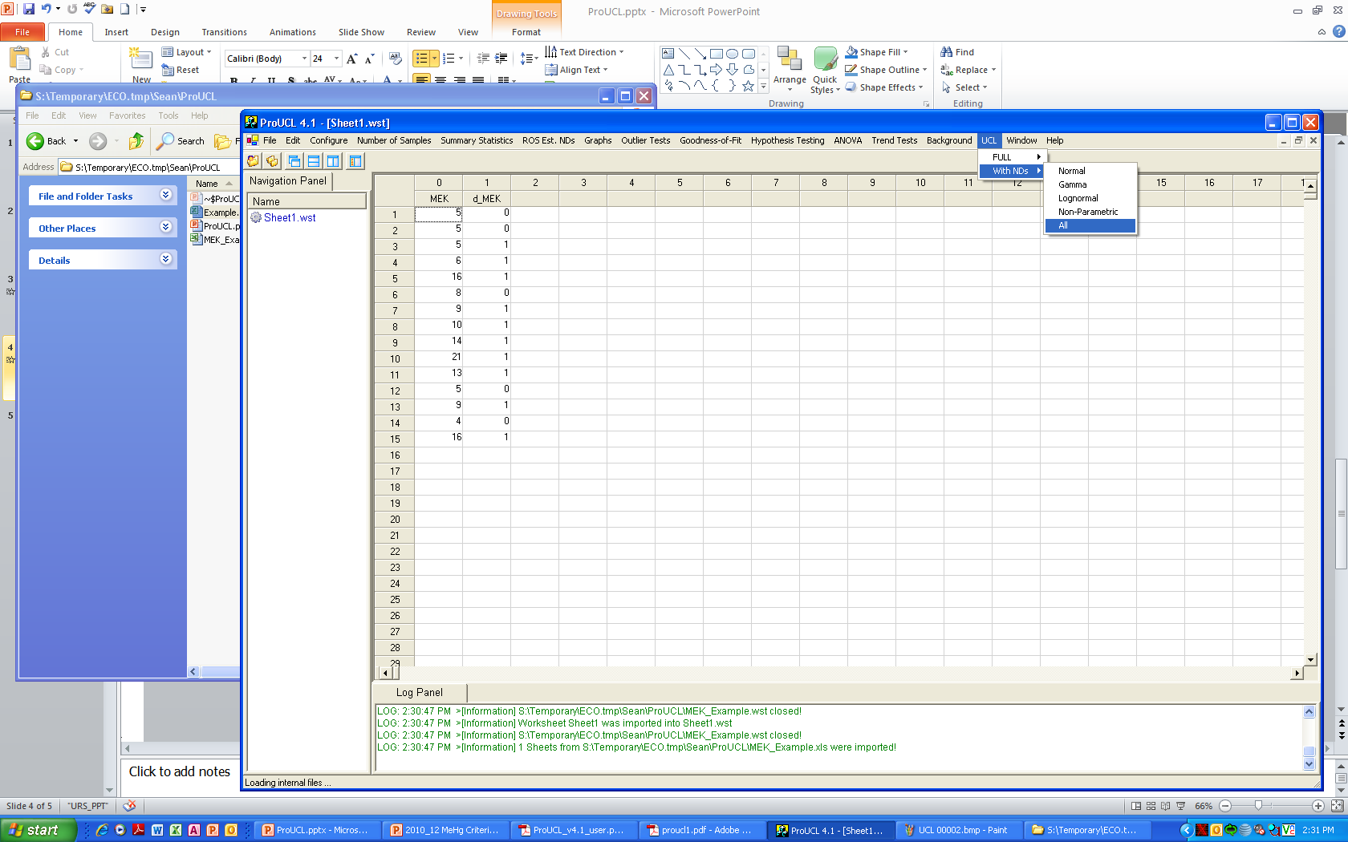
Uncertainty and Bias
Issue: Unclear presentation of uncertainty and bias in the risk results
  Option – Provide information so that uncertainties and bias can be understood
  Option – Provide detailed consideration of toxicological assumptions
  Option – Provide detailed consideration of exposure assumptions
  Option – Include multiple descriptors of risk
Figure Sources: ITRC 2012, ISM-1; USEPA 2010, ProUCL
Notes:
Figure sources:
USEPA. 2010. ProUCL Version 4.1.00 Technical Guide (Draft). EPA/600/R-07/041. Washington, DC: United States Environmental Protection Agency. http://www.epa.gov/osp/hstl/tsc/ProUCL_v4.1_tech.pdf.
ITRC. 2012. Incremental Sampling Methodology. ISM-1. Washington, D.C.: Interstate Technology & Regulatory Council. http://www.itrcweb.org/Ism-1/Executive_Summary.html.

Slide 113
Other Issues Addressed in Chapter 7
Summation of risk results for multiple media or pathways
Considerations for probabilistic risk assessment
Resources and tools
  Tools available to calculate risk
    Spatial Analysis and Decision Assistance http://www.sadaproject.net
    Army Risk Assessment Modeling System http://el.erdc.usace.army.mil/arams/arams.html
    EPA Regional Screening Level (RSL) Calculator
    http://epa-prgs.ornl.gov/cgi-bin/chemicals/csl_search
    Risk Assessment Information System (RAIS) Contaminated Media (Risk) Calculator http://rais.ornl.gov
Notes:
No associated notes.

Slide 114
Risk Management (Chapter 8)
Notes:
No associated notes.

Slide 115
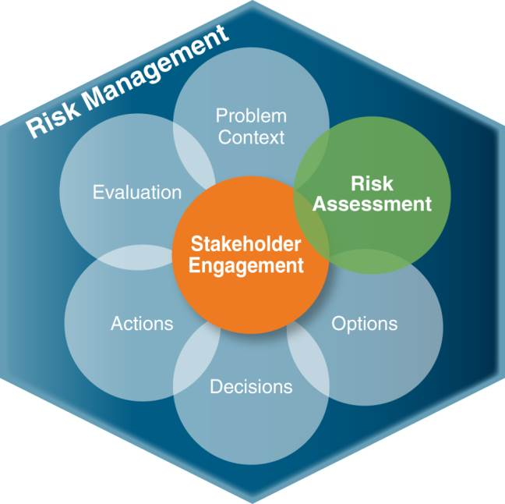
Risk Management Overview
(Chapter 8)
The process of identifying, evaluating, selecting, and implementing actions to reduce risk to human health
  Science
  Policy
  Professional judgment
  Social, Political and Economic Concerns
Figure 8-1. Risk management process.
Source: Adapted from Commission 1997
Notes:
Figure Source: Adapted from Commission, Presidential/Congressional. 1997. "Framework for Environmental Health Risk Management. Final Report, Volume 1." Washington, D.C.: The Presidential/Congressional Commission on Risk Assessment and Risk Management. http://www.riskworld.com/riskcommission/default.html.

Slide 116
Poll Question – Changes in Land Use
Have the land use assumptions for your projects ever changed after the risk assessment was completed?
    Yes, frequently
    Yes, a few times
    No
Poll Question
Notes:
No associated notes.

Slide 117
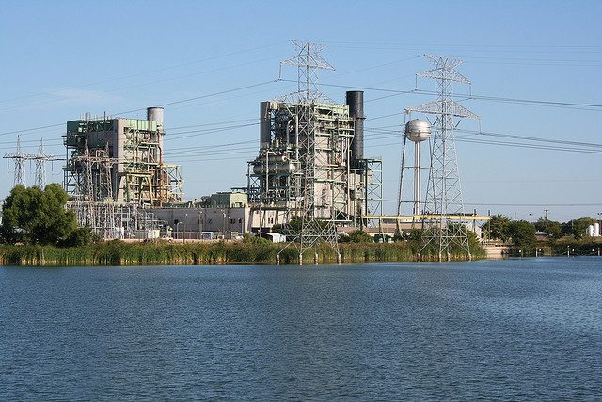
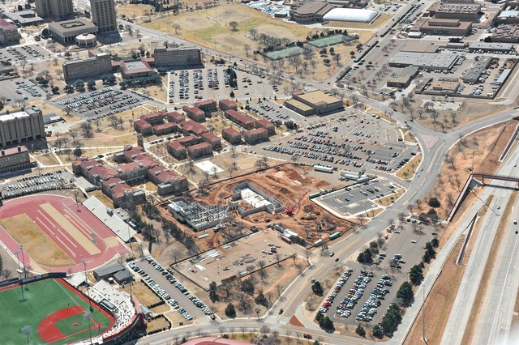
Risk Assessment to Inform Risk Management
Issue: Accounting for changes in scientific consensus or land use
  Option – Have ongoing communication between Project Managers and Risk Assessors
ITRC RISK-3 Section 8.2.1
Notes:
No associated notes.

Slide 118
Risk Assessment to Inform Risk Management
Issue: Accounting for changes in scientific consensus or land use
  Option – Perform a qualitative or semi-quantitative reevaluation
    Focus on issues pertinent to a specific risk management decision
    Small changes may not need to be updated
ITRC RISK-3 Section 8.2.1.2
Notes:
No associated notes.

Slide 119
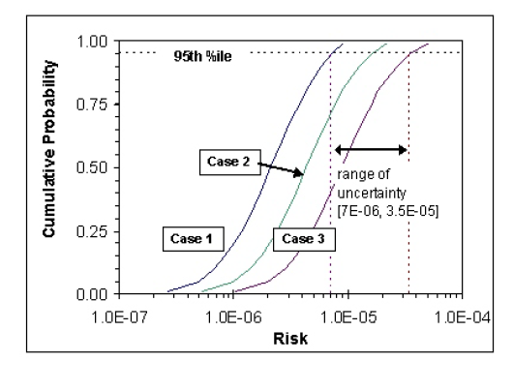
Uncertainty in Numerical Risk Estimates
Issue: Full consideration of uncertainty in numerical risk estimates
  Option – Probabilistic uncertainty evaluation
Figure Source: USEPA 2001 Risk Assessment Guidance for Superfund Volume III Part A. Figure 3-3
ITRC RISK-3 Section 8.2.2.3
Notes:
USEPA. 2001c. Risk Assessment Guidance for Superfund (RAGS), Volume III, Part A: Process for Conducting Probabilistic Risk Assessment. EPA 540/R-02/002. Washington, D.C.: United States Environmental Protection Agency, Office of Emergency and Remedial Response. http://itrcweb.org/FileCabinet/GetFile?fileID=6872

Slide 120
Other Issues Addressed in Chapter 8
Risk management in project planning
Other factors in risk management
  Use guidance to identify other factors
  Apply sustainability as the organizing principle for risk management
  Facilitate stakeholder acceptance
Resources and tools
Notes:
No associated notes.

Slide 121
Risk Communication (Chapter 9)
Notes:
No associated notes.

Slide 122
Risk Communication (Chapter 9)
Goal is for all stakeholders to have a common understanding of how the risk assessment effectively support risk management decisions
Designed to be iterative and to inform the risk assessment and risk management decisions
Interwoven and important element of the risk assessment process
Notes:
No associated notes.

Slide 123
Risk Communication (Chapter 9)
Issues
  When to Soliciting Stakeholder Input
  Risk Perception and Interpretation Create Challenges
  Identifying Effective Presentation Strategies
Notes:
No associated notes.

Slide 124
Risk Communication
Issue: Risk Perception and Interpretation Create Challenges
  Option – Be aware of, and address, possible differences in perceived risks
ITRC RISK-3 Section 9.2.1.1
Notes:
No associated notes.

Slide 125
Risk Communication
Issue: Risk Perception and Interpretation Create Challenges
  Subjective context of the perceiver (qualitative personal views) as important as (quantified) risk in influencing perception of hazard
  Must not underestimate the importance and validity of risk perception
Notes:
No associated notes.

Slide 126


Risk Communication
Be Aware of Risk Perceptions
MORE RISK, LESS FEAR MORE FEAR, LESS RISK
1:200
Risk of Being Hospitalized
1:6,000,000
1:30,000
Risk of Being Killed
1:600,000,000
Notes:
No associated notes.

Slide 127
Risk Communication
Be Aware of Risk Perceptions
Numerical Risk Estimates
  Voluntary/involuntary
  Dreaded or catastrophic event
Personal Context
  Equity
  Fairness
  Control
  Levels of Trust in the Institution or Industry
  Familiarity
Notes:
No associated notes.

Slide 128
Risk Communication
Issue: Risk Perception and Interpretation Create Challenges
  Option – Use effective risk communication methods
ITRC RISK-3 Section 9.2.1.2
Notes:
No associated notes.

Slide 129
Risk Communication
Use Effective Risk Communication Methods
Accept and involve the public as a legitimate partner
Plan carefully and evaluate your efforts
Listen to the public’s specific concerns
Be honest, frank, and open
Coordinate and collaborate with other credible sources
Meet the needs of the media
Speak clearly and with compassion
USEPA. 1988.
Seven Cardinal Rules of Risk Communication.
ITRC RISK-3 Section 9.2.1.2
Notes:
USEPA. 1988b. Seven Cardinal Rules of Risk Communication. OPA-87-020. Washington, D.C.: United States Environmental Protection Agency. http://itrcweb.org/FileCabinet/GetFile?fileID=6889

Slide 130
Risk Communication
Issue: Identifying Effective Presentation Strategies
  Option – Develop an appropriate message for communication with the public
ITRC RISK-3 Section 9.3.1.1
Notes:
No associated notes.

Slide 131
Risk Communication
Develop and Appropriate Message
Message Mapping
Identify stakeholders
Elicit stakeholder concern(s)
Identify common concern(s)
Develop key message(s)
Develop supporting information
Test the message
Plan for delivery
USEPA. 2007. Effective Risk and Crisis Communication During Water Security Emergencies.
ITRC RISK-3 Section 9.3.1.1
Notes:
USEPA. 2007g. Effective Risk and Crisis Communication During Water Security Emergencies. EPA/600/R-07/027. Washington, D.C.: United States Environmental Protection Agency. http://itrcweb.org/FileCabinet/GetFile?fileID=6884

Slide 132
Summary and Wrap-up
Notes:
No associated notes.

Slide 133

How do I use this document?
Notes:
No associated notes.

Slide 134
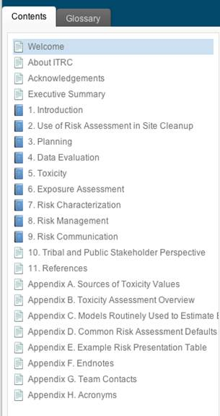
Navigating the Document
Contents bar organized by chapter
Notes:
No associated notes.

Slide 135
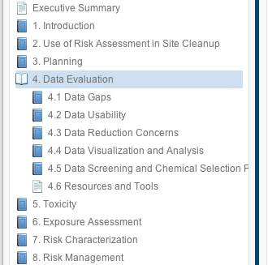
Navigating the Document
Contents bar organized by chapter
Chapter organized by topic
Notes:
No associated notes.

Slide 136
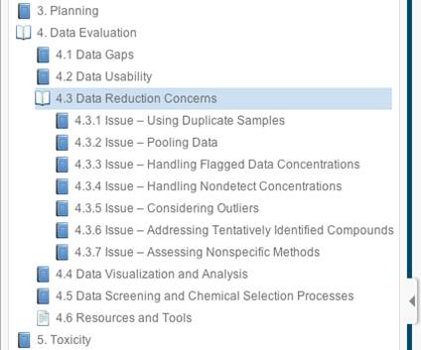
Navigating the Document
Contents bar organized by chapter
Chapter organized by topic
Topic organized by issue
Notes:
No associated notes.

Slide 137
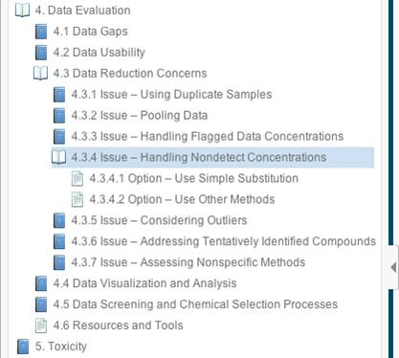
Navigating the Document
Contents bar organized by chapter
Chapter organized by topic
Topic organized by issue
Issue followed by options
Notes:
No associated notes.

Slide 138
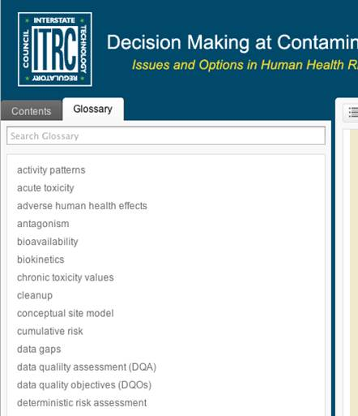
Navigating the Document
Contents bar organized by chapter
Chapter organized by topic
Topic organized by issue
Issue followed by options
Glossary tab
Notes:
No associated notes.

Slide 139
Summary
Challenges for both risk assessors and project managers
  Variability between programs
  Sites can be complex
  Applying risk assessments to different situations
These challenges translate to a number of key issues with one or more possible options to address these issues
Notes:
No associated notes.

Slide 140
Summary
The RISK-3 web-based document
  Organizes these key issues in topic areas specific to the risk assessment process
  Provides potential options and sources of additional information
The electronic web-based format allows a user to drill down through a dense and technically-challenging topic to core concepts
You can view or download the document for free at itrcweb.org
Notes:
No associated notes.

Slide 141



Thank You
Follow ITRC
2nd question and answer break
Links to additional resources
  http://www.clu-in.org/conf/itrc/risk3/resource.cfm
Feedback form – please complete
  http://www.clu-in.org/conf/itrc/risk3/feedback.cfm
Poll Question
Need confirmation of your participation today?
Fill out the feedback form and check box for confirmation email and certificate.
Notes:
Links to additional resources: http://www.clu-in.org/conf/itrc/risk3/resource.cfm
Your feedback is important – please fill out the form at: http://www.clu-in.org/conf/itrc/risk3/feedback.cfm
The benefits that ITRC offers to state regulators and technology developers, vendors, and consultants include:
Helping regulators build their knowledge base and raise their confidence about new environmental technologies
Helping regulators save time and money when evaluating environmental technologies
Guiding technology developers in the collection of performance data to satisfy the requirements of multiple states
Helping technology vendors avoid the time and expense of conducting duplicative and costly demonstrations
Providing a reliable network among members of the environmental community to focus on innovative environmental technologies
How you can get involved with ITRC:
Join an ITRC Team – with just 10% of your time you can have a positive impact on the regulatory process and acceptance of innovative technologies and approaches
Sponsor ITRC’s technical team and other activities
Use ITRC products and attend training courses
Submit proposals for new technical teams and projects

