Slide 1



Starting Soon: ITRC Panel Event
Based on ITRC Guidance: Stormwater Best Management Practices Performance Evaluation (Stormwater-1) Oct-18
  Enter your questions about using the ITRC guidance in the Q&A pod
Pre-event videos - We assume you have watched
Access panel overview, panelist bios, links
  CLU-IN panel page: https://clu-in.org/conf/itrc/stormwaterBMP/ Under “Download Training Materials”
Using Adobe Connect
  Related Links (on right)
    Select name of link
    Click “Browse To”
  Full Screen button near top of page
Poll Question
Follow ITRC
Notes:
Poll Question:
What do you hope to get out of this session? (SELECT MULTIPLE)
General information about post-construction stormwater BMPs.
Information about how your document can help me.
How to use the tool.
Other “insert short answer”

Slide 2

ITRC Guidance: Stormwater Best Management Practices Performance Evaluation
WELCOME - ITRC Panel Event
DRY RUN
Poll Question
  Enter your questions about using the ITRC guidance in the Q&A pod
Sponsored by: Interstate Technology and Regulatory Council (www.itrcweb.org) Hosted by: US EPA Clean Up Information Network (www.cluin.org)

Slide 3





ITRC (www.itrcweb.org) – Shaping the Future of Regulatory Acceptance
Host organization
Network
  State regulators
    All 50 states, PR, DC
  Federal partners
  ITRC Industry Affiliates Program
  Academia
  Community stakeholders
Follow ITRC
Disclaimer
  Full version in “Notes” section
  Partially funded by the U.S. government
    ITRC nor US government warranty material
    ITRC nor US government endorse specific products
ITRC materials available for your use – see usage policy
Available from www.itrcweb.org
  Technical and regulatory guidance documents
  Online and classroom training schedule
  More…
DOE
DOD
EPA
Notes:
The Interstate Technology and Regulatory Council (ITRC) is a state-led coalition of regulators, industry experts, citizen stakeholders, academia and federal partners that work to achieve regulatory acceptance of environmental technologies and innovative approaches. ITRC consists of all 50 states (and Puerto Rico and the District of Columbia) that work to break down barriers and reduce compliance costs, making it easier to use new technologies and helping states maximize resources. ITRC brings together a diverse mix of environmental experts and stakeholders from both the public and private sectors to broaden and deepen technical knowledge and advance the regulatory acceptance of environmental technologies. Together, we’re building the environmental community’s ability to expedite quality decision making while protecting human health and the environment. With our network of organizations and individuals throughout the environmental community, ITRC is a unique catalyst for dialogue between regulators and the regulated community.
For a state to be a member of ITRC their environmental agency must designate a State Point of Contact. To find out who your State POC is check out the “contacts” section at www.itrcweb.org. Also, click on “membership” to learn how you can become a member of an ITRC Technical Team.
Disclaimer: This material was prepared as an account of work sponsored by an agency of the United States Government. Neither the United States Government nor any agency thereof, nor any of their employees, makes any warranty, express or implied, or assumes any legal liability or responsibility for the accuracy, completeness, or usefulness of any information, apparatus, product, or process disclosed, or represents that its use would not infringe privately owned rights. Reference herein to any specific commercial product, process, or service by trade name, trademark, manufacturer, or otherwise does not necessarily constitute or imply its endorsement, recommendation, or favoring by the United States Government or any agency thereof. The views and opinions of authors expressed herein do not necessarily state or reflect those of the United States Government or any agency thereof and no official endorsement should be inferred.
The information provided in documents, training curricula, and other print or electronic materials created by the Interstate Technology and Regulatory Council (“ITRC” and such materials are referred to as “ITRC Materials”) is intended as a general reference to help regulators and others develop a consistent approach to their evaluation, regulatory approval, and deployment of environmental technologies. The information in ITRC Materials was formulated to be reliable and accurate. However, the information is provided "as is" and use of this information is at the users’ own risk.
ITRC Materials do not necessarily address all applicable health and safety risks and precautions with respect to particular materials, conditions, or procedures in specific applications of any technology. Consequently, ITRC recommends consulting applicable standards, laws, regulations, suppliers of materials, and material safety data sheets for information concerning safety and health risks and precautions and compliance with then-applicable laws and regulations. ITRC, ERIS and ECOS shall not be liable in the event of any conflict between information in ITRC Materials and such laws, regulations, and/or other ordinances. The content in ITRC Materials may be revised or withdrawn at any time without prior notice.
ITRC, ERIS, and ECOS make no representations or warranties, express or implied, with respect to information in ITRC Materials and specifically disclaim all warranties to the fullest extent permitted by law (including, but not limited to, merchantability or fitness for a particular purpose). ITRC, ERIS, and ECOS will not accept liability for damages of any kind that result from acting upon or using this information.
ITRC, ERIS, and ECOS do not endorse or recommend the use of specific technology or technology provider through ITRC Materials. Reference to technologies, products, or services offered by other parties does not constitute a guarantee by ITRC, ERIS, and ECOS of the quality or value of those technologies, products, or services. Information in ITRC Materials is for general reference only; it should not be construed as definitive guidance for any specific site and is not a substitute for consultation with qualified professional advisors.

Slide 4
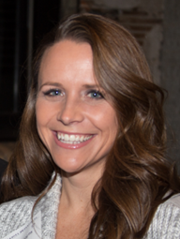
Moderator
Rebecca Higgins
Minnesota Pollution Control Agency
St. Paul, MN
651-757-2240
rebecca.higgins@state.mn.us
Introduction to ITRC Guidance: Stormwater Best Management Practices Performance Evaluation
Poll Question
  Enter your questions about using the ITRC guidance in the Q&A pod
Access bios at: https://clu-in.org/conf/itrc/stormwaterBMP/
Notes:
What is your role in stormwater management?
I select stormwater BMPs (Best Management Practices) at sites
I install or maintain stormwater BMPs at sites
I review, approve, and/or inspect stormwater BMPs
I regulate stormwater BMPs, but I am not involved in the selection of stormwater BMPs
I advise others on stormwater program requirements
I am a provider of stormwater BMP technologies and/or approaches
I have no role in stormwater management
Other “insert short answer”
Rebecca Higgins is a Senior Hydrogeologist in the East Metro Unit of the Minnesota Pollution Control Agency (MPCA) in St. Paul. In her roll at the MPCA, she is a member of the team assigned to evaluate releases of hazardous substances and PFAS compounds that pose a risk to human and ecological receptors. Rebecca also serves as liaison between the stormwater program and remediation divisions of the MPCA. In that role she seeks to find innovative technical solutions for sites where contamination poses a risk to human health and the environment from infiltrated stormwater. Rebecca is an ITRC Point-of-Contact for the State of Minnesota and a Co-Team Leader the Stormwater BMP Performance Evaluation Team. She earned a Bachelor's degree in Geology from North Dakota State University in 1998 and spent 9 years in the environmental consulting industry in Colorado and Minnesota until joining the MPCA in 2007. Rebecca is a licensed Professional Geologist in the state of Minnesota.

Slide 5
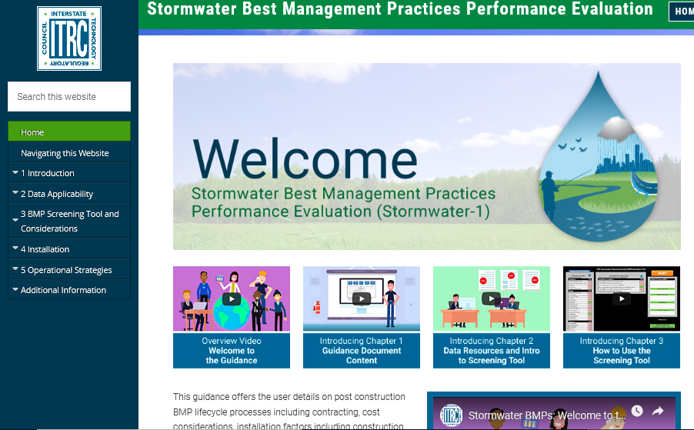
ITRC’s Online Stormwater BMP Guidance Document
Centralized resource for information on stormwater BMP effectiveness and how to use and implement that information
Poll Question
Notes:
Poll Question:
Have you or are you currently using the ITRC Stormwater Best Management Practices (BMPs) Performance Evaluation guidance document?
Yes, I am using the document
Not yet, but I plan to use the document within the next 6 months
No, I am not using the document
I was not aware of this document until this panel session
Poll Question:
What is your level of expertise in post-construction stormwater?
I am an expert
I have a few years experience and work with post-construction stormwater issues on a regular basis
I have a little knowledge, but don’t work with post-construction stormwater issues the field very often
I know nothing about post-construction stormwater, and am looking to expand my overall knowledge base

Slide 6
BMP Performance Evaluation Regs
Federal Guidelines
State Manual
Municipal Ordinance
LAND
DEVELOPMENT
CHALLENGES
STORMWATER
LIFECYCLE
MANAGEMENT

Slide 7
A Resource for YOU –
Centralized Information Source
Lifecycle Basis
  screening, selection, installation, operation, and monitoring and maintenance
Limitations and benefits of specific BMPs
Starting point in the absence of established numeric standards
Helps you in avoiding or resolving regulatory conflicts
PERFORMANCE
STANDARDS

Slide 8
This guidance document does NOT:
Address sediment and erosion BMPs during construction
Replace policy or regulatory standards
Provide detailed design criteria for individual site-specific use
Provide an exhaustive BMP selection tool
Verify or certify BMPs

Slide 9
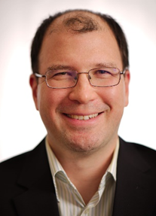

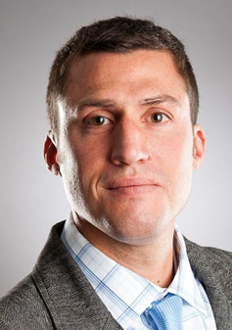
Meet the Panelist
Patrick Hsieh
Dalton, Olmsted, & Fuglevand
Seattle, WA
206-414-2455
phsieh@dofnw.com
Allison Dunaway
Virginia Dept. Environmental Quality
Glen Allen, VA
804-527-5086
allison.dunaway@deq.virginia.gov
Brandon Steets
Geosyntec Consultants
Santa Barbara, CA
805-979-9122
bsteets@geosyntec.com
Access bios at: https://clu-in.org/conf/itrc/stormwaterBMP/
Notes:
Patrick Hsieh is a Senior Engineer with Dalton, Olmsted, & Fuglevand (DOF) based out of their Seattle, Washington office. Since 2016, Patrick has worked at DOF specializing in managing environmental concerns at complex sites (upland and sediment remediation as well as environmental compliance) with a focus on stormwater management for industrial clients in the Pacific Northwest. He is responsible for the completion of feasibility studies, corrective action plans, and engineering design for cleanups at superfund sites as well as for supporting environmental compliance engineering design at active industrial manufacturing facilities.
He has led the design and operation and maintenance (O&M) of air sparging, soil vapor extraction, groundwater extraction and treatment, stormwater treatment, dredge return water treatment, and in situ bioremediation systems for environmental remediation projects throughout the country. He has directed clients in improving industrial stormwater treatment to reach benchmarks, designed stormwater facilities to meet low impact development goals and aided clients in negotiations with regulators and third party groups. Patrick has evaluated the efficacy of hundreds of water treatment devices or best management practices to treat for metals, polychlorinated biphenyls, suspended solids, pH, volatile organic compounds, 1,4-dioxane, turbidity, chemical and biological oxygen demand in stormwater and wastewater.
Prior to DOF, he worked for 11 years in the environmental consulting field with AMEC Earth and Environmental (previously Geomatrix). Since 2016, Patrick has contributed to ITRC as a team member and trainer for ITRC's Stormwater BMP Evaluation team. Patrick earned a bachelor's (2001) and master's (2003) degree in chemical engineering from University of Rochester in Rochester, New York Patrick is certified as a Professional Engineer in Washington, Oregon, Alaska, and Nevada.
Allison Dunaway manages the Wetland and Stream Protection Program and the Construction Stormwater Program at the Virginia Department of Environmental Quality, Piedmont Regional Office. Over the last 20 years, Allison has worked in the public and private sectors performing water quality monitoring, water and wetlands permitting and inspections, and air, water and waste program enforcement and policy development. She currently supervises a staff of 14 environmental specialists who evaluate permit applications, review plans and conduct compliance inspections related to the wetland and stream protection program and the construction stormwater program. Allison has been active in ITRC since 2011, serving on the Biochemical Reactors for Mining Influenced Waters team from 2011 to 2013 and as a sub-group leader on the Long Term Contaminant Management Using Institutional Controls team from 2014-2015. Since 2016, she has served as the co-team leader on the Stormwater BMP Performance Evaluation team. Allison earned a bachelor's degree with distinction in environmental science from the University of Virginia in 2000, and a master's in environmental science and engineering from Virginia Tech in 2003.
Brandon Steets is a Senior Principal at Geosyntec Consultants in Santa Barbara, California. He has served as a consultant since 2000 and specializes in National Pollutant Discharge Elimination System (NPDES) and Total Maximum Daily Load (TMDL) regulations, water quality modelling and monitoring, pollutant source investigation, and stormwater Best Management Practices (BMP) planning and design. Brandon has led watershed modeling to plan over $6 billion in new green infrastructure and demonstrate compliance with TMDL limits. He has led numerous award winning projects, including biofilter design for the Boeing Santa Susana Field Laboratory (2013 CASQA award) and microbial and nutrient source tracking for the Boston Water and Sewer Commission (2018 NACWA award).He has performed training for the American Society of Civil Engineers (ASCE) and for numerous municipalities across the United States Brandon recently advised the National Academy of Sciences industrial stormwater committee regarding recommendations for U.S. EPA's 2020 Multi-Sector General Permit renewal. He received his BS in environmental engineering from Rensselaer Polytechnic Institute in 1998 and his MS in environmental engineering from the University of California at Santa Barbara in 2000.Â He is a licensed professional chemical engineer (CA), and California Stormwater Quality Association (CASQA) certified Qualified Industrial Stormwater Practitioner and Trainer of Record.

Slide 10
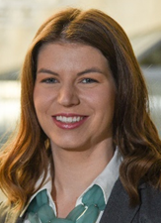
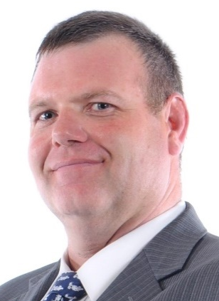
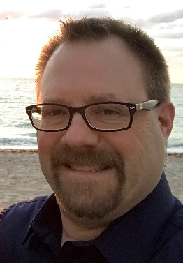
Meet the Responders
(responding in writing to questions submitted in Q&A pod)
Toni McCrory
Walmart, Inc.
Bentonville, AR
479-277-3468
toni.mccrory@walmart.com
Chris Nickell
Drake University
Des Moines
515-271-3804
chris.nickell@drake.edu
Access bios at: https://clu-in.org/conf/itrc/stormwaterBMP/
Kevin Lienau
GES, Inc
Eagan, MN
800-735-1077
klienau@gesonline.com
Notes:
Toni McCrory is a Director in U.S. Environmental, Health, and Safety Compliance for Walmart, Inc in Bentonville, AR. Toni has worked within the water compliance field since 2008. She oversees all water-related compliance programs (stormwater, wastewater, pre-treatment, drinking water, groundwater, wetlands, and water reuse) for over 5200 U.S. facilities. In her role, Toni has developed, implemented, and refined national stormwater programs by generating innovative compliance solutions for performance-based contract management, predictive analytics for asset management, and digital transformation. Toni has been an active member of ITRC since the inception of the Stormwater BMP Performance Evaluation team in 2016 and is currently a trainer for the team. Toni earned her bachelor's degree in biological and agricultural engineering from the University of Arkansas in Fayetteville, Arkansas in 2007 and a master's in business administration from John Brown University in Siloam Springs, Arkansas in 2010.
Chris Nickell is the Director of Environmental Health and Safety at Drake University in Des Moines, Iowa, since 2015. He oversees the Universities environmental compliance. Before joining Drake, he worked in the private sector in Environmental Health and Safety, and as an environmental compliance consultant. Prior to working in the public sector Chris served in the United States Air Force, where he was an Emergency and Disaster Manager. He also holds both the Certified Safety Professional (CSP) and Certified Hazardous Materials Manager (CHMM) designations. Chris is a member of the ITRC Stormwater BMP Performance Evaluation Team. He joined the team in 2017 and served as the operations and maintenance sub team lead. He graduated with a bachelor's degree in Emergency and Disaster Management from Upper Iowa University in 2009.
Kevin Michael Lienau, PE is a Corporate Engineering Manager / Principle with Groundwater and Environmental Services, Inc. (GES) located in GES' Eagan, Minnesota office. Since 1992, Kevin has worked at GES specializing in investigation, remediation, and site progression of a wide variety of industrial and petroleum projects. Contaminants of concern include both chlorinated and non-chlorinated hydrocarbon sites. With his knowledge of varied contaminants and remedial techniques, Kevin also provides third-party review services to clients.
Other areas of expertise include industrial facility auditing, spill prevention, control, and countermeasure (SPCC) plan preparation, stormwater pollution prevention (SWPP) plan preparation, National Pollutant Discharge Elimination System (NPDES) and underground injection control permit acquisition and compliance, analysis and implementation of feasibility tests, control system design, electrical code classification/interpretation, and PLC programming. Additionally, Kevin has extensive experience in landfill leachate and gas system operations, maintenance, design, and control.
Since 2015, Kevin has contributed to ITRC as a team member and now trainer for ITRC's Stormwater Best Management Practices Performance Evaluation team. Kevin earned a bachelor's degree in Chemical Engineering and a bachelor's degree in Material Science and Engineering from the University of Minnesota - Twin Cities in Minneapolis, Minnesota in 1992. Kevin is a licensed professional engineer in 21 states.

Slide 11
Panelist
Patrick Hsieh
Dalton, Olmsted, & Fuglevand
Seattle, WA
206-414-2455
phsieh@dofnw.com
The most common question I get-
“Will this treatment system work?”
  Enter your questions about using the ITRC guidance in the Q&A pod
Access bios at: https://clu-in.org/conf/itrc/stormwaterBMP/
Notes:
Patrick Hsieh is a Senior Engineer with Dalton, Olmsted, & Fuglevand (DOF) based out of their Seattle, Washington office. Since 2016, Patrick has worked at DOF specializing in managing environmental concerns at complex sites (upland and sediment remediation as well as environmental compliance) with a focus on stormwater management for industrial clients in the Pacific Northwest. He is responsible for the completion of feasibility studies, corrective action plans, and engineering design for cleanups at superfund sites as well as for supporting environmental compliance engineering design at active industrial manufacturing facilities.
He has led the design and operation and maintenance (O&M) of air sparging, soil vapor extraction, groundwater extraction and treatment, stormwater treatment, dredge return water treatment, and in situ bioremediation systems for environmental remediation projects throughout the country. He has directed clients in improving industrial stormwater treatment to reach benchmarks, designed stormwater facilities to meet low impact development goals and aided clients in negotiations with regulators and third party groups. Patrick has evaluated the efficacy of hundreds of water treatment devices or best management practices to treat for metals, polychlorinated biphenyls, suspended solids, pH, volatile organic compounds, 1,4-dioxane, turbidity, chemical and biological oxygen demand in stormwater and wastewater.
Prior to DOF, he worked for 11 years in the environmental consulting field with AMEC Earth and Environmental (previously Geomatrix). Since 2016, Patrick has contributed to ITRC as a team member and trainer for ITRC's Stormwater BMP Evaluation team. Patrick earned a bachelor's (2001) and master's (2003) degree in chemical engineering from University of Rochester in Rochester, New York Patrick is certified as a Professional Engineer in Washington, Oregon, Alaska, and Nevada.

Slide 12
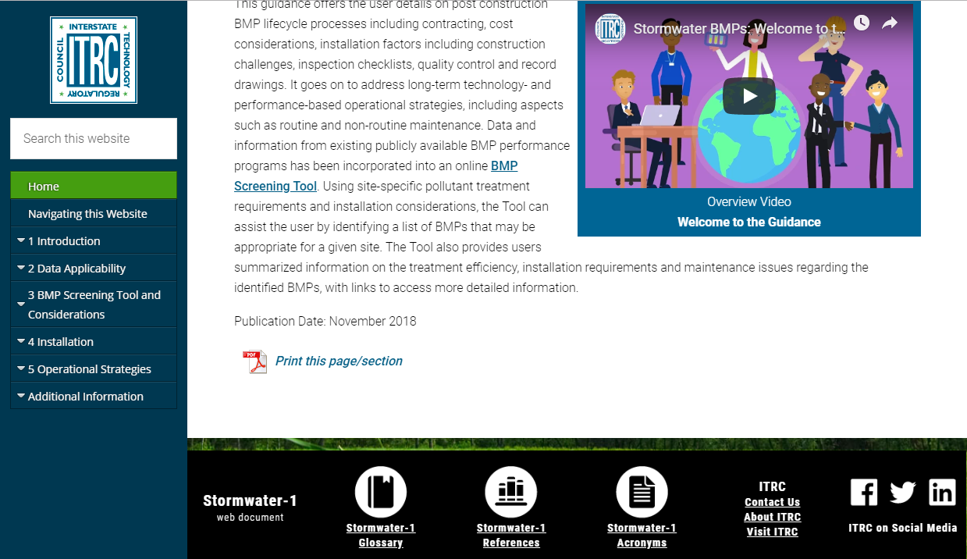
ITRC’s Online Stormwater BMP Guidance Document
Centralized resource for information on stormwater BMP effectiveness and how to use and implement that information

Slide 13
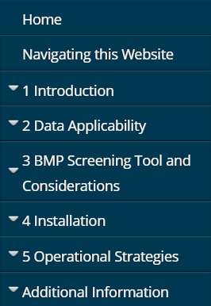
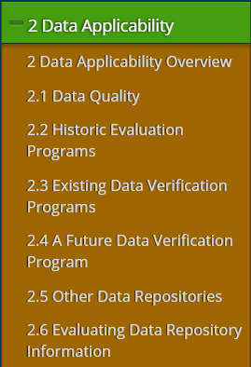
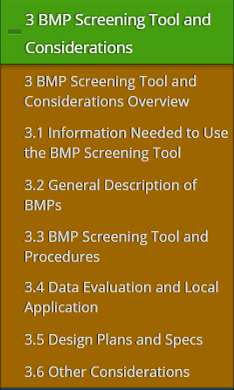
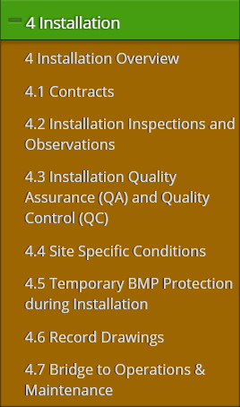
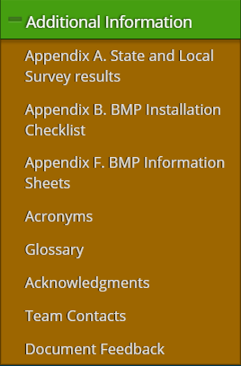
ITRC’s Online Stormwater BMP Guidance Document

Slide 14

YOUR QUESTIONS
ITRC Guidance: Stormwater Best Management Practices Performance Evaluation
Poll Question
Notes:
Poll Question:
What type of organization do you represent?
City/local government
State government
Federal government
Technology vendor
Consultant
Community stakeholder
Other
Poll Question:
What are challenges that you’ve experienced when evaluating a BMP for use on a site? (Note: The challenges could be experienced from a site design, approving-authority or owner perspective.) [select all that apply]
It’s difficult to find data to determine if the BMP will be effective.
There’s no standard, national protocol to certify or prove a BMP will be effective.
I’m unsure if the maintenance requirements of the BMPs will be acceptable to the client and/or the approving authority.
I don’t have reliable information on short- and long-term costs.
Other

Slide 15
Panelist
Allison Dunaway
Virginia Dept. Environmental Quality
Glen Allen, VA
804-527-5086
allison.dunaway@deq.virginia.gov
Stormwater Best Management Practices Screening Tool
  Enter your questions about using the ITRC guidance in the Q&A pod
Access bios at: https://clu-in.org/conf/itrc/stormwaterBMP/

Slide 16
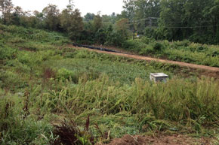
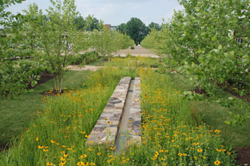
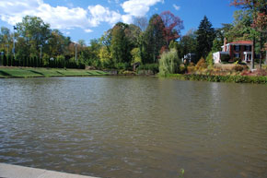
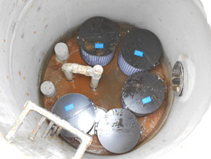
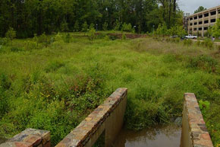
The Stormwater Tool Can Help
Photo credit: University of Virginia

Slide 17
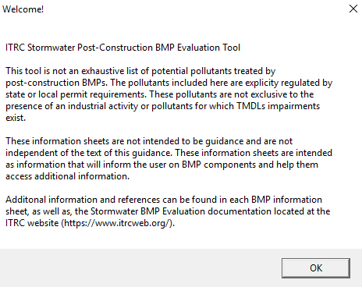
Stormwater Best Management Practices Performance Evaluation (Stormwater-1) Oct-18

Slide 18
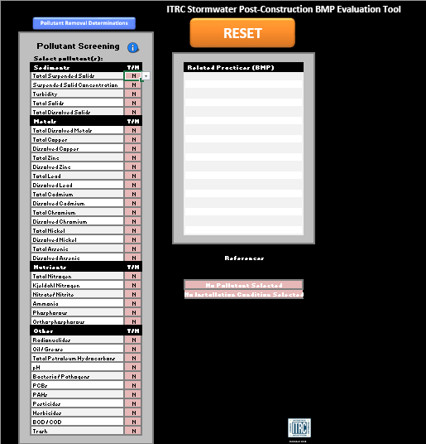
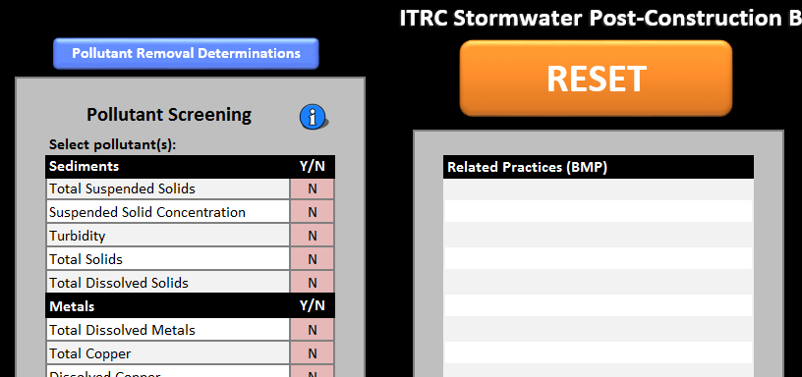
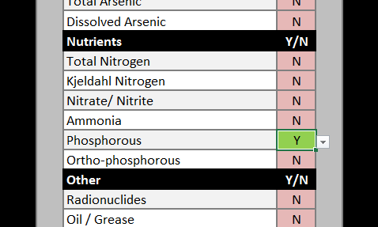
Step 1: Choose Pollutants

Slide 19
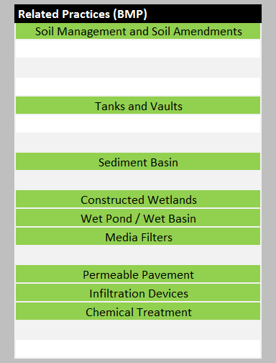
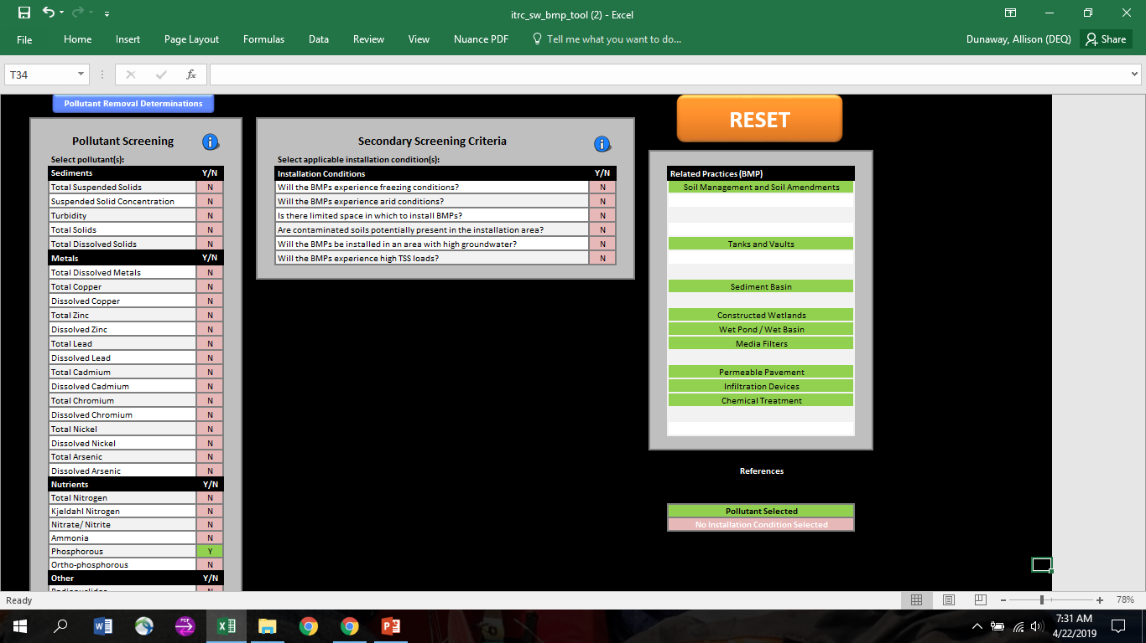
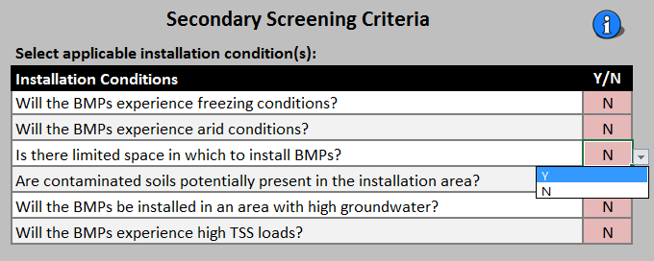
Step 2: Secondary Screening

Slide 20
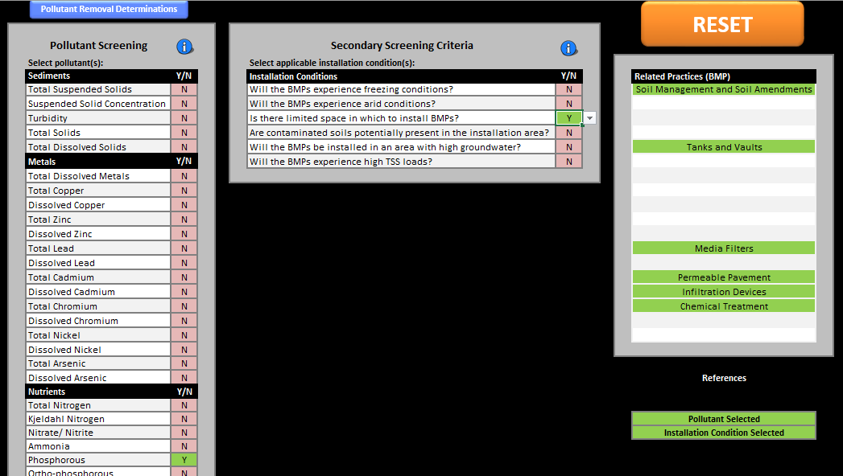
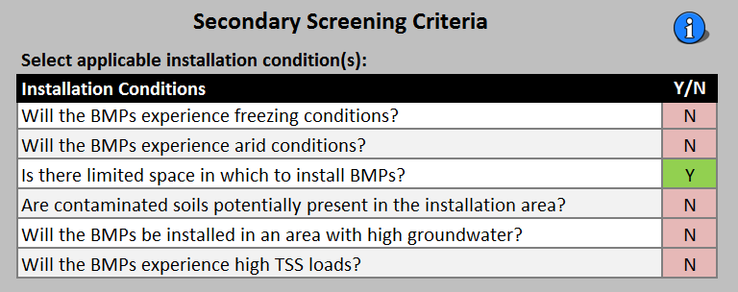
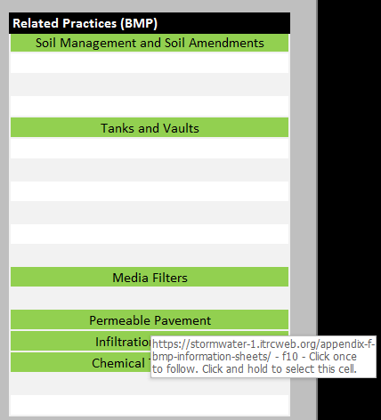
Step 3: Review Related Practices

Slide 21
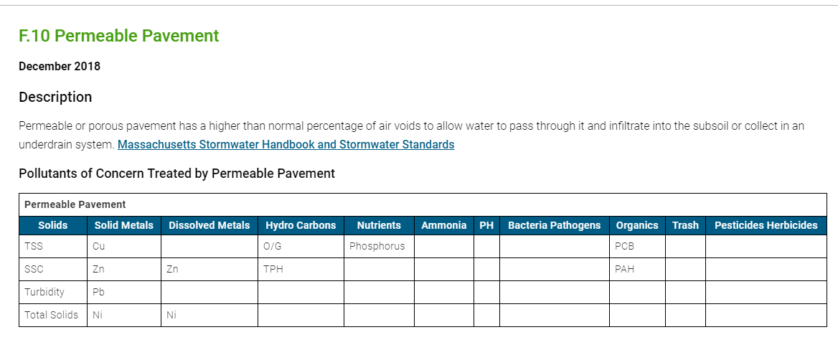
BMP Information Sheet
Description & Pollutant Summary

Slide 22
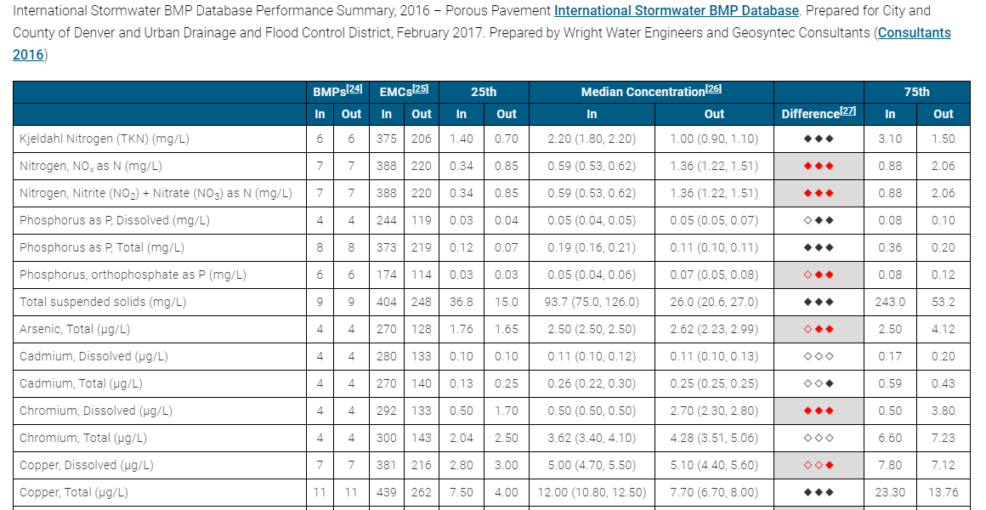
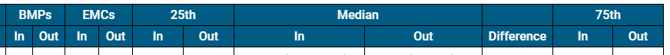
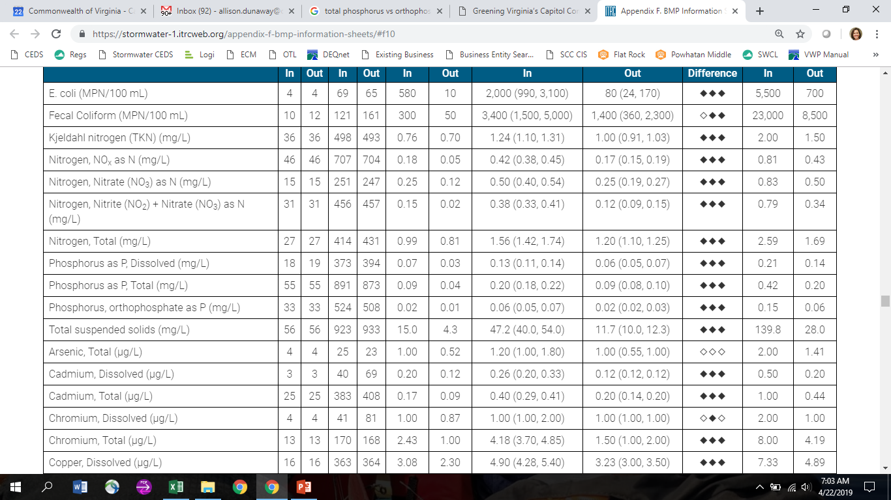
BMP Information Sheet
Data Summary

Slide 23
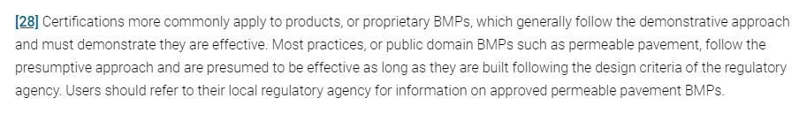
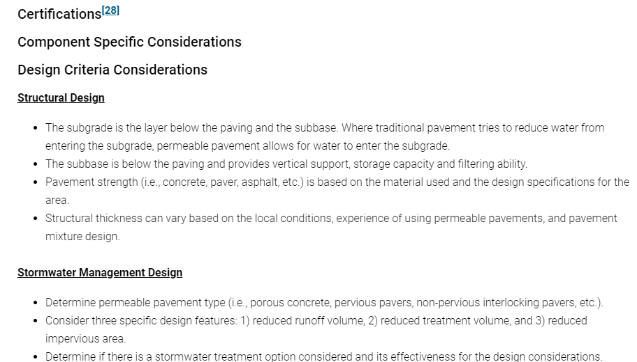
BMP Information Sheet
Design

Slide 24

BMP Information Sheet
Additional Information

Slide 25
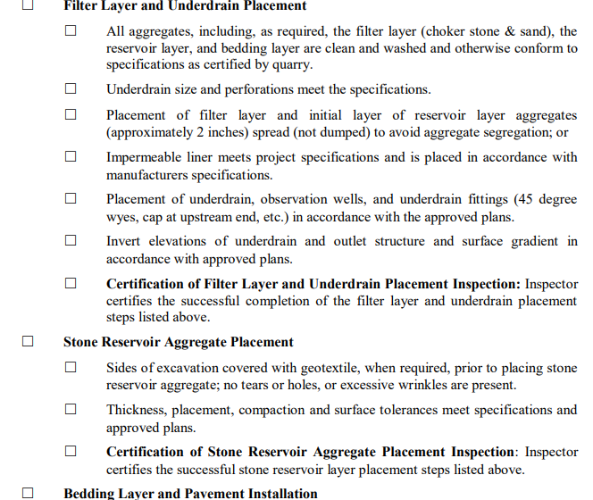
BMP Information Sheet
Sample Inspection Checklists

Slide 26

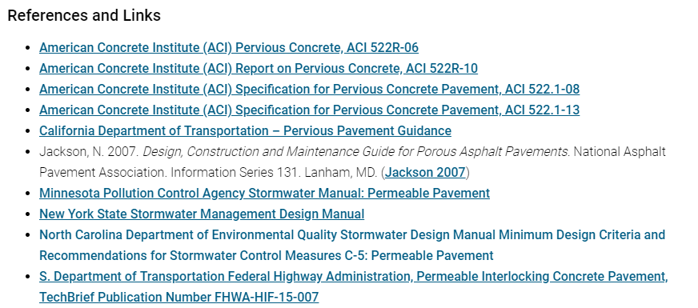
BMP Information Sheet
O&M and More Information Sources

Slide 27
YOUR QUESTIONS
ITRC Guidance: Stormwater Best Management Practices Performance Evaluation
Poll Question
  Enter your questions about using the ITRC guidance in the Q&A pod
Notes:
Poll Question:
What road blocks have you or others encountered when using the ITRC Stormwater BMP document? [short answer]

Slide 28
Panelist
Brandon Steets
Geosyntec Consultants
Santa Barbara, CA
805-979-9122
bsteets@geosyntec.com
Use of BMP performance data contained in the tool
  Enter your questions about using the ITRC guidance in the Q&A pod
Access bios at: https://clu-in.org/conf/itrc/stormwaterBMP/
Notes:
Brandon Steets is a Senior Principal at Geosyntec Consultants in Santa Barbara, California. He has served as a consultant since 2000 and specializes in National Pollutant Discharge Elimination System (NPDES) and Total Maximum Daily Load (TMDL) regulations, water quality modelling and monitoring, pollutant source investigation, and stormwater Best Management Practices (BMP) planning and design. Brandon has led watershed modeling to plan over $6 billion in new green infrastructure and demonstrate compliance with TMDL limits. He has led numerous award winning projects, including biofilter design for the Boeing Santa Susana Field Laboratory (2013 CASQA award) and microbial and nutrient source tracking for the Boston Water and Sewer Commission (2018 NACWA award).He has performed training for the American Society of Civil Engineers (ASCE) and for numerous municipalities across the United States.Â Brandon recently advised the National Academy of Sciences industrial stormwater committee regarding recommendations for U.S. EPA's 2020 Multi-Sector General Permit renewal. He received his BS in environmental engineering from Rensselaer Polytechnic Institute in 1998 and his MS in environmental engineering from the University of California at Santa Barbara in 2000.Â He is a licensed professional chemical engineer (CA), and California Stormwater Quality Association (CASQA) certified Qualified Industrial Stormwater Practitioner and Trainer of Record.

Slide 29
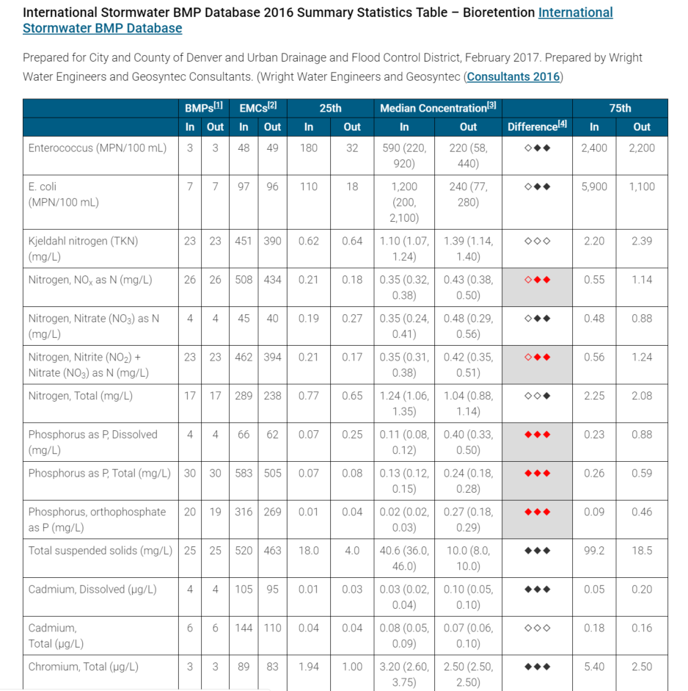

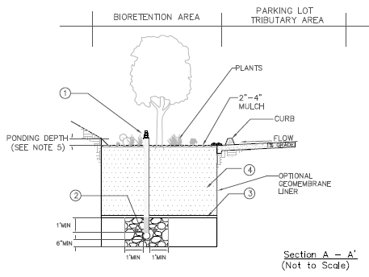
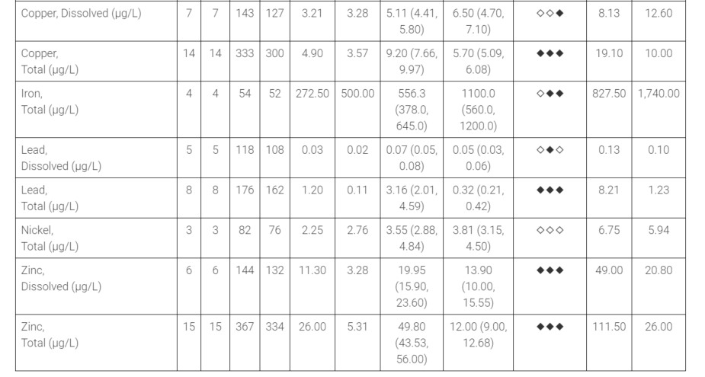
Use of BMP Performance Data Contained in Tool – Case Study Example
Scenario: Engineer assesses site, finds low infiltration rates, then seeks a flow-through treatment option that meets aesthetic needs and is effective for site-specific pollutants of concern (based on 303(d) listings and/or TMDLs) – E. coli and total copper. Tool is used, biofilter/bioretention is identified.
Question: What information can I present to show how effective my BMP will be?
Answer: effluent concentrations and statistically significant difference
Source: Ventura County Technical Guidance Manual
Notes:
Difference diamonds:
Left diamond: overlap of 95% confidence intervals (strongest)
Middle: whether medians are statistically different from each other, mann whitney test (least strong)
Right: wilcoxen rank sum test on paired influent-effluent, very useful for flow-through BMPs with short residence times (so not wet ponds)

Slide 30
Case Study Example – What Else Should You Look For?
Robustness of dataset (note data counts)
Pollutant concentration increases (e.g., phosphorus and iron)
How the BMP achieves this removal (e.g., removing particulate copper only, so don’t expect less copper-based toxicity)

Slide 31
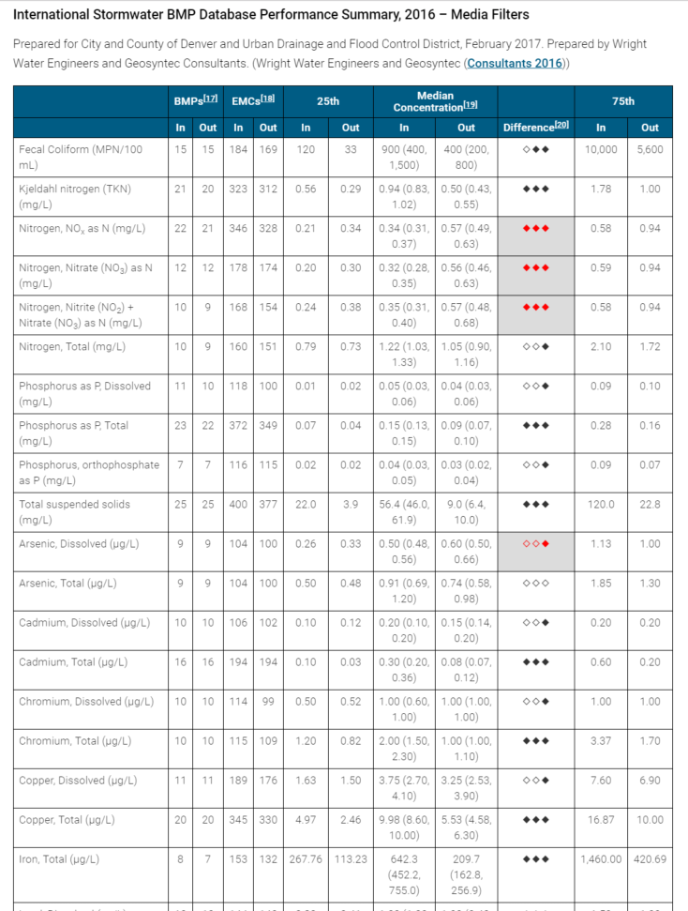
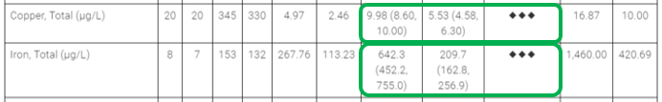
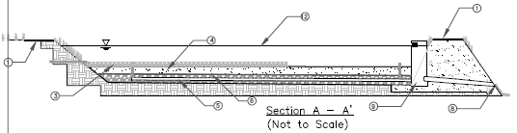
Case Study Example – Exploring Options
Question: Media filter is another option for the site, though less attractive. How would its performance compare for my pollutants of concern?
Answer: similar (using Fecal Coliform as surrogate for E. coli), and without the increases in phosphorus and iron
  But greater confidence in nitrate increase (likely converted from organic nitrogen)

Slide 32
Other Uses - Evaluating BMP’s Reliability For Meeting Permit Limits
Question: Existing site runoff at 50 ug/L copper, limit is 10 ug/L, how consistently will media filter meet this limit?
Answer: 75% of effluent samples <=10 ug/L, but at 17 ug/L influent (takeaway: select pretreatment BMP to meet ~17 [i.e., treatment train concept])
For more info: Look at paired influent-effluent in BMP Database to match 50 ug/L influent, and review design info (e.g., media type, contact time)

Slide 33
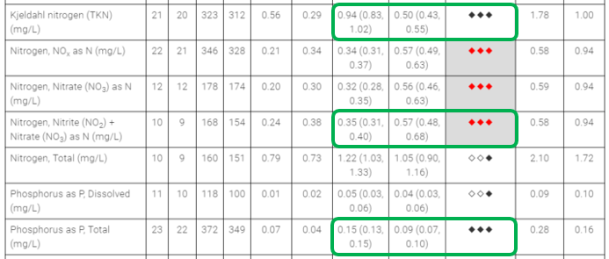
Other Uses – 2. Evaluating Achievability of Proposed Limits
Question: Can BMP meet biostimulatory criteria for total nitrogen/total phosphorus at 1.0/0.1 mg/L?
Answer: TN median is close but above, TP media is close but below, so this general BMP type is unlikely to consistently achieve these limits, may need design enhancements.
Notes:
For TN, consider saturated zone that will go anoxic to allow nitrate reduction, for TP consider iron-based media enhancements to sequester TP. Also outlet controls to increase contact time.
Two last things:
Data tables are also useful to support modeling to estimate load reductions achieved through BMP implementation scenarios.
Remember this concentration info is just one side of the load story. For loads to be reduced, also consider the volume reduction differences between sites (perc rates are site specific) and BMPs (eg, sizing, volume storage, etc.). There’s also data on this in the BMP database, particularly for bioretention.

Slide 34
YOUR QUESTIONS
ITRC Guidance: Stormwater Best Management Practices Performance Evaluation
Poll Question
  Enter your questions about using the ITRC guidance in the Q&A pod
Notes:
Poll Question:
What is your interest in the development of a national program to certify BMP effectiveness?
1 - no interest
2 - some interest
3 - significant interest

Slide 35

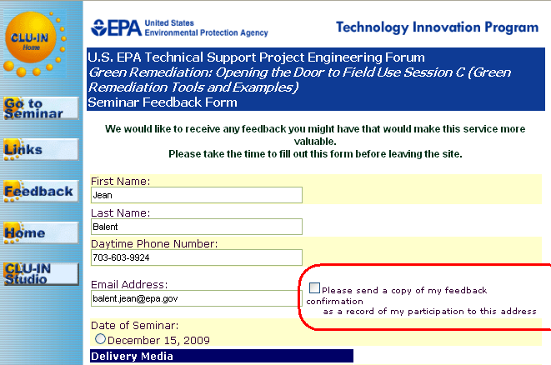
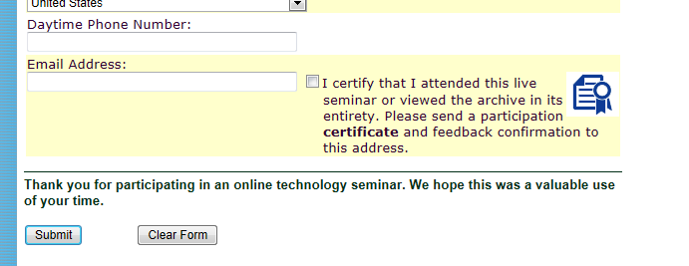
Thank You
Follow ITRC:
Links to additional resources
  http://www.clu-in.org/conf/itrc/stormwaterBMP/resource.cfm
Feedback form – please complete
  http://www.clu-in.org/conf/itrc/stormwaterBMP/feedback.cfm
Poll Question
Need confirmation of your participation today?
Fill out the feedback form and check box for confirmation email and certificate.
Notes:
Poll Question:
Do you feel more confident in applying the ITRC Stormwater BMP document?
Yes
No
Unsure – need to learn more
Think about projects that you are working on. In the next 6 months, how could you use this ITRC guidance? [short answer]
---------------------------
Links to additional resources:
http://www.clu-in.org/conf/itrc/xxxx/resource.cfm
Your feedback is important – please fill out the form at:
http://www.clu-in.org/conf/itrc/xxxx/feedback.cfm
The benefits that ITRC offers to state regulators and technology developers, vendors, and consultants include:
Helping regulators build their knowledge base and raise their confidence about new environmental technologies
Helping regulators save time and money when evaluating environmental technologies
Guiding technology developers in the collection of performance data to satisfy the requirements of multiple states
Helping technology vendors avoid the time and expense of conducting duplicative and costly demonstrations
Providing a reliable network among members of the environmental community to focus on innovative environmental technologies
How you can get involved with ITRC:
Join an ITRC Team – with just 10% of your time you can have a positive impact on the regulatory process and acceptance of innovative technologies and approaches
Sponsor ITRC’s technical team and other activities
Use ITRC products and attend training courses
Submit proposals for new technical teams and projects

