Slide 1
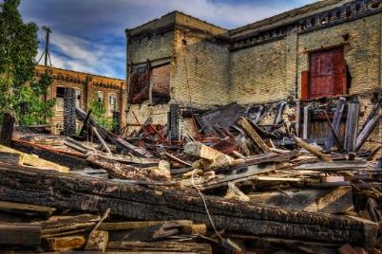

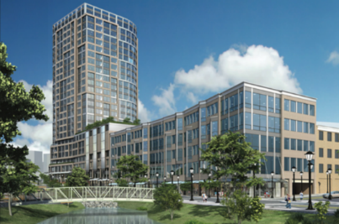
Leveraging Resources for
Brownfields Revitalization
Meet the Funders: Infrastructure
One of a series of leveraging webcasts from the U.S. Environmental Protection Agency’s
Office of Brownfields & Land Revitalization

Slide 2


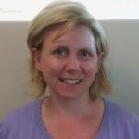
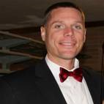
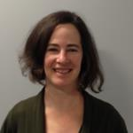

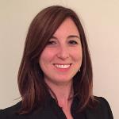
Today’s Speakers
Andrew Seth
President
Sustainable Strategies DC
Matt Ward
CEO
Sustainable Strategies DC
Aimee Storm
Land Revitalization Coordinator
U.S. Environmental Protection Agency
Marc Gerdeman
Brownfield Redevelopment Officer
City of Toledo
Danielle Rinsler
Team Lead
U.S. Department of Transportation
David Dysard
Engineering Services Administrator
City of Toledo
Sonia Brubaker
Program Manager
U.S. Environmental Protection Agency
Scott Sibley
Engineering Services Administrator
City of Toledo

Slide 3
Today’s Agenda
Introductory Remarks
Meet the Funders – Infrastructure
      U.S. Department of Transportation
      U.S. Environmental Protection Agency
      U.S. Army Corps of Engineers
Infrastructure Case Studies
      Toledo, Ohio
Q & A

Slide 4


Leveraging Resources for Brownfields Reuse
Identify, Plan & Align Resources
What specific actions are needed to implement the
plan for cleaning up and reusing your brownfield(s)?
  • What assessment/cleanup will be needed
  • What site improvements and other area improvements
  are needed
  • What funding/investment is needed? Consider all sources!
    Grants
    Technical assistance
    Local funds
    Financing
    Partner resources
    • What actions are near-term v. long-term, and where to start
  • Who is going to lead each effort (partners involved or needed)

Slide 5
Recent EPA Efforts to
Promote Leveraging
Ongoing webcasts on leveraging best
practices and “Meet the Funders” series;
next one on sustainability (February 28 @1 – 2:30pm ET)
“Setting the Stage for Leveraging Resources
for Brownfields Revitalization” – new EPA
guidebook
Brownfields Federal Program guide (updated 2015)
Brownfields Area-Wide Planning Federal Resources Matrix
Ongoing technical assistance on funding/financing available to brownfields communities via the Council of Development Finance Agencies

Slide 6



Meet the Funders – Infrastructure

Slide 7


Meet the Funders – Infrastructure
Danielle Rinsler
Team Lead
U.S. Department of Transportation

Slide 8
What DOT funding options might be available and applicable?
U.S. Department of Transportation (DOT)

Slide 9
DOT Funding
The US Department of Transportation operating administrations and Office of the Secretary administer a wide variety of grant programs
  Office of the Secretary (OST)
    TIGER (OST)
    FASTLANE (OST/Build America Bureau)
  Federal Highway Administration (FHWA)
  Federal Transit Administration (FTA)
  Federal Railroad Administration (FRA)
  Federal Aviation Administration (FAA)
  Maritime Administration (MARAD)
  Pipeline and Hazardous Materials Safety Administration (PHMSA)
Notes:
I’ll highlight a few of the larger programs that are often used in conjunction with other sources of funding to advance infrastructure projects, and touch on some of the mode-specific grant programs and resources available.

Slide 10
DOT Grants – Freight and Surface Transportation
FASTLANE Grants:
  Nationally/Regionally Significant Freight Grants.
  $4.5 Billion over five years.
  Annual Application Cycle (Notice of Funding Opportunity).
  May cover up to 60 percent of project costs.
  www.transportation.gov/buildamerica/FASTLANEgrants
TIGER:
  Surface Transportation Grants Impacting Nation, Metropolitan Area or Region.
  $500 million multimodal, merit-based discretionary grant program.
  Strong focus on transformative projects and creating ladders of opportunity.
  Eligible applicants: State, local, and tribal governments, transit agencies, MPOs, and other public entities
  Cost Share or Match
    TIGER funds may cover up to 80 percent of projects costs in urban areas and 100 percent of project costs in rural areas
  www.transportation.gov/tiger/
Notes:
While much of the BATIC’s work is focused on financing - or loans that require repayment, the Department of Transportation also has several funding – or grant programs that do not require repayment. Project sponsors should know about these programs and leverage DOT grants to the extent that they can when developing the overall project’s funding strategy. I will talk here about just a few of these but you should be aware that there are many specialized grant programs within DOT beyond the ones I am addressing today.
The FAST Act established a discretionary competitive grant program of $4.5 billion over five years for nationally and regionally significant highway, rail, port, and intermodal freight and highway projects. DOT refers to this program as “FASTLANE” grants. In the first round in FY16, $800 million in grants were awarded to 18 project sponsors. A notice of funding opportunity for the second round for FY17 closes tomorrow – on December 15. There will be three more annual solicitations for applications running through 2020.
States, large MPOs, Tribes, localities, Port Authorities and Federal land management agencies may apply for grants for projects, which generally must have a total cost of at least $100 million. Each year, a minimum amount of funds must be used for rural projects (25 percent) and projects under the $100 million cost threshold (10 percent).
Another program that can help various surface transportation projects is the TIGER grants program. TIGER is appropriated by Congress on a year-by-year basis, but they have done so every year since 2009. The last round, which also closed in April, was for a total of $500 million. There is a good chance that TIGER will see future rounds at or near the $500 million mark.

Slide 11
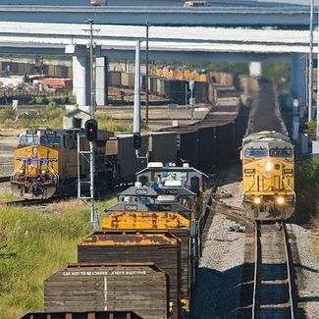
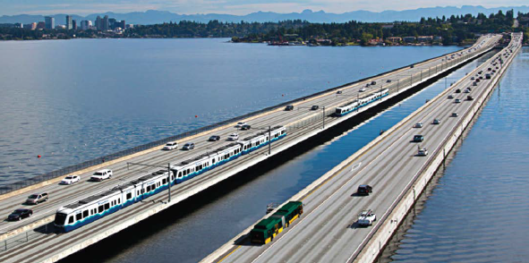
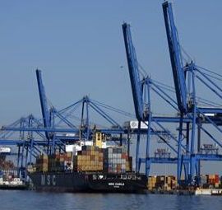
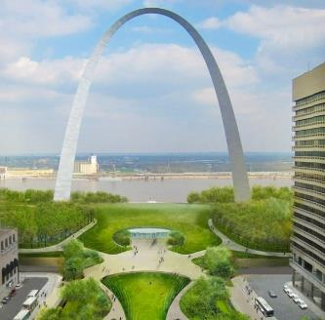

TIGER Discretionary Grants
Notes:
I’ll talk a little more about TIGER, which is a good potential source of funding for brownfield redevelopment projects that include transportation components.

Slide 12
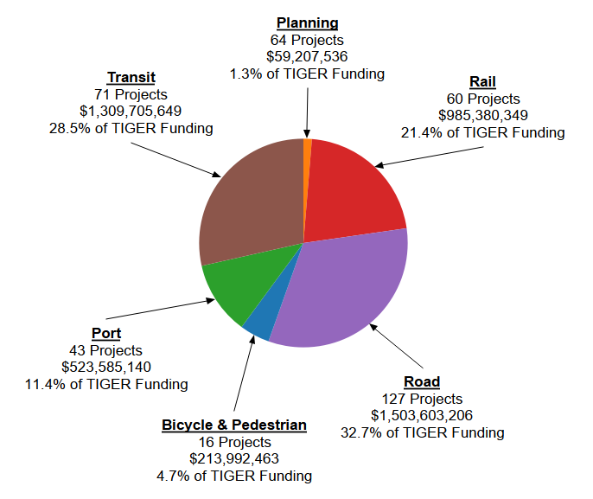
TIGER Competitive Grant Program
TIGER Program
  Surface transportation modes (road, rail, transit, port)
  Projects with significant impact on Nation, region or metro area
  $5.1 billion since 2009 (421 projects)
Selection Criteria
  Safety
  State of good repair
  Economic competitiveness
  Quality of life
  Environmental sustainability
  Innovation
  Partnership
Also...Project Readiness and Ladders of Opportunity

Slide 13
Technical Assistance
USDOT offers technical assistance to help applicants through the TIGER process
Previous TIGER application debriefs
Benefit cost analysis resource guide
Special Topics Webinars
Email questions to: TIGERGrants@dot.gov

Slide 14
DOT Grants – Transit and Formula
Transit Capital Investment Grants:
  Fixed guideway Grants for new projects (New Starts/Small Starts) and to Expand Core Capacity.
  $2.3 Billion/year through FY 2020.
  Applications accepted at any time during the year.
Formula-Based Grants:
  States receive funding from USDOT via a distribution formula.
  States and MPOs award grants.
  Examples:
    Congestion Mitigation & Air Quality (CMAQ) - $2.3 Billion/year
    National Highway Freight Program - $1.1 Billion/year.
Notes:
For transit projects, there are also several programs worth investigating. For example, the Federal Transit Administration offers Capital Investment Grants, which can help fund light rail, heavy rail, commuter rail, streetcar, and bus rapid transit projects. Three key programs are:
New Start Grants are for new projects of greater than $300 million in value.
Small Start Grants are for new projects that are below $300 million in value.
And Core Capacity Grants which are investments that increase capacity in existing transit systems.
The last thing I will mention, is formula-based grants. These funds are distributed from the Department of Transportation to each state based on a predetermined formula. States – and in some cases, Metropolitan Planning Organizations - in turn, award grants to individual projects. There are quite a few formula grant programs available and each state has its own application procedures, but a couple examples of formula grants are:
Congestion Mitigation and Air Quality, which offer $2.3 billion nationwide each year. Grants can be used for a broad range of projects that accomplish just what the title says: reduce congestion and improve air quality.
Another formula program is the National Highway Freight Program, which distributes about $1.1 billion each year.
Again, I just offered a small sampling of grants that are offered. There are far too many programs available for transportation projects than we have time to cover here, but the BATIC team is happy to help sponsors identify which ones may be helpful for their individual project.

Slide 15
DOT Funding: FTA Resources
FTA: Office of Program Management (TPM)
Administers a national program of capital and operating assistance by:
  Managing financial and technical resources
  Directing program implementation through Regional Offices
Provides major capital project management for FTA assistance programs
Coordinates the development and dissemination of program guidance and technical assistance
Notes:
Resources within FTA for more information

Slide 16
DOT Funding: FTA Resources
Office of Transit Programs (TPM-10)
Fixed guideway Grants for new projects (New Starts/Small Starts) and to Expand Core Capacity. Manages formula and Discretionary Grant Programs for: Urbanized Areas (5307), Passenger Ferries (5307), Fixed Guideway Capital Investments (5309), the Enhanced Mobility of Seniors and Individuals with Disabilities (5310), Rural Areas (5311), Tribes (5311), Emergency Relief (5324), State of Good Repair (5337), and Grants for Buses and Bus Facilities (5339)
Develops technical assistance information regarding new statutory, regulatory, policy, or procedural requirements for the annual apportionment of capital and operating funds;
Develops Technical Assistance Programs in support of FTA’s grant programs, including the Rural Transit Assistance Program, and administering the Coordinating Council on Access and Mobility (CCAM).
  https://www.transit.dot.gov/grants
  https://www.transit.dot.gov/about/regional-offices/regional-offices#

Slide 17
FHWA Apportioned Programs Under FAST
Average annual highway apportionments,
FY 2016-2020 ($ billions)
Notes:
The apportioned programs are those where the funds are distributed to the States by statutory formula. About 92% of FHWA funds are apportioned.
National Highway Performance Program (NHPP) – funds for the construction and improvement of the National Highway System
Surface Transportation Block Grant Program (STBG) – flexible funds for Federal-aid highways, bridge rehab or replacement or safety project on any public road or for public transportation. Also eligible are Transportation Alternatives and Recreational Trails.
Congestion Mitigation and Air Quality Improvement Program (CMAQ) – funds transportation projects or programs that will contribute to attainment or maintenance of air quality standards for ozone, CO, and particulate matter.
Highway Safety Improvement Program (HSIP) – fund to be invested under a data-driven State Strategic Highway Safety Plan to improve safety on any public road.
National Highway Freight Program (NHFP) – a new formula program for the improvement of the National Highway Freight Network
Metropolitan Planning – funds the transportation planning expenses of metropolitan planning organizations
Rail-Highway Grade Crossing Program – to improve safety at rail-highway grade crossings.

Slide 18
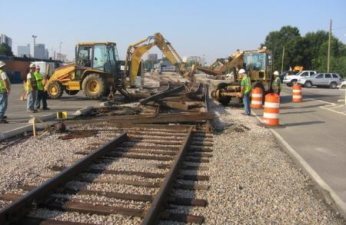
DOT Funding: Federal Railroad Administration (FRA) Rail Network Development
Rail Program
  High-Speed Intercity Passenger Rail (HSIPR) Grants
  Amtrak Operating and Capital Grants*
  Railroad Safety Technology Grants for PTC
  Railroad Safety Infrastructure Improvement Grants
  Railroad Safety Grants for the Safe Transportation of Energy Products by Rail
  Rail Line Relocation Grants*
  Disaster Assistance Grants
  Transportation Investment Generating Economic Recovery Grants
  Research, Development, and Technology
* The Fixing America’s Surface Transportation (FAST) Act modifies these grant programs.
Notes:
FRA has a $25 Billion grant portfolio, with the vast majority of Rail Program grants funding High Speed Rail and Amtrak operations and capital programs

Slide 19
What DOT financing options might be available and applicable?
U.S. Department of Transportation (DOT)

Slide 20
Build America Bureau - Programs
Bureau Credit Assistance: TIFIA, RRIF
Private Activity Bonds
FASTLANE Grants
Innovative Finance Best Practices

Slide 21
Transportation Infrastructure
Finance and Innovation Act (TIFIA)
What is TIFIA?
Federal program that provides loans, loan guarantees and lines of credit to transportation projects
Program’s lending capacity has grown to about $20 billion in credit assistance
Why use TIFIA?
Leverages Federal, State and local resources and stimulates private investment
Accelerates project delivery by accessing additional upfront funds
Provides low interest rates and flexible repayment terms
Notes:
WHAT
Transportation Infrastructure Finance and Innovation Act = TIFIA
TIFIA credit assistance encourages private investment by offering loans at rates comparable to those available to the public sector
Following the FAST ACT transportation bill that passed in 2015, TIFIA now has the capacity to provide up to $$20 billion in credit assistance
WHY
Facilitates new revenue streams and private investment
Provides low interest rates and flexible repayment terms
Federal government can serve as flexible, patient investor

Slide 22
Private Activity Bonds (PABs)
What are PABs?
Allow for tax-exempt bonds for projects with private investment
$15 Billion authorized for allocation by U.S. DOT
Why use PABs?
Offset higher costs of capital generally incurred by the private sector in Public Private Partnerships (P3s)
Can contribute to making P3 projects financially feasible
Notes:
WHAT
Private Activity Bonds = PABs
Private Activity Bonds (PABs) are tax-exempt bonds for projects with private investment.
WHY
PABs serve to lower the cost of capital to the private sector and therefore encourage their investment.
PABs are often used within a P3 structure to provide lower cost capital to the private sector.

Slide 23
Railroad Rehabilitation &
Improvement Financing (RRIF)
What is RRIF?
Federal program that provides direct loans and loan guarantees to finance railroad and intermodal equipment and infrastructure that results in public benefits (safety, economic development, environmental improvements, service and capacity)
Authorized to loan up to $35 billion ($7 billion reserved for freight railroads other than Class I)
Why use RRIF?
Direct loans can fund up to 100% of eligible project costs
Small Loans (< $100,000) can be approved
Provides low interest rates and flexible repayment terms

Slide 24
RRIF
RRIF Program Priorities
Enhance public safety
Promote economic development*
Enhance the environment
Improve competiveness of U.S companies in international markets
Endorsed in State planning documents
Improve railroad stations and passenger facilities and increase TOD*
Preserve or enhance rail or intermodal service to small communities/rural areas
Enhance service and capacity in the national rail system*
Materially alleviate rail capacity problems….

Slide 25
Build America Bureau – TOD Eligibility
Transit-Oriented Development (TOD)
FAST Act makes TOD projects eligible under RRIF and TIFIA to
  Promote commercial and residential development near transit hubs
  Increase transit ridership
  Promote walkable, sustainable land use
TOD under RRIF can include commercial and residential development
TOD under TIFIA requires a project-specific review (eligible elements might include: property acquisition, demolition, site preparation, walkways, pedestrian and bicycle access,, etc.)
Project must be physically or functionally related to a transportation facility (RRIF….to a passenger rail station or multimodal station that includes rail service)

Slide 26
Additional Resources
Federal Register Notice Regarding Consideration and Processing of Applications for Financial Assistance Under the Railroad Rehabilitation and Improvement Financing (RRIF Program), 75 Fed. Reg. 60165 (September 29, 2010) (https://www.fra.dot.gov/eLib/details/L02706)
Program Guide (https://www.fra.dot.gov/Page/P0128)
Letter of Interest Form (https://www.fra.dot.gov/eLib/Details/L02705)
Letter of Interest Checklist, Application Checklist and Application Process Quick Guide (www.fra.dot.gov)
Buy America Information (http://www.fra.dot.gov/Page/P0185)

Slide 27
I have a specific project and I’m looking for assistance with navigating the various DOT funding/financing options, what should I do?
U.S. Department of Transportation (DOT)

Slide 28

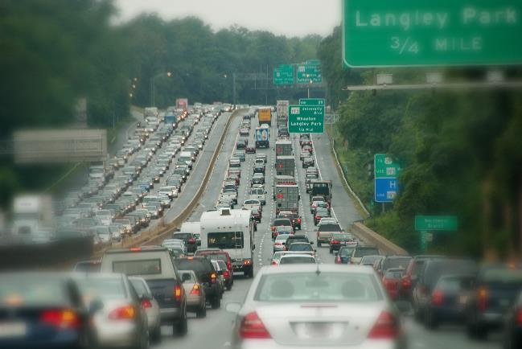
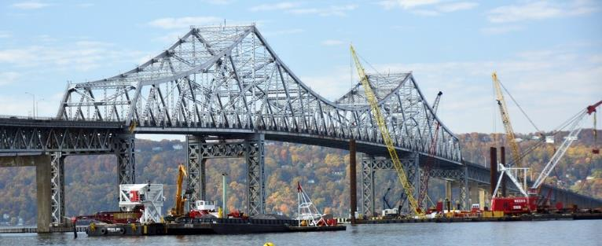
The Status Quo: U.S. Infrastructure Backlog
Notes:
The short answer is “Call the Build America Bureau,” but I’ll provide some context. In 2015, Secretary Foxx released a thirty year framework called “Beyond Traffic.” This paper looks at the latest data and anticipates the trends and choices facing our transportation system over the next three decades. If we fail to invest in its transportation infrastructure despite projections for population growth, peak congestion, and increased freight and trade flows the future will mean stranded commuters, congested ports, and failing bridges and tunnels.
If we’re going to continue to grow economically and leave an infrastructure system better than we’ve inherited, we have to plan for these challenges today. We have the opportunity to build world class transportation infrastructure. A system that moves people and goods safely, quickly, and maybe even in style.
However, making those investments is not an easy task….

Slide 29
The Status Quo: U.S. Infrastructure Backlog
Financing and funding infrastructure has become more difficult than actually building it
Not due to lack of financing dollars: U.S. DOT has over $50 billion available in Federal assistance programs
Access to this financing requires complying with federal regulations, complex credit structures, and the need to coordinate with multiple points of contact within the federal government
Notes:
The fact is that financing and funding infrastructure has become more difficult than actually building it and many steps need to be taken before the first shovel goes into the ground for any given project. Project sponsors have to:
Figure out the permitting and developing process
Marshall stakeholders to design and develop the project while taking into account the needs of the community
And figure out how they are going to pay for projects that can cost millions or billions of dollars
And, importantly, these problems aren’t due to lack of financing dollars: U.S. DOT has over $50 billion available in Federal credit programs such as TIFIA – and this does not include grant programs like TIGER, FAST Lane and New Starts for transit systems.
The problem is many communities either don’t know about these programs, or don’t know how to effectively utilize them because of the complicated regulations, complex credit structures, and the need to coordinate with multiple points of contact within the federal government.
On the private side – we have investors ready to jump in – but they have trouble identifying suitable projects, because too few sponsors are willing or knowledgeable enough to engage in public-private-partnerships.
We developed the Build America Bureau to change all this.

Slide 30
Build America Initiative – The Bureau
July 2014 Build America Administration-wide initiative. BATIC Working Group forms. Credit/technical functions disbursed.
July 2015 BATIC adds full-time core team. Centralized coordination – functions remain disbursed.
December 2015 President Obama signs the FAST Act – 5-year legislation calling for a National Surface Transportation Innovative Finance Bureau.
July 2016 – DOT unveils the Build America Bureau. Credit/Technical functions centralized – some functions remain disbursed.
Notes:
Historical Context: In 2014, the Department of Transportation came together with other agencies in the Obama Administration to tackle a persistent problem:
Throughout the Federal government, there are countless programs and experts available to help develop infrastructure – Including Transportation - but often, communities don’t know they’re there or how to use them to finance and accelerate projects.
Furthermore, private sector firms want to help drive and invest in the development of transportation infrastructure but identifying suitable projects, navigating the entitlement, permitting and credit processes and finding sponsors willing to engage in public private partnerships has been far too cumbersome.
___________________________________________________
We created the BATIC or the Build America Transportation Investment Center - in July 2014 - to make the process run more smoothly and drive the development of P3s where they make sense to help build US transportation infrastructure.

Slide 31
FAST Act Establishes the “Bureau”
The FAST Act:
1st long-term Federal transportation bill in 10+ years
Authorized $305 billion for FY16 - 20 for all surface transportation modes.
Established National Surface Transportation and Innovative Finance Bureau (Build America Bureau).
Made TOD expenses and projects eligible under the TIFIA and RRIF Credit Assistance Programs.

Slide 32
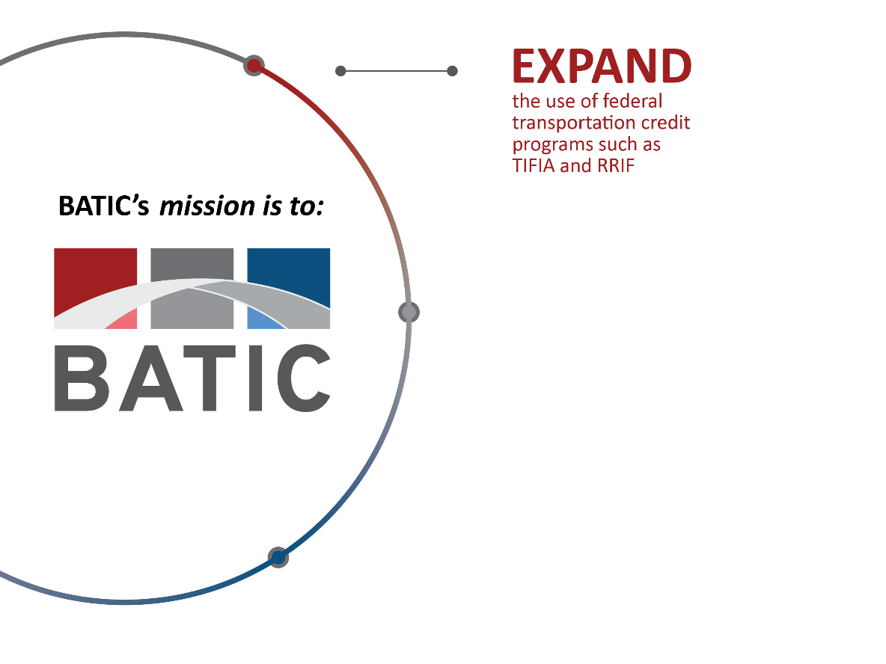
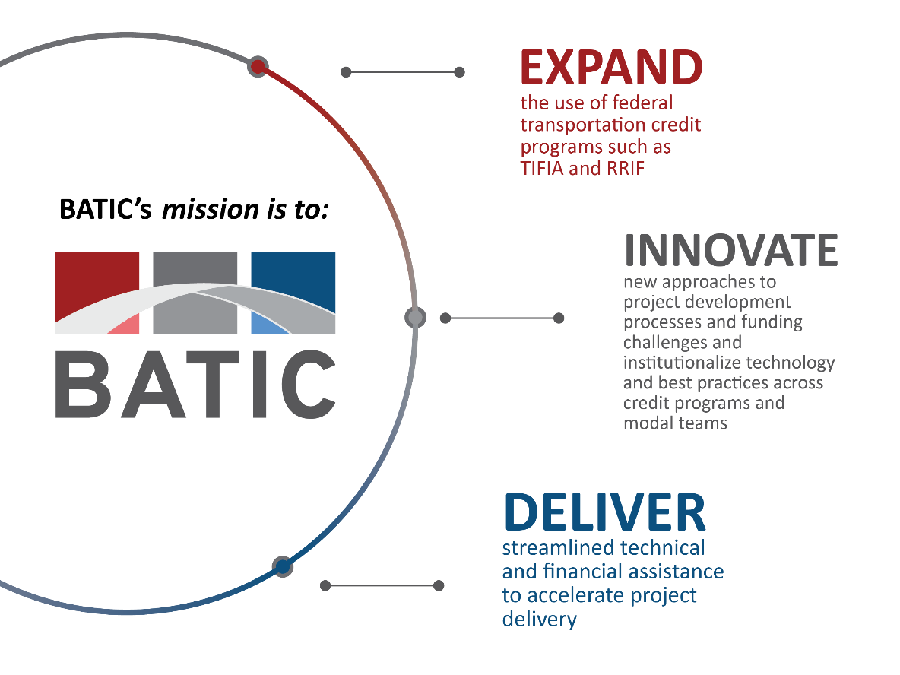
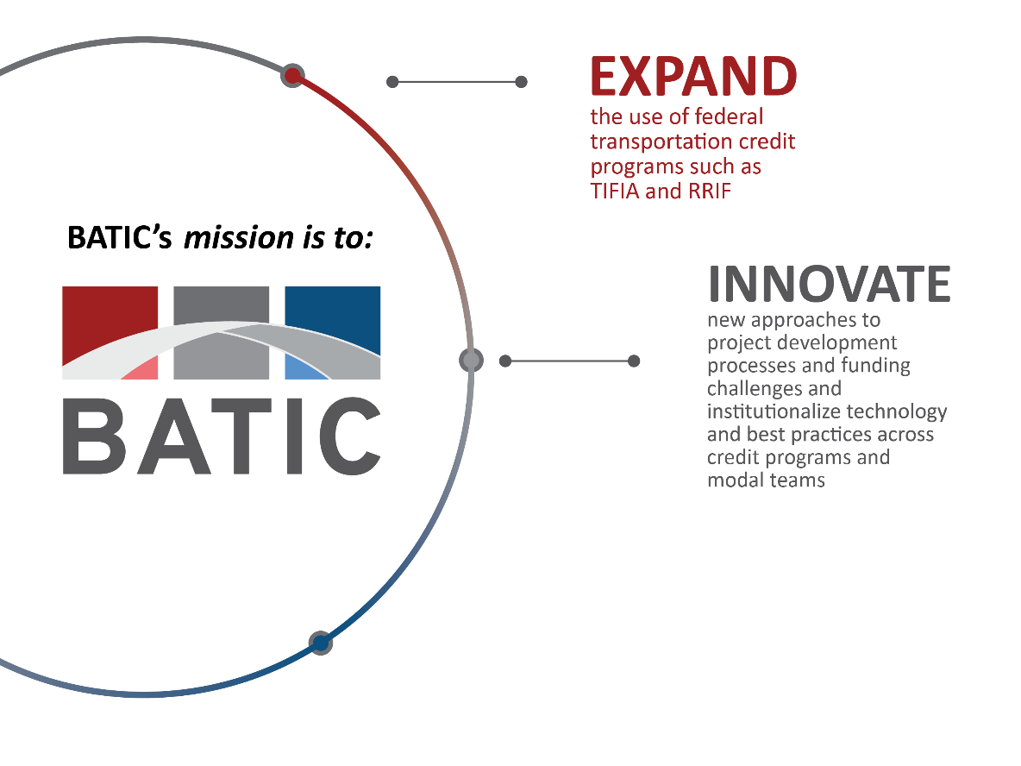
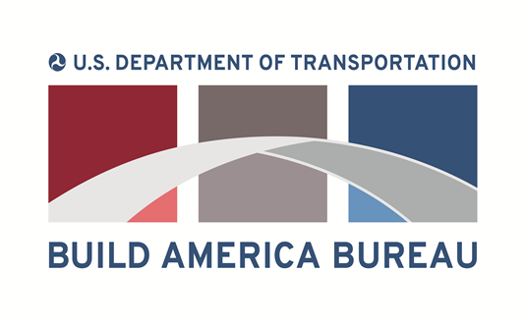
The Bureau’s Mission
Notes:
We are already serving as the single point of contact and coordination for states, municipalities and project sponsors to help develop and build transportation projects.
Through the Bureau…
We are encouraging sponsors to utilize technical assistance on permitting, project delivery and other issues. We’re delivering that assistance through direct consultations and by laying out best practices that can be utilized by both the public and the private sector.
We are also working to increase access to existing credit programs. We are increasing the number and types of projects that are eligible for credit and working to remove barriers to accessing the programs.
And finally we are making sure that potential applicants – including those in the private sector – know about the tools that we have available.
The first leg of our mission is to EXPAND the use of federal transportation credit programs.
Why is this important? As I mentioned, the Bureau’s Credit Programs have $50 billion in loans available.
2.3 percent yesterday
Loans out to 35 years
Defer payments up to 7 years after construction
Structure payment schedule to revenue projections
This can have a MAJOR impact on US transportation infrastructure.
_____________________________________________
The second leg of the mission is to INNOVATE. We help find new approaches to project development and funding challenges then institutionalize technology and best practices to benefit future projects.
The innovation and transferability of this innovation is critical.
In a partnership with AASHTO, we have established the Build America Institute to help educate and inform project sponsors. The Institute, combined with our team’s experience, can provide communities with the tools to tackle a wide range of projects and address the numerous roadblocks that can come up in the development and financing of infrastructure projects.
_________________________________________________
The third leg of the mission is to DELIVER streamlined technical and financial assistance to accelerate project delivery.
By providing a single point of contact for each project and a focus from the highest level of the department, the Build America Bureau can guide projects through every stage of the process.

Slide 33
Build America Bureau - Components

Slide 34
Current and Future Roles of the Bureau
Serve as the One-Stop Shop for project sponsors to access DOT technical assistance and credit programs;
Administer the Credit Programs for RRIF and TIFIA loans, PABs and the new FASTLANE Grant program;
Streamline DOT credit application and review processes;
Provide technical assistance and best practices and financing and funding opportunities;
Reduce uncertainty and delays related to environmental reviews and permitting;
Assist in mitigating project delivery and procurement risks and costs for projects financed by the USDOT infrastructure finance programs;
Increase transparency and the public availability of information regarding projects financed by the USDOT infrastructure finance programs.
Notes:
So the Bureau is in place and many of the staff are already on board and we are committed to filling the remaining vacancies as quickly as possible.
While the credit programs are now located in-house, we are working hard to make TIFIA and RRIF to streamline and simplify the application processes.
We are assembling a Best Practices team to improve the technical assistance available to Project Sponsors, in areas such as:
Public-Private Partnerships and Value for Money
Transit Oriented Development – which might be of interest to many of the folks on this webinar
Environmental reviews and permitting

Slide 35
Additional Bureau Resources
Innovation in Practice Case Studies Webinar Series through BATIC Institute:
  Pennsylvania Rapid Bridge Replacement
  Denver Union Station
  Eagle P3 Commuter Rail
TIFIA’s FAST Act guidance webinars:
  Active Transportation Networks
  State Infrastructure Banks (SIBs)
  Ports
  Transit Oriented Development (TOD)
Best Practices Papers:
  Surface Transportation P3s
  Availability Payment Concessions P3 Model Contract Guide
  Core Toll Concession P3 Model Contract Guide
Notes:
I’d also like to mention a few resources we have available to help project sponsors understand some of the best practices and techniques that can help in early project development.
One is the BATIC Institute, which will become the Build America Institute shortly.
And also, within the Bureau we have
Continuing Guidance on FAST Act changes and
Several Best Practices Papers that can help in the development of public private partnerships

Slide 36
Email: BuildAmerica@dot.gov
Phone: 202-366-2300
Notes:
In closing, let me say that the Build America Bureau can be an excellent asset and partner to communities as they seek to modernize and expand their transportation infrastructure.
The establishment of the Bureau, along with:
Increased access to low-cost credit;
New authority to finance Transit Oriented Development;
To finance smaller projects at the local level,
To capture expertise and capital through Public Private Partnerships, and;
The ability of the Bureau to serve as your one-stop shop
Can make a real difference in delivering more good transportation projects in your states and municipalities.
Thank you for the opportunity to talk to you about this exciting new organization.

Slide 37
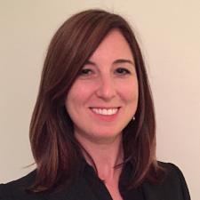
Meet the Funders – Infrastructure
Sonia Brubaker
Program Manager
U.S. Environmental Protection Agency

Slide 38
What is the Water Finance Center?
U.S. Environmental Protection Agency (EPA)

Slide 39

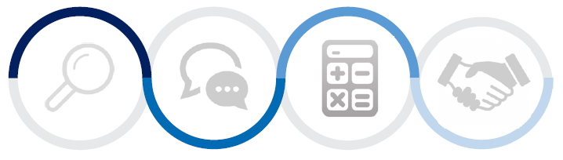
Water Infrastructure and Resiliency Finance Center
The Water Finance Center is an information and assistance center, helping communities make informed decisions for drinking water, wastewater, and stormwater infrastructure to protect human health and the environment.
Research
Advise
Innovate
Network
Notes:
A Think and Do Tank
Launched on January 16, 2015.
Focus on drinking water, wastewater, and stormwater – financing sustainable and resilient infrastructure.
Provide innovative financing and technical guidance to communities and stakeholders.
Work includes advising, convening, facilitating peer-to-peer learning opportunities, and providing access to information to share community models of financial and partnership success.

Slide 40
What are the funding sources for water infrastructure?
U.S. Environmental Protection Agency (EPA)

Slide 41
EPA Water Infrastructure Funding
Clean Water State Revolving Fund (CWSRF)
  $42 billion (1987-2016)
Drinking Water State Revolving Fund (DWSRF)
  $19 billion (1997-2016)
Alaska Native Villages and Rural Communities Grant Program
  $519.6 million (1995-2016)
U.S.-Mexico Border Water Infrastructure Grant Program
  Approx $600 million (2003-2014)
Tribal Assistance Program
  Clean Water Indian Set-Aside - $516.4 million (1987-2016)
  Drinking Water Infrastructure Tribal Set-Aside - $285.8 million (1997-2015)
Water Infrastructure Finance and Innovation Act (WIFIA)
Notes:
The SRFs have much to offer communities in need
Can set interest rates as low as 0%
Loans at or below market interest rate with repayment terms of:
- DWSRF: generally 20 years, 30 for disadvantaged communities
- CWSRF: up to 30 years or useful life, whichever is less
Buy or refinance local debt obligations (refinance terms up to 30 years for both SRFs)
Insurance or guarantees for local debt obligations
Additional subsidy as grants, principal forgiveness or negative interest rates (amounts established by Congress)
Communities across the country are facing the immediate challenges of aging and inadequate infrastructure for drinking water and wastewater. To support communities with replacement or upgrade efforts, EPA’s state revolving funds have provided over $66 billion in low-interest loans for water infrastructure projects since 2009.
Since 2009, CWSRFs have had the ability to provide additional subsidization. Over $4.3 billion has been provided to date.
The DWSRFs have had to option to provide additional subsidy from 1999-2008. Cumulative total of $377M in additional subsidy provided
And from 2009-2015 (additional subsidy mandated at various percentages, but not necessarily to disadvantaged communities*), the cumulative total of $2.254B in additional subsidy provided
We also provide funding through other mechanisms:
Alaska Native Villages and Rural Communities Grant Program
$519.6 million (1995-2016)
U.S.-Mexico Border Water Infrastructure Grant Program
Approx $600 million (2003-2014)
Tribal Assistance Program
Clean Water Indian Set-Aside - $516.4 million (1987-2016)
Drinking Water Infrastructure Tribal Set-Aside - $285.8 million (1997-2015)
Anticipated - Water Infrastructure Finance and Innovation Act (WIFIA)

Slide 42

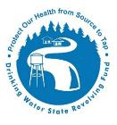
Clean Water State Revolving Fund
&
Drinking Water State Revolving Fund
Funds Awarded
Cumulative federal funds awarded DW: $17.5B CW: $39.5B
Cumulative assistance provided DW: $30B CW: $111.2B
Assistance provided in 2015 DW: $2.1B CW: $5.8B
Funds Status & Uses
Loans at or below market interest rate
  2015 Average Interest Rate: 1.7% versus the market rate of 3.8%
Repayment terms
  DWSRF: generally 20 years, 30 for disadvantaged communities
  CWSRF: up to 30 years or useful life, whichever is less
Buy or refinance local debt obligations (refinance terms up to 30 years for both SRFs)
Insurance or guarantees for local debt obligations
Additional subsidy as grants, principal forgiveness, or negative interest rates (amounts established by Congress)

Slide 43
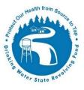

Eligible Projects Under the SRFs
DWSRF
Source (e.g., well replacement, aquifer storage and recovery)
Treatment (includes reuse and desal)
Transmission and distribution
Finished water storage
Water system consolidation
Creation of new water systems (limited)
Technical assistance for project planning and design
Climate change mitigation / adaptation (e.g., energy efficiency, renewables, water conservation -- as part of projects)
Resilience and sustainability (e.g., security measures, green infrastructure -- as part of projects)
CWSRF
Constructing Publicly Owned Treatment Works (POTWs)
Nonpoint source
National Estuary Program projects
Centralized systems
Stormwater
Reducing demand for POTW capacity (e.g., through water conservation, efficiency and reuse)
Watershed pilot projects
Energy efficiency
Reusing or recycling wastewater, stormwater or subsurface drainage water
Security measures at POTWs
Technical assistance
Notes:
Operation and maintenance

Slide 44
What types of water infrastructure financing mechanisms does the Center provide information on?
U.S. Environmental Protection Agency (EPA)

Slide 45
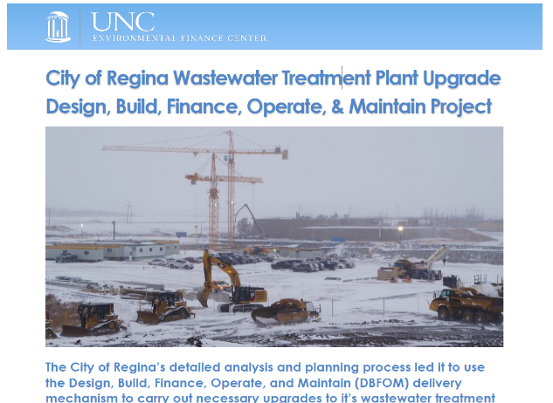
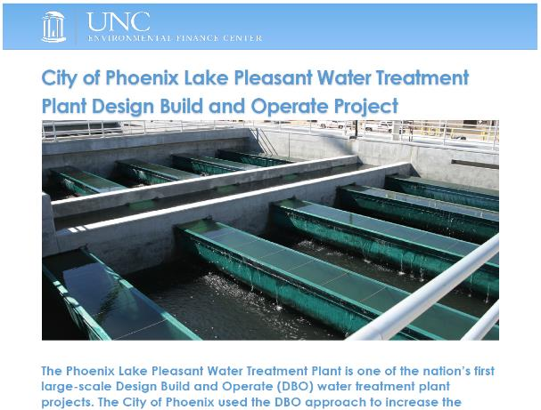
Public-Private & Public-Public Partnerships
The Water Finance Center, in conjunction with UNC Environmental Finance Center, is examining previously closed P3s to understand the:
proposed benefits
processes involved in closing a transaction
realized benefits
performance of the agreement over the useful life of the assets

Slide 46
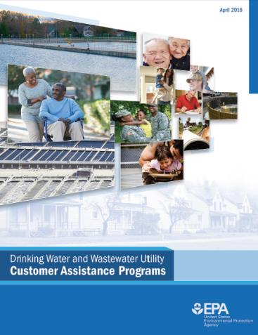
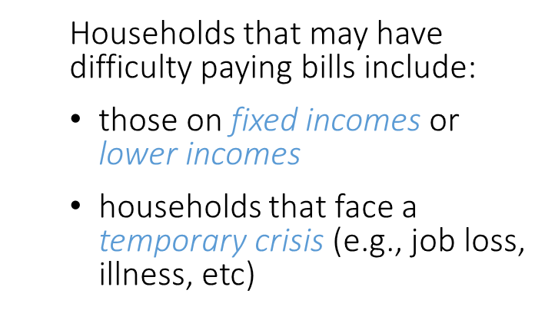
Utility Customer Assistance Programs
CAPs are voluntary programs that utilities have created for customers having difficulty paying water and sewer bills
  In 2014, 46.7 million people (14.8% of the U.S. population) lived in poverty
  (U.S. Census Bureau)
  Utilities often find approximately 1% of their customers are unable to pay at any particular time
  (WRF 2010)
Compendium available at: http://ow.ly/4nvSyO

Slide 47
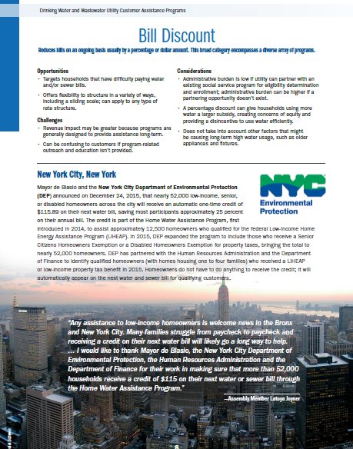
Types of CAPs
Bill Discount
Flexible Terms
Lifeline Rate
Temporary Assistance
Water Efficiency
Each Type includes:
opportunities
challenges
considerations
Short write-ups of examples are included for
each type

Slide 48
What is the Water Finance Center doing to increase funding access and readiness in communities?
U.S. Environmental Protection Agency (EPA)

Slide 49
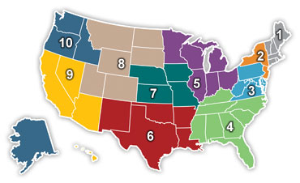
Environmental Finance Centers (EFCs)
The EFCs deliver targeted technical assistance to states, tribes, local governments, and the private sector in providing innovative solutions to help manage the costs of environmental financing and program management
Rural Community Assistance Corporation
University of Southern Maine
Michigan Technological University
California State University at Sacramento
Syracuse University
10
9
University of Maryland
Wichita State University
University of New Mexico
University of North Carolina at Chapel Hill

Slide 50
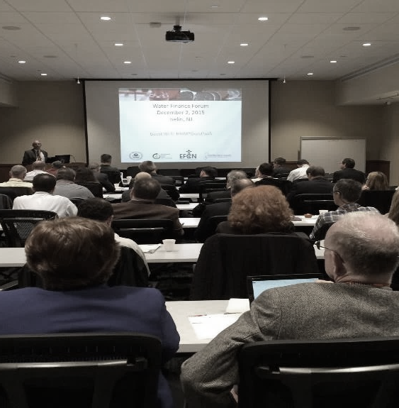
Regional Water Finance Forums
Series of Finance Forums
Bringing together communities with water infrastructure financing needs in an interactive peer-to-peer networking format.
Hear how local utilities have financed resilient water infrastructure projects
Have the opportunity to meet key regional funding and technical assistance contacts.
Scheduled forums:
  September 2015 – Addison, TX
  December 2015 – Iselin, NJ
  March 2016 – Portland, OR
  June 2016 – Big Stone Gap, VA
  November 2016 – Durham, NH
  April 2017 – R9
Topics range from:
  Communicating infrastructure needs to the public
  Strategically using the SRF
  Setting sustainable rates
  Incorporating asset management for preplanning
  Disaster funding
  Stormwater financing
  Utility partnerships
Notes:
The Center is co-sponsoring a series of regional Finance Forums with the Environmental Finance Center Network.
These events are bringing together communities with water infrastructure financing needs in an interactive peer-to-peer networking format.
Attendees will hear how local utilities have financed resilient water infrastructure projects and will have the opportunity to meet key regional funding and technical assistance contacts.
SRFs and communities participating.
Intended to be an interactive, peer-to-peer learning event to provide opportunities to better understand financing success stories from neighboring communities.
The first forum is scheduled for September 10-11 just north of Dallas., in Addison, TX.
Agenda highlights:
The Dallas forum will highlight financing success stories of:
-Resilient water infrastructure to protect from the stresses of drought, floods and other hazards;
-Disaster recovery funding;
-Financial partnerships;
-Water infrastructure communication campaigns and community engagement efforts that focus on local drivers;
-Financing water conservation measures using incentives and allow maximum returns; and
-Creating a dedicated revenue stream for stormwater and green infrastructure programs.

Slide 51
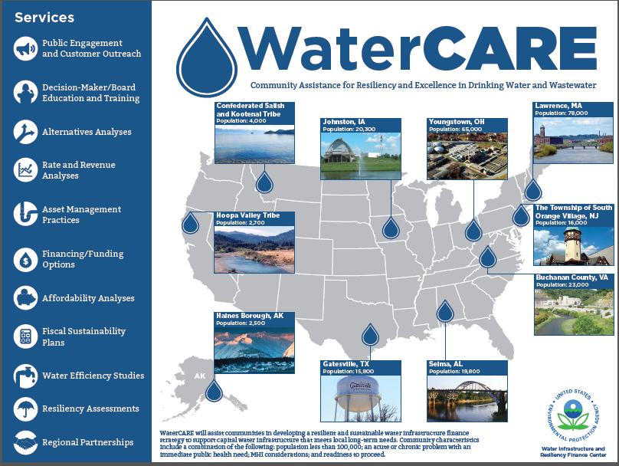
WaterCARE Communities
Predevelopment Technical Assistance Program
Community Assistance for Resiliency and Excellence (WaterCARE)
Providing mid-sized communities with drinking water and wastewater predevelopment services
Receiving financial and technical guidance for supporting community investment in water infrastructure
  Community characteristics:
    Mid-sized (population less than 100,000),
    Acute or chronic problem with an immediate public health need,
    MHI considerations, and/or
    Readiness to proceed.
Notes:
One community selected from each EPA Region – announced in January 2016
Providing financial planning services
Community characteristics:
-Mid-sized (population less than 100,000),
-Acute or chronic problem with an immediate public health need,
-MHI considerations, and/or
-Readiness to proceed.

Slide 52
US EPA Environmental Financial Advisory Board (EFAB)
A Federal Advisory Committee (governed under “FACA”)
Operates with about 30 board members representing a cross section of government, tribes, industry, not-for-profit and educational institutions
Post SRF enactment, EFAB was created to assist EPA build financial expertise. Has been active since early 90s
Holds public meetings twice a year: Next meeting is in Washington, DC in late winter/early spring
www.epa.gov/efab/envirofinance
Recent Recommendations:
  Household Affordability Challenges in the Water Sector
  Financial Capacity Development for Small Water Systems
  Financing Pre-development Activities in Communities
  Developing Dedicated Stormwater Revenues

Slide 53
What’s next?
U.S. Environmental Protection Agency (EPA)

Slide 54
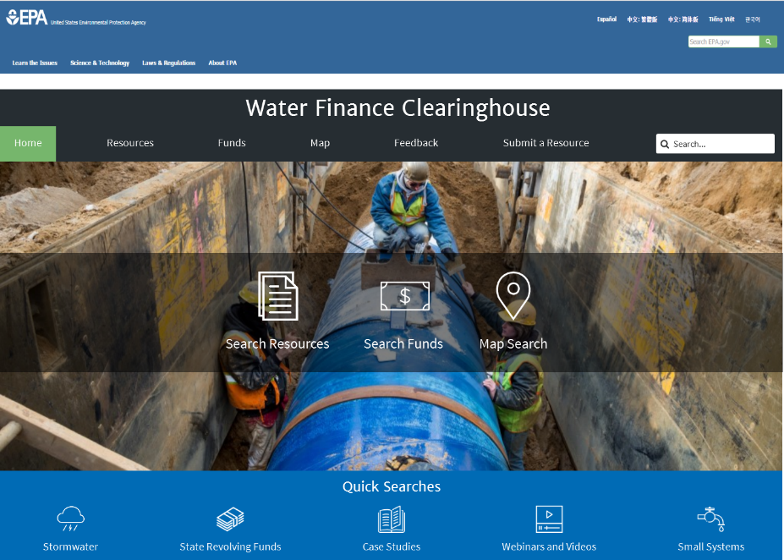




Water Finance Clearinghouse – Under Development!
Key Features:
2 Databases in 1
  Resources
  Funds
Multiple Search Options
  Search Resources
  Search Funds
  Map Search
  Quick Search – applies search filters for the user
  Search Bar

Slide 55
Resource Search Filters (Draft)
Funding Sources
Federal
  U.S. Environmental Protection Agency (EPA)
    Clean Water State Revolving Fund
    Green Project Reserve
    Drinking Water State Revolving Fund
    Clean Water Act Nonpoint Source Grant Program (319)
    Water Infrastructure Finance and Innovation Act (WIFIA)
  U.S. Federal Emergency Management Agency (FEMA)
  U.S. Department of Agriculture (USDA)
  U.S. Department of Housing (HUD)
  U.S. Department of Transportation (DOT)
  U.S. Department of Energy (DOE)
  U.S. Department of the Interior (DOI)
  U.S. National Oceanic and Atmospheric Administration (NOAA)
  U.S. Army Corps of Engineers (ACOE)
  U.S. Department of Homeland Security (DHS)
  U.S. Economic Development Administration (EDA)
  U.S. Treasury
  Coordinated Federal Funding
State
  (All States will be Listed)
Tribes & Territories
Local Government
Grants & Principal Forgiveness
Philanthropic
Private Capital
Other
Sectors
Green Infrastructure
Stormwater
Drinking Water
Wastewater
Groundwater
Potable Water ReUse
Greywater
Combined Sewer System
Financing Approaches
Drinking Water Rates
Wastewater Rates
Stormwater Utilities/Fees
General Fund
Municipal Bonds
Green Bonds
Property Taxes
Tax Districts
Public-Private Partnerships
Public-Public Partnerships
Environmental Markets/Trading Programs
Conservation Financing
Pay for Performance
Private Property Incentives
Voluntary Programs
Public Property Incentives
Multi-Use/Multi-benefit Approaches
Special Topics
Planning and Predevelopment
Technical Assistance for Financing
Community Engagement and Marketing
Costs, stormwater
Program Costs
Project Costs
Maintenance Costs
Cost Savings & Effectiveness
Legal Issues/Barriers
Affordability
Economic Development
Economically Distressed Communities
Triple Bottom Line
Climate Change & Resiliency
Financing Flood Protection
Financing Drought Resiliency
Disaster Recovery Financing
Water Efficiency Financing
Energy Efficiency Financing
Asset Management
GIS
Small Systems
Sourcewater
Scope
National
Regional
State
Resource Type
Reports
Webinar/Video
Case Study
Video
Website
Trainings
Guides
Outreach
Presentations
Events
Feasibility Studies
Resource List
Tools
Other
Author
Federal
State
Environmental Finance Center
EPA Environmental Financial Advisory Board
Local Government
Association
Non-governmental Organization
Educational Institution
Journal
Other
Date
Year
Upload Date

Slide 56
Funds Search Filters (Draft)
Funding Sources
Federal
  U.S. Environmental Protection Agency (EPA)
  U.S. Federal Emergency Management Agency (FEMA)
  U.S. Department of Agriculture (USDA)
  U.S. Department of Housing (HUD)
  U.S. Department of Transportation (DOT)
  U.S. Department of Energy (DOE)
  U.S. Department of the Interior (DOI)
  U.S. National Oceanic and Atmospheric Administration (NOAA)
  U.S. Army Corps of Engineers (ACOE)
  U.S. Department of Homeland Security (DHS)
  U.S. Economic Development Administration (EDA)
  U.S. Treasury
  Coordinated Federal Funding
State
  (All States will be Listed)
Tribes & Territories
Local Government
Grants & Principal Forgiveness
Philanthropic
Private Capital
Other
Sectors
Green Infrastructure
Stormwater
Drinking Water
Wastewater
Groundwater
Potable Water ReUse
Greywater
Combined Sewer System
Eligible Uses
Planning & Predevelopment
Capital Projects
Operations & Maintenance
Green Projects
Conservation
Eligible Applicants
Conservation District
Educational Institution
Farmers
Federal Agency
Tribes & Territories
Irrigation & Drainage Districts
Local Government
Not for Profit
Private Business or Landowner
Ranchers
State/Territorial Agency
Water Utility
Wastewater Utility
Stormwater Utility

Slide 57
Have a Water Finance Question?
Send us an email: waterfinancecenter@epa.gov

Slide 58
www.epa.gov/waterfinancecenter
Sonia Brubaker
Program Manager, Water Finance Center
Brubaker.Sonia@epa.gov

Slide 59

Meet the Funders – Infrastructure
Matt Ward
CEO
Sustainable Strategies DC

Slide 60
What role does the Army Corps play in addressing contaminated sites on rivers, lakes, harbors & other waterfronts?
U.S. Army Corps of Engineers

Slide 61
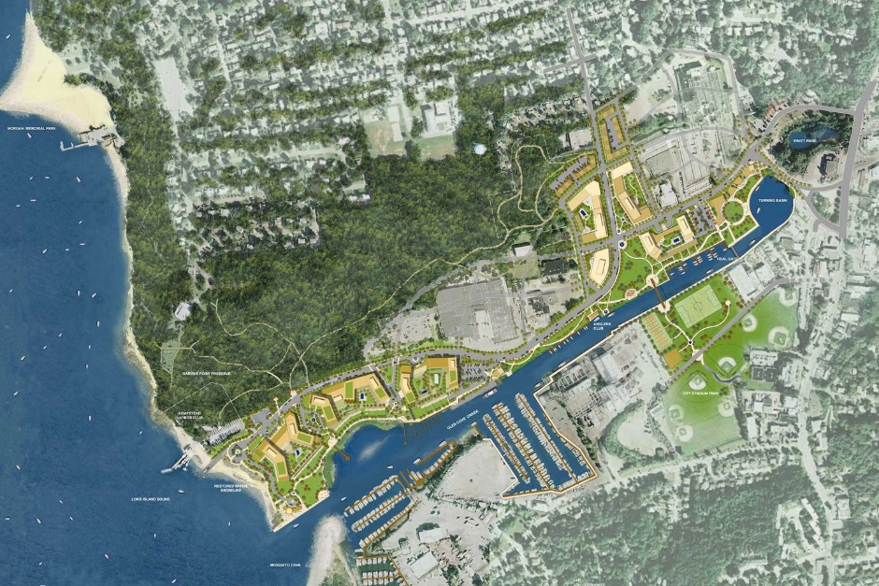
Corps Mission Areas that can support brownfields revitalization:
USACE provides design, engineering, and construction services to communities and regions on a range of public works projects connected to America’s waterbodies
Key water resource mission areas including flood control, dredging, inland waterways navigation (1/6 of America’s freight), ports and harbors (300 commercial and 600 other harbors), coastal restoration, and water recreation. (2,463 recreation areas across U.S.)
Environment mission areas include ecosystem restoration, cleanup of military installations, abandoned mine land restoration, EPA Superfund site cleanups, environmental infrastructure, and wetlands and dredge-and-fill regulations

Slide 62
Corps roles with contamination:
Corps can provide design, engineering, and construction support to address HTRW – Hazardous, Toxic & Radioactive Wastes
Corps services can include water, soil & sediment testing; site investigations, feasibility studies, remedial design & remedial action; human health & ecological risk assessments; expedited removal actions; underground storage tank closure; asbestos & lead paint abatement; compliance assessments; ordinance removal; pollution prevention projects; stormwater management; hazardous waste management
Generally, Corps can include HTRW cleanup as federal project cost if contamination is in water, but land-side contamination is typically local sponsor’s responsibility

Slide 63
What Corps programs & authorities can support local brownfield projects?
U.S. Army Corps of Engineers

Slide 64
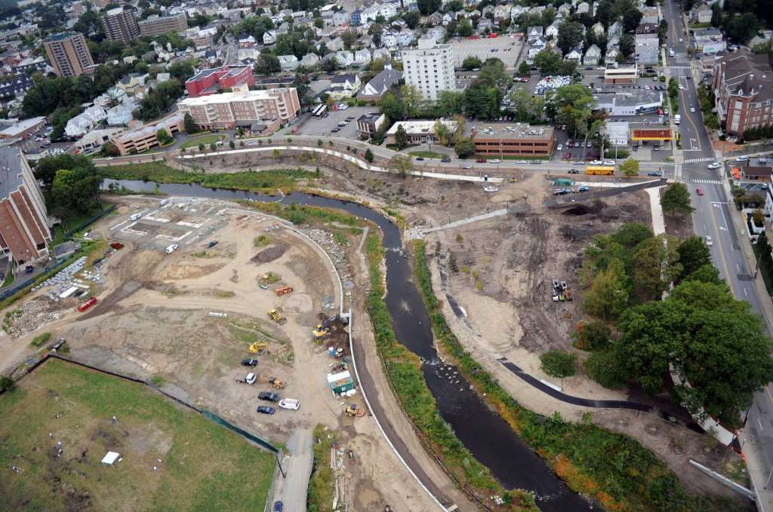
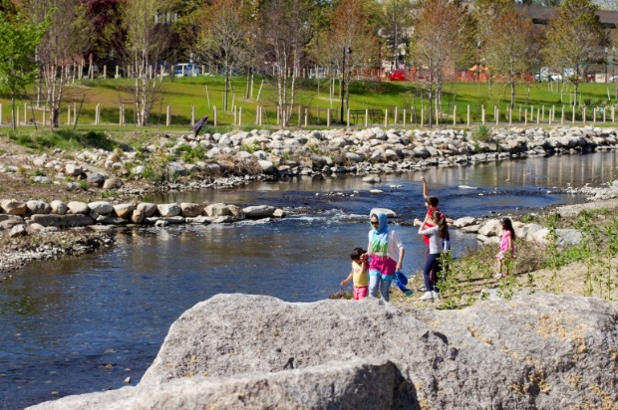
Corps Authorities & Programs:
New Section 7001 process enables localities to propose water resource projects to Corps District office, which are then evaluated for mission consistency, ranked and prioritized, and potentially created as study, engineering, and/or construction project in a USACE-Congressional process
“Continuing Authorities Programs” or “CAP” allow localities to conduct project partnerships in targeted areas

Slide 65
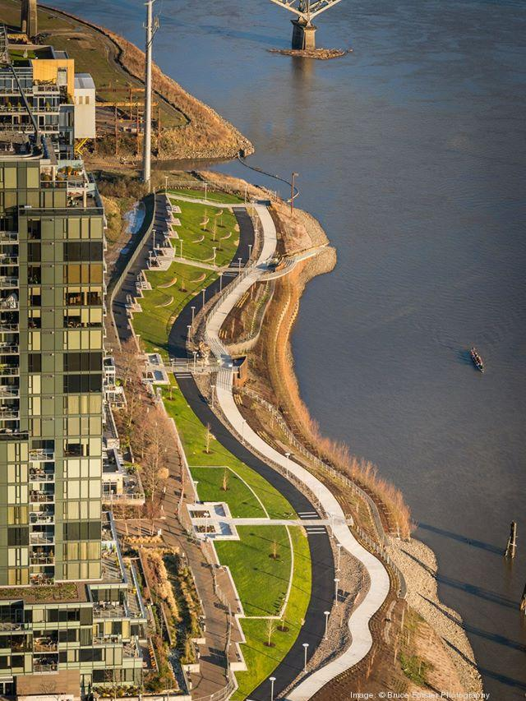
Continuing Authorities Program:
All CAPS start with $100,000 feasibility study funded by Corps, followed by 50/50 cost share on further planning
Engineering & construction cost share varies by program
Section 14 – Streambank & Shoreline Erosion ($10 million max, 35% local match)
Section 22 – Planning Assistance (50% cost share)
Section 107 – Navigation Improvements ($10 million max, match for commercial navigation varies, 50% local match for recreational navigation)
Section 204 – Beneficial Reuse of Dredged Materials ($10 million max, 35% local cost share)
Section 205 – Flood control ($10 million max, 35% cost share)
Section 206 – Aquatic ecosystem restoration ($10 million max, 35% local cost share
Section 1135 – Project modifications for environmental improvement ($10 million max, 25% local cost share)

Slide 66
How would the Corps process work for a locality seeking to conduct a waterfront brownfield project?
U.S. Army Corps of Engineers

Slide 67

Navigating the Corps Process:
Most important – work closely with the local Corps District
  41 District Offices organized under eight Divisions
  See www.usace.army.mil/Locations.aspx
Identify matching sources early on
Draft Section 7001 Proposal Letter
Work closely with your congressional delegation

Slide 68

Meet the Funders – Infrastructure
Marc Gerdeman
Brownfield Redevelopment Officer
City of Toledo, Ohio
David Dysard
Engineering Services Administrator
City of Toledo, Ohio
Scott Sibley
Engineering Services Administrator
City of Toledo, Ohio

Slide 69
City of Toledo, Ohio
Brownfield Revitalization Program
Manage funds and projects for the purpose of redeveloping Toledo’s land for higher and better uses.
Toledo has received 21 U.S. EPA grants and two supplemental grants totaling $8 million and also acquired over $14 million in various federal, state, local and private funding sources to redevelop land in Toledo.

Slide 70
U.S. EPA Grants
$820,000 Revolving Loan Fund (2016)
$500,000 Coalition Assessment (2015)
$127,825 Cleanup (2014)
$200,000 Area-Wide Planning (2013)
$800,000 Coalition Assessment (2012)
$200,000 Workforce Development/Job Training (2012)

Slide 71
Transportation Programs
Roundabouts and Roadway
Congestion Mitigation/Air Quality funds (also roadway funds USDOT to State DOT to Metropolitan Planning Organization MPO – for Toledo area the Toledo Metropolitan Area Council of Governments): $2,532,000
Roadway
Surface Transportation Block Grant Program (roadway funds USDOT to State DOT to Metropolitan Planning Organization MPO – for Toledo area the Toledo Metropolitan Area Council of Governments): $3,557,189
State of Ohio
Ohio Public Works Commission funds (LTIP and SCIP) funds for roadway work, especially for small jurisdictions from a statewide bond fund administered in 12 districts by County Engineers.
Bike Paths
Transportation Alternatives Program (roadway funds USDOT to State DOT to Metropolitan Planning Organization MPO – for Toledo area the Toledo Metropolitan Area Council of Governments)

Slide 72
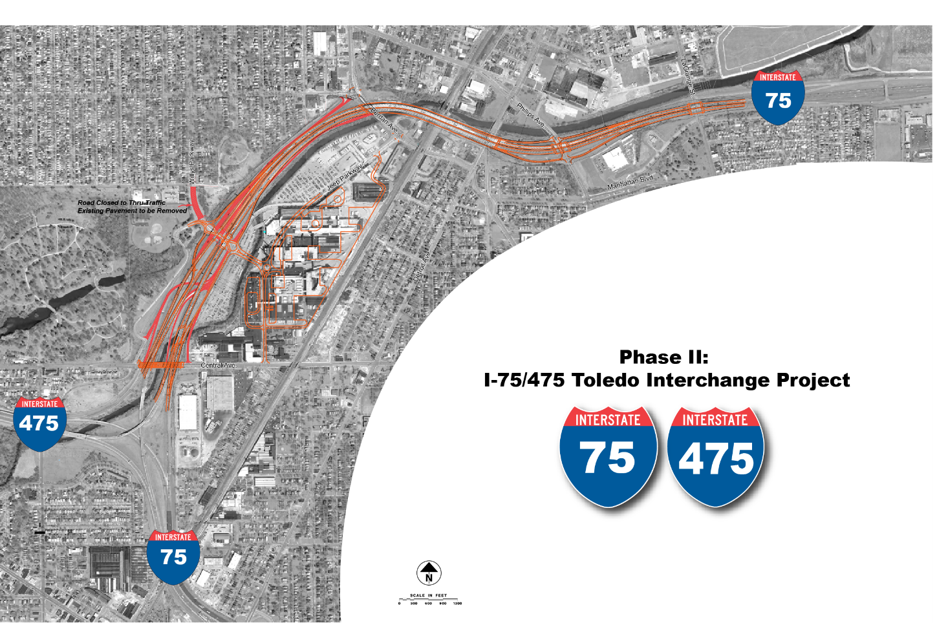
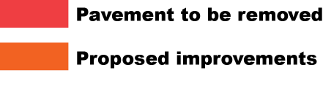
I-75 Changes

Slide 73
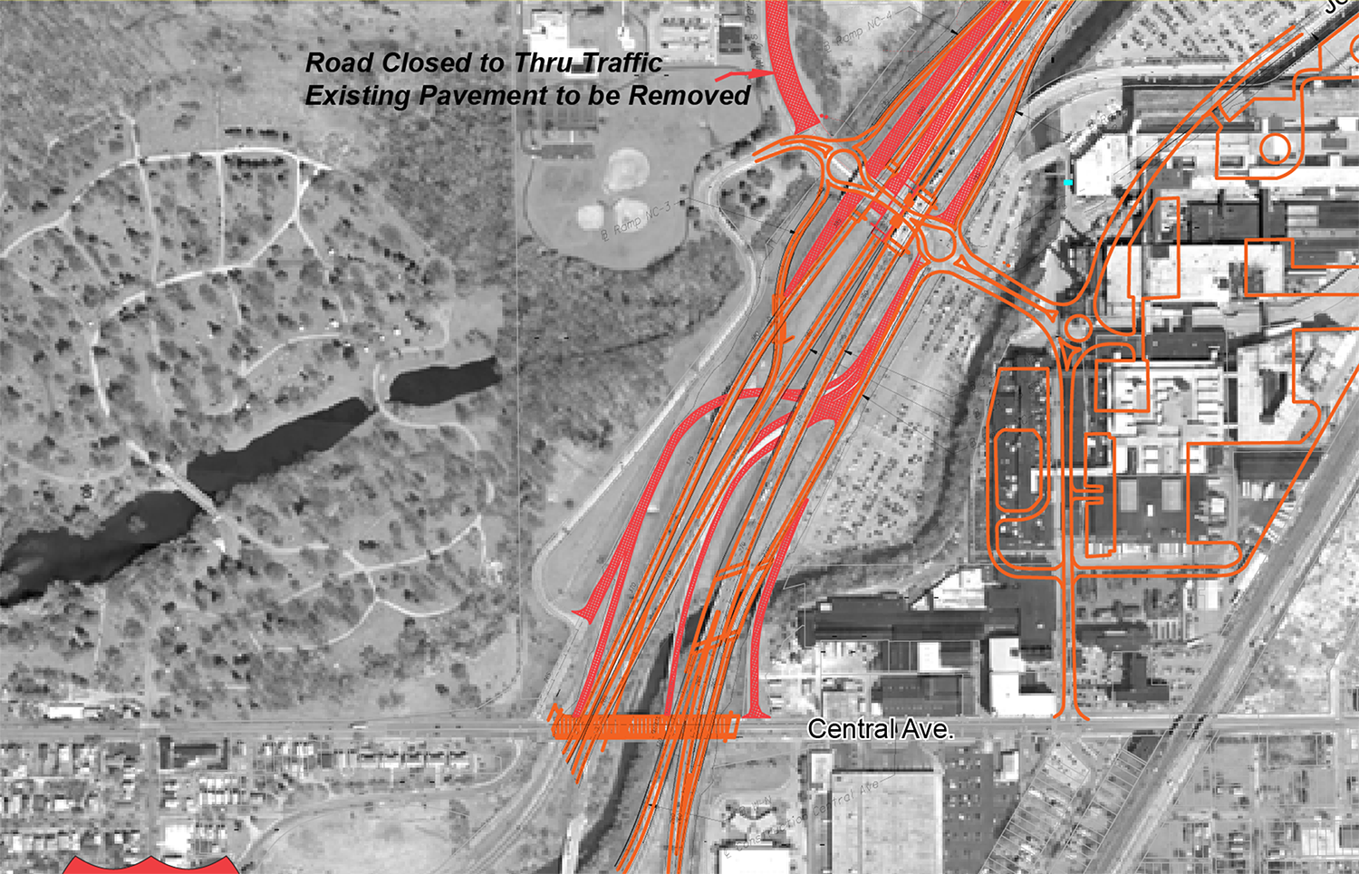

Slide 74
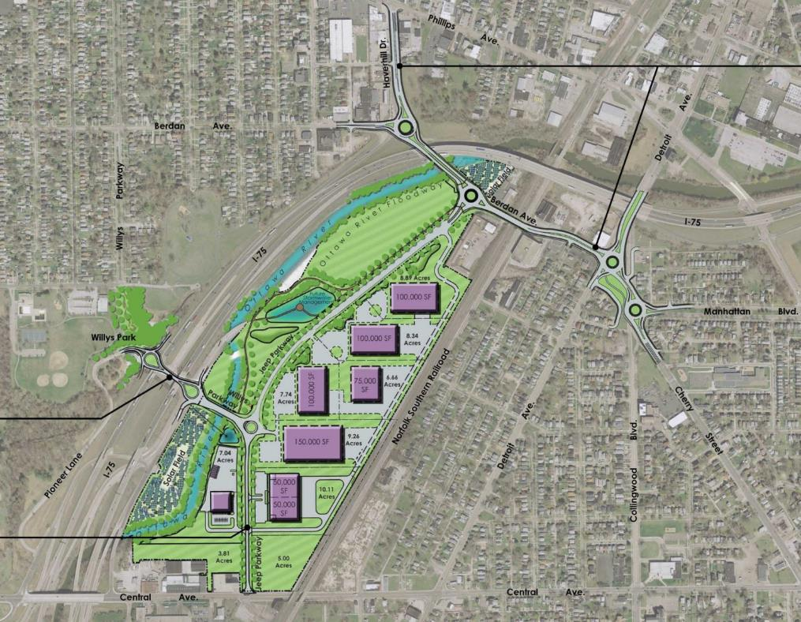
Overland Industrial Park Site
Former Brownfield (Jeep Site)
Will add hundreds of jobs
Need to improve connections to:
  Phillips Interchange
  Cherry Street
  Collingwood Boulevard

Slide 75
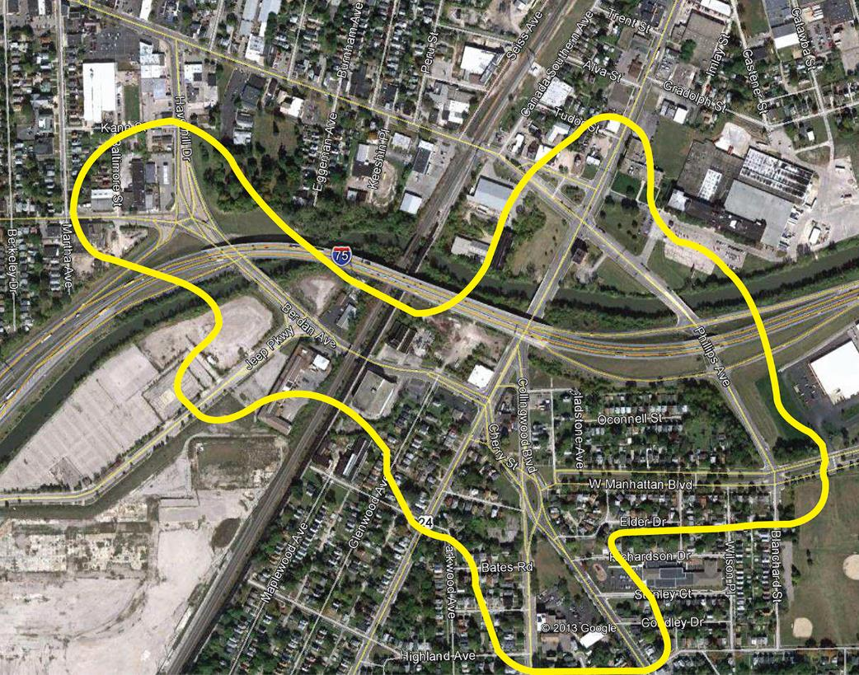
Study Area
  Berdan & Haverhill
  Berdan & Jeep Pkwy
  Berdan & Detroit & Cherry
  Collingwood & Detroit
  Cherry & Collingwood & Manhattan
  Manhattan & Phillips
  Phillips & Detroit

Slide 76
Purpose and Need
Improve Connectivity
  Promote redevelopment of the Overland Park Site and surrounding areas between the I-75/Phillips and I-75/Willys interchanges
Improve Traffic Operations
  Improve Geometry
  Improve Traffic Capacity
  Improve Operational Flow
Improve Wayfinding and Access/Added Benefits
  From I-75/Willys Parkway and I-475/Phillips Ave to the surrounding neighborhoods
  To the major institutions in the area
  To the central City and the downtown Toledo area consistent with the Cherry Street Legacy Plan
  Promote pedestrian and bicycle friendly connectivity
  Promote health, safety and neighborhood beautification

Slide 77
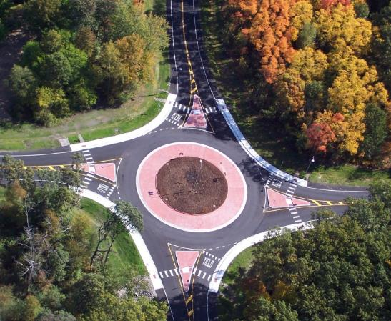
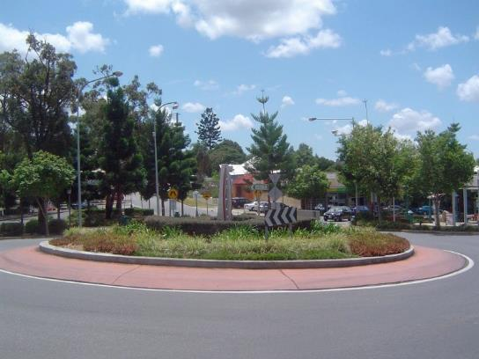
Modern Roundabouts
  A “Tool”
  Efficient
  Safe
    90% reduction in fatal accidents
    76% reduction in injury accidents
    35% reduction in overall accidents
  Low Life Cycle Cost vs. Signals
  Pedestrian Safety and Mobility
  “Green”
  Aesthetic

Slide 78
Aesthetic Opportunities
Green corridor concepts including options for a dedicated and separated multi-use trail
Landscaped median islands - traffic calming & includes shade trees to enhance the corridor
Roundabouts - gateway opportunity to the community
Wayfinding signage and gateway elements will identify the area, and direct traffic to key destinations

Slide 79
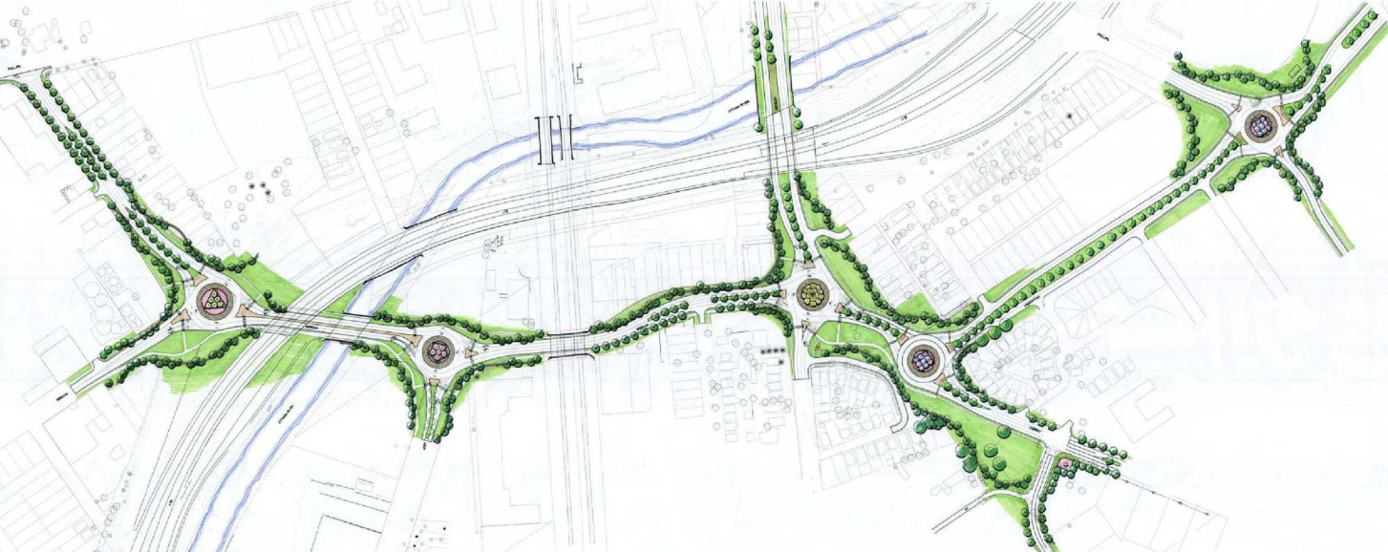
A NEW CORRIDOR TO SUPPORT REDEVELOPMENT

Slide 80
Bike Trails

Slide 81
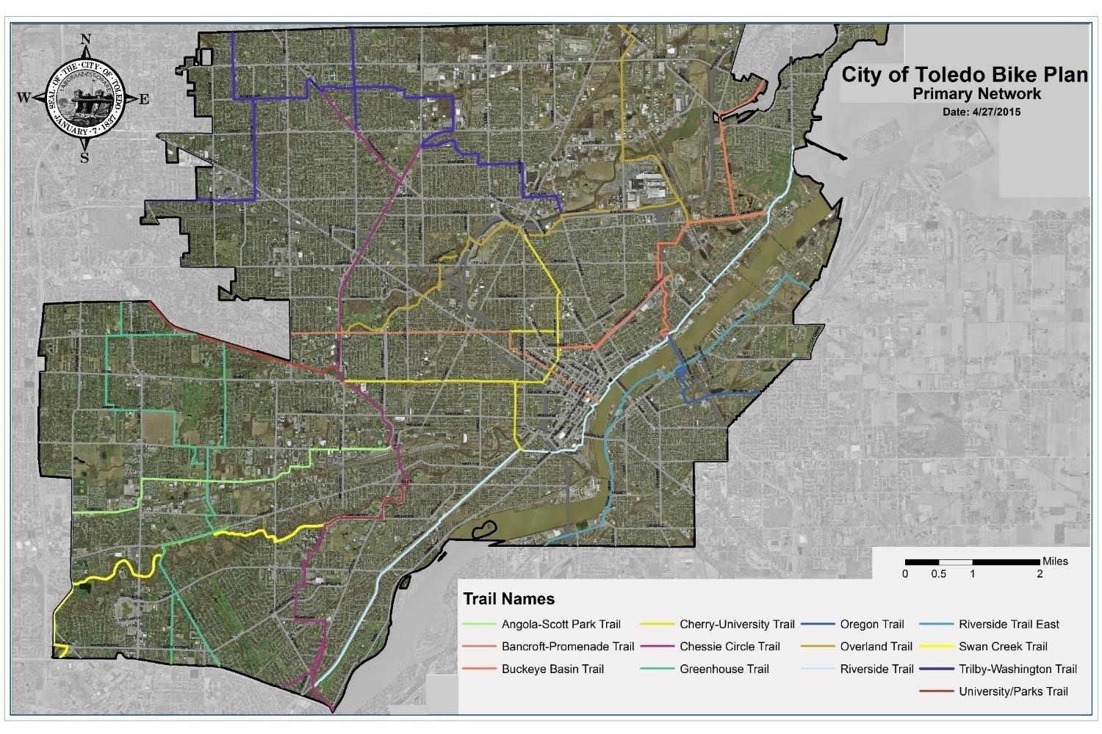

Slide 82
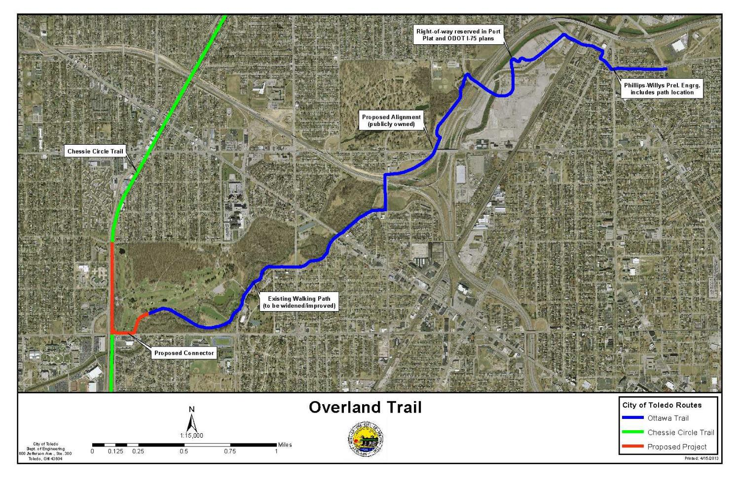

Slide 83
Ohio EPA Water Pollution Control Loan Fund
Toledo is installing an underground storage pipeline and basin to help minimize the effects of Combined Sewer Overflows (CSO’s), which will improve water quality in the Maumee River.
The project, part of the Toledo Waterways Initiative, will be paid for in part through a $26.2 million low-interest loan from Ohio EPA’s Water Pollution Control Loan Fund.
When water from rain and snow melt infiltrates Toledo’s sewer systems, it mixes with raw sanitary sewage and overwhelms the city’s ability to clean the water before it is discharged to the Maumee River. This project will allow the city to store the excess flow in a 6.9 million gallon CSO storage facility, which can then be sent in a more measured way through the wastewater treatment plant.
Scheduled completion in October 2018

Slide 86
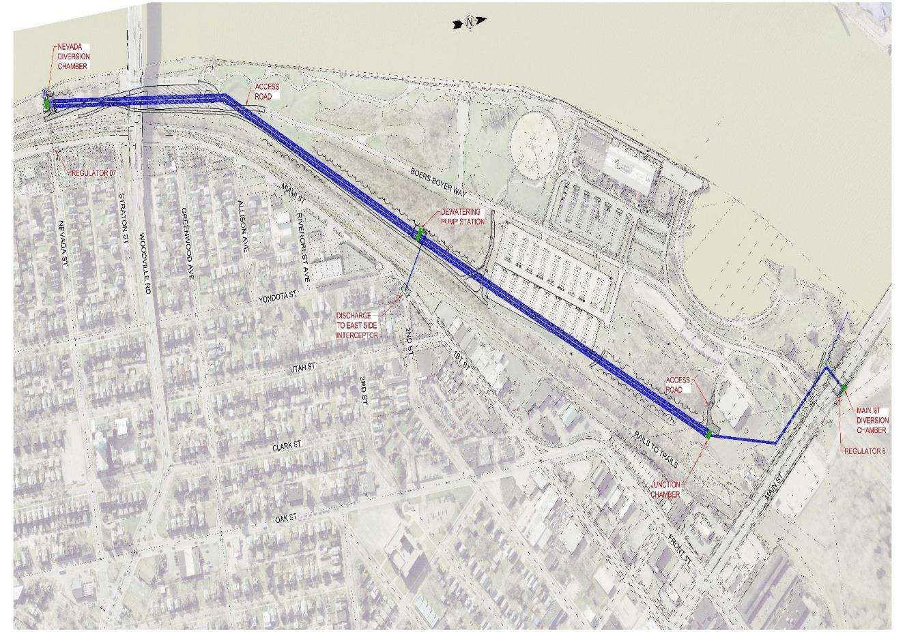

Slide 87
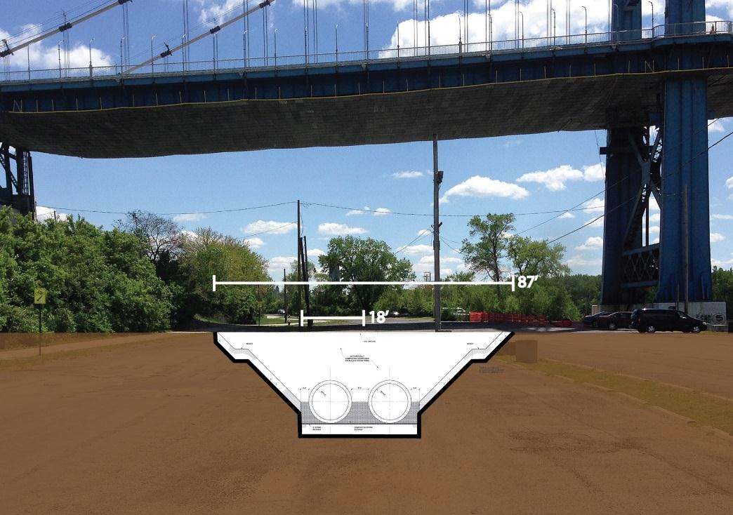

Slide 88
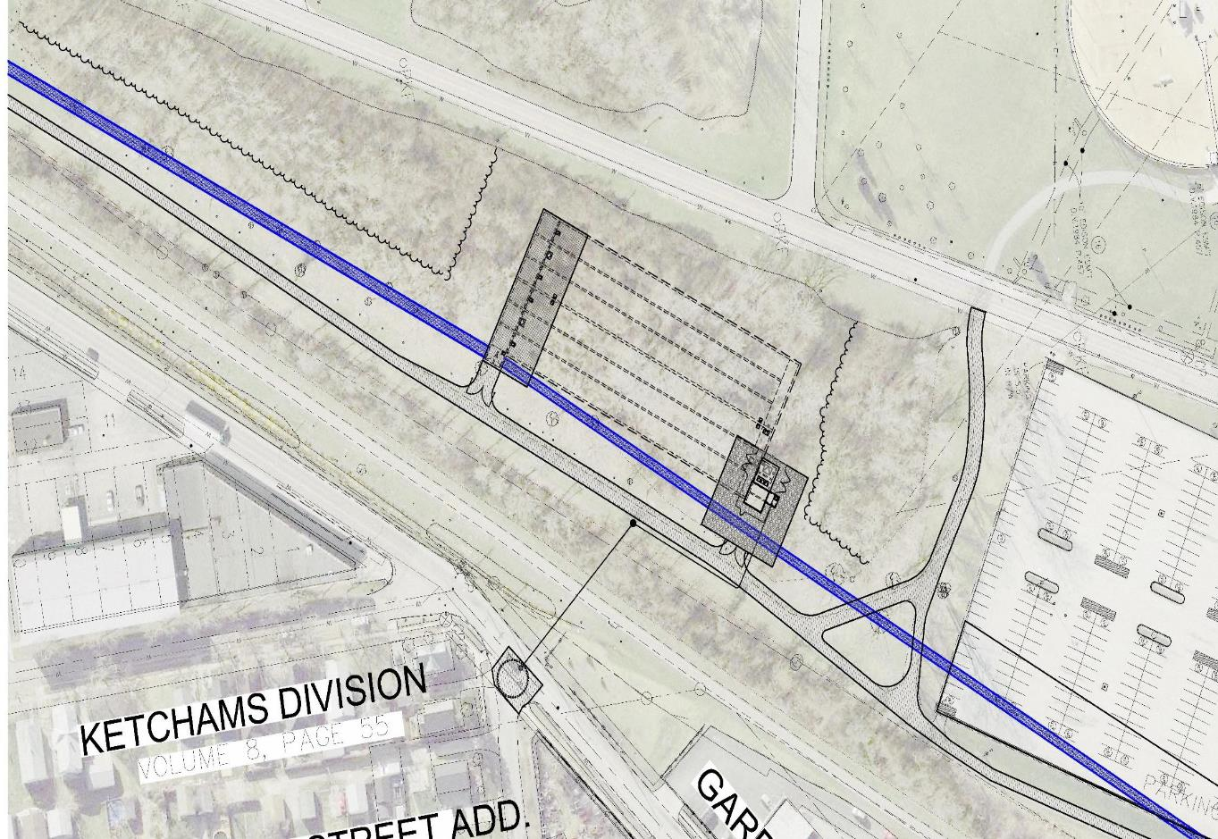

Slide 89
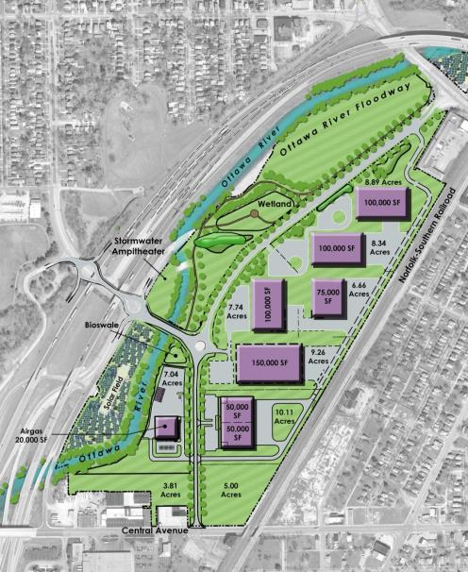









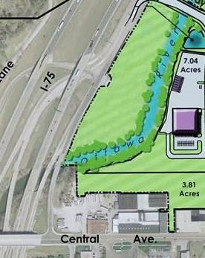
Restorative Improvements
GLRI Funding
$182,000
Phytoremediation on brownfields
Habitat restoration
Increase in flood capacity
Stormwater improvement
Wetland
Great Lakes Restoration Initiative (GLRI) Funding –Ottawa River Wetland Restoration
Feasibility Study
Habitat restoration
Increase in flood capacity

Slide 90


Slide 91


Stormwater Amphitheatre

Slide 92
Other Funding Opportunities
USDA, Forest Service GLRI
2012 - $250,000 Ohio Department of Natural Resources, GLRI Phytoremediation
Site Issues – Lead contamination in soil and surface water runoff.
Solution - Hybrid poplar trees were planted to sequester lead contamination in the soil and construction of a 100’ x 150’ bioswale to mitigate runoff. (Grantee: City of Toledo)

Slide 93


Slide 94


Slide 95


Slide 96
Thank You
David Dysard
City of Toledo
Division of Engineering Services
One Lake Erie Center
Toledo, Ohio
419.936.2693
david.dysard@toledo.oh.gov
Scott Sibley
City of Toledo
Division of Engineering Services
One Lake Erie Center
Toledo, Ohio
419.936.2851
scott.sibley@toledo.oh.gov
Marc Gerdeman
City of Toledo
Division of Environmental Services
348 S. Erie St.
Toledo, Ohio
419.936.3771
marc.gerdeman@toledo.oh.gov

Slide 97
Q & A

