Slide 1


Welcome to the CLU-IN Internet Seminar
CEC Training for OSCs...Pipeline Emergencies
Sponsored by: EPA Office of Superfund Remediation and Technology Innovation
Delivered: November 14, 2013, 2:00 PM - 5:00 PM, EST (19:00-22:00 GMT)
Instructors:
  Earl Liverman, EPA Region 10, liverman.earl@epa.gov
  Jim Mullins, Tetra Tech, Inc., james.mullins52@gmail.com
Moderators:
  Jean Balent, U.S. EPA Technology Innovation and Field Services Division (balent.jean@epa.gov)
Visit the Clean Up Information Network online at www.cluin.org

Slide 2
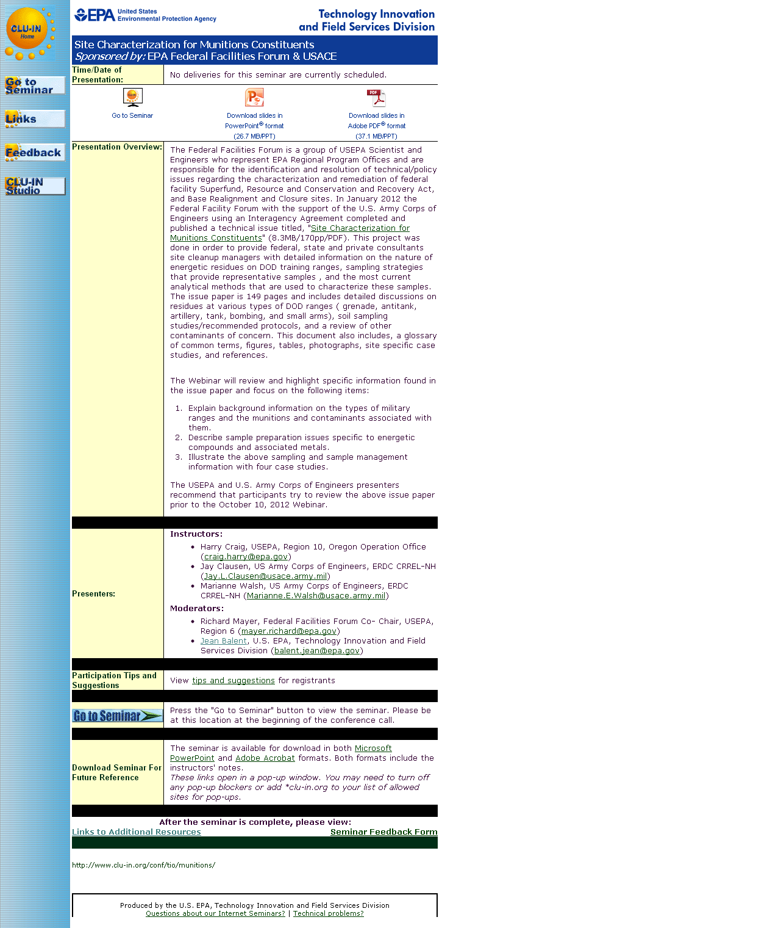
Seminar Homepage
Join the seminar online
Download Slides
Feedback

Slide 3

Housekeeping
Entire broadcast offered live via Adobe Connect
  participants can listen and watch as the presenters advance through materials live
  Some materials may be available to download in advance, you are recommended to participate live via the online broadcast
Audio is streamed online through by default
  Use the speaker icon to control online playback
  If on phones: all lines will be globally muted
Q&A – use the Q&A pod to privately submit comments, questions and report technical problems
This event is being recorded and shared via email shortly after live delivery
Archives accessed for free http://cluin.org/live/archive/
Notes:
Although I’m sure that some of you have these rules memorized from previous CLU-IN events, let’s run through them quickly for our new participants.
Please mute your phone lines during the seminar to minimize disruption and background noise. If you do not have a mute button, press *6 to mute #6 to unmute your lines at anytime. Also, please do NOT put this call on hold as this may bring delightful, but unwanted background music over the lines and interupt the seminar.
You should note that throughout the seminar, we will ask for your feedback. You do not need to wait for Q&A breaks to ask questions or provide comments. To submit comments/questions and report technical problems, please use the ? Icon at the top of your screen. You can move forward/backward in the slides by using the single arrow buttons (left moves back 1 slide, right moves advances 1 slide). The double arrowed buttons will take you to 1st and last slides respectively. You may also advance to any slide using the numbered links that appear on the left side of your screen. The button with a house icon will take you back to main seminar page which displays our agenda, speaker information, links to the slides and additional resources. Lastly, the button with a computer disc can be used to download and save today’s presentation materials.
With that, please move to slide 3.

Slide 4
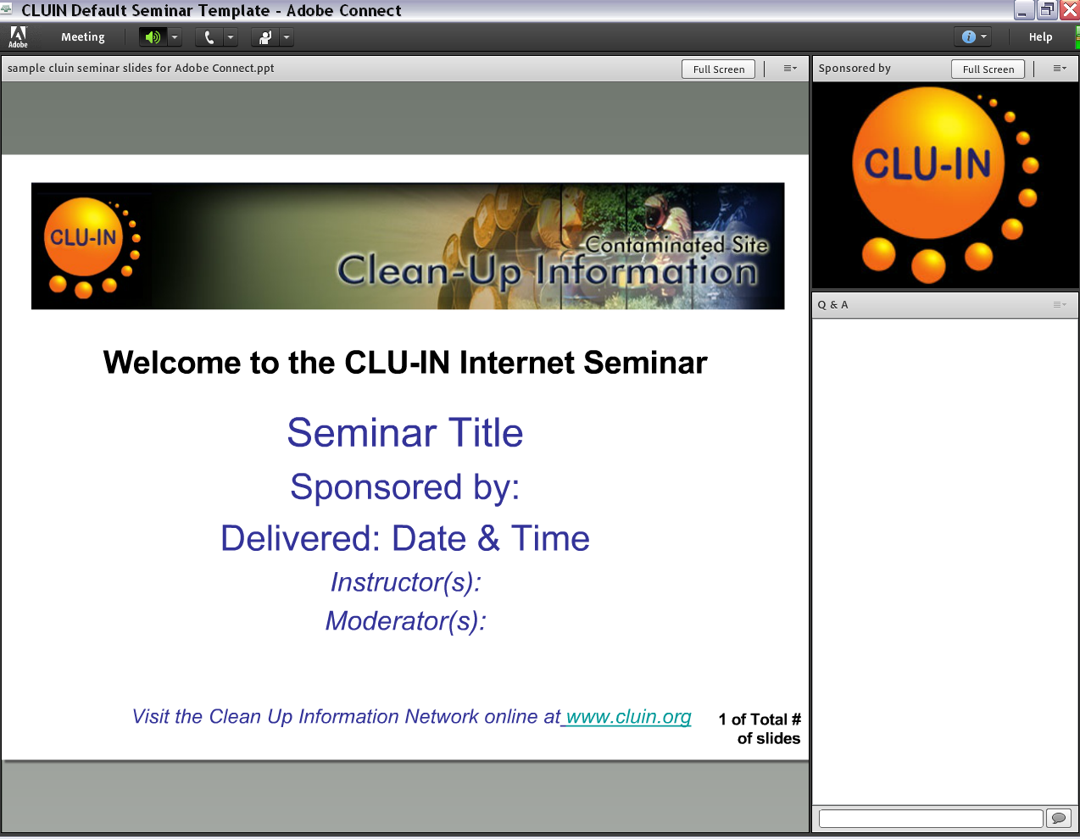


New online broadcast screenshot
Enlarge presentation
Control online audio
View presentation live online here
Information about Sponsors & Speakers
Submit private questions, comments or report technical problems

Slide 5
Disclaimer
The purpose of this presentation is to stimulate thought and discussion.
Nothing in this presentation is intended to supersede or contravene Federal Statutes, Regulations, or Official EPA Policies.

Slide 6
Instructor Bio
Earl Liverman is an EPA On-Scene Coordinator located in the Region 10 Coeur d’Alene, Idaho, field office. Earl has been with EPA since 1991 working in the Remedial and Emergency Response and Removal programs.
Jim Mullins works part time for TetraTech, a support contractor to EPA. Jim retired from the EPA Region 6 Dallas TX office after working 25 years in oil spill and hazardous waste response programs.

Slide 7
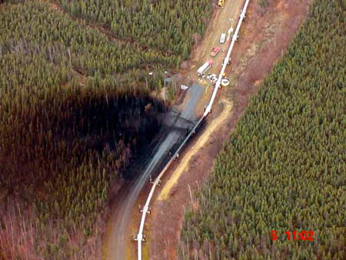
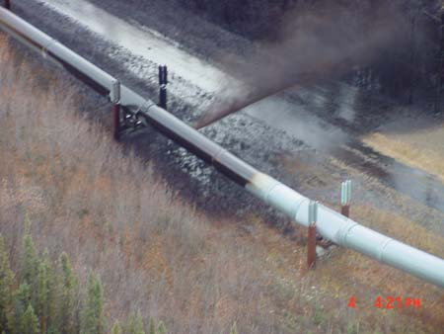
Pipeline Emergency Response
Webinar

Slide 8

Instructors
Instructors
  Names
  Work Experience
Participants Overview
Notes:
Comment re background provided by introductory slides

Slide 9
Course Overview
Better understand:
  Pipeline transportation system
  Basic types of pipelines
  Laws, regulations, and standards
  Pipeline operations
  Factors affecting response and cleanup decisions
  Pipeline Incidents
  Oil spill emergency response operations
  Oil spill response techniques
  Disposal of oil and oily debris
Notes:
The purpose of this course is to provide an overview of pipeline emergency response operations.
There is no way to include all possible subjects, references, or guidance for something as complex as incident response in a single course; however it is hoped that this course will assist you when responding to pipeline emergencies

Slide 10
AGENDA
I. Introduction and Course Objective/Overview
II. Pipeline Transportation System
III. Basic Types of Pipelines
IV. Laws, Regulations, Standards
V. Pipeline Operations
VI. Factors Affecting Response and Cleanup Decisions
VII. Pipeline Incidents
VIII. Oil Spill Emergency Response Operations
IX. Oil Spill Response Techniques
X. Disposal of Oil and Oily Debris
XI. Summary Statement
Notes:
Shows course modules . . . red highlight is where we are now

Slide 11
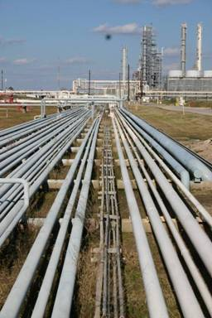
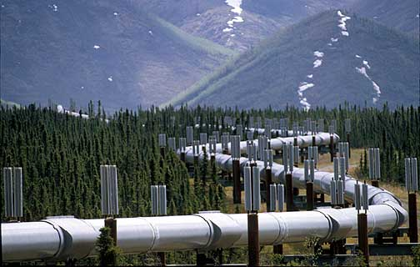
II. Pipeline Transportation System
Notes:
In this brief, introductory module, we will provide an overview of pipeline transportation system

Slide 12
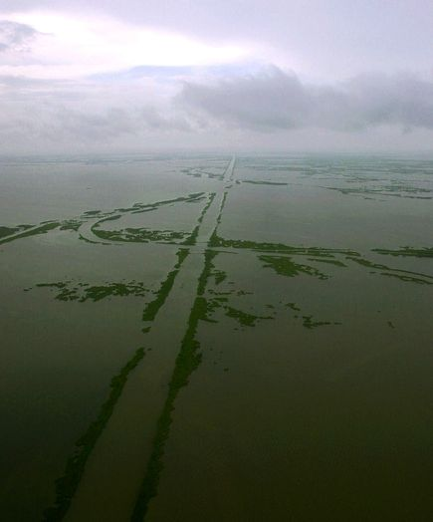
Pipeline Transportation System
Nearly half a million miles of pipeline transporting natural gas, oil, and other hazardous liquids crisscross the United States
  Roughly 170,000 miles carry hazardous liquids; over 75% of the nation’s crude oil and around 60% of its refined petroleum products, along with other products
  Within this network, there are nearly 200 interstate crude oil and interstate pipelines, which account for roughly 80% of total pipeline mileage and transported volume
Notes:
These pipelines are operated by approximately 3,000 companies, large and small

Slide 13
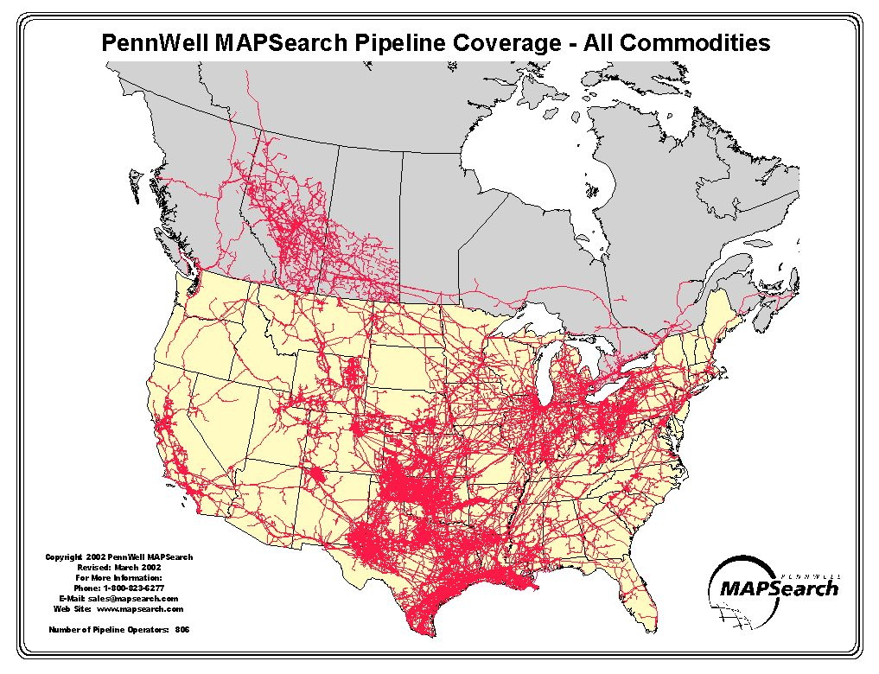


All Commodities Map
Notes:
Slide is shown to reinforce
There are many pipelines located throughout the U.S.
Pipelines are found in all EPA Regions . . . not evenly distributed

Slide 14
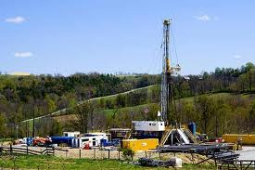
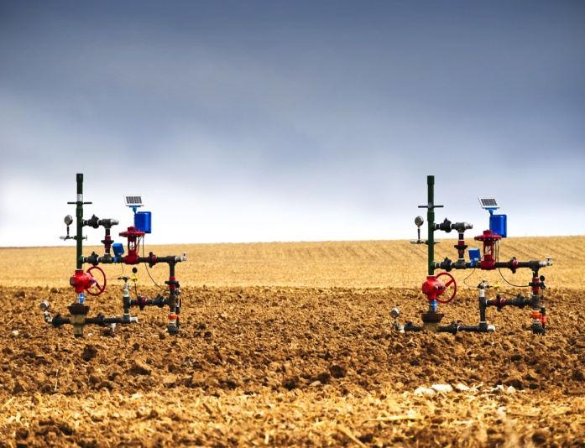
Pipeline Transportation System . . .
U.S. natural gas pipeline network consists of around 217,000 miles on interstate transmission and 89,000 miles of intrastate transmission
It also contains some 20,000 miles of field and gathering pipelines, which connect gas extraction wells to processing facilities
Around 125 systems make up the interstate gas transmission network; another 90 or so systems operate strictly within individual states
Notes:
Typical natural gas drilling rig
Natural gas wells

Slide 15
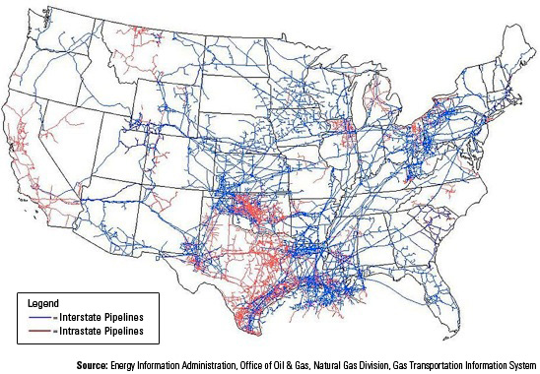
Natural Gas Pipelines
Notes:
As mentioned earlier . . .
There are many pipelines located throughout the U.S.
Pipelines are found in all EPA Regions . . . not evenly distributed

Slide 16
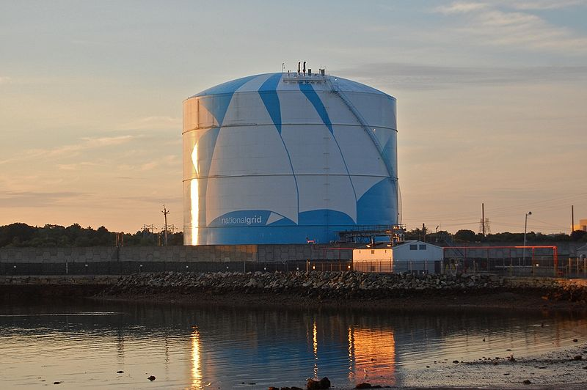
Pipeline Transportation System . . .
These interstate and intrastate gas transmission pipelines feed about 1.2 million miles of regional pipelines in some 1,400 local distribution networks
Natural gas pipelines also connect to 113 liquefied natural gas storage sites
Notes:
The most important type of natural gas storage is in underground reservoirs, consisting of depleted gas reservoirs and salt cavern reservoirs

Slide 17
Pipeline Transportation System . . .
Pipeline incidents can bring a wide range of organizations to the scene
The type of respondents will depend on the scope and nature of the incident
Key to success is to have a coordinated incident command structure where all of the respondents integrate their resources in a safe and efficient manner

Slide 18


Slide 19
AGENDA
I. Introduction and Course Overview
II. Pipeline Transportation System
III. Basic Types of Pipelines
IV. Laws, Regulations, Standards
V. Pipeline Operations
VI. Factors Affecting Response and Cleanup Decisions
VII. Pipeline Incidents
VIII. Pipeline Emergency Response Operations
IX. Oil Spill Response Techniques
X. Disposal of Oil and Oily Debris
XI. Summary Statement

Slide 20
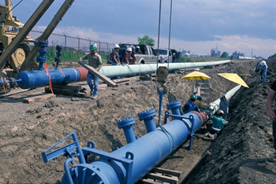
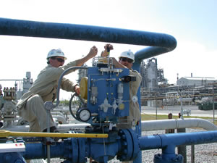
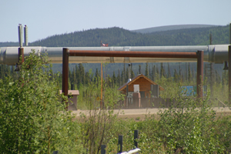
III. Basic Types of Pipelines
Notes:
Purpose of this module is to provide an overview of the basic types of pipelines – petroleum pipeline systems and natural gas pipeline systems

Slide 21
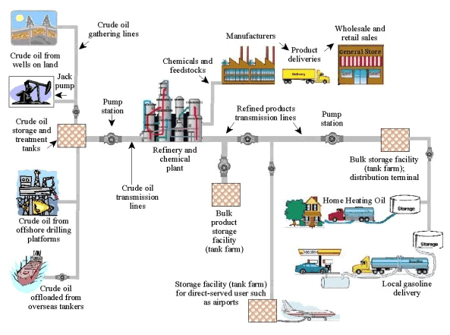
Petroleum Pipeline Systems
Notes:
From the wellhead to the consumer, petroleum pipeline systems provide us with energy fuels and products we use every day. There are essentially three major types of pipelines along the petroleum transportation route: gathering systems, crude oil pipeline systems, and refined products pipeline systems
Gathering pipeline systems gather crude oil from production wells
Crude oil pipeline systems transport crude oil from the gathering systems to refineries. Crude oil systems can be tens to hundreds of miles in length and cross state and continental borders
Refined products pipeline systems transport refined products such as gasoline, kerosene and many industrial feedstock petrochemicals from refineries to the end user or to storage and distribution terminals. Refined products pipelines can extend tens to thousands of miles and cross state and continental borders
The pipe used in oil pipeline systems can range in size from 2 inches to 42 inches in diameter. Oil pipeline systems are owned and operated by many different companies. The location, construction and operation of these systems are generally regulated by federal and state regulations.

Slide 22
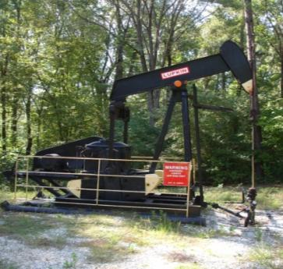
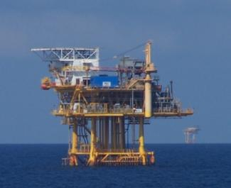
Crude Oil Pipelines
Crude oil is petroleum taken directly out of the ground from both on-shore and off-shore production facilities
The exact composition of this produced fluid varies depending upon where in the world the crude oil was produced

Slide 23
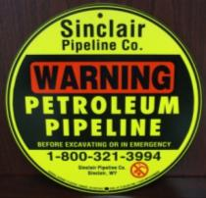
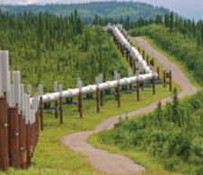
Crude Oil Pipelines . . .
Gathering lines are small pipelines, usually 2 to 8 inches in diameter
  They move the crude oil mixture from individual wellheads and production locations to an oil processing facility
Depending upon the location of the production site and the type of crude oil being produced, the crude oil is then shipped through larger trunk lines, 8 to 24 inches in diameter, or by cargo tank trucks to a refinery or shipping terminal
Notes:
Most recognized crude oil trunk line is the 800-mile long Trans Alaska Pipeline System (TAPS)

Slide 24
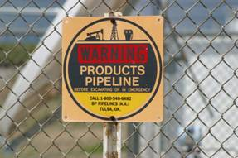
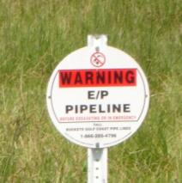
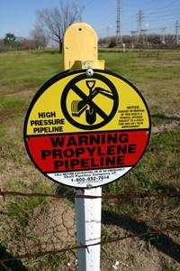
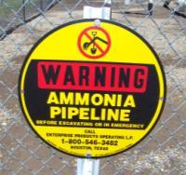
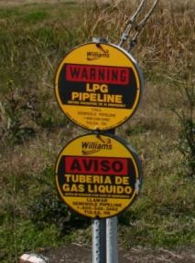
Liquid Pipelines
The most common liquids transported by pipelines are crude oil and refined petroleum products:
  Gasoline
  Aviation gas
  Jet fuel
  Home heating fuels
  Diesel fuels
  Natural gas liquids (NGL)
  Liquefied petroleum gas (LPG)
  Anhydrous ammonia
Pipelines vary in size from 8- to 12-inch diameter pipelines up to 42-inch transmission lines
Notes:
Ammonia Carbon dioxide and anhydrous ammonia are not refined petroleum products . . . but both are transported by pipeline . . . particularly in the mid-west grain belt

Slide 25
Liquid Pipelines . . .
Transmission pipelines move refined products from refineries to marketing and distribution terminals
The products are then loaded onto rail cars, cargo tanks trucks, and barges for delivery to the consumer
Refined petroleum product transmission pipelines may carry several different liquid products sequentially

Slide 26
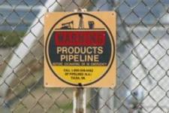
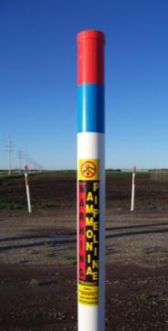
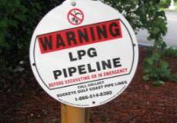

Liquid Pipelines – High Volatile Liquids
Highly volatile liquids or “HVL” pipelines are hazardous liquids which will form a vapor cloud when released to the atmosphere
Examples of common highly volatile liquids (HVLs)
  Liquefied petroleum gas (LPG)
  Propane
  Butane
  Ammonia
  Carbon dioxide
  Hydrogen

Slide 27
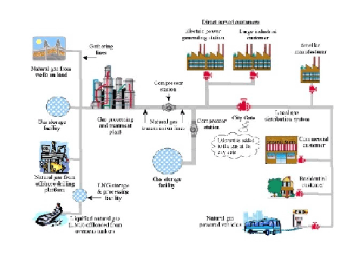
Natural Gas Pipeline Systems
Notes:
There are essentially three major types of pipelines along the transportation route: gathering systems, transmission systems, and distribution systems
Gathering pipeline systems gather raw natural gas from production wells
Transmission pipeline systems transport natural gas thousands of miles across many parts of the continental United States
Natural gas distribution pipeline systems can be found in thousands of communities from coast to coast and distribute natural gas to our homes and businesses through mains and service lines
Except for gas service lines, the pipe used in natural gas pipeline systems can range in size from 2 inches to 42 inches in diameter; gas service lines are generally from ½ inch to 2 inches in diameter. Natural gas gathering and transmission pipeline systems are constructed from steel pipe. However, natural gas distribution systems have been constructed from many different materials including cast iron, steel, copper, and plastic pipe. Plastic pipe is most commonly installed today for gas distribution systems
Natural gas pipeline systems are owned and operated by many different companies; the location, construction and operation of these systems are generally regulated by federal and state regulations.

Slide 28
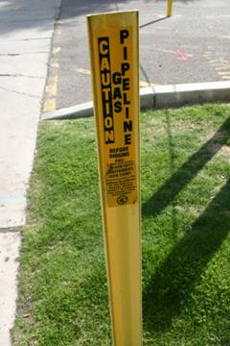
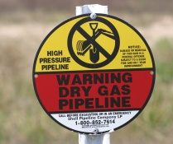
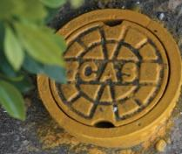
Natural Gas Pipelines
Transmission pipelines ranging up to 48-inches in diameter move the natural gas from production and processing to the distribution network
Ultimately delivering the product to residential and industrial consumers via distribution lines ranging from a diameter of 0.5 inches to 18 inches

Slide 29
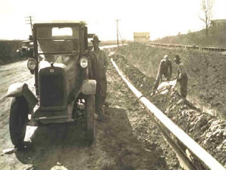
Time for Questions

Slide 30
AGENDA
I. Introduction and Course Overview
II. Pipeline Transportation System
III. Basic Types of Pipelines
IV. Laws, Regulations, Standards
V. Pipeline Operations
VI. Factors Affecting Response and Cleanup Decisions
VII. Pipeline Incidents
VIII. Pipeline Emergency Response Operations
IX. Oil Spill Response Techniques
X. Disposal of Oil and Oily Debris
XI. Summary Statement

Slide 31

IV. Laws, Regulations, and Standards
Notes:
Pipeline design, construction, and operations are governed by a wide array of local, state, and federal laws, regulations, and ordinances
In addition, there are industry voluntary consensus standards and industry best practices to help ensure that pipelines are safely operated and maintained
Purpose of this module is to provide an overview of certain statutes, executive orders, and regulations so that you better understand EPA’s statutory and regulatory authority for responding to an oil spill

Slide 32
Emergency Response Authorities
The federal government's responsibilities for emergency response are established by statute and by executive orders issued by the President
The Stafford Act provides the authority for the federal government to respond to disasters and emergencies in order to provide assistance to save lives and protect public health, safety, and property
The Federal Water Pollution Control Act Amendments of 1972/Oil Pollution Act of 1990 expands the National Oil and Hazardous Substances Pollution Contingency Plan (NCP) to include response to releases of hazardous substances, as well as oil, to any navigable waters of the US. The Oil Pollution Act (OPA) broadens the response and enforcement authorities of the federal government.
The Resource Conservation and Recovery Act (RCRA) gives EPA the authority to control hazardous waste from "cradle to grave", including its generation, transportation, treatment, storage, and disposal.
The Comprehensive Environmental Response, Compensation, and Recovery Act (CERCLA) expands the NCP to apply to releases to any environmental media and to cover releases at hazardous waste sites requiring emergency removal actions.
The Emergency Planning and Community Right-to-Know Act (EPCRA) expands EPA enforcement authority and establishes a chemical emergency response planning infrastructure at the state and local levels.

Slide 33

Emergency Response Authorities . . .
EO 12088-Federal Compliance with Pollution Control Standards delegates pollution prevention, control, and abatement responsibilities to federal agencies, including EPA
EO 12580-Superfund Implementation, as amended by EO 12777-Implementation of Section 311 of the Clean Water Act (CWA), delegates to EPA specific authorities under the NCP, as well as the responsibility for its amendment
Homeland Security Presidential Directives give EPA the legal authority for its emergency response program.

Slide 34

U.S. Environmental Protection Agency
CWA § 311 and OPA
Section 311 of the Clean Water Act (33 U.S.C. §1251 et seq.) and the Oil Pollution Act (33 U.S.C. §2701 et seq.) are the primary federal programs for responding to oil spills
Implementation of CWA § 311 and OPA dual responsibility of EPA (non-transportation-related facilities and onshore operations) and U.S. Coast Guard (vessels and marine transportation)
Scope of CWA § 311 and OPA applies to traditional navigable waters and wetlands adjacent to navigable traditional navigable waters
Notes:
The term “waters of the US” is defined at 40 CFR 230.3(s):
All waters which are currently used, or were used in the past, or may be susceptible to use in interstate or foreign commerce, including all waters which are subject to the ebb and flow of the tide
All interstate waters including interstate wetlands;
All other waters such as intrastate lakes, rivers, streams (including intermittent streams), mudflats, sandflats, wetlands, sloughs, prairie potholes, wet meadows, playa lakes, or natural ponds, the use, degradation or destruction of which could affect interstate or foreign commerce including any such waters: (I) Which are or could be used by interstate or foreign travelers for recreational or other purposes; or (ii)(From which fish or shellfish are or could be taken and sold in interstate or foreign commerce; or (iii) Which are used or could be used for industrial purposes by industries in interstate commerce;
All impoundments of waters otherwise defined as waters of the United States under this definition;
Tributaries of waters identified in paragraphs (s)(1) through (4) of this section;
The territorial sea;
Wetlands adjacent to waters (other than waters that are themselves wetlands) identified in paragraphs (s)(1) through (6) of this section; waste treatment systems, including treatment ponds or lagoons designed to meet the requirements of CWA (other than cooling ponds as defined in 40 CFR 423.11(m) which also meet the criteria of this definition) are not waters of the United States
Waters of the United States do not include prior converted cropland. Notwithstanding the determination of an area’s status as prior converted cropland by any other federal agency, for the purposes of the Clean Water Act, the final authority regarding Clean Water Act jurisdiction remains with EPA

Slide 35
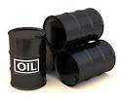
CWA/OPA Threshold Criteria for Initiating a Response
The substance involved is an oil
There is a discharge or substantial threat of discharge
Discharge or substantial threat of discharge into navigable waters or adjoining shorelines
Removal actions are consistent with the NCP
Notes:
Threshold criteria for initiating a response:
- Is the substance involved an oil? [CWA § 311(a)(1)]
- Is there a discharge or substantial threat of a discharge? [CWA § 311(c)(1)]
- Is the discharge or substantial threat of discharge into navigable waters or adjoining shorelines? [CWA § 311(c)(1)]
- Are removal actions consistent with the NCP? [CWA § 311(c)(3)]

Slide 36
Substantial Threat Determination . . .
33 CFR 154
Substantial threat of a discharge means any incident or condition involving a facility that may create a risk of discharge of oil. Such incidents include, but are not limited to storage tank or piping failures, above ground or underground leaks, fires, explosions, flooding, spills contained within the facility, or other similar occurrences
Notes:
No single definition . . .
33 CFR Part 154 - FACILITIES TRANSFERRING OIL OR HAZARDOUS MATERIAL IN BULK
This part applies to each facility that is capable of transferring oil or hazardous materials, in bulk, to or from a vessel, where the vessel has a total capacity, from a combination of all bulk products carried, of 39.75 cubic meters (250 barrels) or more.

Slide 37
Substantial Threat Determination . . .
40 CFR 112.1
  . . . which due to its location, could reasonably be expected to discharge oil in quantities that may be harmful, as described in part 110 of this chapter, into or upon the navigable waters of the United States or adjoining shorelines, or into or upon the waters of the contiguous zone .
Notes:
40 CFR Part 112 – OIL POLLUTION PREVENTION
This part establishes procedures, methods, equipment, and other requirements to prevent the discharge of oil from non-transportation-related onshore and offshore facilities into or upon the navigable waters of the United States or adjoining shorelines
Recall 40 CFR Part 110 - Discharge of Oil Regulation (Sheen Rule)
Discharges that cause a sheen or discoloration on the surface of a body of water
Discharges that violate applicable water quality standards

Slide 38
Substantial Threat Determination . . .
40 CFR 300.322
Factors to be considered by the OSC in making this determination include, but are not limited to, the size of the discharge, the character of the discharge, and the nature of the threat to public health or welfare of the United States
Notes:
40 CFR Part 112 – OIL POLLUTION PREVENTION
This part establishes procedures, methods, equipment, and other requirements to prevent the discharge of oil from non-transportation-related onshore and offshore facilities into or upon the navigable waters of the United States or adjoining shorelines
Recall 40 CFR Part 110 - Discharge of Oil Regulation (Sheen Rule)
Discharges that cause a sheen or discoloration on the surface of a body of water
Discharges that violate applicable water quality standards

Slide 39

CERCLA Threshold Criteria for Initiating a Response
Release or threatened release into the environment of a hazardous substance, or pollutant or contaminant
Conditions at the Site meet the § 300.415(b) criteria for a removal action
Removal actions are consistent with the NCP
Notes:
Discuss why introduce CERCLA

Slide 40

CERCLA
Comprehensive Environmental Response, Compensation, and Liability Act (1980) 42 U.S.C. §9601 et seq.
Petroleum Exclusion
  Term “hazardous substance” is defined in CERCLA section 101(14)
  Definition excludes “petroleum, including crude oil or any fraction thereof,” unless specifically listed or designated under CERCLA

Slide 41
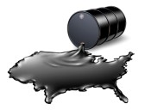
CERCLA . . .
Petroleum Exclusion
  Term “pollutant or contaminant” is defined in CERCLA section 101(33)
  Definition excludes “petroleum, including crude oil or any fraction thereof,” unless specifically listed or designated under CERCLA, and shall not include natural gas, liquefied natural gas, or synthetic gas of pipeline quality (or mixtures of natural gas and such synthetic gas)

Slide 42

CERCLA . . .
EPA interprets CERCLA section 104(14) to exclude crude oil and fractions of crude oil – including hazardous substances such as benzene, that are intrinsic in those petroleum substances – from the definition of hazardous substance
Under this interpretation, petroleum includes hazardous substances that are normally mixed with or added to crude oil or crude oil fractions during the refining process
This includes intrinsic hazardous substances, the concentrations of which are altered a normal part of the refining process
Notes:
Tie to pipelines . . . provide examples

Slide 43

When could CERCLA be used to respond to a Pipeline Emergency?
Hazardous substances added to petroleum or that increase as a result of contamination of the petroleum during use are not considered part of the petroleum, and are therefore regulated under CERCLA
In each case, entire volume of the mixture is treated as a hazardous substance
Notes:
Examples not within the exclusion:
- PCBs mixed with oil
Pesticides in an oil-based carrier or propellant
Oil-based paints and solvents
Used oil contaminated with hazardous substances

Slide 44
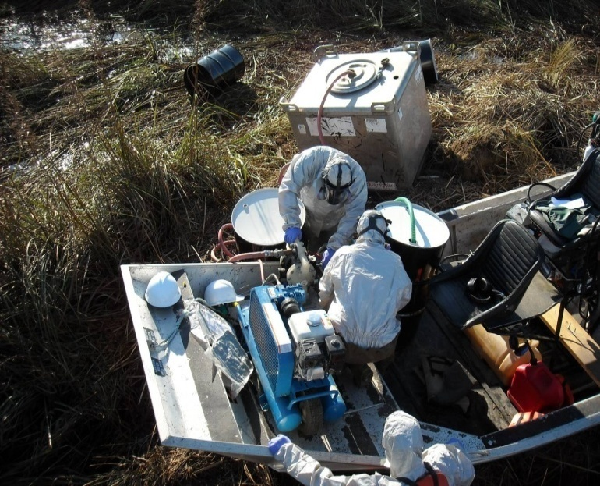
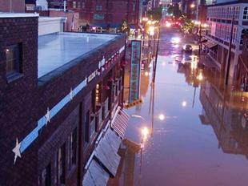
Stafford Act
Robert T. Stafford Disaster Relief and Emergency Assistance Act (Stafford Act) was enacted to support state and local governments and their citizens when their resources are overwhelmed by the effects of a disaster
Enacted in 1974 to provide federal assistance to state and local governments in disaster relief; amended by the Disaster Mitigation Act of 2000

Slide 45

Stafford Act . . .
ESF#10 - Oil and Hazardous Materials
  Coordinates, integrates, and manages overall Federal effort to detect, identify, contain, decontaminate, clean up, dispose or minimize discharges of oil or releases of hazardous materials, or prevent, mitigate, or minimize the threat of potential releases
  Provides OSCs for incidents within its jurisdiction
  Manages EPA special teams under the NCP, which provide specialized technical advice and assistance to responders

Slide 46
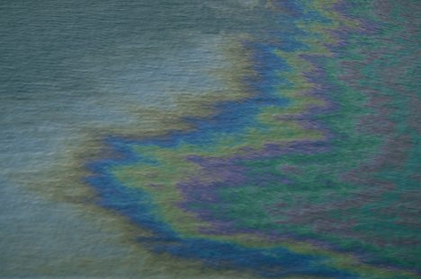
Discharge of Oil Regulation
(40 CFR 110)
Discharge of Oil regulation, commonly known as "sheen rule,” establishes criteria for determining whether an oil spill may be harmful to public health or welfare as follows:
  Discharges that cause a sheen or discoloration on the surface of a body of water
  Discharges that violate applicable water quality standards
  Discharges that cause a sludge or emulsion to be deposited beneath the surface of the water or on adjoining shorelines
Notes:
Because the Oil Pollution Act of 1990, which amended the Clean Water Act, broadly defines the term "oil," the sheen rule applies to both petroleum and non-petroleum oils (e.g., vegetable oil)
The regulation also provides several exemptions from the notification requirements:
Properly functioning vessel engines → discharges of oil from a properly functioning vessel engine are not deemed to be harmful and, therefore, do not need to be reported; however, oil accumulated in a vessel's bilge is not exempt
Research and development releases → EPA Administrator may permit the discharge of oil on a case-by-case basis in connection with research, demonstration projects, or studies relating to the prevention, control, or abatement of oil pollution
NPDES-permitted releases
Discharges permitted under MARPOL → Certain discharges beyond the territorial seas (defined as extending three miles seaward from the coast) are allowed if they are permitted under international law (International Convention for the Prevention of Pollution from Ships [MARPOL])

Slide 47
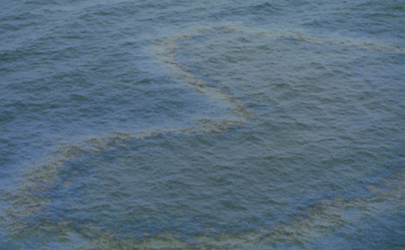
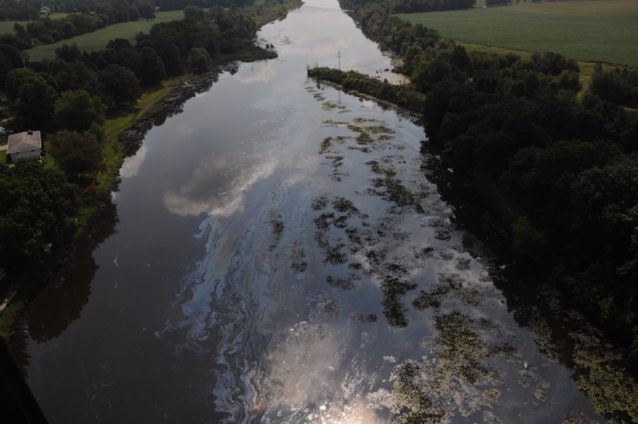
Discharge of Oil Regulation . . .
Sheen means an iridescent appearance on the surface of water
Sludge means an aggregate of oil or oil and other matter of any kind in any form other than dredged spoil having a combined specific gravity equivalent to or greater than water

Slide 48

Key Provisions of the NCP
§300.120 – Establishes general responsibilities of federal On-Scene Coordinators
§300.135(a) – Authorizes pre-designated OSC to direct all federal, state, and private response activities at the site of a discharge
§300.135(d) – Establishes unified command structure for managing responses to discharges
§300.175 – Lists federal agencies that have duties associated with responding to releases

Slide 49
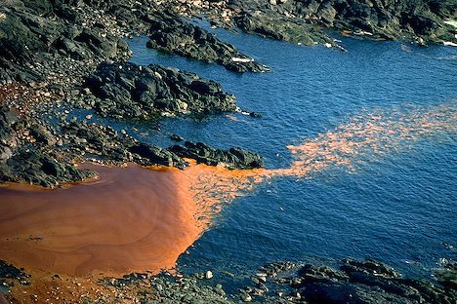
Key Provisions of the NCP Related to Oil Removal
300.317 - Establishes national priorities for responding to a discharge
§§300.320 - Establishes the general pattern of response to be executed by the OSC, including determination of threat, classification of the size and type of the release, notification of the RRT and the NRC, and supervision of thorough removal actions

Slide 50
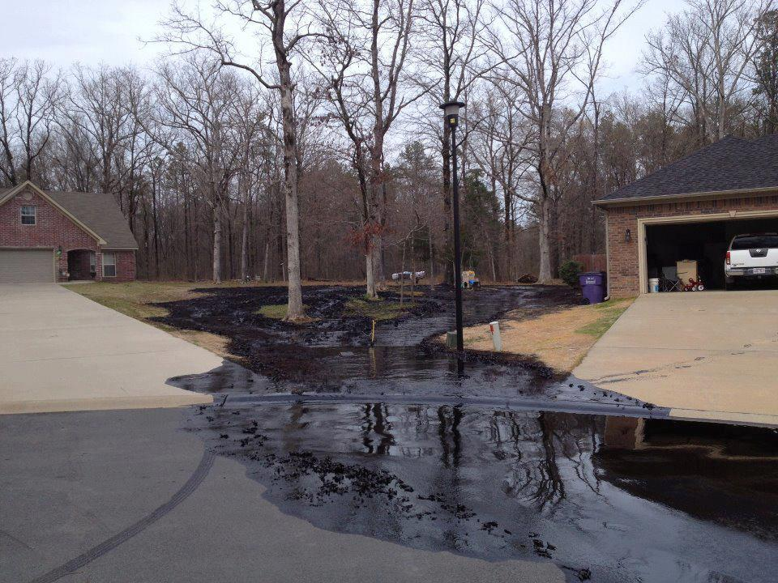
Key Provisions of the NCP related to Oil Removal . . .
§300.322 - Authorizes the OSC to determine whether a discharge poses a substantial threat to the public health or welfare of the United States based on several factors
§300.323 - Provides special consideration to discharges which have been classified as a spill of national significance
§300.355 - Provides funding for responses to oil discharges under the OSTLF, provided certain criteria are met
Subpart J – Product Schedule (dispersants and other chemical or biological products)
Appendix E to Part 300 – Oil Spill Response

Slide 51

U.S. Department of Transportation
Pipeline and Hazardous Materials Safety Administration
The Pipeline and Hazardous Materials Safety Administration (PHMSA) is the primary federal regulatory agency responsible for ensuring that pipelines are safe, reliable, and environmentally sound
  Oversee the development and implementation of regulations concerning pipeline construction, maintenance and operation, and we share these responsibilities with state regulatory partners
Protect people and the environment from the risks inherent in transportation of hazardous materials - by pipeline and other modes of transportation
Notes:
Federal Hazardous Materials Transportation Statute, 49 U.S.C. § 5101 et seq; Hazardous Materials Safety Regulations, Title 49 CFR Parts 100-185
Hazardous Materials Regulations (HMR) govern the transportation of hazardous materials by highway, rail, vessel, and air. HMR address hazardous materials classification, packaging, hazard communication, emergency response information and training.
Pipeline Safety Statute, 49 U.S.C. § 60101 et seq; Pipeline Safety Regulations, Title 49 CFR Parts 190 – 199
Pipeline Safety Regulations governs the design, construction, operation, safety, and maintenance of interstate pipelines.

Slide 52

PHMSA Base Programs
Data Analysis and Trending
Regulatory Development and Coordination
Inspection, Enforcement and Emergency Response
State Pipeline Safety Grant Programs
Damage Prevention and Public Education
Research and Development

Slide 53
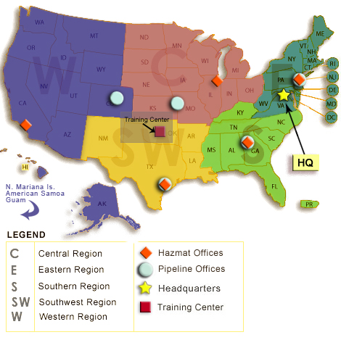
PHMSA Organization

Slide 54
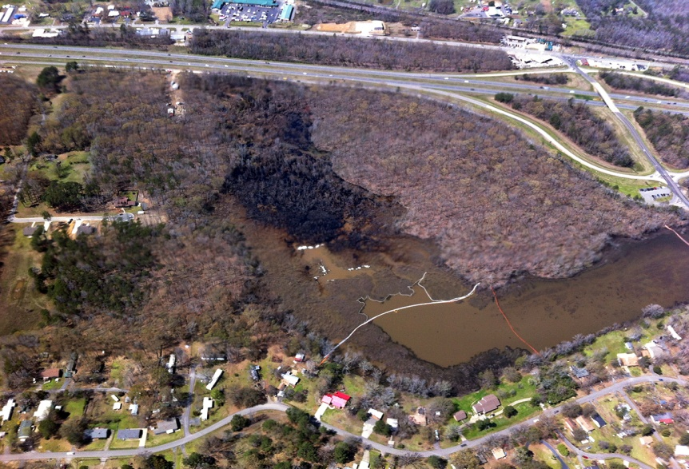
PHMSA from an FOSC’s Spill Response Perspective
FOSC responsible for response operations (NCP §300.120)
PHMSA is not a response agency (informed, but seldom seen on-Site), rather functions as a technical specialist
  Do not hesitate to ask for assistance
PHMSA responsible for pipeline repair and resumption of pipeline operations
Preparedness - Pipeline operators required to develop response plans outlining planning, training, and response to an oil spill
Notes:
2nd statement. For example, ask PHMSA what kind of questions to ask, including requests for information such as last couple of corrosion pipe to soil readings, last valve actuation report, and a copy of the last pipeline inspection report (required anytime a pipeline is exposed)

Slide 55

State and Local Government
State Public Utilities/Public Service Commission
State Fire Marshal’s Office
State Department of the Environment
State and County Emergency Management Agency
Local Fire Department
Notes:
A state or local government may adopt additional or more stringent regulations, provided they are consistent and compatible with OPS regulations
State Public Utilities/Public Service Commission: Many states manage intrastate pipeline issues
State Fire Marshal’s Office: Typically responsible for regulation of flammable liquids and gases
State Department of the Environment: Development and enforcement of environmental safety regulations such as oil pollution contingency plans
State and County Emergency Management Agency: Local emergency planning
Local Fire Department: Enforces fire prevention and hazardous materials codes

Slide 56




Voluntary Consensus Standards
Voluntary guidelines normally developed through professional organizations or trade associations
  American Gas Association
  American National Standards Institute
  American Petroleum Institute
  National Fire Protection Association
Notes:
Normally developed through professional organizations or trade associations as a method of improving quality of a product or system
American Gas Association: represents local energy distribution companies that deliver natural gas to homes, businesses, and industries
American National Standards Institute: establishes process and procedures requirements for the standards development process
American Petroleum Institute: national trade association for the petroleum industry
National Fire Protection Association: association devoted to fire prevention and safety

Slide 57
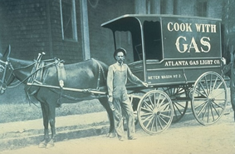
Time for Questions

Slide 58

OSC Pipeline Response Authority Scenarios
Notes:
Pipeline scenarios selected based upon the common and likely pipeline incidents that OSCs may encounter
Each scenario follows a similar format – present scenario and discuss the OSC’s regulatory authority to respond
There are one or more “brain teasers”

Slide 59


Scenario I
Rupture of a 24-inch Crude Oil Transmission Pipeline
Notes:
Alarm sounded in a Pipeline Control Center (PCC) notifying personnel of a suspected rupture of a 24-inch crude oil transmission pipeline leak
PCC initiates teleconference call involving federal, state, and local personnel to determine regulatory framework for response

Slide 60
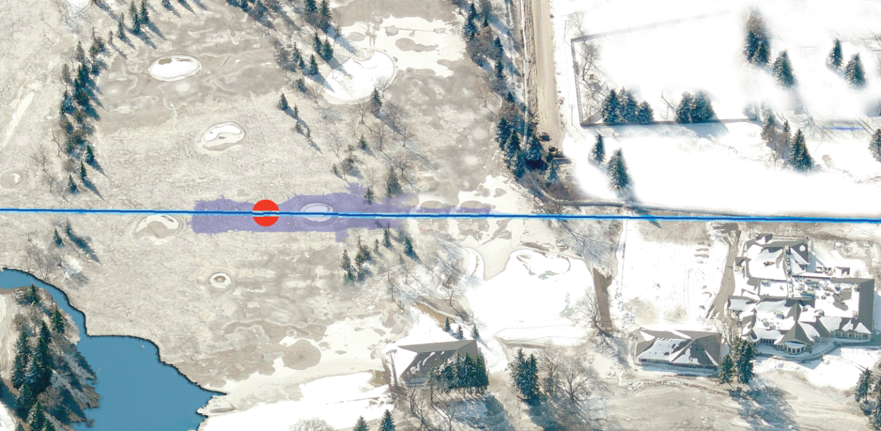
Scenario I – Site Map
Crude Oil Pipeline
Spill below surface of the snow
Stream
Club House
Maintenance Building
Pond
Notes:
Note proximity of release to pond and stream, as well as club house and maintenance building.

Slide 61
Does EPA have CWA/OPA Authority to respond to this incident?
Pipeline Control Center requests EPA assistance
You are the phone duty officer; how do you respond?
  Yes
  No
  Maybe

Slide 62

Answer
Depends on whether threshold criteria for initiating a response under CWA § 311 are met
Notes:
Is it oil?
Is it entering /threatening to enter water?
Are the waters appropriately classified as “navigable waters” ?
Are actions taken consistent with NCP (implementing regulations)?

Slide 63
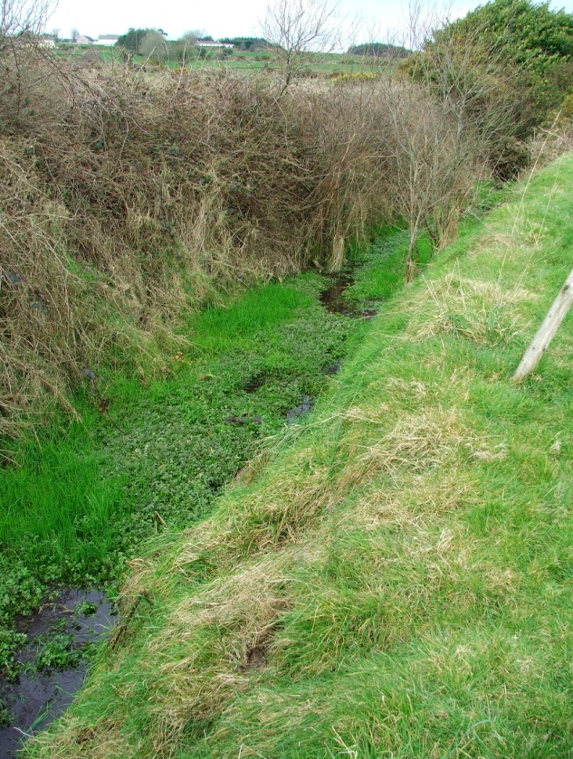
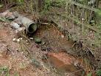
Would your answer change if . . . ?
Notes:
Would your answer change if:
The pond were a swale or erosional feature?
This suggests ephemeral flow patterns.
A ditch excavated wholly in and draining only uplands and that do not carry a relatively permanent flow?
Not trib to waters of the US

Slide 64
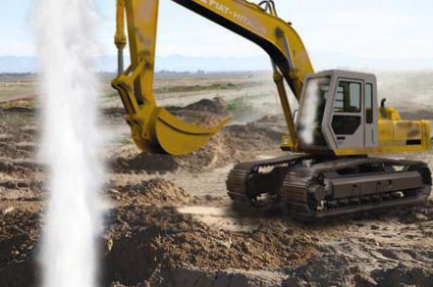
Scenario II
Puncture of a 20-inch liquid transmission line transporting gasoline in an urban area
Notes:
An excavation contractor punctured a 20-inch pipeline transporting gasoline; local fire department personnel respond to the incident and addressed the immediate threats to life and property
You are the assigned EPA Response Duty Officer and are watching television coverage in the emergency operations center (EOC) when a televised new flash advises viewers of the incident

Slide 65



Scenario II Site Map
Notes:
MSNBC notes that reporters are traveling to the incident, and in the meantime shows the following site map
The newly appointed Regional Administrator walks into the EOC at the same time the news flash crosses the television screen and sees the site map, paying particular attention to the nearby crowd

Slide 66
Does EPA have CWA/OPA or CERCLA Authority to respond to this incident?
Regional Administrator exclaims EPA must have CWA/OPA or CERCLA authority to respond to the incident and asks whether you intend to deploy EPA resources to the incident
You are the phone duty officer; how do you respond?
  Yes
  No
  Maybe

Slide 67

Answer
CWA/OPA → No . . . Federal criteria for initiating a response under CWA § 311 are not met
CERCLA → No . . . Petroleum Exclusion

Slide 68
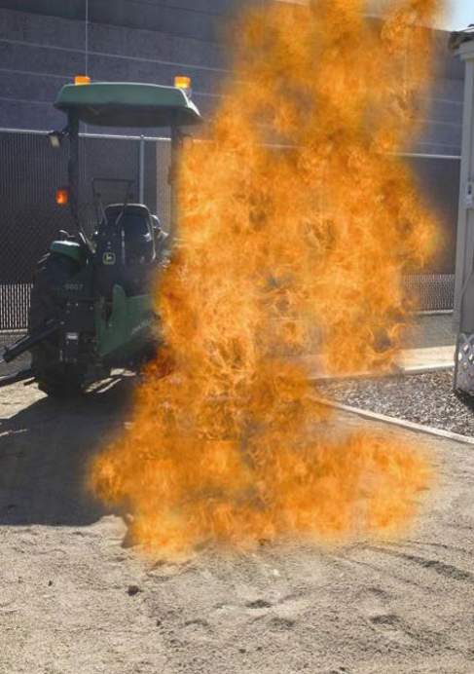
Scenario III
Rupture of a 6-inch plastic natural gas distribution pipeline in an industrial area
Notes:
A backhoe operator accidentally struck a 6-inch plastic underground natural gas distribution line
The natural gas ignited creating a flash fire; the backhoe operator was able to escape unharmed
The brush fire near the backhoe was rapidly spreading to a nearby field located next to a petroleum storage tank facility

Slide 69




Scenario III – Site Map

Slide 70
Does EPA have CWA/OPA or CERCLA Authority to respond to this incident?
You are an OSC visiting with a coworker from another program when both of you hear this incident described on the radio; your coworker is curious and asks if someone from the removal program will respond to the incident
Do you respond?
  Yes
  No
  Maybe?

Slide 71

Answer
CWA/OPA → No . . . Federal criteria for initiating a response under CWA § 311 are not met
CERCLA → No . . . Petroleum Exclusion

Slide 72


Scenario IV
Rupture of a 6-inch Fuel Oil Pipeline
Notes:
A 6-inch pipeline transporting No. 6 fuel oil ruptures and discharges about 15,000 gallons of fuel oil into a nearby brackish marsh
The incident is not discovered for several hours

Slide 73

Scenario IV – Site Map
Fuel Oil Pipeline
Power Generation Station
Pipeline Break
Power Lines
Marsh
Water
Notes:
Note “salt water” marsh

Slide 74
Does EPA have CWA/OPA Authority to respond to this incident?
You are the phone duty officer and receive the National Response Center incident report
You report this incident to you Removal Manager (RM) and the RM asks for your recommendation whether EPA should respond
What is your advice?
  Yes
  No
  Maybe

Slide 75

Answer
CWA/OPA → Yes . . . Federal criteria for initiating a response under CWA § 311 are met
Should EPA respond → Likely no because the incident occurred in the coastal zone
  § 300.120(a)(1) USCG shall provide OSCs for discharges or releases into or threatening the coastal zone
  - § 300.120(a)(2) EPA shall provide OSCs for discharges or releases into or threatening the inland zone
However, responsibility for response could shift from USCG to EPA or visa versa (see § 300.140)

Slide 76

Scenario V
All North Slope crude oil flows into PS01 which is one of eleven pump stations
A leak was detected in the Booster Pump Building basement at PS01; TAPS was shut down within one hour of discovery of leak
No release to the environment, but EPA is directed by HQ to respond

Slide 77

Deadhorse, Alaska

Slide 78

Scenario V – Site Map
North Slope oil flows into PS01 before flowing through TAPS to the Valdez Loading Facility.
On 8 January 2011, a leak was detected in the Booster Pump Building basement at PS01; TAPS was shut down within one hour of discovery of leak.

Slide 79
Does EPA have CWA/OPA or CERCLA Authority to respond to this incident?
Yes
No
Maybe

Slide 80
Answer
CERCLA → No . . . Petroleum Exclusion
CWA/OPA → Yes . . . Federal criteria for initiating a response under CWA § 311 are met
Notes:
Immediate removal of a discharge, and mitigation or prevention of a substantial threat of a discharge, of oil or a hazardous substance . . . .

Slide 81





Scenario VI
A 36-inch natural gas transmission pipeline ruptures near an apartment complex with 1500 residents
Recognizing the likely impact on the community and resources, the Fire Chief immediately requests federal assistance

Slide 82

Scenario VI – Site Map

Slide 83
Does EPA have Authority to respond to this incident?
Yes
No
Maybe

Slide 84
Answer
CWA/OPA & CERCLA → No
Other approach → Yes. Stafford Disaster Relief and Emergency Assistance Act (Stafford Act - 42 U.S.C. 5721 et seq.)
    Authorizes the President to issue “major disaster” or “emergency” declarations before or after catastrophes occur
    Emergency declarations trigger aid that protects property, public health, and safety
FEMA issues Mission Assignment (ESF-10) to EPA
Notes:
While this is possible, it is not too likely. Stafford Act mobilizations are generally rather slow…..days or sometimes weeks after the “insult” is over. Reality is that the place burns down before the Stafford Act can be invoked.

Slide 85

Scenario VII
  A gasoline pipeline ruptures releasing an estimated 116,000 gallons of gasoline to soil

Slide 86
Does EPA have Authority to respond to this incident?
Yes
No
Maybe

Slide 87
Answer
CERCLA – No. The terms "hazardous substance" and "pollutant or contaminant" do not include petroleum or natural gas
CWA – No . . . Release to soil.

Slide 89
AGENDA
I. Introduction and Course Overview
II. Pipeline Transportation System
III. Basic Types of Pipelines
IV. Laws, Regulations, Standards
V. Pipeline Operations
VI. Factors Affecting Response and Cleanup Decisions
VII. Pipeline Incidents
VIII. Pipeline Emergency Response Operations
IX. Oil Spill Response Techniques
X. Disposal of Oil and Oily Debris
XI. Summary Statement

Slide 90

V. Pipeline Operations

Slide 91

Pipeline Transportation Chain

Slide 92
Basic Pipeline System Design
Balance of effort/expense with capacity
Simple “dendritic pattern”
  Gathering systems (2” to 8” diameter)
  Transmission lines-typically 8” and larger
  Distribution systems
Notes:
Dendritic pattern shown on next slide

Slide 93

Pipeline System Basic Design
Wells
Gathering systems
2-8”dia
Well Field
Transmisssion
Lines > 8”
Compressor/Pump Stations
Notes:
This dendretic pattern is common to transmission pipelines and to natural rivers. The outline of this pattern (drainage basin of a river ) could represent a mineral field (or portion of a field)
At the end of each “tributary” is a well, which is the supply source
Wells are served by gathering lines (2-8” diameter); gathering lines connect to transmission pipelines >8” diameter
Pumping or/compressor stations are spaced about every 40-100 miles
Not shown are valves throughout and manual and/or remote valve operation (SCADA)

Slide 94
Gas Pipeline Distribution System
Consumers
Metering and
valve gateway
Notes:
Distribution system follows the familiar “riverine dendritic” pattern, but flow is reversed—from the mouth of the river to the headwaters of the tributaries
Meter and valve stations are essential and may be for City Utilities
Consumers are at the headwater of each tributary

Slide 95



Identification of Pipelines
The location of an underground pipeline is usually marked by aboveground signs and markers that indicate the presence of a pipeline
Notes:
The primary function of these markers is to alert those who might be working along the pipeline corridor or doing construction in close proximity to the pipeline, and to provide initial emergency contact information
Markers are required to be present whenever a pipeline crosses under roads, railroads, or waterways
They may also be found at other intervals and locations along the pipeline right-of-way, such as near buildings and structures

Slide 96



Identification of Pipelines . . .
Notes:
Various types of pipeline markers may be found to identify location of liquid and gas pipelines
Might even see small signs epoxyed to city street curbs

Slide 97

Identification of Pipelines . . .
1
2
3
Notes:
Although color, format, design may vary, all markers are required to provide:
No. 1 - Pipeline contents
No. 2 - Pipeline operator
No. 3 - Emergency telephone number

Slide 98




Pipeline Rights-of-Way
Pipeline Right-of-Way
Notes:
The ROW is a strip of land usually about 25 to 150 feet wide containing one or more pipelines or other subsurface utilities (e.g., cables communications)
ROW:
- Enables pipeline personnel to gain access for inspection, maintenance, testing or emergencies
- Maintains an unobstructed view for frequent aerial surveillance of the pipeline Identifies an area that restricts
certain activities to protect the landowner and the community
- May be located adjacent to a power line right-of-way or within a highway right-of-way

Slide 99

Basic Pipeline Design and Construction
Powered by pumps/compressors
Restricted by valves and storage capacity
Controlled by hand and remote SCADA

Slide 100

Pipeline Construction
Pipelines can vary from 2-inch diameter for gathering lines to 48-inches for transmission or trunk lines
Most modern pipelines are constructed of either seamless steel or steel with a welded longitudinal seam (straight or spiral) in 40- to 60 foot sections

Slide 101


Pipeline Construction . . .
The individual pipe joints are welded together into sections
To inhibit corrosion, pipe coatings and wrappings applied at the steel mill or on-site are used

Slide 102
Pipeline Construction . . .
When crossing a river, most pipelines are drilled under the riverbed without disturbing the bottom surface
If drilling is not possible, the piping may be laid and weighted with concrete or steel anchors to keep it on the bottom or laid in a cut trench and covered on the bottom

Slide 103

Corrosion Control
Corrosion is a natural process that, under the proper conditions, can affect any metal or alloy
Pipeline operators must also have written guidelines and procedures for most corrosion-related activities
Pipeline corrosion is most prevalent when the failure of coatings, inhibitors, or cathodic protection occurs in a corrosive environment
Notes:
Typical cathodic protection curve for steel

Slide 104
Corrosion Control . . .
External corrosion may be caused by damage to coatings, manufacturing defects within the metal, or through the loss of cathodic protection
Internal corrosion of pipelines is a concern because
  Causes include chloride, carbon dioxide, hydrogen sulfide, oxygen, and micro-biological activity
  Stress corrosion cracking (SCC) is the cracking of a pipeline from the combined influence of tensile stress and a corrosive medium

Slide 105


Corrosion Control . . .

Slide 106


Maintenance, Inspection, and Prevention
Corrosion protection tools
  Corrosion control injection systems
  Protective coatings
  Inhibitors
  Cathodic protection
Corrosion inspection and monitoring
  Laboratory samples of fluids
  Corrosion coupons
  Electrical readings at specific points along the pipeline
  In line inspection tools or
  smart pigs

Slide 107


Moving and Controlling the Product - Pumps/Compressors
Pumps
  Provide the pressure and force to move products in a liquid pipeline
Compressors
  Typically used on gas pipelines to boost and maintain pipeline pressure, thereby keeping the gas flowing
Notes:
Pump stations and compressor stations are placed at regular intervals along liquid and gas transmission lines in order to sustain product flow through the pipeline
Size of pumps and compressors used will be dependent on the type of product and the volumes being transported
NEVER operate valves – always have the company do it

Slide 108



Moving and Controlling the Product - Valves
Critical and essential element of a pipeline system in controlling the movement and flow of product
  May be manually actuated, electric, pneumatic
Depending on type, location, and pipeline pressures, a considerable amount of time and effort may be required to close a pipeline

Slide 109

Moving and Controlling the Product - Block Valves
“Block” is function; not a type
  Ball, check, gate, and other valve types
  Remote & manual operation
  “Auto-close”—rapid change pressure/volume
Notes:
Valves, need their own inspection programs. U.S. Department of Transportation has developed natural gas pipeline valve inspection criteria detailed in CFR Title 49, part 192, “The Transportation of Natural and Other Gas by Pipeline: Minimum Federal Safety Standards.” Paragraph 192.745 of that title states, “Each transmission line valve that might be required during any emergency must be inspected and partially operated at intervals not exceeding 15 months, but at least once each calendar year.” Similar requirements are published for crude oil and hazardous liquid pipelines in CFR Title 49, part 195, “Transportation of Hazardous Liquids by Pipeline,” paragraph 195.420.
Many block valve installations are outfitted with automatic shutdown controls. These controls are set to close the valve if pressure or flow rates change, indicating a possible breach in the line. By having these valves spaced throughout the line, the amount of potential fluid leakage that might occur during a line break is limited. Additionally, many pipeline valves are designated as emergency shutdown valves (ESD), which are remotely operated from the pipeline control center.

Slide 110
Moving and Controlling the Product - Block Valve Placement and Operation
Land surface
River
Block valve
Block valve
Liquid pipeline
Line failure here – valves “auto-close” – then
gravity drains pipeline contents between block valves
Notes:
Crude diagram to illustrate principles:
River
Liquid pipeline river crossing
Block valves installed (could be miles apart---5 to 20 miles
Pipeline fails . . . block valves automatically close (less than 1 minute) …gravity does NOT fail
No absolute spacing requirements; block valves miles apart will have a large drainup quantity
What do you expect now?
Volume = cross sectional area x distance between valves
For example: approximately 16,550 gallons per linear mile are contained within a 24 inch diameter pipeline

Slide 111





Batched Products
Pipelines move different grades of a product or distinct products sequentially through the same line in “batches”
Batches of different grades and products are pumped back-to-back in the line without any separating device; at the boundary of two consecutive batches some mixing occurs
Dissimilar and especially sensitive products may be separated using spherical plastic “pigs” to prevent mixing
D1
D2
D3
D4
D5
Head Terminal
Segment
Segment
P2
P1
P3
P4
Refinery
Interfaces

Slide 112



Notes:
No. 1: Interface - if the two batched products are similar, such as different grades of gasoline
No. 2: Transmix – two dissimilar products, such as diesel and gasoline
No. 3: “Pigs” such as plastic sphere are used to prevent mixing between especially sensitive products such as jet fuel from other pipeline contents

Slide 113
Significance of Batching to OSCs
Pipeline rupture with discharge of contents → block valves closes
Product(s) discharge to environment between block valves (drainup)
Safety considerations may vary
Cleanup techniques may vary

Slide 114


Moving and Controlling the Product - Manifolds
Both liquid and gas pipelines use valve manifolds to control the flow path of products
Manifolds, with numerous valves and meters, are used to divide the pipeline flow into parts, to combine several flows into one larger pipeline flow, or to reroute product flow to several possible locations

Slide 115


Pipeline Control Centers
Pipelines are controlled remotely
  Supervisory Control and Data Acquisition (SCADA)
  “Control Rooms”
Notes:
Information about the pipeline’s operating equipment and parameters is communicated into the control center, where operators use computers to monitor the pipeline operation
Major transmission and distribution pipelines have an automated leak detection system that constantly checks the “line balance” and system pressures
People make a career out of the Star Trek/Star Wars screens
Satellite/Phone Tower/any reliable comms
Some fail safe mechanisms
SCADA is monitored in central control rooms “alarm fatigue”

Slide 116
Takeaways
Take the time to at least call 811 or your state One Call agency
  Federal OSC’s have influence and a presence
  Industry tends to be responsive when directed to do so
Understand the energy stored in the system
  Physical, Chemical
  Never operate the system

Slide 117

Time for Questions

Slide 118
AGENDA
I. Introduction and Course Overview
II. Pipeline Transportation System
III. Basic Types of Pipelines
IV. Laws, Regulations, Standards
V. Pipeline Operations
VI. Factors Affecting Response and Cleanup Decisions
VII. Pipeline Incidents
VIII. Pipeline Emergency Response Operations
IX. Oil Spill Response Techniques
X. Disposal of Oil and Oily Debris
XI. Summary Statement

Slide 119

VI. Factors Affecting Response and Cleanup Decisions
Notes:
Purpose of this module is to provide an overview of the environmental and human factors affecting cleanup decisions

Slide 120

Potential Human and Ecological Concerns Associated with Pipeline Incidents
Pipelines carry products that can directly or indirectly cause risks to human health and the environment
  Refined petroleum products such as diesel, gasoline, and jet fuel, and anhydrous ammonia
  Flammable and nonflammable gas products such as natural gas, vaporized liquefied petroleum gases
Notes:
2008 Aleyska Pipeline Incident
2004 anhydrous ammonia pipeline rupture with vapor cloud, Kingman, KN
2010 gas pipeline rupture with vapor cloud, Fort Worth, TX

Slide 121


Human
Health
  Type of product released
  Location and quantity of release
  Media affected by release
  Weather
Notes:
Type of product released → Recall from prior modules that heavy crudes and heavy fuel oils (persistent; potential to travel great distances) or refined products such as gasoline and diesel (not as persistent)
Location and quantity of release → Influence requirement for and extent of response, as well as the degree of damage to the environment and economic resources
Nuisance to people living along the affected shoreline (health concerns, breathing difficulties)
Cultural artifacts either through direct contact with oil or as a result of cleanup operations
Heritage sites may require extreme care and sensitivity
Media affected by release → open water/at-sea response or shoreline
Weather → seasonal differences with use

Slide 122

Human . . .
Industry
  Need to keep production and cleanup activities from interfering with each other
  Management of response operations
  Organizational context and design and learning
  Cost
Notes:
No. 1: Avoid restricting access and prolonged closures (continue to conduct business activities)
No. 2: (1) Setting the command structure; (2) speed of establishing command; (3) decision-making outside the command structure; (4) appropriate role of a responsible party; (5) allocation and management of resources; (6) costs; (7) role of federal, state, local, and tribal governments
No. 3: Institutional pressures (governments, regulators, customers, competitors, community, interest groups, industry groups), which in turn influence organizational characteristics such adoption of environmental management practices and performance beyond regulatory compliance; may be tendency to react to perceptions and pressures, rather than basing decisions on technical realities
No. 4: Varies considerably from one incident to another depending on a number of interrelated factors including:
Type of oil; location of the spill and characteristics of affected area; quality of contingency plan; management and control of response operations

Slide 123


Human . . .
Political
  Agency
  Legal constraints
  Multi-agency jurisdiction
  Public opinion
  Non-governmental interest groups
Notes:
No. 1: Internal and external agency constraints/initiative/policy
No. 2: (1) Statutory and regulatory framework; (2) influence of existing agreements (MOAs, MOUs, etc.)
No. 3: Coordination/interaction of federal, state, local, and tribal agencies with different legal, geographic, and functional responsibilities
Occurs in context of I/UC
Agencies have responsibilities beyond the immediate scope of the incident that they are responsible for
No. 4: Perceptions of (1) control; (2) appropriate role of responsible party; (3) role of state and local and tribal governments; (4) how clean is clean (very important → will discuss in greater detail tomorrow)
No. 5: Such groups may press for aggressive responses on oiled shorelines (off-shore, near shore, shoreline) despite evidence that such operations can cause greater long-term environmental damages

Slide 124


Human . . .
Socio-economic
  Amount spilled, spill location, and rate of spillage
  Aesthetic appeal and amenity use of the shoreline and beaches
  Media
  Primary and secondary economic impacts
Notes:
No. 1:
Some areas will be of high regional, national, or international importance, whereas others will rank as locally important
Seasonal differences will also occur in the sensitivity of these resources to an oil spill, and therefore the economic impact of the incident (e.g., salmon spawning run)
No. 2:
- Is the affected area aesthetically and recreationally pleasing or has the experience been degraded?
No. 3:
- May be referred to as “social media” or “social networks” and include channels such as “Facebook” and “Twitter”
One v. many spokespeople
Communications tactics may not be directly transferable across mediums
Consider the ethics of social channels
No. 4:
Loss of income due to tourism, marina and fishing harbors, and fishery closures
Substitute income: (1) Primary: Wages or taxes earned resulting from cleanup activities; (2) Secondary: Buy products from local suppliers and purchase transportation and other services from local companies

Slide 125
Legacy Concerns
Pumps and Compressor Stations
  Potential soil and groundwater contamination
  Metering
  Disposal Pits
Notes:
Older pipeline pump and compressor stations (1940s. 50s 60s) had operations different than today . . . mostly since the environmental statues and EPA did not exist yet. Employees often lived on site. Most of these sites had a burn and/or disposal) pit.
Fireproof lubricants of the day were PCB based (20-60% by weight). Absent any regulations, these spent lubricants (oil change waste) were disposed of in the pits or used for dust control on local unimproved (dirt) roads. Degreasing solvents were similarly used and indiscriminately disposed of in the pit.
Metes for measuring flow in this era were Mercury filled manometers. These were spilled, broken, vandalized, and/or repaired thru the years. Result was mercury everywhere . . . or dumped into the onsite pit.
Cooling towers often develop a biological growth that clogs filters and valves, and interferes with pumping. These growths are collectively referred to as “slime”. Slime was historically most often controlled with “slimicides” which are typically heavy metals such as chrome (hexavalent). Disposal in an onsite pit (historical practice) creates larger problems later.
Result was soil and/or groundwater contamination. If these problems exist and the pipeline operator is aware, a PRP cleanup will likely follow.

Slide 126



Ecological
Type of product released
Location and quantity of release
Geology of shoreline and rate of flow
Weather
Notes:
This category include both physical and biological components
No. 1: You’ll recall from earlier modules that the type of oil and the amount spilled and rate of spillage are important factors
Lighter oils tend to evaporate and degrade very quickly; heavier oils tend to form thick oil-and-water mixture which clings to rocks and sand
Larger spills will result in far wider contamination and will require a far more extensive cleanup response
Response to a large release of oil may be considerable but may be completed in a couple of weeks; however, the same quantity of oil lost over several months may prompt a major cleanup effort, repeated cleaning of amenity areas, and long-term effects on natural resources and tourism
No. 2: Physical characteristics such as prevailing winds, currents, water depth, distance from shoreline will have considerable bearing on the feasibility of mounting a cleanup
No. 3: Oil tends to stick to sediments and surfaces of cobbles and pebbles; standing or slow-moving water is more likely to incur severe impacts than flowing water

Slide 127


Ecological . . .
Type and sensitivity of biological communities likely to be affected
  Physical properties
  Food chain
  Habitat
Notes:
No. 1: Animals and plants may be affected by physical properties of spilled oil (e.g., form surface sheens, sludge's, emulsions, soluble fractions of oil) which prevent respiration, photosynthesis, or feeding
Asphyxiation of fish and benthic fauna due to coating by oil; harm to waterfowl because of loss of buoyancy or loss of insulating capacity of feathers
May cause fish kills due to increased biological oxygen demand and/or “closing” the air water interface where gas exchange occurs
No. 2: May be toxic to some animals and plants which other organisms may depend on for food

Slide 128




Ecological . . .
  Species of wildlife present
  Timing of breeding cycles and seasonal migration

Slide 130
AGENDA
I. Introduction and Course Overview
II. Pipeline Transportation System
III. Basic Types of Pipelines
IV. Laws, Regulations, Standards
V. Pipeline Operations
VI. Factors Affecting Response and Cleanup Decisions
VII. Pipeline Incidents
VIII. Pipeline Emergency Response Operations
IX. Oil Spill Response Techniques
X. Disposal of Oil and Oily Debris
X. Summary Statement
Notes:
Shows course modules . . . red highlight is where we are now
Break may not occur exactly when shown on this agenda

Slide 131

VII. Pipeline Incidents

Slide 132
U.S. Department of Transportation
Incident Definition
Fatality or major injury
Evacuation of 25 or more persons
Closure of a major transportation artery
Alteration of an aircraft flight plan or operation

Slide 133




U.S. Department of Transportation
Incident Definition . . .
Release of radioactive materials from Type B packaging
Release of over 11.9 gallons or 88.2 pounds of a severe marine pollutant
Release of a bulk quantity (over 119 gallons or 882 pounds) of a hazardous material

Slide 134

U.S. Department of Transportation
Definition of Hazardous Material . . .
A substance or material capable of posing an unreasonable risk to health, safety, or property when transported in commerce
Notes:
Other DOT definitions
Hazardous Substance--Appendix A to § 172.101 and the quantity in one package equals or exceeds the reportable quantity (RQ). Material may be in solution or mixture. This definition does not apply to petroleum (lubricants or fuel) products. EPA CERCLA definition
Hazardous Waste- Any material that is subject to the Hazardous Waste Manifest requirements of the EPA. Refer to 40 CFR Part 262.

Slide 135

Pipeline Incident Experience
Pipeline transport
  Safe
    Underground
    Public contact
    Safest mode of transport
  Efficient
    Low cost per unit
    High Volume volume
  Low accident rate
Notes:
Primary incident cause—physical damage to pipeline by third party, material or weld failure/corrosion, operator error

Slide 136

Pipeline Incidents
Releases of a product carried by these pipelines can impact surrounding populations, property, and the environment, and may result in injuries or fatalities as well as property and environmental damage

Slide 137

What causes pipeline failure?
Enbridge Pipeline August 2010
Notes:
Region 5---look familiar?

Slide 138

Major Causes
Material and/or weld failures
Corrosion
Excavation damage
Incorrect operation
Outside forces
All other causes

Slide 139
All other
Causes
7%
Outside
Forces
9%
Corrosion—24%
Excavation
14%
Material and/or
Weld failure
36%
Incorrect
Operation 10%
Notes:
Summary of the principle failure causes of main liquid transmission pipelines—
2011 stats for trunk line liquids. Stats vary some from year to year, and for gas transmission. Stats vary some between gathering, transmission, and distribution…..but trends are well illustrated
We will go thru each category briefly on next slides
Apx 1/3 is weld/material failure
Apx ¼ are corrosion
Apx 1/6 are Excavation related
1/10 are bad operation
Apx 1/10 are outside forces
Apx 1/10 are all other causes

Slide 140

Material or Weld Failure
Approximately 1/3 of all incidents
Steel pipe joining technique
Extremely large number nationally
Technique
  1970 Electric Resistance Abandoned
  Welding-abandoned
  Weld inspection
    Fresh welds
    Failure analysis

Slide 141

X-ray inspection of welds

Slide 142


Corrosion
Approximately ¼ of incidents
Prevention
  Protective coatings
  Injections-inhibitors, biocides, dewaxers, etc.
  Cathodic protection
  Inspection and monitoring (pigs, smart pigs)

Slide 143


Excavation
Approximately 1/6 of all incidents
  Pipeline workers
  Third party
  Gas distribution pipelines
Largely preventable
One-call system 811
  State level operation and regulations

Slide 144


Incorrect Operations
Approximately 1/10 of incidents
Inadvertent actions
  Wrong valve open
  Overfilling or overpressuring a piece of equipment
  Mismarking an underground pipeline prior to excavation work
Training related
  Not following proper procedures
  Using improper equipment or techniques to effect a repair
  Improperly assessing a situation resulting in inappropriate actions or decisions
Notes:
Not a major cause

Slide 145

Outside Force
Approximately 1/10 of incident
  Earth Movement
  Weather
  Fire or explosion external to the pipeline
  Being struck by vehicles not related to excavation, rupture of previously damaged pipe
  Vandalism

Slide 146

Time for Questions

Slide 147
AGENDA
I. Introduction and Course Overview
II. Pipeline Transportation System
III. Basic Types of Pipelines
IV. Laws, Regulations, Standards
V. Pipeline Operations
VI. Factors Affecting Response and Cleanup Decisions
VII. Pipeline Incidents
VIII. Pipeline Emergency Response Operations
IX. Oil Spill Response Techniques
X. Disposal of Oil and Oily Debris
XI. Summary Statement

Slide 148


VIII. Pipeline Emergency Response Operations

Slide 149

Incident Management
Pipeline emergencies require coordination of information and resources among the various players in no different manner than other emergency response actions

Slide 150
Incident Management . . .
National Incident Management System (NIMS) approach
Incident Command System (ICS) Organization
May encounter different characterizations of incident phases
Notes:
As with EPA, you can anticipate a national approach to incident management (NIMS)
Flexibility: system components can be utilized to develop plans, processes, procedures, agreements, and roles for all types of incidents; it is applicable to any incident regardless of cause, size, location, or complexity
Standardization: provides an organized set of standardized operational structures, which is critical in allowing disparate organizations and agencies to work together in a predictable, coordinated manner
ICS is an organzed systems of roles, responsibilities, and procedures for the command and control of incidents
Reactive phase v. emergency response phase; proactive phase v. cleanup phase

Slide 151
Example: Pipeline Incident Command System Structure
Incident Commander
Command Staff
Deputy Incident Commander
Legal Officer
Operations Section Chief
Planning Section Chief
Business Interruption Chief
Logistics Section Chief
Finance
Section Chief
Notes:
Note potential presence of non-standard positions such as legal officer and business interruption section chief
Legal officer: advice and direction on matters such as claims, legal requirements relating to emergency response, investigations, major procurement contracts, insurance coverage, and review of information releases to media, government agencies, public
Business interruption section chief: identify, contact, and consult with all internal and external groups whose business is impacted by the incident; determine staffing needs for impacted business while continuing to manage daily operations; address and communicate agreements for prior commitments or contracts that are related to the impacted business
Branches, Divisions/Groups, Single Resource/Strike Teams/Task Forces created on an as needed basis

Slide 152

Development of the Incident Action Plan
Development of the IAP will be based upon a number of factors, including:
  Size and type of pipeline
  Product(s) involved
  Nature of the incident
  Exposures
Notes:
Some of the factors to consider when developing the Incident Action Plan may sound familiar to you, while others may not:
- Size and type of pipeline: what type is involved – gathering, transmission, or distribution pipeline? What is its diameter? What is its operating pressure?
Product(s) involved: what products are being transported by the pipeline – crude oil, natural gas, refined liquid petroleum products? If a refined petroleum products pipeline is involved, can other products become involved?
Nature of the incident: flammable liquid or gas leak with no fire? Flammable liquid or gas leak with fire? Toxic vapor cloud release?
Exposures: what types of exposures are in proximity to the incident? Is the problem in an urban, suburban, or rural area?

Slide 153

Development of the Incident Action Plan
Environmental conditions
Safety considerations
Isolation of the pipeline
Incident potential
Infrastructure impacts
Notes:
- Environmental conditions: how ill current and future weather conditions affect the incident? For example, liquid releases into waterways must consider temperature, wind, and wave direction, velocity, and tides
Safety considerations: are there any unique safety hazards or considerations associated with the incident?
Isolation of the pipeline. Can the pipeline be isolated? What is the distance between pipeline isolation points? Will the pipeline contents backflow to the breach point? If so, how much product can be expected and for what duration of time will the backflow continue?
Incident potential. Can the incident escalate into a more serious event? Influencing factors may include weather, damage to surrounding pipeline facilities and operations, release of additional product, and the potential for ignition of flammable vapors or gases.
Infrastructure impacts. What are the upstream and downstream impacts of the incident? Are any special occupancies or infrastructures impacted by the incident?

Slide 154

Common Strategic Goals at Pipeline Incidents
Safety of public and response personnel
Rescue
Spill Control (confinement)
Leak Control (containment)
Fire Control
Recovery

Slide 155

Common Strategic Goals at Pipeline Incidents . . .
Keep stakeholders and the public informed of response activities
Maximize protection of environmentally sensitive areas
Recover/rehabilitate injured wildlife

Slide 156


Common Strategic Goals at Pipeline Incidents . . .
Minimize adverse economic impacts
Minimize adverse impact to cultural and historic resources

Slide 157


Cleanup Endpoints
Cleanup endpoints can be:
  Qualitative which are based primarily on visual, olfactory, or tactile observations and do not necessarily require collection of analytical chemistry data
  Quantitative which rely on measurements or quantitative data, as opposed to qualitative data such as categorical observations (e.g., sheen or no sheen)

Slide 158

Examples of
Qualitative Cleanup Endpoints
There is no longer any detectable constituent or compound of concern present on the water, adjoining shorelines, or places where it is likely to reach the water again
Further removal operations would cause more environmental harm than the constituent or compound of concern to be removed
Cleanup measures would be excessively costly in view of their insignificant contribution to minimizing a threat to the public health or welfare, or the environment

Slide 159

Examples of Quantitative Cleanup Endpoints
Constituent or compound of concern on surface water, groundwater, soil, or sediment does not exceed background concentrations for the constituent or compound of concern
Constituent or compound of concern of concern on surface water, groundwater, soil, or sediment does not exceed predetermined concentrations for the constituent or compound of concern

Slide 160


Issues Affecting the Selection Of Endpoints
Type and amount of constituent or compound spilled
Type of shoreline
Value of habitat or use of the segment and the timing of that use
Technical and operational feasibility of cleanup activities
Anticipated rate of natural attenuation
Environmental influences such as weather
Perceptions of risk
Notes:
Process of determining appropriate endpoints range from a relatively simple one to one that is difficult and complex and involves several rounds of negotiation
Often requires a compromise due to the wide range of factors that come into play and the varied interests of national, state, regional, local, and tribal government agencies, political groups, the media, and the local population that live in the affected area

Slide 161

Practical Considerations for Achieving Cleanup
  Type and amount of constituent or compound spilled
  Environmental sensitivities
  Consultation
  Widely varying cleanup standards
Notes:
Decision to bring cleanup operations to a close depends on a wide range of different considerations and often there are conflicting concerns to be resolved and overcome
The most frequently encountered conflict likely arises from a demand to remove every last drop of constituent or compound

Slide 162

Practical Considerations for Achieving Cleanup . . .
  Long-term deployment of absorbent materials
  Not all spilled constituent or compound oil will be recovered
  Weather
  Natural attenuation

Slide 163

Practical Considerations for Determining When the Cleanup is Complete When Not All Spilled Constituent or Product is Recoverable
Technical and operational feasibility of investigation and cleanup
Is there a balance between cost in relation to the added degree of protection or reduction of risk afforded by additional cleanup?
Is there a state or other entity that has the capability to assume responsibility for the cleanup action?
Anticipated rate of natural removal processes
Notes:
No. 1: Is it practicable at what cost (cost balancing)
No. 2: Question is more than a technical or logistical issue: potentially has profound social and political dimensions
- Perceptions of risk can vary depending on whether risk is:
Familiar v. unfamiliar
Visibility of threat
Catastrophic v. non-catastrophic
Character of affected resource
Equal v. unequal affects

Slide 164


Practical Considerations for Determining When the Cleanup is Complete When Not All Spilled Constituent or Compound is Recoverable . . .
Institutional constraints/pressures
Is the remaining constituent or compound likely to damage environmentally sensitive resources?
Does it interfere with the aesthetic appeal and amenity use of the land base?
Is the constituent or compound detrimental to economic resources or disrupting economic activities?

Slide 165

Common Operational Modes for Pipeline Incidents
Offensive mode
Defensive mode
Non-intervention mode
Notes:
Offensive mode: Aggressive leak, spill, and fire control tactics designed to quickly control or mitigate the emergency
Defensive mode: Less aggressive spill and fire control tactics where certain areas may be “conceded” to the emergency, with response efforts directed towards limiting the overall size or spread of the incident
Examples include isolating a pipeline by closing remote valves, shutting down pumps, constructing dikes, and exposure protection
Non-intervention mode: 2008 natural gas transmission pipeline explosion due to corrosion.

Slide 166






Pipeline Emergency Response Safety Issues
  Basic safety issues that likely apply to all types of pipeline emergencies:
    Products flowing from liquid pipeline ruptures can be large and create significant runoff control problem
    Pipeline emergencies can present multiple hazards
Notes:
Recall “batching”

Slide 168
AGENDA
I. Introduction and Course Overview
II. Pipeline Transportation System
III. Basic Types of Pipelines
IV. Laws, Regulations, Standards
V. Pipeline Operations
VI. Factors Affecting Response and Cleanup Decisions
VII. Pipeline Incidents
VIII. Pipeline Emergency Response Operations
IX. Oil Spill Response Techniques
X. Disposal of Oil and Oily Debris
XI. Summary Statement

Slide 169

IX. Oil Spill Response Techniques
Notes:
Purpose of this module is to review a variety of oil spill techniques

Slide 170

Selecting Response Options
Benefits and impacts of response options depend upon incident-specific conditions
Incident-specific feasibility considerations include:
  Safety
  Nature and amount of oil
  Proximity
  Timing
  Environment
  Authorization
Specific response options vary based on affected media
Notes:
Insert statement somewhere noting emphasis on surface water v. soil and groundwater

Slide 171
Cleanup Alternatives - Soil
Bioremediation
Bioventing
Land Farming
Land Spreading
Soil Vapor Extraction
Soil Washing
Natural Attenuation and Monitoring
Incineration
Notes:
Soil cleanup of oil must endanger surface water…….else you have no authority

Slide 172

Cleanup Alternatives - Groundwater
Natural attenuation and monitoring
Bioremediation
Air sparging
Pump-and-Treat

Slide 173
Cleanup Alternatives – Surface Water
Notes:
Statement regarding emphasis given surface water

Slide 174




Natural Attenuation and Monitoring
Notes:
Need image(?)
Basically a “no action” alternative that allows for oil to be removed and degraded by natural means such as
Evaporation (removal of lighter-weight components)
Photooxidation (sunlight reacts with oil components leading to breakdown of more complex compounds into more simpler compounds)
Biodegradation (microorganisms oxidize petroleum hydrocarbons)

Slide 175




Barriers/Berms

Slide 176


Booms

Slide 177



Skimmers
Notes:
Image of weir oil skimmer (known as weir skimmers because they rely on oil to flowing into a sump)
Image of drum skimmer (known as oleophilic skimmers because they use process of adhesion to pick up oil; in this instance oil adheres to rotating drum)

Slide 178

Physical Herding

Slide 179


Manual Oil Removal/Cleaning

Slide 180


Mechanical Oil Removal

Slide 181



Sorbents

Slide 182


Vacuum
Notes:
Photo of worker with vacuum hose sucking up oil from shoreline

Slide 183



Debris Removal

Slide 184

Flooding
Notes:
Photo of workers and a small ship spraying multiple streams of water

Slide 185


Flushing
Notes:
Photos of workers spraying water on rocky shore

Slide 186



Alternative Countermeasures
Chemical Dispersants
Biological Agents
In-situ Burning

Slide 187



Response Options to Protect Wildlife
Keep the oil away from the resource
Keep the resource away from the oil
Capture and treat oiled wildlife

Slide 189
AGENDA
I. Introduction and Course Overview
II. Pipeline Transportation System
III. Basic Types of Pipelines
IV. Laws, Regulations, Standards
V. Pipeline Operations
VI. Factors Affecting Response and Cleanup Decisions
VII. Pipeline Incidents
VIII. Pipeline Emergency Response Operations
IX. Oil Spill Response Techniques
X. Disposal of Oil and Oily Debris
XI. Summary Statement

Slide 190

X. Disposal of Oil and Oily Debris
Notes:
Gulf oil soaked debris heading for local landfill.

Slide 191



What types of wastes are collected from response and cleanup activities?
From shoreline cleanup:
  Oiled debris, oiled solid materials such as sand, wood, and vegetation, used personal protective equipment (PPE), disposal equipment
  From oil containment and recovery operations
  Oil and oily water, oiled debris and solid materials, oiled sorbent materials, PPE
From vessel or other decontamination operations:
  Oily water, oiled sorbent materials, PPE
Notes:
Oil spill response and cleanup will generate several types of waste, and key considerations are the types, characteristics, and quantities of waste.
These factors are largely dependent on the specific cleanup methods employed, which may change as the work progresses.
Oily water in vac trucks/tanks may be decanted on site and “clean water” discharged back to stream… Regional differences/preferences.
Oiled debris/vegetation may be open-burned/buried in some States under some circumstances (Katrina-Murphy Oil)….. Regional differences/preferences.

Slide 192
What must be done with wastes resulting from response and cleanup activities?
To the extent practicable, water is separated from the oil, treated and reused, or disposed at permitted facilities
Recovered oil is sent to facilities that recycle or reprocess the oil
Recovered oil that is not suitable for recycling or reprocessing may be disposed of at properly permitted facilities
Oil spill response and cleanup activities may generate small quantities of other wastes such as chemical and solvents and wildlife carcasses
Oil, oily solids, oiled debris, and other wastes must be handled in accordance with all relevant regulations of local/state/federal health and environmental agencies

Slide 193

Is oiled waste considered hazardous?
Petroleum products such as diesel generally do not designate as hazardous waste
  If not designated as a hazardous waste they are classified and managed as solid waste
Knowledge of the material spilled can be used to classify all of the released material
Oily waste that cannot be recycled or reprocessed may need to be analyzed for hazardous characteristics before choosing a treatment or disposal option

Slide 195
AGENDA
I. Introduction and Course Overview
II. Pipeline Transportation System
III. Basic Types of Pipelines
IV. Laws, Regulations, Standards
V. Pipeline Operations
VI. Factors Affecting Response and Cleanup Decisions
VII. Pipeline Incidents
VIII. Pipeline Emergency Response Operations
IX. Oil Spill Response Techniques
X. Disposal of Oil and Oily Debris
XI. Summary Statement

Slide 196

XI. Summary Statement

Slide 197

Summary Statement
The purpose of this course is to provide an overview of pipeline emergency response operations.
There is no way to include all possible subjects, references, or guidance for something as complex as incident response in a single course; however it is hoped that this course will assist you when responding to pipeline emergencies

Slide 199
Certificates
If you are interested in receiving a certificate for participating in this training, please send an email to Austin Oelschlager, Tetra Tech, at austin.oelschlager@tetratech.com
An electronic certificate will be emailed to you within 30 days

Slide 200



New Ways to stay connected!
www.cluin.org
Follow CLU-IN on Facebook, LinkedIn, or Twitter
  https://www.facebook.com/EPACleanUpTech
  https://twitter.com/#!/EPACleanUpTech
    http://www.linkedin.com/groups/Clean-Up-Information-Network-CLUIN-4405740

Slide 201

Resources & Feedback
To view a complete list of resources for this seminar, please visit the Additional Resources
Please complete the Feedback Form to help ensure events like this are offered in the future
Need confirmation of your participation today?
Fill out the feedback form and check box for confirmation email.

