Slide 1


Welcome to the CLU-IN Internet Seminar
CEC Training for OSCs...Oil Spill Response (Part 1)
Sponsored by: EPA Office of Superfund Remediation and Technology Innovation
Delivered: November 6, 2013, 1:00 PM - 4:00 PM, EST (18:00-21:00 GMT)
Instructors:
  Doug Kodama, EPA Region 2, kodama.doug@epa.gov
  Earl Liverman, EPA Region 10, liverman.earl@epa.gov
  Jim Mullins, Tetra Tech, Inc., james.mullins52@gmail.com
  Greg Weigel, EPA Region 10, weigel.greg@epa.gov
Moderators:
  Jean Balent, U.S. EPA Technology Innovation and Field Services Division (balent.jean@epa.gov)
Visit the Clean Up Information Network online at www.cluin.org

Slide 2
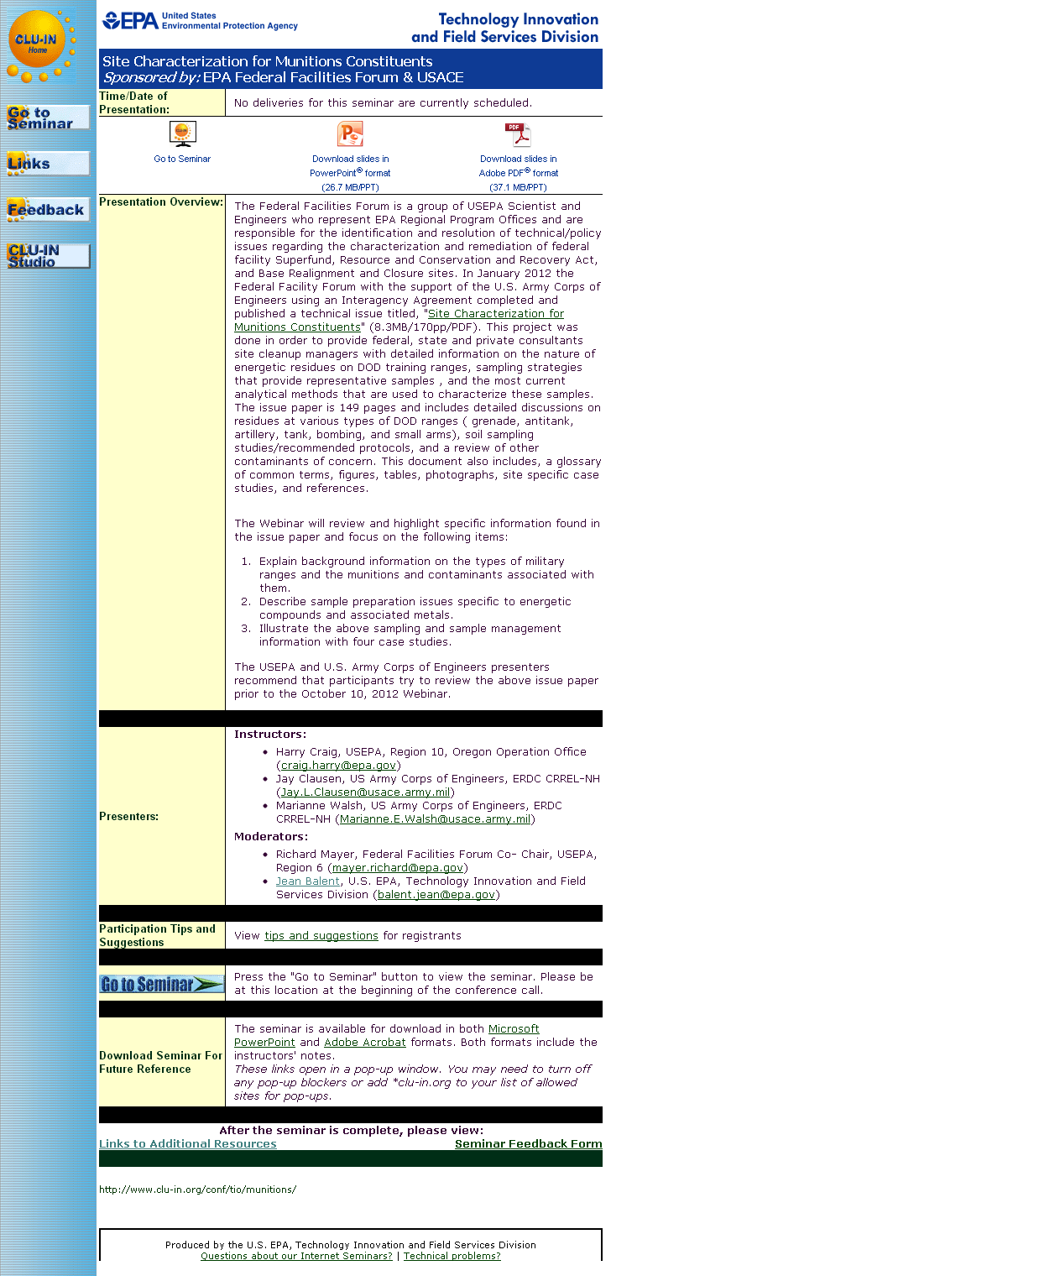
Seminar Homepage
Join the seminar online
Download Slides
Feedback

Slide 3

Housekeeping
Entire broadcast offered live via Adobe Connect
  participants can listen and watch as the presenters advance through materials live
  Some materials may be available to download in advance, you are recommended to participate live via the online broadcast
Audio is streamed online through by default
  Use the speaker icon to control online playback
  If on phones: all lines will be globally muted
Q&A – use the Q&A pod to privately submit comments, questions and report technical problems
This event is being recorded and shared via email shortly after live delivery
Archives accessed for free http://cluin.org/live/archive/
Notes:
Although I’m sure that some of you have these rules memorized from previous CLU-IN events, let’s run through them quickly for our new participants.
Please mute your phone lines during the seminar to minimize disruption and background noise. If you do not have a mute button, press *6 to mute #6 to unmute your lines at anytime. Also, please do NOT put this call on hold as this may bring delightful, but unwanted background music over the lines and interupt the seminar.
You should note that throughout the seminar, we will ask for your feedback. You do not need to wait for Q&A breaks to ask questions or provide comments. To submit comments/questions and report technical problems, please use the ? Icon at the top of your screen. You can move forward/backward in the slides by using the single arrow buttons (left moves back 1 slide, right moves advances 1 slide). The double arrowed buttons will take you to 1st and last slides respectively. You may also advance to any slide using the numbered links that appear on the left side of your screen. The button with a house icon will take you back to main seminar page which displays our agenda, speaker information, links to the slides and additional resources. Lastly, the button with a computer disc can be used to download and save today’s presentation materials.
With that, please move to slide 3.

Slide 4
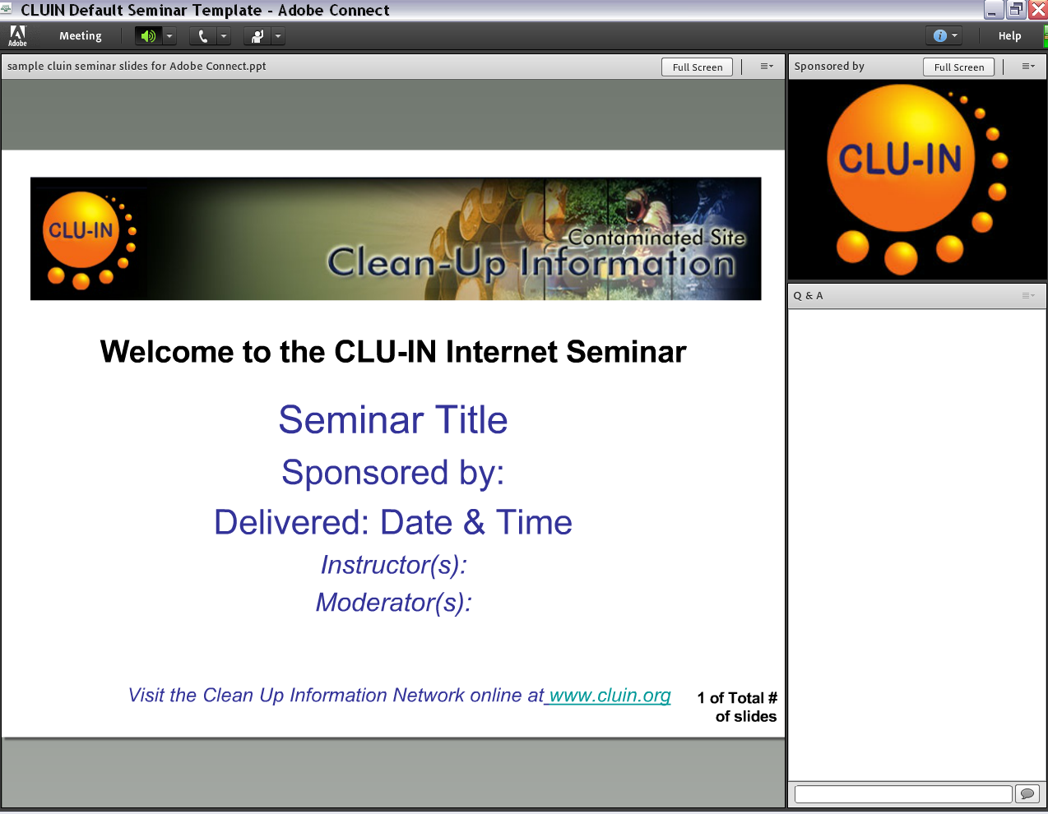


New online broadcast screenshot
Enlarge presentation
Control online audio
View presentation live online here
Information about Sponsors & Speakers
Submit private questions, comments or report technical problems

Slide 5
DISCLAIMER
The purpose of this presentation is to stimulate thought and discussion.
Nothing in this presentation is intended to supersede or contravene Federal Statutes, Regulations, or Official EPA Policies.

Slide 6
Instructors
Earl Liverman is an EPA On-Scene Coordinator located in the Region 10 Coeur d’Alene, Idaho, field office. Earl has been with EPA since 1991 working in the Remedial and Emergency Response and Removal programs.
Greg Weigel is an EPA On-Scene Coordinator in Region 10. Greg is located in a field office in Boise, Idaho, where he has served as an OSC for the past 18 years.
Doug Kodama is a Section Chief in EPA Region 2, serving New York, New Jersey, Puerto Rico and the US Virgin Islands. Doug has been with EPA since 1986 working in the Emergency Response and Oil Spill preparedness and prevention programs.
Jim Mullins works part time for TetraTech, a support contractor to EPA. Jim retired from the EPA Region 6 Dallas TX office after working 25 years in oil spill and hazardous waste response programs.

Slide 7
Oil Spill Response - I
Earl Liverman, Doug Kodama, Greg Weigel, and Jim Mullins

Slide 8

Introductions
Instructors
  Names and oversight costs
  Work experience
Participants (provided by instructors)
Notes:
This course is intended to provide only a broad overview of many, but not all, concerns/issues potentially associated with the vast field of oil spill response
Note national and international diversity of participants

Slide 9
AGENDA – Day 1
Wednesday, 6 November 2013
Course Overview
I. Statutory and Regulatory Authority
II. Oil Spill Liability Trust Fund
III. What is Oil?
IV. Fate and Behavior of Oil in the Environment
V. Factors Affecting Response and Cleanup Decisions

Slide 10
AGENDA – Day 2
Thursday, 7 November 2012
VI. Statutory and Regulatory Authority Thresholds for Response to Oil Spills
VII. Oil Spill Management
VIII. Oil Spill Response Techniques
IX. Disposal of Oil and Oily Debris
X. Summary Statement

Slide 11
Course Overview
Better understand the statutory and regulatory authority for responding to an oil spill
Gain an awareness of the Oil Spill Liability Trust Fund
Better understand the definition of oil and the fate and behavior of oil in the environment
Gain an awareness of the effect of oil spills on human health, environment, and wildlife
Gain an awareness of the environmental and human factors affecting cleanup decisions

Slide 12
Course Overview . . .
Better understand the main tasks an OSC is responsible for during an oil spill response
Better understand the statutory and regulatory thresholds for Response to Oil Spills
Gain an awareness of oil spill response techniques
Better understand how to dispose of oil and oily debris

Slide 13


Slide 14

I. Statutory and Regulatory Authority

Slide 15

Clean Water Act
Establishes basic structure for regulating discharges of pollutants into waters of U.S. and regulating quality standards for surface waters
Basis of CWA enacted in 1948 and was called Federal Water Pollution Control Act; in 1972 CWA was significantly reorganized and expanded
Notes:
Most participants in this class do not have a good sense of the staggering water pollution of the late 1960’s early 1970’s.. An Ohio river caught on fire a number of times. This (and other gross pollution events) stimulated mass demonstrations. Up to 20 million Americans were involved. Because apx 10% of the population of USA was demonstrably angry, President Nixon created US EPA and the Clean Water Act was passed by Congress...both in the early 1970’s
https://www.youtube.com/watch?feature=endscreen&NR=1&v=nlHiaZFvcXA

Slide 16

Oil Pollution Act of 1990
Expanded prevention and preparedness activities
Strengthened federal response authorities
Expanded the scope of liability for responsible parties (RPs)
Increased the liability limits applicable to spill incidents
Established a new Oil Spill Liability Trust Fund (OSLTF)

Slide 17

Similarities between CWA and CERCLA
Spill reporting
Failure to Notify (CERCLA-civil, OPA-criminal)
Removal authority for actual discharge/release or threat of discharge
Removal order authority and penalties for lack of compliance
Notes:
Mention that the Comprehensive Environmental Response, Compensation, and Liability Act provides a comprehensive group of authorities focused on one main goal: to address any release or threatened release of hazardous substances, pollutants, or contaminants that could endanger human health and/or the environment. CERCLA’s response provisions focus on human health and the environment.
Explain why the following slides discuss the similarities and differences between CWA and CERCLA

Slide 18
Similarities between CWA and CERCLA . . .
Liability provisions and cost recovery provisions (“polluter pays”)
Both have trust fund allowing direct government cleanup action
United States Coast Guard (USCG) does cost recovery for CWA/OSLTF while EPA does for CERCLA
Both CERCLA and oil removals must be consistent with the NCP
Similar natural resource provisions

Slide 19
Differences between CWA and CERCLA
CWA
CWA/OPA addresses navigable waters and adjoining shorelines
OPA has third party claims
Requirement for preparedness at a facility and governmental level
CERCLA
Addresses any environmental media
Does not
Response and cleanup

Slide 20
Differences between CWA and CERCLA . . .
CWA
No Agency decision document
No general permit exemption provision
311(j) prevention program (e.g., SPCC)
CERCLA
Agency decision document
General permit exemption provision
Nothing comparable

Slide 21
Differences between CWA and CERCLA . . .
CWA
Significant administrative and civil judicial penalty assessments for the prohibited discharge of oil or CWA hazardous substances
States may access the fund through Pollution Removal Funding Agreements (PRFAs) or direct access approved by the OSC
CERCLA
Does not have
Federal tool
FUNDING

Slide 22
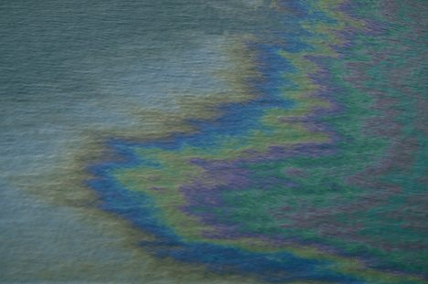
Discharge of Oil Regulation
(40 CFR 110)
Discharge of Oil regulation, commonly known as "sheen rule,” establishes criteria for determining whether an oil spill may be harmful to public health or welfare as follows:
  Discharges that cause a sheen or discoloration on the surface of a body of water
  Discharges that violate applicable water quality standards
  Discharges that cause a sludge or emulsion to be deposited beneath the surface of the water or on adjoining shorelines

Slide 23
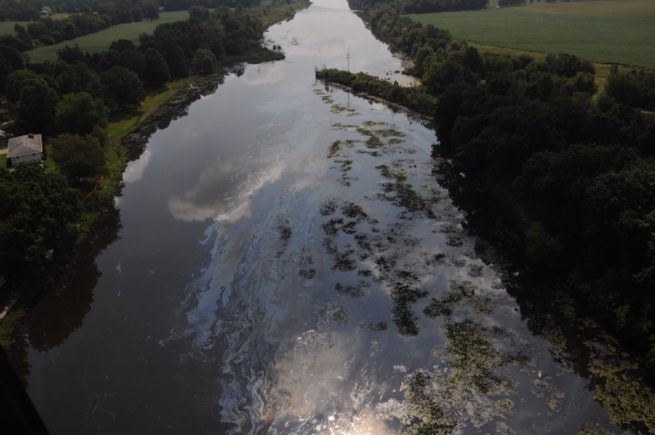
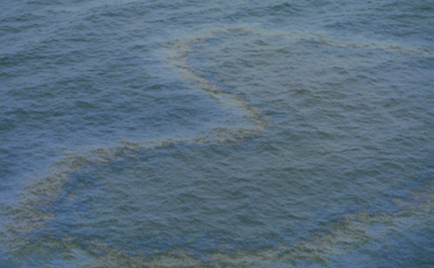
Discharge of Oil Regulation . . .
Sheen means an iridescent appearance on the surface of water
Sludge means an aggregate of oil or oil and other matter of any kind in any form other than dredged spoil having a combined specific gravity equivalent to or greater than water

Slide 24

National Oil and Hazardous Substances Pollution Contingency Plan
National Oil and Hazardous Substances Pollution Contingency Plan (NCP) was established in 1968 and amended by the CWA and CERCLA
Promotes overall coordination of the hierarchy of responders and establishes procedures for conducting responses for oil and hazardous substances
Designates the OSC as the manager of spills of oil and removal response for hazardous substances

Slide 25
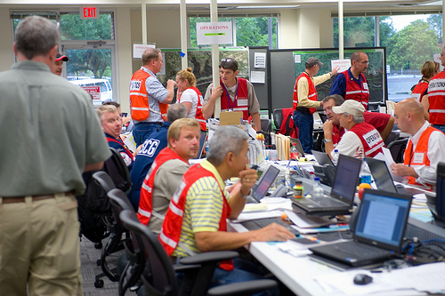
Key Provisions of the NCP
§300.120 – Establishes general responsibilities of federal On-Scene Coordinators
§300.135(a) – Authorizes pre-designated OSC to direct all federal, state, and private response activities at the site of a discharge
§300.135(d) – Establishes unified command structure for managing responses to discharges
§300.175 – Lists federal agencies that have duties associated with responding to releases

Slide 26
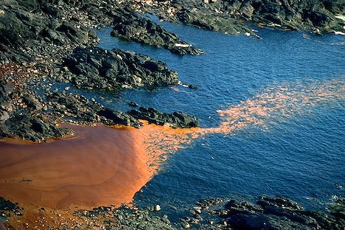
Key Provisions of the NCP Related to Oil Removal
300.317 - Establishes national priorities for responding to a discharge
§§300.320 - Establishes the general pattern of response to be executed by the OSC, including determination of threat, classification of the size and type of the release, notification of the RRT and the NRC, and supervision of thorough removal actions

Slide 27
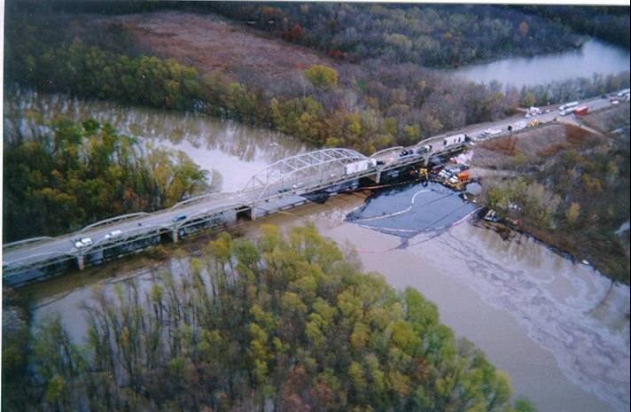
Key Provisions of the NCP related to Oil Removal . . .
§300.322 - Authorizes the OSC to determine whether a discharge poses a substantial threat to the public health or welfare of the United States based on several factors
§300.323 - Provides special consideration to discharges which have been classified as a spill of national significance
§300.355 - Provides funding for responses to oil discharges under under the OSTLF, provided certain criteria are met
Subpart J – Product Schedule (dispersants and other chemical or biological products)
Appendix E to Part 300 – Oil Spill Response

Slide 28

FOSC Removal Authority
Clean Water Act Section 311( c )
  Statutory Authority
Executive Order 12777
  Delegates Statutory Authority to Executive Branch
Delegation 2-89
  Removal of Discharge or Threat of Discharge
  Delegates EPA’s Authorities to OSCs
Notes:
Delegations may vary a bit from Region to Region . . . refer to Regional delegations memoranda

Slide 29
FOSC Removal Authority . . .
(from Delegation 2-89)
To remove or arrange for the removal of a discharge and to mitigate or prevent a substantial threat of a discharge
To direct or monitor all Federal, State, and private actions
To remove and, if necessary, destroy a vessel that is discharging or threatening to discharge
To consult with affected natural resource trustees
To determine when the removal is complete

Slide 30

Trust Natural Resource
OPA and CERCLA define natural resources broadly to include land, fish, wildlife, biota, air, water, ground water, drinking water supplies, and other such resources [CERCLA §101(16); OPA §1001(20); 40 CFR 300.5]

Slide 31
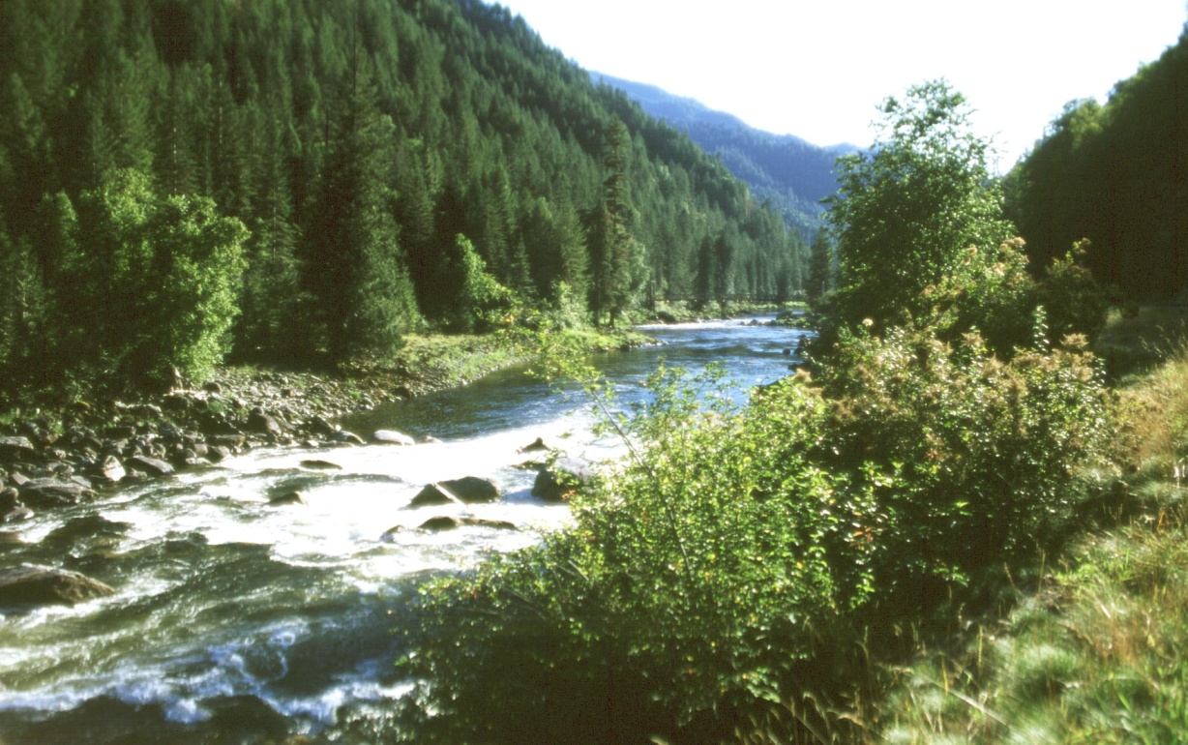
Trust Natural Resource . . .
Both statutes limit natural resources to those resources belonging to, managed by, held in trust by, appertaining to, or otherwise controlled by the United States, any, State, an Indian Tribe, a local government, or a foreign government

Slide 32
Natural Resource Trustees
Federal - Secretaries of Agriculture, Commerce, Defense, Energy, Interior (40 CFR 300.600)
State - designated by the Governor (40 CFR 300.605)
Tribal - designated by Tribal Chairperson or the Secretary of the Interior may serve as trustee at request of the tribe (40 CFR 300.610)
Other – Under OPA, foreign officials can also act as Trustee (40 CFR 300.612)

Slide 34
AGENDA
Course Overview
I. Statutory and Regulatory Authority
II. Oil Spill Liability Trust Fund
III. What is Oil?
IV. Fate and Behavior of Oil in the Environment
V. Factors Affecting Response and Cleanup Decisions

Slide 35
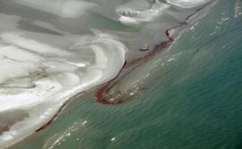
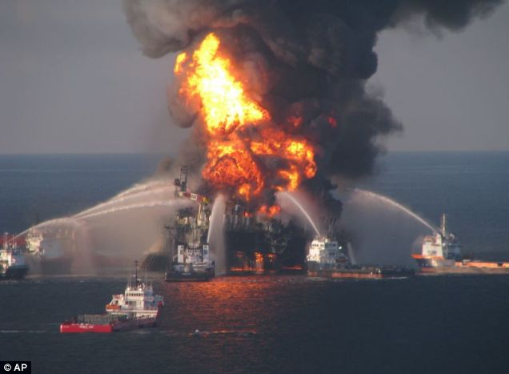
II. Oil Spill Liability Trust Fund

Slide 36

Oil Spill Liability Trust Fund
Authorized by OPA 90 at $2+ Billion
Fund sources
  Investment interest on the Fund’s principal
  Costs recovered from responsible parties (RPs)
  Penalties from RPs
  Eight cents a barrel tax on domestic and imported oil through 2016
  Nine cents a barrel tax on domestic and imported oil in 2017
Notes:
The Principal Fund of the OSLTF has several recurring and nonrecurring sources of revenue.
Barrel Tax. The largest source of revenue has been a per-barrel excise tax, collected from the oil industry on petroleum produced in or imported to the United States
Transfers. A second major source of revenue has been transfers from other existing pollution funds
Interest. A recurring source of OSLTF revenue is the interest on the Fund principal from U.S. Treasury investments
Cost Recoveries. Another source is cost recoveries from responsible parties (RPs); those responsible for oil incidents are liable for costs and damages. NPFC bills RPs to recover costs expended by the Fund. As these monies are recovered, they are deposited into the Fund
Penalties. In addition to paying for clean-up costs, RPs may incur fines and civil penalties under OPA, the Federal Water Pollution Control Act, the Deepwater Port Act, and the Trans-Alaska Pipeline Authorization Act. Penalty deposits into the OSLTF are generally between $4 million and $7 million per year.

Slide 37
Principal and Emergency Funds
Appropriations by Congress
Claims
Emergency Fund
Principal Fund
Removal actions
State access
NRDA “initiation”
Tax collections, recoveries, fines, penalties, interest
Notes:
Emergency Fund
A core mission of the NPFC is to administer the disbursement and ensure proper use of the Emergency Fund, 24 hours a day, every day, so that the FOSC can immediately respond to a discharge or monitor prompt and effective cleanup activities by the responsible party (RP)
The Emergency Fund can be used by FOSCs to cover expenses associated with mitigating the threat of an oil spill, as well as the costs of oil spill containment, countermeasures, cleanup, and disposal activities
While the use of the OSLTF is most closely associated with discharges from ships, it has increasingly been used for discharges at industrial or onshore oil storage and production facilities.

Slide 38

Access to the Oil Spill Liability Trust Fund (OSTLF or Fund)
US Coast Guard and EPA OSCs have direct access to the Fund via the on-line Ceiling and Number Assignment Processing System (CANAPS)
EPA OSCs can immediately access up to $50,000 in approved project ceiling; above this amount requires approval from an National Pollution Funds Center (NPFC) Case Officer
Notes:
All who access (listed above) use CANAPS

Slide 39
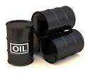
Threshold Criteria for Accessing the OSTLF
The substance involved an oil
There a discharge or substantial threat of discharge into navigable waters or adjoining shorelines
The removal actions consistent with the NCP

Slide 40
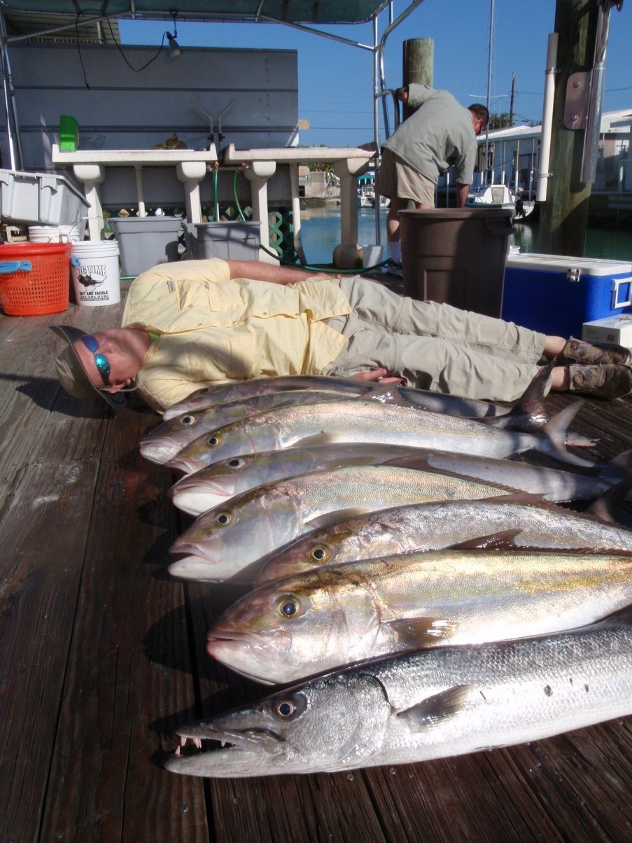
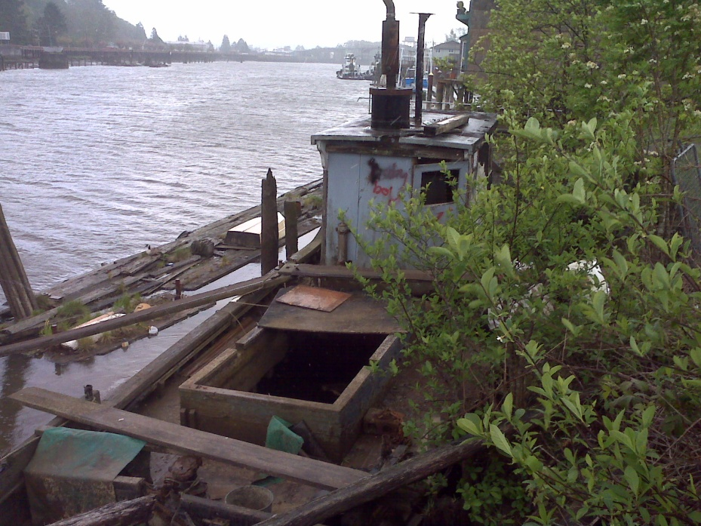
Access to the OSTLF . . .
The OSC can “hire” other government agencies via a Pollution Removal Funding Authorization (PRFA)
Federal trustees conducting Natural Resource Damage Assessment (NRDA)
Claimants
Notes:
PRFA issued by OSC
Images - WA Department of Ecology:
Hoquiam River, abandoned fishing vessel diesel spill into river from fuel tanks
State and their local contractor respond to spill within 1 hour

Slide 41

Emergency Response Costs funded by OSLTF
Oil spill assessment by OSC
Oil spill response conducted, overseen, or directed by an OSC, including:
  EPA or Coast Guard response and oversight costs
  State direct access costs
  Costs for other federal, state, tribal, or local agency authorized by a PRFA
  NRDA “initiation”

Slide 42

NRDA and FOSC Actions
FOSC does not conduct natural resource damage assessment (NRDA)
FOSC cannot open the OSLTF for NRDA activities
FOSC does not use FPN for NRDA, or PRFA specifically to pay natural resource trustees (trustees) for NRDA
FOSC does initially make sure trustees and RP are coordinating
Trustees have a separate access/funding route to the OSLTF for NRDA and can file claim
Notes:
Part of OSC responsibility per the NCP is to notify Natural Resources Trustees whose administered resources are impacted or potentially impacted by the spill (e.g., NOAA Fisheries, U.S. F&W, Federal land management agencies, Tribes).
OSC may also need to initiate emergency consultation per the Endangered Species Act, or National Historic Preservation Act.
Costs for these efforts are appropriately funded under the FPN. However, the OSC cannot fund NRDA activities, even though the same agencies and personnel might be involved. Must separate out those activities and costs from “response” costs.

Slide 43
Enforcement/Cost Recovery
Enforcement conducted in order to
  Identify RP(s)
  Enforce RP(s) effective oil response, removal
  Effect cost recovery
FOSC responsible for initial attempts at locating, notifying RP of responsibilities
NPFC (often through DOJ) conducts cost recovery – EPA does not conduct cost recovery
EPA still has authority for spill fines, orders
Notes:
Expectation—EPA OSCs must “set up” elements of an OSLTF cost recovery case.

Slide 44

OSLTF Funding Scenarios

Slide 45
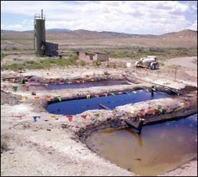
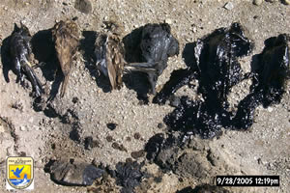
Scenario I
All that remains of an abandoned oil field is 3 waste pits filled with of oily waste; the pits drain to a nearby wetland
EPA will close the pits due to frequent oil discharges to the wetland and harm to migratory waterfowl
Pits 1 and 2 are filled with oil and water, while Pit 3 is known to contain F001 waste waste
Can all three pit closures be funded by OSLTF?
Notes:
F001 waste – non-specific spent solvent---designated hazardous substance

Slide 46

Answer
Yes: Pits 1 and 2 may be closed using the OSLTF
No: Pit 3 has F001 and must be closed under CERCLA

Slide 47

Scenario II
Leaking underground gasoline tank near Mojave, CA has contaminated 16 residential drinking water wells in a nearby subdivision
Nearest navigable water is more than 5 miles away
Can OSLTF be used for a temporary bottled water supply? Could carbon filters be installed on each well?

Slide 48
Answer
No . . . must have clear nexus to navigable water

Slide 49
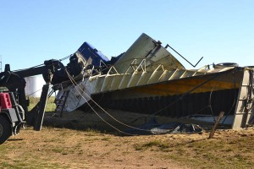
Scenario III
A tractor trailer wreck released 8,000 gallons of red-dyed diesel fuel to roadside ditch
Could the OSLTF be used to cleanup the diesel-contaminated soil?

Slide 50
Answer
Maybe . . . must have clear nexus to navigable water

Slide 52
AGENDA
Course Overview
I. Statutory and Regulatory Authority
II. Oil Spill Liability Trust Fund
III. What is Oil?
IV. Fate and Behavior of Oil in the Environment
V. Factors Affecting Response and Cleanup Decisions

Slide 53

III. What is Oil?

Slide 54
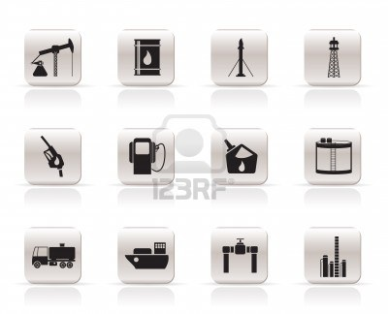
Regulatory and Statutory Definitions of Oil
40 CFR § 300.5. Oil of any kind or in any form, including, but not limited to, petroleum, fuel oil, sludge, oil refuse, and oil mixed with wastes other than dredged spoil

Slide 55

Regulatory and Statutory Definitions of Oil . . .
Oil, as defined by section 1001 of OPA means oil of any kind or in any form, including, but not limited to, petroleum, fuel oil, sludge, oil refuse, and oil mixed with wastes other than dredged spoil, but does not include petroleum, including crude oil or any fraction thereof, which is specifically listed or designated as a hazardous substance under subparagraphs (A) through (F) of section 101(14) of CERCLA and which is subject to the provisions of that Act

Slide 56

Regulatory and Statutory Definitions of Oil . . .
40 CFR § 112.2. Definitions. Oil means oil of any kind or in any form, including, but not limited to: fats, oils, or greases of animal, fish, or marine mammal origin; vegetable oils, including oils from seeds, nuts, fruits, or kernels; and, other oils and greases, including petroleum, fuel oil, sludge, synthetic oils, mineral oils, oil refuse, or oil mixed with wastes other than dredged spoil

Slide 57

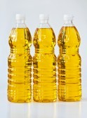

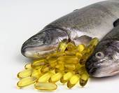
Regulatory and Statutory Definitions of Oil . . .
40 CFR § 112.2. Definitions. Non-petroleum oil means oil of any kind that is not petroleum-based, including but not limited to: Fats, oils, and greases of animal, fish, or marine mammal origin; and vegetable oils, including oils from seeds, nuts, fruits, and kernels
Notes:
Fish oil capsules
Bottles of cooking oil
Grape seed oil
Lavender oil

Slide 58
Regulatory and Statutory Definitions of Oil . . .
Common phrase
  “. . . oil of any kind in any form . . .”
The statute language defines oils as broadly and comprehensively as possible
No definitive, specific EPA list of what constitutes an oil or EPA Guidance

Slide 59

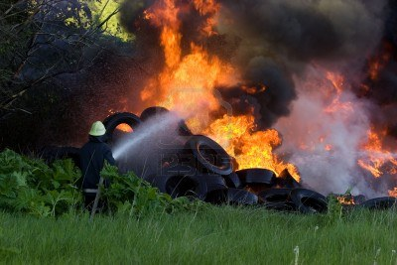
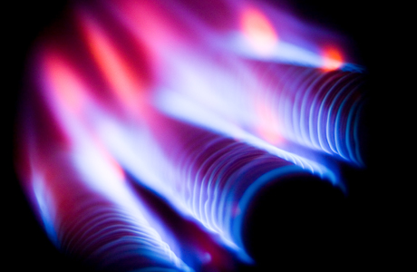
What is Not an Oil
Coal Tar “waste” from former manufactured gas plants
Creosote “Waste” from Wood Treatment Facilities
Tires, unless they’re burning and by “pyrolysis” creating an oil discharge
CERCLA Hazardous Substances
Listed CWA Hazardous Substances (40 CFR 116)
Natural Gas
Notes:
These area things that may appear to be/contain oil…..but are not
Tires are controversial . . . tires are ABS plastics made from acrylonitrile, butadiene, styrene
Pyrolytic decomposition will break tires down to liquid forms of these chemicals
NPFC may (appropriately) elect to request OSC get funding through CERCLA

Slide 60

CERCLA Petroleum Exclusion
Petroleum is defined not to be a “hazardous substance” or “pollutant or contaminant”
    CERCLA 101(14)(A) through (F) and the NCP specifically excludes crude oil and natural gas. “The term does not include petroleum, including crude oil or any fraction thereof which is not otherwise specifically listed or designated as a hazardous substance … and the term does not include natural gas, natural gas liquids, liquefied natural gas, or synthetic gas usable for fuel (or mixtures of natural gas and such synthetic gas)”

Slide 61
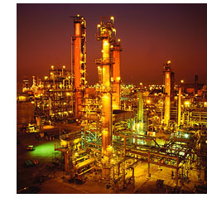
CERCLA Petroleum Exclusion . . .
The term “petroleum” also includes hazardous substances normally mixed with or added to crude oil or crude oil fractions as part of the refining process (even if their concentrations changed)
HOWEVER,
Hazardous substances that are added to, or increase in concentration as a result of contamination during use are NOT considered part of petroleum and are covered by CERCLA

Slide 62
CERCLA Petroleum Exclusion . . .
What does this mean for the FOSC when handling oil spills? Some examples:
  Cannot use CERCLA to handle a crude oil spill because there is benzene in it
  Cannot use CWA/OPA to handle an oil-based pesticide spill or mixed waste spill
EPA petroleum exclusion website:
  http://www.epa.gov./emergencies/content/reporting/faqsubs.htm#exclusion

Slide 63
Mixed Substances
OPA excludes use of Fund for CERCLA hazardous substances
CWA definition of oil includes “. . . oil mixed with waste other than dredged spoil . . .”
EPA is united on how to address mixed substances, and has developed a position paper on “Mixed Substance Spills”

Slide 64

Mixed Substances . . .
Oil with a “minor” amount of hazardous substance(s) is an oil
EPA will use the “primary threat posed by the material” to determine which authority/fund to use
If concentration(s) of CERCLA hazardous substance(s) do not independently meet eligibility factors for a CERCLA removal action listed in 40 CFR 300.415(b)(2), material will be considered oil and EPA will use CWA authority and OPA funding

Slide 65

Is it oil, or not?
EPA Position Paper states:
OSCs must make “swift, field determinations”
Use readily available information regarding source of oil (RP, State, locals)
If source is unknown . . . use “physical behavior of the material and any observed adverse environmental effects”

Slide 67
AGENDA
Course Overview
I. Statutory and Regulatory Authority
II. Oil Spill Liability Trust Fund
III. What is Oil?
IV. Fate and Behavior of Oil in the Environment
V. Factors Affecting Response and Cleanup Decisions

Slide 68

IV. Fate and Behavior of Oil in the Environment

Slide 69
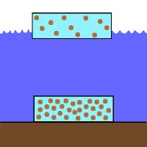
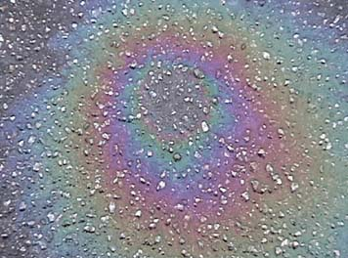
Physical and Chemical Properties of Oil
Specific gravity:
  Comparison of a substance’s density to water
  < 1.0 floats on water
  > 1.0 sinks in water
Surface tension
  Force of attraction between molecules of a liquid
  Lower surface tension, greater potential spreading rate
  Surface tension increases with temperature, and rate of spread increases
Viscosity
  Measure of an oil’s resistance to shear
  High viscosity indicates high resistance to flow
  Low viscosity indicates low resistance to flow
Notes:
Ask students why properties are important to cleanup
Specific gravity → Oil is on top or bottom of water column
Surface tension → Influences spreading rate of oil
Viscosity → influences spreading rate of the oil slick; the stickiness of the oil; the oil’s penetration into soil or beaches; and ability of pumps to remove/move oil

Slide 70

Physical and Chemical Properties of Oil . . .
Pour point
  Lowest temperature at which oil will pour or flow
  Overrides effects of viscosity and surface tension
Flash point
  Temperature at which an oil’s vapors will ignite
Solubility
  Amount of oil that can dissolve in a particular solvent

Slide 71
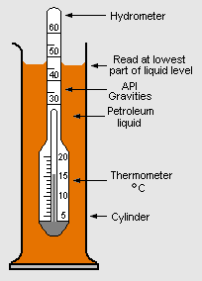
Hydrometer test for API gravity
OSC Significance
API degree significance
API <10 sinks in water
API 10 = density of water
API>10 floats on water
API <20 biodegrades slowly
API >40 biodegrades quickly
Notes:
API gravity . . . quick accurate test of petroleum density
Higher numbers are lighter oils (more light ends) and lower

Slide 73
Notes:
Depicts weathering processes, including spreading, evaporation, dispersion, dissolution, oxidation, emulsification, sedimentation, and microbial degradation

Slide 75
Notes:
Loss of lighter fractions to surrounding atmosphere
Influenced by type of oil, air and water temperature, wave action

Slide 77
Notes:
Long term process and continues as oxidation and biodegradation produce additional soluble compounds

Slide 78
Notes:
Chemical combination of hydrocarbons with oxygen

Slide 79
Notes:
Process by which one liquid is dispersed into another liquid in the form of small droplets

Slide 80
Notes:
Oils may adhere to sediments in water
Addition of sediment to oil may cause oil to sink

Slide 81
Notes:
Oil degrading microbes are present in all aquatic environments to some extent
Rate depends on temperature, nutrients, adequate substrate

Slide 83
AGENDA
Course Overview
I. Statutory and Regulatory Authority
II. Oil Spill Liability Trust Fund
III. What is Oil?
IV. Fate and Behavior of Oil in the Environment
V. Factors Affecting Response and Cleanup Decisions

Slide 84
V. Factors Affecting Response and Cleanup Decisions
Notes:
This section draws information together from a wide variety of sources and experiences
Will consider both human and environmental factors

Slide 85
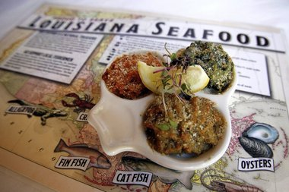
Human
Health
  Type of product released
  Location of release
  Media affected by release
  Weather

Slide 86
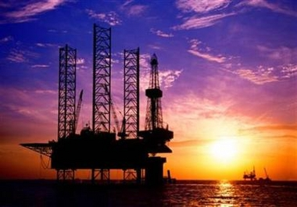
Human . . .
Industry
  Need to keep production and cleanup activities from interfering with each other
  Management of response operations
  Organizational context and design and learning
  Cost
Notes:
No. 1: Avoid restricting access and prolonged closures (continue to conduct business activities)
No. 2: (1) Setting the command structure; (2) speed of establishing command; (3) decision-making outside the command structure; (4) appropriate role of a responsible party; (5) allocation and management of resources; (6) costs; (7) role of federal, state, local, and tribal governments
No. 3: Institutional pressures (governments, regulators, customers, competitors, community, interest groups, industry groups) impose coercive and normative pressures on companies, which in turn influence organizational characteristics such adoption of environmental management practices and performance beyond regulatory compliance
No. 4: Varies considerably from one incident to another depending on a number of interrelated factors including:
Type of oil; location of the spill and characteristics of affected area; quality of contingency plan; management and control of response operations
Often rely predominantly on “hindsight” (examine historical spill cost data, if available); concern for both predictable and unpredictable circumstances as they play themselves out

Slide 87

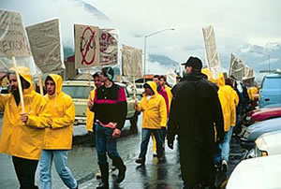
Human . . .
Political
  Agency
  Legal constraints
  Multi-agency, multi-jurisdiction
  Public opinion
  Non-governmental interest groups
Notes:
No. 1: Internal and external agency constraints/initiative/policy
No. 2: (1) Statutory and regulatory framework; (2) influence of existing agreements
No. 3: Coordination/interaction of federal, state, local, and tribal agencies with different legal, geographic, and functional responsibilities
No. 4: Perceptions of (1) control; (2) appropriate role of responsible party; (3) role of state and local and tribal governments; (4) how clean is clean
No. 5: Such groups may press for aggressive responses on oiled shorelines (off-shore, near shore, shoreline) despite evidence that such operations can cause greater long-term environmental damages

Slide 88
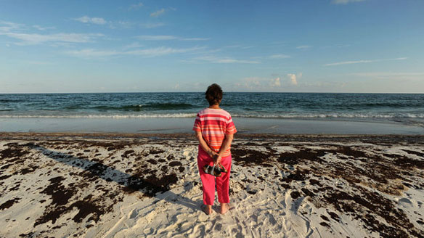
Human . . .
Socio-economic
  Amount spilled, spill location, and rate of spillage
  Aesthetic appeal and amenity use of the shoreline and beaches
  Media
  Primary and secondary economic impacts
Notes:
No. 1:
Some areas will be of high regional, national, or international importance, whereas others will rank as locally important
Seasonal differences will also occur in the sensitivity of these resources to an oil spill, and therefore the economic impact of the incident (e.g., salmon spawning run)
No. 2:
- Is the affected area aesthetically and recreationally pleasing or has the experience been degraded?
No. 3:
One v. many spokespeople
Communications tactics are not may not be directly transferable across mediums
Consider the ethics of social channels
No. 4:
Loss of income
Substitute income: (1) Primary: Wages or taxes earned resulting from cleanup activities; (2) Secondary: Buy products from local suppliers and purchase transportation and other services from local companies

Slide 89
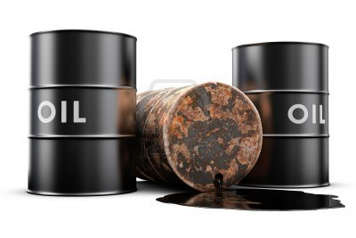
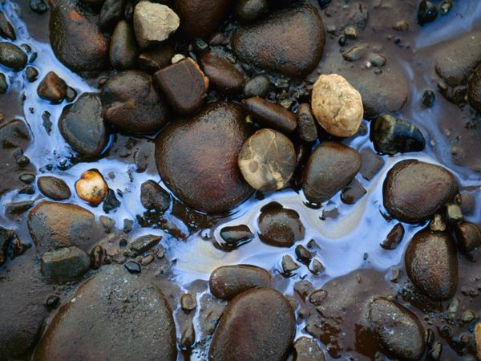
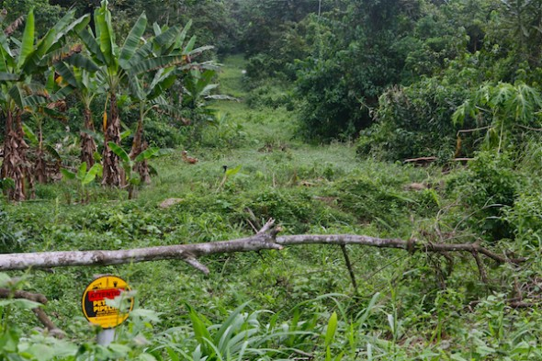
Ecological
Environment
  Type of product released
  Location of release
  Geology of shoreline and rate of flow
Notes:
1st Statement: Lighter oils tend to evaporate and degrade very quickly; heavier oils tend to form thick oil-and-water mixture which clings to rocks and sand
2nd Statement: Rain forest
3rd Statement: Oil tends to stick to sediments and surfaces of cobbles and pebbles; Standing or slow-moving water is more likely to incur severe impacts than flowing water

Slide 90
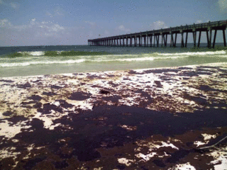
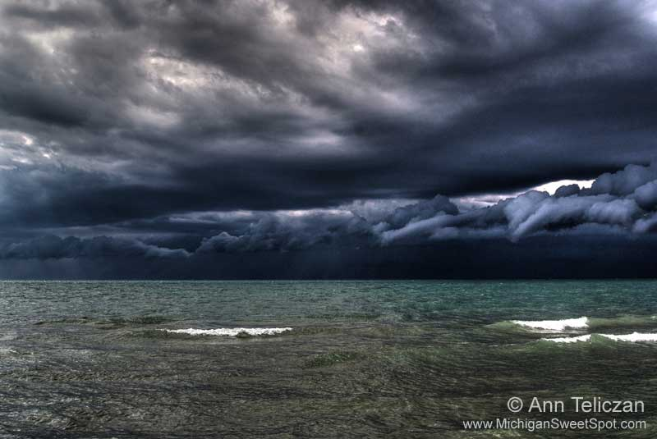
Ecological . . .
  Weather

Slide 91
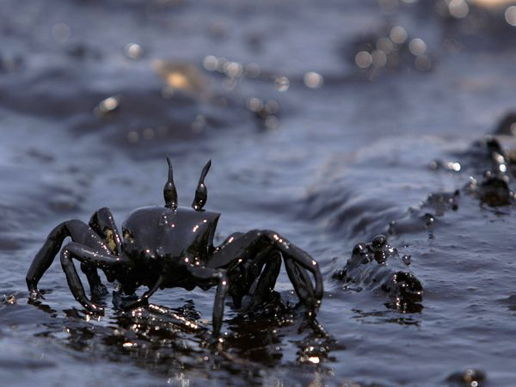

Ecological . . .
Type and sensitivity of biological communities likely to be affected
  Physical properties
  Food chain
  Habitat
Notes:
No. 1: Animals and plants may be affected by physical properties of spilled oil (e.g., form surface sheens, sludge's, emulsions, soluble fractions of oil) which prevent respiration, photosynthesis, or feeding
Asphyxiation of fish and benthic fauna due to coating by oil; harm to waterfowl because of loss of buoyancy or loss of insulating capacity of feathers
May cause fish kills due to increased biological oxygen demand and/or “closing” the air water interface where gas exchange occurs
No. 2: May be toxic to some animals and plants which other organisms may depend on for food

Slide 92
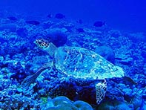
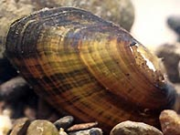


Ecological . . .
  Species of wildlife present
  Timing of breeding cycles and seasonal migration

Slide 93
End of Agenda - Day 1
Notes:
Comment regarding the trilogy of courses v. a stand alone course and the need to address the “basics”

Slide 94
Certificates
If you are interested in receiving a certificate for participating in this training, please send an email to Austin Oelschlager, Tetra Tech at austin.oelschlager@tetratech.com

Slide 95



New Ways to stay connected!
www.cluin.org
Follow CLU-IN on Facebook, LinkedIn, or Twitter
  https://www.facebook.com/EPACleanUpTech
  https://twitter.com/#!/EPACleanUpTech
    http://www.linkedin.com/groups/Clean-Up-Information-Network-CLUIN-4405740

Slide 96
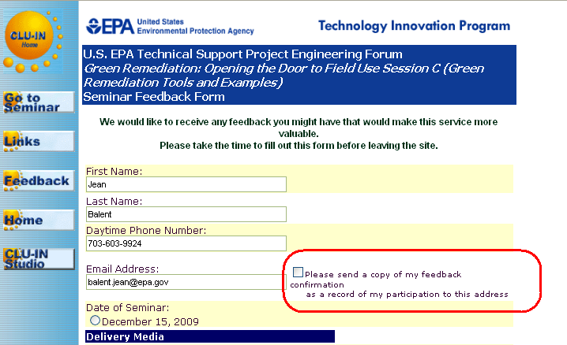
Resources & Feedback
To view a complete list of resources for this seminar, please visit the Additional Resources
Please complete the Feedback Form to help ensure events like this are offered in the future
Need confirmation of your participation today?
Fill out the feedback form and check box for confirmation email.

