Slide 1
Community Involvement Case Study – Standard Mine
Gina Cristiano
R8 Emergency Planning

Slide 2
Standard Mine

Slide 3
Site Overview
Abandoned mine located approx. 7 miles from the town of Crested Butte, Colorado
Site at elevation of 11,000+ feet
Harsh weather conditions – SNOW! Short construction season
Consists of about 5 “Levels”, one of which has year-round adit drainage

Slide 4
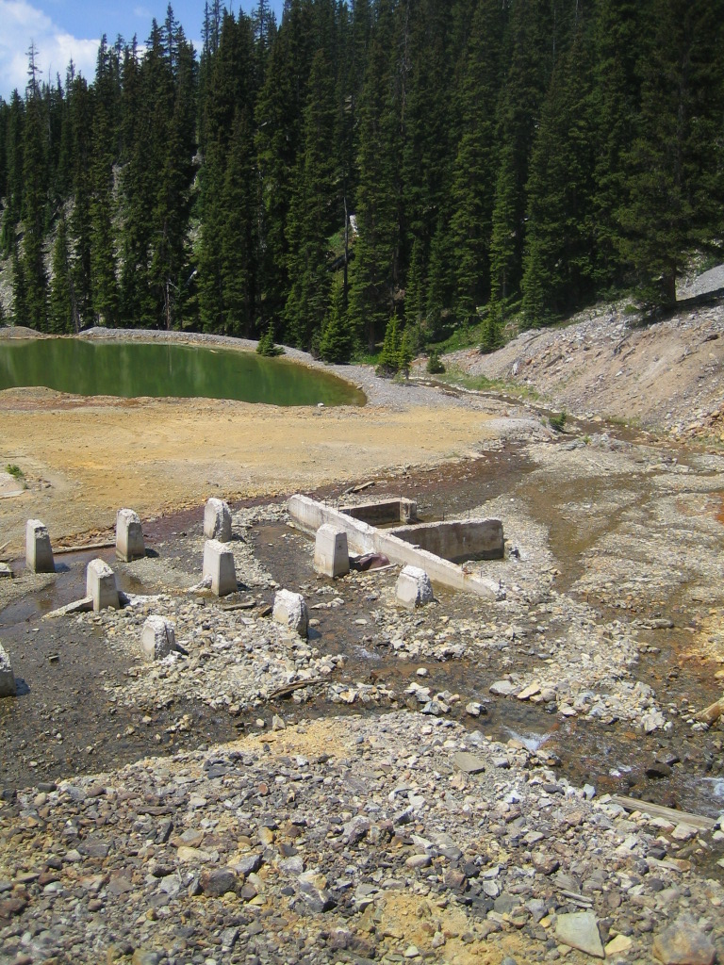
Site Overview
Added to the National Priorities List (NPL) September 2005
Contaminants of Concern (COCs) are lead, arsenic, zinc, cadmium
Major concern – tailings dam failure!!

Slide 5
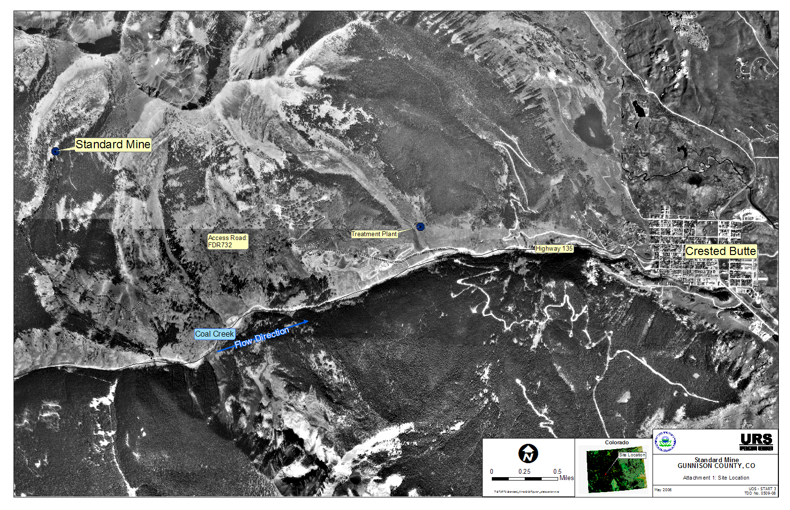
1.1-Basic Site Overview

Slide 6
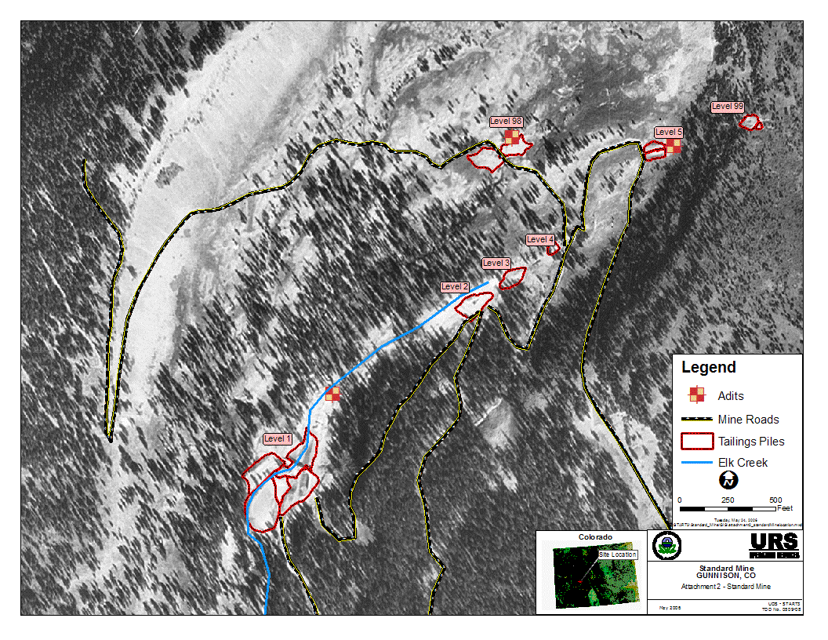
1.1-Basic Site Overview

Slide 7
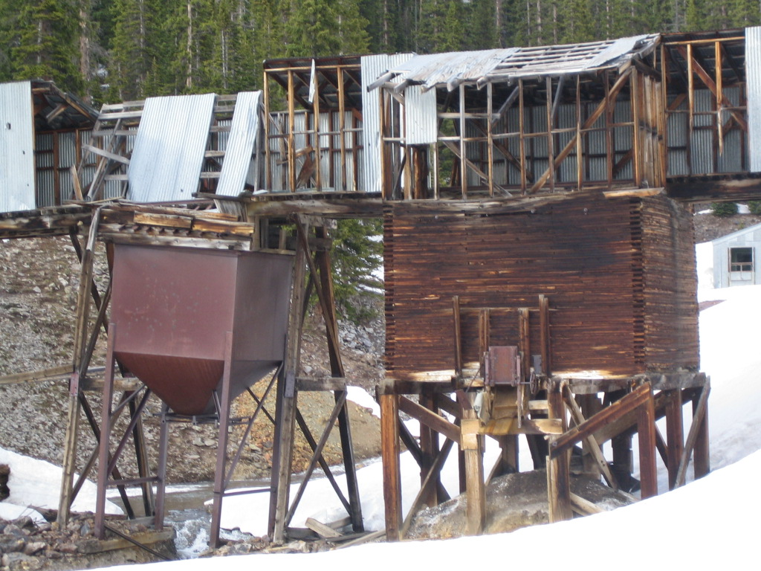
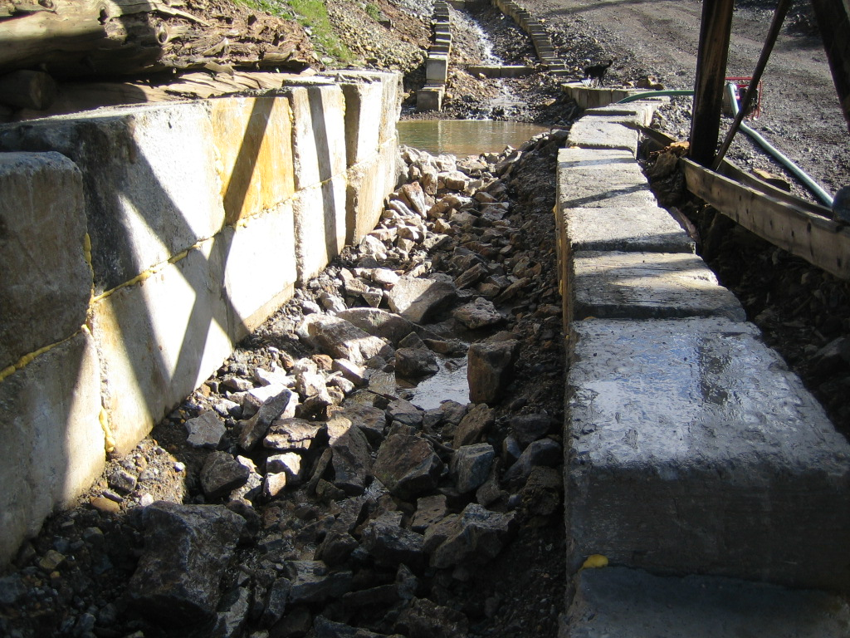
Site Overview
Cleanup plan
Stabilize site – channelize stream, road improvements, safety hazards

Slide 8
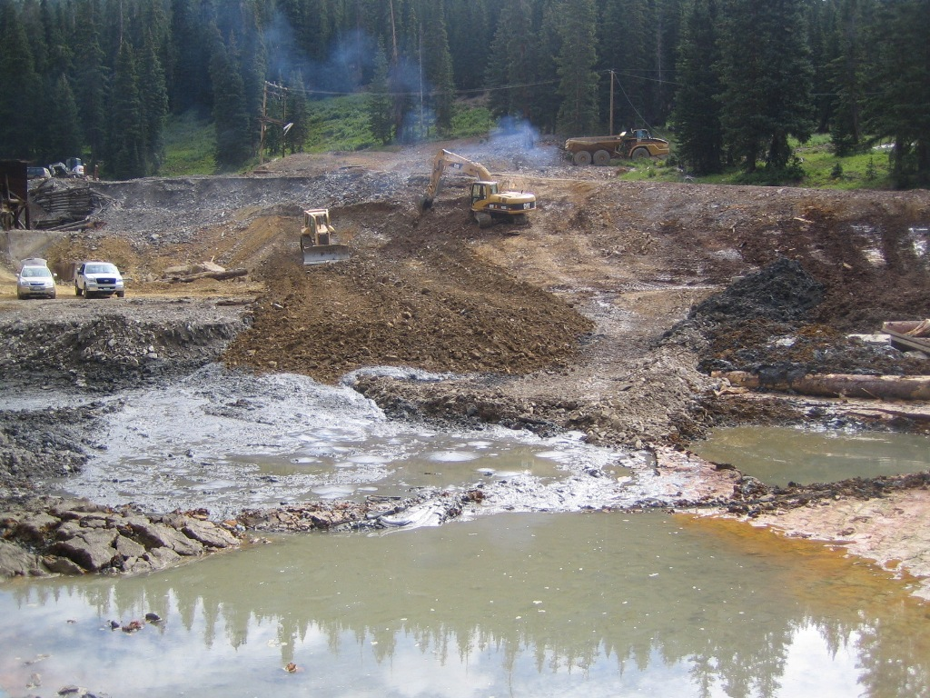
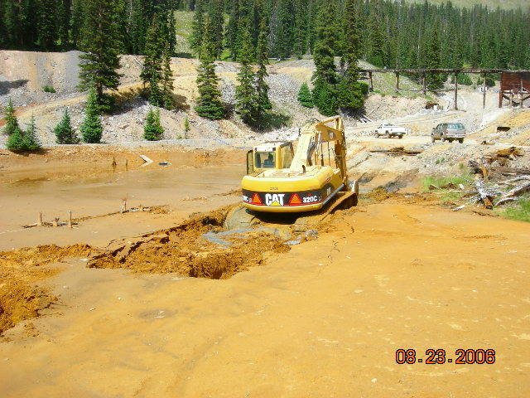
Site Overview
Cleanup plan
Remove tailings impoundment – dewatering, identify/prepare waste repository

Slide 9
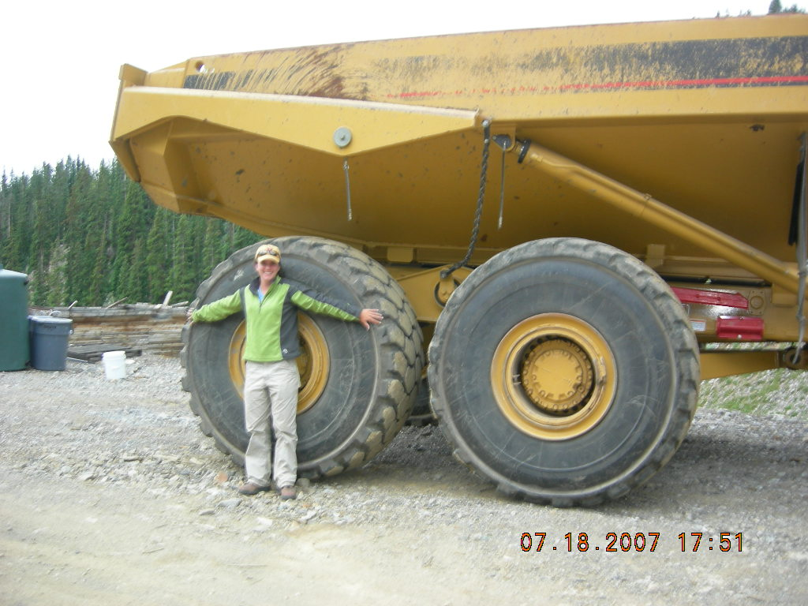
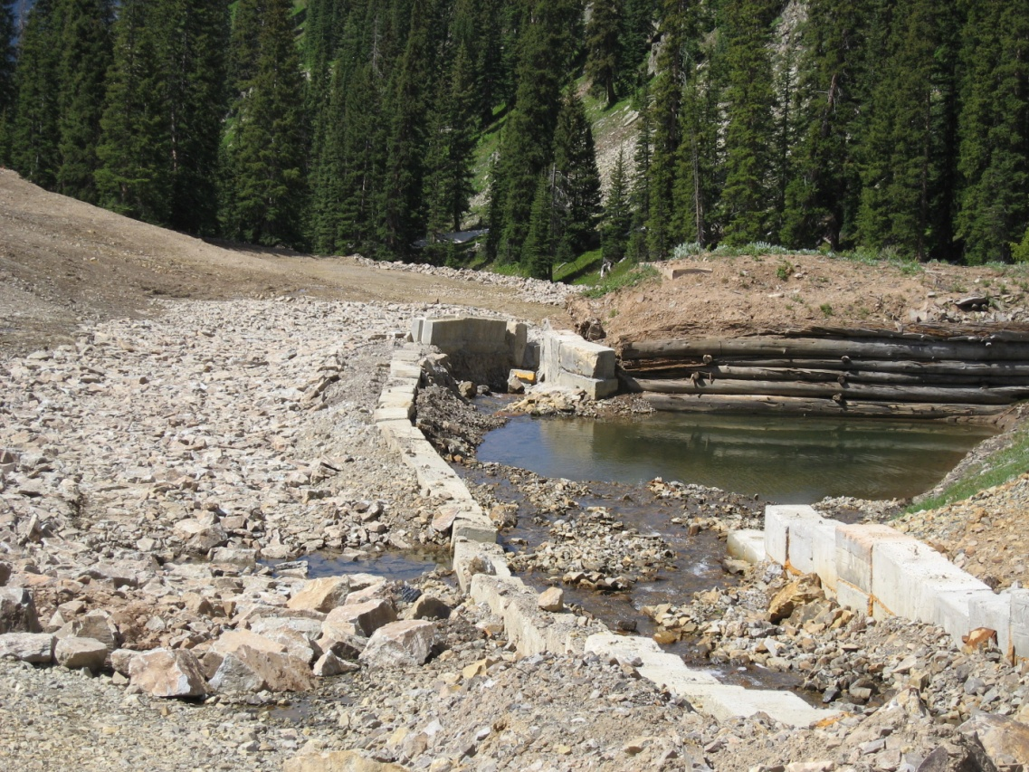
Site Overview
Cleanup plan
Restore site – reconstruct stream, increase habitat
Watch out for RPM!

Slide 10
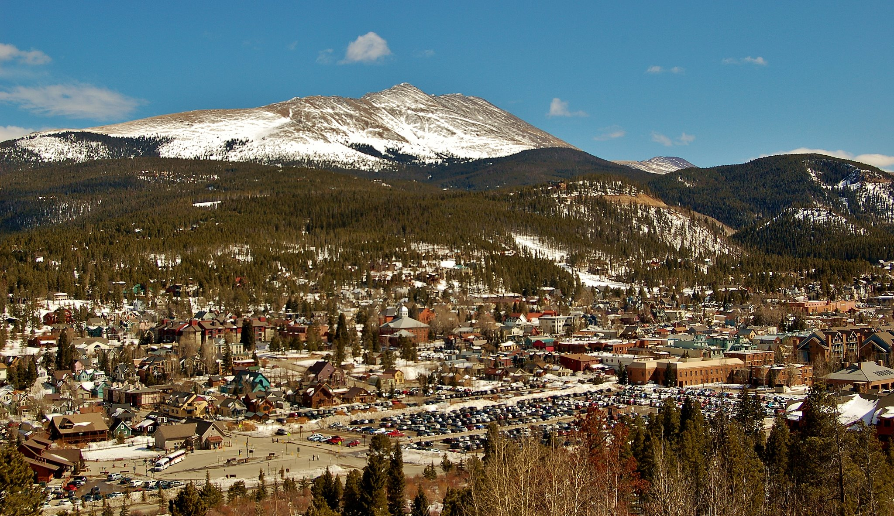
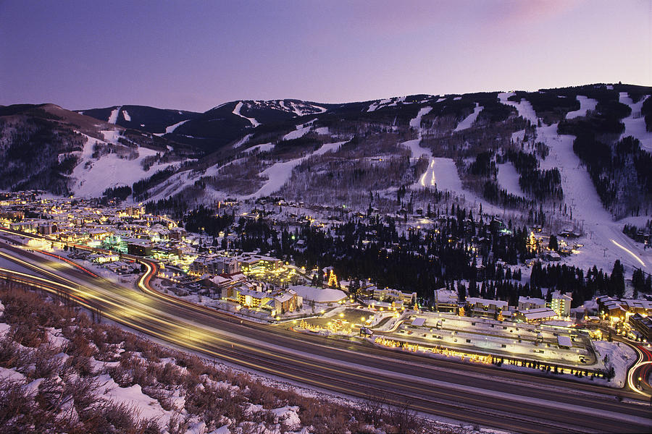
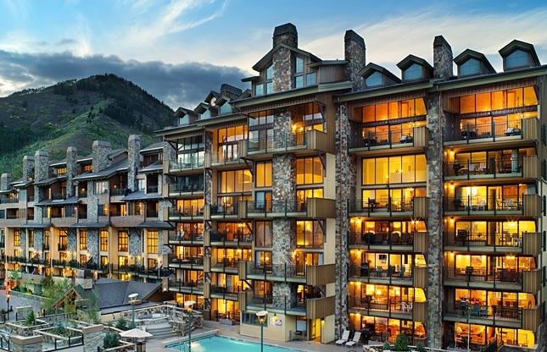
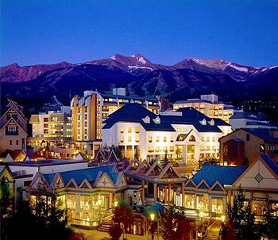
Site Overview
Community Concerns and Issues

Slide 11
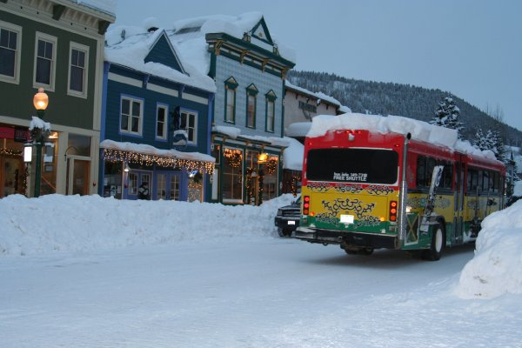
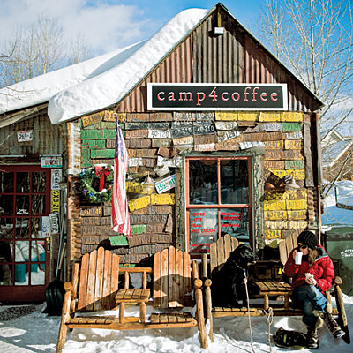
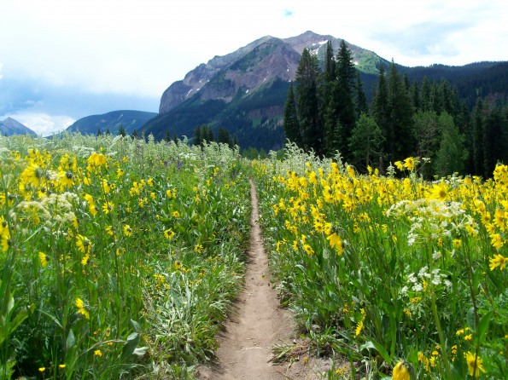
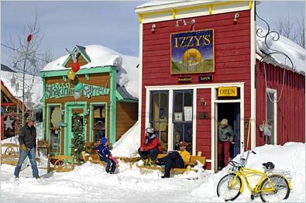
Site Overview
Community Concerns and Issues

Slide 12
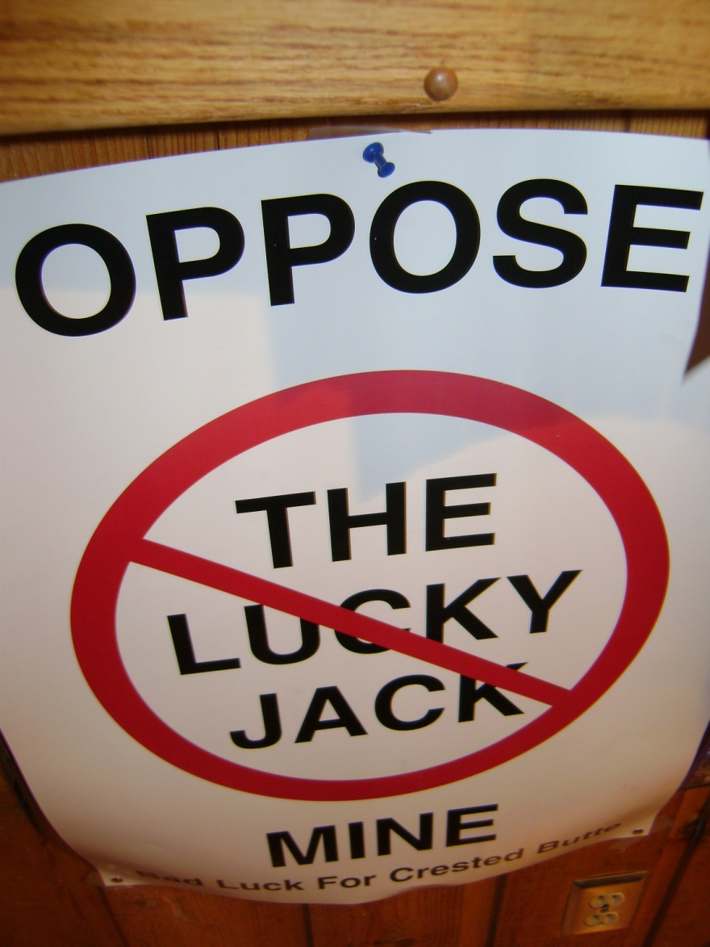
Community Involvement Objectives
Information, issues warranting EPA response
Required to give prompt, accurate information per § 300.155 and § 300.415(n)
Folks in Crested Butte are VERY involved!!!

Slide 13
Community Involvement Objectives
Information, issues warranting EPA response
Consequences of tailings dam failure – health, environmental
Project timeline – 3 years for Removal action, concurrent Remedial action
Community disruption – out of town but not out of site/mind
Development and future land use
Historic preservation, endangered species, sensitive habitats

Slide 14
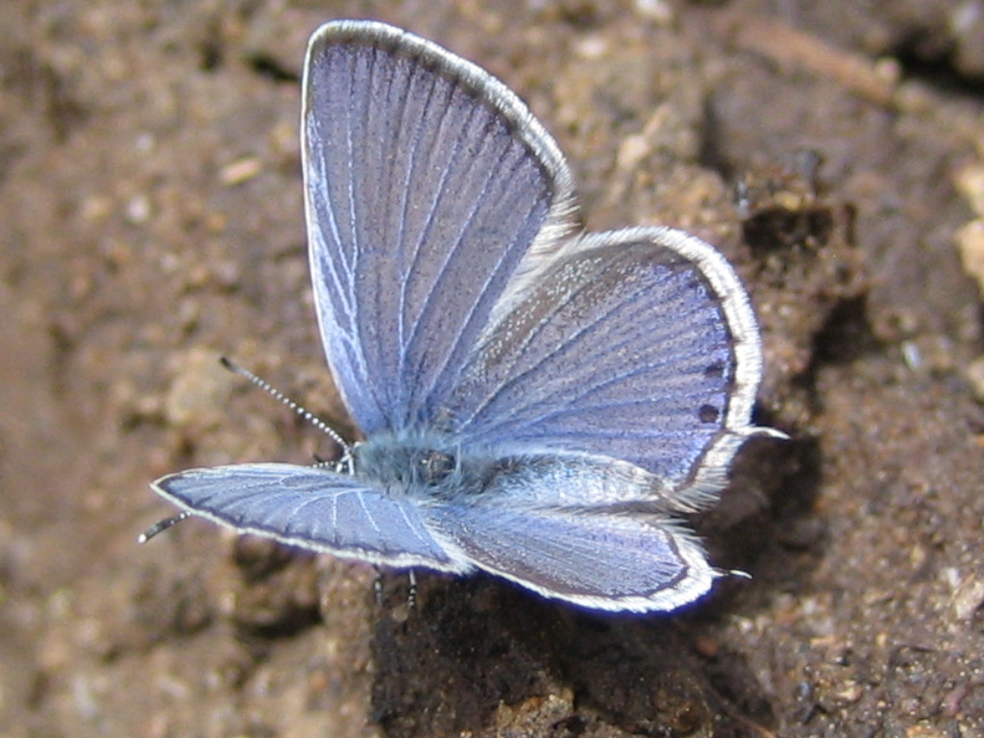
Community Involvement Objectives
EPA’s Communication Goals - Make the SMAG group part of the process!!
Provide information – weekly reports, site visits
Increase awareness
Building consensus
Ask for input –
repository location,
stream reclamation

Slide 15
Key Audiences
SMAG was main audience
Local officials - Town Planner, Town Council members, Public Works Director
State agencies
US Forest Service
Local newspapers
Residents - scientists, hippies, mountain men, adjacent mines

Slide 16
Key Audiences
Local officials
Road improvements that would promote development
Final waste repository visible from town, other locations
Audience concern/potential reactions
State agencies
CDPHE – water quality, repository design
DRMS – adit closures

Slide 17
Key Audiences
US Forest Service
Agency partner
District Ranger vs. Forest – different interests/authorities
Local newspaper
Report to others, get the story out
Residents – numerous interests
Watershed group, SNOTEL, ecologists
US Energy
Other property owners

Slide 18
Key Messages
Long term site plan
Explain sample results and threats – Sampling Activities Report
Explain the work EPA intends to do – Conceptual Project Plan
Local issues
The Road
The Trestle
The Fen, Endangered species

Slide 19
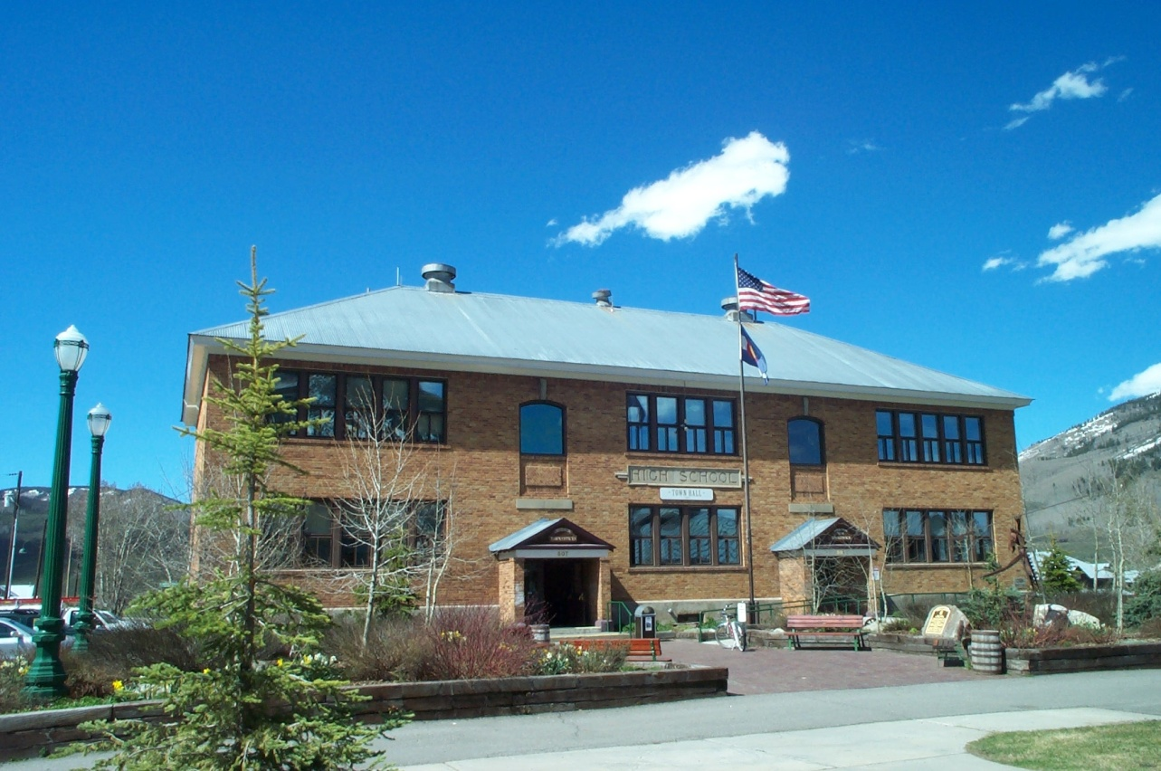
Communication Approach
Numerous Community involvement vehicles and techniques used
The Usual - public meetings, factsheets, information repository

Slide 20
Communication Approach
Other vehicles and techniques used
A Step Up – shared every report, analysis:
Water Treatability Study
Conceptual Project Plan
Potential Repository Plan
Sampling Activities Report
EE/CA Phase I
EE/CA Phase II
Viewshed Analysis
Reclamation Plan

Slide 21
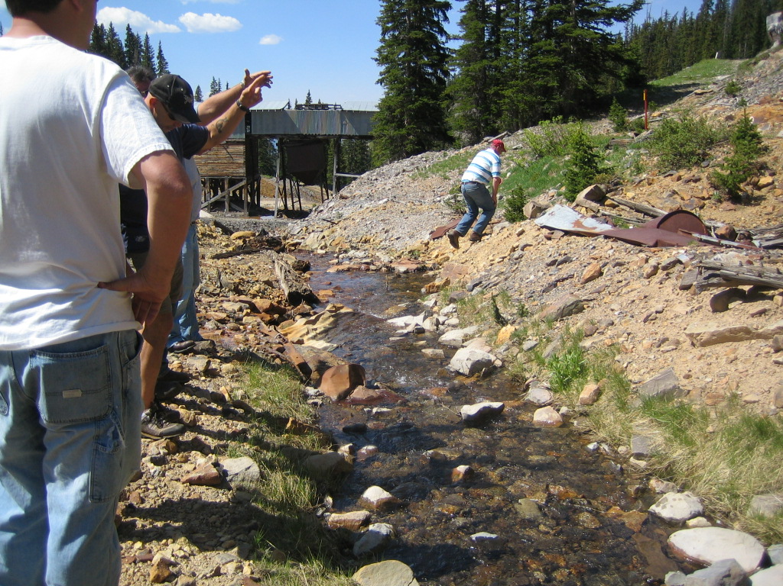
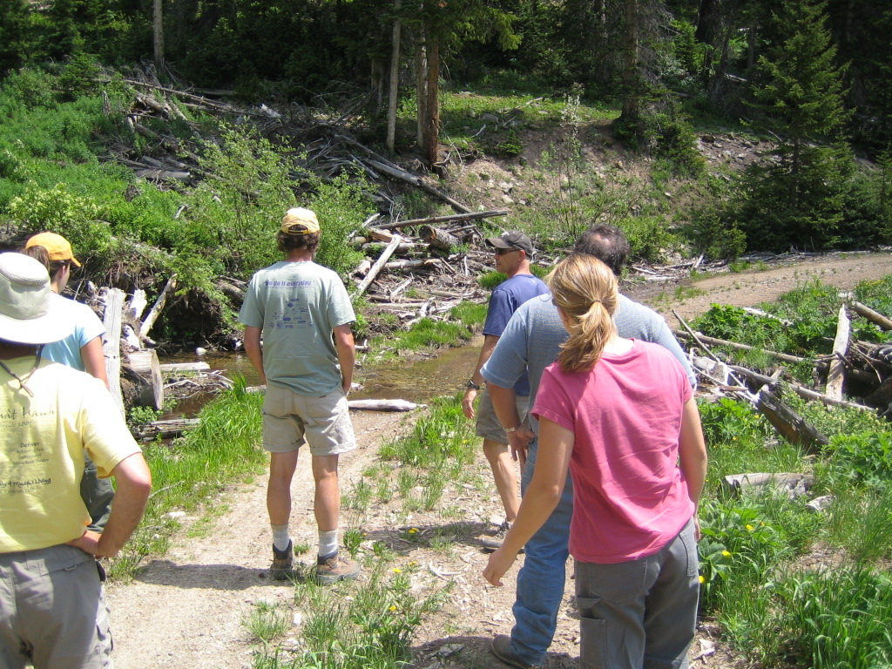
Communication Approach
Other vehicles and techniques used
Crème de la crème - weekly status reports, site visits, office hours, special issues

Slide 22
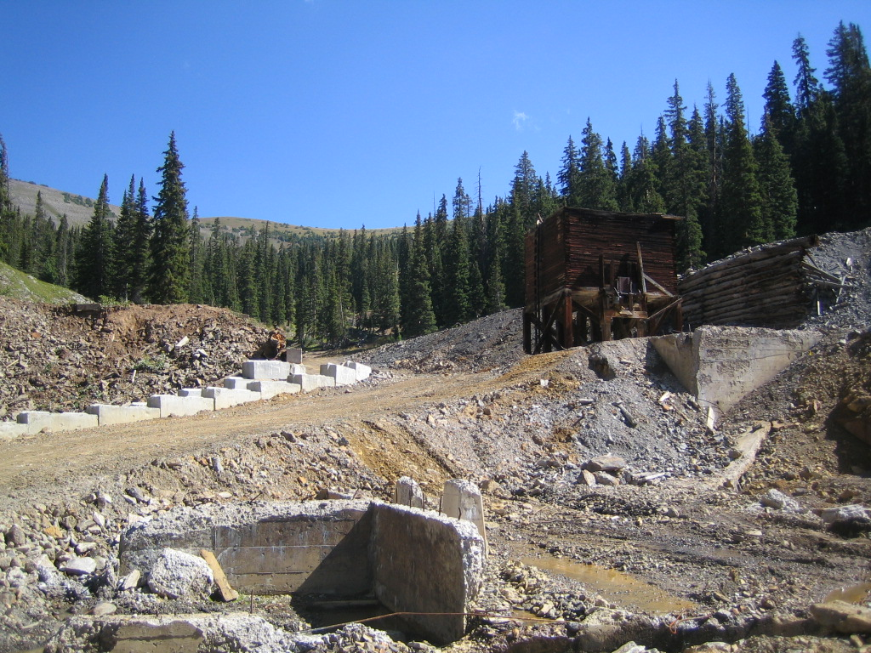
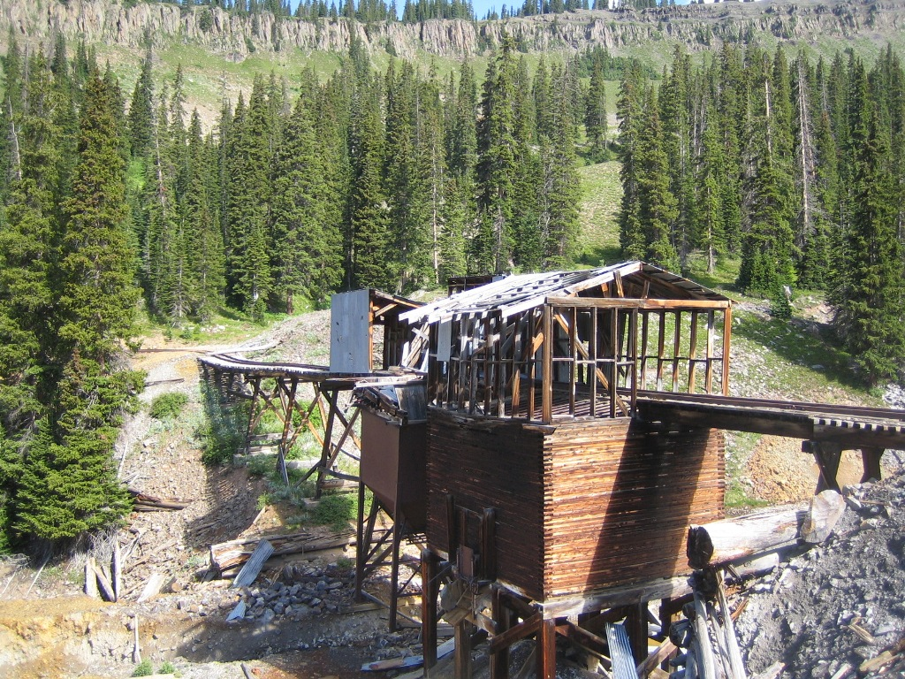
Communication Approach
Crème de la crème – special issues
The Trestle – potential historic significance, community identity

Slide 23
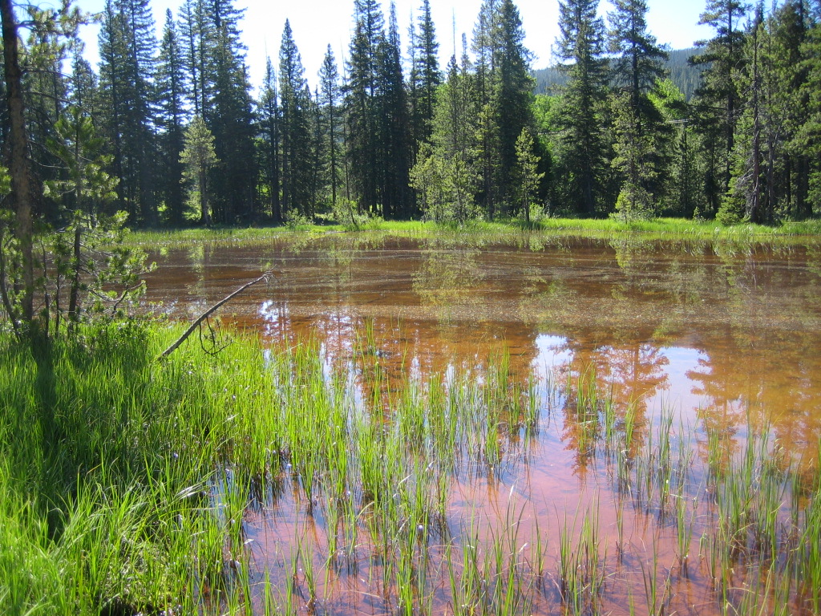
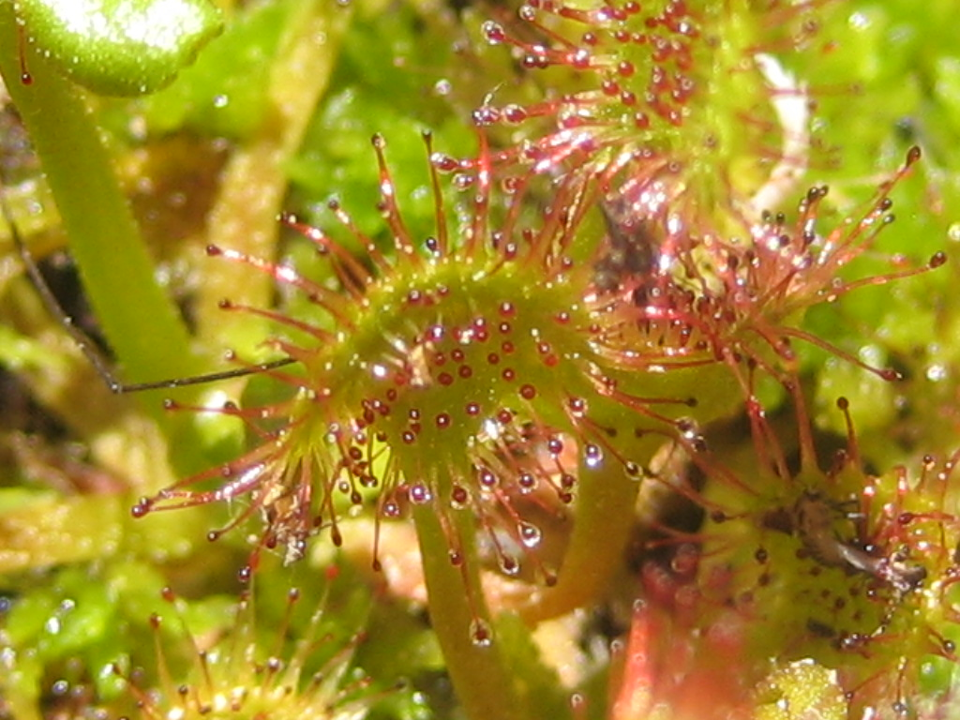
Communication Approach
Crème de la crème – special issues
The Fen – iron bog down gradient from site, special ecological assessment

Slide 24
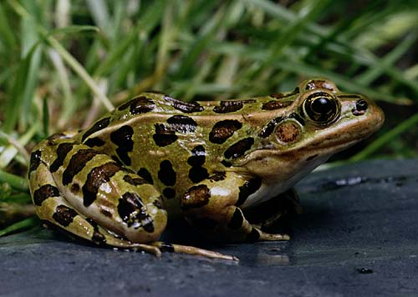
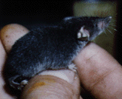
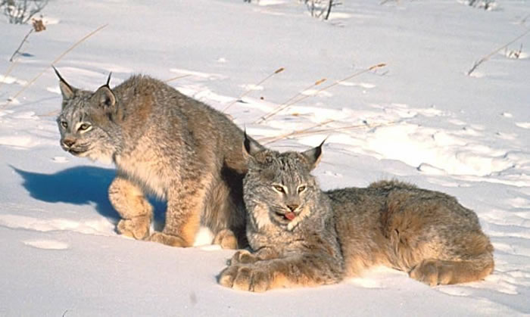
Communication Approach
Crème de la crème – special issues
Endangered Species – Lynx, toads, moles, habitat assessment

Slide 25
Best Management Practices
What worked well
Site Visits
Full disclosure – reports/analysis
Serious contemplation of their issues – trestle, lynx
Regular schedule for updates
What did not work well
Regular schedule for updates

Slide 26
