Slide 1


Welcome to the CLU-IN Internet Seminar
CEC Training for OSCs...CERCLA Coordination with Natural Resource Trustees
Sponsored by: EPA Office of Superfund Remediation and Technology Innovation
Delivered: November 21, 2013, 11:00 AM - 1:00 PM, EST (16:00-18:00 GMT)
Instructors:
Earl Liverman, EPA Region 10 (liverman.earl@epa.gov)
Moderators:
Jean Balent, U.S. EPA Technology Innovation and Field Services Division (balent.jean@epa.gov)
Visit the Clean Up Information Network online at www.cluin.org

Slide 2
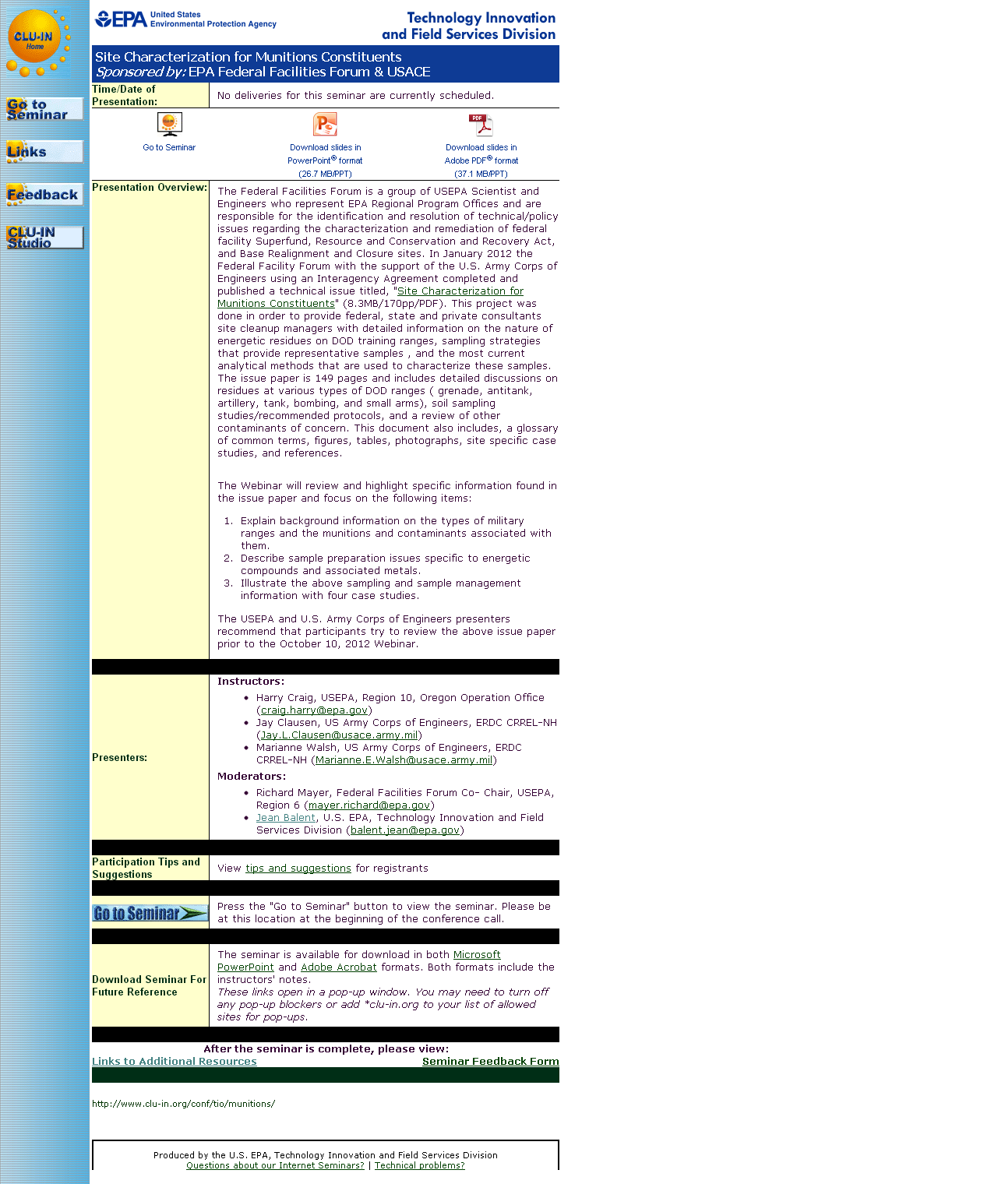
Seminar Homepage
Join the seminar online
Download Slides
Feedback

Slide 3

Housekeeping
Entire broadcast offered live via Adobe Connect
participants can listen and watch as the presenters advance through materials live
Some materials may be available to download in advance, you are recommended to participate live via the online broadcast
Audio is streamed online through by default
Use the speaker icon to control online playback
If on phones: all lines will be globally muted
Q&A – use the Q&A pod to privately submit comments, questions and report technical problems
This event is being recorded and shared via email shortly after live delivery
Archives accessed for free http://cluin.org/live/archive/
Notes:
Although I’m sure that some of you have these rules memorized from previous CLU-IN events, let’s run through them quickly for our new participants.
Please mute your phone lines during the seminar to minimize disruption and background noise. If you do not have a mute button, press *6 to mute #6 to unmute your lines at anytime. Also, please do NOT put this call on hold as this may bring delightful, but unwanted background music over the lines and interupt the seminar.
You should note that throughout the seminar, we will ask for your feedback. You do not need to wait for Q&A breaks to ask questions or provide comments. To submit comments/questions and report technical problems, please use the ? Icon at the top of your screen. You can move forward/backward in the slides by using the single arrow buttons (left moves back 1 slide, right moves advances 1 slide). The double arrowed buttons will take you to 1st and last slides respectively. You may also advance to any slide using the numbered links that appear on the left side of your screen. The button with a house icon will take you back to main seminar page which displays our agenda, speaker information, links to the slides and additional resources. Lastly, the button with a computer disc can be used to download and save today’s presentation materials.
With that, please move to slide 3.

Slide 4
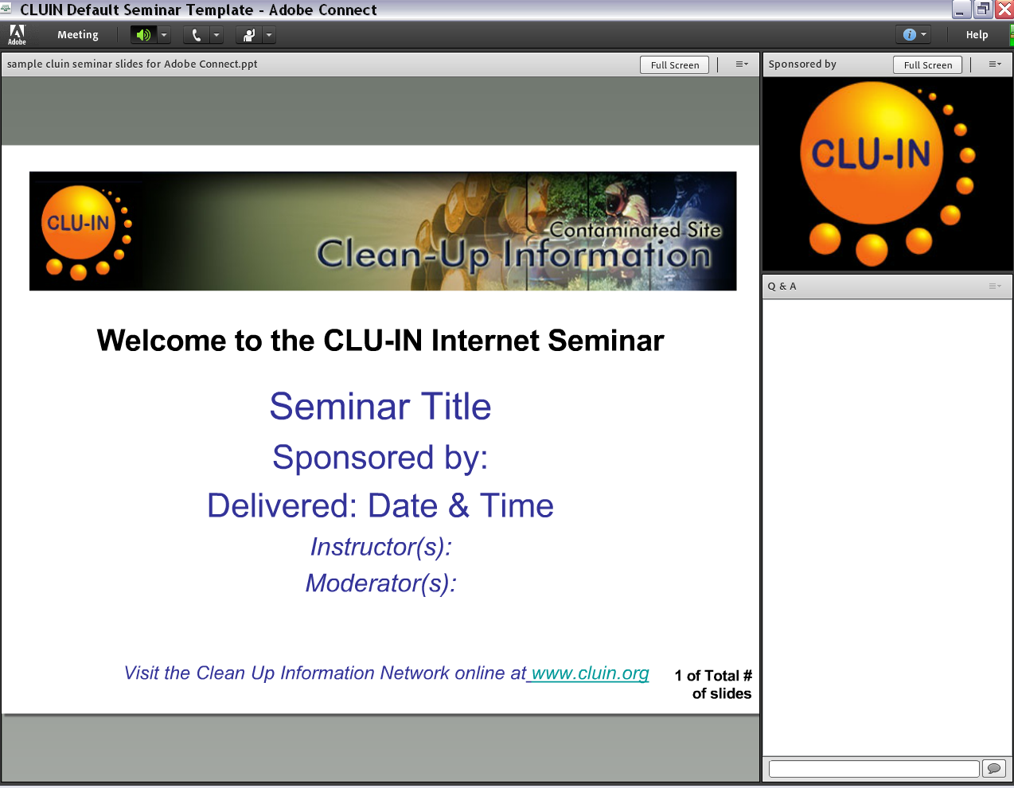


New online broadcast screenshot
Enlarge presentation
Control online audio
View presentation live online here
Information about Sponsors & Speakers
Submit private questions, comments or report technical problems

Slide 5
CERCLA Coordination with Natural Resource Trustees

Slide 6
Course Objectives
Acquire a general understanding of:
Natural resources and natural resource trustees
Trustee notification and coordination requirements
Trustee participation in I/UC and activities in emergency response
Trustee responsibilities for natural resource damage assessment and restoration

Slide 7

I. Natural Resources and Natural Resource Trustees

Slide 8
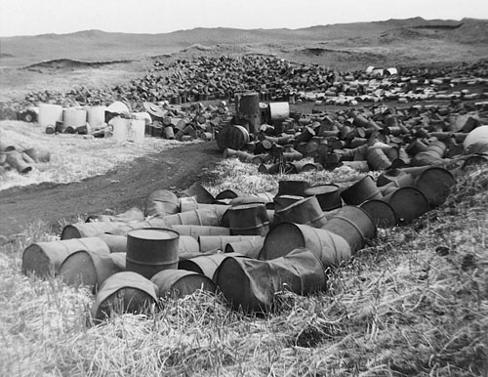
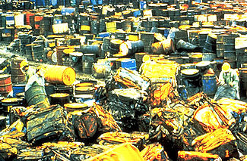
Statutory Framework
Response provisions of the Comprehensive Environmental, Response, Compensation, and Liability Act (CERCLA) focus on the protection of human health and the environment
Statute also provides authority for assessment and restoration of natural resources that have been injured by a hazardous substance release or response
CERCLA authorizes the United States, States, and Tribes to act on behalf of the public as Natural Resource Trustees for natural resources under their trusteeship [CERCLA §107(f)(1)]
Notes:
Congress passed the Comprehensive Environmental Response, Compensation, and Liability Act (CERCLA or Superfund) in December 1980 to address the dangers of abandoned or uncontrolled hazardous waste dumps by developing a nationwide program for
Emergency response; information gathering and analysis; liability for responsible parties; and site cleanup
Also created a Trust Fund (or "Superfund") to finance emergency responses and cleanups
In the late 19th century, Love Canal was proposed as a planned community, a "utopian metropolis“
Developer only got as far as digging a large pit before giving up due to lack of people who actually wanted to live there
In 1920, Niagara Falls bought the pit and used it for a chemical dump
US army disposed of waste from chemical warfare experiments in Love Canal's pit; Hooker Chemical acquired the property in 1947 and continued chemical disposal. By the 1950s, it was filled with 21,000 tons of toxic waste. Hooker Chemical covered it with clay and soil and declared it sealed
Hooker Chemical sold it back to the city of Niagara Falls, which built a neighborhood on top
Residents noticed strange smells and odd illnesses, as well as a shockingly high rate of miscarriages and birth defects. It wasn't until 1978 that the extent of the area's toxicity was revealed when an investigation by the local newspaper led to federal attention
Over a thousand families were relocated, and the Superfund program was born out of the incident.
Valley of the Drums is a 23 acre (9.3 hectare) toxic waste site near Louisville, Kentucky, named after the waste-containing drums strewn across the area
It is also known as one of the primary motivations for the passage of the Comprehensive Environmental Response, Compensation, and Liability Act, or Superfund Act of 1980
While the widely publicized Love Canal disaster is often credited as the reason the Superfund law was passed, Love Canal activist Lois Gibbs has said that Love Canal looked like a suburban community, while "Valley of the Drums became the visualization of the problem

Slide 9
Statutory Framework . . .
Oil Pollution Act (OPA) provides authority for oil pollution liability and compensation as well as for the Federal government to direct and manage oil spill cleanups
Similar to CERCLA, OPA contains authorities to allow the assessment and restoration of natural resources that have been contaminated by the discharge, or threatened discharge, of oil [OPA §1006(c)]
OPA also authorizes foreign governments to act as Trustees [OPA § 1006(b)(5)]
Notes:
The Oil Pollution Act (OPA) was signed into law in August 1990, largely in response to rising public concern following the Exxon Valdez incident
On March 24, 1989, shortly after midnight, the oil tanker Exxon Valdez struck Bligh Reef in Prince William Sound, Alaska, spilling more than 11 million gallons of crude oil
The spill was the largest in U.S. history and tested the abilities of local, national, and industrial organizations to prepare for, and respond to, a disaster of such magnitude

Slide 10

National Oil and Hazardous Substances Pollution Contingency Plan
National Oil and Hazardous Substances Pollution Contingency Plan (NCP) was established in 1968 and amended by the Clean Water Act (CWA) and CERCLA
Promotes overall coordination of the hierarchy of responders and establishes procedures for conducting responses for oil and hazardous substances
Designates the On-Scene Coordinator (OSC) as the manager of spills of oil and removal response for hazardous substances
Notes:
The first National Contingency Plan was developed and published in 1968 in response to a massive oil spill from the oil tanker Torrey Canyon off the coast of England the year before; more than 37 million gallons of crude oil spilled into the water, causing massive environmental damage
To avoid the problems faced by response officials involved in this incident, U.S. officials developed a coordinated approach to cope with potential spills in U.S. waters
Congress has broadened the scope of the National Contingency Plan over the years
As required by the Clean Water Act of 1972, the NCP was revised the following year to include a framework for responding to hazardous substance spills as well as oil discharges
Following the passage of Superfund (CERCLA) legislation in 1980, the NCP was broadened to cover releases at hazardous waste sites requiring emergency removal actions
Over the years, additional revisions have been made to the NCP to keep pace with the enactment of legislation; the latest revisions to the NCP were finalized in 1994 to reflect the oil spill provisions of the Oil Pollution Act of 1990

Slide 11

Trust Natural Resources
CERCLA and OPA define natural resources broadly to include land, fish, wildlife, biota, air, water, ground water, drinking water supplies, and other such resources [CERCLA §101(16); OPA §1001(20); 40 CFR 300.5]
Notes:
Trust resources include both species and places
Fish, wildlife, migratory birds, and marine mammals are all mentioned in CERCLA and the NCP as trust resources, as are National Marine Sanctuaries and Estuarine Research Reserves; DOI protects no only endangered species but also National Parks and Monuments
NCP acknowledges hat protecting a living resource entails not only preventing or mitigating contamination of the protected species itself but also ensuring the continued availability and quality of that species’ habit and food sources
Clear implication is that the definition of what is a trust resource is left to the trustee
Thus within the bounds of trustees’ responsibilities defined by various statutes, trustees may interpret their CERCLA mandate to include whatever biota “and their supporting ecosystems” that the trustees consider appropriate
With regard to specific sites, the OSC should let trustee agencies determine whether trust resources as present and potentially affected by a release or discharge

Slide 12
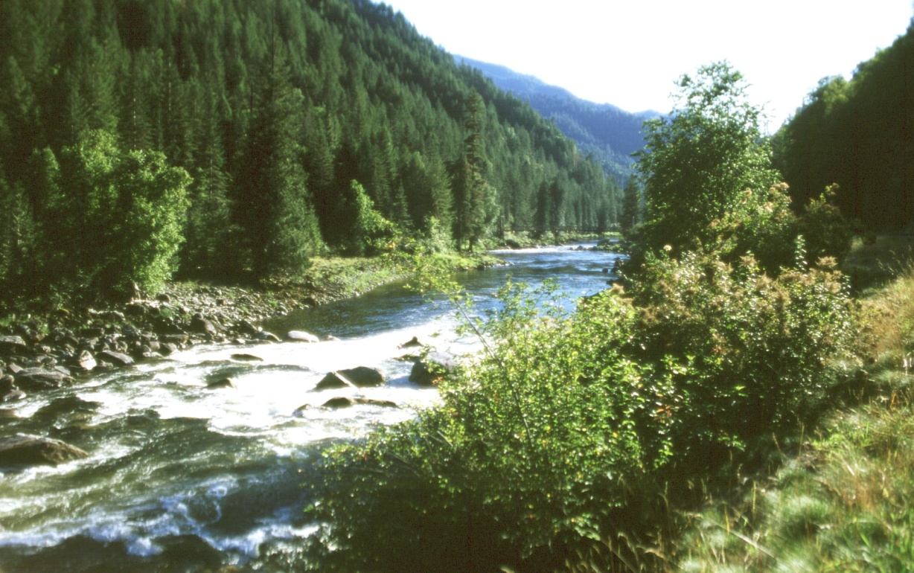
Trust Natural Resources . . .
Both statutes limit natural resources to those resources belonging to, managed by, held in trust by, appertaining to, or otherwise controlled by the United States, any, State, an Indian Tribe, a local government, or a foreign government

Slide 13
Natural Resource Trustees
Federal - Secretaries of Agriculture, Commerce, Defense, Energy, Interior (40 CFR 300.600)
State - designated by the Governor (40 CFR 300.605)
Tribal - designated by Tribal Chairperson or the Secretary of the Interior may serve as trustee at request of the tribe (40 CFR 300.610)
Other – Under OPA, foreign officials can also act as Trustee (40 CFR 300.612)
Notes:
By Executive Order 12580 and in the NCP, the President has designated certain executive officers as Federal trustees for natural resources

Slide 14
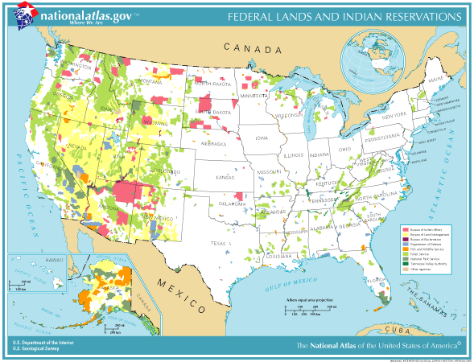
Notes:
Map intend only to give you a sense of where the federal resource trustees are located
Lavender – Bureau of Indian Affairs
Yellow – Bureau of Land Management
Purple – Bureau of Reclamation
Blue – Department of Defense
Orange – Fish and Wildlife Service
Light green – Forest Service
Sage – National Park Service
Dark green – Tennessee Valley Authority
Light grey – Other federal agencies

Slide 15
Natural Resource Trustees and Natural Resource Managers
Natural resource trustees are from agencies that have land and resource management responsibilities
Natural resource trustees have responsibilities as natural resource managers to protect natural resources under their trusteeship
Natural resource managers provide technical assistance and expertise for use by the OSC for a variety of program activities such as cultural and historic, fisheries, habitat, minerals, recreation, water, and wildlife
Notes:
2nd Statement → Will discuss in greater detail during the next slide

Slide 16

Trustee Responsibilities beyond CERCLA and OPA
Trustees have statutory responsibilities to protect natural resources that may affect their actions and recommendations during a hazardous substance release or an oil discharge
These laws may authorize them to take protective actions with or without OSC concurrence and to recover their costs from the responsible party

Slide 17

Department of Agriculture (USDA)
Federal rangeland
Federally-managed fisheries
Federally-owned or managed farmland
Land enrolled in the Wetlands Reserve Program
National Forest System land
Notes:
Secretary of Agriculture, through USFS, has jurisdiction over large tracts of land in all areas of the country → 232,895,585 acres

Slide 18

Department of Commerce (DOC)
Coastal environments, including salt marshes, tidal flats, estuaries, or other tidal wetlands
Endangered marine species
Marine mammals
Rivers or tributaries to rivers which historically or presently support anadromous fish
Notes:
National Oceanic and Atmospheric Administration
Anadromous fish – fish such as salmon which spawn in fresh water and spend a portion of their lives in the ocean

Slide 19

Department of Defense (DOD)
All lands owned by the Department of Defense or the Air Force, Navy, and Defense Logistics Agency
These lands include military bases and training facilities, research and development facilities, and munitions plants

Slide 20

Department of Energy (DOE)
Natural Resources under its jurisdiction, custody or control
These lands include national research and development laboratories, facilities, and offices

Slide 21

Department of the Interior (DOI)
Certain anadromous fish
Certain endangered species
Certain marine mammals
Migratory birds
National Wildlife Refuges and Fish Hatcheries
National Parks and Monuments
Tribal Resources
Notes:
Bureau of Reclamation
Bureau of Land Management
Fish and Wildlife Service
National Park Service

Slide 22

US Environmental Protection Agency (EPA)
RESTORE Act established a Gulf Coast Ecosystem Restoration Council comprised of governors from the five affected Gulf States
Council comprised of the Secretaries from the U.S. Departments of the Agriculture, Commerce, Interior, and Homeland Security, as well as, the Secretary of the Army and the Administrator of the U.S. Environmental Protection Agency
Notes:
RESTORE Act established a Gulf Coast Ecosystem Restoration Council comprised of governors from the five affected Gulf States’, the Secretaries from the U.S. Departments of the Interior, Commerce, Agriculture, and Homeland Security as well as the Secretary of the Army and the Administrator of the U.S. Environmental Protection Agency
RESTORE Act dedicates 80 percent of all administrative and civil penalties related to the Deepwater Horizon spill to a Gulf Coast Restoration Trust Fund and outlines a structure by which the funds can be utilized to restore and protect the natural resources, ecosystems, fisheries, marine and wildlife habitats, beaches, coastal wetlands, and economy of the Gulf Coast region

Slide 23
State Natural Resource Trustees
State Trustees act on behalf of the public for natural resources, including ground and surface water, and the resources’ supporting ecosystems, that are:
Within the boundary of the State
Belonging to, managed by, controlled by, or appertaining to the State
Examples of resources under trusteeship of individual State officials include:
State forest lands
State-owned minerals
State parks and monuments
State wildlife refuges and fish hatcheries
Notes:
Note that state natural resource trustees may be found in a variety of state offices

Slide 24








State Natural Resource Trustees . . .

Slide 25
Indian Tribe Trustees
Indian Tribe Trustees act on behalf of the Indian Tribe for natural resources, including their supporting ecosystems, that are:
Belonging to, managed by, controlled by, or appertaining to such Tribe
Held in trust for the benefit of the Tribe
Belonging to a member of the Tribe, if such resources are subject to a trust restriction or alienation
Examples of resources under trusteeship of Tribal groups include:
Tribal-owned minerals
Ground and surface water resources on Tribal lands
Any other natural resources found on Tribal land

Slide 26








Indian Tribe Trustees . . .

Slide 27
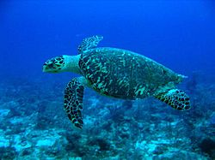
Co-Trusteeship
Federal and state agencies and Indian Tribes may be co-trustees for the same natural resource [40 CFR 300.615(a)]
Examples:
Department of the Interior and States are co-trustees for migratory birds
Departments of Commerce and Interior can be co-trustees for certain natural resources
Sea turtles are the trust responsibility of DOC in water and DOI on land
States are co-trustees with DOC and DOI for sea turtles both at sea and on land

Slide 28


Slide 29
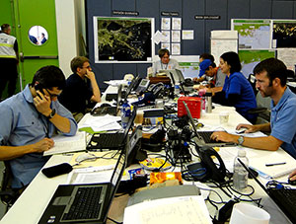
II. Trustee Notification and Coordination
Notes:
Natural resource trustees have a broad mandate to protect and restore resources under their jurisdiction → therefore, the responsibilities of the trustees are not restricted to any single point in the Superfund process

Slide 30
NCP Directs Federal On-Scene Coordinators and Natural Resource Trustees to work together
OSCs shall work with natural resource trustees in specific preparedness and response activities, to help ensure that natural resources are protected when they are at risk from an actual or potential hazardous substance release or oil spill [40 CFR 300.135(j)]
Trustees shall provide timely advice concerning recommended actions with regard to trustee resources potentially affected by such releases or spills [40 CFR 300.305(e) and 615(c)(3)(i)]
Trustees shall coordinate natural resource damage assessment activities with response operations and provide data from these activities that may support more effective operational decisions to the OSC in a timely manner [40 CFR 300.305(e) and 615(c)(3)(ii)]
Notes:
Note “shall”

Slide 31

OSC Responsibilities to Trustees during Preparedness Activities
Consult trustees in writing the Fish and Wildlife and Sensitive Environments Plan of the Area Contingency Plan [40 CFR 300.210(c)(4)]
Obtain concurrence for preapproval of application of specific countermeasures such as use of dispersants, in situ burning, bioremediation, and so on 40 CFR 300.210(c)(4)(ii)(D) and 910(a)]

Slide 32

Trustee responsibilities to OSCs during Preparedness Activities
Participate in area committees to identify fish and wildlife sensitive environments and strategies for protecting and treating them, for inclusion in the Area Contingency Plan [40 CFR 300.210(c)(4) and 615(c)(3)(i)]
Provide concurrence for preapproval of application of specific countermeasures such as use of dispersants, in situ burning, bioremediation, and so on [40 CFR 300.210(c)(4)(ii)(D) and 910(a)

Slide 33
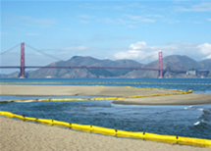
OSC responsibilities to Trustees during Response Activities
Notify trustees of incidents [40 CFR 300.135(j)(1), 300.305(e), 300.320(a)(5)]
Consult trustees about protection priorities and methods [40 CFR 300.135(j)(2)]
Share non-monetary response resources with trustees conducting Natural Resource Damage Assessment activities so along as this does not hinder response activities [40 CFR §300.305(e) and 615(c)(3)(iii)]
Federal agencies assisting the OSC in response to an oil spill may be reimbursed [40 CFR 300.335(b)]
Notes:
Notification → important, particularly with respect to tribes (other Agency requirements)

Slide 34
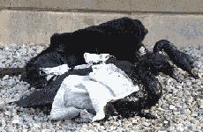
Trustee responsibilities to OSCs during Response Activities
Work with OSCs on the appropriate removal action to be taken [40 CFR 300.135(j)(2)]
Provide timely advice to the OSC on trustee resources that are potentially affected by a discharge of oil, including identifying/recommending preapproved response techniques [40 CFR 300.305(e) and 615(c)(3)(i)]
Designate a lead administrative trustee to serve as the focal point for coordination between natural resource damage assessment activities and response operations [40 CFR 300.305(e) and 615(c)(3)(ii)]

Slide 35
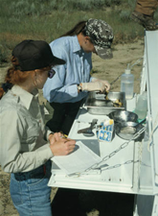
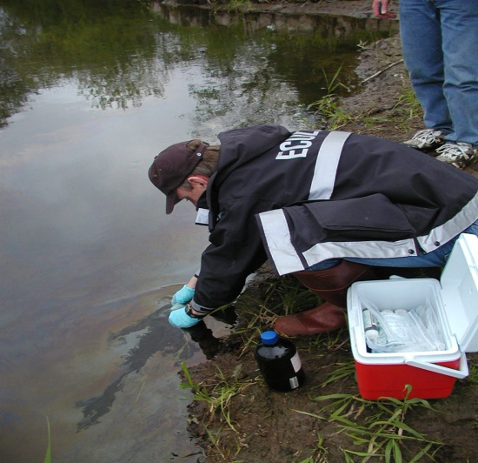
Trustee responsibilities to OSCs during Response Activities . . .
Ensure that natural resource damage assessment activities do not interfere with response operations [40 CFR 300.615(c)(3)(ii)]
Provide data from natural resource damage assessment activities that may support more effective operational decisions to the OSC in a timely manner [40 CFR 300.305(e)]

Slide 36
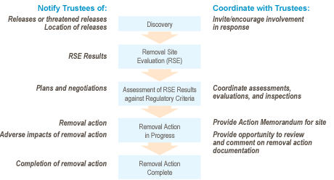
CERCLA Removal Actions – Notification and Coordination Flow Chart

Slide 37
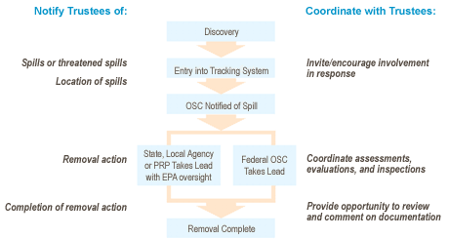
OPA Removal Actions – Notification and Coordination Flow Chart

Slide 39

III. Trustee participation in I/UC and Activities in Emergency Response

Slide 40
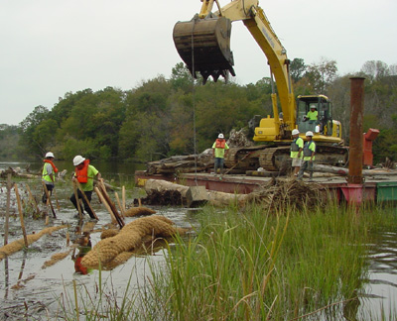
Trustee Participation in I/UC
Depending on the nature of the incident, trustee representatives, acting as natural resource or land managers, may participate in one or more ICS units
Each trustee agency may have a different approach to participation in ICS

Slide 41
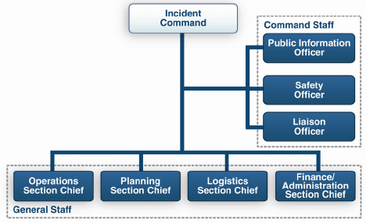
Trustee Participation in I/UC – Command
For incidents with significant effect or the potential for significant effect on trust resources, having a trustee representative in Command would help to ensure that information on these resources is available to and used appropriately in decision-making

Slide 42
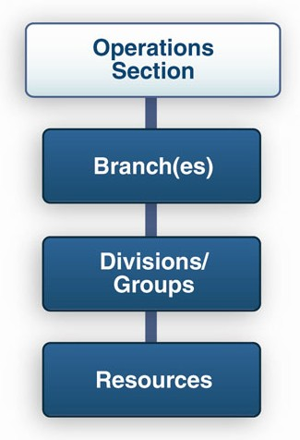
Trustee Participation in I/UC – Operations Section
Trustee representatives should participate and assist in activities affecting lands and resources under their jurisdiction and could assist in implementation of wildlife response efforts

Slide 43
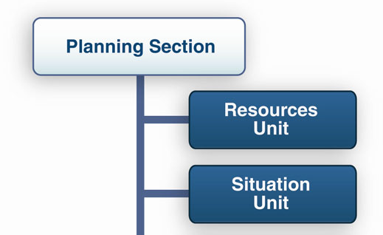
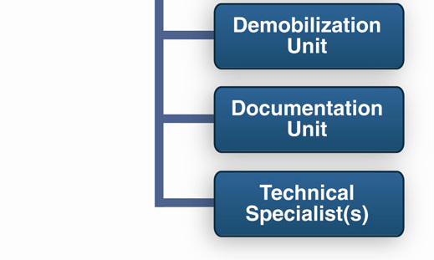
Trustee Participation in I/UC – Planning Section
Provide information about sensitive resources and appropriate response techniques

Slide 45
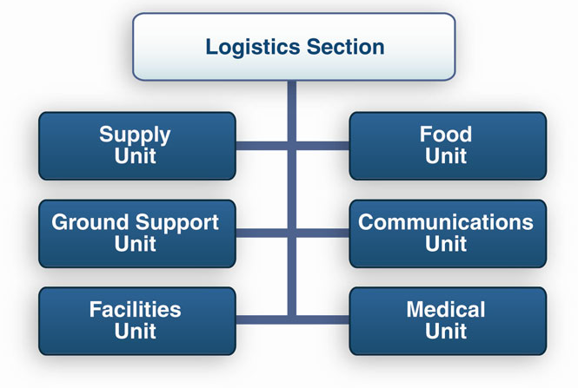
Trustee Participation in I/UC – Logistics Section
It may be useful to have trustee representatives in this section when trustees have significant equipment and vehicle resources or facilities to contribute to the response

Slide 46
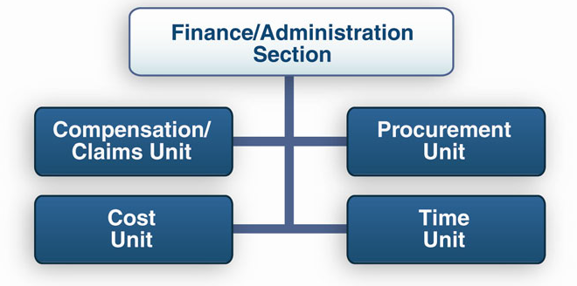
Trustee Participation in I/UC – Finance/Administration Section
A trustee representative in this section could assist in supporting trustee personnel if there is significant trustee agency participation in the response

Slide 47
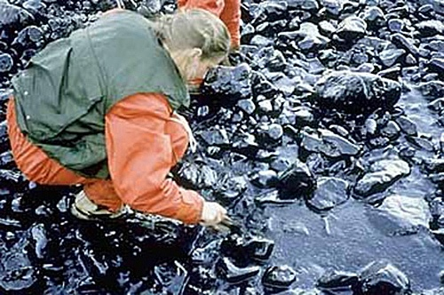
Trustee Activities in Emergency Response
Identify/prioritize resources at risk
Supplement OSC’s information on sensitive resources found in the ACP; provide local expertise and up-to-date information relative to the specifics of the incident; assist OSC in priorities in the ACP for sensitive habitat and resources requiring protection
Evaluate protective measures and clean-up strategies
Advise the OSC on determination of cleanup end-points
Participate in Team Assessing Cleanup
Provide resource experts to assist in assessment of clean-up activities

Slide 48
Notes:
The Resources at Risk Summary provides information about sites in the incident area which are sensitive due to environmental, archaeological-cultural, or socio-economic resources at risk, and identifies incident-specific priorities and issues
. The information recorded here may be transferred to ICS 232a-CG, which acts as a key to the Area Contingency Plan (ACP) or Geographic Response Plan (GRP) site numbers shown on the Situation Map.

Slide 49
Notes:
This optional form is designed to be a key to the site numbers or site names shown on the Situation Map
The information on priorities for environmentally-sensitive areas and archaeological-cultural and socioeconomic issues from the ICS 232 may be transferred to ICS 232a, which provides more information on the Area Contingency Plan (ACP) or Geographic Response Plan (GRP) site numbers or names shown on the Situation Map
What is a GRP: A GRP is a site-specific strategy for the initial response to a spill of oil or oil products on water
What is the purpose of a GRP: A GRP provides initial guidelines for responders in the event of spill, greatly reducing the time needed to make decisions about how to respond
Why create GRPs: A GRP gives responders the information they need to ensure that response to a spill is fast and effective while protecting sensitive resources threatened by the spill
How are GRPs developed: A GRP is the result of a planning process. Representatives from various levels of government, response groups, resource specialists, and industry work together to identify the best ways to minimize damage to sensitive natural, cultural, and economic resources
Where are they developed: Locations are identified based on the presence of sensitive resources that could be adversely affected in places where the risk of a spill is significant; natural conditions of the location affect choices
What resources are considered: Sensitive species and habitat, water intakes, culturally significant sites and landmarks, economic resources, such as marinas, fisheries, or parks, potential spill sources
What conditions are considered: river conditions, seasonal weather changes, accessibility of site, responder safety, shoreline sensitivity to oil

Slide 50
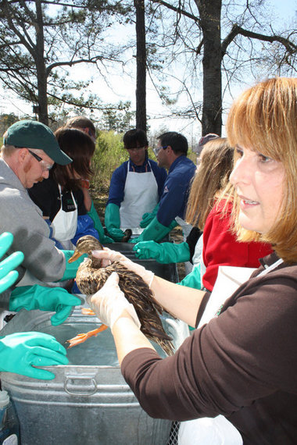
Trustee Activities in Emergency Response . . .
Participate in Post Clean-up Inspection (Sign-off)
- Assist OSC in determining adequacy of cleanup activities)
Wildlife Rehabilitation
Advise the OSC on appropriate response actions for injured wildlife; ensure proper rehabilitation organizations are contacted and necessary permits have been obtained; and provide oversight to ensure wildlife response plans are implemented appropriately
Notes:
Comment emphasizing the importance of end points

Slide 52
IV. Trustee Responsibilities for Natural Resource Damage Assessment and Restoration

Slide 53
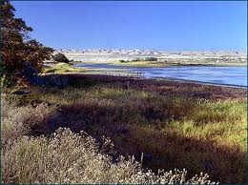
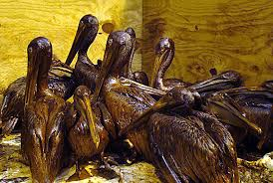
Trustee Responsibilities for Natural Resource Damage Assessment and Restoration
Natural resource damages (NRD) refer to:
Costs to restore, rehabilitate, replace, or acquire the equivalent of the injured resource
Any interim lost use or diminution in value of the injured resource pending restoration
Reasonable cost of assessing those damages

Slide 54
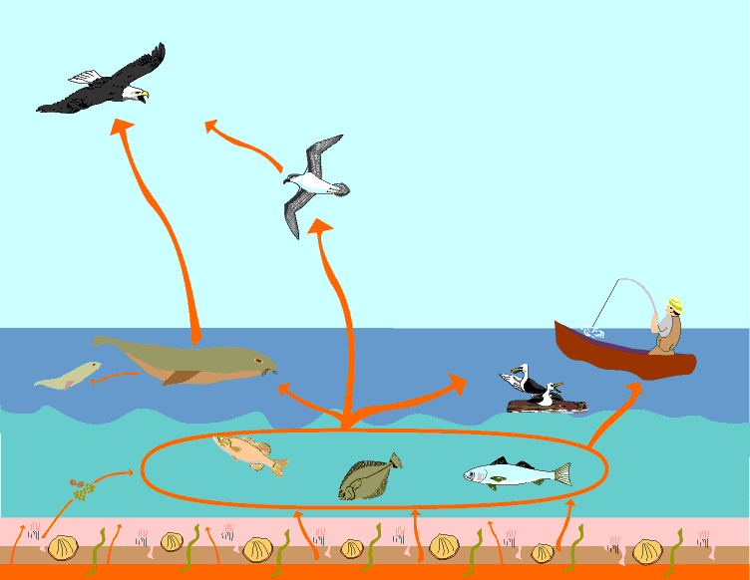
Trustee Responsibilities for Natural Resource Damage Assessment and Restoration . . .
Natural resource damage assessment (NRDA)
Process of collecting and analyzing information to evaluate the nature and extent of injuries resulting from an incident
Determine the restoration actions needed to bring the injured natural resources and services back to baseline and make the environment and public whole for interim losses

Slide 55

Major Concepts in NRDA
Natural resource damage process is the responsibility of the trustee agencies, not of EPA
EPA is not required to collect or fund the collection of all the information needed to carry out a NRDA
Equally important to remember CERCLA and NCP require prompt notification of, and close coordination with, trustees

Slide 56
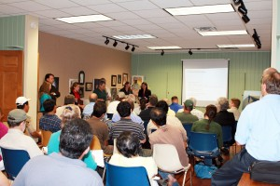
Major Concepts in NRDA . . .
Damages are monetary compensation for injuries residual to response actions
Damages are compensatory, not punitive
Public and responsible parties are involved in process
Recovered damages must be used for restoration

Slide 57
Natural Resource Damage Assessment Process
Notes:
Pre-Assessment Screen: Conducted to determine if additional action is warranted; determine whether an injury has occurred and a pathway of exposure exists
Assessment Plan: Confirm exposure of trust resources and develop an assessment plan to identify how the potential damages will be evaluated
Assessment Implementation: Purpose is to gather data necessary to quantify the injuries and determine damages
Post-Assessment: Prepare report detailing the results of the Assessment implementation plan; restoration alternatives are proposed and a preferred alternative is selected

Slide 58

IV. In Review

Slide 59
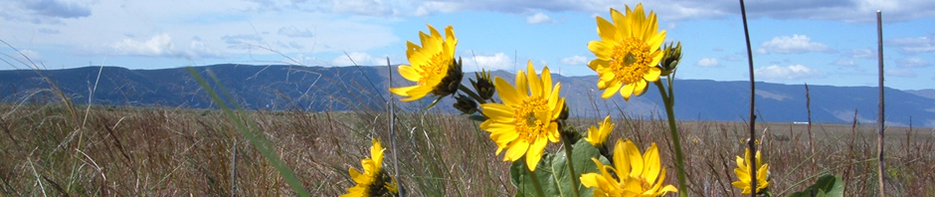
V. In Review
Trust resources include both species and places
Trustees may consider biota and their supporting ecosystems
Definition of as trust resource is left to the trustee
Responsibilities of trustees are not restricted to any single point in the Superfund or OPA processes

Slide 60
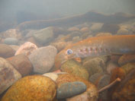
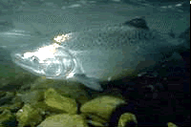
V. In Review . . .
EPA is responsible for:
Notifying Trustees
Coordinating activities
When a natural resource is injured, Trustees are responsible for:
Assessment
Restoration

Slide 61
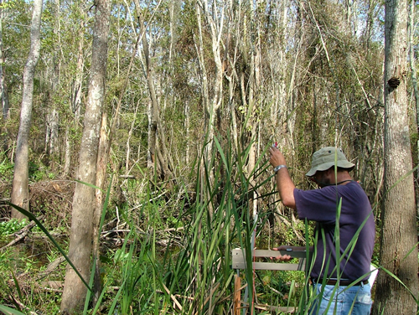
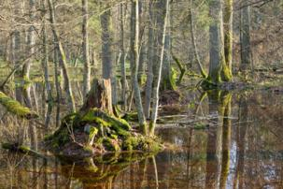
V. In Review . . .
EPA encourages participation by all affected Trustees
Notification and coordination occurs throughout CERCLA and OPA processes

Slide 63
Certificates
If you are interested in receiving a certificate for participating in this training, please send an email to Austin Oelschlager, Tetra Tech, at austin.oelschlager@tetratech.com
An electronic certificate will be emailed to you within 30 days

Slide 64



New Ways to stay connected!
www.cluin.org
Follow CLU-IN on Facebook, LinkedIn, or Twitter
https://www.facebook.com/EPACleanUpTech
https://twitter.com/#!/EPACleanUpTech
http://www.linkedin.com/groups/Clean-Up-Information-Network-CLUIN-4405740

Slide 65
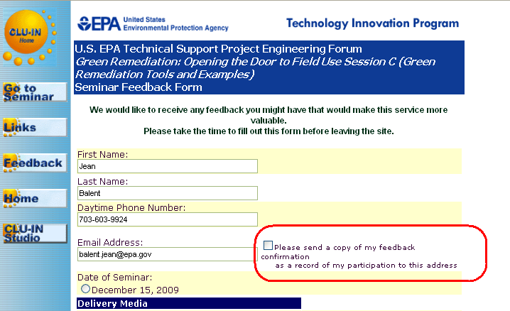
Resources & Feedback
To view a complete list of resources for this seminar, please visit the Additional Resources
Please complete the Feedback Form to help ensure events like this are offered in the future
Need confirmation of your participation today?
Fill out the feedback form and check box for confirmation email.

