Slide 1
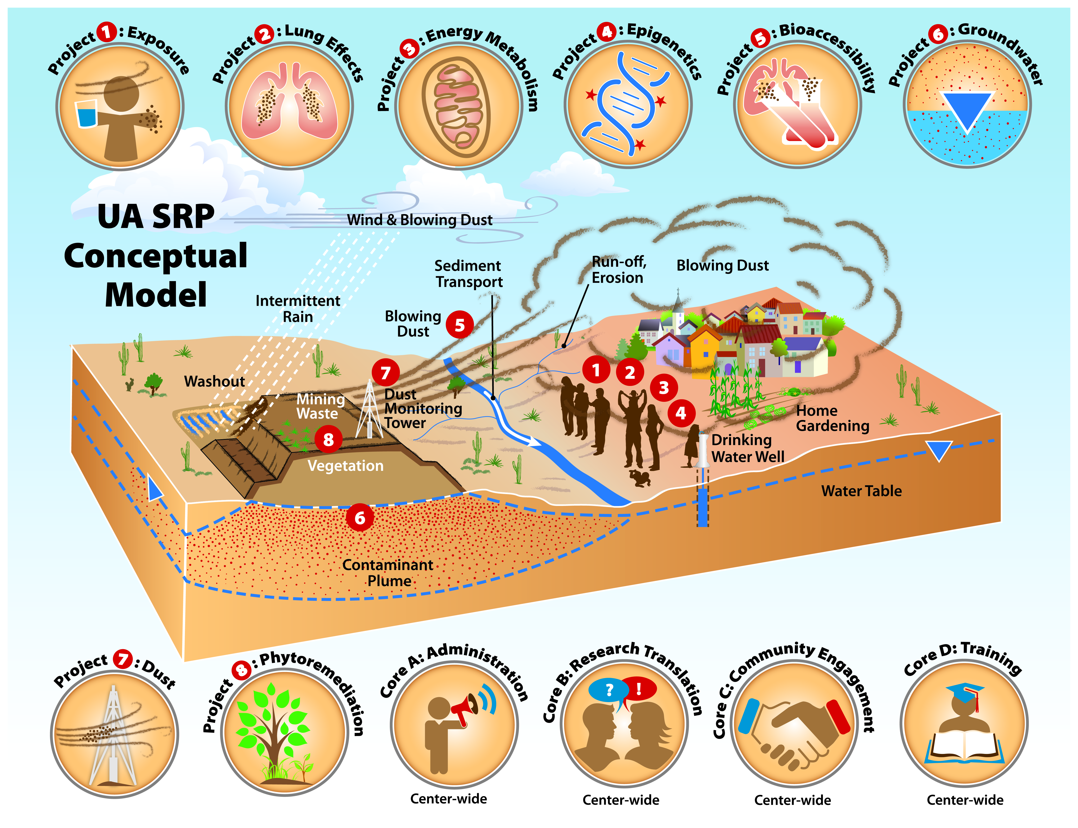

Measuring cytotoxic and subcytoxic effects of nanoparticles and arsenic using the xCELLigence real time cell analyzer platform
Scott Boitano, Ph.D.
Respiratory cell physiology lab
University of arizona
Superfund Research Project
August 11, 2014

Slide 2
Presentation Outline
Laboratory Focus – Airway Signaling and Toxicity
The xCELLigence Platform
Cytotoxicity of engineered nanoparticles (ENPs)
Cytotoxicity testing (live/dead assay vs. RTCA)
Cellular signaling toxicity (RTCA vs Ca²⁺ signaling)
Ongoing toxicity screening using the RTCA

Slide 3
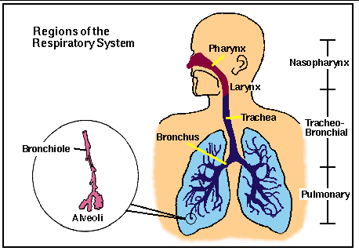
Conducting Airway Epithelium
The conducting airway epithelium provides first line of defense from inhaled particulates and pathogens
http://www.mfg.mtu.edu/cyberman/environment/air/anatomy.html
Our cell line (16HBE14o-) models the airway epithelium

Slide 4
Particulate Matter Studies
Studies examined particulate matter in pollution (PM₁₀ and PM_{2.5})
  Increased mortality and morbidity due to cardiovascular and respiratory effects
  Increased hospital admissions in patients with chronic obstructive pulmonary disease (COPD) and asthma
Ultrafine, Engineered Nano-Particles (ENP) cause inflammation and airway epithelium injury
ENPs are similar in size, but have different physical/chemical properties
We used Hafnium Oxide (HfO₂) as a model ENP

Slide 5
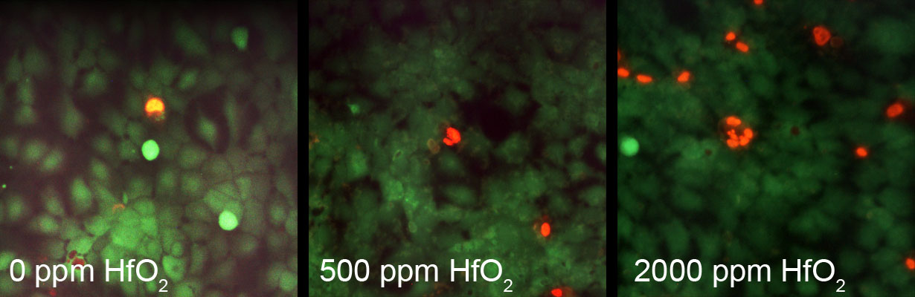
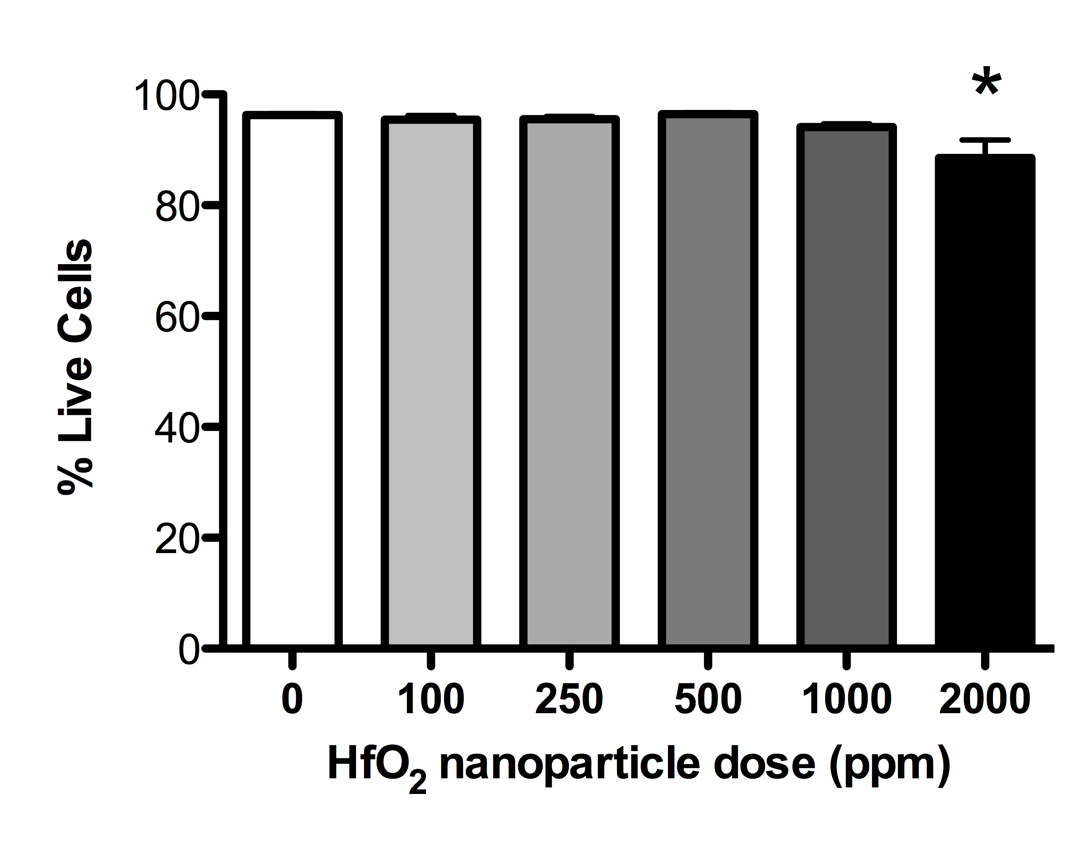
Examination of HfO₂ ENP cytotoxicity: live/dead assay
Fluorescent Assay:
Grew 16HBE14o- cells to confluence (24 mm tissue culture wells)
Incubated 16HBE14o- cells in culture media +/- ENPs for 2 hr
Evaluated cytotoxicity with fluorescent dyes
  Cell permeant green dye (Calcein-AM) = live cells
  Cell impermeant red dye (ethidium homodimer) = dead cells
Limitations:
• Single time point response
• Time-intensive analysis (not high-throughput)
Notes:
The first assay I used was a fluorescent-based Live/Dead assay, where cells are grown to confluence, and then exposed to HfO2-supplemented medium for 2 hrs.
The status of the cells is evaluated with fluorescent dyes, so that dead cells appear red, and live cells appear green. The cytotoxicity is quantified by determining the percent of live cells in each experiment.
In this experiment, we see that a 2 hr exposure to the HfO2 NPs does not cause significant toxicity until very high concentrations – 2000 ppm.
So, this assay is effective in assessing toxicity. However, it has some limitations. Single time point, tedious, also potential for interference of fluorescence with ENPs.
Therefore, we move to a more high-throughput assay.
Permeant, green, cleaved inside cells
Impermeant, red, only enters membrane compromised cells

Slide 6
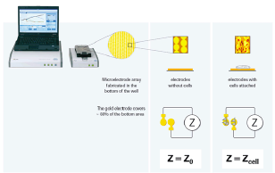
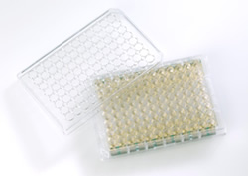
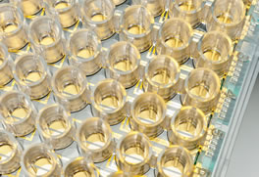
Examination of HfO₂ ENP cytotoxicity:
Real Time Cell Analysis (RTCA)
E-plate (96-well)
RTCA Experiment:
  Non-fluorescence-based assay that measured cell interaction with base plate membrane
  Grow Cells to Confluence
  Wash with Nanoparticle-supplemented Medium
  Follow Exposure over time for 8 hrs or more
Notes:
This real time cell analysis assay does not use fluorescence. Instead, it measures cell attachment to a membrane, which can monitor cytotoxicity by sensing a loss of attachment.
*The RTCA uses 96-well cell culture plates that have microelectrode arrays in the bottom of the wells. As cells attach and grow, the electrodes sense impedance changes, which are related to the biological status of the cells.
I’ll go through a more detailed explanation of this assay in the next slides. Here, I just want to show you a typical output of an RTCA experiment. To test cytotoxicity of a particle, we grow cells to confluence, and then expose them to the NP by washing on nanoparticle-supplemented medium, after which we can follow the activity of the cells for 8 hrs or more. Advantage here, is that we can see cytotoxicity develop after an extended time, where before we only saw the one time point, two hrs after exposure

Slide 7
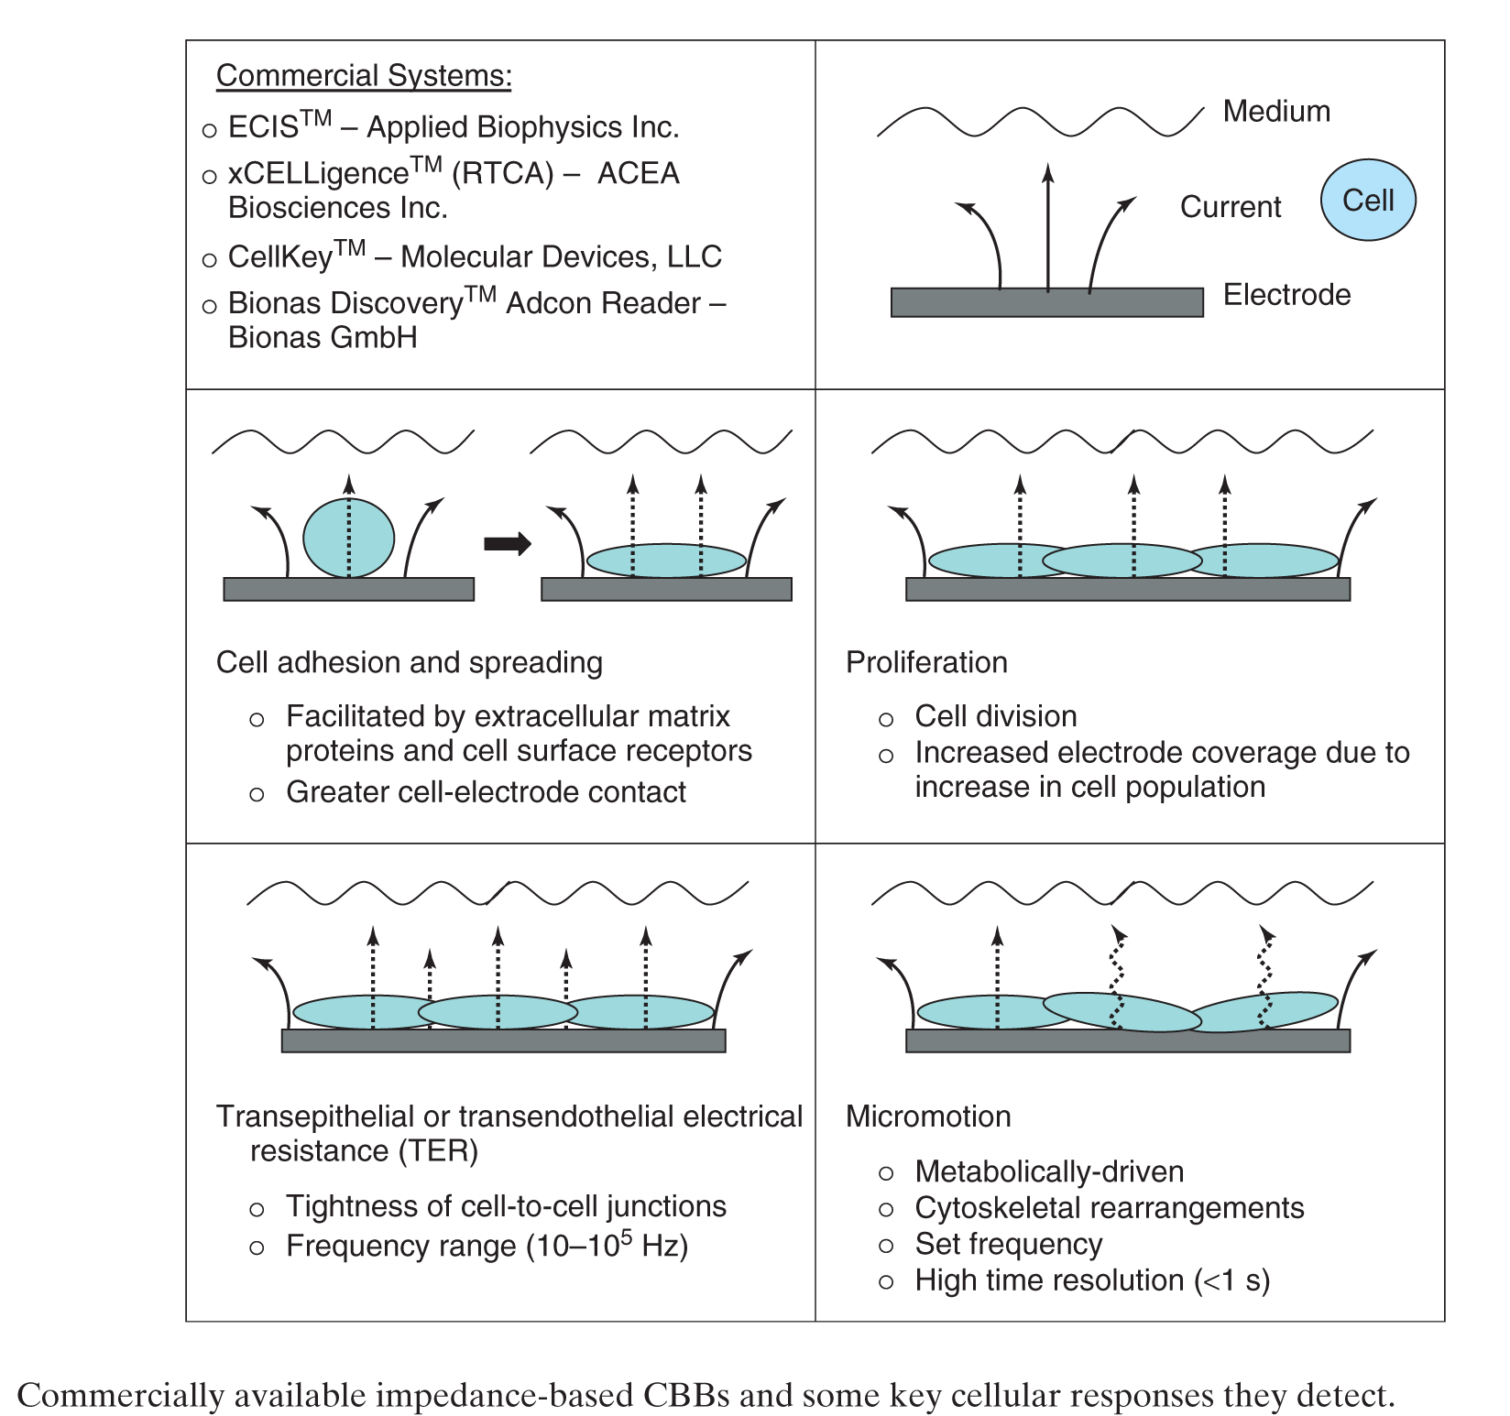
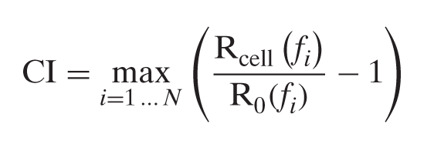
RTCA measures cellular lipid contact with E-plate surface
Quantified by “cell index”
In effect: Change in impedance measured at optimal frequency minus cell-less background value
Cytotoxicity is indicated by a dramatic loss in cell index
Moe, et al., 2014, Encyclopedia of Analytical Chemistry

Slide 8
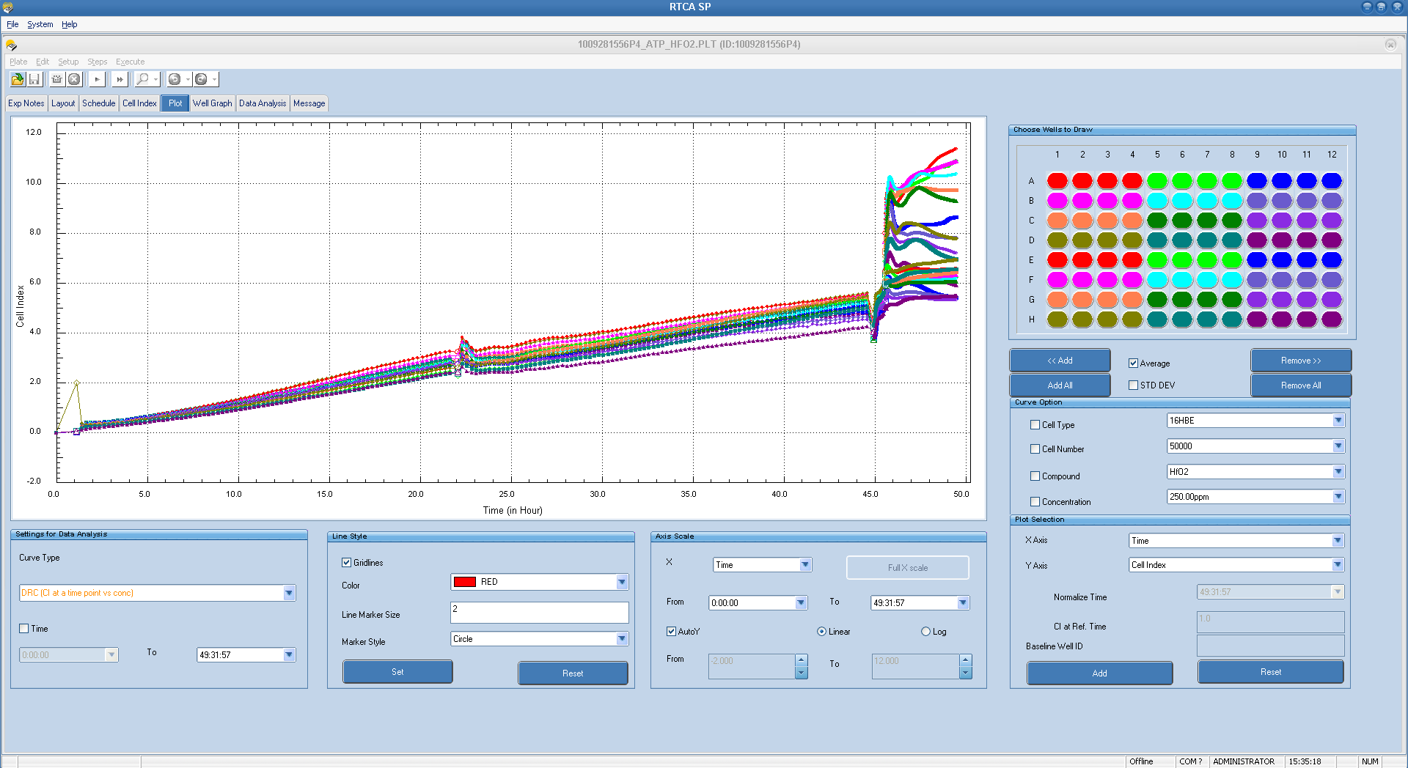
RTCA Assay
Raw data obtained from RTCA
Signaling Response (ATP)
24-hr HfO2 NP exposure
Grow cells in normal conditions

Slide 9
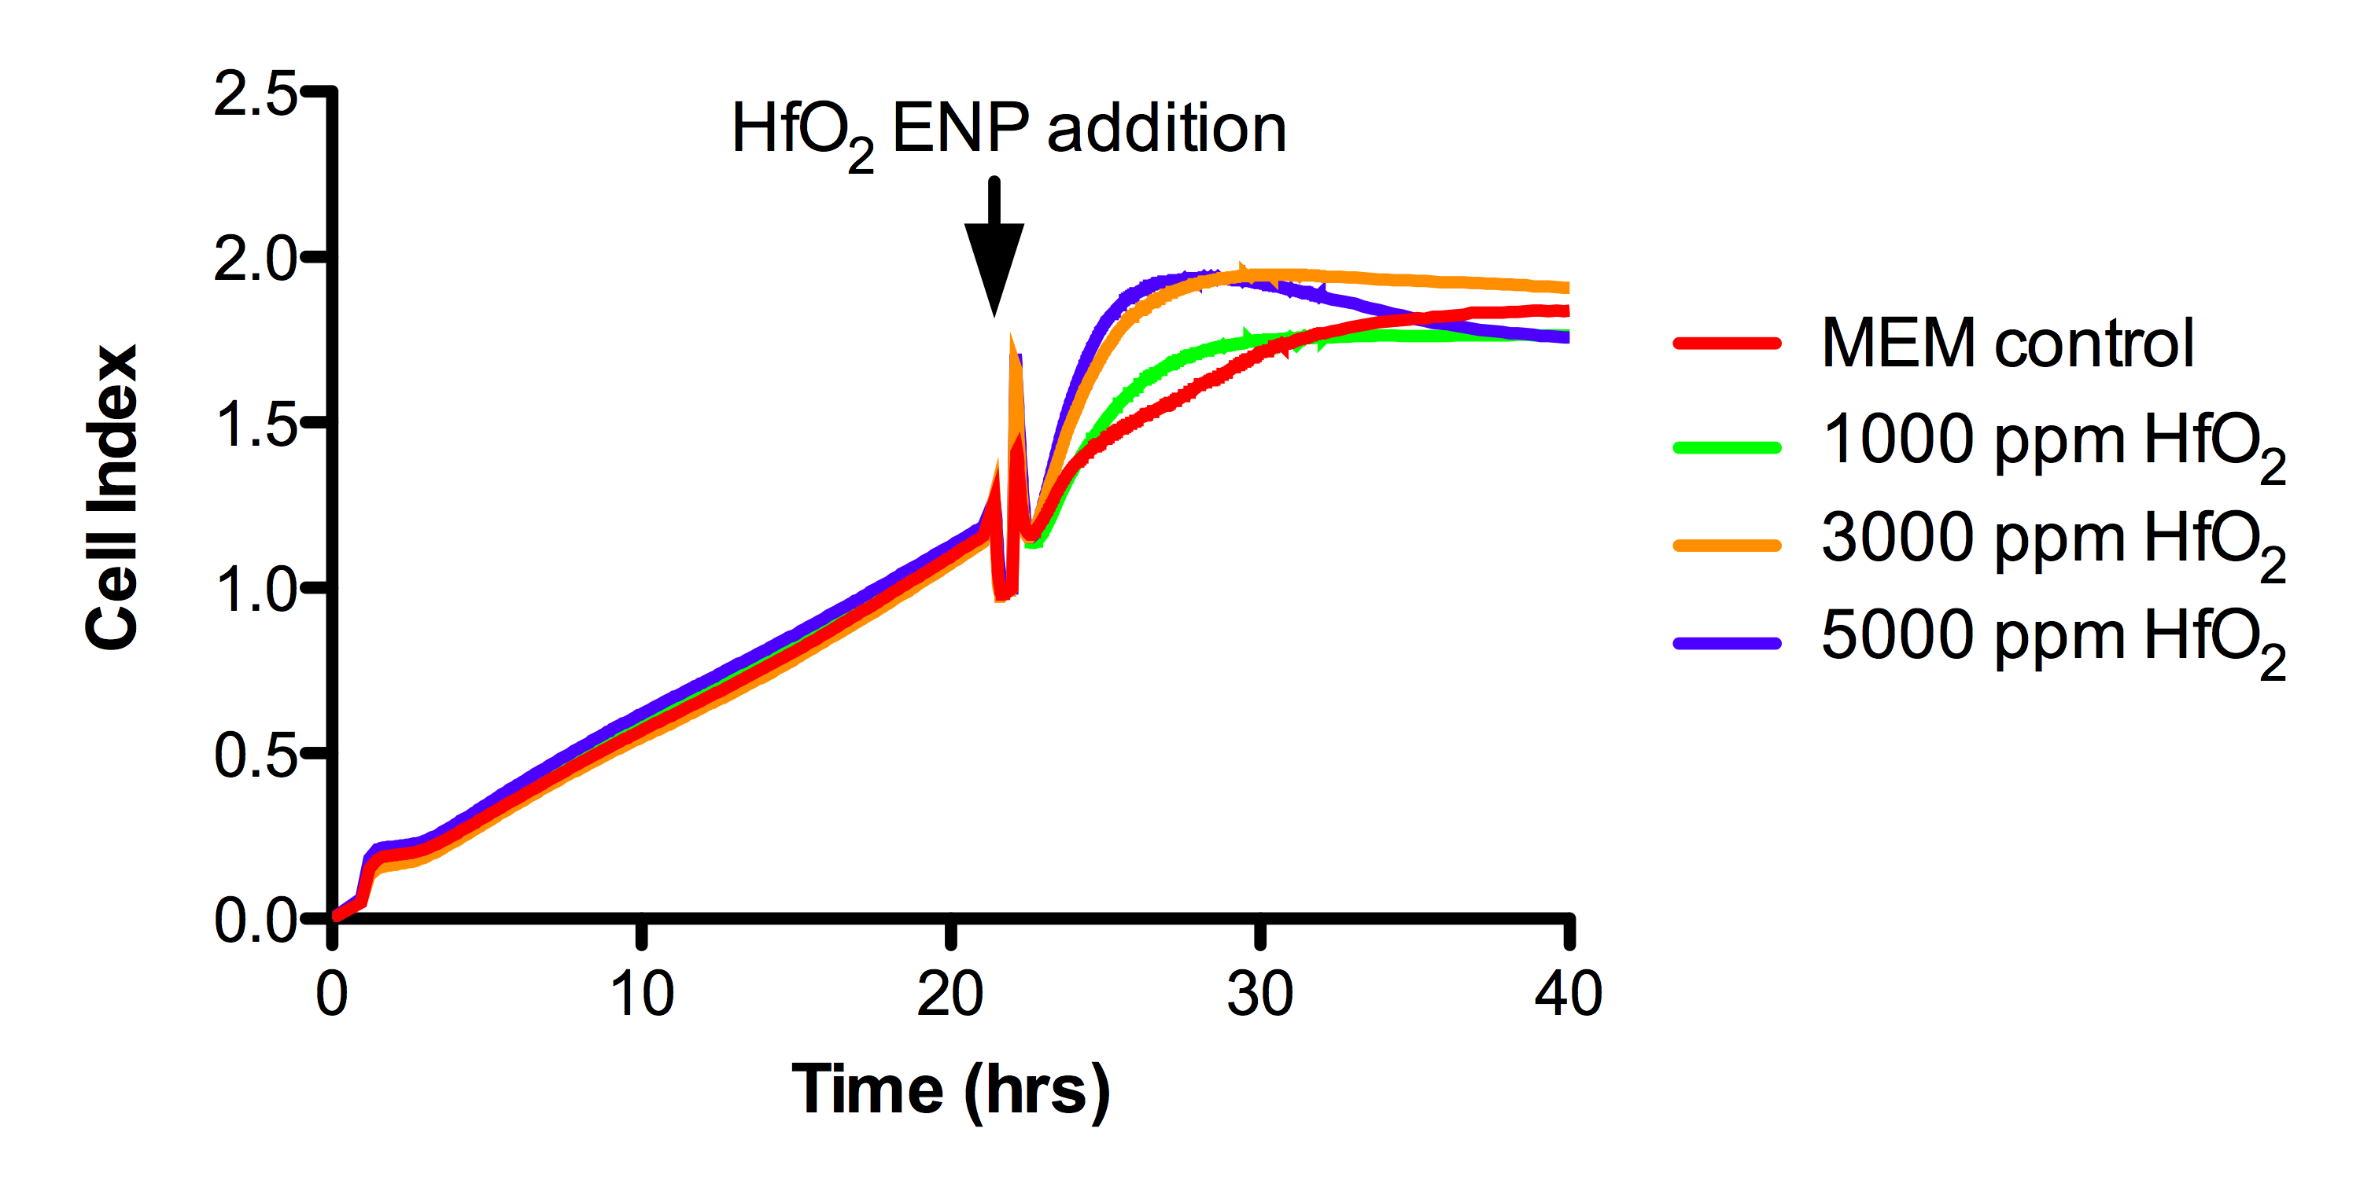
RTCA results with 16HBE14o- cells
HfO₂ ENPs do not result in significant cytotoxicity
HfO₂ ENPs do show cellular response
Compared ENP HfO₂ with micron-sized HfO₂ and untreated controls
No significant difference in HfO₂ cytotoxicity between different sized particles
Notes:
After this troubleshooting on the RTCA assay we were able to asses the toxicity of various NPs. Collaborators provided this data on CeO2 and SiO2 NP.
For these assays, we plated cells, monitored their growth, as you can see by the steady increase in impedance. We expose the cells to NPs by washing on NP-supplemented medium, shown by the arrow. Then we examine cytotoxicity by comparing the cell index trace of cells exposed to NPs to that of the MEM control.
The CeO2 NPs displayed no apparent toxicity to airway epithelial cells, since the cell index traces of cells exposed to quite high NP concentrations did not significantly vary from the control.
However, the SiO2 NPs induced cytotoxicity at concentrations as low as 200 ppm and greater toxicity at 300 and 600 ppm.
HfO2 matches lack of toxicity shown in Live/dead assay…Focus: One interesting thing we see is that HfO2 appears to induce an increase in impedance upon exposure to NPs,. This is indicative of a cellular response of some kind and needs further examination
Minimal cell death -- - -

Slide 10
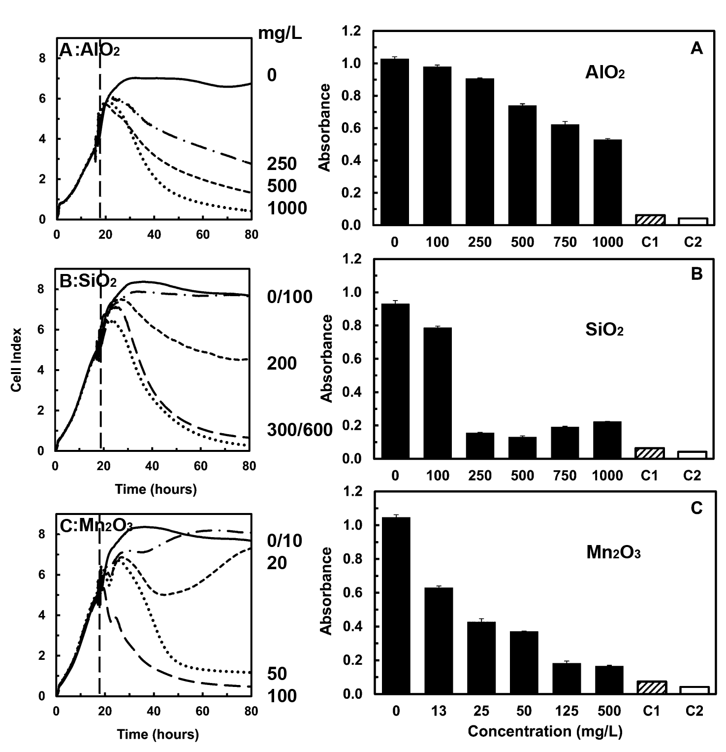
Nanoparticle Toxicity Comparison:
RTCA and MTT
RTCA measured over time (19 – 80 hrs)
Downward deflection = cytotoxicity
MTT measured at 48 hrs
Low absorbance = cytotoxicity
Conclusions:
In agreement on cytotoxicity
RTCA is “Data-Rich”
Otero-Gonzales, et al., 2012
Environmental Science and Technology

Slide 11
Beyond cytotoxicity: cellular effects of HfO₂
Cell death is the end point for toxicity testing
Detrimental cellular effects can occur in the absence of cell death
  Cell transformation – e.g., Cancer
  Loss of ability to respond to cellular signals or stress
Are there adverse effects in lung epithelial cells from HfO₂ ENPs exposure in the absence of cell death?
We used the RTCA to evaluate low-dose ENP exposure on ATP-induced airway epithelial cell signaling
  Alterations in ATP signaling is associated with innate immune impairment and chronic lung diseases
  ATP initiates an immediate physiological response that translates to an increase in cell index when measured by RTCA

Slide 12
RTCA Assay
Raw data obtained from RTCA
Signaling Response (ATP)
24-hr HfO2 NP exposure
Grow cells in normal conditions

Slide 13
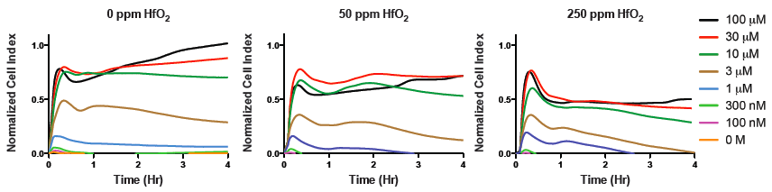
Physiologic response to ATP following ENP and micron-sized HfO₂ exposure in 16HBE14o- cells
HfO₂ ENPs:
[ATP]
HfO₂ Micron-sized:
[ATP]

Slide 14
Quantification of physiologic response to ATP following ENP and micron-sized HfO₂ exposure
• 24-hr incubation with low-dose ENP HfO₂ reduces physiologic response to ATP:
  P <0.05 at 100 μM ATP
  (0 vs. 50 and 250 ppm)
  P <0.05 at 30,10, and 3 μM ATP (0 vs. 250 ppm)
• 24-hr incubation with low-dose micron-sized HfO₂ reduces physiologic response to ATP:
  P <0.05 at 100 μM ATP
  (0 vs. 50 and 250 ppm)
  P <0.05 at 30 μM ATP (0 vs. 250 ppm)

Slide 15
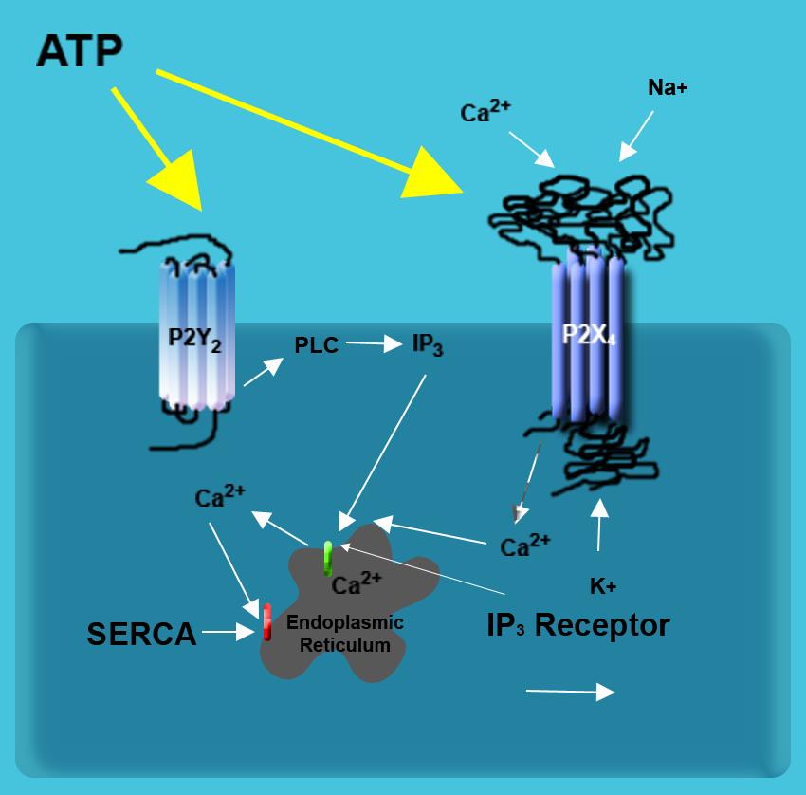
Ca²⁺ signaling is downstream of ATP
ATP mediates an increase in intracellular Ca²⁺ concentration ([Ca²⁺]_{i})
ATP can activate P2 receptors and increase [Ca²⁺]_{i}
  P2Y receptors are G protein-coupled receptors
  P2X receptors are cation-selective ion channels activated by ATP
Hypothesis
  Exposure of airway epithelial cells to low-dose HfO₂ will decrease their [Ca²⁺]_{i} response to ATP

Slide 16
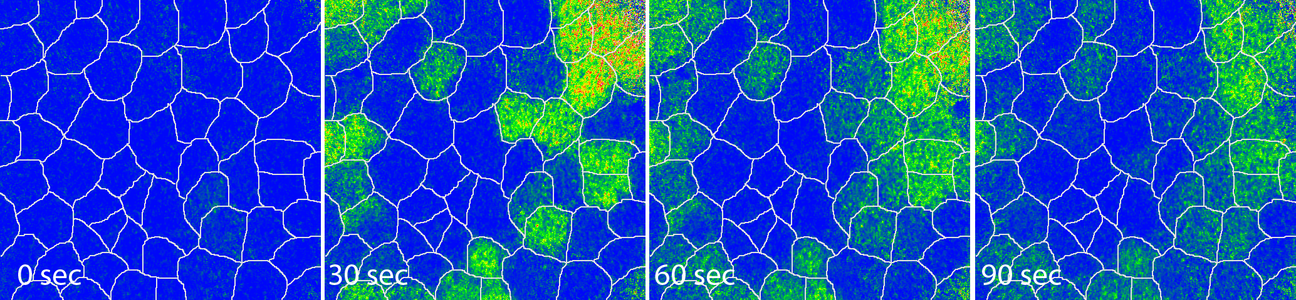
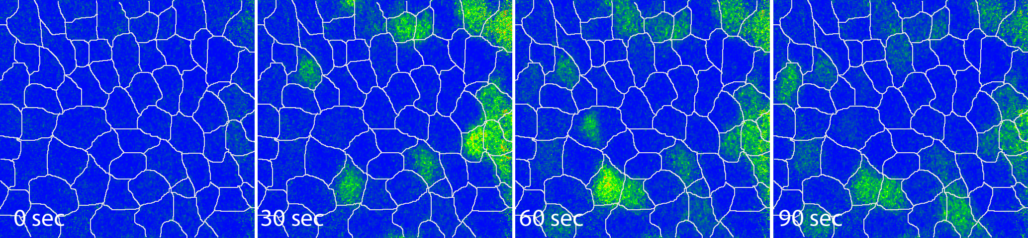
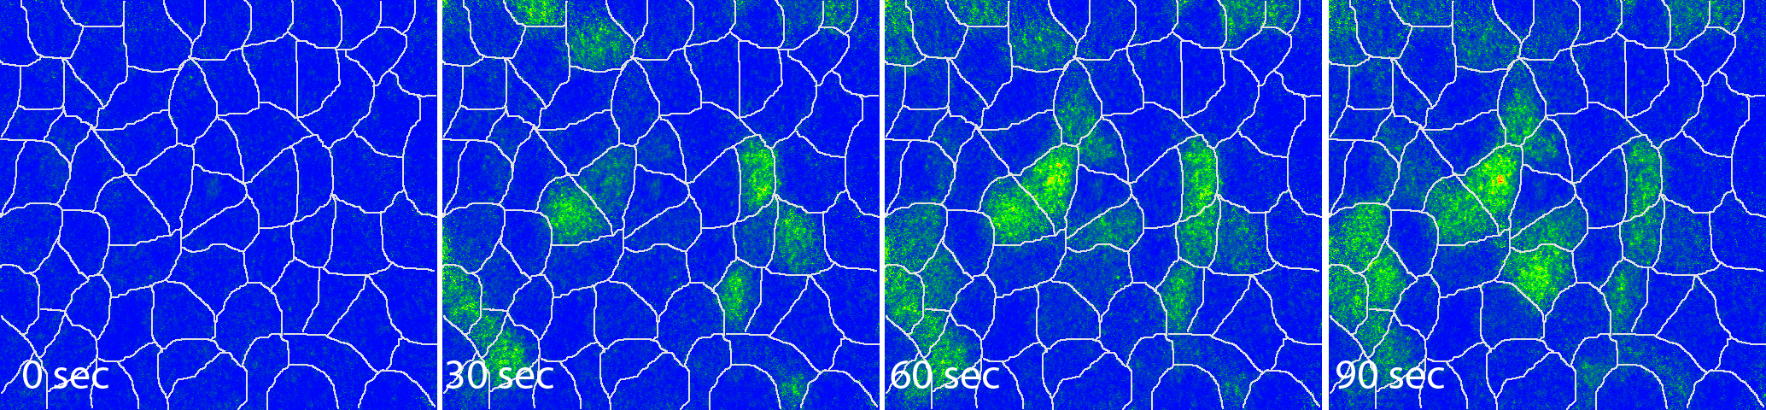

HfO₂ ENPs reduce ATP-mediated Ca²⁺ signaling
Confluent monolayers of 16HBE14o- cells were incubated with low-dose HfO₂ ENPs for 24 hr
1 μM ATP was applied exogenously and intracellular Ca²⁺ [Ca²⁺]_{i} monitored for 3 minutes
[Ca²⁺]_{i} are calculated and presented on a color map
0 ppm HfO₂
50 ppm HfO₂
250 ppm HfO₂

Slide 17
Quantification of Ca²⁺ signaling
Cells that increase [Ca²⁺]_{i} to 200 nM or more are considered positive
ENP concentrations ~1/10 – 1/100 of where cytotoxicity can be measured have reduced ATP-mediated Ca²⁺ signaling
Micron-sized HfO₂ showed some variation in ATP-mediated Ca²⁺ signaling that was not significantly reduced

Slide 18
Effects of HfO₂ on Ca²⁺ signaling: particle concentration vs. surface area
These graphs demonstrate HfO₂ Ca²⁺ signaling reductions are due to metals toxicity more than particle size

Slide 19
Conclusions: HfO2 Toxicity
Size of ENPs
  Size reported by manufacturer should be verified
HfO₂ ENPs did not cause significant cell death
Sub-cytotoxic exposures to HfO₂ can alter mechanisms of innate immune function in lung epithelial cells
  Cellular response to ATP is altered by ENP exposure (RTCA)
  ATP-mediated [Ca²⁺]_{i} response reduced by ENP exposure (Ca²⁺ imaging)
  ENP altered ATP-mediated [Ca²⁺]_{i} response appears to be a metals toxicity
Notes:
Overall, I can draw multiple conclusions from the various aspects of my project
I discussed how the characterization of ENPs is important when we are evaluating their cytotoxicity. We learned that the size reported by the NP supplier should be verified, and also, that the size and agglomeration state varies with the medium, so these aspects should be carefully considered when examining toxicity to cell cultures.
In our cytotoxicity assays, we concluded that HfO2 NPs did not cause cell death.
However, we found that sub-cytotoxic exposures to HfO2 NPs, as well as CeO2 and SiO2 NPs, can alter ATP-induced cell signaling. And we saw this in the overall response to ATP measured by RTCA, and also by digital imaging microscopy that evaluated the Ca2+ response to ATP.

Slide 20
Initial Conclusions: RTCA
Allows for screening cytotoxicity and sub-cellular cytotoxicity over time
No fluorescence/absorbance measurements needed
Relatively high-throughput way of screening single or multiple compounds
Excellent “first step” in toxicology analysis

Slide 21
Acknowledgements
Work in this study
  Lila Otero-Gonzales (Jim Fields, Reyes Sierra-Alvarez)
  Mia McCorkle, M.S.
  Cara L. Sherwood, Ph.D. – Presenting a Poster on Cell Signaling Toxicity
    HfO₂, Arsenic, and “E-juice.”
Funding
  SRC/Sematech Engineering Research Center for Environmentally Benign Semiconductor Manufacturing (James A. Field (P.I.), Scott Boitano, Farhang Shadman, Buddy D. Ratner, Chris Barnes, and Reyes Sierra-Alvarez)
  Intel Foundation fellowship (Mia McCorkle, Lila Otero-Gonzoles)
  NIH Superfund Research at University of Arizona (Raina Maier, P.I.)

Slide 22
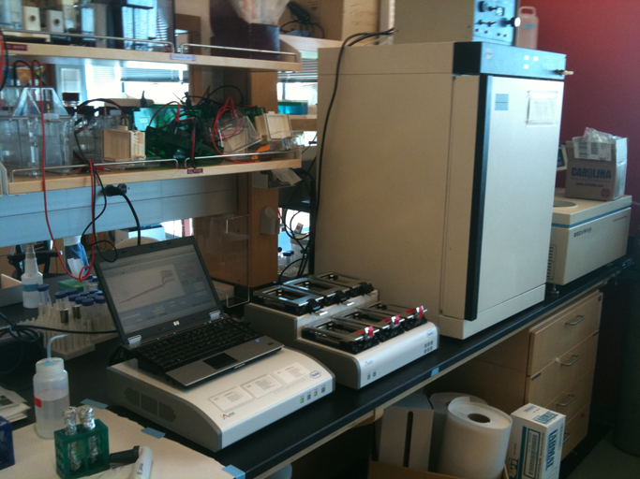
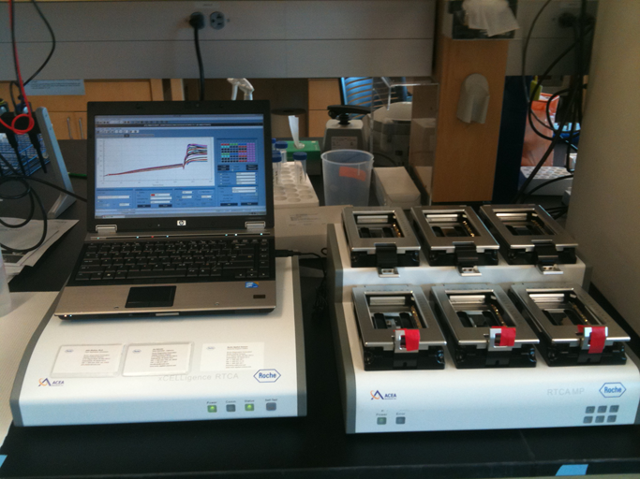
RTCA: Practical Use
Laptop Computer (that stays put)
Controller Device
Plate Reader
Incubator

Slide 23
RTCA: Things to Consider Before Use
Cell Type
  Adherent
  Confluence — How Much upon Addition of Compound?
Experimental Protocol – (Plate Map)
  Trying to Match a Separate Experiment?
  Temperature
  Incubator (with CO₂)
  Mixing Solutions
  Dose Response(s)
Controls
  Cells Alone
  Wells Alone

Slide 24
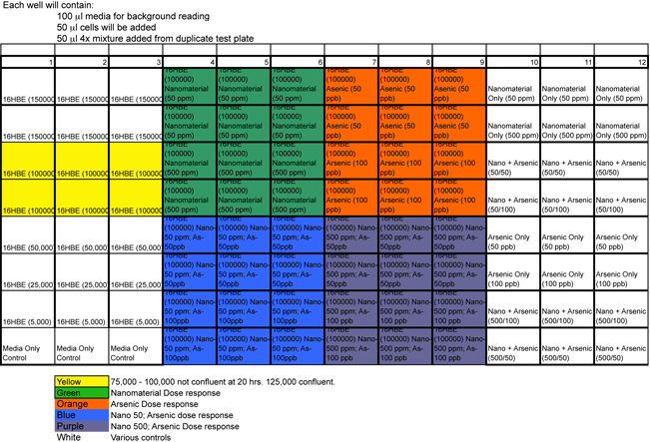
RTCA: Plate Map

Slide 25
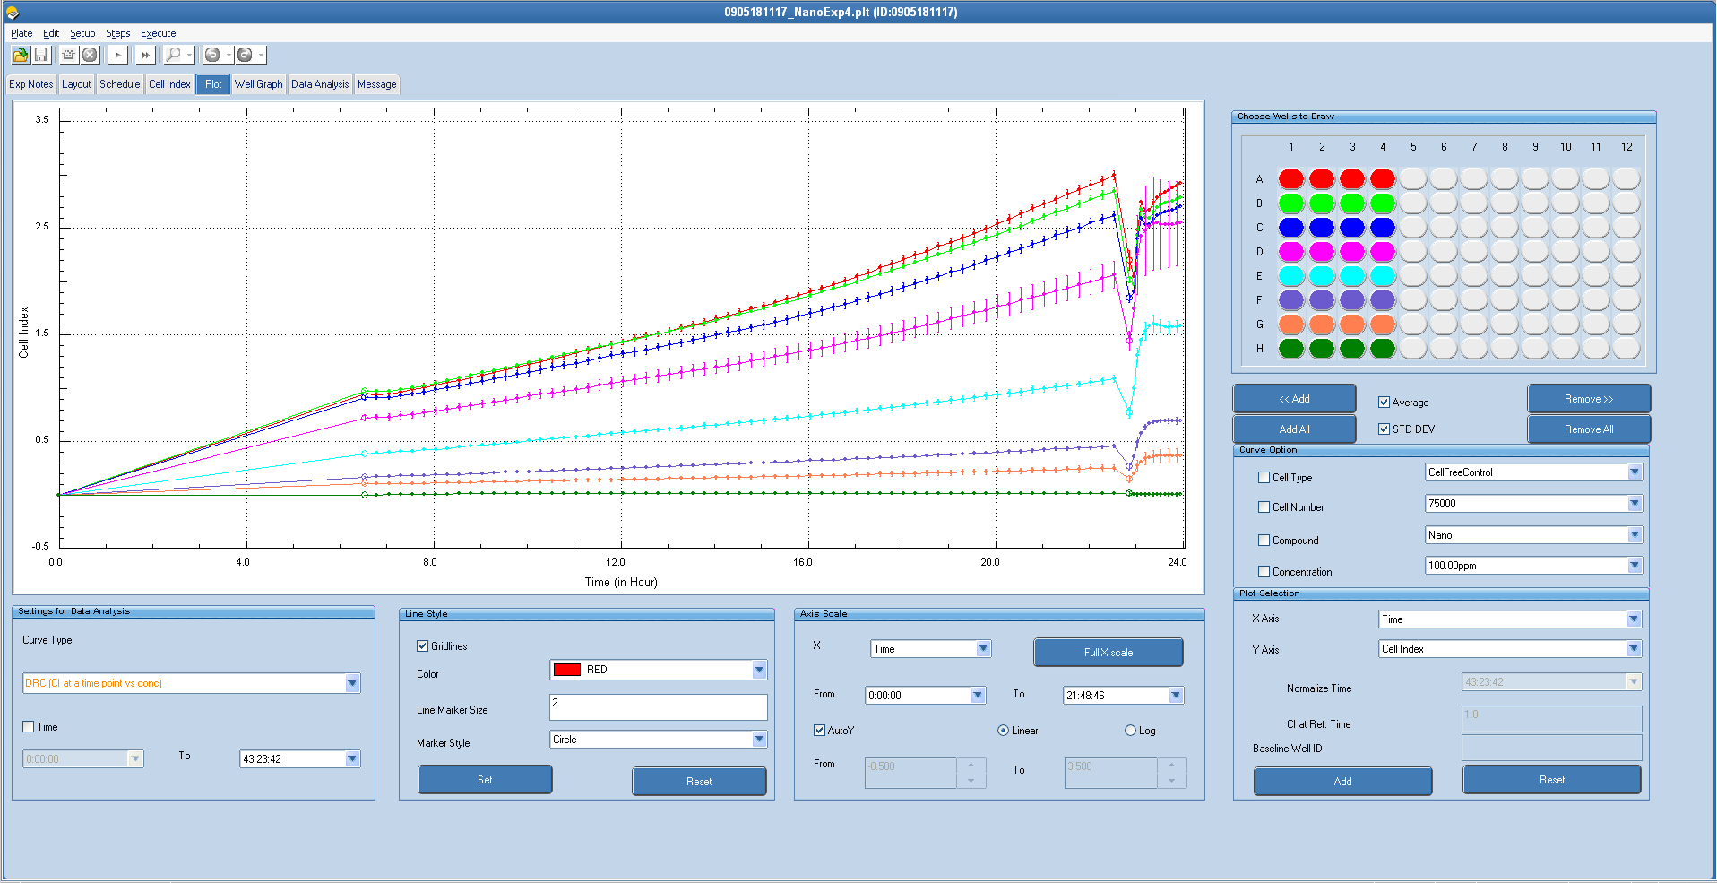
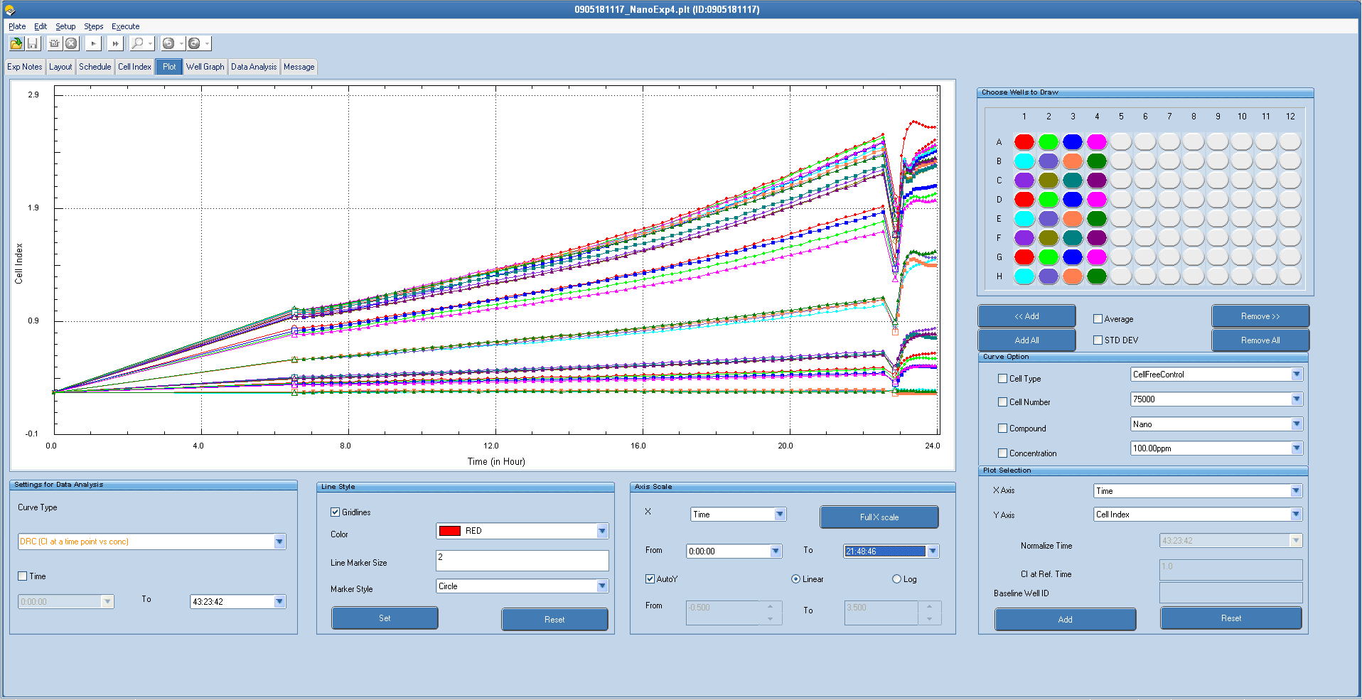
RTCA: Cell Number
Establishing Correct Cell Number Differs Widely:
1) Among Cell Types
2) According to the Timing of Experiment

Slide 26
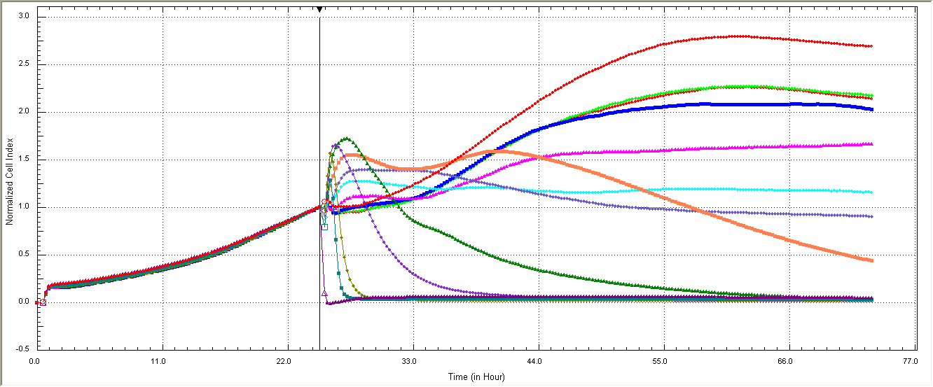
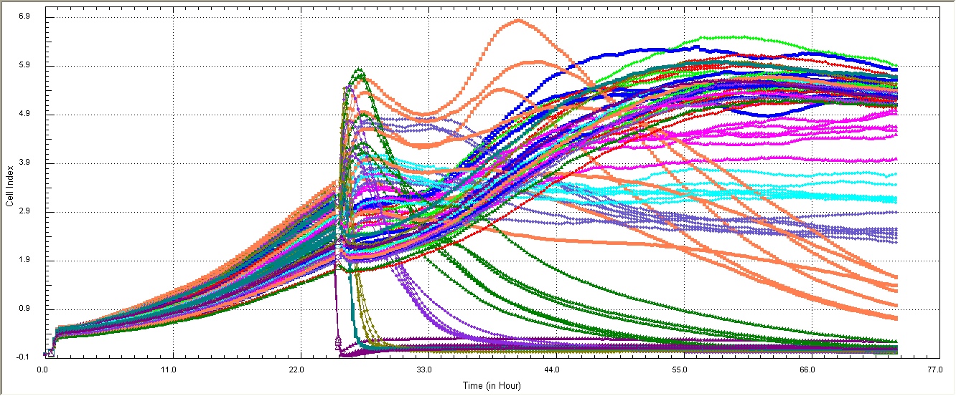
RTCA Experiment: Arsenic Toxicity
Experiment:
Grow Cells to Subconfluence
Add Dose Response (Arsenic; 0 – 1 mM)
Evaluate Toxicity over 24 hrs
Raw Data:
Raw Data (4 well Averages):

Slide 27
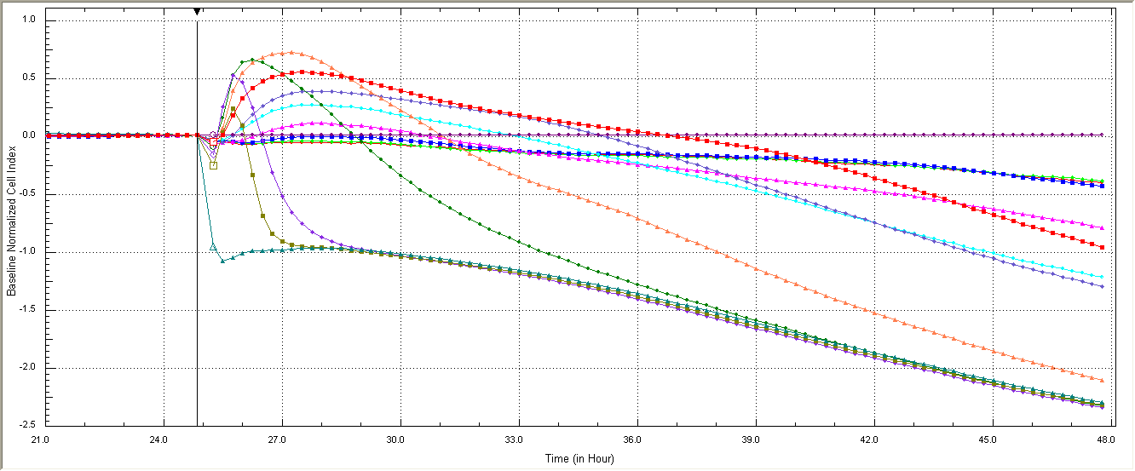
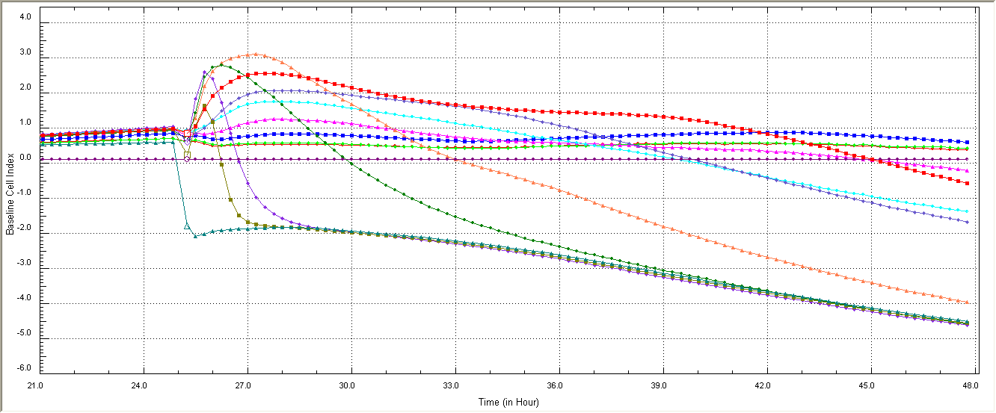
RTCA Experiment: Arsenic Toxicity
Experiment:
Grow Cells to Subconfluence
Add Dose Response of Arsenic (0 – 1 mM)
Evaluate Toxicity over 24 hrs
What about variation?
Baseline Data--Zoomed, Averaged
Baseline Data -Zoomed, Averaged, Normalized

Slide 28
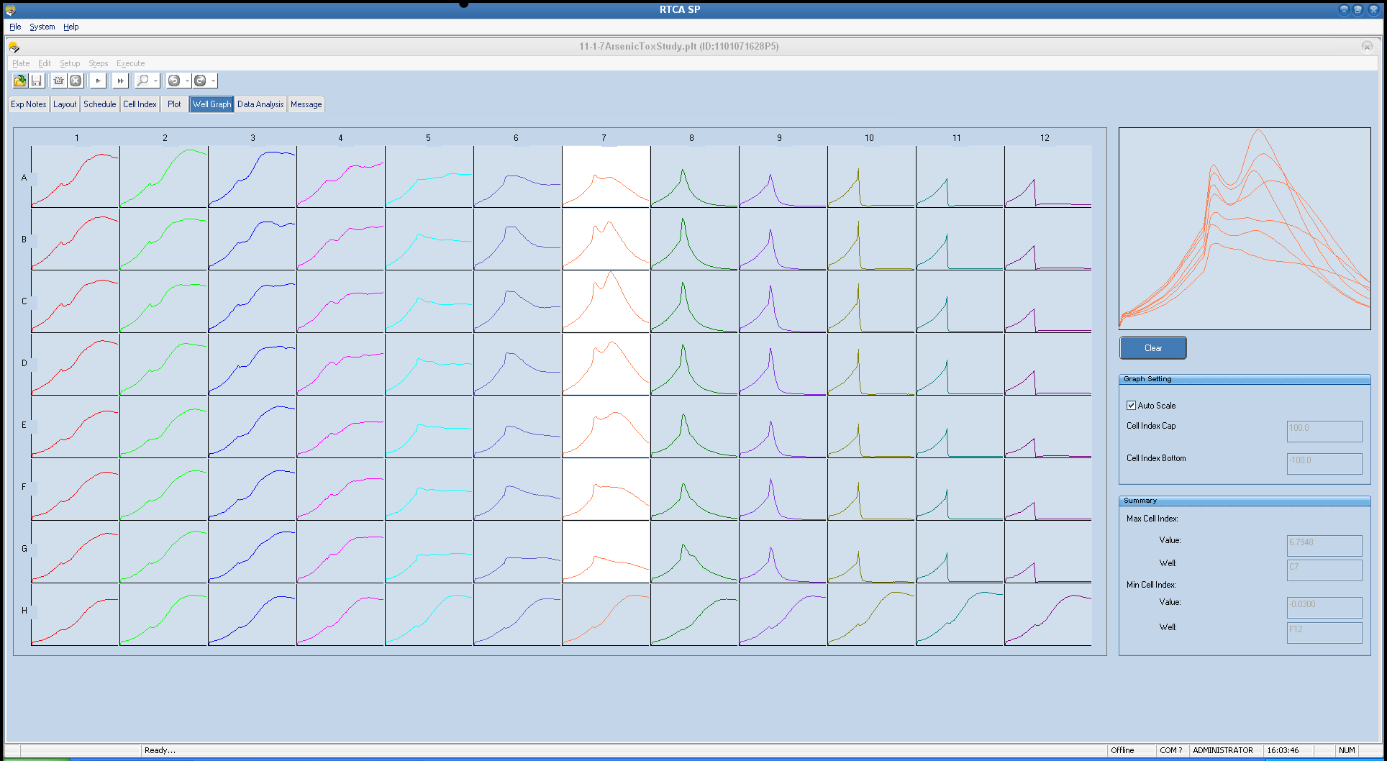
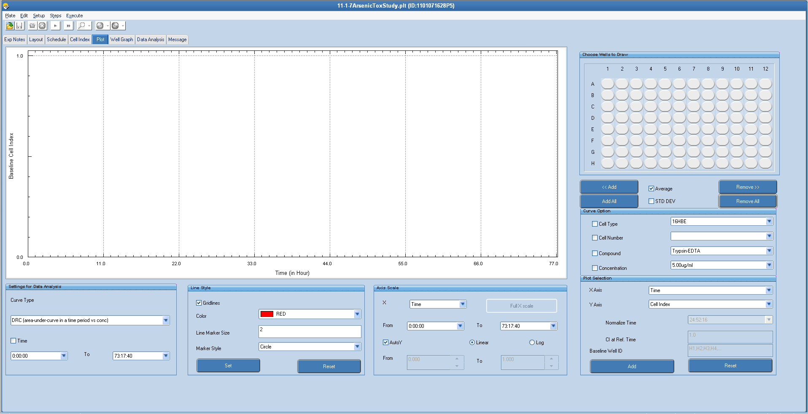
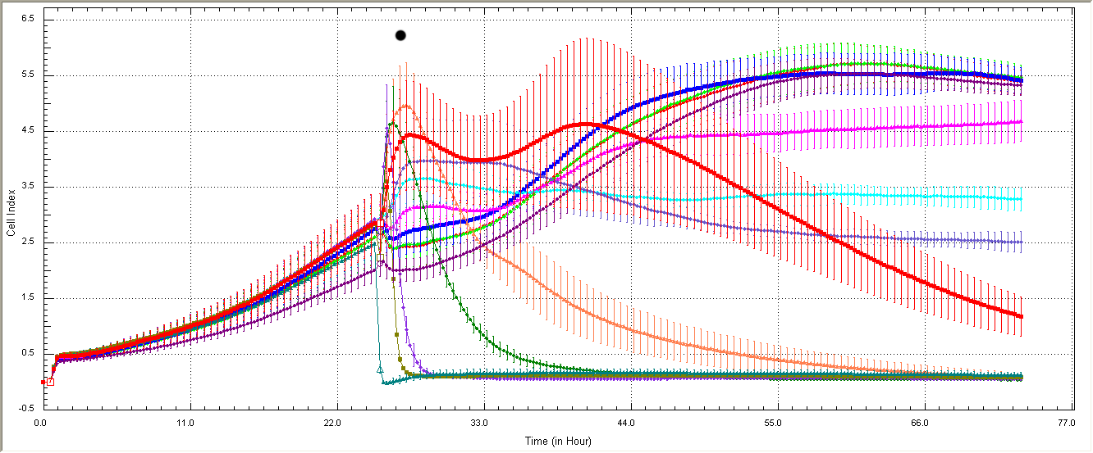
RTCA: Arsenic Toxicity: Troubleshooting Data

Slide 29
Understand “Normal Responses”
Same Cell Type (16HBE14o-) Growth Conditions
Similar Drug Concentrations
Concentration Responses for Both Drugs
Impedance changes are very different

Slide 30
Measuring cytotoxic and subcytoxic effects of nanoparticles and arsenic using the xCELLigence real time cell analyzer platform
Scott Boitano, Ph.D.
Respiratory cell physiology lab
University of arizona
Superfund Research Project
April 21, 2014

Slide 31
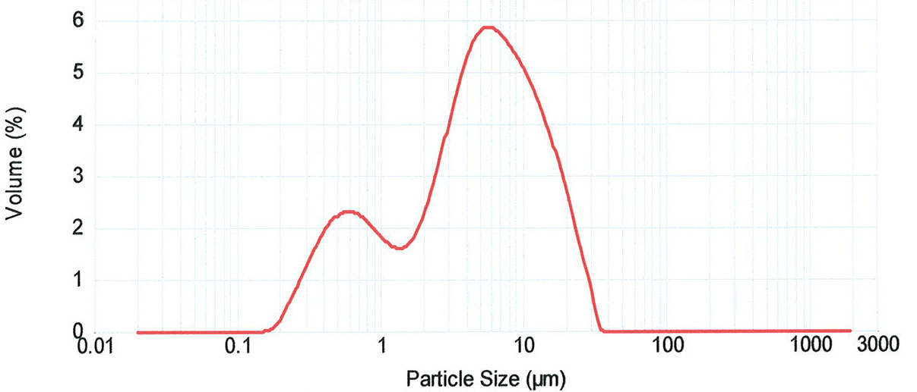
Characterization of HfO₂ particles
Particle characterization is important in elucidating affected cellular mechanisms
Measured particle size distribution (PSD) for HfO₂ ENPs
Only a fraction of HfO₂ ENPs were in the nano-range (i.e. <100 nm)
(PSD by dynamic light scattering)
PSD for micron-size HfO₂ was wide, with average particle size 6.768 µm
Notes:
So I’ll take you back to the HfO2 particles that I showed you before, but I’ll focus on the “clean” batch (without the surface contaminants). These HfO2 particles had an average size of 150 nm, with a fraction of the particles in the nano-range under 100 nm. Since these particles are well-defined, I used them in my toxicity studies to test exposure to the airway epithelium
Range of size

