Slide 1



Implementing Sustainable Remediation at a Portfolio Level
Gerlinde Wolf, PE
Sustainable Remediation Forum (SURF)
President, 2018
June 2018

Slide 2

Who Is SURF?
Founded in 2006
Mission: to maximize the overall environment, societal, and economic benefits from the site cleanup process by:
  Advancing the science and application of sustainable remediation
  Developing best practices
  Exchanging professional knowledge
  Providing education and outreach
  Thought leadership group that collaborates with environmental professionals from all disciplines to develop and advance sustainable remediation principles and practices.
http://www.sustainableremediation.org

Slide 3

Drivers for a Programmatic Approach to Sustainable Remediation (SR)
Increasing focus on corporate and agency sustainability goals
  Desire for consistent approach for application of sustainability
Increasing energy costs
Proliferation of regulatory and industry guidance and frameworks
Federal and state regulations
Recognition that impacts and decisions may be bigger than just the site and surrounding area
SR can be an effective communication tool and stakeholder engagement mechanism

Slide 4

Example Approach for SR Program Development
Decide on SR program goals/objectives and priority metrics
Identify SR tools for metric tracking and sustainability evaluations
Develop a guidance document describing the program
Develop metric tracking and reporting methodology
Pilot test identified tools and framework

Slide 5


AECOM Developed Comprehensive SR Program for North American Class 1 Railway Company
Provides consistent application of SR analysis and implementation using transparent tools across entire portfolio of sites
Program based on a tiered approach that is scalable depending on site and management specific goals
SR implemented throughout all stages of remediation project lifecycle
Tools developed for metric tracking and reporting, aligning with corporate goals

Slide 6
Example Priority Metrics
  Air Emissions (GHG, NO_{x}, SO_{x}, PM₁₀)
  Water Consumption
  Electricity Usage
  Landfill Disposal (Hazardous & Non-Hazardous)
  Topsoil Consumption
  Cost
  Lost Hours – Injury
  Percent Electricity from Renewable Sources
Remedy Evaluation Criteria Under CERCLA
Overall protection of human health and the environment;
Compliance with [applicable or relevant and appropriate requirements (ARARs)];
Long-term effectiveness and permanence;
Reduction of toxicity, mobility, or volume;
Short-term effectiveness;
Implementability;
Cost;
State acceptance; and
Community acceptance
These metrics go beyond the standard CERCLA
evaluation criteria, and state requirements

Slide 7
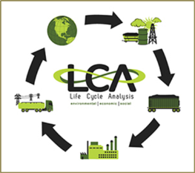





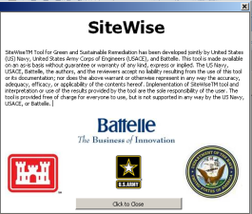
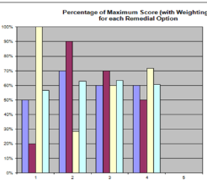
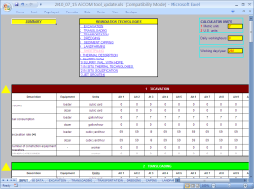


Frameworks & Tools to Consider
LCA / Advanced
Quantitative Sustainability Evaluations
BMPs / Programmatic Strategies
SuRF
UK
EPA
SEFA

Slide 8
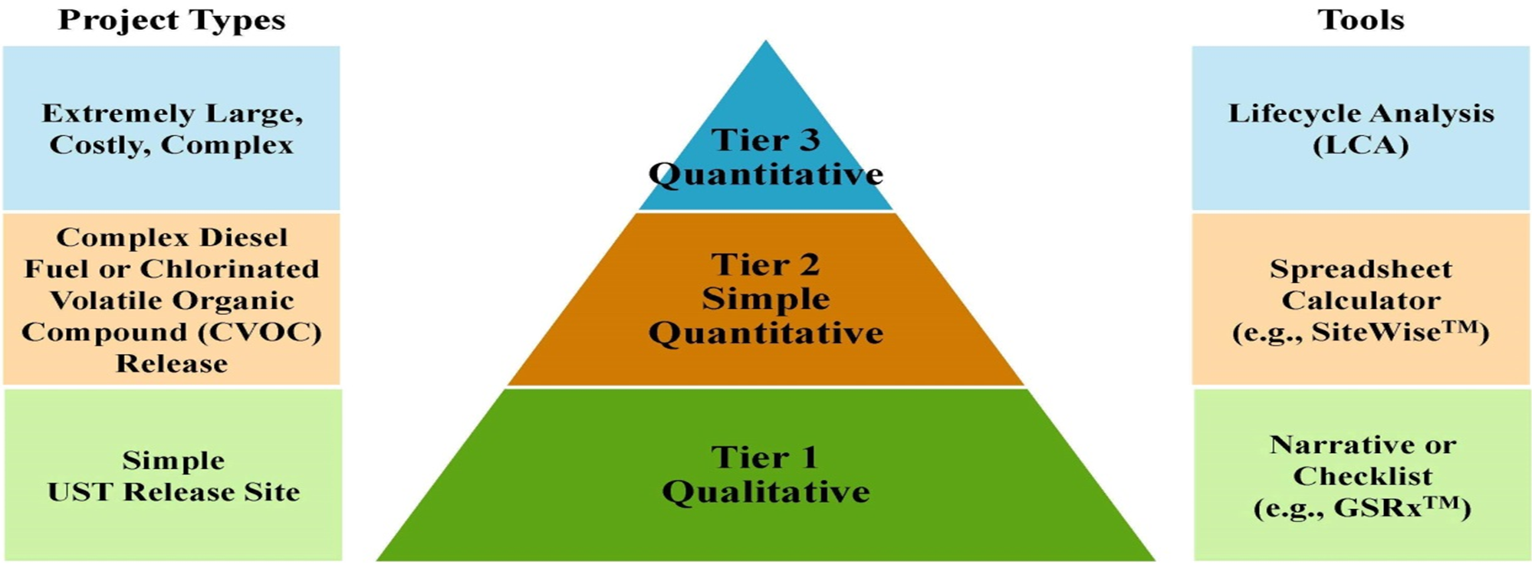
Example Tiered SR Approach

Slide 9
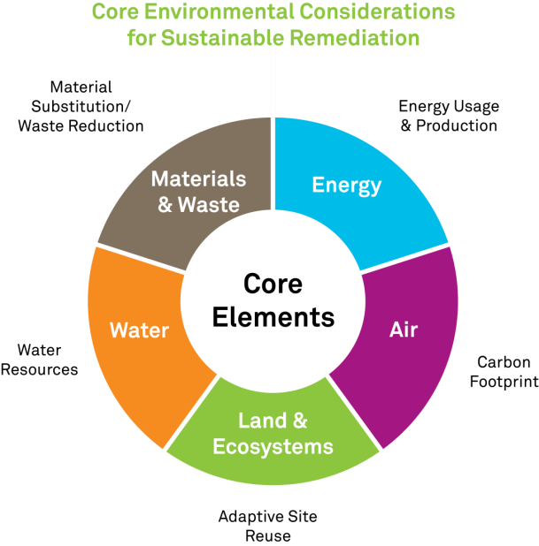
Programmatic Implementation of Best Management Practices
BMP: An action or practice that improves an environmental, social and/or economic aspect of a site.
Resources for BMPs
  SURF
  USEPA
  US State Agencies
  US Department of Defense
  ASTM Guidelines
BMPs may be qualitative or quantitative

Slide 10

Programmatic SR Implementation and Metric Tracking
Important to consider on project scale and portfolio scale
Qualitative assessments can still have quantitative benefits
    Recycling
    Travel Miles Saved
    Beneficial Reuse of Materials
    Idle Reduction Time
    Cost Savings
    Waste Reduction
    Ecosystem Benefits
Tracking on project level leads to large scale programmatic impact

Slide 11
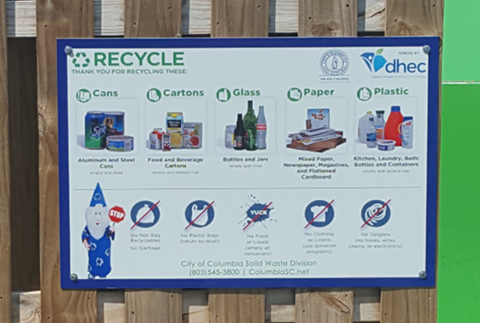
Programmatic Lessons Learned
Starting discussion early on with contractors, i.e. during the bid walk, sets up expectations and clearly shows SR program requirements
Incorporation of sustainability into daily tailgate meetings keeps field staff engaged and focused
Frequent discussion of sustainability goals during project status calls helps track progress and identify areas of improvement
Field implementation of selected BMPs can sometimes be challenging
  Recycling

Slide 12
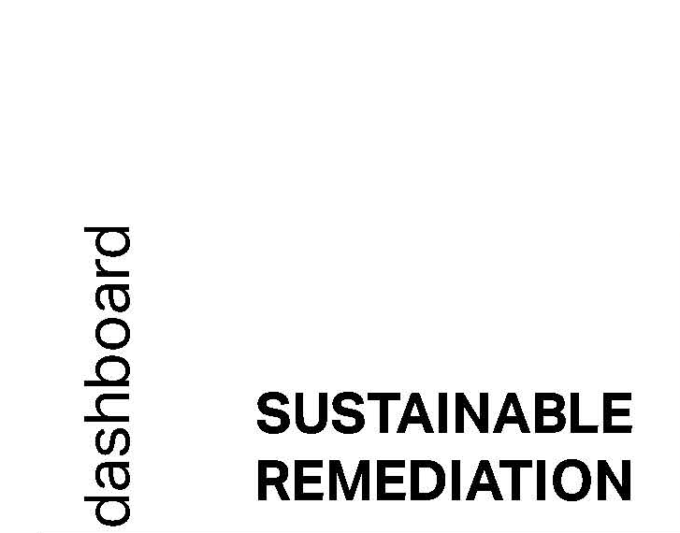
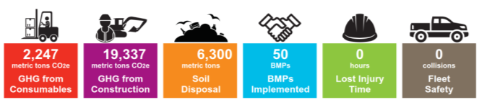
The Broader Perspective – Value of SR Programs
  Corporate philosophies of sustainability and environmental stewardship
  Desire for consistent approach for application of sustainability
  Corporate sustainability reporting now widely practiced
  Many sustainability benefits are linked
    Gaining efficiency often results in cost savings
    Cost saving measures may lead to environmental and social benefits

Slide 13



Thank You!
Questions?
Gerlinde Wolf, PE
Gerlinde.Wolf@aecom.com
518-951-2370

