Slide 1


Protective Remedies with a Lower Environmental Footprint
Building Sustainability Into Our Core Mission Through Greener Cleanups
September 28, 2016 Webinar
Carlos S Pachon
Team Lead, Greener Cleanups
US EPA

Slide 2
Forward Momentum:
Policy, Tools & Practice
Greener cleanups are consistent with Agency policy and authorities
The ASTM Standard Guide for Greener Cleanups is an effective tool for all parties at the project level
Site cleanup consulting and engineering companies are increasingly incorporating greener cleanup practices into their standard operations

Slide 3
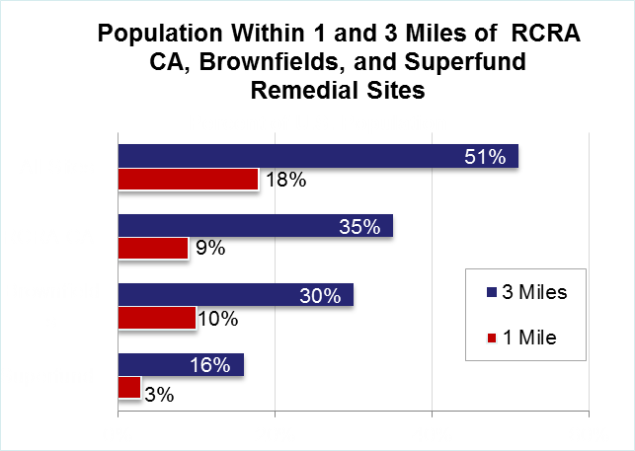
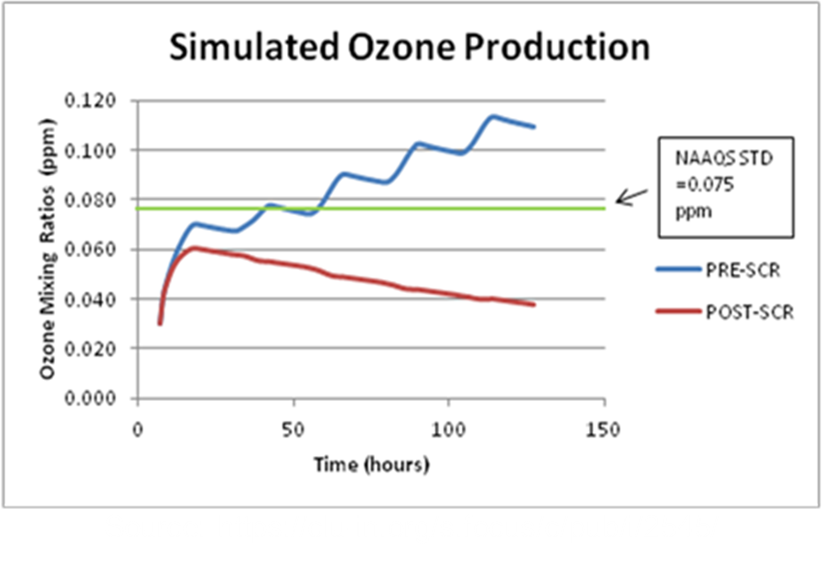
EPA Cleanup Programs Address Contamination at Sites Near 51% of the U.S. Population
It’s also a local question
Source: https://www3.epa.gov/osweraccomplishments/story.html
https://clu-in.org/s.focus/c/pub/i/2545/

Slide 4
Strong Agency Support for Greener Cleanups
EPA Strategic Plan (2014-18):
  EPA's hazardous waste programs also are working to reduce the energy use and environmental footprint during the investigation and remediation of hazardous waste sites
Encouraging Greener Cleanup Practices through Use of ASTM International's Standard Guide for Greener Cleanups (12/2013)
  I recommend that regions and OSWER programs facilitate and encourage use of ASTM's Standard Guide for Greener Cleanups in your efforts to implement greener cleanup practices.
New - Consideration of Greener Cleanup Activities throughout the CERCLA Process (8/2016)
www.epa.gov/greenercleanups

Slide 5
Consideration of Greener Cleanup Activities in The Superfund Cleanup Process (8/2016)
Links back to basic CERCLA authorities, but neither modifies nor amends the NCP
Includes three main recommendations
  Consider greener cleanup measures in the life of a project
  Evaluate BMPs or need for Environmental Footprint
  Addresses Fund lead and PRP lead sites
Provides key definitions & includes seven references to ASTM Standard Guide E2893
www.epa.gov/greenercleanups

Slide 6
Superfund Remedial Acquisition Framework
ASTM Referenced in Published Superfund Sources Sought/Request for Information*
ASTM E2893 Referenced in Two Suites of Contracts:
  Remediation Environmental Services Contract (RES)
  Environmental Services and Operations (ESO)
SOW Requirements under section 1.4 Green Remediation
  “…the contractor shall explore and implement green remediation strategies…”
  Refers to ASTM International’s Standard Guide for Greener Cleanups (E2893)
* Published in FedConnect: The reference number is SOL-R1-14-00003 for ESO; SOL-HQ-14-00022 for DES and SOL-HQ-14-00023 for RES (posted 9/16/16)

Slide 7



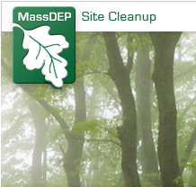
State Partners: Moving Greener Cleanups Forward
Notes:
MADEP Greener Cleanup guidance references ASTM Guide as a means of reducing environmental footprints . Hi Carlos
The 2016 Greener Cleanup Recognition Award were handed out at the Licensed Site Professionals Meeting “Annual Kick-Off” Monthly Meeting on Tuesday, September 13th 2016. This meeting traditionally focuses on MassDEP’s regulatory and programmatic priorities for the year.
Award: Mr. Podsen is an LSP working for the environmental consulting firm Brown and Caldwell here in Andover, MA. a greener cleanups evaluation has been conducted in accordance the Guide. with the MassDEP’s Greener Cleanups Guidance WSC #14-150 which recommends the use of the ASTM E2893-13 “Standard Guide for Greener Cleanups” in conducting the evaluation. Following the ASTM standard, the Technical Summary Form and Best Management Practices evaluation summary are in appendinx. Employ closed loop greywater washing system for decontamination of trucks, Implement an idle reduction plan and Use alternate drilling methods including DPT or sonic drilling to minimize drill
cuttings that require disposal
We also recognized the Potentially Responsible Party (PRP)/property owner for the site as the City of Medford, MA. That was a separate award and certificate that I don’t have photo of. It includes the same text. I’ve attached a picture of the award recipients.
Also, an LSP from AECOM received an Honorable Mention. I expect they will do some marketing around this in the future as they were interested in follow-up information.
Our goal is to continue this on an annual basis.
Hope this helps and thanks for mentioning it.
Tom

Slide 8
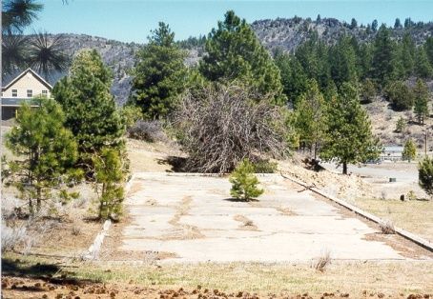
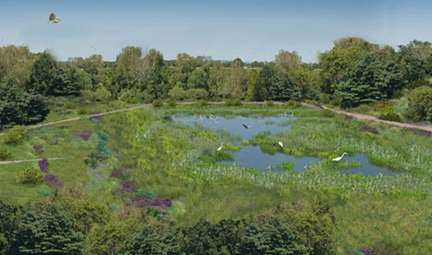
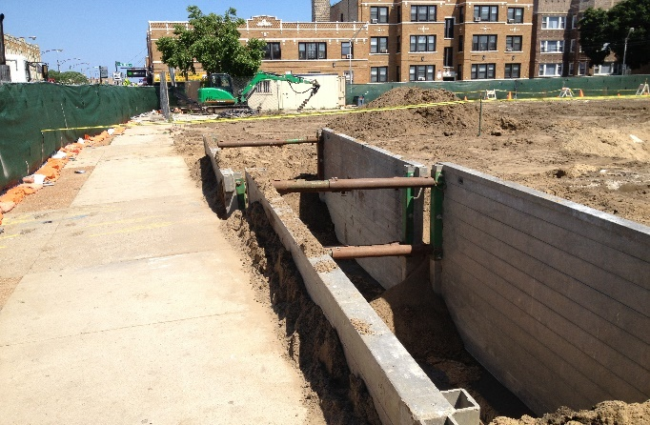
ASTM Standard Applied Across the Country: Sample BMPs
Land & Ecosystems: - Choose native vegetation needing little/no irrigation or other maintenance (OR Superfund site)
Water / Land & Ecosystems: Install earthen berms to prevent run-off or run-on in excavation areas (WA TSCA site)
Water / Land & Ecosystems: Construct wetlands for stormwater management and habitat creation (CT RCRA-CA site)
Materials & Waste: Mix reactive agents in situ to minimize material handling and transfer (IL Brownfield)
Project profiles at: www.clu-in.org/greenremediation/profiles
Notes:
Whitney Young (http://www.naep.org/2014-environmental-excellence-award-recipients)
United States Environmental Protection Agency (USEPA), Region 5National Award of Excellence for Outstanding Environmental Clean-Up ProgramChinatown Branch Library, Whitney Young Library Site (September), 2015 Illinois Governors sustainability award http://www.istc.illinois.edu/info/govs_awards_docs/2015GSASheddRelease.pdf
8

Slide 9


























Green Remediation: A Growing Practice
Examples of companies with green remediation on corporate websites*
* Based on query conducted June 2016

Slide 10
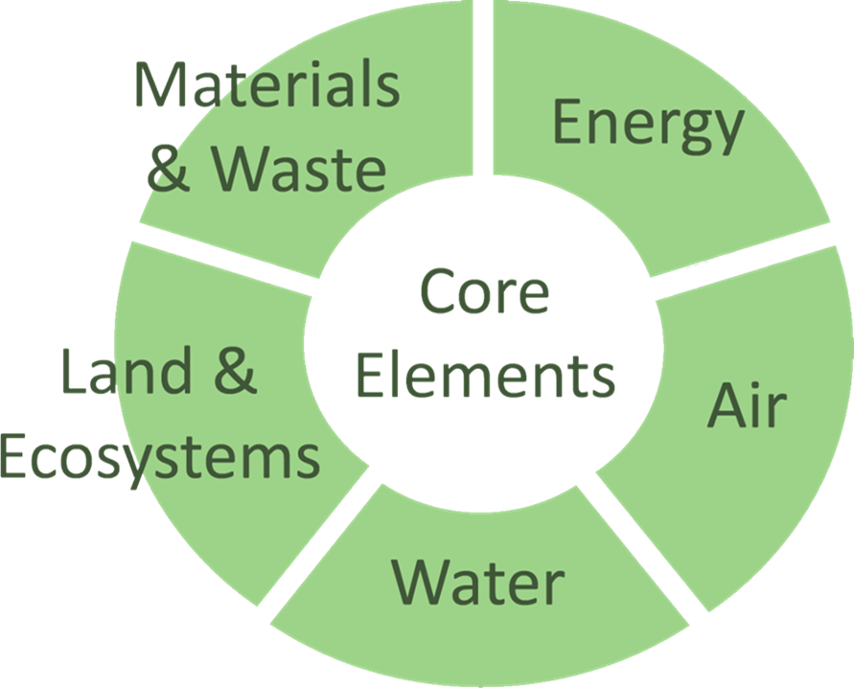
In Closing: At EPA cleanup programs we see greener cleanups as a means to build sustainable practices into our core mission: to protect human health and the environment
Thank You!!
www.epa.gov/greenercleanups

