Slide 1
Industry Perspective on Greener Cleanups PHARMACIA & UPJOHN COMPANY LLC Greener Cleanup Case Study
USEPA Clu-In Webinar
September 28, 2016

Slide 2
Presentation Outline
Approach to Sustainable, Greener Cleanup
Pharmacia & Upjohn Company LLC Site Site Background and Selected Remedy
CMI Greener Cleanup Design/Execution and Best Management Practices (BMPs)
Project Recognition – Greener Cleanup

Slide 3
Why Sustainable, Greener Cleanup?
Pfizer’s core value of “Respect for Society”
Communities want properties returned to beneficial use
Experience has shown that, given the option, communities are receptive to safe and sustainable solutions
Value Proposition:
Reduce environmental footprint
Increase social responsibility and community acceptance
Obtain regulatory acceptance
Reduce remedial construction and long-term costs
Gain economic benefit to the community
Achieve cleanup!

Slide 4
Some General Principles
Start with Conceptual Site Model and plan with end in mind
Identify and engage appropriate stakeholders early in the process
Consider environmental footprint and greener cleanup design through-out life cycle of investigation, remedy, and OM&M
To the extent possible, preserve and enhance the assets of the property and create opportunities for beneficial reuse
Seek opportunities to incorporate green remediation techniques in the design and implementation phase
Where appropriate, ensure future use is consistent with the site’s location in the community and in the environment

Slide 5
Pharmacia & Upjohn Company LLC Site North Haven, CT
Case Study
Site Background &
Selected Remedy

Slide 6
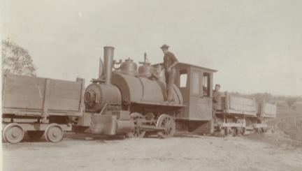
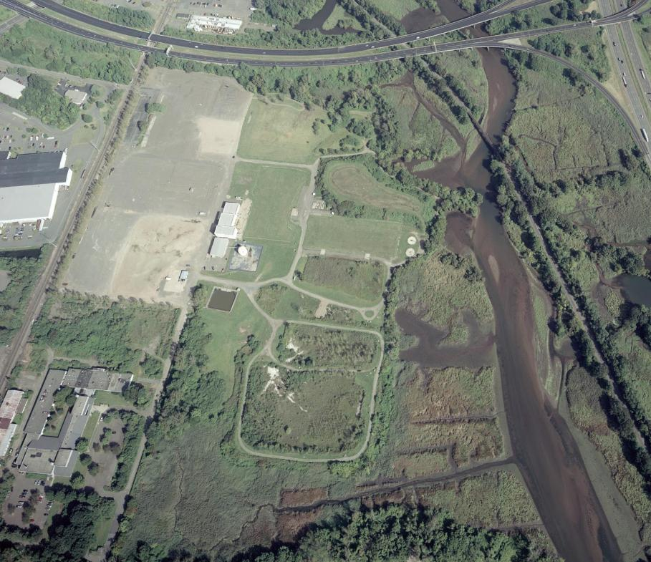
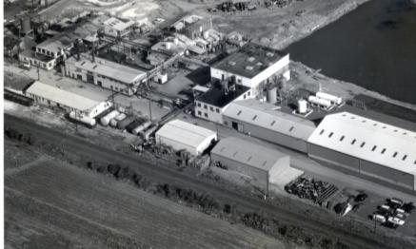
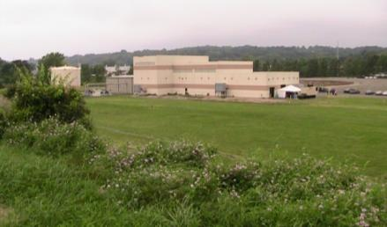
Pharmacia & Upjohn Company LLC Site
1800s - 1944
1948 - 1996
1998 - Present
Circa 2003
Notes:
How Pfizer became responsible for The Upjohn Company site.

Slide 7
Site Conditions – Post Operations
Primary Causes
140 year industrial history
Releases from aboveground / underground tank operations
Use of lagoons (former clay borrow pits) for wastewater treatment
Onsite stockpiling of wastewater treatment residuals/sludge
Resulting Site Conditions
Chemical impacts in soil, groundwater and adjacent title flat sediments
Constituents include broad range VOCs, SVOCs, PCB and metals
Areas with free phase organics (DNAPL) below water table
Large quantities of impacted waste water residuals/sludge
Shallow groundwater impacts across the Site
Limited impacts below aquitard
Regulatory Drivers
RCRA 3008(h) Corrective Action Order
CT Transfer Act

Slide 8
Greener Cleanup Design/Construction Considerations
Environmental footprint
Overall chemical mass removal (i.e. DNAPL area)
Impact/nuisances to the community
Remediation worker safety
Beneficial reuse of Site
Public support for remedy
Short term vs long term costs
Core elements for greener cleanup (defined by ASTM)
Energy
Air
Water
Land & Ecosystems
Materials & Waste

Slide 9
CMS Carbon Footprint Comparison Energy, Air, Water, Materials & Waste, Land Reuse

Slide 10
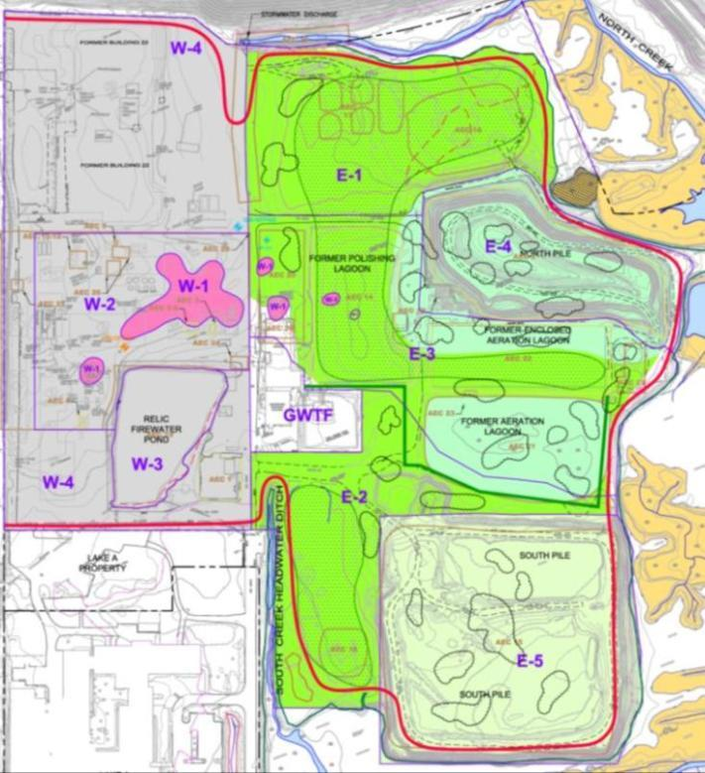
Key Components of EPA Approved Remedy
Groundwater control and treatment, long-term operations
East Side Components
Sediment removals, tidal wetlands mitigation
Eastern side consolidation, protective barriers, ecological enhancements
West Side Components
Thermal desorption to treat the most impacted area
Western side protective barrier
Notes:
The bullet in red will be discussed in this presentation.

Slide 11
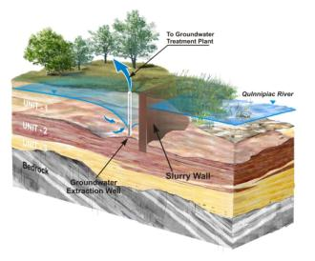
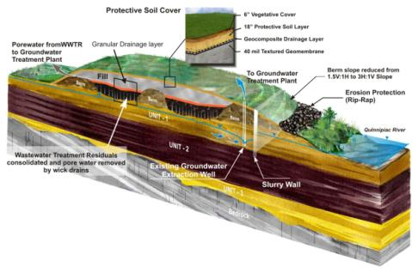
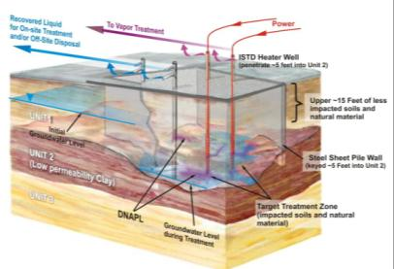
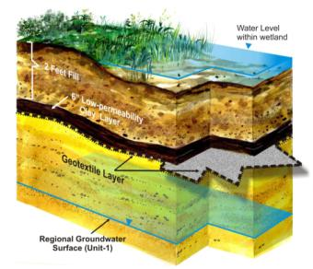
Key Components of CMS Selected Remedy
Hydraulic Containment with Barrier Wall and GW Treatment
Consolidation and Capping
In-Situ Thermal
Constructed Wetlands

Slide 12
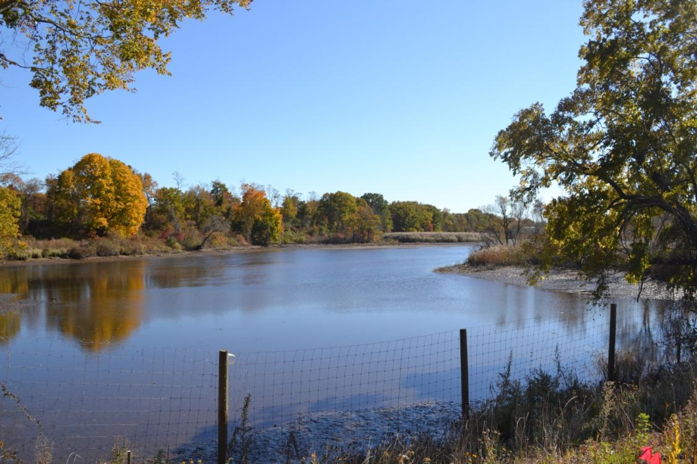
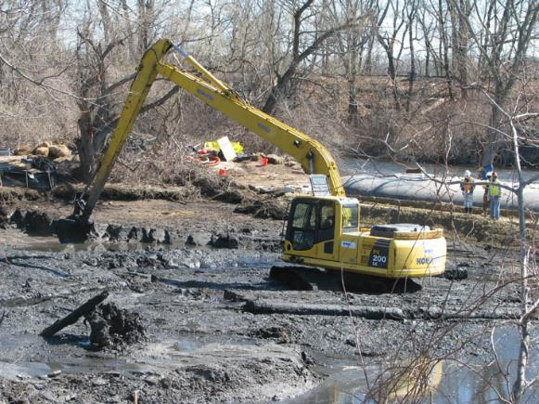
Sediment Removals Land & Ecosystems: Conserve, Protect & Restore
Sediment Removals
2013 - 2014
Tidal Wetland Mitigation
2014 - 2015

Slide 13
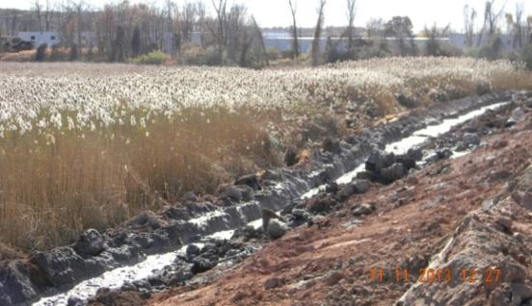
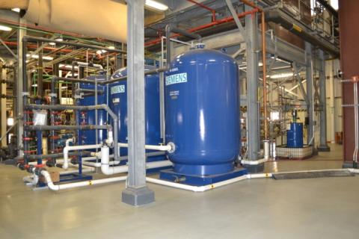
Groundwater Control Water: Improve Quality, Decrease Quantity of Use
Initial upgrades to existing Groundwater Treatment Facility
2012 - 2013
Installation of Perimeter Hydraulic Barrier Wall
2013
Expansion of Groundwater Extraction System
2013 - 2014
Final retrofit of existing GWT Facility
On-Going

Slide 14
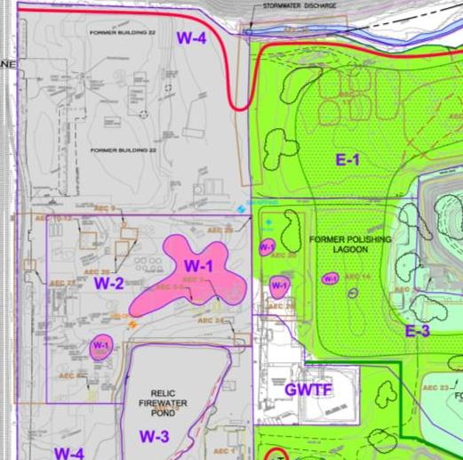
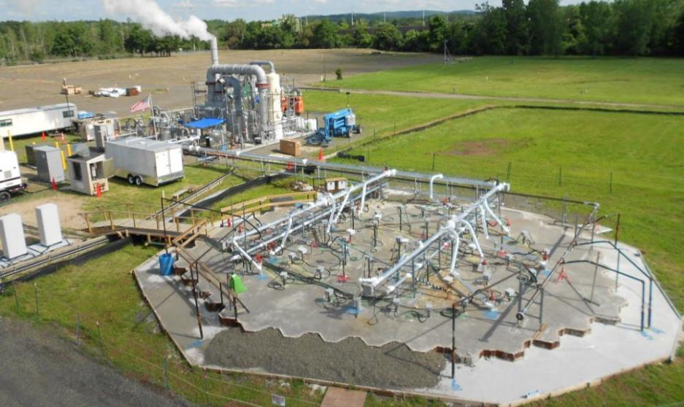
In-Situ Thermal Remediation of DNAPL Energy: Reduction, Efficiency and Renewables
Full-scale & Pilot-scale design, construction, operation, decommissioning
2014 – 2016
275,000 lbs removed
Dichlorobenzenes
PCBs

Slide 15
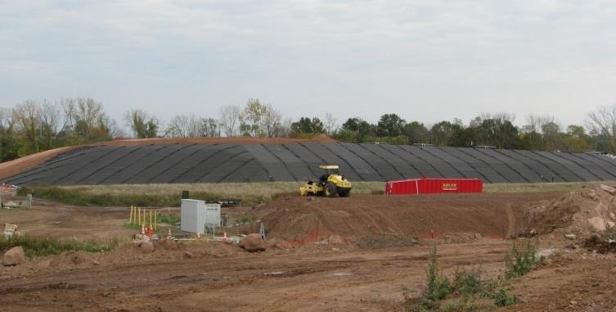
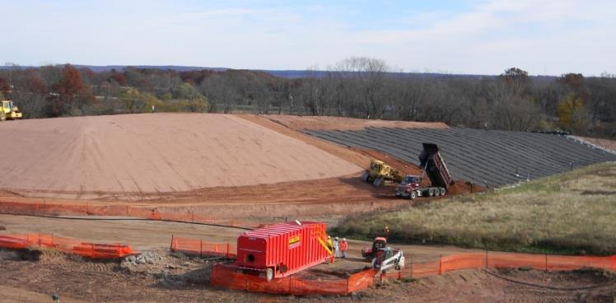
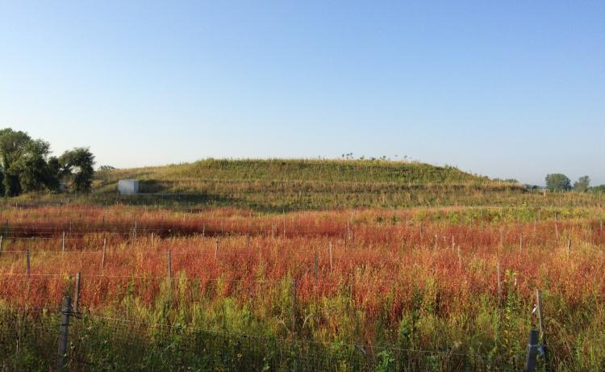
East Side Consolidation, Stabilization, Covers Materials & Waste: Minimize, Reuse, Recycle
Reuse of onsite soil for grading below caps thus reducing volume of imported fill material
2013
New cover system completed including final cover and planting
2014
North Pile

Slide 16
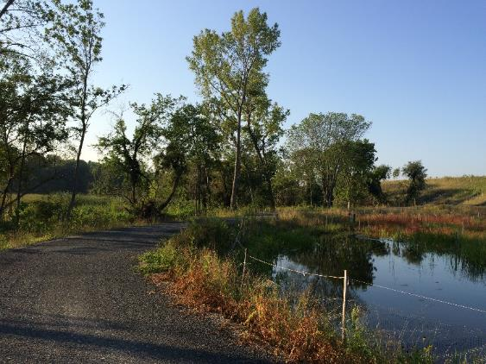
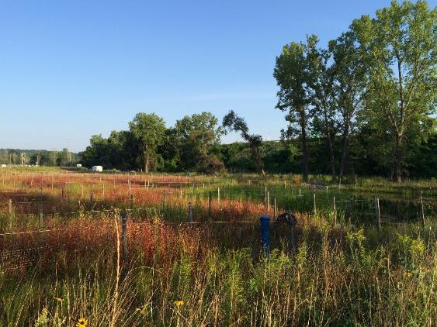
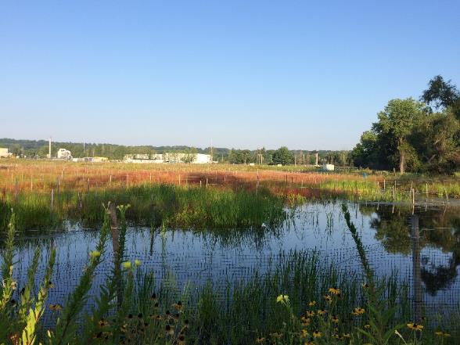
East Side Ecological Restoration Land & Ecosystems: Conserve, Protect & Restore
Ecological restoration and Tidal Wetland Mitigation
Creation of 6+ acres of new freshwater wetland habitat
Planting and subsequent monitoring / maintenance
2014 – On-going

Slide 17
Pharmacia & Upjohn Company LLC Site North Haven, CT
Case Study
CMI Sustainability and Greener Cleanup BMPs

Slide 18
Greener Cleanup Value-Added: Not Just Money Saved
The cost of Greener Cleanup is not only measured in dollars but also the comparative environmental footprint over the project life-cycle as well as the timeframe for return of the property to future beneficial reuse
The currency of added value or reduced costs must be viewed in terms of resources consumed and impacts to the environment, as well as dollars spent

Slide 19
Notable Green BMPs
Identified over 75 Green BMPs
Key environmental BMPs include:
Consolidation of over 80,000 cubic yards of “cut” material and drill cuttings under engineered caps, avoiding off-site disposal and importing fill
Reduction of groundwater extraction rates by 50% via use of subsurface cutoff wall and covers
Creation of 6+ acres of fresh water and tidal wetlands mitigation
Use of approximately 2,500 tons of blast furnace slag, a manufacturing byproduct, in hydraulic barrier wall construction
Use local labor, suppliers and labs when possible to reduce daily transportation
Key economic BMP
Local buying commitment
North Haven - 7% of project purchases to date
Within 25 miles – 44% of project purchases to date
State of CT – 58% of project purchases to date

Slide 20
Review of Green Remediation Cost Impacts for North Haven
Green Remediation Aspects | Cost Impacts
Use of local labor resources (where feasible) | Cost neutral since this was included in contract terms at the beginning of the contract
Use of recycled material in hydraulic barrier wall mix design | Unit cost comparable to other reagents – Change in mix design resulted in project cost change
Hydraulic barrier wall at toe of slope | Resulted in reduction of HBW mix and elimination of a MSE wall
Low permeability cover system with storm water directed to BMP/wetland restoration area | Results in 50% reduction in groundwater treatment flows due to reduced storm water infiltration (treatment plant operational savings)
In-Situ Thermal Remediation (ISTR) | ISTR costs offset by cost avoidance (savings) for need of DNAPL waste incineration at Port Arthur, TX
Consolidation of on-site material for cover system sub-grade | Reduced amount of clean fill import that was needed by 80,000 cu yds

Slide 21
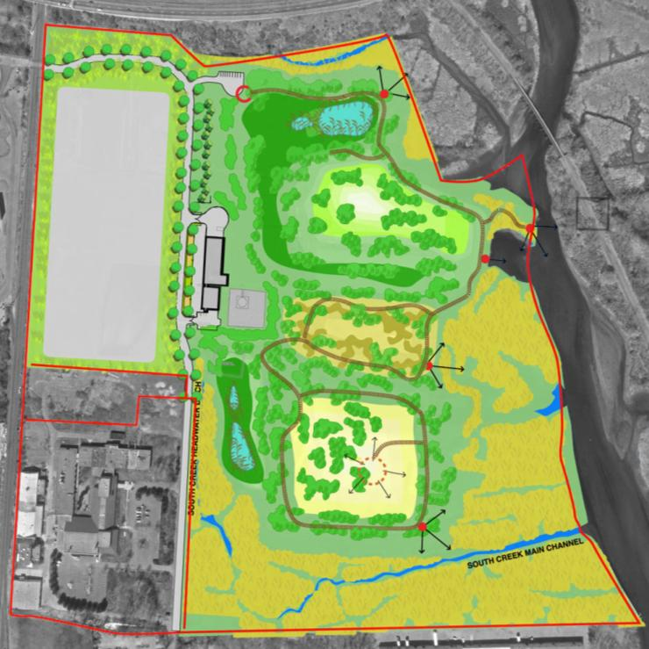
Sustainability in Reuse Plan
Land & Ecosystems: Conserve, Protect & Restore
60 acre ecological restoration
Re-established lost habitat
Creation of on-site wetlands
Selected re-vegetation requires minimal mowing
Controlled public access
17-acres designated for economic development
On-going

Slide 22
Pharmacia & Upjohn Company LLC Site North Haven, CT
Case Study
Project Recognition
Greener Cleanup

Slide 23
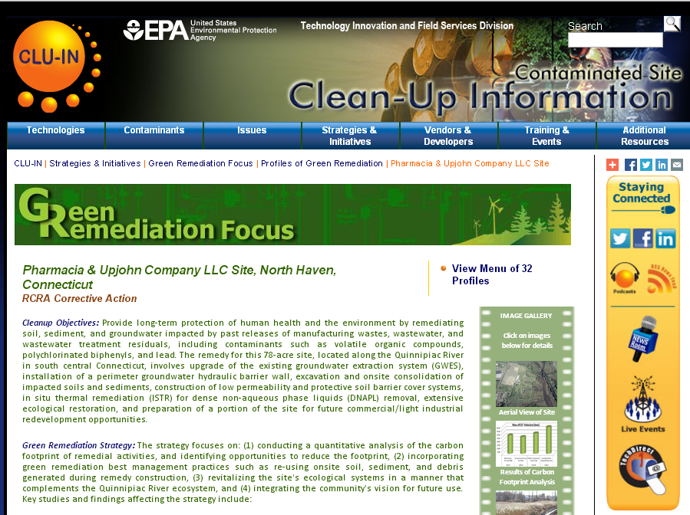
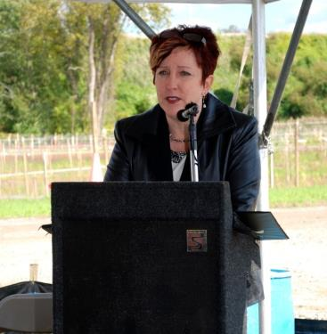
EPA Recognition of Achievements

Slide 24
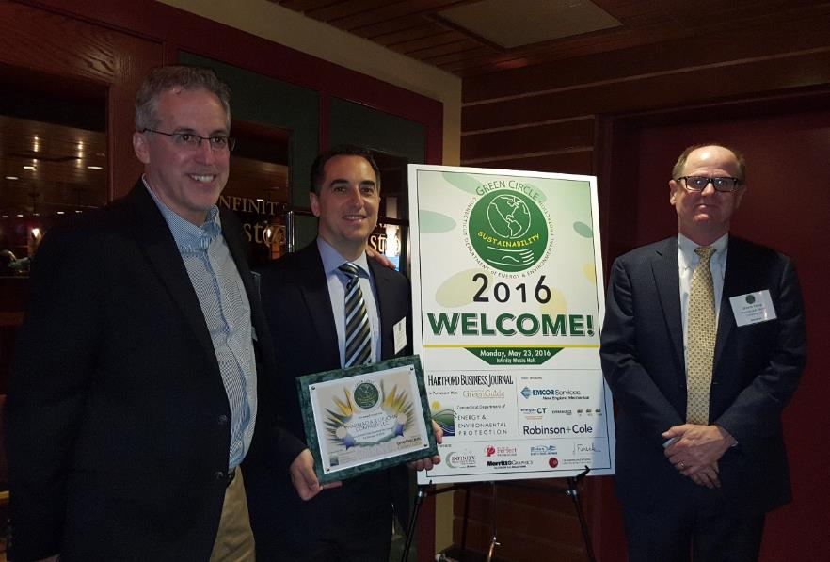
CT DEEP Green Circle Sustainability Award
Project recognized for its sustainability and green remediation initiatives
Green Circle award presented by CT DEEP Commissioner and USEPA Regional 1 Administrator
Project recognized for its sustainability and green remediation initiatives
One of 59 final nominees
One of 15 award winners
One of 4 businesses recognized
Notes:
The bullet in red will be discussed in this presentation.

