Slide 1



Oak Ridge Environmental Information System: No Longer Just a Database
PRESENTED BY
PETER a. Salpas, Ph.d., salpas consulting, Inc.
with
Patricia J. Halsey, U.S. Department of Energy
Deidre tharpe, restoration services, inc.
Phillip A. Clark, Restoration Services, Inc.
Larry Lewis, restoration services, inc.

Slide 2
Road Map
Oak ridge reservation
Oak Ridge Environmental Information System
Database reconfigurations
Database examples
Geospatial data
conclusions

Slide 3
Oak Ridge Reservation
(ORR)
Introduction and history
Location and history
Complexity of the orr in terms of the comprehensive environmental Response, compensation, and Liability act (CERCLA)

Slide 4
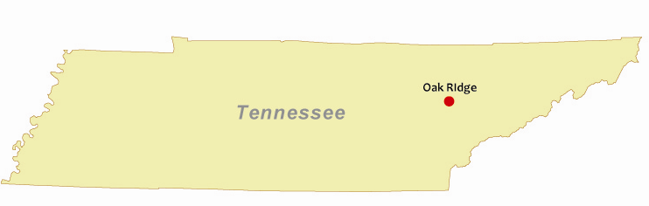
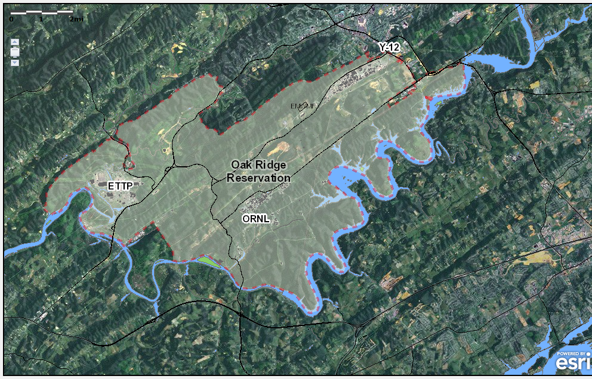
  ORR
  33,500 acres of land in East Tennessee
  East Tennessee Technology Park (ETTP)
  Oak Ridge National Laboratory (ORNL)
  Y-12 National Security Complex (Y-12)
  Surrounding land areas within the Department of Energy’s (DOE’s) administrative boundaries
  Put on Comprehensive Environmental Response, Compensation, and Liability Act’s (CERCLA’s) National Priority List (NPL) in 1989

Slide 5
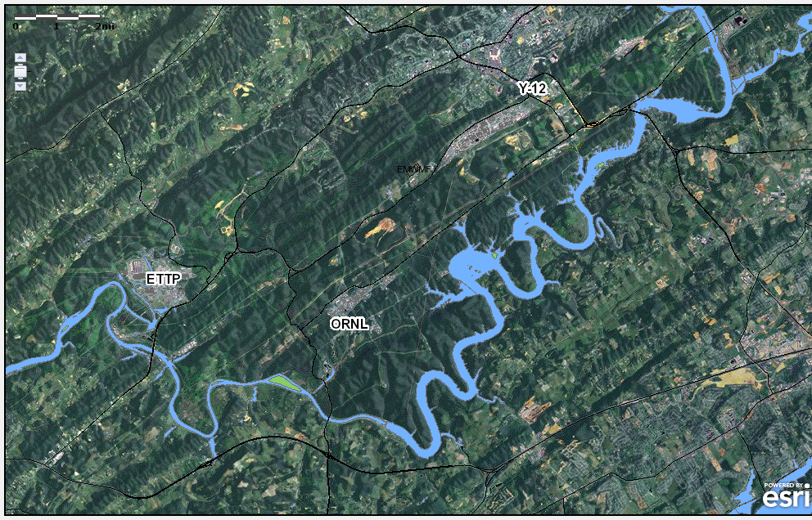
  Complexity of ORR → Interim Watershed Records of Decision (RODs) for Source Remediation to Reduce Risk and Protect Groundwater
  Valley and ridge
  Folding, faulting, karst
  Different site missions → different contaminant suites
  Proximity to population centers
  Proximity to water bodies
City | Population | Distance from ORR (miles)
Oak Ridge | 26,000 | adjacent
Knoxville | 179,000 | 10
Oliver Springs | 2,200 | 1.5
Farragut | 21,000 | 2
Kingston | 5,900 | 5

Slide 6
Oak Ridge Environmental Information System
(OREIS)
History and evolution
OREIS background
OREIS Spatial Query Tool
Changing role of oreis
Oreis enhancements

Slide 7
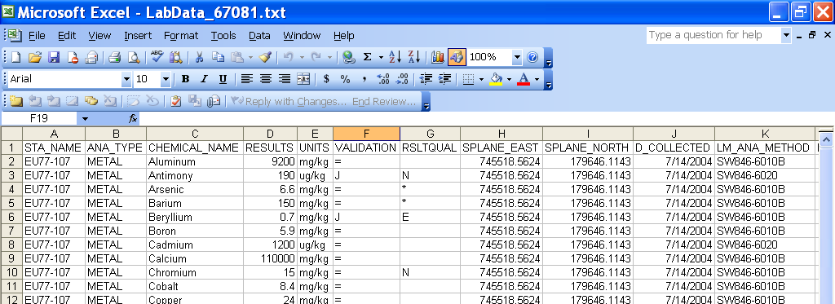
OREIS Background
Federal Facility Agreement for ORR (1992) requires an environmental database
OREIS – ORR database for storing and retrieving environmental characterization data
Database is integrated with a geographic information system (GIS) map to provide visual representation of data
Over 14 million data records currently stored in OREIS

Slide 8
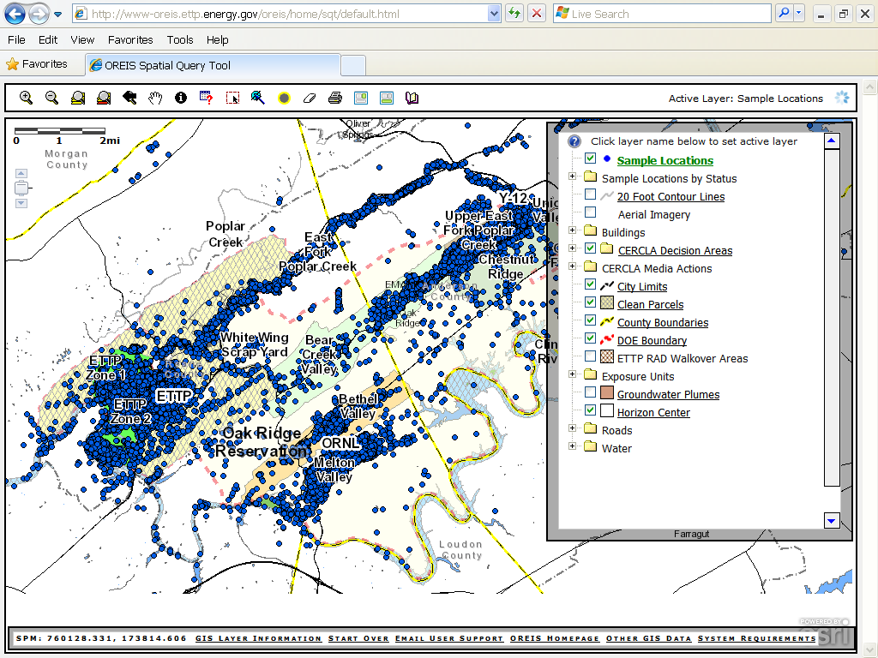
OREIS Spatial Query Tool (SQT)
Data Queries
Identify tool
Query tool
Geospatial data
Map layer list

Slide 9
The Changing Role of OREIS
OREIS should support the future user’s ability to visualize, obtain, and manage data in order to:
  Document the history of the ORR under CERCLA
  Understand risk-based decisions made under the watershed Interim RODs
  Identify post-remediation conditions
  Support future ecological, surface water, and groundwater final decisions
  Document permit compliance

Slide 10
OREIS Enhancements for the Future User
New fields have been added to the OREIS database and new map layers added to the GIS map to support the future user’s needs
Database Fields | GIS Map Layers
Documents
Exposure Units | Exposure Units
Sample Status | Sample Status
 | Buildings
 | Media Actions
 | CERCLA Decision Areas
 | Clean Parcels
 | Groundwater Plumes

Slide 11
Database Reconfigurations
New field Descriptions
Documents
Exposure units
Sample status

Slide 12
Documents
Database Fields | GIS Map Layers
Documents
Exposure Units | Exposure Units
Sample Status | Sample Status
Documents provide the rationale for decisions that have been made
Data records in the database are associated with the document(s) referencing the data
Document names in OREIS are hot-linked to electronic document files in the DOE Information Center
A document map layer is impractical because of the large number of documents

Slide 13
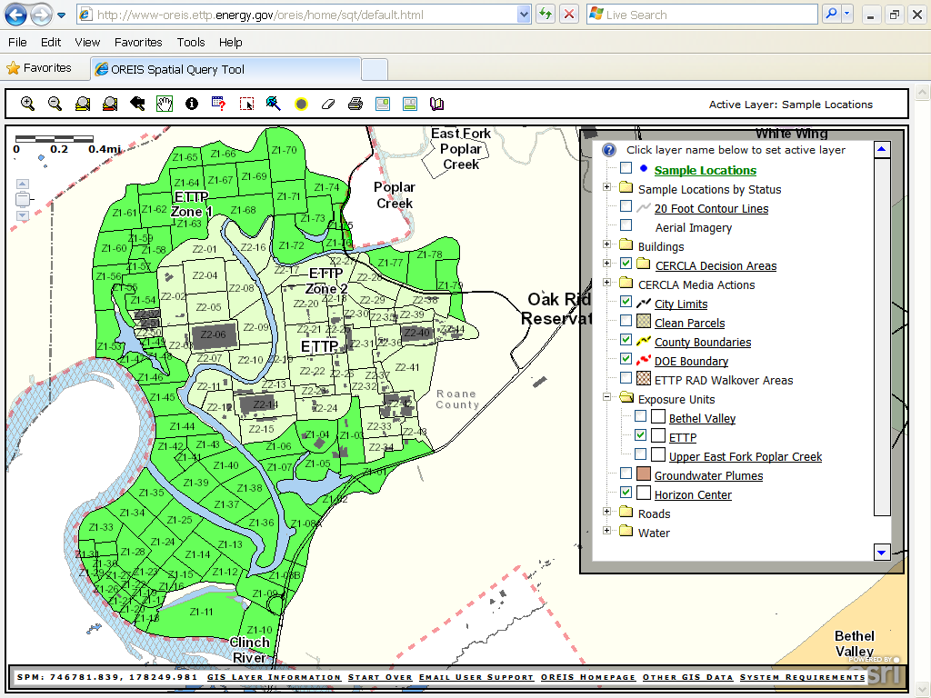
Exposure Units
Database Fields | GIS Map Layers
Documents
Exposure Units | Exposure Units
Sample Status | Sample Status
Areas over which risk to a hypothetical receptor is calculated
Action/no action decisions made on exposure units
Exposure units are defined in 3 Interim RODs
Each data record in the database includes the associated exposure unit when applicable
Exposure unit layer added to GIS map
ETTP Exposure Units

Slide 14
Sample Status
Database Fields | GIS Map Layers
Documents
Exposure Units | Exposure Units
Sample Status | Sample Status
Refers to the status under an Interim ROD
Four status codes
Each data record in the database contains a sample status code
Sample status layer added to GIS map
Sample Status Codes
EX – remediated by excavation
IP – remediated in place by an in situ action such as capping, grouting, etc.
NAR – no action required under an Interim ROD
ND – no decision under an interim ROD

Slide 15
Database Examples
Querying the new database fields with the query and identify tools
Documents query
Exposure unit query
Sample status query
Identify tool – documents and sample status
New fields Data download

Slide 16
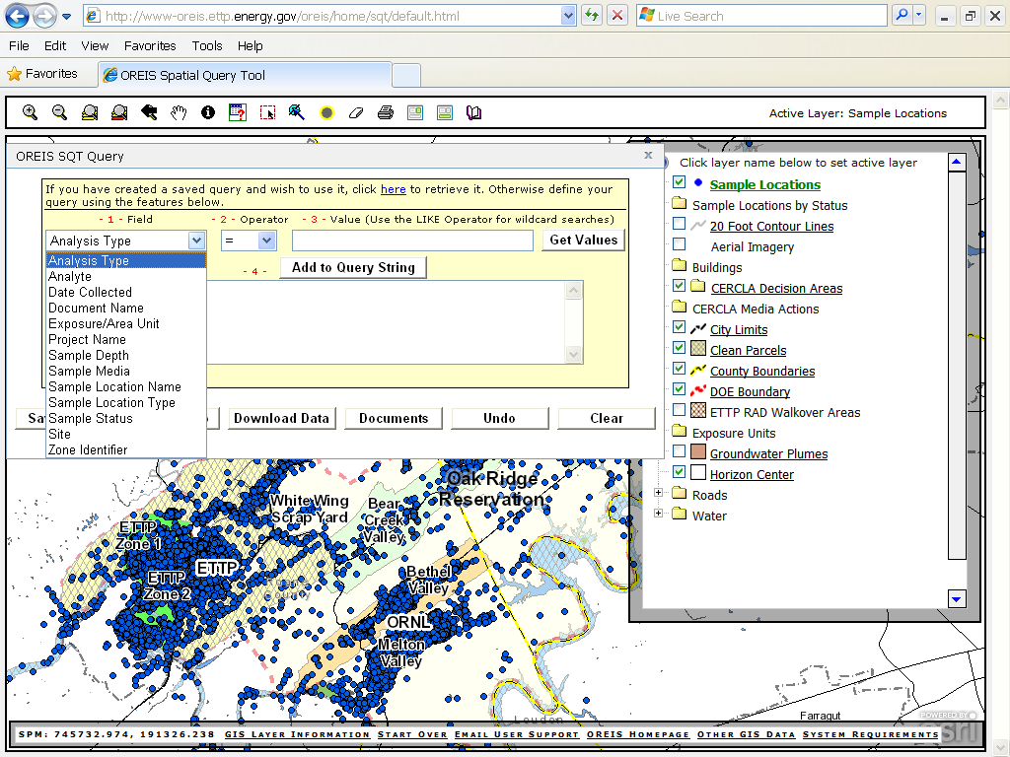
Querying the Database with the OREIS SQT Query Tool
The Query Tool allows querying of several fields in the database including:
Documents
Exposure unit
Sample status

Slide 17
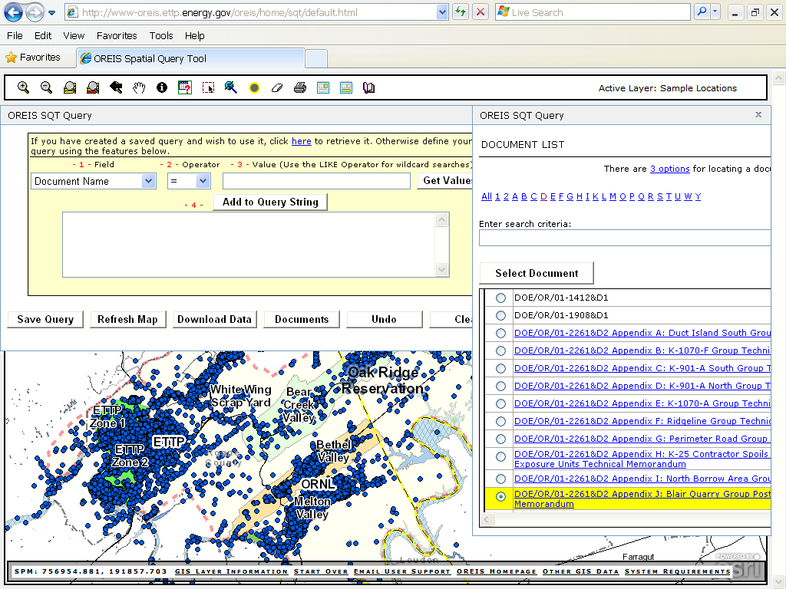
Query Tool – Building a Query

Slide 18
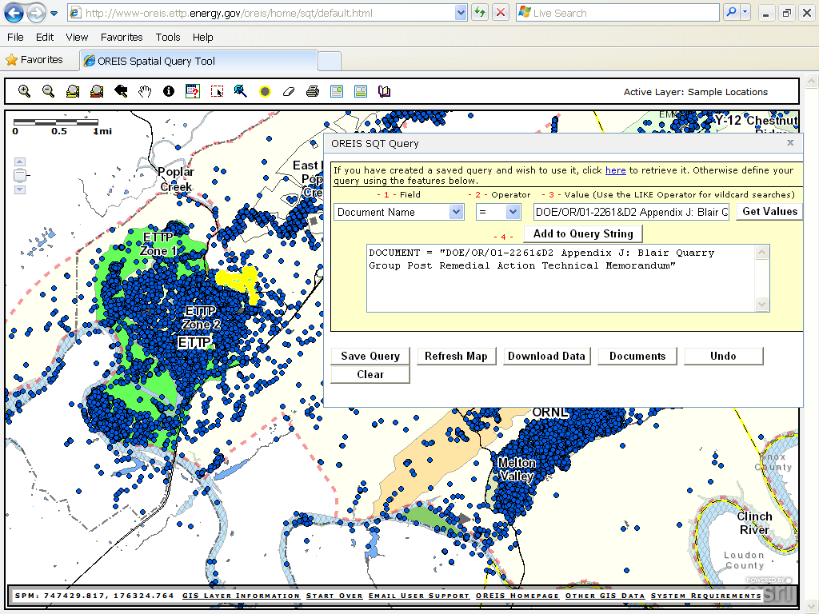
Query Tool - Document Query
Database Fields | GIS Map Layers
Documents
Exposure Units | Exposure Units
Sample Status | Sample Status

Slide 19
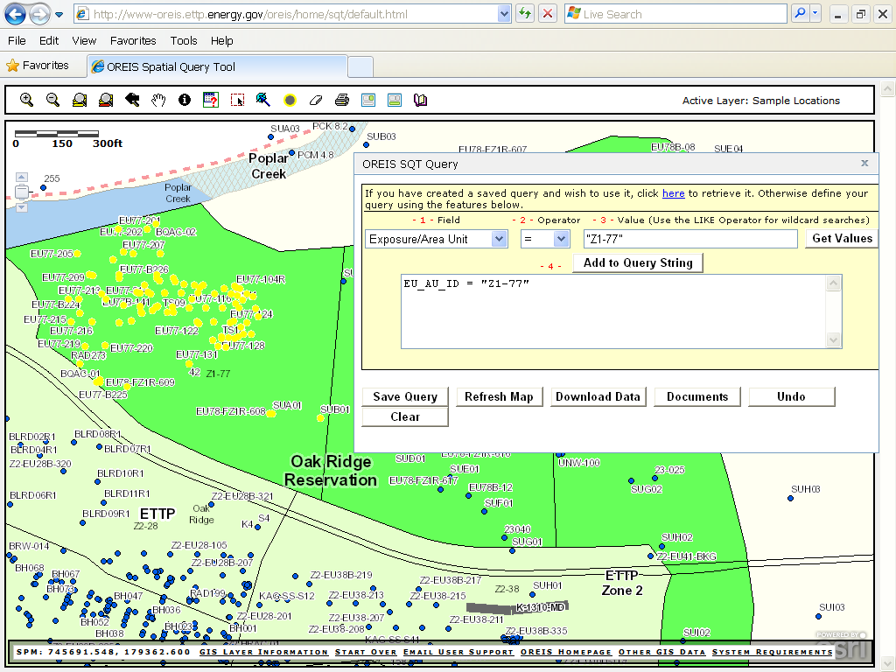
Query Tool – Exposure Unit Query
Database Fields | GIS Map Layers
Documents
Exposure Units | Exposure Units
Sample Status | Sample Status

Slide 20
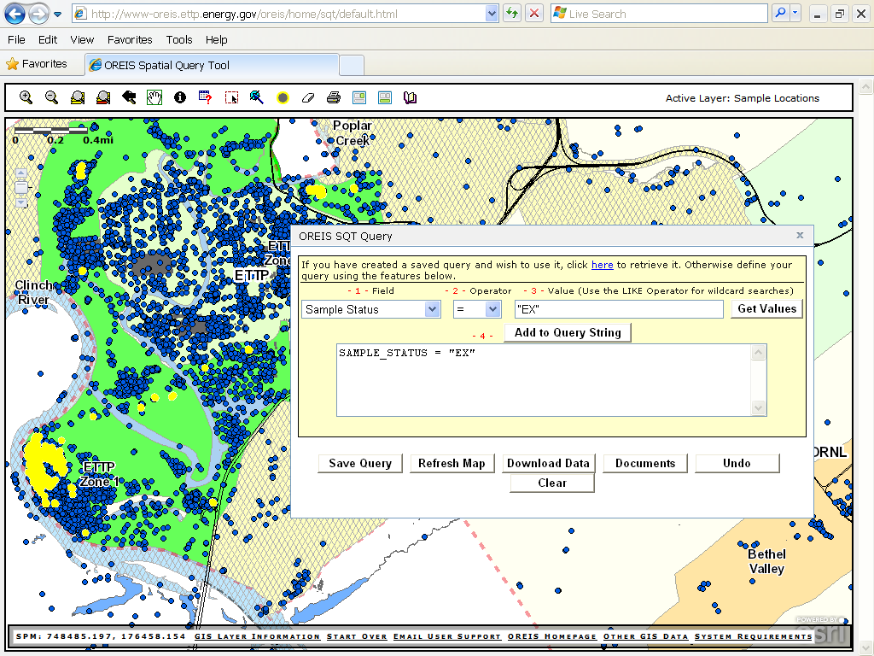
Query Tool – Sample Status Query
Database Fields | GIS Map Layers
Documents
Exposure Units | Exposure Units
Sample Status | Sample Status

Slide 21
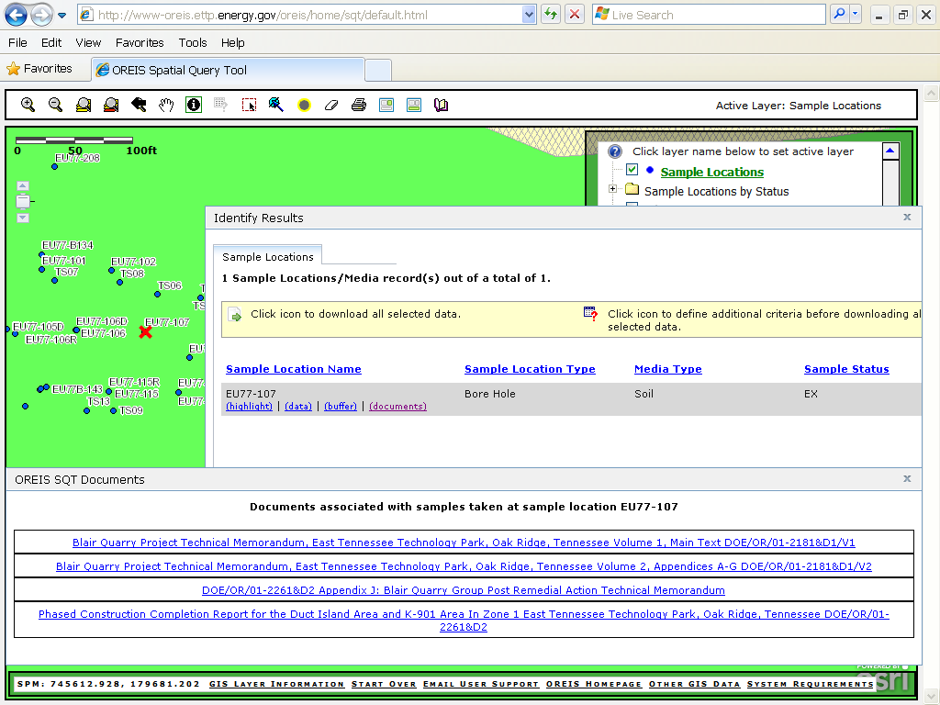
Identify Tool – Documents and Sample Status

Slide 22
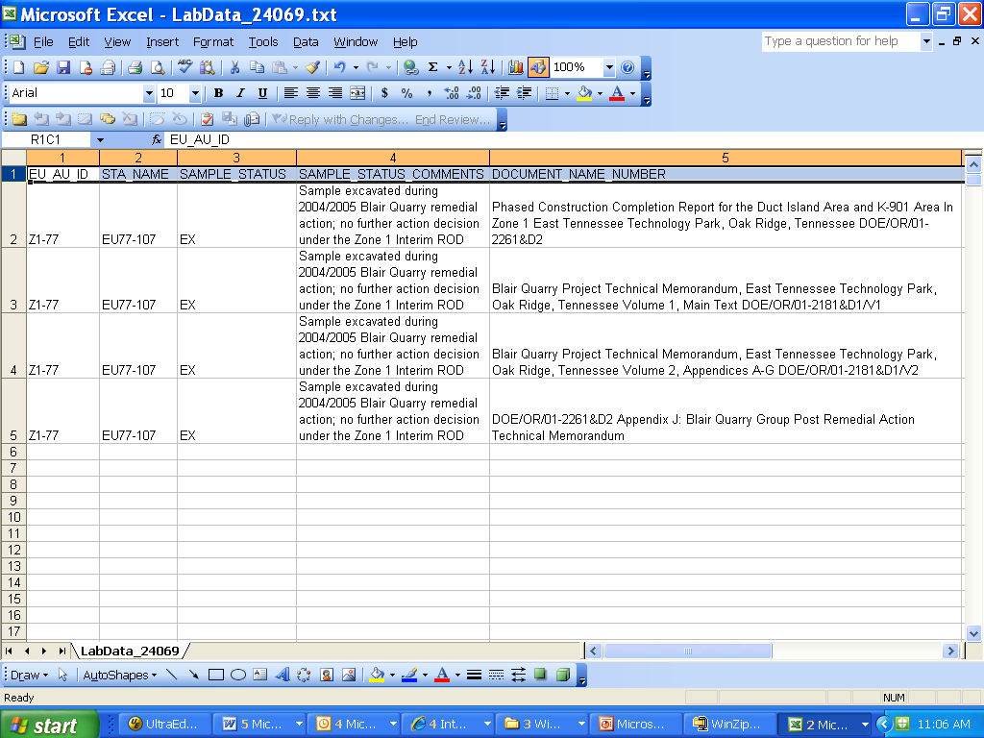
Query Tool – New Fields Data Download

Slide 23
Geospatial Data
New map layers
Descriptions
Exposure units example
Sample status example
Other map layer examples
Environmental media actions example

Slide 24
New Map Layer Descriptions
Database Fields | GIS Map Layers
Exposure Units | Exposure Units
Sample Status | Sample Status
Exposure Units ✓
Sample Status ✓
Buildings
  Existing
  Building demolished to slab
  Building and slab demolished
Media Actions – actions taken on environmental and non-environmental media
CERCLA Decision Areas – areas included in an Interim ROD
Clean Parcels – areas determined to have never been on the NPL
Groundwater Plumes – areas of subsurface groundwater contamination

Slide 25
Geospatial Data - Exposure Units
Database Fields | GIS Map Layers
Documents
Exposure Units | Exposure Units
Sample Status | Sample Status

Slide 26
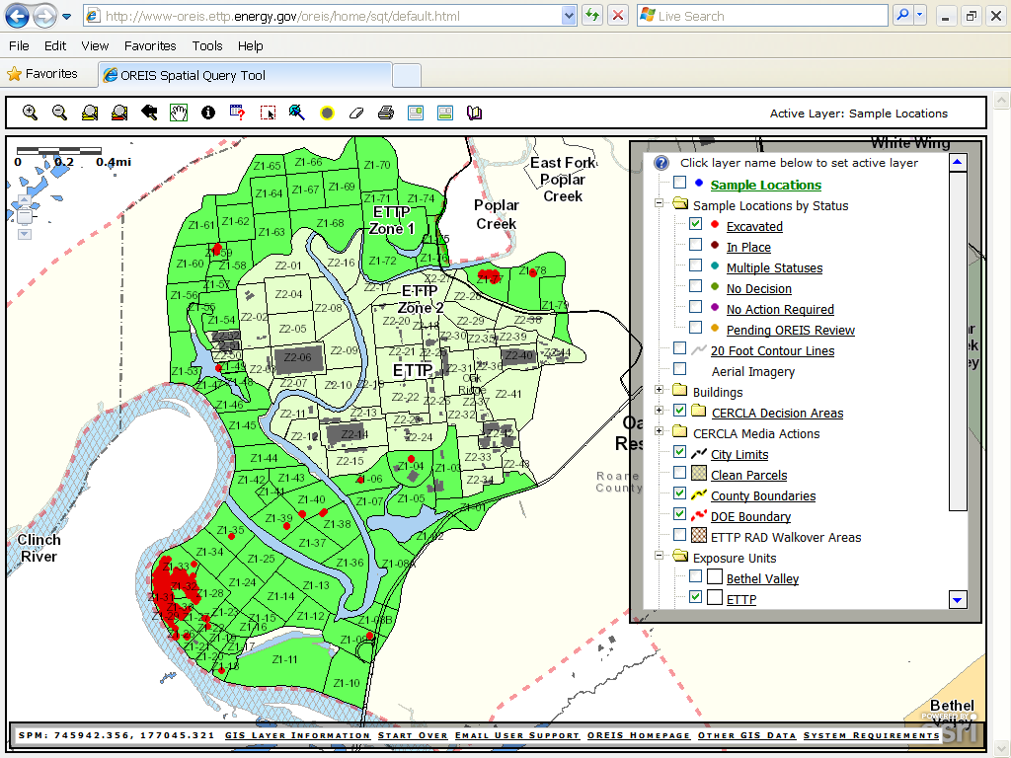
Geospatial Data – Sample Status
Database Fields | GIS Map Layers
Documents
Exposure Units | Exposure Units
Sample Status | Sample Status

Slide 27
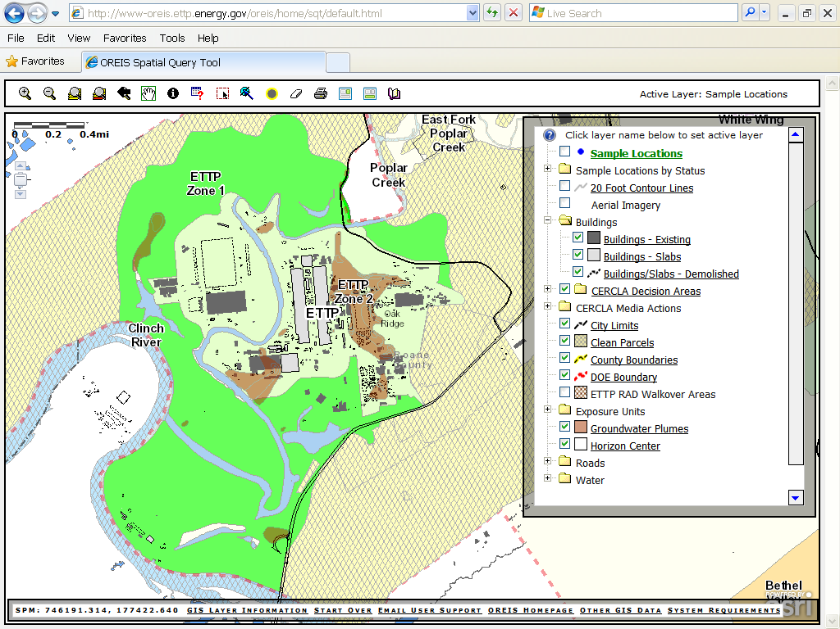
Other Geospatial Data

Slide 28
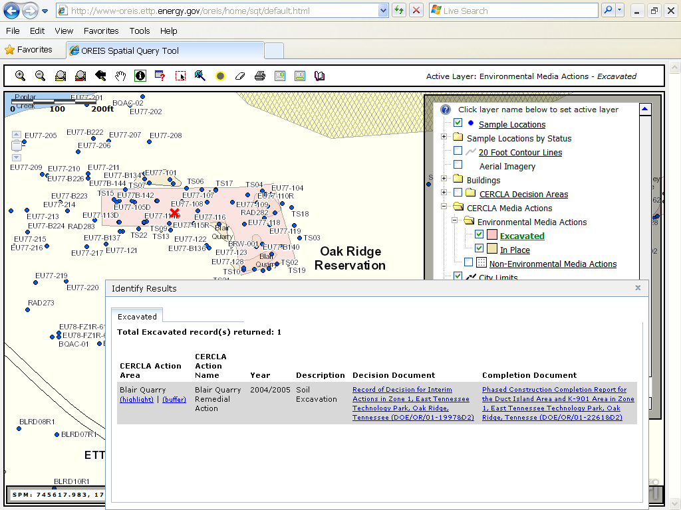
Geospatial Data – Environmental Media Actions

Slide 29
Conclusions
The complexity of the ORR has led to watershed Interim RODs to manage risk to the industrial worker and protect groundwater
OREIS has been the database for storing and retrieving the data that support the Interim RODs
OREIS has been reconfigured to support the user’s needs to understand risk management decisions that have been made and to access the data necessary to make future decisions
To obtain information on OREIS and/or to obtain a userid and password, contact OREIS Support at oreis@ettp.doe.gov

