Slide 1

Columbia University Superfund Research Program Online Mapping Project
NPL Superfund Footprint:
Site, Population, and Environmental Characteristics
GIS Tools for Hazardous Site Tracking
Risk e Learning Web Seminar Series
6 December 2013
Presentation by Meredith Golden and Tricia Chai-Onn
Columbia University SRP Research Translation Core
Funding from the NIEHS Superfund Research Program Supplemental Grant for the Columbia University Superfund Research Program on the Health Effects and Geochemistry of Arsenic and Manganese (NIEHS 3 P42 ES010349-10)

Slide 2
Overview
Superfund background
Why GIS for Superfund Site monitoring?
Columbia University Superfund Research Program online mapping project
How to use the Columbia SRP NPL Superfund Footprint Mapper
Brief comparison of selected interactive maps
Conclusion

Slide 3
Superfund: Prioritizing Clean-ups, Protecting Human Health, and Providing for Citizen Participation
Comprehensive Environmental Response, Compensation and Liability Act (CERCLA or Superfund) Law, 11 December 1980
  CERCLA Authorizes EPA and its partners to address abandoned, accidentally spilled, and illegally dumped hazardous wastes that pose current or future threats to human health or the environment
National Priorities List (NPL), created in 1983
  Classifies nation’s hazardous waste sites and sets priorities for cleanup under Superfund. Only sites on the NPL may qualify for long-term remedial actions financed by the Superfund. The NPL most recent update 31 Oct 2013: 1313 Final NPL sites, 372 deleted, 54 proposed
Superfund Amendments & Reauthorization Act (SARA), enacted
Oct 17, 1986
  SARA increases the focus on human health problems posed by hazardous waste sites;
  Encourages greater citizen participation in making decisions on how sites should be cleaned up

Slide 4
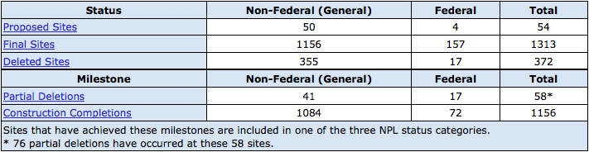
Number of Federal and General NPL sites as of October 31, 2013

Slide 5
Key Administration of the EPA Superfund Program
EPA Office of Solid Waste and Emergency Response
(OSWER)
Office of Superfund Remediation and Technology Innovation (OSRTI)
  Responsible for long-term management of Superfund program
Office of Emergency Management
  Responsible for short term responses conducted under the authority of Superfund
Federal Facilities Response and Reuse Office (FFRRO)
  Responsible for the long-term Superfund response program at federal sites; interfaces with federal agencies such as DOE and DOD

Slide 6
Additional EPA Superfund Responsibilities
EPA Office of Enforcement and Compliance Assurance (OECA),
Office of Site Remediation and Enforcement (OSRE)
  Enforcement of Superfund
EPA Office of Research and Development (ORD)
  Conducts research on contaminants and technologies to aid in cleanup decisions
EPA Office of Regional Operations
  Links to State and Tribal organization Superfund sites
EPA Regional Offices
  Links to State programs on specific sites

Slide 7
EPA Superfund Partners
Agency for Toxic Substances and Disease Registry (ATSDR)
  Conducts health assessments of Superfund Sites and maintains toxicological profiles of many contaminants found at Superfund Sites
US Army Corps of Engineers (US ACE)
  Conducts much of the construction and oversight of the EPA Superfund cleanups
National Institute of Environmental Health Sciences (NIEHS):
Superfund Research Program (SRP)
  Conducts research on health effects of hazardous substances that are part of Superfund assessment and cleanup decisions

Slide 8
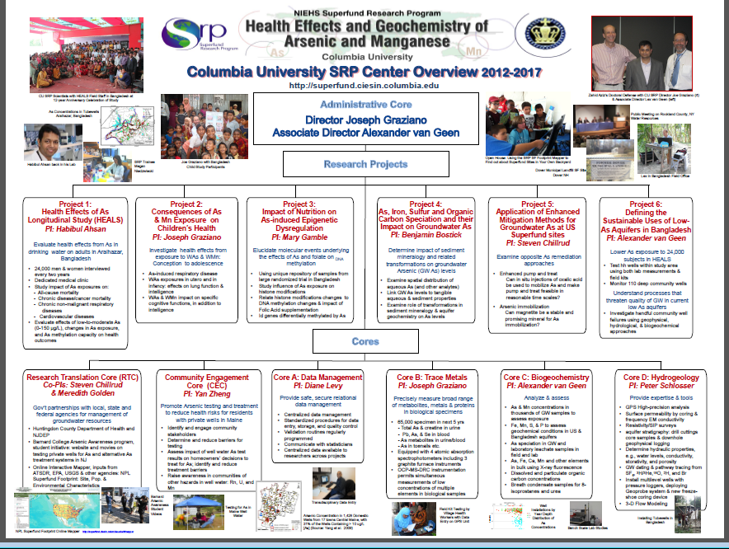

Slide 9
Other Agencies and Stakeholders
US Department of Health and Human Services
US Department of Energy (DOE)
US Department of Defense (DOD)
US Department of Homeland Security (DHS), Federal Emergency Management Program (FEMA) and the United States Coast Guard (USCG)
US Geological Survey (USGS)
US Department of Housing and Urban Development (HUD)
State Departments of Health and the Environment
US National Library of Medicine (NLM)
Principle Responsible Parties
Academic Researchers
Community Groups
Public

Slide 10
SUPERFUND DATA
Comprehensive Environmental Response, Compensation, and Liability Information System (CERCLIS) database in Envirofacts. CERCLIS Search permits the retrieval of SF data via any combination of facility name and/or geographic location.
It links to the Superfund Site Profiles.
(The Superfund Program is in the process of deploying a new information system, the Superfund Enterprise Management System (SEMS) which is replacing CERCLIS. CERCLIS was frozen as of November 12, 2013. Updated data will become available in early 2014 when SEMS is fully operational.)
Agency for Toxic Substances and Disease Registry (ATSDR) Toxicological Profiles - By Congressional mandate, ATSDR produces "toxicological profiles" for hazardous substances found at Superfund sites
Integrated Risk Information System (IRIS) - The Integrated Risk Information System (IRIS) is an electronic data base containing information on human health effects that may result from exposure to various chemicals in the environment
ATSDR ToxFAQs - The ATSDR ToxFAQsTM is a series of summaries about hazardous substances. Information for this series is excerpted from the ATSDR Toxicological Profiles and Public Health Statements

Slide 11
So many sites, so much data and so many stakeholders
How to support Superfund’s goals:
Prioritize Clean-ups, Protect Human Health, and Provide for Citizen Participation?

Slide 12
GIS for Complicated Environmental Health Issues
Ability to sort and integrate records from multiple sources into a “more coherent whole”
Access to “new types of data…use GPS to receive signals from satellites to determine latitude and longitude coordinates for point location”
Part of the “toolkits of epidemiology and health services research, e.g., for exploratory analysis in response to community concern”
“Compared to tables and charts… extremely effective tools to help community decision makers visualize and understand a public health problem”
Richards TB, et al. Geographic information systems and public health: mapping the future. Public Health Reports 1999;114:359-373.

Slide 13
Why did the Columbia SRP create an online interactive mapping service focused on Superfund sites?
Quick visualization of potential hotspots
Easy access to data on NPL sites, multiple hazardous exposures, and vulnerable pops.
Adjustable scale: National, Regional, Local
Help researchers, health practitioners, regulators, and community groups identify multiple hazardous exposures & health concerns
Existing online mapping tools only used points, not polygons, to demarcate the location of NPL Superfund sites
Existing online mappers that include NPL Superfund sites do not use gridded population data

Slide 14
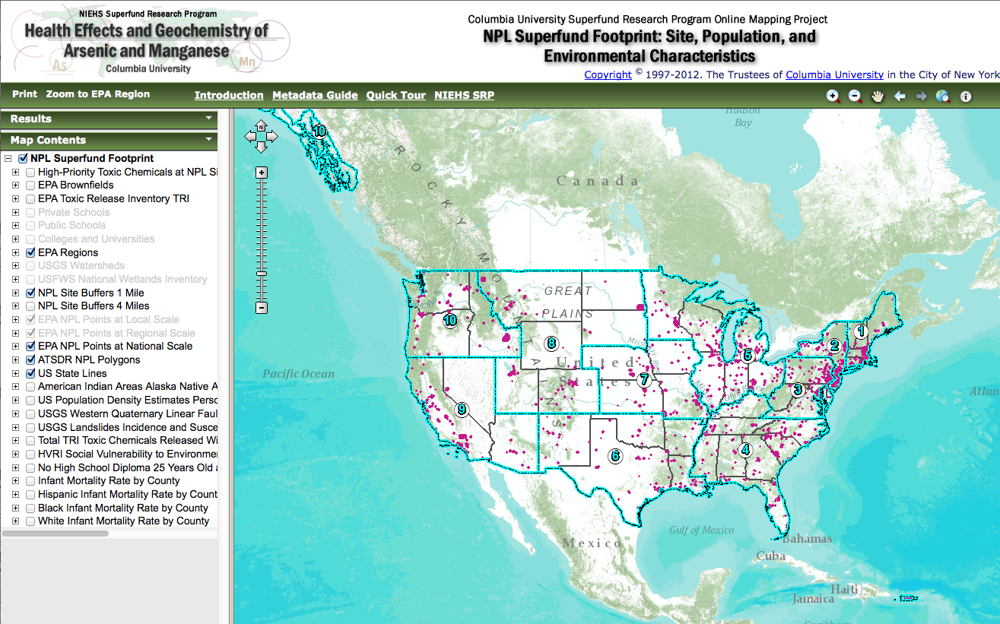
NPL Superfund Footprint Mapper http://superfund.ciesin.columbia.edu/sfmapper

Slide 15
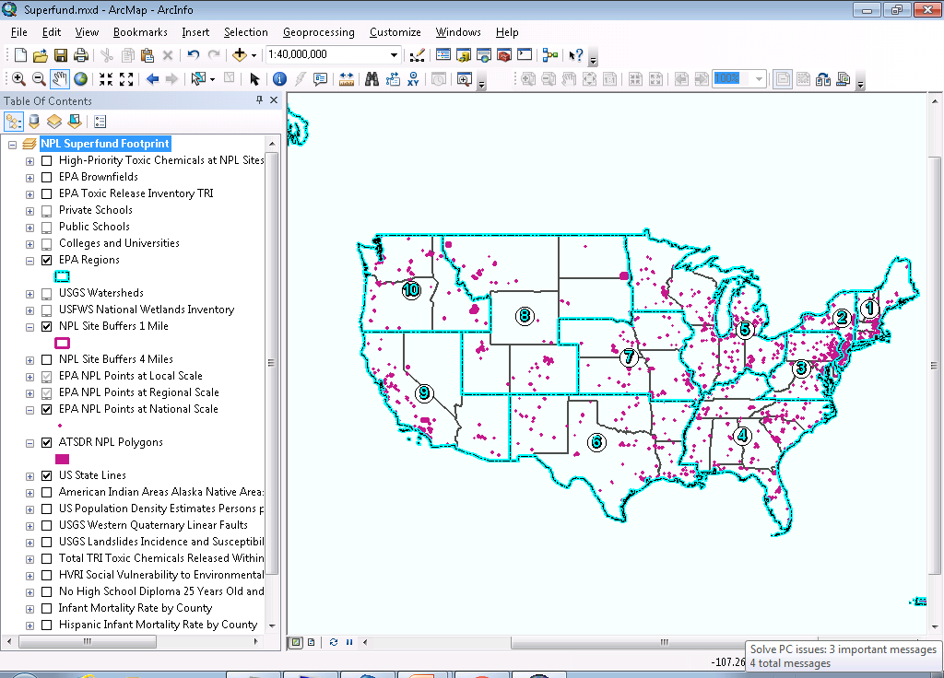
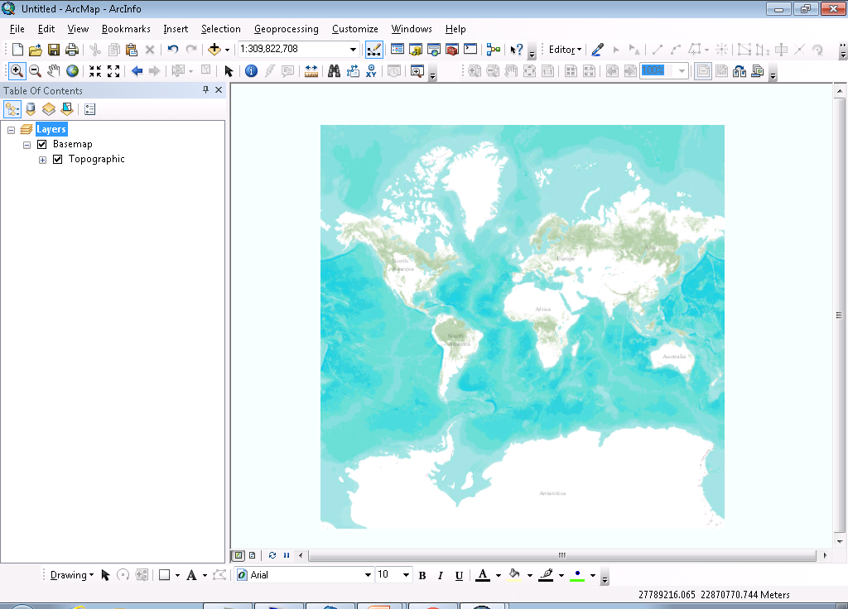
How does the SF Footprint Mapper work?
Esri Web Application Development Framework (WebADF)
Integration of Data Layers
ArcGIS map document published
ArcGIS Online Topographic Base Map Service

Slide 16
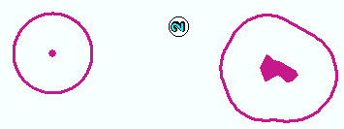
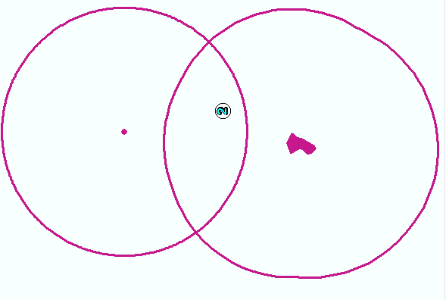
How does the SF Footprint Mapper work?
Creating 1 and 4 mile Buffers
1 mi.
1 mi.
4 mi.
4 mi.

Slide 17
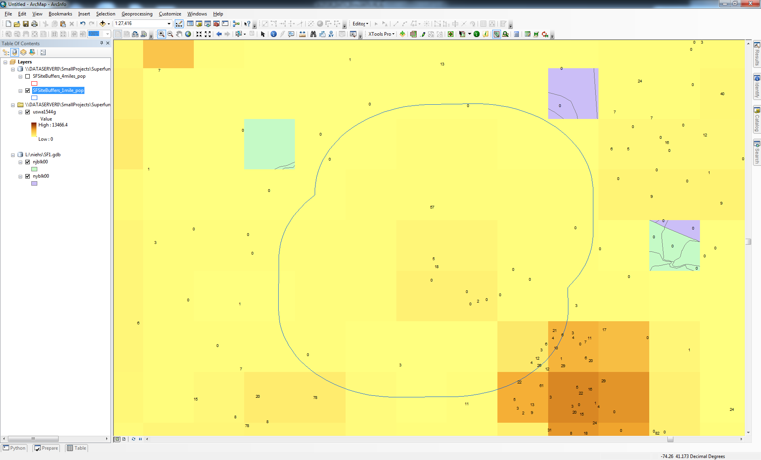
How does the SF Footprint Mapper work?
Algorithms for calculating demographic characteristics within buffers (US Census Grids)

Slide 18
What does the SF Footprint Mapper show?
Polygons with actual Superfund site footprints (not just centroid points)
Thirty socio-economic characteristics of populations within 1 and 4 miles buffers of site boundaries
Public/private secondary schools & colleges with names & # of students
Other potential hazards: Brownfields, TRI, high-priority chemicals, fault lines, landslide areas
Population densities (gridded) and county data for infant mortality rates by race, percentage over 25 with no hs diploma, SoVI (social vulnerability to environmental hazards index)
Vulnerable resources: watersheds and wetlands
Polygons of American Indian Areas, Alaska Native Areas, and Hawaiian Home Land Populations

Slide 19
How to use the SF Footprint Mapper?
User guides and links to other resources
Legend embedded in Map Contents menu
Metadata available for each data layer
Multiple Tools for zooming
Pointer to identify features and detailed data
Save results
Print maps and data results
Possible to easily add new layers

Slide 20
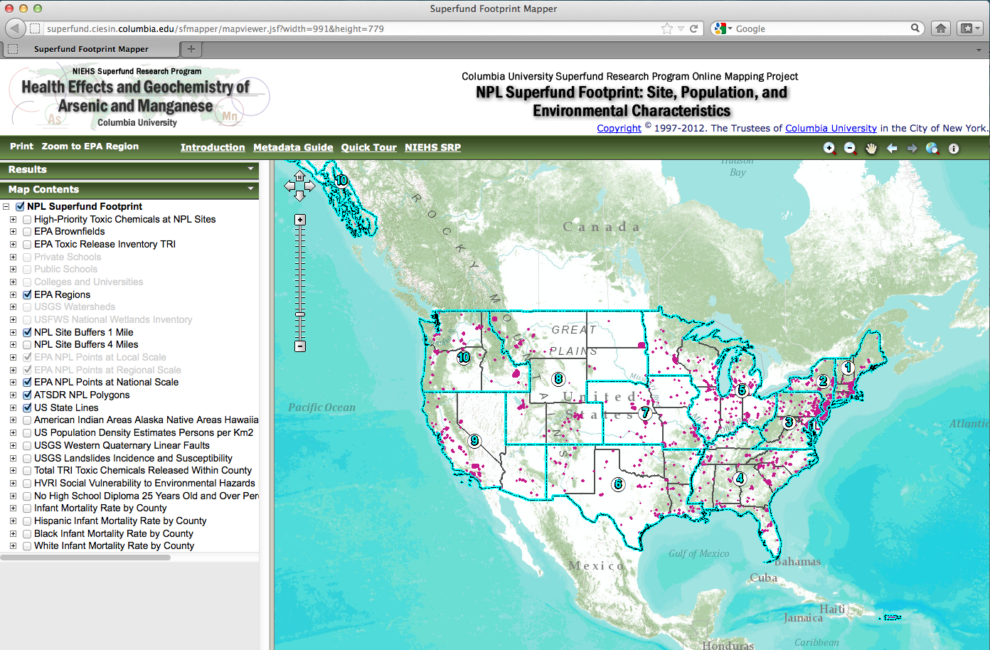
Menu Options: Quick Tour
How to Use the Mapper

Slide 21
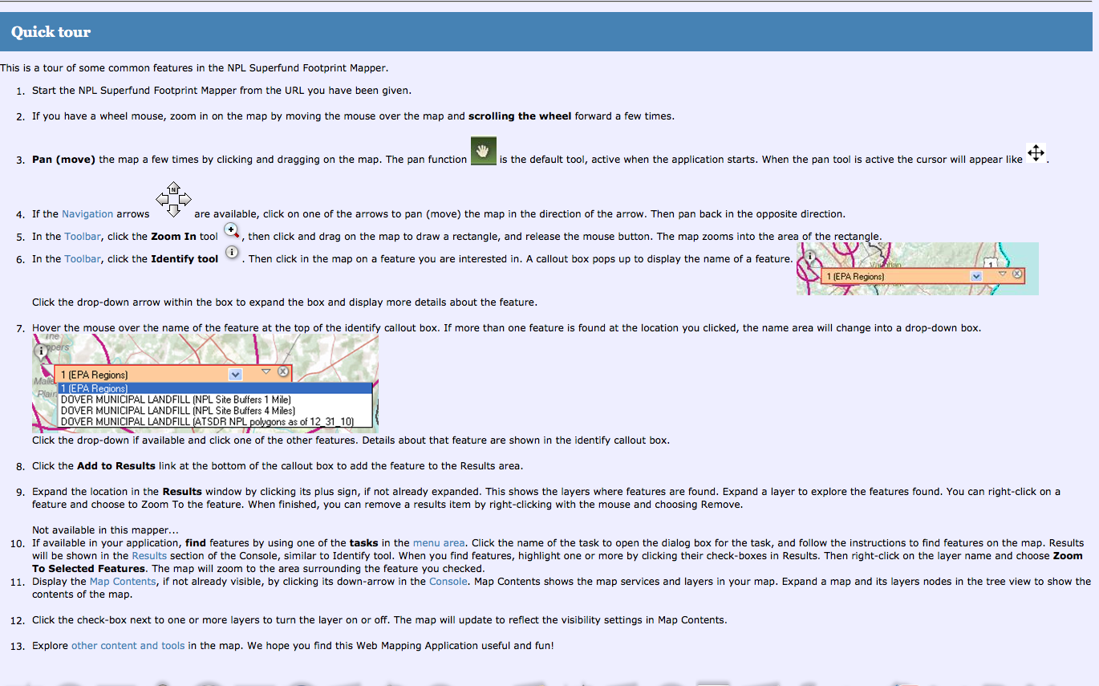

Slide 22
How to use the SF Footprint Mapper?
User guides and links to other resources
Legend embedded in Map Contents menu
Metadata available for each data layer
Multiple Tools for zooming
Pointer to identify features and detailed data
Save results
Print maps and data results
Possible to easily add new layers

Slide 23
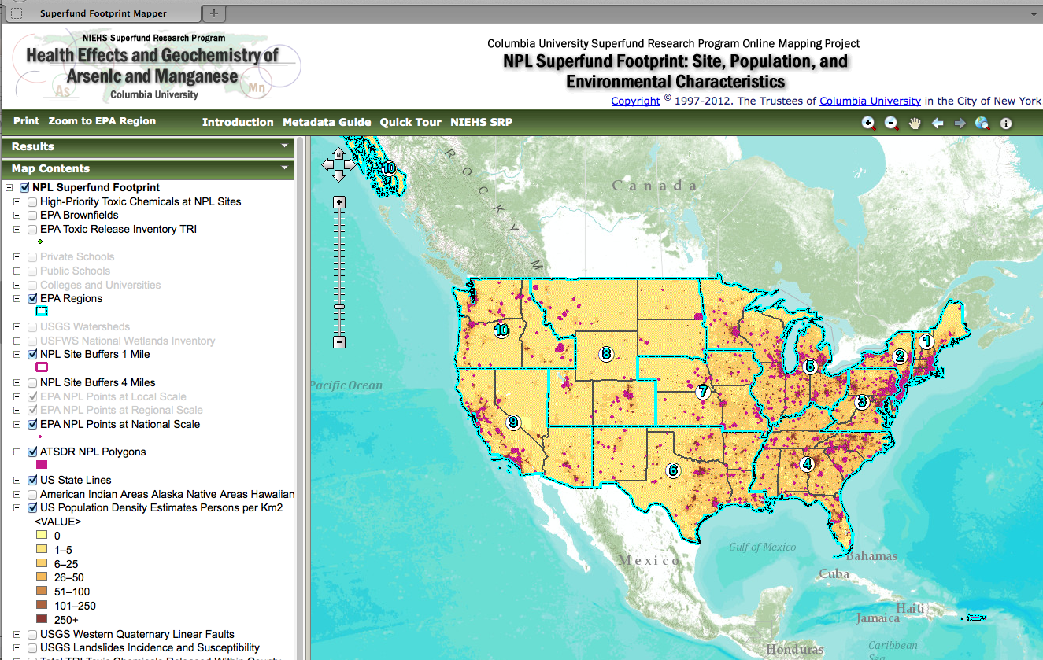
Menu Options: Legend

Slide 24
How to use the SF Footprint Mapper?
User guides and links to other resources
Legend embedded in Map Contents menu
Metadata available for each data layer
Multiple Tools for zooming
Pointer to identify features and detailed data
Save results
Print maps and data results
Possible to easily add new layers

Slide 25
Menu Options: Metadata Guide
Find data source & info

Slide 26
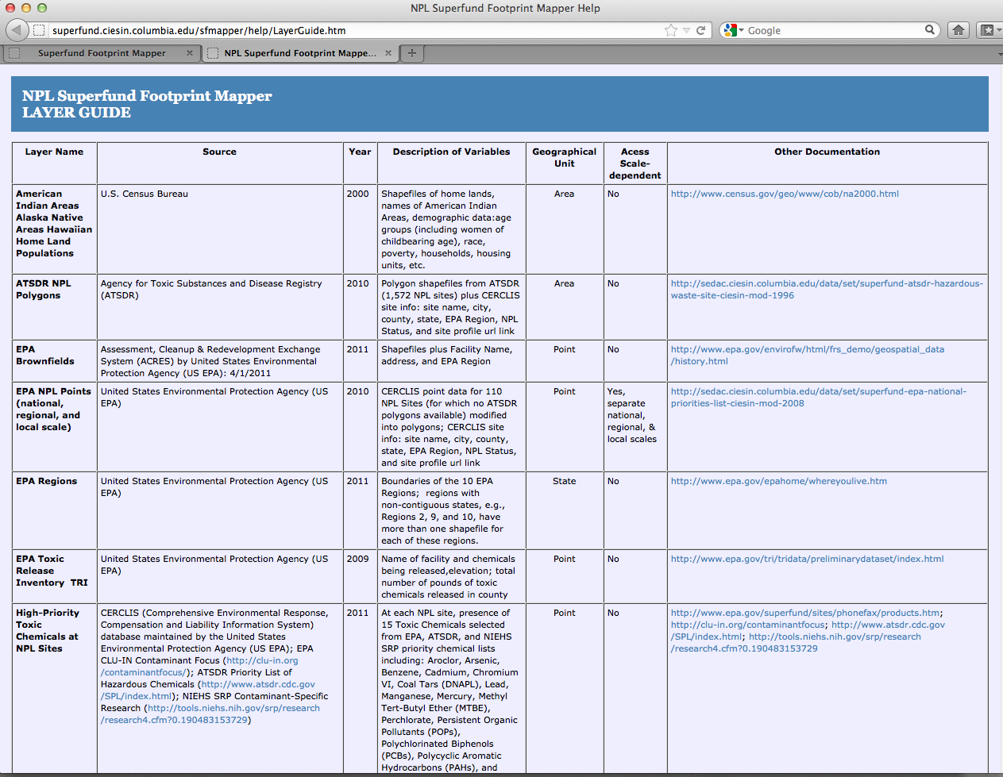

Slide 27
How to use the SF Footprint Mapper?
User guides and links to other resources
Legend embedded in Map Contents menu
Metadata available for each data layer
Multiple Tools for zooming
Pointer to identify features and detailed data
Save results
Print maps and data results
Possible to easily add new layers

Slide 28
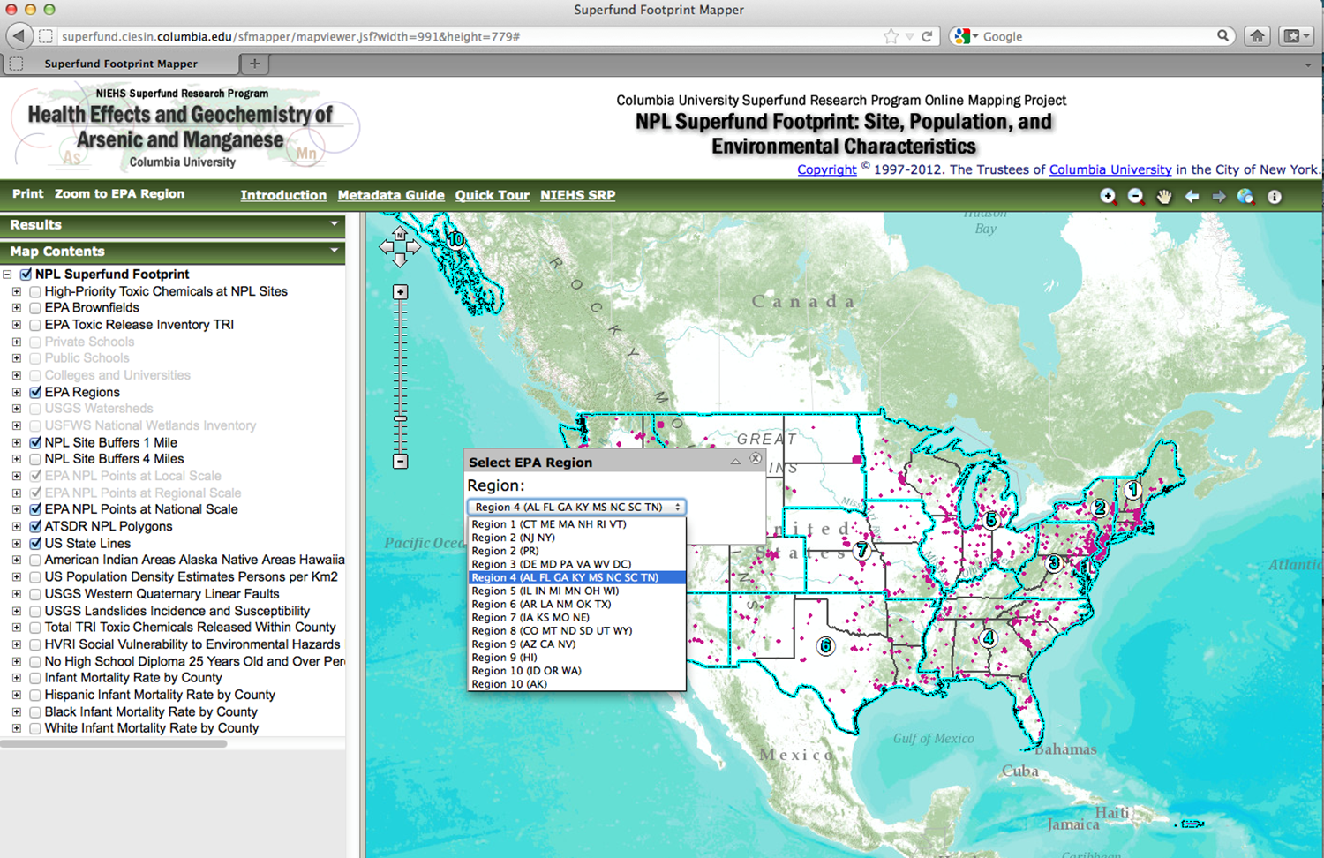
Menu Options: Zoom to EPA Region

Slide 29
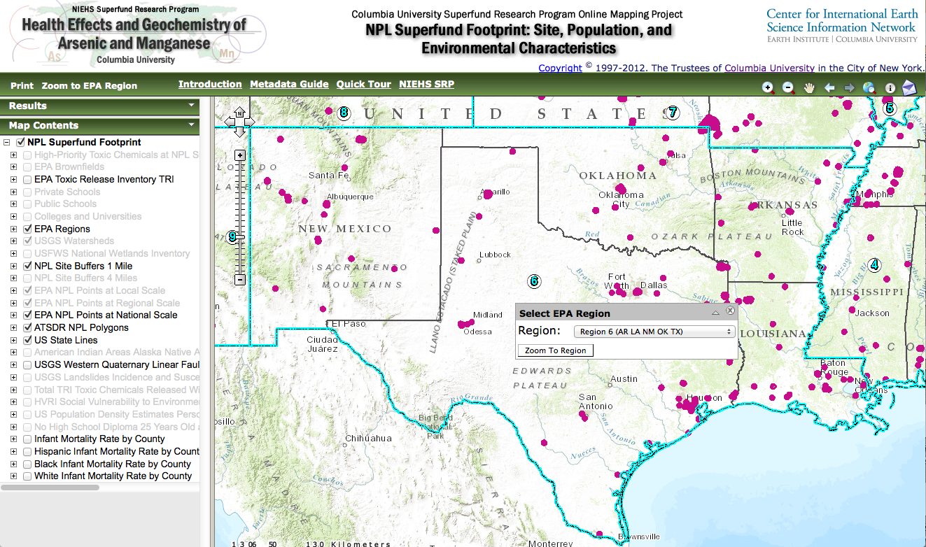
Zoom to EPA Region 6

Slide 30
How to use the SF Footprint Mapper?
User guides and links to other resources
Legend embedded in Map Contents menu
Metadata available for each data layer
Multiple Tools for zooming
Pointer to identify features and detailed data
Maps and data results: save & print
Possible to easily add new layers

Slide 31
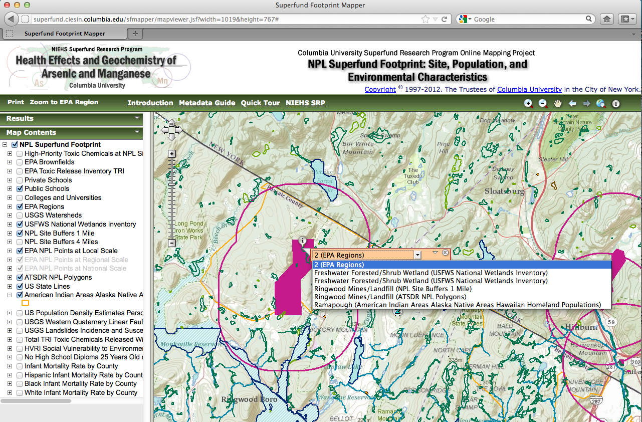
Zoom in & Identify:
Ringwood NJ Superfund Site

Slide 32
How to use the SF Footprint Mapper?
User guides and links to other resources
Legend embedded in Map Contents menu
Metadata available for each data layer
Multiple Tools for zooming
Pointer to identify features and detailed data
Save results
Print maps and data results
Possible to easily add new layers

Slide 33
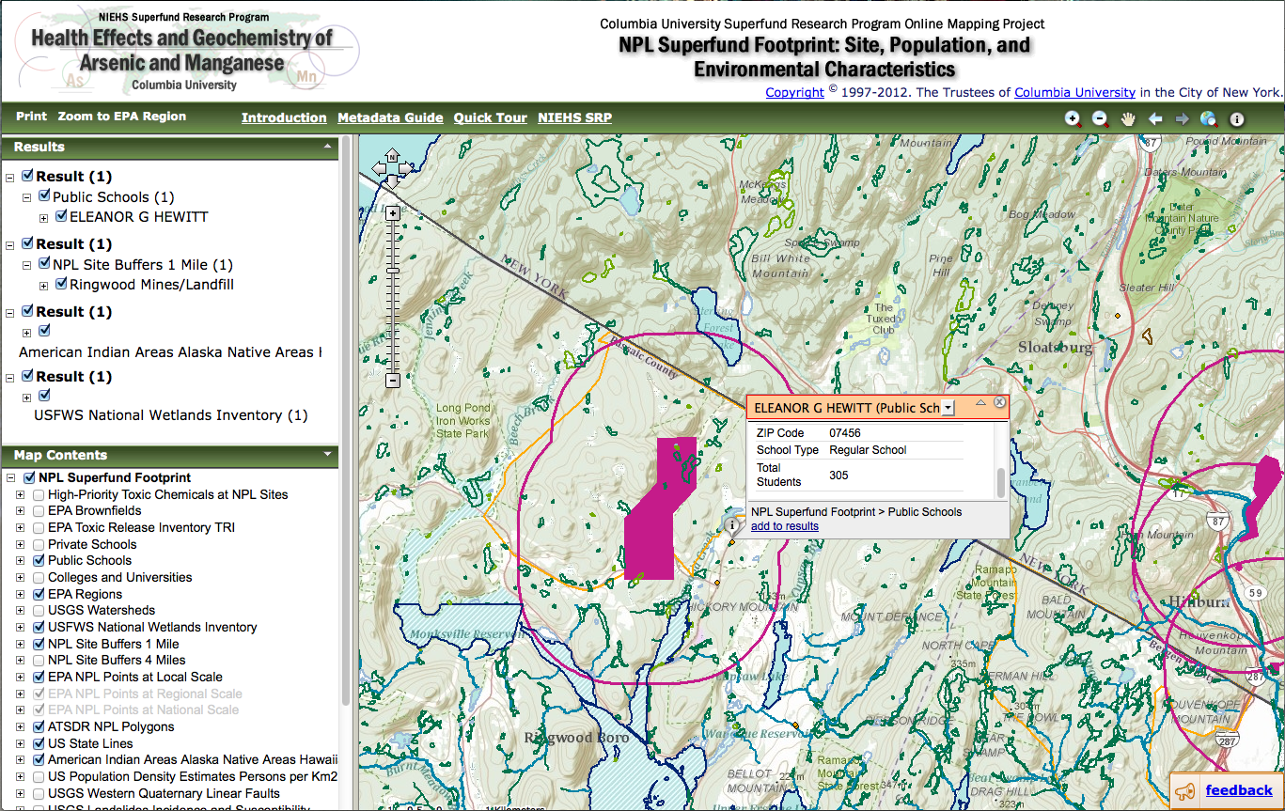
Save Results: Ringwood NJ SF Site

Slide 34
How to use the SF Footprint Mapper?
User guides and links to other resources
Legend embedded in Map Contents menu
Metadata available for each data layer
Multiple Tools for zooming
Pointer to identify features and detailed data
Save results
Print maps and data results
Possible to easily add new layers

Slide 35
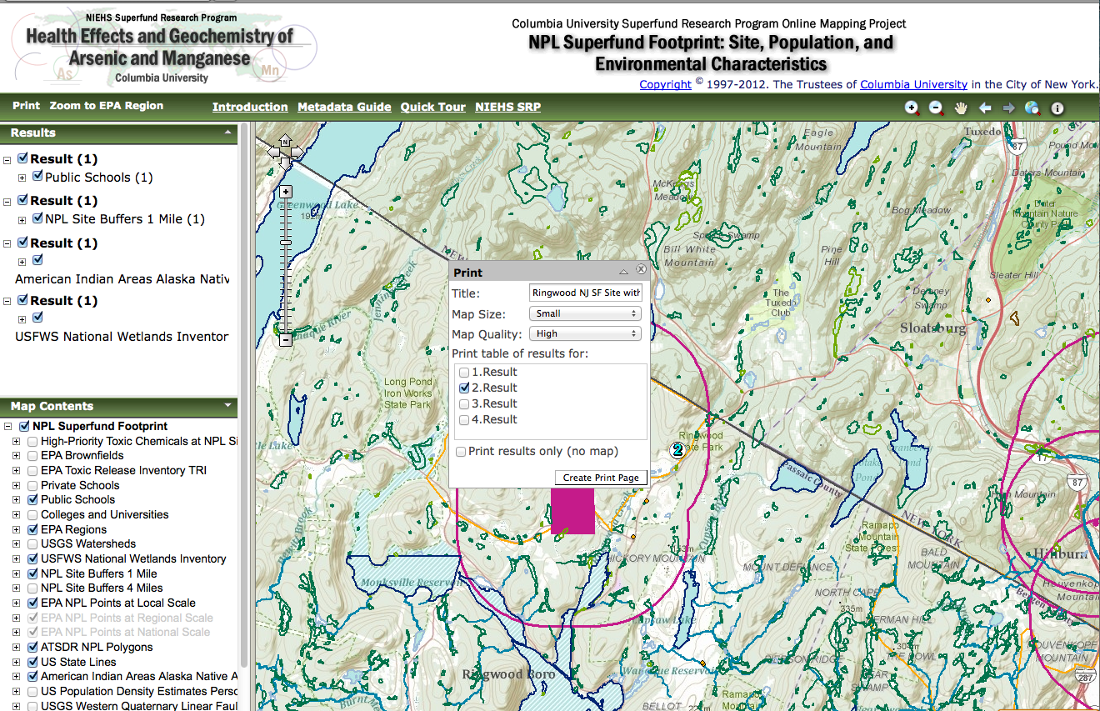
Print: Map & Results

Slide 36
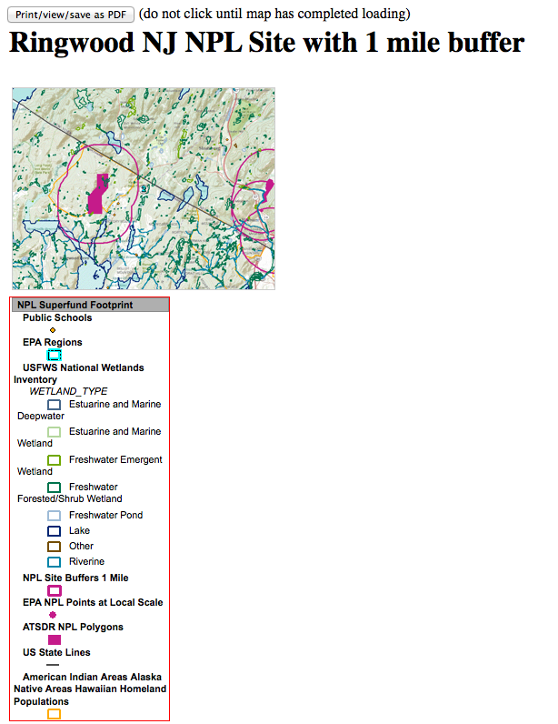
Print Map: Ringwood NJ SF Site with 1 Mile Buffer

Slide 37
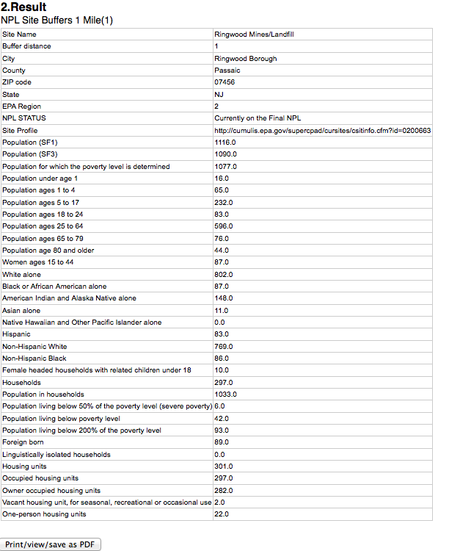
Print Results: Ringwood NJ SF Site with 1 Mile Buffer

Slide 38
How to use the SF Footprint Mapper?
User guides and links to other resources
Legend embedded in Map Contents menu
Metadata available for each data layer
Multiple Tools for zooming
Pointer to identify features and detailed data
Save results
Print maps and data results
Possible to easily add new layers

Slide 39
Residents near Ringwood, NJ Superfund site
Photo credit: Sylwia Kapuscinski for NYT; Superfund365 www.superfund365.org/

Slide 40
Moving Forward
Create polygon shapefiles for remaining of NPL sites
Add health data (state, surveys, local)
Zoom to state, county, or specific site
Compare multiple sites simultaneously
Query tools:
  Which SF sites have arsenic in groundwater?
  In North Carolina, how many women of childbearing age live within a mile of a Superfund site?
  How many students are there in Santa Clara County, CA who live within 4 miles of a Superfund site?
Basic spatial analysis techniques
Links with other sources: documents, websites, videos, images and stories from SF sites
Migrate the Mapper from the ADF architecture to Javascript Application Programming Interface (API)
OR Integrate with Existing Mapping tools?

Slide 41
Who Maps Superfund Sites Across the US?
Environmental Protection Agency (EPA)
My Environment (http://www.epa.gov/myenvironment/)
EnviroMapper for EnvironfactsEnviroMapper (http://www.epa.gov/enviro/emef/)
EJView (http://epamap14.epa.gov/ejmap/ejmap.aspx)
EPA National Priorities List (NPL) Map http://www.epa.gov/superfund/sites/query/queryhtm/nplmapsb.htm
EPA GeoPlatform will coordinate all geospatial activities, data, and applications…
Agency for Toxic Substances and Disease Registry (ATSDR)
Environmental Health Maps (http://gis.cdc.gov/grasp/webmaps/main.html)
National Library of Medicine (NLM)
TOXMAP: Environmental Health e-Maps (http://toxmap.nlm.nih.gov)
US Geological Survey (USGS)
National Atlas (http://www.nationalatlas.gov/)
Environmental Defense
Scorecard (http://www.scorecard.org/env-releases/land/community.tcl)
Columbia University NIEHS Superfund Research Program (SRP)
NPL Superfund Footprint: Site, Population, and Environmental Characteristics Mapper http://superfund.ciesin.columbia.edu/sfmapper)

Slide 42
Quick Comparison of
Existing Mapping for NPL sites
For example, finding Agriculture Street Landfill
New Orleans, LA
          EPA
            My Maps for MyEnvironment
            EnviroMapper for Envirofacts
            EJView
            National Priorities List (NPL) Map Search
          ATSDR
            Environmental Health WebMaps
            Public Health Assessments & Health Consultations Map
          NLM
            ToxMap
          USGS
            National Atlas
          Environmental Defense
            ScoreCard
          Columbia University NIEHS Superfund Research Program
            NPL Superfund Footprint:
            Site, Population, and Environmental Characteristics Mapper

Slide 43
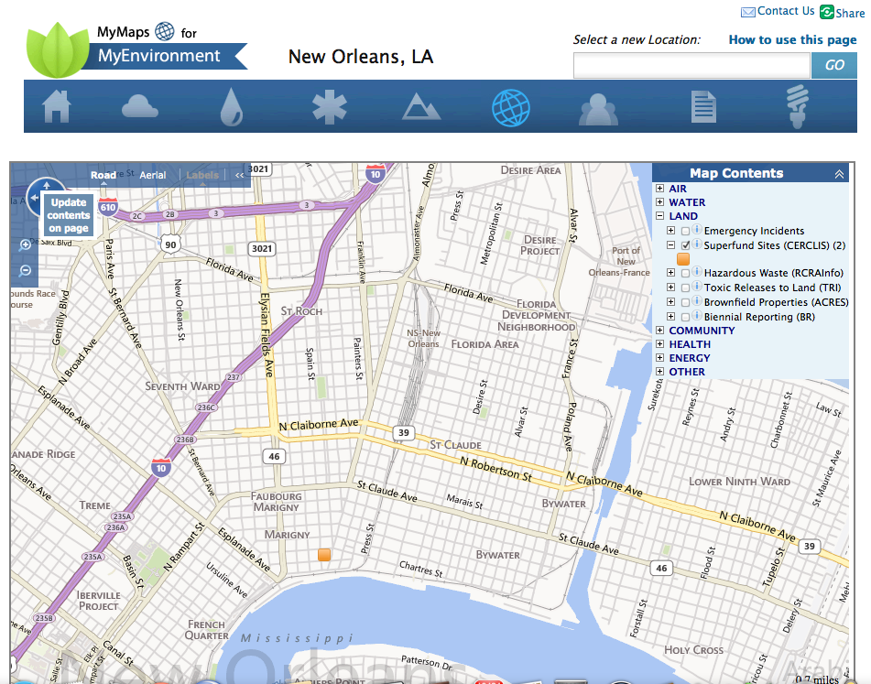
EPA My Maps for MyEnvironment
Includes 2 SF Sites
Not Agriculture Street Landfill http://www.epa.gov/myenvironment/

Slide 44
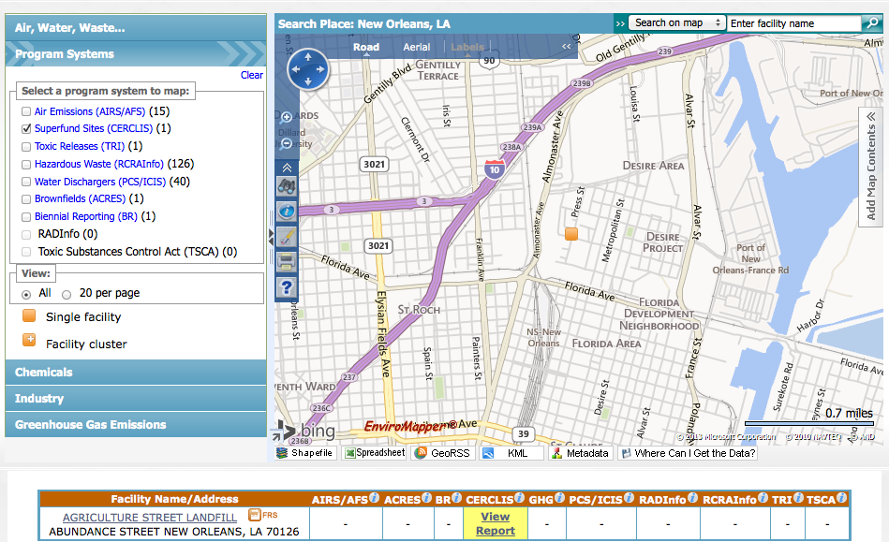
EPA EnviroMapper for Envirofacts
Agriculture Street Landfill http://www.epa.gov/emefdata/em4ef.home

Slide 45
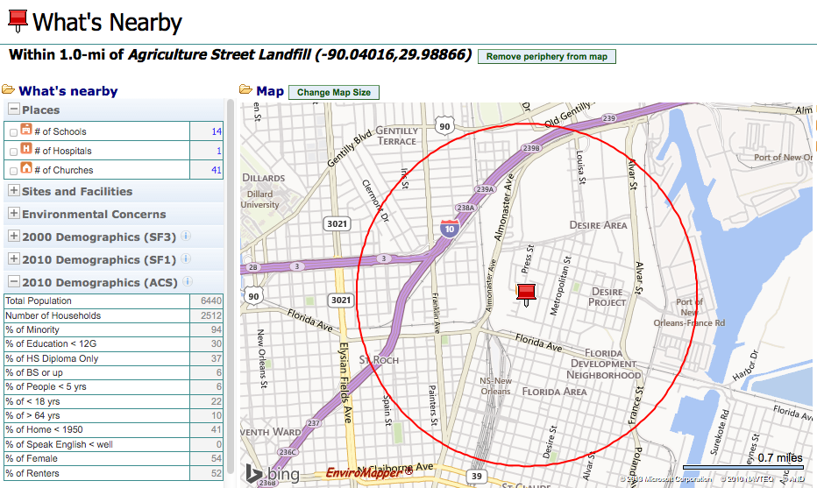
EPA EnviroMapper
Agriculture Street Landfill
With Variable Size Buffers

Slide 46
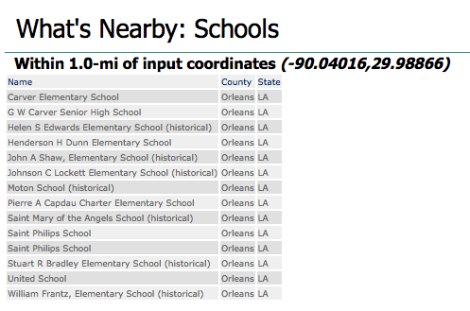
EPA EnviroMapper:
School Names, No Addresses or Number of Students

Slide 47
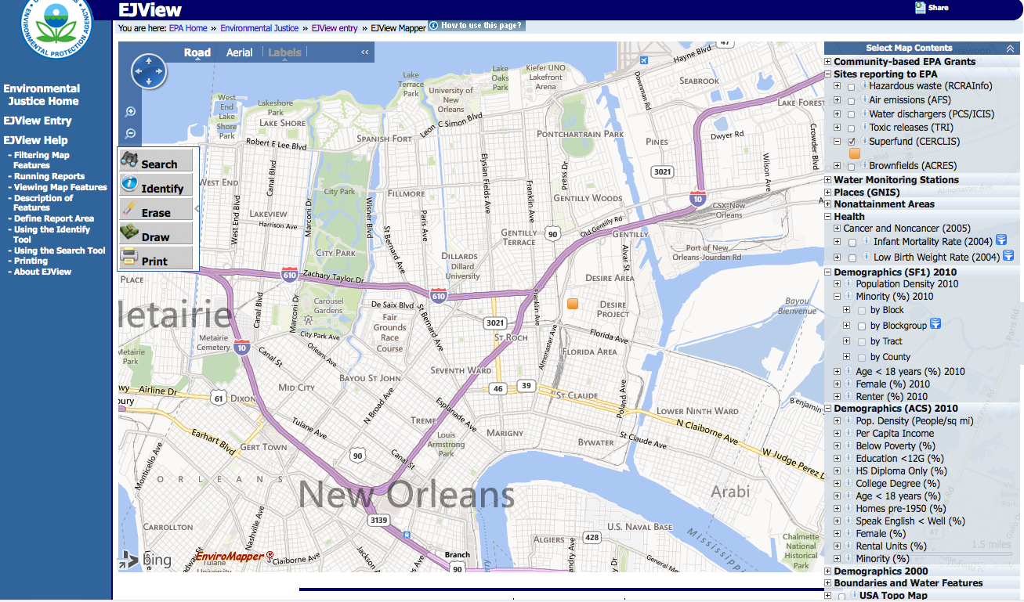
EPA EJView
Agriculture Street Landfill with Multiple Layers http://epamap14.epa.gov/ejmap/ejmap.aspx

Slide 48
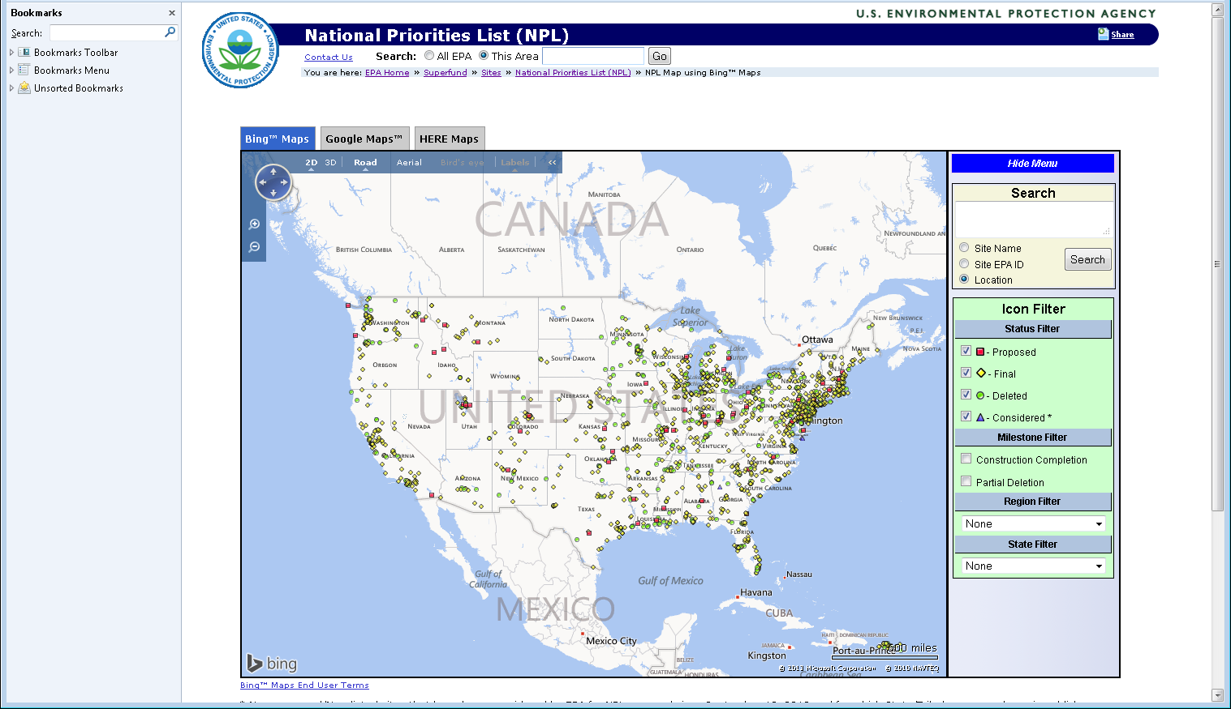
EPA National Priorities List (NPL) Map Search
Option of Using Bing, Google or HERE Maps http://www.epa.gov/superfund/sites/query/queryhtm/nplmapsb.htm

Slide 49
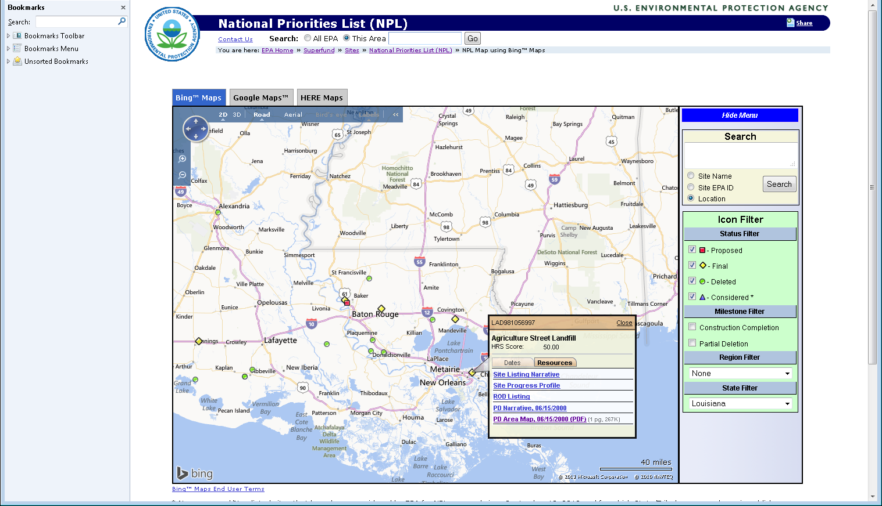
EPA National Priorities List (NPL) Map Search
Agriculture Street Landfill, New Orleans, Louisiana with NPL Site information

Slide 50
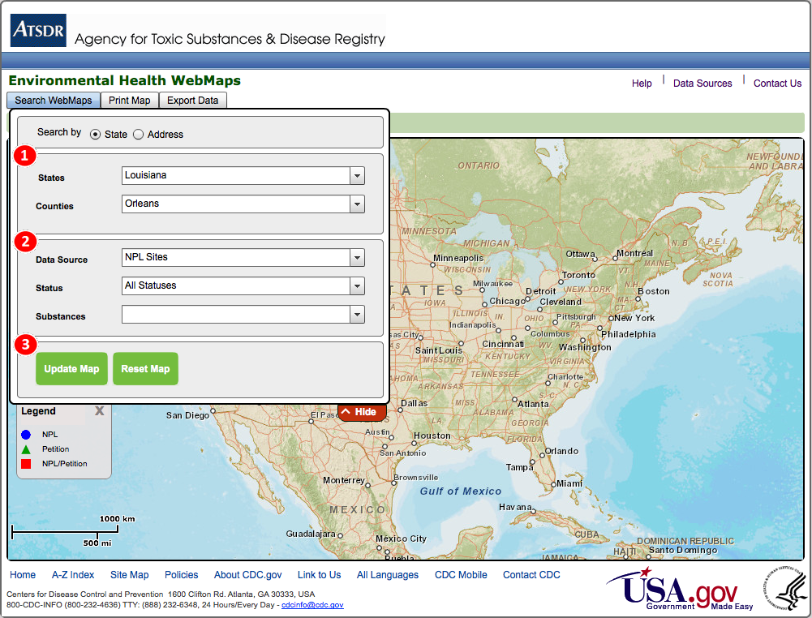
ATSDR Environmental Health WebMaps
Search Query http://gis.cdc.gov/grasp/webmaps/main.html

Slide 51
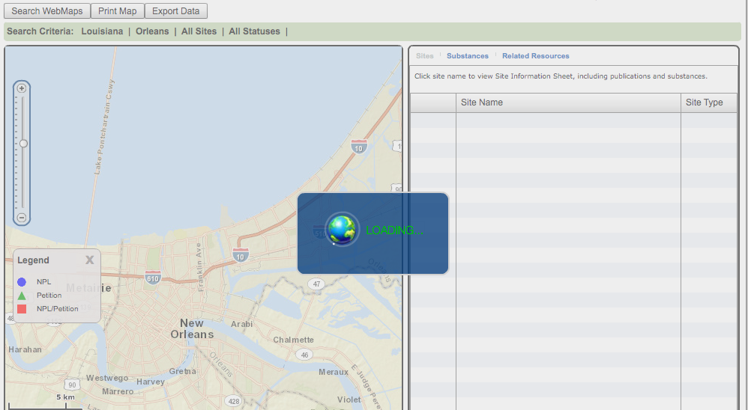
ATSDR Environmental Health WebMaps
NPL Sites in New Orleans, LA – not found

Slide 52
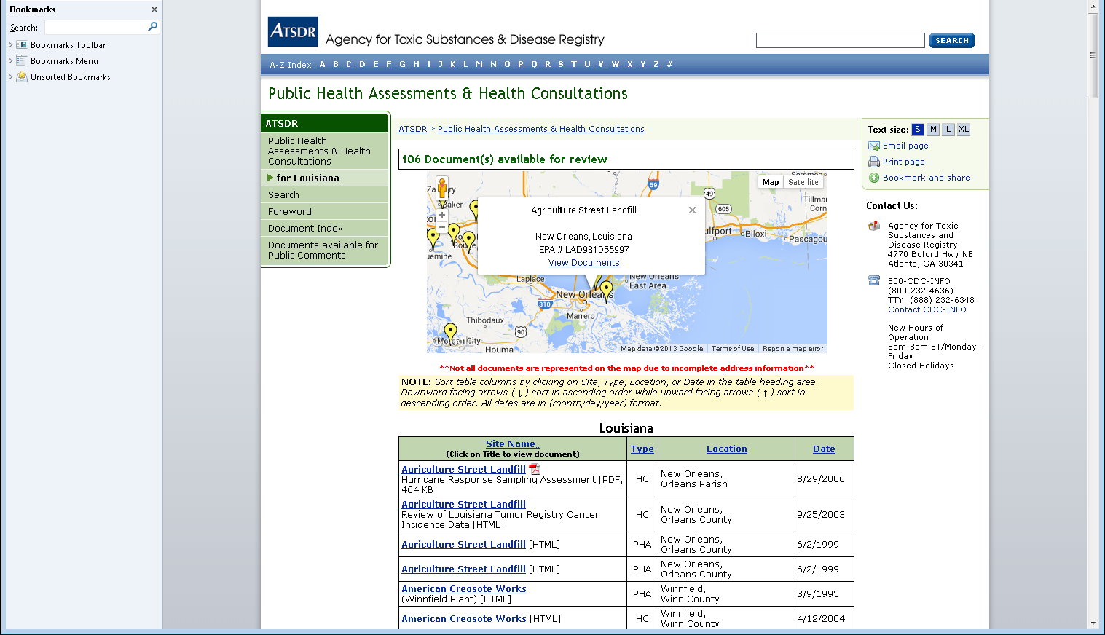
ATSDR
Public Health Assessments & Health Consultations
Agriculture Street Landfill http://www.atsdr.cdc.gov/hac/pha/HCPHA.asp?State=LA

Slide 53
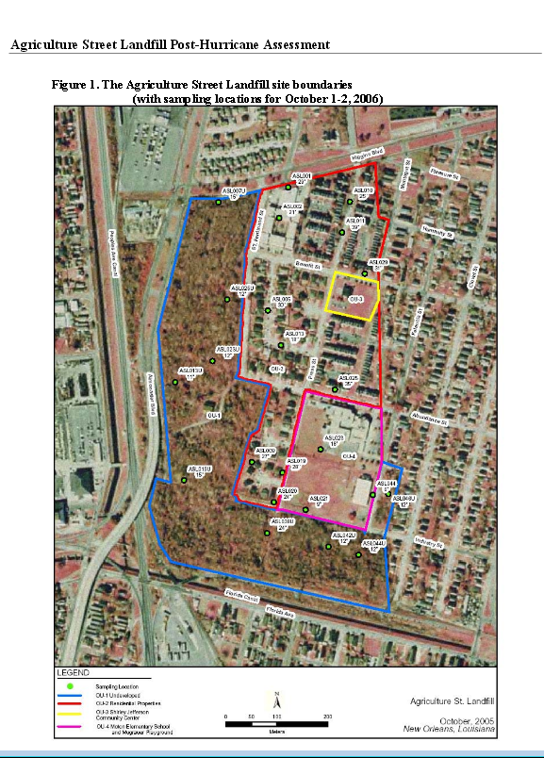
ATSDR Health Consultation Map
HURRICANE RESPONSE SAMPLING ASSESSMENT FOR THE
AGRICULTURE STREET LANDFILL http://www.atsdr.cdc.gov/HAC/pha/AgricultureStreetLandfill/AgricultureStLandfill-NewOrleansHC082906.pdf

Slide 54
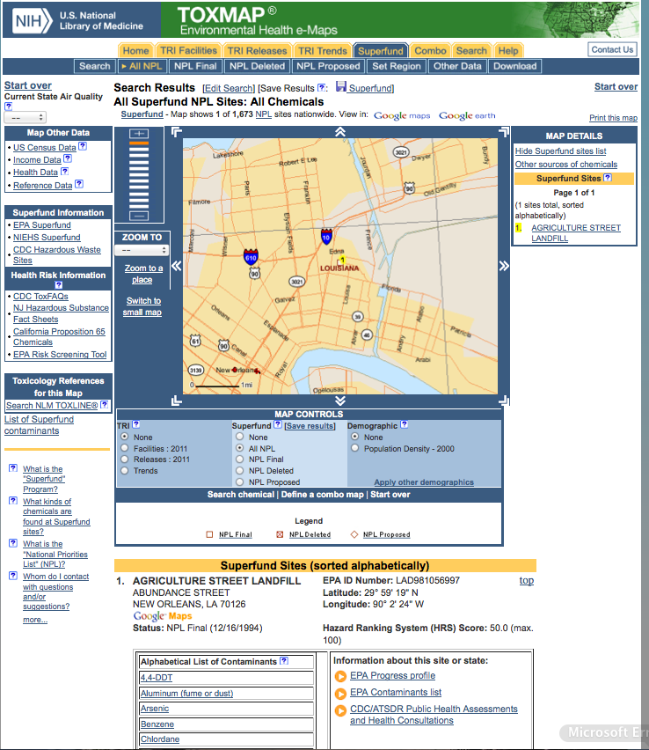
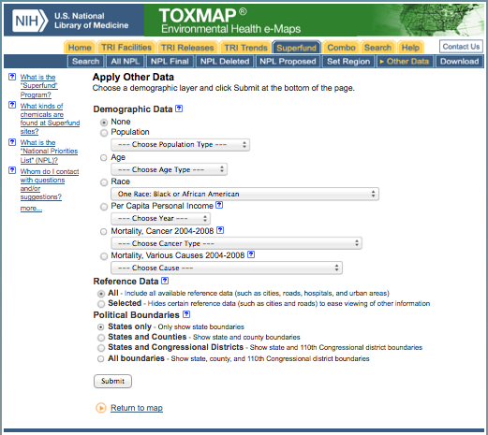
National Library of Medicine TOXMAP
Agriculture Street Landfill with Demographic and Health Data http://toxmap.nlm.nih.gov

Slide 55
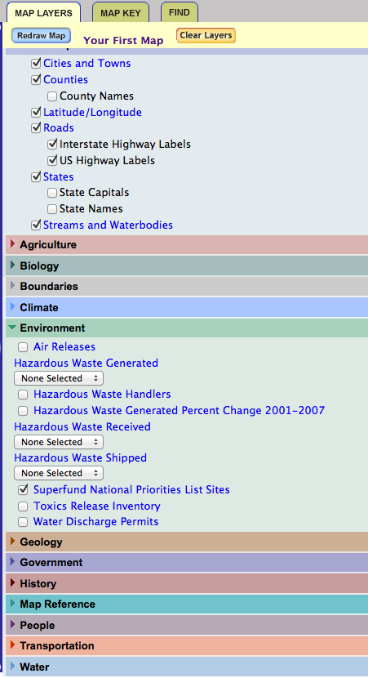
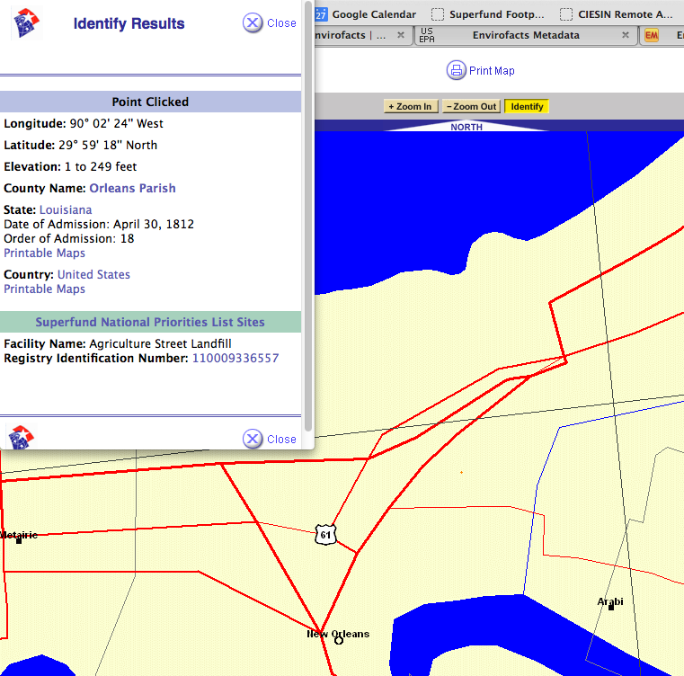
USGS National Atlas
Agriculture Street Landfill with
Multiple Thematic Layers http://nationalatlas.gov/mapmaker
Agriculture Street Landfill

Slide 56
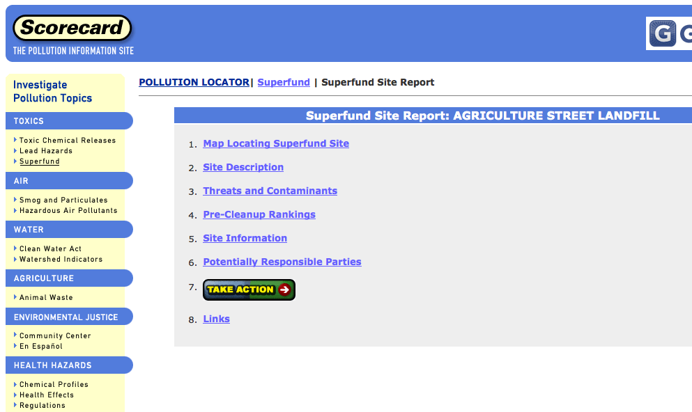
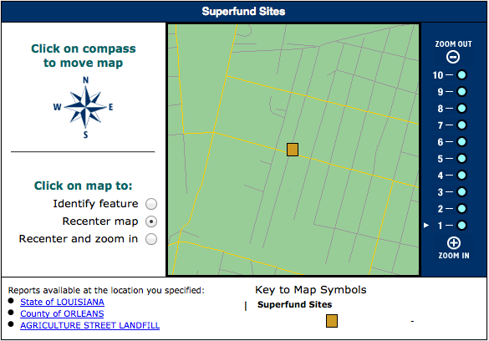
Environmental Defense
ScoreCard: The Pollution Information Site
Agriculture Street Landfill Site Information http://scorecard.goodguide.com

Slide 57
Columbia Superfund Research Program
NPL Superfund Footprint Mapper
Zooms to EPA Region 6

Slide 58
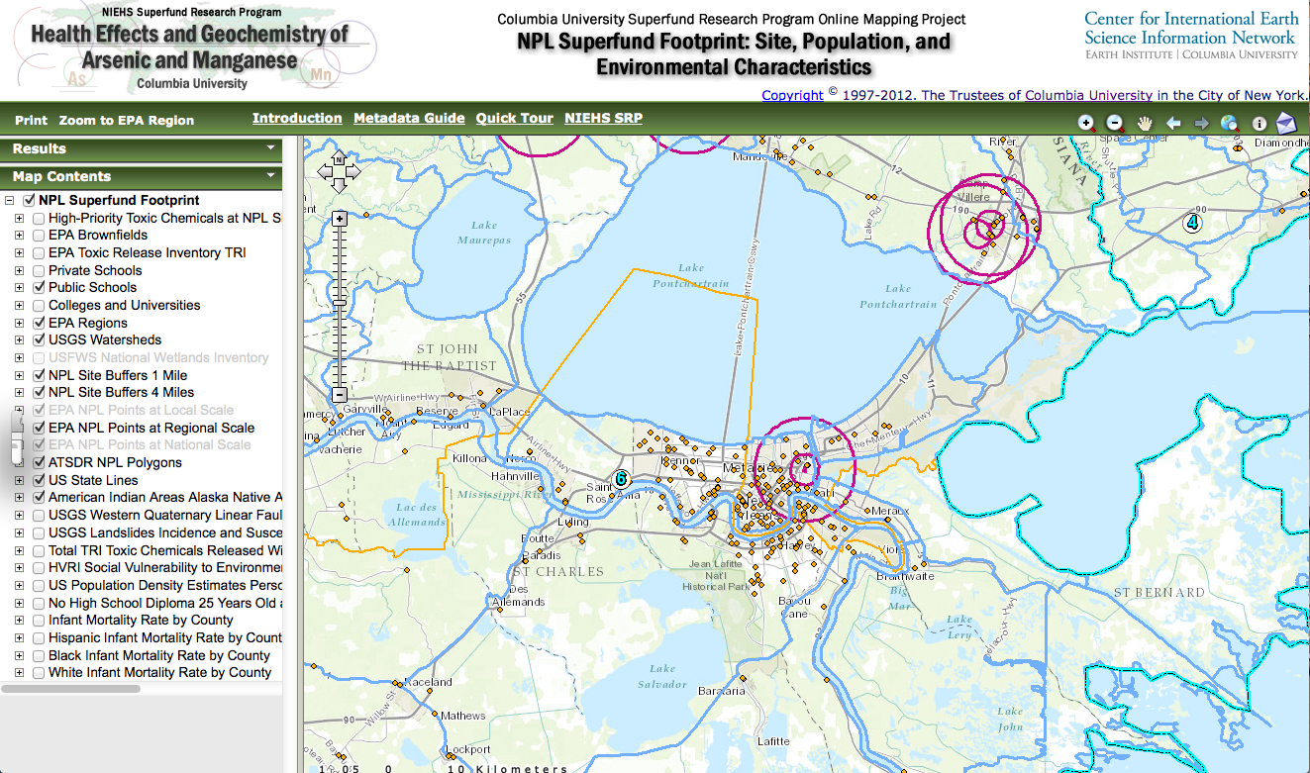
Columbia Superfund Research Program
NPL Superfund Footprint Mapper
Then Zoom in to New Orleans, LA

Slide 59
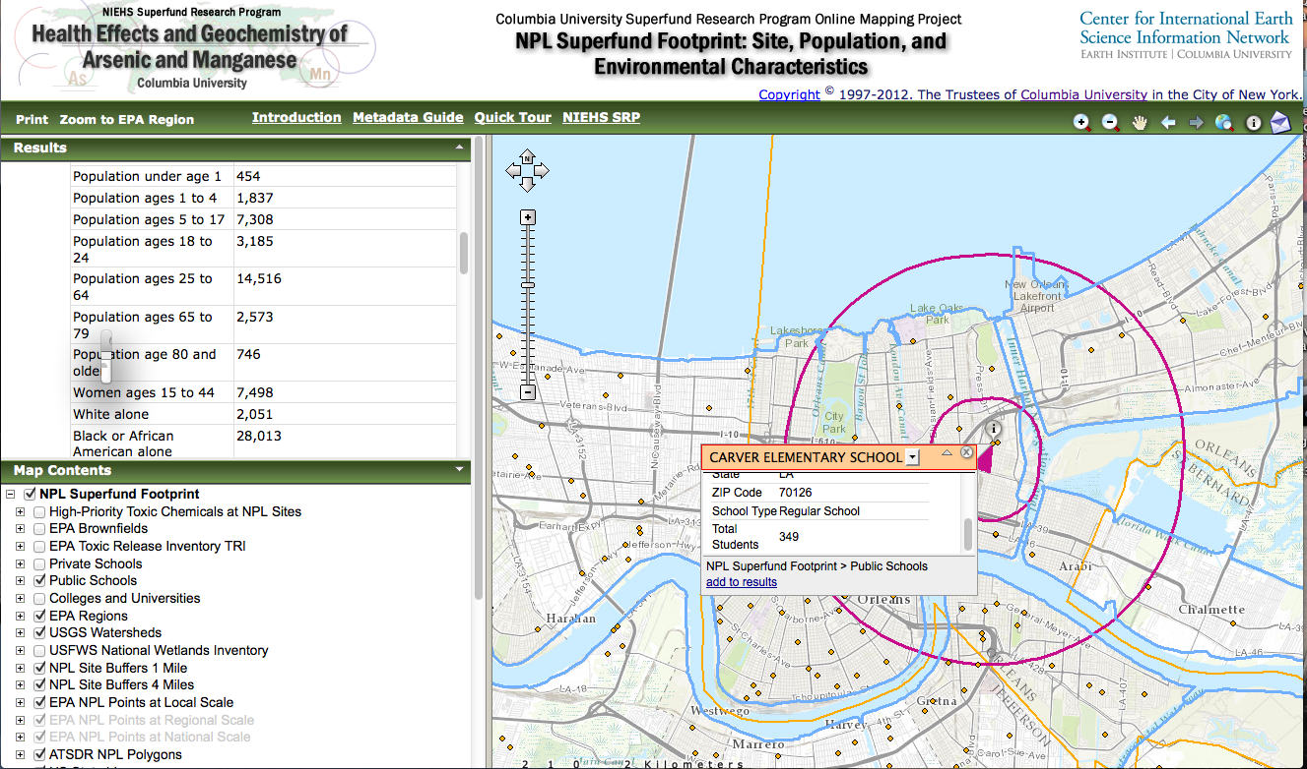
Columbia Superfund Research Program
NPL Superfund Footprint Mapper
Vulnerable Populations near Agriculture Street Landfill

Slide 60
We all must work together to support the Superfund Program Goals:
Prioritize Clean-ups, Protect Human Health, and Provide for Citizen Participation
Please let us know your ideas for GIS collaborations
Thank you!

Slide 61
Acknowledgements
Funding for this project is from the NIEHS Superfund Research Program as a supplemental grant to the Columbia University SRP (NIEHS 3 P42 ES010349-10).
Superfund Footprint Mapper Development Team
Columbia SRP Research Translation Core, CIESIN:
Meredith Golden, RTC Co-PI & Project Manager
Tricia Chai-Onn, Geographic Information Specialist
Kytt MacManus, Geographic Information Specialist
Gregory Yetman, (now with Esri Canada)
James Carcone, Senior Analyst Programmer
Annie Gerard, Media Designer
Special Thanks for Support and Data
ATSDR GRASP: Andrew Dent
EPA OSRT: Brette Beasley and Randy Hippen
NIEHS SRP: Bill Suk, Beth Anderson, Danielle Carlin, Mary Gant
MDB, Inc: Larry Read, Rebecca Wilson, and Maureen Avarkian
Numerous Beta Testers

Slide 62

Columbia Superfund Research Program http://superfund.ciesin.columbia.edu
NPL Superfund Footprint Mapper
http://superfund.ciesin.columbia.edu/sfmapper
Your is welcome!

