Slide 1
Scale, Diversity, and Complexity: Tackling Data Challenges in the Superfund Research Program
William A. Suk, Ph.D., M.P.H.
Director, Superfund Research Program
Director, Center for Risk and Integrated Sciences
Division of Extramural Research and Training National Institute of Environmental Health Sciences
Notes:
Welcome and introduction
Because of the wealth of data in the SRP, tackling data challenges and finding ways to integrate data is a new opportunity to improve the SRP.
SRP is a mature program with 28 years of programmatic and research successes
SRP led the way in support of the multi/transdisciplinary research needed to address the complex human health and environmental issues related to hazardous substances
The next step in the evolution is increased collaboration to include not only sharing of ideas and approaches – but to enable sharing of data

Slide 2
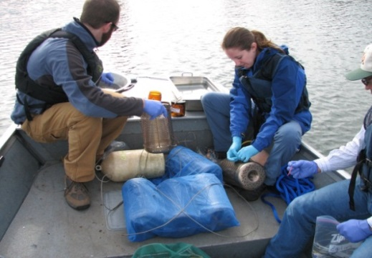
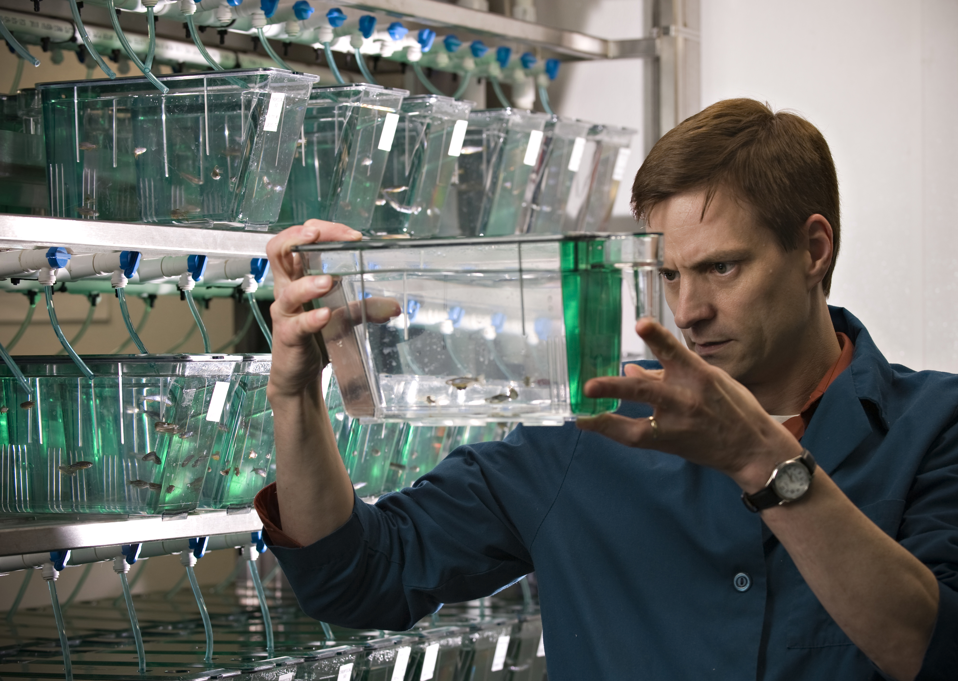
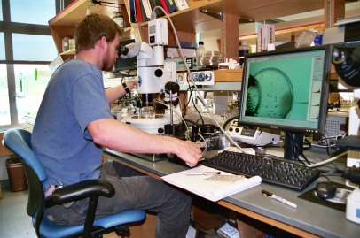
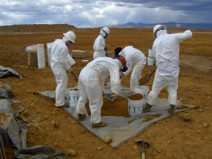
Primary Objectives - SRP Mandates
Supported by the National Institute of Environmental Health Science, the Superfund Research Program (SRP) funds research related to the development of:
Methods and technologies to detect hazardous substances in the environment
Advanced techniques for the detection, assessment, and evaluation of the effects on human health of hazardous substances
Methods to assess the risks to human health presented by hazardous substances
Basic biological, chemical, and physical methods to reduce the amount and toxicity of hazardous substances
Notes:
The NIEHS Superfund Research Program funds university-based multidisciplinary research on human health and environmental issues related to hazardous substances. The central goal is to understand and break the link between chemical exposure and disease.
The Superfund Research Program is conducted in accordance with the Superfund Amendments and Reauthorization Act (SARA) of 1986. The mandates specified in SARA describe the Program's primary objectives to be the development of:
methods and technologies to detect hazardous substances in the environment
advanced techniques for the detection, assessment, and evaluation of the effects on human health of hazardous substances
methods to assess the risks to human health presented by hazardous substances
basic biological, chemical, and physical methods to reduce the amount and toxicity of hazardous substances.

Slide 3
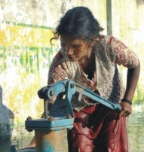
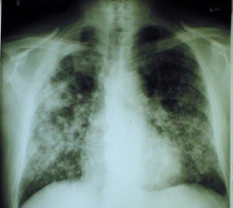
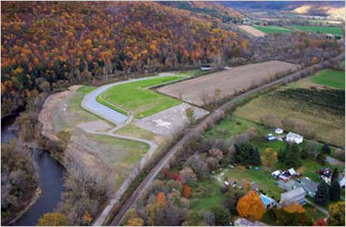
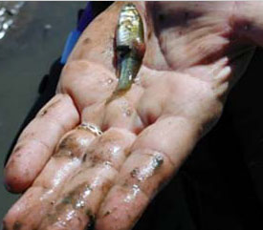
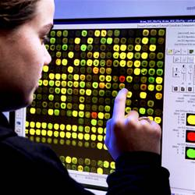
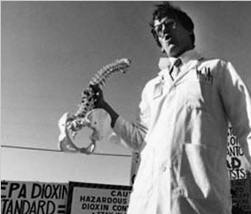
Multidisciplinary research addressing broad, complex issues related to hazardous substance exposure
Fate and Transport
Epidemiology
Health Effects
Remediation
Unifying
Theme
Mechanistic Toxicology
Ecology
Studies
Community Outreach
Research Translation
Training
Notes:
The SRP uses multiple funding mechanisms to support research including individual research projects, small business grants, training and education programs, and multi-project Centers. The SRP multi-project Centers are the mainstay of the program and bring many of these disciplines together in the same Center to bear on these complex issues.
Each multi-project Center includes a variety of health and environmental disciplines, shown here, as well as training, outreach and research translation – all tied together and integrated under a unifying theme, which helps to capture the complexity of hazardous waste sites across disciplines. This unifying theme at each Center helps link the projects in different research domains. Some Centers are linked with a unified theme related to specific contaminants or groups of chemicals like arsenic and mercury or polycyclic aromatic hydrocarbons (PAHs). A few other examples of themes relate to nutrition and Superfund toxicity, risk assessment, developmental and reproductive toxicity of Superfund chemicals, and regional hazardous waste issues.
In keeping with the NIEHS mission, teams of diverse professionals develop, test, and implement unique, solution-oriented approaches to address complex environmental health problems. They are improving the understanding of environmental contaminants, which may lead to lower environmental cleanup costs, reduced risk of exposure, and improvements in human health.

Slide 4
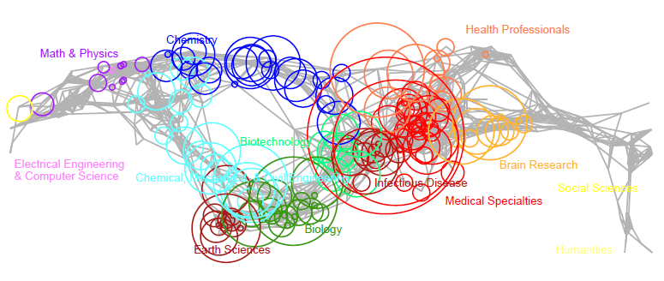
A diversity of research A diversity of data
Opportunity for data integration and data sharing
Opportunity to take advantage of new resources and broaden data available to researchers
Notes:
This map of publications from the SRP shows SRP publications distributed based on the journals that published the work.
This diversity of research across the science spectrum helps to illustrate the diversity of data being generated by the program.
SRP grantees are working in a variety of fields, from chemistry and biology basic research, earth science research, medical research, to social science research.
Since the SRP has been around since 1987, there is also a wealth of historical data that needs to be tapped into.
(enter) This huge diversity of data, including historical data, presents an opportunity for the SRP. By integrating all of these types of data and sharing them across the different disciplines and research projects, we may be able to better answer important questions related to reducing the burden of disease and improving human health. Because of the complexity surrounding exposure to environmental agents and health effects, coming at questions from a wide range of angles may help answer tough questions.
(enter) The diversity within the program also presents an opportunity to take advantage of new resources and broaden data available to researchers. We want to help researchers in different research domains become aware of and understand data resources in other research domains. This will help scientists better understand data diversity and take advantage of data sharing.
_____
For reference:
Info about publication topic map:
-Grants (P42, R01, and SBIR) funded between 2008 and 2012 were used in a grant # search of PubMed and Web of Science
-951 publications – pubs were generally between 2008 and 2012
-Pubs classified by the journal they were published in.
-circle area =fractional journal count (number of pubs per journal – size adjusted based on number of articles)

Slide 5
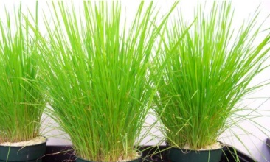
Enhancing environmental health solutions through data integration
Biological response data
Exposure data
Fate and transport data
Sustainable remediation data
Epidemiology data
Reducing the burden of disease
Enhance the knowledge base
Notes:
SRP is in a unique position because we have a huge variety of types of data. For 28 years, the SRP has been bringing together research domains that do not normally meet under the same roof. We want to take that to the next level and bring diverse data formats from a variety of scientists – from engineers to microbiologists – integrating diverse data to enhance environmental health research.
(enter) Ultimately, by integrating and sharing data across these different research domains, we hope to enhance the knowledge base, enhancing environmental health solutions through data integration --- (enter) and therefore, reducing the burden of disease and improving public health.

Slide 6
Putting the pieces together
How can the diverse science within SRP be used together and shared?
How do we enable projects to share data with other projects and Centers?
How do we make this data available and more useable?
How do we encourage researchers to leverage existing data?
Notes:
To begin to accomplish this, we have to figure out how to put the pieces together.
Here are a few questions we need to address to begin moving toward integrating data. These questions emphasize the need for data sharing, which is an NIH priority. Data sharing is essential for expedited translation of research results into knowledge to improve human health.
So how do we get there? We are very interested in your thoughts and would like to benefit from your experience and expertise. Here are some thoughts to begin this conversation:
We know we have diverse science - How can the diverse science within SRP be used together and shared?
We know researchers are already talking to each other but how do we take it to the next level and enable projects to share data with other projects and Centers?
How do we make this data available and more useable?
How do we encourage researchers to leverage existing data?
We want your input on these questions – if you have thoughts or examples that may be useful to the SRP, please get in touch with me to discuss them.

Slide 7
First steps: Integrating data from multidisciplinary research – across multiple platforms
Inventory
Repository
Useable Knowledge Architecture
Image Source: University of Washington International Doctoral Education Research Network (IDERN)
Notes:
The SRP has a variety of different kinds of data across multiple platforms. We want to figure out how to integrate these data across platforms and create a new knowledge architecture.
To do this, we need to discuss and develop ways to inventory the data we already have. We also should consider creating repositories to store and collect data.
By creating and integrating an environmental health knowledge architecture, we will:
Enhance collaborations and communications among environmental health science investigators
Integrate investigator-initiated research
Seize emerging scientific opportunities
Manage knowledge to meet public health and disease burden outcomes and products

Slide 8
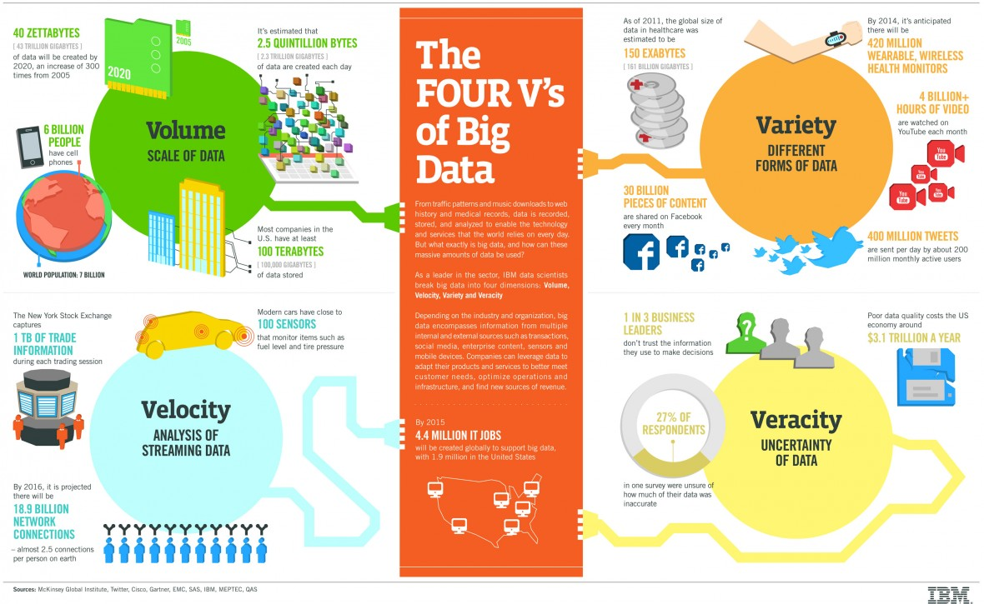
Infographic Source: IBM
Notes:
As a segue into Allen Dearry’s presentation, who will discuss how NIH is beginning to address issues related to big data, including the “Four V’s” of Big Data – Volume, Velocity, Variety, and Veracity.
As you have just heard, the SRP definitely has the “Variety” – so looking forward, we are interested in seeing what other agencies and programs are doing in the realm of “Big Data” and using this information to work toward integrating SRP data across multiple platforms in order to enhance the knowledge base and protect human health.

