Slide 1
Towards SRP
Data Sharing
Related projects: principles and architecture
The importance of community building
Ilya Zaslavsky, San Diego Supercomputer Center
and the UCSD SRP team

Slide 2
Goals of SRP Data Sharing
Enable data discovery and re-use across SRP sites
Facilitate cross-SRP research work and expertise sharing
Light-weight integration layer over existing resources already developed by SRP projects
BIG QUESTIONS
WHAT KIND OF DATA ARE WE TALKING ABOUT
WHY DO WE WANT TO SHARE DATA
Notes:
Note that that I am not asking about HOW.

Slide 3
Success examples put into use
EarthCube
Critical Zone Observatories
Hydrologic Information System
Brain Atlas Integration
There are many more projects,
with different domain and technical foci

Slide 4
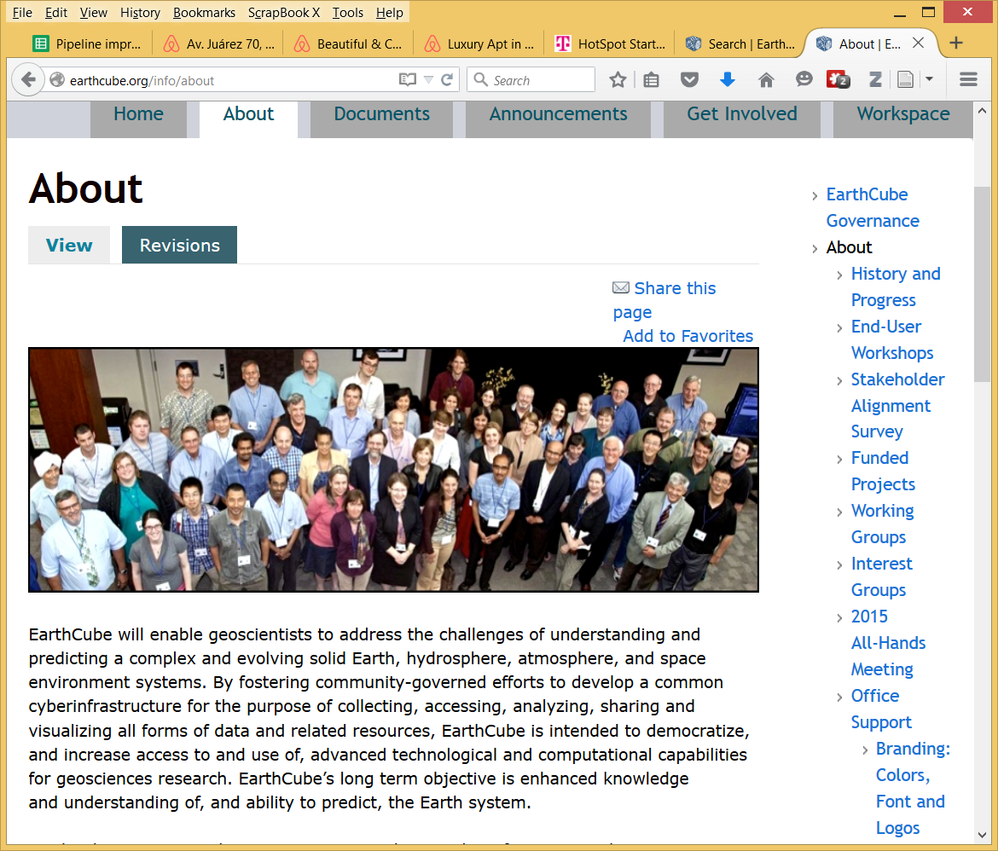

What is EarthCube?
http://earthcube.org
A future state of geosciences cyberinfrastructure that serves the entire academic geosciences community
  facilitates science on the Earth System
  simple and easy access to data and information
  seamless connection to tools and services
  flexible and community-driven development

Slide 5
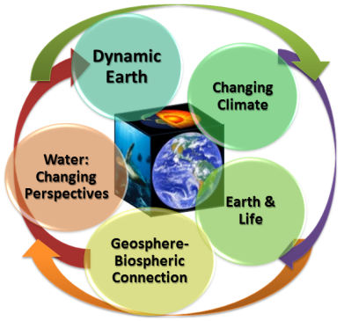

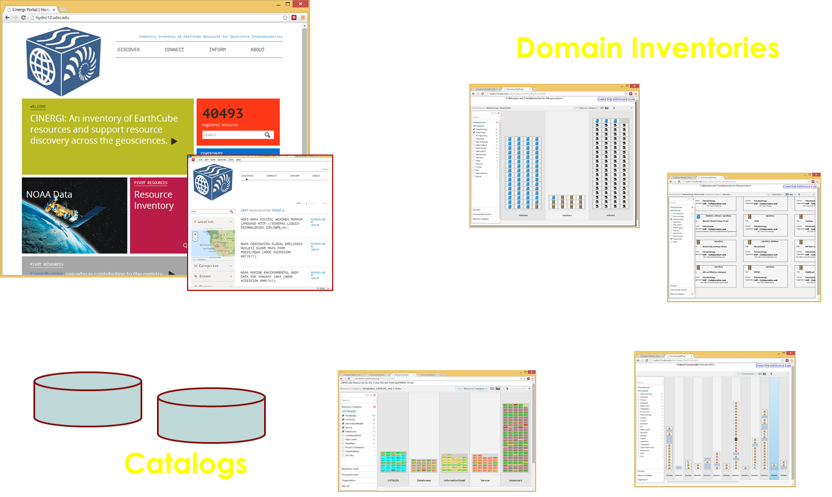
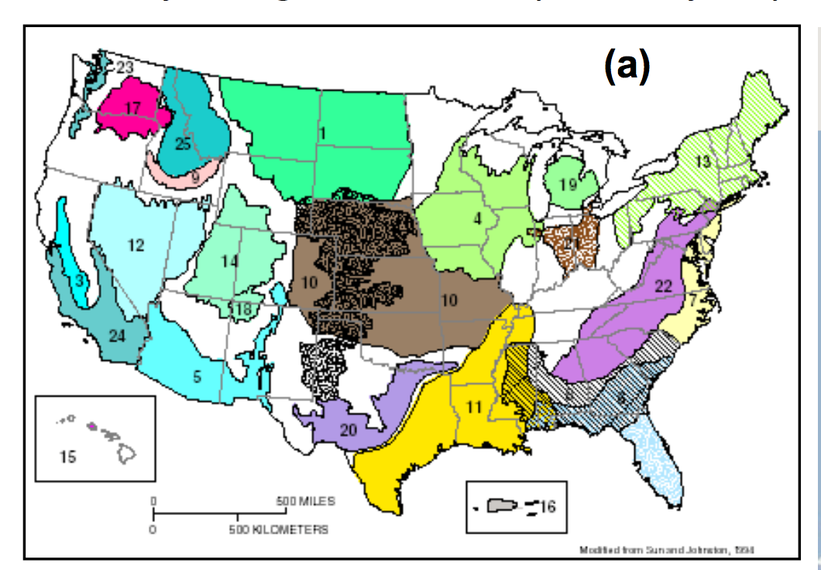
EarthCube
EarthCube: a large-scale effort to create
advanced cyberinfrastructure for
geosciences; a new model
a joint initiative of NSF GEO and ACI
SDSC projects:
Community
Inventory of
EarthCube
Resources for
Geoscience
Interoperability
Digital Crust
Also: GeoWS; IEDA Alliance

Slide 6
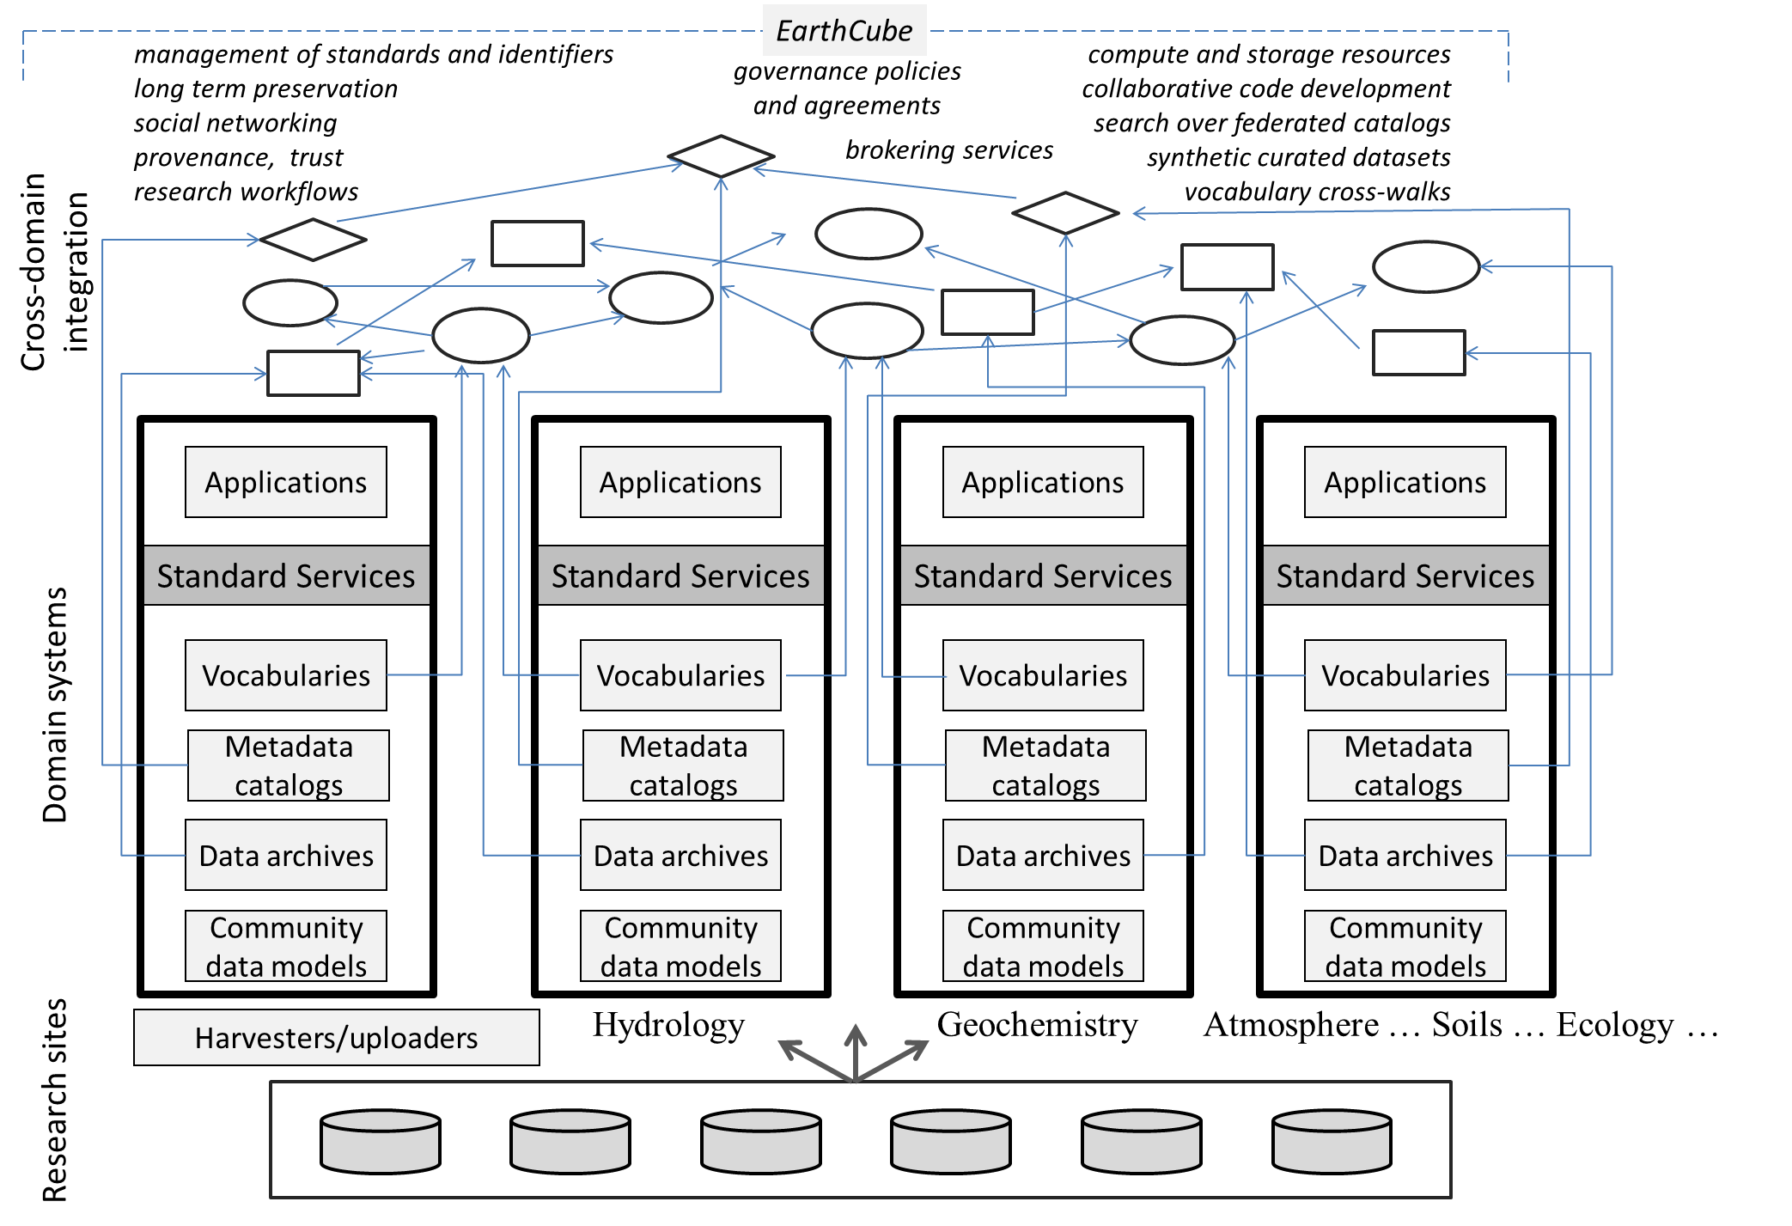

High-level EarthCube Model
feedback
Explore, Create, Use, Connect
feedback

Slide 7
Timeline
9/13
9/14
9/15
9/16
9/17
Planning
Demo
Enterprise Governance
Wkshps
RCN Pilot
RCNs
Building Blocks
Building Blocks II
Prototypes
Conceptual Designs
Refined Designs
TEG-Run Event
TEG-Run Event
EG-Run Event
EG-Run Event

Slide 8
~30 End-User Workshops
~2,500 participants, multiple agencies (NOAA, NASA, USGS, USDA, NRL, +)
Earth ~70%
Ocean ~60%
Atmosphere ~30%
Polar - distributed
Ocean
Atmosphere
Atmosphere,
Earth
and Ocean
Earth
and Ocean
SURVEY
Earth
Notes:
Getting Science done now and in the future--Science drivers and aspirations
Similar barriers and challenges across communities
There are many similar activities/solutions to barriers without much cross-communication
Assessing distribution of resources (data and CI) and access to them
Same outputs: simple exec summary
identify community leaders – many are early career
Fields identified by POs; help organizing
Some communities are not here.This is not a complete set, but don’t expect it to be.

Slide 9
EarthCube: principles
Science-driven and data-driven
Supports articulating and matching user needs with technical capabilities and expertise
Evolutionary
Interoperable, modular building blocks, based on standard services
Community ownership model
Sustainable
Fosters open science practices
Distributed system of systems
Scalable and flexible
Knowledge-rich components
Supports trust and reproducible science

Slide 10
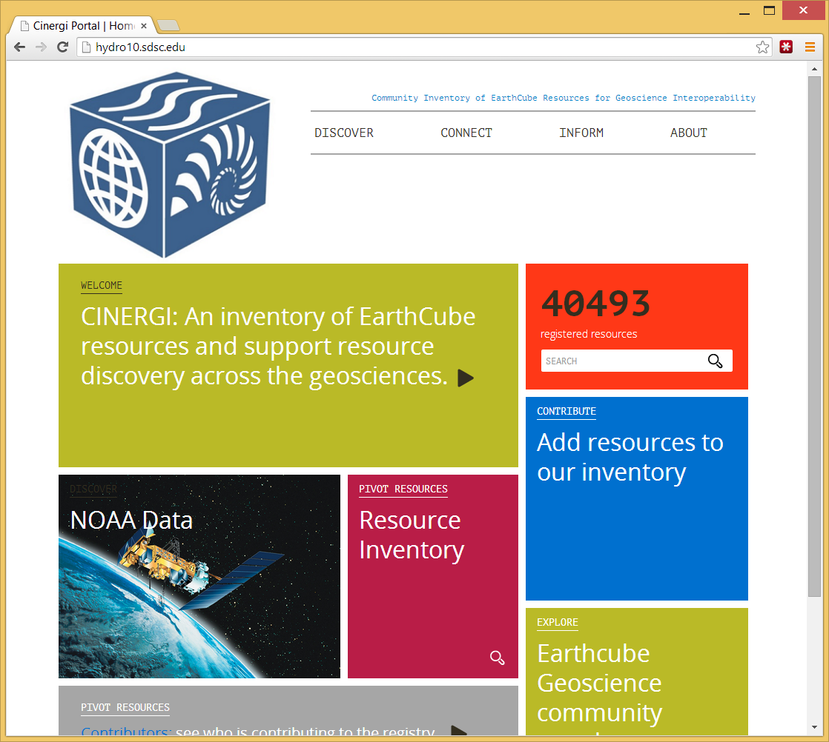
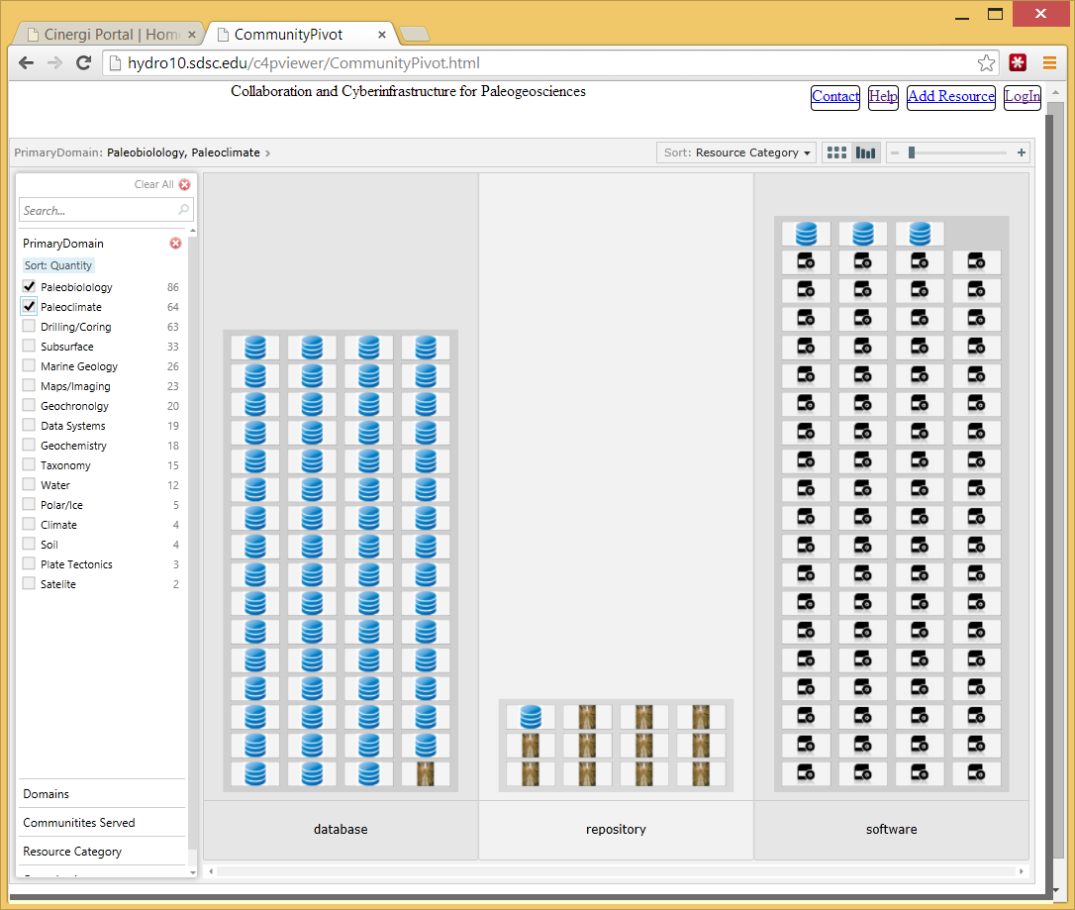
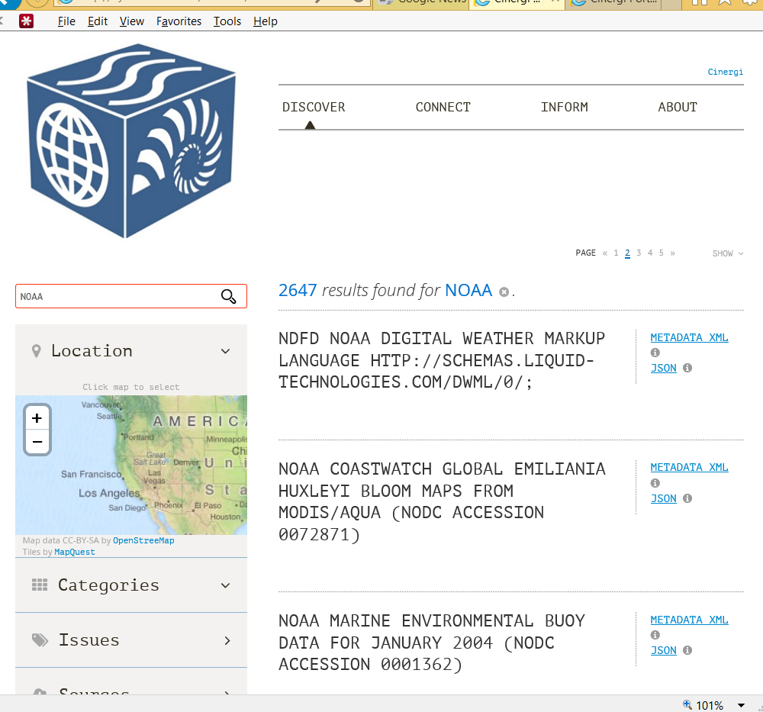
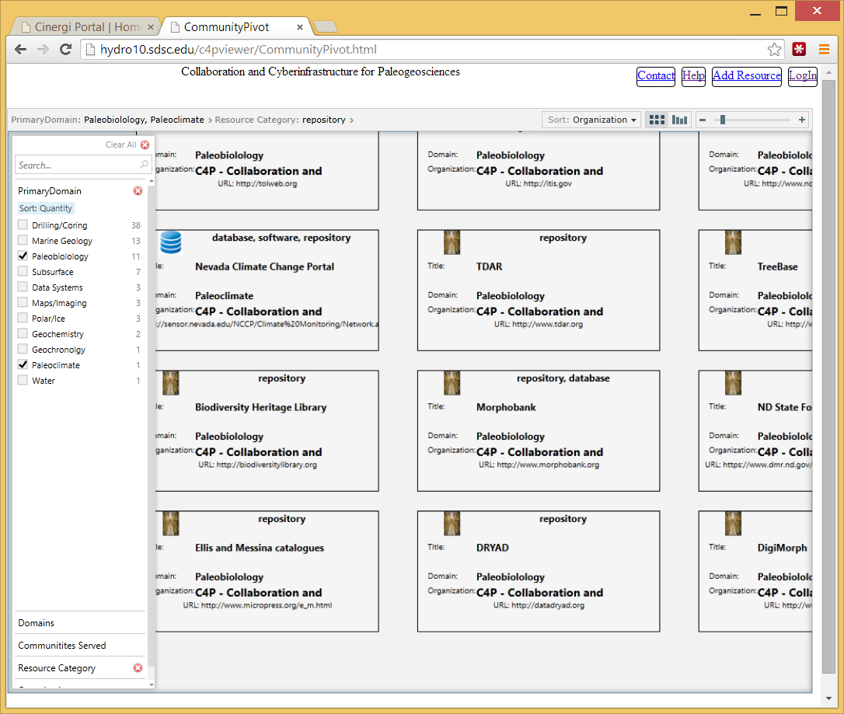
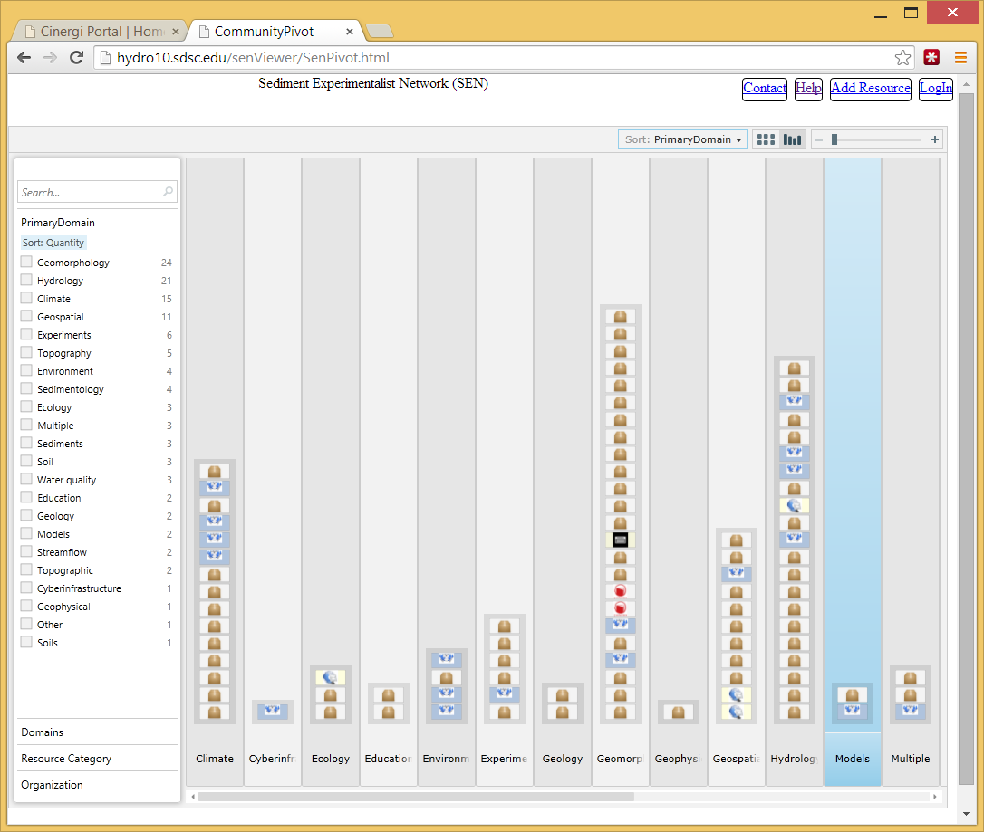
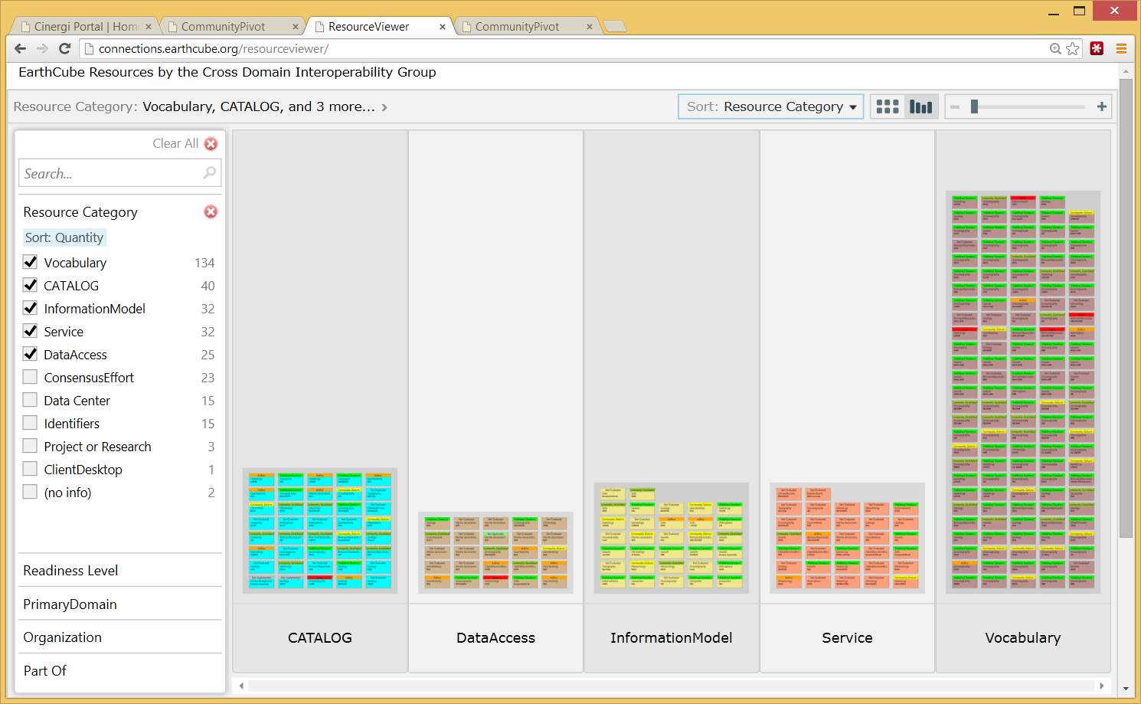
Metadata aggregation in CINERGI
Domain Inventories
CINERGI Metadata Pipeline
RCN
(Research Coordination
Networks)
Domain workshops
High-level assets
Catalogs

Slide 11
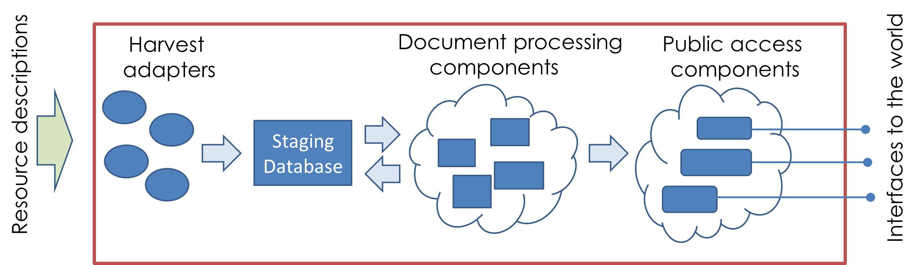
CINERGI metadata harvesting and content enhancement
Harvest adapters: description of information sources , allows connection and ingestion
Staging database: persist original harvested descriptions and updates from processing/curation
Document processing components: enhance content or presentation, update provenance record
Public access components: external interfaces to present content for users

Slide 12
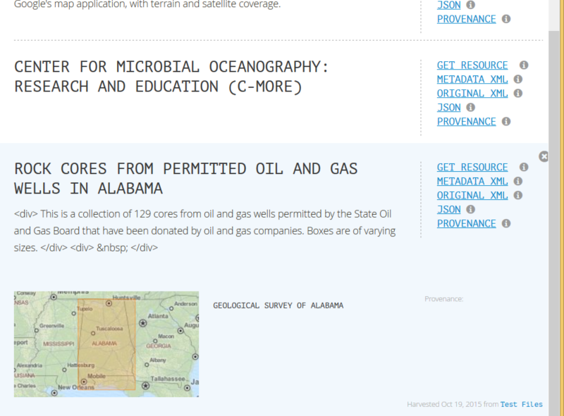
Content enhancement components
Common enhancer API
Provenance recording:
W3C PROV and Neo4J
Spatial enhancer
(bounding boxes)
Keyword enhancer
  Materials; Processes;
  Equipment; Methods;
  Features; Activities;
  Science Domains;
  Geologic age;
  Organizations;
  Resource types
  SciGraph API for
  semantic processing
Validation and provenance components

Slide 13
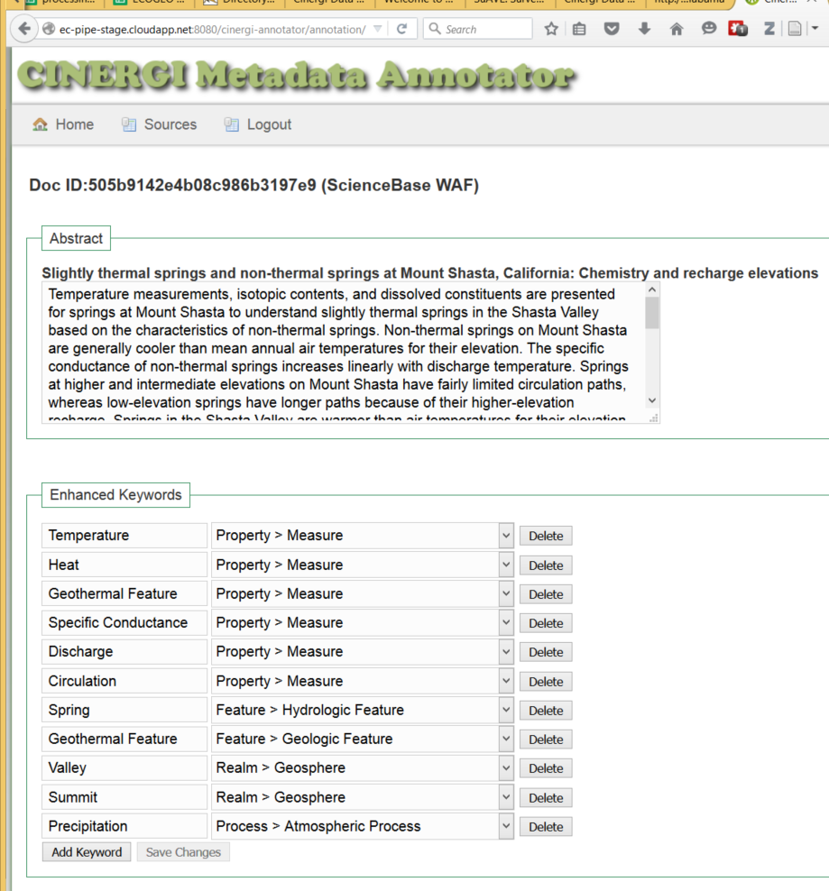
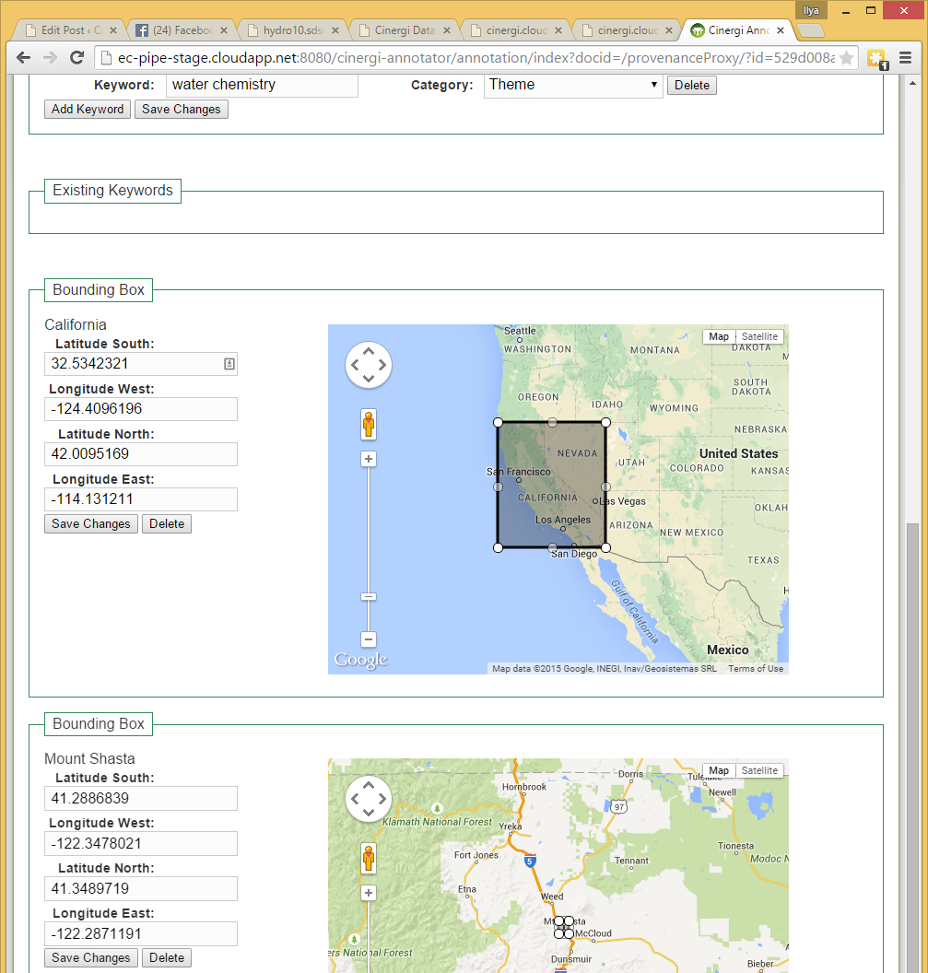
Manual
Review of
Keyword and
Location
Assignments for Machine
Learning

Slide 14
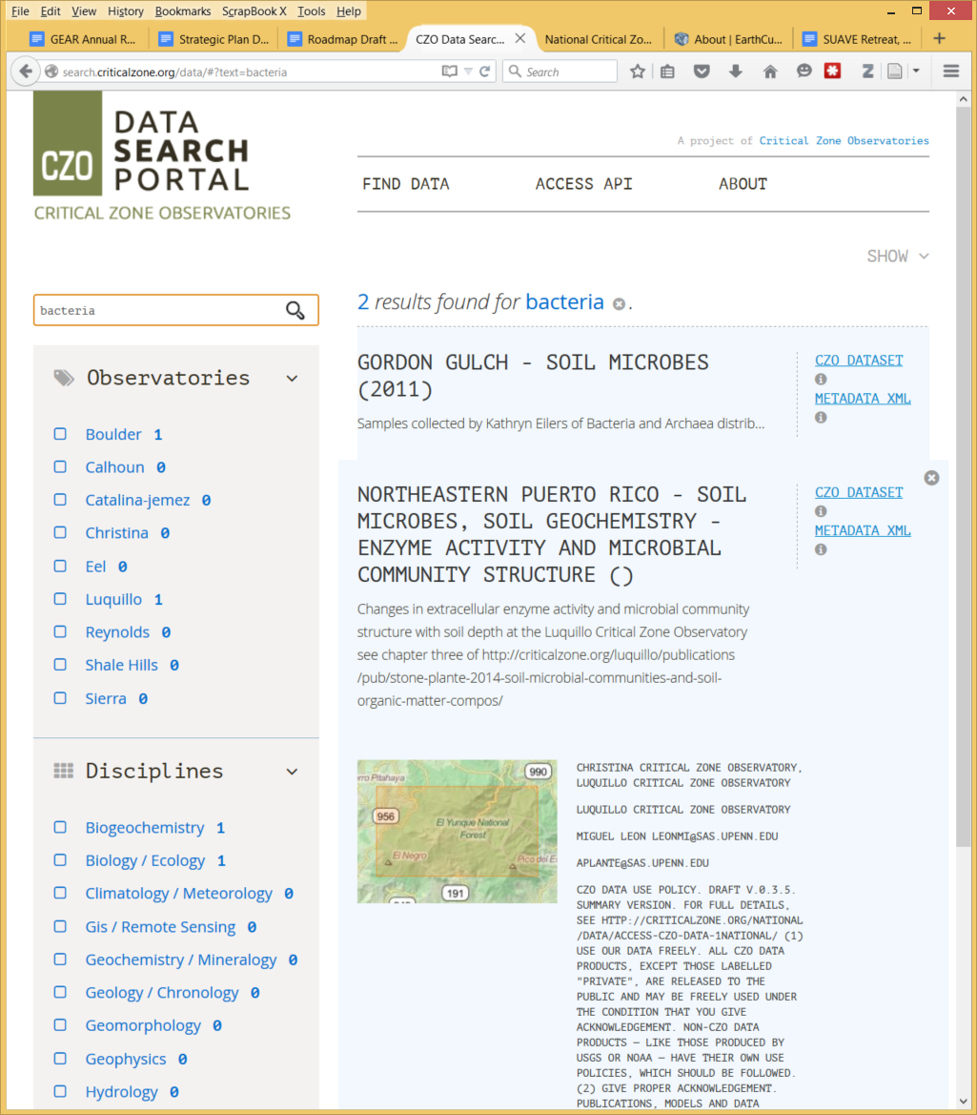
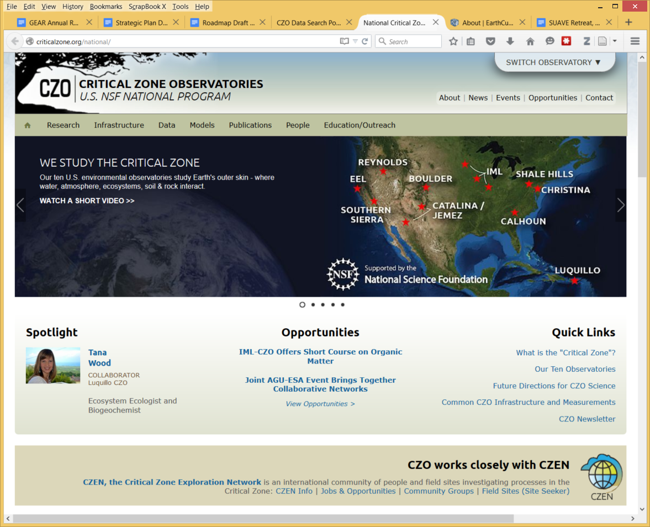
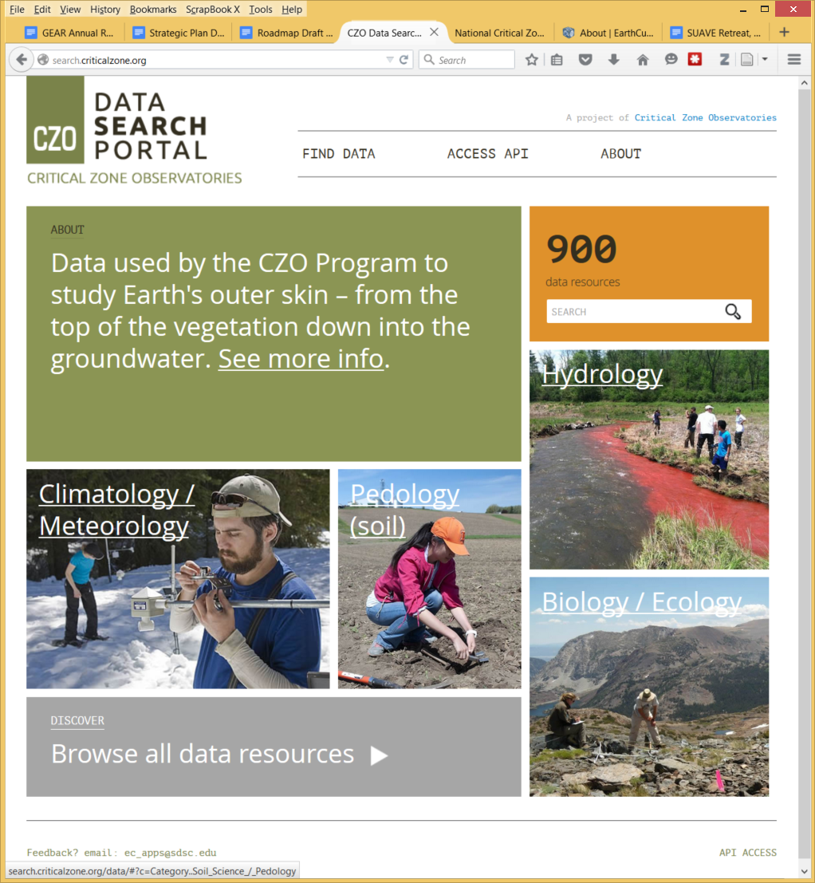
Critical Zone Observatories
Cross-observatory data search and download
Front-end and data
submission/registration

Slide 15
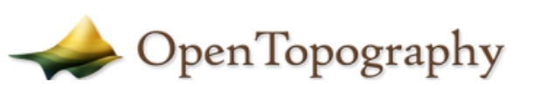
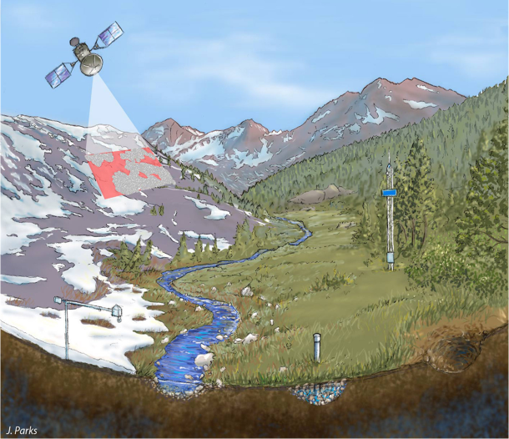






Leveraging other systems
Well-defined information models
Standard services for data discovery and access
Formal semantics, vocabulary management
Common data submission and discovery portal

Slide 16
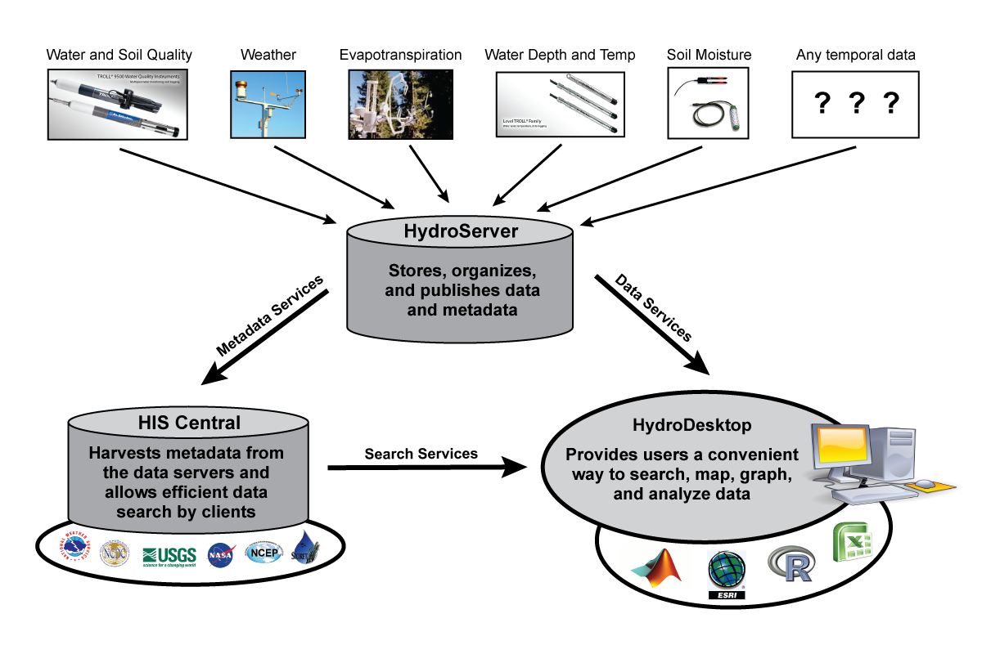
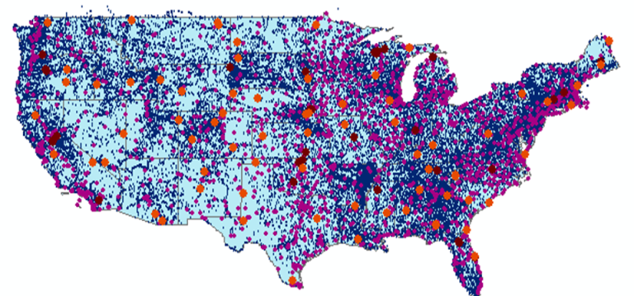
Sharing Water Observations
Over 100 registered water data services
2,600+ measured properties
1.25 million locations
Referencing 400+ billion
data values
Continuously updated
CUAHSI Hydrologic
Information System

Slide 17
A common situation in hydrology…
Hydro Jack
Need flow data!
Don
Hmm maybe Don can help…
*RING RING*
Hi Don, I need some upper Derwent flow readings for my geochemical model. Any ideas?
To: Jack
01/02/09, 3.2, 3, 1
01/02/09, 3.1, 3, 1
Hmm, I’ve got one site. I’ll send it through…
*RING RING*
Ok. Got the data. Where is the site located?
10 minutes…
10 minutes…
Oh, it’s at laughing jack bridge.
Ummm. (papers shuffle)
147.123 -41.588
Coordinates?
What reference system??
I think it’s GDA94
Ok. What sensor is used?
It’s calculated from the stream gauge reading using a rating curve..
Oh…how accurate is that?
Umm......
DON?
*CLICK*
From Peter Taylor (CSIRO)

Slide 18
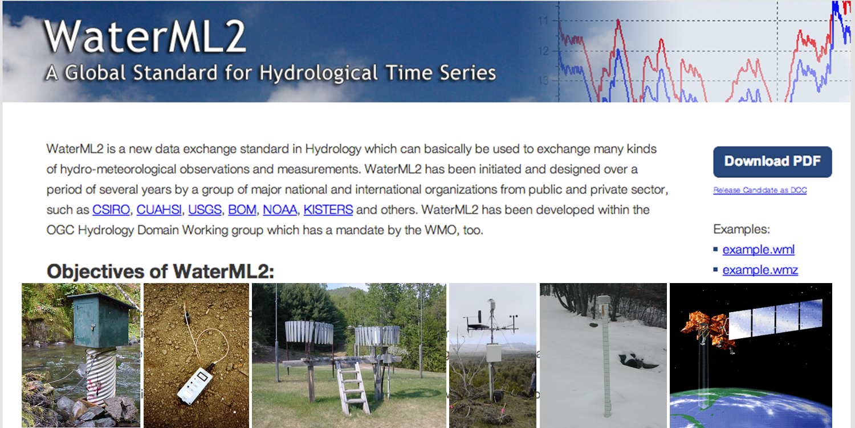
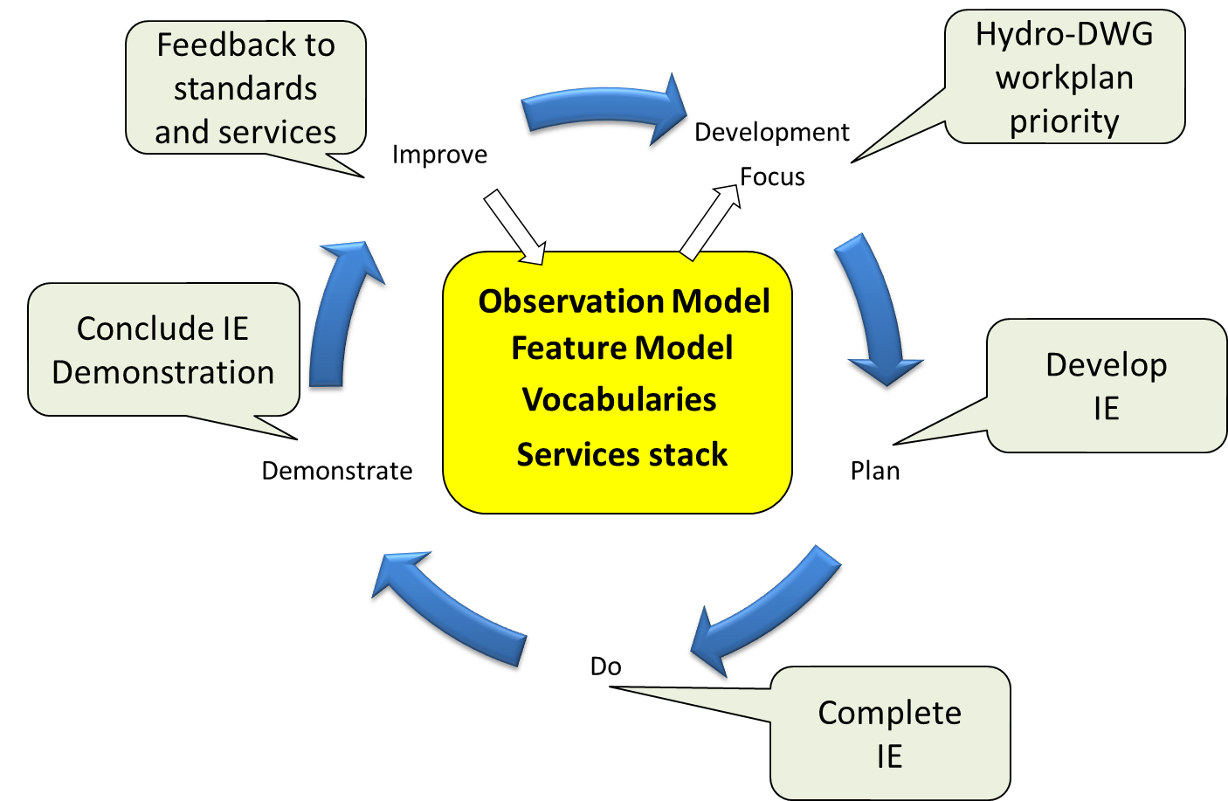

International Standardization for Water Data
OGC/WMO Hydrology Domain Working Group
  standards for water data: WaterML 2.0 suite
  organizing Interoperability Experiments (IEs) focused on different
  sub-domains
  of water
Iterative Development
Chairs: Tony Boston (Australia),
Silvano Pecora (Italy),
Ilya Zaslavsky (USA)
http://external.opengis.org/twiki_public/bin/view/HydrologyDWG/WebHome

Slide 19
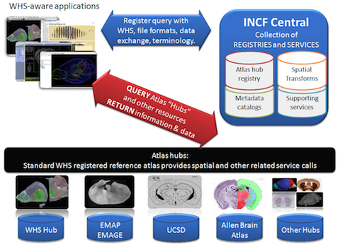

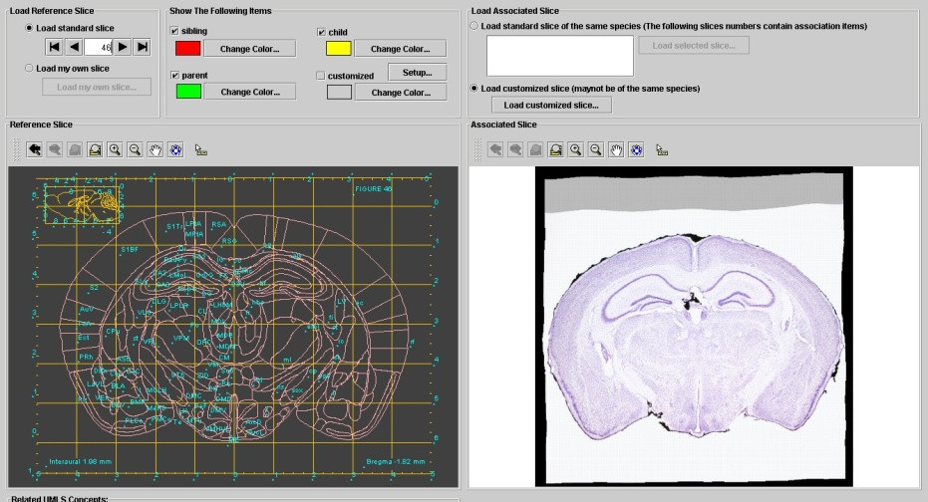
Sharing Brain Atlas Data
Development of standard web services
to share and integrate information
across several brain atlas projects:
nomenclature, tissue descriptions, gene
expression, images, annotations, etc.
Zaslavsky I, Baldock RA and Boline J (2014) Cyberinfrastructure for the digital brain: spatial standards for integrating rodent brain atlases. Front. Neuroinform. 8:74. doi: 10.3389/fninf.2014.00074

Slide 20
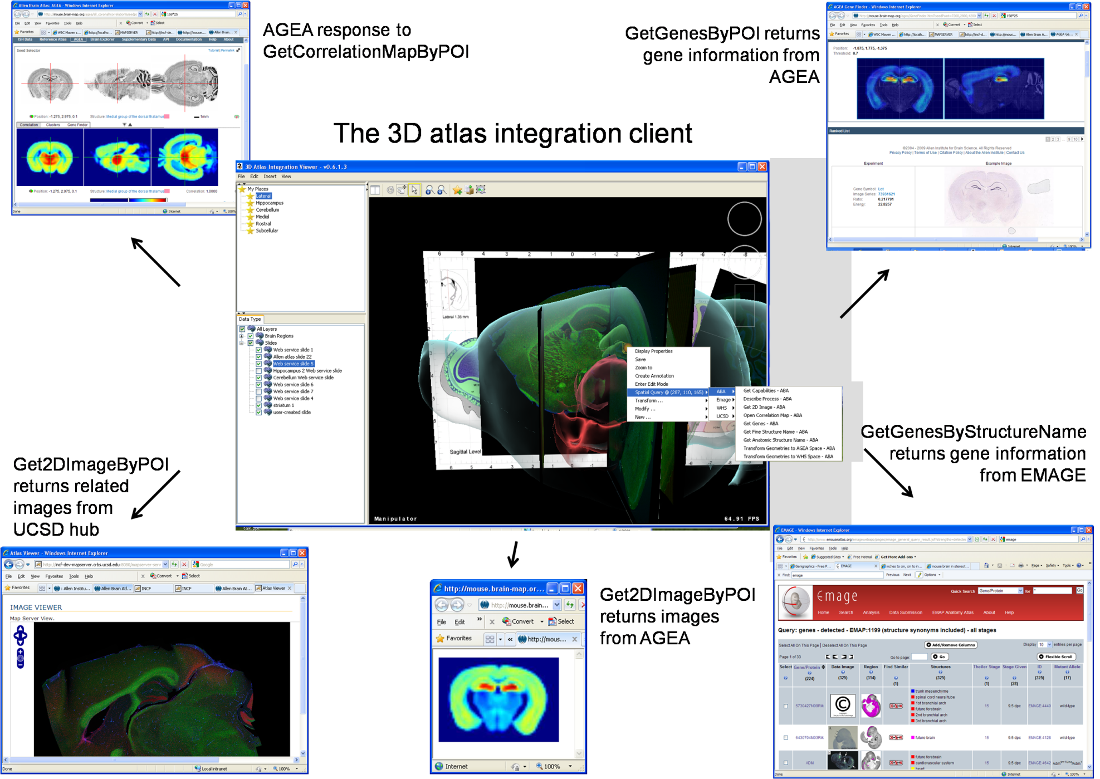
Accessing atlases from the Whole Brain Catalog

Slide 21
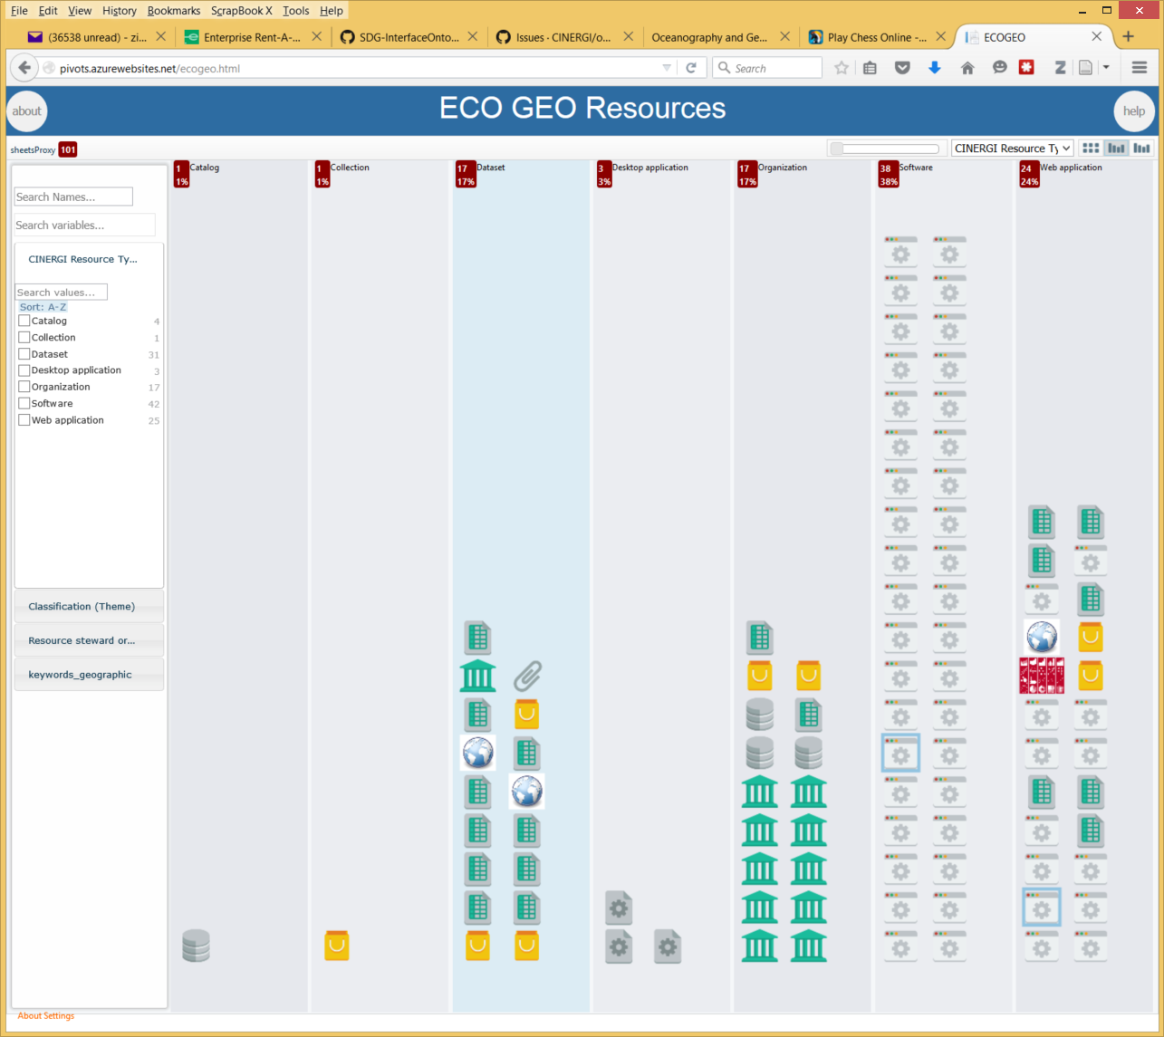
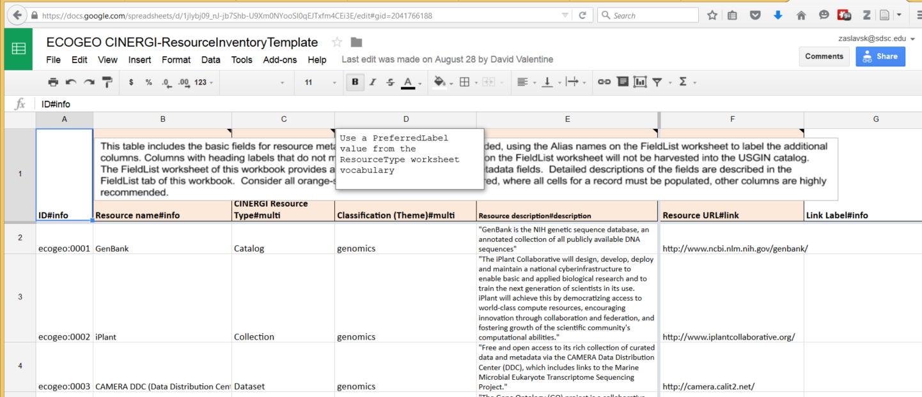
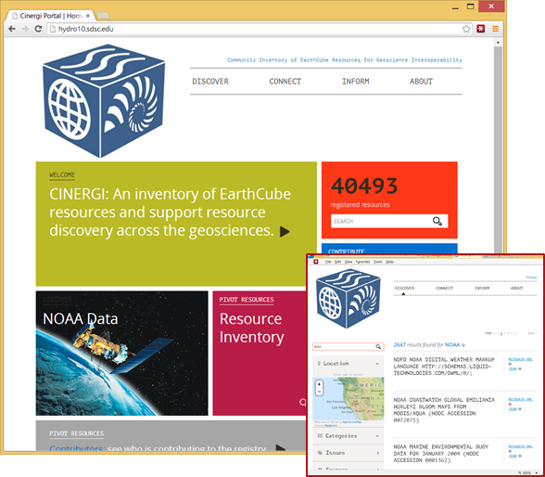
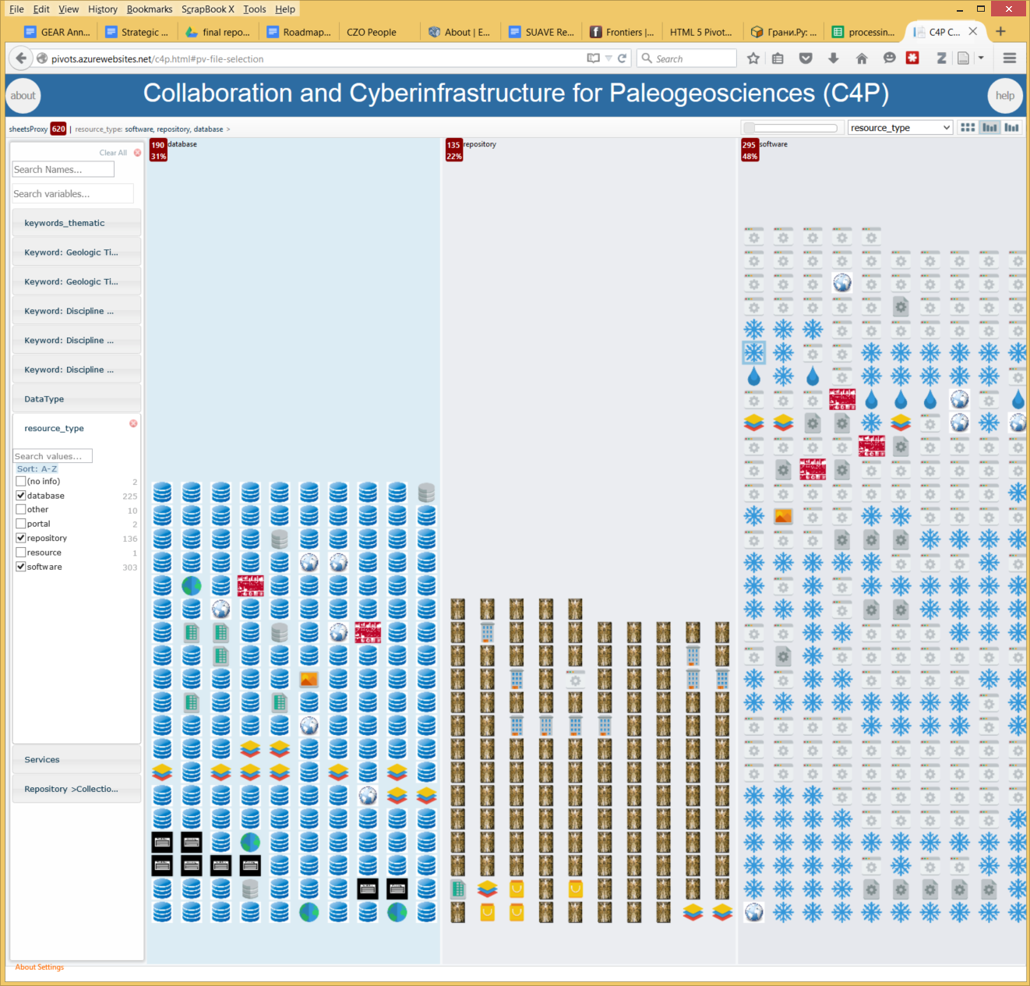
Beyond sharing data
Sharing other resources
  Resources assembled by ECOGEO:
  “EarthCube Oceanography and
  Geobiology Environmental 'Omics”
pivots.azurewebsites.net/ecogeo.html
  Resources assembled by the EarthCube paleogeoscience RCN
CINERGI Portal

Slide 22
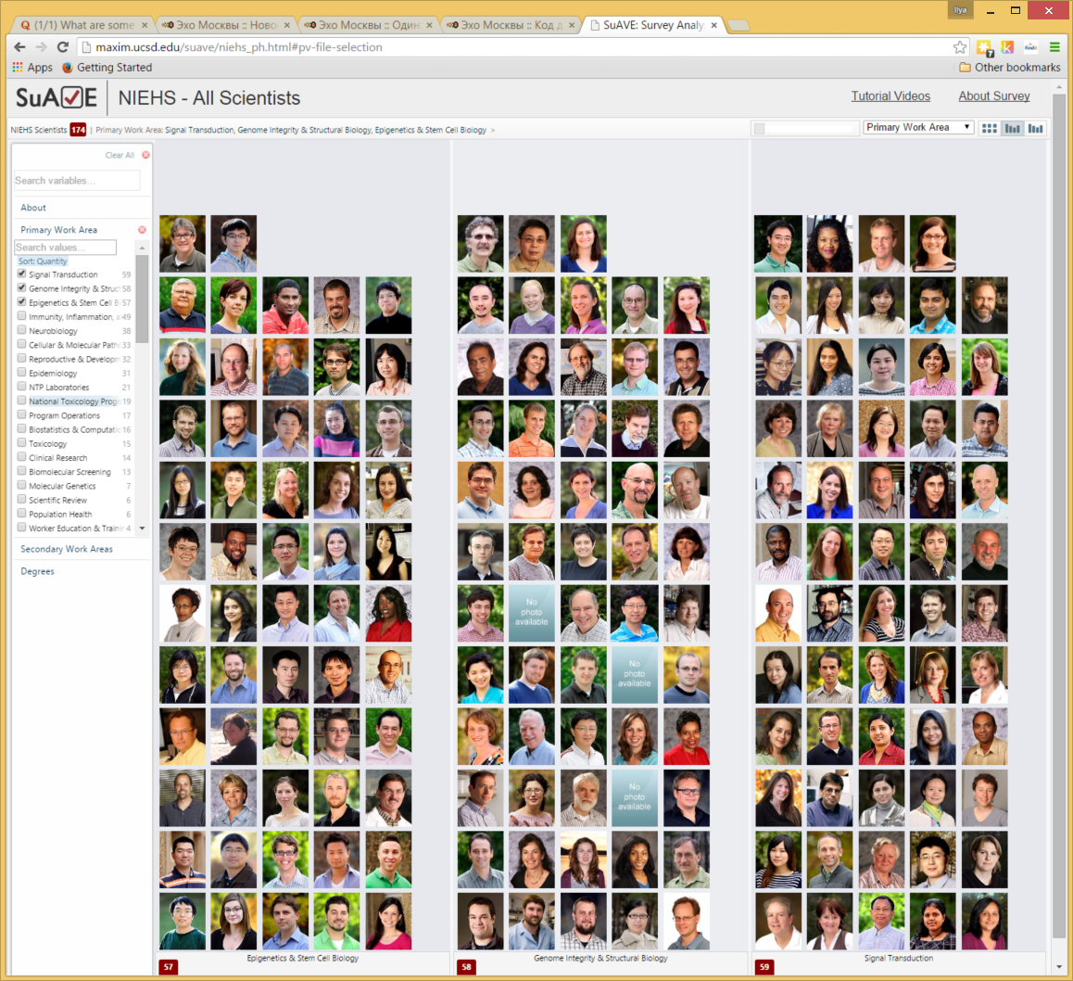
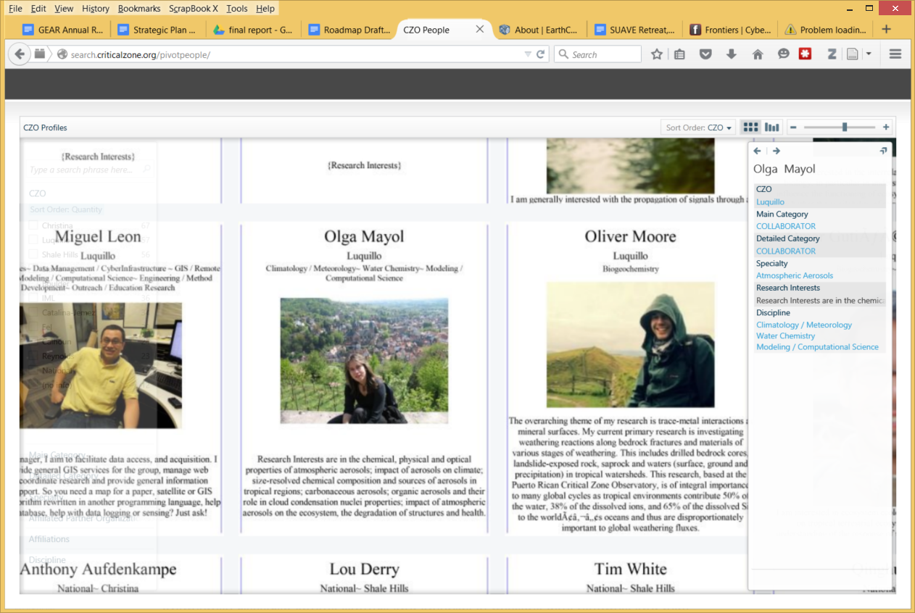
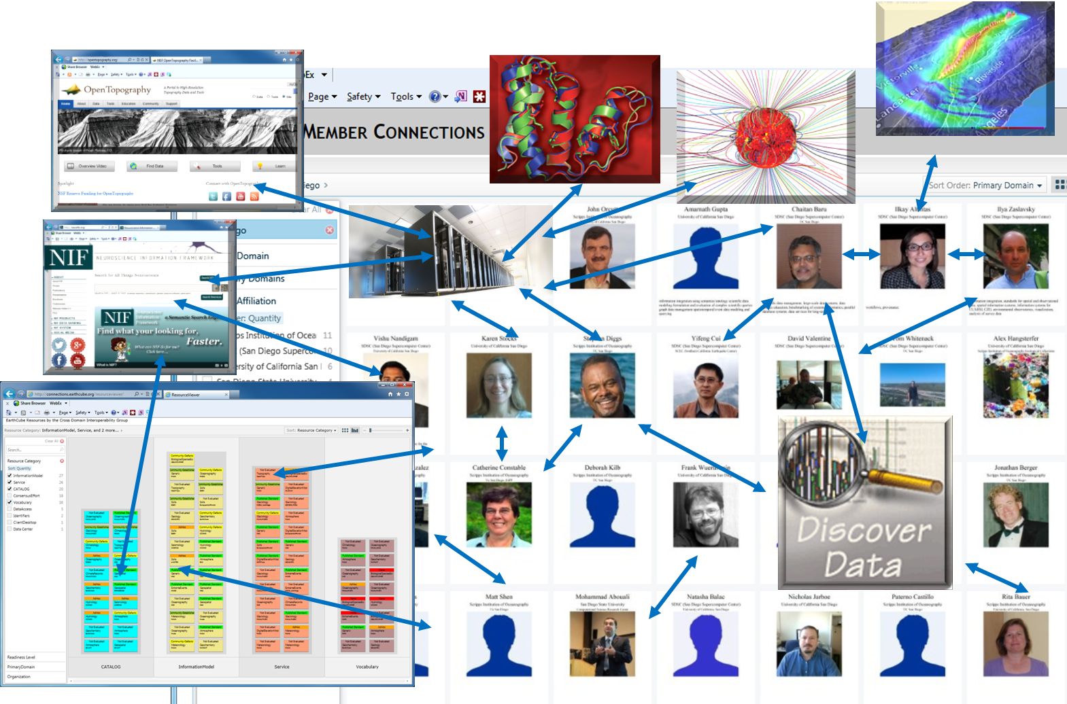

Connecting resources and expertise
maxim.ucsd.edu/suave/niehs_ph.html
Gallery of project members across CZOs
Survey Analysis via Visual Exploration

Slide 23
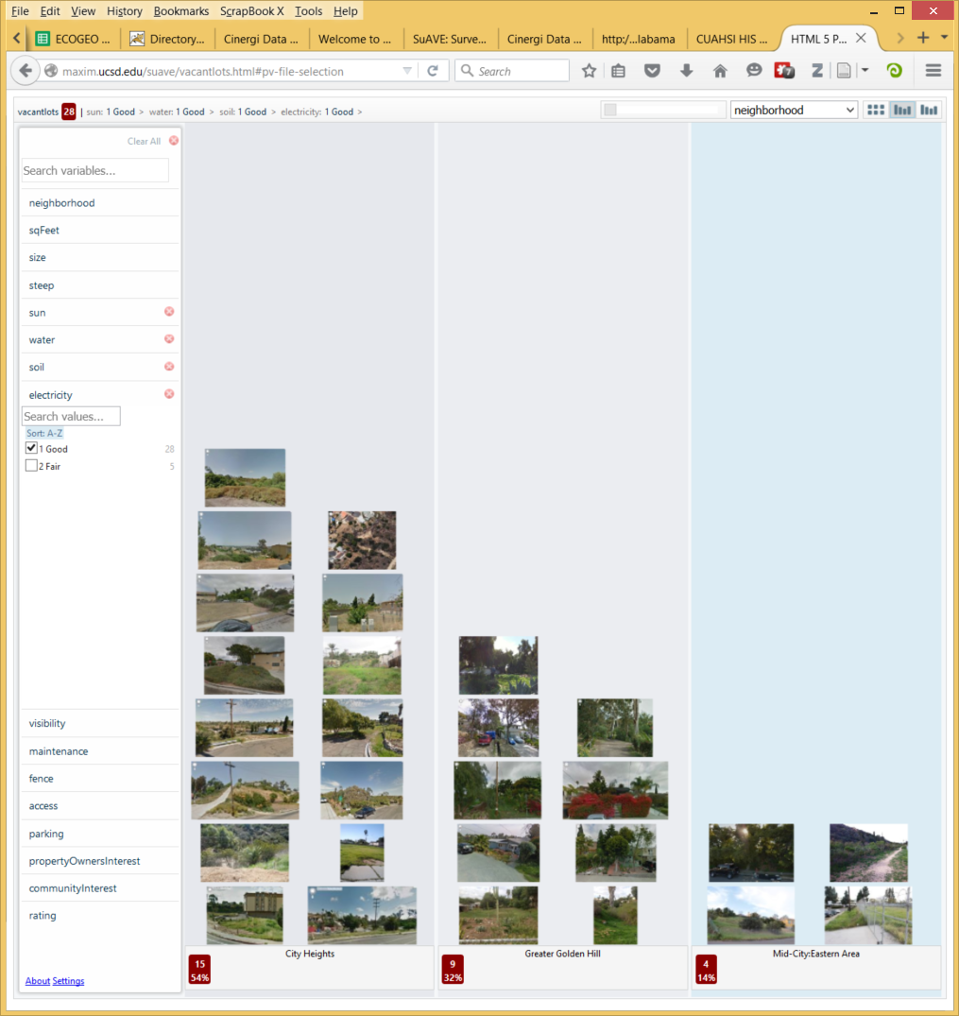
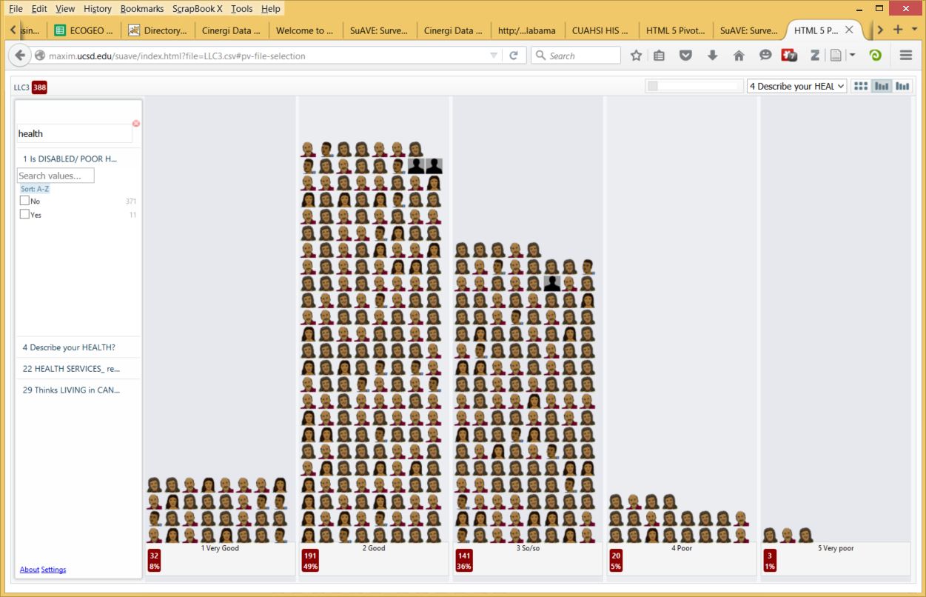
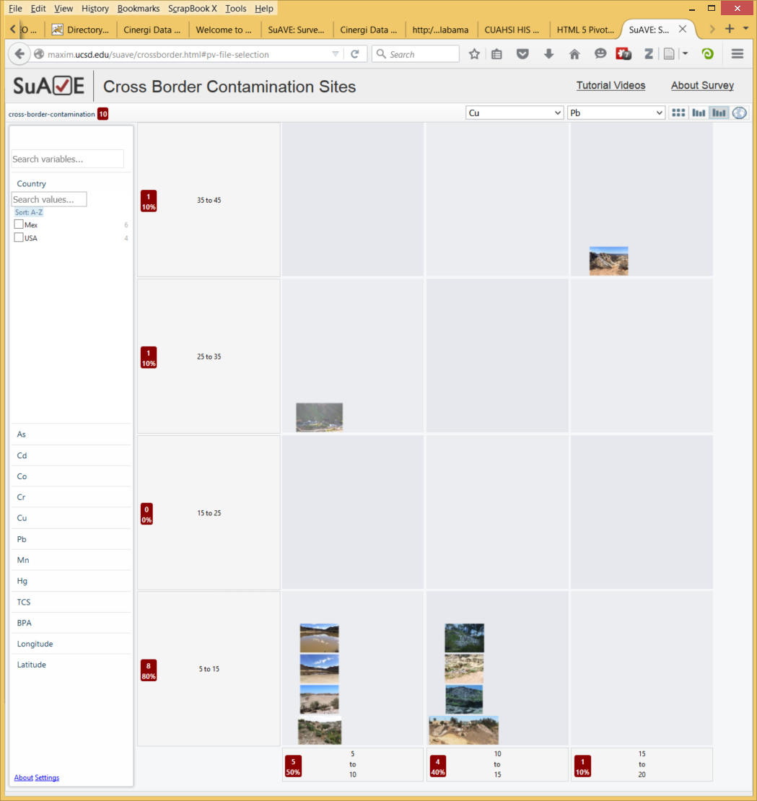
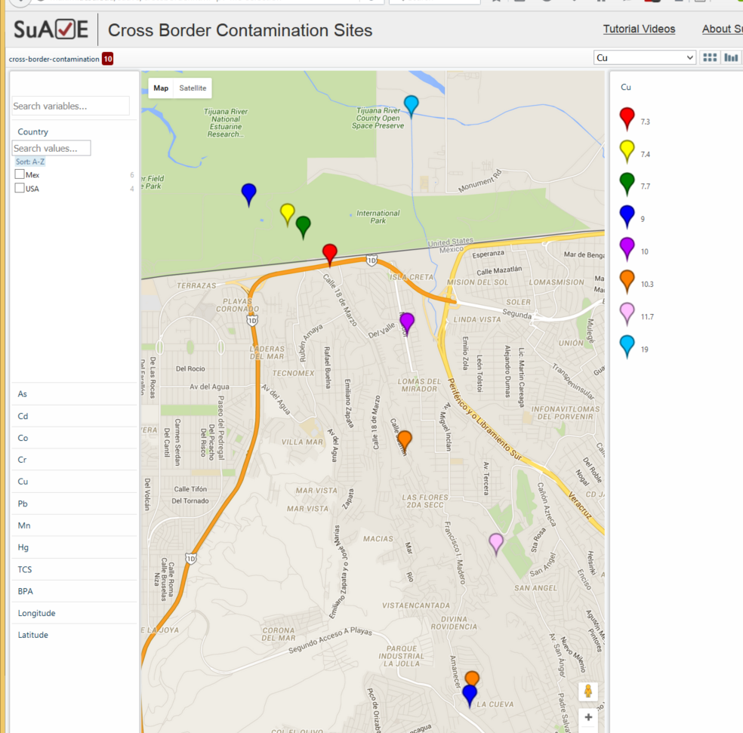
SuAVE in SRP RTC/CEC projects
Suitability of vacant lots for development:
  Household survey of health, health care, hygiene and social conditions in 4 colonias
  in Mexico:
  Cross-border
  contamination sites:

Slide 24
Lessons learned
Must be immediately useful, even before data sharing becomes the norm
Community building and understanding of use cases is critical
Visualization is critical
Must be supportive of careers
Social and organizational issues trump technical
It must be clear and super-easy for users and data publishers to join the system
Need to build on existing systems, but ready to evolve

Slide 25
First steps for SRP – for discussion
  An initial inventory of projects, datasets, and participants; making it available via a portal
    Projects and participants should be fairly easy to collect
  Collecting use cases, requirements and challenges
    Starting with two-three use case scenarios?
  Identify stakeholdes and plan community building
  Determine the scope: institutional scale of effort; funding
  Questionnaire:
    What do you have to share? Data types and formats?
    What data or resources from other SRPs are you interested in?
    Are you engaged in cross-SRP research and do you have adequate infrastructure support for this?
  A white paper on conceptual design for SRP data

Slide 26

References, URLs
Hydrology CI: Zaslavsky, I., and Maidment, D. R., (2011), “Service orientation in the design of a community hydrologic information system”, In G. R. Keller and C. Baru (eds.) Geoinformatics. Cyberinfrastructure for the Solid Earth Sciences, Cambridge Univ Press. pp. 193-209
Critical Zone CI: Zaslavsky, I., T. Whitenack, M. Williams, D. G. Tarboton, K. Schreuders, and A. Aufdenkampe, (2011) “The Initial Design of Data Sharing Infrastructure for the Critical Zone Observatory”, in Proceedings of the Environmental Information Management Conference, Santa Barbara, CA, 28-29 September, EIM'2011, pp. 145-150.
Brain Atlasing CI: Zaslavsky I, Baldock RA and Boline J (2014) Cyberinfrastructure for the digital brain: spatial standards for integrating rodent brain atlases. Front. Neuroinform. 8:74. doi: 10.3389/fninf.2014.00074
EarthCube: http://earthcube.org
EarthCube CINERGI: http://earthcube.org/group/cinergi
Critical Zone Observatories: http://criticalzone.org/, http://search.criticalzone.org/
SUAVE: http://besuave.azurewebsites.net/
Hydrologic Information System: http://his.cuahsi.org/, http://hiscentral.cuahsi.org/
INCF Digital Brain Atlasing: https://incf.org/activities/our-programs/atlasing
zaslavsk@sdsc.edu

