Slide 1


Integrating Data from Multidisciplinary Research:
Cross Domain Discovery and Integration
Chaitan Baru
Senior Advisor for Data Science
CISE Directorate
National Science Foundation
NIEHS Webinar
October 27, 2015
Image Credit: Exploratorium.

Slide 2
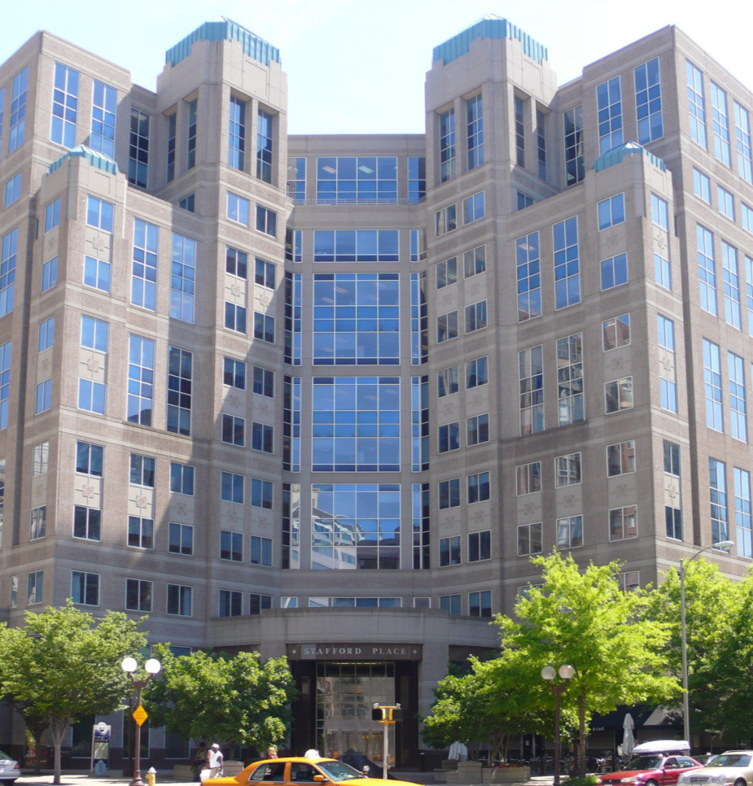

NSF’s Perspective and Role
The NSF funds basic, curiosity driven research
To promote the progress of science;
to advance the national health, prosperity, and welfare;
to secure the national defense....

Slide 3
NSF’s Big Data / Data Science Investment Strategy
Foundational research to develop new techniques and technologies to derive knowledge from data
New cyberinfrastructure to manage, curate, and serve data to research communities
Policy
New approaches for education and workforce development
New types of inter-disciplinary collaboration, community building
Notes:
Please identify, in a few high-level bullet points, the key FY 2016 priorities/goals of your agency’s research investments in this focus area. This information will help your group and the NCO develop the text for the SSG’s “Strategic Priorities” section of the Supplement.

Slide 4
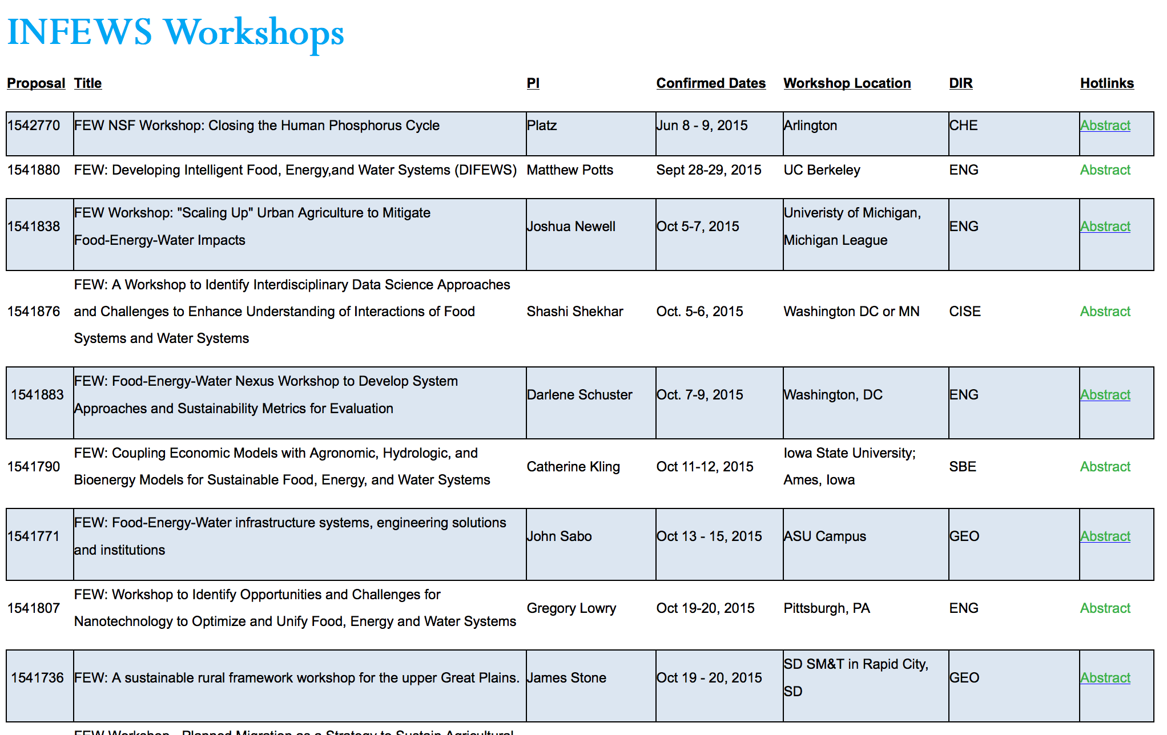

Slide 5
Programs Related to Data Integration
CISE
  III: Information Integration and Informatics
Cross-directorate
  DIBBS: Data Infrastructure Building Blocks
  INFEWS: Innovation at the Nexus of Food, Energy and Water
Multi-directorate
  EarthCube: EAR & ACI (Earth Sciences and Cyberinfrastructure)
  Designing Materials to Revolutionize and Engineer our Future, DMREF (MPS, ENG, CISE)

Slide 6
Data-Intensive Science
Past: Data producer often data consumer
Present: Greater number of roles for data management
  Data producers, data providers, data consumers, data stewards, etc.
  Emerging Policies: Data Management Plans, Data Citation, Public Access
Future: Solving grand scientific challenges will require
  New methods, algorithms, technologies for data-intensive science and data management
  Integration of diverse, distributed data sets within and across domains
  Increased understanding of research data quality and reliability
  Prioritizing and choosing data for retention
  More sustainable data infrastructure, community data governance, policy to ensure robust, reliable scientific discovery
  Data-savvy STEM workforce
Notes:
Borrowed from Jim Deshler
Add concept that Interoperability, multidisciplinary increase complexity
Earlier: Data producer often data consumer
Science question framed data capture and use
Data often “throw away” by-product of research
Now: Greater number of roles (and often distinct groups)
Roles
Data producers
Data providers
Data consumers
Data are recognized for long-term value
Require more organizational structure, including infrastructure, governance, policy, clarity of roles/responsibilities

Slide 7
Data Integration Issues
Creating venues for sustained multidisciplinary engagements
NSF Big Data Regional Innovation Hubs (BD Hubs)

Slide 8

BDHubs: What are the Benefits? Partnering?
Initiate Partnerships
Common Resources
Access to Top Talent
ShareD Best Practices
ReduceD Coordination costs
Hubs will bring together academia, industry, non-profits, and government to initiate new partnerships.
By collectively ideating and bringing together resources from across sectors, partnerships can drive faster innovation and more novel ideas
Participants can leverage the resources contributed by partners to Hub partnerships. Hubs can help develop “plug and play” infrastructure resources for partners.
Resource providers can find users that will develop novel applications for their infrastructure.
In a world where demand for Big Data talent far exceeds supply, Hubs will connect partners with students in academia.
Projects with academia will train those students in projects of interest to partners before they even leave school.
Big Data practices, especially in a socio-technical context, are increasingly complex.
Partners can develop and share best practices in areas such as privacy, discrimination, and ethics to ensure adoption while minimizing unwanted consequences.
Partnerships always come with a logistical cost. With BDHubs, NSF will fund the staff and logistics support necessary for more complex collaborations, reducing overhead and maximizing benefits for participants.
Achieve collectively what is impossible individually
Notes:
There are a lot of benefits to Big Data stakeholders to think about partnering with other organizations, and the benefits tend to be different whether the organization is academic or industry or government, and on whether they are data providers, users, big organization and small organizations. I’m going to list a few of the top line broad benefits for why your organization might want to participate in this program.
The first advantage is of course the benefit of initiating new partnership and collective ideation. By interacting with other organizations, your organization will have access to a wider set of ideas and collective action, and getting help for your organization to pursue it’s own agenda or mission. One might say that it parallels of the benefits of “Big Data” and all the things that are made possible by merging disparate data sources!
The other is the benefit of working to pool resources and shared infrastructure that individual organizations might not have access to typically or scale to obtain by themselves. User will be able to leverage the resource contributed by other partners, and providers will be able to find users to test out or develop novel applications for that infrastructure.
A third point is connecting organization to facilitate better access to talent through our academic partners. As it is often pointed out, a data scientist is as rare as a unicorn– a mythical being that is often dreamed about but near impossible to find. We would hope that hub partners might be able to not only find some of these unicorns within the schools participating, but perhaps through specific partnership, give students training and experience while they are still in school working on specific problems that the partner might want to hire for.
A fourth benefit is around sharing best practices and similarly, working on standards. There are many topics where sharing best practices would benefit the community, but one particular one that has strong resonance in recent months is around privacy, discrimination, and the social and ethical implications of Big Data. People involved in data analytics everywhere are concerned and really still trying to sort the basics of what to do in these areas. So providing that healthy discussion and sharing of what we discover works and doesn’t work should help ensure adoption of technology while minimizing the unwanted consequences.
Finally the big advantage of NSF’s role in the Big Data Hubs program is that we’ve taken on funding a lot of the coordination costs that always comes with forming partnerships. As most people who have don’t this before know, there’s a very real dollars and cents cost to partnering with another group coming from just the logistics and planning. Through the program, NSF will fund the full time FTEs that will help organize the meeting, and we’ll fund the workshops and travel and other costs needed to get the partners together working efficiently.

Slide 9
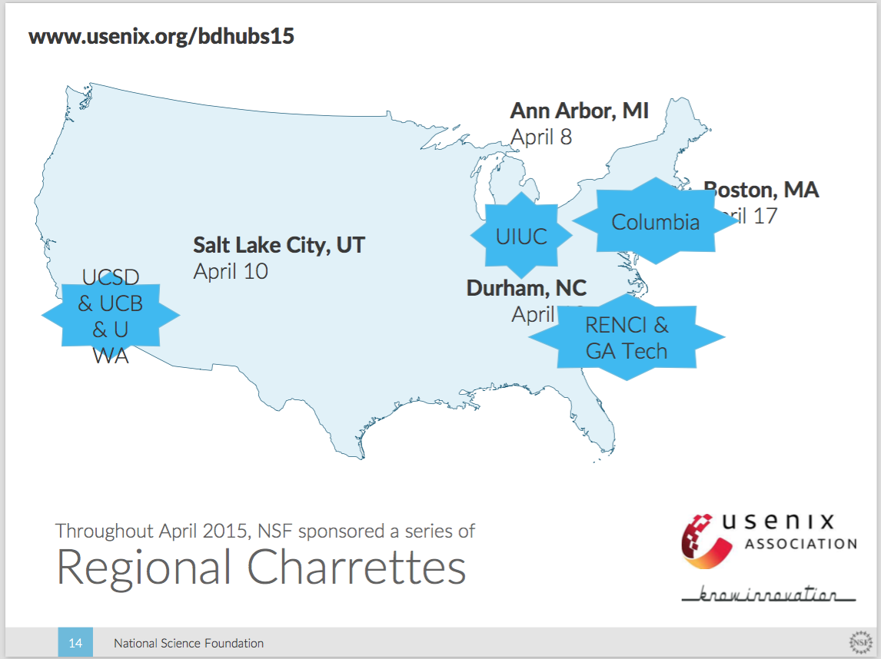

Slide 10
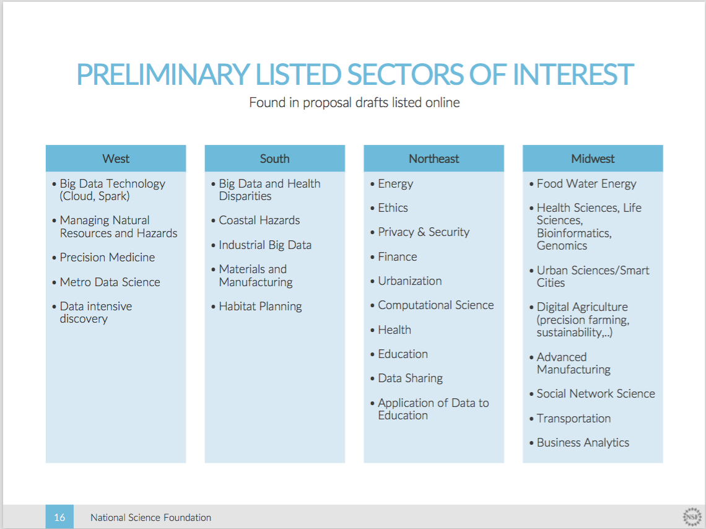

Slide 11
Community Building:
Upcoming Activities
BD Hubs Charrette meeting (by invitation, for BD Hubs awardees), Nov 3-5, 2015, Arlington, VA
Big Data Spokes (BD Spokes) solicitation under preparation
Meeting of Data Science Meetup groups, Nov 5-6, Arlington, VA
  Meeting of Meetup group coordinators

Slide 12
Community Building:
Upcoming Activities
Developing the “soft” architecture
  Standards
  Governance
RDA: Research Data Alliance, rd-alliance.org
  Completed their 6th Plenary Meeting, Sept 23-25, Paris, France
International Data Week 2016:
  BRDI: Board on Research Data and Information
  CODATA, ICSU, World Data Centers

Slide 13
Some Challenges
Providing research community access to increasing amounts of “real” data
Sustained platforms for data analytics
Dealing with data/language semantics
  Technological as well as cultural issues

Slide 14

Thanks!
cbaru@nsf.gov

