Slide 1
Children’s Health Exposure Analysis Resource (CHEAR)
CHEAR Center for Data Science
Susan Teitelbaum, PhD
November 4, 2015

Slide 2
CHEAR Objectives
Expand the number of studies that include environmental exposure analysis in their studies
Implement the exposome concept in children’s health studies
Create a public resource of children’s exposures across the country
Develop data and metadata standards for the environmental health sciences community

Slide 3
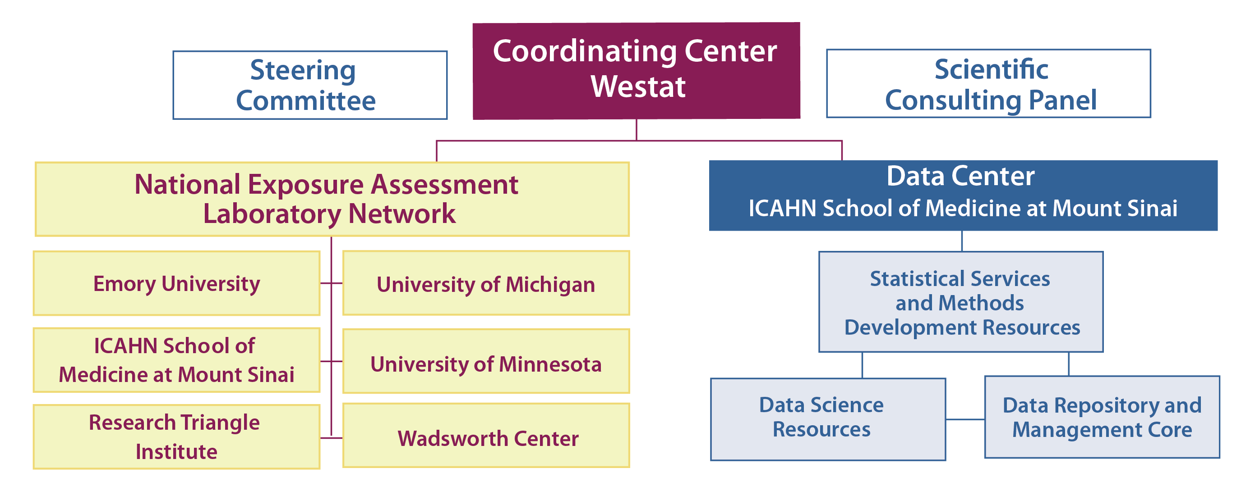
CHEAR Components
Notes:
National Exposure Assessment Laboratory Network(Lab Network or Hubs, RFA-ES-15-009) – A network of laboratories providing access to state-of-the-art infrastructure for analysis of biological samples as well as understanding biological responses associated with those exposures.
Coordinating Center(RFA-ES-15-011) –
Provide administrative management of the resource including:
Interface to the research community
Index of additional exposure analysis tools not included within the CHEAR infrastructure
The main access to CHEAR
Provide pre-application consulting services in support of study design and analysis
Develop and oversee a proposal process
Data Repository, Analysis, and Science Center(Data Center, RFA-ES-15-010) – A data and analytics support resource providing a repository for all data and support for statistical analysis and interpretation. This resource will also lead the development of community based data standards and support the development of technologies and metadata standards.

Slide 4
Data Repository, Analysis, and Science Center (Data Center)
A data and analytics support resource
Provides a repository for all data
Support for statistical analysis and interpretation
Lead the development of community based data standards
Support the development of technologies and metadata standards

Slide 5
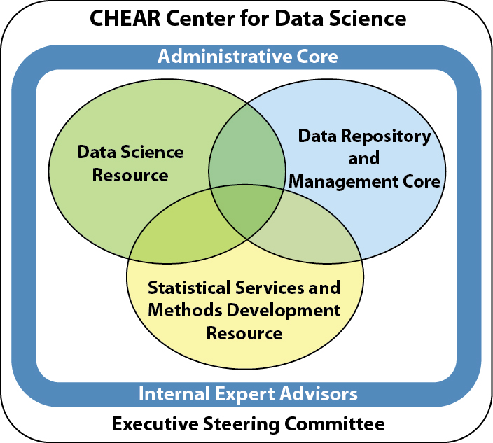
Data Center: Structure

Slide 6
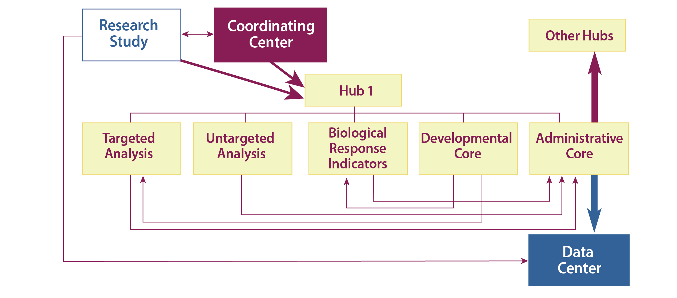
CHEAR Workflow

Slide 8


Data Repository and Management Core
CHEAR Center for Data Science
Patricia Kovatch
November 4, 2015

Slide 9
Building on existing expertise and infrastructure
We will
  Establish a repository for the collection, curation, display, storage, retrieval, integration, interoperability, and reuse of data
  Establish a data submission pipeline with the Lab Network
  Establish a user-friendly portal
Using our experience operating
  World Trade Center Health Program Data Center
  National data centers: e.g. Minerva has over 1,000 users (200 external), 11 petabytes of storage and 12,000 compute cores

Slide 10
Enhancing our effectiveness through partnership
Within the Data Center
  Deploy ontologies with Deborah, statistic tools with Chris
Throughout the CHEAR network
  Streamline process and protocols for data sharing, account validation, etc. with the Coordinating Center and Lab Network
Engage directly with researchers
  Collaborative tools on the portal
  User Engagement and Data Quality Assurance Boards
Engage nationally
    Link to national databases and integrate high dimensional data (Comparative Toxicogenomics database, dbGAP, EPA’s AirData, etc.)

Slide 11
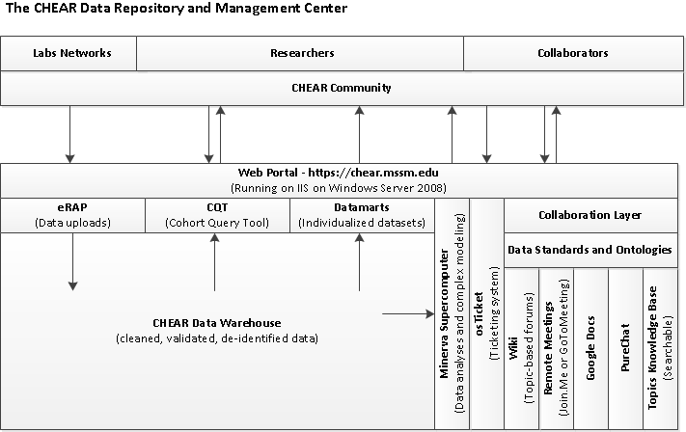

Slide 12
In the first year, we will
Setup initial data sharing, account validation policies with the Lab Network and the Coordinating Center
Deploy the web portal and ticket system
Deploy the CHEAR data ingest tool, data warehouse and Cohort Query Tool
Test and validate the infrastructure with friendly users in the Lab Network
Create training videos, documentation

