Slide 1



Data Science Core
CHEAR Center for Data Science
Deborah McGuinness
Tetherless World Senior Constellation Chair
Professor of Computer, Cognitive, & Web Sciences
Director RPI Web Science Research Center
RPI Institute for Data Exploration and Application Health Informatics Lead
Adjunct Icahn School of Medicine at Mount Sinai
November 4, 2015

Slide 2
Data and Metadata Standards
“…the Data Center will work with the Laboratory Network and the Coordinating Center to identify and implement existing data and metadata standards to support the establishment of the infrastructure. The Data Science Resource will also lead a longer term, stakeholder-driven process to extend these and identify and address key gaps in existing standards in exposure domains represented in CHEAR. Data and metadata standards being developed and/or used in CHEAR will be catalogued and made available to the broader scientific community.”
From http://grants.nih.gov/grants/guide/rfa-files/RFA-ES-15-010.html

Slide 3
Vocabulary (family) for Exposure Science Community
“Lead a community of stakeholders with expertise appropriate for data standards development (e.g., ontologists, bioinformaticians, domain experts, technical developers) in the process of developing/adapting and implementing data/metadata standards for exposures, including approaches to: survey the landscape of existing data standards in the environmental domain to identify gaps or potential overlaps in standards, standards currently in development (e.g. ExO), and opportunities to build on current efforts;
Identify and prioritize use cases around practical data issues of immediate relevance to CHEAR to address gaps in data/metadata standards; and
Manage an iterative process of accessing, extending, developing, testing, and implementing data standards based on the use cases”
From http://grants.nih.gov/grants/guide/rfa-files/RFA-ES-15-010.html

Slide 4
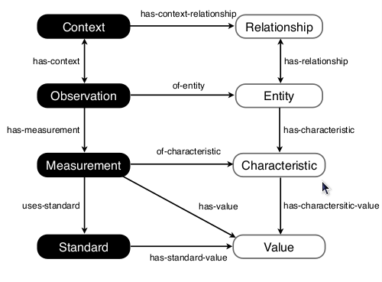
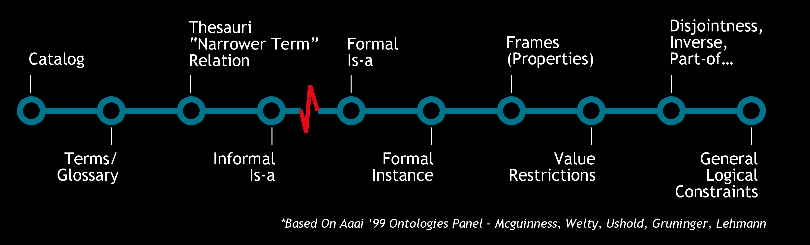
Ontologies
An ontology specifies a rich description of the
Terminology, concepts, nomenclature
Relationships among concepts and individuals
Sentences distinguishing concepts, refining definitions and relationships (constraints, restrictions, regular expressions) relevant to a particular domain or area of interest.
* Based on AAAI ‘99 Ontologies Panel ̶ McGuinness, Welty, Uschold, Gruninger, Lehmann
Deborah L. McGuinness. ``Ontologies Come of Age ''. In Dieter Fensel, Jim Hendler, Henry Lieberman, and Wolfgang Wahlster, editors. Spinning the Semantic Web: Bringing the World Wide Web to Its Full Potential. MIT Press, 2003.

Slide 5
Use Case Approach
Using a well used use-case driven methodology
NIH also has recognized this approach
  Keynote at BD2K Workshop on Community-based Data and Metadata Standards Development: Best Practices to Support Healthy Development and Maximize Impact: http://1.usa.gov/1JeEI9P
Starting points exist for use cases
  See a use case document with annotation: NIEHS Vocabulary Standards Use Case Template 1.23.15 at: http://bit.ly/1Jv5aHO from an NIEHS meeting in Jan 2015

Slide 6
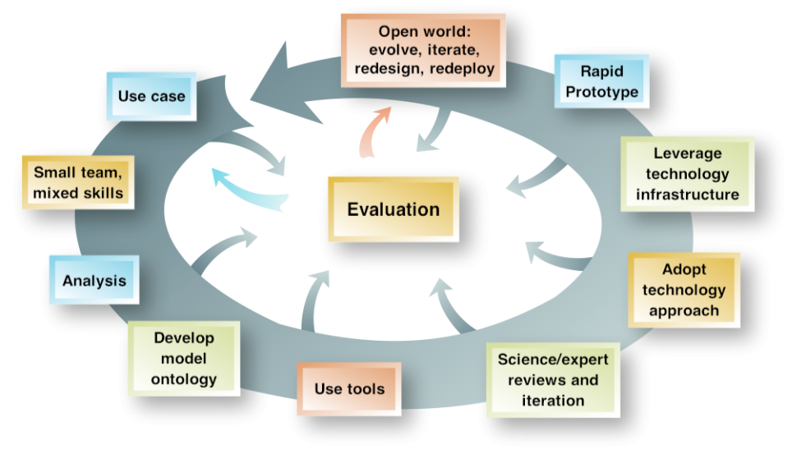
Use Case Driven Methodology
Originally developed for Virtual Observatories (in large physical observing centers – e.g., NCAR)
Now widely reused in many areas of natural science
Basis of semantic eScience class
McGuinness, Fox, West, Garcia, Cinquini, Benedict, Middleton The Virtual Solar-Terrestrial Observatory: A Deployed Semantic Web Application Case Study for Scientific Research. Innovative Applications of Artificial Intelligence http://www.vsto.org
McGuinness, Lebo, Ding, McCusker, Shaikh, Moser, Morgan, Tatalovich, Willis, Hesse, Contractor, Courtney: Towards Semantically Enabled Next Generation Community Health Information Portals: The PopSciGrid Pilot. HICSS 2012:
Successful Semantic eScience Methodology
http://tw.rpi.edu/web/doc/TWC_SemanticWebMethodology

Slide 7
Vocabularies / Resources
Use Cases, data schemas, and advisors identify starting points: http://bit.ly/1LAjFyK
Mount Sinai/RPI has worked with many vocabularies and resources
RPI has worked with many relevant vocabularies and resources:
  ReDrugS: Bio2RDF, iRefIndex (and all protein-related subcomponents), GO, OMIM, UniProt, Drugbank, SIDER,
  SemNExT: Cortecon, GO, Ensembl, UMLS, NCBI gene, PROV, datacube vocabulary, String-DB, …
  MediNet: UMLS, SNOMED-CT, ICU logs, health bulletin boards, ….

Slide 8
Outreach, Input, Scoping
Data Standards Working Group
Workshops: 3 planned
Publish early and often – Web Observatory portal
  Downloadable ontologies (also plan to publish to bioportal)
  Browsable
  High level conceptual maps (cmaps)
  Plan to put up a wiki to support input
  Transdisciplinary leadership helps with outreach to many communities
  Leverage linkages to active communities such as Healthy Birth, Growth, and Development Knowledge Integration, …

Slide 9
DOMAIN-DRIVEN ONTOLOGY DEVELOPMENT: SOURCES, WORKFLOW, TOOLS, INTEGRATION
Sources
Generated Vocabularies[1]
Knowledge
Base
Integration
Use Cases [1]
* Driving Questions
* Resource Discovery
* User Stories
Generated Ontology
* (list ontology features)
Concepts
Spreadsheet[2]
Automated
Tools
Repository
Integration
Existing Ontologies
& Vocabularies [1]
Expert
Guidance
Operational Definitions [1]
Ontology Browser
* Designed for collaboration
* Integrated commentary
* Provenance recorded
* (other OB features)
Knowledge-
Enhanced
Search
Database Schemas
& Data Dictionaries [1]
Ontology
Curation
(ongoing)
Expert Interviews
(Internal Team)
Expert Collaboration
(External community)
Reviewers & Curators
* Ontology Development Team
* Domain collaborators
* Invited experts (domain, ontology)
* "Consumers" (data analysts)
[1] Crowdsourced (Google Docs, Sheets, etc) e.g.
CHEAR DataScience Ontologies/Vocabularies
[2] See backup slides for details
Notes:
TODO
- get an updated spreadsheet with just column headers that are NOT external project dependent
- get updated screen shots that have some small amount of exposure-related content and NOT external project content (except ok to use terms from external ontologies that are imported into external project
- determine what goes in backup slides - expected links to google docs
- need updated pointer to ontology browser with chear content - https://docs.google.com/document/d/1hmLYlYR372567f8sdmmRXQ4QJ_h3vUaBnRUqPrSZ3iA/edit
OLD comments Points to make somewhere - Spreadsheet was authoritative source while epidemiologists were “owning” the ontology. Worked REALLY well - co-designed spreadsheet and ontology ingest/validation tools. Leveraged some existing tools and provided customization that worked well in the evolving HBGD setting. NOW ontology is the authoritative source - this will go into a writeup
and i will reuse this process in the NIH CHEAR program
UW Start - technically one epidemiologist and 2 epidemiology students

Slide 10
Possible Input
Use cases that help identify vocabularies/ontologies
Ontology pointers / Ontology repository pointers
Evaluations of prominent ontologies (and gaps)
Potential evaluators for ontologies
…
Questions/Comments/Input?
Deborah McGuinness dlm@cs.rpi.edu

Slide 11
Acknowledgements
Rensselaer Polytechnic Institute
  Deborah McGuinness
  Kristin Bennett
  Paulo Pinheiro
  Jim McCusker
  Yue (Robin) Liu
  Evan Patton
Mount Sinai
  Susan Teitelbaum
  Rochelle Osborne
  Nancy Mervish
  Chris Gennings
  Patricia Kovatch
  Jon Mercado
  Xin Zheng
NIEHS (U2CES026555-01)
  David Balshaw
  Claudia Thompson
  Cindy Lawler

Slide 12
Connecting CHEAR with genetic and genomic databases
microarray
GEO
Gene-environment
interaction
Regulatory
genetic variants
Functional
genetic variants
Array
Express
CTD
FANTOM5
RVS
ENCODE
CHEAR
dbGap
Roadmap Epigenomics
DIVAS
OMIM
GWAS catalog
HGMD
VarDi
Disease genetic variants
Rong Chen

