Slide 1






Center for Causal Discovery (CCD) of Biomedical Knowledge from Big Data
University of Pittsburgh
Carnegie Mellon University
Pittsburgh Supercomputing Center
Yale University
PIs: Greg Cooper, Ivet Bahar, Jeremy Berg
Notes:
The project is a collaborative effort among investigators at Pitt, UPMC, CMU, and the Pittsburgh Supercomputer Center.
Some of the key personnel on the project have been collaborating on methods for causal modeling and discovery for more than 20 years.
One driving biomedical problem will be the discovery of cell signaling pathways in several cancers, including breast, lung, and colon cancer. Understanding these pathways is central to developing drug therapies that can effectively treat the cancers.
Another driving biomedical problem will be the discovery of the mechanisms of disease in COPD.
Both of these biomedical problems are translational and involve using data that spans from the molecular to the clinical.

Slide 2
Outline
  What is the U.S. NIH big data to knowledge (BD2K) initiative?
Why focus on the discovery of causal knowledge from big biomedical data?
Why establish a Center for Causal Discovery (CCD)?
What are some basic methods being used by CCD?
What are the goals of the CCD?
Notes:
NIH recently announced a funding opportunity for developing methods that help derive biomedical knowledge from big data.
Six to eight Centers of Excellence will be supported for up to 4 years starting next year.

Slide 3
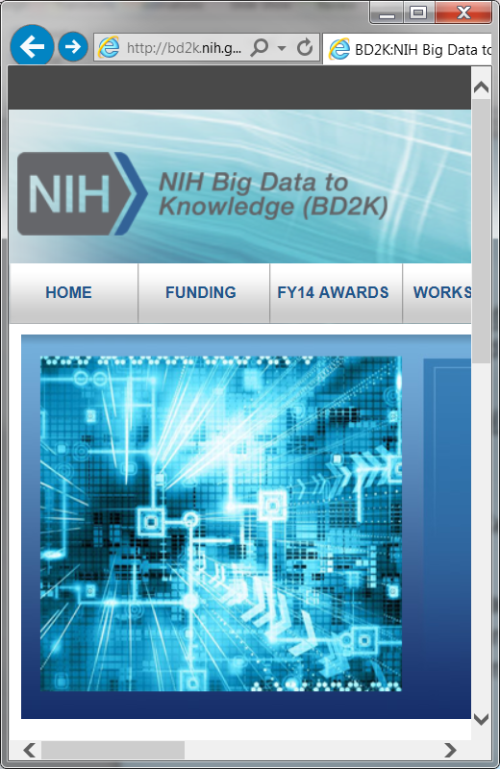
NIH BD2K Centers of Excellence
  The Centers of Excellence are part of the overall NIH BD2K initiative, which started in 2012.
  The goal is to develop and disseminate computational methods and associated training in order to assist biomedical researchers in using big data to significantly advance biomedical science.
  Biomedical Big Data is more than just very large data or a large number of data sources. It is diverse and complex. It includes imaging, phenotypic, molecular, exposure, health, behavioral, and many other types of data. These data could be used to discover new drugs or to determine the genetic and environmental causes of human disease.
https://datascience.nih.gov/bd2k/about/what
Notes:
NIH recently announced a funding opportunity for developing methods that help derive biomedical knowledge from big data.
Six to eight Centers of Excellence will be supported for up to 4 years starting next year.

Slide 4
Causal Discovery in Biomedicine
  Science is centrally concerned with the discovery of causal relationships in nature.
    Understanding
    Prediction
    Control
  Examples:
    Determine the genes and cell signaling pathways that cause breast cancer
    Discover the clinical effects of a new drug
    Uncover the mechanisms of pathogenicity of a recently mutated virus that is spreading rapidly in the population
Notes:
NIH recently announced a funding opportunity for developing methods that help derive biomedical knowledge from big data.
Six to eight Centers of Excellence will be supported for up to 4 years starting next year.

Slide 5
Why Establish a Center for Causal Discovery Now?
Algorithmic Advances
+
Availability of Big Biomedical Data
Notes:
NIH recently announced a funding opportunity for developing methods that help derive biomedical knowledge from big data.
Six to eight Centers of Excellence will be supported for up to 4 years starting next year.

Slide 6


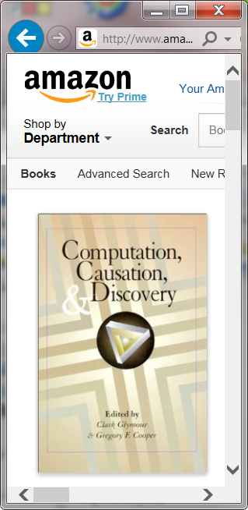

Algorithmic Advances
  In the past 25 years, there has been tremendous progress in the development of computational methods for representing and discovering causal networks from a combination of data and knowledge.
  These methods are often applicable to biomedical data.
Notes:
NIH recently announced a funding opportunity for developing methods that help derive biomedical knowledge from big data.
Six to eight Centers of Excellence will be supported for up to 4 years starting next year.

Slide 7

Availability of Big Biomedical Data
http://aldousvoice.files.wordpress.com/2014/06/database.jpg
  The variety, richness, and quantity of biomedical data have been increasing very rapidly.
    High-throughput molecular data (e.g., whole-genome sequencing)
    Clinical EMR data
    Population health data from social media and mobile sensors
  The appropriate analysis of these data has great potential to advance biomedical science.
Notes:
NIH recently announced a funding opportunity for developing methods that help derive biomedical knowledge from big data.
Six to eight Centers of Excellence will be supported for up to 4 years starting next year.

Slide 8

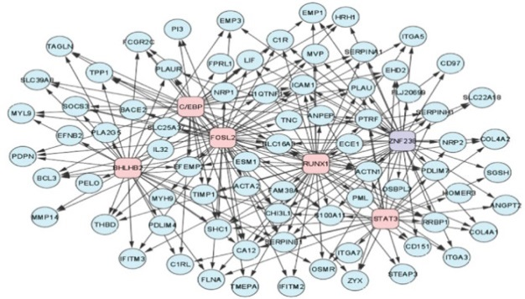
The Time Seems Right to Disseminate These Algorithms to Scientists to Use in Analyzing Biomedical Data to Help Discover Causal Relationships
Big Biomedical Data
Causal Networks
Causal Discovery Algorithms
Notes:
NIH recently announced a funding opportunity for developing methods that help derive biomedical knowledge from big data.
Six to eight Centers of Excellence will be supported for up to 4 years starting next year.

Slide 9
The Basic CCD Workflow
Experiments
Causal Hypotheses
Both observational and experimental data
Data
Causal
Analysis
Causal Networks
Prior Knowledge
Notes:
NIH recently announced a funding opportunity for developing methods that help derive biomedical knowledge from big data.
Six to eight Centers of Excellence will be supported for up to 4 years starting next year.

Slide 10
Basic Components Needed to Learn Causal Networks from Data
  Model representation
  Model search
  Model evaluation
Notes:
Causation is important because it estimates the effects of possible actions, which can guide which actions we choose to take.
The concept is a general one and includes predicting the response of a cell to a drug, as well as
predicting how a given patient is likely to respond to alternative surgical procedures, for example.

Slide 11
Model Representation:
Causal Bayesian Networks (CBNs)
  Nodes represent variables
  Arcs represent direct causation
  A directed acyclic graph
  A variable is modeled as independent of its non-effects, given its causal parents
  Example:
A
B
C
Notes:
Causation is important because it estimates the effects of possible actions, which can guide which actions we choose to take.
The concept is a general one and includes predicting the response of a cell to a drug, as well as
predicting how a given patient is likely to respond to alternative surgical procedures, for example.

Slide 12
Model Representation:
Causal Bayesian Networks (CBNs)
  Nodes represent variables
  Arcs represent direct causation
  A directed acyclic graph
  A variable is modeled as independent of its non-effects, given its causal parents
  Example:
}
A
B
C
CBN
structure
Notes:
Causation is important because it estimates the effects of possible actions, which can guide which actions we choose to take.
The concept is a general one and includes predicting the response of a cell to a drug, as well as
predicting how a given patient is likely to respond to alternative surgical procedures, for example.

Slide 13
Model Representation:
Causal Bayesian Networks (CBNs)
  Nodes represent variables
  Arcs represent direct causation
  A directed acyclic graph
  A variable is modeled as independent of its non-effects, given its causal parents
  Example:
  There is a factorization of the joint probability distribution
  Example:
  P(A, B, C) = P(A) P(B | A) P(C| B)
}
A
B
C
CBN
structure
}
CBN
parameters
Notes:
Causation is important because it estimates the effects of possible actions, which can guide which actions we choose to take.
The concept is a general one and includes predicting the response of a cell to a drug, as well as
predicting how a given patient is likely to respond to alternative surgical procedures, for example.

Slide 14
Model Search
  The space of CBNs is very large
  Heuristic search is generally applied in seeking to find the most likely CBNs
  We search for the most likely CBN structures
Notes:
Causation is important because it estimates the effects of possible actions, which can guide which actions we choose to take.
The concept is a general one and includes predicting the response of a cell to a drug, as well as
predicting how a given patient is likely to respond to alternative surgical procedures, for example.

Slide 15
Model Search
A
B
C
A
B
C
A
B
C
A
B
C
A
B
C
A
B
C
A
B
C
A
B
C
Notes:
Causation is important because it estimates the effects of possible actions, which can guide which actions we choose to take.
The concept is a general one and includes predicting the response of a cell to a drug, as well as
predicting how a given patient is likely to respond to alternative surgical procedures, for example.

Slide 16
Model Evaluation:
Two Primary Approaches
  Constraint based
  Bayesian
Notes:
Causation is important because it estimates the effects of possible actions, which can guide which actions we choose to take.
The concept is a general one and includes predicting the response of a cell to a drug, as well as
predicting how a given patient is likely to respond to alternative surgical procedures, for example.

Slide 17
Model Evaluation:
Two Primary Approaches
  Constraint based
  Bayesian
Notes:
Causation is important because it estimates the effects of possible actions, which can guide which actions we choose to take.
The concept is a general one and includes predicting the response of a cell to a drug, as well as
predicting how a given patient is likely to respond to alternative surgical procedures, for example.

Slide 18
Model Evaluation
The Constraint-Based Approach
  Determine constraints that hold among the nodes (e.g., independence conditions based on statistical tests)
  Use the patterns of constraints to narrow the causal possibilities
Notes:
Causation is important because it estimates the effects of possible actions, which can guide which actions we choose to take.
The concept is a general one and includes predicting the response of a cell to a drug, as well as
predicting how a given patient is likely to respond to alternative surgical procedures, for example.

Slide 19
Constraint-Based Evaluation: An Example
  Suppose in searching over CBNs we apply statistical tests to the observational data* on A, B, and C and obtain the following constraints:
  A dep B
  B dep C
  A dep C
  Which of the following models is consistent with the above constraints?
A
B
C
A
B
C
* More generally, a combination of observational data, experimental data, and background knowledge can be provided as input.
Notes:
Causation is important because it estimates the effects of possible actions, which can guide which actions we choose to take.
The concept is a general one and includes predicting the response of a cell to a drug, as well as
predicting how a given patient is likely to respond to alternative surgical procedures, for example.

Slide 20
Constraint-Based Evaluation: An Example
  Suppose in searching over CBNs we apply statistical tests to the observational data on A, B, and C and obtain the following constraints:
  A dep B
  B dep C
  A dep C
  Which of the following models is consistent with those constraints?
A
B
C
Notes:
Causation is important because it estimates the effects of possible actions, which can guide which actions we choose to take.
The concept is a general one and includes predicting the response of a cell to a drug, as well as
predicting how a given patient is likely to respond to alternative surgical procedures, for example.

Slide 21
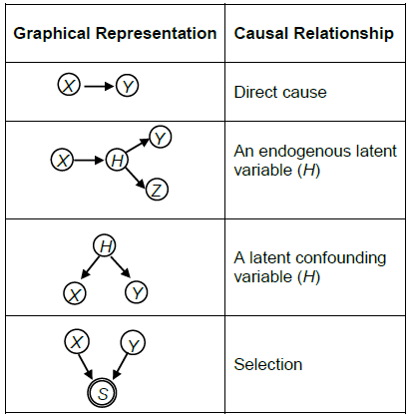
Several Key Causal Relationships
Notes:
Causation is important because it estimates the effects of possible actions, which can guide which actions we choose to take.
The concept is a general one and includes predicting the response of a cell to a drug, as well as
predicting how a given patient is likely to respond to alternative surgical procedures, for example.

Slide 22
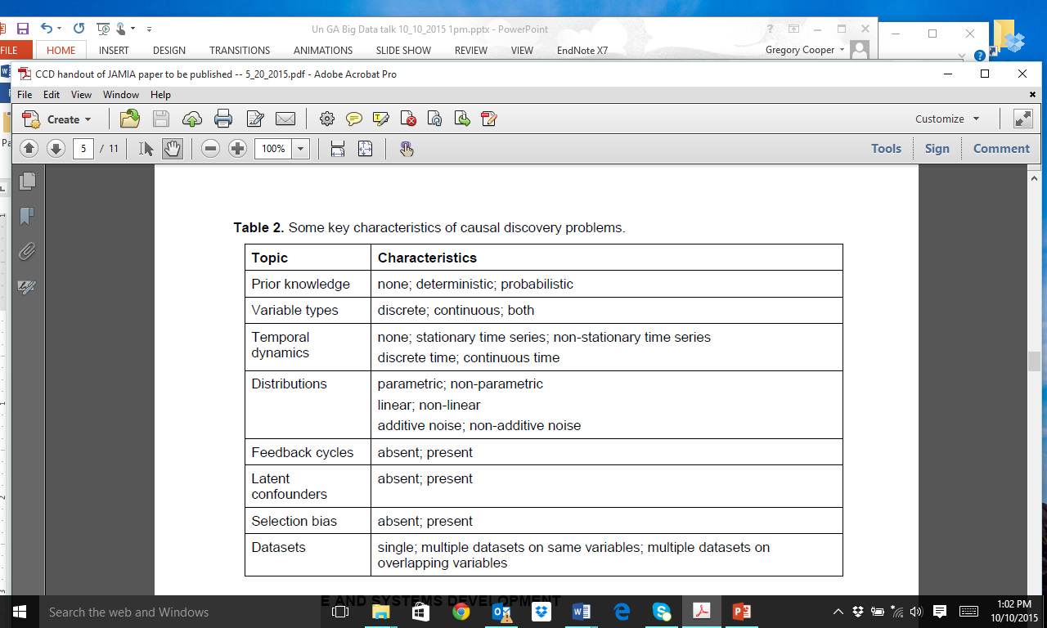
Some Key Characteristics of Causal Discovery Problems
Notes:
Causation is important because it estimates the effects of possible actions, which can guide which actions we choose to take.
The concept is a general one and includes predicting the response of a cell to a drug, as well as
predicting how a given patient is likely to respond to alternative surgical procedures, for example.

Slide 23
Types of Big Data Problems Include …
  Volume of data
    Number of samples
    Number of variables per sample
  Variety of data – the different types of data
  Velocity of data – how fast the data are being generated
  Veracity of data – the uncertainty in the data (e.g., noise, biases)
Notes:
NIH recently announced a funding opportunity for developing methods that help derive biomedical knowledge from big data.
Six to eight Centers of Excellence will be supported for up to 4 years starting next year.

Slide 24
What is the Big Data Problem on which the CCD is Primarily Focused?

Slide 25
Causal Network Discovery Methods Have Been Applied Successfully to Small Biomedical Datasets
Sachs K, et al. Protein-signaling networks learned from multi-parameter single-cell data of
human T cells Science 308 (2005) 523-529. (The figure above appears in this paper.)
Notes:
This slide shows a signaling network in human T cells that was learned from single-cell data using a causal network-discovery algorithm. The arcs show direct activation of one protein or lipid by another. Data on thousands of individual cells were used in this research.
Abstract from the cited paper:
Machine learning was applied for the automated derivation of causal influences in cellular signaling networks. This derivation relied on the simultaneous measurement of multiple phosphorylated protein and phospholipid components in thousands of individual primary human immune system cells. Perturbing these cells with molecular interventions drove the ordering of connections between pathway components, wherein Bayesian network computational methods automatically elucidated most of the traditionally reported signaling relationships and predicted novel interpathway network causalities, which we verified experimentally. Reconstruction of network models from physiologically relevant primary single cells might be applied to understanding native-state tissue signaling biology, complex drug actions, and dysfunctional signaling in diseased cells.

Slide 26

The Methods Have Also Been Successfully
Applied to Medium Sized Biomedical Datasets
Carro MS, et al. The transcriptional network for mesenchymal transformation of brain tumours. Nature
463 (2010) 318-325. . (The figure above appears in this paper.)
Notes:
Causation is important because it estimates the effects of possible actions, which can guide which actions we choose to take.
The concept is a general one and includes predicting the response of a cell to a drug, as well as
predicting how a given patient is likely to respond to alternative surgical procedures, for example.

Slide 27
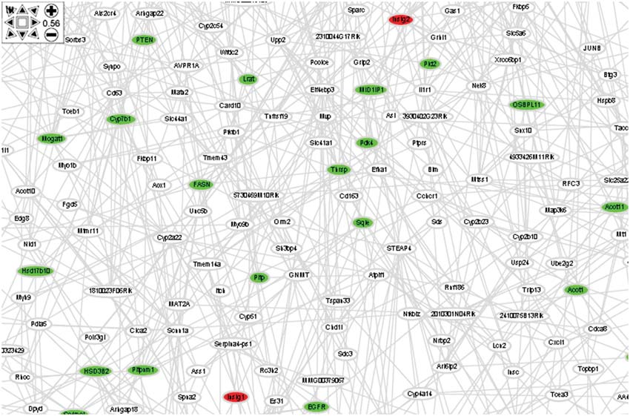
Most Algorithms Are Not Able to Handle Big Data Containing Many Thousands of Variables
Yang X, et al. Validation of candidate causal genes for obesity that affect shared metabolic pathways and networks. Nature Genetics 41 (2009) 415-423.
Notes:
In the past 30 years, researchers in computer science and related fields have made significant progress in developing methods for the modeling and discovery of causal network from data.
The first two references shown here describe work done by researchers in Pittsburgh, including individuals at Pitt and CMU. These individuals are collaborating currently on developing an NIH project proposal that I will describe in more detail in a moment.
These methods have been applied to a variety of types of data.
The next few slides show several cases in which researchers have applied the methods to biomedical data.

Slide 28
Our Big Data Problem:
Analyze biomedical datasets containing a large number of variables in order to generate plausible hypotheses of the causal relationships that hold among those variables
Notes:
NIH recently announced a funding opportunity for developing methods that help derive biomedical knowledge from big data.
Six to eight Centers of Excellence will be supported for up to 4 years starting next year.

Slide 29
Big Data Problems Being Pursued in CCD
  Volume of data – the scale of the data
    Number of samples
    Number of variables per sample
  Variety of data – the different types of data
  Velocity of data – how fast the data are being generated
  Veracity of data – the uncertainty in the data (e.g., noise, biases)
Notes:
NIH recently announced a funding opportunity for developing methods that help derive biomedical knowledge from big data.
Six to eight Centers of Excellence will be supported for up to 4 years starting next year.

Slide 30
Big Data Problems Being Pursued in CCD
  Volume of data – the scale of the data
    Number of samples
    Number of variables per sample
  Variety of data – the different types of data
  Velocity of data – how fast the data are being generated
  Veracity of data – the uncertainty in the data (e.g., noise, biases)
Notes:
NIH recently announced a funding opportunity for developing methods that help derive biomedical knowledge from big data.
Six to eight Centers of Excellence will be supported for up to 4 years starting next year.

Slide 31
Primary Aims of the CCD
Aim 1. Develop and implement state-of-the-art computational methods to support causal discovery from biomedical big data
Aim 2. Investigate four biomedical projects to test and drive algorithmic development
Aim 3. Disseminate these algorithmic methods and ideas widely to biomedical researchers and data scientists
  Software: open source and free
  Training: online and in person
Notes:
A group of investigators in the School of Medicine at the University of Pittsburgh will be submitting an application on the topic of modeling and discovery of causal networks from big biomedical data.
The primary aims will be to advance the representation, discovery, and uses of causal network models when applied to very large biomedical datasets.

Slide 32
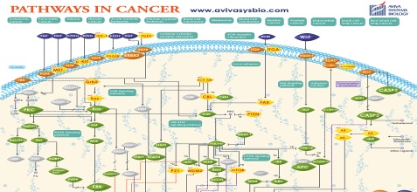
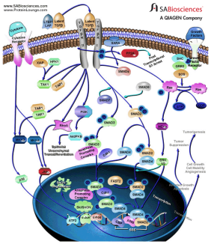
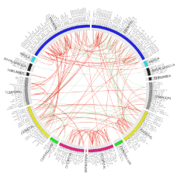

Driving Biomedical Projects (DBPs)
  Discovery of cell signaling networks in cancer
  Discovery of the mechanisms of disease onset and progression in chronic obstructive pulmonary disease and idiopathic pulmonary fibrosis
  Discovery of the functional (causal) connectivity of regions of the human brain from fMRI data
  Investigate possible causes and subtypes of autism
www.theguardian.com
Notes:
NIH recently announced a funding opportunity for developing methods that help derive biomedical knowledge from big data.
Six to eight Centers of Excellence will be supported for up to 4 years starting next year.

Slide 33
Cancer DBP: Goal 1
  Develop methods to identify driver (disease causing) somatic genomic alterations (SGAs) of tumors
  Big Data: The Cancer Genome Atlas (TCGA)
Notes:
NIH recently announced a funding opportunity for developing methods that help derive biomedical knowledge from big data.
Six to eight Centers of Excellence will be supported for up to 4 years starting next year.

Slide 34
Cancer DBP: Goal 1
  Develop methods to identify driver (disease causing) somatic genomic alterations (SGAs) of tumors
  Big Data: The Cancer Genome Atlas (TCGA)
Available Cancer Types | # Cases with Data
Acute Myeloid Leukemia [LAML] | 200
Adrenocortical carcinoma [ACC] | 80
Bladder Urothelial Carcinoma [BLCA] | 412
Brain Lower Grade Glioma [LGG] | 516
Breast invasive carcinoma [BRCA] | 1098
Notes:
NIH recently announced a funding opportunity for developing methods that help derive biomedical knowledge from big data.
Six to eight Centers of Excellence will be supported for up to 4 years starting next year.

Slide 35
Cancer DBP: Goal 1
  Develop methods to identify driver (disease causing) somatic genomic alterations (SGAs) of tumors
  Big Data: The Cancer Genome Atlas (TCGA)
Available Cancer Types | # Cases with Data
Acute Myeloid Leukemia [LAML] | 200
Adrenocortical carcinoma [ACC] | 80
Bladder Urothelial Carcinoma [BLCA] | 412
Brain Lower Grade Glioma [LGG] | 516
Breast invasive carcinoma [BRCA] | 1098
Notes:
NIH recently announced a funding opportunity for developing methods that help derive biomedical knowledge from big data.
Six to eight Centers of Excellence will be supported for up to 4 years starting next year.

Slide 36
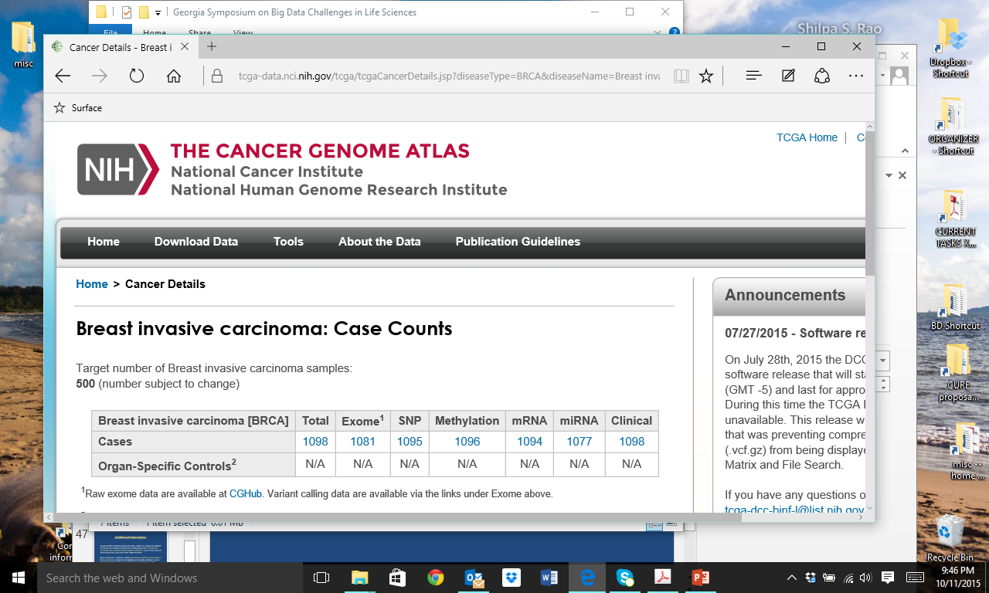
Cancer DBP: Goal 1
  Develop methods to identify driver (disease causing) somatic genomic alterations (SGAs) of tumors
  Big Data: The Cancer Genome Atlas (TCGA)
Notes:
NIH recently announced a funding opportunity for developing methods that help derive biomedical knowledge from big data.
Six to eight Centers of Excellence will be supported for up to 4 years starting next year.

Slide 37
Cancer DBP: Goal 1
  Develop methods to identify driver (disease causing) somatic genomic alterations (SGAs) of tumors
  Big Data: The Cancer Genome Atlas (TCGA)
Notes:
NIH recently announced a funding opportunity for developing methods that help derive biomedical knowledge from big data.
Six to eight Centers of Excellence will be supported for up to 4 years starting next year.

Slide 38
Cancer DBP: Goal 1
  Develop methods to identify driver (disease causing) somatic genomic alterations (SGAs) of tumors
  Big Data: The Cancer Genome Atlas (TCGA)
  Methods: Search for somatic alterations (A) that the data support as causing changes in the cellular behavior of tumors (G)
Notes:
NIH recently announced a funding opportunity for developing methods that help derive biomedical knowledge from big data.
Six to eight Centers of Excellence will be supported for up to 4 years starting next year.

Slide 39
Cancer DBP: Goal 1
  Develop methods to identify driver (disease causing) somatic genomic alterations (SGAs) of tumors
  Big Data: The Cancer Genome Atlas (TCGA)
  Methods: Search for somatic alterations (A) that the data support as causing changes in the cellular behavior of tumors (G)
Notes:
NIH recently announced a funding opportunity for developing methods that help derive biomedical knowledge from big data.
Six to eight Centers of Excellence will be supported for up to 4 years starting next year.

Slide 40
Cancer DBP: Goal 1
  Develop methods to identify driver (disease causing) somatic genomic alterations (SGAs) of tumors
  Big Data: The Cancer Genome Atlas (TCGA)
  Methods: Search for somatic alterations (A) that the data support as causing changes in the cellular behavior of tumors (G)
  General findings:
    Found many known drivers of cancer
    Also found some mutations not known to be drivers of cancer that we plan to test experimentally
Notes:
NIH recently announced a funding opportunity for developing methods that help derive biomedical knowledge from big data.
Six to eight Centers of Excellence will be supported for up to 4 years starting next year.

Slide 41
Causal Discovery in the Cloud
  A collaboration between CCD and PIC-SURE BD2K Centers to develop a proof-of-principle system to share both data and analytic services in a secure and scalable manner in the cloud
  Will use the Simons Foundation Autism Research data
    2500+ samples
    Clinical, genomic, fMRI, and other types of data
  Biomedical Aims
    Develop insights into the causes and subtypes of autism
  Computational Aims
    Make complex data available in the cloud
    Make causal discovery algorithms available in the cloud
    Apply these algorithms to the data in the cloud
Notes:
NIH recently announced a funding opportunity for developing methods that help derive biomedical knowledge from big data.
Six to eight Centers of Excellence will be supported for up to 4 years starting next year.

Slide 42
Summary
  The NIH BD2K initiative is focused on developing ways to enhance the translation of increasing amounts of digital data into biomedical knowledge.
  Causal relationships are a central type of biomedical knowledge.
  The Center for Causal Discovery (CCD) is focused on developing and making readily available algorithms and systems for generating plausible causal hypotheses from big biomedical data.
  The CCD is exploring several biomedical problems to test and drive the development and refinement of causal discovery methods
Notes:
NIH recently announced a funding opportunity for developing methods that help derive biomedical knowledge from big data.
Six to eight Centers of Excellence will be supported for up to 4 years starting next year.

Slide 43
Acknowledgements
  Thanks to the 40+ members of the Center for Causal Discovery for their contributions to the Center activities that are described here.
  The Center for Causal Discovery is supported by grant U54HG008540 awarded by the National Human Genome Research Institute through funds provided by the trans-NIH Big Data to Knowledge (BD2K) initiative (www.bd2k.nih.gov). The content of this presentation is solely the responsibility of the authors and does not necessarily represent the official views of the National Institutes of Health.
Notes:
NIH recently announced a funding opportunity for developing methods that help derive biomedical knowledge from big data.
Six to eight Centers of Excellence will be supported for up to 4 years starting next year.

Slide 44
Thank you
  gfc@pitt.edu
  www.ccd.pitt.edu
Notes:
NIH recently announced a funding opportunity for developing methods that help derive biomedical knowledge from big data.
Six to eight Centers of Excellence will be supported for up to 4 years starting next year.

