Slide 1
Integrating Data from Multidisciplinary Research
Session III – Establishing Infrastructure for Data Integration
William A. Suk, Ph.D., M.P.H.
Director, Superfund Research Program
Chief, Hazardous Substances Research Branch
Division of Extramural Research and Training
National Institute of Environmental Health Sciences
Notes:
In the third session of this series, we will hear from data science experts who are developing tools through NIH-funded grants to establish infrastructure to coordinate data and develop sophisticated approaches to utilize big data to advance our understanding of human health and disease.
Before we turn it over to our presenters, I wanted to quickly introduce two NIH-funded programs they will be discussing today: The NIEHS Children's Health Exposure Analysis Resource (CHEAR) and the NIH Big Data to Knowledge Initiative. In the first presentation, you will hear from Susan Teitelbaum, Patricia Kovatch, and Deborah McGuinness who recently received a CHEAR award. In the second presentation, you will hear Greg Cooper, the director of the Center for Causal Discovery, which is an NIH-funded Big Data to Knowledge Center of Excellence.

Slide 2
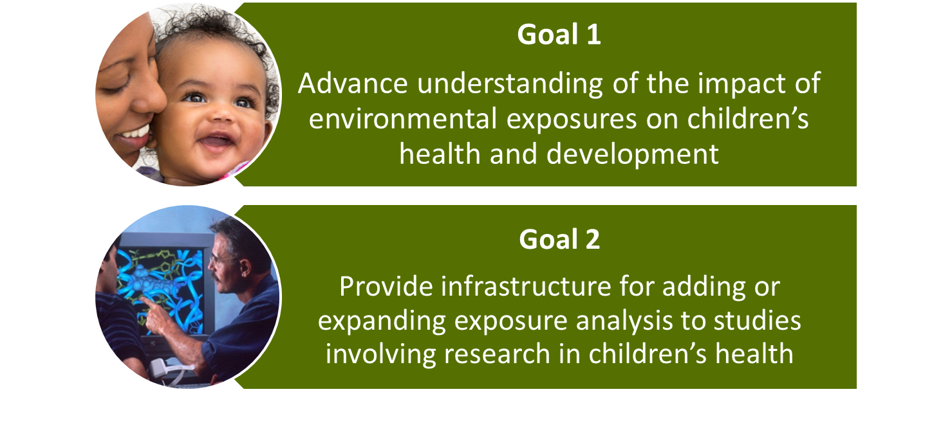
Children’s Health Exposure Analysis Resource (CHEAR)
New Resource for Exposome Research
Notes:
Our first presenters, Susan Teitelbaum and Patricia Kovatch from the Icahn School of Medicine at Mount Sinai, and Deborah McGuinness from the Rensselaer Polytechnic Institute, are recent NIEHS Children's Health Exposure Analysis Resource (CHEAR) awardees.
CHEAR is a new program that continues the original intent of the National Children’s Study.
First, it will advance our understanding of the impact of environmental exposures on children’s health and development.
Second, it will provide access to infrastructure for adding comprehensive exposure analysis of biological samples to existing epidemiological and clinical studies involving research in children’s health.
Nearly $144 million in new grants will develop tools and measures for investigating environmental exposures from the womb through later years in a child’s life.
Exposures measured by CHEAR will encompass the breadth of the exposome, the totality of biological, psycho-social, chemical, and physical exposures through the use of both comprehensive targeted and non-targeted methods of analysis.

Slide 3
The Children’s Health Exposure Analysis Resource (CHEAR)
1. National Exposure Assessment Laboratory Network
Institution and PI
Emory University PI: Gary Miller
ICAHN School of Medicine at Mount Sinai PI: Robert Wright
University of Michigan PI: John Meeker
University of Minnesota PI: Lisa Patterson
Wadsworth Center PI: Kenneth Aldous
Research Triangle Institute PI: Timothy Fennell
Emphasis on Class Targets:
PAHs
Phenols and Parabens
Tobacco smoke markers
Phytoestrogens
Perfluorochemicals
Lipids
Vitamins
OP, OC, and other Pesticides
Phthalates
Flame retardants
PCBs
Hormone panel VOCs
Various therapeutics
Nutritional indicators and dietary factors
Untargeted Analysis: measurement of large sets of analytes simultaneously to allow unbiased association between exposure and biological response.
Biological Response Indicators: measurement of integrated, functional measures of individual response to environmental stressors, using established markers.
Developmental Core: development and validation of new methods for future analytic services.
Notes:
The CHEAR infrastructure is comprised of three distinct units:
First, the National Exposure Assessment Laboratory Network will provide access to state-of-the-art infrastructure for analysis of biological samples as well as understanding biological responses associated with those exposures.
The main emphasis for these Hubs is to provide capacity for targeted analyses using state-of-the-art assays specific to known compounds or stressors, such as the methods used by the CDC National Biomonitoring Program. With a few exceptions, each of these labs are essentially looking at similar target class compounds.
These labs will also be conducting Untargeted Analysis, measuring biological response indicators, and will include a developmental core to develop and validate new methods for future analytic services.

Slide 4
The Children’s Health Exposure Analysis Resource (CHEAR)
2. Data Repository, Analysis, and Science Center
Institution | Purpose
ICAHN School of Medicine at Mt. Sinai PI: Susan Teitelbaum | Manage a repository for all data Provide data analytics tools and expert support for statistical analysis and interpretation Develop data science resources by identifying and implementing existing data and metadata standards to support an infrastructure for the exposure community
3. Coordinating Center
Institution | Purpose
Westat, Inc. PI: Barbara O'Brien | Provide main access to CHEAR, an index of additional tools for analyses, and overall administrative management
Notes:
Second, the Data Repository, Analysis, and Science Center (or Data Center) is a data and analytics support resource providing a repository for all data and support for statistical analysis and interpretation. This resource will also lead the development of community based data standards and support the development of technologies and metadata standards. This is the Center we will hear about today.
Third, the Coordinating Center provides administrative management of the resource including an interface to the research community and an index of additional exposure analysis tools not included within the CHEAR infrastructure. The main access to CHEAR will be through the Coordinating Center which will provide pre-application consulting services in support of study design and analysis, as well as develop and oversee a proposal process.

Slide 5

Goals for CHEAR
Expand number of studies with environmental exposure analysis
Implement exposome concept in children’s health studies
Create a public resource of children’s exposures across the U.S.
Develop data and metadata standards for the environmental health sciences community
Notes:
These research projects, funded with fiscal year 2015 dollars, are designed to provide researchers with an expanded range of tools to accurately measure, record and analyze environmental exposures.
Greater accuracy will help improve our understanding of how these exposures change human biology to affect child health and development.
The research will continue to inform programs aimed at developing strategies to reduce the risk of childhood illnesses and disabilities.

Slide 6
NIH Big Data to Knowledge (BD2K) Initiative
Launched in 2012
Research and development of innovative tools to maximize the integration of big data and data science into biomedical research
Advance understanding of human health and disease
Diverse
Big Data
Complex
Unwieldy
Notes:
Greg Cooper, who will be presenting in the latter portion of the webinar, is a member of the Center for Causal Discovery at Pittsburgh, an inaugural member of the NIH Big Data to Knowledge (BD2K) Consortium.
NIH launched the Big Data to Knowledge (BD2K) Initiative in 2012 – a trans-NIH initiative that aims to support research and development of innovative tools to maximize the integration of big data and data science into biomedical research.
The BD2K Centers program has established 11 Centers of Excellence for Big Data Computing and one Center that is a collaborative project with the NIH Common Fund LINCS program, the LINCS-BD2K Perturbation Data Coordination and Integration Center. The centers are located all across the United States. They are large-scale projects aiming to develop new approaches, methods, software tools, and related resources. The Centers will also provide training to advance Big Data science in the context of biomedical research. The 12 BD2K Centers function with the other BD2K grantees as a consortium and collaborate with one another, with the purpose of furthering every aspect of the field of biomedical data science research.
The ability to harvest the wealth of information contained in biomedical Big Data will advance our understanding of human health and disease.

Slide 7
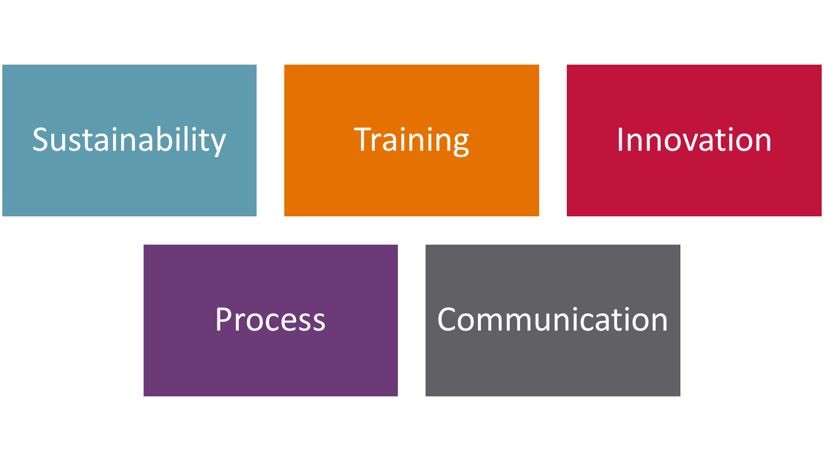
NIH Big Data to Knowledge (BD2K) Initiative
Notes:
The BD2K initiative has five main points of emphasis:
Sustainability: How to maintain a vibrant research infrastructure driven by digital data at a time when budgets are flat, yet data are growing at an unprecedented rate.
Training: Supporting the workforce of tomorrow when biomedical research increasing relies on computational, mathematical, and statistical analysis and beyond.
Innovation: Through the BD2K initiative, stimulating the best developments in the data science community.
Process: Refining NIH internal processes to make the most of the data revolution.
Communication: Breaking down barriers to new initiatives, as data have no boundaries as defined by national or agency funding.

Slide 8
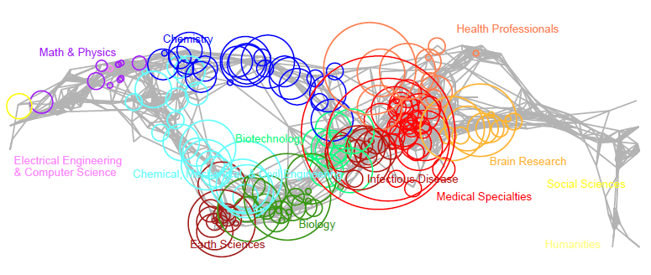
Putting the pieces together
  How can the diverse science within SRP be used together and shared?
  How do we enable projects to share data with other projects and Centers?
  How do we make this data available and more useable?
  How do we encourage researchers to leverage existing data?
Notes:
This webinar series explores challenges and opportunities for integrating datasets to solve complex environmental health problems.
We are having this webinar series to begin the conversation about how we might accomplish this.
This map of publications from the SRP shows SRP publications distributed based on the journals that published the work.
This diversity of research across the science spectrum helps to illustrate the diversity of data being generated by the program.
Here are a few questions we need to address to begin moving toward integrating data. These questions emphasize the need for data sharing, which is an NIH priority. Data sharing is essential for expedited translation of research results into knowledge to improve human health. Today, we will hear from speakers that are developing ways to establish infrastructure to share and coordinate data with the ultimate goal of protecting human health and reducing the burden of disease.

