Slide 1


Welcome to the CLU-IN Internet Seminar
NARPM Presents...RECs, Renewables and Remediation
Sponsored by: EPA Office of Superfund Remediation and Technology Innovation
Delivered: June 6, 2013, 1:00 PM - 3:00 PM, EDT (17:00-19:00 GMT)
Instructors:
  Katie Brown, Office of Solid Waste and Emergency Response (brown.katie@epa.gov)
  John Frey, EPA Region 7 (frey.john@epa.gov)
  Laura Knudsen, Office of Superfund Remediation and Technology Innovation (knudsen.laura@epa.gov)
  Hilary Thornton, EPA Region 4 (thornton.hilary@epa.gov)
  Stephanie Vaughn, EPA Region 2 (vaughn.stephanie@epa.gov)
Moderator:
  Jean Balent, U.S. EPA, Technology Innovation and Field Services Division (balent.jean@epa.gov or 703-603-9924)
Visit the Clean Up Information Network online at www.cluin.org
0
Notes:
0

Slide 2
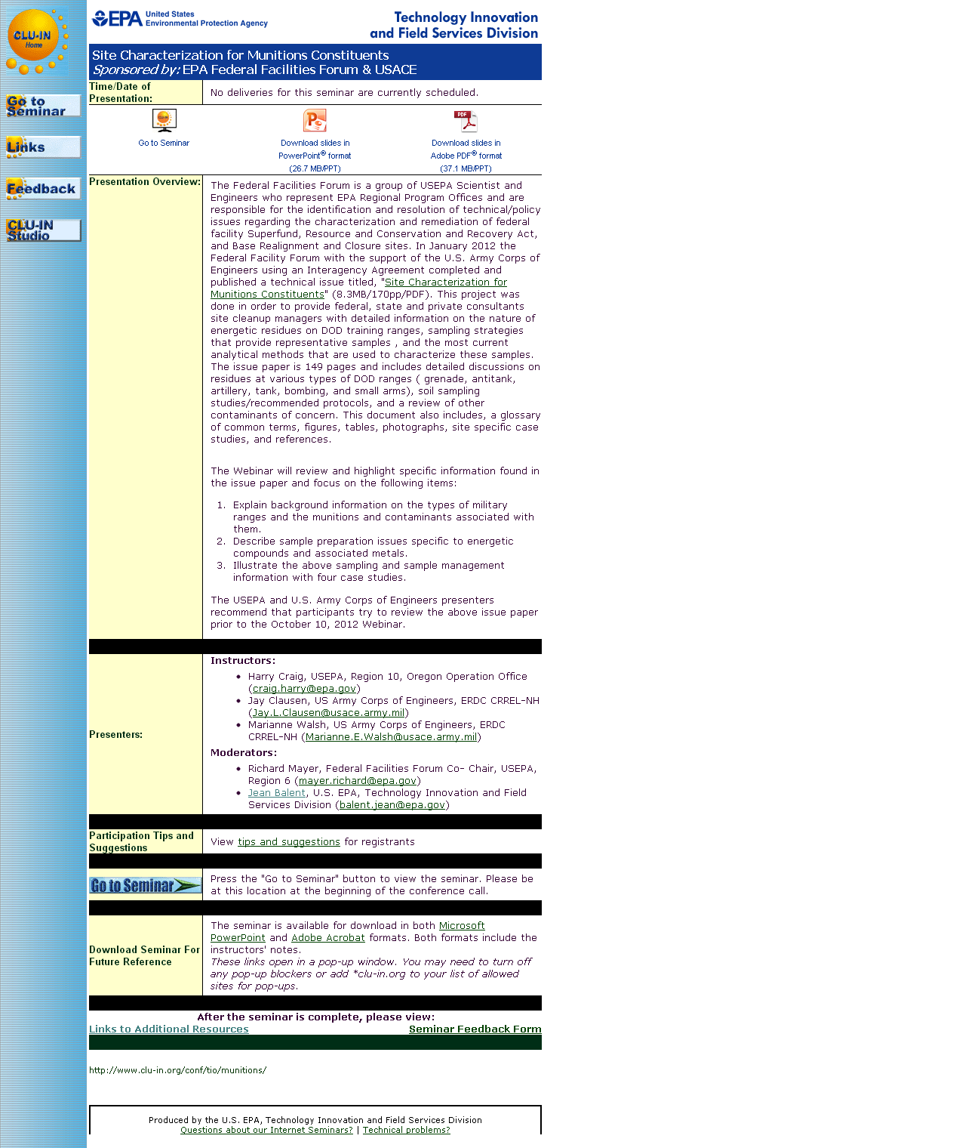
Seminar Homepage
Join the seminar online
Download Slides
Feedback
1

Slide 3

Housekeeping
Entire broadcast offered live via Adobe Connect
  participants can listen and watch as the presenters advance through materials live
  Some materials may be available to download in advance, you are recommended to participate live via the online broadcast
Audio is streamed online through by default
  Use the speaker icon to control online playback
  If on phones: all lines will be globally muted
Q&A – use the Q&A pod to privately submit comments, questions and report technical problems
This event is being recorded and shared via email shortly after live delivery
Archives accessed for free http://cluin.org/live/archive/
2
Notes:
2
Although I’m sure that some of you have these rules memorized from previous CLU-IN events, let’s run through them quickly for our new participants.
Please mute your phone lines during the seminar to minimize disruption and background noise. If you do not have a mute button, press *6 to mute #6 to unmute your lines at anytime. Also, please do NOT put this call on hold as this may bring delightful, but unwanted background music over the lines and interupt the seminar.
You should note that throughout the seminar, we will ask for your feedback. You do not need to wait for Q&A breaks to ask questions or provide comments. To submit comments/questions and report technical problems, please use the ? Icon at the top of your screen. You can move forward/backward in the slides by using the single arrow buttons (left moves back 1 slide, right moves advances 1 slide). The double arrowed buttons will take you to 1st and last slides respectively. You may also advance to any slide using the numbered links that appear on the left side of your screen. The button with a house icon will take you back to main seminar page which displays our agenda, speaker information, links to the slides and additional resources. Lastly, the button with a computer disc can be used to download and save today’s presentation materials.
With that, please move to slide 3.

Slide 4
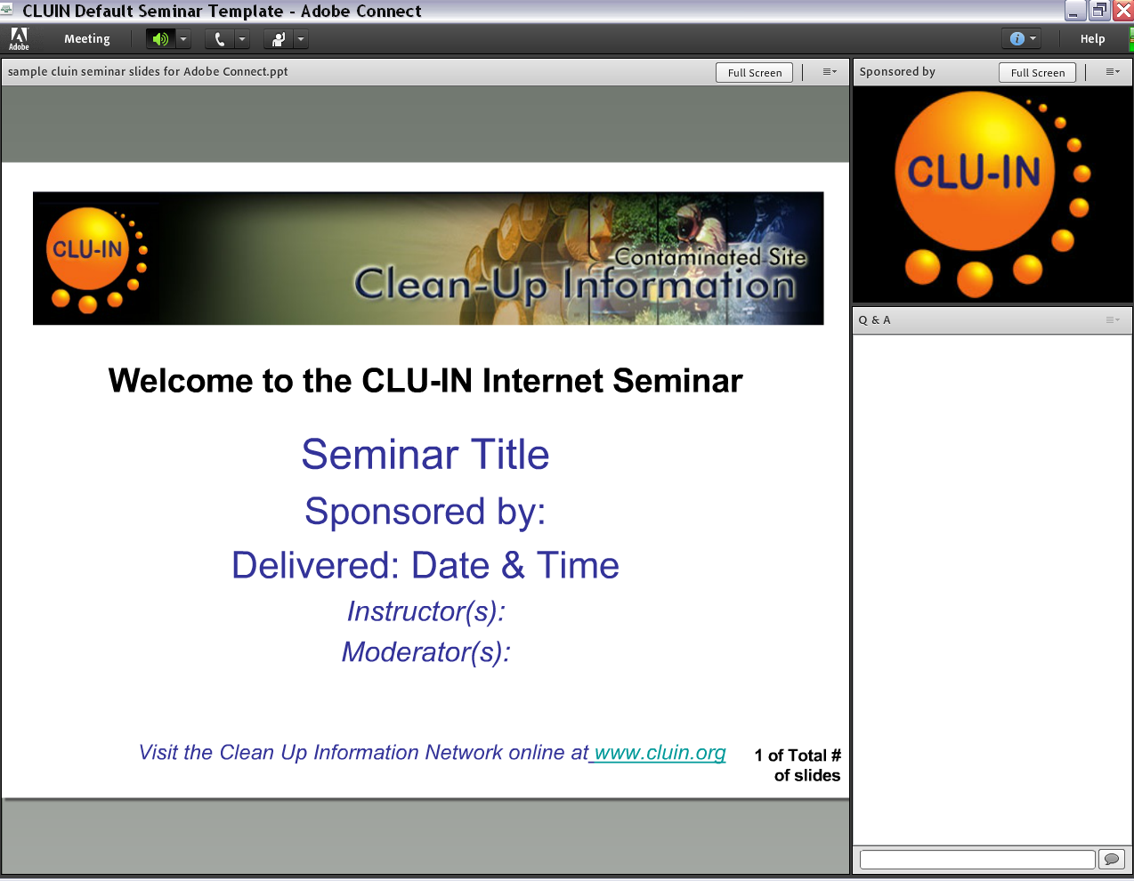


New online broadcast screenshot
Enlarge presentation
Control online audio
View presentation live online here
Information about Sponsors & Speakers
Submit private questions, comments or report technical problems
3

Slide 5
RECS, Renewables, and Remediation
What does it all mean and how do I do it?

Slide 6
Why Focus on Renewable Energy?
“Despite advances in pollution controls over the last 30 years…conventional power generation is still the nation’s single largest source of industrial air pollution and is a major contributor to greenhouse gas emissions.”
Source: Guide to Purchasing Green Power, EPA, March 2010
Notes:
Conventional Power includes fossil and nuclear fuels.

Slide 7
More Statistics….
On average, replacing 1 kWh of traditional power with renewably generated power avoids the emissions of more than 1 pound of CO₂
  A typical commercial building could avoid the carbon emissions of nearly 28 vehicles per year
In 2008, renewable energy generation in the United States (excluding hydropower) equaled nearly 124 billion kWh
  Enough to meet the annual electricity needs of nearly 12 million average homes

Slide 8

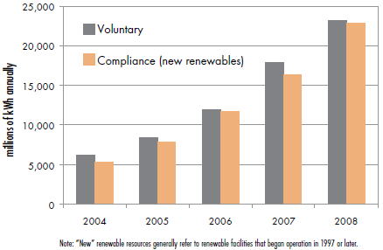
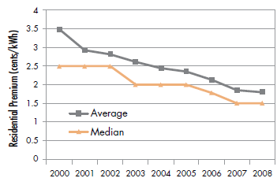
The Renewable Energy Market Is Growing
Notes:
Many states require utilities to supply some of their electricity through renewable sources (i.e., compliance renewables)
As supply goes up, costs go down

Slide 9
What is Renewable Energy?
Electricity generated from
  Solar
  Wind
  Geothermal
  Small-scale hydroelectric sources
  Biomass/biogas
Can be large-scale or small-scale
  For example, a solar field versus a solar panel on a portable air monitor
What we do at our sites CAN make a difference!

Slide 10
Course Overview
Section 1 – RECs and Purchasing Renewably Generated Electricity
Section 2 – Portable Renewable Energy Generation Options
Section 3 – Assessing the Feasibility of Onsite Renewable Energy at Various Scales
Section 4 – Open Discussion: Questions, Concerns, Ideas
Notes:
Laura Knudsen, USEPA HQ, Superfund CIPIB
Stephanie Vaughn, EPA Region 2, RPM
John Frey, EPA Region 7, OSC
Katie Brown, Region 9, RPM ????
Hilary Thornton, Region 4, RPM
Will have note cards to write down questions/ideas during the presentations….

Slide 11
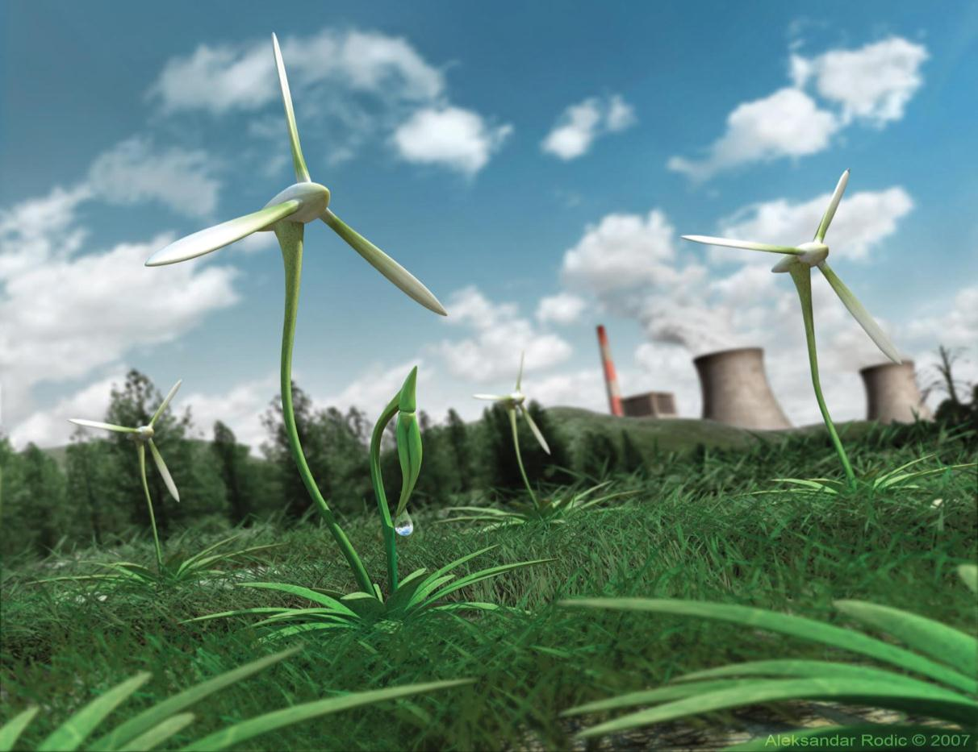
Renewable Energy Certificate (REC)
What Does It Mean and How Do I Do It?
Stephanie Vaughn, USEPA Region 2
Laura Knudsen, USEPA HQ, Superfund CIPIB
Notes:
Many states require utilities to supply some of their electricity through renewable sources (i.e., compliance renewables)
As supply goes up, costs go down

Slide 12
What is a REC?
(Quick Quiz)
Research Ethics Committee
Renewable Energy Certificate
Radio Electronic Combat
Notes:
These are all meanings of the acronym ‘REC’ but we will obviously be discussing the Renewable Energy Certificate (REC)

Slide 13
Agenda
What is a REC?
Examples of REC Purchases
  EPA Region 2 & REC Work
  EPA HQ National REC Purchases
Questions

Slide 14
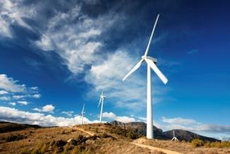
What is a REC?
Also known as green tag, renewable energy credit, tradable renewable certificate
One REC…
  A REC is a certificate that
    Represents the environmental benefits (such as reduced pollution and greenhouse gas emissions, conservation of natural resources) associated with generating one MWh (megawatt hour) of electricity from a renewable energy source
    Thus, RECs may be sold independently of the power itself
Notes:
RECs are said to be “bundled” when sold with renewable power.
When RECs are sold independently the power is no longer considered “renewable”

Slide 15
What is a REC?
Environmental Benefits
Renewable Energy/Power
Conventional Energy/Power
REC
U.S. Electric Grid
Electrons
Electrons
OR
REC
Electrons
Point of Use for RECs
(Fund Lead Superfund Sites)
Graphic inspired by the Green Power Partnership graphic found here: http://www.epa.gov/greenpower/gpmarket/rec_chart.htm
Notes:
A REC is an attribute of renewable electricity that is used for accounting purposes. It represents the generation of 1 mWh of electricity from an eligible renewable energy, and they represent a claim to the environmental attributes associated with renewable energy generation. After a REC is assigned to a point of use, it is retired.

Slide 16
Types of RECs
Bundled
Unbundled
Paired by the utility with grid electricity delivered to a buyer
Functionally equivalent to directly purchasing renewably generated electricity
Create a direct demand for renewable energy
  Utilities base their contracts on meeting the renewable energy demands of their customers.
Not linked to the demand for renewably generated electricity
Can be purchased anywhere, in any amount
Lower cost than bundled
  No geographic constraints
  No requirement to deliver power in real-time
Not as effective a market mechanism, and quality varies
  Independent certification
Future RECs also exist
15
Notes:
The REC can be sold with the electricity (bundled) or sold separately. A bundled REC is paired by the electric service provider with grid electricity delivered to a buyer. Bundled RECs are functionally equivalent to directly purchasing renewably generated electricity from a local utility, regardless of where the REC comes from. Buying bundled RECs creates a direct demand for renewable energy, because utilities base their contracts on meeting the renewable energy demands of their customers.
On the other hand, non-bundled RECs are delinked them from the demand for renewably generated electricity, and are therefore not as effective a market mechanism. Because the RECs become disassociated from the electrons, the purchase price can be used to, for example, help renewable energy generators increase their capacity (future RECS), or the RECs can be generated anywhere in the world. Nonetheless, the long-term environmental benefits of purchasing these RECs are similar.
For these reasons, R2 believes there is a hierarchy of renewable energy: on-site generation; bundled renewables (purchased through local providers); RECs (market purchased).

Slide 17
Region 2 & RECs
Region 2 “Clean and Green” Policy in place since March 2009
Use of renewable energy, including through the purchase of RECs, is a touchstone practice
Keeping track of metrics
  Data needs include kWh used, utility provider/zipcode (to determine energy mix), and costs
Notes:
Priorities:
Purchase RECs to offset 100% of usage
Purchase locally/regionally generated RECs, keeping cost in mind
No general preference for type of renewable energy (wind/solar/small hydro/geothermal), so choose least expensive option

Slide 18
Region 2 Results
Carbon Offset FY 2012 – 41,877 Metric Tons CO₂ Equivalent (MTCO₂E)
Carbon Offset since signing of policy – 262,293 MTCO₂E
Number of sites participating – 37
The Clean & Green Policy is in:
  20 RODs
  29 Enforcement Agreements/Statements of Work

Slide 19
What does a reduction of about 260,000 MTCO₂E mean?
Annual greenhouse gas emissions from 50,980 passenger vehicles
CO₂ emissions from 29,147,982 gallons of gasoline consumed
CO₂ emissions from 604,651 barrels of oil consumed
CO₂ emissions from 3,429 tanker trucks’ worth of gasoline
CO₂ emissions from the electricity use of 32,419 homes for one year
CO₂ emissions from the energy use of 22,511 homes for one year
Carbon sequestered by 6,666,667 tree seedlings grown for 10 years
Carbon sequestered annually by 55,437 acres of pine or fir forests
Carbon sequestered annually by 2,576 acres of forest preserved from deforestation
CO₂ emissions from 10,833,333 propane cylinders used for home barbeques
CO₂ emissions from burning 1,416 railcars’ worth of coal
Greenhouse gas emissions avoided by recycling 90,592 tons of waste instead of sending it to the landfill
Annual CO₂ emissions of 0.062 coal fired power plants
Source: http://www.epa.gov/cleanenergy/energy-resources/calculator.html

Slide 20
EPA HQ National REC Purchases
For 2012 and 2013, this purchase only applies to energy use associated with remediation at fund lead Superfund sites. Region 2 sites are not included in this purchase.
Why a national bulk REC purchase?
  September 2010 Superfund Green Remediation Strategy
    Recommendation 3.1: Identify methods to maximize use of renewable energy with a goal of using 100% renewable energy to power site operations
  RECs are the most cost-effective way to meet the above goal in the near term in comparison to other options, such as:
    Initial capital outlays to generate renewable energy on-site
    Green power purchased from local electricity providers

Slide 21
EPA HQ National REC Purchases
REC Purchases were made by EPA HQ in 2012 and 2013
How do we assess the quality of these RECs?
  The RECs for this purchase are Green-e certified which means that our RECs are:
    From operating wind farms
    Are from new projects
    Have not been double counted

Slide 22
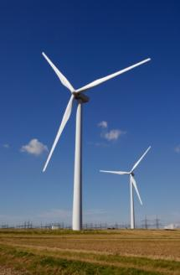
EPA HQ National REC Purchases
2012 Purchase
Where did the RECs come from for the 2012 purchase?
  100,000 RECs purchased by OSRTI through the Western Area Power Administration (WAPA) of the Department of Energy (DOE)
  These RECs were applied from July 2011 – March 2013
  The RECs were from Iberdrola wind farms

Slide 23
EPA HQ National REC Purchases
2013 Purchase
Where did the RECs come from for the 2013 purchase?
  40,000 RECs purchased by OSRTI through the Defense Logistics Agency
  These RECs will be applied from March 2013 – December 2013
  RECs are provided by 3Degrees
  We will not know the exact sources of the RECs until they are delivered to us, however the general breakdown of the RECs are as follows:
    20,000 RECs from wind power
    10,000 RECs from biomass
    10,000 RECs from landfill gas

Slide 24
EPA HQ National REC Purchase
Communication Materials Prepared for the 2012 Purchase
EPA Internet site for the public
  www.epa.gov/superfund/renewableenergy
EPA REC FAQ Sheet
EPA It’s Our Environment Blog (published June 26^{th,} 2012)
Facebook & Twitter Posts (published June 26th, 2012)
Webinars to EPA Staff, States, and Other Interested Parties!
Notes:
Before and during this slide I intend to ask some questions to the audience, such as ‘How many of you are using the REC FAQ sheets at your fund lead sites’, ‘How many of you have visited our Internet site’?

Slide 25
Questions?
Laura Knudsen: knudsen.laura@epa.gov
Stephanie Vaughn: vaughn.stephanie@epa.gov

Slide 26

How Solar Panels Saved Our Backs During The Joplin Tornado Response
25

Slide 27
Joplin Tornado Facts
Occurred on May 22, 2011, 1741 local time
EF-5 (estimated winds over 200 mph)
Damaged an area spanning a distance nearly seven miles long and up to a mile wide in some areas
161people killed
Damaged or destroyed nearly 8,000 structures

Slide 28
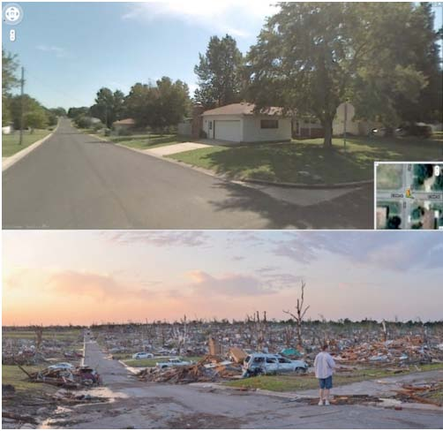
Before and After

Slide 29
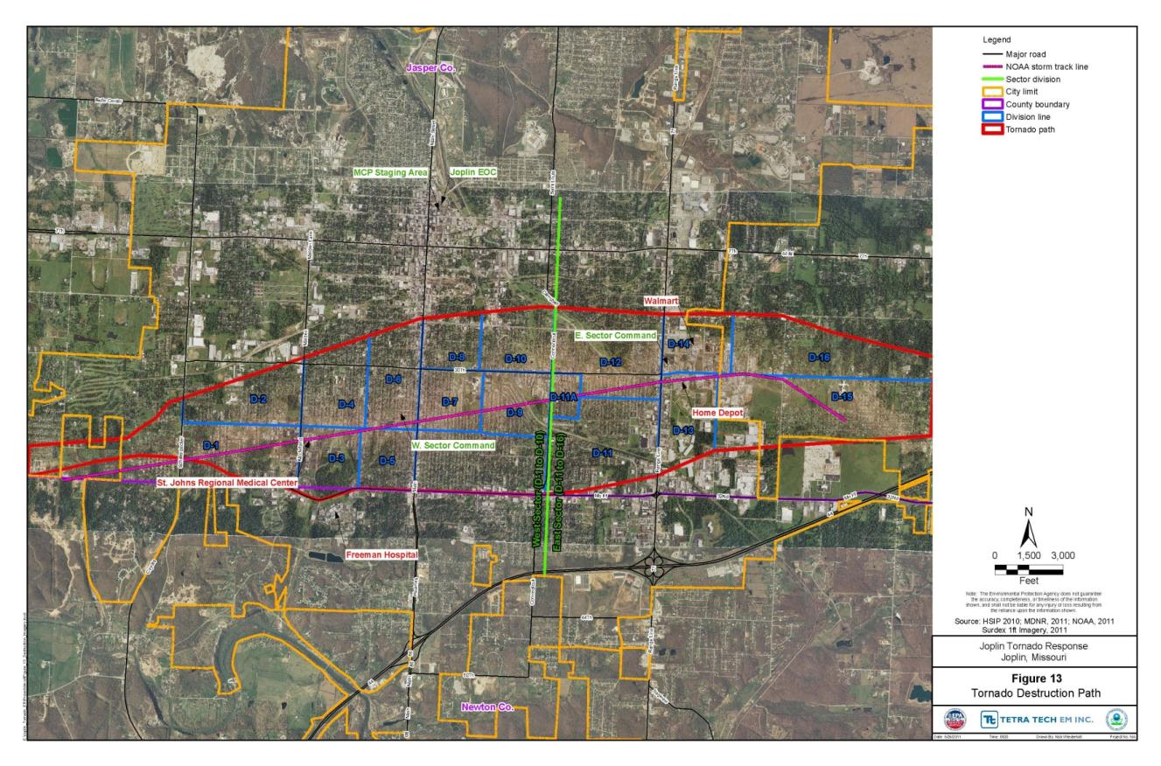
nsert Section Title
Ariel Photo of Tornado Path
28

Slide 30
Mission Assignments
    Rapid Needs Assessment - $135K
    Air Monitoring - $100K
    HHW Collection and Disposal – $4.5M
29

Slide 31
Air Monitoring
    Conducted from May 28 – August 19
    24/7 Real Time Particulate Monitoring & Daily Asbestos Sampling
    804 Asbestos air samples Collected
    Results were mapped, QA performed, and published to the internet within 24 hours of receiving the data
`
30

Slide 32
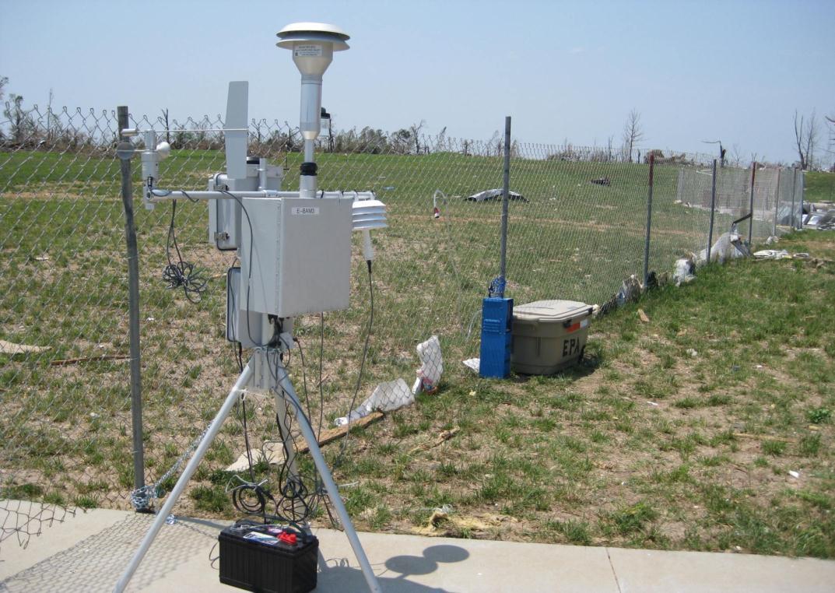
EBAM (Environmental Beta Attenuation Monitor) running off a deep cycle marine battery
31

Slide 33
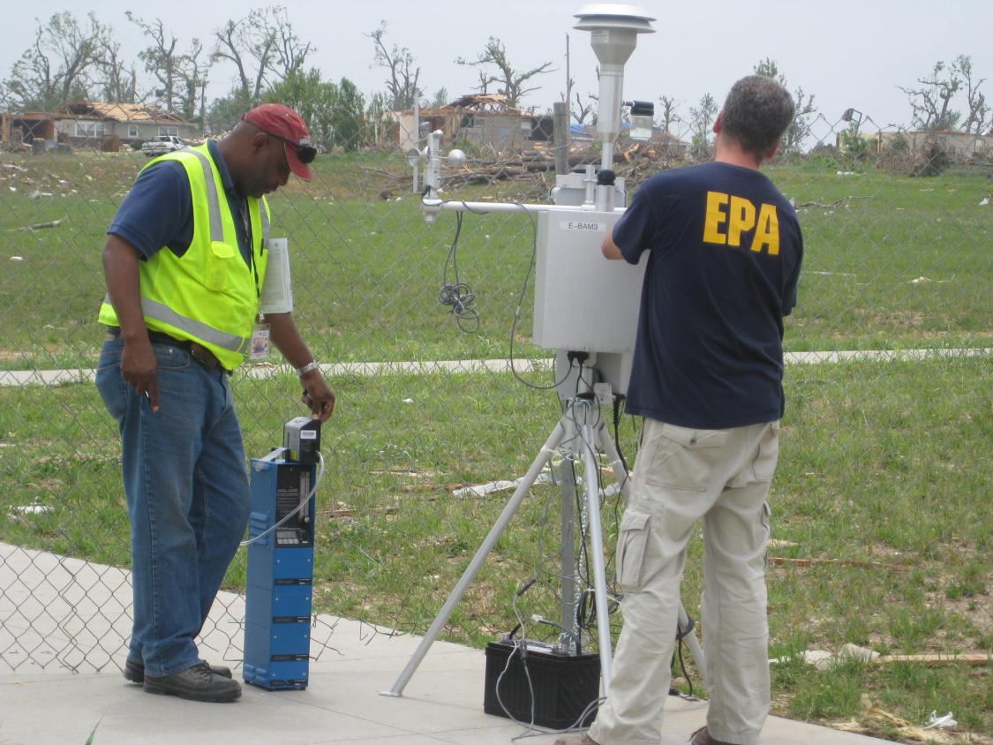
32

Slide 34
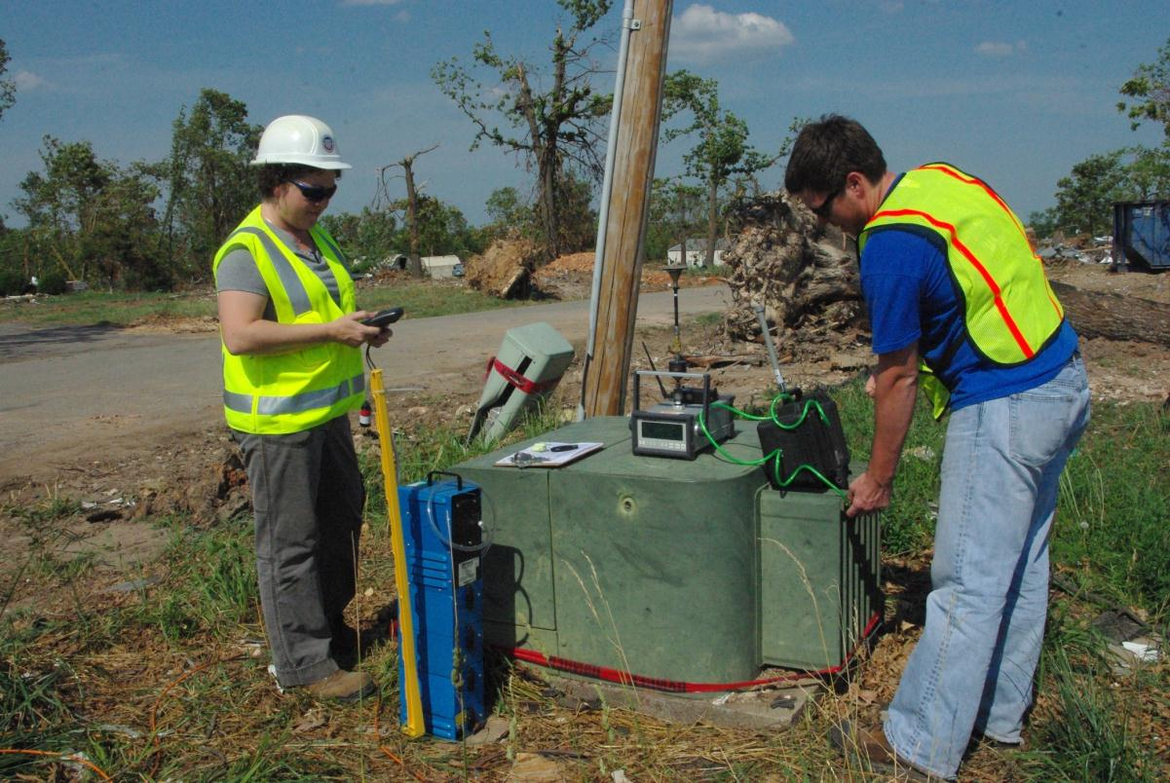
33

Slide 35
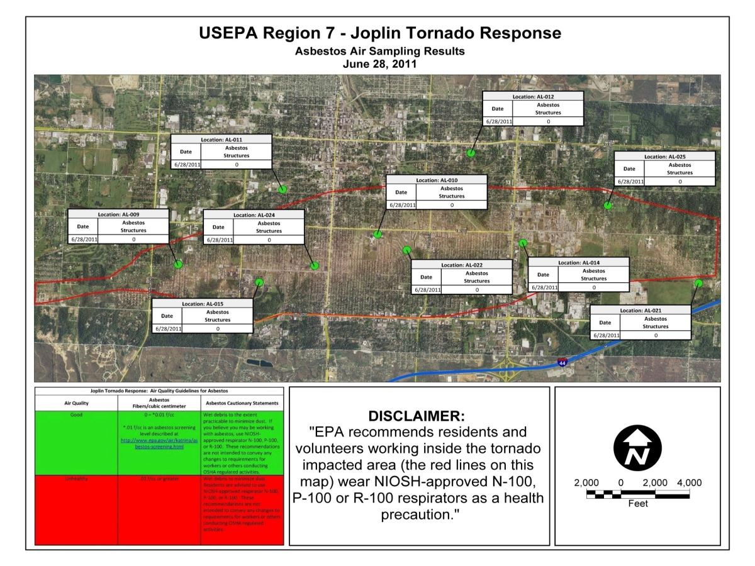
34

Slide 36
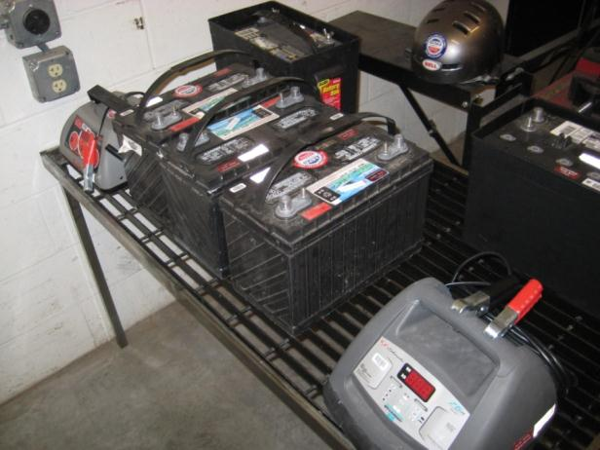
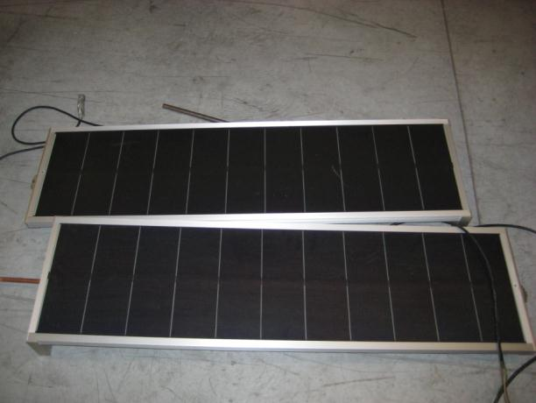
Solar Panels
Deep Cycle Marine Batteries and Chargers
35

Slide 37
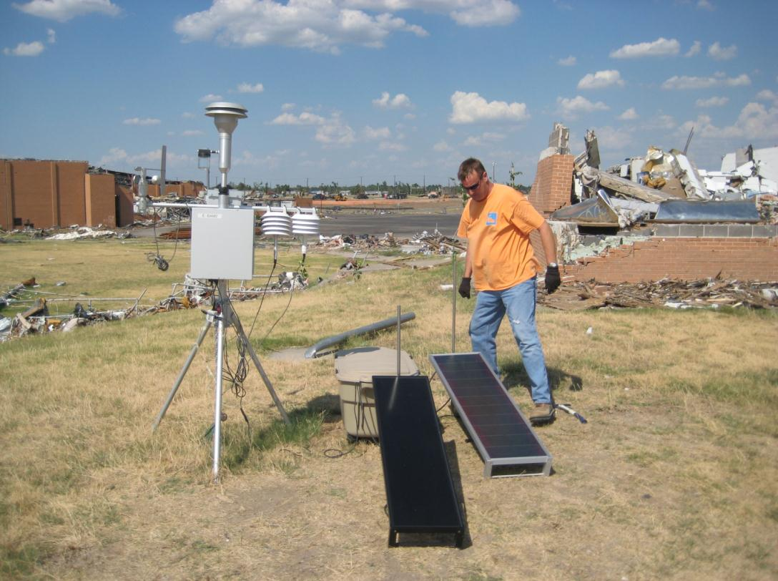
36

Slide 38
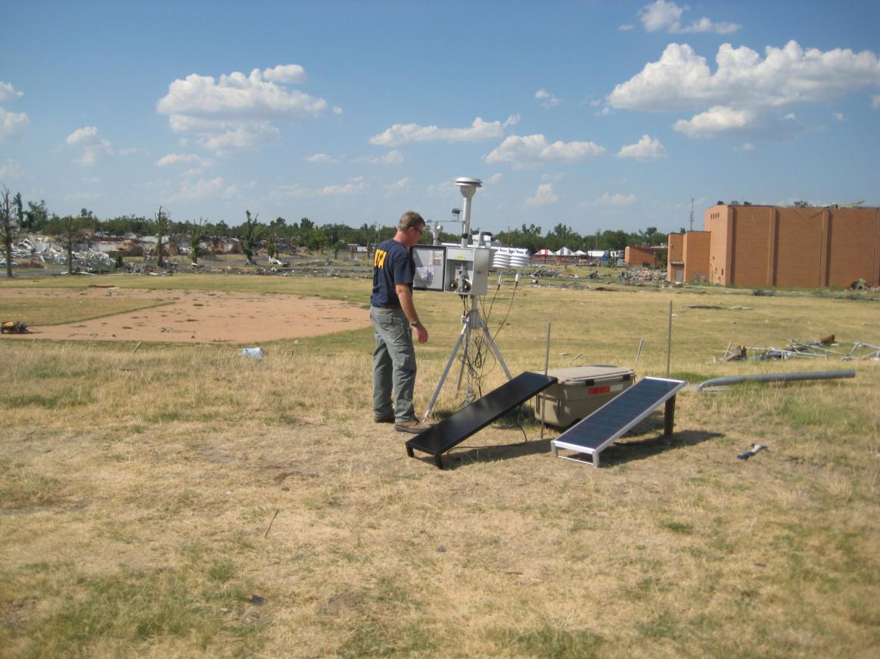
37

Slide 39
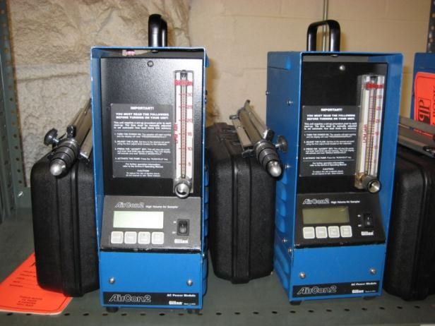
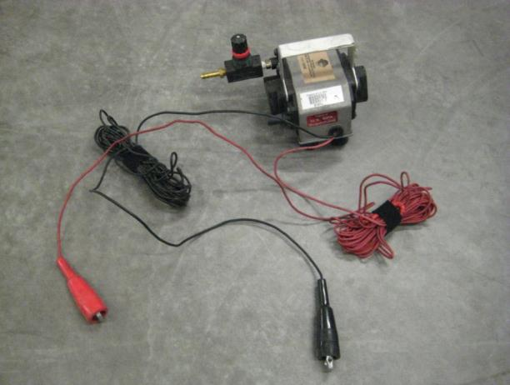
EMS Sampling Pumps
(Mario Bombs)
AirCon Samplers
38

Slide 40
For the Math Fans
Solar panels can produce about 30 Watts of power when exposed to full sun. The panels put out about 2 Amps at 15 Volts (2A X 15V = 30W of power). If the panels are exposed to twelve hours of “Good" sun light per day, then they will produce about 360 Watt-Hours per day (30W X 12 Hrs = 360 W-Hrs).
39

Slide 41
More Math
The EBAM draws about 48 Watts (4 Amps X 12 Volts). So if it running 24 hours per day, it would require 1152 Watt-Hrs. per day (48W X 24 hrs). So, to keep the EBAM running (24 hrs per day), we are required to use 4 solar panels to keep the unit running, and produce enough power to charge the batteries for the overnight run period.
152 W-Hrs, divided by 360 W-Hrs = 3.2 = 4 solar panels (round up). The batteries also need enough storage capacity to run the unit during the dark hours.
40

Slide 42
…and since this is NARPM a BONUS Math Slide
152 W-Hrs, divided by 360 W-Hrs = 3.2 = 4 solar panels (round up). The batteries also need enough storage capacity to run the unit during the dark hours.
The AirCon sampling pumps draw about 432 W-Hrs per day (4A X 12V X 9 hour run time per day), so it will require two solar panels to run the sample and charge the battery for the next day.
The EMS sampling pumps (Mario Bombs) draw about 324 W-Hrs per day (3A X 12V X 9 hour run time per day), so we have found that they will run very well on just one panel (and keeps the battery charged for the next day).
41

Slide 43

42

Slide 44
RE-Powering Superfund
Snapshot of Renewable Energy on
Contaminated Lands, Landfills, and Mine Sites
43

Slide 45
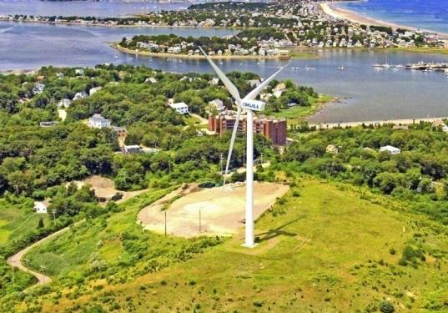
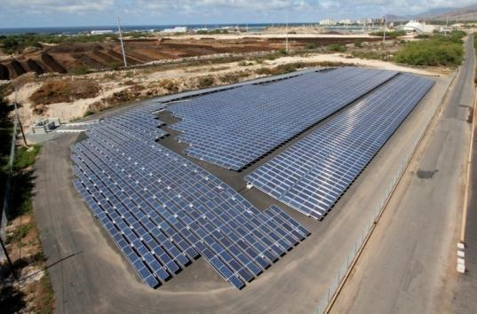
RE-Powering America’s Land
Topics
Wind turbine installed on upgraded landfill cap
RE-Powering America’s Land
National snapshot
Resources & Tools
  Google Earth Screening
  Solar & Wind Decision Trees
  Success Stories
RE-Powering Contacts
Massachusetts
Solar array installed on remediated industrial site
Hawa’ii

Slide 46
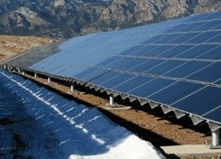
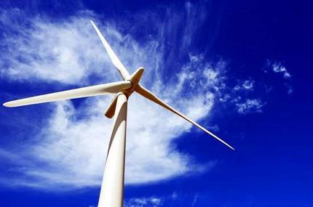
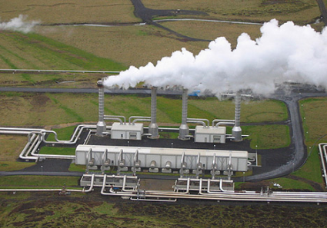
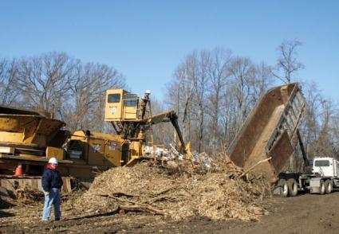
RE-Powering America’s Land
EPA’s RE-Powering America’s Land Initiative encourages renewable energy development on current and formerly contaminated land and mine sites when aligned with the community's vision for the site.
SOLAR
WIND
GEOTHERMAL
BIOMASS

Slide 47
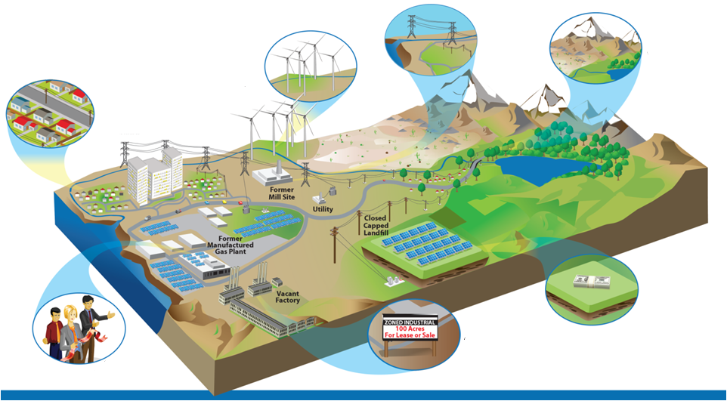
Benefits of Redeveloping Potentially Contaminated Sites
Build sustainable land development strategy
Leverage existing
infrastructure
Protect open
space
Provide low-cost, clean power to communities
Improve project economics through reduced land costs & tax incentives
Reduce project cycle times with streamlined zoning and permitting
Gain community support

Slide 48
National Snapshot
Installed projects & trends
47

Slide 49
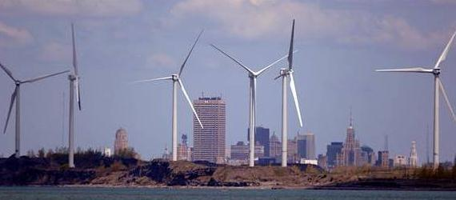
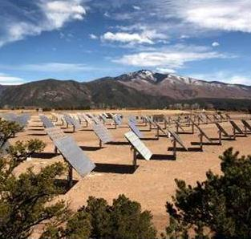
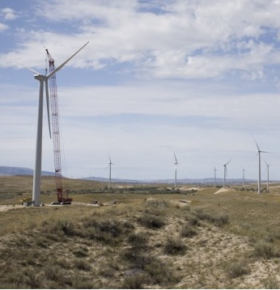
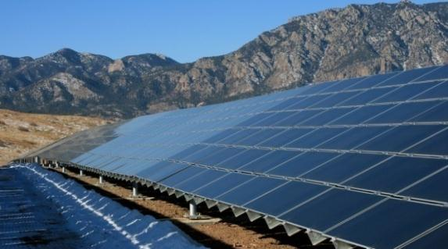
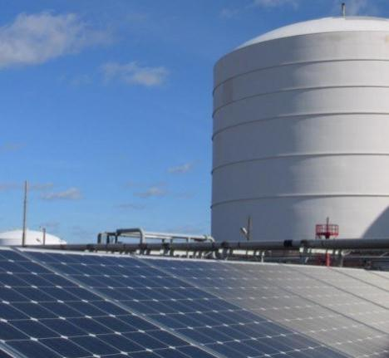
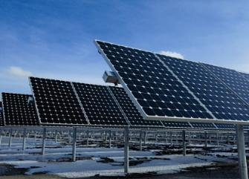
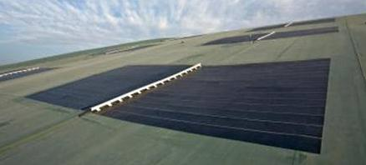
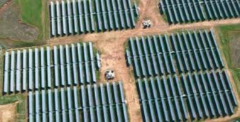
RE-Powering America’s Land
Wind turbines installed during remediation at abandoned steel mill
Concentrators installed on remediated mine tailings
Wind turbines at former industrial site
New York
Solar array installed on landfill cap
New Mexico
Wyoming
Solar array at former manufactured gas plant
Solar array at former foundry
Colorado
Solar geomembrane capping landfill
Illinois
Solar array at Superfund site
Georgia
Massachusetts
California
48

Slide 50
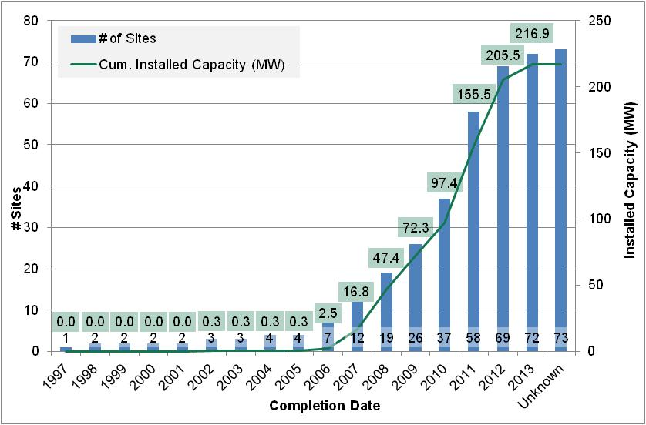
Project Tracking
National tracking of trends for RE on CL
RE-Powering Installations
 | # Sites | Installed Capacity (MW)
NY | 6 | 67.2
NJ | 10 | 22.7
MA | 16 | 21.4
SC | 1 | 20.0
WY | 2 | 19.8
NV | 1 | 14.2
CA | 8 | 12.1
IL | 2 | 10.9
TN | 2 | 9.7
CO | 5 | 5.9
RoUS | 20 | 13.0
 | 73 | 216.9

Slide 51
Resources & Tools
50

Slide 52
RE Development Process
CERCLA Progression
PA / SI
RE Development Timeline
RE-Powering Tools & Resources
NPL
Listing
Site Identification
Screening & Feasibility
Google Earth Mapping Tool
Solar & Wind Decision Trees
EPA-NREL Feasibility Studies
RI / FS
Precedent & Support
Statutory Protections & Enforcement Discretion
Site-specific Comfort Letters
Success Stories & Fact Sheets
Project Tracking Matrix
ROD
Feasibility
Study
RD / RA
RFP
Best Practices & Considerations
Handbook on Siting RE while Addressing Environmental Issues
Best Practices for Siting Solar PV on MSW Landfills
Design & Construction
Construction
Complete
Operation & Maintenance
NPL
Deletion

Slide 53
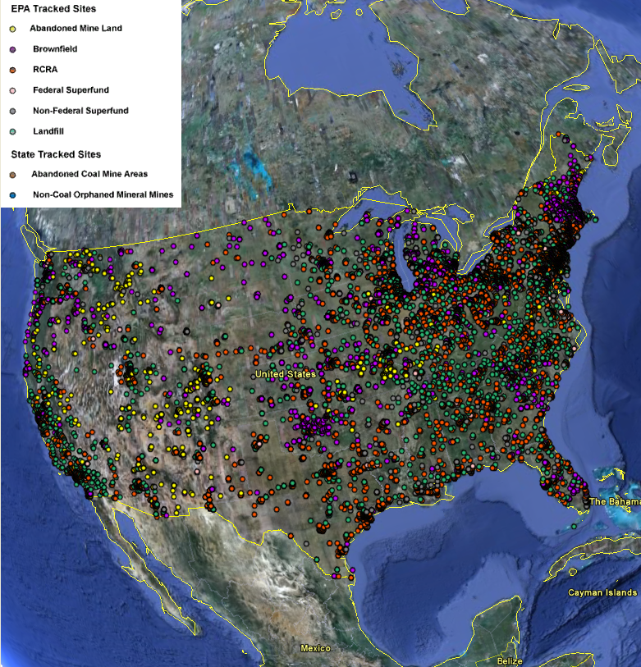
RE-Powering Google Earth
EPA Tracked Sites
RE-Powering Google Earth overlay showing 11,000 potentially contaminated sites pre-screened for renewable energy potential
  Abandoned Mine Lands
  Brownfields
  RCRA
  Superfund: Fed / Non-fed
  Landfills
1,410 Superfund sites screened thru RE-Powering
1,243 RE opportunities
State-lead sites screening potential
Adding NY, NJ, CA, WA, and HI
52

Slide 54
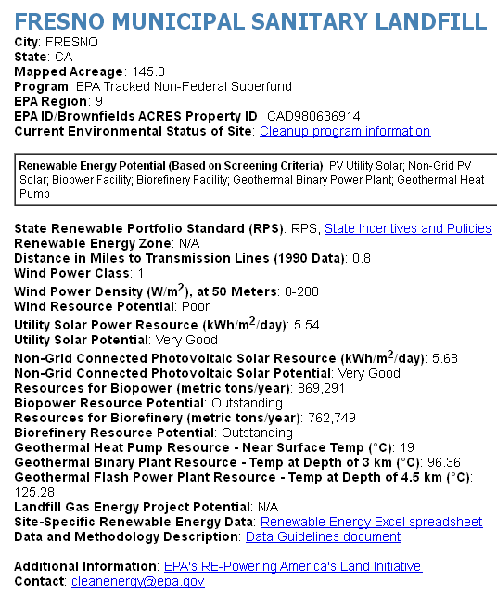
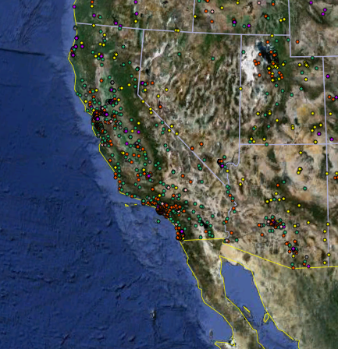
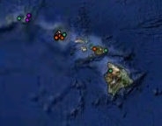
RE-Powering Google Earth
EPA Tracked Sites: Site-level information
53

Slide 55
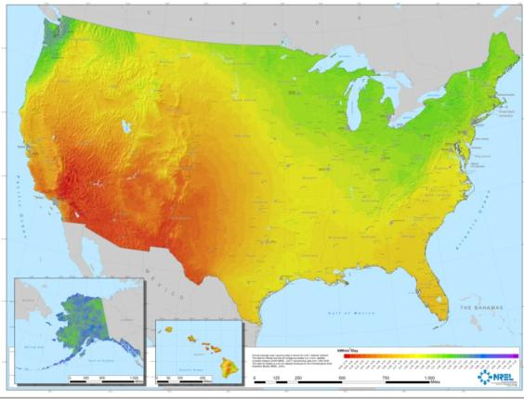
RE-Powering Google Earth
Site Screening Criteria
Renewable Energy Screening Criteria
Superfund Opportunities – by the numbers
Greener
Remediation
Beneficial
Reuse
PV Solar Resource of the U.S.
Source: NREL
Available resource
Acreage
Distance to
  Transmission lines
  Graded roads
  Rail (biopower only)
*Includes preliminary results for new screening criteria
54

Slide 56
RE-Powering Google Earth
Superfund Solar PV Potential
Superfund Opportunities – by the numbers
5.5 GW
potential using mapped acreage
Greener
Remediation
Beneficial
Reuse
1.4 GW
potential using 2% of mapped acreage
> 10% of RE installed in US
*Includes preliminary results for new screening criteria
2010 Renewable Energy Data Book
Source: NREL
55

Slide 57
Solar & Wind Decision Trees
Site Screening Tool
Designed to guide users through a three-phase process to assess sites for redevelopment with solar PV or wind energy
Objective
Empower stakeholders to build successful projects that return potentially contaminated sites to beneficial use or increase productivity of already developed, but underutilized sites
Inputs
Data readily available through (i) visual site inspection; (ii) GIS parcel maps or online databases; (iii) site owners or managers; (iv) economic and policy incentives
Results
Go/no go recommendation to pursue renewable energy development project
I. Pre-Screening
II. Site Screening
III. Financial Screening
Solar or Wind Resource
Distance to Existing Infrastructure
Site Topology
Redevelopment Priorities & Land Use Exclusions
Available Area
Owner interest
System Type: Rooftop or Ground Mount
Contaminated Site & Landfill Considerations, Status, and Readiness
Electricity Costs
Federal and State rebates and incentives
Installation costs
Policy Considerations
Energy Demand
56
Notes:
High-Level Phases
Pre-Screening
Addresses data readily available through GIS parcel maps and online databases, as well as information that can be easily obtained through visual inspection
Site Screening
Addresses data that generally requires collecting information from property owners or site managers. May also require site-level investigation, potentially using specialized tools or equipment.
Financial Screening
Addresses economic, policy, and incentive factors that further influence payback.

Slide 58
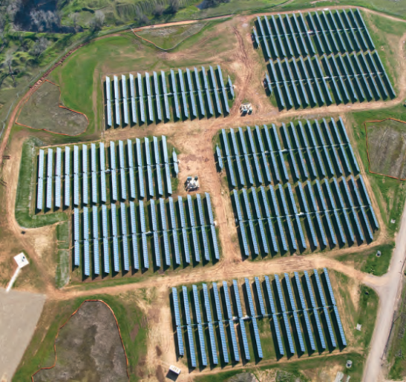
Aerojet Superfund Site
Sacramento, CA
  Historical use
  Rocket propulsion development and testing
  PV System description
  40 acres
  6 MW (equiv. 15,000 homes)
  Single-axis tracking system
  Deal structure
  Power Purchase Agreement between private developer & Aerojet
  Green remediation: offsets energy consumption for extensive groundwater remediation program onsite
  Three-tier incentive program negotiated with local utility
“While our priority was making sure that the solar project would not impact the site’s cleanup, we were also interested in supporting an innovative, green remediation project like this.”
- Kevin Mayer, Superfund Project Manager
U.S. EPA

Slide 59

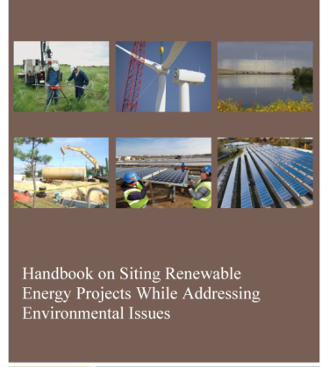
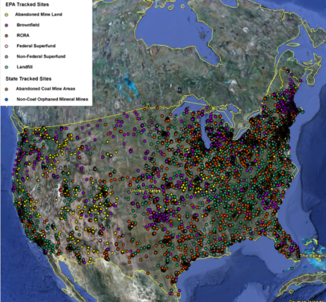
Renewables on Contaminated Lands
Handbook on Siting Renewable Energy Projects While Addressing Environmental Issues
Opportunities for siting renewable energy projects while addressing environmental site issues during all phases of cleanup
Best Practices for Siting Solar PV on Landfills
Current best practices unique to siting solar systems on landfills associated with system design, construction, O&M
Other tools & resources
EPA-NREL feasibility studies
Liability factsheets
Success stories & case studies
Quarterly webinars & newsletters
Topic-specific workshops

Slide 60
RE-Powering Contacts
        RE-Powering America’s Land Initiative
        Adam Klinger
        202 566-0546
        Marc Thomas
        202 566-0791
        Brigid Lowery
        202 566-0198
        Katie Brown, AAAS Fellow
        415 972-3073
        Regional Rapid Response Team
        EPA Region 1
        John Podgurski
        EPA Region 2
        Fernando Rosado
        EPA Region 3
        Charlie Howland
        EPA Region 4
        Margaret Olson
        EPA Region 5
        Rosita Clarke
        EPA Region 6
        Karen Peycke
        EPA Region 7
        Shelley Brodie
        EPA Region 8
        Tim Rehder & Nat Miullo
        EPA Region 9
        Andria Benner & ZiZi Searles
        EPA Region 10
        Carolyn Gangmark
        www.epa.gov/renewableenergyland

Slide 61
Renewable Energy Assessments
Hilary Thornton
RPM, EPA R4
60

Slide 62
What is a Renewable Energy Assessment (REA)?
An REA is a study that evaluates the feasibility of using renewable energy to power a remedy or produce energy to feed into the electricity grid
Why do an REA?
  All 10 of EPA’s regions have policies promoting Greener Cleanups
  Use of Renewable Energy to power remedies is preferred

Slide 63
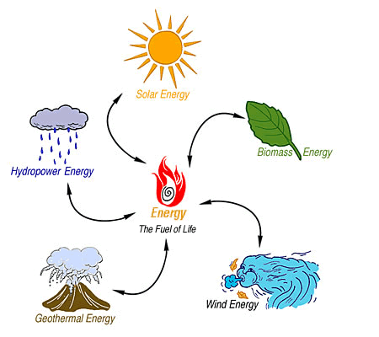
What Types of Renewable Energy?
Evaluate any types of RE that you think might be appropriate for your site

Slide 64
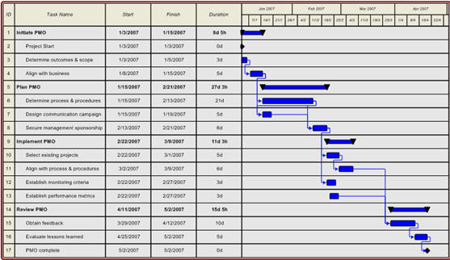
How Long Will It Take?
Allow 3-6 months for a typical screening-level REA at a Superfund Site

Slide 65

What Will It Cost?
Allow approximately $10K for a typical contractor-performed REA at a Superfund site

Slide 66
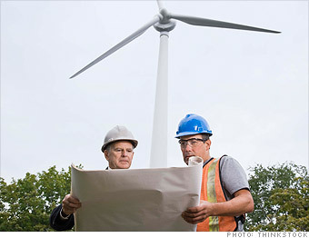

Who Does an REA?
Typically, an REA is performed by a contractor following a Scope of Work (SOW) developed by the EPA Project Manager

Slide 67
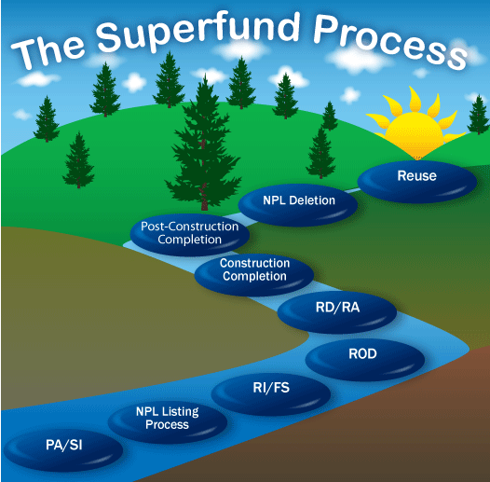
When Should I Do an REA?
Anytime from the Feasibility Study stage through the Long-Term Monitoring stage

Slide 68

Where Does An REA Fit In?
If you have a site where you think Renewable Energy might make sense, do an REA
If you are using one of EPA’s Decision Trees, you can “branch off’ to doing an REA

Slide 69
Questions?
Hilary Thornton
RPM, EPA R4
thornton.hilary@epa.gov
404-562-8809

Slide 70
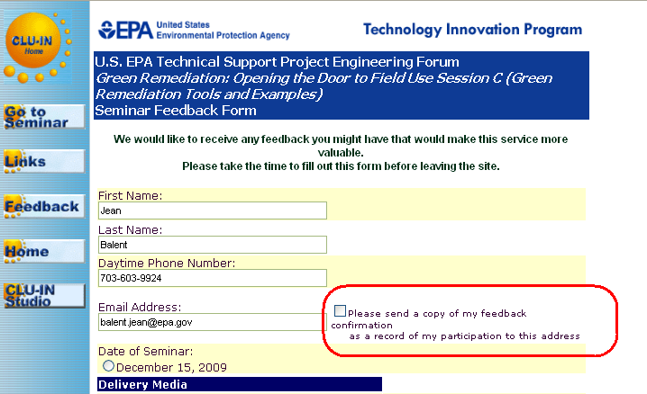
Resources & Feedback
Need confirmation of your participation today?
Fill out the feedback form and check box for confirmation email.
69
To view a complete list of resources for this seminar, please visit the Additional Resources
Please complete the Feedback Form to help ensure events like this are offered in the future
Notes:
69

Slide 71



New Ways to stay connected!
70
Follow CLU-IN on Facebook, LinkedIn, or Twitter
  https://www.facebook.com/EPACleanUpTech
  https://twitter.com/#!/EPACleanUpTech
    http://www.linkedin.com/groups/Clean-Up-Information-Network-CLUIN-4405740
Notes:
70

