Slide 1
Remediation Plan for Arkansas River Flood Plain
OU11 of the California Gulch National Priority Site

Slide 2
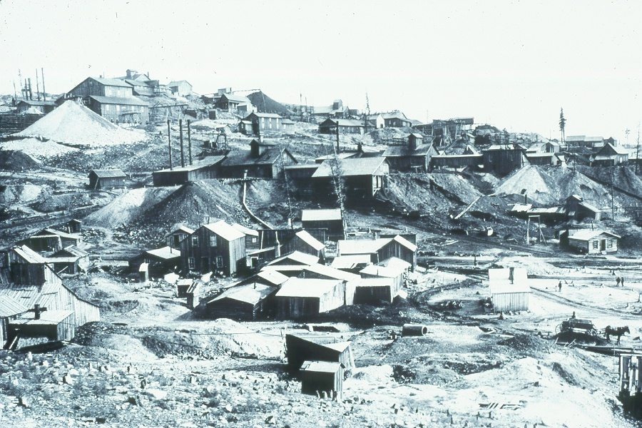
Leadville, Colorado – Gold Rush Days (1859-1880)
Notes:
Leadville, Colorado – Gold Rush Days (1859-1880)

Slide 3
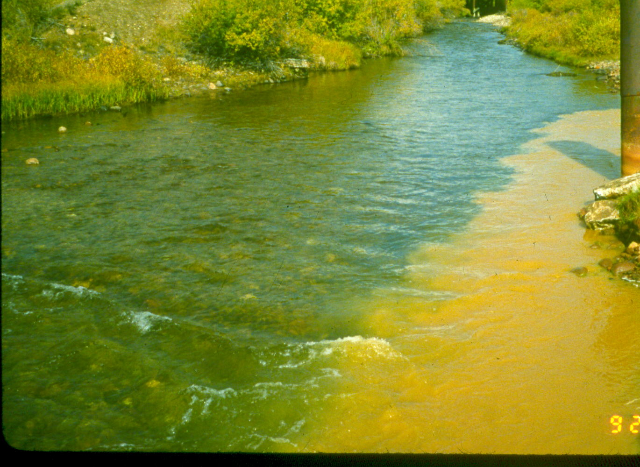
Confluence of California Gulch and Arkansas River
Notes:
Confluence of California Gulch and Arkansas River

Slide 4
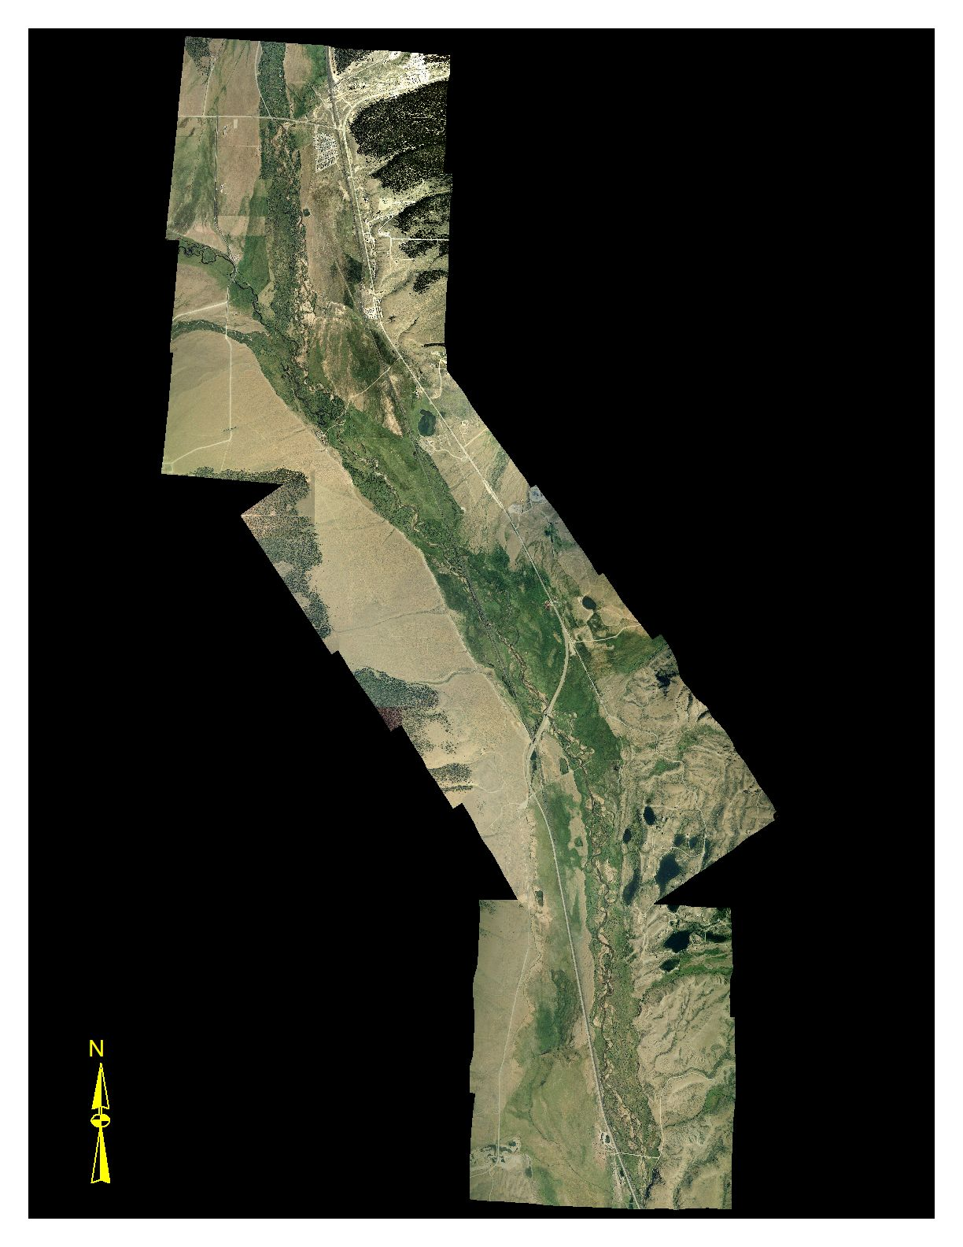
OU11

Slide 5
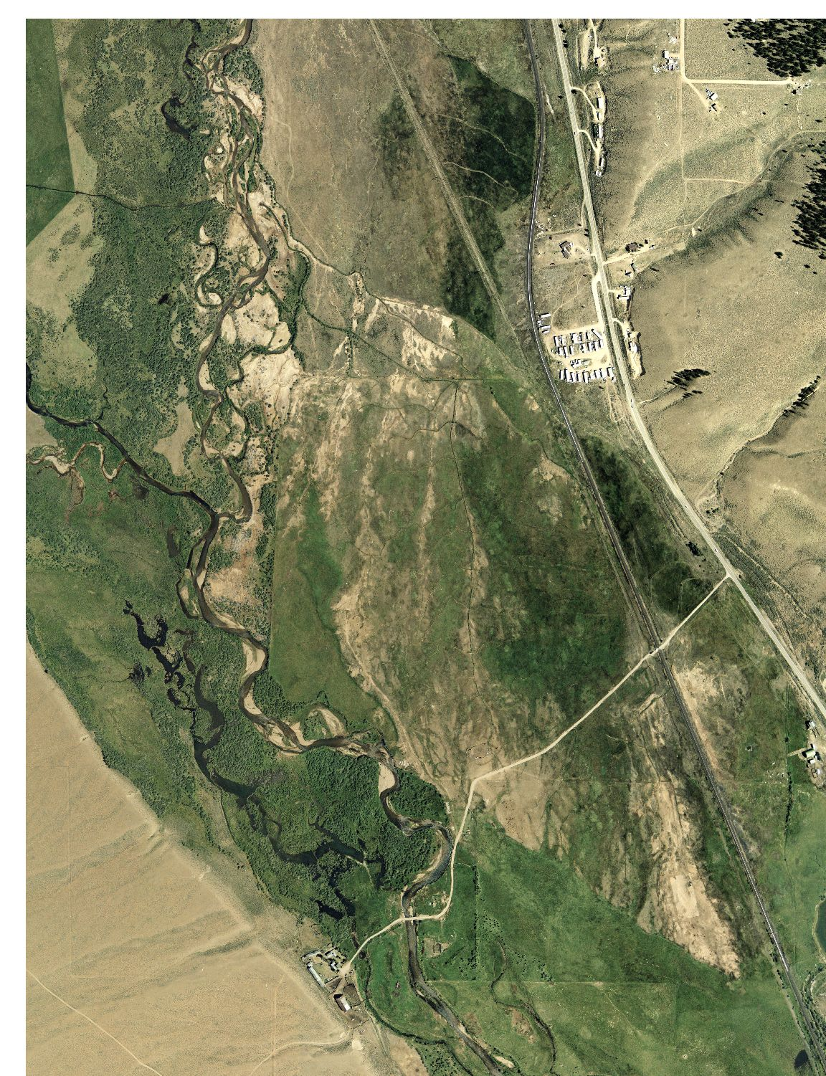

Slide 6
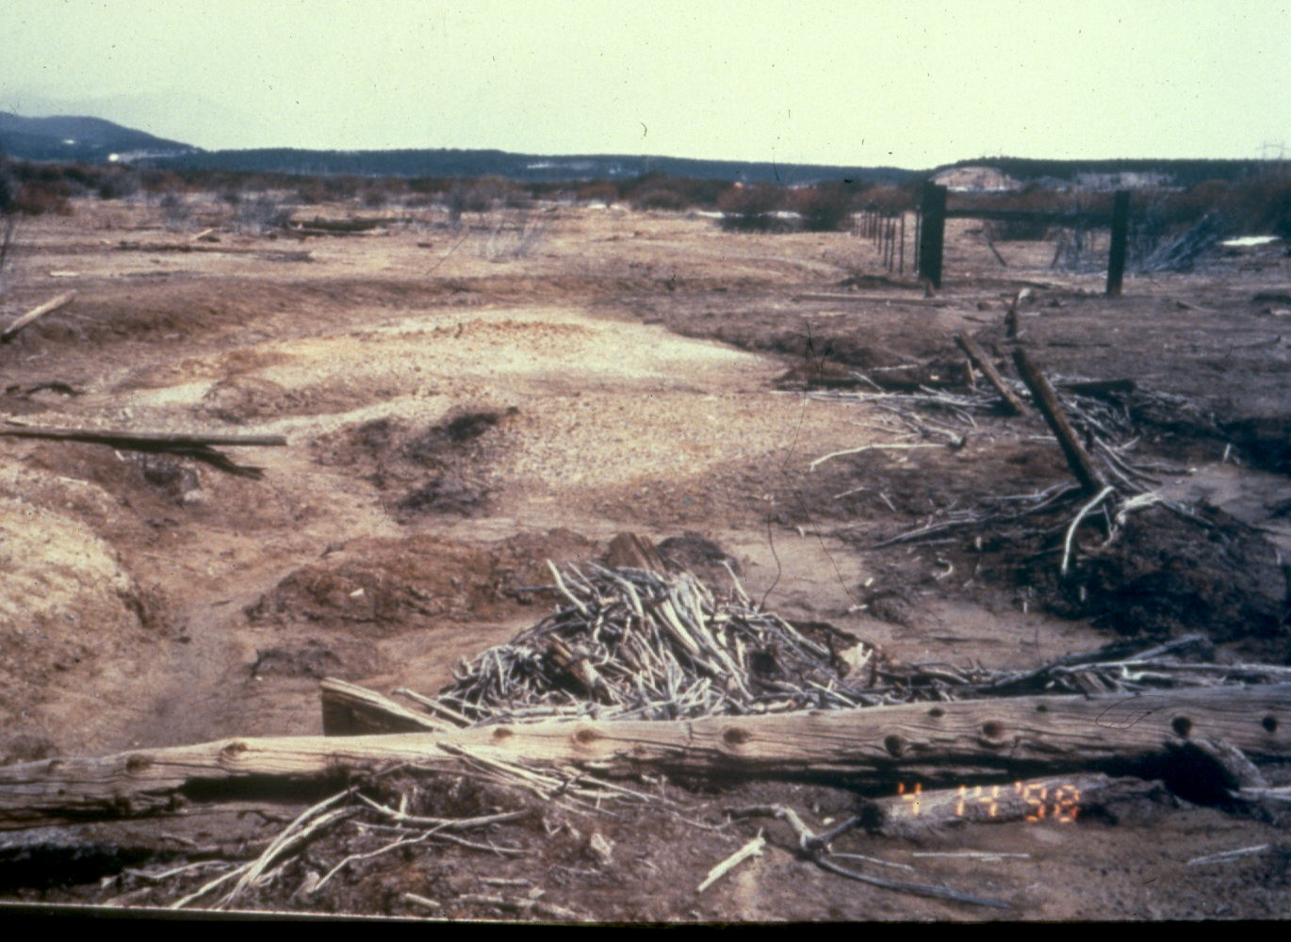
Fluvial Tailings – Highly Contaminated
Notes:
Fluvial Tailings – Highly Contaminated

Slide 7
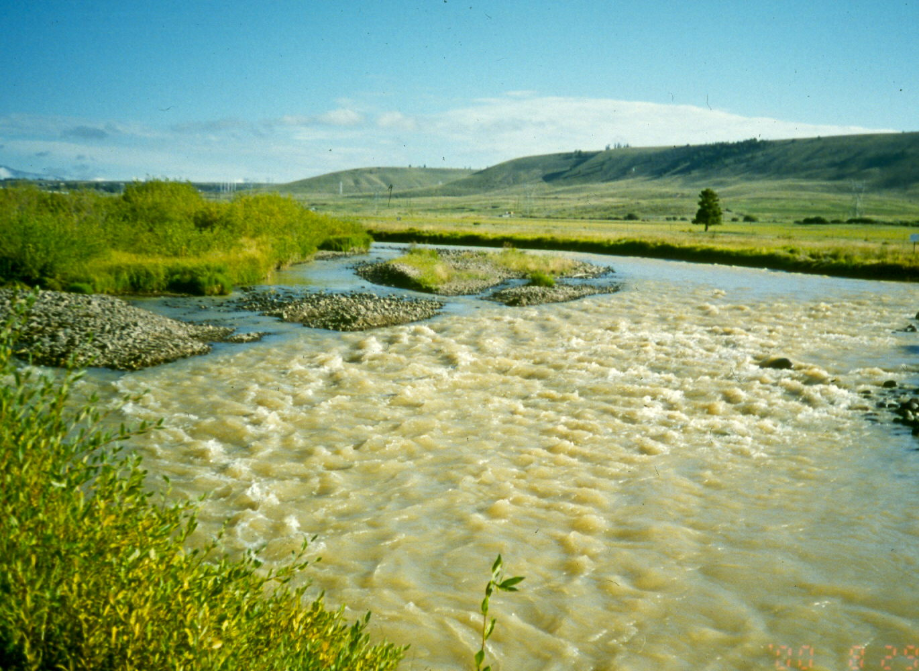
Arkansas River During Spring Run-off
Notes:
Arkansas River During Spring Run-off

Slide 8
Removal/Remedial Action Objectives
Prevent human exposure to unacceptable levels of metals.
Prevent erosion of fluvial mine wastes into the Arkansas River
Control infiltration of metals into groundwater
Reduce plant uptake of metals and improve plant diversity
Reduce exposure of wildlife and livestock to metals

Slide 9
Summary of Alternatives
Areas
Irrigated Meadows (354 acres)
Fluvial Mine Waste Deposite (65 acres)
Riparian Areas
(344 acres)
Alternatives
No Further Action
Soil Admendments and Vegetative Cover
Excavation and disposal of hign metal soils
Institutional Controls

Slide 10
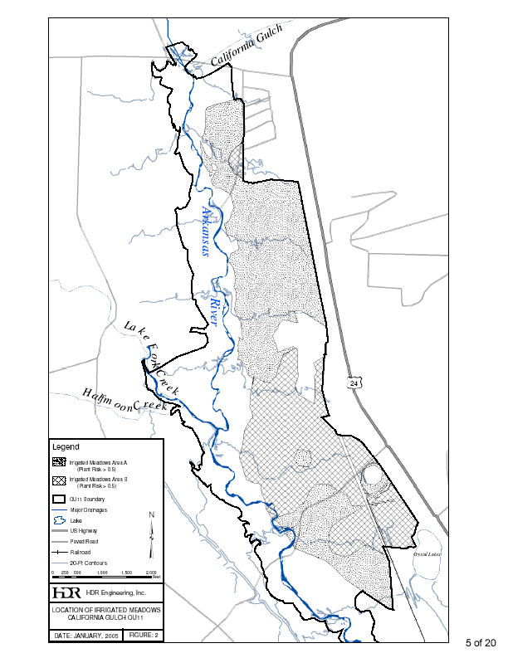

Slide 11
Fluvial Mine Waste Deposits
No Action
Lime, Organic Amendments, Deep Till, and Reseed
Removal, Disposal, Lime and Reseeding
Institutional Controls

Slide 12
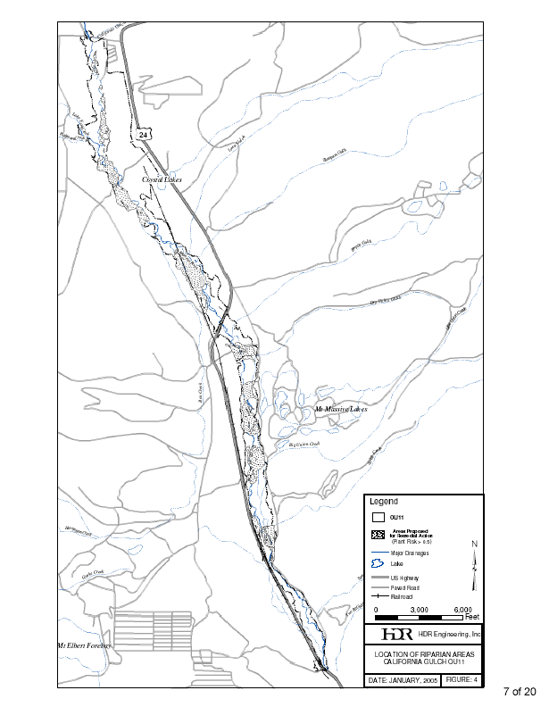

Slide 13
Evaluation of Alternatives
Overall Protection
Compliance w/ Applicable or Relevant and Appropriate Requirements (ARARs)
Long-Term Effectiveness
Treatment of High Metals Soils
Short-Term Effectiveness
Implementability
Cost
Stakeholder Acceptance
Community Acceptance

Slide 14
Preferred Alternative
Fluvial Mine Waste Deposits - Lime, Soil Amendments, Deep Till, Reseed, Institutional Controls

Slide 15
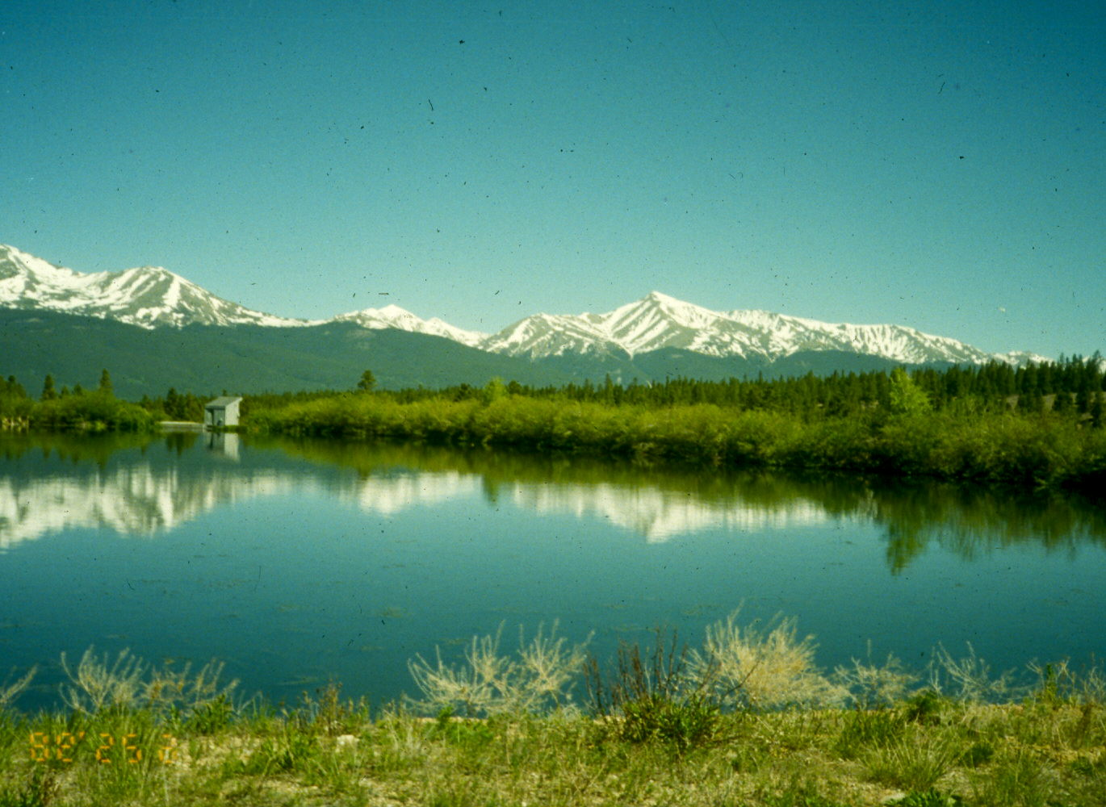
High Mountain Environment – Extreme Conditions

Slide 16
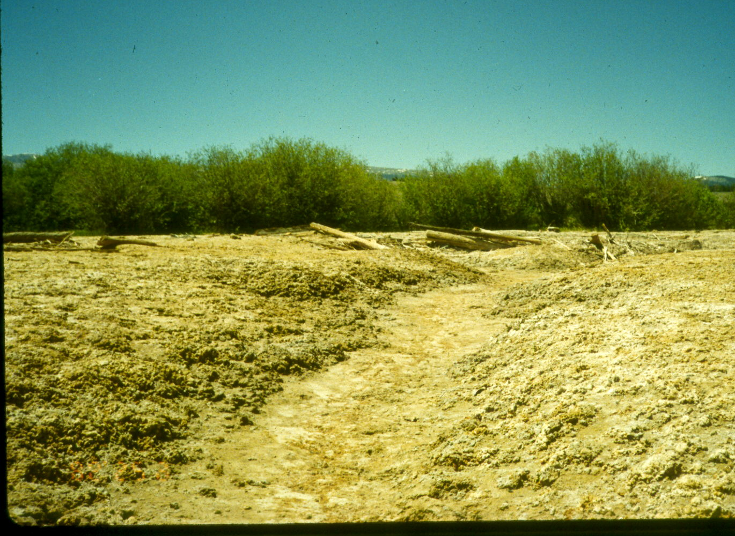
Highly Contaminated Fluvial Tailings Deposits
Notes:
Highly Contaminated Fluvial Tailing Deposits

Slide 17
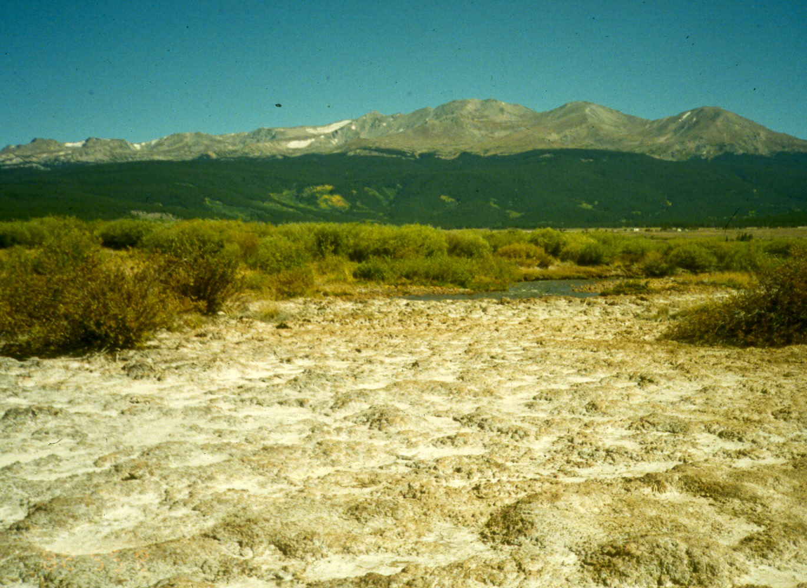
Zinc Contamination – 10% Surface Salts

Slide 18
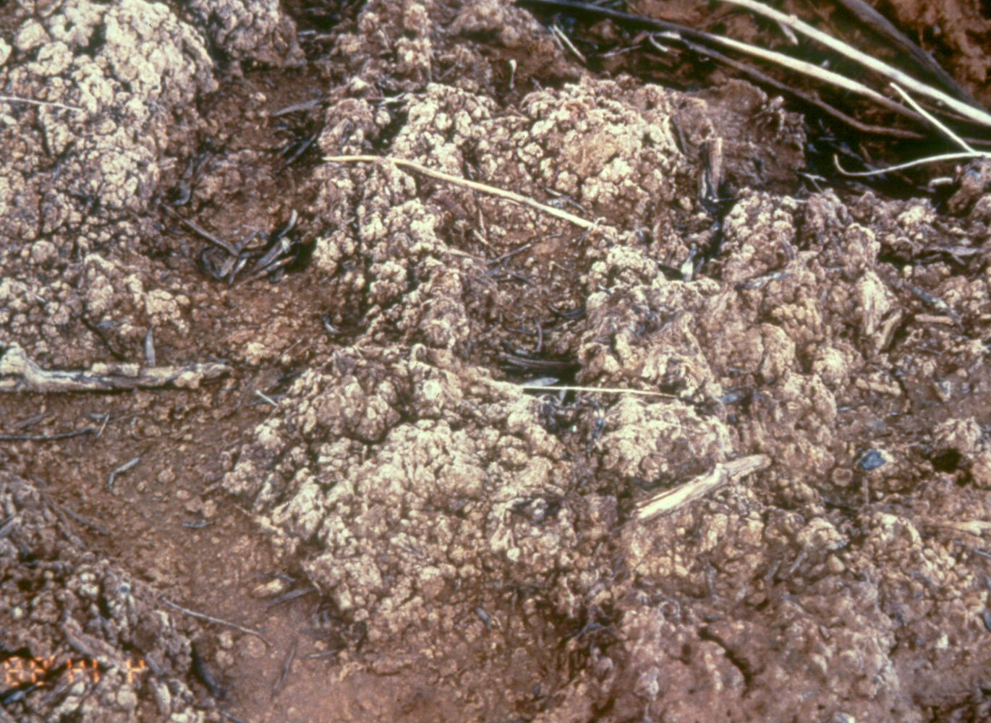

Slide 19
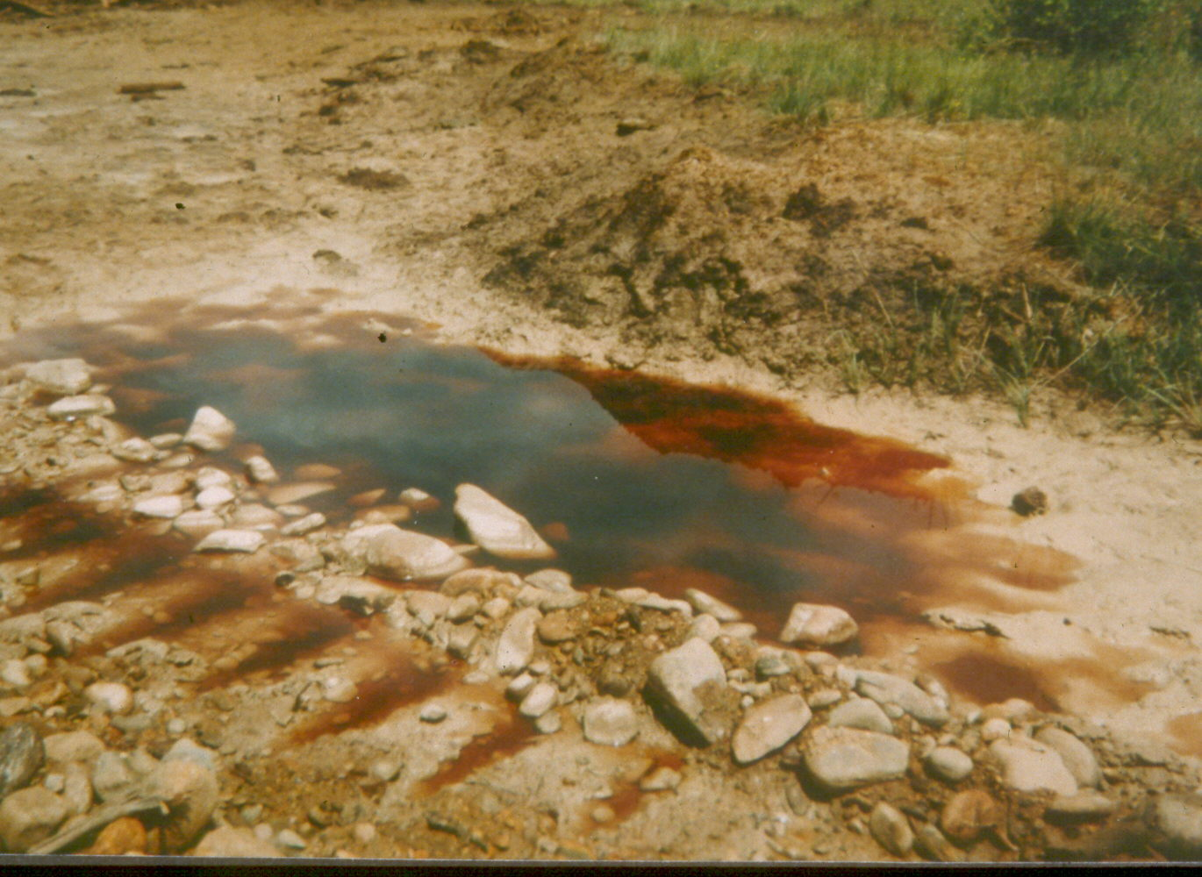
Rain Water Adjacent to Arkansas River – pH 1.0
Notes:
Rain Water Adjacent to Arkansas River – pH 1.0

Slide 20
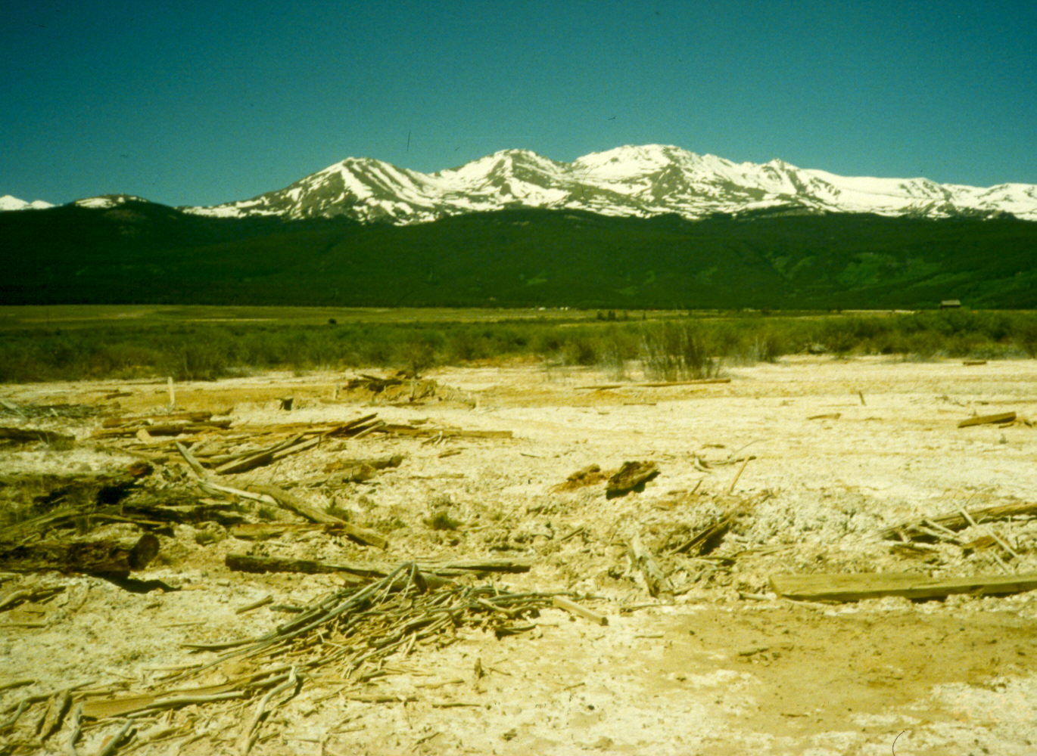
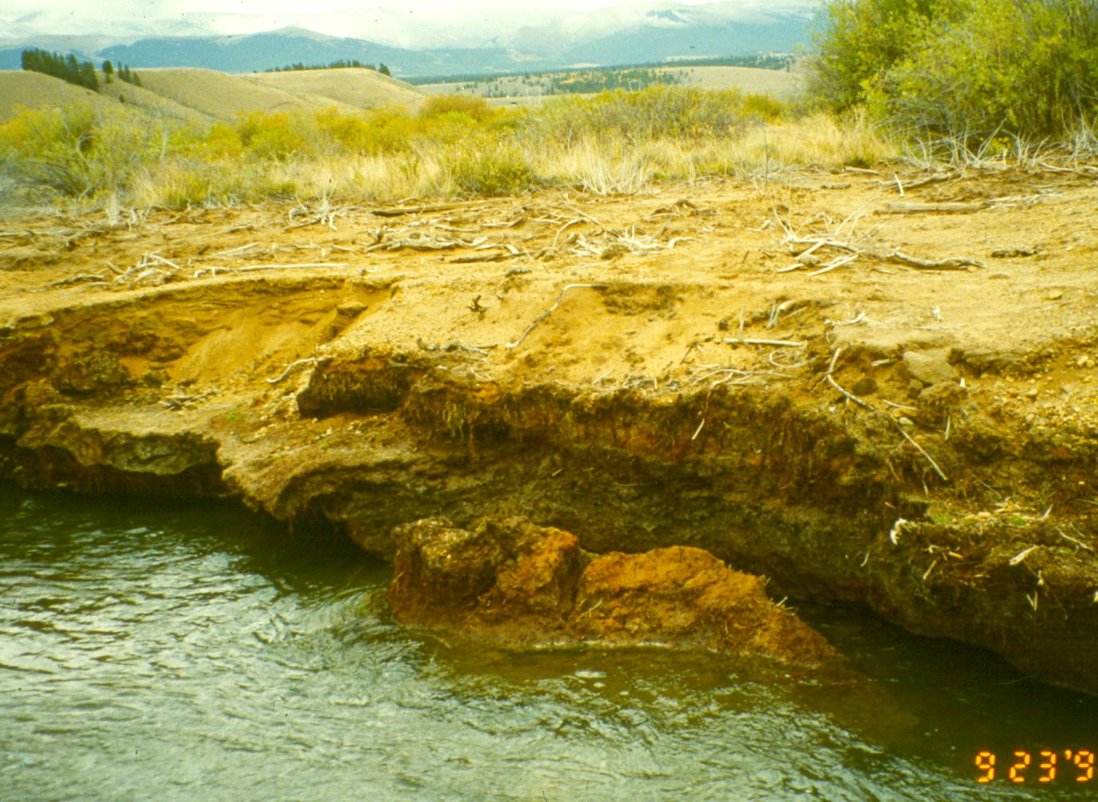
Calving Embankment – Stream Contamination
Notes:
Calving Embankment – Stream Contamination

Slide 21
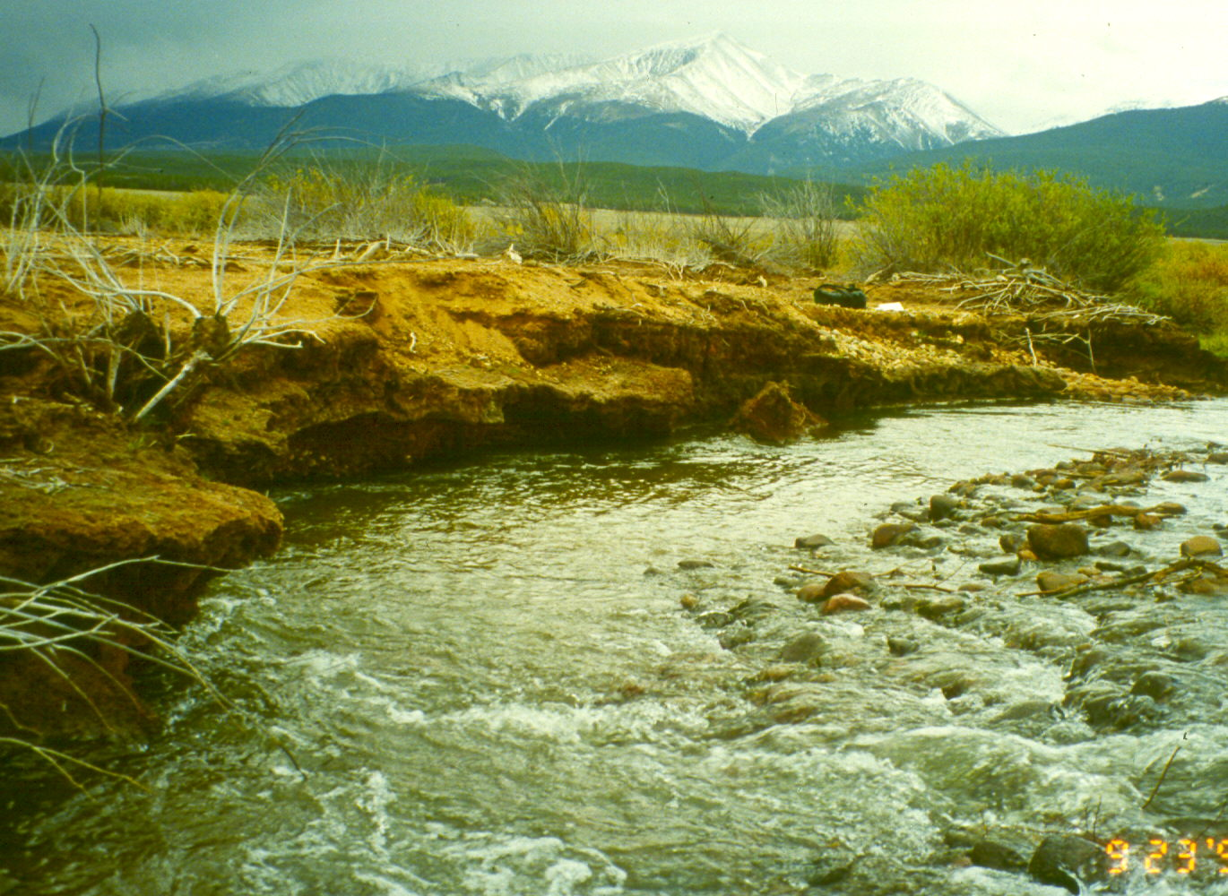
Calving Embankment
Notes:
Calving Embankment

Slide 22
Fluvial Tailings
Field Observations
  Cut banks
  Surface Salts
  Standing Water

Slide 23
Upper Arkansas River Fluvial Tailings
XRF Results
- Cadmium ND to 1,100 ppm
- Copper ND to 7,800 ppm
- Lead 58 to 50,000 ppm
- Manganese ND to 33,000 ppm
- Zinc ND to 115,000 ppm

Slide 24
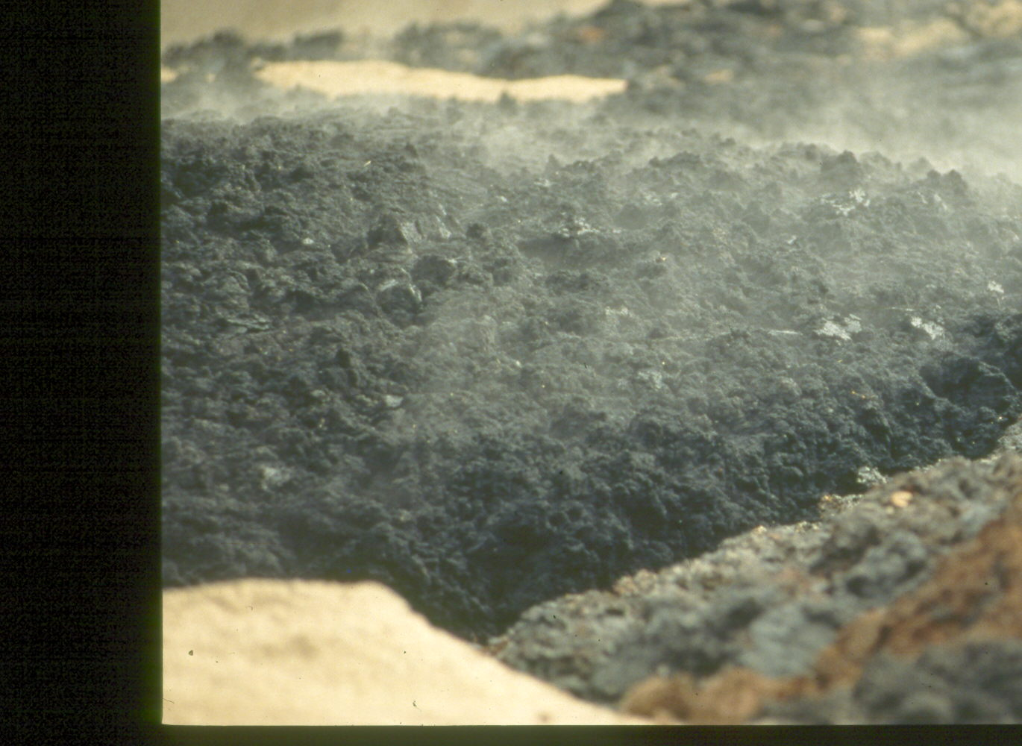
Steaming Biosolids – Organic Amendment
Notes:
Steaming Biosolids – Organic Amendment

Slide 25

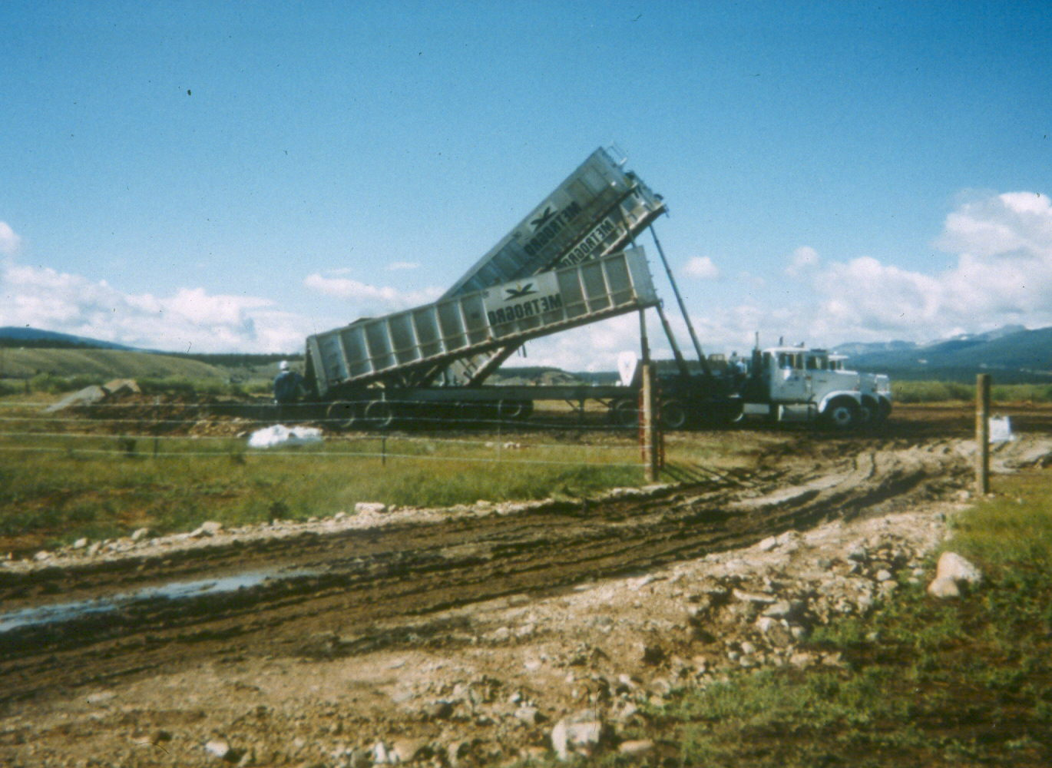
Biosolids Delivery – 4,600 Tons of Wet Biosolids (Denver Metro)
Notes:
Biosolids Delivery – 4,600 Tons of Wet Biosolids (Denver Metro)

Slide 26
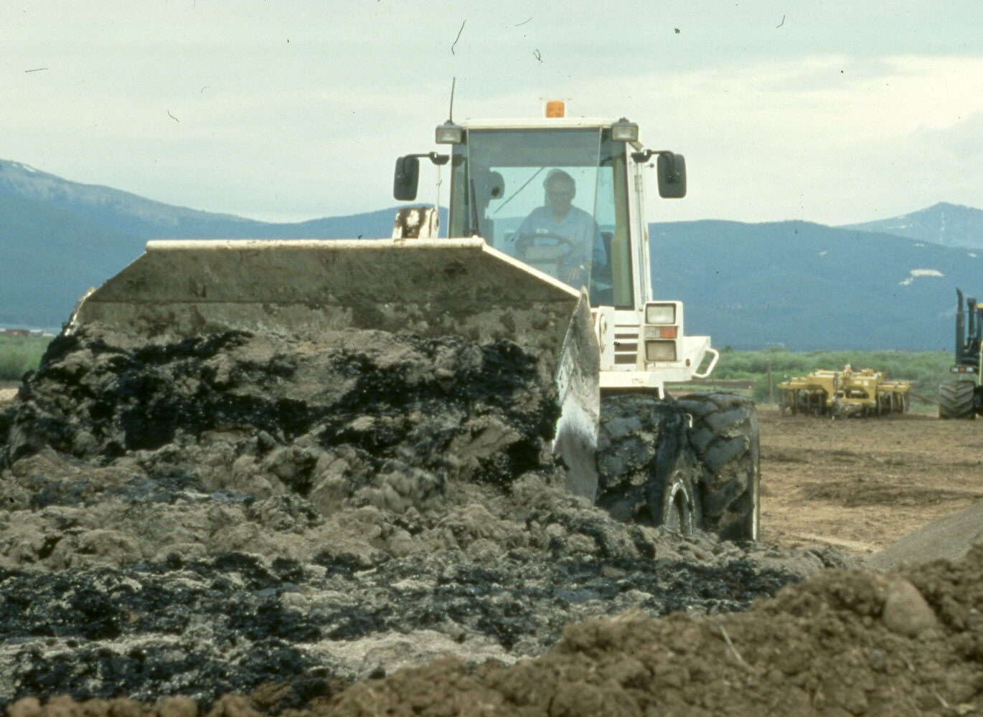
Mixing of Biosolids and Lime
Notes:
Mixing of Biosolids and Lime

Slide 27
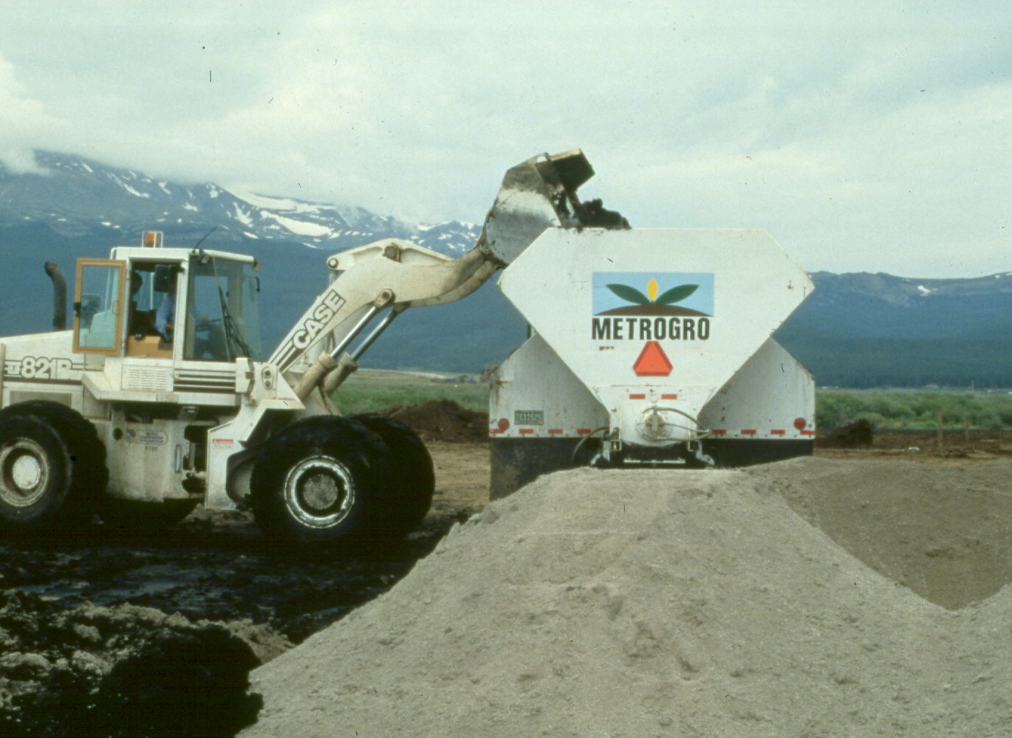
Loading of Biosolids and Lime Amendment
Notes:
Loading of Biosolids and Lime Amendment

Slide 28
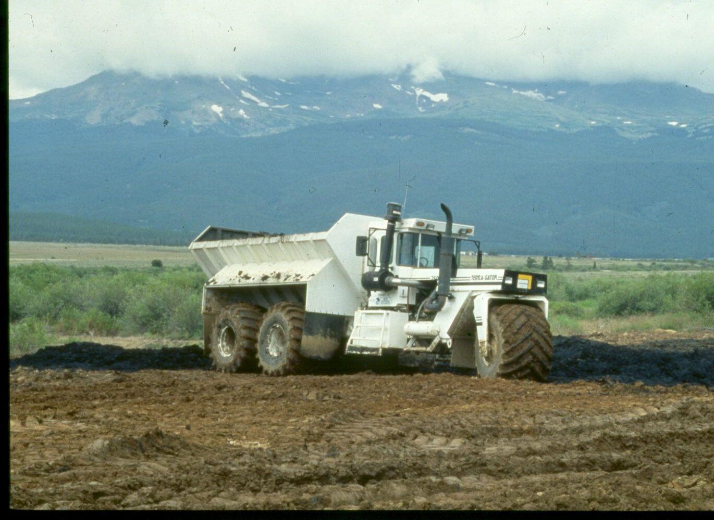

Slide 29
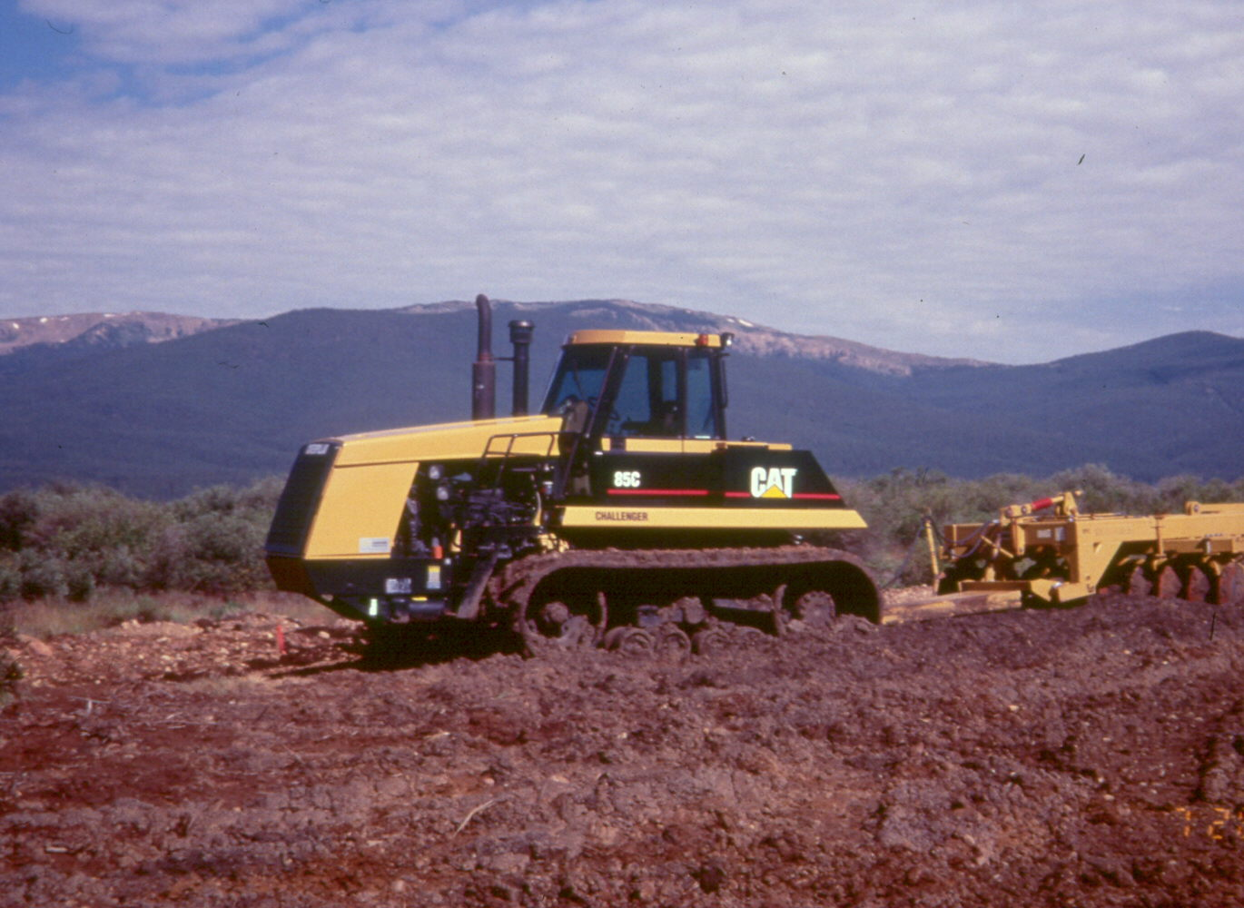

Slide 30
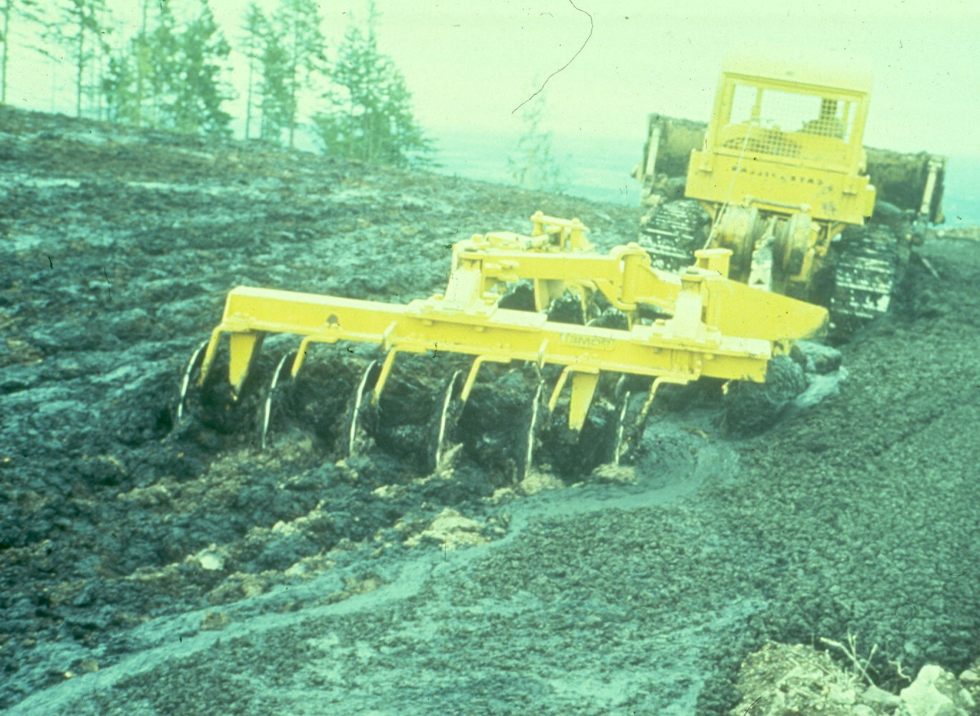

Slide 31
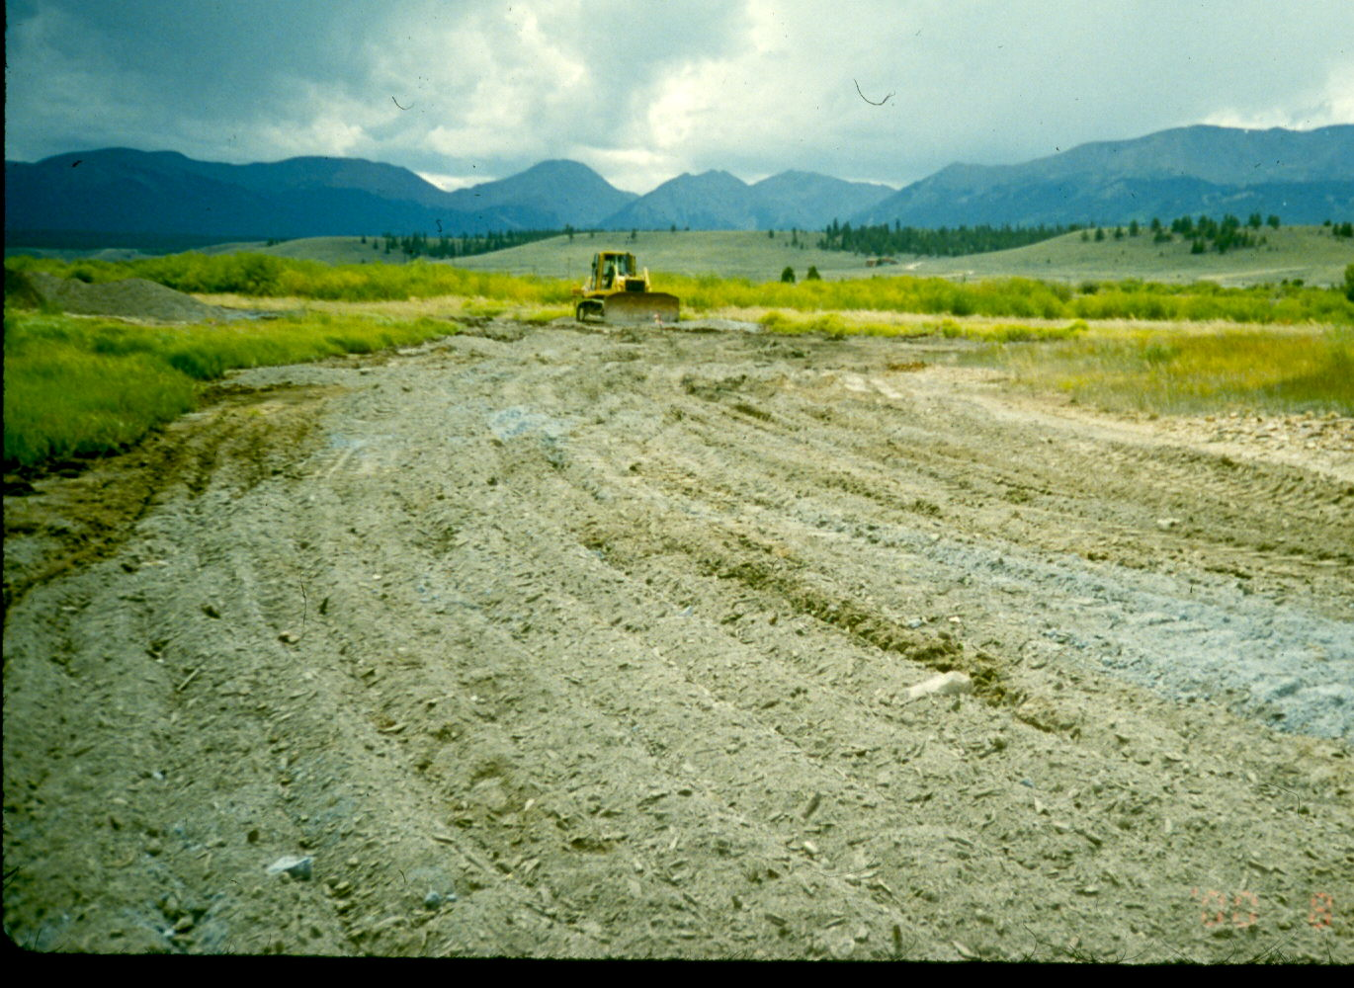

Slide 32
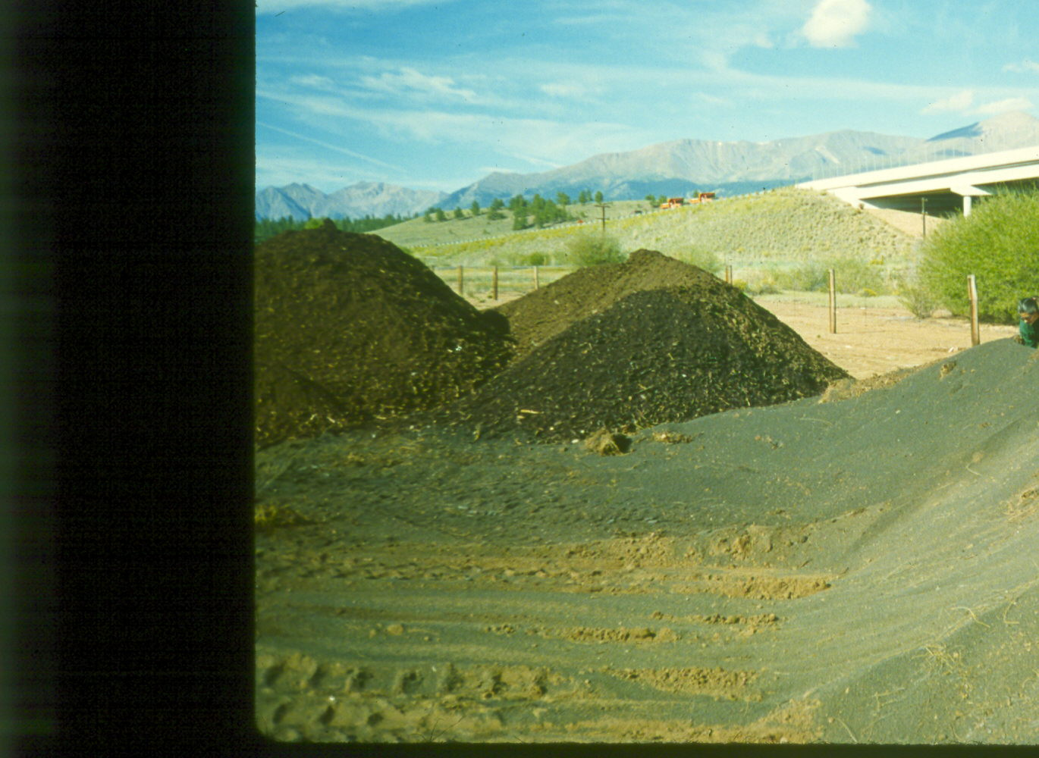
Compost and Lime Stockpile
Notes:
Compost and Lime Stockpile

Slide 33
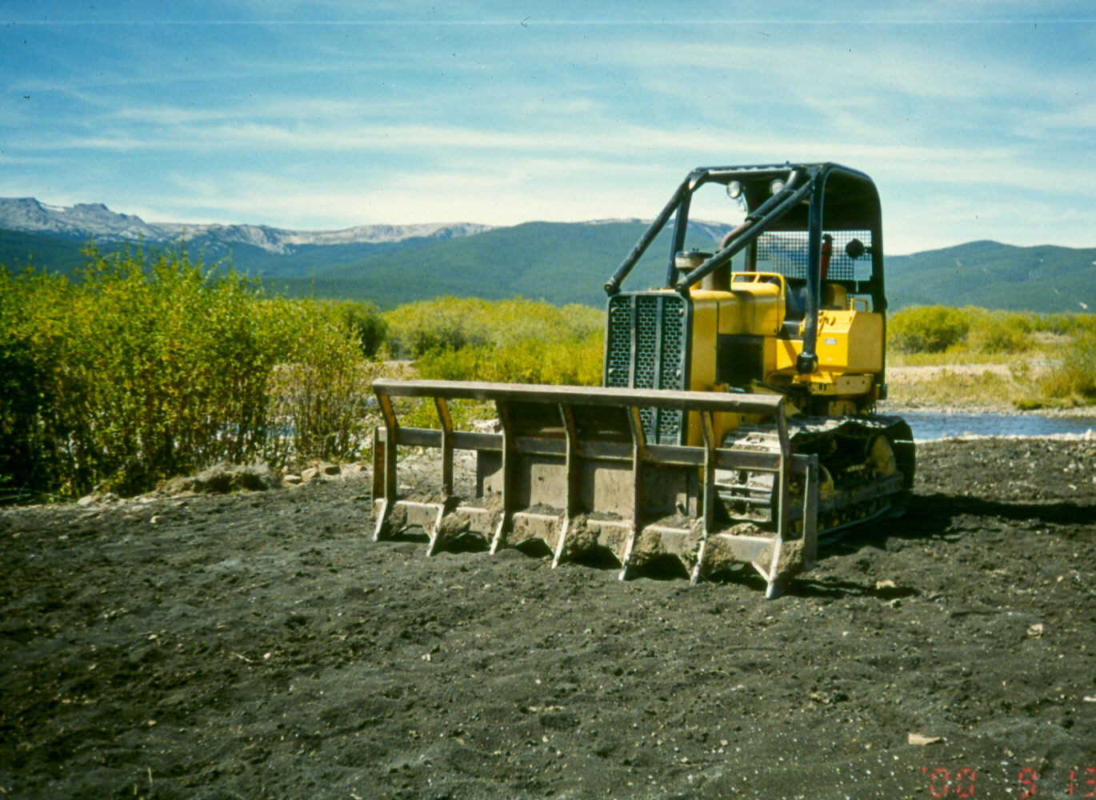

Slide 34
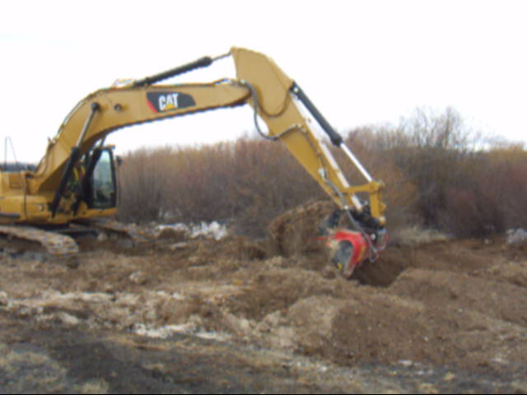
Allu-mixer

Slide 35
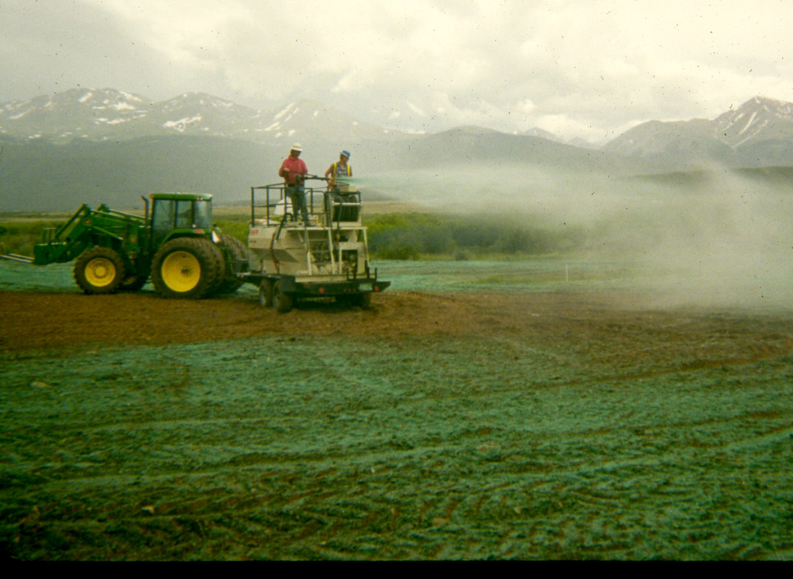
Hyroseeding of Amended Fluvial Tailings
Notes:
Hyroseeding of Amended Fluvial Tailings

Slide 36
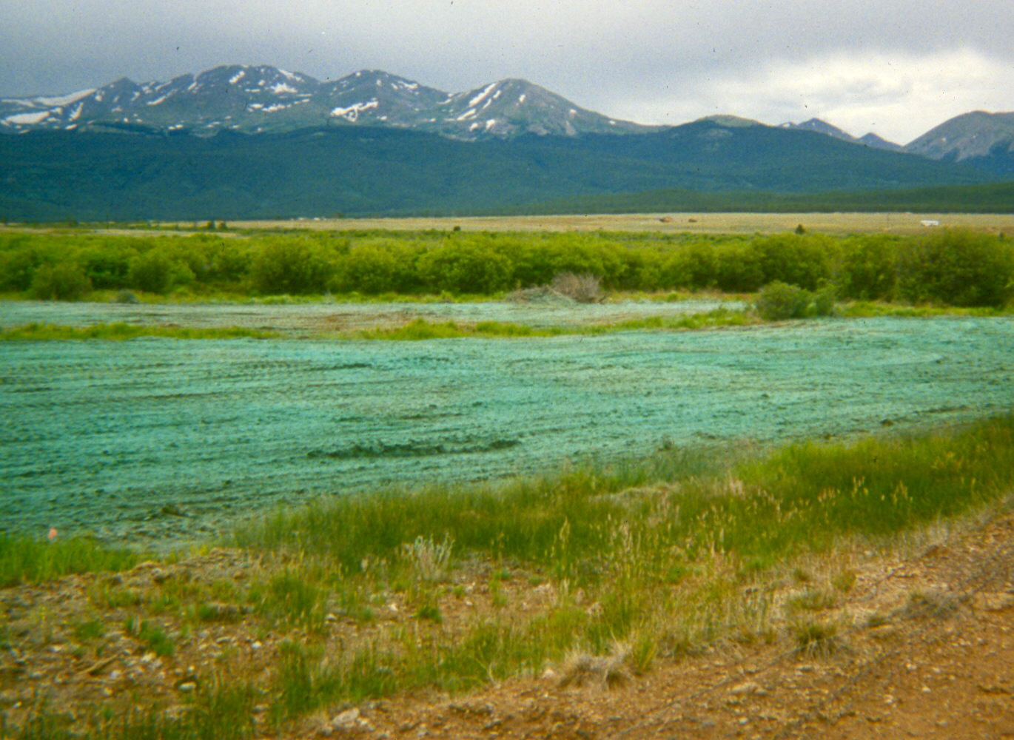

Slide 37
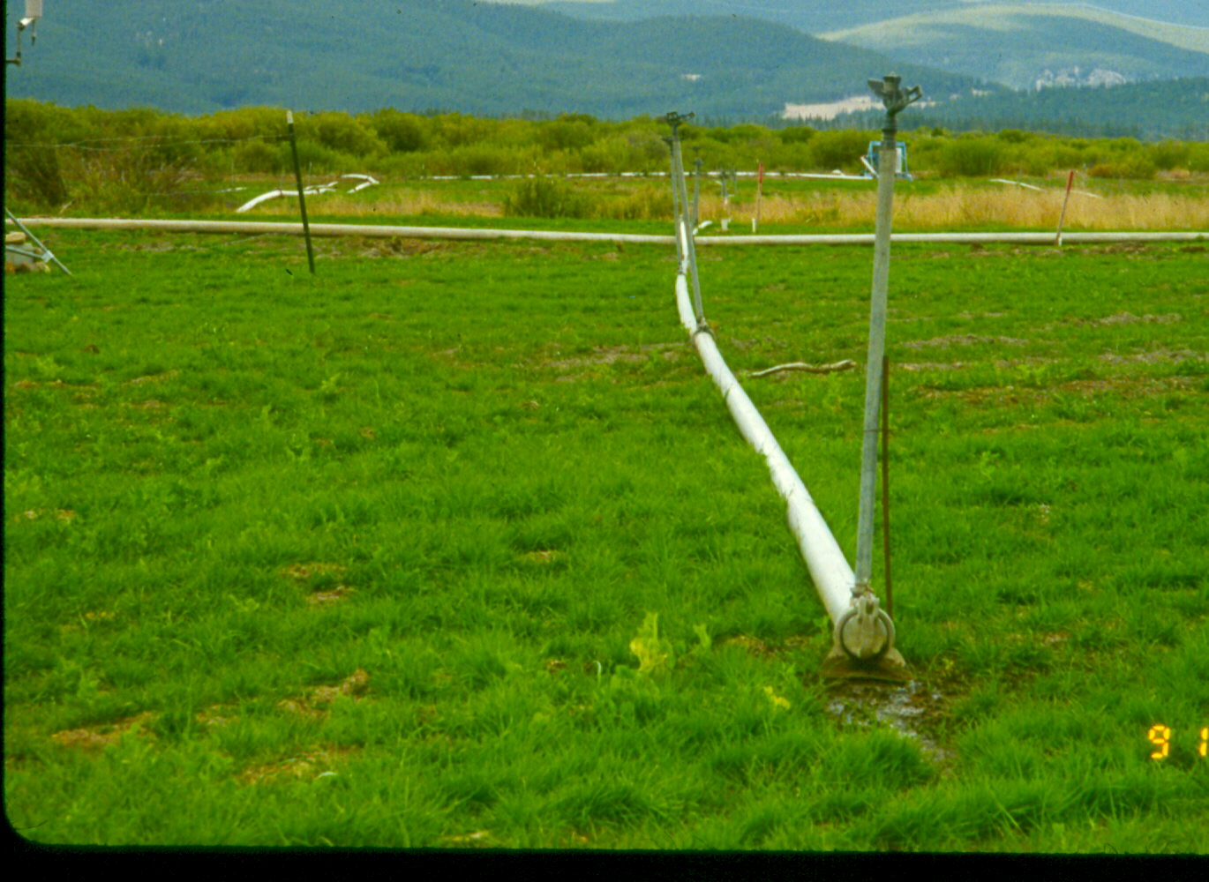
Irrigation of Fluvial Tailings During Drought
Notes:
Irrigation of Fluvial Tailings During Drought

Slide 38
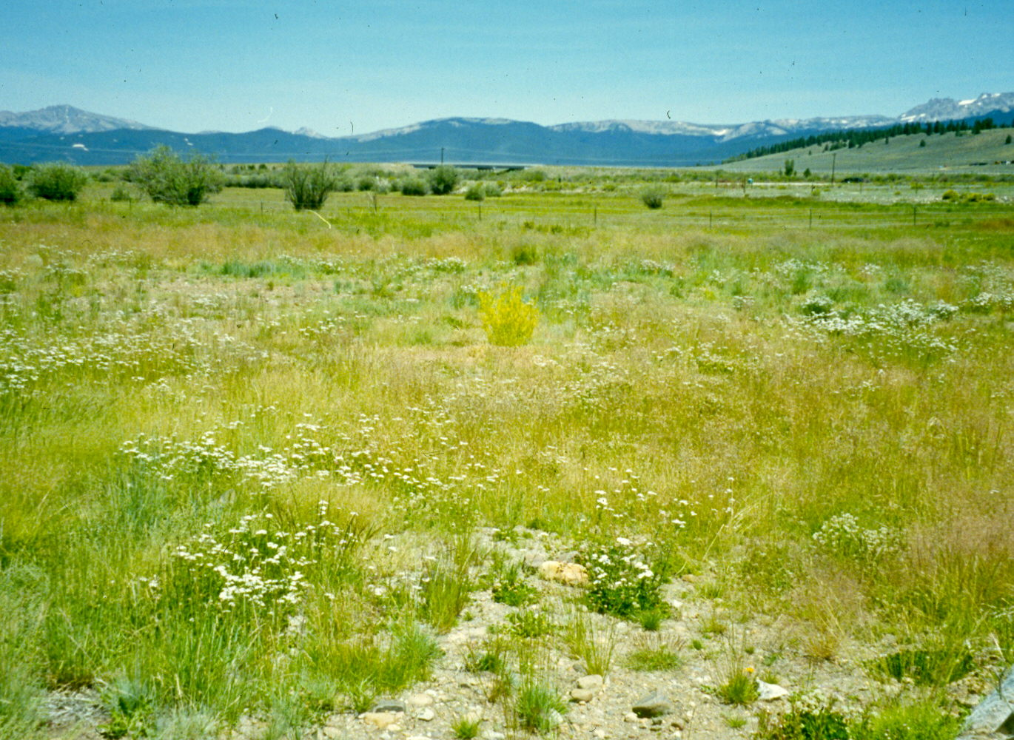
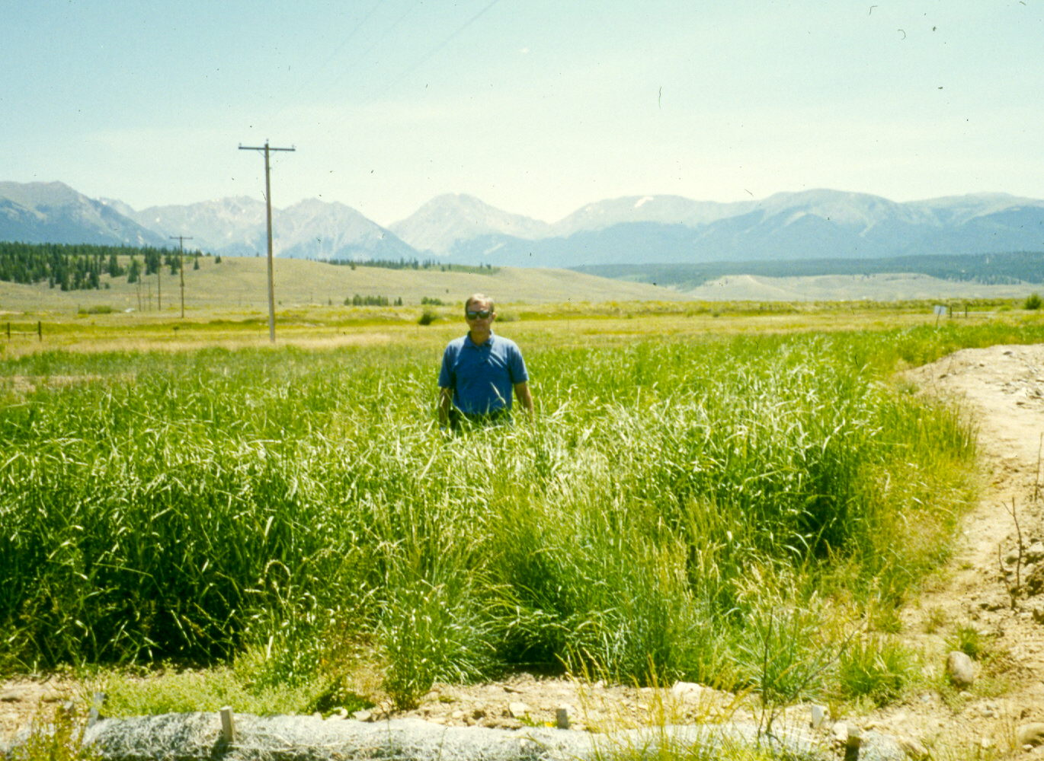

Slide 39
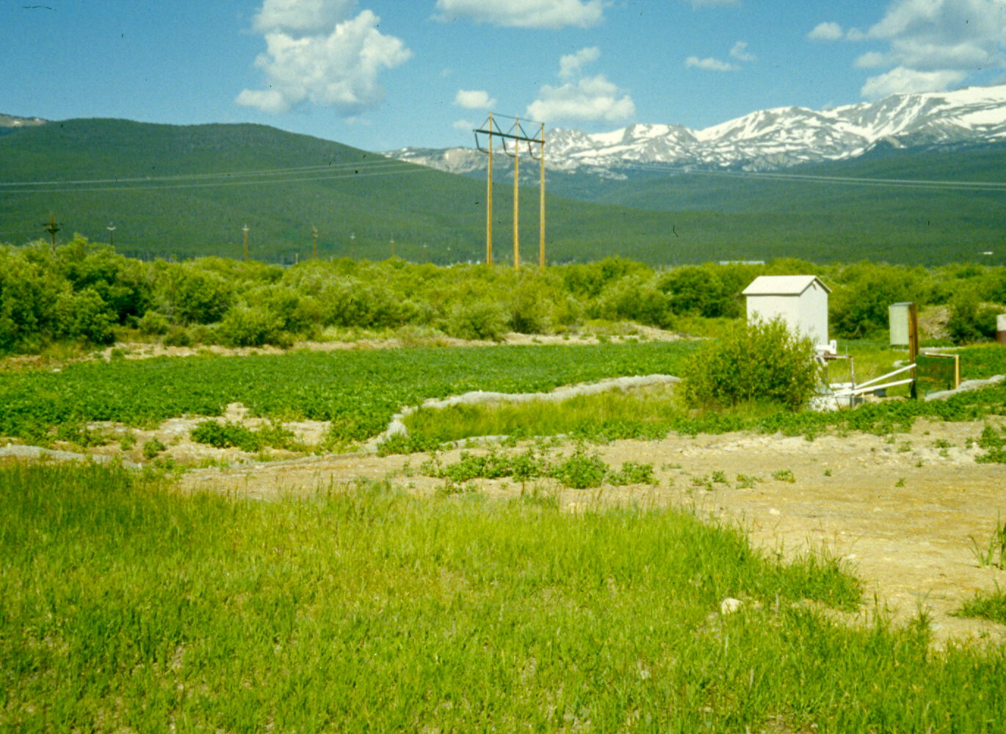

Slide 40
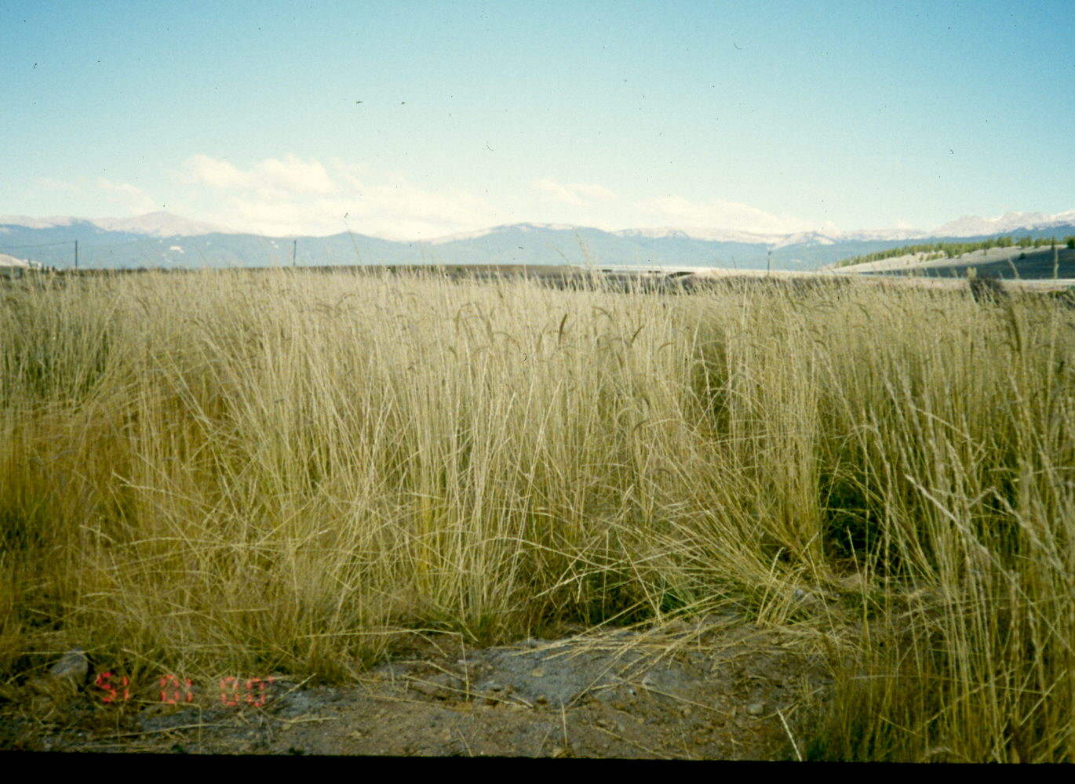

Slide 42
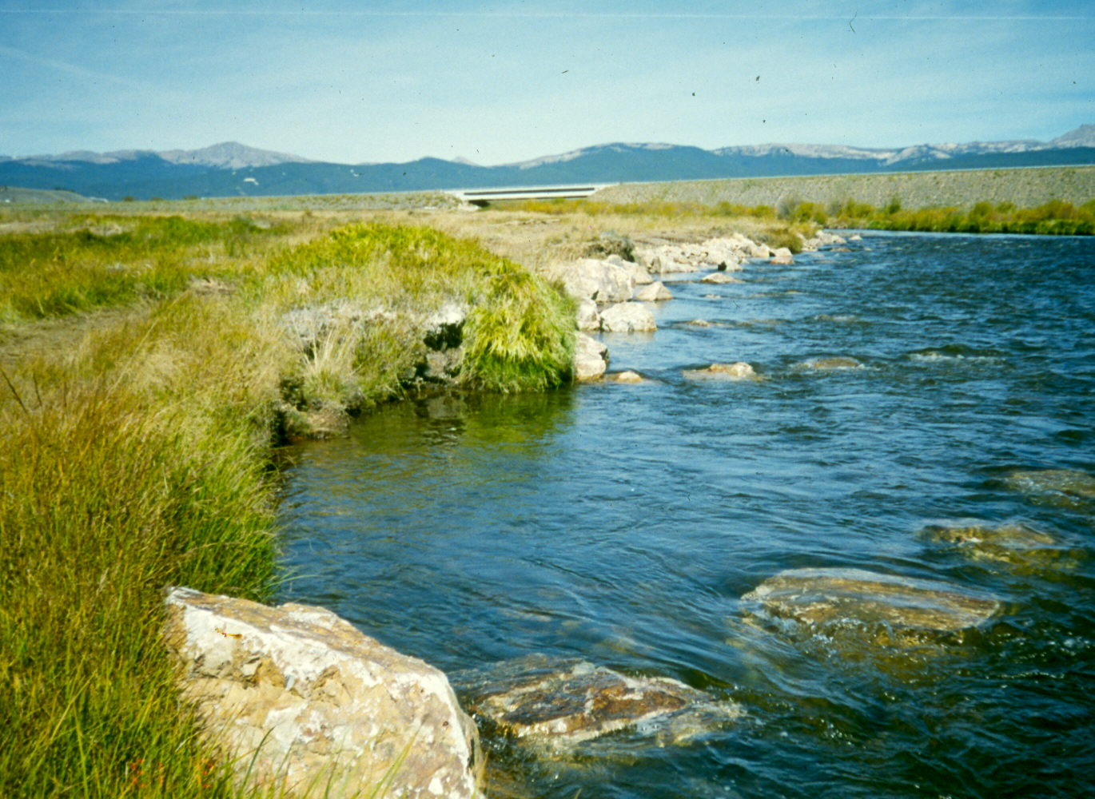
Rip-Rap Protection of Embankment Plus Bendway Weirs
Notes:
Rip-Rap Protection of Embankment Plus Bendway Weirs

Slide 43
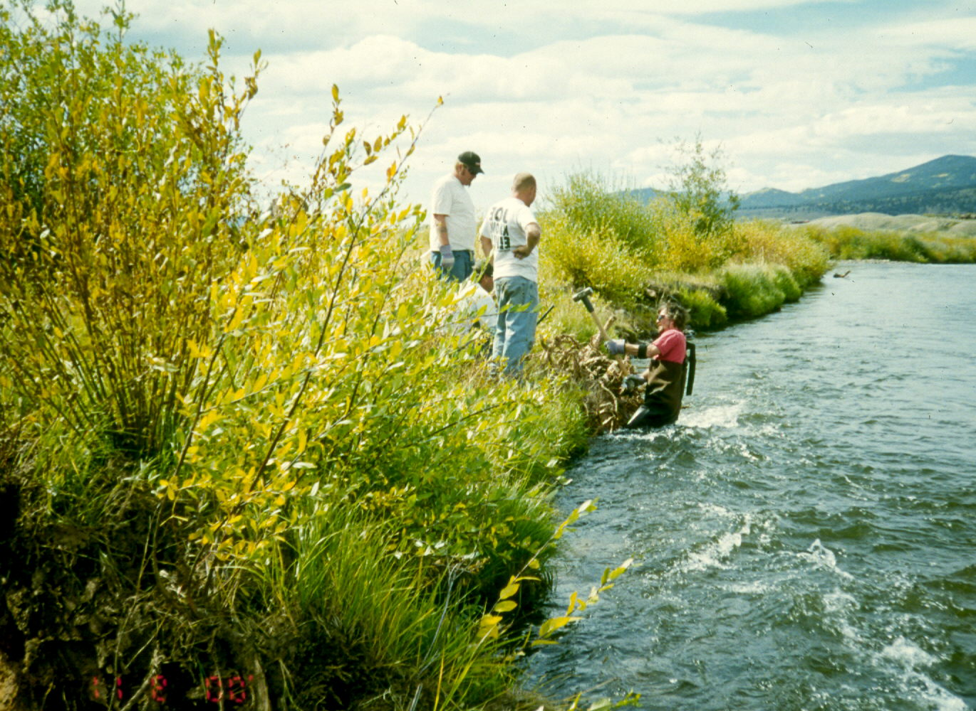
Embankment Protection with Root Wads – Fish Habitat
Embankment Protection with Root Wads – Fish Habitat
Notes:
Embankment Protection with Root Wads – Fish Habitat

