Slide 1


Decision Support System for Matrix Diffusion Modeling
Charles Newell and Shahla Farhat
GSI Environmental Inc.

Slide 2
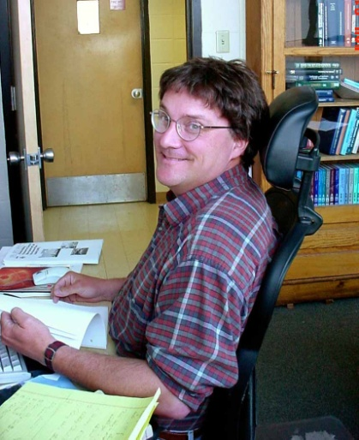
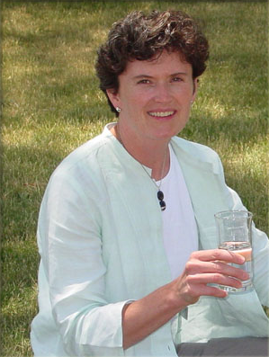
Acknowledgements
Dr. Tom Sale, Colorado State
Dr. Beth Parker, U. of Guelph
SERDP/ESTCP
Schlumberger, Geosyntec
USEPA TIO

Slide 3
Road Map
Introduction
Matrix Diffusion Background
Options for Modeling Matrix Diffusion
Introduction to MDT – Square Root Model
Dandy-Sale Model in the MDT
Case Study 1
Case Study 2
Wrap-up and Open Discussion

Slide 4
Mini Road Map
Matrix Diffusion Background
Lines of Evidence
New Conceptual Model
Collecting Field Samples

Slide 5
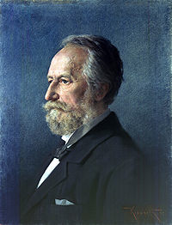
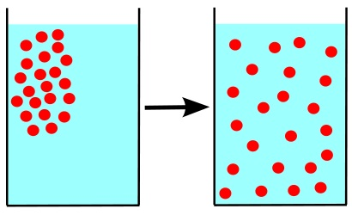
What is Diffusion?
Diffusion describes the spread of particles through random motion from regions of higher concentration to regions of lower concentration.
Key people: Fourier (1822), Fick (1855), Einstein (1905), Smoluchowski (1906)
dC
J = D
dx
J = Diffusive flux flowing though a particular cross section (mg/ meter² / sec)
D = Diffusion coefficient (meter² / sec)
dC
= Concentration gradient
(mg / liter / meter)
dx
Coffee Cup: Convection + diffusion
Laminar Groundwater: Molecular diffusion - movement of molecules only
4

Slide 6

Incomplete History of Matrix Diffusion in Groundwater
Foster (1975): Chalk system in England.
Where is the tritium going?
Goodall and Quigley (1977): Core analysis.
Matrix diffusion (30 cm penetration in clay) vs. advection in clay (4 cm). Matrix Diffusion “overwhelms” advection..
5

Slide 7
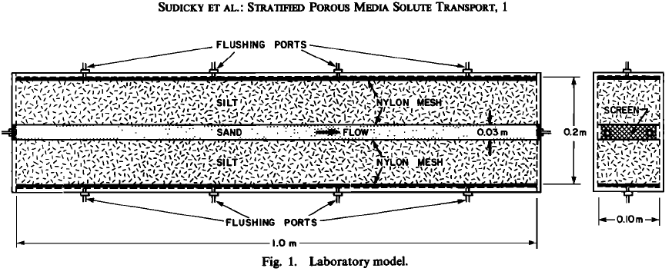
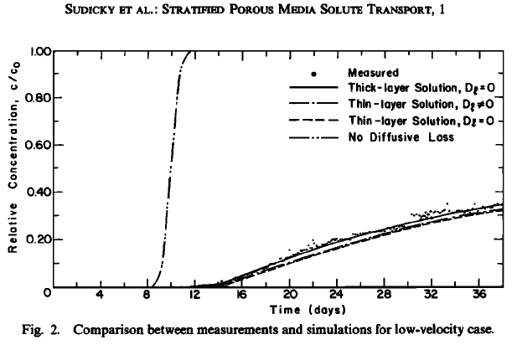

Incomplete History of Matrix Diffusion in Groundwater
Sudicky, Gillham, and Frind (WRR: 1985):
“…these effects are the result of a transient redistribution of the tracer across the strata by transverse molecular diffusion …”
6

Slide 8


Incomplete History of Matrix Diffusion in Groundwater
Mackay and Cherry (ES&T: 1989)
“As plumes spread through aquifers, the dissolved contaminants move quickly through more permeable zones while they slowly invade the less permeable ones by flow or diffusion.”
“Over the years and decades, this invasion can cause the plume to occupy large volumes of low permeability material. To obtain clean water from wells, it is generally necessary for the lower permeability parts of the aquifer system to be cleaned as well as the high permeability zones.
7

Slide 9
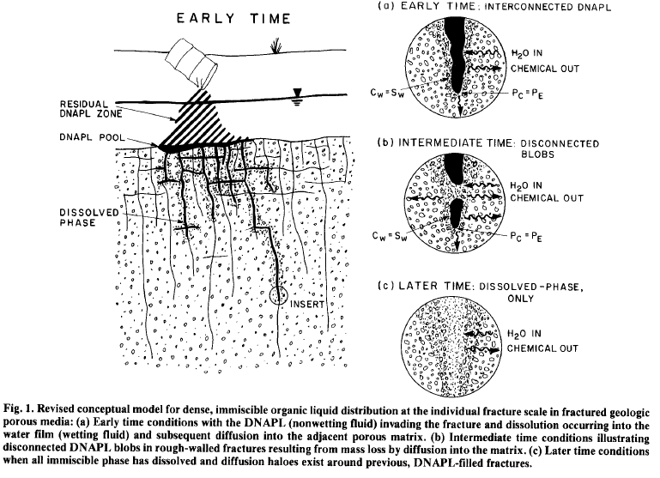
Incomplete History of Matrix Diffusion in Groundwater
Parker, Gillham, Cherry (G. W.: 1994):
Matrix diffusion can soak up DNAPL in fractures – sometimes really quickly (days to weeks).
8

Slide 10
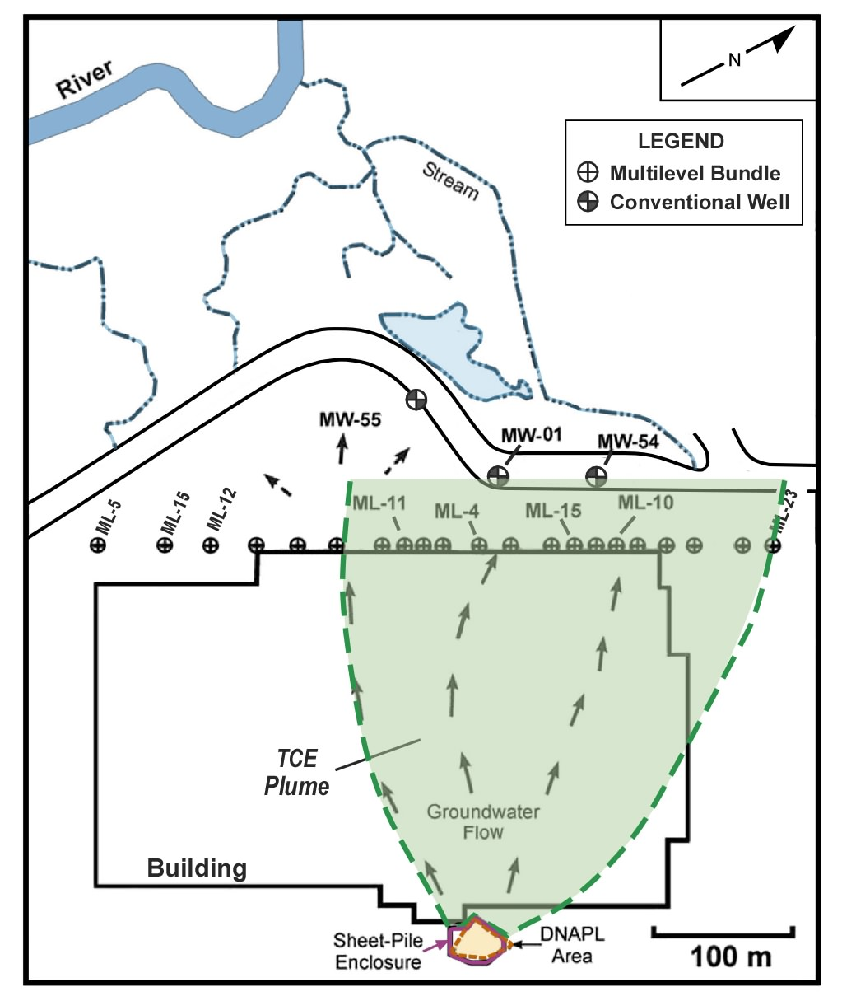
Incomplete History of Matrix Diffusion in Groundwater
Chapman and Parker (WRR: 2005).
“Vertical back diffusion from the aquitard combined with horizontal advection and vertical transverse dispersion account for the TCE distribution in the aquifer and that the aquifer TCE will remain much above the MCL for centuries.”
Modified from figure in Chapman and Parker, 2005.
9

Slide 11
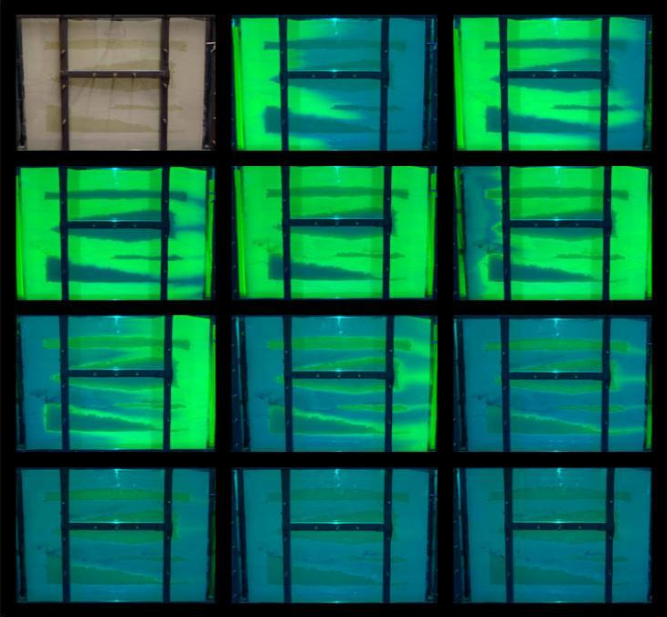


Frequently Asked Questions (Sale et al, 2008)
Provides quick access to key concepts and references for those who need to know more
Matrix-diffusion centric
Tom Sale, Chuck Newell, Hans Stroo, Rob Hinchee, and Paul Johnson
Frequently Asked Questions Regarding Management of Chlorinated Solvents in Soils and Groundwater
August 2008
Tom Sale, Charles Newell, Hans Stroo, Robert Hinchee, and Paul Johnson
10

Slide 12
Old Plume Paradigm?
Advection Dispersion Model
• Advection
• Dispersion
• Adsorption
• Biodegradation
Transport at time t with dispersion
11

Slide 13
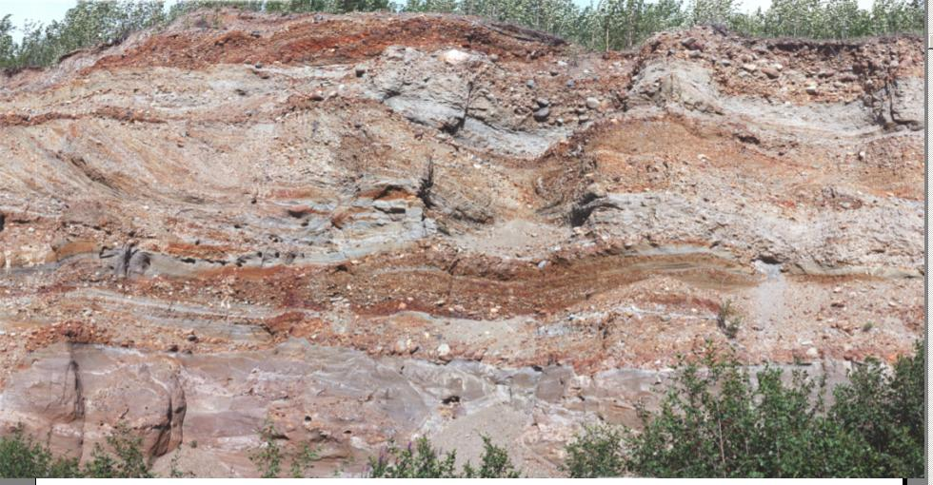

New Plume Paradigm Heterogeneity Rules, Even in “Sandy Aquifers”
Matrix Diffusion Paradigm:
Remediation Hydraulics (CRC Press)
Fred Payne, Joseph Quinnan, Scott Potter
Image from Fred Payne /ARCADIS
12

Slide 14
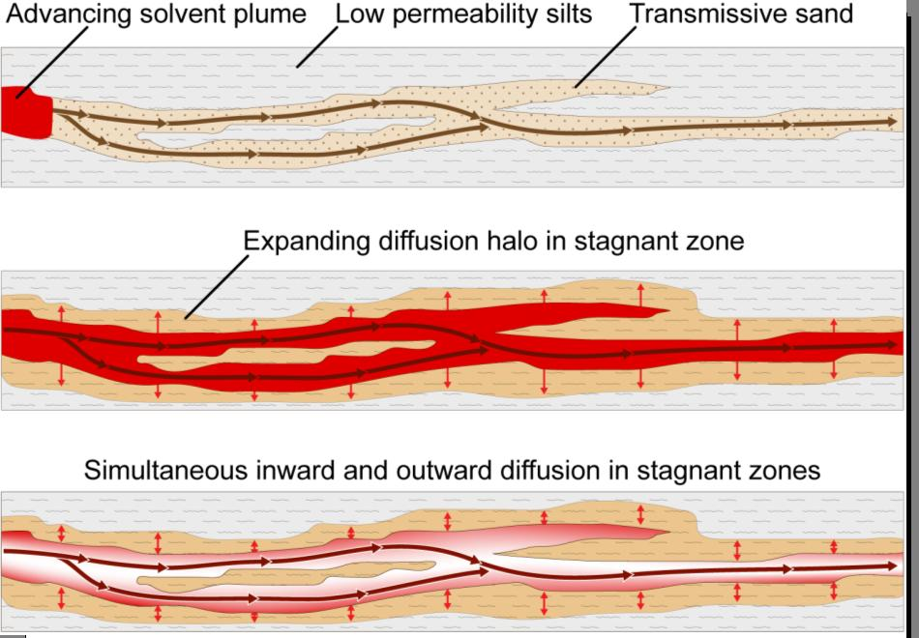
New Plume Paradigm Matrix Diffusion
After NRC 2005
13

Slide 15
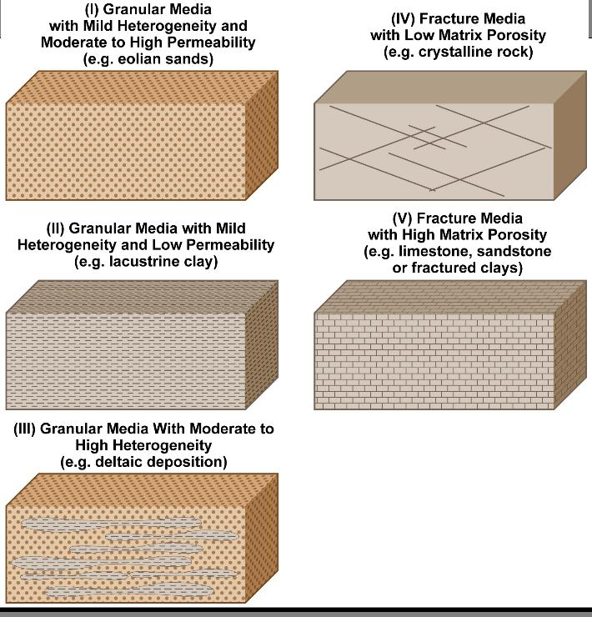
Where is Matrix Diffusion Important?
?
?
YES
YES
YES
After NRC 2005
14

Slide 16
Mini Road Map
Matrix Diffusion Background
Lines of Evidence
New Conceptual Model
Collecting Field Samples

Slide 17
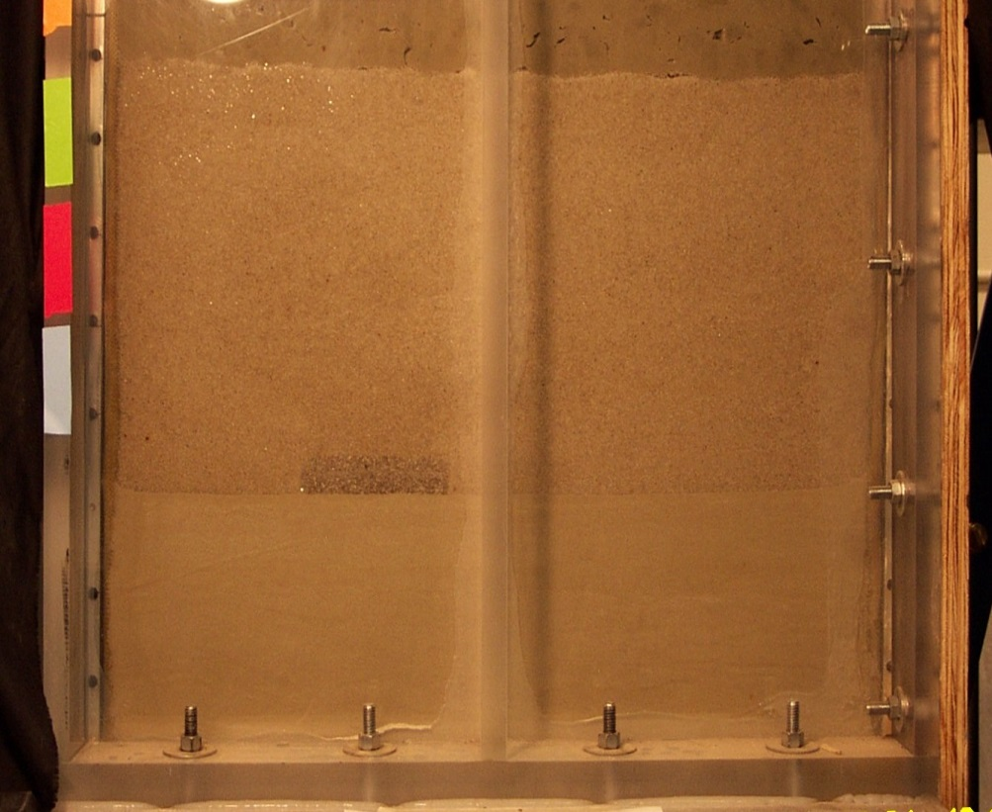
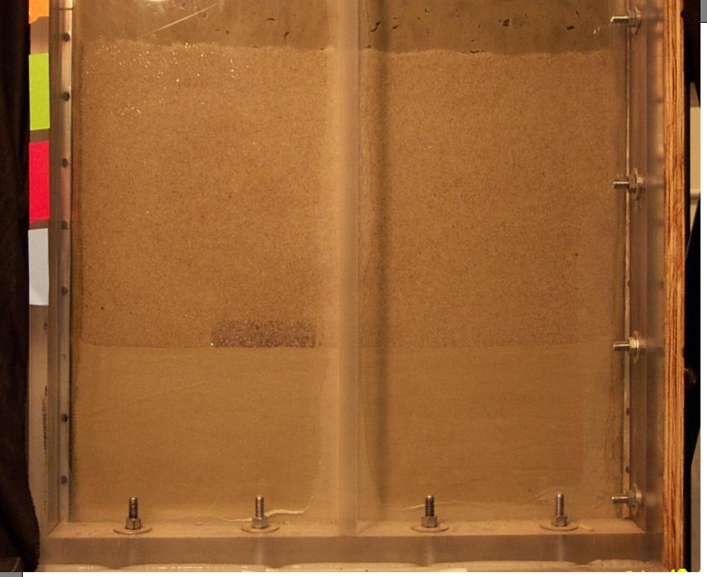
Two layer sand tank study Colorado School of Mines (Tissa Illangasekare and Bart Wilkins)
Groundwater
Groundwater
#30 Sand
Flow 1.5 ft/day
#30 Sand
Flow 1.5 ft/day
56cm
56cm
1,1,2
1,1,2
-
-
TCA DNAPL
Pool 2.5 x 10 cm
Pool 2.5 x 10 cm
45 cm
45 cm
TCA DNAPL
18 cm
18 cm
#140 sand
#140 sand
AFCEE Source Zone Initiative (2007)
16
Notes:
16

Slide 18
Distribution of TCA Mass Recovered vs. Time
Distribution of TCA Mass Recovered vs. Time
YES DNAPL
NO DNAPL
Remaining DNAPL by X-ray adsorption
Cumulative Mass Discharged
Mass in low permeability layer
AFCEE Source Zone Initiative (2007)
17
Notes:
17

Slide 19

Matrix Diffusion Movie Doner and Sale, Colorado State University
18
Notes:
18

Slide 20
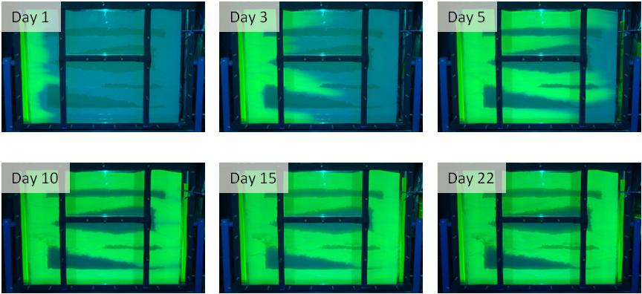
Matrix Diffusion Movie Doner and Sale, Colorado State University
Loading Phase
To Download: www.gsi-net.com
19

Slide 21
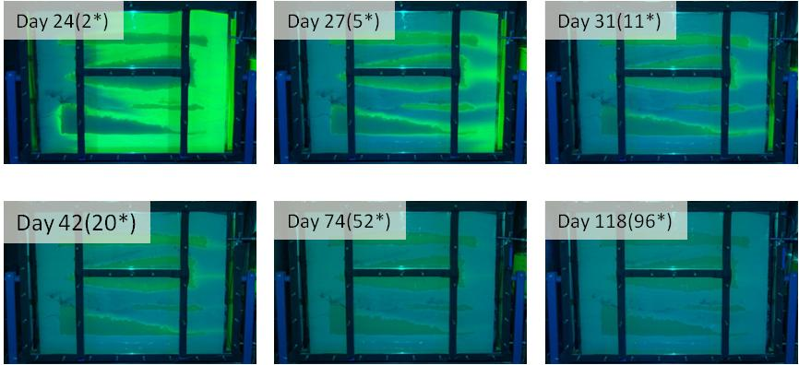
Matrix Diffusion Movie Doner and Sale, Colorado State University
Flushing Phase
To Download: www.gsi-net.com
20

Slide 22

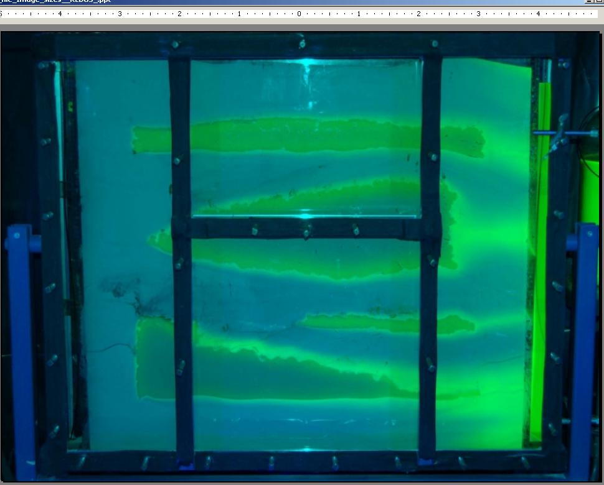
Key Point – Matrix Diffusion is a Small Scale Phenomena
Matrix diffusion governed by concentrations gradients that occur at scales of centimeters to millimeters.
A
84 cm
B
C
D
107 cm
Day 28
21

Slide 23
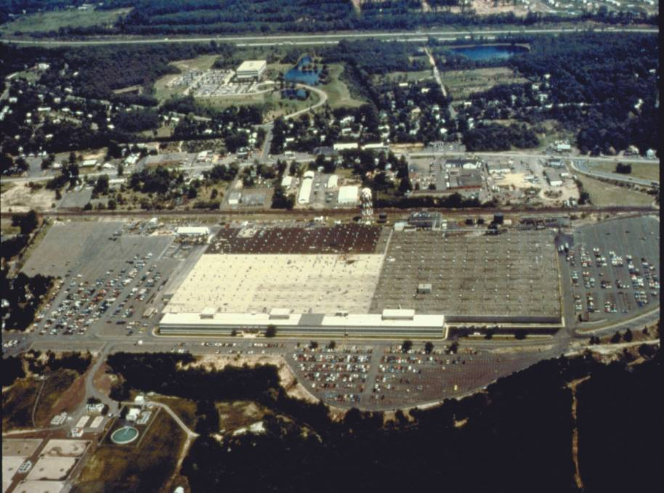

Connecticut Site
N
Source
Zone
Groundwater
Flow
Transect 1
Chapman and Parker WRR 2005
Image Courtesy of B. Parker
500 ft
22
Notes:
22
22
Aerial photograph – source area east of facility, monitoring transect along west side of facility 900 ft from source along entire width of facility (~1400 ft).

Slide 24

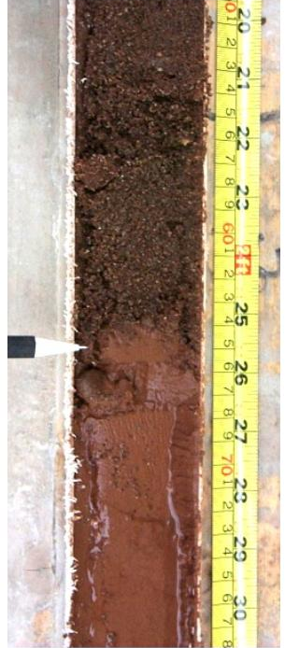
High-Resolution Data from Core
Aquifer
Aquifer
Aquitard
Aquitard
23
Chapman and Parker, 2005
Notes:
23
23

Slide 25
N
Source
Zone
3000 kg TCE present in low-perm zone!
Transect 1
Groundwater Flow
500 ft
Modified from figure provided by B. Parker. Source of Data: Chapman and Parker, 2005.
24
Notes:
RITS Spring 2008: Dilute Groundwater Plume Management
24
24
Aerial photograph – source area east of facility, monitoring transect along west side of facility 900 ft from source along entire width of facility (~1400 ft).

Slide 26
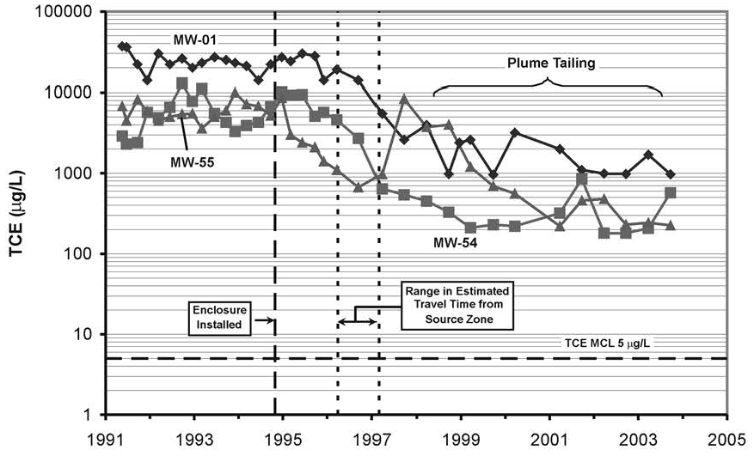
Concentration vs. Time from Monitoring Wells
With Tailing
If No Tailing
Source: Chapman and Parker, 2005 Copyright 2005 American Geophysical Union. Reproduced/modified by permission of AGU.
25
Notes:
RITS Spring 2008: Dilute Groundwater Plume Management
25

Slide 27
Mini Road Map
Matrix Diffusion Background
Lines of Evidence
New Conceptual Model
Collecting Field Samples

Slide 28
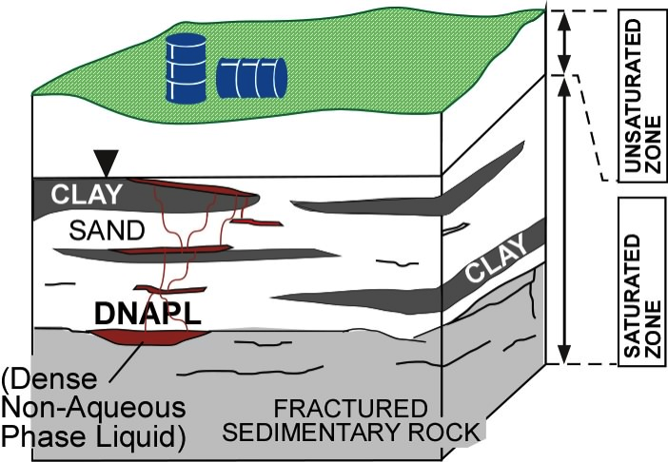
Life Cycle of a Chlorinated Solvent Site
Early Stage
Sale et al., 2008
27
Notes:
27

Slide 29
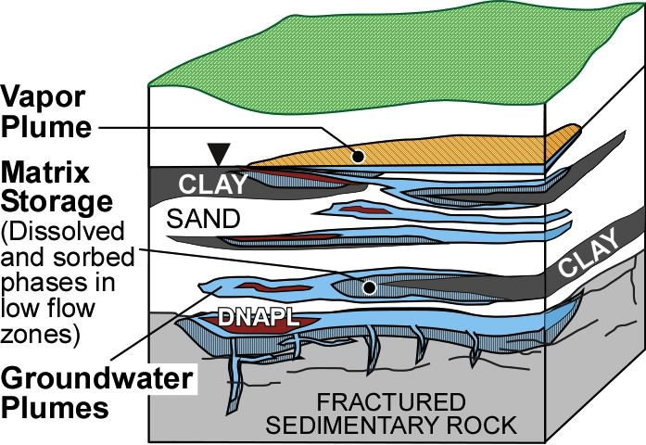
Life Cycle of a Chlorinated Solvent Site
Middle Stage
Sale et al., 2008
28
Notes:
28

Slide 30
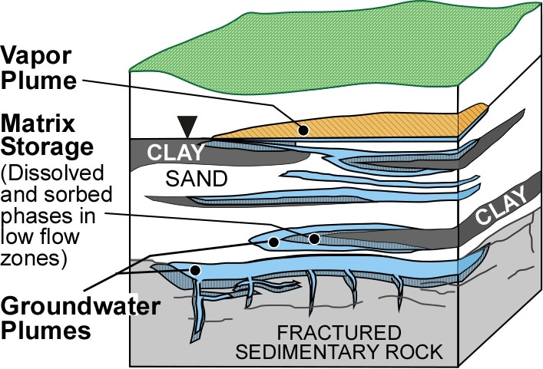
Life Cycle of a Chlorinated Solvent Site
Late Stage
Sale et al., 2008
29
Notes:
29

Slide 31

Early Stage
EARLY STAGE
GW. or equivalent GW. conc.
>1,000s
100s
10s
1s
30

Slide 32
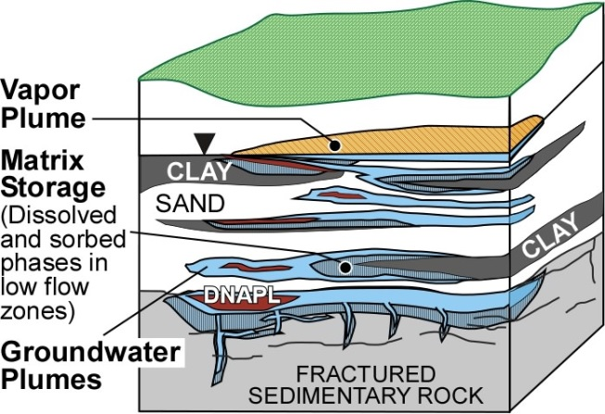
MIDDLE STAGE
Middle Stage
GW. or equivalent GW. conc.
>1,000s
100s
10s
1s
31

Slide 33

Late Stage
GW. or equivalent GW. conc.
>1,000s
100s
10s
1s
32

Slide 34
MD Toolkit Does This…
GW. or equivalent GW. conc.
>1,000s
100s
10s
1s
OR
33

Slide 35
Mini Road Map
Matrix Diffusion Background
Lines of Evidence
New Conceptual Model
Collecting Field Samples

Slide 36
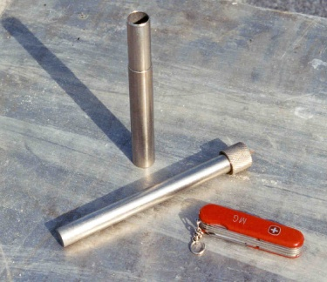
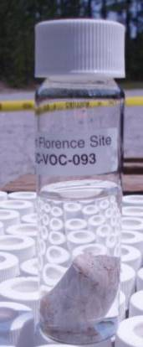
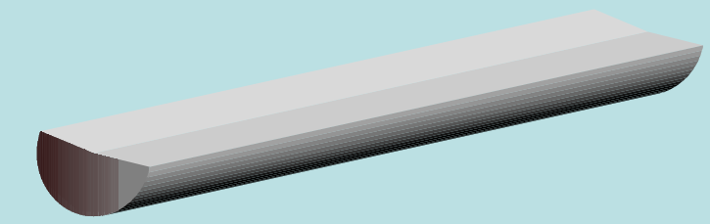
High-Resolution Soil Core Subsampling
Sorbed
mass
Stainless steel
sampler (3/4” ID)
Sample
volume
Dissolved
mass
plunger
Soil core
Subsample in
pre-weighed
vial with MeOH
0
4 in
Guilbeault, 1999
35
Notes:
35

Slide 37
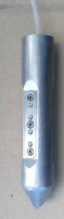

Field Sampling Step 1. Real-time Profiling to Identify Intervals of Interest
Several tools available, including Waterloo^{APS} (from Stone Environmental Inc.)
Index of Hydraulic Conductivity (I_{k})
Contaminant concentration and physical-chemical properties through GW sample collection
I_{k}
GW conc.
Low K silt
36

Slide 38
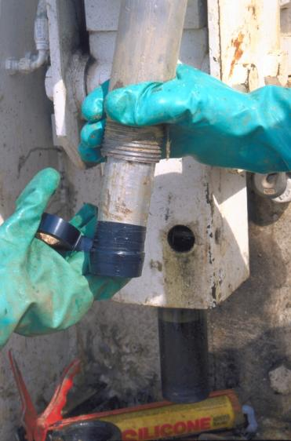
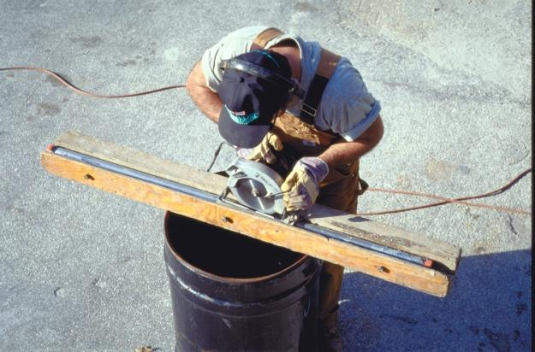
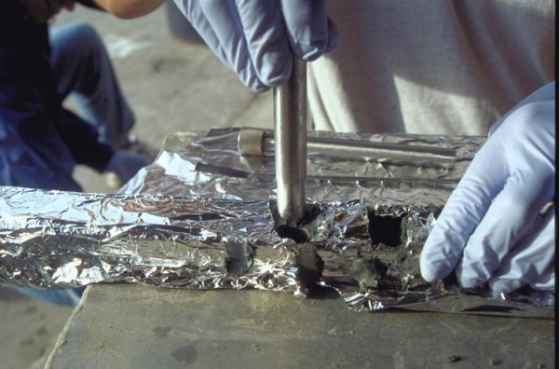
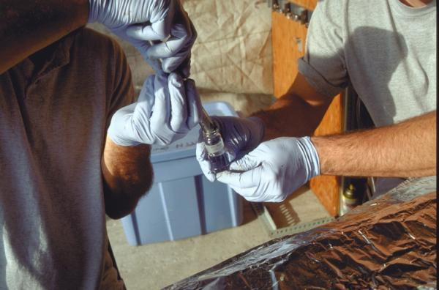
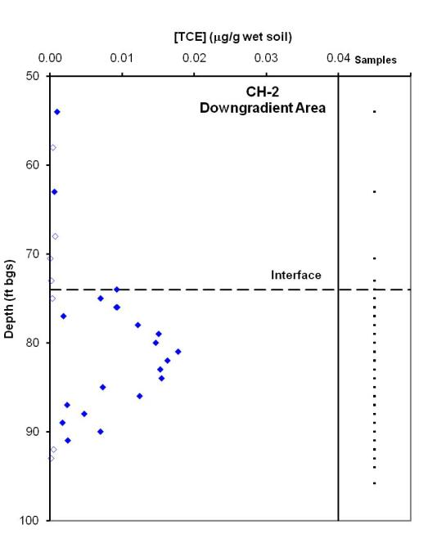
Step 2. Soil Subsampling
2”
Core contained in
aluminum tube or other liner
Half of core wrapped in foil to minimize volatilization
Splitting core tube lengthwise
[TCE] (mg/g wet soil)
Obtain several high-resolution soil profiles per site
CH-2 Downgradient Area
Depth (ft bgs)
Interface
Subsampling for VOC analyses: sub-sample placed in
pre-weighed vial with MeOH
37

Slide 39
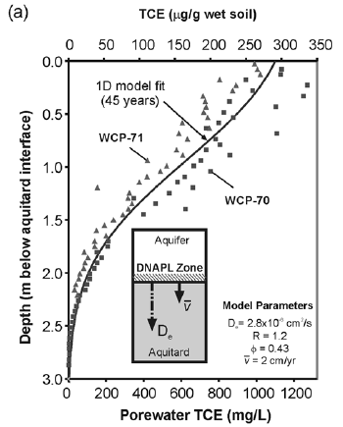
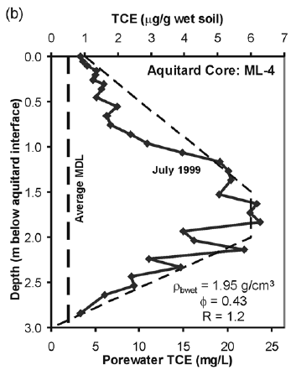
Constant Loading vs. Declining Aquifer Concentration
Downgradient of Isolated Source
Zone with DNAPL
Chapman and Parker, 2005

Slide 40

Exercise
N U M B E R 1
Diffusion Curves
t
39
Notes:
39
39
39

Slide 41
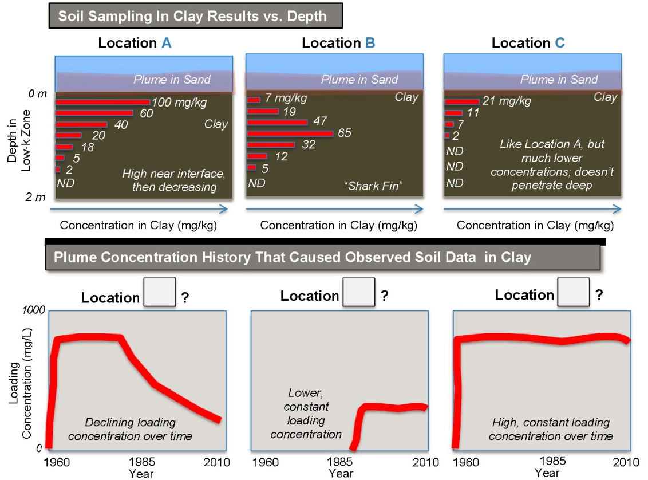
Match the Curves

Slide 42
Match the Curves - Answers

Slide 43

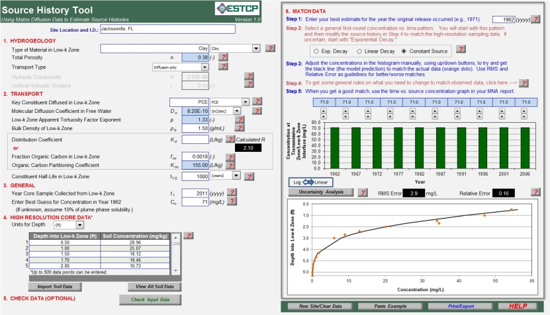
Modeling Historical Impacts –
Source History Tool
Analytical groundwater model that estimates source concentration over time, i.e., a “source history”
WHAT:
Free download from:
http://www.serdp.org (soon)
http://www.gsi-net.com (now)
WHERE:
S. Farhat, P. de Blanc, C. Newell, and D. Adamson
GSI Environmental Inc.
Project Team: B. Parker and
S. Chapman
University of Guelph
T. Sale
Colorado State University
Funded by ESTCP
(ER-201032)
WHO:
Notes:
42
42
42

Slide 44
Road Map
Introduction
Matrix Diffusion Background
Options for Modeling Matrix Diffusion
Introduction to MDT – Square Root Model
Dandy-Sale Model in the MDT
Case Study 1
Case Study 2
Wrap-up

Slide 45
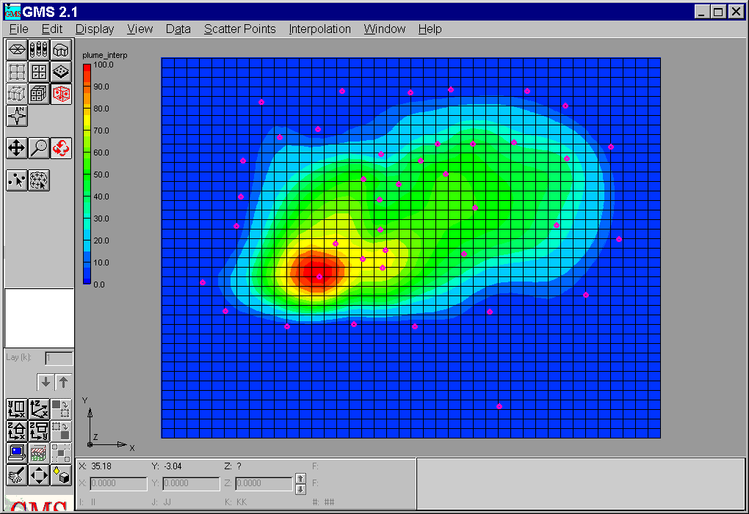
Types of Groundwater Models
Flow vs. Transport Models
Numerical Models
Analytical Models
44

Slide 46
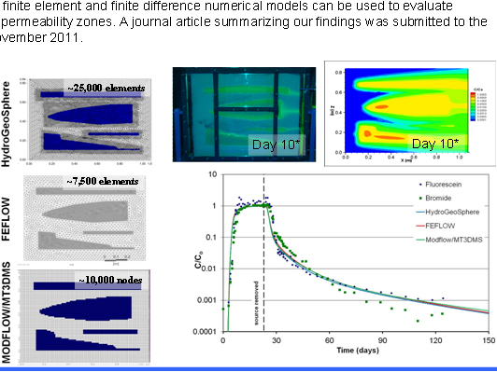
Numerical Models: It takes a lot of grid cells to model this….
(Chapman, Sale, Doner, Parker, 2012)
~25,000 elements
~7,500 elements
~10,000 nodes
45

Slide 47
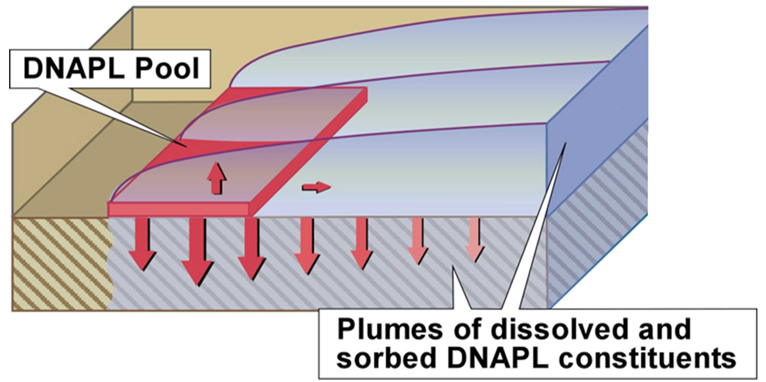
Three Simple Analytical Matrix Diffusion Models
“Square Root” “Dandy-Sale”
REMChlor
46

Slide 48



REMChlor and REMFuel
Source/Plume/Remediation Models
Falta et al., 2007
Source
Plume
But no matrix diffusion
In the plume
Matrix Diffusion in Source
Flow
You enter source mass, concentration leaving source
You decide how mass leaves over time with “gamma”
A high gamma (>1.0) can simulate matrix diffusion
47
Notes:
47
47
47

Slide 49
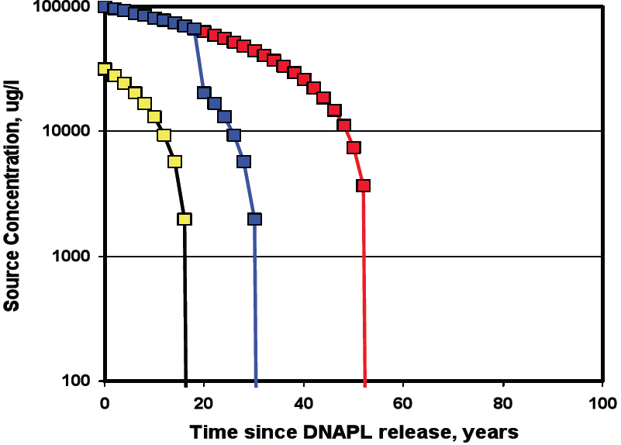
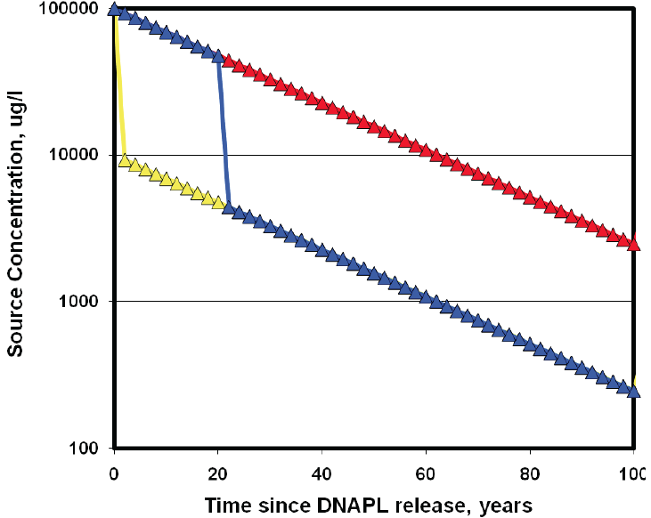
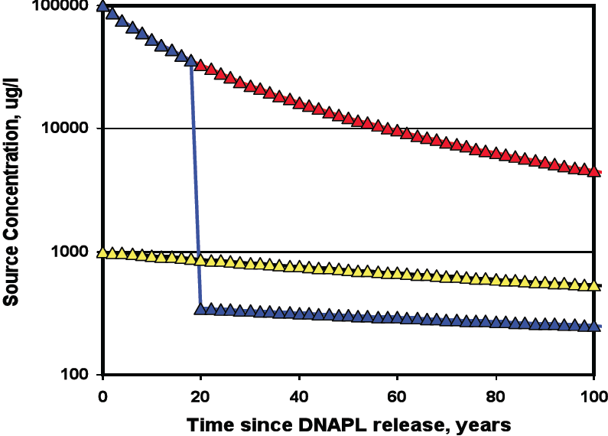
Gamma = 0.5
Gamma = 1.0
REMChlor Model – Effect of Gamma
Can simulate matrix diffusion in source, but not plume…
Gamma > 1.0 Gives “long tail” in source similar to matrix diffusion
Gamma = 2.0
Notes:
48
48
48

Slide 50
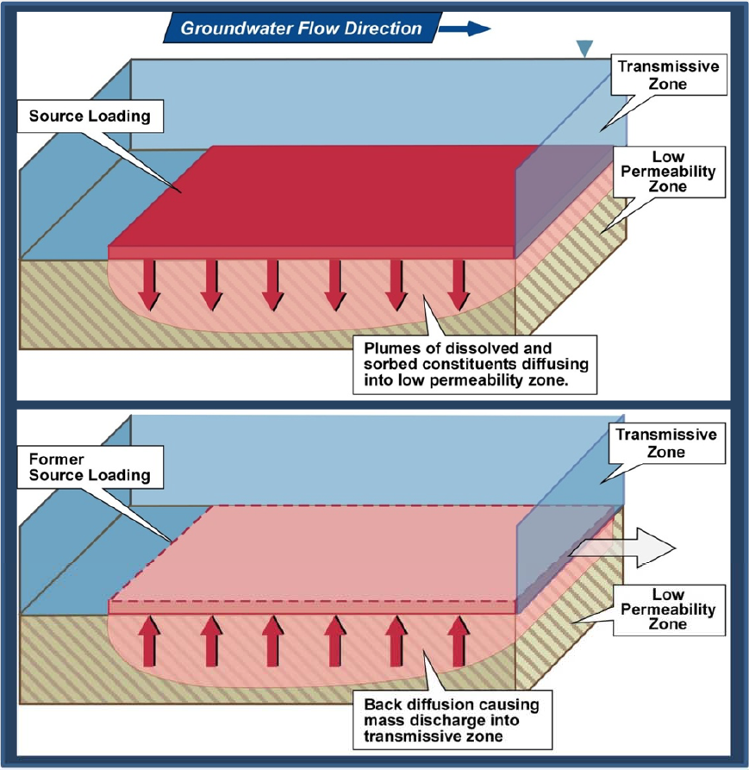
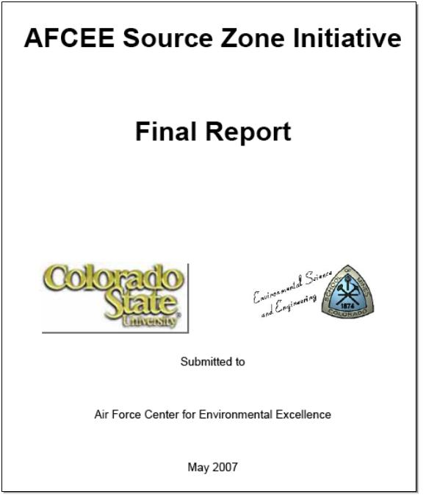
“Square Root Model” for Matrix Diffusion
“On-Off” Source
Dr. Tom Sale
Dr. Tissa Illangasekare
Adapted from
Parker et al., 1995
49
Notes:
49

Slide 51
“Square Root” Matrix Diffusion Model
M_{D}: Mass Discharge from Low Perm. Unit (grams per day) assuming no concentration in transmissive zone
ϕ_{LP} - Low Permeability Unit Porosity
D_{e} - Effective Diffusion Coefficient of Low Perm Unit,
R - Retardation Factor of Low Perm Unit
t - Time Loading Started, years before simulation time
t’ - Time Loading was Removed, years before simulation time
C_{s} - Concentration at interface during loading period
50

Slide 52
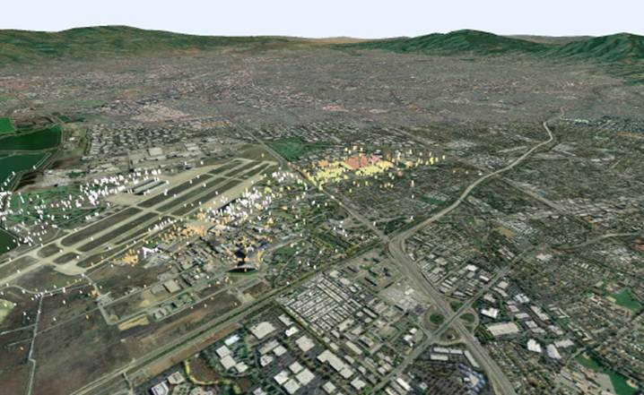
MEW Site
Mountain View, California
Team members: Schlumberger, GSI, Geosyntec
Seyedabbasi et al., Remediation, 2013
McDade et al., Remediation, 2013
51

Slide 53
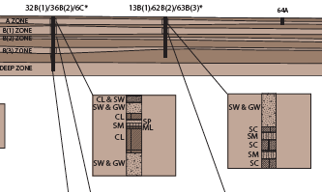
MEW Site: Site Hydrogeology
Source: Geosyntec
52

Slide 54
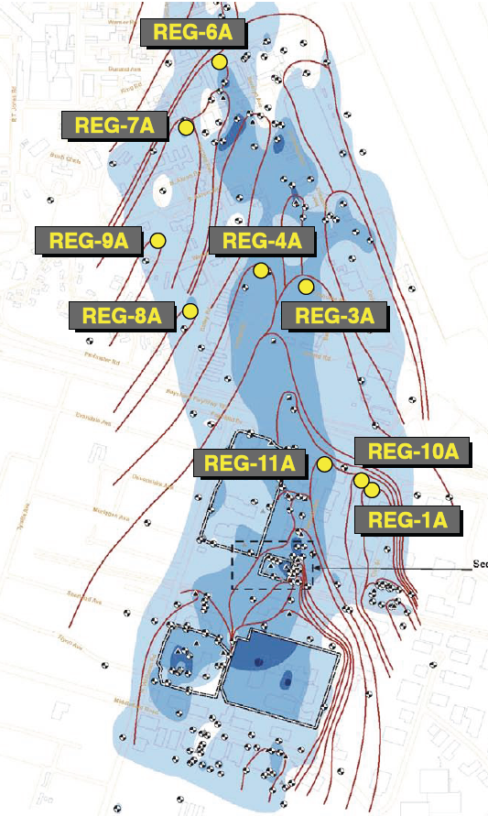

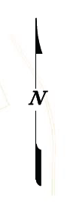

Pump & Treat System at MEW Site
Middlefield–Ellis–Whisman Site
Three Zones: A/A1, B1/A2, B2
1980s: Slurry Walls, Pump & Treat
Today ~100 recovery wells, ~500 gpm
Removal: ~97,000 pounds VOCs
Reduction: Approximately 1 OoM decrease in average TCE concentration 1992-2009
53

Slide 55
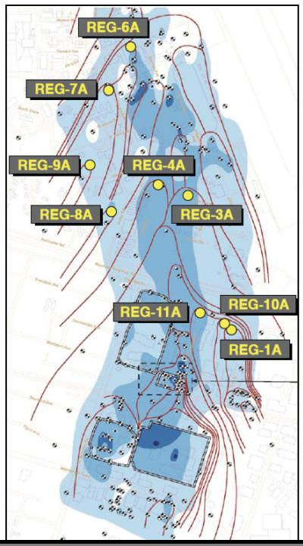
Example A: MEW Site Pump and Treat Capture Zones
Pumping Well
Ground-
water Flowline
54

Slide 56


Matrix Diffusion Model Applied to MEW Site
“Charging Period”
Then Build Slurry Walls, P&T Wells, Contain Sources
“Back Diffusion Period”
55

Slide 57
Results: Recovery Well REG-8A: 30 Pore Volumes
Matrix Diffusion Model
Flushing/Retardation
Model
56
Notes:
56

Slide 58



Dandy-Sale Model
Loads up the low perm zone, then release period
Vertical Plane Source
(Higher concentration near bottom)
Sale, Zimbron, Dandy, 2008
57

Slide 59

Dandy-Sale Analytical Matrix Diffusion Model
58

Slide 60
1. REMChlor | 2. Square Root Model | 3. Dandy-Sale Model
Simple | Very simple | Complex Function
Vertical plane source | Horizontal source is directly over low perm zone | Vertical plane source upgradient of low perm zone
No matrix diffusion in plume | On-off source Unimpeded back diffusion | On-off source More accurate back diffusion
Concentration or Mass Discharge | Mass discharge Mass in low perm Concentration in Well | Same as Square Root, but with Conc. in Low Perm.
U.S. EPA CSMoS (Google: “EPA” and “REMChlor”) | ESTCP Matrix Diffusion Toolkit (www.gsi-net.com)
59
59

Slide 61
Road Map
Introduction
Matrix Diffusion Background
Options for Modeling Matrix Diffusion
Introduction to MDT – Square Root Model
Dandy-Sale Model in the MDT
Case Study 1
Case Study 2
Wrap-up

Slide 62
Matrix Diffusion Toolkit
Analytical groundwater transport models that estimates matrix diffusion effects
WHAT:
Free download from:
http://www.serdp.org
http://www.gsi-net.com
WHERE:
S. Farhat and C. Newell
GSI Environmental Inc.
T. Sale, D. Dandy, and
J. Wahlberg Colorado State University
Funded by ESTCP
WHO:
Notes:
61
61
61

Slide 63

Square Root Model: Data Input Screen
Header #2
62

Slide 64




Select “Source Zone Analysis” to see matrix diffusion impacts in a source zone:
Select “Plume Analysis” to see matrix diffusion impacts in a downgradient plume:
Select “PRB Analysis” to see matrix diffusion impacts downgradient of a PRB:
63

Slide 65

Parameter | Description
Low-k Zone Description | Choose from dropdown menu or enter directly
Low-k Zone Total Porosity | Keep Toolkit default or enter directly. Based on Pankow and Cherry (1996) Domenico and Schwartz (1999) Davis (1969) and Johnson and Morris (1962)
Transmissive Zone Darcy Velocity | Enter directly or use Toolkit to calculate
64

Slide 66
Square Root Model: Transport
Parameter | Description
Molecular Diffusion Coefficient in Free Water | Keep Toolkit default or enter directly From TRRP (2008) TCE = 9.1E-06 cm²/s PCE = 8.2E-06 cm²/s Benzene = 9.8E-06 cm²/s Other refs: Pankow and Cherry (1996), Wiedemeier et al. (1999), etc.
65

Slide 67
Apparent Tortuosity Factor Exponent
Parameter | Description
Apparent Tortuosity Factor Exponent | Keep Toolkit default or enter directly
tortuosity
τ = n^{p}
porosity
p varies:
1/3: Millington, 1959
0.3 to 1.5: Charbeneau, 2000
1.3 to 4.5: Pankow and Cherry, 1997
0.33 for Clay: Parker et al., 1994
66

Slide 68
GSI’s Decision Support for Tortuosity
(1) Pick Material
(2) Software Produces
Gravel
Sand
Silt
Clay
Sandstone/Shale
Granite
If no porosity value is entered:
Default Porosity
Tortuosity factor
If porosity value is entered:
Tortuosity factor
67

Slide 69
Current Look-up Table
Soil Type | Default Porosity | Relationship* | Estimated Tortuosity
Fine Sand | 0.20 | τ = n^{0.33} | 0.59
Silt | 0.48 | τ = n^{1.1} | 0.45
Clay | 0.47 | τ = n^{1.1} | 0.44
Sandstone/ Shale | 0.10 | τ = n | 0.10
Granite | 0.006 | τ = n^{0.55} | 0.06
* From Parker et al. (2004); Millington and Quirk (1961); and Pankow and Cherry (1996)
68

Slide 70
Retardation Factor
Parameter | Description
Retardation Factor | Enter directly or use Toolkit to calculate Transmissive zones 1-3 (typical for BTEX) 2-5 (typical for CVOC) Low-k zones Thought to be > trans zones. Currently, few sites with data
69

Slide 71
Calculating Retardation Factor
Parameter | Description
K_{oc} | Keep Toolkit default or enter directly From TRRP (2008) TCE = 93 mL/g PCE = 155 mL/g Benzene = 66 mL/g Other refs: Pankow and Cherry (1996), Wiedemeier et al. (1999), etc.
70

Slide 72
Calculating Retardation Factor Cont’d
Parameter | Description
Low-k zone fraction organic carbon | Enter directly Likely range: 0.0002 - 0.10 Chapman and Parker (2005): silts and clays = 0.0024 to 0.00104 Adamson (2012): clay = 0.001; silts = <0.0005 to 0.0022
Soil bulk density of low-k zone | Enter directly Typical value = 1.7 g/mL Lovanh et al. (2000) and Domenico and Schwartz (1990): Clay = 1.0 to 2.4 Sandstone = 1.6 to 2.68 Koerner (1984): Stiff glacial clay = 2.07 organic clay = 1.43
71

Slide 73

Square Root Model: Plume Charac.
5
50
500
5000
72

Slide 74
Plume Characteristics Cont’d
5
50
500
5000
73

Slide 75

500
5
5000
50
74

Slide 76

Square Root Model: General
75

Slide 77
Square Root Model: Field Data
Can enter up to 8 values for comparison
Helps with model calibration
76

Slide 78




SRM Output
Mass discharge
Concentration in transmissive zone
Mass in low-k zone
SRM = Square Root Model
77

Slide 79
Road Map
Introduction
Matrix Diffusion Background
Options for Modeling Matrix Diffusion
Introduction to MDT – Square Root Model
Dandy-Sale Model in the MDT
Case Study 1
Case Study 2
Wrap-up

Slide 80

Dandy-Sale Model: Data Input Screen
79

Slide 81

Dandy-Sale Model: Hydrogeology
Similar to SRM Data Input
Choose from dropdown menu or enter directly
Keep Toolkit default or overwrite
Enter directly or use Toolkit to calculate value
80

Slide 82

Dandy-Sale Model: General
81

Slide 83

Dandy-Sale Model: Outputs
Low-k Zone
2-D aqueous concentration
Aqueous concentration vs. distance
Aqueous concentration vs. depth
2-D sorbed concentration
2-D total concentration
Transmissive Zone
Aqueous concentration
Mass discharge
Sorbed concentration
Total concentration
Aqueous, Sorbed, and Total Mass
Low-k zone
Transmissive zone
82

Slide 84
Road Map
Introduction
Matrix Diffusion Background
Options for Modeling Matrix Diffusion
Introduction to MDT – Square Root Model
Dandy-Sale Model in the MDT
Case Study 1
Case Study 2
Wrap-up

Slide 85

84

Slide 86

Case Study #1: Industrial Site, CT
Site from Chapman and Parker, 2005
Metal product manufacturing site (1952 – 2001)
TCE occurs in surficial sandy aquifer
overlying a clayey silt aquitard
TCE DNAPL isolated in 1994 using steel sheet pile enclosure
Historical industrial pumping resulted in a long-term downward hydraulic gradient across the aquitard
In 2000, TCE observed in
Vertical cores collected from aquitard below plume
Depth-discrete multilevel sampling
85

Slide 87
Case Study #1: Industrial Site, CT
Matrix Diffusion Toolkit used to:
Estimate effects of diffusion into and from low-k zones
Both SRM and DSM applied
Step 1: Initial values entered into the Toolkit
Step 2: Toolkit outputs compared to field observed TCE
86

Slide 88
SRM: Site-specific Parameters
Parameter | Value
Low-k porosity | 0.43
Darcy velocity | 0.13 m/d
Retardation factor | 1.2
Representative concentration | 37,000 ug/L (max observed)
Conc. zone dimensions | 330 m x 300 m
Source starts | 1952
Source removed | 1996 (“effective”)
Mol. Diff. coeff. (Toolkit default) | 9.1 x 10⁻¹⁰ m²/sec
App. tort. fac. exp. | 0.42
87

Slide 89

SRM: Input Screen
88

Slide 90


SRM: Concentration Output
89

Slide 91

SRM: Mass in Low-k Zone
90

Slide 92


SRM: Output
Estimate of Time to Clean
> 500 years to reach MCL of 5 ug/L
91

Slide 93
Case Study #1: SRM Key Points
Matrix Diffusion Toolkit reproduced observed concentrations within an order of magnitude
No adjustment needed for Toolkit default parameters
Matrix Diffusion Toolkit reproduced observed mass in low-k zone within an order of magnitude
SRM modeling estimates >500 yr to reach MCL of 5 ug/L
Compares well to Chapman and Parker’s more sophisticated modeling that indicated concentrations “will remain much above the MCL for centuries.”
Typical advection-dispersion type model would show no mass in the low-k unit, a fundamentally incorrect conceptual model
MCL = Maximum Contaminant Level
92

Slide 94
Road Map
Introduction
Matrix Diffusion Background
Options for Modeling Matrix Diffusion
Introduction to MDT – Square Root Model
Dandy-Sale Model in the MDT
Case Study 1
Case Study 2
Wrap-up

Slide 95
Case Study #2: DSM Modeling
Same site as Case Study #1
DSM used to estimate effects of diffusion into and from low-k zones
Estimate groundwater concentrations in the low-k zone
Source area
Plume area
Modeling approach:
Step 1: Initial values entered into the Toolkit
Step 2: Toolkit outputs compared to field observed TCE values
94

Slide 96
DSM: Site-specific Parameters
Parameter | Value
Low-k (silt) porosity | 0.43
Trans zone (sand) porosity | 0.35
Seepage velocity | 0.37 m/d
Mean concentration | 1100 mg/L (TCE solubility)
Trans zone bulk density | 1.7 g/mL
Low-k zone bulk density | 1.5 g/mL
95

Slide 97
DSM: Site-specific Parameters
Parameter | Value
Trans zone foc | 0.038%
Low-k zone foc | 0.054%
Conc. zone dimensions | 32 m x 39 m
Source starts | 1952
Source removed | 1997
foc = fraction organic carbon
96

Slide 98
DSM: Toolkit Default Parameters
Parameter | Value
Mol. diff. coeff. | 9.1 x 10⁻¹⁰ m²/sec
Trans zone app. tort. fac. exp. | 0.33
Low-k zone app. tort. fac. exp. | 0.42
Organic carbon part. coeff. | 93.3 L/kg
Coeff. Transverse hyd. disp | 0.16
97

Slide 99

Source Evaluation
98

Slide 100

Comparison of DSM with Observed
99

Slide 101
Case Study #2: Key Points
Matrix Diffusion Toolkit reproduced observed concentrations reasonably well
Comparison using max reported source concentration of 1300 mg/L
Also reproduced observed concentrations reasonably well
No adjustment needed for Toolkit default parameters
100

Slide 102


Future Predictions
2020
Concentration in low-k zone
Lateral Distance from Source
2030
Concentration in low-k zone
Lateral Distance from Source
101

Slide 103
Road Map
Introduction
Matrix Diffusion Background
Options for Modeling Matrix Diffusion
Introduction to MDT – Square Root Model
Dandy-Sale Model in the MDT
Case Study 1
Case Study 2
Wrap-up

Slide 104
Which model should I use: SRM or DSM?
I Want the Following Information: | Which Model? | Output
1. Mass Discharge (sometimes called mass flux) data from a low-k zone to a transmissive zone in units of grams per day versus time (both past and future). | Square Root OR Dandy-Sale | Mass discharge vs. time plot
2. How much mass could be present in low-k zones at my site? | Square Root OR Dandy-Sale | Mass in low-k zone vs. time plot
103

Slide 105
Which model should I use: SRM or DSM?
I Want the Following Information: | Which Model? | Output
3. If I install a permeable reactive barrier, will I have trouble achieving downgradient cleanup standards? | Square Root OR Dandy-Sale | Concentration* vs. time plot or mass discharge vs. time plot
4. I want to know the concentration vs. depth profile in a low-k zone. | Dandy-Sale | Concentration* vs. depth plot or Concentration vs lateral distance plot
* Concentration assuming a monitoring well with a 10-foot screened interval (this cannot be changed in the model)
104

Slide 106
Which model should I use: SRM or DSM?
I Want the Following Information: | Which Model? | Output
5. If I remove all the DNAPL in a source zone, is there a chance I’ll still be above MCLs? How much longer might I have to wait for a source zone to achieve MCLs after the DNAPL is all gone? | Dandy-Sale | Concentration* vs. time plot or mass discharge vs. time plot
* Concentration assuming a monitoring well with a 10-foot screened interval (this cannot be changed in the model)
105

Slide 107
Which model should I use: SRM or DSM?
I Want the Following Information: | Which Model? | Output
6. I want to make sure the matrix diffusion model accounts for contaminant concentrations in the transmissive zone when calculating the release for low-k zones? | Dandy-Sale | Concentration* vs. time plot or mass discharge vs. time plot
* Concentration assuming a monitoring well with a 10-foot screened interval (this cannot be changed in the model)
106

Slide 108
Which model should I use: SRM or DSM?
I Want the Following Information: | Which Model? | Output
7. I want to account for the travel time of the plume in the transmissive zone so that the loading period for the downgradient low-k zones starts later than the loading period for the near-source low-k zones. (This is more important for plumes, such as plumes with long residence times, > 20 years). | Dandy-Sale | Concentration* vs. time plot or mass discharge vs. time plot
* Concentration assuming a monitoring well with a 10-foot screened interval (this cannot be changed in the model)
107

Slide 109
Model Demo

