Slide 1
Groundwater Restoration Remedial Action Completion

Slide 2
Welcome!
Introduction to your instructors

Slide 3
Course Objectives
Understand EPA’s recommendations for determining if a groundwater restoration remedial action is complete;
Understand recommendations for evaluating contaminant of concern concentration levels on a well-by well basis;
Have exposure to the groundwater statistics tool and understand how it may be used to evaluate well-specific data; and
Understand how well-specific conclusions may be used to make a determination that the restoration remedial action is complete

Slide 4
Course Outline
Overview of the Guidance for Evaluating Completion of Groundwater Restoration Remedial Actions – November 2013
Overview of the Recommended Approach for Well-specific Analysis and the Groundwater Statistics Tool- August 2014

Slide 5
Groundwater Completion Guidance

Slide 6
Purpose of the Guidance
Provide guidance for EPA Regions on how to determine when a groundwater restoration remedial action is complete.
Provide EPA Superfund Program and stakeholders an OSWER document that clarifies groundwater attainment expectations that are referenced and/or discussed in a number of existing OSWER and EPA -wide guidance

Slide 7
Existing Attainment Guidance and Approach
“Methods for Monitoring Pump-and-Treat Performance”, June 1994. Office of Research and Development Publication EPA/600/R-94/123

Slide 8
Guidance Overview
Recommends evaluating contaminant of concern (COC) concentration levels on a well-by-well basis
EPA Regions should use monitoring well-specific conclusions to provide a technical and scientific basis supporting the Agency’s conclusion that the groundwater has met and will continue to meet cleanup levels for all COCs in the future

Slide 9
Well-by-Well Analysis - Why?
Groundwater restoration is a long term and dynamic process
Monitoring well network
Well network should be designed to adequately characterize and evaluate the contaminated aquifer
Number of wells and frequency of sampling changes as lateral and vertical extent of contaminated aquifer change during remediation
Well specific conclusions should be made throughout the lifetime of the remedial action

Slide 10
Clean Well
Contaminated Well
Time 0
Time 100

Slide 11
Well-by-Well Analysis: An Overview
Two “Phases”
Remediation Monitoring Phase
Attainment Monitoring Phase

Slide 12
Remediation Monitoring Phase
Phase of the remedy where either active or passive remedial activities are being implemented to reach groundwater cleanup levels selected in a remedy decision document
The completion of this phase provides stakeholders a decision point for determining that the groundwater in a well has reached cleanup levels for all contaminants of concern
Decision point to start evaluating attainment

Slide 13
Attainment Monitoring Phase
Phase of the remedy and monitoring conducted after cleanup levels have been reached
Considerations of active versus passive systems
Evaluations done on a contaminant by contaminant-specific basis
The completion of this phase when monitoring data analysis provides conclusions that:
The contaminant cleanup level has been met; and
Groundwater will continue to meet the contaminant cleanup level in the future

Slide 14
Remedial Action Completion Determination
Based on well-specific conclusions
Guidance does not recommend:
Aggregating conclusions between well
Aggregating conclusion between intervals for wells with multiple discrete screening depths
Well-specific conclusions should be evaluated in conjunction with the conceptual site model to ensure well network sufficient to characterize lateral and vertical extent of contaminated aquifer

Slide 15
Remedial Action Completion Determination
Well-specific conclusions should be evaluated in conjunction with the conceptual site model to ensure well network sufficient to characterize lateral and vertical extent of contaminated aquifer
Rationale is documented in a Final Close Out Report

Slide 16
QUESTIONS ON THE GUIDANCE?

Slide 17
Recommended Approach and Statistical Tool

Slide 18
Recommended Approach
Provides a methodology for conducting a well-specific analysis
Document contains recommendations on:
Data set considerations
Remediation Monitoring Phase statistical evaluation (if needed)
Attainment Monitoring Phase statistical evaluation (if needed)

Slide 19
Statistical Tool
Comports with the Recommended Approach
Tool to use statistics to evaluate completion of a groundwater remediation action at a specific well (for a specific contaminant)
Other potential uses

Slide 20
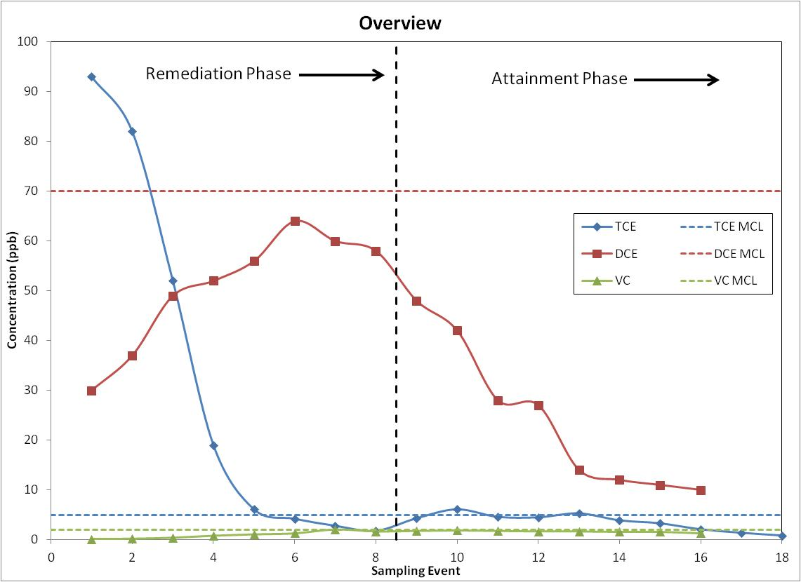

Slide 21
Remediation Monitoring Phase Completion Determination
Done for ALL contaminants in a well
Goal(s):
Provide a decision point to start attainment monitoring phase data collection and analysis
Terminate active systems if they are being employed
Methodology:
Nonstatistical or visual evaluation
Statistical tools (2 types)
Mean test
Trend test

Slide 23
Attainment Monitoring Phase Completion Determination
Performed for each contaminant separately
Goal(s):
Provide assurance that the cleanup level for each contaminant in the well has been met; and
Provide assurance that the groundwater in the well will remain below contaminant cleanup level(s) in the future
Steady State Considerations
Active systems versus passive systems
Data set considerations

Slide 24
Attainment Monitoring Phase Completion Determination
Guidance recommends two lines of evidence to support completion of this phase
Methodology:
Nonstatistical or visual evaluation
Meeting contaminant cleanup level?
Mean test
Groundwater anticipated to continue to meet contaminant cleanup levels in the future?
Trend test (slope)

Slide 26
QUESTIONS ON THE RECOMMENDED APPROACH AND STATISTICAL TOOL?

Slide 27
Contact Information
Kate Garufi Dave Bartenfelder
garufi.Katherine@epa.gov bartenfelder.david@epa.gov
703-603-8827 703-603-9047

