Slide 1
Region 5 Recreational and Educational Reuse Highlights
Tom Bloom,
Region 5 Superfund Redevelopment Coordinator
Notes:
Thanks, Fran! Hello, Everyone. My name is Tom Bloom and I am an RPM for EPA Region 5. I am also the Region 5 Superfund Redevelopment Coordinator, so I am always on the lookout for ways to promote the safe and beneficial reuse of Superfund sites in Michigan, Wisconsin, Minnesota, Illinois, Indiana and Ohio.

Slide 2
Recreational and
Educational Reuse Highlights
Butterworth #2 Landfill (Grand Rapids, Michigan)
DuPage County Landfill (Warrenville, Illinois)
PMC Groundwater (Petoskey, Michigan)
Torch Lake (Houghton County, Michigan)
Kerr-McGee (Reed-Keppler Park) (West Chicago, Illinois)
Notes:
Region 5 has strongly supported Superfund redevelopment efforts for more than 15 years. From commercial and industrial land uses providing jobs and tax revenues to ecological revitalization, parks and innovative renewable energy projects, Region 5 is committed to helping communities turn Superfund sites into valued assets. Today, there are over 75 Superfund sites in reuse in Region 5, and even more are in continued use and/or planned reuse.
Today, I will provide a brief overview of some of the sites in recreational and educational reuse in Region 5. Then, we will delve into an in-depth case study looking at recreational and educational reuse opportunities at one site in particular – the Southside Sanitary Landfill in Decatur Township, Indiana.

Slide 3
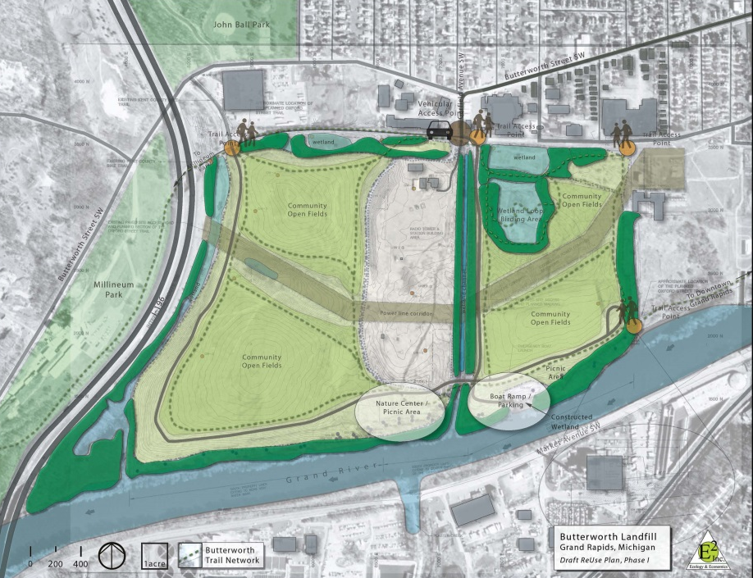
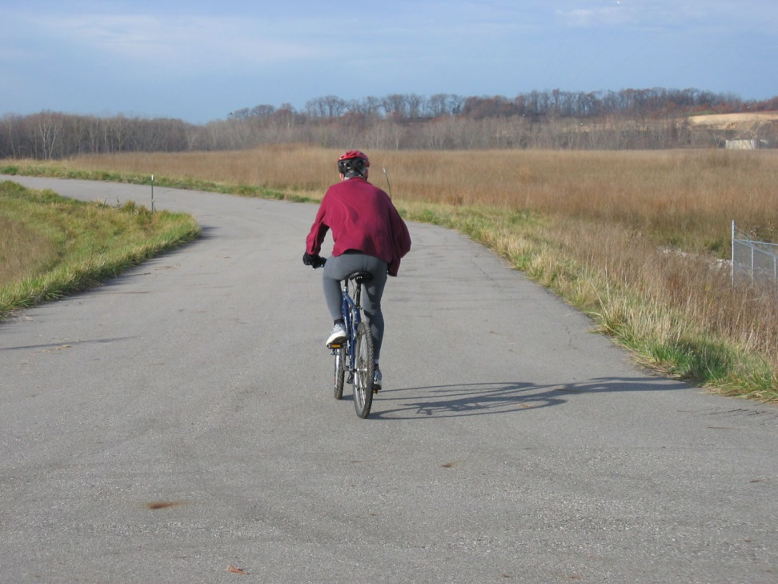
Butterworth #2 Landfill
(Grand Rapids, Michigan)
Reuse planning leads to recreational reuse
Reuse plan
Trails for bicyclists
Notes:
The 120-acre Butterworth #2 Landfill site is located in Grand Rapids, Michigan. From 1950 until 1973, the landfill was an open dump and a sanitary landfill.
Cleanup began in 1990 with the removal of waste drums and soil. The Site’s remedy also included a landfill cover and ground water monitoring, which is ongoing.
SRI Region 5 and the City of Grand Rapids worked together to develop a site assessment and conceptual reuse plan for the site. From this work, plans to extend a bike trail through the site were approved. In fall 2009, EPA constructed access road extensions to connect the site to the bicycle trail network. The City and EPA also worked together to facilitate use of the access road for marathon running races.
To keep reuse possibilities moving forward, in 2013 Region 5 conducted a renewable energy assessment to determine if installing a solar energy facility at the site would be feasible.
Pictured: A draft reuse plan for the Butterworth Landfill site; Recreational biking trails at the Butterworth Landfill site

Slide 4
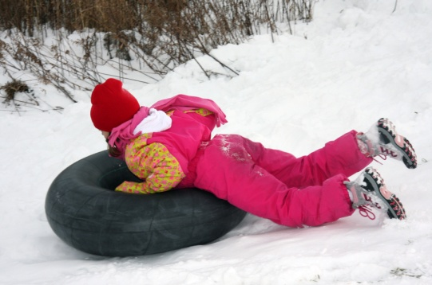
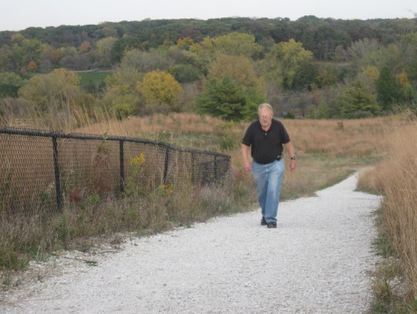
DuPage County Landfill (Warrenville, Illinois)
Recreational opportunities for every season
Source: Forest Preserve District of DuPage County
Notes:
At the DuPage County Landfill Superfund site in Warrenville, Illinois, cleanup was designed with future recreational use in mind. The 40-acre landfill area is not only a containment area, but is more widely known as Mt. Hoy, a 150-foot hill that is the centerpiece of a multi-use recreational area. Area residents now hike the former landfill to bird watch and sled during the winter. EPA, Illinois EPA and the DuPage County Forest Preserve District collaborated to clean up the site, which now provides picnic and camping areas, hiking and cross-country skiing trails, and fishing and boating areas. The Urban Stream Research Center on site provides conservation and environmental education opportunities.
Pictured: Snow tubing and gravel trails on the site.

Slide 5

DuPage County Landfill
http://www.epa.gov/superfund/programs/recycle/info/dupage.html
Notes:
Now, I’d like to share a video with you about this fantastic site.

Slide 6
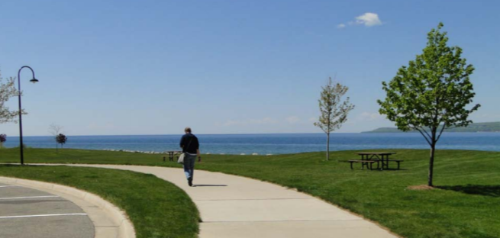
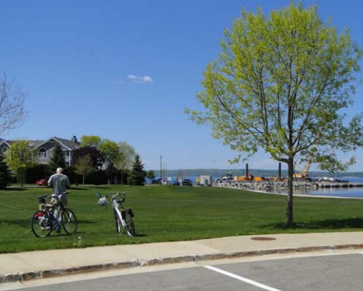
PMC Groundwater
(Petoskey, Michigan)
Local government, state and EPA collaboration created residential and recreational assets for the community
Notes:
The PMC Groundwater Superfund site is located in a former industrial area on the shores of Lake Michigan’s Little Traverse Bay in Petoskey, Michigan. The Petoskey Manufacturing Company (PMC) operated a die casting plant at the site and improperly disposed of wastes from the casting process. This resulted in contamination of area ground water, soil and the town’s municipal well. EPA placed the site on the National Priorities List (NPL) in 1983. EPA’s cleanup plan for contaminated soil included excavation and disposal of soil as well as the installation of a soil vapor extraction system.
EPA, MDEQ, the City of Petoskey and local developers collaborated on the cleanup and redevelopment of the site and surrounding waterfront area. This collaboration and persistence, combined with the city’s visionary planning efforts and creative financing strategies, transformed the formerly-contaminated industrial zone into a mixed use residential, commercial and recreational waterfront. The site also supports new condominiums with integrated all-underground utilities, an improved road, parking and lakefront bicycle path infrastructure. The number of visitors that come to enjoy Petoskey’s lakefront scenery and recreational amenities has significantly increased in recent years. In addition, the taxable value of the site properties has increased 15 times since the PMC facility operated in the 1960s.

Slide 7
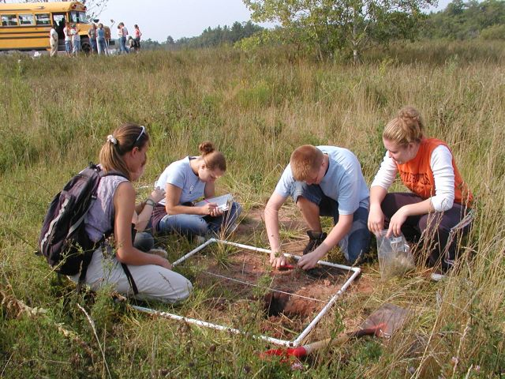
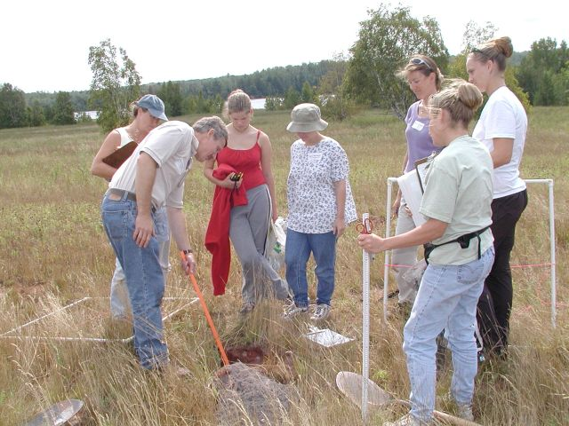
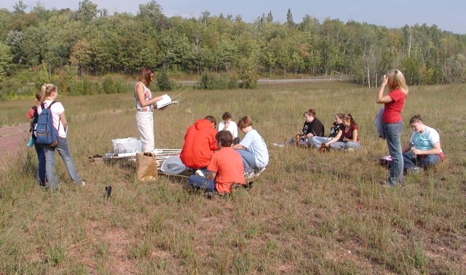
Torch Lake (Houghton County, Michigan)
    Learning on site
Notes:
The Torch Lake Superfund site is located in Houghton County, Michigan, on the Keweenaw Peninsula, a region known for its intensive copper industry during the nineteenth and twentieth centuries. The Keweenaw mines once produced over 80 percent of the nation's copper. These mining, milling and smelting activities contaminated lake sediment and shorelines with mill tailings (called stamp sands).
Local area high schools have been part of EPA’s monitoring and surveying project at the site since 2003. EPA Region 5 created a model monitoring program in collaboration with the Western Upper Peninsula Center for Science, Mathematics and Environmental Education. The program engages the students in the Torch Lake community while providing EPA with the necessary data to track improvements to the soil fertility and the return of plants, birds, and mammals to the site following cleanup.
Through this collaborative effort, high school students are learning the skills necessary to perform an ecological evaluation while providing valuable monitoring data to EPA that will help the Agency monitor the progress of the cleanup efforts. In addition, the students are planning to share their survey findings with the local community, which will help them develop public speaking skills and educate the broader community about the cleanup progress at the site.
Site images: student sampling efforts and teacher training sessions on site.

Slide 8
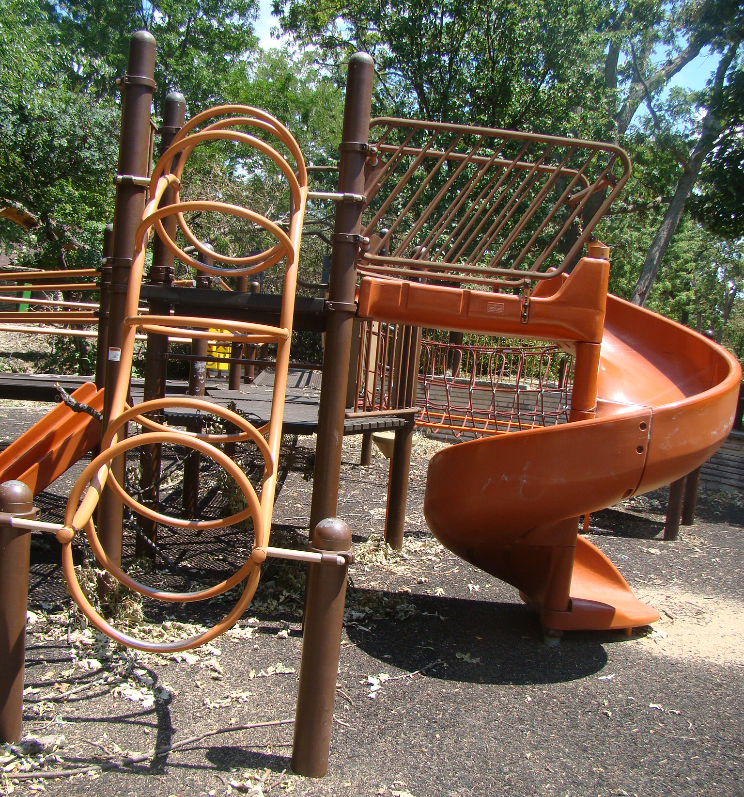
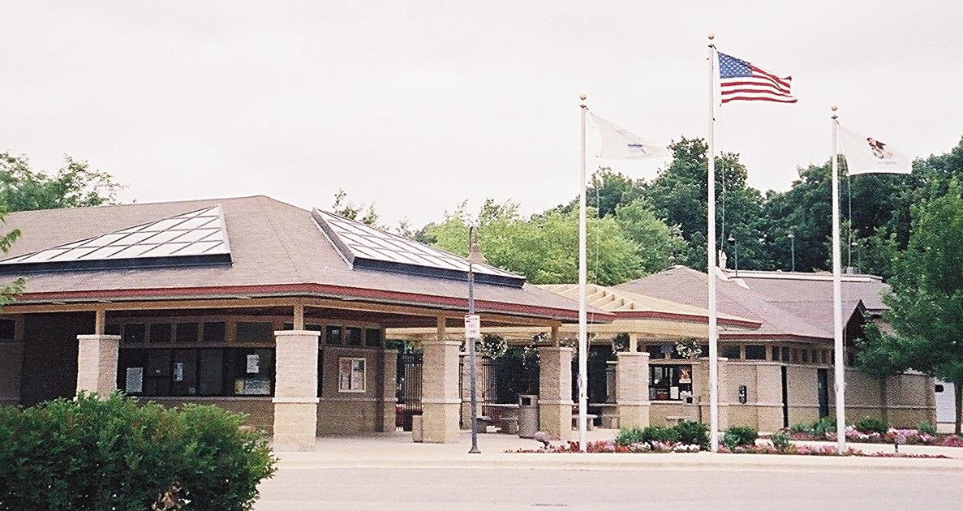
Kerr-McGee
(Reed-Keppler Park)
(West Chicago, Illinois)
Early planning leads to acres of recreational assets
Notes:
The Kerr-McGee (Reed-Keppler Park) Superfund site is one of four Kerr-McGee sites associated with radioactive waste contamination in West Chicago, DuPage County, Illinois. The 90-acre property operated as a sand and gravel quarry in the late 1800s. The City of West Chicago purchased the area from the local railroad company in the early 1930s and used it as a community park with a small swimming pool constructed in the 1950s. The area also contained a small municipal landfill. From the 1930s until 1974, the municipal landfill accepted waste materials, including radioactive tailings from the nearby Rare Earths Facility. Site operators used the waste materials to cover the landfill and provide fill in the surrounding park.
Prior to cleanup activities, the local community had expressed interest in redeveloping the property as an aquatics center. EPA worked with the local park district to perform a more focused investigation in the proposed development area. EPA, the Park District and site stakeholders identified potential areas of contamination and modified building plans for the aquatic center to be compatible with the site remedy. Construction began in 1993 and the Prairie Oaks Family Aquatic Center opened on a portion of the site in 1995. Cleanup activities at the site between 1997 and 2000 removed all contaminated soil. In 2010, EPA deleted the site from the NPL and now the site can accommodate unrestricted use. The redeveloped Reed-Keppler Park now features various sports fields, a skateboard park, two playgrounds, a concession stand and pavilions, a 25-acre nature sanctuary, a dog park and parking. The park is also home to the West Chicago Park District Wildcat Youth Football League. Collaboration between EPA and stakeholders has resulted in the successful remediation and reuse of this site, which provides valuable recreational opportunities for the community.

Slide 9
Southside Sanitary Landfill
In-Depth Case Study
Notes:
Now, I’d like to hone in on a very special site, the Southside Sanitary Landfill. We are going to see how innovative thinking on the part of site stakeholders has allowed for this Superfund site to become a leading example of alternative energy, commercial, industrial use, AND -- in keeping with the theme for today -- how this site has become both a recreational and an educational asset to the area.

Slide 10
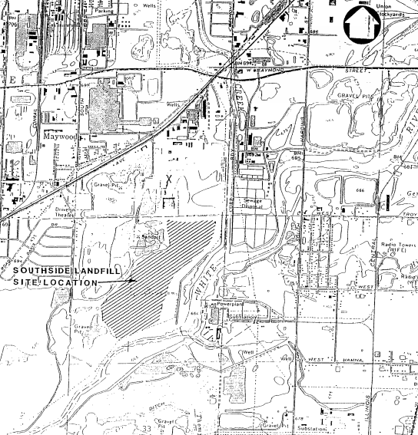
Site Location
312 acres
Decatur Township, Indiana
4.5 miles southwest of downtown Indianapolis
Notes:
The Southside Sanitary Landfill (SSL) occupies 312 acres in Decatur Township, Marion County -- about 4.5 miles southwest of downtown Indianapolis, in Indiana. To give you an idea of the surrounding area, Eagle Creek and White River form the site boundaries to the east and south respectively, and portions of Strakis Lake, and a Martin Marietta limestone mine border the site to the west. The actual SSL facility is located on the west bank of the White River.

Slide 11
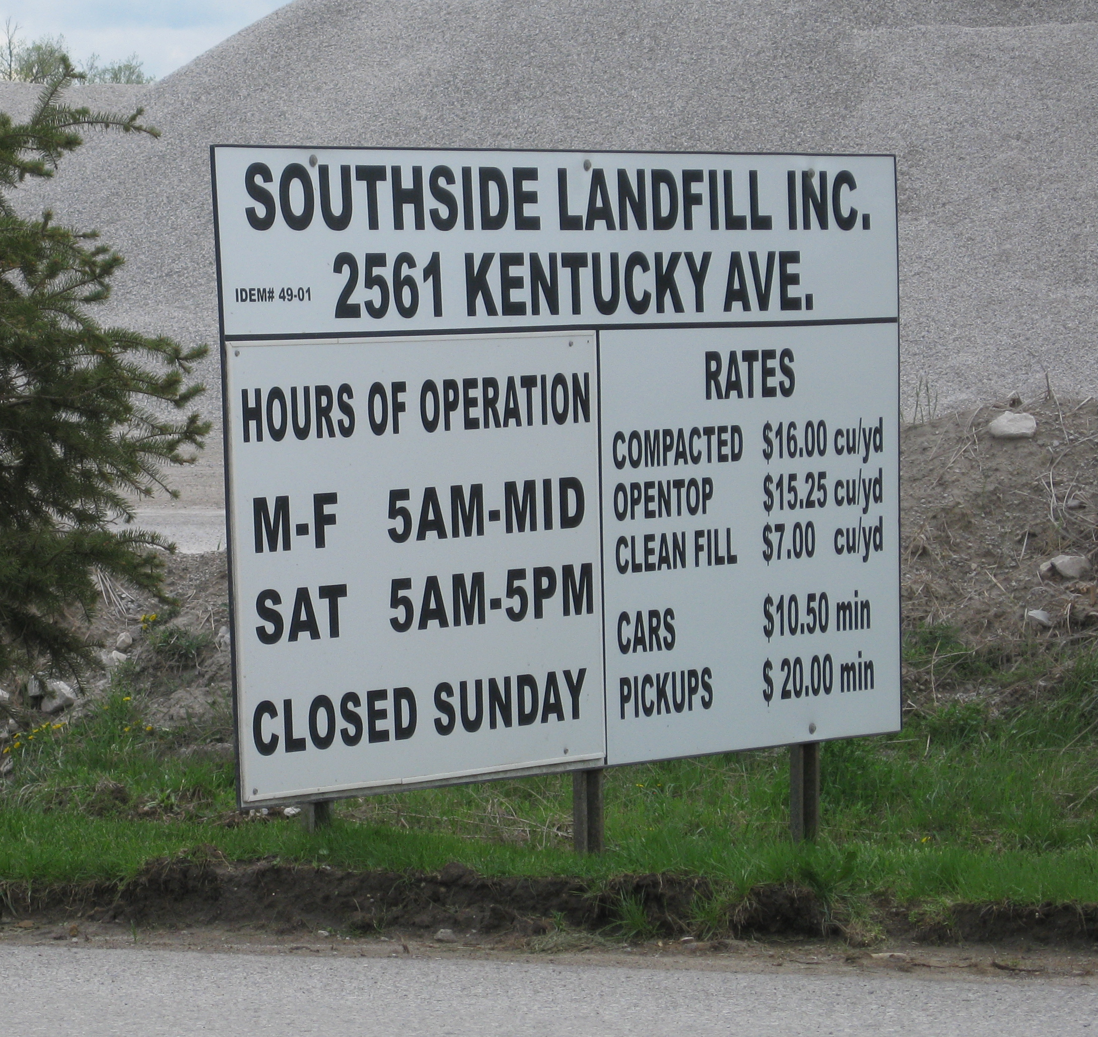
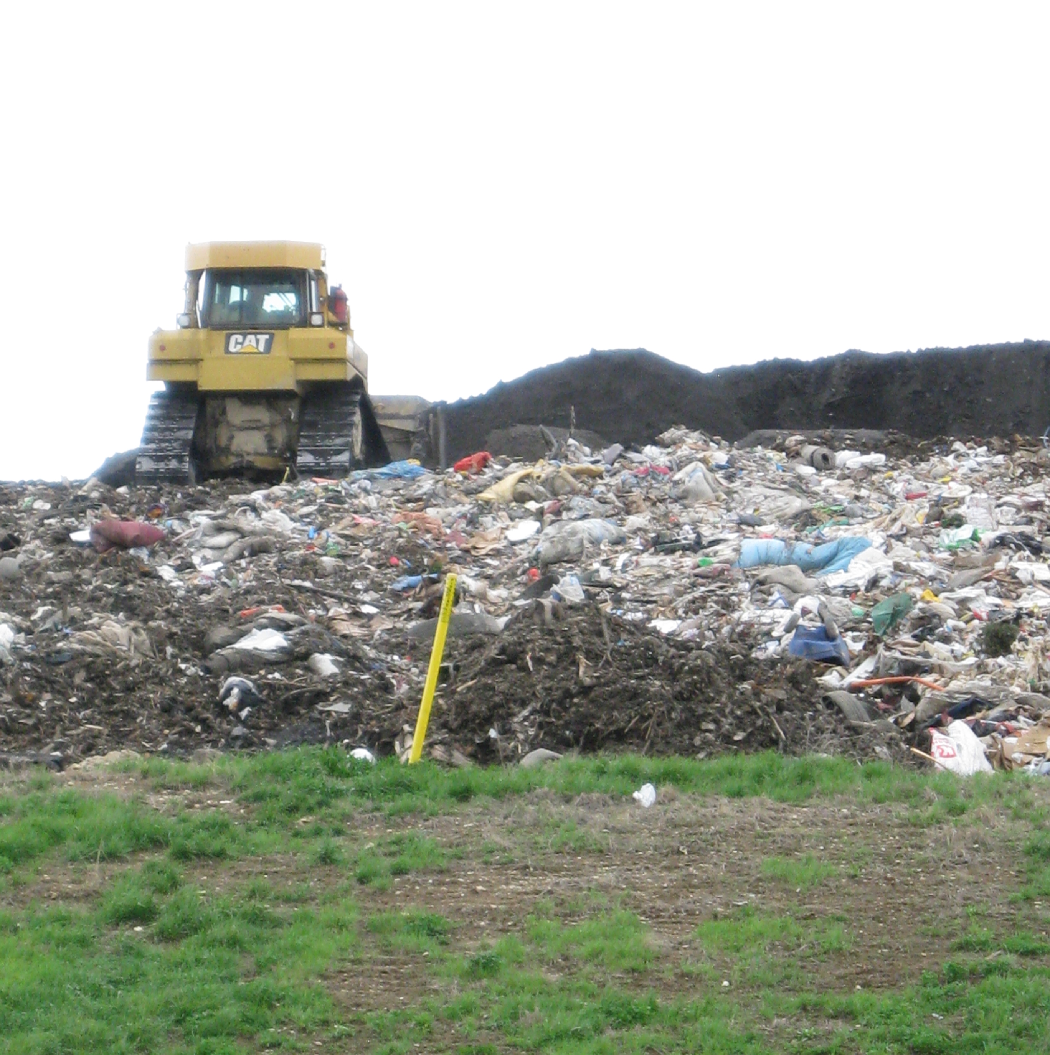
Site History
Landfill activities began in 1971 and continue today.
Notes:
The SSL is an active solid waste disposal facility that began landfill activities in 1971. In 1974, the local government licensed the northern side of the site for disposal of solid waste. The first excavated area was filled by dumping refuse, and covering with a layer of soil. A second disposal area was excavated 150 feet to the south.
The initial operation used a cut and fill procedure. In 1981, operations switched to the area method of filling, which consists of dumping, spreading, and covering. Municipal solid waste is considered to be the site's primary waste; however, over the years, industrial and agricultural wastes have also been dumped at the site. An estimated 4 million cubic yards of waste, including coal tar, asbestos, iron oxide, clarifier sludge, and paint waste, have been disposed at the landfill.
In 1984, EPA contractors conducted a site inspection to acquire data to determine whether the Agency should place the site on the NPL. When ground water samples from on-site wells indicated the presence of heavy metals, EPA proposed the site for the NPL in June 1986 and finalized the site on the NPL in March 1989. The primary contaminants of concern were arsenic, iron, manganese, cadmium, chromium, silver, and nickel.

Slide 12
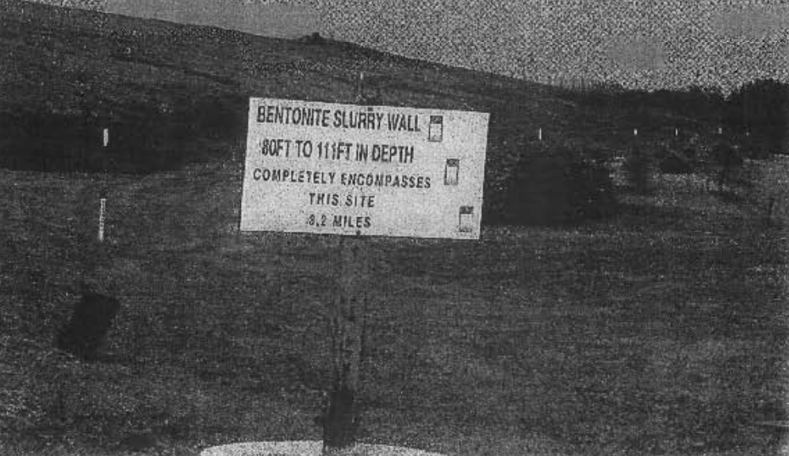
Site Cleanup and Continued Use
1986 – Agreed Order
Notes:
The landfill continued to operate throughout all the cleanup activities. This required open lines of communication between all site stakeholders and ongoing site operational improvements to ensure the site could continue to function as a landfill throughout cleanup.
In 1985, the SSL operators signed an agreement with the Indiana State Board of Health (ISBH) to correct drainage problems that were identified at the landfill.
In 1986, the SSL owners signed an Agreed Order with the Indiana Department of Environmental Management (IDEM) to construct both a hydraulic cut-off barrier (slurry wall) and a leachate collection system, in order to isolate the ground water beneath the landfill from the surrounding ground water.
Additionally, the Agreed Order included a performance monitoring network, cover and grading requirements, operating procedures, closure and post-closure
procedures and requirements, and the establishment of both closure and post-closure funds. The established well network monitors ground water levels and quality both inside and outside the slurry wall.

Slide 13
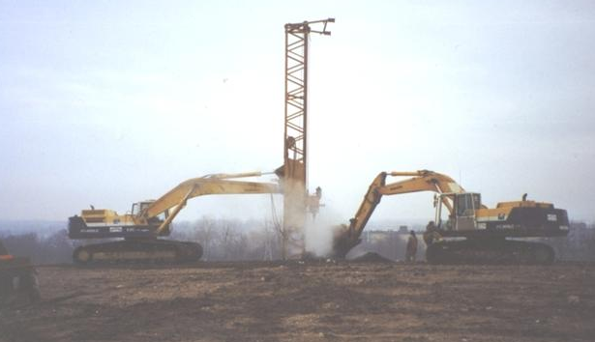
Early Green Uses
Landfill gas:
  heats vehicle maintenance shop
  renewable energy source for landfill liquid pump systems
  supplies landfill gas-to-energy for area businesses
Well drilling during landfill gas energy research at the Site in the 1980s. (Source: South Side Landfill, Inc.)
Notes:
Early on there was an interest in recycling the on-site landfill gases, which are produced when the organic portion of solid waste biodegrades naturally. The landfill owners and other parties interested in putting the landfill gas to use would need to work with EPA and IDEM to ensure that reuse would not interfere with their monitoring activities. Recovery wells were installed at the SSL site in the early 1980s. Tests were conducted with these wells to determine if the landfill gas could be collected safely and in sufficient, reliable quantities to be used as an energy source.
After considerable research and investment, more than 100 landfill gas recovery wells were installed. An intricate pipeline system was constructed at the landfill site to collect and transport the landfill gas.
Some of the landfill gas collected is used to heat an on-site vehicle maintenance shop and power the landfill's liquid pumping system.

Slide 14
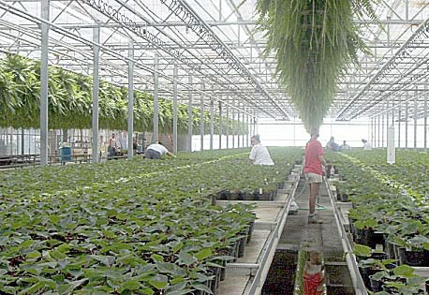
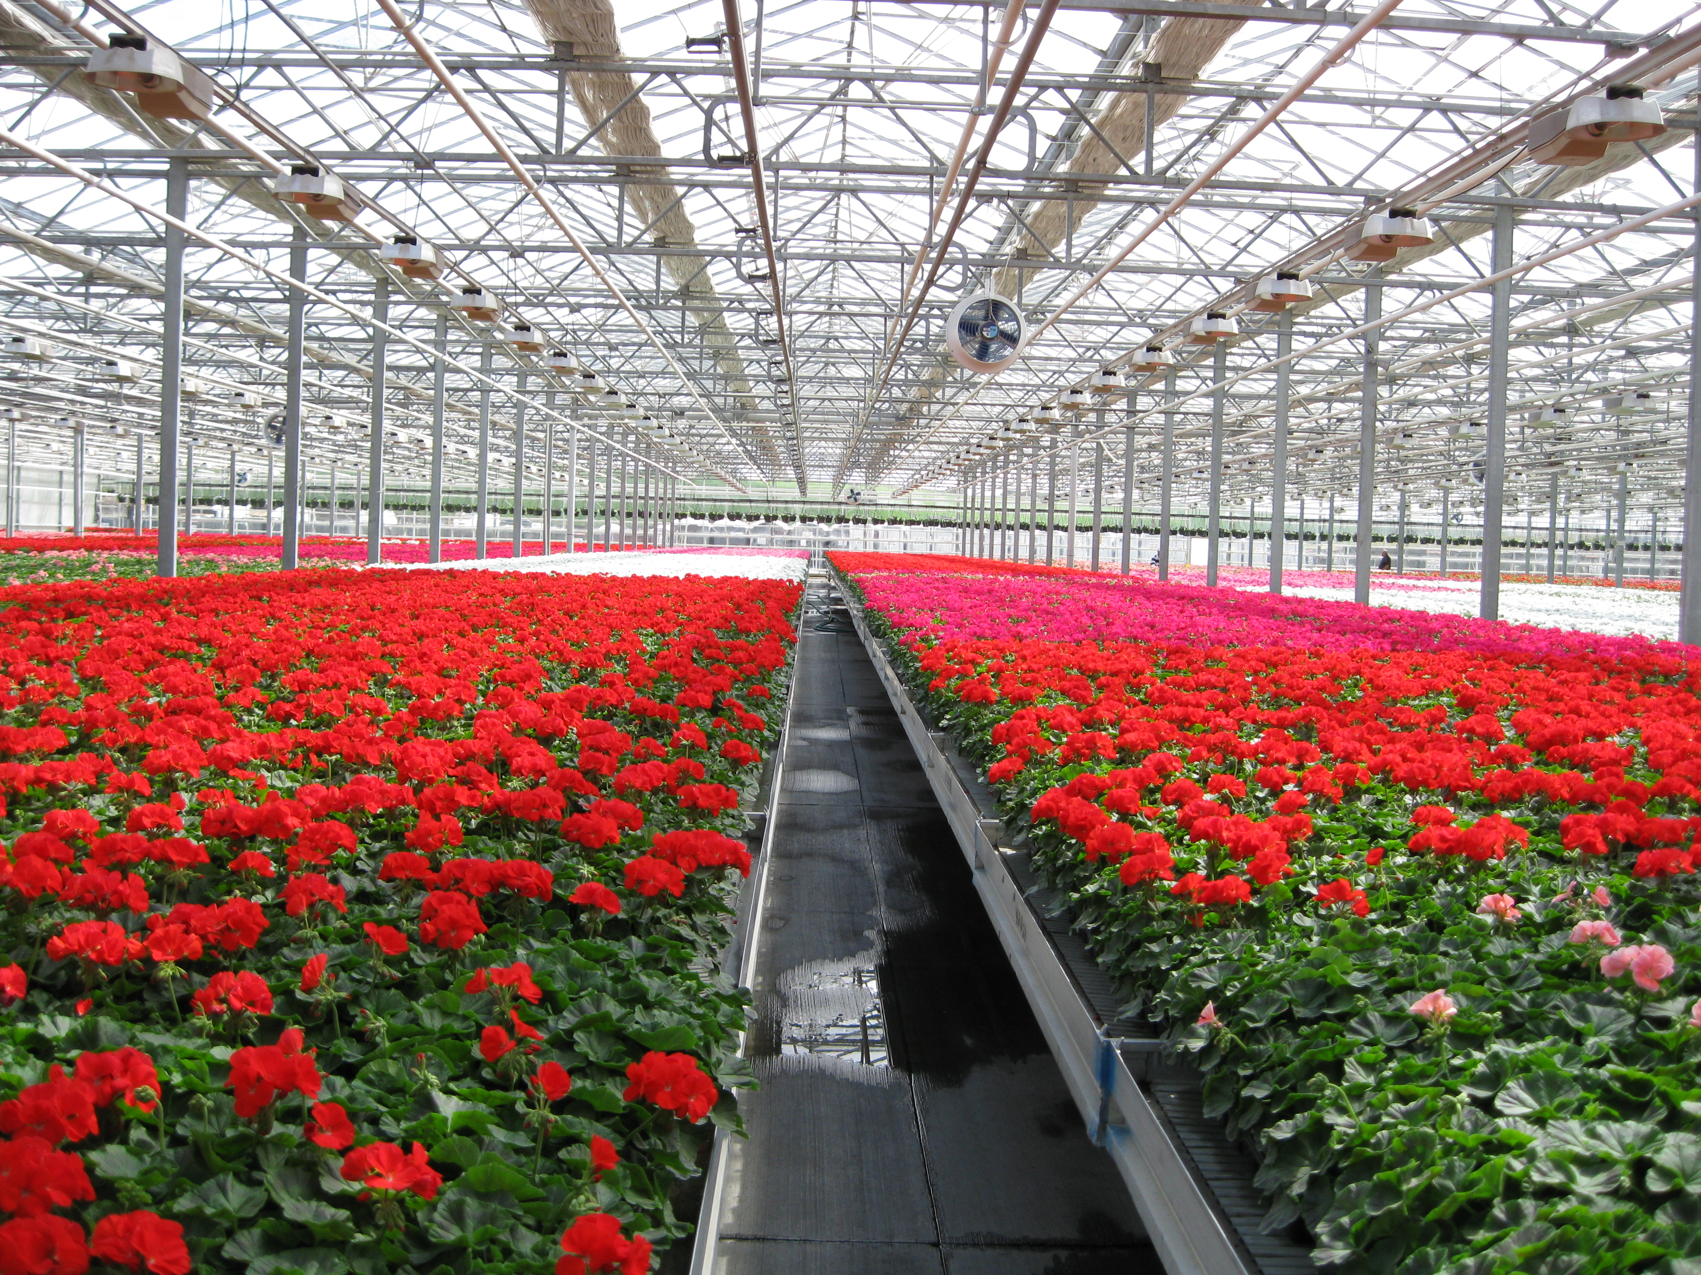
Crossroads Greenhouse
Notes:
The Crossroads Greenhouse, a 6.5 acre glass greenhouse which opened in April 1989, is the major consumer of landfill gas from the site.
Annually, more than 400,000 poinsettias, bedding plants, and hanging baskets are grown and supplied from the Crossroads Greenhouse.
One of the largest methane-powered greenhouses in the United States, the Crossroads Greenhouse has pulled, on average, more the 2.2 million cubic feet of landfill gas each day from the landfill since 1989.

Slide 15
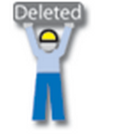
Deleting the Site
July 3, 1997
Notes:
A Remedial Investigation, conducted between January 1992 and November 1993, revealed the chemical contamination found in the ground water did not pose an unacceptable risk to human health and the environment. The RI concluded that the remedial measures implemented per the 1986 Agreed Order (the slurry wall, monitoring network and leachate system) were adequately protecting the surrounding media from the landfill contamination. So, the ROD was signed just a couple years after the RI, on September 14, 1995 and documented that the existing remedial measures were sufficient to protect human and environmental health. A "No Further Action" remedy was selected under CERCLA.
EPA deleted the site from the NPL on July 3, 1997.

Slide 16
Public-Private Partnership
Southside Sanitary Landfill, Rolls Royce and Granger Energy, LLC
Multi-year contract to obtain landfill gas from the site in 1998
Rolls Royce has saved over $2 million in avoided fuel costs
“This truly has been a ‘win-win-win-win’ situation for Rolls-Royce, Granger,
Southside Landfill, and the environment.”
– Thomas Jennings, Manager of Power & Utilities at Rolls-Royce
Notes:
Shortly after the site deletion, the Rolls Royce Allison Aircraft Engine Plant signed a multi-year contract with SSL through Granger Energy in 1998 to obtain landfill gas from the site. They use the landfill gas for boiler and generator fuels.
This successful public-private partnership between SSL, Rolls Royce and Granger Energy LLC, and Rolls Royce’s access to harvested landfill gas has saved Rolls Royce over $2 million in avoided fuel costs. And the reduction in greenhouse gas emissions is estimated to be more than 20 tons per year.
Vertellus Specialties, Inc. Indianapolis is also a customer using landfill gas from the site for boiler fuel.

Slide 17
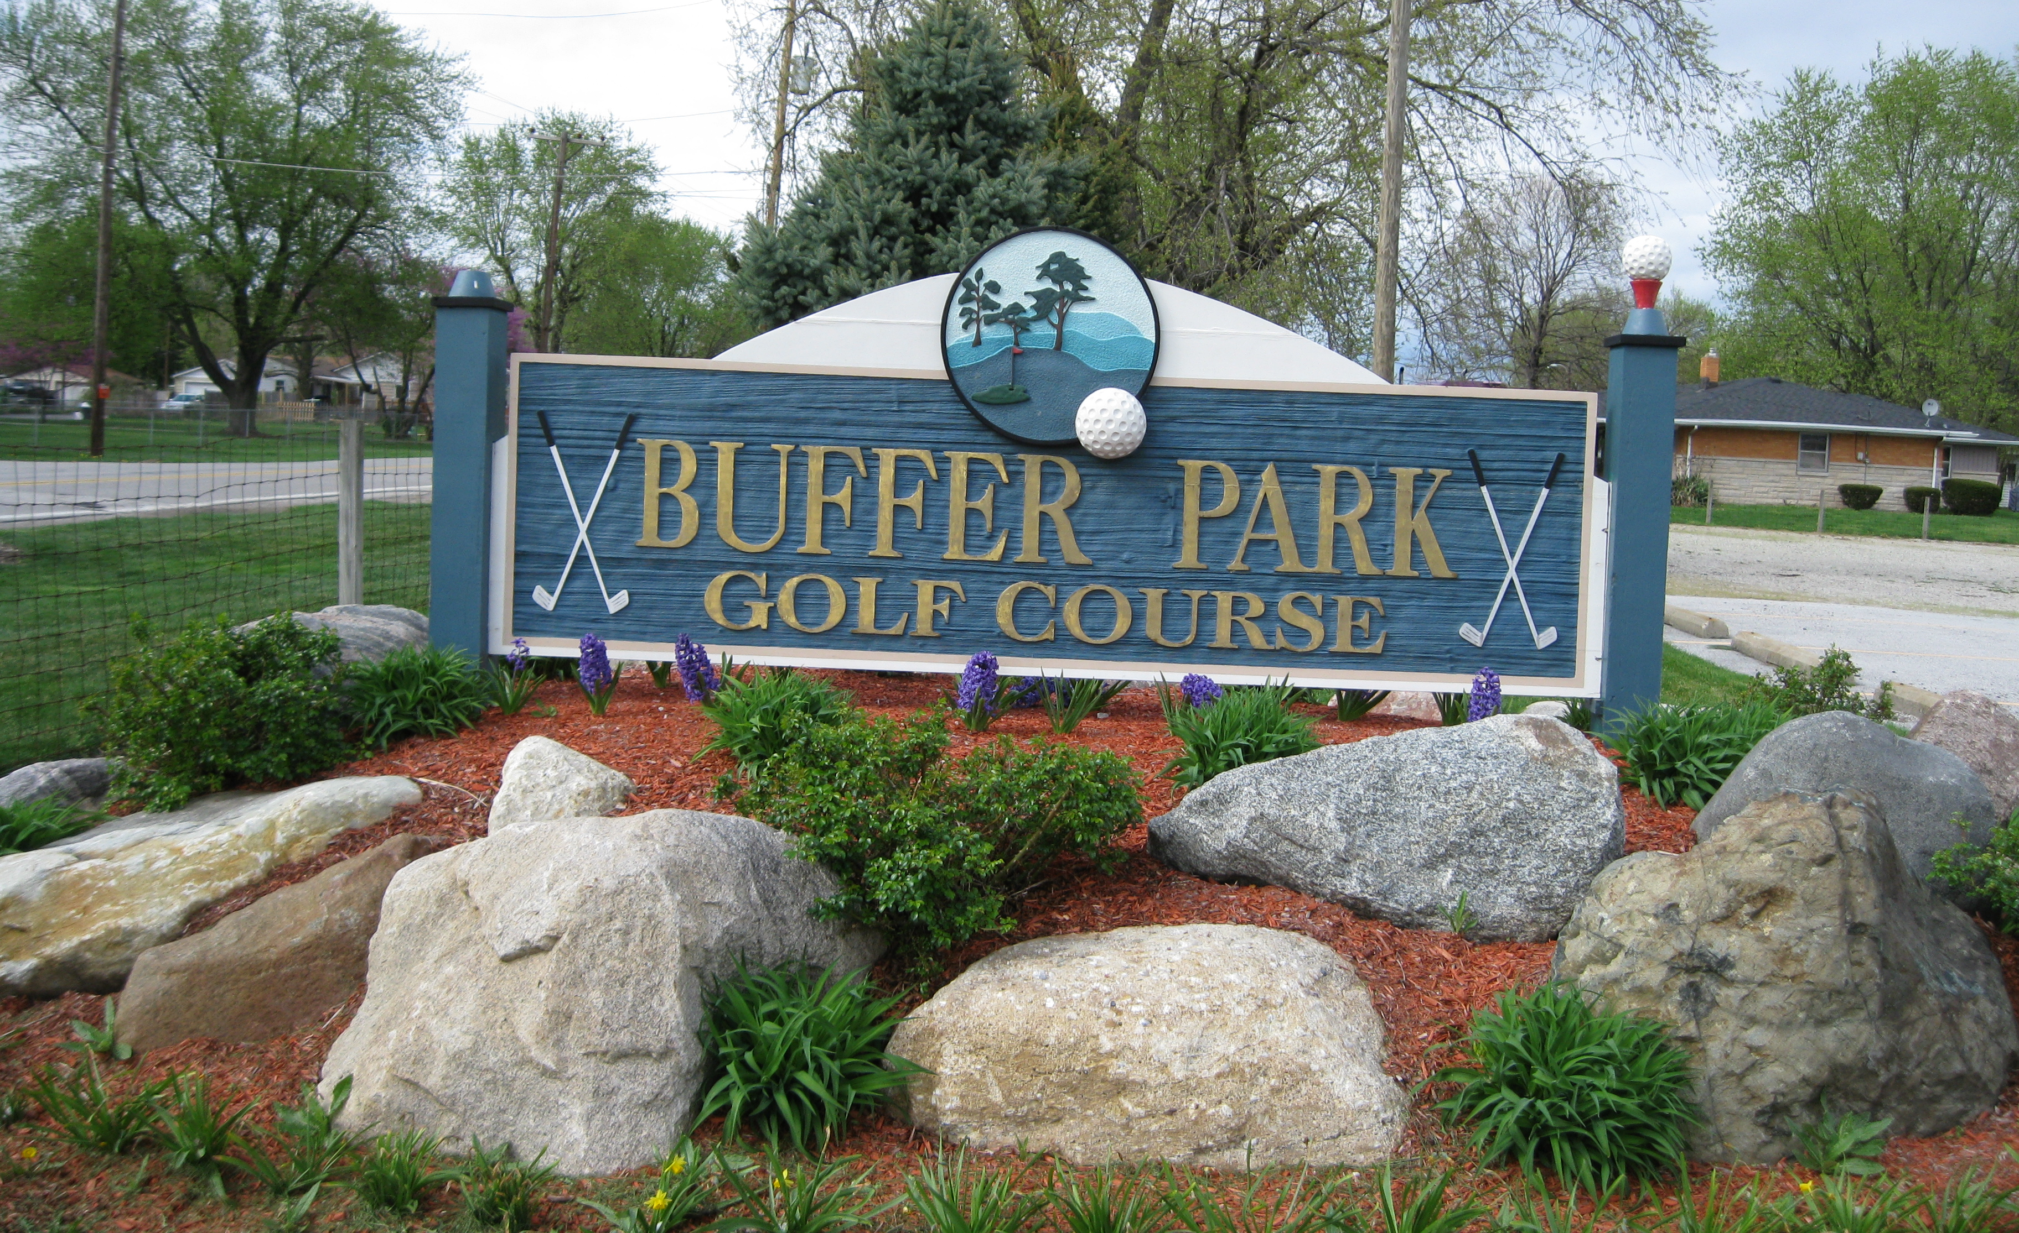
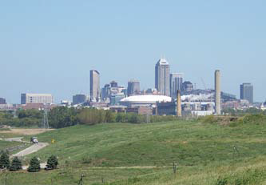
Reuse Today
Buffer Park Golf Course
Notes:
The site has continued on to support many different types of reuse over the years.
In addition to the gas-to-energy production, additional businesses have begun to use site property as well, such as the Buffer Park golf course (owned by South Side Landfill, Inc.), which got its name from being the buffer between the landfill and surrounding properties.
On your screen you can see the entryway to the golf course as well as a view of the 9-hole golf course with the Indianapolis skyline in the background.

Slide 18
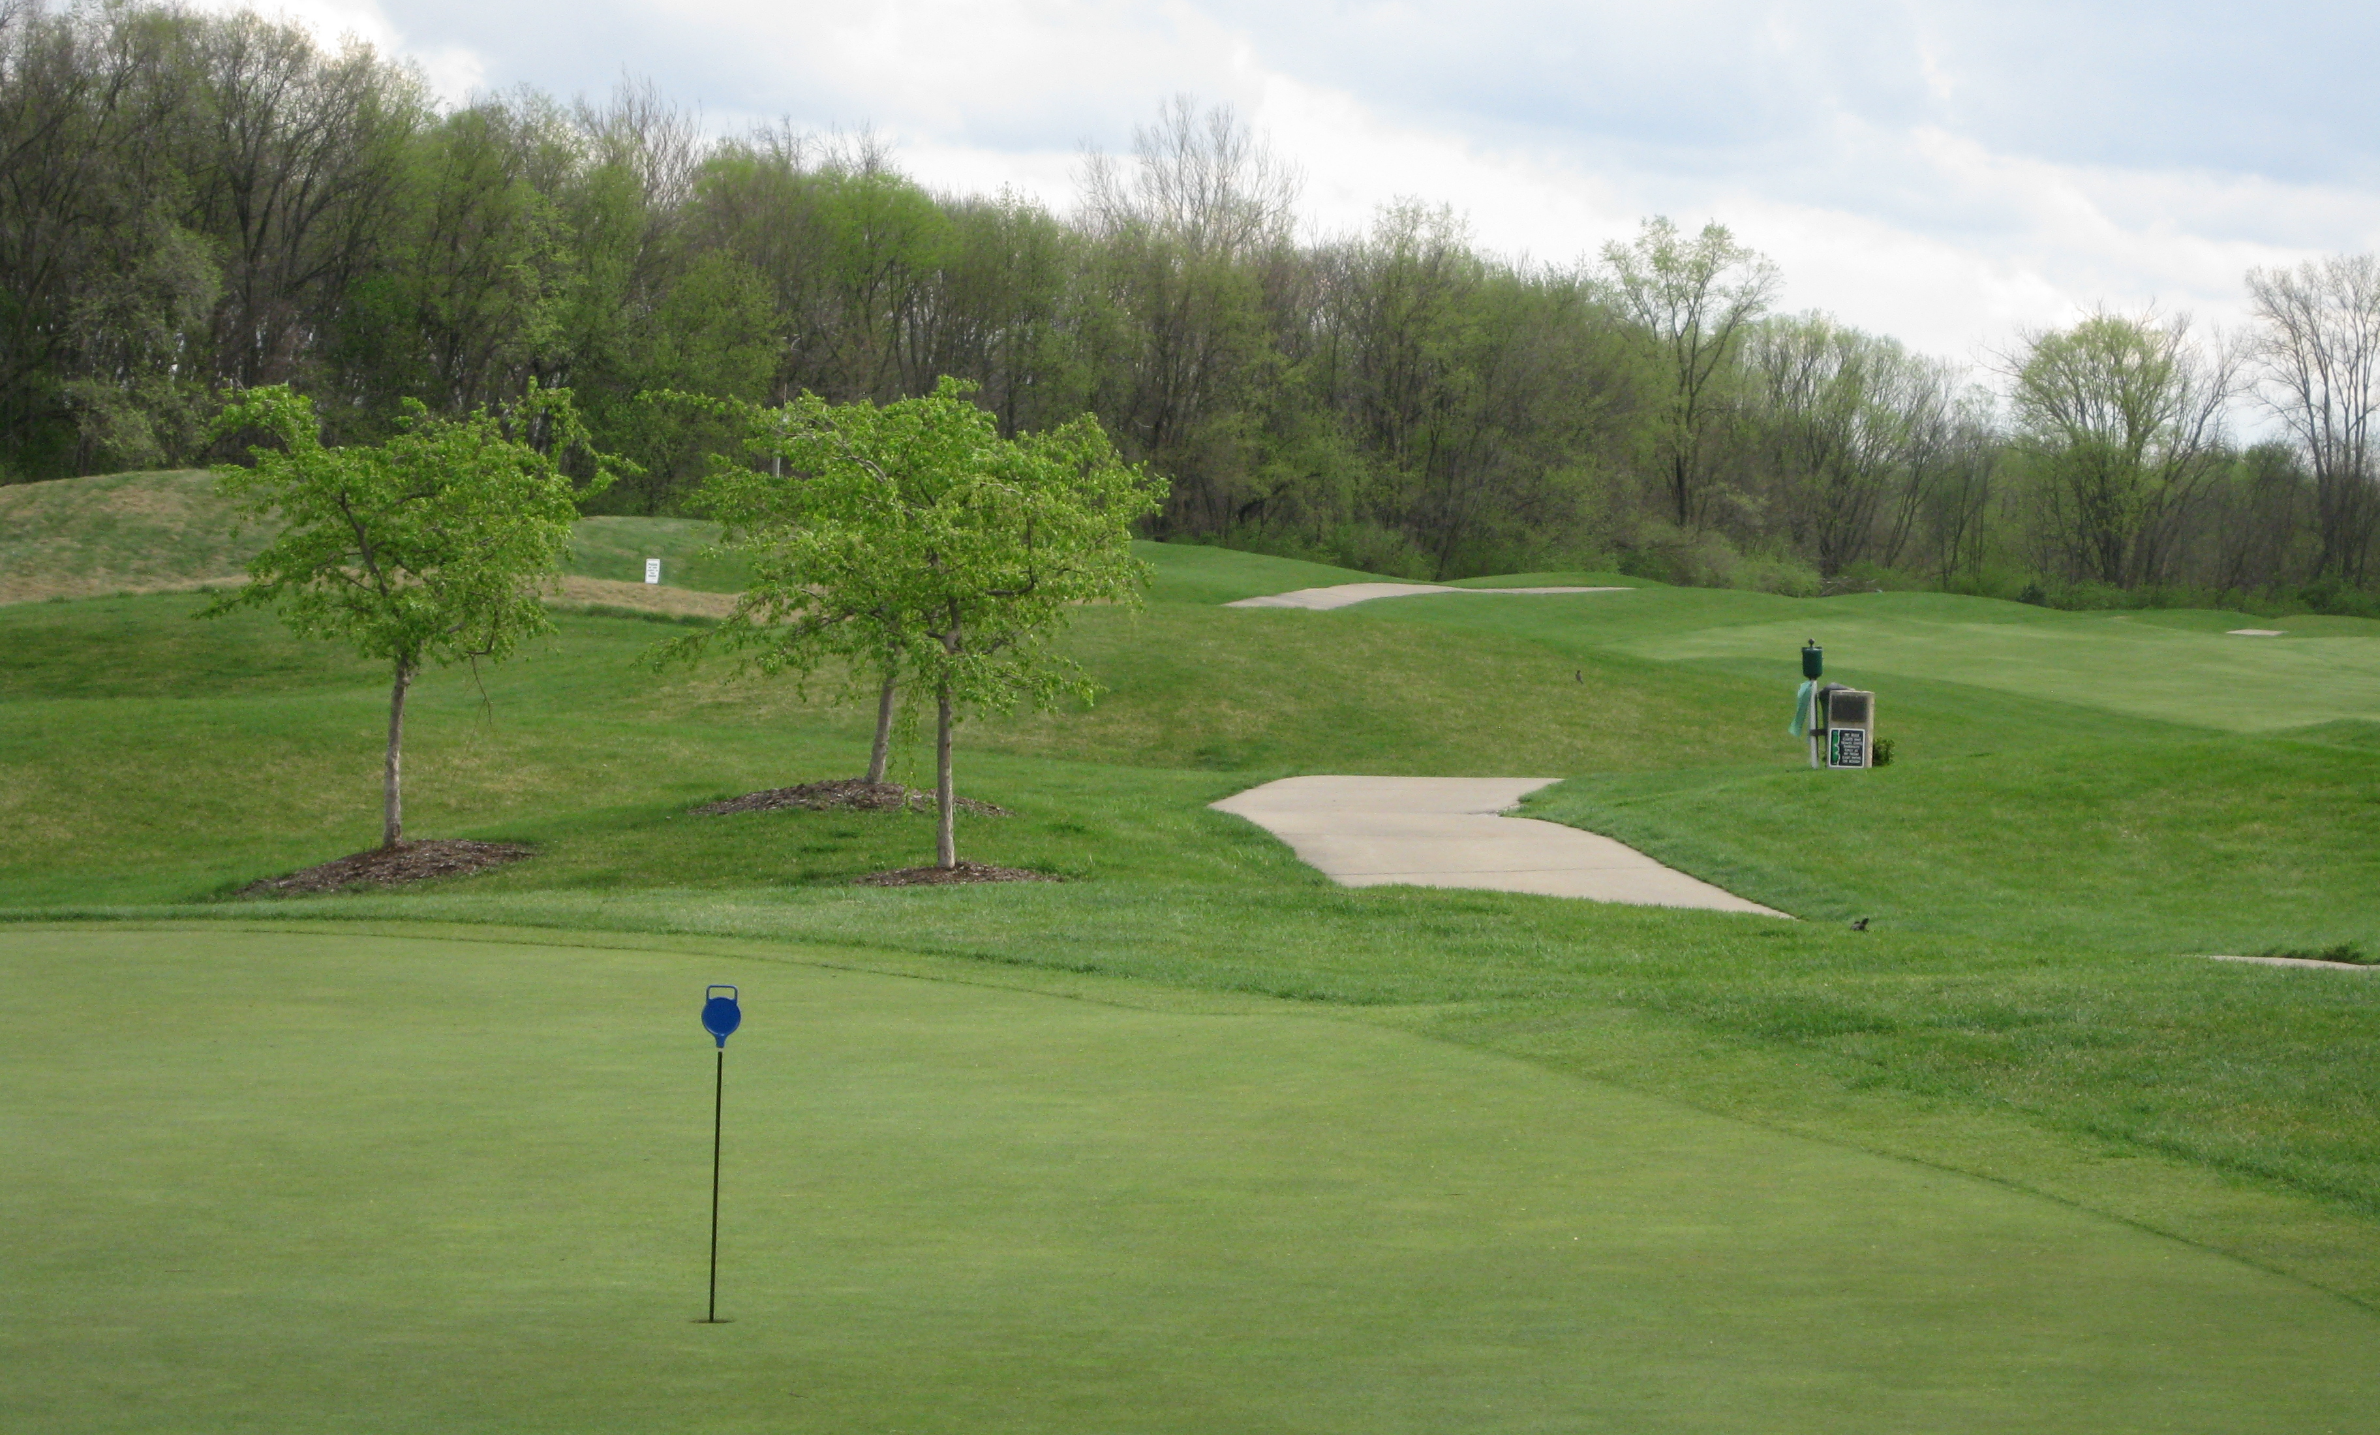
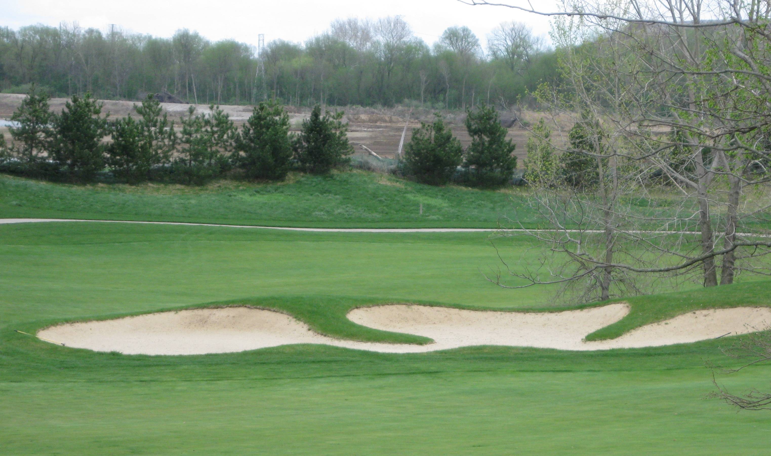
Reuse Today
Buffer Park Golf Course
Notes:
More photos of the golf course – as you can see, this area doesn’t bring to mind thoughts of contamination or cleanup, it is a vibrant, green and popular recreational asset.

Slide 19
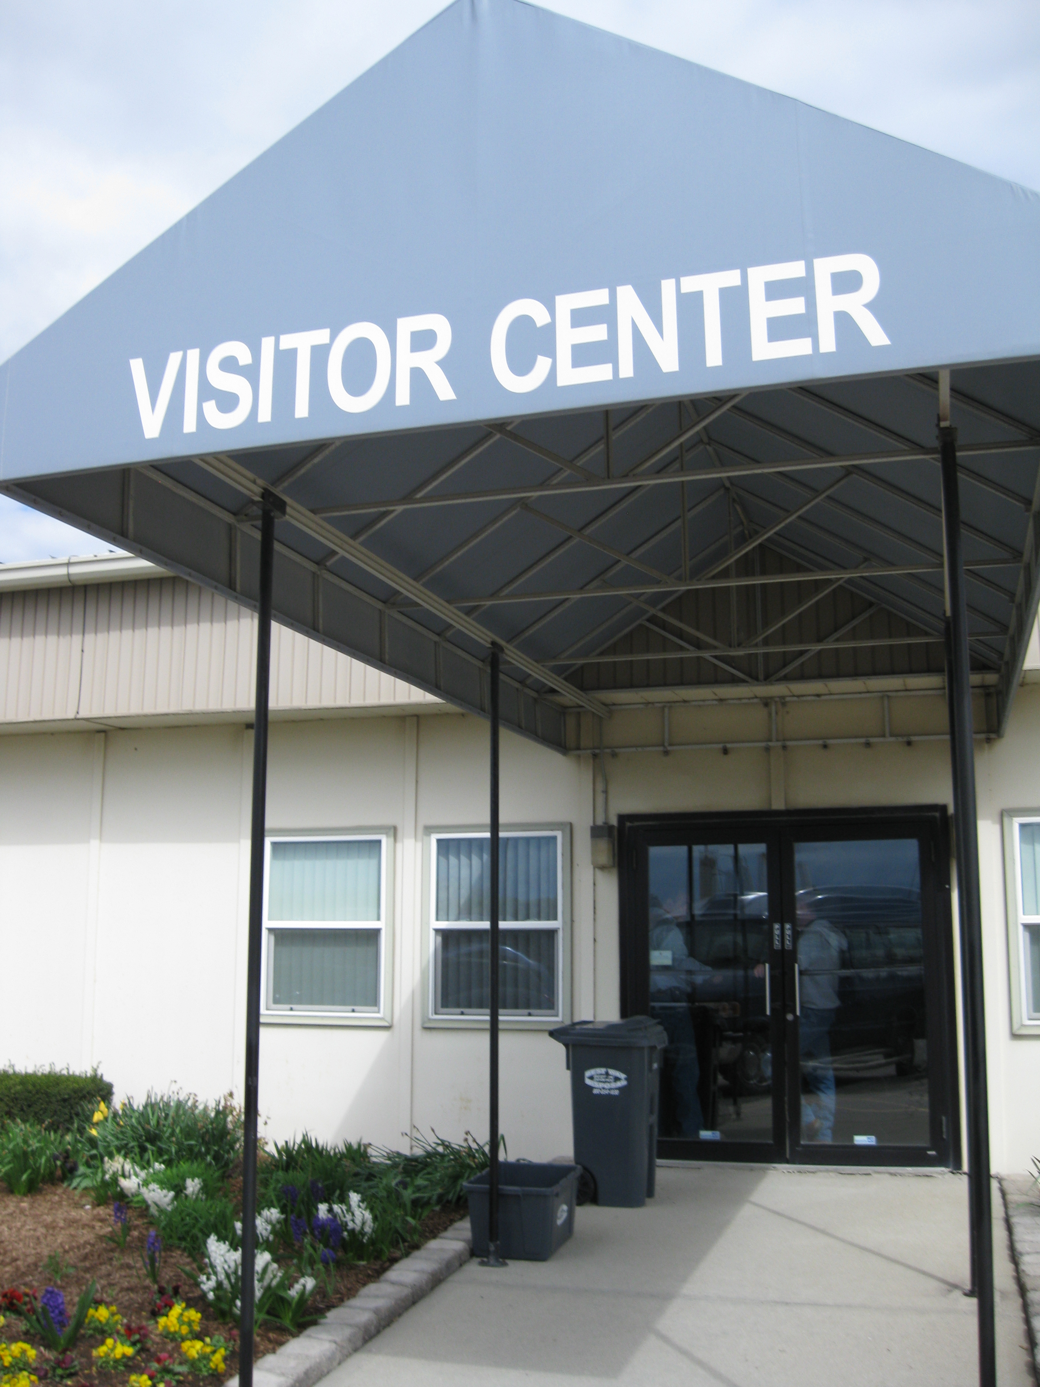
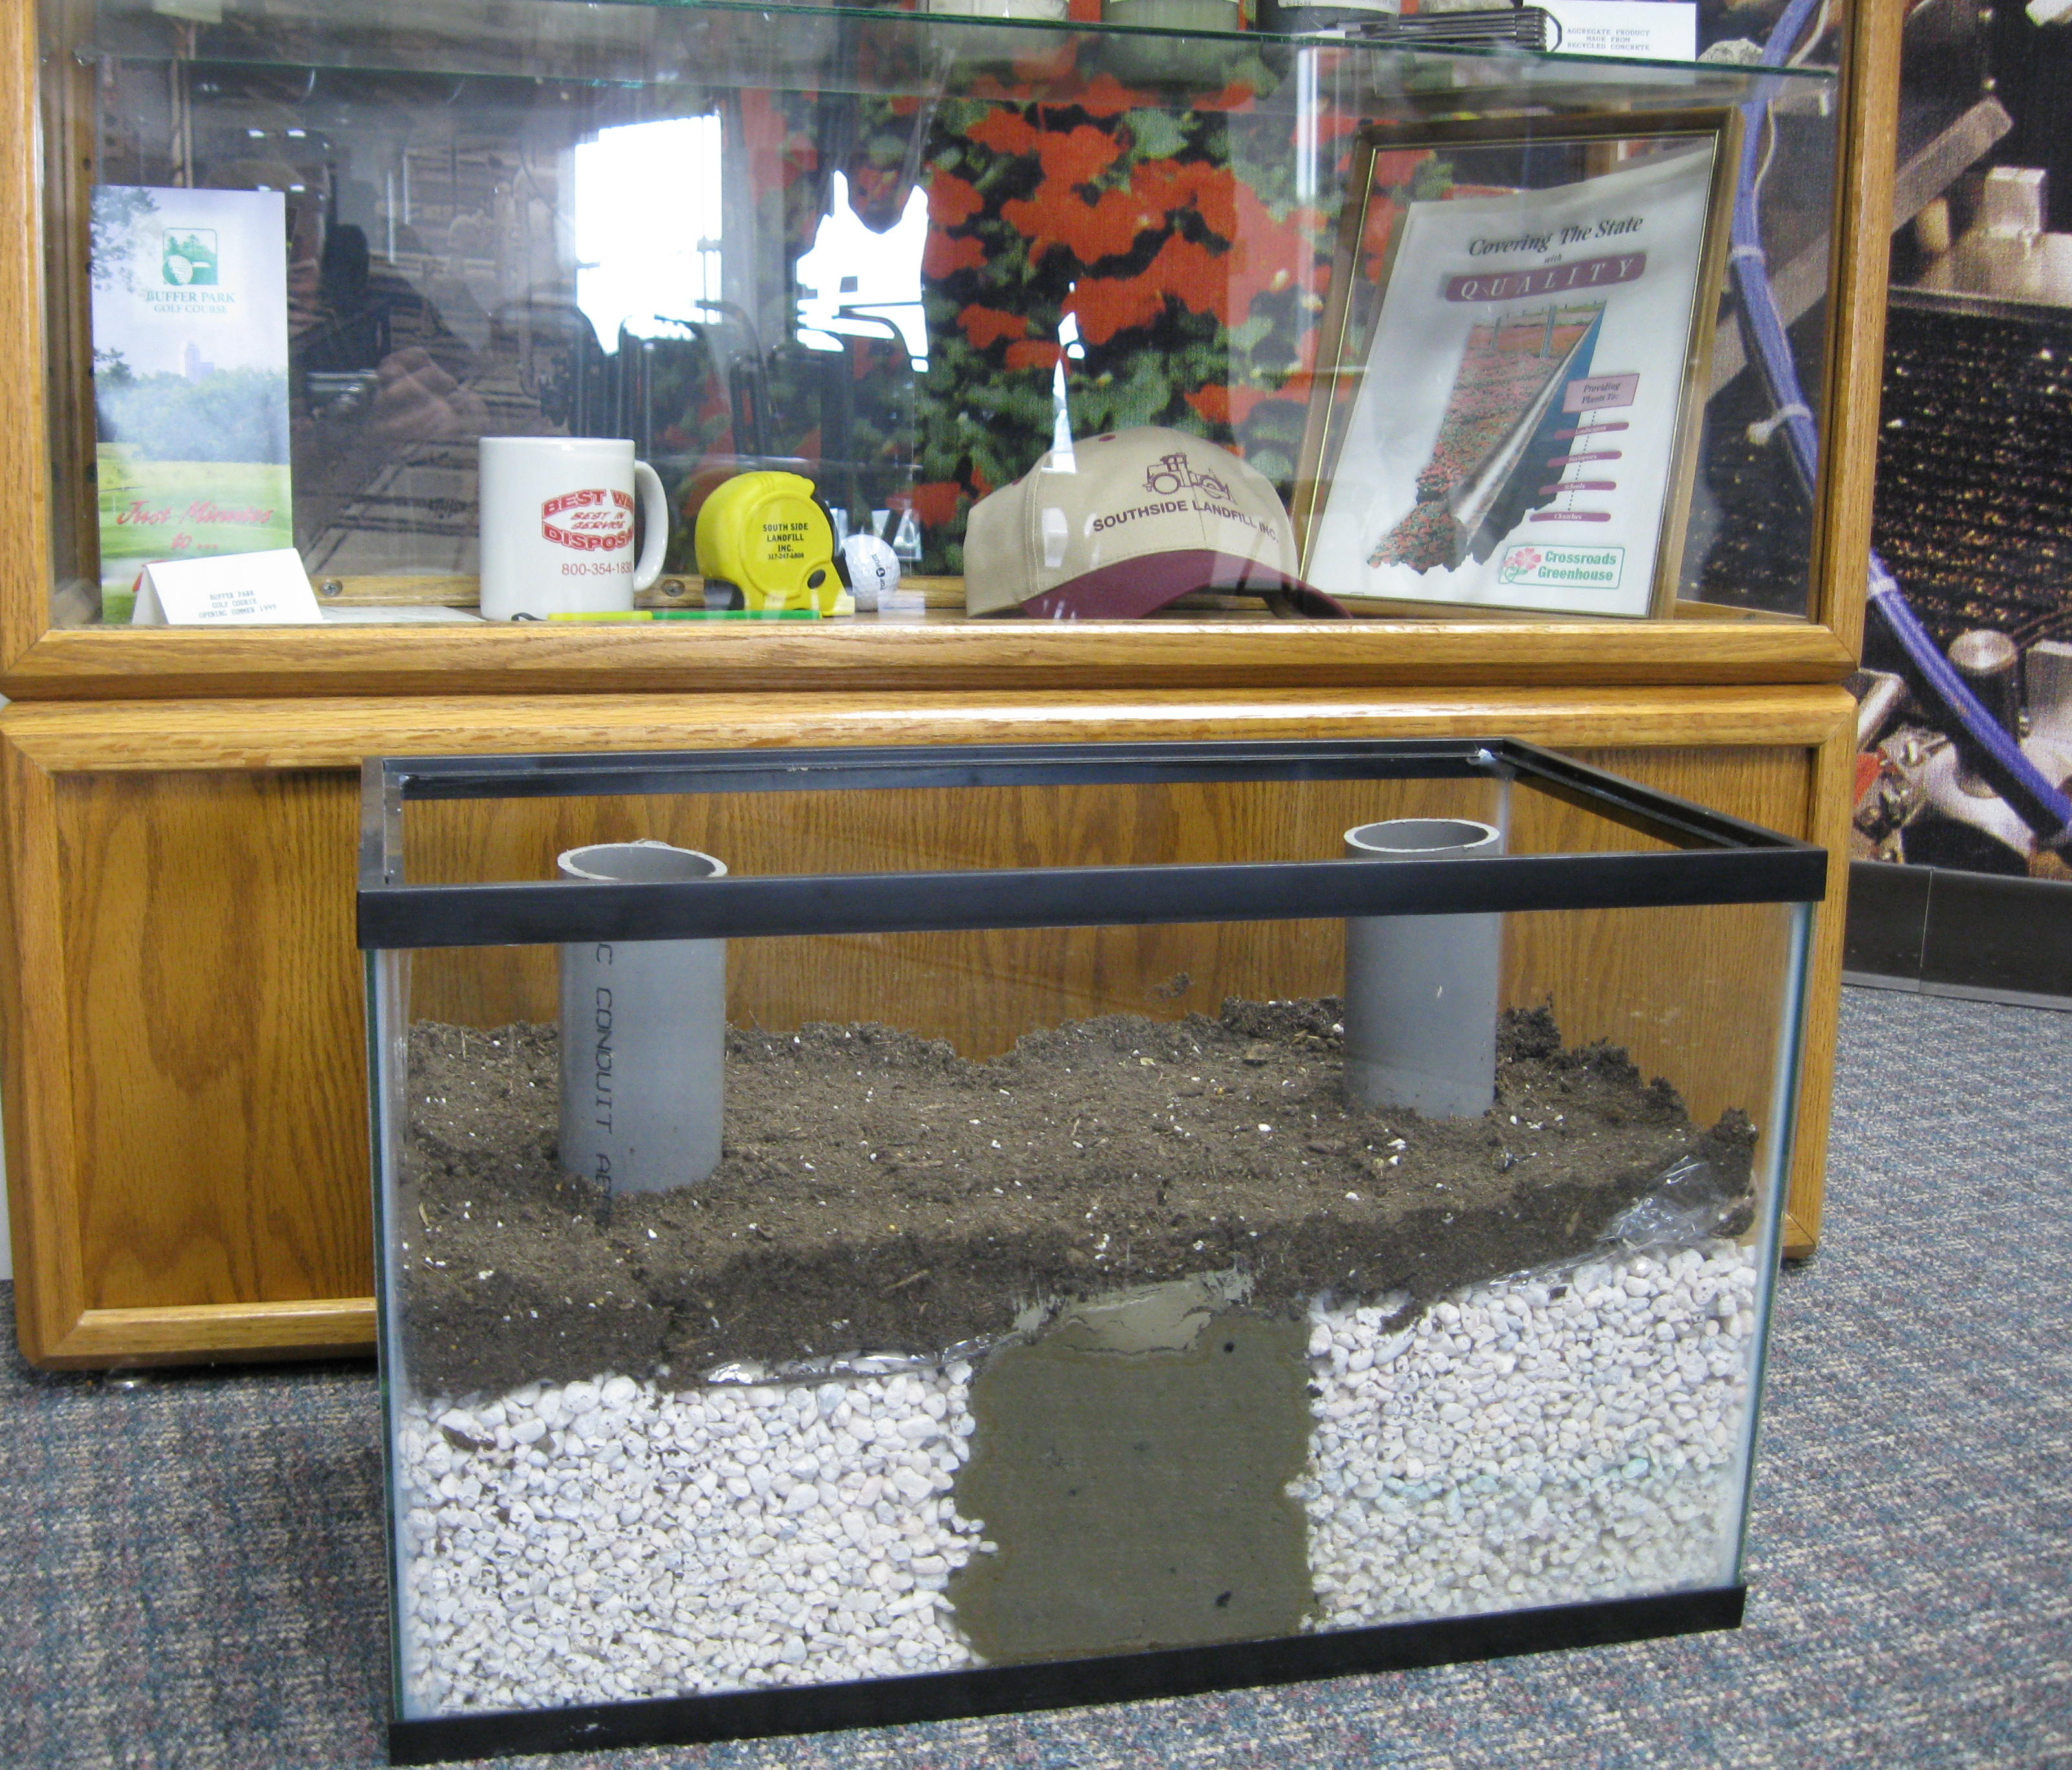
Educational Reuse
Notes:
The alternative energy uses of the site’s landfill gas provide an excellent learning opportunity for local schools. In 2003, the landfill donated land on the site for use by the Indianapolis School Board for outside environmental education. SSL provides educational tours to approximately 6,000 individuals every year. The vast majority of those are local students (3rd grade and above), but they also host university classes, civic groups, and even large numbers of the FFA conventioneers.
A tour typically lasts about 1-1/2 hours and begins with a 25 minute video that describes landfills in general as well as many features that are specific to South Side Landfill in particular. The video also describes many of the features of the Crossroads Greenhouse. After the video, groups are taken on a driving tour of the landfill (weather permitting). At the conclusion of the driving tour there is a walkthrough tour of the Crossroads Greenhouse.
Local school classes take fieldtrip tours as part of their science and civics curriculum to experience the three “Rs” -- Reduce, Reuse and Recycle -- in action. This course, which was developed at the site, helps area teachers incorporate landfill science into their curriculum. In light of budget cuts to local schools, SSL has even developed classroom activities, puzzles and games that teachers can use in the classroom when resources aren’t available to take students on field trips.

Slide 20
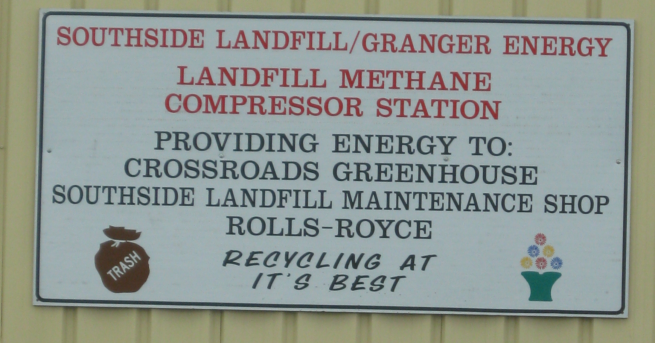
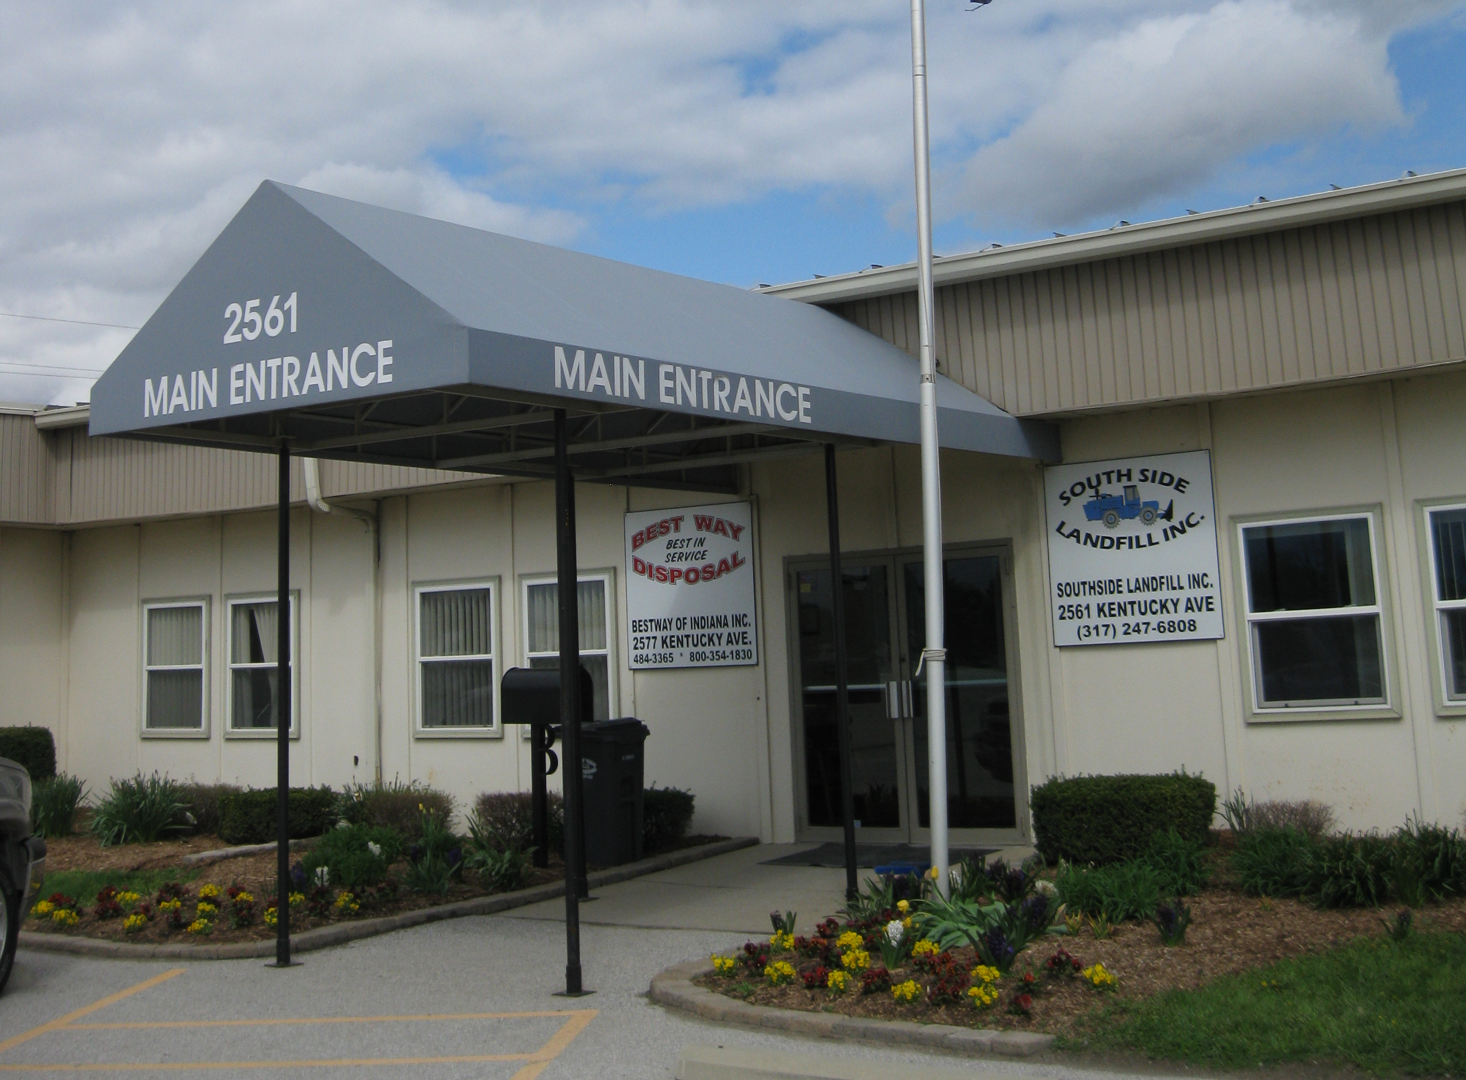
Impacts by the Numbers
Notes:
A few years ago, the Superfund Redevelopment Initiative took a look at the economic impacts of the site and here is what we found. The numbers really show the impact that this site has had on the community.
Crossroads Greenhouse generates more than $530,000 in annual sales, employs eight people and contributes approximately $196,000 in employment income to the community annually.
Buffer Park Golf Course generates approximately $500,000 annually in revenue, employs around 20 people and contributes approximately $366,000 in employment income to the community.
SSL employs approximately 25 people a year, supplying approximately $860,000 in annual income to the community.
The landfill receives 900,000 tons of waste per year.
[Note to Tom – numbers are rounded down for cautionary purposes since they are a few years old – 2011 econ case study]

Slide 21
Lessons Learned
Open lines of communication throughout process
Consider on-site resources for both site operation purposes as well as commercial or public uses
Bring reuse discussions to the table early
Pride in reuse can lead to educational opportunities
Notes:
There are a lot of take home points from the redevelopment of the Southside Sanitary Landfill. The reuses are diverse and benefit the community in so many ways. Site operations now provide educational, recreational, industrial and commercial opportunities.
One of the first things I want to highlight is the importance of communicating throughout the process. The site remained in continued use throughout the cleanup process and that requires coordinating between those trying to cleanup the site, those that are trying to operate and then lastly the agencies that are responsible for monitoring and regulating the site’s cleanup.
Many sites simply flare off landfill gases and don’t think about harnessing it for use. But at sites like this where there is ongoing landfilling, and thus a steady supply for developing landfill gas, it is a valuable resource and the site stakeholders recognized its value for heating on-site buildings and powering the landfill’s liquid pumping system as well as commercial purposes.
It is ideal to bring reuse discussions to the table early. The first reuse effort at the site took place while EPA was finalizing the Site on the NPL. It’s never too early to consider reuse opportunities, especially since reasonably anticipated future land uses should play a role in selecting the remedy for a site.
And lastly, I think it is pretty clear that SSL is extremely proud of what they have accomplished here. And they are eager to share their story and experiences with others, even finding creative ways in to incorporate landfill science and teaching about the site cleanup and reuse in area schools.

Slide 22
Contact
Tom Bloom
312-886-1967
bloom.thomas@epa.gov
Notes:
Please feel free to contact me with any questions about SSL, Region 5 reuse or anything else I can help you with.
Next up will be Rob Stites from Region 8.

