Slide 1
Exploring Recreational and Educational Opportunities at the Picayune Wood Treating Site
Michele Mahoney,
EPA TIFSD
Notes:
Thanks, Melissa. And thank you to everyone for joining us today. I am very glad to be here. My name is Michele Mahoney and I work at headquarters in EPA’s Technology Innovation and Field Services Division, or TIFSD.
TIFSD supports the Superfund Program as well as other EPA programs including the Office of Solid Waste, Office of Emergency Management, Office of Underground Storage Tanks, and Office of Brownfields Cleanup and Redevelopment. We also partner with other federal and international agencies, other countries, and state, tribal, local, and private organizations to improve site remediation practices. I deal specifically with providing tools and support to RPMs and OSCs related to ecological revitalization. As Melissa mentioned earlier, many sites where ecological revitalization has taken place lend themselves well to recreational and educational reuse components as well.

Slide 2
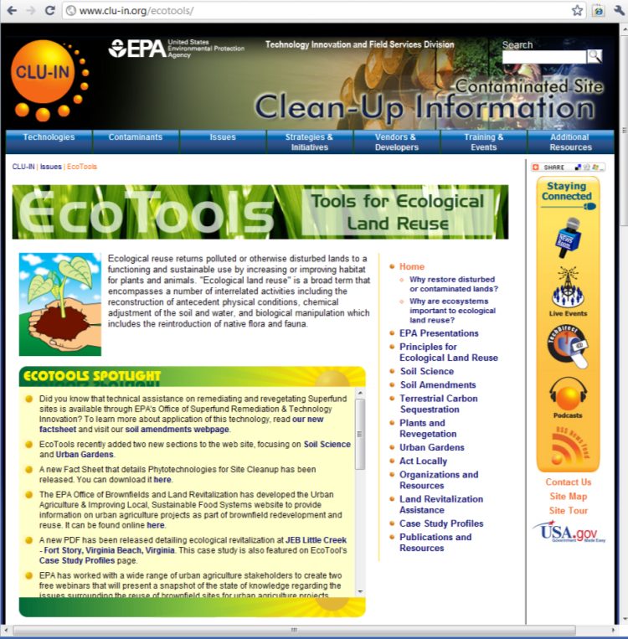
TIFSD Tools and Support
Technical Assistance
Information exchange (Eco-Forum)
Reuse planning
Eco-curriculum
http://www.cluin.org/ecotools
Notes:
Much of the technical assistance that TIFSD provides focuses on site remedial components. But don’t forget that, as Melissa mentioned before, the agency as a whole has a priority to consider reuse throughout the cleanup process. This means that the technical aspects of how a remedy is designed play a key part in future site reuse. A great place to find all of TIFSD’s eco-tools is on our eco-tools webpage (pictured here)
Three major ways that we provide technical assistance for ecological revitalization and reuse of sites is through information exchange in “Eco-Forums”, reuse planning and an educational eco-curriculum. These tools and support are done through interagency agreements, at a regional level, and directly with site stakeholders. Interagency agreements allow for us to bring experts on technical aspects of remedies to the table during reuse discussions with RPMs and site stakeholders. We can also provide support directly to RPMs and OSCs. I would like to briefly touch on each of these and provide you with some examples of these tools in action.

Slide 3
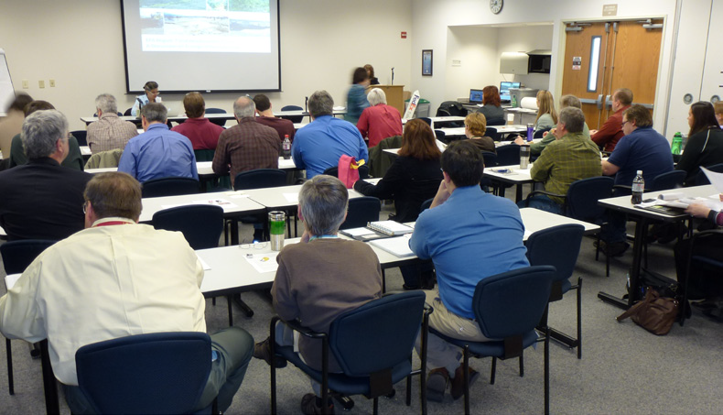
Eco-Forum
Day-long forum
Brings together EPA headquarters staff from TIFSD, EPA regional staff, and other federal and state agency personnel
Notes:
The Eco-Forums are held at a regional level and provide the opportunity to integrate reuse into the remedy discussion. TIFSD, EPA regional staff and other agency personnel to meet together to discuss agency and regional priorities related to ecological revitalization at sites in the Region, which can tie nicely into considering whether these sites can provide playing and learning opportunities as well.
TIFSD’s Ecological Revitalization Forum (Eco Forum) is a day-long event:
interactive activities
innovative dialogue
panel discussions
Goals
Advancements in ecological revitalization
Strengthen internal relationships
Tailored to region-specific needs and priorities
Variety of participants and speakers; sessions may include industry professionals or topic-area experts from –
EPA (Superfund Director, branch chiefs, remedial project managers, on-scene coordinators, risk assessors, regional counsel, SRI Coordinator and other regional staff); or state agencies, federal agencies, industry professionals, academic institutions
Whether discussing general ecological revitalization topics or specific technical approaches, the forum also provides an opportunity to integrate reuse into the remedy discussion, perhaps even to facilitate recreational and educational reuse at sites down the road. The region can consider innovative cleanup techniques that could be implemented at sites and then how these techniques could not only address contamination at the site but also provide an educational component of how cleanup works.
Each forum shares a number of site-specific case studies with real-world examples to get participants thinking about their own sites.
If we are considering site reuse throughout all stages of the cleanup process, each of these topics can tie directly into reuse planning and considerations for site reuse. We have held eco-forums in Region 7 and Region 9 and are currently planning one for Region 5. We would love to hear from you if you are interested in learning more about these forums.
Pictured: Eco-Forum held in Region 7 in November 2012

Slide 4
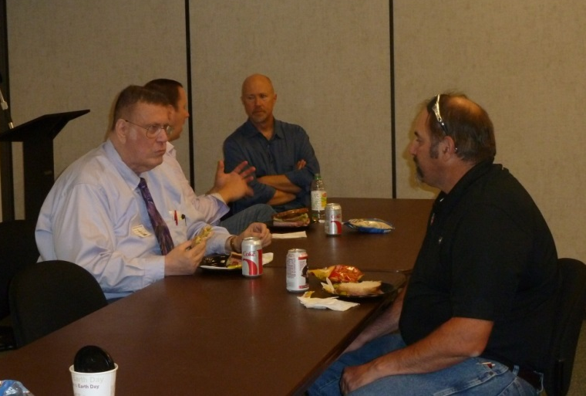
Example Forum Outcomes
Increased knowledge and understanding of ecological revitalization and science behind decision-making
Continuous Learning Points (CLPs)
Participants identified sites needing site-specific support from TIFSD
“An excellent method for information-sharing – a way to learn about other studies regarding topics of interest that span across the country.”
-Region 9 Eco-Forum Participant
Notes:
Our forums have resulted in very positive feedback. Some of the outcomes are listed here. Items not listed on the slide include:
Follow-up webinars hosted to share ideas with national audience
Strengthening of regional collaboration as well as collaboration across Regions and with Headquarters
Participants brainstormed in-situ remediation options for several site-specific settings with site managers
The Region 7 eco-forum focused on providing an overview of ecological revitalization and reuse through a series of case study sites. The Region 9 eco-forum provided in-depth technical information regarding soil amendments on large mining sites in the region. TIFSD was able to bring in technical experts in the area of soil amendment to discuss with RPMs how soil amendments could be implemented and benefits sites from the remedy phase to the reuse phase.

Slide 5
Reuse Planning
Steps for Planning & Implementation
Determine pre-disturbance and reference conditions
Conduct a property inventory
Establish revitalization goals and objectives
Evaluate revitalization alternatives
Develop a property-specific ecological design
Prepare specifications for construction contractors
Construct habitat features
Conduct maintenance and monitoring activities
Notes:
Next, we have reuse planning. TIFSD can help RPMs and site stakeholders consider the opportunities for planning and carrying out ecological revitalization projects during the cleanup process. Planning for specific recreational or educational elements related to the ecological revitalization or reuse of a property can also be conducted.
Here are some general steps taken when planning and carrying out ecological revitalization projects during cleanup.
Determine pre-disturbance conditions as a reference to use in planning ecological revitalization work.
A property inventory provides a baseline ecological inventory of biodiversity at a site, including species composition and vegetative community structure, which can be used to guide ecological revitalization planning.
In some cases, appropriately designed ecological revitalization may be self-sustaining and require little or no maintenance after the initial establishment period. In most cases, though, O&M will be required and depend on the type of cleanup as well as the ecological revitalization component. O&M typically includes inspection, sampling and analysis, routine maintenance and small repairs, and reporting, as necessary.
Several of these steps are key if additional recreational or education reuse components are being considered:
Develop a property-specific ecological design
Prepare specifications for construction contractors
Construct habitat features
The following steps could also tie into educational components at the site:
pre-disturbance and reference conditions
maintenance and monitoring activities

Slide 6
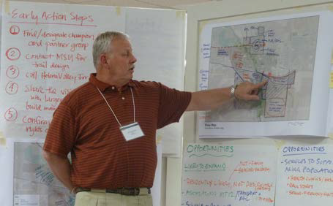
East Helena, MT, Region 8
TIFSD Technical Assistance
On-site consultation
Day-long charrette
Soil sampling via inter-agency agreement
SRI Regional Funding
Develop a vision for redevelopment
Reuse Planning Goals
Land use
Cultural heritage
Habitat and recreation
Notes:
The East Helena site in Montana, Region 8, is an excellent example of TIFSD technical assistance and reuse planning in action. It also demonstrates how TIFSD and SRI work together to support reuse.
TIFSD provided technical assistance:
On-site consultation
Participation in day-long charrette to integrate technical expertise into remedy and reuse considerations
Soil sampling via inter-agency agreement
SRI provided planning support and regional funding:
Develop a vision for redevelopment
The goals were of the reuse planning project were:
Land Use: Identify a vision for growth in East Helena that considers the undeveloped land annexed in 2009.
Cultural Heritage: Develop a vision for the former Plant Manager’s property that serves as a catalyst for celebrating East Helena’s history and cultural heritage -- participants expressed interest in developing a heritage museum to showcase the area’s history, establishing additional recreational spaces and natural heritage spaces, such as outdoor classrooms and environmental education opportunities.
Habitat and Recreation: Identify habitat restoration and recreational opportunities around the Prickly Pear Creek -- the consultants and the community identified strategies to create a regional trail network that would build off the Prickly Pear Creek corridor, connecting East Helena to regional recreational destinations and looked for ways to connect local schools with outdoor learning activities.
NEED CURRENT STATUS or RESULT OF PROJECT

Slide 7
GM Massena, NY, Region 2
Reuse Plan
TIFSD Technical Assistance
SRI Regional Funding
EPA Region 2 Funding
Explored several reuse scenarios, including a tourism center with trails and habitat restoration
Notes:
In 2010, EPA Region 2, SRI and TIFSD sponsored a reuse assessment for the GM Massena Site to clarify reuse goals, identify potential future uses for the site that are consistent with the proposed cleanup, and to facilitate discussion regarding ownership and long-term stewardship options.
The reuse assessment determined the Site could accommodate a mix of commercial, industrial, tourism-related uses and open space for public use that could be phased in over time. Facilitators worked with stakeholders to develop various scenarios for the site property, one of which included a tourism center with trails and habitat restoration enhancing access to the St. Lawrence River and the capped landfill.
The reuse assessment also provided the community, local government and site stakeholders with a set of recommendations to best facilitate the successful redevelopment of the Site through available public and private funds.
As a result, in 2011, St. Lawrence County and the Town of Massena submitted an application to the BOA program requesting funding assistance for redevelopment efforts and sharing the reuse scenarios explored in the reuse assessment. In 2012, New York’s BOA program awarded a $360,000 brownfield grant to the North Country Redevelopment Task Force that will be used to conduct market and infrastructure feasibility studies and create a redevelopment plan for the property.
Between the lessons learned through the reuse assessment and securing key resources to prepare a redevelopment plan for the Site, the stage has been set for successful redevelopment with coordinated efforts between the local community, all levels of government and the property owner, and the site is now on the market.

Slide 8
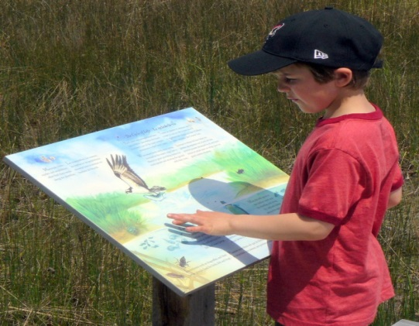
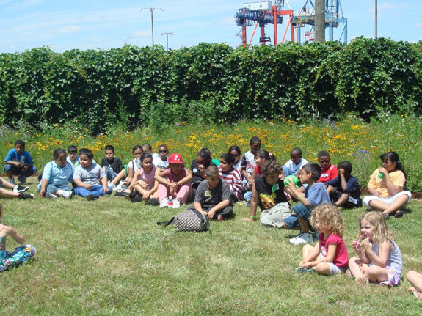
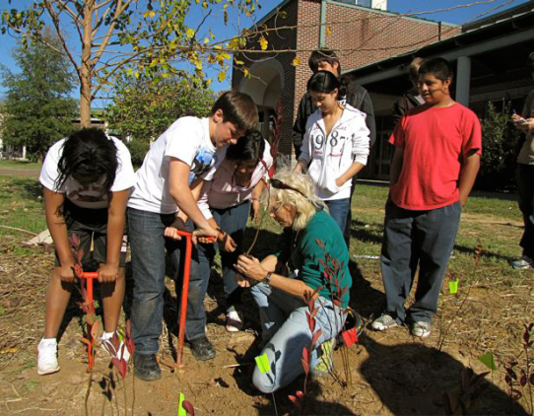
Eco-Curriculum
Integrate the scientific aspects of cleanup and remedial components
Tailored to site-specific features and school board priorities
Builds on existing EPA educational materials
Notes:
Finally, TIFSD has recently created a eco-curriculum framework that can help integrate the scientific aspects of cleanup and remedial components into a curriculum for local schools. Possible activities as part of this eco-curriculum can vary depending on the site and the types of ecological revitalization and reuse. The activities can highlight ecological topics and supplement existing EPA curricula. EPA offers a variety of educational materials for students of all ages and their teachers. The learning series as part of a site’s eco-curriculum could build from existing EPA Superfund classroom activities and environmental education lesson plans.
TIFSD has sponsored a pilot project to develop a Superfund environmental education curriculum for the elementary school adjacent to the Picayune Wood Treating Superfund site in Mississippi, Region 4. I would like to take my remaining time today to give you an in-depth look at this site and the eco-curriculum pilot project.
Pictured: examples of outdoor classrooms and learning opportunities

Slide 9
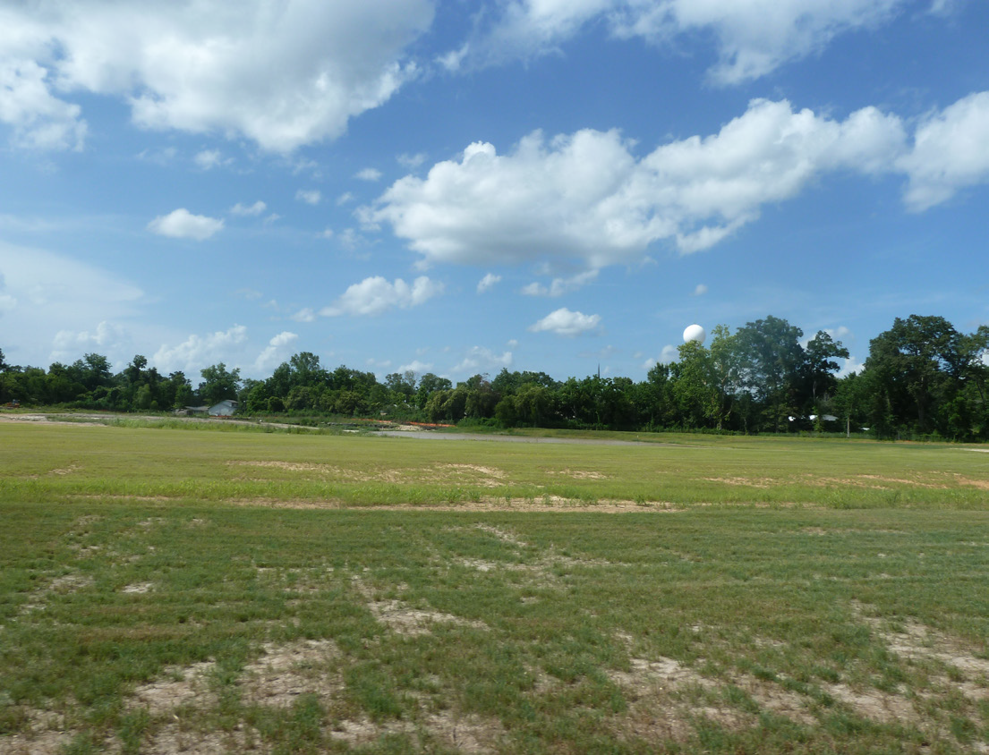
In-Depth Case Study: Picayune Wood Treating site
Notes:
The 32-acre Picayune Wood Treating Superfund site is located in Picayune, Mississippi. Various timber and lumber-related operations took place at the site from the early 1900s until 1999. Since the site’s listing on the NPL in 2004, EPA and the Mississippi Department of Environmental Quality (MDEQ) have investigated site conditions and taken steps to clean up the site in order to protect people and the environment from contamination. EPA has excavated contaminated soil identified on residential properties near the site and placed the soil in a fenced area on site.
In 2005, SRI supported a reuse planning assessment for the site. Soil cleanup was completed in 2013 and EPA sponsored a second planning process to update the future use plan. As part of this update, stakeholders identified a number of short-term and long-term action steps to transition the site into reuse.
Pictured: a view of a portion of the site that could provide forest and wetland trail opportunities

Slide 10
Site Boundaries and Surrounding Land Use
Notes:
The site consists mostly of flat, undeveloped land. Active manufacturing and light industrial facilities border the site to the north; an elementary school, residential community, vacant land and a small community park border the site to the south. The site is in close proximity to downtown. Currently, the primary site access is via Davis Street.

Slide 11
Remedial Features
Notes:
The map here highlights the remedial features that need to be considered during reuse planning and implementation. In addition to the remedial components, land use restrictions will be placed on the effected properties to ensure the remedial components stay protected and to prohibit residential use and ground water access.

Slide 12
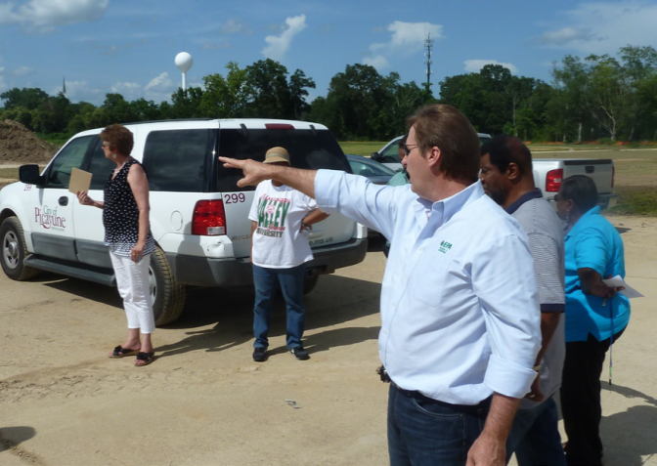
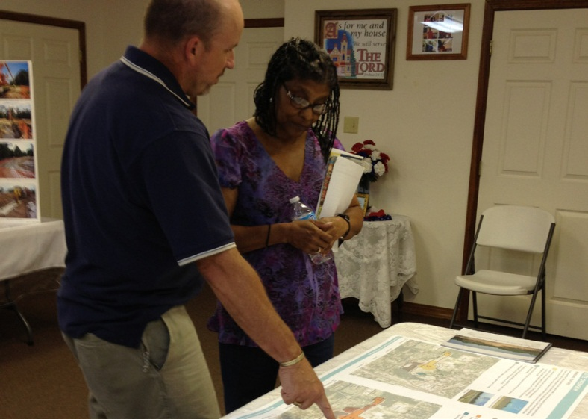
Reuse Planning Process
2005: initial reuse planning assessment
2013: updated future use plan
Site tour
Working session
Public availability session
Notes:
In 2005, SRI supported a reuse planning assessment for the site.
In 2013, following the completion of soil cleanup activities, a second planning process was initiated to update the future use plan based on the remedial features at the site, community goals and the surrounding land uses.
To initiate the planning process, a site visit was conducted in January 2013 to tour the site and identify local reuse goals. A working session was held in June 2013 with city staff and elected officials to review a draft suitability assessment, refine a reuse framework, identify potential funding sources and refine a Superfund environmental education curriculum.
In July 2013, EPA hosted a public availability session to answer questions about the site cleanup and solicit input on the revised reuse framework. The framework reflects the ideas and recommendations of city staff, elected officials and community members and is provided as a tool for returning the site to a safe and productive use. This framework offers a flexible, long-term planning tool that can be adapted as new information becomes available.
Pictured: various stakeholder and community meetings during the planning process

Slide 13
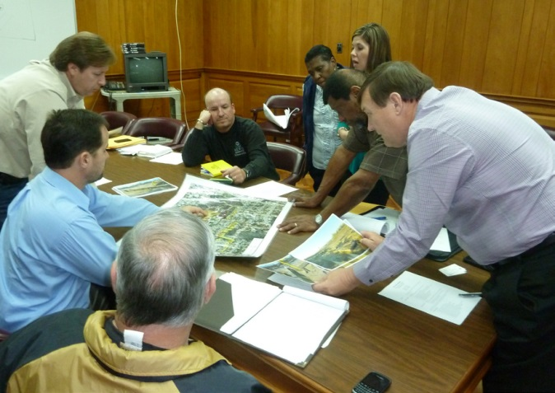
Reuse Priorities
Access and Circulation
Community Hub
Open Space and Environmental Education
Notes:
In January 2013, City representatives expressed interest in acquiring ownership of the site from the State. During the working session in June 2013, city staff and stakeholders identified the these goals to guide future use planning for the site.
Access and Circulation:
Improve pedestrian access between South Side Elementary school and site.
Ensure school access to the site is secure and public access is restricted during school hours and activities
Enhance pedestrian and vehicular access at Davis Street site entrance.
Improve connectivity through on-site, well-lit biking and walking trails.
Increase connectivity to downtown and Main Street.
Community Hub:
Support community activities and programs—community center, pool, splash pad, farmer’s market, outdoor amphitheater and gathering and play spaces.
A community center could provide activities and programs for youth, indoor theater, computer room and all-purpose rooms.
Recreational features could include soccer fields, basketball courts, dog park, skateboard park and disc golf.
Explore locating school facilities and activities on western portion of site property.
Incorporate heritage tourism opportunities, such as interpretive kiosks and walking trails celebrating the area’s history.
Open Space and Environmental Education:
Enhance and connect recreational opportunities through trails, gathering areas and habitat viewing areas.
Provide educational opportunities for school children, such as learning-oriented playground, outdoor lab space, covered amphitheater or meeting area for outside lessons and shaded teaching area.
Provide public environmental education programs, such as signage and themed nature walks.
Support and promote eco-tourism opportunities.
Provide community gardening opportunities.

Slide 14
Reuse Concept Plan
Notes:
The reuse planning process at the site has resulted in the development of the concept plan that you see here.
The plan illustrates how the reuse goals could be integrated on the site to align with remedial considerations and other site characteristics. Once implemented, this concept plan will benefit the community by providing recreational and community amenities that connect the site to downtown and surrounding neighborhoods. The future use of the adjacent Valspar property (currently for sale) may present additional opportunities for supporting the reuse concept plan goals.

Slide 15
Incorporating Educational Components
Educational Amenities
Leaning-oriented playground
Outdoor lab space for soil and water collection
Covered amphitheater or meeting area for outside lessons and shaded teaching area
Possible eco-curriculum activities:
Soil study
Water study
Butterfly study
Raised bed gardening study
Benefit study
Bird study
Reuse and recovery in motion
Notes:
One major stakeholder focus for the site is the environmental education reuse component.
Due to its location adjacent to the South Side Elementary School, the site could offer a unique outdoor classroom opportunity where students could experience hands-on learning about environmental issues.
TIFSD has been able to supplement SRI’s 2014 regional seed by providing technical assistance to develop the environmental education curriculum for the site and local schools. EPA has discussed potential environmental educational learning ideas and considerations with Picayune School Board and South Side Elementary School staff. An outline curriculum was developed based on existing EPA curricula and Mississippi Common Core standards and has been updated based on input and ideas from the school board.
Possible educational activities will cover ecological aspects of the site area as well as the site history, cleanup and reuse of the site from a Superfund perspective.

Slide 16
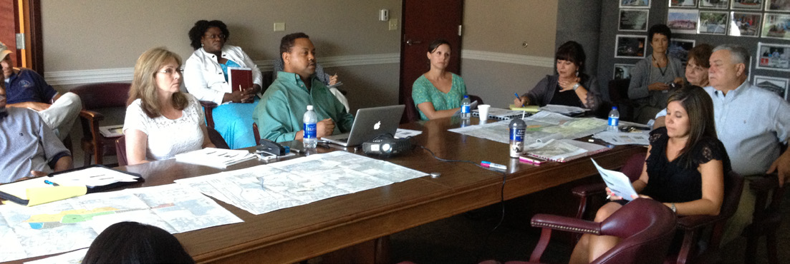
Next Steps
Continued reuse planning and coordination
Early reuse phasing
Later reuse phasing
TIFSD’s national eco-curriculum tool
Notes:
Site stakeholders identified a number of near-term and long-term action steps for the site at the working session in 2013. Currently, the State and City are working to transfer ownership of the site to the City.
Other action steps include continued coordination for the planning and development of the educational components for the site and associate eco-curriculum, defining site maintenance roles and responsibilities, placing institutional controls on the property, identification of funding opportunities, and exploration of opportunities for site-adjacent properties.
Early reuse implementation could focus on improving site access from Davis Street, Main Street and downtown; connecting and enhancing open space and environmental education opportunities on-site; and establishing short-term parking. Later phasing could include transforming surrounding to support community hub activities.
TIFSD is taking lessons learned from the site so far and developing a national eco-curriculum framework. This tool will support Superfund site stakeholders and maybe some of you as RPMs consider, plan and implement an environmental education component as part of ecological reuse or revitalization. When complete this national eco-curriculum framework will be available on the EcoTools website.

Slide 17
Contact Information
Michele Mahoney, TIFSD, EPA Headquarters
703-603-9057
mahoney.michele@epa.gov
http://clu-in.org/ecotools/default.cfm

