Slide 1
Interactions between Superfund and RCRA
Case Studies and Review

Slide 2
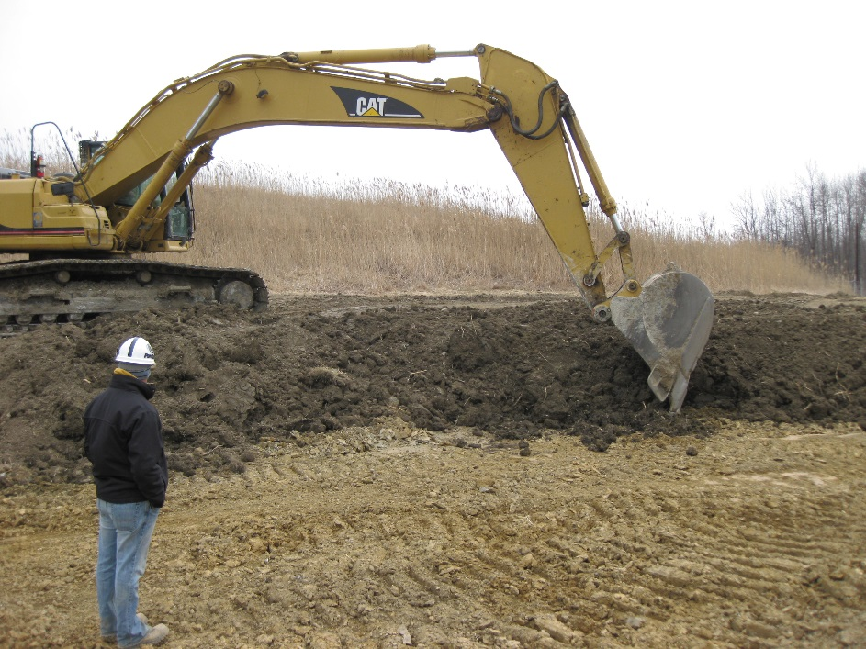
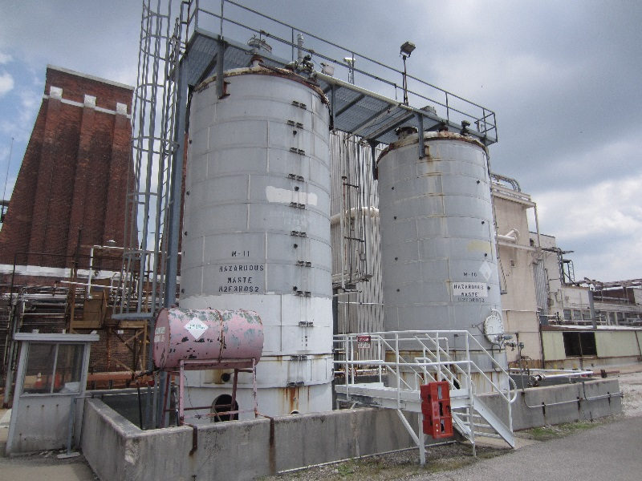
Goals
To inform Superfund RPMs, and others, of the RCRA process be it regulation, guidance or personal interactions between the programs.

Slide 3
Presenters
Mike Beedle – RCRA
John Fagiolo – Superfund RPM
Chris Black – RCRA Corrective Action PM
Carolyn Bury – RCRA Corrective Action PM

Slide 4
Mike Beedle
An Overview of the RCRA Regulations

