Slide 1
RCRA Corrective Action vs. CERCLA or
The Top 5 Misconceptions about RCRA Corrective Action
Christopher Black, RCRA CA PM
November 18, 2014

Slide 2
Misconceptions
#1 RCRA Corrective Action is a Compliance Program

Slide 3
REALITY

Slide 4
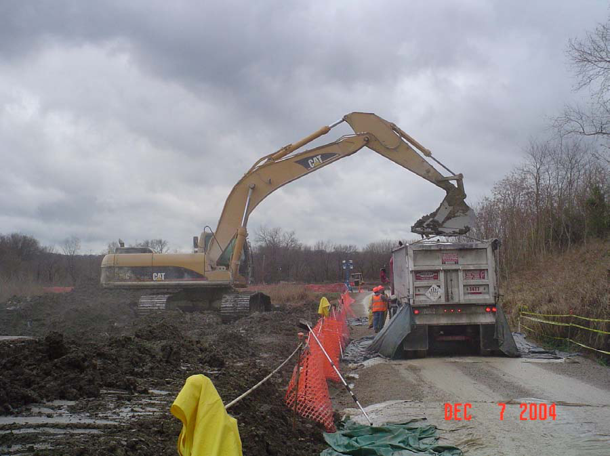
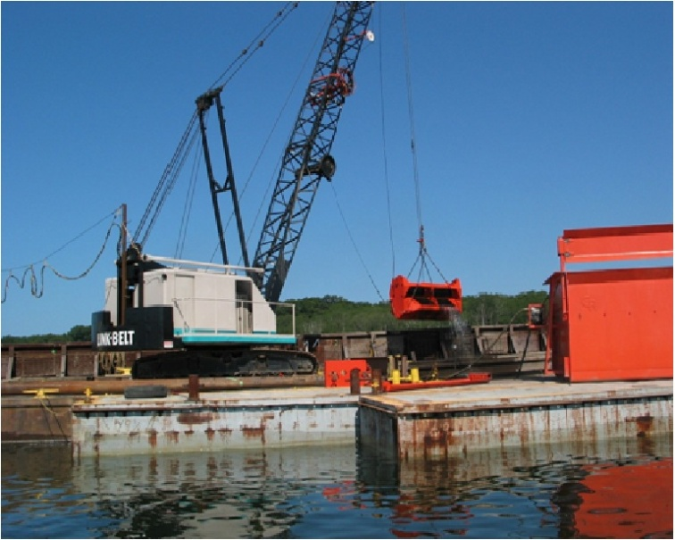
RCRA Corrective Action = Cleanup

Slide 5
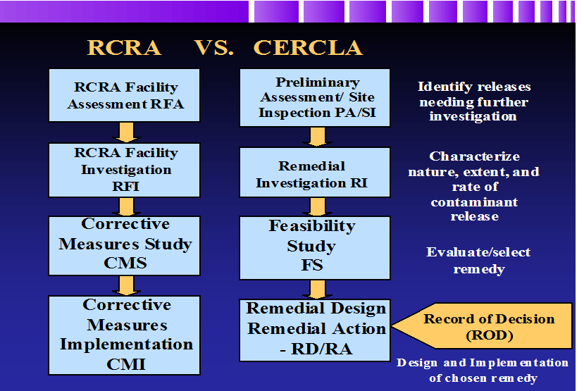
“We are doing the same thing”
Statement of Basis/Final Decision
Proposed Plan/Record of Decision

Slide 6
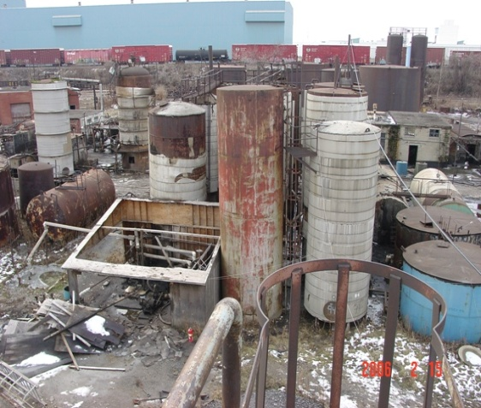
RCRA Corrective Action Authorities
Pre-HSWA Statutory Enforcement Authorities
1976 – Section 7003 provides judicial authority to compel any person to abate conditions that present an imminent and substantial endangerment to human health or the environment (CERCLA 106)
1980 – Section 3013 added - provides administrative authority to compel investigations

Slide 7
1984 RCRA HSWA
Corrective Action Authorities
Can happen through an Order or a Permit:
  Statutory Authority in RCRA - for Interim Status facilities – 3008(h) ~ Usually an Administrative Order on Consent (AOC)
  RCRA Permits issued after 11/8/84 include CA for releases from Solid Waste Management Units (SWMUs) at the facility - 3004(u)
  Requires the Owner/Operator (O/O) to perform CA on releases beyond the facility’s boundaries - 3004(v)

Slide 8
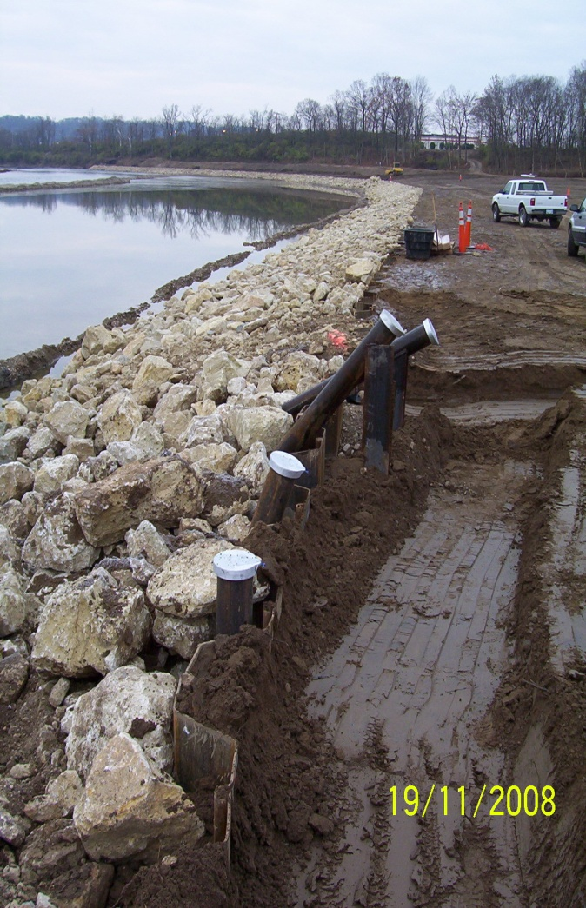
Similarities w/ CERCLA
Both Cleanups
Both Stepped Approach
Similar Technical Guidance
NPL vs. NCAPS
NCP vs. 1996 ANPR

Slide 9
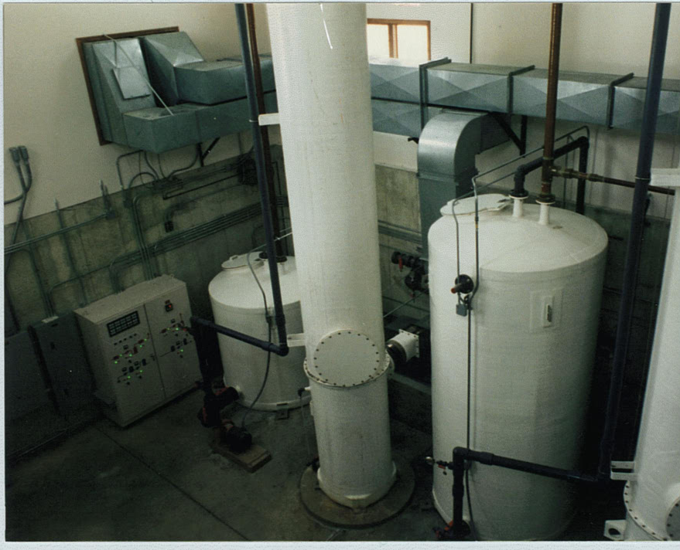
Differences w/ CERCLA
  Operating/Owned facilities (RCRA CA) vs. Abandoned (CERCLA)
Cost Recovery in CERCLA/ NO Cost Recovery in RCRA CA
  RCRA CA – facility pays for cleanup – No PRPs
  Training, Support, Contractor & FTE Resources greater in CERCLA

Slide 10
Misconceptions
#2 It just deals with RCRA Regulated Units

Slide 11
REALITY

Slide 12
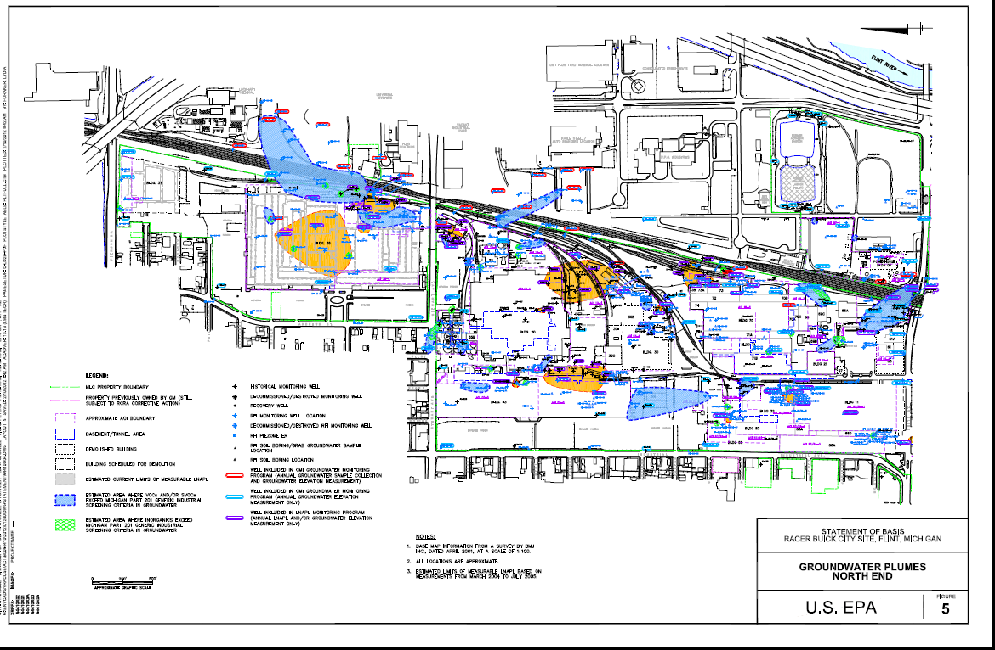
It’s Sitewide Remediation

Slide 13
Misconceptions
#3 It’s a small program

Slide 14
REALITY

Slide 15
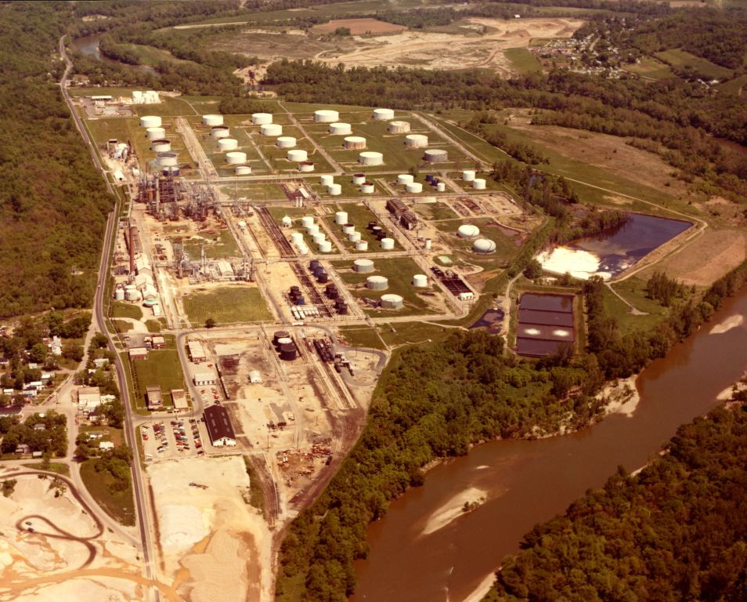
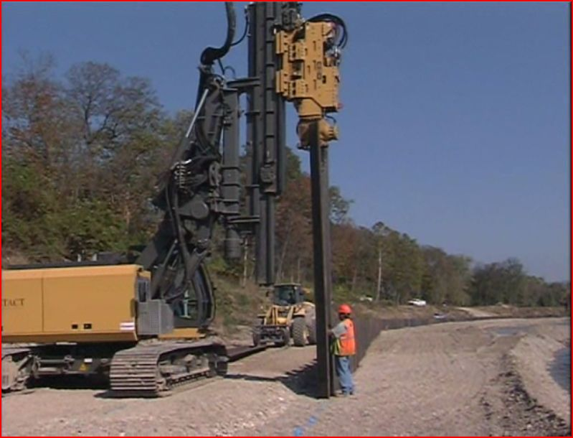
National Numbers
More than 6000 facilities subject to RCRA Corrective Action
3,747 (2020 List) facilities have Corrective Action already underway
1322 sites on the NPL (Final Sites)

Slide 16
Location of RCRA Corrective Action 2020 Sites

Slide 17
Misconceptions
#4 It’s all based on regulations

Slide 18
REALITY

Slide 19
Streamlined Approaches
Results Based Orders (negotiate the process)
Interim Measures, Short term and Long term goals for the remedies
Environmental Indicators for Human Health and Groundwater under Control

Slide 20
Misconceptions
#5 It doesn’t affect us

Slide 21
REALITY

Slide 22
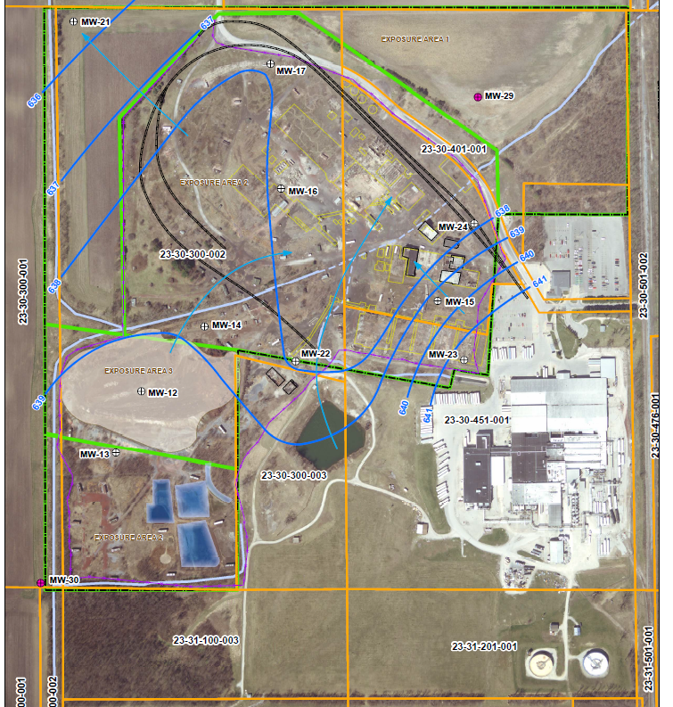
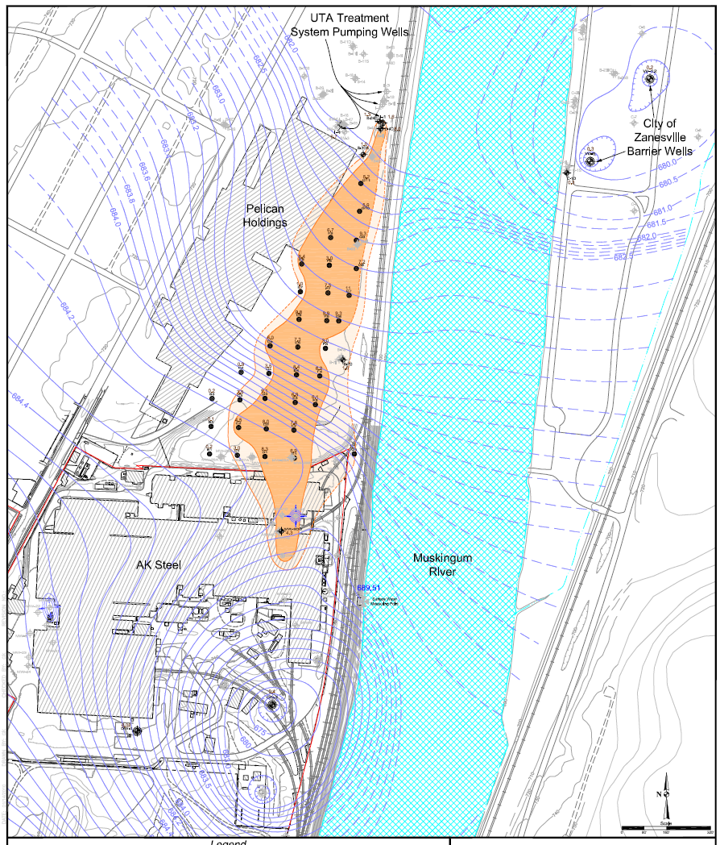
Mixed Plumes
Overlap of Cleanups
Program Differences can confound shared goals

Slide 23
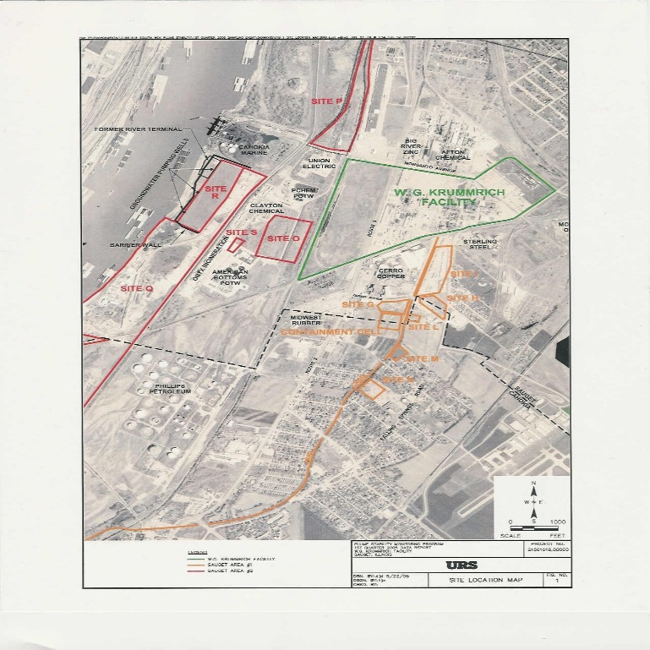
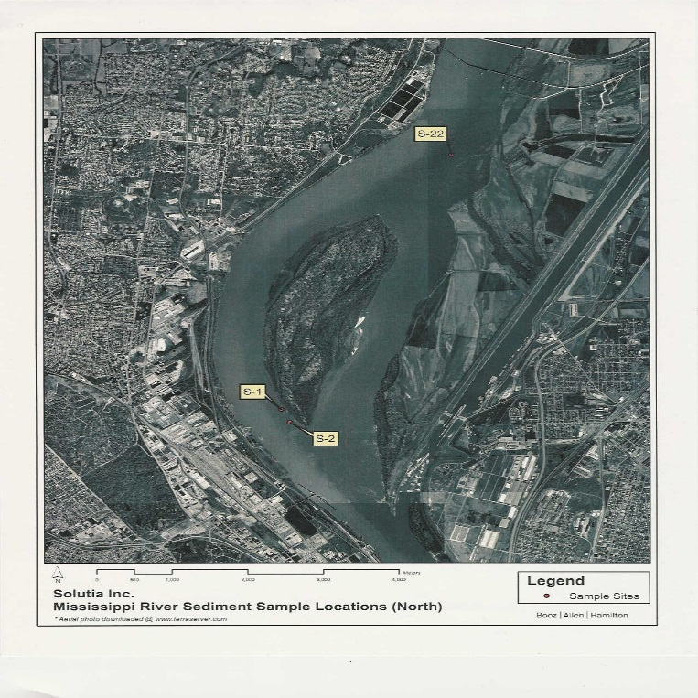
We can see some of these RCRA Corrective Action and Superfund overlapping Issues at the Solutia Site

