Slide 1
Superfund and Corrective Action
Case Study in Sauget, Cahokia, and East St. Louis, IL
Carolyn Bury
Project Manager
Corrective Action Region 5
November 18, 2014

Slide 2
Corrective Action (CA) Solutia and
SF Sauget Sites
Share :
One PRP/Respondent
Groundwater plumes
Current (and future?) remedies

Slide 3
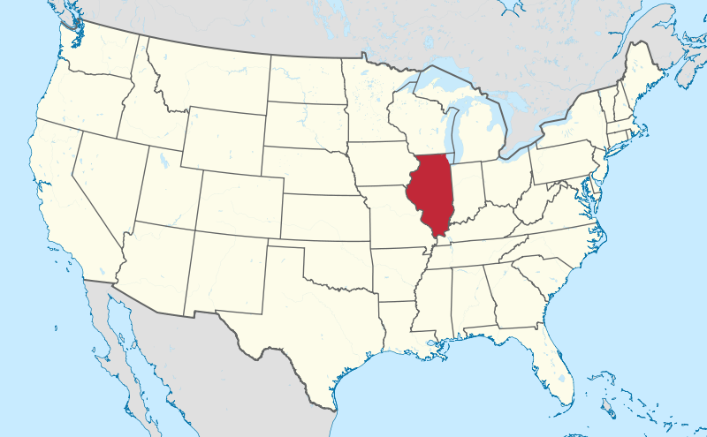
Illinois
Source: Wikipedia

Slide 4
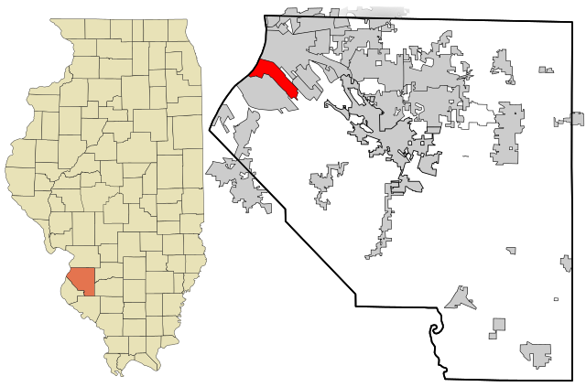
Mississippi River
Town of Sauget
Next to East St Louis and
Cahokia
St. Clair County
Source: Wikipedia

Slide 5
Solutia-Sauget Remedial Site
Town of Sauget and Sites Setting
Industrialized area – original town name “Monsanto”
Population of 250 – dominated by heavy industry
Sauget operates physical/chemical treatment plant (American Bottoms POTW) for industrial wastewater
(part of SF and CA remedy)
One of only three such municipal treatment plants in the U.S.
Mississippi River SF area adjacent, ½ mile away from Solutia.

Slide 6
Two Superfund Sites
Sauget Area One
= “Sauget”
Sauget Area Two
> 50 PRPs

Slide 7
One Corrective Action Site
Solutia’s W.G. Krummrich Plant =
“Solutia”

Slide 8
Solutia
Sauget Area 1
Sauget Area 2

Slide 9
Sources
Simple Conceptual Site Model
Significant plumes
Impacted Areas
Contaminated soil
Landfills
Waste piles
Operations releases
Dumping
Sludge lagoons
Drum disposal
NAPL
VOCS
PCBs
Mississippi River
Dead Creek
On-site aquifer
Off-site aquifer
On-site terrestrial
Off-site residential
Atmospheric deposition
PCBs
Contaminants
VOCs
SVOCs
PCBs
Metals
Pesticides
Petroleum products

Slide 10
Solutia: Shared PRP and Respondent/Owner Operator
Solutia is Sauget’s principal PRP of > 50 PRPs
Solutia is the sole Corrective Action Respondent

Slide 11
Why two masters?
Why Superfund:
Areas in Sauget and Cahokia heavily contaminated
Subject of CERCLA investigation
Lead had long toggled between State and Feds
Widespread contamination, many abandoned facilities, landfills, dumping, sludge lagoons
Dead Creek used for waste disposal
Mississippi River impacted by contaminated groundwater
Solutia was a responsible party
PRPs were issued a CERCLA Order in September 2002 requiring a groundwater remedy for the discharge to the Mississippi River

Slide 12
Why two masters?
Why Corrective Action:
Operating Facility w/ RCRA Permit
Solutia is a treatment, storage or disposal facility
Financially solvent facility
Under CA Administrative Order since 2000

Slide 13
Sauget Area 1
September 2013 ROD, short and long-term remedies
EPA became involved in the late 1980s when PCBs, pesticides, and metals found in sediments
Area 1 is source of plume migrating to Mississippi
Dead Creek Removal Action
Action based on human health and ecological risk
Construction of Judith Lane Landfill for removal materials (shared remedy)
Drainage improvements e.g. culvert replacement; partial creek liner
Landfill/Soil Selected Remedy
Consolidation and cover including landfills
NAPL removal and off-site disposal
Pulsed biosparging residual source treatment

Slide 14
Dead Creek 3.5 miles of completed removal action
72,000 cubic yards of sediment (some PCBs at TSCA levels)
Creek spans industrial, residential, commercial, agricultural and undeveloped areas
Shared remedy: Solutia shared responsibility for contamination

Slide 15
Sauget Area 2
January 2014 ROD
Industrial, municipal, and chemical wastes
Four landfills, four backfilled lagoons
Remedy:
Removal of 3,721 drums including in riverbank
17,000 tons of soil
Soil cap and cover
NAPL collection
Mississippi shoreline erosion
Institutional controls
PLUS …

Slide 16
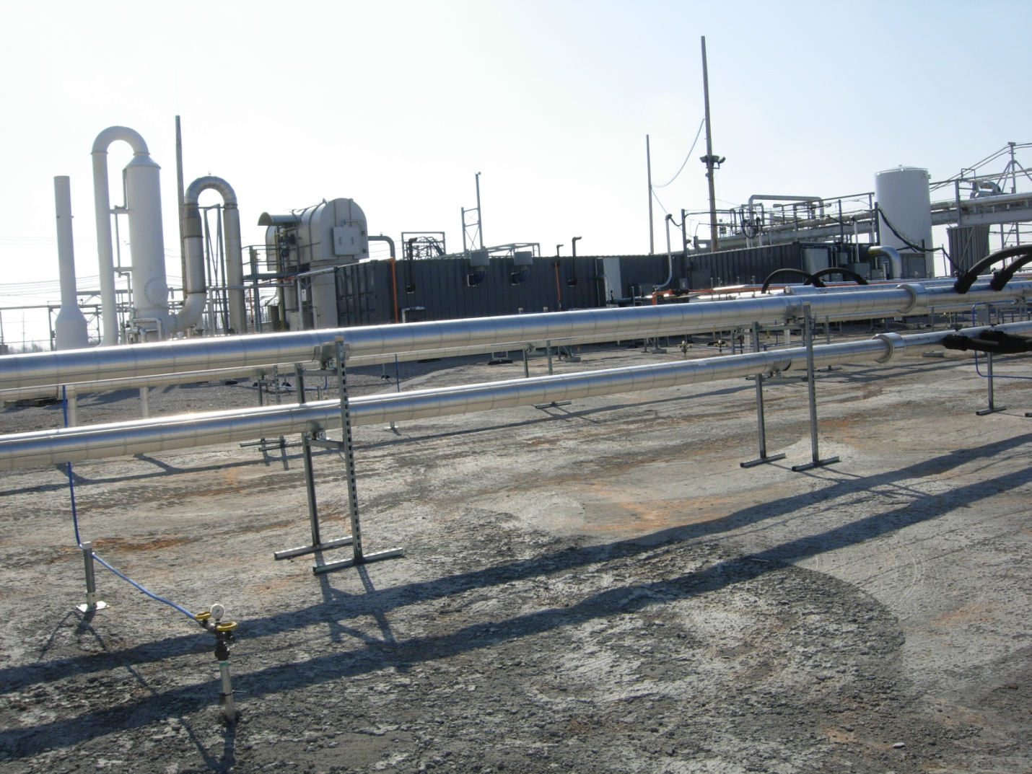
Groundwater: Source Control, Capture, Pump and Treat
Remedy (shared)
Chlorobenzenes, di-chlorobenzene
Soil Vapor Extraction System
In-Situ Thermal Desorption, field pilot
MNA
Barrier Wall (more later)
Groundwater quality assessment
PCB
Soil Excavation
Judith Lane Landfill – shared with Superfund
Barrier Wall – Shared with Superfund
Contingency remedy
Groundwater quality assessment

Slide 17
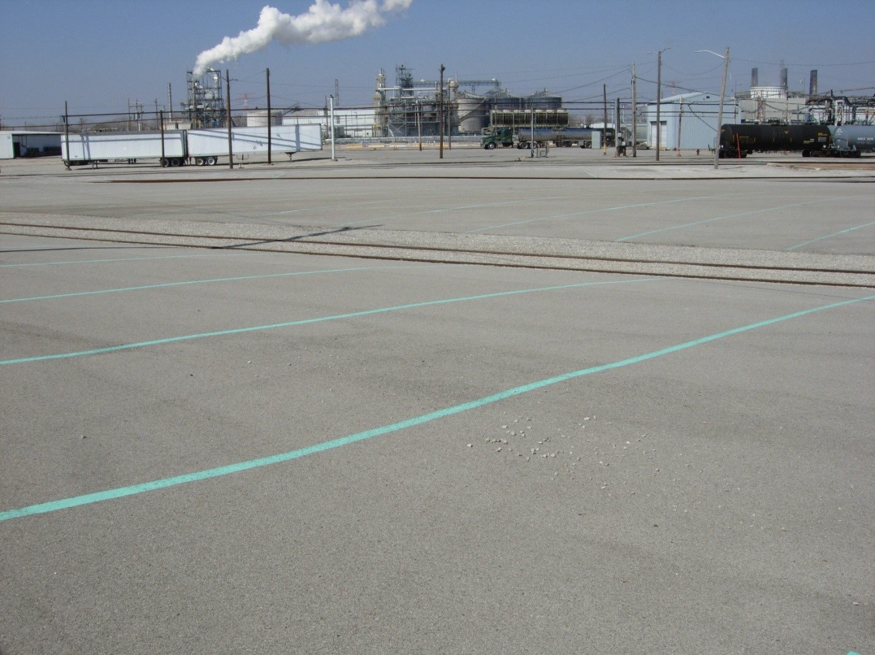
Solutia Site Background
Operating Chemical Manufacturer, ½ mile from Mississippi
Began in 1917 as Monsanto Company, Monsanto sold its chemical business (Solutia) in 1997

Slide 18
RCRA Consent Order in May 2000
Final Decision and Response to Comments 2008
Selected remedies for contaminated groundwater, soil, surface water, sediment, and indoor air
Remedial objectives based on human health and ecological risk assessment, IL TACO and IL WQS

Slide 19
Selected Remedy
Soil excavation (completed)
(Partial completion) of former PCB Manufacturing Area > 1.0 ppm
Lead contamination in surface soil (0 to 2-feet) > 700 ppm
Mercury > 3.3 ppm (assuming a soil pH between 6.9 and 7.24)
Soil excavation (remaining)
PCB Manufacturing Area > 50 ppm
- About 12,000 cubic yards
- Solutia is pursuing permits from IL and EPA to use Judith Lane Landfill

Slide 20
Remaining Remedial Work
Characterization of off-site PCB characterization in residential area (continuing)
Characterization of ff-site benzene/chlorobenzene plume extent migrating in deep aquifer

Slide 21
Shared Remedy
GW interception/pump treat system
SF Interim Remedy (2005)
CA Final Remedy
3,500 foot slurry wall barrier around “Area R”
Three-well extraction system
Pumped to municipal POTW
210 million gal/year
$23 million

Slide 22
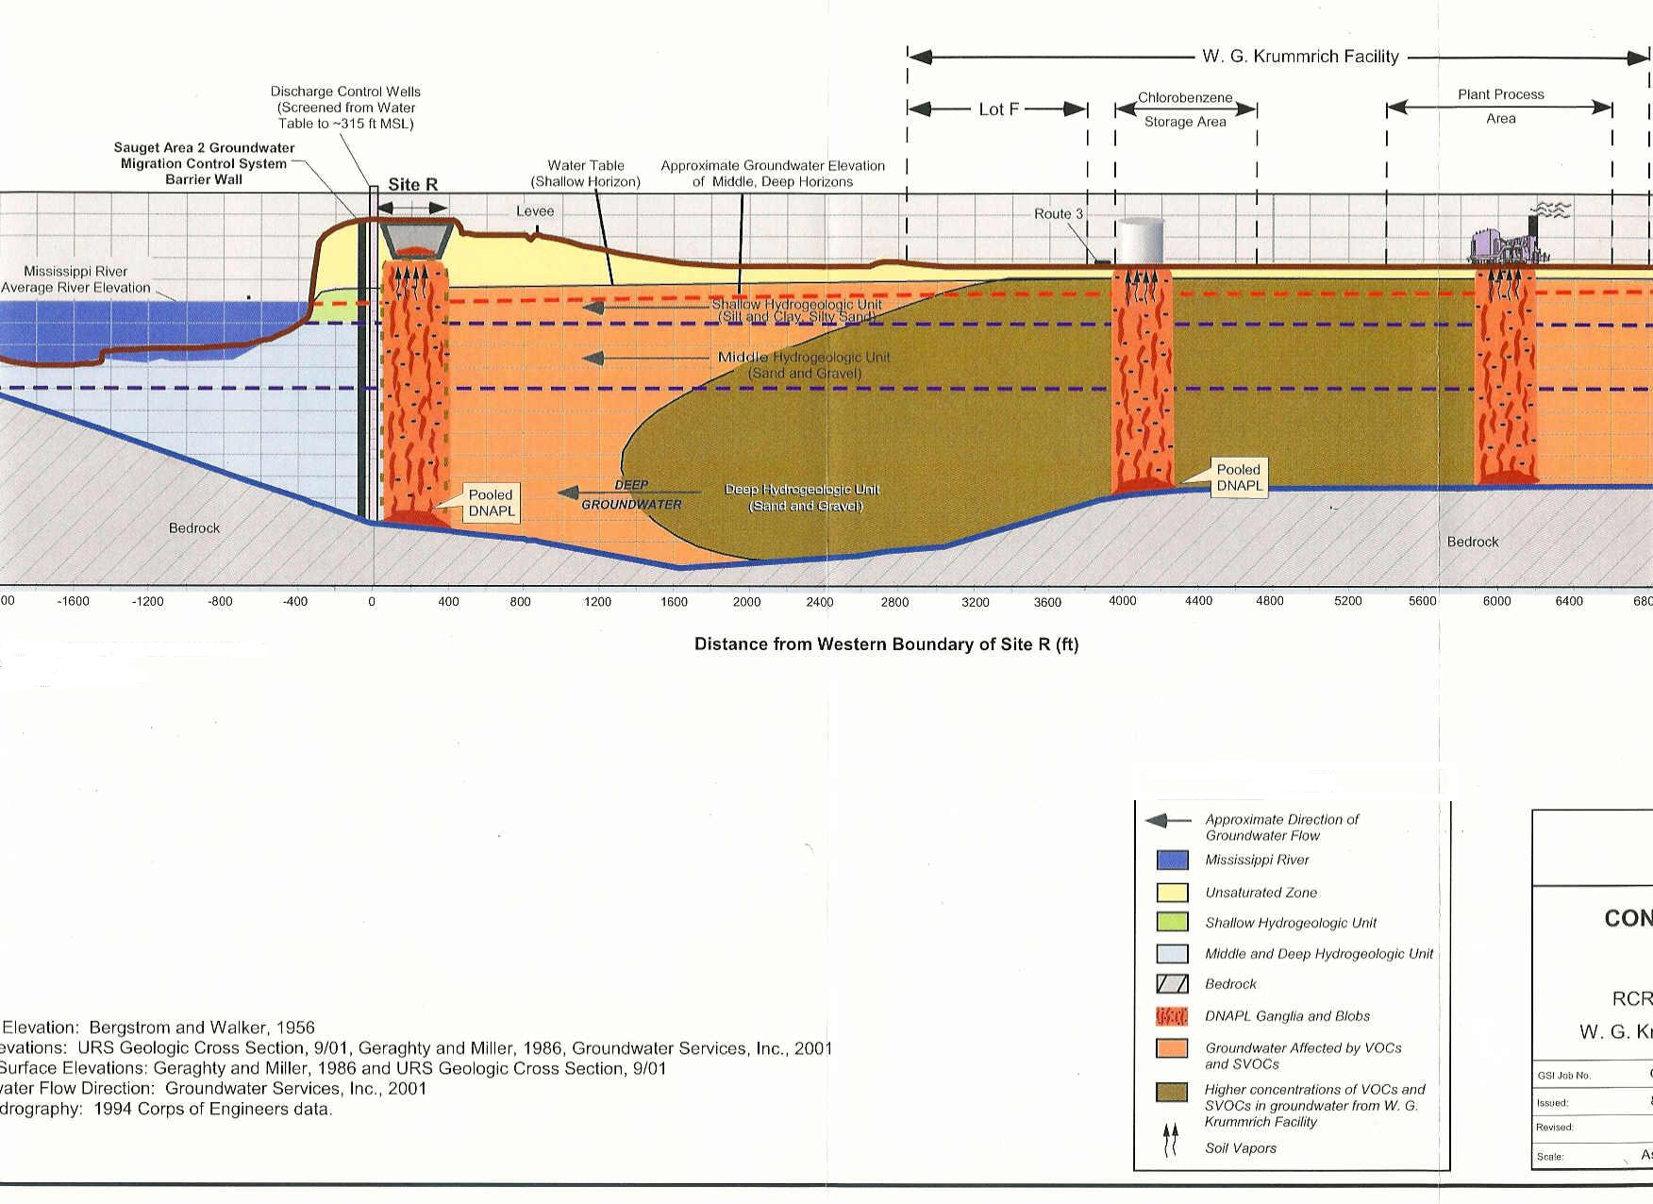
Barrier wall keyed into bedrock
Surrounds “Site R” landfill with PCBs, VOCs, metals

Slide 23
Solutia Environmental Indicator (EI)
Groundwater Migration Under Control
EI “yes” taken back in 2011
Why:
Chlorobenzene plume off-site to north and west
IL DOT dewatering wells (protecting roads from flooding), three systems, exert significant force
Solutia is developing a plan to delineate current plume
State concerned about river impacts

Slide 24
GW total chlorobenzenes
measured above criterion
Barrier Wall

Slide 25
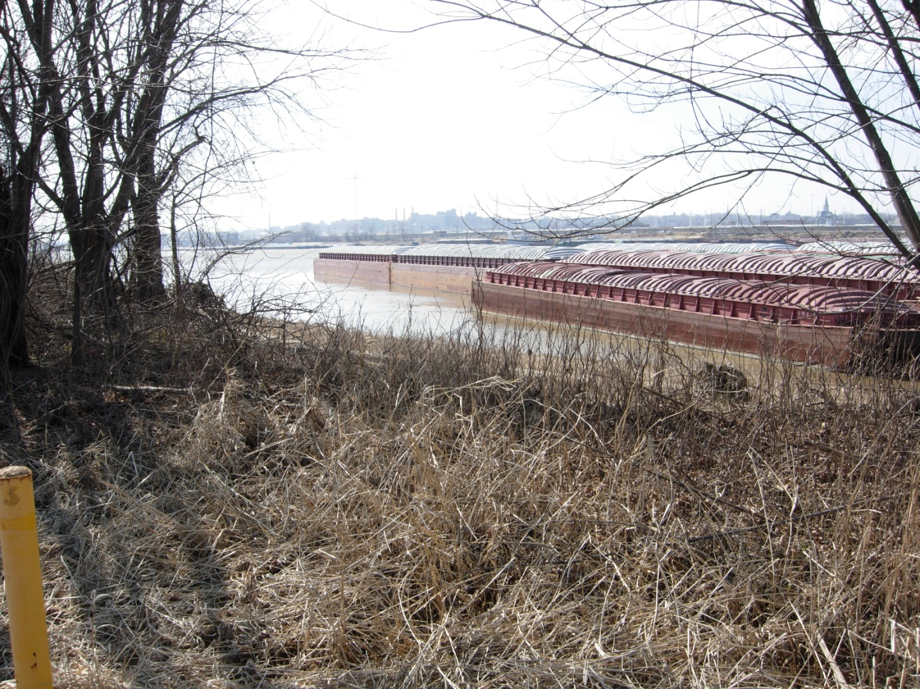
View of Mississippi River and barges with off-site monitoring well CPA cluster (in foreground
Deep aquifer MW CPA-5-D

Slide 26
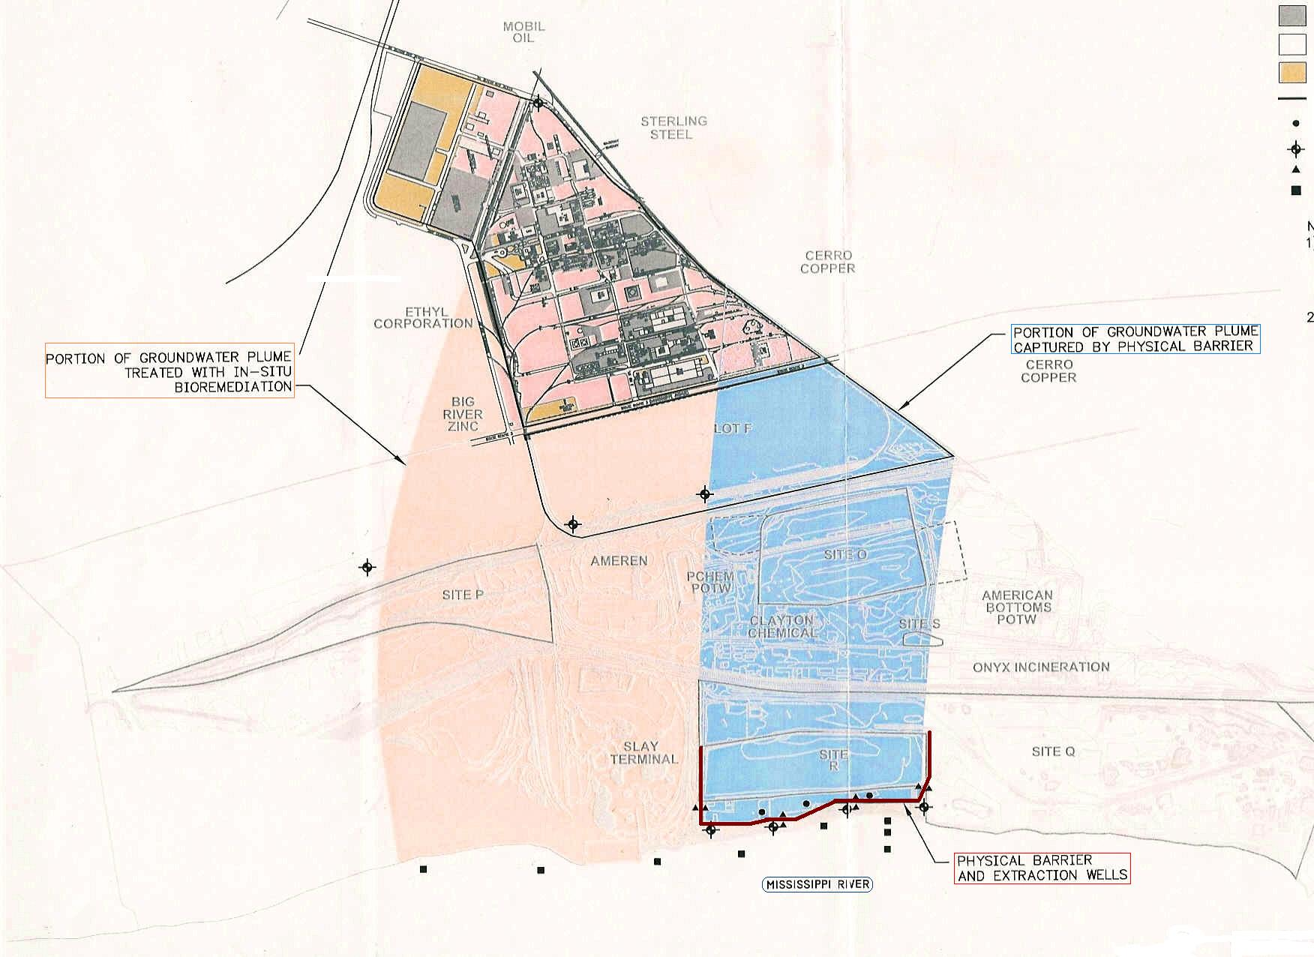

Slide 27
Additional Characterization and Monitoring
Mississippi –
Major portion of the contaminant plume originating from Solutia facility is not captured by the barrier wall and discharges to the Mississippi River
Yearly evaluation of surface water, sediment, and groundwater data obtained at and near the Mississippi River, north of the wall
Measure and assess mass over time: increase, decrease, stable?
Impact to receptors? If so, additional remedial proposals for control
Off-site plume under East St Louis (deep aquifer) –
IDOT de-watering wells influencing plume off-site
New well installation to ID extent and impacts to river

Slide 28
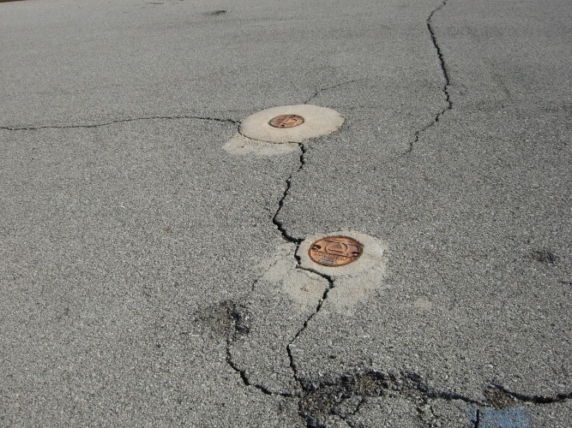
Other Remedies, Requirements
– both programs
Periodic Technical Reviews
Institutional Controls
O & M

Slide 29
Summary of Shared Remedies
Interceptor Barrier Wall at Mississippi
Pumps to American Bottoms POTW
(co-mingled chlorobenzenes plumes)
Judith Lane Landfill
SF: Originally Constructed for Superfund
(Dead Creek sediment and soil excavation)
CA: Under IEPA permit process for Corrective Action

Slide 30
Summary of mutual concerns
Environmental Justice Area
Off-Site PCB contamination (atmospheric deposition from PCB manufacturing) – SF or CA?
IDOT dewatering system influencing plume migration to north
Mississippi River influences on groundwater conditions
River contamination extent and impact

Slide 31
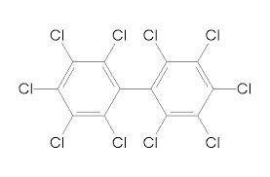
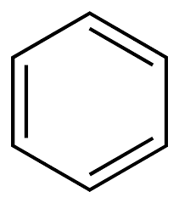
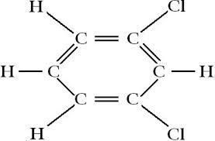
Thank you.
Questions?

