Slide 1
NEPA & Mining 101
May 12, 2016
Cindi Godsey, Permit Writer and Alaska Mining Coordinator, US EPA Region 10
Patty McGrath, Permitting Manager, Donlin Gold LLC
Lorraine Edmond, Hydrogeologist, US EPA Region 10

Slide 2
Mining Information Session
Module 1: Mining Fundamentals
Module 2: Environmental Concerns & Issues
(May 24th at 1 – 3 pm EDT)
Module 3: Regulatory Process & How Tribes can Engage
(June 8th at 1 – 3 pm EDT)

Slide 3
Module 1
Mining in the U.S.
Mining Development Process
Mining Fundamentals
  Exploration
  Types of mining
  Types of mineral processing
  Mining waste products

Slide 4
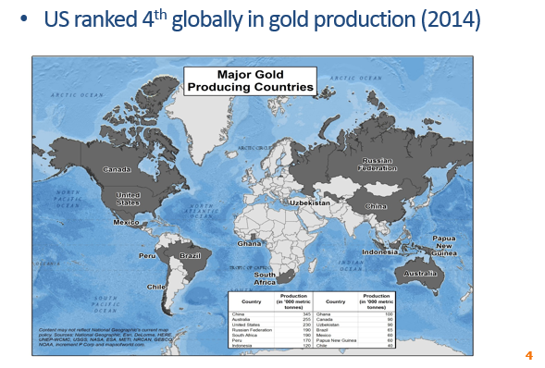
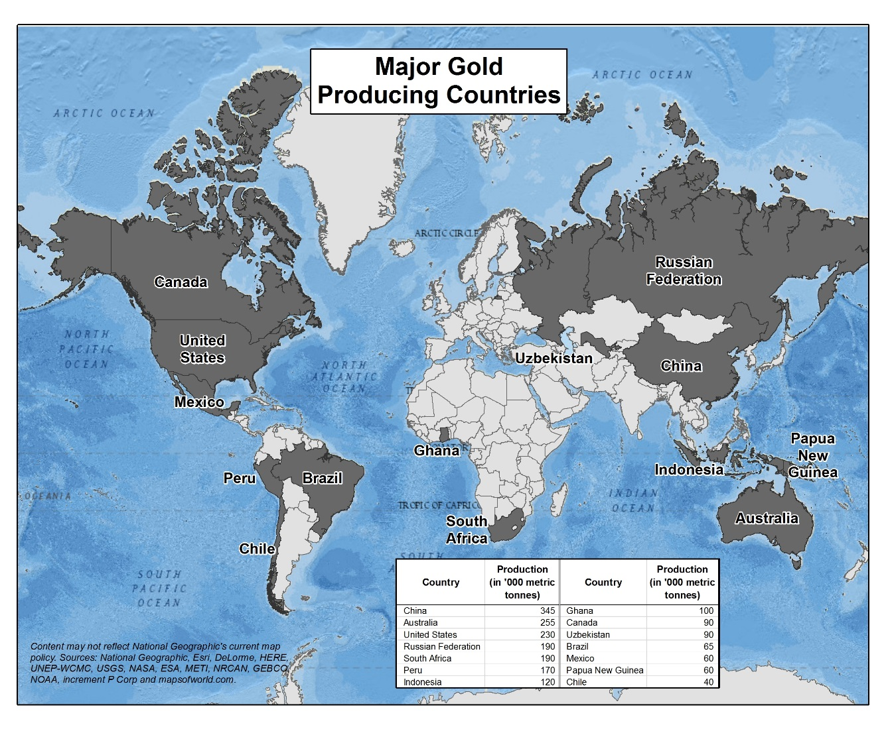
Mining Overview: Gold
US ranked 4th globally in gold production (2014)

Slide 5
U.S. Mining Overview: Gold
Large gold mines found in NV, CO, AK, UT, SD, CA
New mine under construction in SC
New copper/gold mine potential in AK, ID, MT, MN, WI
Copper and gold mines = >70% of large U.S. facilities

Slide 6
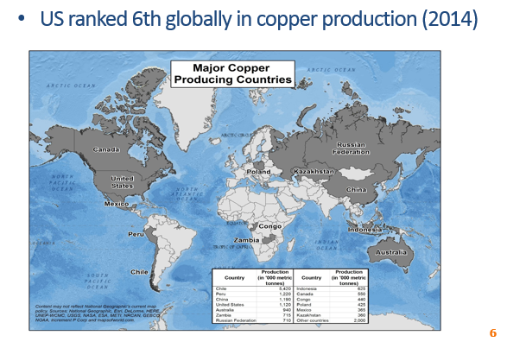
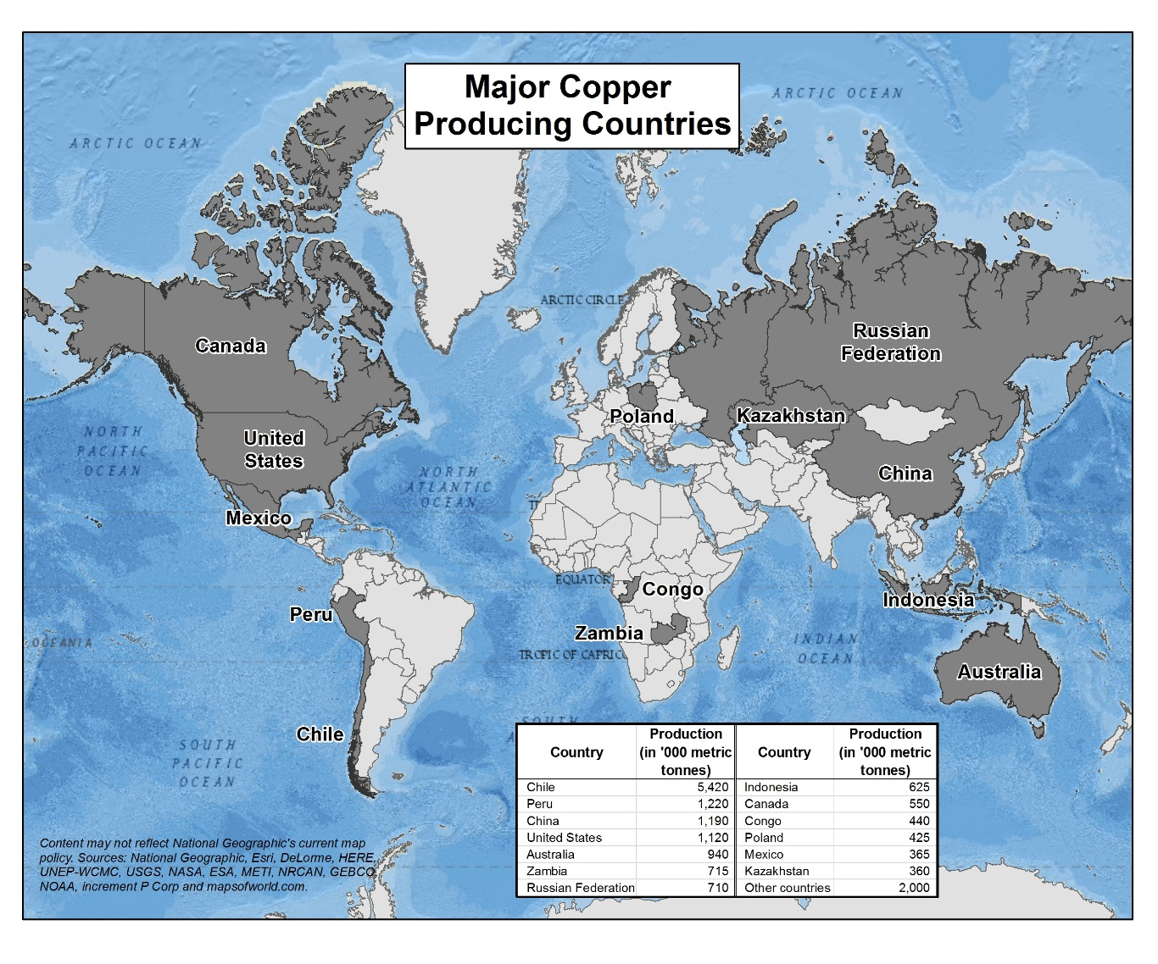
Mining Overview: Copper
US ranked 6th globally in copper production (2014)

Slide 7
U.S. Mining Overview: Copper
Top copper producing states include AZ, NM, UT, NV, MT
New copper/gold mine potential in AK, ID, MT, MN, WI
Used mainly in construction (43%) and electric equipment (19%)
Copper and gold mines = >70% of U.S. mines

Slide 8
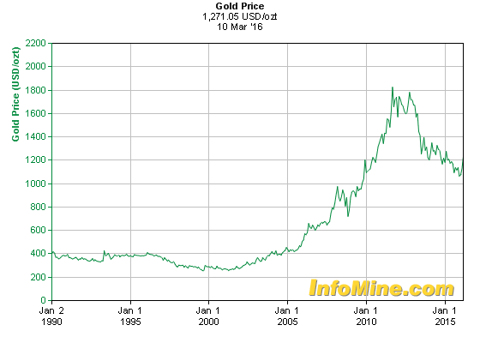
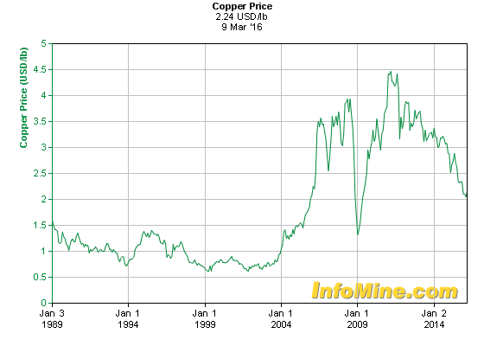
Commodity Prices
Commodity prices have a direct effect on exploration expenditures

Slide 9
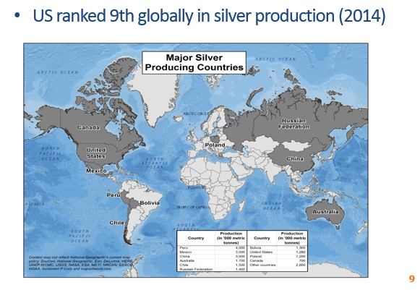
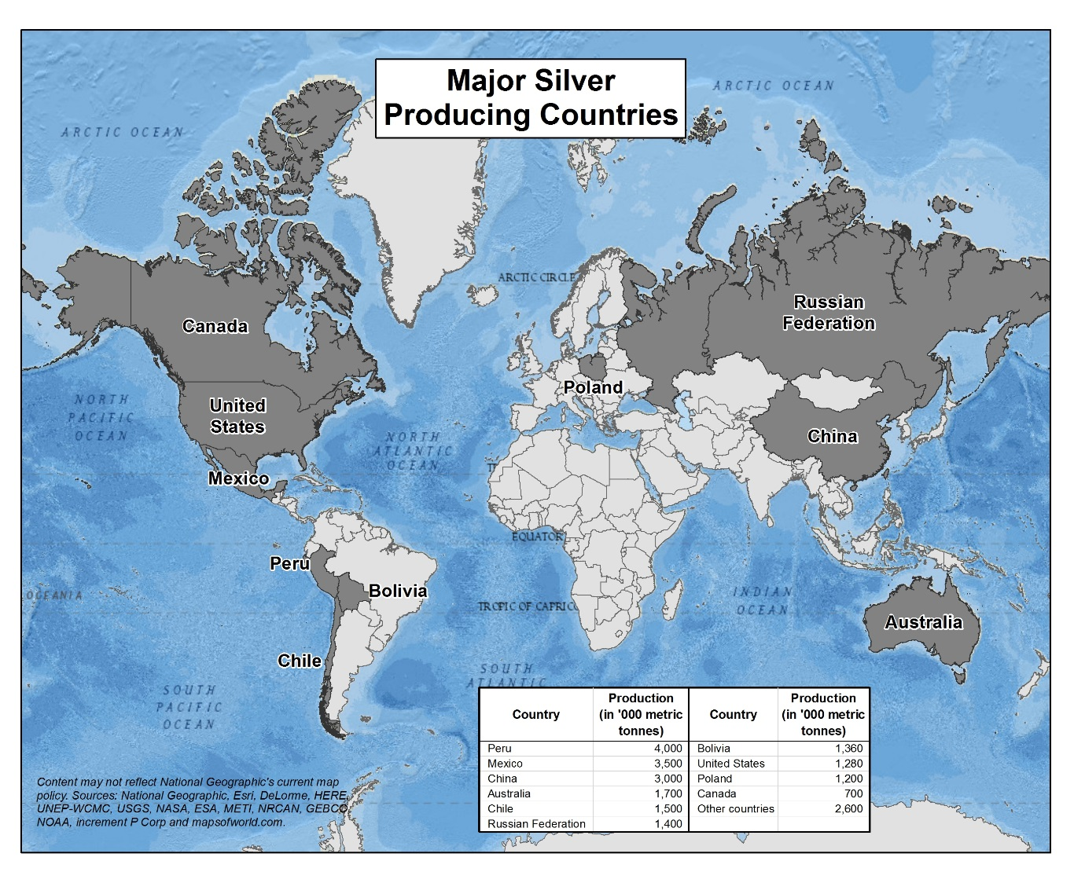
Mining Overview: Silver
US ranked 9th globally in silver production (2014)

Slide 10
U.S. Mining Overview: Silver
Silver produced from mines in AK, AZ, UT, NV and others
The majority of silver mining in the US is a byproduct of copper, zinc/lead and gold mining
Current uses of silver include industry electronics and energy (e.g., cell phones or solar panels)

Slide 11
Uranium Deposits

Slide 12
US Uranium Production
US ranked 9th globally in uranium production (2014)
U.S. uranium mines produced 3.3 million pounds of U₃O₈ in 2015 (DOE EIA)
  Production came from one uranium mill in Utah, and in-situ leach operations in Wyoming, Texas and Nebraska.
  This production accounts for 9% of the uranium consumed by US nuclear power plants. The remainder is imported.
US uranium reserve estimates are strongly sensitive to price.

Slide 13
Other U.S. Metals Mining
Lead mining: MO and AK
Zinc mining: TN and AK
Phosphate mining: FL and ID
Iron ore mining: MN and MI
Molybdenum mining: AZ, CO, ID

Slide 14
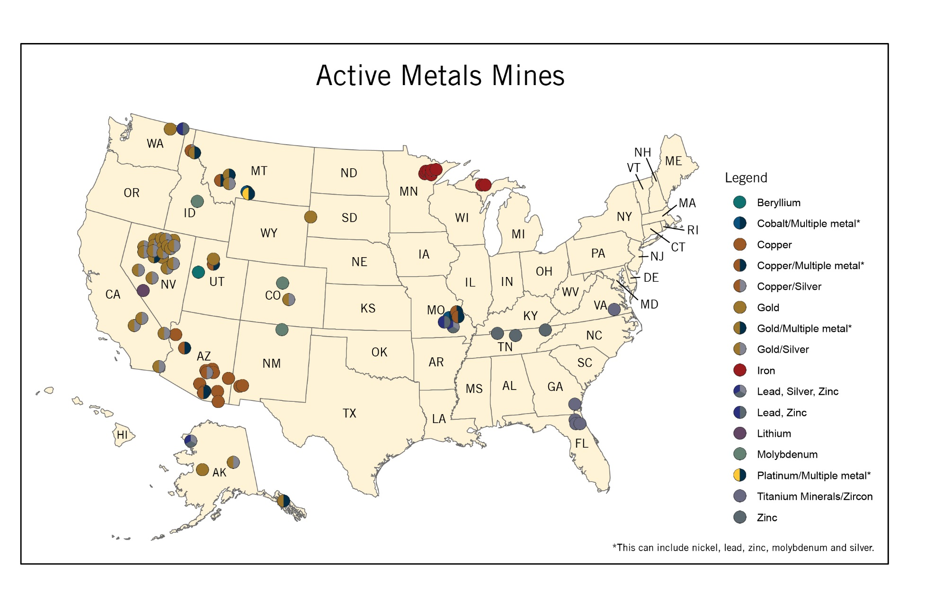
Active Metals Mines
Notes:
Mine information from National Minerals Information Center of the USGS.

Slide 15
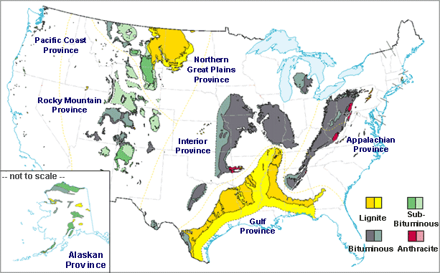
Coal Deposits

Slide 16
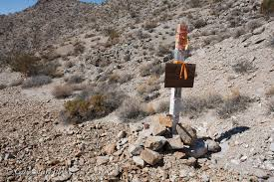
Major Steps in Mine Development
Prospecting: geological data and map reviews, non- invasive exploration
Staking: establish mining rights
Exploration (includes drilling, geophysics, bulk sampling)

Slide 17
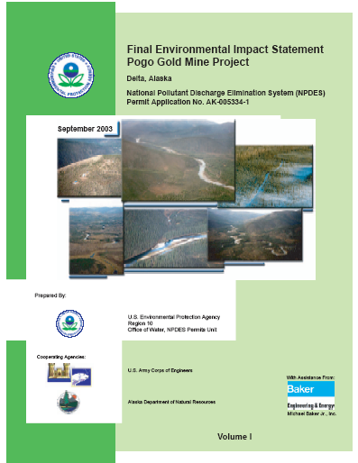
Cont. Major Steps in Mine Development
Assessment of mineral potential and economic feasibility
Mine development planning, environmental review and permitting process
Mine development (construction)

Slide 18
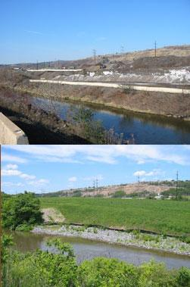
Cont. Major Steps in Mine Development
Mine operations
Shutdown and reclamation
Long-term monitoring and site maintenance

Slide 19
Typical Timeframe for a Successful Mine Project
Initial
Exploration
Advanced
Exploration
Environmental Studies
Pre-feasibility
Studies
Feasibility
Studies
NEPA & Permitting
Financing
Construction
1
2
3
4
5
6
7
8
9
10
11
12
YEARS

Slide 20
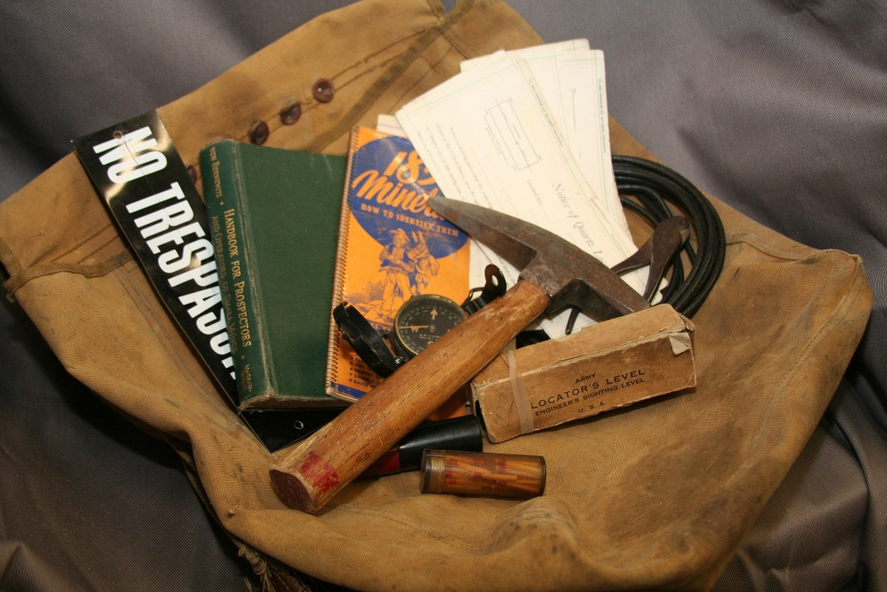
Mineral Prospecting
& Exploration

Slide 21
Mining

Slide 22
Lands Open/Closed to Mining
Open lands: all federal lands not specifically withdrawn from entry under the Mining Law, including national forests
Closed lands:
  Bureau of Reclamation lands
  Conservation Areas
  National Monuments and National Parks, National Wildlife Refuges
  Wild & Scenic Rivers within quarter-mile of bank
States laws are generally similar to federal laws

Slide 23
State & Federal Mining Claims
Laws and regulations:
  1872 Mining Law + State-specific laws
Federal mining claims require a “discovery” of a “valuable deposit”
Claims are “self-initiated” and staked
  a claim is the right to explore for and extract minerals from a tract of land
Locatable minerals are claimed
  Platinum, gold, silver, copper lead, zinc, uranium…
Leasable minerals are leased through bidding
  Petroleum, coal, phosphate, sodium, potassium…

Slide 24
State & Federal Mining Claims
Claims are held through rental fees and assessment work:
  Claims on federal land: file notice with BLM; $135/year per claim (20-160 acres)
  Claims on state land: state laws vary
Royalties during production:
  Federal: none required
  State: laws vary from none up to 10% of net income/year from mining

Slide 25
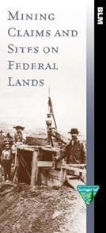
Patents
Convert federal land to private land
There is currently a moratorium on new patenting, but patented claims are common in older mining districts, often as “in-holdings” surrounded by federal land

Slide 26
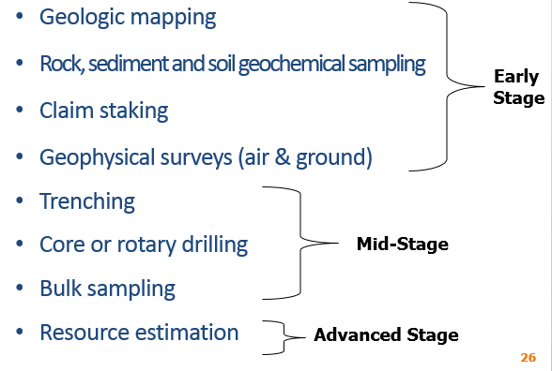
Exploration Activities
Geologic mapping
Rock, sediment and soil geochemical sampling
Claim staking
Geophysical surveys (air & ground)
Trenching
Core or rotary drilling
Bulk sampling
Resource estimation
Early
Stage
Mid-Stage
Advanced Stage

Slide 27
Exploration is activity spent searching for mineral deposits
Activities generally have little ground disturbance
More expensive with continued success
Permits required for ground-disturbing activities such as road building, trenching

Slide 28
Types of Permits for Exploration
Federal Permits
  Clean Water Act 404 general permit or
  Individual for wetlands disturbance
  On federal land: approval by USFS and/or BLM
State Permits
  Vary by state
  Typically a land use permit
  Temporary water use permit

Slide 29
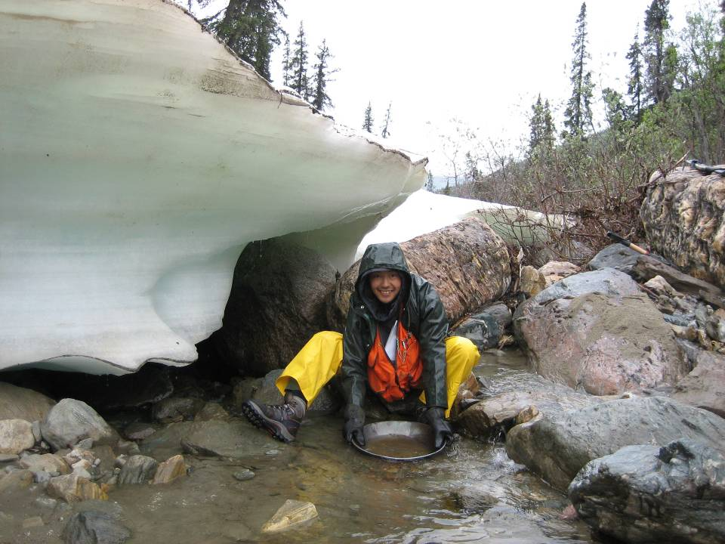
Sediment Sampling

Slide 30
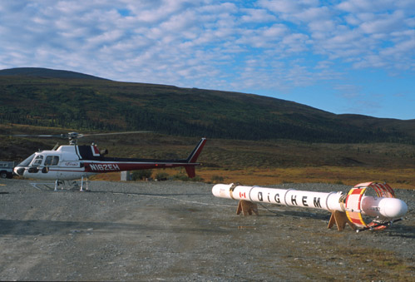
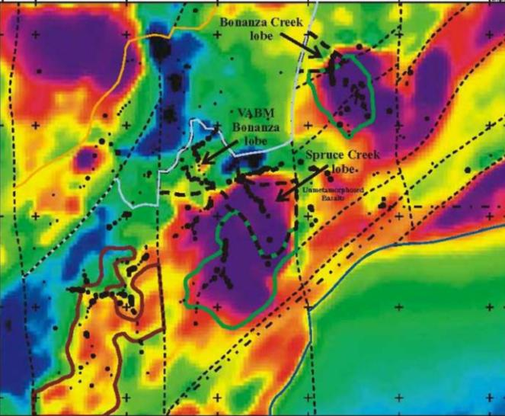
Airborne Geophysics

Slide 31
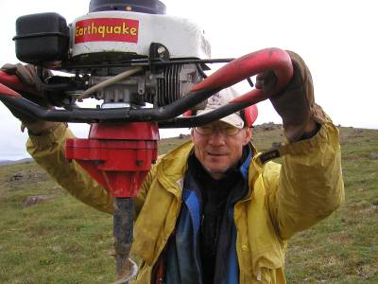
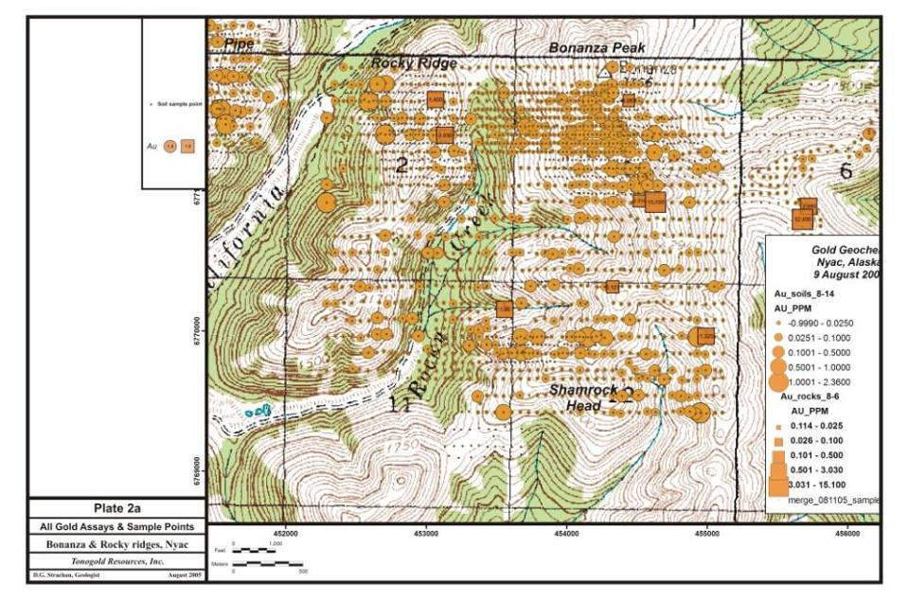
Soil Sampling to Explore for Gold
31

Slide 32
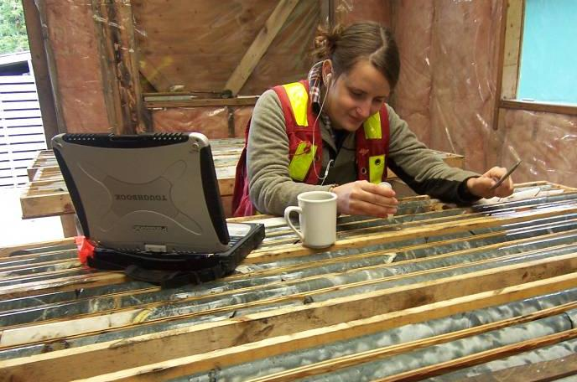
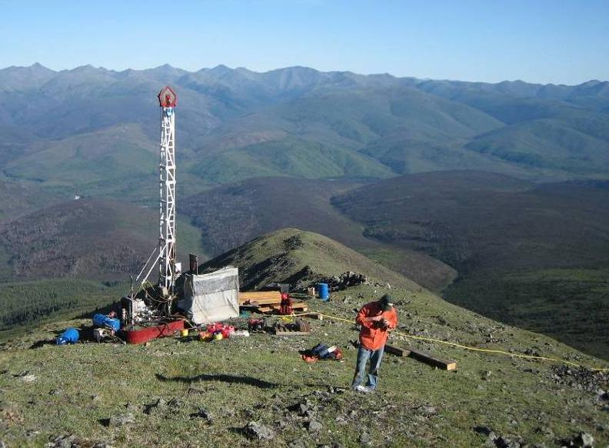
Core Drilling

Slide 33
What Is a Mine?
Location where rocks containing valuable minerals (ore) are extracted from the ground
Rates: 100s – 100,000s of tons/day
Types of mining:
  open pit
  underground
  strip mining
  placer mining (gold)

Slide 34
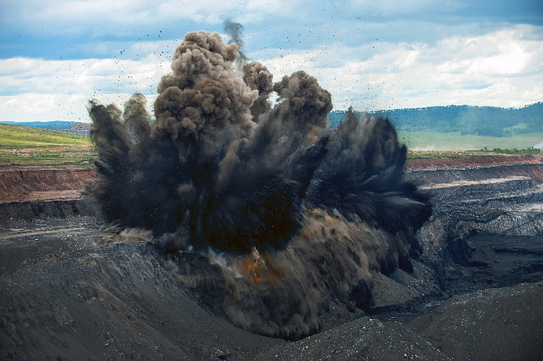
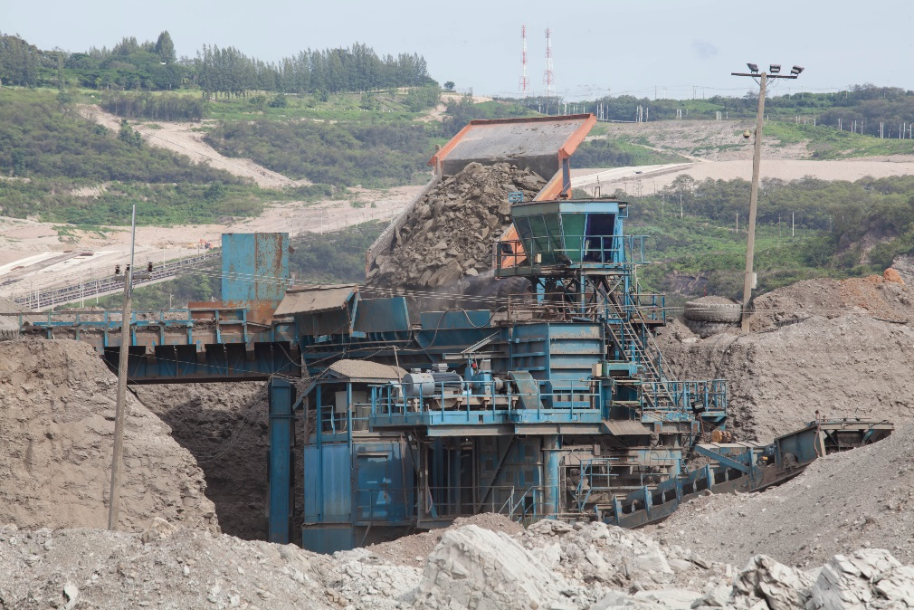
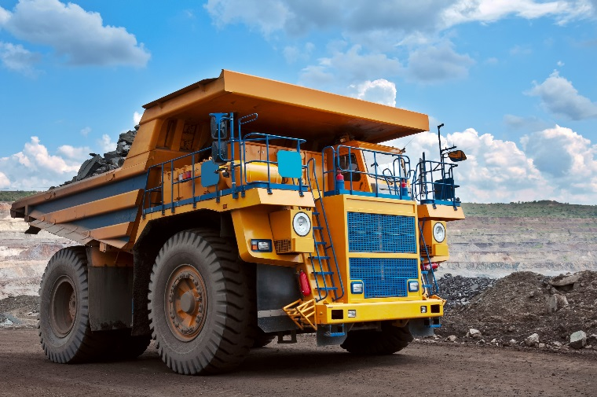
Open Pit Mining
Ore accessed from the surface
Blasting
Haul to crusher/mill
Starting clockwise from top right, images from agnormark, sashagrunge, supapornss used with permission of Adobe Stock in this publication and future work product generated by Skeo for EPA.

Slide 35
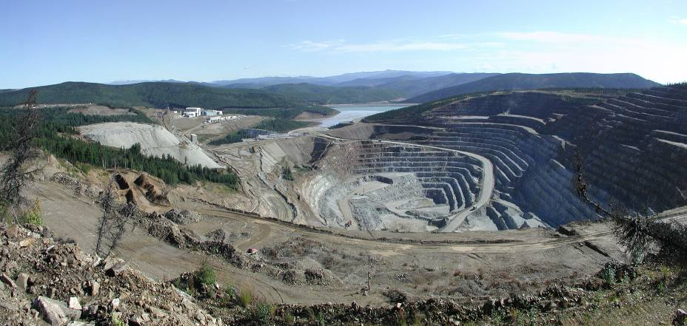
Open Pit Mine
Fort Knox Mine, AK

Slide 36
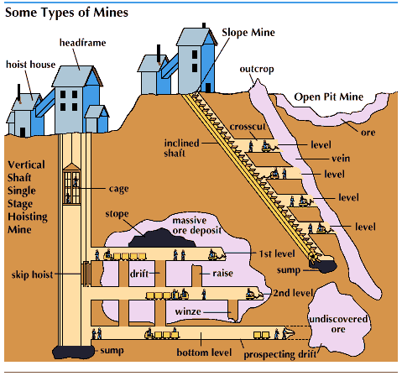
Underground Mining
Ore accessed by adit, shaft and tunnel

Slide 37
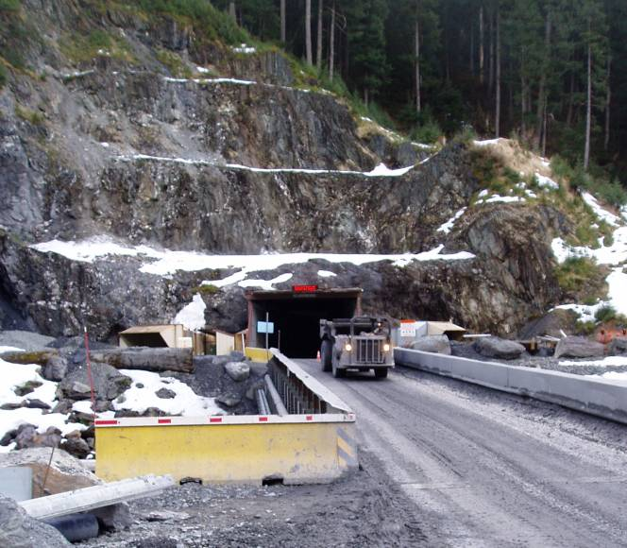
Underground Mine
Greens Creek Mine, AK

Slide 38
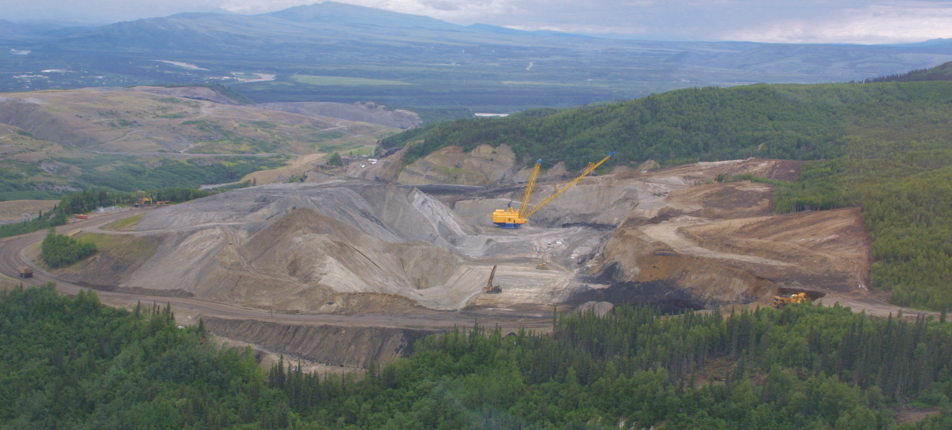
Strip Mining
Reclamation
Active Mining
Pre-Mining
Usibelli Coal, AK
Two Bull Ridge
Usibelli Coal Mine
Healy Alaska
Topsoil Replaced/
Revegetation
Regrade
Backfilling
Active Pit
Pre-stripping/
Topsoil removal
Direction of
Mining
Over and Inter
Regraded Area
Burden
Topsoil
Coal
Seams
Spoils

Slide 39
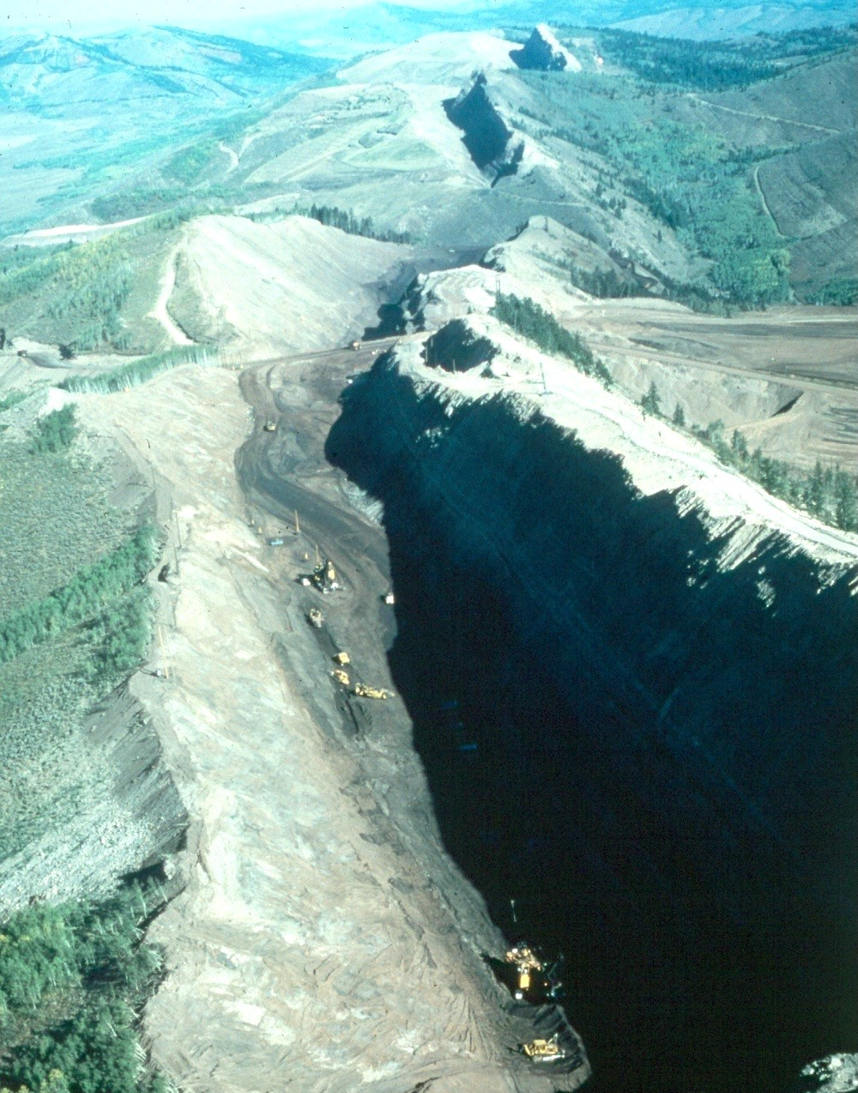
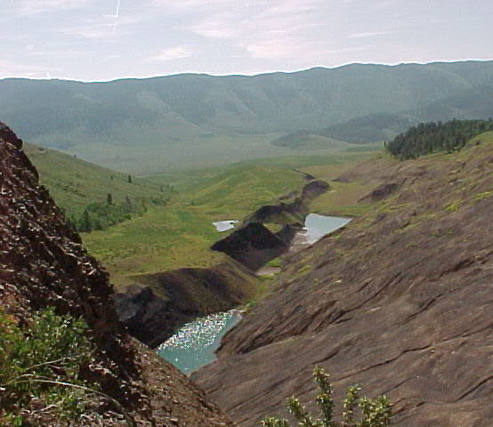
Strip Mining
Southeast Idaho Phosphate Mines

Slide 40
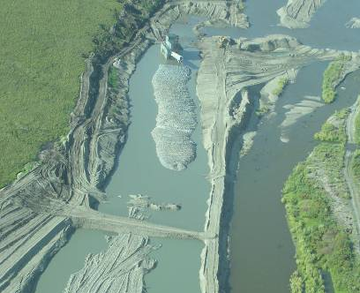
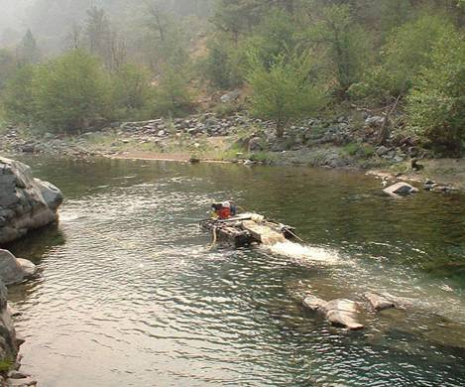
Gold Placer Mining
Alaska Mechanical Dredge
Oregon Suction Dredge

Slide 41
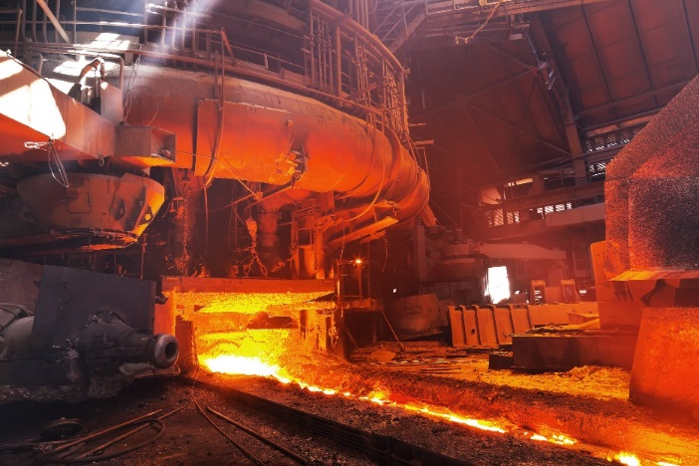
Mineral Processing

Slide 42
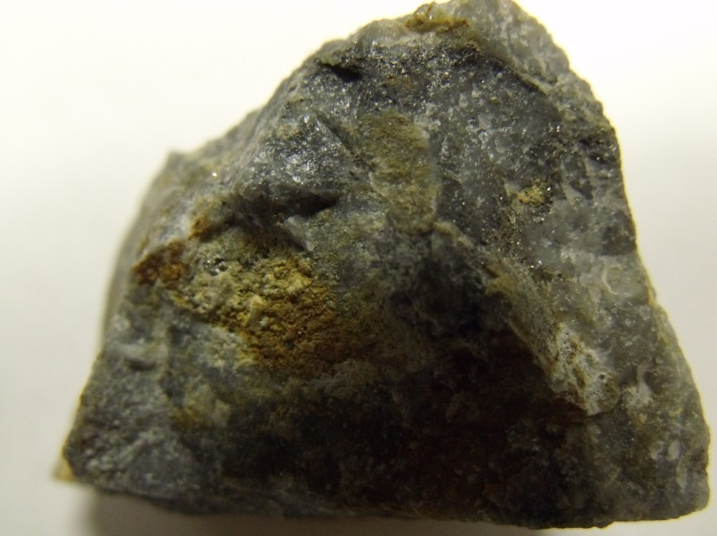
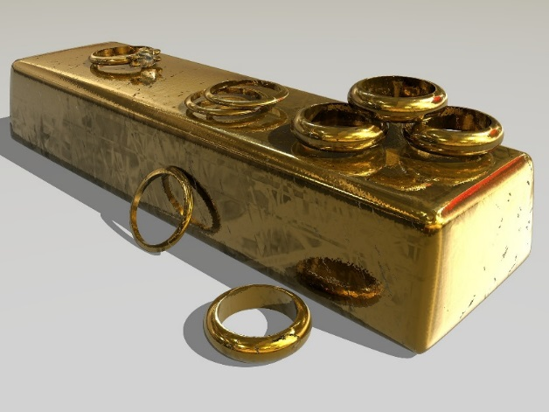
What Is Mineral Processing?
Production of valuable metal from mined ore

Slide 43
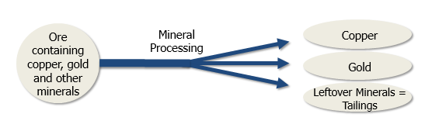
Mineral Processing
Valuable mineral(s) separated from waste minerals

Slide 44
Mineral Processing Steps
Particle size reduction
  Crushing & grinding
Concentrating the valuable metal
  Gravity separation
  Flotation
  Leaching
  Others
Purifying the valuable metal
  Smelting
  Refining
  Others
Ore containing 2% cooper as chalcopyrite (copper-iron-sulfide mineral)
Flotation concentrate containing 30% copper as chalcopyrite
Smelting & refining to produce pure (99.9%) copper

Slide 45
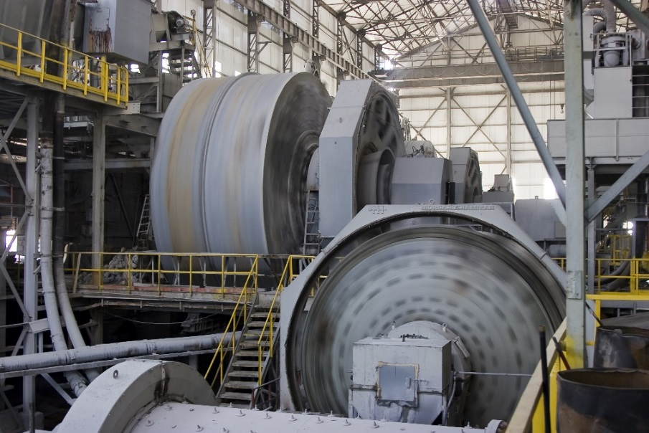
Crushing & Grinding
Reduce particle size to expose the target minerals.
Water is added during the grinding stage
Image from Onur Hazar Altindag used with permission of Adobe Stock in this publication and future work product generated by Skeo for EPA.
Video from Nimito used with permission of Adobe Stock in this publication and future work product generated by Skeo for EPA.

Slide 46
Flotation
Commonly used for many minerals
Chemicals added to ground ore cause mineral particles to stick to air bubbles, create a froth, and “depress” waste minerals
  Examples: organic compounds (xanthates), cyanide, copper sulfate, zinc sulfate, oils, alcohols, lime, acids

Slide 47
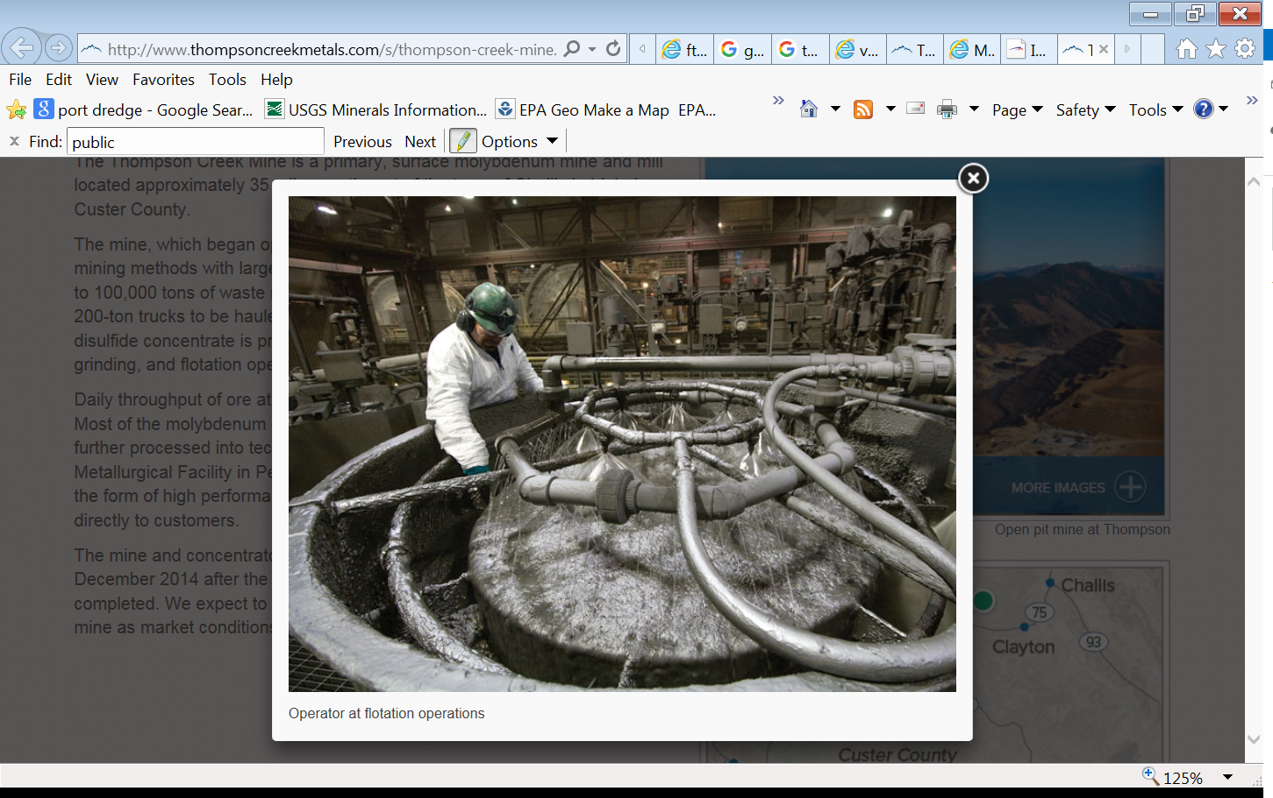
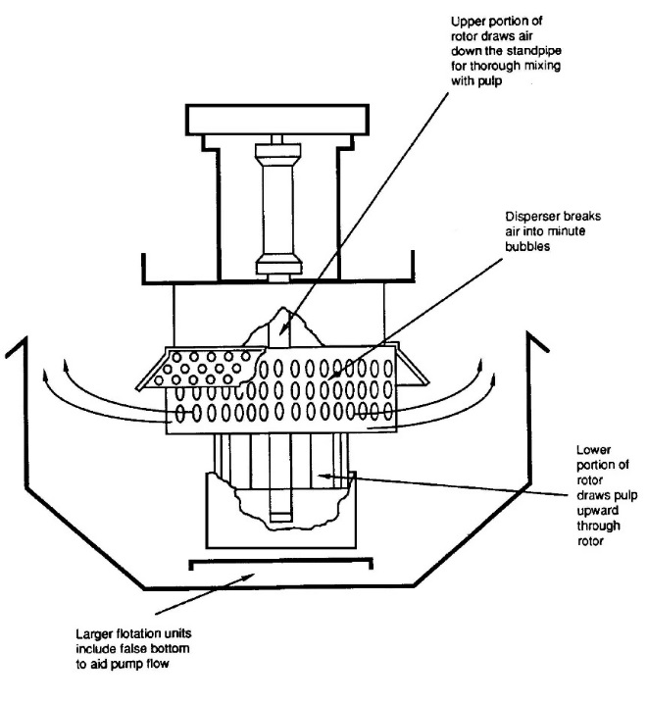
Flotation
Cross Section of a Flotation Cell

Slide 48
Leaching
Can be used on ore or flotation concentrates
Chemical added to dissolve the valuable metal
Examples:
  cyanide is used to dissolve gold and silver from ores
  acid is used to dissolve copper and uranium from ores

Slide 49
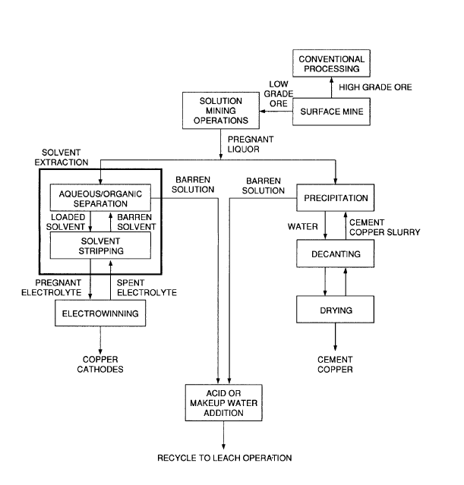
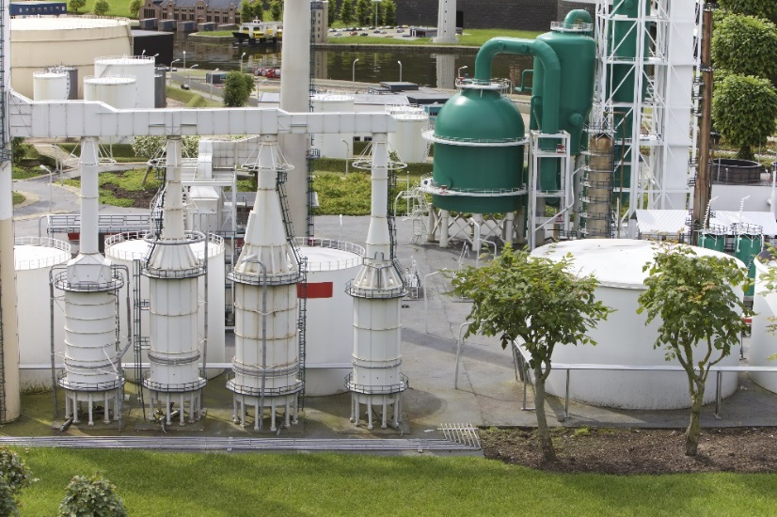
Vat & Tank Leaching
Image from Vividrange used with permission of Adobe Stock in this publication and future work product generated by Skeo for EPA.

Slide 50
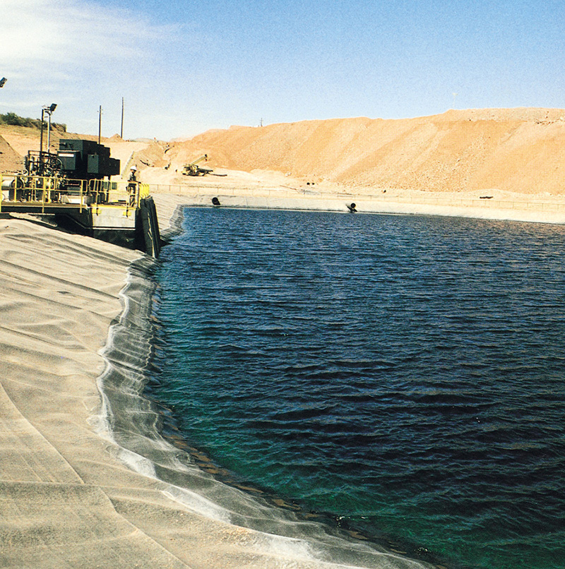
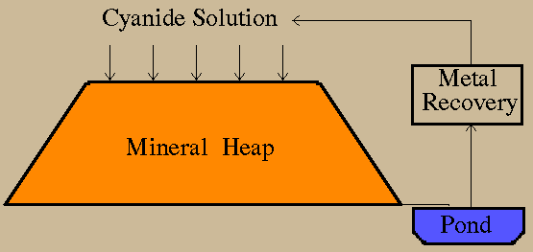
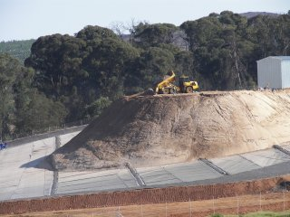
Heap Leaching

Slide 51
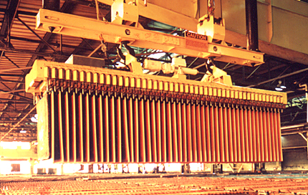
Separation of Metal from
Leach Solution
Carbon Adsorption: gold adsorbs onto carbon
Electrowinning: uses steel wool or copper as a cathode to extract the metal in acid or base solution
Precipitation: solution
combined with
chemicals to
form metal precipitate

Slide 52
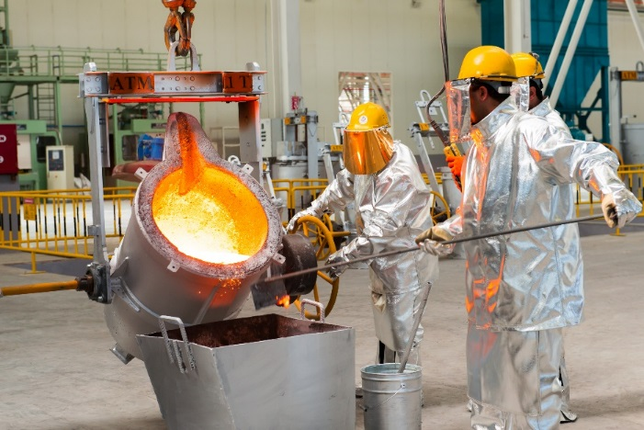
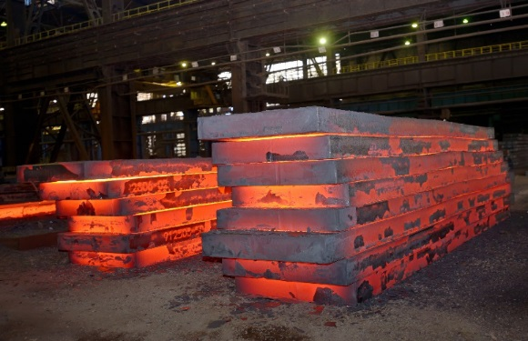
Purification and Production of Metal
Smelting and Refining
Starting clockwise from top left, images from Oleksiy Mark, nasimi, icarmen13 used with permission of Adobe Stock in this publication and future work product generated by Skeo for EPA.

Slide 53
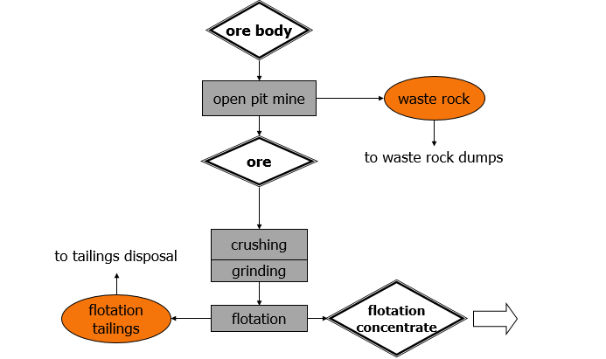
Example of Gold Processing

Slide 54

Example of Gold Processing

Slide 55


Mineral Processing
Red Dog Mine, AK
Bingham Canyon Mine, UT
55

Slide 56

Questions and Comments
Next Webinars on NEPA and Mining 101:
May 24th
Part 2- Mining Environmental Concerns and Issues
June 8th
Part 3- The Regulatory Process and How Tribes can Engage

Slide 57
ADOBE STOCK IMAGE / VIDEO NOTICE
This presentation contains Adobe Stock images and video that may not be used elsewhere without permission from Adobe Stock. Readers may not access or download Adobe Stock images or video from this document for any purpose and must comply with Adobe Stock’s Terms of Use, which require users to obtain a license to the work.

