Slide 1
NEPA and Mining 101
Part 2
May 24, 2016
Shahid Mahmud, EPA OSRTI, Team Lead Abandoned Mine Lands
John Hillenbrand, EPA Region 9, Mine Group Leader

Slide 2
Mining Information Session
Module 1: Mining Fundamentals
Module 2: Environmental Concerns and Issues
Module 3: Regulatory Process and How the Public and Tribes Can Engage

Slide 3
Module 2
Environmental Concerns and Issues
Mining waste products: waste rock, tailings, contaminated waters
Potential environmental impacts from mines (to water, air, soil)
Ways of preventing and controlling impacts
Clean-up and Remediation

Slide 4
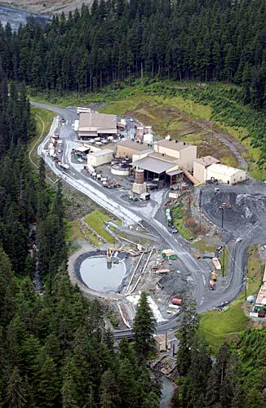
Mining Waste Products
Overburden and waste rock
Tailings
Heap leach spent ore
Wastewater
Air emissions
Greens Creek Mine, AK

Slide 5
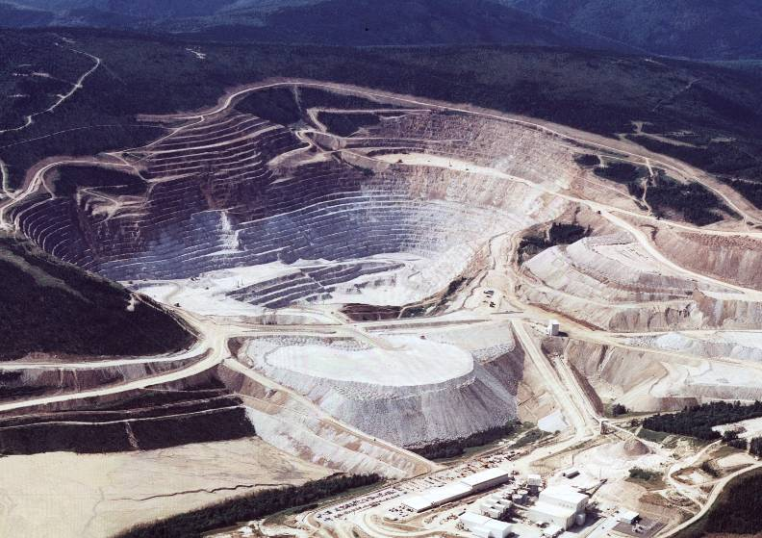
Mining Overview
Fort Knox Mine, Alaska
OVERBURDEN
ORE
ORE
ORE
WASTE
WASTE
WASTE ROCK
PILE
TAILINGS POND
MILL
Notes:
Overview of mining facilities

Slide 6
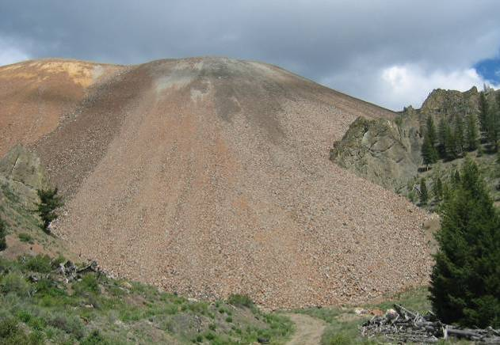
Waste Rock
Mineralized rock that is not economic for mining
For every ton of ore mined, one to four tons of waste rock are produced
Thompson Creek Mine, Idaho

Slide 7
Tailings and Disposal Methods
Tailings: the ground-up remains of mineral processing
  85% – 95⁺% of ore milled ends up as tailings
  Contain water and chemicals from processing
Tailings disposal methods
  Tailings impoundments
  Paste tailings impoundments
  Dry stack tailings
  Disposal in lakes (since 2009)

Slide 8
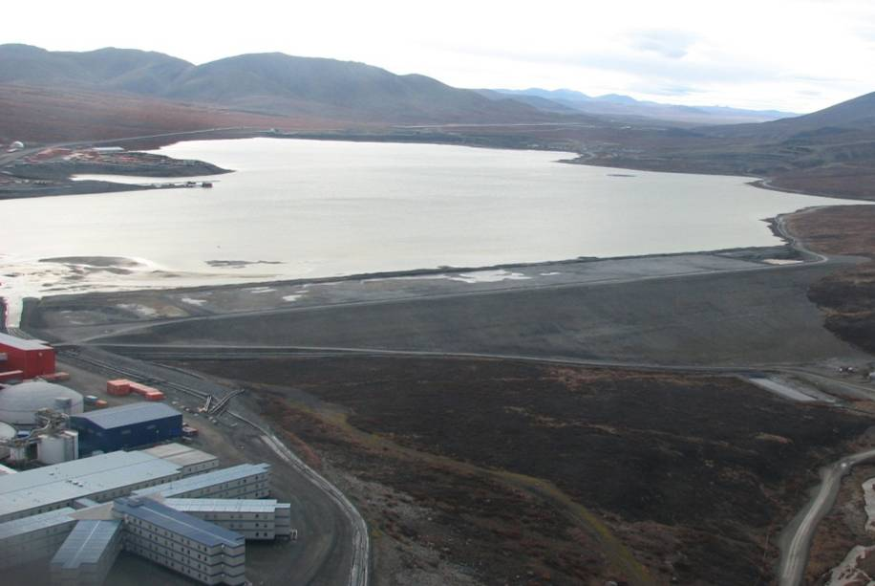
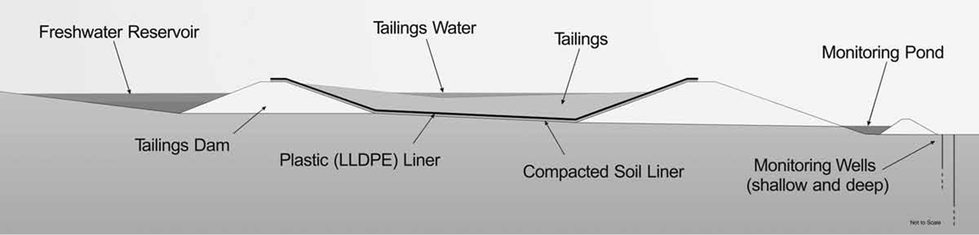
Tailings Impoundments
Built across stream valleys or in uplands
Dams can be hundreds of feet tall
Red Dog Mine, Alaska

Slide 9
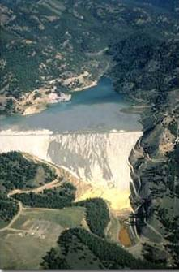
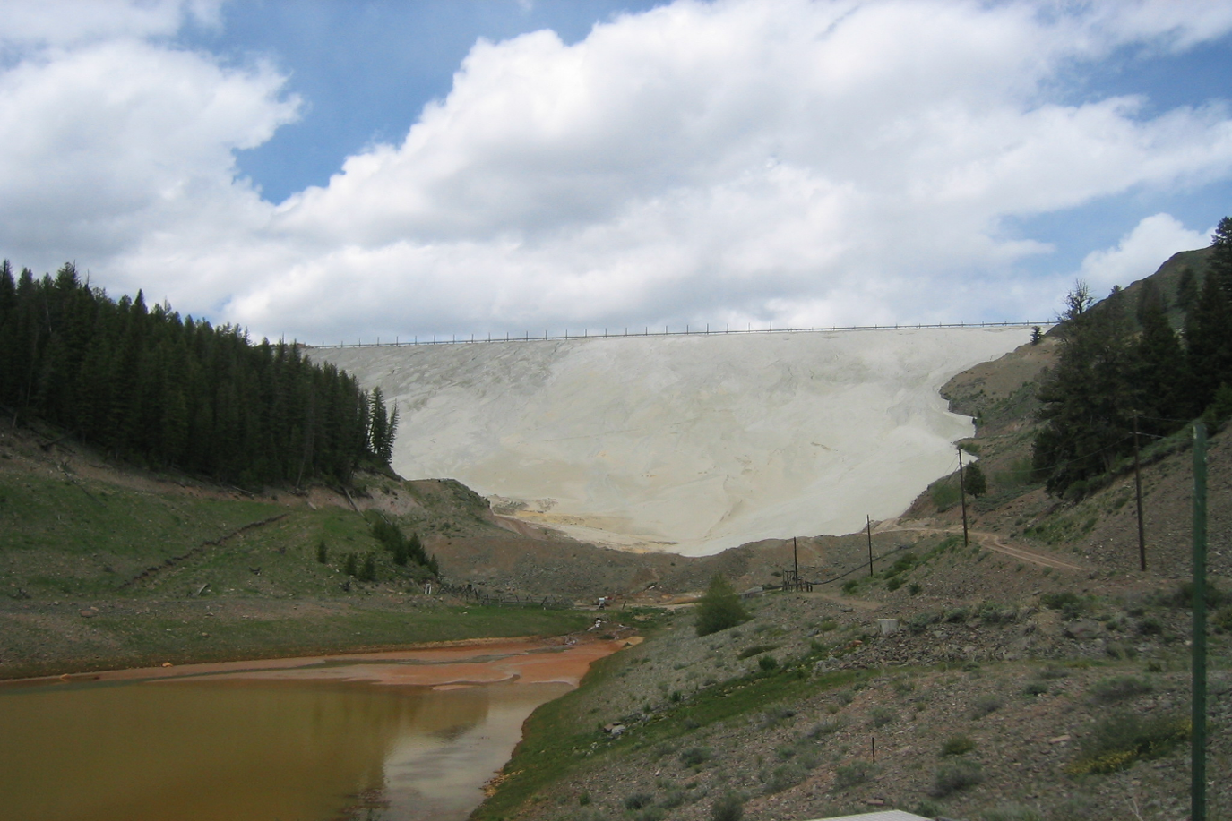
Tailings Impoundments
Thompson Creek Mine, Idaho
Notes:
Mention problems to be aware of (leaching, water seepage, and geotech stability)

Slide 10
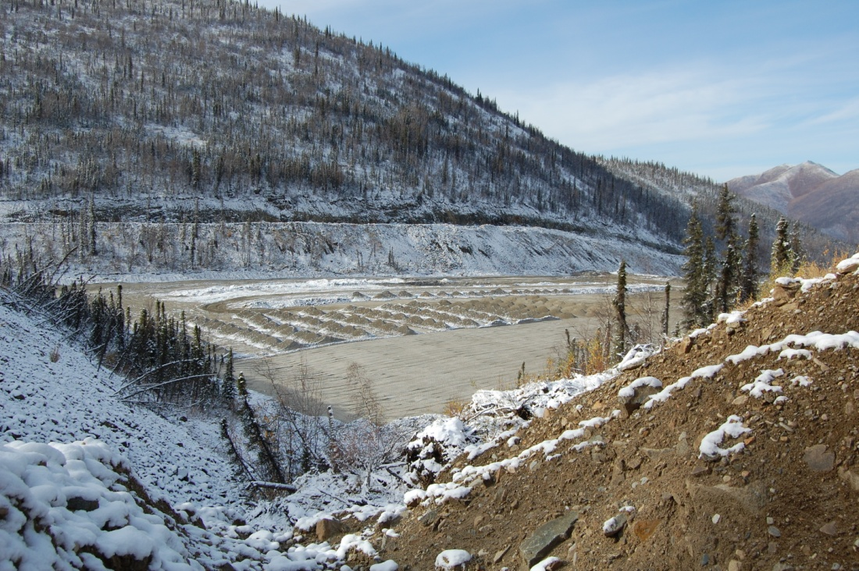
Dry Stack or Paste Tailings
Tailings are thickened and filtered to reduce wastewater
Stacked on liner
Pogo Mine, Alaska
Dry Tailings
Settling pond
Liner

Slide 11
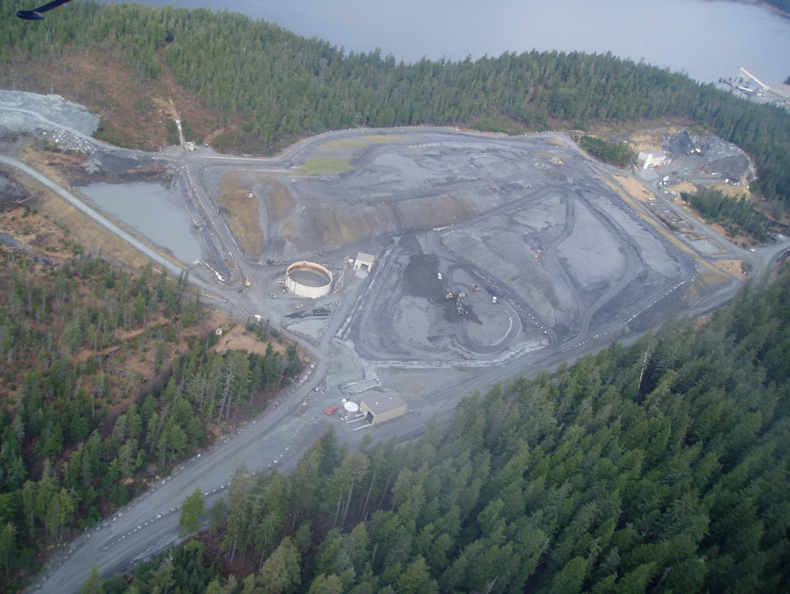
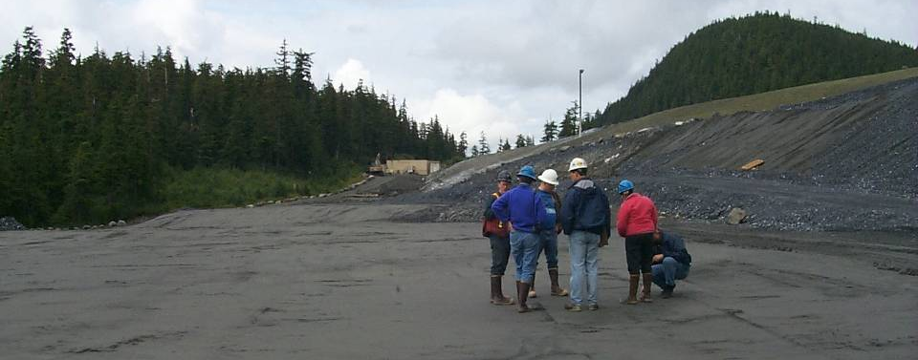
Tailings Dry Stack
Greens Creek Mine, Alaska

Slide 12
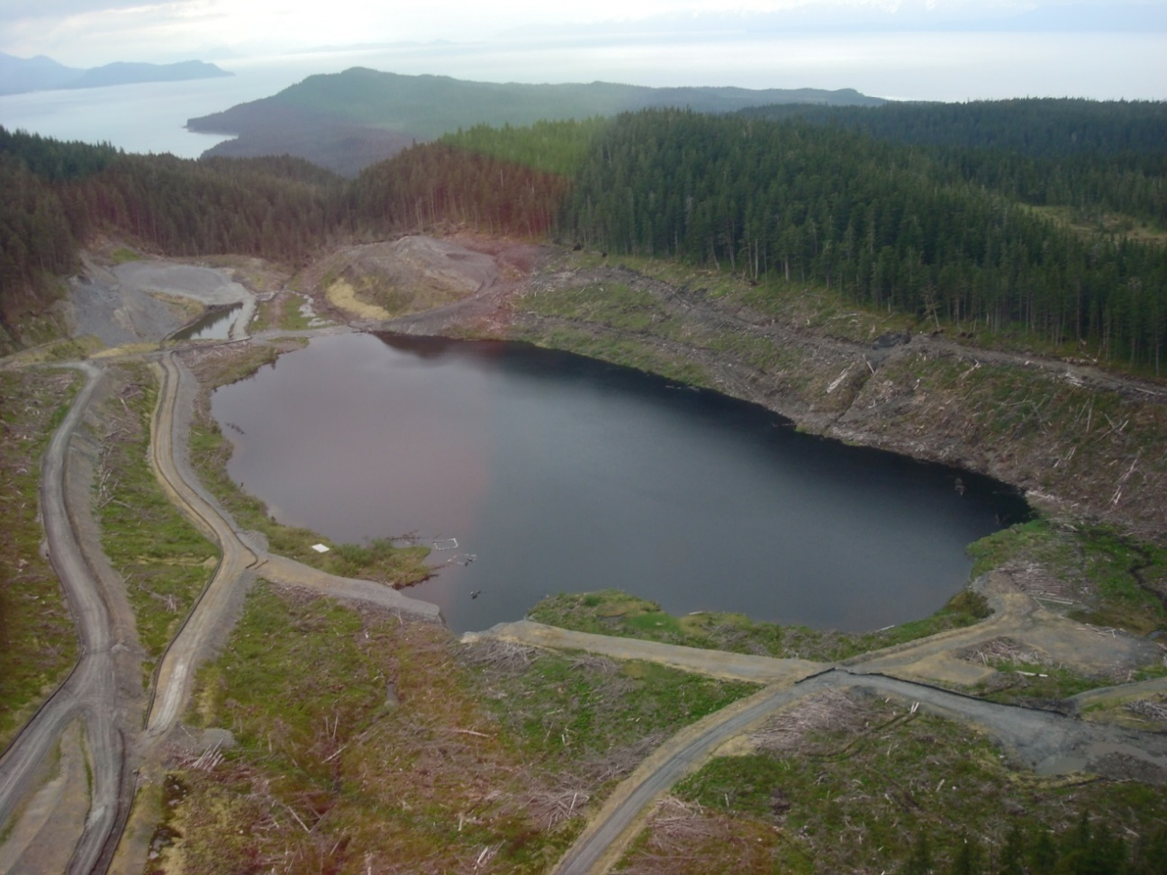
In-Lake Tailings Disposal
Kensington Mine, Alaska

Slide 13
Technical Issues for Dams
Site location and hazard potential
Geology and seismicity
Hydrology and hydraulics
Structural integrity and slope stability
Seepage control
Operations and maintenance
Emergency contingency planning

Slide 14
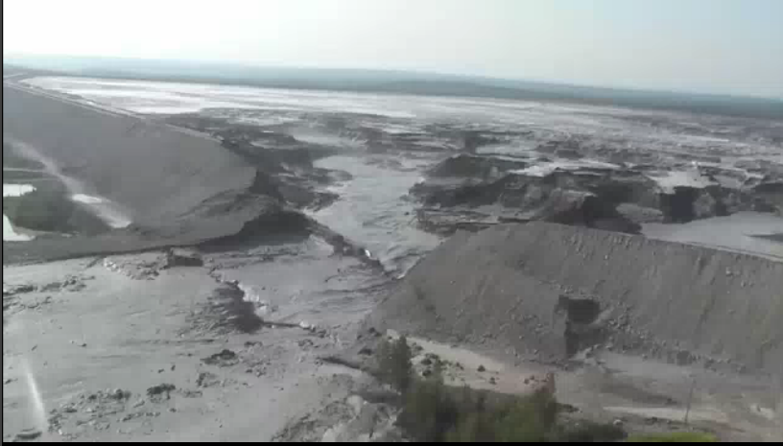
Mount Polley Dam Failure
Notes:
Happened in the middle of the night rare fly over filming the next day of the dam failure. This is an extreme example of an unanticipated event at a mine. The majority of tailings impoundments are considered stable.
August 2014 Millions of gallons of water into the Frasier river watershed, one of the most important salmon rivers in Canada. In a two-month period following the tailings pond breach (from Aug. 4 to Oct. 4), researchers recorded a lake level rise, a temperature rise of 1 to 2.5 C (36.5 F) at the bottom of the lake and copper concentrations in sediment samples that – in some areas – were three time higher than quality guidelines for freshwater ecosystems.

Slide 15
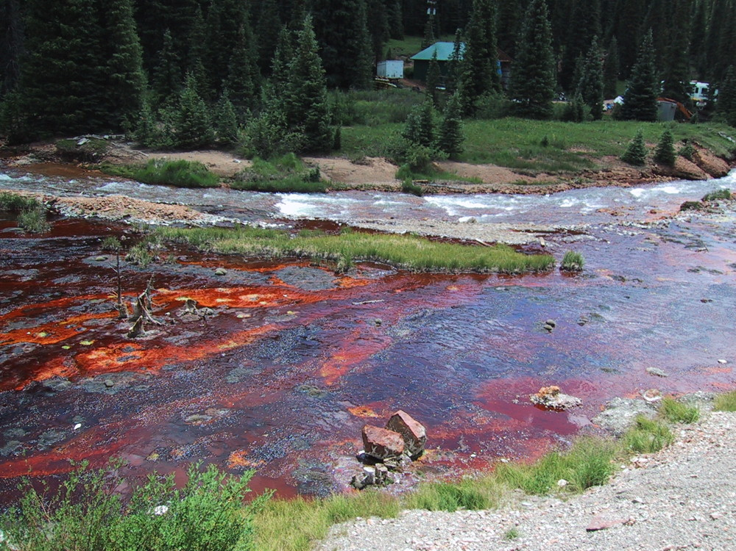
Environmental Concerns
Notes:
Now we’ll talk more about environmental concerns and methods for predicting and preventing. Picture: Cement Creek, Colorado from USGS

Slide 16
Potential Environmental
Concerns
Groundwater
Surface water
Soil
Vegetation
Habitat – aquatic and uplands
Air
How do physical, chemical and biological changes affect human health and the environment?

Slide 17
Surface Water and Groundwater Concerns
Sources:
  Underground mine water
  Open pit mine water
  Seepage/runoff from waste rock & tailings disposal sites
  Sedimentation/erosion from waste and tailings disposal
  Discharges and chemical releases from processing operations

Slide 18
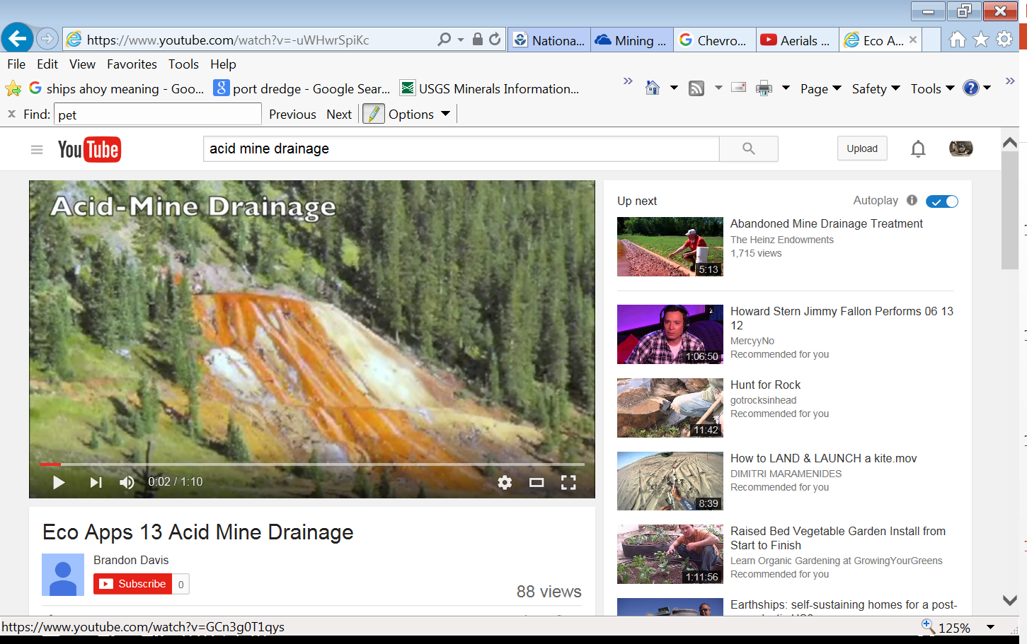
Surface Water and
Groundwater Concerns
Contaminants:
  Acid rock drainage: acid, metals (iron, lead, zinc, copper, cadmium, mercury)
  Neutral or alkaline drainage: selenium, arsenic, manganese, nitrates
  Chemicals used in mineral processing such as acids and cyanide

Slide 19
Acid Rock Drainage (ARD)
Generated when metal sulfide minerals are exposed to air and water
ARD contains dissolved metals from ore, waste rock, tailings
FeS₂ + 15/4 O₂ + 7/2 H₂O → 2 H₂SO₄ + Fe(OH)₃
Fe⁺² + ¼ O₂ + H⁺ → Fe⁺³ + ½ H₂O
Fe⁺³ + 3 H₂O → Fe(OH)₃ + 3 H⁺
FeS₂ + 7/2 O₂ + H₂O → 2 SO₄ ⁻² + Fe⁺² + 2H⁺

Slide 20
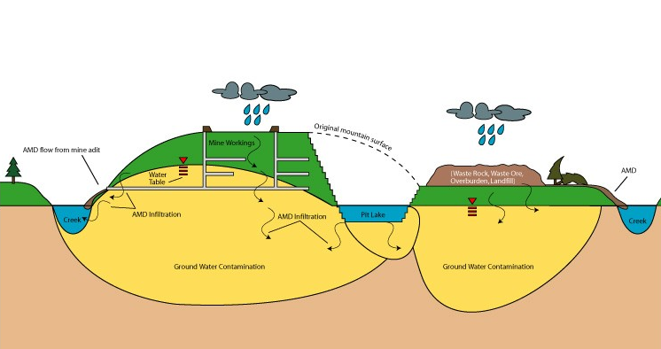
ARD/Metal Leaching Model

Slide 21
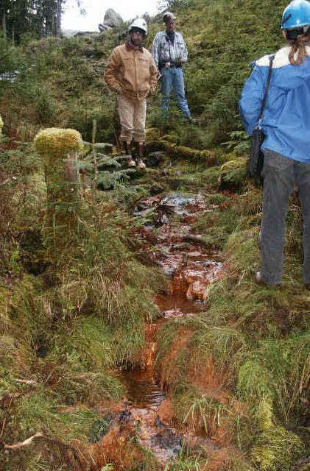
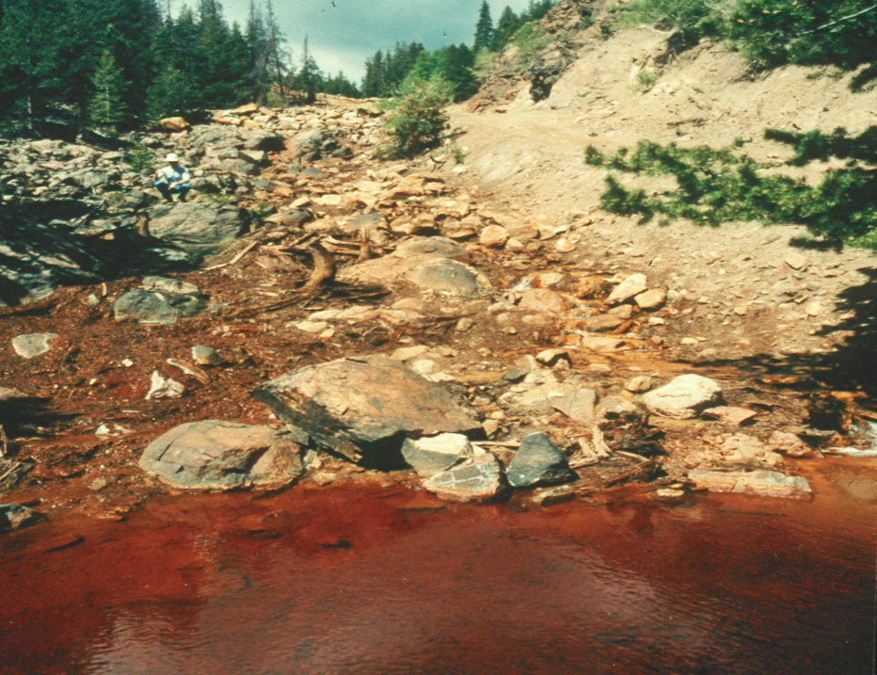
Acid Rock Drainage (ARD)
Can occur at historic and modern mines

Slide 22
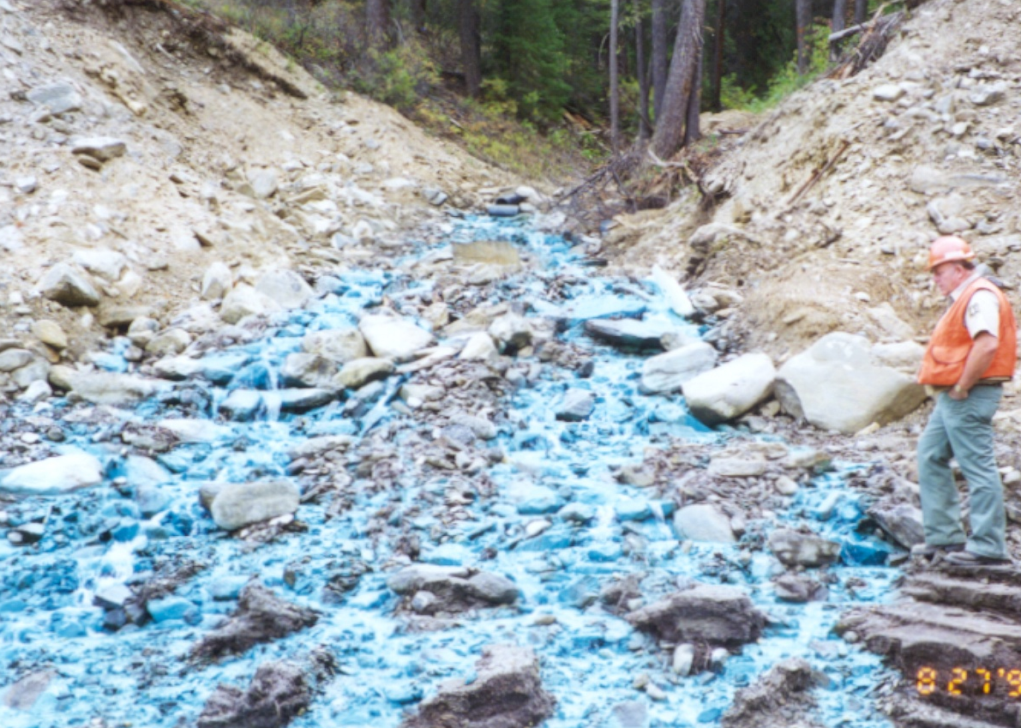
Metal Leaching
Can occur with ARD or under neutral conditions
Contaminants: copper, lead, zinc, cadmium, arsenic, selenium, mercury, radionuclides
Blackbird Mine, Idaho

Slide 23
Spills of Chemicals,
Concentrates or Tailings
Pipelines
Truck incidents
Liners
Dam failures

Slide 24
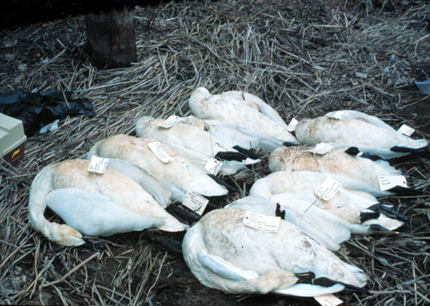
Surface Water Impacts
  Degraded aquatic habitat
  Harming or killing of fish and other aquatic life
  Food chain impacts: wildlife, human health
  Sedimentation
  Water contamination with acidity, metals, process solutions (cyanide)

Slide 25
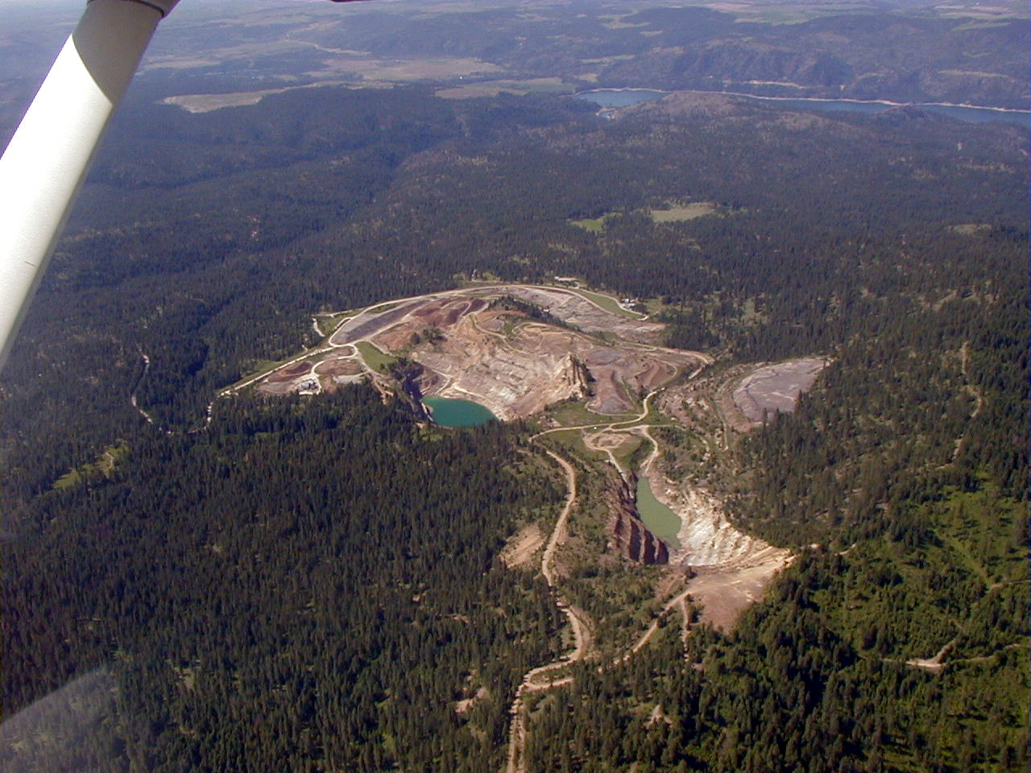
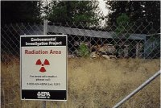
Groundwater and Surface Water Impacts
Midnite Mine, Washington
Notes:
Midnite Mine is an inactive, open-pit uranium mine on the Spokane Indian Reservation in Washington. It became a Superfund Site in 2000 when EPA added it to the National Priorities List. Site investigations found that metals, including arsenic, cadmium, manganese, and uranium, and radioactive isotopes and decay products related to uranium, have migrated from open pits, ore/protore/waste rock piles into local groundwater and surface waters as a result of mining activities and environmental processes, such as acid mine drainage, radioactive decay, dust, and particle or dissolved contamination moving in surface water and groundwater. The mined area contains more than 33 million tons of waste rock, unprocessed and low-grade ore.

Slide 26
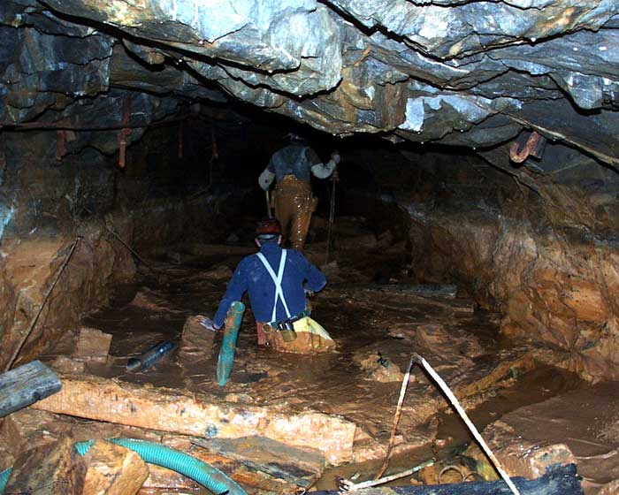
Groundwater Concerns
  Water contamination with acidity, metals
  Water quantity reduced during/after mining (pit dewatering)
  Contamination of connected wetlands, surface waters
  Drinking water supply impacts
Holden Mine, Washington

Slide 27
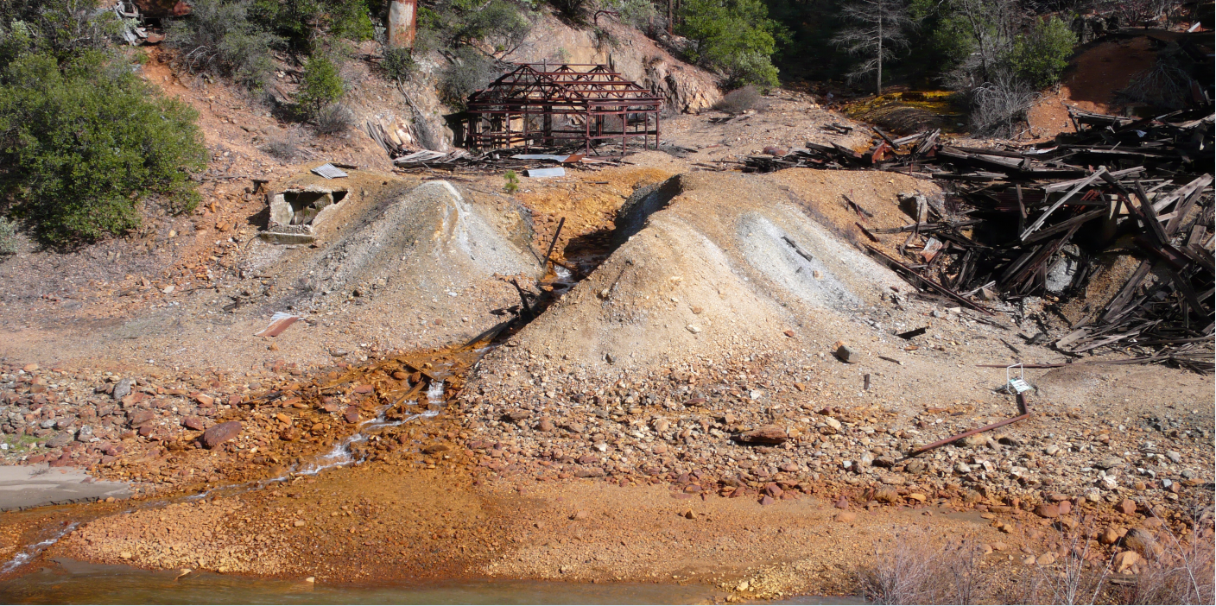
Environmental Impact Prediction, Prevention and Control

Slide 28
Predicting Environmental Impacts
Systematic planning: Data Quality Objectives Seven Step Process (EPA Guidance)
  State the Problem
  Identify the Purpose of Study
  Identify Information Needs
  Define the Boundary
  Develop the Analytical Approach
  Specify Performance Criteria
  Develop Plan for Gathering Data

Slide 29
Predicting Environmental Impacts
Interdisciplinary Team
  Surface and groundwater hydrology
  Geochemistry
  Engineering
  Biology
Uncertainty – need to understand sources and magnitude

Slide 30
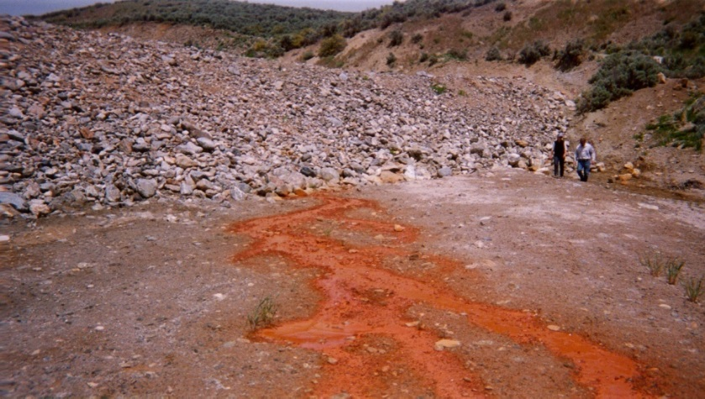
Predicting Impacts on Water Resources
Water balance
Water-rock interaction
Effectiveness of mitigation
  Covers/Liners
  Run-on controls/Capture systems
  Treatment systems
  Amendments
Transport and mixing
Attenuation
Risks to fish, wildlife, people
Rio Tinto Mine, NV

Slide 31
Water Balance
Need good understanding of water balance (inputs, losses, recycling)
  Characterize waste streams
  During operations, closure, inactive phases
  Changes associated with seasonality and extreme weather events
  Climate change effects
    Precipitation
    Permafrost melting
    Draft NEPA guidance from Council of Environmental Quality

Slide 32
Example Water Balance
Thompson Creek Mine Closure-Water Management

Slide 33
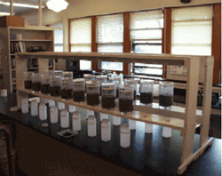
Understanding Water-Rock Interaction
Many tests evaluate waste materials for ARD and metal leaching potential
Many waste types
Representativeness issues
Very large data sets
Variability
Interpretation complicated

Slide 34
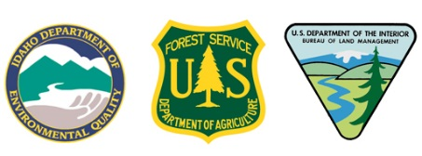
Baseline Geochemistry Study
4,085 ARD samples from 55 boreholes and nine trenches
XRF analysis for 629 uncomposited samples
Thin section, XRD and EDS work for nine samples
Whole rock, ABA and SPLP testing for 158 samples
Column testing
  Six monolithic unsaturated columns
  Three ROM unsaturated columns
  One ROM saturated column
  Four columns for QC
Batch adsorption tests
  Three phases of testing for six samples
Notes:
Different types of characterization techniques from phosphate mine

Slide 35
Static ARD Testing
Neutralization Potential (NP)
tons CaCO3/1000 tons
Acid Potential (AP) Sulfide Sulfur
tons CaCO₃/1000 tons
Notes:
When doing geochemical characterization from a lot of different tests and can be challenging to make sense of and use info to make management decisions (what type of cover etc).

Slide 36
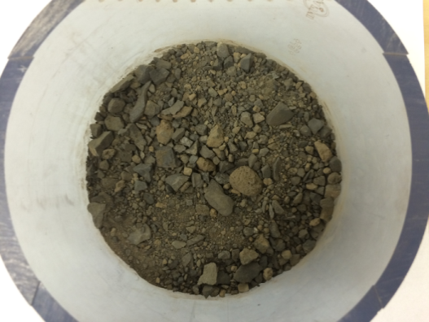
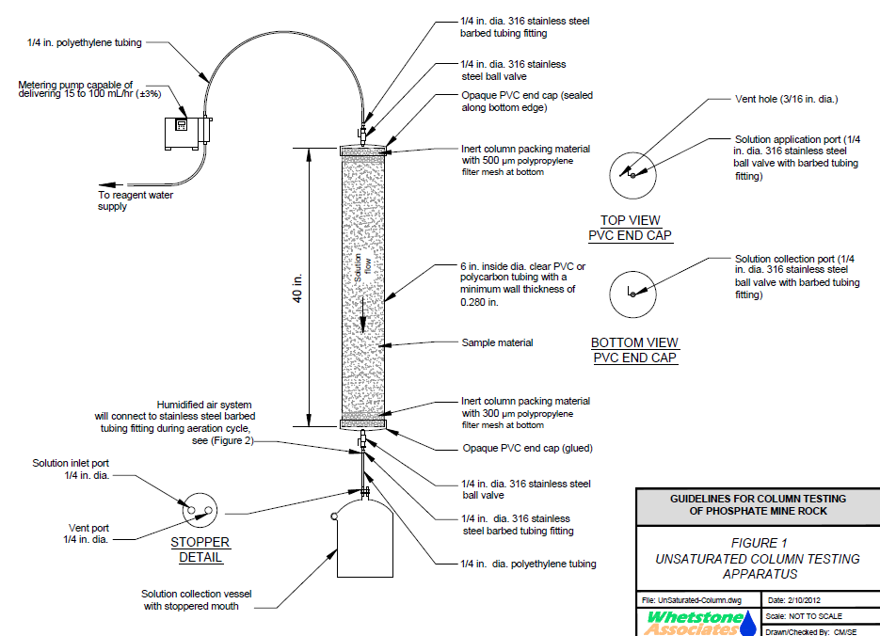
Column Leaching Tests to Identify Metals for Contaminant Fate and Transport Modeling

Slide 37
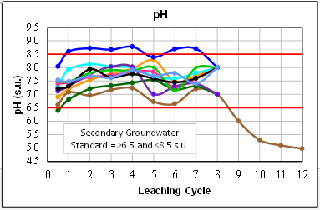
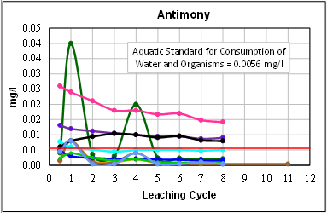
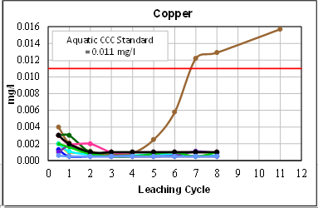
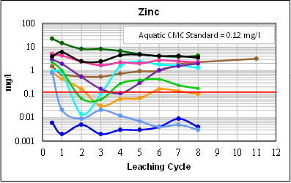
Constituents Exceeding Potentially Applicable Water Quality Standards in Column Leachates

Slide 38
Humidity Cell ARD Test
This test lasted for 103 weeks
Notes:
Some of these tests can take a long time

Slide 39
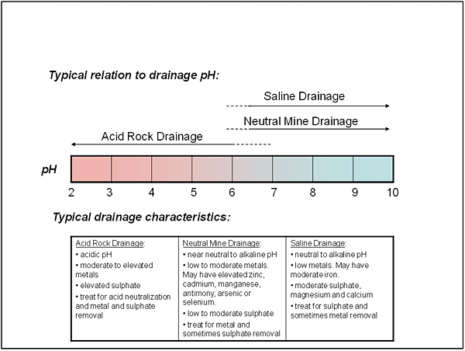
Predicting and Preventing ARD
Global Acid Rock Drainage Guide (2014 GARD Guide) developed by International Network for Acid Prevention
  Prediction
  Prevention
  Management

Slide 40
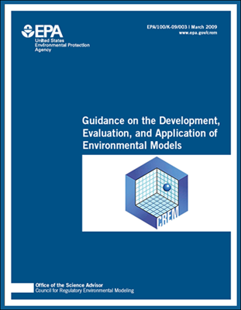
Predicting Water Quality-
Modeling
Modeling techniques have improved and are more complicated; they are still predictions
See EPA guidance:
  Limit use of proprietary models – transparency and good science
  Perform sensitivity and uncertainty analysis
  Effective communication between modelers, analysts and decision-makers
  http://www.epa.gov/CREM

Slide 41
Surface Water and Groundwater Impacts Prevention/Control
Goals:
  Minimize contact between mine wastes and water
  Maximize water reuse
Prevention/Control:
  Backfill
  Segregation of reactive rock
  Divert surface waters and precipitation around site
  Containment – covers, liners
  Evaporation
  Collection and treatment

Slide 42
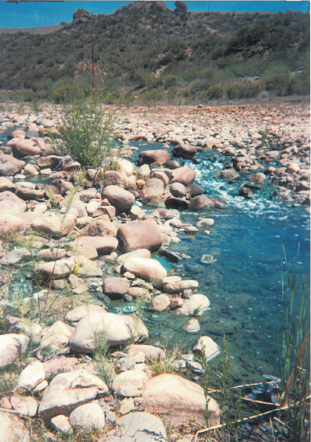
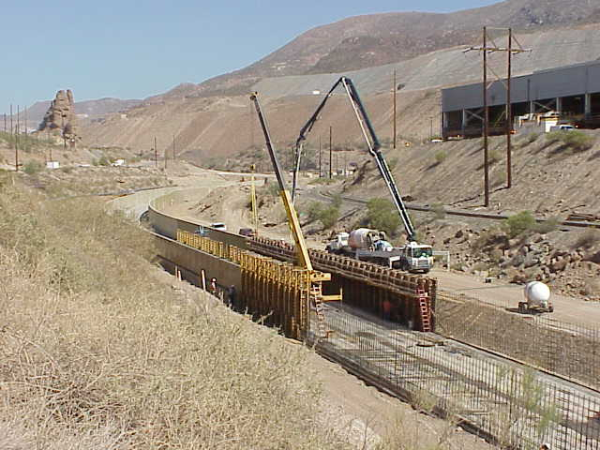
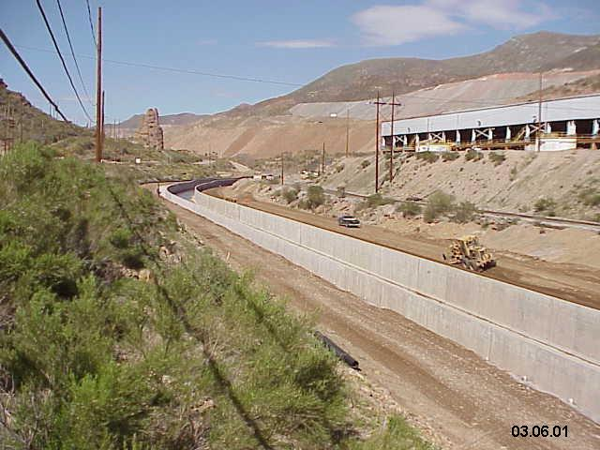
Evaporation and Physical Controls
Ray Mine, Arizona

Slide 43
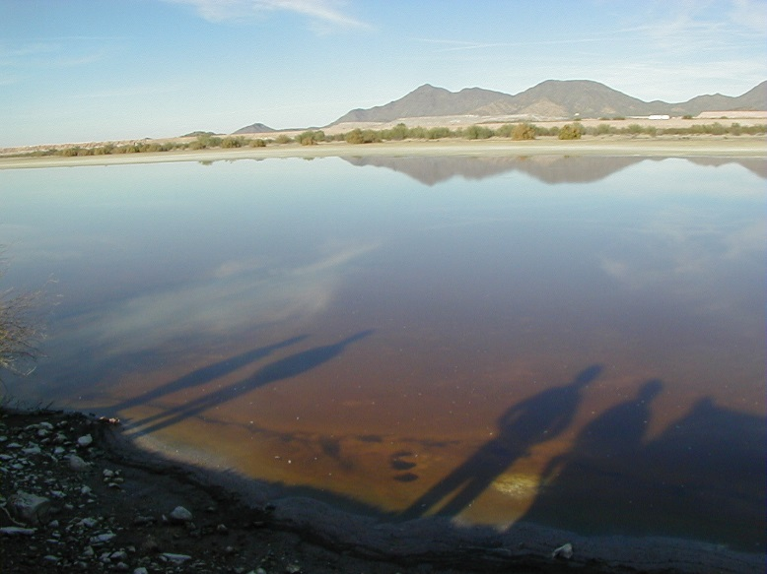
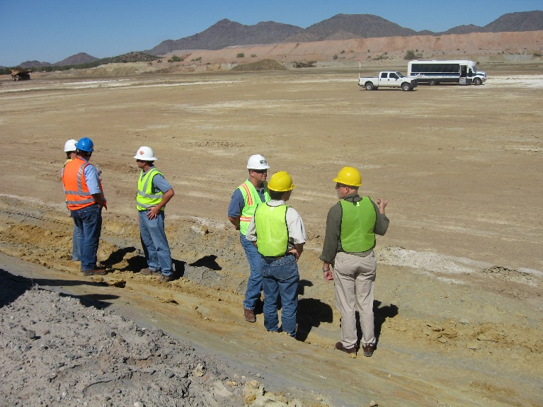
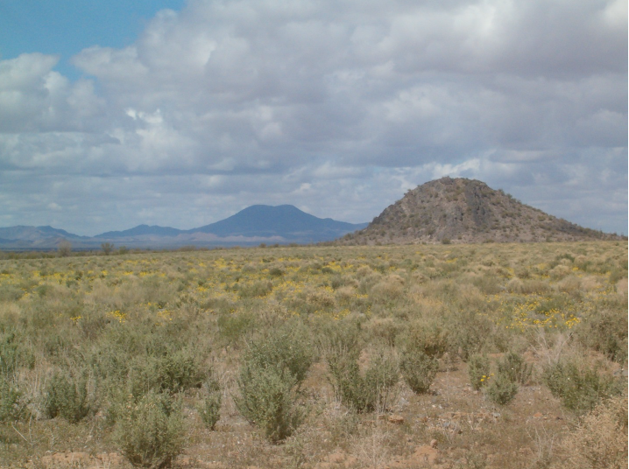
Regrading, Recontouring and Covers
Evaporation Ponds, 2002
Cyprus Tohono, AZ
Evaporation Ponds, 2007
Evaporation Ponds, 2013

Slide 44
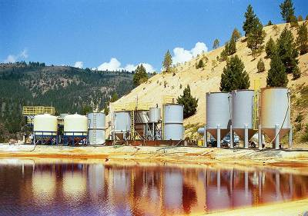
Water Treatment Measures – Metals
Chemical
  Precipitation
  Ion exchange
Biological
  Wetlands
  Bioreactors
Physical
  Settling
  Filtration
Leviathan Mine, California

Slide 45
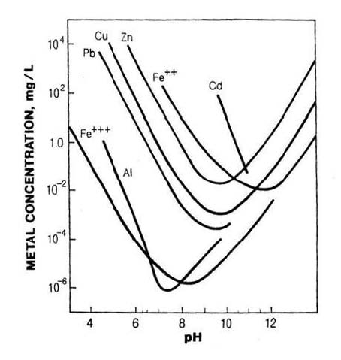
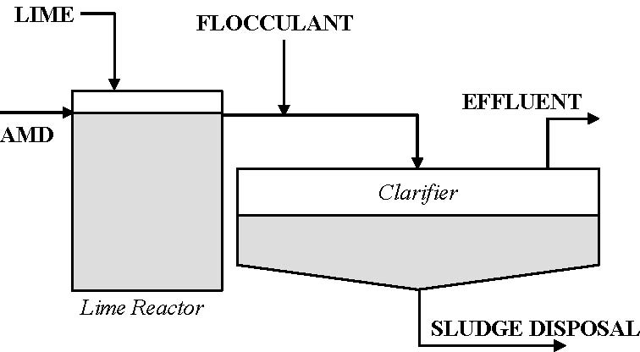
Active Water Treatment
Conventional Lime Treatment

Slide 46
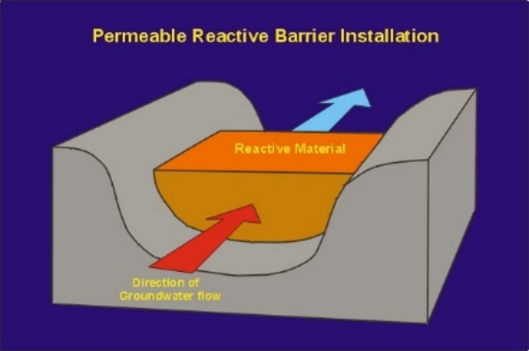
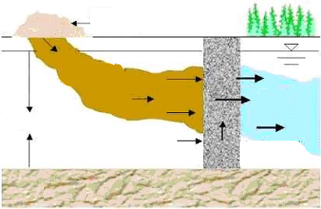
Semi-Passive Reactive Barriers

Slide 47
Water Treatment Measures – Cyanide
Chemicals added to cyanide containing wastewater to destroy cyanide
  Inco sulfur dioxide process
  Noranda copper and ferrous sulfate process
  Alkaline chlorination
  Hydrogen peroxide
Or cyanide can be recovered
  AVR recovery process

Slide 48
Soil- and Land-based Impacts
Direct impacts:
  Physical alteration/loss of habitat and vegetation
  Soil contamination (particles, contained metals)
  Vegetation contamination
Indirect impacts:
  Wildlife
  Subsistence users

Slide 49
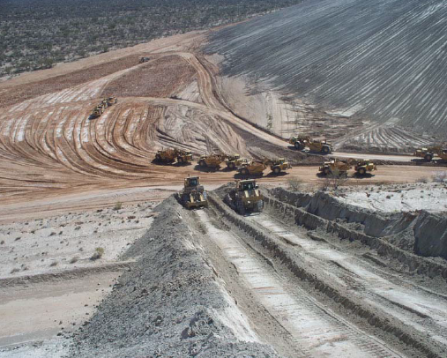
Soil- and Land-based Concerns
Prevention and control measures
  Minimize footprint
  Backfill tailings
  Backfill waste rock
  Consolidate wastes
  Reclaim/revegetate
  Cover/caps of waste
  rock and tailings
Mission Mine, AZ

Slide 50
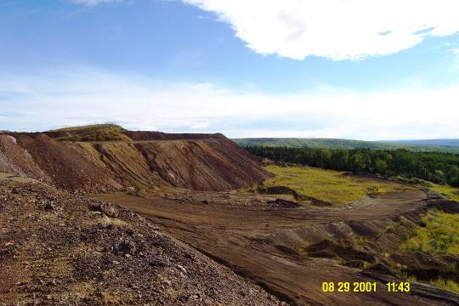
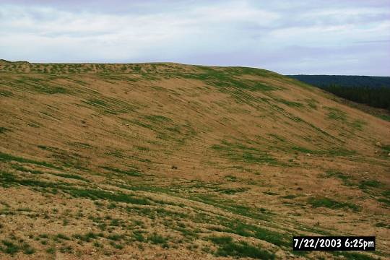
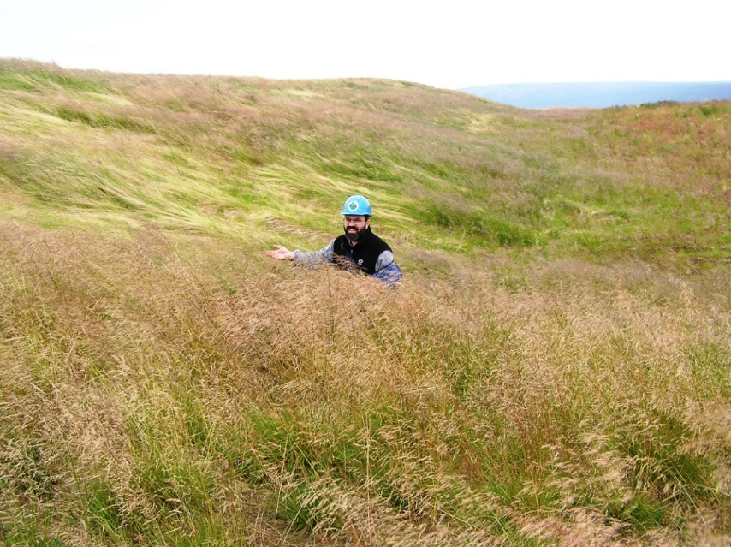
Illinois Creek Reclamation
Illinois Creek Mine Dumps
Initial Recontouring and Seeding
Success

Slide 51
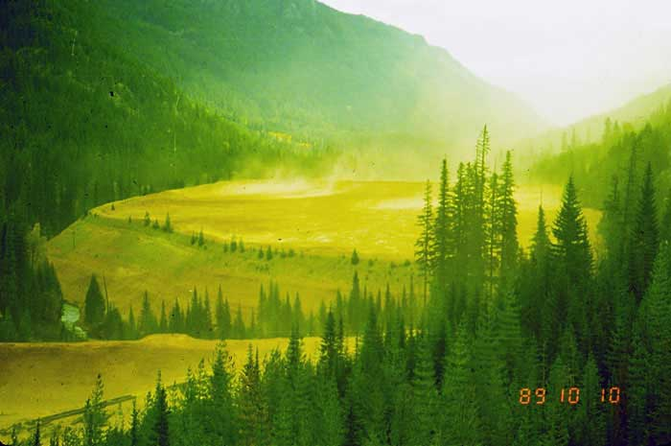

Air Concerns
Issues from dust or chemical emissions
Metals emissions can
impact, sediment, water quality,
and aquatic life
  Impacts on health of workers
  and nearby residents
Sources
  Open pits
  Waste rock piles
  Ore crushing
  Dry tailings
  Roads
Notes:
Not sure where the picture is from.

Slide 52
Air Emissions – Sources
Heat-using Mineral Processing Equipment:
  roasters and autoclaves
  carbon kilns
  furnaces and refineries
Power Sources:
generators
engines
Contaminants:
sulfur dioxide
carbon monoxide
nitrogen oxides
Contaminants:
mercury
arsenic
Notes:
Combine 39 & 40

Slide 53


Dust Issues – Prevention/Control
Watering roads/piles
Use of dust suppressants
Enclose conveyors to mill
Cover trucks
Control technologies –
scrubbers, filters
Reclaim/revegetate
Red Dog Crusher, AK

Slide 54
Successful Mine Closure/Cleanup
Physical stability to prevent:
  Potential failures of waste disposal facilities and open pit mines
  Long-term erosion and air emissions
Chemical stability to prevent:
  Poor quality leachate or runoff from waste disposal facilities
  Poor mine pit water quality or underground mine water quality
Biological stability
  Establish vegetative cover for long term
Land use
  Long-term ownership and control of mined lands
  Safe access to mined lands
  Productivity of the mined lands

Slide 55

Mine site Clean-up
Notes:
Picture- Clean up of mill tailings and groundwater at the Moab Umtra site (uranium mine) (Dept of Energy)

Slide 56
When things go wrong…
State and Federal Media Compliance Programs
State Contaminated Sites Programs
EPA, BLM, USFS – Comprehensive Environmental Response Compensation and Liability Act (CERCLA)
Notes:
The next Part of training will go into reclamation as part of mine administration

Slide 57

CERCLA (Superfund)
Provides legal authority to respond to release of a hazardous substance, any pollutant or contaminant which may present an imminent and substantial endangerment.
Addresses all media, but does not cover releases of petroleum.
Can be used at active or abandoned sites.
Berkley Pit, MT
Notes:
Provides legal authority to respond to release of a hazardous substance, any pollutant or contaminant which may present an imminent and substantial endangerment: In response to environmental disasters, such as the contamination from Love Canal in Buffalo, New York, Congress, in 1980, enacted CERCLA to provide the federal government with unique and distinct authorities to take action in response to releases that threaten human health and the environment in the event responsible parties do not take prompt action. Specifically, CERCLA provides direct federal authority to respond to a release or substantial threat of a release of a hazardous substance or any pollutant or contaminant. Under CERCLA, “release” is broadly defined to include “any spilling, leaking, pumping, pouring, emitting, emptying, discharging, or disposing into the environment.”
Addresses all media, but does not cover releases of petroleum: Congress specifically excluded from the definition of “hazardous substance” petroleum, including crude oil or any fraction thereof, which is not otherwise specifically listed or designated as a hazardous substance. In addition, the definition of “hazardous substance” does not include natural gas, natural gas liquids, liquefied natural gas, or synthetic natural gas usable for fuel (or mixtures of natural and synthetic gas). Responses to discharges of petroleum to navigable waters are covered by the CWA and the Oil Pollution Act (OPA).
Can be used at active or abandoned sites: Historically, CERCLA has been used as a tool to implement cleanup activities at a large number of mining and mineral processing sites across the country. Mining sites are some of the largest, most complex and costly Superfund sites. About 77% of mine sites are greater than 100 acres and 50% are greater than 500 acres. While mining sites represent only seven percent of the sites on the National Priorities List (NPL), they represent 19% of the NPL mega-sites (response costs for the site are greater than $50 million).
Instructor Note: CERCLA does not create a regulatory program. Although CERCLA establishes various reporting requirements for facilities that release hazardous substances into the environment, it does not authorize EPA to create a regulatory program and issue permits to emit or discharge pollutants into the environment like the CAA, CWA, SDWA, or RCRA.

Slide 58

Response Authorities under CERCLA
Includes removal or remedial actions
Requires cleanups comply with the National Contingency Plan (NCP) and applicable or relevant and appropriate requirements (ARARs) of other environmental laws.
Notes:
Response authorities under CERCLA: CERCLA authorizes three types of responses to the release of a hazardous substance or any pollutant or contaminant that may present an imminent and substantial danger to public health. CERCLA defines “response” or “respond” to include removal actions, remedial actions, and enforcement activities related to removal or remedial actions. The lead agency is the agency that provides the On Scene Coordinator (OSC) or Remedial Project Manager (RPM) to plan and implement response actions under the National Contingency Plan (NCP). EPA, the United States Coast Guard (USCG), another Federal agency such as the USFS under the Department of Agriculture, or a state operating pursuant to a contract, cooperative agreement, or Superfund Memorandum of Agreement may serve as the lead agency for a response action. The lead agency will consult with the support agency if one exists, throughout the response process. The support agency means the agency or agencies that furnish necessary data to the lead agency, review response data and documents, and provide other assistance as requested by the OSC or RPM.
Removal action: A removal action is often a short-term action designed to stabilize or clean up a hazardous waste site that poses an immediate threat to human health or the environment. Removal actions also may be conducted to respond to accidental releases of hazardous substances. In addition, removal actions may be taken to abate short-term threats at a site and facilitate a long-term remedial response.
Remedial action: Remedial actions generally are used to respond to long-term and chronic releases. Remedial actions usually are more costly and are intended to achieve a permanent solution for risks to human health and the environment.
Enforcement action: CERCLA provides enforcement authorities for EPA to obtain settlements or to compel potentially responsible parties (PRPs) to implement removal or remedial actions at sites where a release of a hazardous substance occurred for which the parties are liable. CERCLA also provides authority to seek reimbursement from responsible parties, when the Agency has spent trust fund monies to finance removal or remedial actions.
Requires cleanups comply with the National Contingency Plan (NCP) and applicable or relevant and appropriate requirements (ARARs) of other environmental laws: The NCP is set forth at 40 Code of Federal Regulations (CFR) Part 300 and provides the blueprint for conducting Superfund response actions. CERCLA provides that response actions should be in accordance with the provisions of the NCP. In particular, removal and remedial actions must be performed in a manner not inconsistent with the NCP in order to recover costs from responsible parties liable for the release of hazardous substances.
In part, to avoid simply transferring contamination from one medium (air, soil, or water) to another, CERCLA response actions must attain (or justify a waiver of) all ARARs of other Federal environmental laws, as well as more stringent state environmental and siting laws, and state or tribal laws governing the siting of facilities. Specifically, “cleanup standards” for responses under CERCLA typically are governed by other environmental laws and standards that are determined to be ARARs. ARARs may include any standard, requirement, criterion, or limitation under any Federal environmental law (such as the CAA, CWA, or RCRA) and any promulgated standard, requirement, criterion, or limitation under a state environmental or facility-siting law (including those under programs approved by EPA). States and tribal governments are required to identify its ARARs to EPA in a timely manner.

Slide 59

Abandoned Mine Lands
Thousands of abandoned mines in the nation (estimates vary)
Issues with surface and groundwater contamination
Safety Concerns
Efforts by EPA, BLM, USFS, USGS and States
(abandonedminelands.gov)
Notes:
Resource- AbandonedMineLands.gov

Slide 60

Steps in the CERCLA Response Process
Notes:
Steps in the CERCLA Cleanup Process: Although there are differences in types of responses and circumstances presented by each site, the steps to be taken to identify the site, assess the extent of contamination, achieve cleanup, and close out a site follow a general framework established by the NCP. The basic steps in the CERCLA response process are:
Discovery and notification: This includes methods for discovering a release of hazardous substances that may threaten human health and the environment. CERCLA established requirements for facilities report a release of hazardous substance in an amount equal or greater than its Reportable Quantity (RQ) to the National Response Center. Other methods of discovering releases include inspections by federal, state, and tribal authorities. Inspections are a very important way to get CERCLA referrals. Federal, state, and tribal governments and local agencies conduct facility inspections for many purposes, such as, RCRA, CAA, building code inspections, and utility work. During their onsite visits, they will identify triggers for action pursuant to CERCLA or OPA and report the same to EPA. These field inspections can be an important source of discovering a release or a threat of release.
Assessment: Once a site has been discovered or a release has occurred, EPA, the USCG, state, another federal agency, tribal government, or a local agency will verify or assess the data provided; evaluate the information to determine whether a release of hazardous substances has occurred; and if necessary, conduct a response. Assessments evaluate contaminants of concern, exposure pathways, and potential receptors. The assessment process includes the review of all available information as well as sampling for any other necessary information. The process is broad in its application and is a powerful tool in evaluating environmental risks posed by a site. Both the removal program and remedial program establish assessment protocols. The specific requirements for each protocol is in the NCP. CERCLA requires EPA to determine priorities among releases throughout the United States for the purpose of taking remedial action and removal action (taking into account the potential urgency of such action). The NPL is a list of the highest priority sites where releases of hazardous substances have occurred in the United States.
Decision: The Superfund Program has two primary focuses: the removal response program and the remedial response program. The two paths can be separate or concurrent. Each path requires the lead agency to issue a Decision Document describing the need to take action at the site and documenting the selected remedy. For removal actions, the Decision Document issued is called an Action Memorandum (AM). At CERCLA remedial actions, the lead agency will issued a Record of Decision (ROD). Remedial actions require a more detailed study called a remedial investigation/feasibility study (RI/FS) to determine the selected remedy.
Cleanup: This phase of the response process includes designing the selected remedy (remedial design) and constructing the selected remedy as identified in the AM or ROD.
Close out: This phase of the response process refers to operation and maintaince (O&M) of the constructed remedy. It also identifies various milestones EPA has established to measure progress at completing the response, including deleting the site from the NPL upon determining that all necessary remedial response actions at the site have been met. The closeout phase also includes reviews of the remedy required under CERCLA at least every five at those remedial actions that leave hazardous substances at the site above concentrations that do not allow for unlimited use and unrestricted exposure (UU/UE).
Under CERCLA, enforcement and community engagement activities occur throughout the response action. Enforcement activities include identifying potentially responsible parties (PRPs) and using enforcement authorities provided by CERCLA to negotiate or compel responsible parties to pay for or perform the response. Community engagement refers to activities required by the NCP and other efforts performed by the lead agency to involve the community in a meaningful way during the entire CERCLA response process.

Slide 61



Conventional Remedial Technologies and Approaches at Mine Sites
Chemical Treatment of Contaminated Water
Capping
Excavation and Disposal

Slide 62



Innovative Remedial Technologies and Approaches at Mine Sites
  Passivation
  Phytoremediation
Notes:
Passivation: Passivation of acid-generating material involves oxidizing or protecting the sulfide surface from water and oxygen. Techniques for reducing metal sulfide oxidation involve removing oxygen, water, bacteria, or the sulfide minerals, all of which are contribute to the generation of acid mine drainage. All passivation technologies use a spray-on application, either as a solution (phosphate) or as a slurry (silica). It is one of the few treatment methods that can be used to treat exposed pit walls. Although laboratory and small-scale pilot data are available, this new technology has not been applied on a large scale and there are very limited data on long-term performance. In addition, several studies have indicated that there is an initial release of other constituents into the environment when passivation is applied. Techniques to control and possibly treat this release may be needed and regulatory approval obtained before releasing these constituents. This technology may be used alone or with other technologies.

Slide 63


Green Remediation
EPA Principles for Greener Cleanups
EPA’s core elements of a greener cleanup
Questa Molybdenum Mine Solar Project
Notes:
Example- Questa Mine solar, New Mexico https://www.youtube.com/watch?v=qfpHpkfdBQ0
Also, Forest Service just approved a special use permit for a 10KW solar array on closed Carlota Mine in AZ
EPA Principles for Greener Cleanups: EPA Principles for Greener Cleanups outline the Agency’s policy for evaluating and minimizing the environmental “footprint” of activities undertaken when cleaning up a contaminated site. EPA's Superfund Green Remediation Strategy sets out current plans of the Superfund Remedial Program to reduce the demand placed on the environment during cleanup actions and to conserve natural resources.
EPA’s core elements for greener cleanups involve:
Reducing total energy use and increasing the percentage of renewable energy
Reducing air pollutants and greenhouse gas (GHG) emissions
Reducing water use and negative impacts on water resources
Improving materials management and waste reduction efforts, and
Protecting ecosystem services.
Use of the best management practices (BMPs) recommended in EPA’s series of green remediation fact sheets can help project managers and other stakeholders apply the principles on a routine basis while maintaining the cleanup objectives, ensuring protectiveness of a remedy, and improving its environmental outcome. EPA has prepared a recommended mine site checklist for green remediation and sustainability at mine sites. Here are some examples from the checklist:
Choose quickly renewable agricultural products or industrial byproducts rather than raw natural resources as organic-rich materials wherever possible
Integrate stormwater controls and capture rainwater and snowmelt for onsite use
Minimize site disturbance by reusing remnant
Maximize use of renewable energy systems to power cleanup equipment
Deploy mobile units to generate power from solar or wind resources as needed
Explore use of industrial waste products rather than imported soil for cover systems

Slide 64
Take Home Message
Mining operations involve the movement of large quantities of materials
There are many ways to prevent contamination from occurring and to control or remediate contamination once it happens
Keys:
  Understand waste characteristics, water balance and environmental conditions and UNCERTAINTIES
  Minimize footprint and minimize contact with water
  Design for closure
  Appropriate monitoring and inspection
  Implementation, compliance and enforcement of environmental regulations

Slide 65

Questions and Comments
Next Webinar on NEPA and Mining 101:
June 8th
Part 3- The Regulatory Process and How the Public and Tribes can Engage

