Slide 1
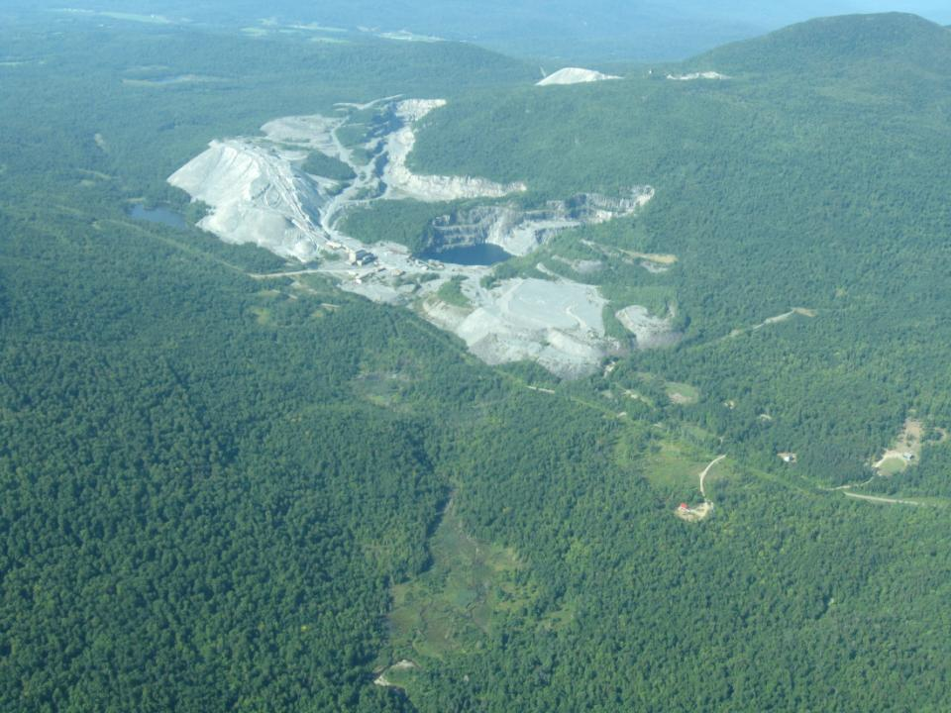
Eden and Lowell, Vermont
VERMONT ASBESTOS GROUP MINE

Slide 2
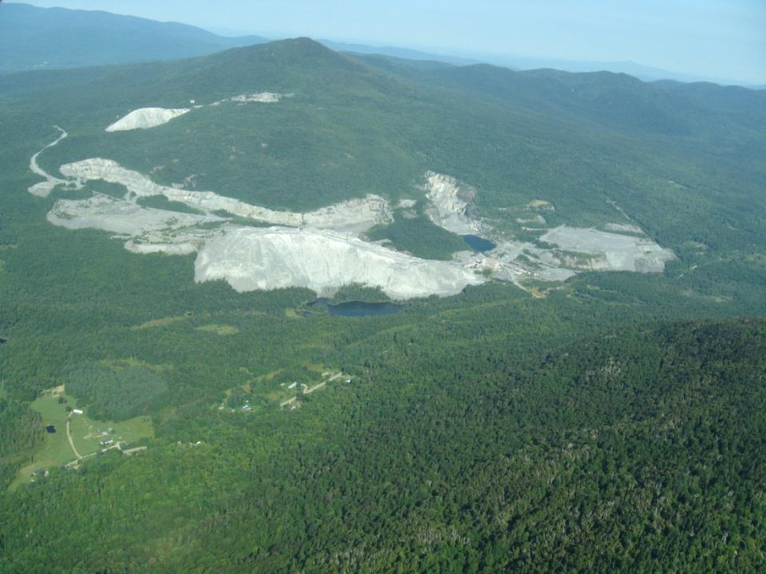

Slide 3
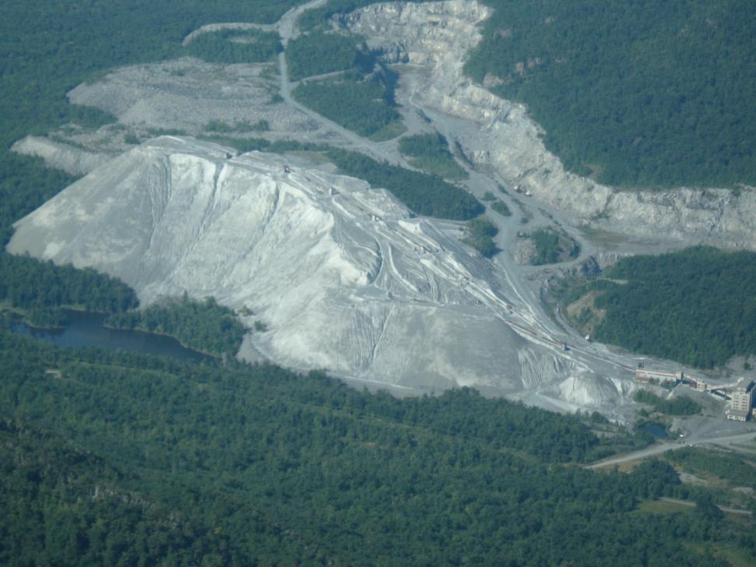

Slide 4
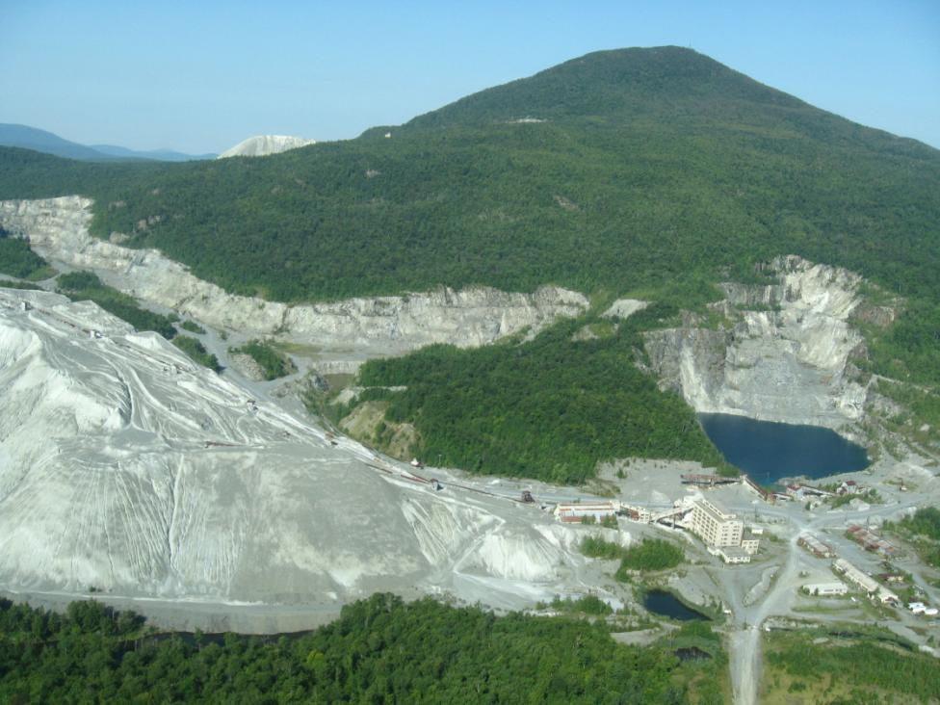

Slide 5
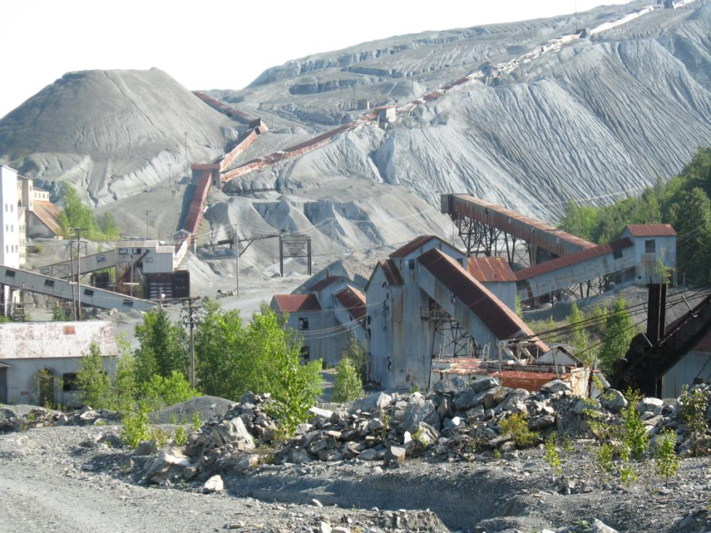

Slide 6
Unstable Tailing Piles, Steep Slopes, Lack of Good Site Closure and Intense Precipitation Events Led to Off-Site Migration

Slide 7
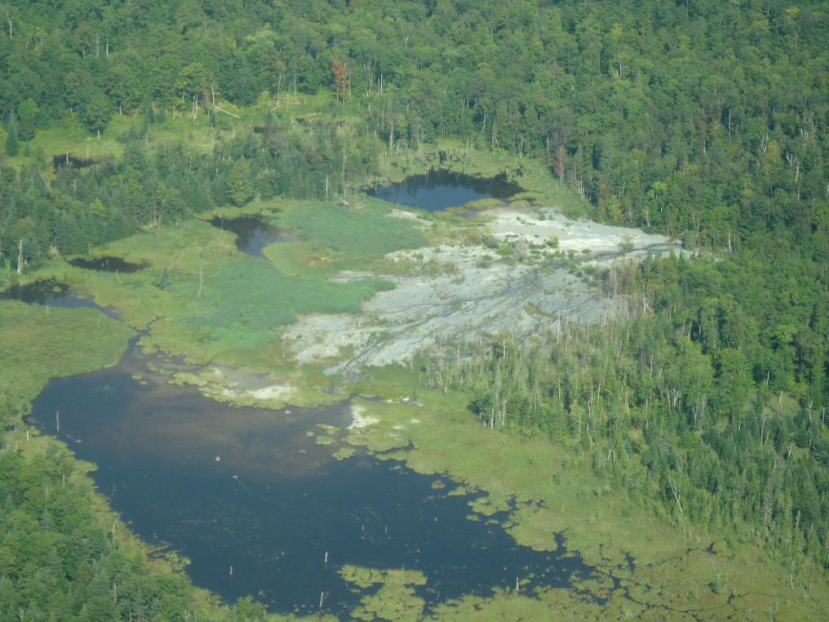

Slide 8
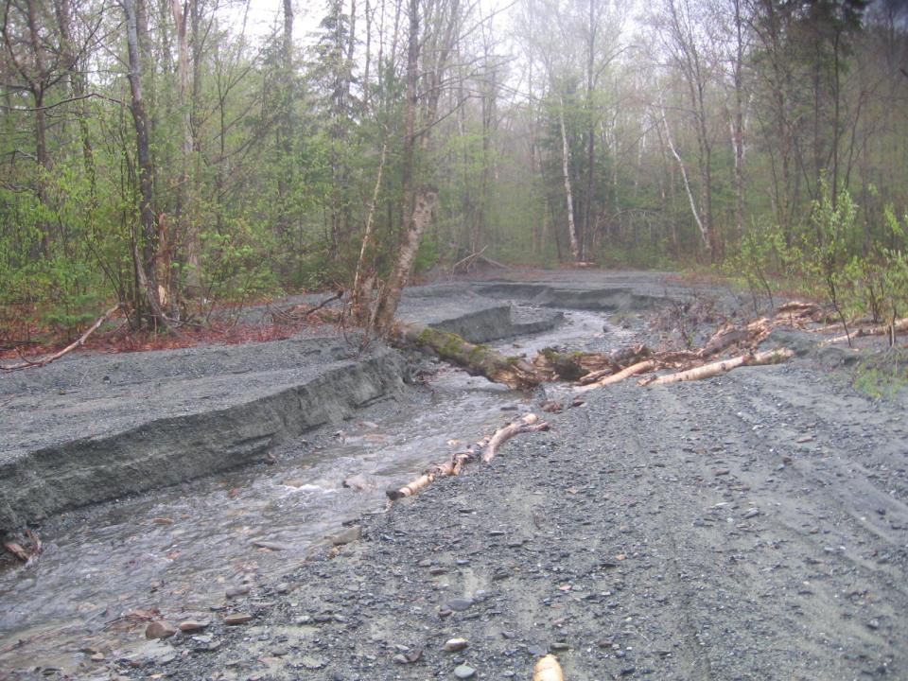

Slide 9
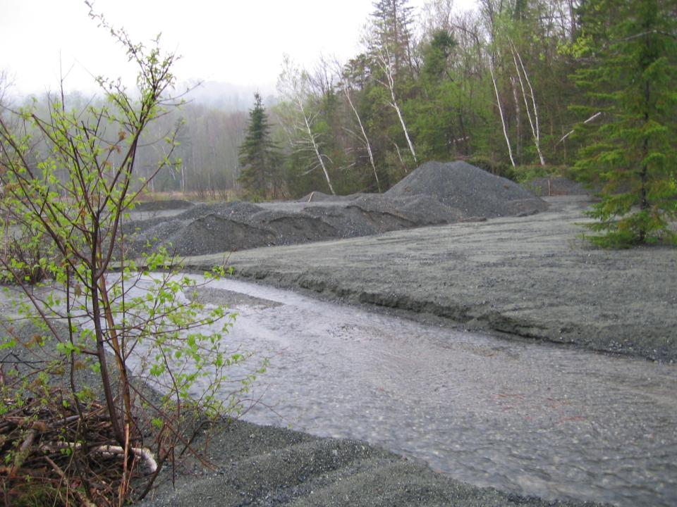

Slide 10
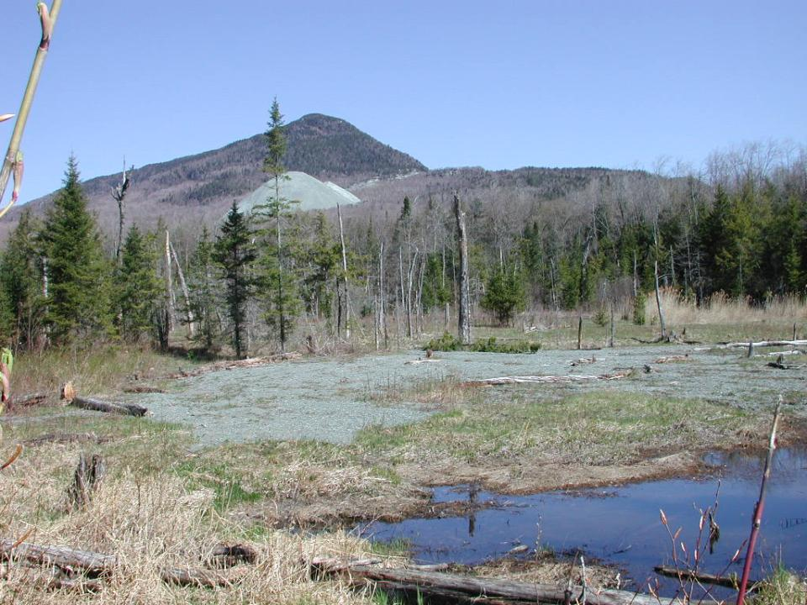

Slide 11
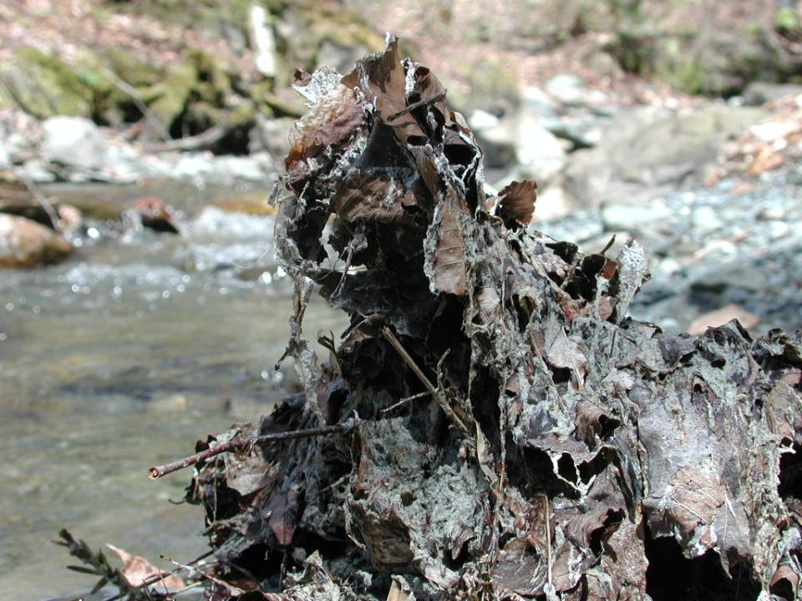

Slide 12
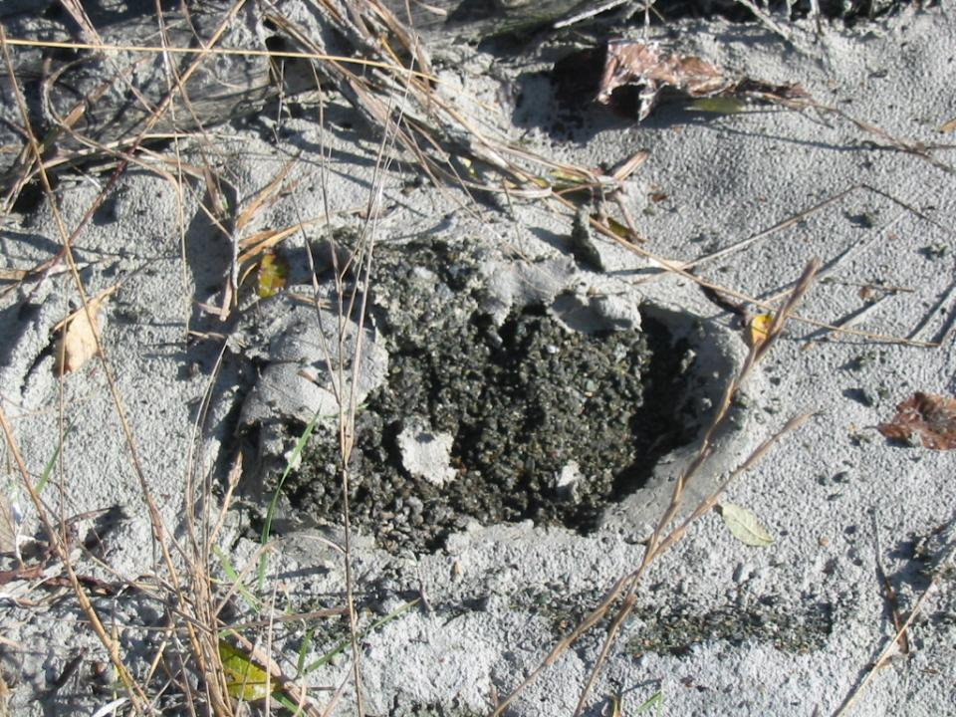

Slide 13
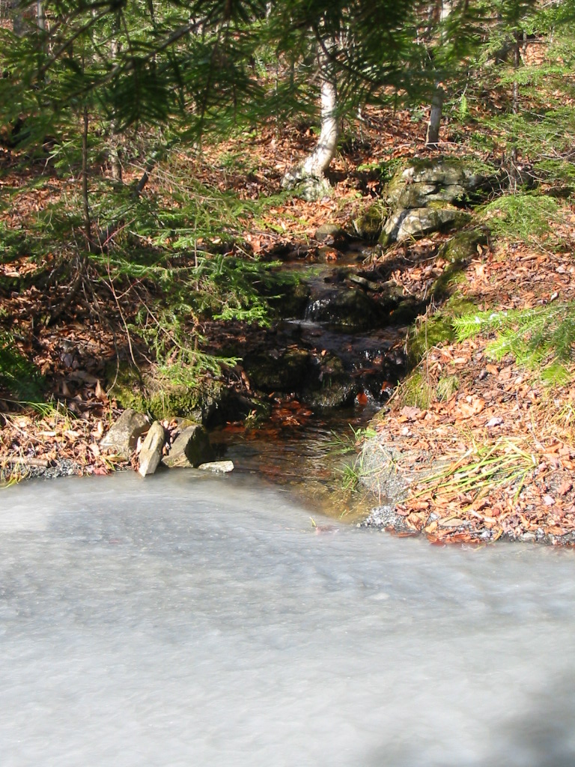

Slide 14
Off-Site Migration of Asbestos Laden Sediment Led to EPA Removal Action

Slide 15
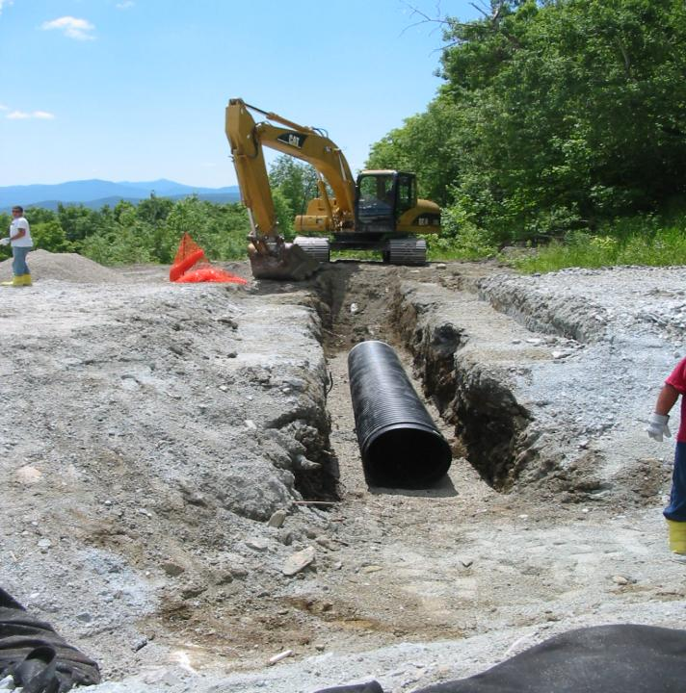

Slide 16
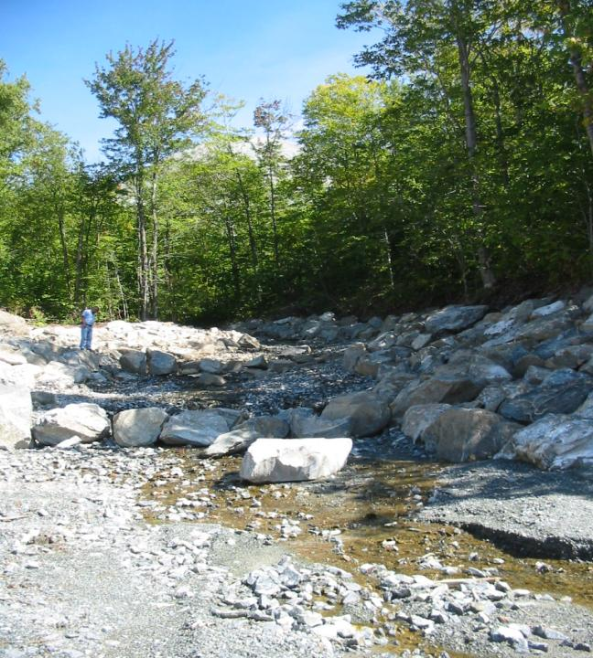

Slide 17
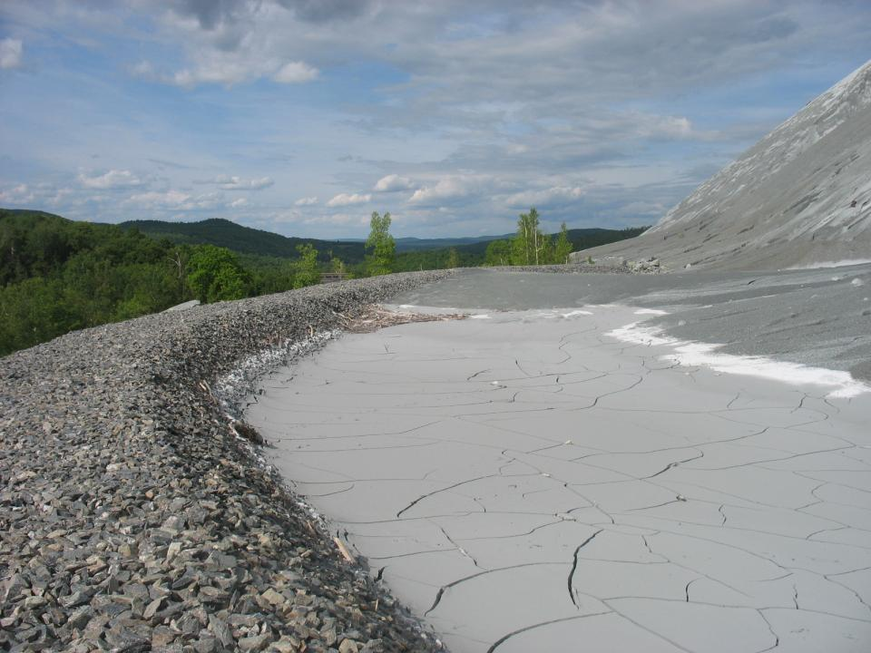

Slide 18
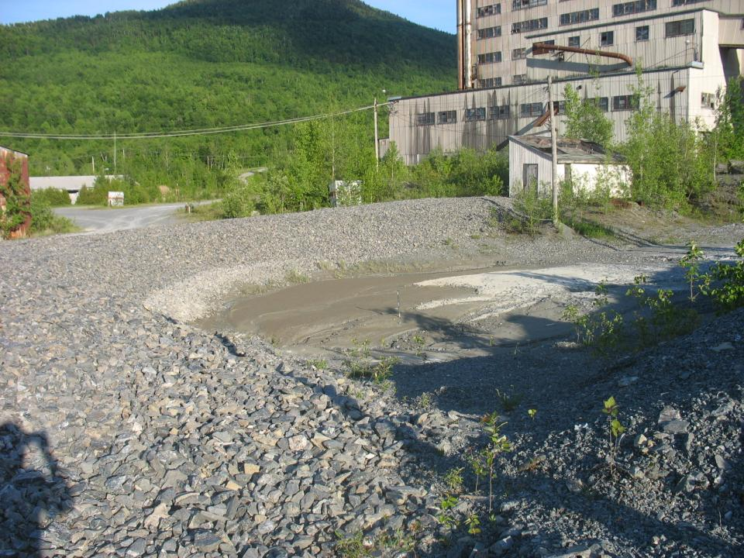

Slide 19
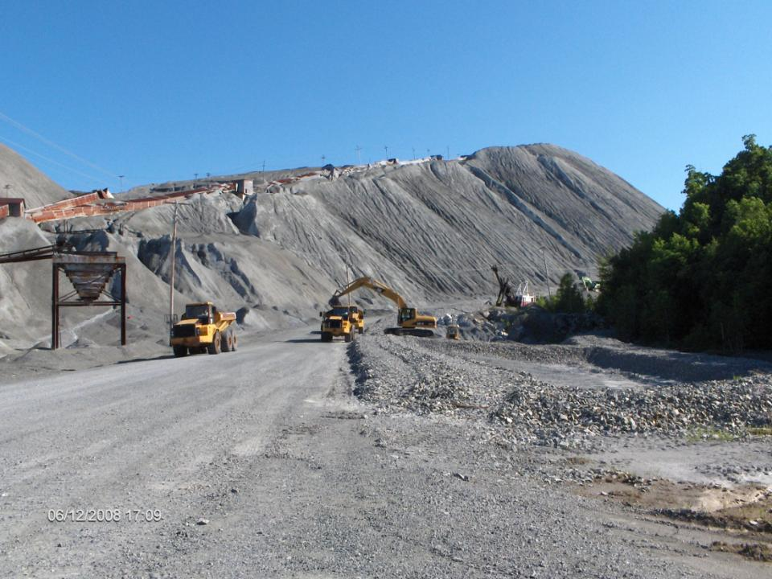

Slide 20
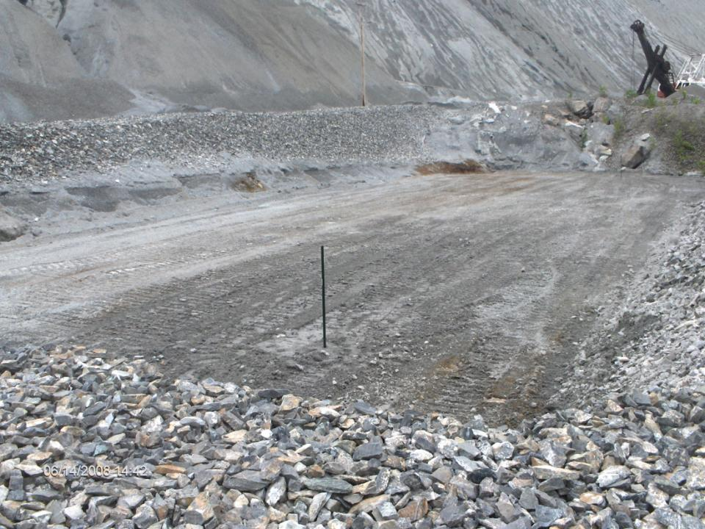

Slide 21
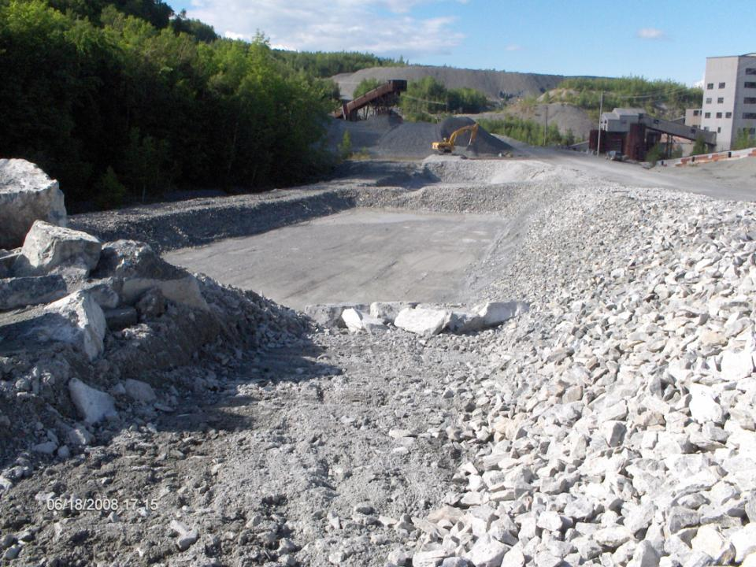

Slide 22
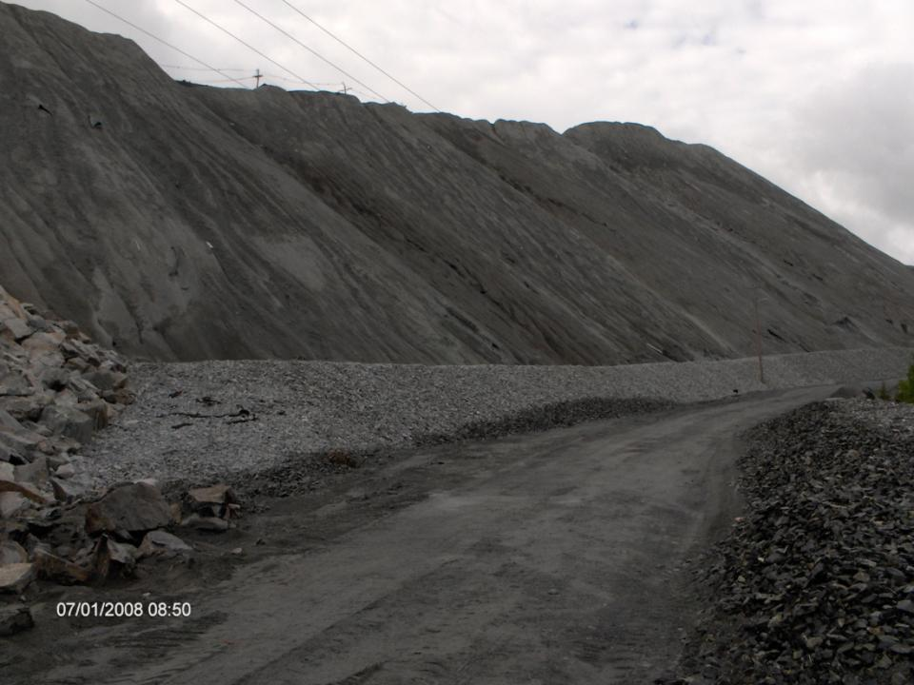

Slide 23
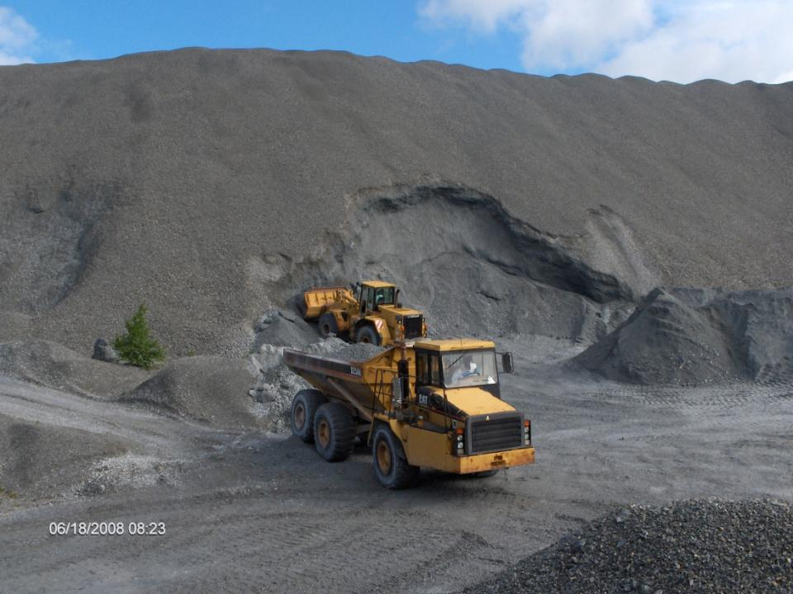

Slide 24
Two years after the removal action, ERT approached Region 1 with an offer to help fund a pilot study that would attempt to grow sustainable vegetation on this inhospitable landscape. The United States Department of Agriculture – Agricultural Research Service worked with the Vermont DEC to collect representative site ‘soil’ in order to run lab tests to determine the optimal amendments and plant species.

Slide 25
Samples of the ‘soil’ matrix were collected and shipped to the USDA laboratory/greenhouse. Nine different plant species were evaluated by attempting growth in a) the control (‘soil’ matrix) b) control + fertilizer (NPK) c) control + compost + NPK d) control + compost + NPK + gypsum e) control + topsoil + NPK

Slide 26
Why fertilizer?
Serpentine soil revegetation studies have shown that
mine wastes are highly deficient in P, Ca, N, and K.
A recommended fertilizer for establishing grass forage
in northern Vermont is 50-100-100 lb/A of NPK
(1:2:2 ratio)

Slide 27
Why compost?
Improves soil structure, porosity, and density
Increases moisture infiltration and permeability of heavy soils, reducing
erosion and runoff
Improves water holding capacity
Supplies a variety of macro and micronutrients
Slow release of N, P, Zn, and Cu
May control or suppress certain soil-borne plant pathogens
Supplies significant quantities of organic matter
Improves cation exchange capacity of soils and growing media (improves
ability of soil to hold nutrients)
Supplies beneficial micro-organisms to soils and growing media
Improves and stabilizes soil pH
This particular compost was a mature product from a local Vermont dairy farm containing manure and yard waste

Slide 28
Why gypsum?
Plant roots on normal plant species do not penetrate into
serpentine subsoils or mine waste with insufficient Ca
Simple Ca deficiency or Mg-induced Ca deficiency will
persist until the Ca:Mg ratio is increased to much higher
levels
Commercial gypsum is a mined product and normally sold in pelletized form. Since this limits the rate of dissolution of Ca to where it can’t satisfy the plant’s Ca requirement, powdered gypsum was used. As reagent chemical powder is extremely expensive, a increasingly available powdered gypsum manufactured during the removal of SO₂ from coal fired power plants (Flue gas desulfurization: FGD-Gypsum) was substituted.

Slide 29
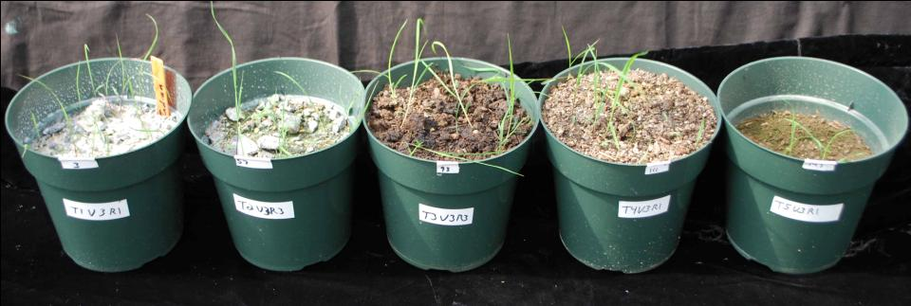
Indiangrass 26 Days from Seeding
Control
Control+NPK
Compost
Compost+Gypsum
Top Soil

Slide 30
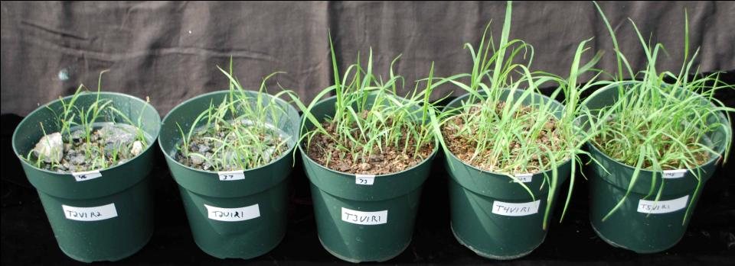
Big Bluestem 26 Days from Seeding
Control
Control+NPK
Compost
Compost+Gypsum
Top Soil

Slide 31
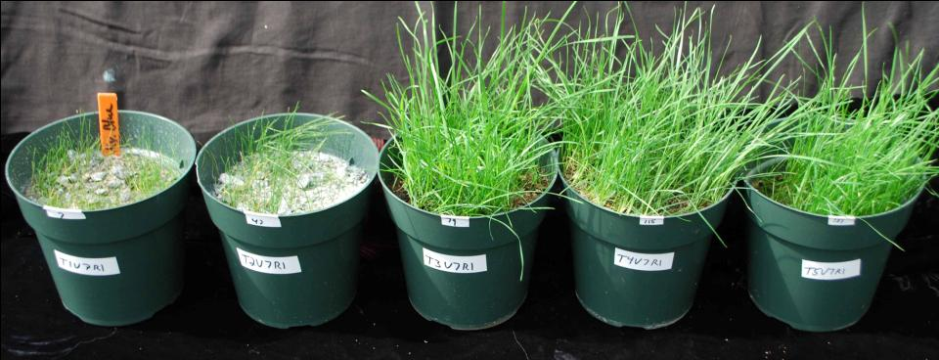
Kentucky Bluegrass 26 Days from Seeding
Control
Control+NPK
Compost
Compost+Gypsum
Top Soil

Slide 32
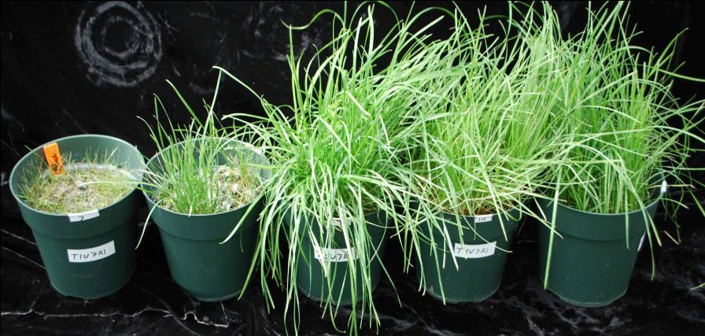
Kentucky Bluegrass 47 Days from Seeding
Control
Compost
Top Soil
Control+NPK
Compost+Gypsum

Slide 33
Analysis of Laboratory Plantings
1) Preparation of pots and seeding
2) Watering and observing treatment responses 3) Harvest of plant shoots for yield measurement and analysis
a) height measured at about 15 cm growth (approximately 6-8 weeks) b) shoots cut at about 2.5 cm for chemical analysis
4) Regrowth of shoots and examination of roots
a) plant growth continued until analysis of shoots are completed
b) depth of root penetration measured

Slide 34
5) Analysis of plant samples a) dried, weighed, dry ashed, and prepped for analysis b) analyzed for Ca, Mg, K, P, Fe, Mn, Zn, Cu, and Ni 6) Analysis of Soil, Mine Waste, and Amendments a) these constituents need to be analyzed so the effects of the amendments can be understood at the end b) analyzed for exchangeable nutrients, phytoavailable phosphorus, total nutrients, and soil solution type extractable nutrients

Slide 35
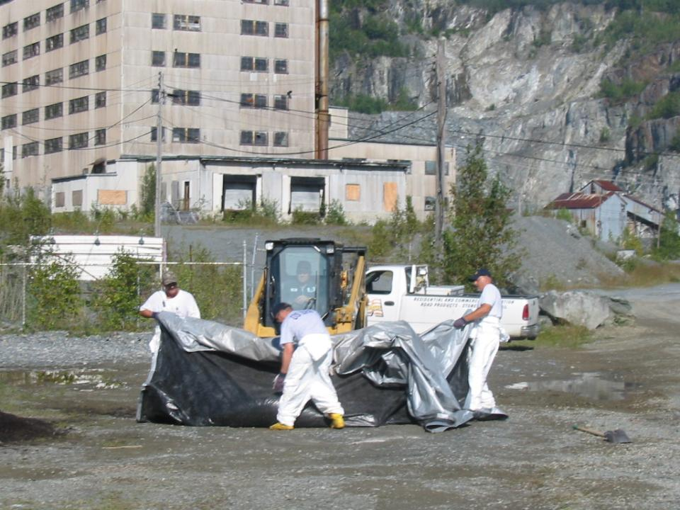
TAKING IT TO THE FIELD

Slide 36
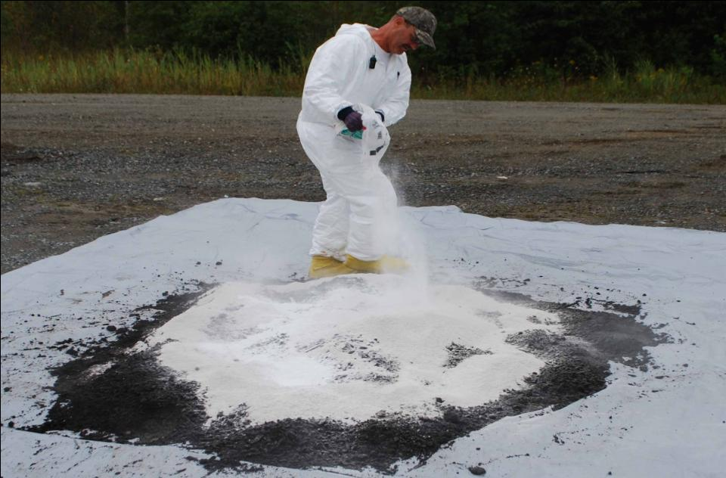
MIXING OF AMENDMENTS AND SEED

Slide 37
Limestone was added to the mixture in the field to offset the acidification of soil from legumes (clover). When legumes fix N, the N is oxidized and generates acidity. If the pH gets to low, the naturally occurring metals in the soil matrix can become phytotoxic.

Slide 38
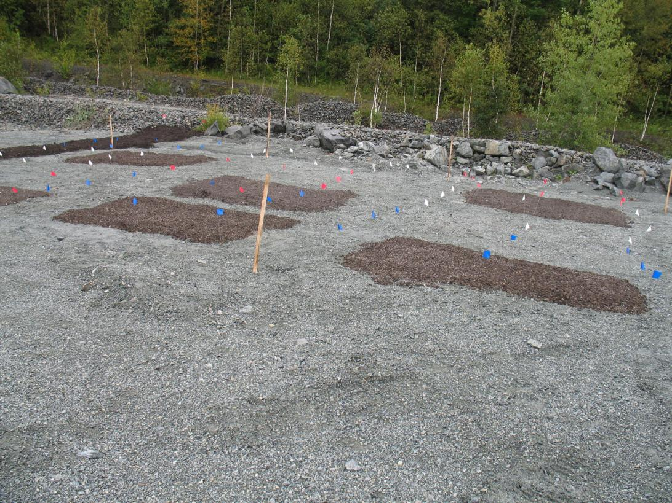

Slide 39
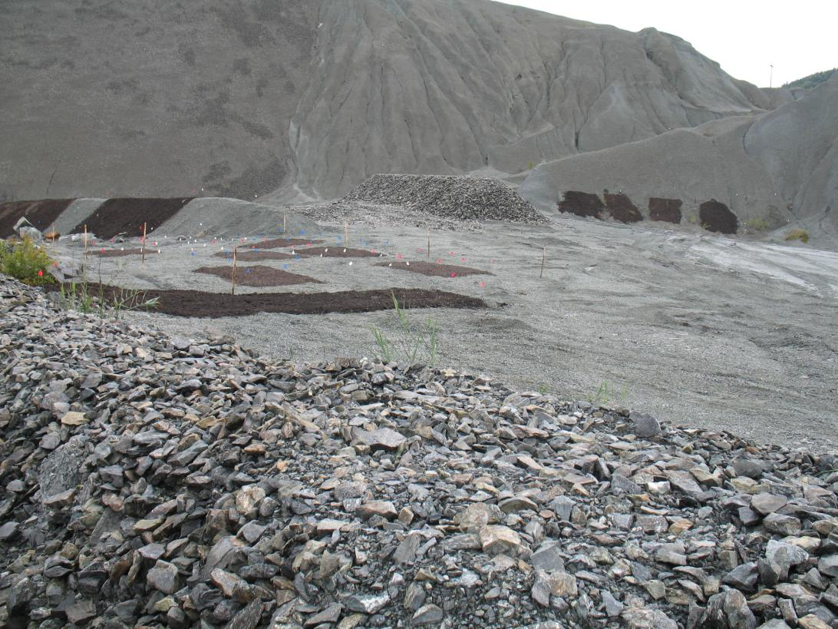

Slide 40
SEPTEMBER 30, 2010 IT IS ALIVE!!!!

Slide 41
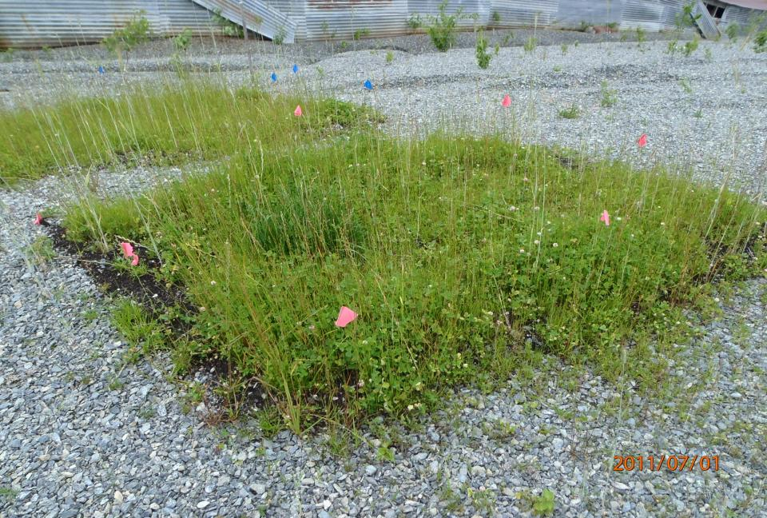
JULY 2011

Slide 42
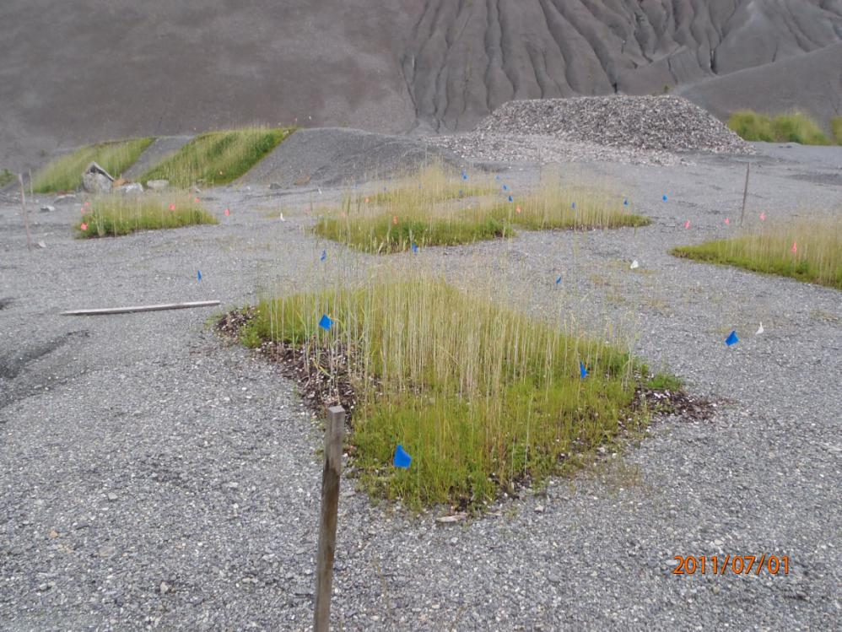

Slide 43
CONTROL PLOT

Slide 44
FIELD SAMPLING JULY 2011

Slide 45
CROSS SECTION OF A FIELD PLOT

Slide 46
ROOTING EXTENDS INTO MINERAL LAYER, WELL BELOW COMPOST

Slide 47
JULY 2012 LOOKING GOOD!

Slide 48
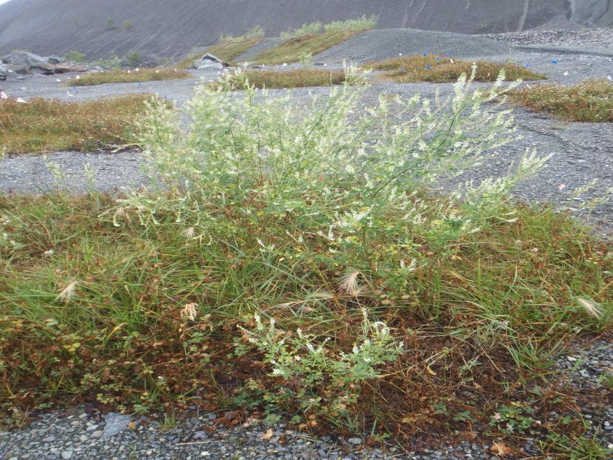

Slide 49
MAY 2013 EMERGING GROWTH

Slide 51
Will it Last? We think so, because: Organic matter routinely deposited Legumes (clover) contain symbiotic bacteria which produce nitrogen. When the plant dies, the nitrogen is released helping to fertilize the soil, ensuring a continuing supply of N Slow release of N, P, Zn, and Cu via compost and fertilizer

Slide 52
WHY WAS THIS PILOT PROJECT SUCCESSFUL? The ‘soil’ matrix was first evaluated for metals, pH, and nutrients Prior knowledge that serpentine soils are severely deficient in Ca and P Evaluated ‘Tailor-Made” amendments and plant species using on-site ‘soil’ in a controlled setting (laboratory /greenhouse)

Slide 53
Amendment mixture included all nutrients needed for plant growth in compost Limestone was added to prevent acidification of compost layer Gypsum was added to boost the Ca in sub-surface soil State and local acceptance

Slide 54
Thanks to Rufus Chaney, Project Director: USDA – Agricultural Research Service, Environmental Management and Byproduct Utilization Laboratory Chris Jennings, Agronomy Technician: USDA – ARS Carrie Green, Lab Manager: USDA – ARS Harry Compton, Project Advisor: EPA/ERT Steven Blaze, Quality Coordinator: EPA/ERT Michele Mahoney, Project Advisor: EPA/Technology Assessment Branch Ellen Rubin, Project Advisor: EPA/TAB John Schmeltzer, Site Manager: VT DEC Linda Elliott, Co-Project Manager: VT DEC

