Slide 1
PCBs in Schools
NIEHS Webinar (April 21, 2014)
Moderator: Mark Maddaloni DrPH, DABT
Introduction
`

Slide 2
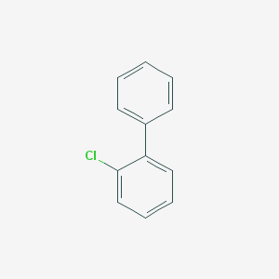
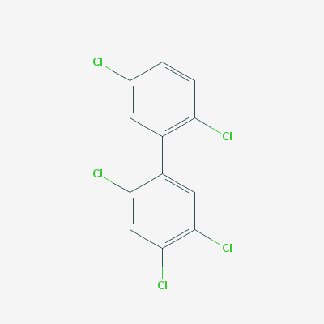
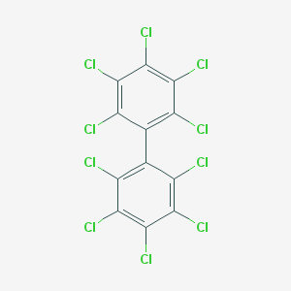
Polychlorinated Biphenyls (PCBs)
209 possible PCB congeners
PCBs are comprised of many similar semi-volatile organic chemicals called “congeners”
PCBs were manufactured in the U.S. as mixtures of congeners from approx.1929 to 1977
“Aroclor” mixtures had the highest U.S. production
PCB 1
PCB 101
PCB 209
Common Aroclors | Chlorine Weight % | Number of Congeners
Aroclor 1221 | 21% | 60+
Aroclor 1232 | 32% | 90+
Aroclor 1016 | 41% | 70+
Aroclor 1242 | 42% | 90+
Aroclor 1248 | 48% | 95+
Aroclor 1254 | 54% | 95+
Aroclor 1260 | 60% | 90+
Aroclor 1262 | 62% | 90+

Slide 3
PCB Congeners in Aroclor Mixtures
Aroclor 1242
>90 PCB congeners in these Aroclor mixtures
Aroclor 1242 (or similar Aroclor 1016) often found in light ballast capacitors
Aroclor 1254 often found in caulk
Differences in amount of chlorine and vapor pressures
Less chlorine
Higher VP
Aroclor 1254
More chlorine
Lower VP

Slide 4
PCB Properties
Electrical insulation
Flame-resistance
Plasticizer
Chemical stability
Durability
Persistent in the environment
Can vaporize and migrate
Persistent in people
Toxic effects
Useful for many applications
Implications for human exposure

Slide 5
PCBs in School Buildings
Possible Uses/Sources
For schools built or renovated from about 1950 to 1979
(potentially >50% of U.S. public school buildings)
Could be or have been in buildings
Motor and hydraulic oil
Electrical device capacitors
Adhesives and tapes
Carbonless copy paper
Paints, coatings and inks
Floor finish
Microscope oil
Have been found in schools
Fluorescent light ballasts
Caulk
Window glazing
Joint sealant
Ceiling tile coatings
Spray-on fireproofing material
Paints

Slide 6
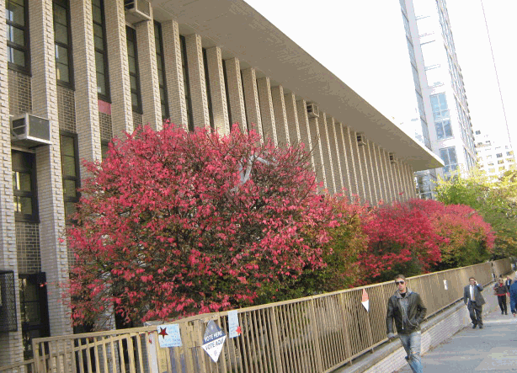
Sentinel School
Brief history of P.S. 199 and events leading to the environmental assessment of PCBs:
P.S. 199
  Elementary (K-6)
  Age (1963)
  Enrollment (880)
  Location (UWS)
How it got on the radar screen
  Herrick (2004, EHP Journal)
    Study of 24 buildings in Boston area
    Samples of exterior caulk
    13 contained PCBs > 50 ppm (70 – 36,200 ppm; mean 15,600 ppm)
  2005 - Concerned parent in NYC suburb (school window replacement in 2003)
    Obtained exterior caulk sample (38,000 ppm)
    Reached out to Daily News
  2008 - Caught attention of P.S. 199 (window replacement occurring)
    Caulk samples obtained → high PCB concentrations (> 100,000 ppm)
    The rest is history

Slide 7
  Indoor air sampling at P.S. 199 revealed indoor PCB concentrations orders of magnitude above urban ambient air background (<1 – 10 ng/m3) ( ATSDR, 2000)
Sample Date | Before HEPA Filtration | After HEPA Filtration |  | After Ventilation |  | No Ventilation | No Ventilation | No Ventilation
 |  | Nighttime | Daytime | Before School Opening | After School Opening |  |  | Daytime
 | 8/23/08 | 8/26/08 | 8/27/08 | 8/26/08 | 10/1/2008 | 1/19/2009 | 5/9/2009 | Jul-2010
Sample Location Unit | ng/m³ | ng/m3 | ng/m³ | ng/m³ | ng/m³ | ng/m³ | ng/m³ | ng/m³
Cafeteria | 230 | 342 | 224 |  | 67 | <53 |  | 596
Classroom 116 |  | - | - | - | 140 | 70 |  | 689
Classroom 118 | - | - | - | - | 81 | 201 | - | 1,444
Classroom 202 |  |  |  |  | 138 | 67 |  | 714
Classroom 308 |  | - | - | 323 | 310 | Sample Void⁽¹⁾ |  | 794
Classroom 316 | 502 | 578 | 495 | 529 | 253 | 186 |  | 409
Classroom 318 |  | - | - | 367 | 251 | 162 |  | 838
Classroom 320 | - | - | 611 | 346 | 207 | 110 | - | 942
Classroom 328 |  |  |  | 687 | 305 | 177 |  | 849
Gymnasium | 402 | 565 | 550 | - | 242 | 325 | - | 1,347
Outdoor Ambient (east of school) | <50 | <50 | <50 |  | <49 | <48 | Sample Void ⁽⁵⁾ | ND
Stairwell, Main Entrance Second Floor Landing |  |  |  |  |  |  |  | 545
Third Floor North Corridor (First) |  |  |  |  |  |  |  | ND
Third Floor North Corridor (Second) |  |  |  |  |  |  |  | 714
Notes:
Develop Risk Based Screening Value

