Slide 1
PCBs in Schools
International Experience:
Inventory, Remediation and Outcomes
Niklas Johansson
Karolinska Institutet and
Melica Biologkonsult

Slide 2
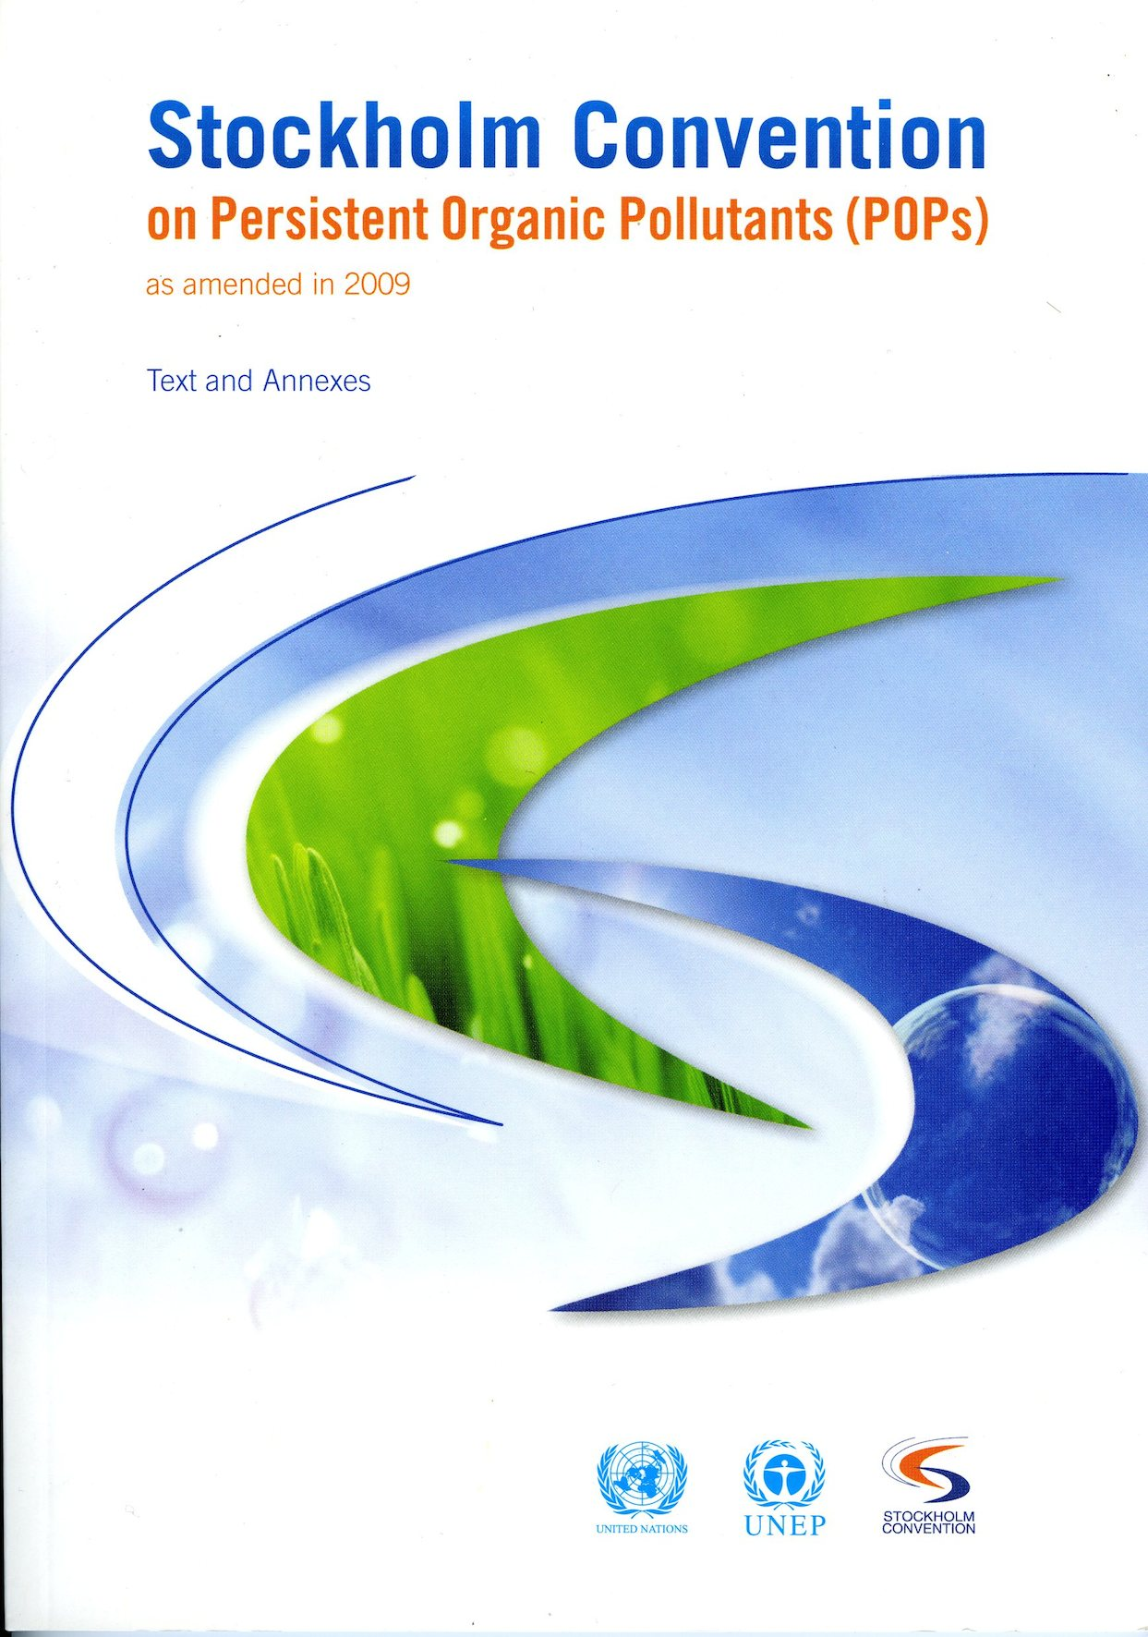
The Stockholm Convention on POPs
One of three global conventions with the common objective of protecting human health and the environment from hazardous chemicals and wastes
179 parties and 5 further signatories
Went into force in 2004
Regulates production and use of POPs
PCBs listed in two annexes, (A) elimination and (C) unintentional production

Slide 3
SC regulation and actions on PCBs
Regarding liquid PCB, each Party shall:
  Make determined efforts to identify, label and remove equipment containing >0.05% PCB and volumes >5 litres
  Endeavour to identify and remove from use equipment containing >0.005% PCB and volumes >0.05 litres;
  Make determined efforts to apply environmentally sound waste management of liquids and equipment containing > 0.005% as soon as possible but no later than 2028
But also:
  Endeavour to identify other articles containing >0.005% PCB and manage them in accordance with §1 of Article 6 (on handling, labelling and disposal)

Slide 4
SC regulation and actions on PCBs
In 2008, global existence of PCBs estimated to be up to 2.9 million tonnes.
Despite many countries’ efforts in establishing PCB inventories, eliminating old equipment, and ensuring environmentally sound disposal of PCBs, much more work is still required in large parts of the world.
As a consequence, the establishment of PCBs Elimination Network (PEN) was proposed and later endorsed by the Conference of the Parties to the Convention in 2009.
  PEN is focussing on dissemination of information on how to meet the SC targets.
  This is done with printed guidance material and at workshops held worldwide

Slide 5
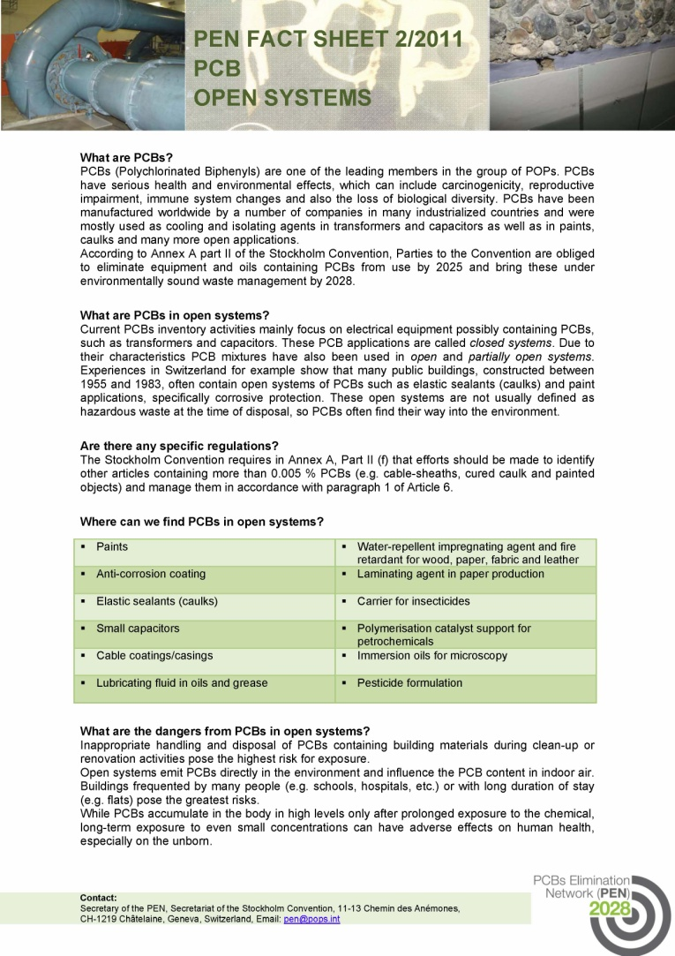
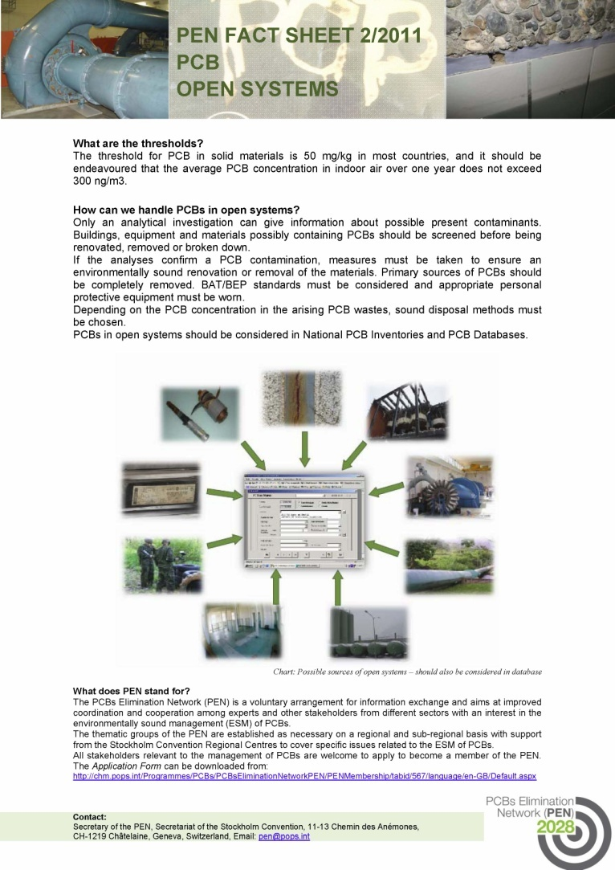
PEN factsheets on open applications

Slide 6
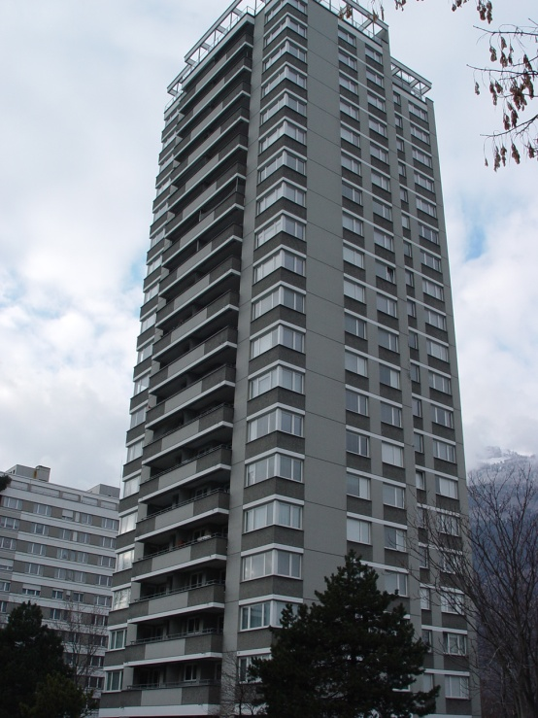
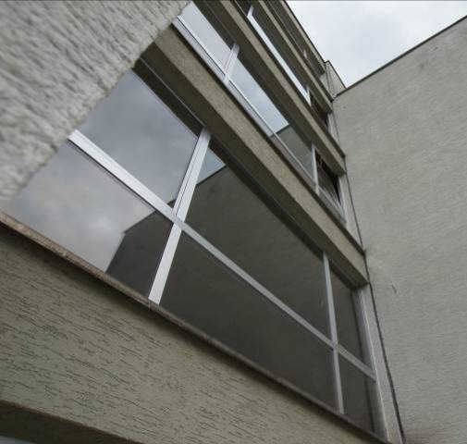
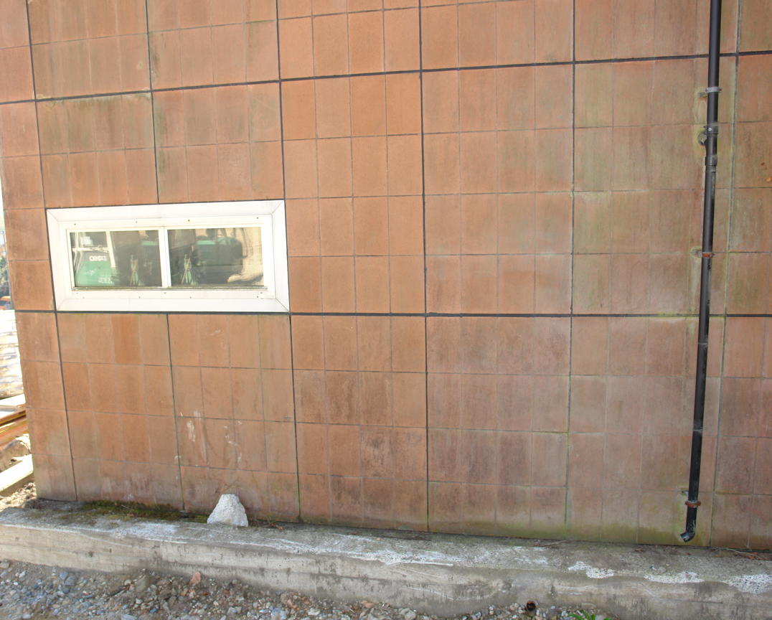
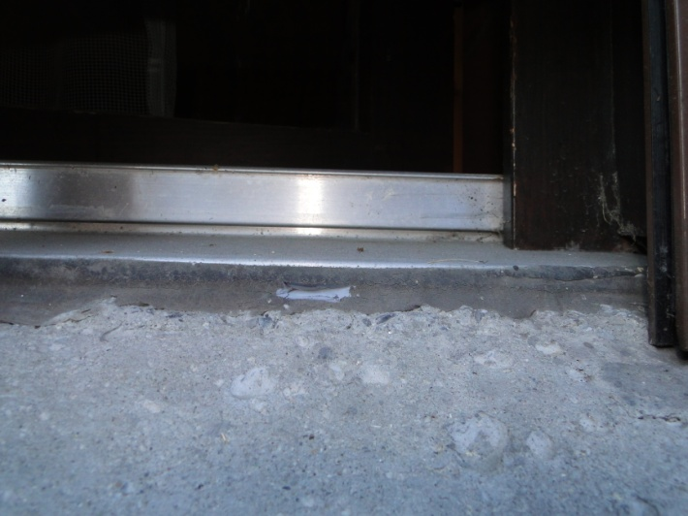
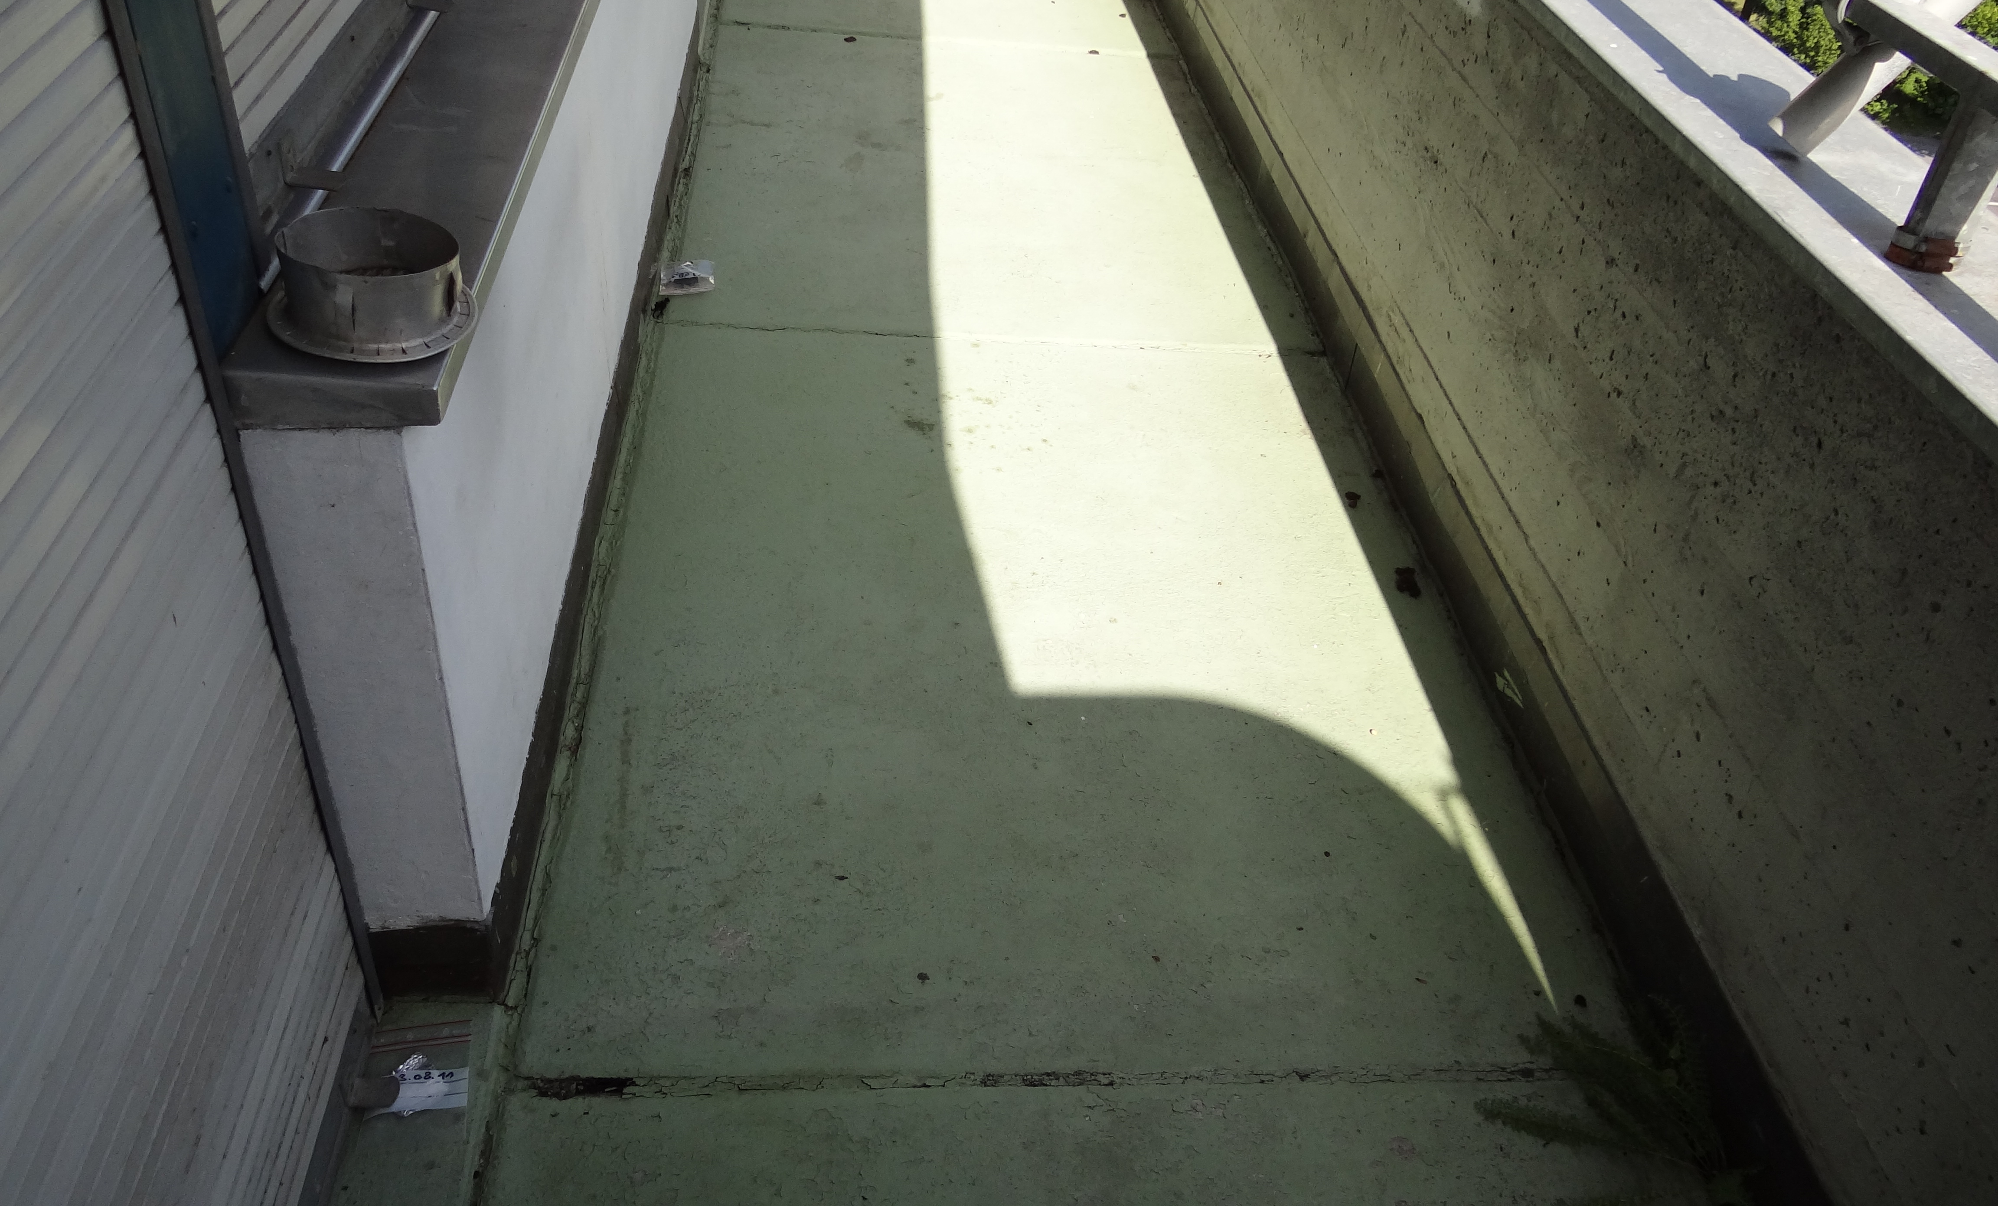
Caulk, exterior
Façades, windows, doors,
balconies, etc.
.

Slide 7
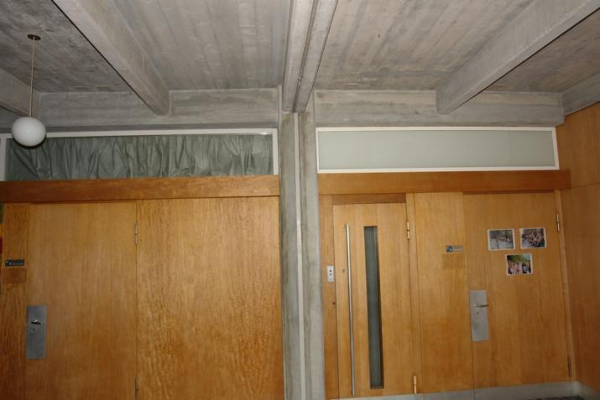
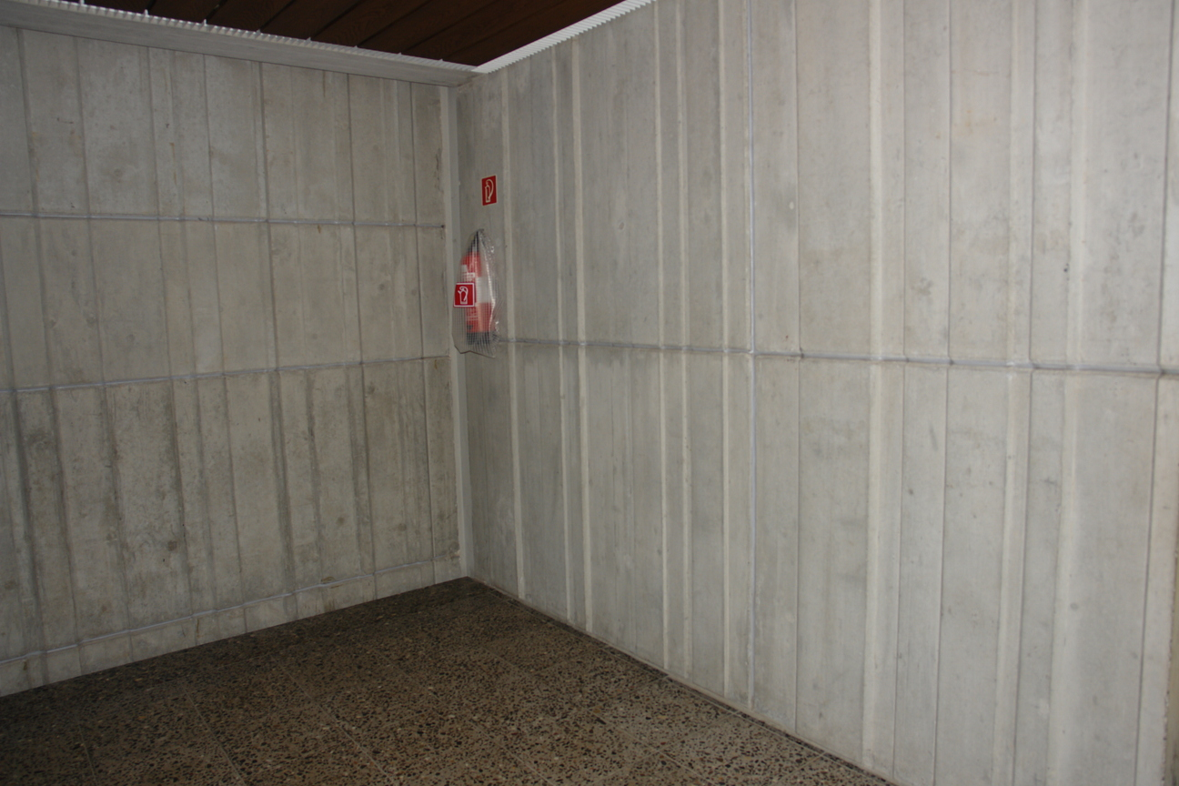
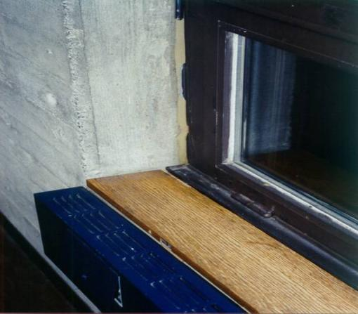
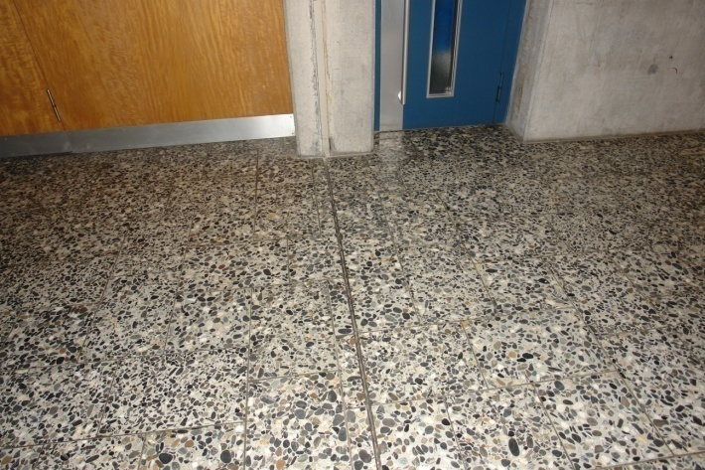
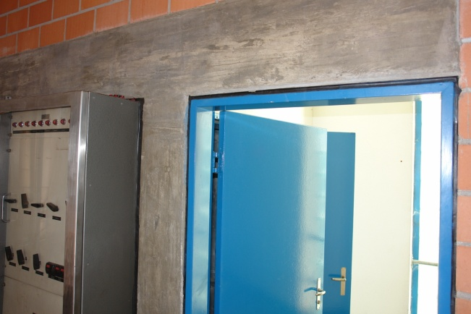
Caulk, indoors
Ceilings, walls, floors, windows, doors, etc.

Slide 8
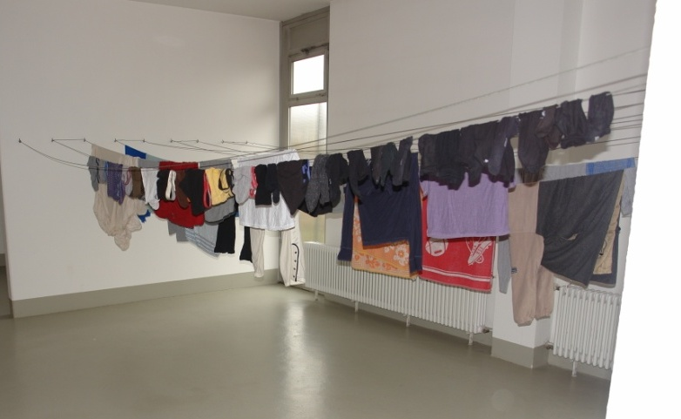
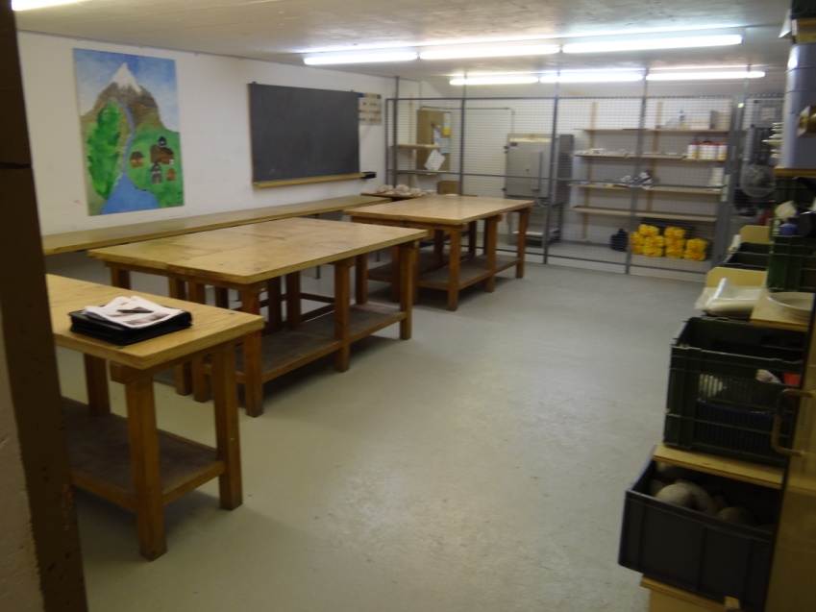
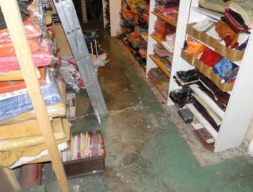
Paint: Floors in Schools and other Buildings

Slide 9
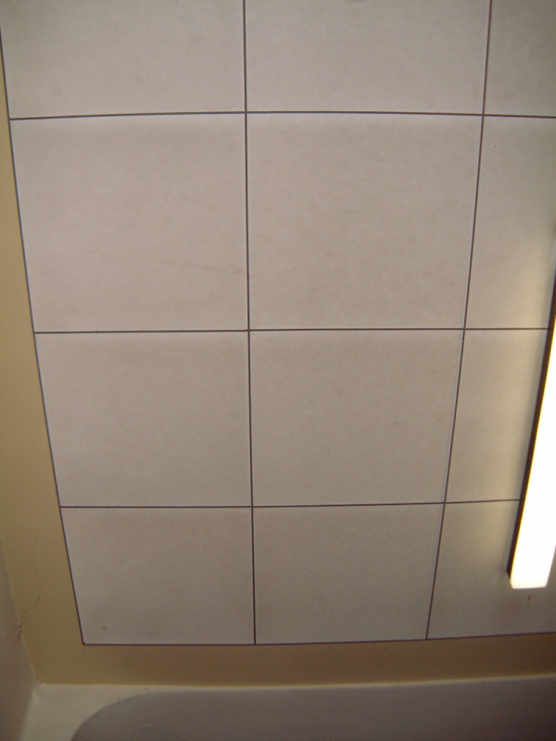
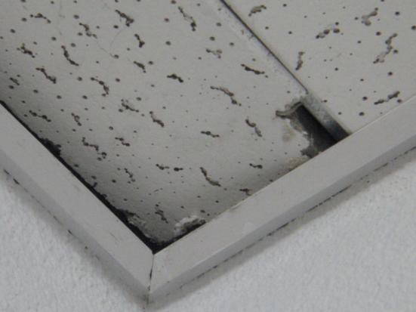
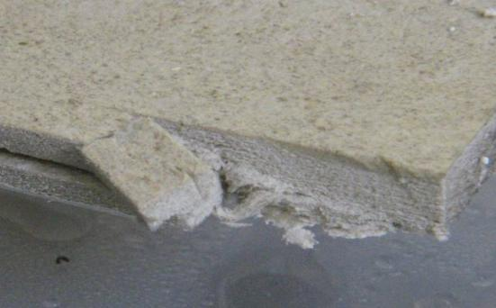
Ceilings tiles, as flame retardant

Slide 10
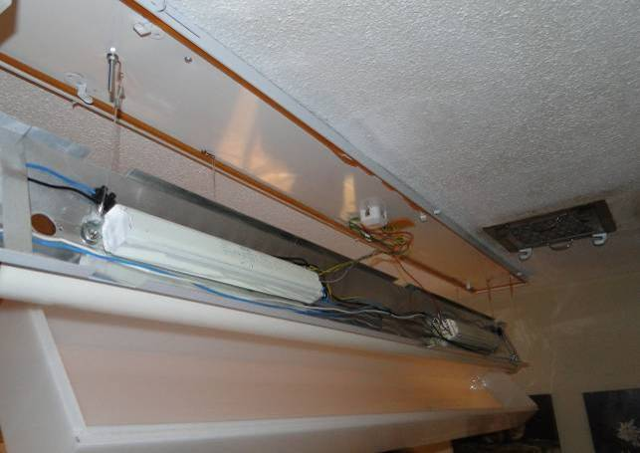
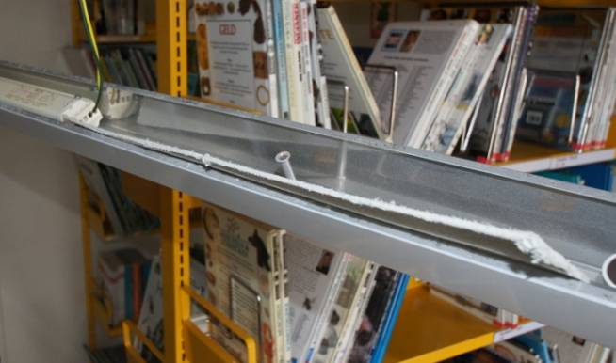
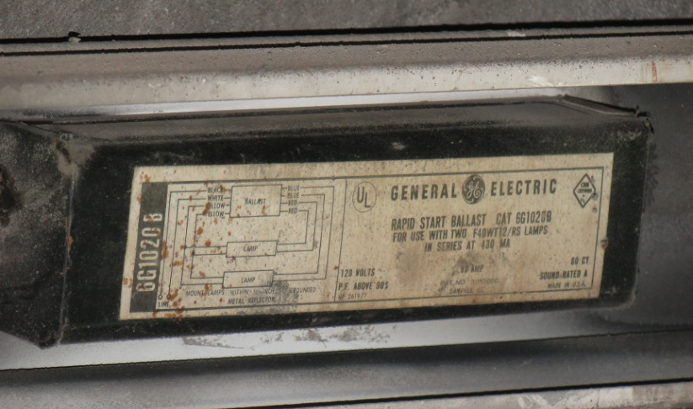
Small capacitors: i.a. in fluorescent lights

Slide 11
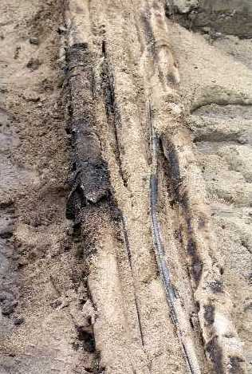
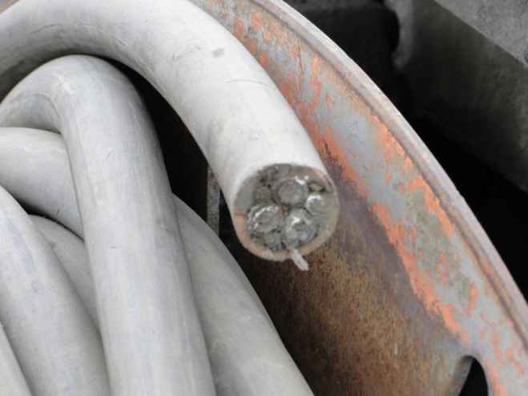
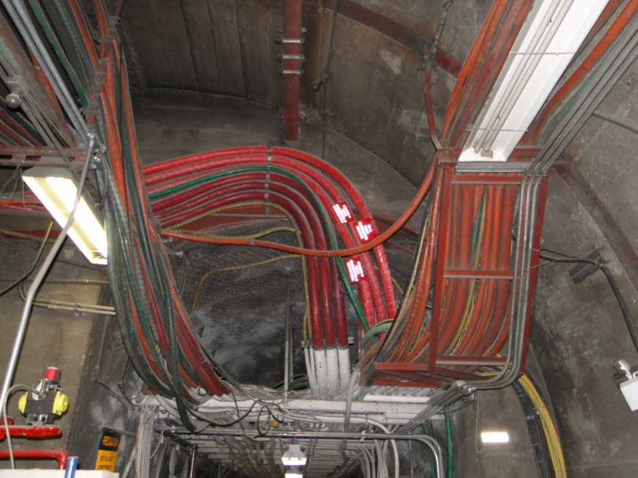
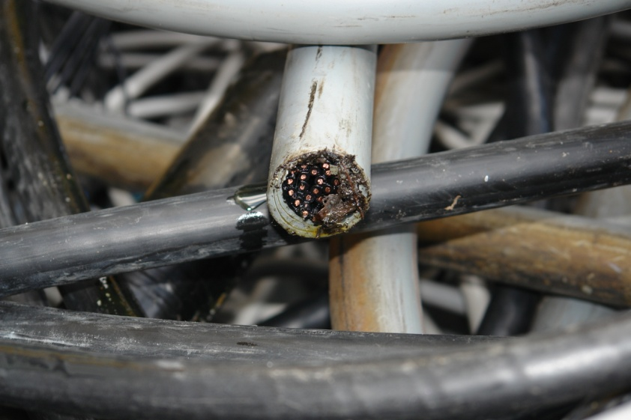
Cables

Slide 12
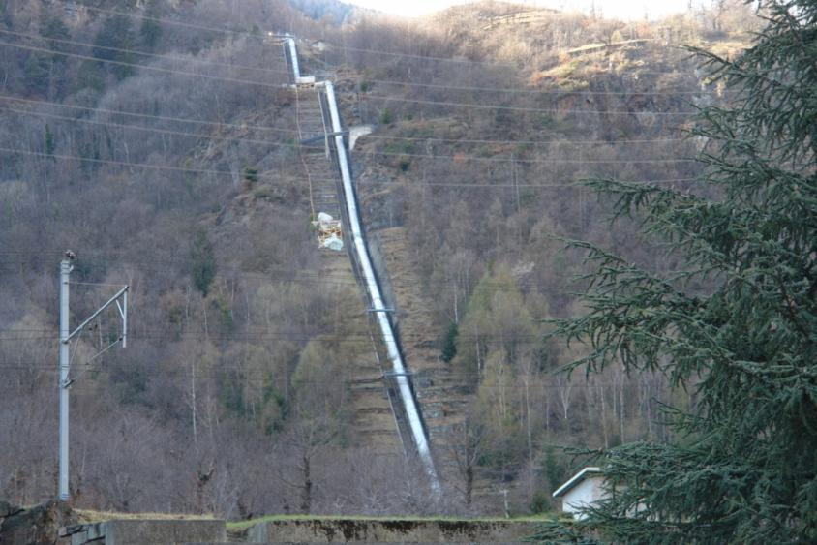
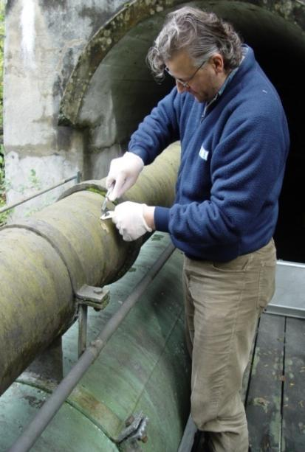
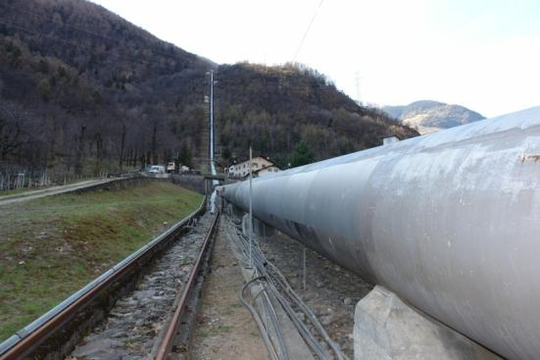
Anti-corrosion coating

Slide 13
Galbestos

Slide 14
DO!
DO Avoid direct contact with PCB suspect materials
DO Verify PCB suspect materials, and have representative samples analysed ASAP
DO Enable access to accredited laboratories, which are qualified to analyse POPs
DO In case of high PCB content in the materials, verify possible indoor air contamination
DO Visually check condition of PCB suspect materials regularly
DO Integrate open system applications in National PCB Inventories
DO Contact regional Environmental Authority prior to any repair and/or removal of suspect materials

Slide 15
DON’T!
DON’T Remove suspect PCB materials yourself
DON’T Reuse, recycle and/or sandblast suspected PCB material
DON’T Abandon and/or dump suspect PCB materials
DON’T Use simple test kits to determine PCB content. They are likely to often provide false results
NEVER Burn suspect PCB materials! Even more toxic compounds could be formed

Slide 16
Swedish experiences
Information, Inventory, Remediation, labelling, Transport, destruction and legislation

Slide 17
Inventories and other actions in Sweden
1972 PCB banned in open applications
1980-1995 Information to housowners
Voluntary undertaking by the the Ecocycle Council project to perform inventory and remediation
2007 Ordinance on PCB in buildings and constructions
Owners should
Investigate and remediate buildings and structures erected (or renovated) 1956 – 1973 concerning PCB in sealants and flooring materials
Inventory should be completed 2008-06-30
Remediation should be completed 2014-2016

Slide 18
The ordinance on PCBs
PCB-containing waste must be handled by authorised personal only
Thermal destruction to be applied. Not allowed to be deposited on landfills
Other methods can be applied only if they are equivalent to incineration with respect to long term environmental impact

Slide 19
The Swedish Approach
Focus has been on removal of all important open PCB depots, not only on these directly related to PCBs in indoor air
Main purpose: to reduce human and environmental exposure
Removal of PCBs in buildings will eventually also lead to positive effects on indoor air

Slide 20
Inventories
In 2010, about 70% of the buildings that might hold PCBs had been investigated
The smaller real estate companies and housing cooperatives had acted more slowly than the big actors
High activity with the development of specific tools and other equipment

Slide 21
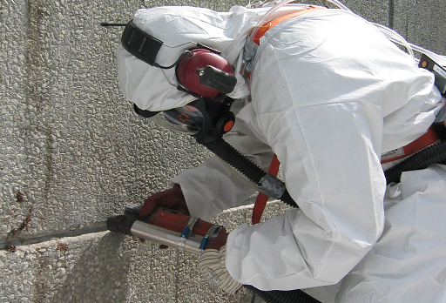

Slide 22
PCB in indoor and outdoor air

Slide 23
Ratio of PCB concentration in blood in PCB versus control group

Slide 24
Decontamination
A few municipalities had in 2010 almost finished the decontamination part and some 50% of the total decontamination was done.
Currently, some 400 people are engaged with decontamination activities

Slide 25
Conclusions
Most the inventories have been carried out
The decontamination will hopefully be completed during 2014 or 2016
Approximately 100 tonnes of pure PCBs (out of some 240 tonnes) remain to be decontaminated.
It is possible to identify and remove PCBs still present in buildings and constructions.
We must consider that we today probably have our last opportunity to prevent this PCB from escaping out into the environment.

