Slide 1
PCBs – Mechanisms of Toxicity
PCBs in Schools
Risk e-Learning Webinar
April 28, 2014
Gabriele Ludewig, PhD
University of Iowa

Slide 2
Outline
Human diseases and PCBs
Receptor-driven mechanisms
  AhR
  RYR
  ER
Metabolic activation
  Initiation of carcinogenicity
  Genotoxic effects
What we learned

Slide 3
Adverse Health Effects of PCBs
Chloracne, skin rashes
Chocolate skin, eye discharges
Liver enlargement and toxicity
Immunotoxicity
Endocrine Disruption
Neurotoxicity
Reproductive Toxicity
Developmental Toxicity
Cancer
Disturbance in energy homeostasis

Slide 4
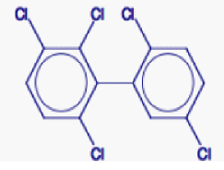
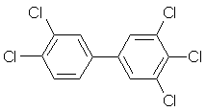
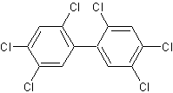
The 209 PCBs are grouped
Number of chlorines
Lower chlorinated (4 Cl or less)
  PCB 3 (4-Cl biphenyl)
  PCB 52 (2,2’,5,5’-tetrachloro biphenyl)
  ‘episodic’, metabolized, reactive intermediates!
Higher chlorinated (more than 4 Cl)
  PCB 95 (2,2’,3,5,5’,6-pentachloro biphenyl)
  more persistent, receptor interaction!
Position of chlorines
Dioxin-like (0 or 1- ortho Cl)
  PCB 126 (3,3’,4.4’,5-pentachloro biphenyl)
  AhR agonists
NDL (non-dioxin like; 2 or more ortho Cl)
  PCB 153 (2,2’,4,4’,5,5’-hexachloro biphenyl)
  CAR, ER, RyR, others
                Each congener belongs to more than1 group

Slide 5
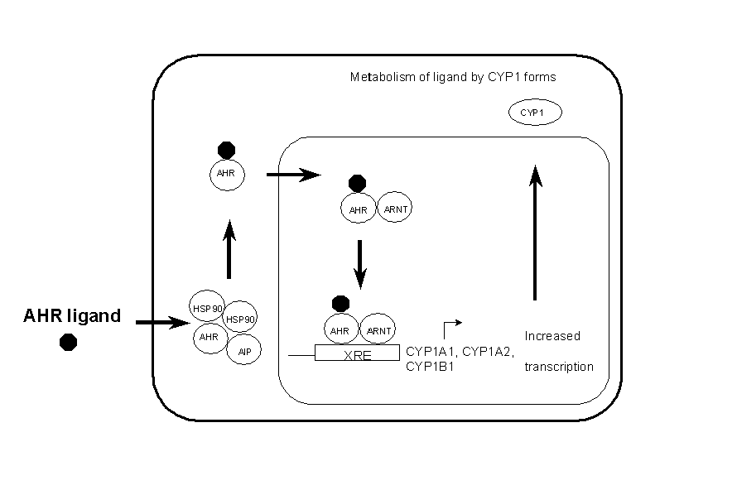
Dioxin-like Compounds → Aryl Hydrocarbon Receptor Activation
Increased Metabolism
(endogenous/exogenous
compounds)
Enzymes,
Regulatory Proteins
Oxidative Stress
Changed cell behavior
TCDD
Dioxin-like PCBs
Cigarette smoke
http://herkules.oulu.fi/isbn9514258649/html/x579.htm
Human Health Effects →immunotoxicity, developmental and neurodevelopmental toxicity, changes in thyroid and steroid hormones and in reproductive function, cancer.

Slide 6
Dioxin-like PCB congeners
TEF
0.0001
0.0003
0.1
0.03
0.00003
0.00003
0.00003
0.00003
0.00003
0.00003
0.00003
0.00003
TEF: Toxic Equivalency Factors (WHO 2005). TCDD = 1

Slide 7
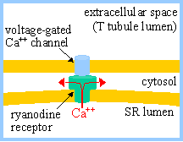
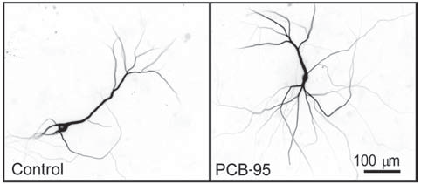
Some NDL PCBs are developmental neurotoxins
Potential mechanisms: disruption of thyroid hormone homeostasis,
interference in calcium signaling (RyR), others
The Ryanodine Receptor regulates Ca++
PCB 95 changes dendritic arborization
Wayman et al (2014) EHP 120:997

Slide 8
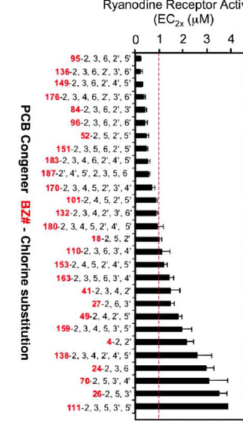
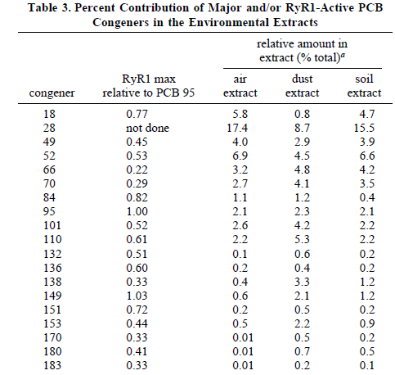
Many PCB congeners activate the RyR
Pessah et al (2006) Chem Res Toxicol 19:92
Pessah et al. (2010) Pharmacol Therapeut 125:260

Slide 9
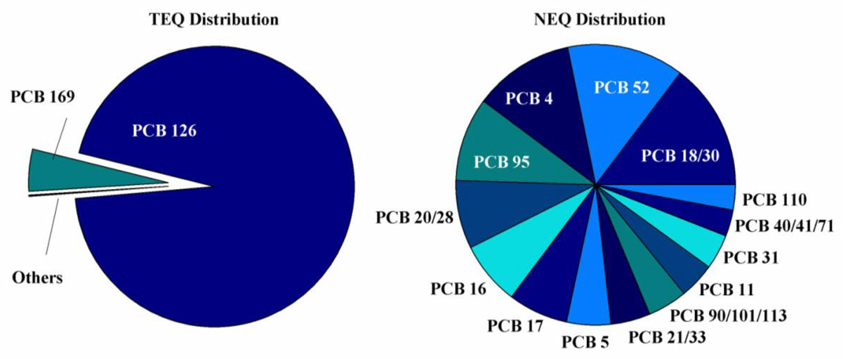
Toxic and Neurotoxic Equivalency contributor PCBs in Chicago Air
Hu et al (2010) Atmos. Environ. 44:1550
Congeners/compounds with the same mechanism may act in an additive fashion!

Slide 10
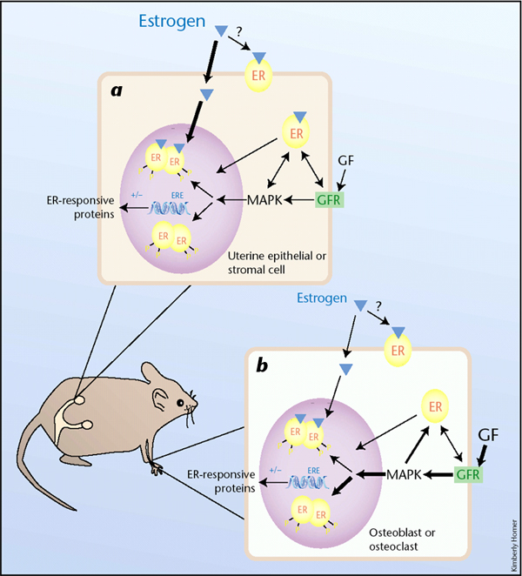
PCBs are endocrine disruptors
Bind to steroid receptors
Change hormone half life
Effects on multiple organ, development, function, and pathologic processes
Greene (2003) Nature Medicine 9, 22 - 23
doi:10.1038/nm0103-22

Slide 11
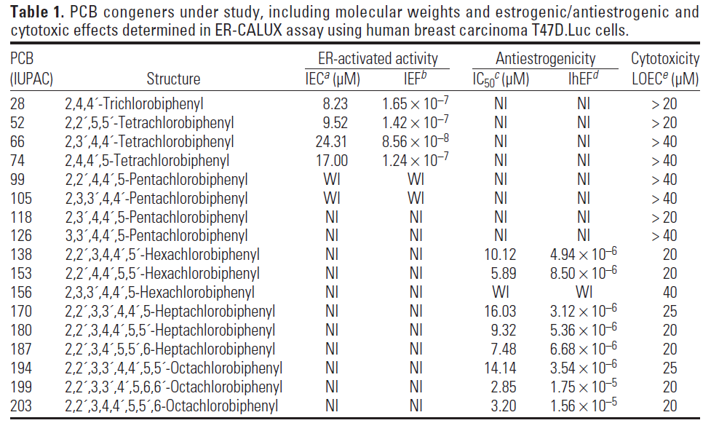
Estrogenic and anti-estrogenic PCBs
Pliskova et al (2005) EHP 113:1277

Slide 12
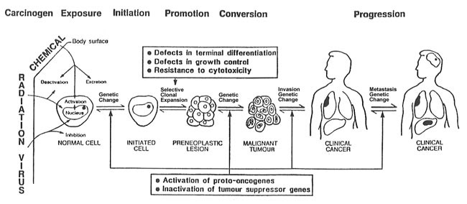
Multistage Carcinogenesis
http://www.bvsde.paho.org/bvstox/i/fulltext/training/fig3a.jpg

Slide 13
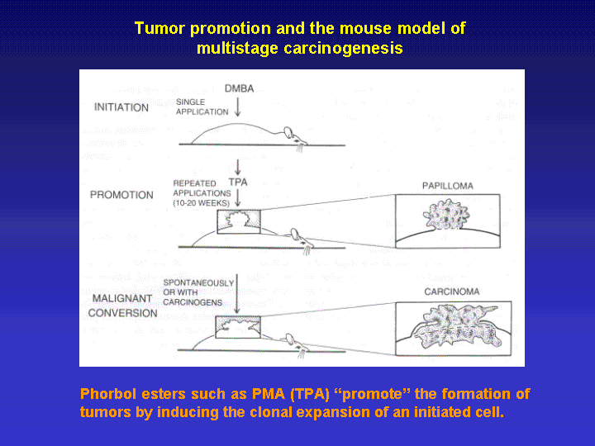
PCB mixtures and congeners (example 126, 153) are promoters!
http://www.med.upenn.edu/marcelo/images/slides/Slide2.gif

Slide 14
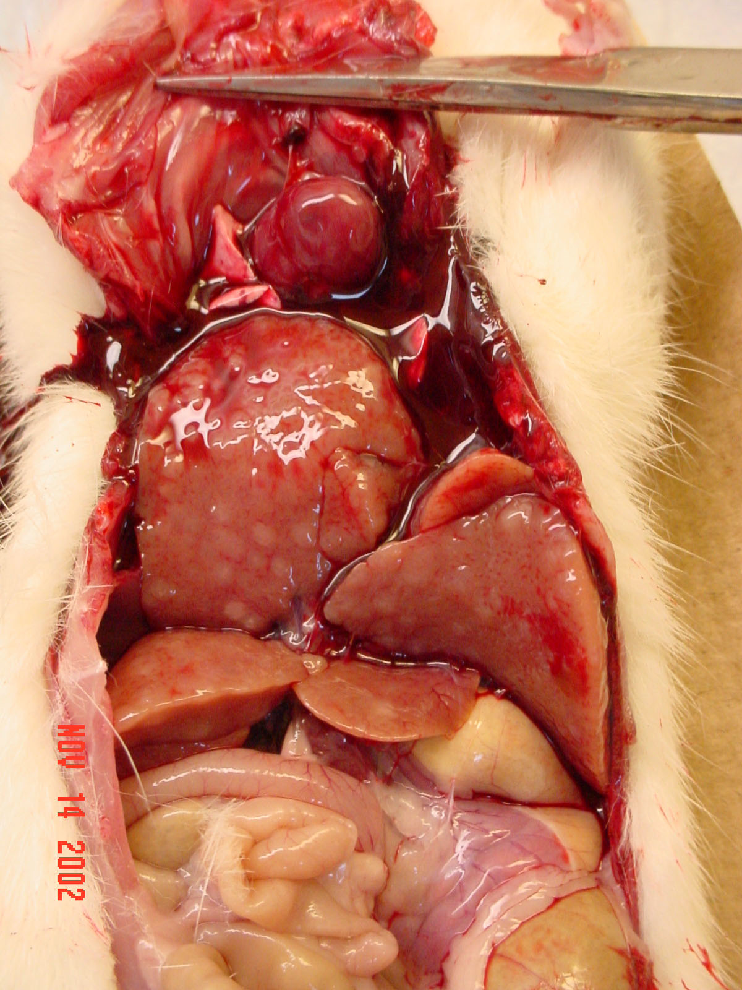

Slide 15
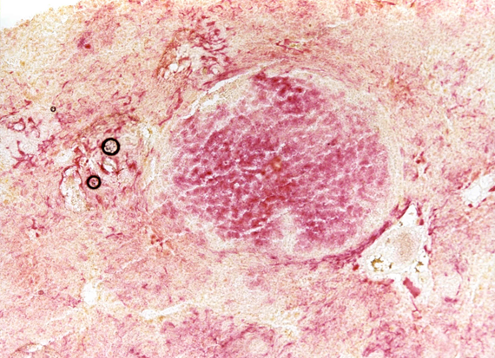
PCB 3 produced preneoplastic foci in rat liver
GGT staining, 40x magnification)

Slide 16
Several PCB congeners produced preneoplastic foci in the Solt-Farber initiation assay
PCB 3*
PCB 15*
PCB 52
PCB 77
*increased number and volume fraction;
Espandiari et al., (2003) Tox Appl Pharm 186, 55-62

Slide 17
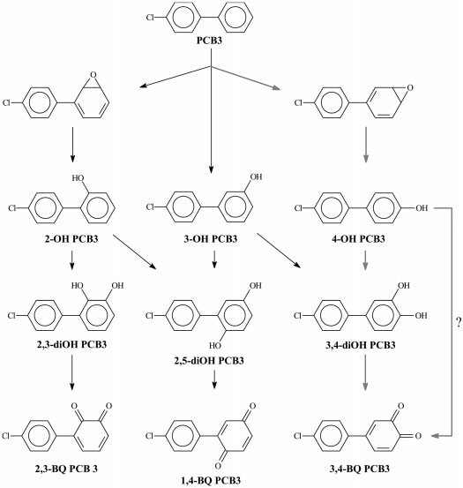
Of all tested PCB3 metabolites the o-quinone was the most potent initiator
Espandiari et al.(2004) Tox Sci 79, 41-49

Slide 18
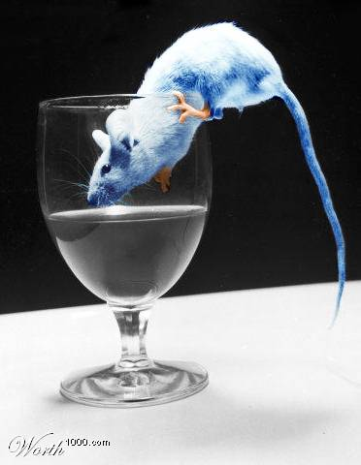
Do PCBs induce gene mutation in vivo?
Assay used→ BigBlue® Rat
Target (Reporter Gene): Lac I
  ~30-40 copies in each cell on chromosome 4
  1080 base pairs in length
  Regulator of the lactose operon
    If intact, it prevents transcription of the lac Z gene (bacterial β-galactosidase, cleaves X-gal)
  Incorporated in a lambda phage DNA →shuttle vector

Slide 19
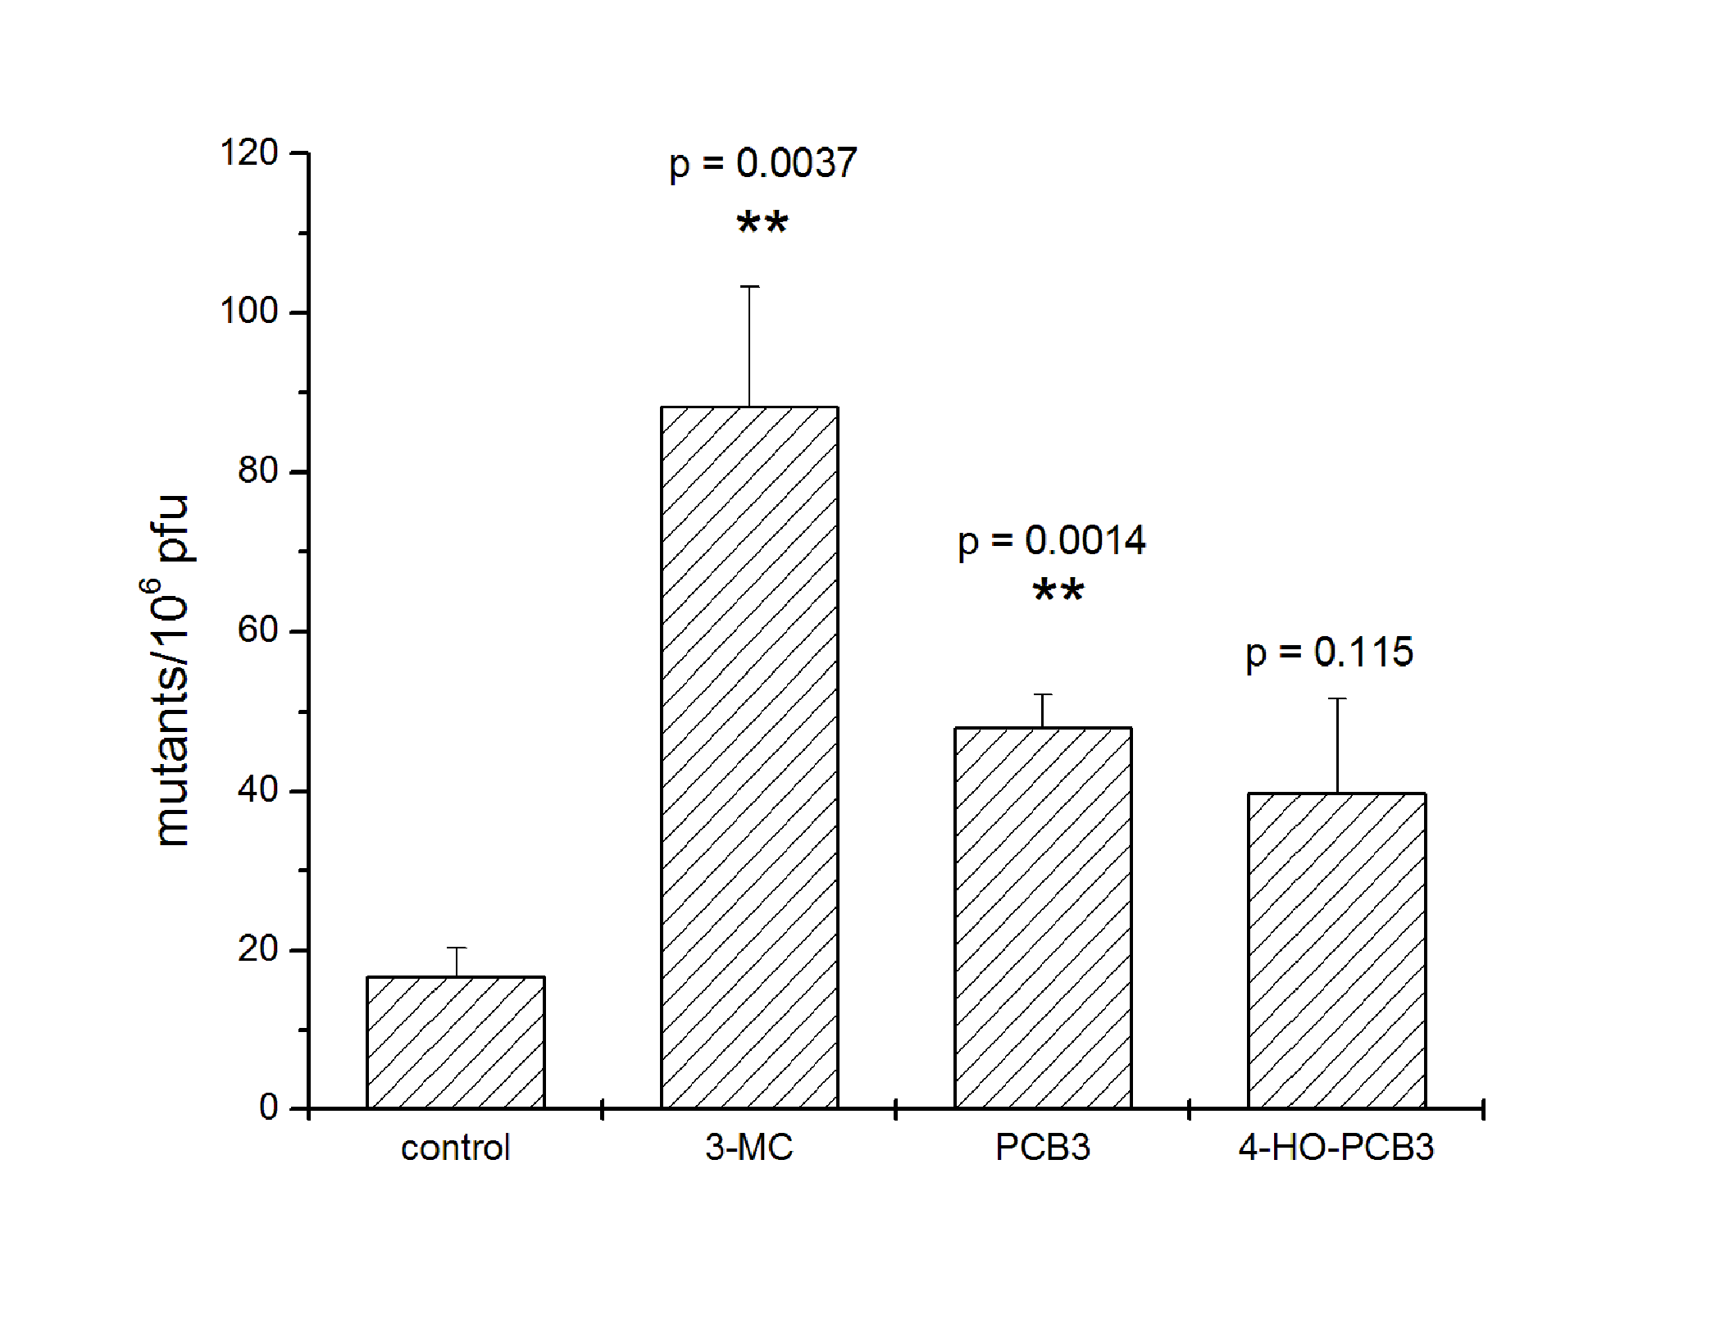
PCB3 induced gene mutations in the liver of male BigBlue rats
Lehmann et al (2007) Carcinogenesis 28:471

Slide 20
Genotoxicity profile of PCB3 and its metabolites in vitro
V79 cells, lowest effective concentration, uM
 | Compound | Point mutat. (TG-R)
 | PCB3 | -
 | 2-OH- | -
 | 3-OH- | -
 | 4-OH- | -
 | 3,4-Cat | -
 | 3,4-oQ | 0.6
 | 2,5-HQ | -
 | 2,5-pQ | 0.5
Zettner et al (2007) Tox Sci 100: 88

Slide 21
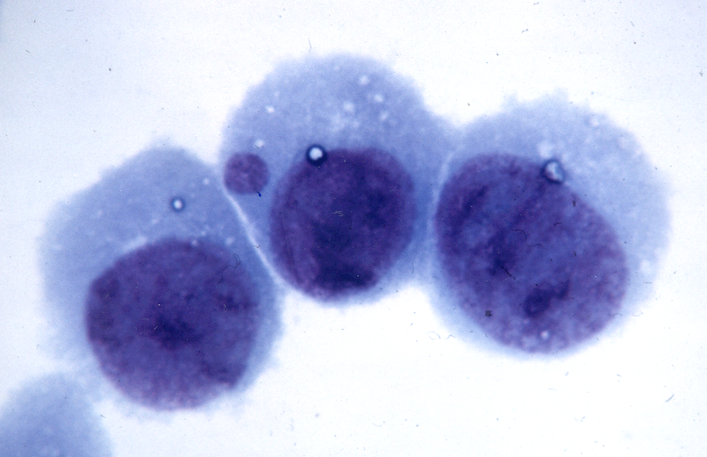
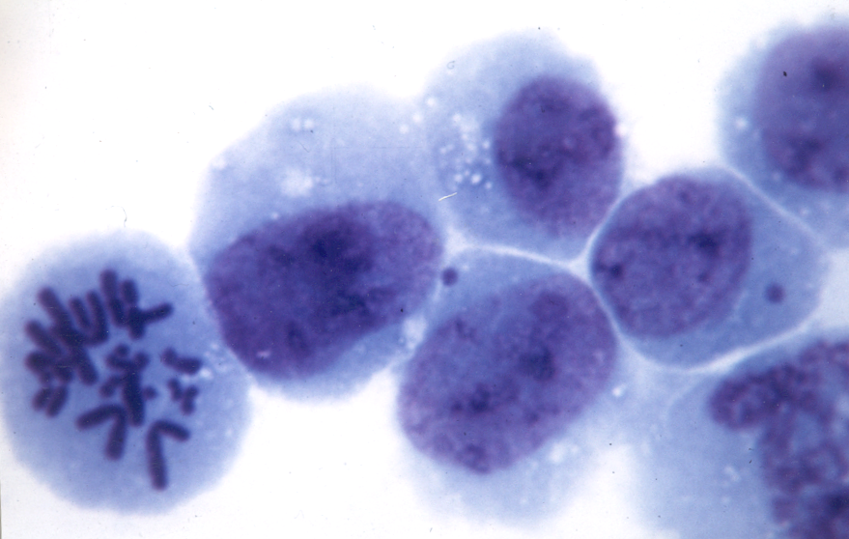
Micronuclei in V79 cells
Piece of a chromosome
(Chromosome break)
Whole chromosome
(chromosome loss)

Slide 22
Genotoxicity profile of PCB3 and its metabolites in vitro
V79 cells, lowest effective concentration, uM
 | Compound | Point mutat. (TG-R) | Chrom. Breaks (MN) |  |  | DNA strand breaks (COMETS)
 |  |  |  |  |  | (HL-60, Jurkat)
 | PCB3 | - | -
 | 2-OH- | - | -
 | 3-OH- | - | -
 | 4-OH- | - | 75
 | 3,4-Cat | - | 25
 | 3,4-oQ | 0.6 | 15
 | 2,5-HQ | - | 5 |  |  | COMET 37C, not 6C, MPx dependent
 | 2,5-pQ | 0.5 | 1 |  |  | COMET 37C & 6C MPx-independent
Xie et al (2010 Env. Int. 36:950

Slide 23
Genotoxicity profile of PCB3 and its metabolites in vitro
V79 cells, lowest effective concentration, uM
 | Compound | Point mutat. (TG-R) | Chrom. Breaks (MN) | Chrom. Loss (MN) | SCE or Poly-ploidy | DNA strand breaks (COMETS) (HL-60, Jurkat)
 | PCB3 | - | - | - | -
 | 2-OH- | - | - | 50
 | 3-OH- | - | - | 100
 | 4-OH- | - | 75 | 75
 | 3,4-Cat | - | 25 | 15 | 5 (SCE)
 | 3,4-oQ | 0.6 | 15 | 5 | -
 | 2,5-HQ | - | 5 | 2.5 | 7.5 (PP) | COMET 37C, not 6C, MPx dependent
 | 2,5-pQ | 0.5 | 1 | 2.5 | - | COMET 37C & 6C MPx-independent
Flor et al (2010) Env. Int. 100:962

Slide 24
What is the Mechanisms of Mutagenesis?
?
GSH conjugation

Slide 25
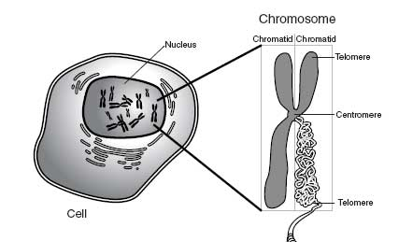
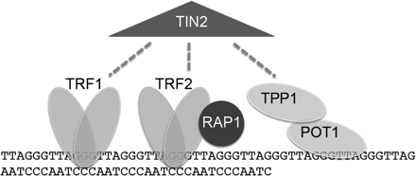
Chromosomes and Telomeres
human telomeres:
[TTAGGG]n
U Iowa

Slide 26
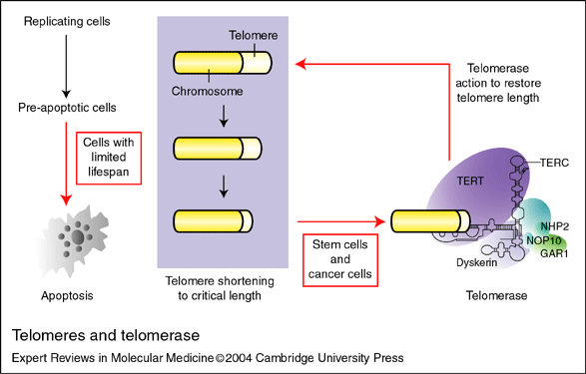
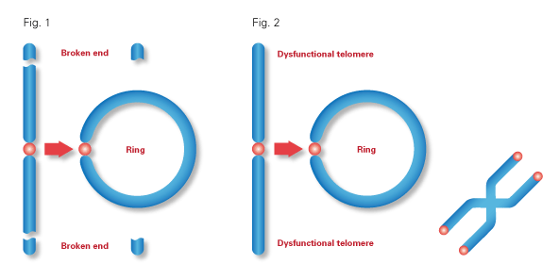
Aging and Cancer
Sticky ends → Chromosomal fusion
Chromosome instability → Crisis → Cancer

Slide 27
Telomere length in HaCaT
PCB3-pQ
12 weeks exposure
4-OH-PCB3 PCB3
Jacobus et al (2008)
Env Tox Pharm 25:267
6 weeks exposure

Slide 28
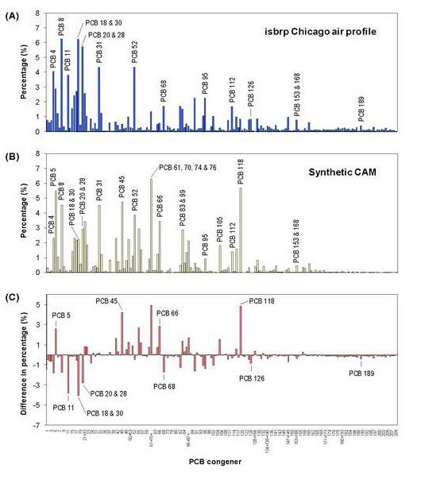
Test compounds: CAM, PCB 28, 52, 126,153
Zhao et al., 2009. Environmental International
U Iowa

Slide 29
All tested PCBs shorten telomere length!
**
Error bars denote SD, * P < 0.05, ** P < 0.01, *** P < 0.001
Senthilkumar et al (2011) Toxicol. Lett. 204: 64
U Iowa

Slide 30
All tested PCB congeners/mixture reduced telomerase activity!
**
**
**
**
***
***
***
*** ***
***
*** ***
*** *** ***
Error bars denote SD, * P < 0.05, ** P < 0.01, *** P < 0.001
Senthilkumar et al (2011) Toxicol. Lett. 204: 64
U Iowa

Slide 31
PCBs, including airborne PCBs, are capable to function in all phases of carcinogenesis!
Pathway from Normal to Malignant Cell
Proposed Role of PCBs
Ludewig et al.(2008), Env Tox Pharm 25, 241-246

Slide 32
Take home message
PCB congeners are assigned to different groups according to chemical structure which determines biological effect
Receptor binding (AhR, CAR) with changes in gene regulation and cell physiology is common among higher chlorinated biphenyls (dioxin-like and NDL, respectively)
Lower chlorinated biphenyls maybe bioactivated to intermediates that interfere with protein function and produce damage DNA
PCB congeners may act in an additive or synergistic way with each other and other compounds

Slide 33
Take home message, cont.
Our knowledge about the basic mechanisms of toxicity is still limited
Our knowledge about mixture effects is miniscule
To understand risk we need more knowledge about kinetics and toxicity of individual PCB congeners and mixtures

Slide 34
  Acknowledgements
PCB synthesis : Drs. U. Bauer, HJ Lehmler and their teams
In vivo studies: Drs. P. Espandiari, L. Lehmann, H. Esch
Cytogenetics: Susanne Flor, Dr W. Xie
Telomere, Telomerase: Drs Senthilkumar P.K., J. Jacobus
Metabolism, PON, chemoprevention and others → many more !!!
Dr. Larry Robertson, Director of the Iowa Superfund, co-organizer of the PCB workshops, researcher.
Granting Agencies
NIEHS P42 ES 07380 (UK) and ES 013661 (UI), DOD, EPA, C

Slide 35
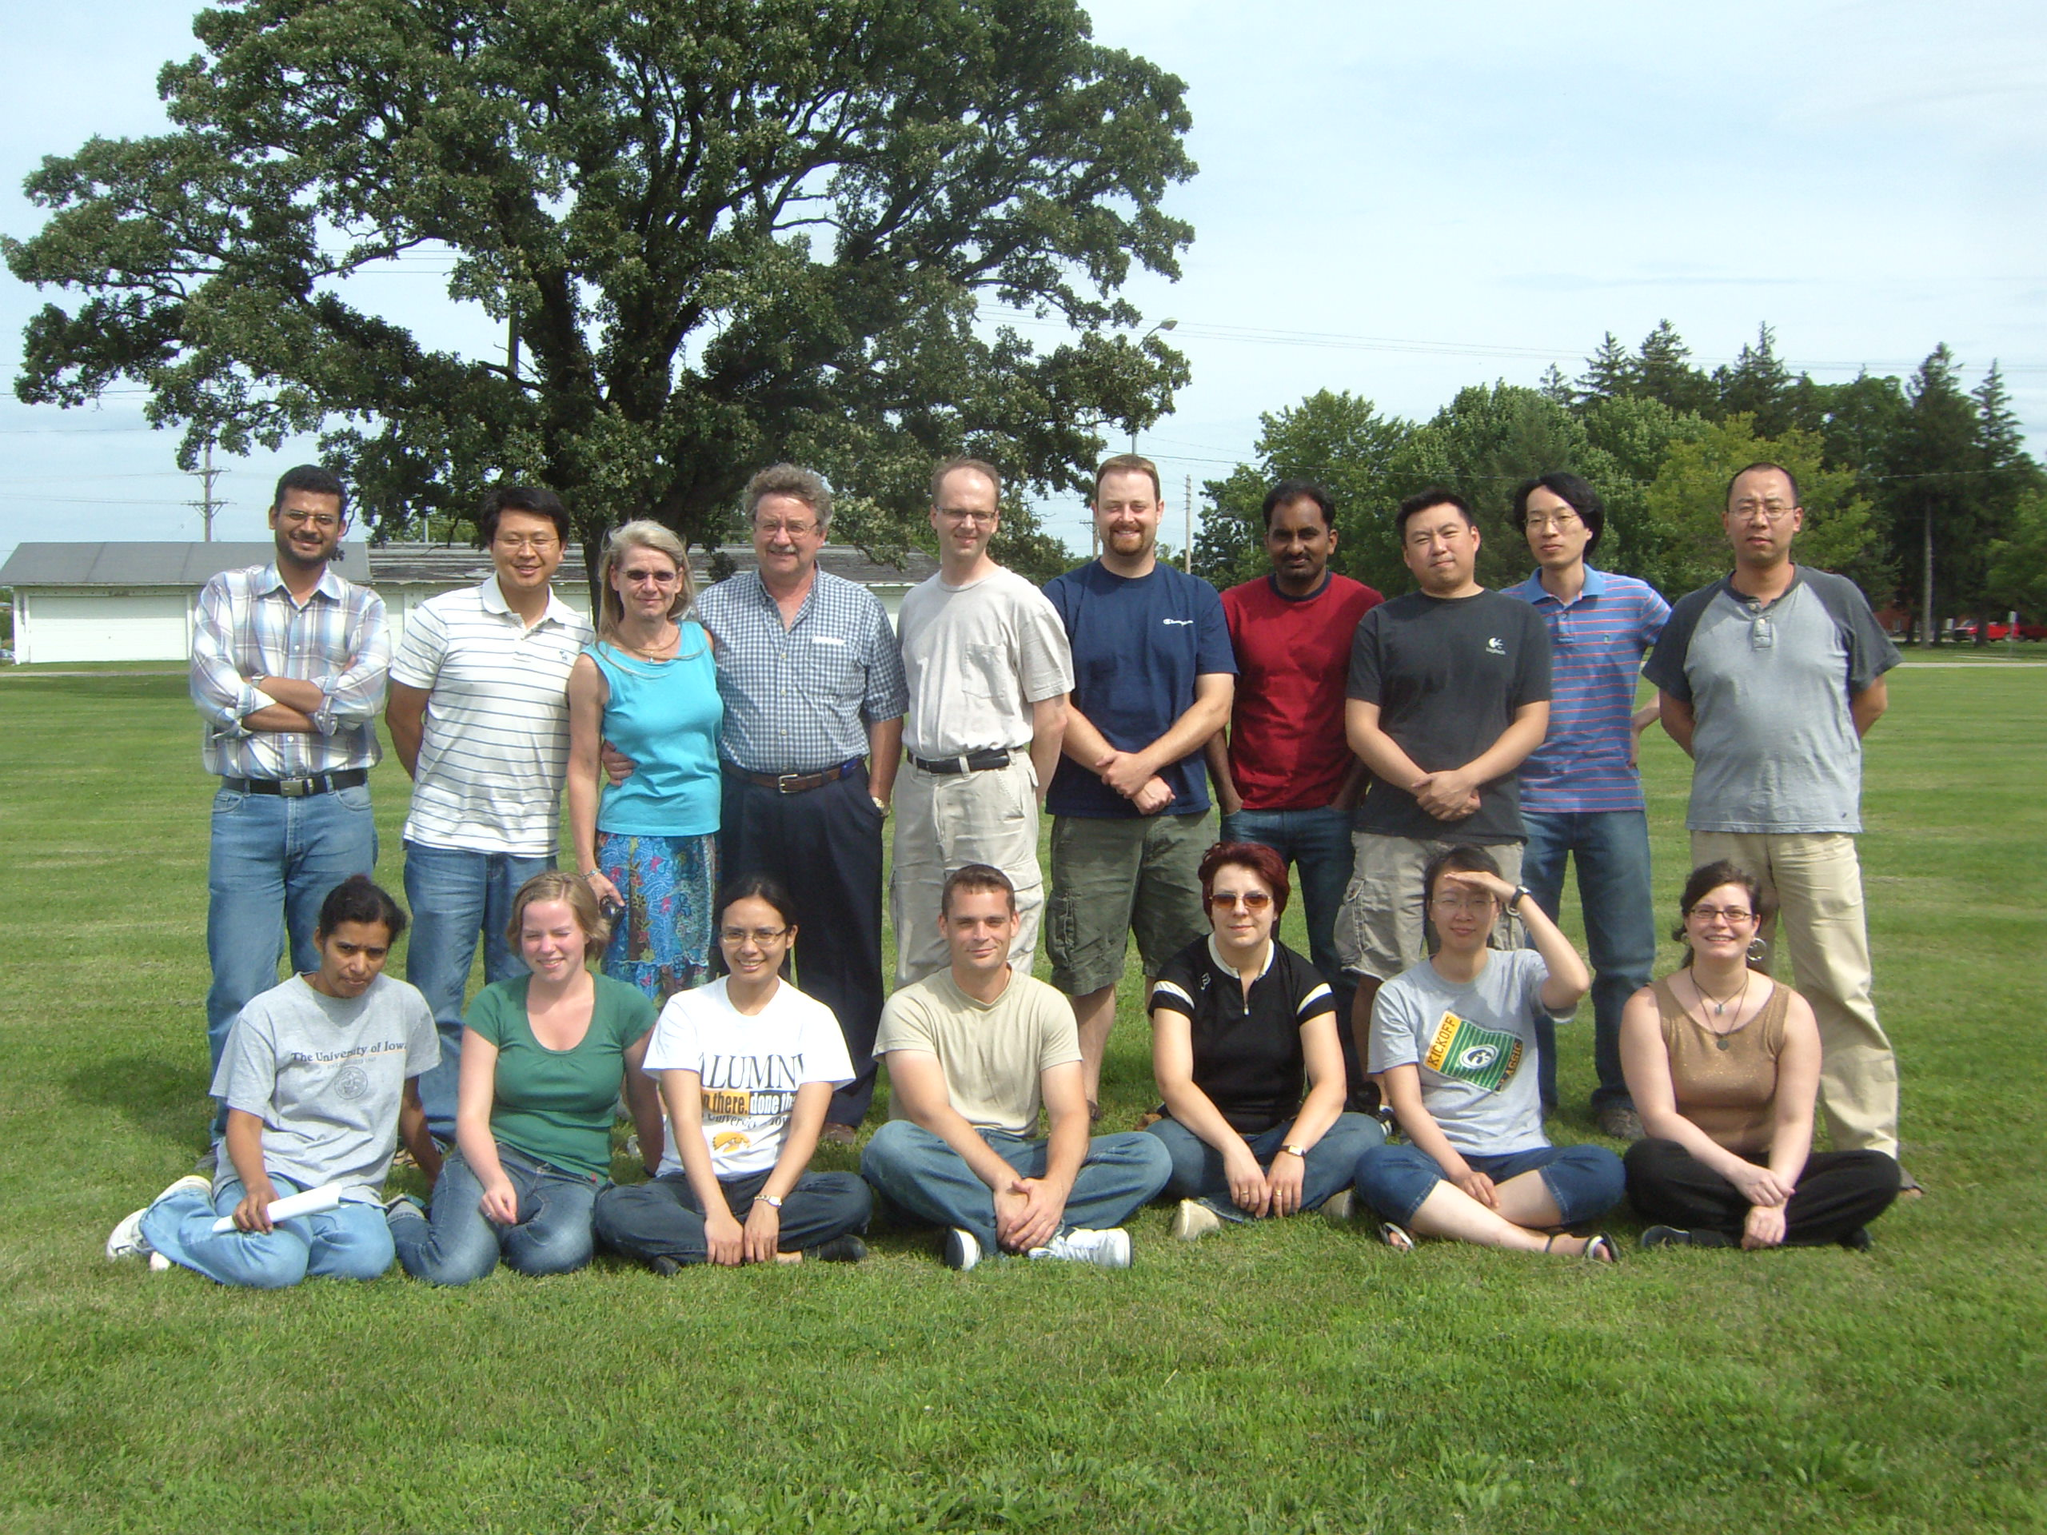
Greetings from sunny Iowa!

