Slide 1
Regional Water Availability and Superfund
Generating a Valuable Resource at Phoenix-Goodyear Airport Area
Melissa Friedland, EPA SRI
Jared Vollmer, EPA Region 9 Urban Waters
Catherine Brown, EPA Region 9
Mark Holmes, City of Goodyear, AZ
Stephanie Koehne, AMEC Foster Wheeler
January 13, 2016 2-3:30PM Eastern

Slide 2
Webinar Overview
Welcome, Introduction to Reuse and SRI
  Melissa Friedland, EPA SRI
Cleaning Up and Restoring Contaminated Water Sources
  Jared Vollmer, EPA Region 9 Urban Waters
Introduction to Phoenix-Goodyear Airport Area Superfund Site
  Catherine Brown, EPA Region 9
Partnering for Success: The City of Goodyear, EPA and PRPs
  Mark Holmes, City of Goodyear, AZ
Putting Cleaned up Groundwater to Use at PGA North
  Stephanie Koehne, AMEC Foster Wheeler
Resources, Contacts and Questions
  Melissa Friedland, EPA SRI

Slide 3
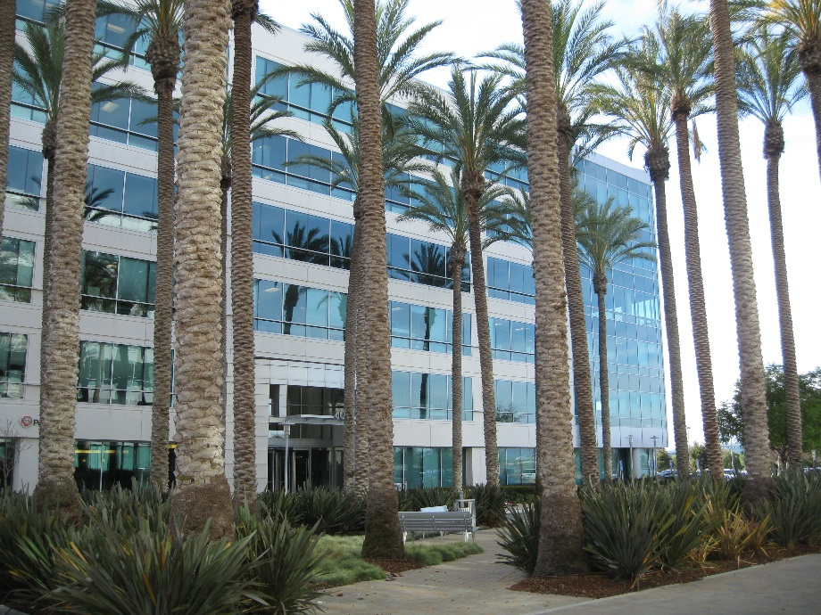
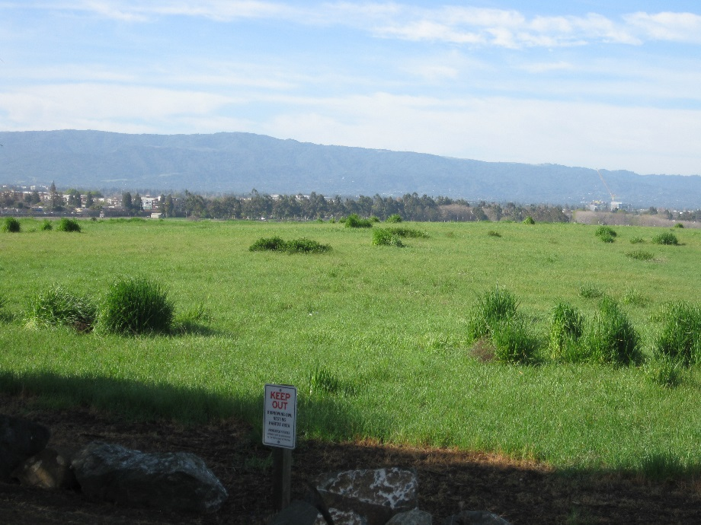
SRI: Superfund Redevelopment Initiative
Working with communities and other partners in considering future use opportunities and integrating appropriate reuse options into the cleanup process
http://www.epa.gov/superfund-redevelopment-initiative

