Slide 1
Introduction to Phoenix-Goodyear Airport Superfund Site
Catherine Brown
EPA Region 9
Superfund Program

Slide 2
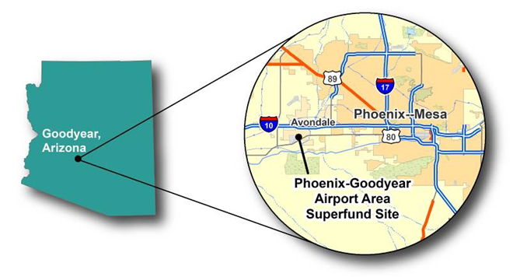
Geography and Climate
Sonoran Desert with arid subtropical desert climate
  Seven to ten inches of rainfall annually
  Average summer temperature of around 105F with extremes in excess of 120F
  Average winter temperature of 72F
Groundwater is the main source of drinking water
Historically open desert and agriculture
Growing population; 2,747 in 1980 and 73,832 in 2014.
In excess of 100,000 residents projected for 2020

Slide 3
Phoenix-Goodyear Airport
Superfund Site
Groundwater contamination discovered in 1981 in City of Goodyear municipal supply wells
Listed on the NPL in 1983
Some cleanup of soil contamination
Primarily groundwater contaminated by chlorinated solvents
Remedy is groundwater pump & treat
Treated water at first injected back into groundwater system to provide plume containment.
ROD allows for ‘beneficial reuse’ of treated water

Slide 4
ROD-specified Potential Beneficial Reuses of Treated Groundwater
Agricultural – irrigation for crop production
Industrial
Municipal
  Drinking water supply
  Certain types of water rights
Recreational
  Creating lakes
  Irrigating public parks or golf courses
Injection for aquifer restoration
Surface Discharge
  Agua Fria River or Gila River discharge
  Diversion downstream for municipal uses

Slide 5
Current Phoenix-Goodyear Airport Superfund Site Beneficial Reuses
Goodyear Recreation Complex Irrigation
  81.5 million gallons per year for an annual savings of $200,000
Goodyear Community Park Irrigation
  21 million gallons used in 2013 for a savings of $75,000
Saint Thomas Aquinas Grade School Heat Exchanger
  197 million gallons used in the exchanger in 2013 and then injected back into the groundwater system for a double benefit
Palm Valley Golf Course Irrigation
  140 million gallons used in 2013 for a savings of $250,000
Agricultural Plots Irrigation
  52 million gallons used in 2013 for a savings between $94K and $250K
Injection for plume control
  967 million gallons injected in 2014

Slide 6
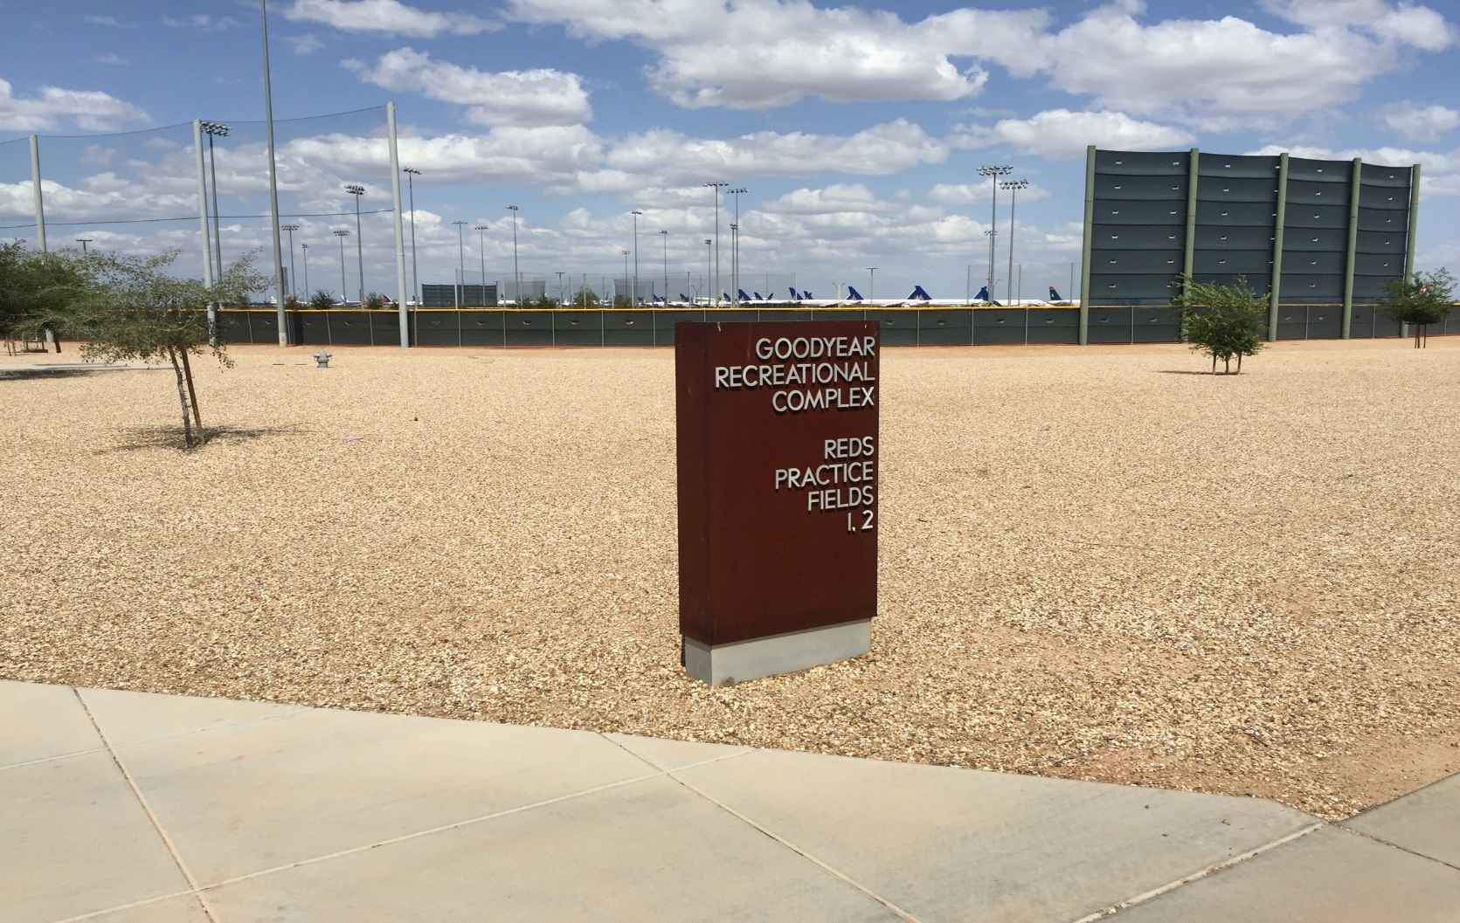
Current Phoenix-Goodyear Airport Superfund Site Beneficial Reuses
Goodyear Recreation Complex

Slide 7
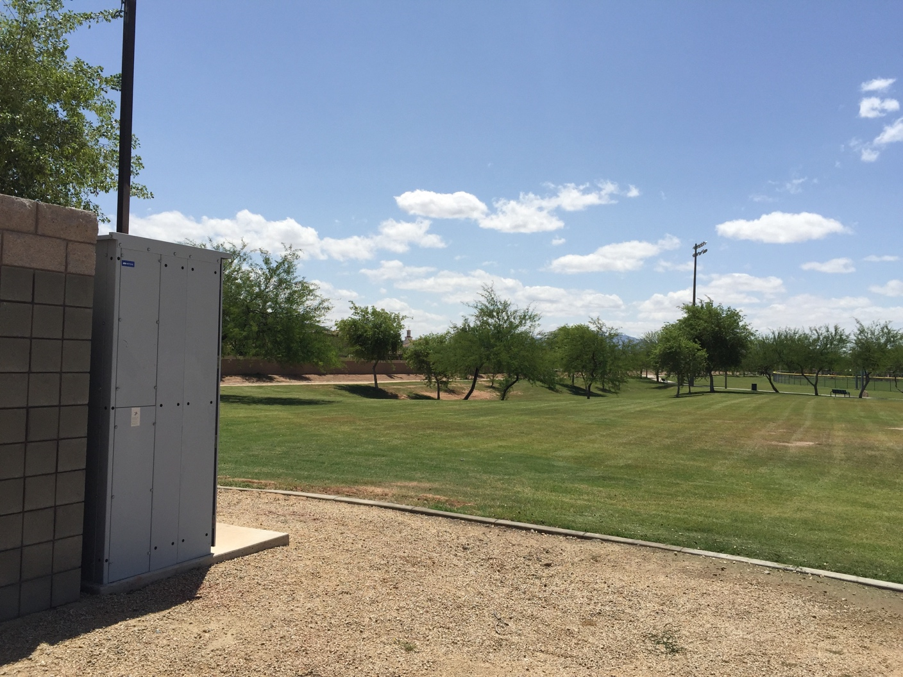
Current Phoenix-Goodyear Airport Superfund Site Beneficial Reuses
Goodyear Community Park

Slide 8
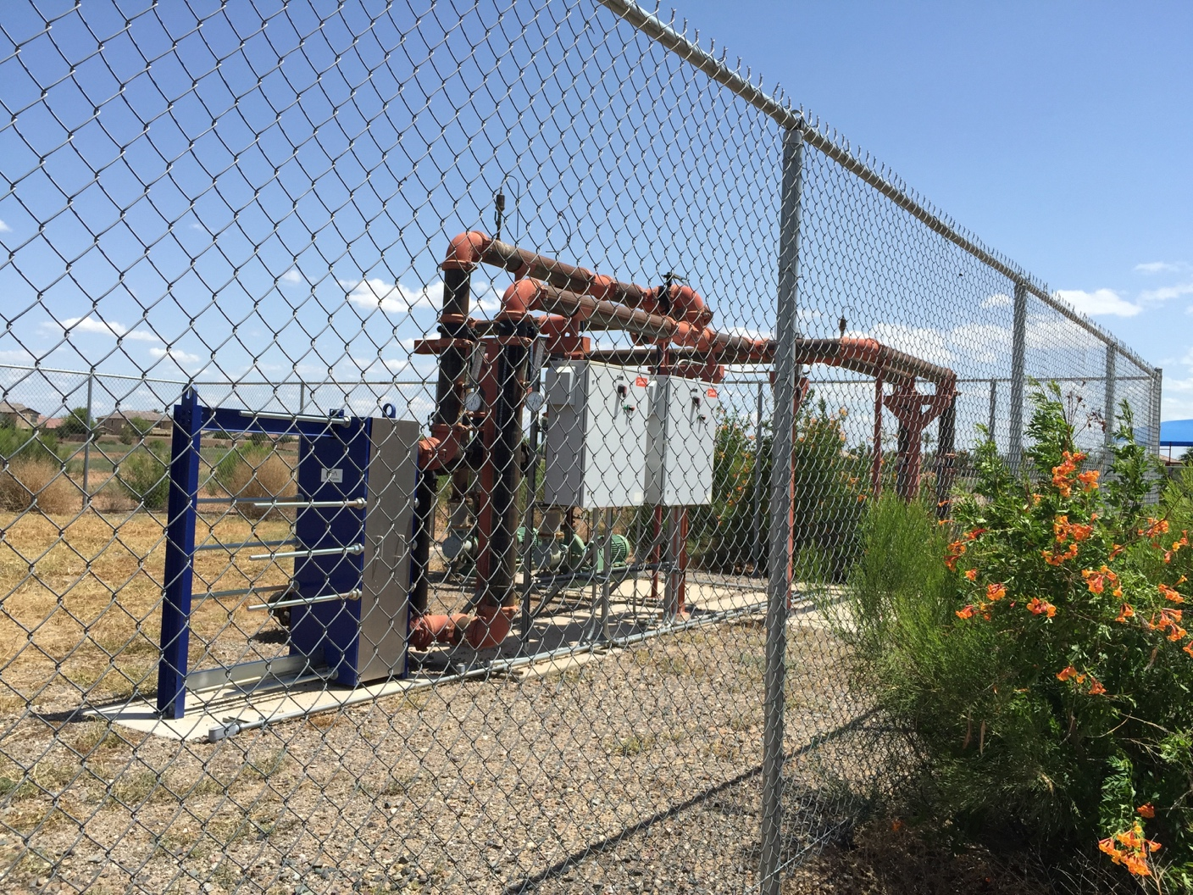
Current Phoenix-Goodyear Airport Superfund Site Beneficial Reuses
Saint Thomas Aquinas Grade School Heat Exchanger

Slide 9
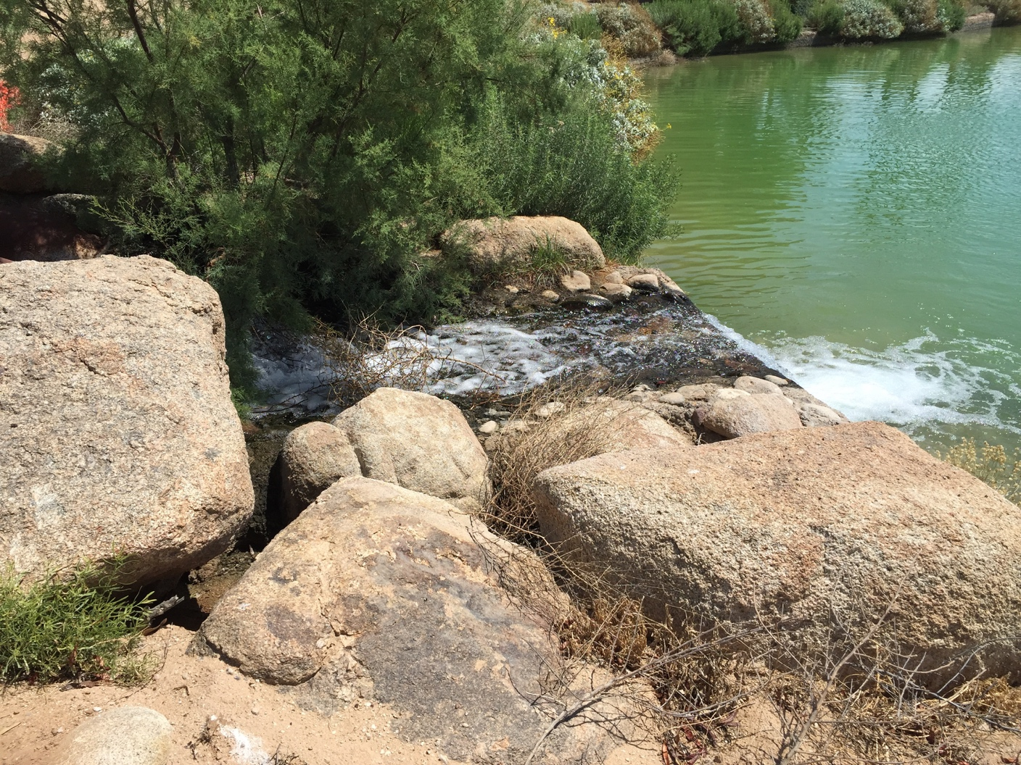
Current Phoenix-Goodyear Airport Superfund Site Beneficial Reuses
Palm Valley Golf Course

Slide 10
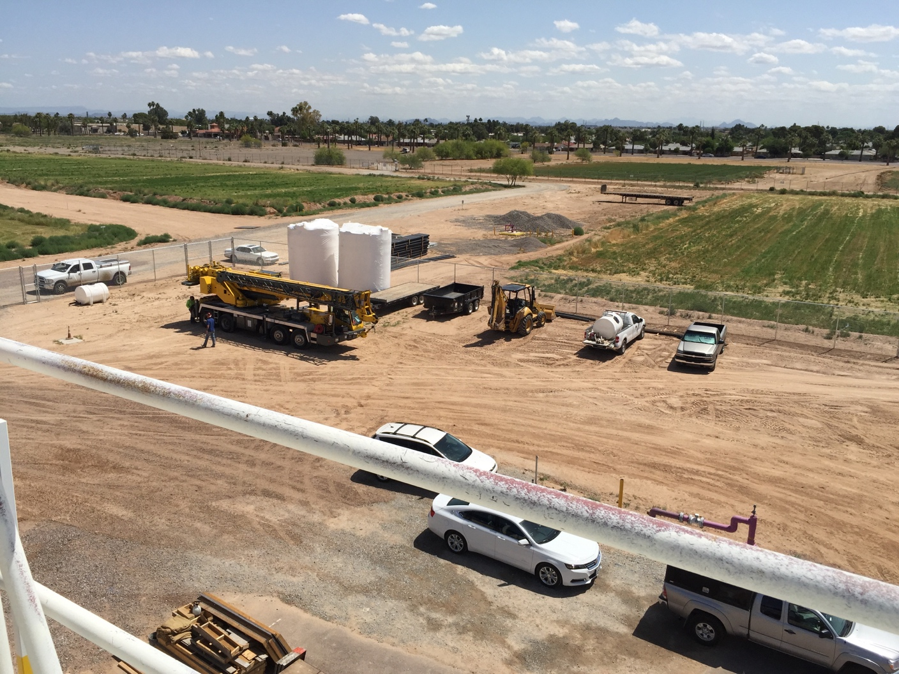
Current Phoenix-Goodyear Airport Superfund Site Beneficial Reuses
Irrigation Plots

Slide 11
For More Information, Contact:
Catherine Brown
Remedial Project Manager, EPA Region 9
Brown.Catherine@epa.gov
(415) 947-4137

