Slide 1
Passive sampling for the measurement of freely dissolved contaminants in water:
Practical Guidance
Upal Ghosh
University of Maryland Baltimore County

Slide 2
OUTLINE
Practical guidance for passive sampling measurement of C_{free} -- IEAM paper
  Polymer type
  Mathematical basis for passive sampler calibration
  Selection considerations
  Calibration of polymer-water partitioning
  Temperature and salinity corrections
  Ex-situ vs in-situ deployments
  Detection limits
Example use of C_{free} in assessing PCB biouptake:
  In benthic organisms
  In fish (current NIEHS study)

Slide 3
RECENT IEAM PAPER
Practical guidance on the use of passive sampling methods (PSMs) for Cfree for improved exposure assessment of HOCs in sediments.
Based on SETAC Technical Workshop “Guidance on Passive Sampling Methods to Improve Management of Contaminated Sediments,” 2012

Slide 4
CONCEPTUAL UNDERSTANDING OF PASSIVE SAMPLING
Hydrophobic chemicals partition among the aqueous and different solid phases
Equilibrium distribution can be described by linear free energy relationships
Passive sampler
Freely dissolved
C_{total} = C_{free} + DOC*K_{DOC}*C_{free} + POC*K_{POC}*C_{free}
DOC
POC
Two approaches to measure total and freely dissolved concentrations:
Remove POC by centrifugation/flocculation, measure total dissolved concentration and DOC, and estimate freely dissolved concentration.
Use calibrated passive sampler to measure freely dissolved concentration,
measure DOC, and estimate total dissolved concentration.

Slide 5
EQUILIBRIUM AND NONEQUILIBRIUM SAMPLING
Equilibrium : deployment time > t₉₅ or 3/k_{e}
Nonlinear uptake rate: deployment time >0.5/k_{e} <3/k_{e}
Linear uptake: deployment time <0.5/k_{e}

Slide 6
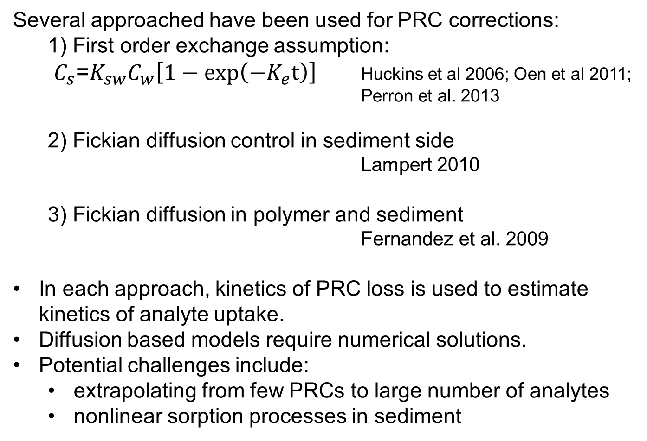
CORRECTION FOR NON-EQUILIBRIUM IN-SITU
Several approached have been used for PRC corrections:
1) First order exchange assumption:
$C_{s}$=$K_{sw}C_{w}\left[1−\exp\left(−K_{e}t\right)\right]$ Huckins et al 2006; Oen et al 2011;
Perron et al. 2013
2) Fickian diffusion control in sediment side
Lampert 2010
3) Fickian diffusion in polymer and sediment
Fernandez et al. 2009
In each approach, kinetics of PRC loss is used to estimate kinetics of analyte uptake.
Diffusion based models require numerical solutions.
Potential challenges include:
  extrapolating from few PRCs to large number of analytes
  nonlinear sorption processes in sediment

Slide 7
SELECTION CONSIDERATIONS FOR PSDs

Slide 8
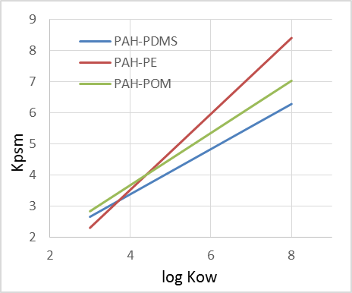
POLYMER PARTITION CONSTANTS
The most important and commonly used parameter necessary for calibration of PSMs is Kpw
Accurate measurement of Kpw for high Kow compounds is challenging
A list of provisional Kpw values are available in Ghosh et al. 2014
PDMS
PAH: logK_{PDMS-w} = 0.725logK_{ow} + 0.479 (R² = 0.99)
PCB: logK_{PDMS-w} = 0.947logK_{ow} – 0.017 (R² = 0.89)
POLYETHYLENE
PAH: logK_{PE-w} = 1.22logK_{ow} – 1.36 (R² = 0.99)
PCB: logK_{PE-w} = 1.18logK_{ow} – 1.26 (R² = 0.95)
POLYOXYMETHYLENE
PAH: logK_{POM-w} = 0.839logK_{ow} + 0.314 (R² = 0.97)
PCB: logK_{POM-w} = 0.791logK_{ow} + 1.02 (R² = 0.95)

Slide 9
TEMPERATURE AND SALINITY CORRECTIONS
Temperature and salinity can influence K_{pw}
Mathematical approaches available for corrections
Can be performed when necessary and viable to validate
Report should clearly state corrections performed
Unless extreme conditions are expected in the field, deviations of K_{pw} from room temperature assessments expected to be small

Slide 10
EX SITU VS. IN-SITU CONSIDERATIONS
Ability to estimate C_{FREE}:
  Easier to achieve and confirm equilibrium in the laboratory
Spatial scale:
  Sediments typically homogenized for lab measurements
  Fine-scale spatial heterogeneity can be measured in-situ
Contaminant depletion:
  Mixing in lab measurements avoids localized depletion
  Localized depletion can confound in-situ measurement
Statistical design:
  Multiple treatments and replication possible in lab
  More challenging logistically in the field and expensive
Ease of implementation:
  Simpler under laboratory conditions compared to the field
Ability to capture field conditions:
  Laboratory conditions are frequently standardized.
  In-situ is the best approach for capturing field conditions

Slide 11
PASSIVE SAMPLER PREPARATION AND PROCESSING
Polymers need to be cleaned before use in the field
Samplers need to be mounted in some form to allow water exposure while proving rigidity for deployment
Important to make sure polymer sheets do not fold up during deployment
Upon retrieval, surface deposits need to be removed
An accurate weight measurement of the polymer is taken
Polymers are extracted in appropriate solvent.
Surrogate standards added to extraction vial
Field blanks analyzed for exposure during transport and handling

Slide 12
DETECTION LIMITS
PE and POM sheets generally have lower detection limits than PDMS‐coated SPME fibers due to their larger mass and absorptive capacities
The mass of polymer needed depends on the detection limit of the chosen analytical method (e.g., regular GC‐ECD or GC‐MS vs HR‐GC/HR‐MS)
Example C_{free} detection limits for PCBs using POM
 | POM MDL | 1g POM PQL | 0.2g POM PQL
 | ng/g | pg/L | pg/L
PCB-3 | 0.542 | 17 | 83
PCB-6 | 0.05 | 0.37 | 1.8
PCB-18 | 0.019 | 0.14 | 0.70
PCB-53 | 0.048 | 0.29 | 1.5
PCB-44 | 0.029 | 0.23 | 1.2
PCB-101 | 0.014 | 0.12 | 0.62
PCB-153 | 0.011 | 0.05 | 0.23
PCB-180 | 0.03 | 0.16 | 0.81

Slide 13
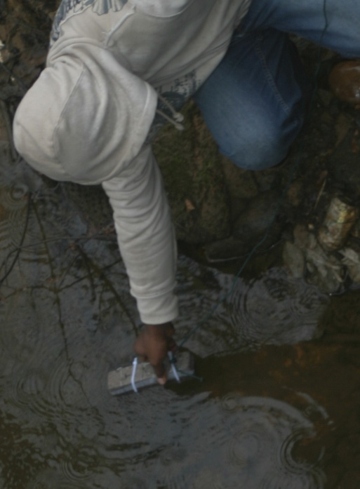
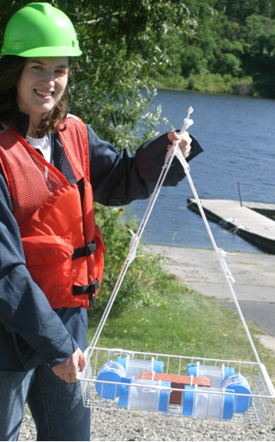
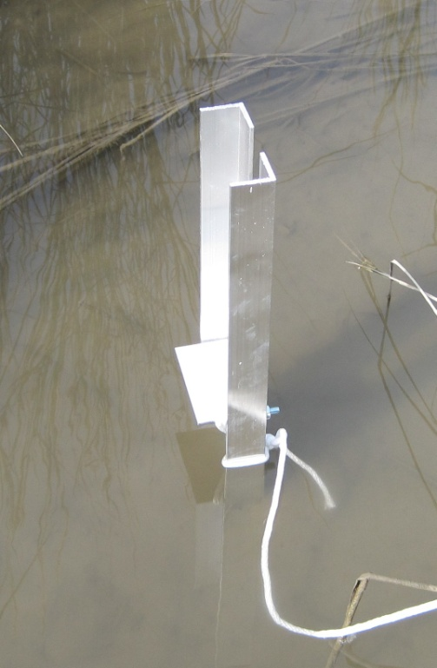
EXAMPLES OF PASSIVE SAMPLING USE
Batch equilibrium measurements for low aqueous concentrations (PCBs, PAHs, dioxins)
In-situ probing to assess ambient contaminant concentrations or to assess changes with time or with treatment
Pictures of typical applications:
water
sediment
Laboratory batch equilibrium
Stream water quality assessment
Field evaluation of treatment performance
Depth profiling of porewater in sediment

Slide 14
1. BIOUPTAKE PREDICTION IN WORMS USING
SEDIMENT CONC. VS. C_{FREE}
7 freshwater and marine sediments
Freely dissolved conc. measured by passive sampling and also directly
Lipid concentrations better predicted from freely dissolved porewater
Predicted from sediment
Predicted from porewater
Werner et al. ES&T 2010

Slide 15
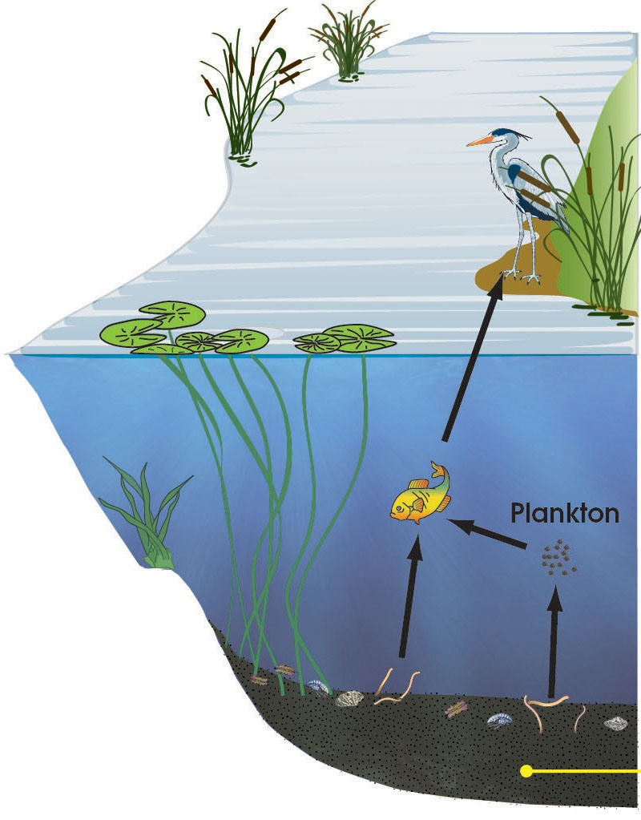
2: PREDICTING UPTAKE IN FISH AFTER IN-SITU TREATMENT
Evaluate the effect of sediment amendment with AC on PCB uptake in fish
Test the ability of existing PCB bioaccumulation models to predict changes observed in fish uptake upon AC amendment of sediment
Incorporate measured freely dissolved concentrations by passive sampler in food chain models

Slide 16
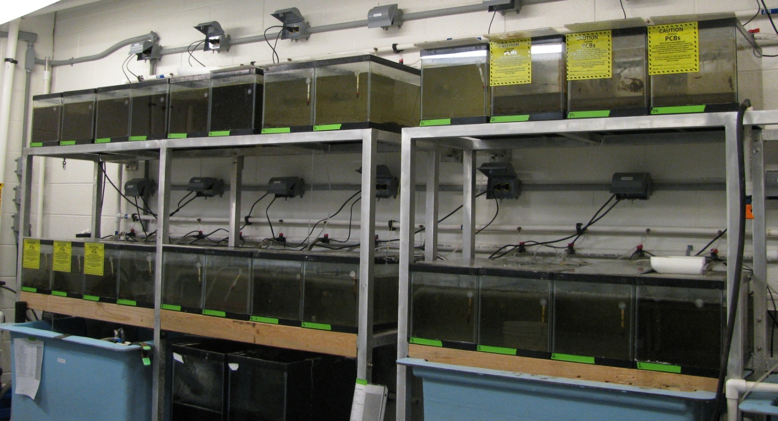
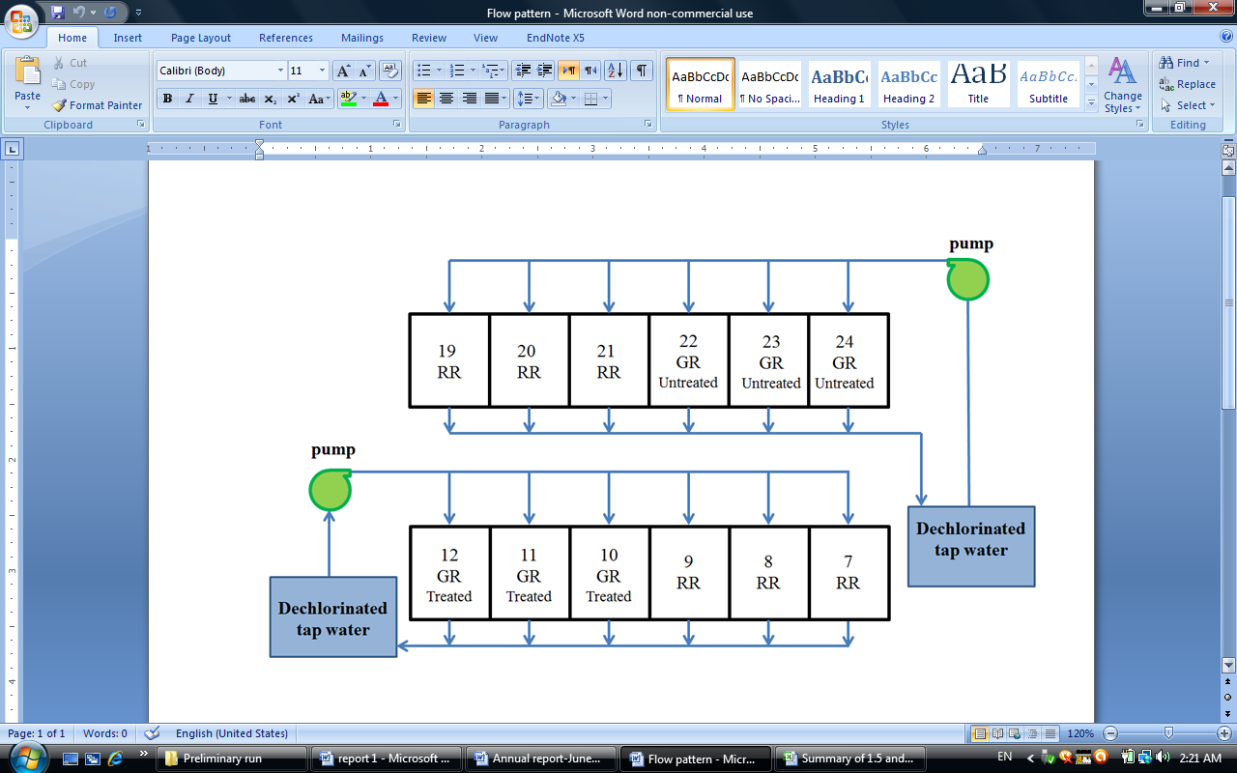

LABORATORY EXPOSURE EXPERIMENTS
Treatments:
  Clean sediment (Rhode River)
  PCB impacted sediment (Near-shore Grasse River)
  PCB impacted sediment-AC treated in the lab
Replicate aquaria with passive samplers (POM)
in water column and sediment
Fish species: Zebrafish
PCB-free diet
Sampling after 45 and 90 days
Water flow in aquaria tanks
Passive samplers
Sediment
Components in each aquaria

Slide 17
POREWATER AND OVERLYING WATER PCBs
Porewater PCB concentration in PCB impacted untreated sediment was high and was reduced by two orders of magnitude upon amendment with AC.
PCBs in overlying water was also greatly reduced in the treated sediment case (24-30 fold) and was close to that seen in the clean Rhode River sediment.
In the PCB-impacted untreated sediment tanks, porewater PCB concentrations were 3-7 fold higher than the overlying concentrations indicating sediment as the PCB source to the water column.

Slide 18
PCB RESIDUE IN FISH AFTER 90 DAYS
The total PCB concentration in fish decreased by 87% after treatment with AC.

Slide 19
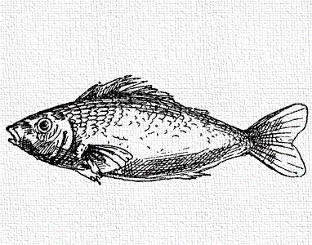
PREDICTING PCB UPTAKE IN FISH
Steady-State Approach
C_{lipid} ≈ K_{lipid}.C_{aq} K_{lipid} ≈ K_{OW}
Kinetic Approach
dM_{B}/dt = W_{B} (k₁C_{W,O}+IR.α.C_{S})-k₂ M_{B} (Arnot & Gobas 2004)
No uptake through food- PCB-free diet
k₁
k₂

Slide 20
EQUILIBRIUM & KINETIC MODEL PREDICTIONS
Worms in sediment come close to equilibrium in 1 month
Fish do not reach equilibrium even after 90 day exposure

Slide 21
KEY CONCLUSIONS
By following this guidance it is possible to use PSMs for contaminated sediment site assessments.
The use and interpretation of PSMs requires the involvement of personnel familiar with the science.
KEY RECOMMENDATIONS
Inter-laboratory tests for greater confidence in precision
Development of SRMs to check method accuracy
Development of the non-equilibrium PSMs in the field and further validation of PRC use in static sediments
More organic compounds with known K_{PW}

Slide 22
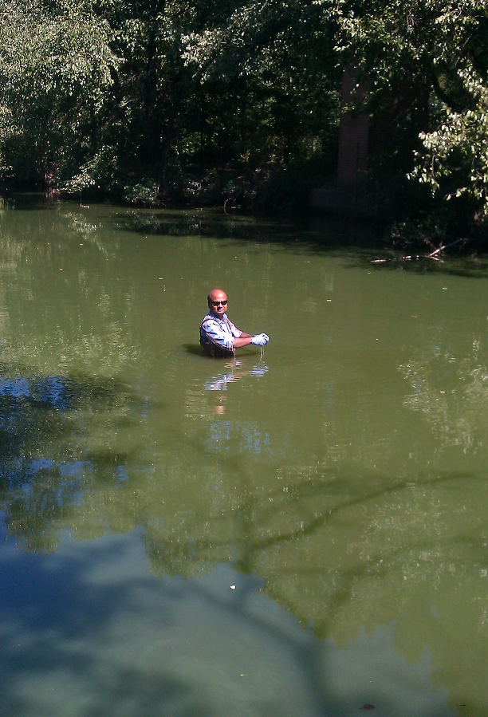
ACKNOWLEDGMENTS
Funding support from SERDP/ESTCP programs, NIEHS, USEPA GLNPO, and Alcoa
Graduate students at UMBC

