Slide 1
Don’t Forget the Well Keys: Lessons Learned from 25 years of Field Work
EPA CLU-IN RCRA Expert Series
7 September 2016
Katherine Baylor, PG
USEPA Region 9, San Francisco

Slide 2

DISCLAIMER
This presentation has been provided as part of a U.S. Environmental Protection Agency webinar. The document does not constitute EPA policy. Mention of trade names or commercial products does not constitute endorsement or recommendation for use. Links to non-EPA web sites do not imply any official EPA endorsement of or a responsibility for the opinions, ideas, data, or products presented at those locations or guarantee the validity of the information provided. Links to non-EPA servers are provided solely as a pointer to information that might be useful to EPA staff and the public.

Slide 3
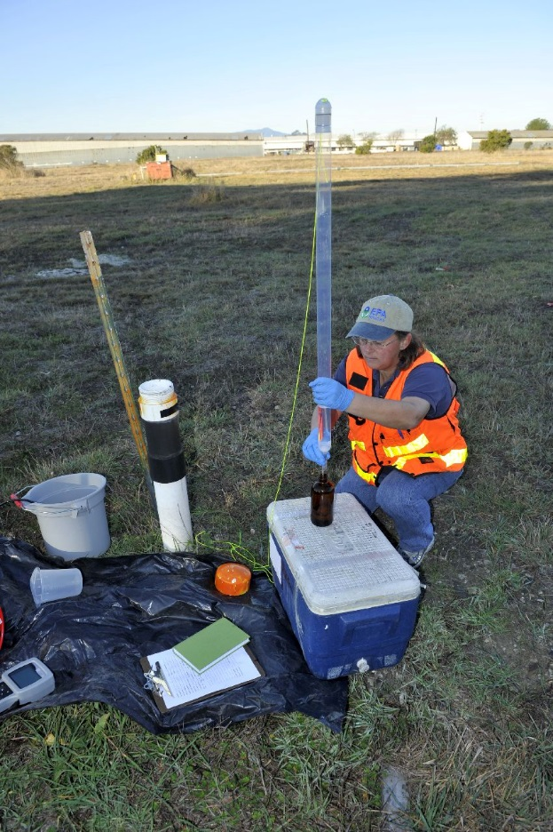
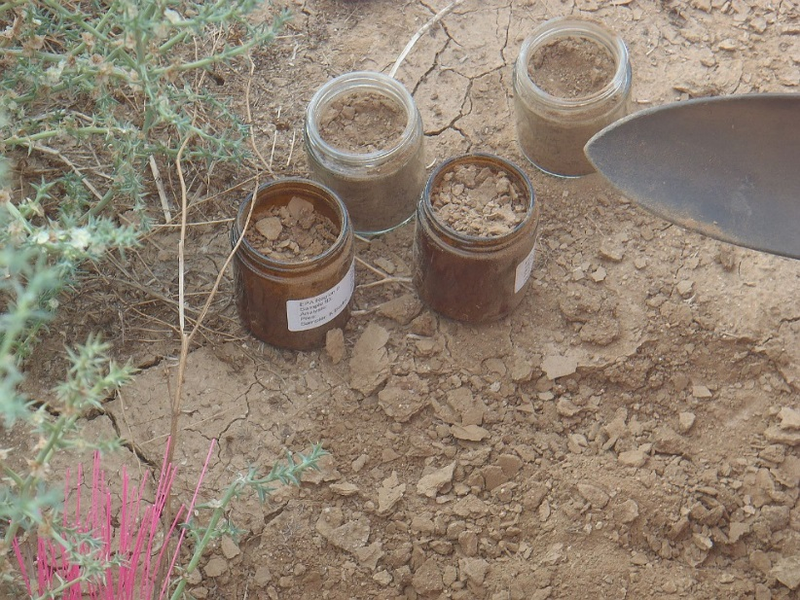
Why Field Work?
Environmental Data Collection (sampling)
Oversight of Regulated Facilities / Enforcement
Site Familiarization
Training

Slide 4
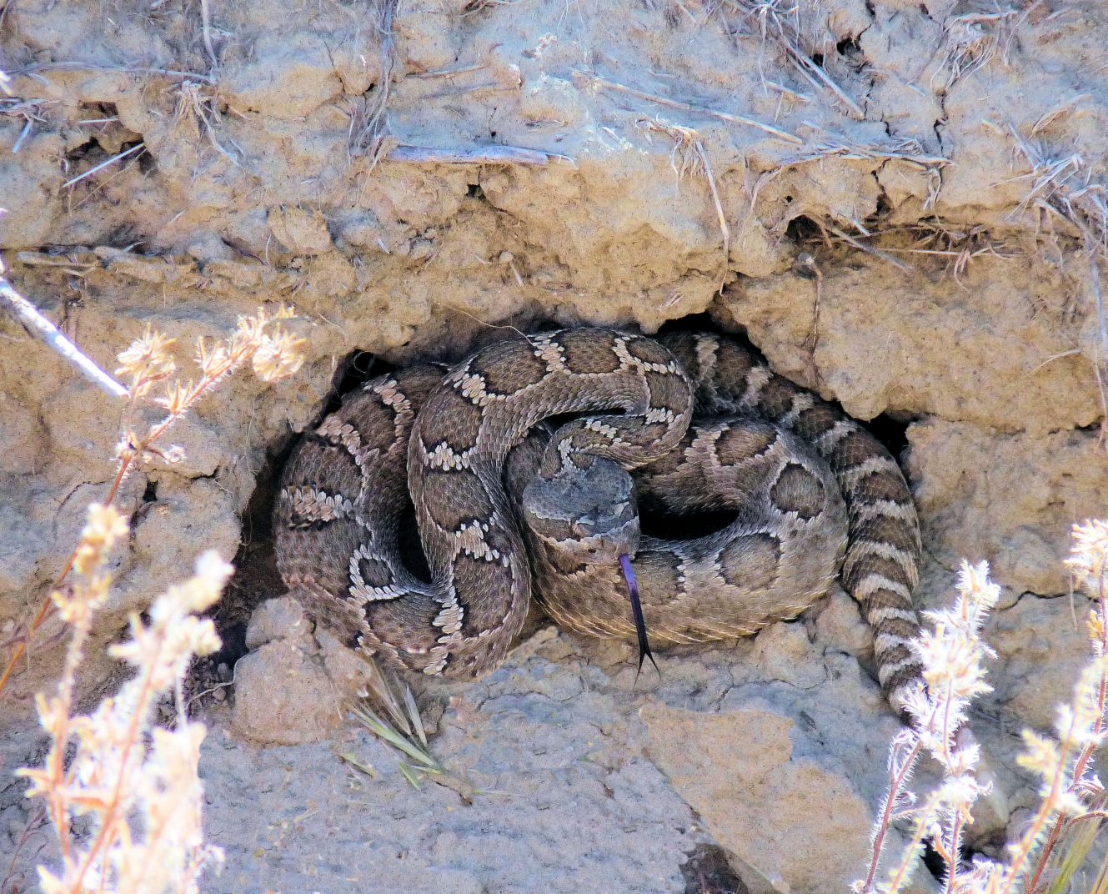
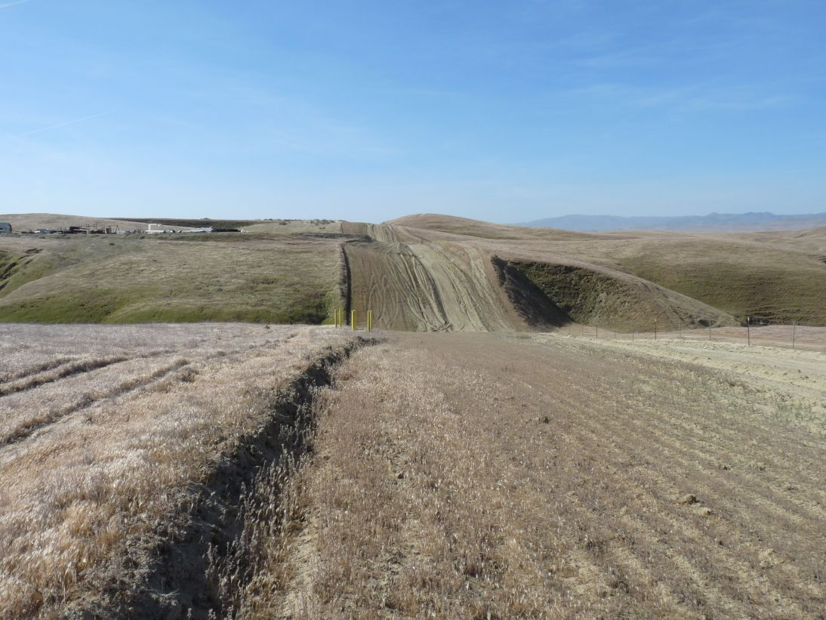
Safety
Safety is the highest priority!
  No sample is worth collecting if it cannot be collected safely
Follow your organization’s health and safety requirements
  Don’t overlook slip/trip/fall, lifting/back injuries, vehicle accidents, sunburn, heat/cold stress

Slide 5
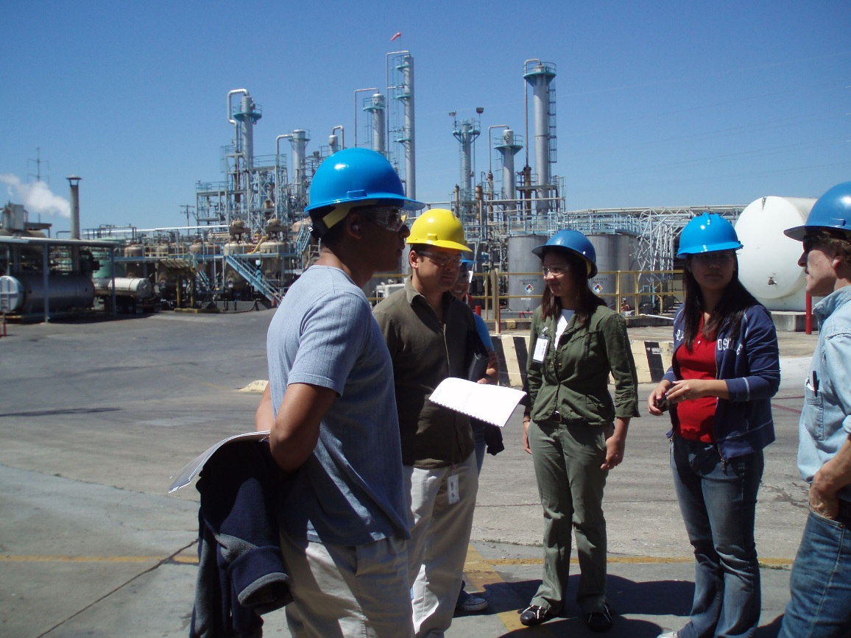
Field Observations
Safety first
Read the appropriate documents before arriving at the site (field sampling plan, workplan, SOP, technology description)
Ask questions, but let the field people do their work.
Work through the facility staff or envt contractors before approaching sub-contractors (e.g., drillers)

Slide 6
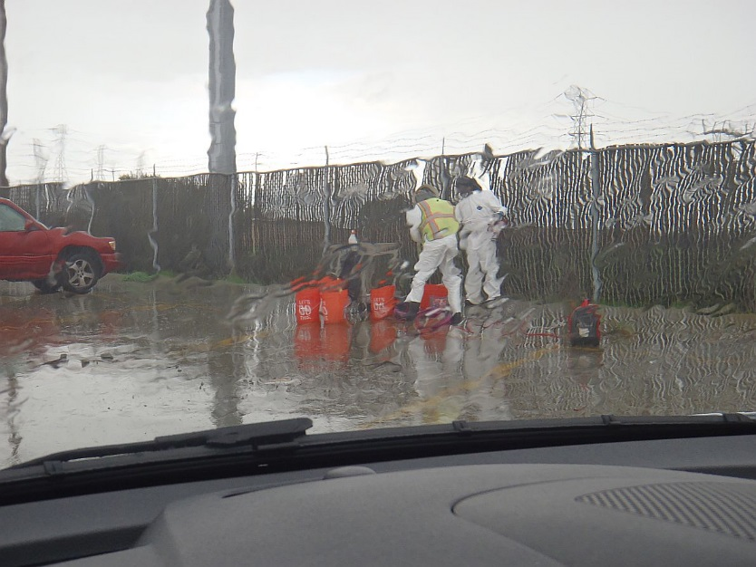
Social Aspects of Field Work
Field work is not the same as office work
  May be more stressful
  Often time-critical
  Different than daily routine
  May be hot, cold, rainy, early and very long days
Not everyone is suited to (or interested in) field work
Need to be conscientious, adaptable, resourceful

Slide 7
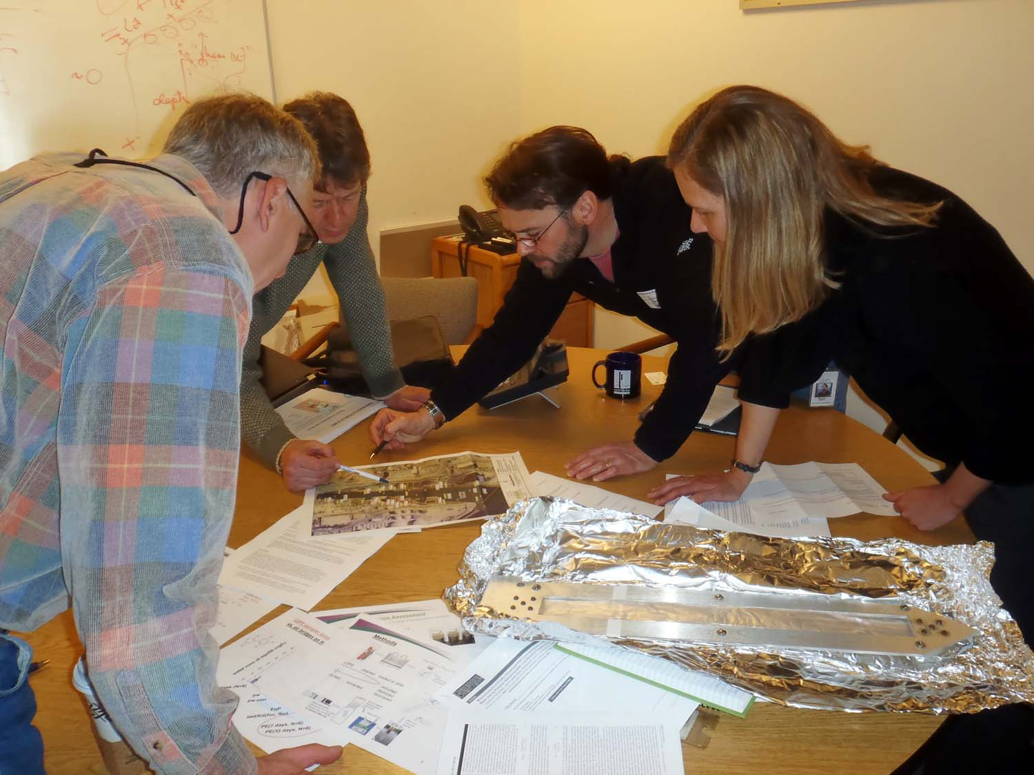
Field Work Planning (DQOs)
What is the problem?
  Example: industrial activities may have resulted in the release of lead (Pb) to the environment
  Example: auto shredder waste pile may contain hazardous waste
  (Bad) Example: this site is a mess!
What question are you trying to answer?
  Example: extent of on-site Pb contamination in surface soil
  Example: Do metals in a waste pile exceed TCLP limit
  (Bad) Example: what is this stuff?
Is there existing/historical information available? What additional data is needed to answer Question 2?
  avoid collecting redundant data

Slide 8
Field Work Planning (DQOs)
Where/when will data be collected?
  On-site, off-site, at depth, during multiple seasons?
What regulatory/risk levels apply?
  Regulatory/risk levels may dictate analytical methods and requested detection limits
Using inputs from Questions 1 through 5, design the sampling/analysis approach
  Consider resources: budget, personnel, time
  How many samples? What media (soil, water, air, biota)?
  What analysis? VOCs, SVOC, metals, PCBs?
    What detection limits are needed?
  Grab samples, composite samples, multi-increment samples?
Work with the laboratory to get the necessary analysis

Slide 9
Field Work Planning (Data Quality Objectives)
State the Problem
Identify the Goals of the Study
Identify Information Inputs
Define the Boundaries of the Study
Develop the Analytic Approach
Specify Performance or Acceptance Criteria
Develop the Plan for Obtaining the Data
Data Quality Objectives: https://www.epa.gov/sites/production/files/2015-06/documents/g4-final.pdf (121 pages)

Slide 10
Strategy: Surface Soils
Grab
  May be best for judgmental samples (stained areas, suspected hot spots)
Composite
  May provide (slightly) more information than grab samples
Multi-Increment Sample, MIS (Incremental Sampling Methodology, ISM)
  “super composite” that has both field and lab elements
  Used for decision making over ‘decision units’ or DUs
  http://www.itrcweb.org/Team/Public?teamID=11

Slide 11
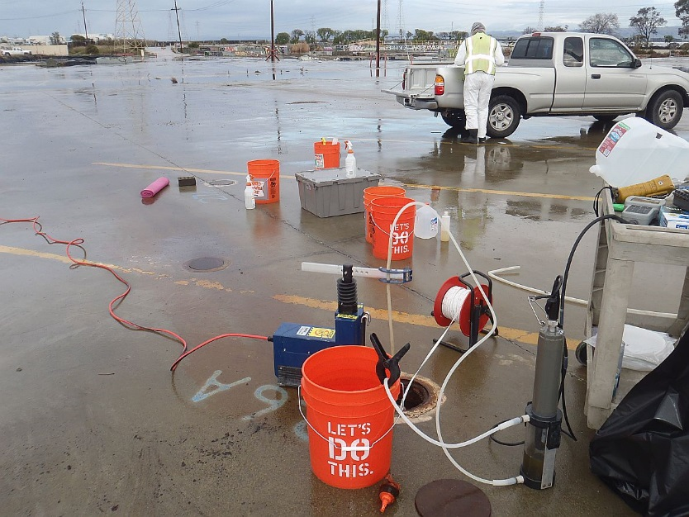
Strategy: Groundwater
Permanent Monitoring Wells
  Good for long-term monitoring
Grab Samples
  One-time samples, often using direct-push rigs (e.g. GeoProbe)
  Good for rapid site characterization
  May be converted to permanent wells
Groundwater sampling is more labor/equipment intensive than surface soil sampling

Slide 12
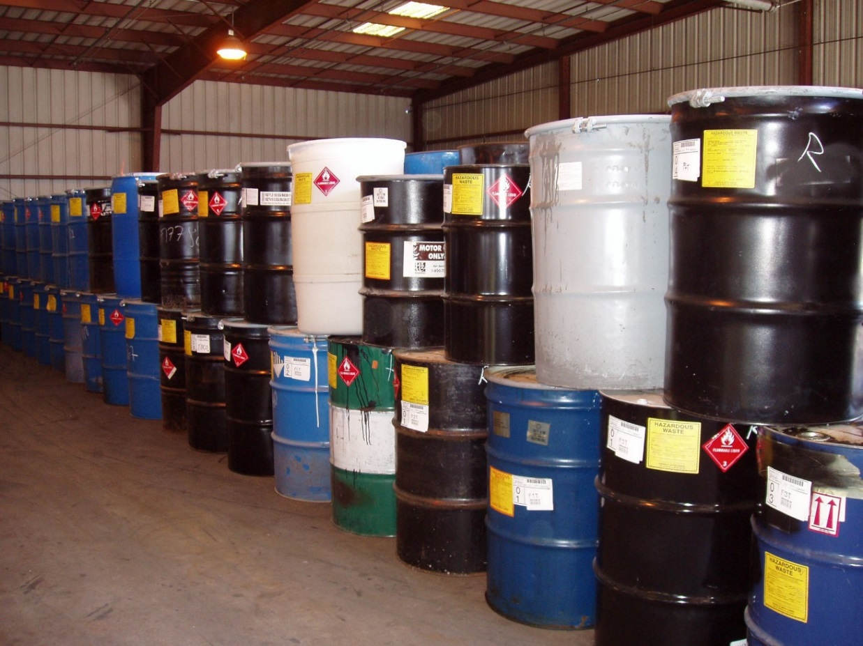
Strategy: Drum Sampling
(A little knowledge is a dangerous thing)
Generally, try to avoid due to:
  Safety concerns
  Shipping / sample transport
  Analytical issues
  Easier/safer ways to get the information needed
Unknown/unlabeled drums
  May be very dangerous!
  Specialized sampling/analytical methods
  Is it waste, or is it product?

Slide 13
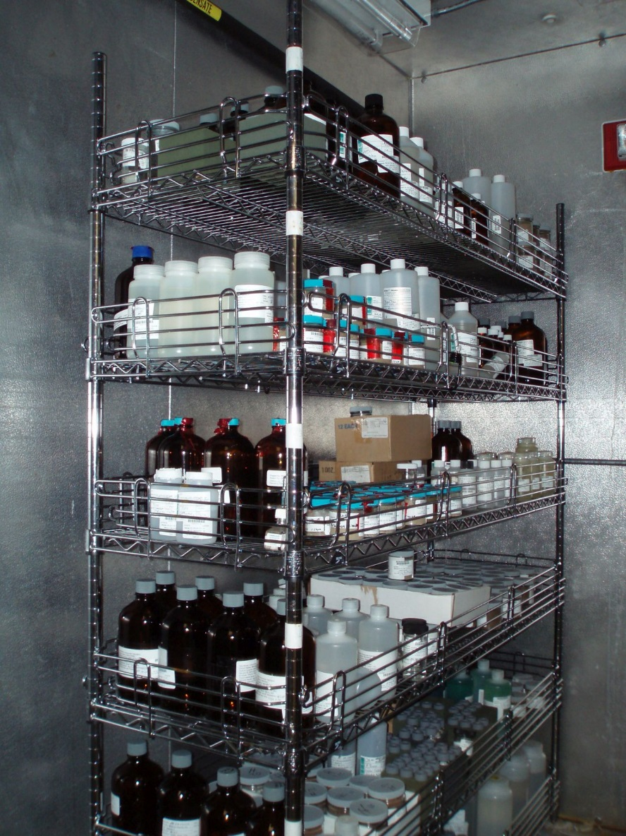
Laboratory Coordination
RCRA: SW-846 methods https://www.epa.gov/hw-sw846/sw-846-compendium
Common RCRA methods include 8260 (VOCs), 8270 (SVOCs), 8082 (PCBs), 6010 or 6020 (metals), 7471 (mercury).
SW-846 methods are common, but rarely required except for specific regulatory requirements (e.g., TCLP by EPA method 1311)
Samples awaiting analysis

Slide 14
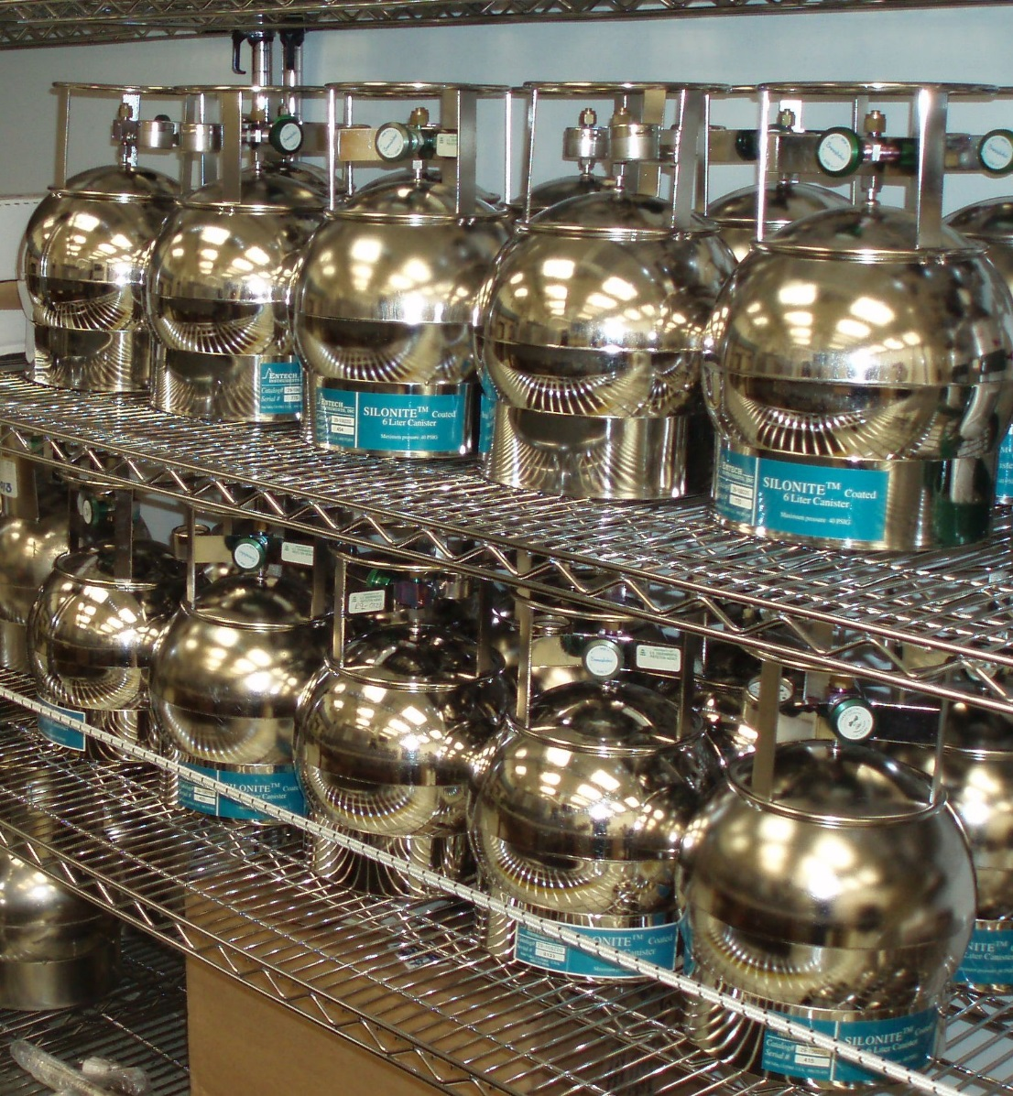
Laboratory Coordination
Need to ensure that lab can do the analysis needed for the project, and:
  Achieve quantitation limits to meet project goals (e.g., regulatory requirement? Human or eco-risk based?
  Meet required hold time and/or turnaround time
  For commercial labs, understand hidden costs
For multi-analyte lists, need fewer/more analytes?
  Fewer example: For indoor air samples, consider analyzing only for site-related compounds
  More example: fuel oxygenates in Method 8260 (MTBE, DIPE, and TBA might not be on the lab’s standard list)
Stainless Steel
Air Sampling
Canisters

Slide 15
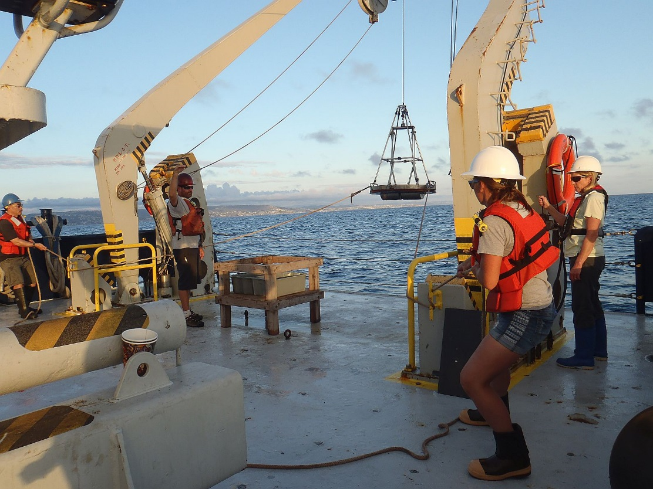
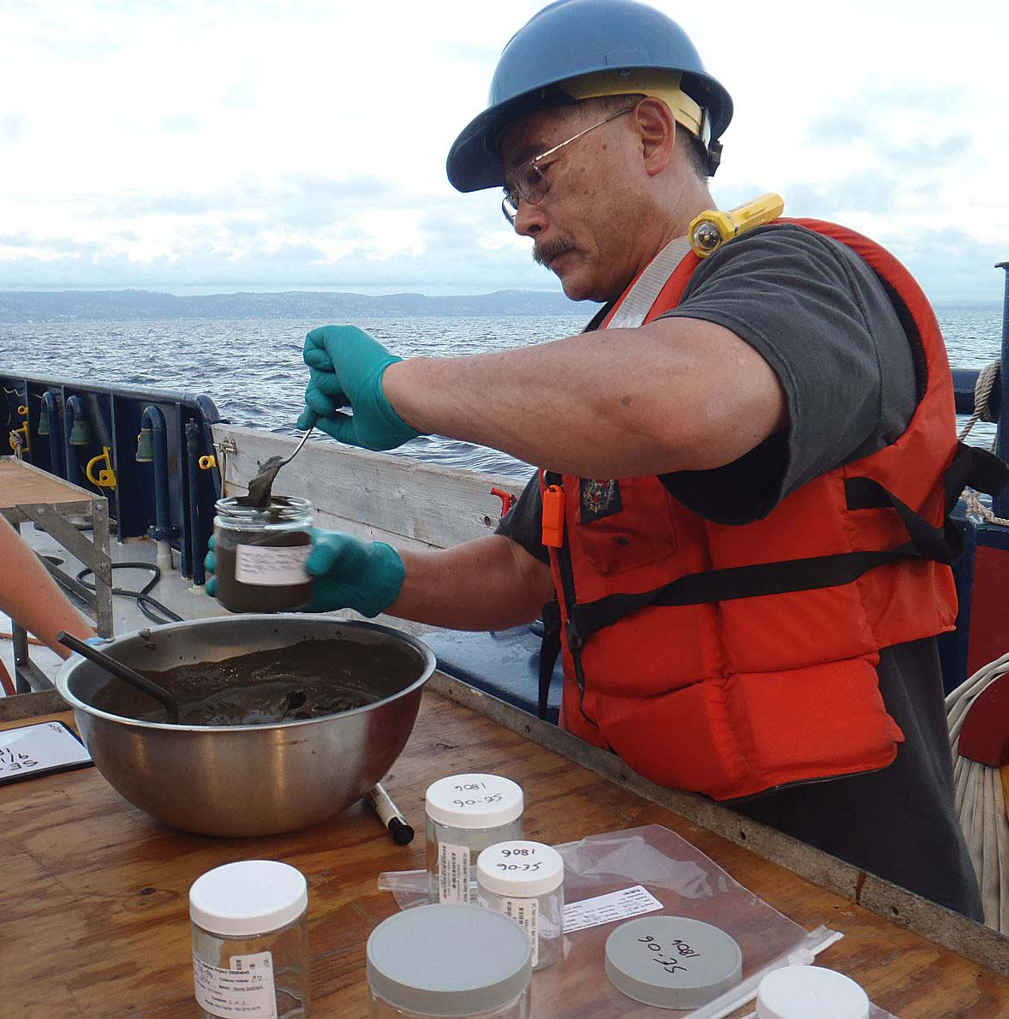
Up-front work
Ocean sediment sampling using Van Veen dredge
Sediment sampling
Checklists
Generate labels in advance (esp. for large/complicated projects)

Slide 16
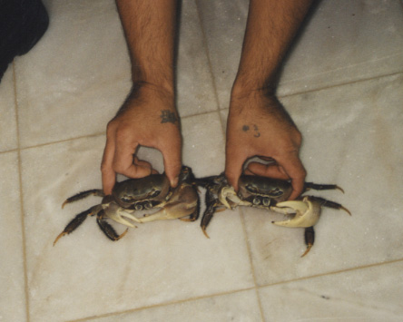
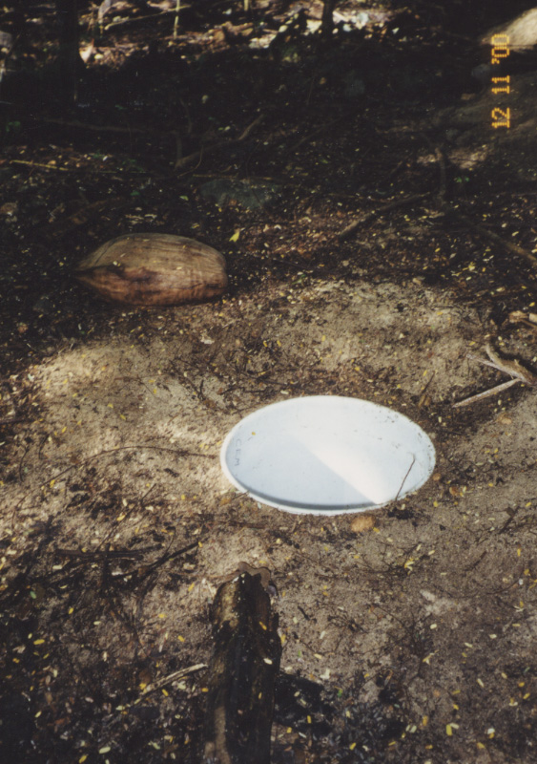
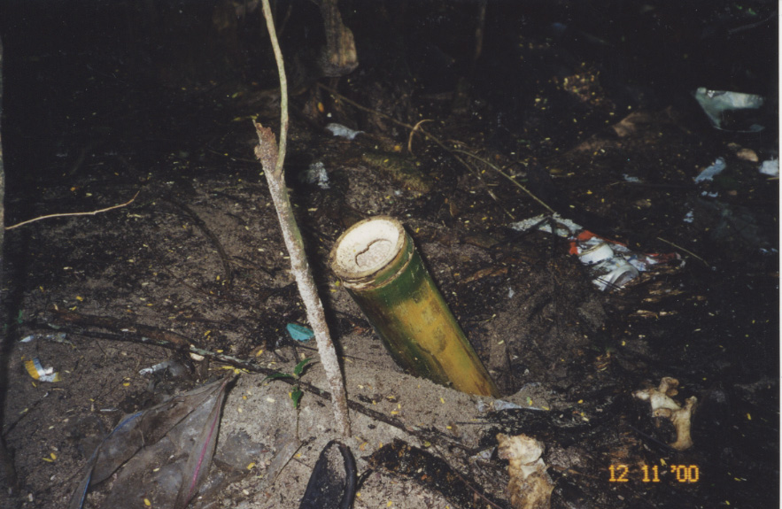
Use Local Resources
Landcrabs
Bamboo trap
5 gallon bucket trap

Slide 17
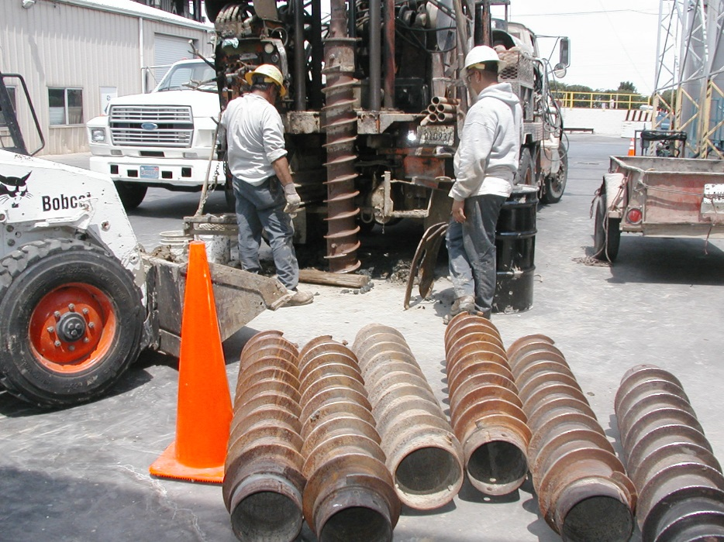
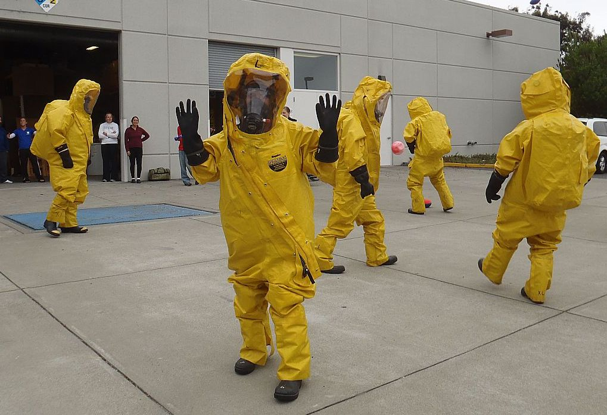
Allow extra time
Drilling activities
Personal
Protective
Equipment

Slide 18
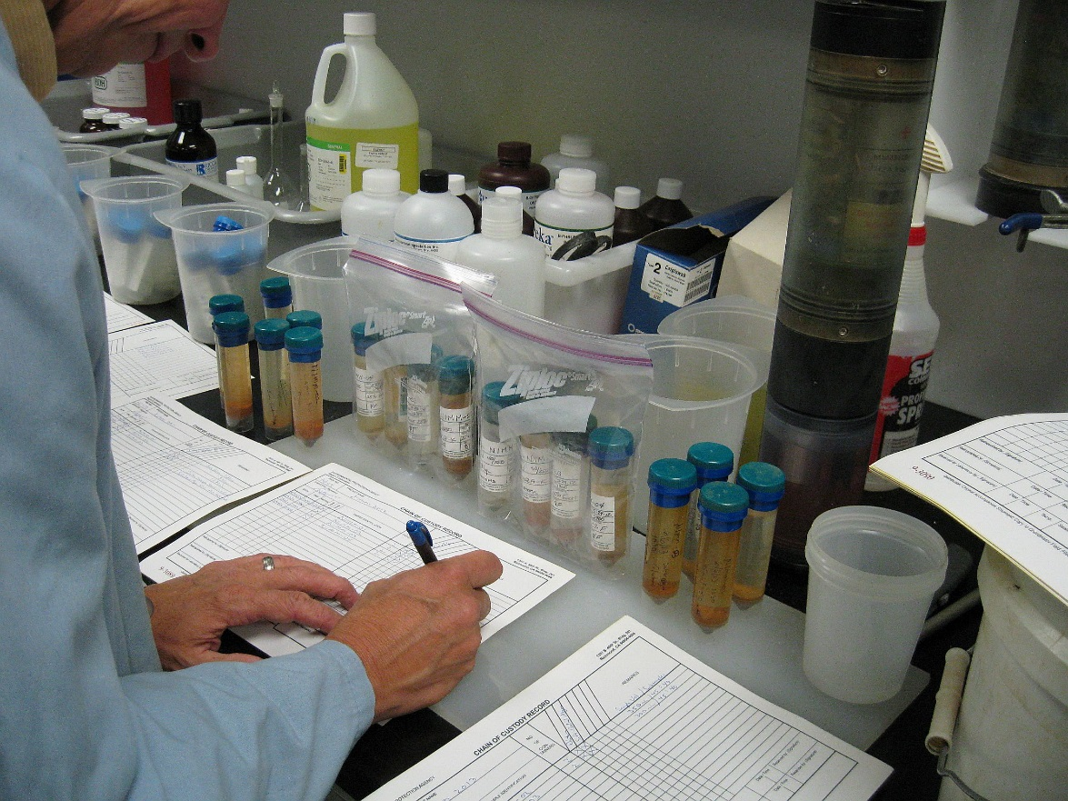
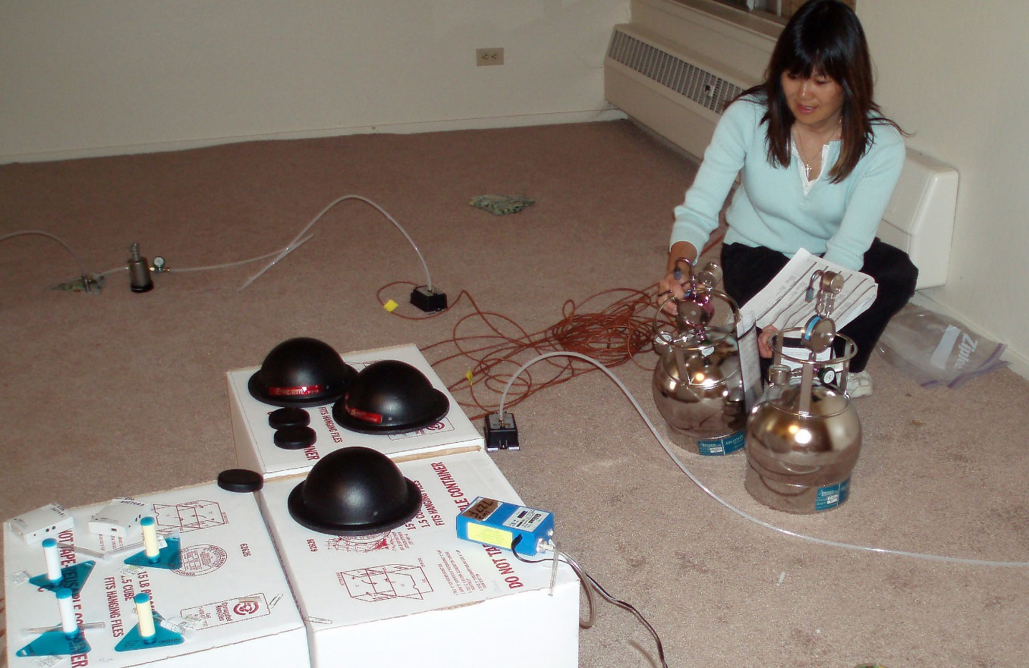
Document, Document, Document
Chain of Custody Form
Field log sheets

Slide 19
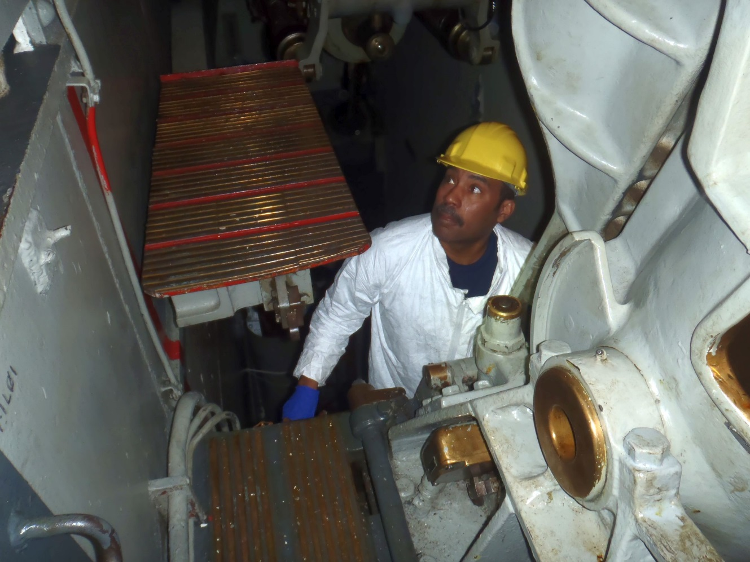
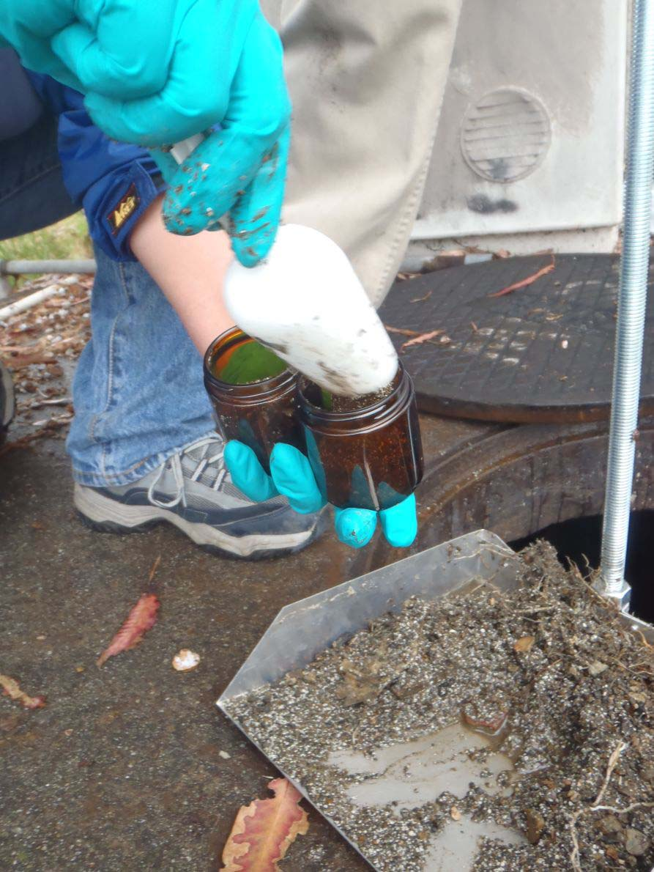
Museum ship site familiarization
Manhole
sediment
sampling

Slide 20
Technical Resources: websites
ITRC: http://www.itrcweb.org/
Clu-In: https://clu-in.org/
EPA SW-846: https://www.epa.gov/hw-sw846
EPA ORD: https://www.epa.gov/aboutepa/about-office-research-and-development-ord

Slide 21
Technical Resources: EPA Documents
RCRA Waste Sampling Draft Technical Guidance: Planning, Implementation, and Assessment EPA 530-D-02-002, August 2002 (353 pages)
Description and Sampling of Contaminated Soils, A Field Pocket Guide. EPA/625/12-91/002 November 1991
Subsurface Characterization and Monitoring Techniques, A Desk Reference Guide (dated, but still packed with useful information)
  Volume 1: Solids and Ground Water, Appendices A and B: EPA/625/R-93/003a
  Volume 2: the Vadose Zone, Field Screening, and Analytical Methods, Appendices C and D: EPA/625/R-93/003b
RCRA Ground-Water Monitoring: Draft Technical Guidance https://www.epa.gov/quality/rcra-ground-water-monitoring-draft-technical-guidance (dated, but parts are very useful)
Statistical Analysis of Groundwater Monitoring Data at RCRA Facilities (Unified Guidance), March 2009 with August 2010 updates. EPA 530/R-09-007

Slide 22
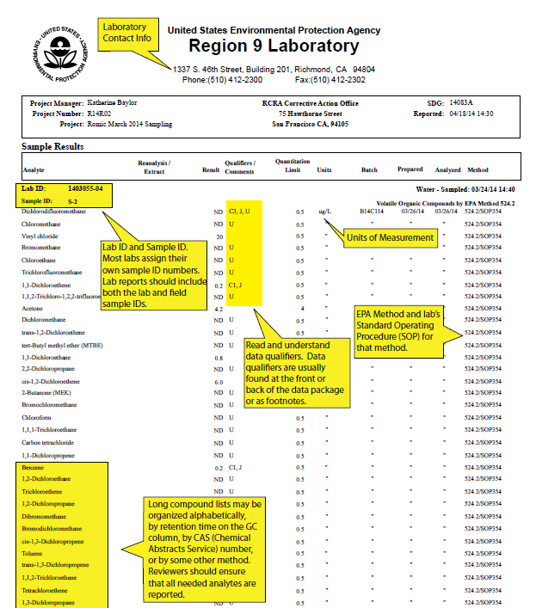
Laboratory Data Review
Available on Clu-in with the presentation materials

Slide 23

Field work career path
Ask colleagues, supervisor: what group/team in our organization does field work?
  Within EPA, may be Environmental Services Division/Branch or specific sections within divisions
Get additional training: on the job, commercial field courses, local colleges, YouTube, online courses
  ITRC, Trainex, state/local govt organizations
Take every field work opportunity available
Get your field work fix outside of work
(e.g., hiking, backpacking, kayaking)

Slide 24
Questions ?
Contact:
Katherine Baylor, EPA Region 9
baylor.katherine@epa.gov
415-972-3351

