Slide 1
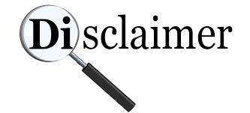
DISCLAIMER
Notice: This presentation has been provided as part of a U.S. Environmental Protection Agency webinar. The document does not constitute EPA policy. Mention of trade names or commercial products does not constitute endorsement or recommendation for use. Links to non-EPA web sites do not imply any official EPA endorsement of or a responsibility for the opinions, ideas, data, or products presented at those locations or guarantee the validity of the information provided. Links to non-EPA servers are provided solely as a pointer to information that might be useful to EPA staff and the public.

Slide 2

RCRA Expert Brownbag Series
The Definition of Solid Waste
Presented By:
Tracy Atagi
EPA Headquarters
March 3, 2016

Slide 3
What is the Purpose of this Webinar?
This webinar is intended to provide a roadmap of the right questions to ask when dealing with the RCRA definition of solid waste (DSW).
This webinar is not a training; in general, you won’t find specific answers to DSW here
However, by the end of the webinar, you should know where to find those answers.
A separate webinar on the definition of legitimate recycling will be presented April 6.
Notes:
Notes:

Slide 4
RCRA Section 1004(27)
“The term “solid waste” means any garbage, refuse, sludge from a waste treatment plant, water supply treatment plant, or air pollution control facility and other discarded material, including solid, liquid, semisolid, or contained gaseous material resulting from industrial, commercial, mining, and agricultural operations, and from community activities, but does not include…”
Q: Wait a minute, you’re saying a “solid waste” doesn’t actually have to be solid?
A: That’s correct! It can include solid, liquid, semisolid, or contained gaseous material. But that’s just the beginning…

Slide 5
Why Does It Matter if a Material is a Solid Waste?
EPA’s authority to regulate a material stems from it first being defined as a “solid waste.” If a material isn’t a solid waste, then RCRA doesn’t regulate it – even if it is hazardous!
There are different “definitions of solid waste” that apply in different cases. For example:
  The statutory definition of solid waste at RCRA section 1004(27) applies to certain clean up and emergency response authorities.
  The non-hazardous regulatory definition of solid waste at 40 CFR 241 applies to certain non-hazardous material burned as fuel (and is important for how the combustion unit is regulated under the Clean Air Act)
  The hazardous regulatory definition of solid waste at 40 CFR 261.2 applies for the purposes of RCRA Subtitle C regulations (e.g., hazardous waste manifest and permitting requirements, etc).
Today’s focus

Slide 6
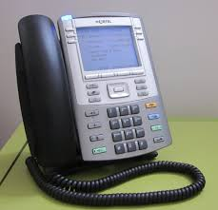
Do you have questions on the definition of solid waste for purposes other than RCRA Subtitle C hazardous waste regulations?
Time to phone a friend!
Tracy Atagi 703-308-8672

Slide 7
The Basics
What do I need to know to determine if something is a solid waste for purposes of RCRA hazardous waste regulation?
What is the material?
What is being done with the material?
In most cases, both these questions need to be answered.
The same material might be a solid waste in some cases, and not others.
The same management practice might be solid waste management in some cases, and not others.

Slide 8
What is the material?
Commercial Chemical Product
  Unused product (e.g., off-specification chemical)
Spent Materials
  Any material that has been used and, as a result of contamination, can no longer serve its intended purpose without undergoing regeneration, reclamation or reprocessing.
Sludges
  Any solid, semisolid, or liquid waste generated from a wastewater treatment plant, water supply treatment plant, or air pollution control facility (not including the treated effluent)
By-products
  Material that is not one of the primary products of a production process and is not solely or separately produced by the production process
Scrap Metal

Slide 9
Solid Waste: The Simple Determinations
There are a few cases where it’s simple to determine something is a solid waste:
  It’s been disposed of in a landfill.
  It’s been burned in an incinerator.
  It’s one of the specific types waste that EPA determined is “inherently waste-like” in 40 CFR 261.2(d)
(Okay, that third one isn’t that simple, but those are rare wastes that are too dangerous to recycle and you’ll hopefully never encounter them).
Everything else? It gets a little trickier.

Slide 10
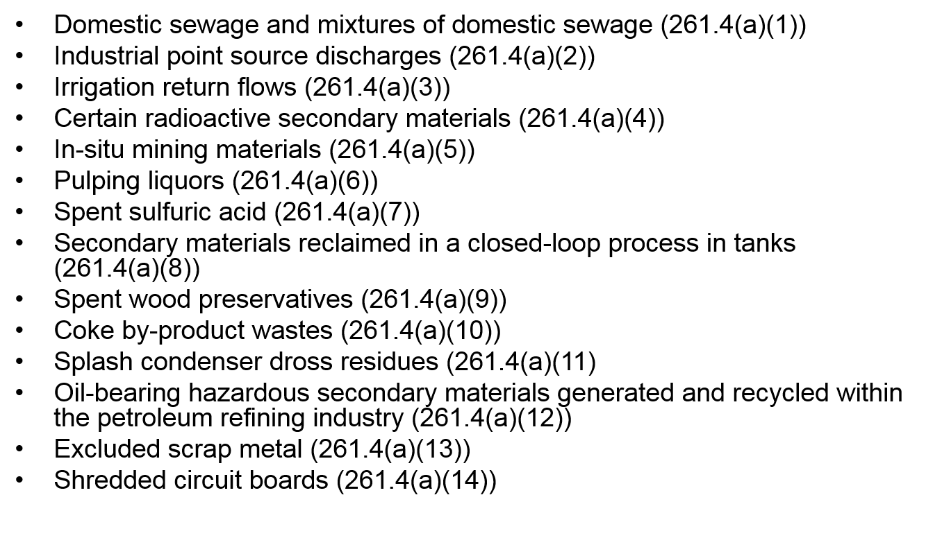
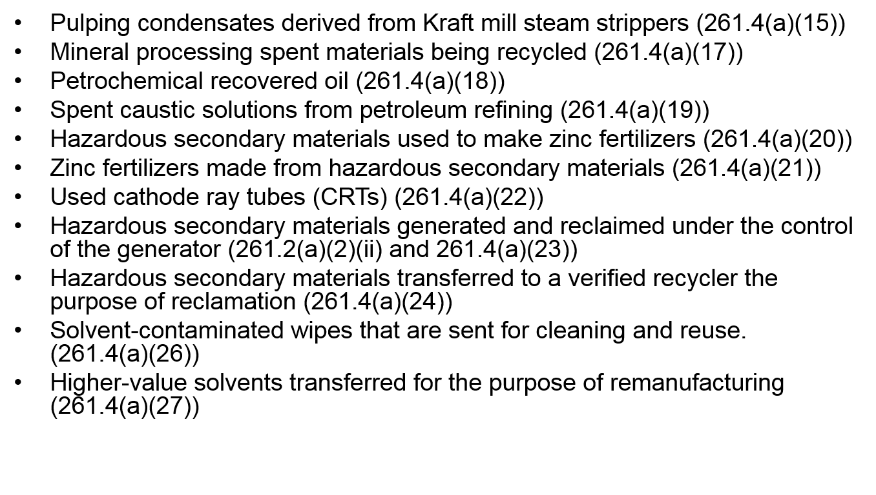
Is it Excluded?
There are a lot of exclusions from the definition of solid waste found in 40 CFR 261.4 that range from fairly simple (e.g., closed-loop recycling) to very complex (e.g., the verified recycling exclusion, promulgated in the new DSW rule in January 2015).
There’s no time to discuss them today, but luckily we don’t have to! There’s a DSW tool online that will walk you through it:
http://www3.epa.gov/epawaste/hazard/dsw/tool.htm

Slide 11
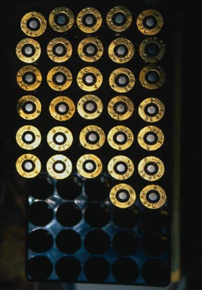
Is it a Military Munition?
Military munitions are a special case – they
get their own definition of solid waste
regulations at 40 CFR 266.202.
Military munitions are not solid wastes when:
  Used for the intended purpose(e.g., lead shot).
  Recycled (e.g., reused, repaired).
Military munitions are solid wastes when:
  Unused munitions
    Disposed of, removed from storage, deteriorated, declared a solid waste.
  Used munitions
    Retrieved & disposed of on-site or sent off-site for treatment or disposal.

Slide 12
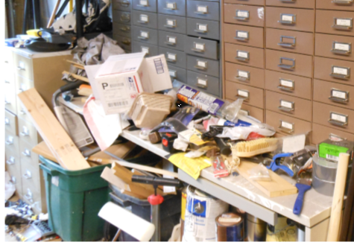
Is it Abandoned?
A material is a solid waste when it’s been “abandoned.” Abandonment is easy to show when it’s been landfilled or burned in an incinerator. But how can you tell when something has been abandoned, and when someone is just storing it to be used later?

Slide 13
It depends on the type of material!
Is it an unused commercial chemical product (CCP)?
Commercial chemical products don’t have specific time limits attached to their storage. However, there is guidance available for determining when a CCP is a solid waste.
CHECKLIST TO ASSIST IN EVALUATING WHETHER COMMERCIAL CHEMICAL PRODUCTS ARE SOLID AND HAZARDOUS WASTE UNDER THE RESOURCE CONSERVATION AND RECOVERY ACT
Is it anything else that’s a secondary material (e.g. spent material, byproduct, sludge, etc.)?
These materials are subject to “speculative accumulation” limits, which means that (1) it must have a feasible means of recycling, and (2) 75% must be recycled or moved offsite for recycling every calendar year.
Notes:
T/F quiz here: True or False: A material that is legitimately recycled is not a solid waste.

Slide 14
Is it Recycled?
Some types of hazardous secondary materials being recycled almost always are regulated as solid waste
  Burning for energy recovery
  “Use constituting disposal” (use in or on the land)
Some types of hazardous waste recycling are regulated under alternative hazardous waste management standards.
  Lead acid battery recycling
  Precious metals recycling
Some types of hazardous waste recycling are almost never regulated as waste management.
  Used directly as an effective substitute for a product or ingredient (when not burned for energy recovery or used on the land).
Then there are specific solid waste recycling exclusions, which are part of the list of exclusions mentioned earlier.

Slide 15
Is it Reclaimed?
Regulation of reclamation (i.e., processing a hazardous secondary material to either recover usable products or regenerate the original product) depends on the material:
  Commercial chemical products and characteristic by-products and sludges are not solid waste when reclaimed.
  Listed by-products and sludges are solid wastes when reclaimed, unless the company is operating under one of the new DSW exclusions:
  Generator Controlled Exclusion (recycling onsite, within the same company or through certain toll manufacturing agreements.
  Verified Recycling Exclusion (recycling at a verified recycler)
  Remanufacturing Exclusion (higher-valued solvents sent for remanufacturing)

Slide 16
Scrap metal recycling
In general, scrap metal recycling is not regulated under RCRA:
Excluded scrap metal (processed scrap metal, home scrap metal and prompt scrap metal) is not a solid waste when recycled. (40 CFR 261.4(a)(13))
Other types of scrap metal are solid waste when recycled, but that recycling is exempt from hazardous waste regulations (40 CFR 261.6)

Slide 17
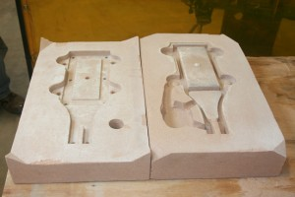
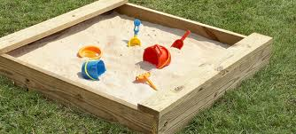
Legitimate recycling
No matter why type of recycling we’re talking about, in order to be excluded or subject to reduced requirements, the recycling must be legitimate and not sham.
The definition of legitimate recycling is the topic of next month’s webinar, but here’s an example.
Legitimate: Lead-contaminated foundry sands reused in foundry molds
Sham: Lead-contaminated foundry sands reused as playground sand

Slide 18
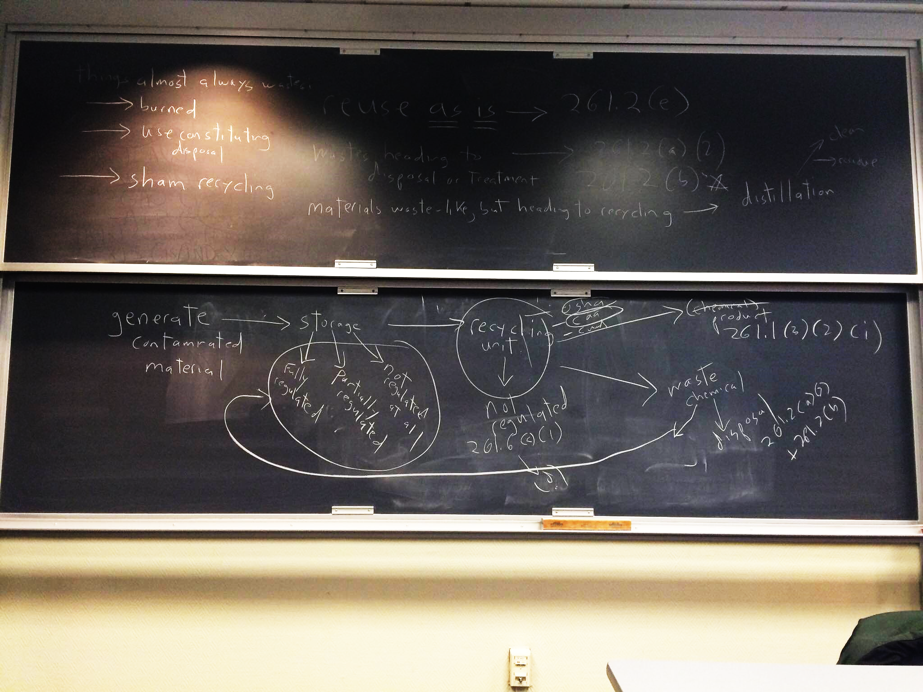
Boston College blackboard picture explaining to law students how RCRA regulation of recycling works.

Slide 19
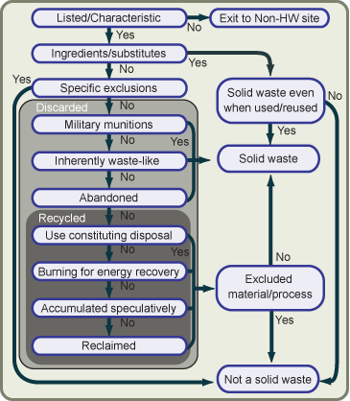
Need Help?
DSW Decision Tool v2
http://www3.epa.gov/epawaste/hazard/dsw/tool.htm#s1

Slide 20

GO TO
RESOURCES

Slide 21
DSW Resources
DSW regulations — Section 261.2 provides the definition of solid waste for the purposes of hazardous waste regulations.
The Definition of Solid Waste Tool — An interactive guide through the DSW regulations, with links to key resources, to help one determine if a material is subject to RCRA hazardous waste regulations.
DSW Compendium — A collection of written materials maintained by the Office of Resource Conservation and Recovery (ORCR)that addresses specific issues related to the federal definition of solid waste.
RCRA Orientation Manual, Section III: Managing Hazardous Waste - RCRA Subtitle C, Chapter 1: Hazardous Waste Identification (PDF) (26 pp, 400)— The RCRA Orientation Manual contains introductory information on the solid and hazardous waste management programs under RCRA. The first part of this chapter discusses the definition of solid waste and exclusions from the definition of solid waste. The full manual can be accessed here.

Slide 22
DSW Resources (continued)
Definition of Solid Waste and Recycling (PDF) (32 pp, 540 Kb) — This slideshow from the Office of Resource Conservation and Recovery provides an overview of the definition of RCRA Hotline Training modules:
  Definition of Solid Waste and Hazardous Waste Recycling (PDF) (23 pp, 69K) — Provides an overview of definition of solid waste and hazardous waste recycling regulation under RCRA.
  Solid and Hazardous Waste Exclusions (PDF) (29 pp, 87K) — Provides an overview of exclusions from the definition of solid waste and exclusions from the Definition of Hazardous Waste.
DSW Inspector's Checklist (PDF) (52 pp, 473.17K) A series of checklists that assist regulatory authorities with monitoring compliance of the definition of solid waste regulations in 40 CFR 261.2

Slide 23
General RCRA Resources
RCRA Online — An electronic database that indexes thousands of letters, memoranda, publications, and questions and answers issued by the Office of Resource Conservation and Recovery (ORCR). These documents include EPA interpretations of the RCRA regulations governing the management of solid and hazardous waste. RCRA Online allows users to locate documents through topical, full text, and advanced search functions. RCRA Online also allows users to view the actual text of the documents identified in a search.
RCRAInfo — A national program management and inventory system about hazardous waste handlers. This system can be used to determine identification and location data for specific hazardous waste handlers, and to find a wide range of information on treatment, storage, and disposal facilities regarding permit/closure status, compliance with Federal and State regulations, and cleanup activities.

Slide 24
FINAL QUESTIONS?

Slide 25
Where Can You Find Information
About the Webinar?
All of the materials, including the recording of the webinar, will be posted to:
https://clu-in.org/conf/tio/rcraexpert/
Once the presentation and recording are posted, visitors to the site will need to:
  Click on the “Links to Additional Resources” at the bottom of the page for the presentation document; and
  Click on the “Go To Seminar” to view the recording.

