Slide 1
Military Munitions Rule
Kenneth Shuster
October 5, 2016

Slide 2
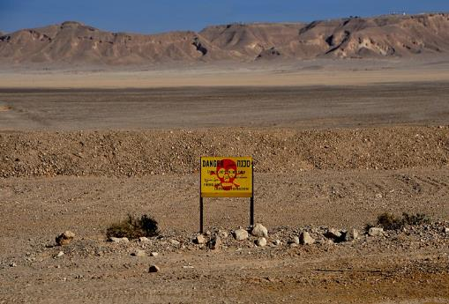
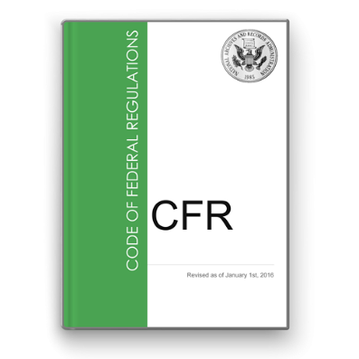
Presentation Outline
History
FFCA
Issues
CT Fishermen’s case
Regulatory solid waste
Statutory solid waste
Ranges
OB/OD
Delay of Closure
Emergencies
Myths
Transportation
Storage

Slide 3
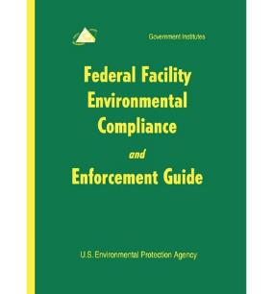
History: RCRA 6001
“…Federal Government…shall be subject to, and comply with, all…requirements, both substantive and procedural…to the same extent, as any person is subject to such requirements…The United States hereby expressly waives any immunity…to any such substantive or procedural requirement.”

Slide 4
History: Federal Facility Compliance Act (1992)
FFCA Section 107 added Section 3004(y) to RCRA:
(1) EPA shall promulgate regulations, after consulting with DOD and State officials, identifying when military munitions become hazardous waste subject to Subtitle C; and providing for the safe transportation and storage of such waste. Such regulations shall assure protection of human health and the environment.
(2) the term ‘military munitions’ includes chemical and conventional munitions.
Notes:
Originally DOD in consultation with EPA

Slide 5
History: Chronology (My Involvement)
Asked to write the rule: Jan 1992
Met with DOD (4 under-secretaries, DDESB Chairman), formed WG
Site visits: Seal Beach; Fallbrook; Edwards; Crane; Ft. Hood, etc.
Rewrote existing interim DOD-EPA policy guidance
Gathered existing DOD rules and policies
Keystone Mil Mun Dialogue, focused on: sustainable munitions, training, ranges
Non-stockpile Chemical Weapons WG
Documented civilian UXO casualties at FUDS & BRAC
Formed Mun Rule WG: EPA, DOD, States, Public (MTP); lots of meetings
Proposed Rule: November 8, 1995 [60 FR 56468]
Final Rule: February 12, 1997 [62 FR 6622]
Administrative Record; RtC Document
Survived court challenge (MTP)
Notes:
35,000 Napalm bombs

Slide 6
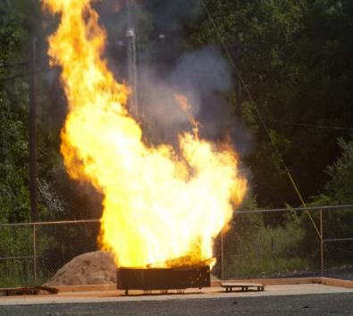
History: RCRA issues identified in rulemaking process
Unused munitions demil stockpiles: when do they become a waste (& storage regs kick in)
When damaged? When obsolete? When treaty says to destroy?
Military mission is paramount
Safety first, then public health & environment
Training in burning propellant: is this RCRA treatment?
Active Ranges: results in depositions/discharges - require RCRA permits?
Closed Ranges
OB/OD; BIP – when are permits required? When are alternatives required?
Emergencies
Transportation
Storage

Slide 7
History - Landmark Case: Statutory v. Regulatory Solid Waste & Hazardous Waste
Connecticut Coastal Fishermen’s Assoc. v. Remington Arms, et al, 2nd Circuit Court of Appeals (1993) [EPA amicus brief, Aug. 31, 1992]:
“ Critical…is the meaning of the terms ‘solid waste’ and ‘hazardous waste’…Defining what Congress intended by these words is not child’s play, even though RCRA has an ‘Alice in Wonderland’ air about it. We say that because…’solid waste’ plainly means one thing in one part of RCRA and something entirely different in another part of the same statute.
“’When I use a word,’ Humpty Dumpty said in a rather scornful tone, ‘it means just what I choose it to mean – neither more nor less.’
‘The question is,’ said Alice, ‘whether you can make words mean so many different things.’
‘The question is,’ said Humpty Dumpty, ‘which is to be master – that’s all.’”

Slide 8
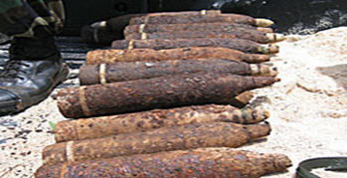
Statutory v Regulatory Solid Waste
Statutory “solid waste” is broader
“Discarded material” “…left to accumulate long after they have served their intended purpose”
2nd circuit opines: “without deciding how long materials must accumulate before the become discarded – that is, when the shot is fired or at some later time – we agree that the lead shot…in Long Island Sound have accumulated long enough to be considered solid waste.”
AMC I case: “once product is ’indisputably ‘discarded,’ it has become part of waste disposal problem and may be regulated under RCRA”
AMC II case: “same; deferring to the EPA’s focus on potential environmental harm in determining whether material is discarded.”
Regulatory “solid waste” is narrower
“Discarded material” that been “abandoned” or “disposed of”

Slide 9
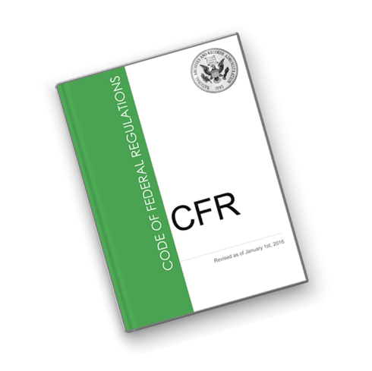
Regulatory & Statutory Corrective Action Authorities
RCRA 3004(u); 40 CFR 264.101: SWMUs releases
RCRA 3004(v); 40 CFR 264.101: releases beyond fac boundary
RCRA 3005(c)(3); 40 CFR 270.32(B)(2): any conditions to protect HH&E
RCRA 3007: info gathering & inspections, incl. sampling
RCRA 3008(a): compliance orders
RCRA 3008(h): interim status corrective action orders
RCRA 3013: monitoring, analysis, & testing orders
RCRA 7003/CERCLA 106/SDWA: imminent & substantial endangerment orders

Slide 10
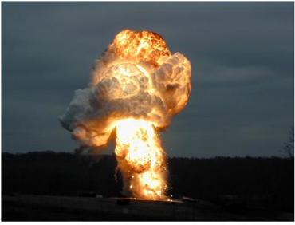
Myths
Just declare a situation involving explosives is an emergency and RCRA doesn’t apply.
Explosives in an emergency situation are not a waste.
If you OB/OD explosives on an active range, RCRA doesn’t apply.
So long as a fired munition or its contaminants are on a range/former range, RCRA doesn’t apply.
OB/OD is the cheapest explosives treatment method.
OB/OD is a clean technology: all the explosives are
consumed in the fireball.
Notes:
Some of these are false; some are either true or false depending on the specific circumstances.
For example:
Just declare the situation is an emergency and RCRA doesn’t apply.
Depends on whether it is a true emergency. The rule basically says the explosives expert decides whether it is a true emergency, but this is not a license for the expert to so declare as some have asserted.
These circumstances will be explained in this seminar.

Slide 11
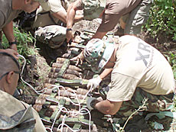
History: OB/OD
All OB/OD of HW is prohibited, except for explosives (May 18, 1980)
Part 265: only when no alternatives; 1980
Part 264: Subp X (performance stds); 1986(?)
OB/OD is treatment, not disposal
Challenged in Court
EPA prevailed
Therefore:
LDRs do not apply
Must clean close

Slide 12
OB/OD Contamination Data
Notes:
These are the worst cases identified to date.
Red numbers are the number of times the concentrations in soil or ground water exceed EPA action levels [action levels used are in brackets after each contaminant].
This data was compiled by two summer interns (Jordan 2014, and Michelle 2015) from RCRA and CERCLA data.
The intern names on the cost table indicate how much the costs increased from 2014 to 2015, costs in red is the difference.

Slide 13
OB/OD Contaminant Data
Soils
RDX [5.6 mg/kg EPA residual screening level]
Chemtronics, Inc. 290 mg/kg 52X
Camp Minden (LA AAP) 100mg/kg explosives
TNT [19 mg/kg EPA resid screening level]
Umatilla Army Depot, OR 36,045 mg/kg 1897X
Chemtronics, Inc. 280 mg/kg
Perchlorate [15 µg/L]
Redstone Arsenal (Army/NASA) 106,000 µg/kg 7067X
Worst concentrations tend to be close in and further out

Slide 14
OB/OD Contaminant Data (cont.)
Groundwater
RDX [2 µg/L]
Bangor Ordnance Disposal (Navy) 10,000 µg/L 5,000X
Nebraska Ordnance Plant 534 µg/L
Mass Military Reservation 370 µg/L, 7300 ft plume
Dahlgren Naval Warfare Center 127 µg/L
Redstone Arsenal (Army/NASA) 96 µg/L
TNT [2 µg/L]
Banger Ordnance Disposal (Navy) 40 µg/L (stormwater) 20X
Nebraska Ordnance Plant 39 µg/L
Perchlorate [15 µg/L]
Mass Military Reservation 500 µg/L, 10,000 ft plume 33X

Slide 15
OB/OD Cleanup Costs
3 contamination zones:
Unit (incl particulate fallout area)
Kick-out area
Ground water plume
Cleanup costs:
Lawrence Livermore Natl Lab (DOE) $180m (Jordan) $447m $626.7m (Michelle)
Ft. Wingate, NM $110m (Jordan) $82m $192m (Michelle)
Air Force Real Property Agency/
Castle Air Force Base >$150m
Nebraska Ordnance Plant $61m
Idaho Natl Engg Lab (DOE) $16m (Jordan) $32m $48.3m (Michelle
Iowa Army Ammunition Plant $40.3m
US Army Garrison/Ft. Wainwright $10.9m
Umatilla Army Depot, OR >$10m
Plattsburgh Air Force Base $8.9m (rounded)
Banger Ordnance Disposal $8.9m
Chemtronics, Inc. $6.2-8.2m
Aqua Tech Environmental Inc. (Groce Labs) $4.7m
Picatinny Arsenal, NJ $3.9m
Cecil Field USN Air Station $2.8m
US Army/NASA Redstone Arsenal $1.7m
Moffett Naval Air Station, CO $1.1m
Bangor Naval Submarine Base $.9m

Slide 16
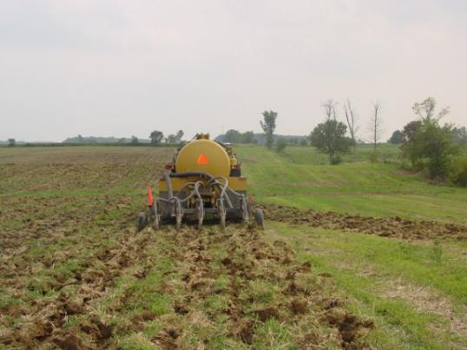
Regulatory solid waste
“Products are not solid wastes if they are applied to the land when used and that is their ordinary manner of use.”
That is, RCRA regs do not apply;
Statutory authorities may apply.

Slide 17
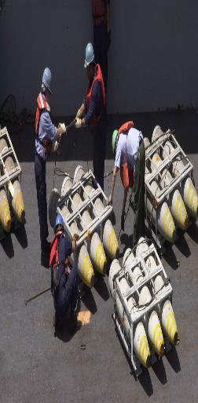
A Military Munition is NOT a Solid Waste When: [Section 266.202(a)]
Used for it’s intended purpose:
In training (including safe destruction)
In research, testing
On-range destruction of UXO or frag during range clearance at active or inactive ranges (i.e., OB/OD)
Does not include:
On-range disposal/burial (i.e., when deposition is not a result of product use)
On-range OB/OD of off-range explosives

Slide 18
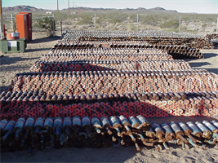
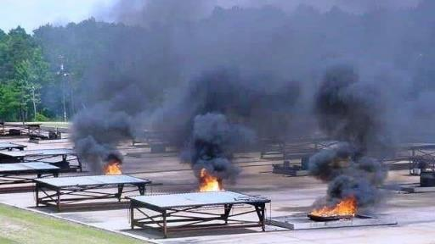
A Military Munition is NOT a Solid Waste When:
2) Unused munition is repaired, reused, recycled, reclaimed, disassembled, reconfigured, etc, unless involve use constituting disposal or burning for energy recovery.

Slide 19
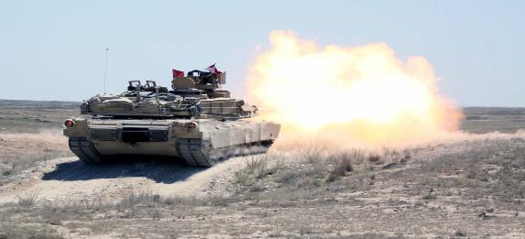
Delay of Closure
Concept borrowed from pvt sector petition for surface impoundments to continue to receive non-haz wastes
As applied to DOD, applies to RCRA-permitted OB/OD units that:
Continue to treat only RCRA-exempt wastes:
On-range treatment of range clearance materials
Training
Emergencies
Closed units on an active range that continues to generate the same contaminants.

Slide 20
Emergencies
Exemption from RCRA for immediate responses
Only for true emergencies: immediate responses
Only very short delays allowed, e.g., due to weather, mobilization time (generally hrs or days, not weeks or months)
If involves military munitions, the responding unit must retain records for 3 yrs identifying dates, persons, type & description of material addressed, and its disposition [40 CFR 270.1(c),(3)(iii)]
Important to record if munition had been fired (used, UXO) or not
Otherwise, emergency permit [40 CFR 270.62]
Only good for 90 days; not renewable
Otherwise, full permit

Slide 21
Transportation & Storage
Conditionally Exempt:
From RCRA manifest, if transport from DOD to DOD by DOD bill of lading
From RCRA storage permit, if stored according to DDESB standards
Or RCRA storage permit

Slide 22
Qualifiers
Mil Mun Rule mostly clarified existing rules/policies
More stringent in 2 respects:
DOD to retrieve munitions landing off-range or keep a record of the event [266.202(d)]
For immediate emergency responses involving mil mun, must keeps records [40 CFR 270.1(c),(3)(iii)]
Less stringent in 2 respects:
Conditional exemption from manifest
Conditional exemption for storage
States can be more stringent
E.g., Must notify State before any emergency responses
UT; MA
Adoption status:
Fed imple (2) or State adopted as is – 34
State adopted with changes – 10
Not adopted - 9
RCRA applies to all DOD activities in U.S. and territories
RCRA not applicable to overseas activities nor operations aboard ship

Slide 23
Myths
Just declare a situation involving explosives is an emergency and RCRA doesn’t apply.
Only in true emergencies
Explosives in an emergency situation are not a waste.
They are a waste, just exempt from regs under certain conditions
If you OB/OD explosives on an active range, RCRA doesn’t apply.
Only if the wastes originated on-range
So long as a fired munition or its contaminants sit on a range/former range, RCRA doesn’t apply.
Regulatorily – true; Statutorily – not true
OB/OD is a clean technology: all the explosives are consumed in the fireball.
Extensive kickout, soil & GW contamination
OB/OD is the cheapest explosives treatment method.
When considering full cost of clean-up/closure, is far more expensive

Slide 24
History: Chronology (My Involvement post MMR, cont.)
EPA-DOD Munitions Principals: March 7, 2001
Digital geo-referenced technologies to replace mag & flag
Led effort to replace explosive spot charges with non-explosives: Oct 2015
FUDS
Universe
Site-specific work:
Mass. Military Reservation (active training range shut down by EPA, lead)
On apex of recharge zone of SDWA-designated sole source aquifer
Donovan Chamber
Notes:
My research uncovered:
DOD 29 Palms 1989 study: Mag and Flag only finds 25-33%; STOLS GeoCenters finds 84%
Jefferson Proving Grounds, Aberdeen Proving Grounds, and other tests significantly flawed.
Presented my concerns to DOD Undersecretary Sheri Wasserman-Goodman and EPA’s Tim Fields and Jim Woolford
Worked with Jeff Marquesee (head of SERDP), NRL, DDESB, ACOE, AEC, JUXOCO, etc. to develop new policy
Digital georeferenced now typically finds 90-100%; plus provides oversight and permanent record.

Slide 25
My Contact Information:
Shuster.Kenneth@epa.gov
703-308-8759

Slide 26
Maybe slide
More Site-Specific Examples
American University Experimental Center, Spring Valley, Wash, DC
Arsenic; Lewisite; Mustard gas; Arsine gas; Phosgene; Chloropicrin
Brandt dirt
AU Child Development Center
David Oates
Camp Croft, SC
Camp Minden, LA
Radford AAP, VA
Ft. Wainwright, AK
Sea Disposal
Data base
Incidents
A better way

