Slide 1
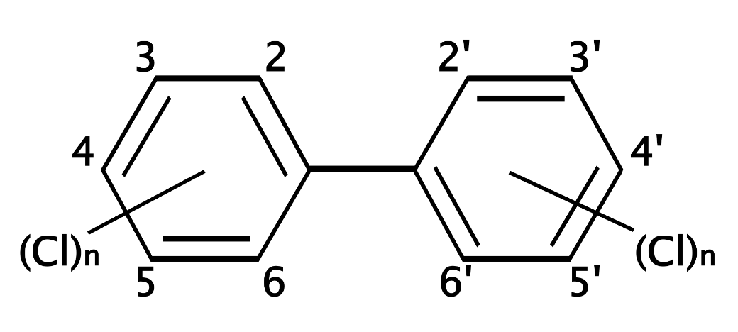


RCRA Expert Brownbag Series:
PCBs 101
Amy Hensley
USEPA Office of Resource Conservation & Recovery
February 3, 2016

Slide 2
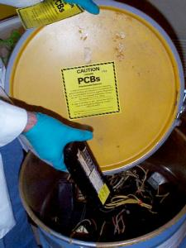
Outline – PCBs 101
PCBs – Properties and health concerns
Regulatory history and structure
Cleanup options
Disposal options
Resources
Regional PCB Contacts
Questions

Slide 3
Physical Properties of PCBs
Viscous liquid or solid
Colorless
Odorless
Low vapor pressure
Low electrical conductivity
Flame retardant

Slide 4
Chemical Properties of PCBs
Used as mixtures of congeners
commonly called Aroclors
(Aroclor 1254 → 54% chlorine by mass)
209 Congeners
Oil & PCBs
Water
Stable to aging
Lipophilic

Slide 5
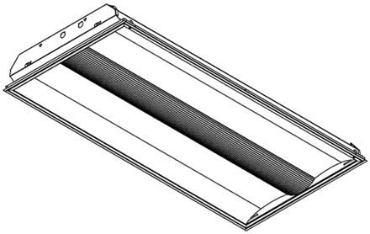
Uses of PCBs (~1950-1978)
Dielectric fluid
Construction materials (ex. caulk, sealants, tiles, etc.)
Heat transfer fluid
Fluorescent light ballasts
Hydraulic fluid
Plasticizer
Lubricants
Gaskets & Damping felt
Cutting oils
Vacuum pump fluid

Slide 6
Uses of PCBs (continued)
Adhesives
Microscopy
(mounting media & immersion oil)
Carbonless copy paper
Dedusting Agents
Electric cable insulation
Fuel tank coatings
Inks and paints
Pesticide extenders
Casting Wax

Slide 7
Health Concerns & Transport
Cancer – Shown to cause cancer in animals and are probable human carcinogens
  12 congeners are “dioxin-like”
Non-Cancer – Cause significant effects in the immune, reproductive, nervous, integumentary (skin), and endocrine systems
Environmental Transport - Persistent, bioaccumulative, and can be transported long distances
  To this day, are found in animals, snow, and sea water in areas far away from where they were released into the environment.

Slide 8
PCBs – Regulatory History
Manufactured in U.S. from 1929 – 1979
TSCA passed by Congress in 1976
  TSCA Section 6(e) banned the manufacture and use of PCBs
  Allowed EPA to authorize limited uses through a rulemaking process
  EPA issued regulations in 1979 on the use, manufacturing, processing, distribution in commerce, cleanup, and disposal of PCBs
  1998 “Mega Rule” – major changes to the cleanup and disposal sections
TSCA PCB Regulations found at 40 CFR 761
PCB Cleanup and Disposal Program evolved separately from other cleanup and disposal programs
  Transferred the program to the “RCRA Office” (Office of Resource Conservation and Recovery) in 2007 but the regs stayed the same
  Regulations regarding the use of PCBs are still managed by the TSCA program office

Slide 9
Implementation of PCB Regs
Unlike RCRA, TSCA not delegated to States
RCRA
TSCA
Regional Implementation
Regional Implementation
State Implementation
PCBs at your cleanup?
Contact your Regional PCB Coordinator early

Slide 10
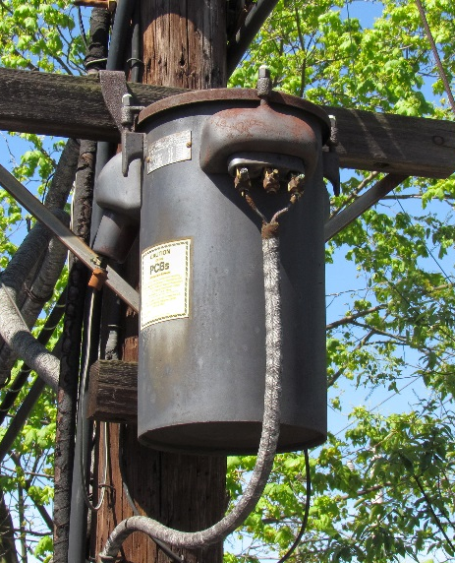
PCB Regulations 40 CFR 761
Key Sections of the Regulations:
  Definitions
  Use Authorizations
  Applicability
  Disposal/Storage options
  Cleanup options
  Import/Export
  Recordkeeping
  Sampling/analytical requirements
*See appendix for a further breakdown of 40 CFR 761

Slide 11
Main Types of PCB Wastes
PCB Liquids
  Liquids like mineral oil dielectric fluid ≥ 50 ppm
PCB Articles
  Transformers, capacitors, natural gas pipelines, electrical equipment
  “PCB-Contaminated” if 50-500 ppm; “PCB” if ≥ 500 ppm
PCB Bulk Product Waste
  Non-liquids that are currently > 50 ppm and were manufactured to contain PCBs
  E.g. Caulk, paint, plastics
  May be disposed of in municipal landfills at any concentration
    If state allows & landfill is able / willing to accept it
PCB Remediation Waste
  Contaminated from a spill or release of PCBs (e.g., soil, concrete, masonry)
  Regulatory requirements depend on spill date & source concentration

Slide 12
Definition of “PCB Remediation Waste”
This is a generalized depiction, see 40 CFR 761.3 for full detail
Currently <50 ppm
Currently ≥50 ppm
Spilled Pre-1978
Spilled Post-1978
Spilled any time
Source at any concentration
Source
< 50 ppm & Authorized
Source
≥ 50 ppm or Unauthorized
Source
at any concentration
NOT PCB Remediation Waste
PCB Remediation Waste

Slide 13
Definition of PCB Remediation Waste
This is a generalized depiction, see 40 CFR 761.3 for full detail
Currently <50 ppm
Key Takeaway Point:
Even if the material is < 50 ppm, it may still be regulated
Currently >50
Spilled Pre-1978
Spilled Post-1978
Spilled any time
Source at any concentration
Source
< 50 ppm & Authorized
Source
≥ 50 ppm or Unauthorized
Source
at any concentration
NOT PCB Remediation Waste
PCB Remediation Waste

Slide 14
PCB Remediation Waste
Cleanup and Disposal Option Basics
NOT PCB Remediation Waste
PCB Remediation Waste*
a
b
c
No cleanup or disposal obligations
No interaction with EPA
Any landfill
761.61(a)
Self Implementing Cleanup Option
761.61(b)
Performance Based Disposal Option
761.61(c)
Risk Based Cleanup & Disposal
Requires EPA approval
Must notify EPA
No notification required
Sampling requirements are prescriptive
Any cleanup and/or disposal plan may be submitted
All PCB Remediation Waste must go to a TSCA facility
Can send
< 50 ppm to municipal landfill
Depends on EPA finding of no unreasonable risk of injury to health or env
Must remove all PCB waste > 1 ppm
* PCB Remediation Waste resulting from a spill or release before 1978 is not subject to the cleanup requirements of the regulations (unless the RA makes a finding), but is subject to the disposal requirements if it is picked up (see 40 CFR 761.50(b)(3)).

Slide 15
PCB Disposal Options
The general, most conservative disposal options are a TSCA-approved landfill (for non-liquids) or a TSCA-approved incinerator.
Other disposal options are available depending on the media, concentration, and the cleanup option.
EPA issues TSCA approvals to:
  Incinerators (761.70)
  Landfills (761.75)
  Alternatives Technologies to Incineration (761.60(e)) (e.g., chemical dechlorination or thermal desorption)
  Alternative Decontamination (761.79(h))
  Risk-Based Disposal Approvals (761.61(c) & 761.62(c))
“Permitted by Rule”
  Certain decon methods (761.79(b))
  Scrap Metal Recovery Ovens (761.72)
  High Efficiency Boilers (761.72)
Non-TSCA Options
  RCRA C landfills
  RCRA D & other non-hazardous landfills
Coordinated Approvals (761.77)
  If already has permit through other authority, like RCRA
  The permit must be “no less stringent in protection of health or the environment than the applicable TSCA requirements”

Slide 16
Resources
Comprehensive Q & A Manual
  Commonly asked questions on all manner of topics
Sampling Guidance
  How to sample natural gas pipeline, apply a grid sampling plan, do wipe sampling, etc.
Spill Cleanup Policy Guidance
  An enforcement policy that applies to spills less than 72 hours old
Checklists for 61(a) and 61(c) cleanup applications
  Excellent resource for those submitting cleanup plan
A more complete list of PCB guidance can be found at the EPA website under “Interpretive Guidance” at http://www3.epa.gov/epawaste/hazard/tsd/pcbs/index.htm (Note: This link will change in the near future to a yet to be determined address, if this link no longer works for you, you should be able to find the page by Googling EPA and PCBs. Sorry for any inconvenience.)

Slide 17
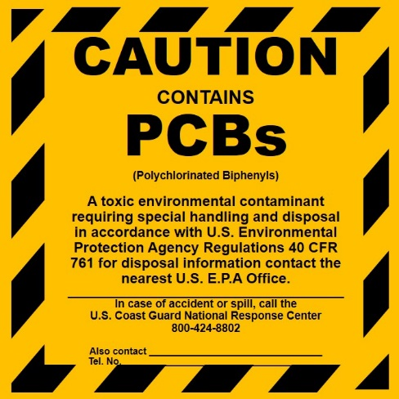
Indicators that you might have PCBs on your hands
Equipment - Labels, trade names, manufactured 1950-79
Building materials – Labels, built or renovated 1950-79
Cleanup Areas – Wherever the following was manufactured, stored, used, serviced, or transported
    Electrical equipment, hydraulic presses, vacuum systems, natural gas compressor systems, aircraft hydraulic oils, dust suppression, etc.
However, even without indications of
these, PCBs may still be present
  Labels were not required prior to 1979
  Servicing of uncontaminated
  equipment has led to contamination
  and unintentional dilution
  Some uses were not well recorded

Slide 18
Key Advice
Contact your EPA Regional PCB Coordinator early – as soon as you think you might have or know you have PCBs on your cleanup site.
Why?
  Because the PCB regulations require a separate and distinct process that often requires EPA notification/approval, delays are likely if EPA is not involved early.

Slide 19
EPA Regional PCB Coordinators
Region | PCB Coordinator | Contact Number | Contact Email
1 | Kim Tisa | 617-918-1527 | Tisa.kimberly@epa.gov
2 | Mark Bean | 732-321-6606 | Bean.mark@epa.gov
3 | Kelly Bunker | 215-814-2177 | Bunker.kelly@epa.gov
4 | Ken Feely | 404-562-8512 | Feely.ken@epa.gov
5 | Peter Ramanauskas | 312-886-7890 | Ramanauskas.peter@epa.gov
6 | Jim Sales | 214-665-6796 | Sales.james@epa.gov
7 | Mike Dandurand | 913-551-7504 | Dandurand.michael@epa.gov
8 | Brenda South | 303-312-6446 | South.brenda@epa.gov
9 | Carmen Santos | 415-972-3360 | Santos.carmen@epa.gov
10 | Michelle Mullin | 206-553-1616 | Mullin.michelle@epa.gov
http://www3.epa.gov/epawaste/hazard/tsd/pcbs/pubs/coordin.htm

Slide 20
Appendix

Slide 21
Outline of the PCB Regulations
40 CFR §761
Subpart A: General
761.1 Applicability
761.2 Assumptions
761.3 Definitions
761.19 References
Subpart B: Manufacturing, Processing,
Distribution in Commerce, and Use
761.20 Prohibitions
761.30 Authorizations
761.35 Storage for reuse
Subpart C: Marking
761.40 Marking requirements
761.45 Marking formats
Subpart D: Storage and Disposal
761.50 Applicability
761.60 Disposal requirements
761.61 PCB remediation waste
761.62 PCB bulk product waste
761.63 PCB household waste
761.64 Waste from R & D activities
Subpart D: Storage and Disposal (continued)
761.65 Storage for disposal
761.70 Incineration
761.71 High-efficiency boilers
761.72 Scrap metal recovery ovens & smelters
761.75 Chemical waste landfills
761.77 Coordinated approvals
761.79 Decontamination
Subpart E: Exemptions
761.80 Manufacturing, processing, and distribution in commerce exemptions
Subpart F: Transboundary Shipments for Disposal
761.91 Applicability (Import/export)
761.93 Import for disposal
761.97 Export for disposal
761.99 Other transboundary shipments

Slide 22
Outline of the PCB Regulations
40 CFR §761
Subpart G: PCB Spill Cleanup Policy
761.120 Scope
761.123 Definitions
761.125 Requirements for PCB spill cleanup
761.130 Sampling requirements
761.135 Compliance and enforcement
Subpart J: General Records and Reports
761.180 Records and monitoring
Subpart K: PCB Waste Disposal Records and Reports
761.202 EPA identification numbers.
761.205 Notification of PCB waste activity (EPA Form 7710-53).
761.207 - § 761.217 Manifesting
761.218 Certificate of disposal.
761.219 One-year exception reporting.
Subpart M: Natural gas pipeline sampling
Subpart N: Characterization sampling for §761.61
Subpart O: Cleanup verification sampling for §761.61
Subpart P: Sampling locations for non- porous surfaces
Subpart Q:Validation of alternate
sampling & analysis
Subpart R: Sampling of PCB bulk product waste
Subpart S: Double wash-rinse procedure
Subpart T: Validating alternative decon solvents

Slide 23
Questions?
Amy Hensley
US EPA
Office of Resource Conservation & Recovery
Hensley.amy@epa.gov

