Slide 1
RCRA Corrective Action Inspection Training
Office of Site Remediation Enforcement
January 14, 2015 Webinar

Slide 2
Course Outline
1. Introduction
Typical Corrective Action (CA) Process Steps
Preparing for a CA Inspection
Conducting a CA Inspection
Preparing a CA Inspection Report
Developing the Case
Notes:
Introduction – includes a definition of corrective action (CA) oversight and inspection [slides 3 – 9]
Typical CA Process Steps [slides 10 - 32]
RCRA Facility Assessment (RFA)
RCRA Facility Inspection (RFI)
Interim Measures (IM)
Corrective Measures Study (CMS)
Statement of Basis, Public Comment Period and Decision on Final Remedy / Response to Comments
Corrective Measures Implementation (CMI)
Preparing for a CA Inspection [slides 33 - 41]
Conducting a CA Inspection [slides 42 - 48]
Preparing a CA inspection Report [slides 49 - 54]
Developing the Case [slides 55 - 58]
Additional References [slide 59]
Summary [slide 60]

Slide 3
Section 1: Introduction
What are the goals of this training?
Provide a fundamental understanding of the corrective action process
Describe how to inspect a facility to help ensure compliance with corrective action requirements
Notes:
This training will provide a fundamental understanding of the corrective action process from start to finish.
An emphasis will be placed on the inspections of corrective action (CA) sites. If the CA inspection is to be a full review of the CA process, then the inspection should include an evaluation of the effectiveness of the current approach and recommendations to troubleshoot stalled investigations or remedy selections, as well as for ineffective CA measures or remedies.
For more information on RCRA CA Code Events, see http://www.epa.gov/epawaste/hazard/correctiveaction/pdfs/ca-evcds.pdf

Slide 4
Intro: Who is the Audience?
Corrective Action Project Managers (PMs) from EPA region or authorized state
RCRA regulatory and corrective action inspectors
Permit writers who have responsibility for corrective action
Attorneys who have responsibility for corrective action
Notes:
This training is intended for a broad audience of federal and state personnel who have responsibility for ensuring compliance with corrective action requirements:
Corrective Action Project Managers (PMs) from EPA regional offices or authorized states;
RCRA regulatory and corrective action inspectors;
Permit writers who have responsibility for corrective action; and
Attorneys who have responsibility for corrective action.

Slide 5
Intro: The State of the Program
Focused on nearly 4,000 facilities across the nation
Includes chemical manufacturing plants, oil refineries, lead smelters, wood preservers, steel mills, commercial landfills, and others
“Facilities” range in size from less than one acre to 2 million acres
Notes:
The CA program is focused on nearly 4,000 facilities across the nation. To more accurately reflect the program workload, EPA and the states established the 2020 Corrective Action Universe or 2020 Corrective Action Baseline. The list includes facilities that have been cleaned up, those that are being cleaned up, and those that were deemed most likely to need a cleanup under the CA program. For more information, see http://www.epa.gov/waste/hazard/correctiveaction/facility/index.htm#2020
RCRA CA facilities include current and former chemical manufacturing plants, oil refineries, lead smelters, wood preservers, steel mills, commercial landfills, and a variety of other types of entities.
Sites range in size from hazardous waste treatment facilities of less than one acre to former military bombing ranges covering 2 million acres.
For more information, see the April 2013 “RCRA Corrective Action: Case Studies Report” at: http://www.epa.gov/epawaste/hazard/correctiveaction/pdfs/rcracorrective.pdf

Slide 6
Intro: The State of the Program
43 states are authorized to implement the RCRA corrective action program
Oversight responsibilities primarily rest on the states and EPA regions
43 States Authorized for RCRA CA (gray)
Notes:
The oversight responsibilities primarily rest on the states and EPA. EPA regions have work-sharing agreements with both authorized and unauthorized states regarding which agency has the lead on oversight and implementation at particular facilities.
A total of 43 states are authorized to implement the CA program.
Unauthorized states include: Region 2 New Jersey
Region 3 Maryland, Pennsylvania
Region 4 Mississippi
Region 7 Iowa, Nebraska
Region 10 Alaska
The District of Columbia also is not authorized to implement the corrective action program.

Slide 7
Intro: Corrective Action Oversight
Definition: management by the lead agency of all activities related to corrective action at the site
reviewing, commenting on, and approval or disapproval of required documents
visiting and inspecting facilities
tailored to site-specific circumstances
Notes:
Corrective action oversight is the management of all activities related to corrective action at the site. It primarily consists of:
reviewing documents such as draft work plans and reports; and
visiting and inspecting facilities.
EPA guidance recommends tailored oversight based on site-specific circumstances.
Corrective action oversight definition is from “Results-Based Approaches to Corrective Action” (July 26, 2000); see http://www.epa.gov/epawaste/hazard/correctiveaction/resources/guidance/pdfs/results.pdf

Slide 8
Intro: Corrective Action Inspection
Definition: an evaluation of a site’s compliance with the corrective action requirements of a permit or order.
also known as Corrective Action Compliance Evaluation (CAC)
is a component of corrective action oversight
may be conducted concurrently with other types of inspections
Notes:
This definition is from Appendix D of the March 18, 2010 Compliance Monitoring Strategy for the Resource Conservation and Recovery Act (RCRA) Subtitle C Program; see http://www.epa.gov/compliance/resources/policies/monitoring/rcra/rcracms.pdf
Other types of inspections that may include a corrective action inspection include:
Compliance Evaluation Inspection (CEI) - primarily an on-site evaluation of the compliance status with regard to all applicable RCRA regulations and permits (with the exception of groundwater monitoring and financial assurance requirements).
Groundwater Monitoring Evaluation (GME) – a detailed evaluation of the adequacy of the design and operation of a site’s groundwater monitoring system; from the Handbook of Groundwater Protection and Cleanup Policies for RCRA Corrective Action; see http://www.epa.gov/wastes/hazard/correctiveaction/resources/guidance/pdfs/gwhb041404.pdf
Operation and Maintenance Inspection (OAM) - a periodic inspection of how well a groundwater monitoring system continues to function once it is considered well designed.
Other types of concurrent inspections may be under authority of other statute(s) as long as inspector has authority to enter under other statute(s).

Slide 9
Intro: Corrective Action Inspection
Differences between
RCRA Credentialed Inspector
and
Corrective Action Project Manager
Notes:
Pursuant to RCRA Section 3007, a duly designated inspector can inspect any generator; treatment, storage and disposal (TSD) facility; transporter; or handler of hazardous waste.
Inspection authority includes:
requesting the site to provide information;
copying information;
entering the site at reasonable times; and
inspecting the site and taking samples.
Inspectors must go through training and a credentialing process.
If an inspector is denied access to a site, a search warrant would be sought to gain access.
The Corrective Action Project Manager (PM), if not credentialed, is not authorized to conduct inspections.
Access rights and the ability to copy records for a particular site are usually spelled out in the site’s permit, corrective action order or agreement.
Typically, access language in orders give the PM the same authority at the site of an inspector (e.g. copy records, take samples).
A site that is not under permit/order/agreement may voluntarily allow a PM onto the site. However, the site could deny access without any repercussions.

Slide 10
Section 2: Typical CA Process Steps
RCRA Facility Assessment
RFA
RCRA Site Investigation
RFI
Where is it?
What is it?
Is it a risk?
Notes:
The next two slides provide a general description of typical RCRA CA process steps; the steps are covered in more detail later in this section.
These steps may be combined or conducted in phases.

Slide 11
Section 2: Typical CA Process Steps
Interim Measures
IMs
Corrective Measures Study
CMS
Corrective Measures Implementation
CMI
Statement of Basis
Public Comment Period
Final Decision/Response to Comments
Corrective Action Complete

Slide 12
Typical CA Process Step 1
RCRA Facility Assessment (RFA) is an initial facility assessment that is used to identify:
Solid Waste Management Units (SWMUs)
Hazardous Waste Management Units (HWMUs)
Areas of Concern (AOCs)
All other readily available or observable information about environmental conditions at and from the facility
Notes:
RCRA Facility Assessment (RFA) - the first element in most cleanup programs is an initial site assessment. During this phase, information is gathered on site conditions, releases of hazardous waste, potential releases, and exposure pathways to determine whether a cleanup may be necessary.
Identify the following:
Solid Waste Management Units (SWMUs)* - any discernible units at which wastes have been placed at any time irrespective whether the units were intended for the management of solid or hazardous waste. Such units include any area at a facility at which solid wastes have been routinely and systematically released.
Hazardous Waste Management Units (HWMUs) – a subset of SWMUs containing hazardous waste.
Areas of Concern (AOCs) - areas that have received, at any time, solid or hazardous waste through the deliberate placement of the waste or because of accidental releases or spills.
Determine if there is evidence of releases that have occurred or the potential for releases from each SWMU/AOC.
The RFA is generally conducted by the state or EPA.
Note: RFA is also known as the Preliminary Assessment/Visual Site Inspection or Preliminary Review/Visual Site Inspection (PA/VSI or PR/VSI).
*See May 1, 1996 “Advance Notice of Proposed Rulemaking for Corrective Action for Releases from Solid Waste Management Units at Hazardous Waste Management Facilities” 61 FR 19442-19443.

Slide 13
Typical CA Process Step 2
RCRA Facility Investigation (RFI)
Determine nature and extent of migration of hazardous waste or hazardous constituents from SWMUs, AOCs, or other source areas
Gather data to support Corrective Measure Study (CMS) or potential Interim Measures (IMs)
Notes:
RCRA Facility Investigation (RFI) – determine the nature and extent of any contamination of a RCRA facility.
A release assessment is an optional step that may be performed as the first phase of an RFI to focus or streamline the RFI. A release assessment may help determine if the RFI should focus on one area before another and/or if interim measures are necessary.
An RFI Work Plan or equivalent Sampling and Analysis Plan (SAP) lays out the initial approach to the investigation of the releases to the environmental media (i.e., soil, surface water, groundwater or air) including the media to be sampled, the locations, the methods for collecting the samples and methods for analyzing the samples.
The plans are based on known or observed historical hazardous materials and/or hazardous waste managed and/or known or potential releases at the site/facility and the suspected locations of those waste management units, areas or releases.
Ensure that representative samples of observed or suspected releases have been appropriately collected pursuant to an established Quality Assurance Project Plan (QAPP).
Other data may be gathered to support Corrective Measure Study (CMS) or Interim Measures; may evaluate the need for further investigation and/or CA.
Assess the validity of the Conceptual Site Model (CSM), potential impacts to nearby receptors (e.g., water well survey) and need for Human Health Risk Assessment and Screening Level Ecological Risk Assessment.
The RFI is conducted by the owner/operator of facility.

Slide 14
Typical CA Process Step 2
RCRA Facility Investigation (RFI)
Common Sampling Types
General sampling | Groundwater
Surface soil | Air
Subsurface | Surface water
Soil gas | Benthic sediment
Notes:
RCRA Facility Investigation (RFI)
Common sampling types:
Groundwater - monitoring wells
Surface soil
Air – indoor air sampling may be needed when there is potential vapor intrusion (VI) from contaminated groundwater or soils. There is potential interference from household chemicals.
Subsurface
Surface Water
Benthic Sediment Sampling - sediment at the bottom of a lake or river in which the presence or lack of presence of certain organisms indicates the health of the water body.

Slide 15
Case Example
Arkansas facility manufactured refrigerators, trash compactors and ice makers
Main COC is trichloroethylene (TCE)
Confirmed elevated levels of TCE in the soil and groundwater
Groundwater plume has TCE levels greater than MCL
Notes:
Case Example
In the State of Arkansas there is a facility that manufactured refrigerators, trash compactors and ice makers.
The main Contaminant of Concern (COC) is trichloroethylene (TCE).
Numerous rounds of sampling confirmed elevated levels of TCE in the soil and groundwater.
The on-site and off-site groundwater plume has TCE levels greater than the Maximum Contaminant Level (MCL).

Slide 16
Case Example: Conceptual Site Model
Notes:
Case Example
Conceptual Site Model
Potential human exposure:
Groundwater ingestion
Vapor intrusion
Groundwater contact (waters)
Direct soil contact (workers and trespassers)
Potential on-site risks for current and future exposure to personnel:
Routine workers
Maintenance workers
Construction workers
Potential off-site risks for current and future exposure to personnel:
Residents
Routine workers
Maintenance workers

Slide 17
Typical CA Process Step 3
Interim Measures (IMs)
Control or abate ongoing threats to human health or the environment
May become part of the final Corrective Measures
Notes:
Interim Measures (IMs)
While site characterization is underway or before a final remedy is selected, there is often a need for interim measures to control or abate ongoing risks to human health and the environment in advance of the final remedy selection. Identify and implement IMs if appropriate.
IMs are often implemented for efficiency or opportunity such as hot spot removal, but also may be used to address more urgent threats like high potential for exposure or contaminants migrating off site toward drinking water wells.
IMs may become part of the final remedy.
Many of the technologies and other aspects of this section also apply to Corrective Measures Implementation (CMI) inspections.
IMs are implemented by the owner/operator of the facility.

Slide 18
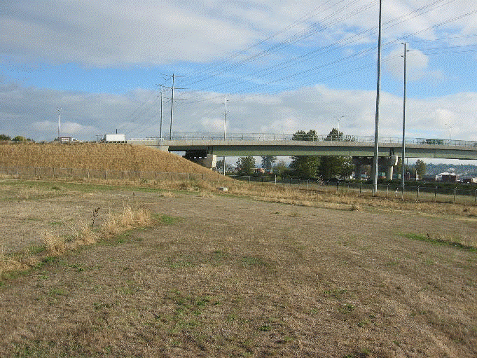
Typical CA Process Step 3
Interim Measures (IMs)
Corrective Action Management Units (CAMUs)
RCRA cap in Kent, WA
Notes:
Interim Measures (IMs)
Corrective Action Management Units or CAMUs are special units created under the Resource Conservation and Recovery Act (RCRA) to facilitate treatment, storage, and disposal of hazardous wastes managed for implementing cleanup.
CAMUs also remove the disincentives to cleanup that the application of RCRA to these wastes can sometimes impose (e.g., triggering Land Disposal Restrictions). For more information, see http://www.epa.gov/wastes/hazard/correctiveaction/resources/guidance/acamur.htm
While CAMUs are relatively rare, they may be important options for Interim Measures because they provide increased flexibility for managing remediation wastes during corrective action.

Slide 19
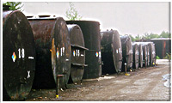
Typical CA Process Step 3
Interim Measures (IMs)
SWMU and/or AOCs
Notes:
Interim Measures (IMs) can include:
Waste excavation or removal;
Soil stabilization;
Physical containment such as groundwater barrier systems and fencing;
Hydraulic containment such as groundwater pumping and treatment systems; and / or
Soil vapor extraction.

Slide 20
Case Example
At the same site in Arkansas, interim measures involved “Hot Spot” removal of TCE contaminated soils on site with the intent to lower the concentration in the groundwater

Slide 21
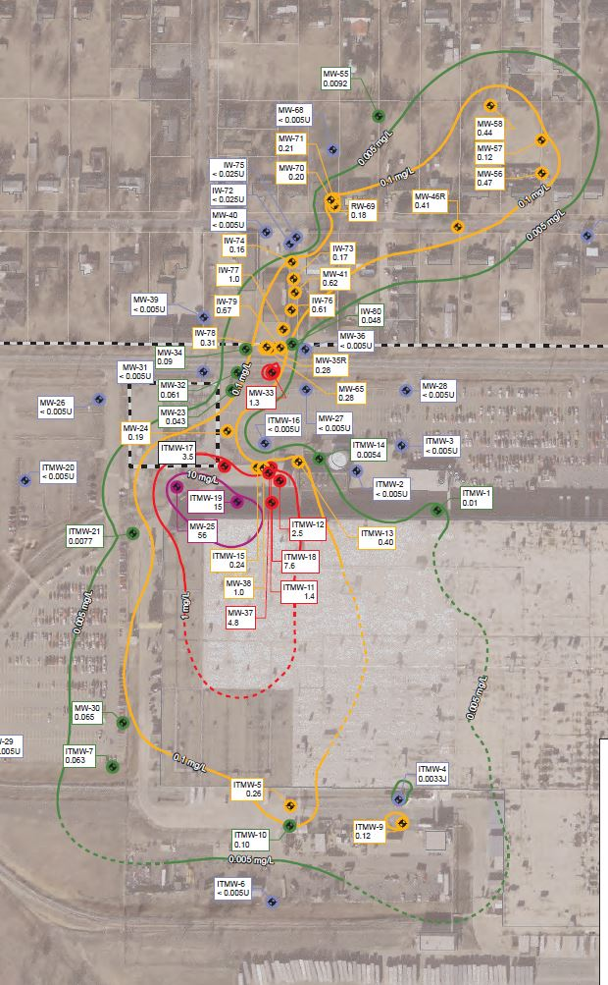
Case Example: Plume map before removal

Slide 22
Case Example: Future In-Situ Chemical Oxidation Locations

Slide 23
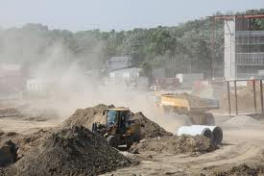
Typical CA Process Step 4
Corrective Measure Study (CMS)
Identify and evaluate potential alternatives for the remediation of releases of hazardous waste or constituents that have been identified at and moving from the facility
Notes:
Corrective Measures Study (CMS)
Identify and evaluate potential alternatives for the remediation of releases of hazardous waste or constituents that have been identified at and moving from the facility.
Before choosing a cleanup approach, program implementers and facility owners and operators will typically analyze a range of alternatives and evaluate their advantages and disadvantages relative to site-specific conditions.
Corrective action and remediation goals (i.e., cleanup standards) are proposed in association with the recommended remedy for EPA/state approval.
Additional studies may be needed to confirm the selection and implementation of the remedy.
The CMS is conducted by owner/operator of facility.
See http://www2.epa.gov/enforcement/guidance-rcra-corrective-action-inspection for more information on common activities and issues for this phase of the RCRA CA process.

Slide 24
Typical CA Process Step 4
Corrective Measure Study (CMS)
Bench Study: small laboratory-scale treatment study
Pilot-Scale Study: treatment study based on actual site conditions
Notes:
Corrective Measure Study (CMS)
Often the CMS is limited to activities that do not involve lab or field work that would be subject to inspections. Some exceptions to this could include:
A Bench Study, which is a laboratory study in which small volumes of media are tested for the individual parameters of a treatment technology.
may not reflect the reality of conditions at the site
shipment and handling of waste material may not be in compliance with regulations
depending on the case, wastes after the completion of the bench study may have to be sent back
A Pilot-Scale Study, which is an on-site simulation of physical and chemical parameters of a full-scale treatment process.
may not be representative of actual waste materials
treatment, storage, and disposal may not be in compliance with regulations
depending on the case, wastes after the completion of the pilot-scale study may have to be sent back
Inspectors who are not CA specialists should consult with CA specialists about their role in inspecting such studies.
For more information on pilot scale studies, see http://www2.epa.gov/enforcement/guidance-rcra-corrective-action-inspection

Slide 25
Case Example
Pilot Tests
On-site pilot test In Situ Chemical Oxidation (ISCO):
Effectiveness limited by aquifer transmission
Off-site pilot test In Situ Chemical Oxidation (ISCO):
Effectiveness limited by aquifer transmission
Notes:
Case Example:
Pilot Tests
On-site pilot test In Situ Chemical Oxidation (ISCO):
Effectiveness limited by aquifer transmission
Off-site pilot test In Situ Chemical Oxidation (ISCO):
Effectiveness limited by aquifer transmission

Slide 26
Case Example: Plume Map 2012

Slide 27
Typical CA Process: Decision on Final Remedy
Statement of Basis
Public Comment Period
Decision on Final Remedy / Response to Comments
Notes:
Decision on Final Remedy:
Statement of Basis – document that seeks public input on the rationale for a proposed final remedy:
draft an order or permit with a draft Statement of Basis;
inform the public and solicit public comment; and
drafted by the state or EPA.
Decision on Final Remedy / Response to Comments – publicly available record that documents the decision by the state or EPA about the final remedy for the facility:
follows public comment period;
finalize order or permit with responsive summary to the public comments received; and
drafted by the state or EPA.

Slide 28
Typical CA Process Step 5
Corrective Measures Implementation (CMI)
Implement chosen corrective measures: often a combination of treatment and disposal of remediation waste on and off of the facility, measures above and below the surface, and often involves engineering and institutional controls
Notes:
Corrective Measures Implementation (CMI)
This is the implementation of the cleanup remedy, based on the Statement of Basis, and typically involves remedy design, remedy construction, remedy operation and maintenance, and remedy completion:
monitor and analyze the performance of the corrective measures;
may include both engineering and institutional controls; and
conducted by the owner/operator of the facility.
For more information, see: http://www2.epa.gov/enforcement/guidance-rcra-corrective-action-inspection

Slide 29
Typical CA Process Step 5
Corrective Measures Implementation (CMI)
Common Activities
Notes:
Corrective Measures Implementation (CMI)
Common activities include:
Contaminated soil / debris excavation
Soil vapor extraction
Bioremediation (in situ and ex situ)
Capping
Air stripping
Carbon filtration (liquids and gases)
Solidification and stabilization (in situ and ex situ)

Slide 30
Case Example
Remedies Evaluated
No Actions
Institutional controls
Soil:
Containment
Removal
Groundwater:
Extraction
In situ chemical oxidation (ISCO)
Permeable texture beds
In situ enhanced bio degradation
Monitored natural attenuation (MNA)
Notes:
Case Example:
Remedies Evaluated
No Actions
Institutional controls
Soil:
Containment
Removal
Groundwater:
Extraction
In situ chemical oxidation (ISCO)
Permeable texture beds
In situ enhanced bio degradation
Monitored natural attenuation (MNA)

Slide 31
Case Example
Chosen Remedy
Site-wide institutional controls (ICs)
Soil with asphalt cover with soil gas monitoring
Groundwater with in situ chemical oxidation (ISCO) and monitored natural attenuation (MNA)
Notes:
Case Example:
Chosen Remedy
Site-wide institutional controls (ICs)
Soil with asphalt cover with soil gas monitoring
Groundwater with in situ chemical oxidation (ISCO) and monitored natural attenuation (MNA)

Slide 32
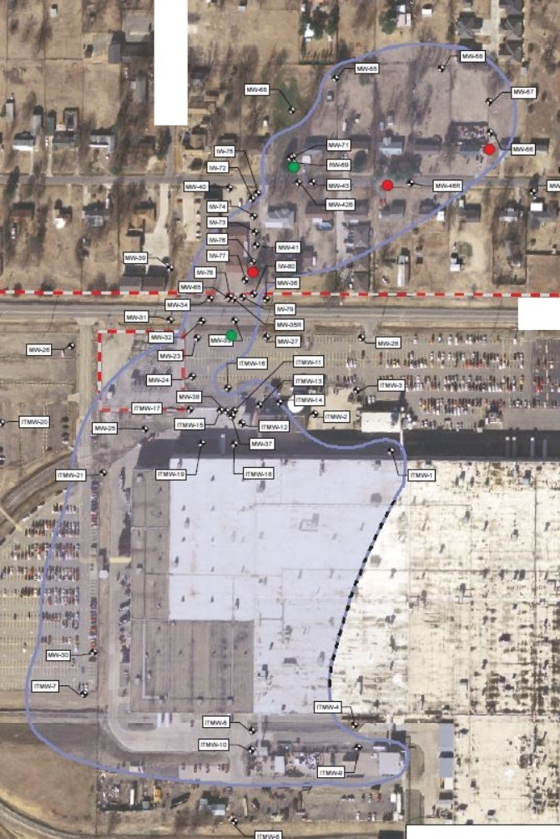
Case Example: Soil gas monitoring

Slide 33
Section 3: Preparing for a CA Inspection
Begin with the end in mind . . .
Prepare early, at least 30 days
before the inspection
Notes:
Begin with the end in mind . . . what would be needed to win a case if it were to go to trial? Understand what information is needed to determine compliance with or to prove a violation of CA obligations.
Preparation is the key to a successful inspection:
start preparing 30 days before the inspection;
understand all of the CA activities at the facility;
know most recent permit issuance or modification (as applicable); and
more compliance points means more time needed to prepare and to conduct actual inspection; actual preparation time will vary depending on site.

Slide 34
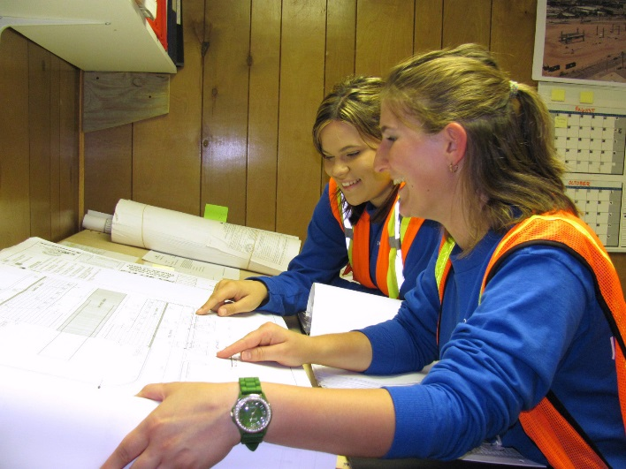
Preparing: Coordination
Communicate with all appropriate offices:
Permitting
Compliance
Enforcement
Corrective action
Notes:
If the inspector does not normally oversee CA activities at a facility, include the CA PM or CA specialist assigned to the facility in the inspection and post-inspection analysis and evaluation.
At a minimum, CA PMs should be interviewed prior to the inspection to obtain information about the type of CA activities present at the facility.
CA PMs have the responsibility to ensure the inspector has information about the site.
Identify priority areas/issues with CA PM.

Slide 35
Preparing: Define Purpose and Scope
Determine inspection objectives
If not in 2020 CA Universe
Identify any releases
Check permit and order status of facility
Notes:
Determine inspection objectives:
determine compliance with permit or order;
verify compliance with CA requirements, land/groundwater use;
identify specific areas of the facility or specific processes that need to be inspected; and
identify new waste management units or releases.
Consider scope of corrective action when assessing the details of the inspection:
if complicated, the inspection may be solely related to corrective action.
Review Environmental Indicators (Eis)
EPA HQ is measuring the intermediate success of the program against two Eis: Current Human Exposures Under Control (aka “Human Exposure EI”) and Migration of Contaminated Groundwater Under Control (aka “Groundwater EI”).
For more information on Eis, see http://www.epa.gov/epawaste/hazard/correctiveaction/eis/index.htm

Slide 36
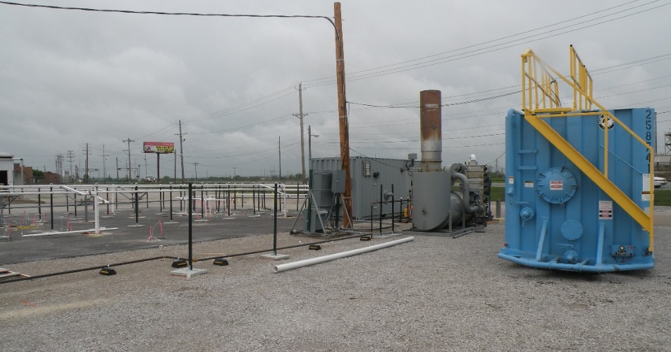
Preparing: Define Purpose and Scope
Determine CA activity being conducted by owner/operator
Review Environmental Indicators
Notes:
Determine CA activity being conducted by owner/operator:
review the current CA phase;
prepare to evaluate engineering controls, institutional controls (ICs) and financial assurance (FA) requirements to determine compliance status; and
determine effectiveness of remedy and whether Environmental Indicator(s) are still being met.
Inspector may need to coordinate with the project manager or other people more familiar with CA activities at a facility.
If one or both EIs were met prior to the inspection, the inspector should verify if that is still the case.
If conditions changed at the facility that caused one or both of the EIs to no longer be met, the inspector should document the changed conditions at the facility.
If appropriate, the inspector should sign an updated EI form.

Slide 37
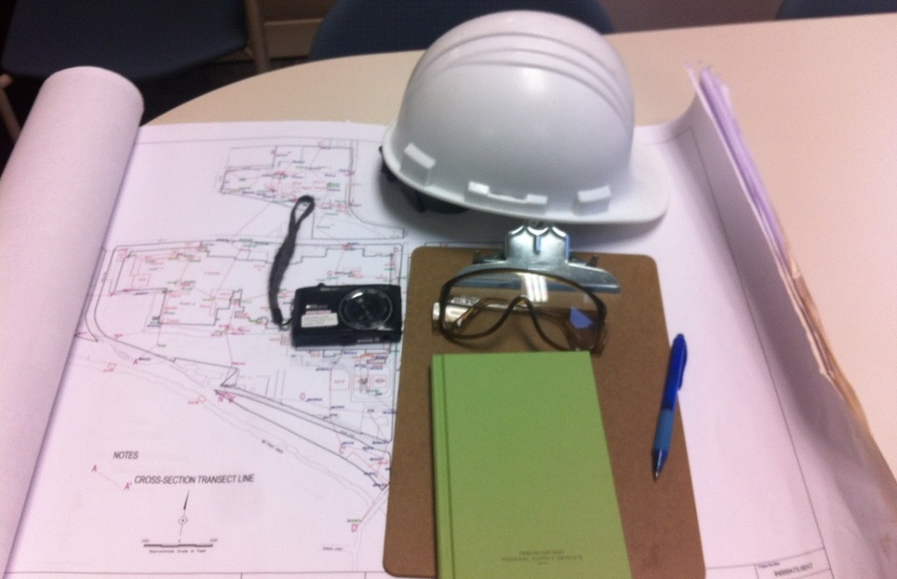
Preparing: Define Purpose and Scope
Identify specific resources necessary to conduct on-site inspection
Notes:
Identify specific resources necessary to conduct on-site inspection:
site map, including Areas of Concern (AOCs) and Solid Waste Management Units (SWMUs);
inspection tools such as notebooks, checklists, cameras;
clothing and personal protective gear; and
if sampling is planned, make arrangements in advance with appropriate personnel and develop:
Health and Safety Plan; and
Sampling and Analysis Plan.
Quality Assurance Project Plan (QAPP)
The QAPP documents how quality assurance (QA) and quality control (QC) are applied to an environmental data operation to assure that the results obtained are of the type and quality needed and expected.
A good QAPP and Sampling and Analysis Plan (SAP) are essential for EPA and state enforcement of RCRA CA requirements. Representative samples must be beyond question in order to support legal enforcement actions as well as to determine the need or status of a CA at a facility.
An inspector may have to prepare because such plans may not exist for a particular facility. For information on QAPPs, see http://www.epa.gov/quality/qapps.html. For more information on EPA’s quality assurance and quality control program, see http://www.epa.gov/quality/qs-docs/overview-final.pdf

Slide 38
Preparing: Review Background Info
The Inspector should be familiar with:
Regulatory / permitting / order status
Site uses
EPA tracking databases
Potential hazards at the facility
Notes:
Review background information on facility such as:
regulatory and permit status, including other existing permits like air or water;
current and historical site uses, including land and groundwater. For example, any sort of large industrial operation with cooling towers operating in the 1930-80 time frame probably used pentachlorophenol as a biocide, and it should be screened for in the list of potential contaminants;
surrounding property and uses, such as residential, recreational, commercial, industrial, and other potential sources of contamination in the area; and
EPA tracking databases such as:
RCRAInfo;
ECHO – provides compliance history for all programs; and
TRI – indicates releases to air, water or land.

Slide 39
Preparing: Review Facility Documents
Review key facility documents such as:
Permits or Orders
CA Work Plans or Reports
Existing SWMU/AOC Maps
Previous inspection reports and notes
Notes:
Review key documents such as:
permits and orders as well as any scopes of work in those documents;
approved work plans;
SWMU/AOC site map or Conceptual Site Model;
reports, field notes and observations from previous inspections;
aerial and onsite photographs;
Environmental Indicator forms / memos;
Remedy Implementation or Construction Complete reports;
Monthly/Quarterly/Annual Reports; and
company records such as regularly required inspections and maintenance and repair records.

Slide 40
Preparing: Obtain Other Information
Contact other federal, tribal, state and local agencies
Use web-based search engines
Review reports and data submitted under other programs
Notes:
Contact Other Agencies such as:
state, local health department and / or EPA for reports of spills and complaints; and
obtain information from National Response Center.
Use Web-based Search Engines such as:
Google, Google Earth, Bing, Ask; and
obtain widely available data about the property or site.
Review Inspection Reports and Data from Other Environmental Statutes or Programs such as:
Comprehensive Environmental Response, Compensation, and Liability Act (CERCLA);
Clean Air Act (CAA);
Clean Water Act (CWA);
Toxic Substances Control Act (TSCA); and
state programs/statutes such as a State Voluntary Cleanup Program.

Slide 41
Preparing: Develop a Checklist
Objectives of inspection
Facility background
Priority areas to review including operation and maintenance (O&M) areas
Tasks to be performed
Quality Assurance Project Plan (QAPP)
Sampling Analysis Plan
Health and Safety Plan
Resources (personnel and equipment)
Compliance Schedule
Performance Monitoring
Remedy Optimization
Institutional controls (ICs)
Financial assurance (FA) requirements
Notes:
Based on the preparation, an inspector should be able to identify specific Areas of Concern, SWMUs, CAMUs, etc.
Additionally, if the inspector observes a previously unidentified AOC, SWMU, or CAMU, the inspector should document (photographs, statements, etc.) for follow up action, including enforcement action.

Slide 42
Section 4: Conducting a CA Inspection
Accessing facility . . .
Checking records . . .
Inspecting / touring . . .
Documenting . . .
Notes:
Possible violations of corrective action requirements may be present during any phase (RFA, RFI, CMS, or CMI) and may be new or different than noted in a previous inspection. Inspectors should be aware of these aspects during all corrective action compliance inspections.
Have appropriate paperwork ready:
EPA/state credentials;
health and safety training, including respiratory clearance; and
proper protective gear.
Inspections are generally unannounced so as to give the inspector a true picture of the site and its operations. Inspections should take place during normal business hours.

Slide 43
Conducting: Access to Facility
Notes:
EPA’s general practice is for an inspector to present his or her credential and issue a notice of inspection to the establishment owner or person in charge of the facility at the time of the inspection.
Inspectors are authorized by law to conduct inspections and are advised not to provide any personal information, including badge number, driver’s license number, or home address (or other information subject to the Privacy Act of 1974) prior to or during an inspection.
The case attorney should be prepared to seek an administrative warrant quickly if the owner/operator denies access to all or any part of a facility.

Slide 44
Conducting: Review Documents
Controlling document –
Permit, Order or Work Plan
Relevant facility documents
Reports
Notes:
Review schedules under Permit / Order / Work Plan and determine if schedules have been met, including:
engineering controls;
Institutional controls (ICs) schedules; and
Financial assurance (FAs) requirements.
Review company records and note any potential violations.
Review hydrogeologic reports to understand:
hydrology;
probable location of the contaminants – “floaters” (LNAPL - light non-aqueous phase liquid) or “sinkers” (DNAPL- dense non-aqueous phase liquid);
operational history;
type of equipment being used; and
operation and maintenance requirements for the system.
Review document / data repository.
Copy records, reports, MSDS, chemical analysis and other appropriate documents.
See Ensuring Effective and Reliable Institutional Controls at RCRA Facilities: http://www.epa.gov/wastes/hazard/correctiveaction/resources/guidance/ics/ic_memo.pdf

Slide 45
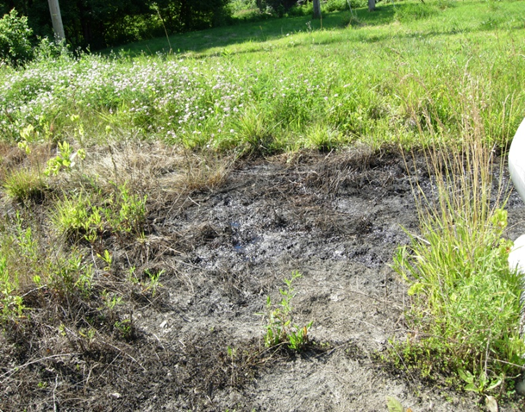
Conducting: Identify and Document Releases
Look for releases
Gather information about the release
Notes:
Look for releases at:
SWMUs / AOCs or new area;
loading / unloading areas;
secondary containment structures; and
waste collection areas, including track-out, and run-on / run-off.
If a release is found, gather as much information as possible about the release:
estimate the size of the release (e.g. 20’ x 20’ stained soil);
note dead vegetation and animals, chemical product, or waste; and
photograph from various angles.
Sample if prepared to do so. If not, go back and sample release as soon as possible.
Document the cause of the release.
Ask company if release was reported.
Ask how the site was cleaned up and how waste was disposed of.
Release reporting requirements will be found in the permit or order; inspectors should also be aware of CERCLA reporting requirements.
For an explanation about the nature and proper handling of remediation waste, see the Office of Resource Conservation and Recovery training module at: http://www.epa.gov/epawaste/hazard/correctiveaction/training/vision/mod9.pdf

Slide 46
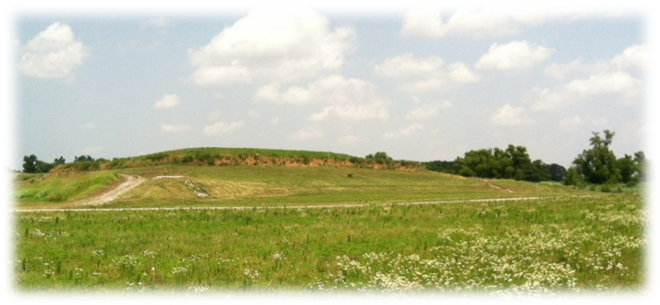
Conducting: Inspect and Review
Each SWMU or AOC
Each CAMU
Notes:
For each SWMU or AOC, the inspector should review:
what type of inspection reports are required -- check dates and status;
what maintenance is required for that measure; and
compliance with O&M plan.
For each CAMU, the inspector should review:
what type of stabilization is used;
integrity of cap;
walk over the cap to check the integrity of the upper layers and to observe the maintenance of that area
look for trees and unwanted vegetation
check for erosion and slumping of the cap
operation and placement if monitoring wells exist;
integrity of required fencing; and
depressurized ventilation for vapor intrusion (VI) concerns.

Slide 47
Conducting: Other Elements
Verify land/groundwater uses
Management of remediation waste
Other issues
Notes:
Verify land and groundwater uses:
interceptor trench / sump subsurface drain;
application of dust suppressant (water or chemical);
metal precipitation from liquids;
slurry walls;
run-on and run-off controls;
temperature controls for thermal desorption;
drum overpacking; and
erosion or poor vegetative cover of landfill caps.
Inspect management of remediation waste.
Ensure in situ technology performance monitoring is robust enough to detect any secondary contamination.
Review nearby receptors and any mechanisms are in place by the facility to monitor threats to those receptors: surface water, groundwater use, vapor intrusion potential.
Check for violations of state air or water permits.

Slide 48
Conducting: Document …Document…Document
Be organized!!!
Complete the checklist
Keep detailed notes
Collect evidence
Maintain chain of custody
Take accurate statements
Copy pertinent documents
Notes:
The better the documentation, the more weight is given to the evidence.
Be organized!!!
Complete appropriate checklists.
Keep detailed notes, including time, place and who was present.
Collect evidence such as photographs and samples.
For a regional example of sample and evidence management procedures, see http://www.epa.gov/region4/sesd/fbqstp/Sample-and-Evidence-Management.pdf
Maintain chain of custody for the evidence collected.
Be accurate when taking statements. Don’t assume words or viewpoints. Statements can only be recorded with the permission of the person being recorded. Please confirm with your case attorney.
Copy pertinent documents such as work plans, schedules, and compliance reports.
Training and related information for inspectors is available on the US EPA website. Note: this Inspector Wiki is free and available to all government employees; if you do not have an EPA LAN account, you may set up an account to view this information. See https://wiki.epa.gov/inspector/index.php/3500.1_Required_Training#.E2.96.BANETI_eLearning_Center

Slide 49
Section 5: Preparing a CA Inspection Report - Tell the Story
Remember . . . begin with the end in mind
Use a narrative description
Support the story with evidence
Confirm any non-compliance
Identify potential problems
Coordinate with legal staff and CA PM
Notes:
Remember . . . begin with the end in mind: understand what information is needed to determine compliance with or to prove a violation of CA obligations if a compliance issue is observed.
All site visits should have a report, even if the visit is not intended to be an inspection because observations are evidence of compliance or a possible violation.
Use a narrative description, as well as clear and concise language when writing your report.
Support the story with evidence obtained in the inspection.
Identify potential problems and deviations from requirements.
Confirm any non-compliance with legal staff and the CA PM. Because non-compliance may result in an enforcement action by the regulating agency, the appropriate response needs to be decided by the case team after the inspection, including emergency response if appropriate.
In addition to collecting information to support a finding of a violation, other relevant information should be gathered and shared with the case team so they can understand potential defenses and propose the most appropriate resolution to the problem.

Slide 50
Reporting: Use an Outline
Example Outline of Inspection Report
General Information
Narrative Summary of Inspection
Identify Potential Problems
Appendices
Notes:
Example Outline of Inspection Report
This sample will be discussed in detail on the next few slides.

Slide 51
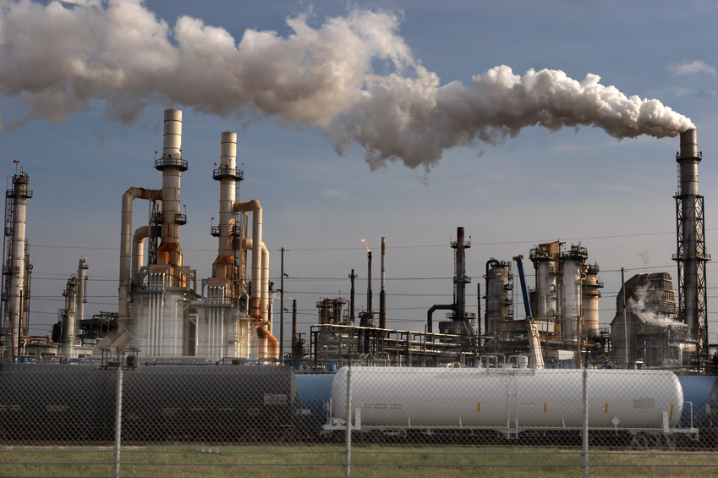
Reporting: Use an Outline
Example Outline of Inspection Report
General Information
Notes:
Example Outline of Inspection Report
General Information:
facility information (Name, address, phone number, lat/long coordinates, type of facility and description of operations and practices of concern in inspection);
date of inspection;
start and end times of the inspection;
facility representatives (names, titles, contact information);
inspection representatives (names, titles, contact information);
state coordination information;
purpose and scope of inspection; and
information provided to the facility such as:
presentation of credentials;
compliance assistance information; and
discussion of company’s right to claim Confidential Business Information (CBI).

Slide 52
Reporting: Use an Outline
Example Outline of Inspection Report
Narrative Summary of Inspection
Notes:
Example Outline of Inspection Report
Narrative Summary of Inspection:
description of corrective action activities being performed at the facility at the time of the inspection;
description of inspection activities -- use references and cites from preparation material to highlight why particular aspect of inspection was conducted;
data analysis, which may include
data from facility owner/operator;
data from sampling conducted at inspection;
comparison to historic data; and
comparison to requirements from work plan or other site specific document.

Slide 53
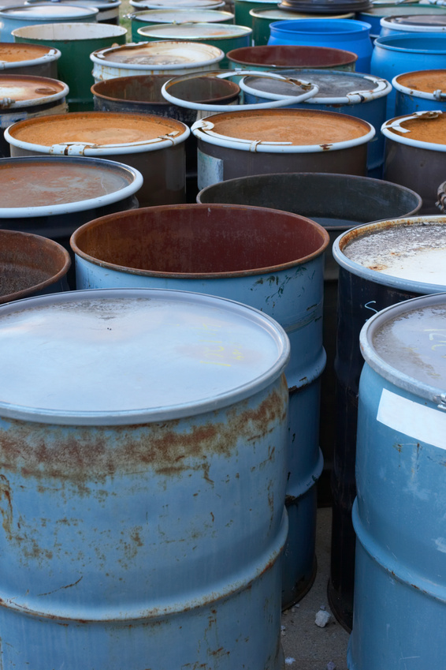
Reporting: Use an Outline
Example Outline of Inspection Report
Identify potential problems and deviations from requirements
Notes:
Example Outline of Inspection Report
Identify actual and potential problems and deviations from requirements.
Problems could include actual or impending harms to health or the environment as well as information about legitimate potential threats to potential receptors.
For each potential violation, identify the requirements of the violation and the evidence needed to support that violation. Example:
Failed to maintain extraction wells according to the work plan.
What does work plan say about extraction wells?
How are the wells non-compliant?
Provide photographs, statement from employees, facility records.
Inspection report should have citations to specific permit, order or regulatory provisions.

Slide 54
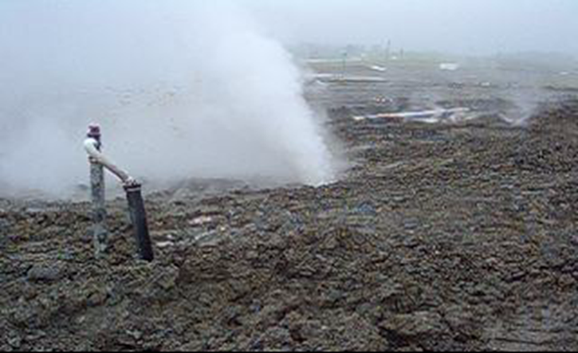
Reporting: Use an Outline
Example Outline of Inspection Report
Appendices
Notes:
Example Outline of Inspection Report
Appendices
Photographs
Maps
Statements
Data tables/sample results
Copied documents
Checklists
Permit or order language violated

Slide 55
Section 6: Developing the Case
Work closely with case attorney to develop enforcement case
Each violation needs to have supporting evidence to back it up
Notes:
Work closely with case attorney to develop the enforcement case.
Each violation needs to have supporting evidence to back it up:
field notes and observations;
photos;
company records;
statement from employees;
sampling test results; and / or
any records from EPA, state or other government office.
Bottom line: no evidence = no violation.

Slide 56
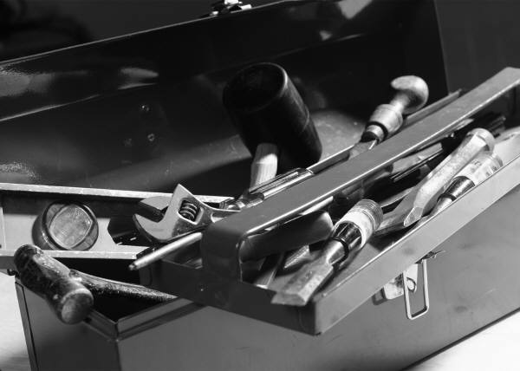
Developing: Select the Best Tools
Determine if enforcement action is necessary
If necessary, select the best tools to ensure compliance
Notes:
Determine if enforcement action is necessary.
Sometimes a simple phone call can clear up a potential problem or misunderstanding.
Review previous reports to determine if there has been a repetitive compliance issue.
If enforcement action is necessary, select the best tools to ensure compliance and meet cleanup goals for enforcement or compliance assurance:
Non-compliance letter;
Notice of Violation (NOV);
RCRA Section 3007 Information request letter;
order;
demand for Stipulated Penalties; or
referral to DOJ for judicial enforcement.

Slide 57
Developing: Make the Case
Determine
Penalty
Any relief necessary
Appropriate corrective action
Consider
Supplemental Environmental Projects (SEPs)
Financial assurance
Criminal referral if egregious
Notes:
Determine
penalty;
any relief which is needed (at CMS stage); and / or
appropriate corrective action.
Consider
green remediation approaches;
Supplemental Environmental Projects (SEPs) in appropriate cases;
Financial assurance; and
referral to criminal investigators if violation is especially egregious.
For more information on EPA’s SEP policy, please see: http://www2.epa.gov/enforcement/supplemental-environmental-projects-seps

Slide 58
Case Example
Facility X was subject to a RCRA Section 3008(h) interim status corrective action order
Order required pumping and treating groundwater
Failed to maintain pumps
Led to drinking well contamination
Consent agreement final order with civil penalty for $650,000

Slide 59
Additional References
Groundwater Sampling Guidelines for Superfund and RCRA Project Managers (May 2002, EPA-542-S-02-001). [PDF file]
Handbook of Groundwater Protection and Cleanup Policies for RCRA Corrective Action (April 2004 updated, EPA/530/R-01/015
Low-Flow (Minimal Drawdown) Groundwater Sampling Procedures (April 1996, EPA/540/S-95/504. [PDF file]
RCRA Ground-water Monitoring: Draft Technical Guidance [PDF, 2.87 MB, 236 pages, About PDF] (November 1992)
Recommended Procedure for Low-Flow Purging and Sampling of Groundwater Monitoring Wells (October 15,1997, Bulleting No. QAD023
Notes:
Groundwater Sampling Guidelines for Superfund and RCRA Project Managers (May 2002, EPA-542-S-02-001). This Groundwater Forum issue paper provides sampling guidelines for groundwater monitoring wells to yield representative results during Superfund and RCRA Corrective Action activities. [PDF file]
Handbook of Groundwater Protection and Cleanup Policies for RCRA Corrective Action (April 2004 updated, EPA/530/R-01/015). Compendium of RCRA corrective action's groundwater policies with hyperlinks to all references available on the internet.
Low-Flow (Minimal Drawdown) Groundwater Sampling Procedures (April 1996, EPA/540/S-95/504). A paper issued by EPA Office of Solid Waste and Emergency Response and Office of Research and Development describing procedures for low-flow purging and sampling. [PDF file]
RCRA Ground-water Monitoring: Draft Technical Guidance[PDF, 2.87 MB, 236 pages, About PDF] (November 1992). Guidance for implementing groundwater monitoring for regulated units contained in 40 CFR Part 264 Subpart F.
Recommended Procedure for Low-Flow Purging and Sampling of Groundwater Monitoring Wells (October 15,1997, Bulleting No. QAD023) - Region 3's recommended procedures for low-flow purging and sampling.

Slide 60
Summary
Corrective action inspection process
Preparation
Inspection
Reporting
Developing case if necessary
Questions?
Notes:
Summary:
Prepare for CA inspection
Conduct CA inspection
Prepare CA inspection report
Develop case if necessary

