Slide 1

Green Infrastructure: Reusing Contaminated Sites and Promoting Sustainable Communities
July 28, 2015 | 2:00 PM - 4:00 PM, EDT

Slide 2
Webinar Overview
Introduction to Reuse and SRI
  Melissa Friedland, EPA SRI
Green Infrastructure Considerations and Opportunities in Superfund Reuse Projects
  Michele Mahoney, EPA TIFSD
Increasing Recreational Amenities at the Butterworth #2 Landfill
  Tom Bloom, EPA Region 5
Green Remediation and Green Infrastructure for a Cleaner and Safer Future
  Carlos Pachon, EPA TIFSD
Habitat Creation and Green Remediation at the Landia Chemical Company Site
  Douglas Reid-Green, BASF
Stormwater Management and Recreational Amenities at the Pemaco Maywood Site
  Rose Marie Caraway, EPA Region 9
Resources, Contacts and Questions
  Melissa Friedland, EPA SRI

Slide 3
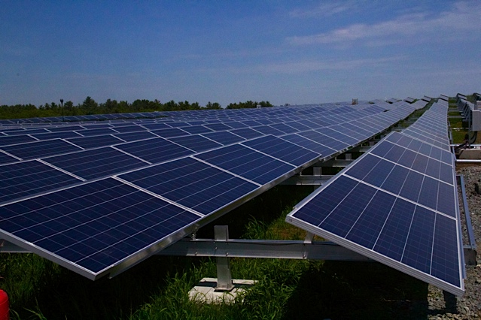
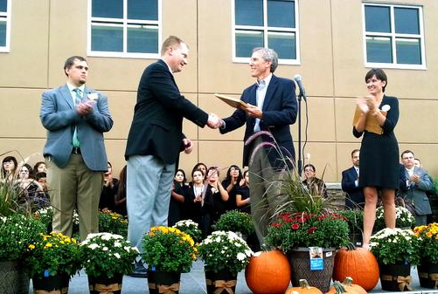
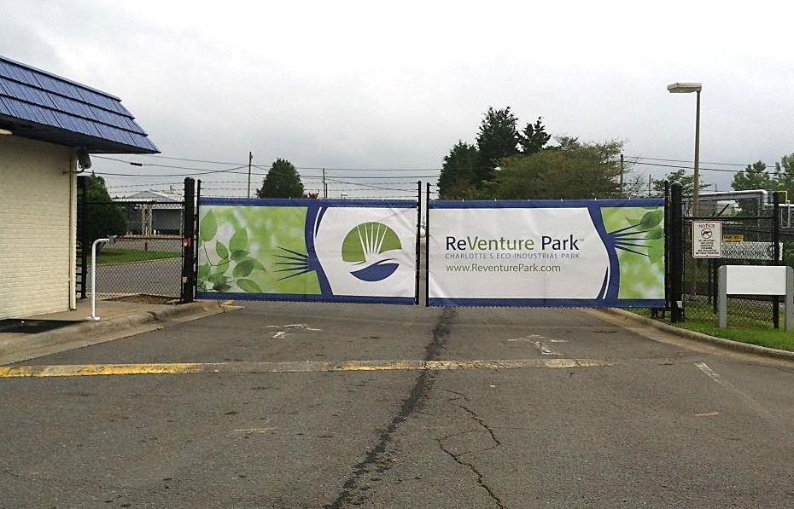
SRI: Superfund Redevelopment Initiative
Working with communities and other partners in considering future use opportunities and integrating appropriate reuse options into the cleanup process
http://www.epa.gov/superfund/programs/recycle/

